Slide 1
EN MME 12T Dipole Project Contribution
Ó. Sacristán, A. Bertarelli

Slide 2
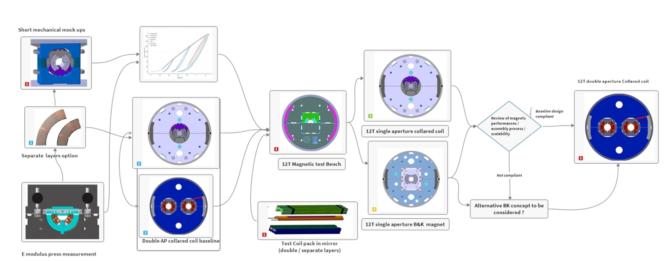
Project overview
Task 6
Dedicated production tooling & processes
Task 1
Task 2
Task 4
Task 5
Task 3
Task 1
Task 2

Slide 3
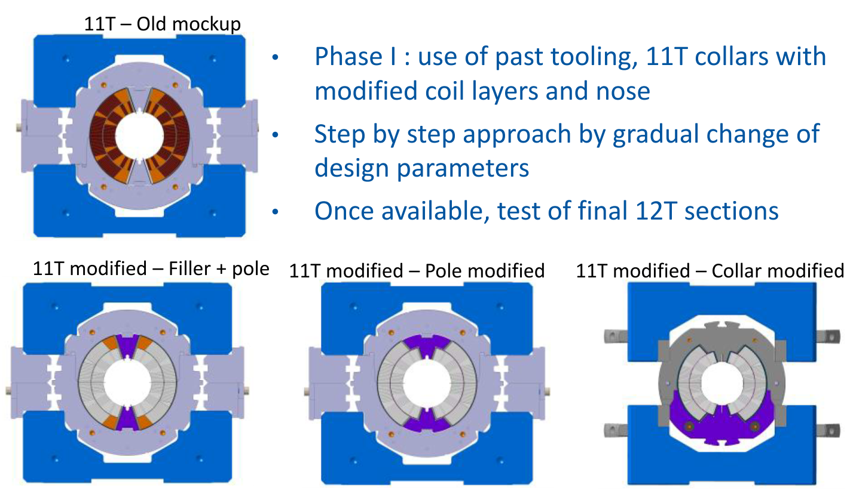
Task 1: Short Mock-Ups
Build on the experience of 11T mock-up campaign from 2020
Experimental campaign can be sensitively optimized without any impact on the outcomes
An equivalent level of detail might not be feasible for all the phases (imperfection mapping). Too expensive FEA wise
Very intensive in FEM.
MME takes care of the campaign definition and documentation
Assistance from student welcome for documentation and follow up (metrology, easy analysis, etc.)
Notes:
Need to specify where things happen

Slide 4
Task 1: Short Mock-Ups
E | Engineering |  | T | test assembly
F | Fabrication |  | C | Cold test |  | P | Power test
 |  |  | 2024 |  |  |  | 2025 |  |  |  | 2026 |  |  |  | 2027 |  |  |  | Total Effort
Project |  |  | Q1 | Q2 | Q3 | Q4 | Q1 | Q2 | Q3 | Q4 | Q1 | Q2 | Q3 | Q4 | Q1 | Q2 | Q3 | Q4 | Hours | FTE | CHF
Short Mockups
Short mock up tooling |  |  | E | F | F | E
Short mock ups coils sections (11T mod., 12 T) ( circ 130mm) |  |  | F | F | T |  | E | F | T
 | Design |  | 100 |  |  |  | 250
 | FEM |  |  | 200 | 200 | 200 |  | 150 | 200
 | Test and Instrumentation |  |  | 150 | 200 | 150 |  | 200 | 150
 | Manufacturing
 | Yearly Effort
 | Design |  | 200 hours -> 12000CHF |  |  |  | 250 hours -> 15000CHF |  |  |  | 0 hours -> 0CHF |  |  |  | 0 hours -> 0CHF |  |  |  | 450 | 0.26 | 27000
 | FEM |  | 600 hours -> 36000CHF |  |  |  | 350 hours -> 21000CHF |  |  |  | 0 hours -> 0CHF |  |  |  | 0 hours -> 0CHF |  |  |  | 950 | 0.56
 | Test and Instrumentation |  | 500 hours -> 30000CHF |  |  |  | 350 hours -> 21000CHF |  |  |  | 0 hours -> 0CHF |  |  |  | 0 hours -> 0CHF |  |  |  | 850 | 0.50 | 51000
 | Manufacturing
 | Overall |  |  |  |  |  |  |  |  |  |  |  |  |  |  |  |  |  | 2250 | 1.32 | 78000
FEM
N. Vejnovic, S. Gowrishankar
Biggest share of design work needs to be devoted to mockup nr. 5. (12T Coils)
Considering 5 different configurations:
    FEM -> 4.5 working weeks per configuration
    Measurements, instrumentation and reporting -> 4 Working weeks per configuration
New dedicated job for measurements needed
Dedicated job ongoing
CAD*
O. Bahmane
Measurements and Instrumentation
Ó. Sacristán
Notes:
Integrate 12T mockup

Slide 5
Task 1: Long Mock-Ups
E | Engineering |  | T | test assembly
F | Fabrication |  | C | Cold test |  | P | Power test
 |  |  | 2024 |  |  |  | 2025 |  |  |  | 2026 |  |  |  | 2027 |  |  |  | Total Effort
Project |  |  | Q1 | Q2 | Q3 | Q4 | Q1 | Q2 | Q3 | Q4 | Q1 | Q2 | Q3 | Q4 | Q1 | Q2 | Q3 | Q4 | Hours | FTE | CHF
Long Mockup
Long mock up structure components (cir. 700mm) |  |  |  | E | E | F | F
Long mock up with collared coil sections (11T) |  |  |  |  | E | F | F | T-C
Long mock up with collared coil sections (12T) |  |  |  | E | E | E | F | F | T-C
Long mock up with b&k coil pad sections (12T) |  |  |  |  | E | E | F | F | F | T-C
 | Design |  |  | 200 | 700 | 300
 | FEM |  |  |  | 500
 | Test and Instrumentation |  |  |  |  |  | 400 | 400 | 400 | 300
 | Manufacturing
 | Yearly Effort
 | Design |  | 1200 hours -> 72000CHF |  |  |  | 0 hours -> 0CHF |  |  |  | 0 hours -> 0CHF |  |  |  | 0 hours -> 0CHF |  |  |  | 1200 | 0.71 | 72000
 | FEM |  | 500 hours -> 30000CHF |  |  |  | 0 hours -> 0CHF |  |  |  | 0 hours -> 0CHF |  |  |  | 0 hours -> 0CHF |  |  |  | 500 | 0.29
 | Test and Instrumentation |  | 0 hours -> 0CHF |  |  |  | 1500 hours -> 90000CHF |  |  |  | 0 hours -> 0CHF |  |  |  | 0 hours -> 0CHF |  |  |  | 1500 | 0.88 | 90000
 | Manufacturing
 | Overall |  |  |  |  |  |  |  |  |  |  |  |  |  |  |  |  |  | 3200 | 1.88 | 162000
FEM
N. Vejnovic, S.Gowrishankar
Extensive design work ahead. An initial estimation of 1200 hours is considered
Measurements and instrumentation cost estimation based on previous experience with magnets
CAD*
O. Bahmane
Measurements and Instrumentation
Ó. Sacristán

Slide 6
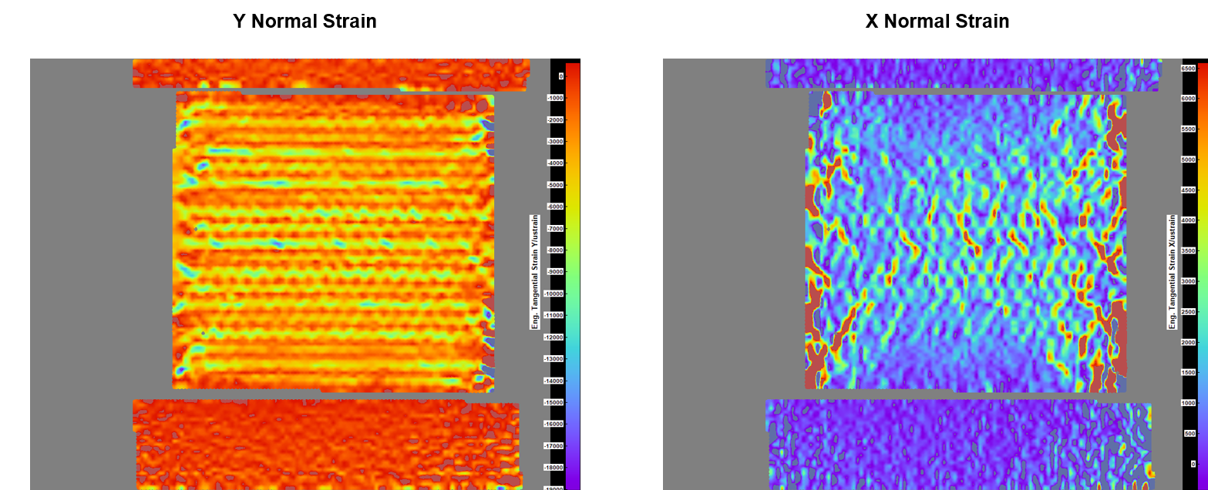
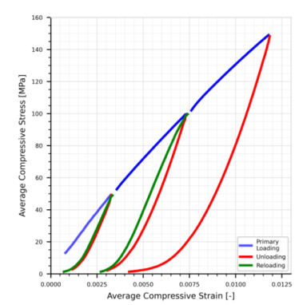
Task 2: Conductor stacks and coil mechanical properties testing and modelling
10 Stacks compression testing campaigns both at RT and 77K are potentially indicated
A mechanical characterization preliminarily (~6000 CHF)
Baseline model is the two phase model developed within 11T mockup study
Extensive repository of MQXF stacks and coils (12T Equivalent) thermal contraction measurements . No need to further investigate this aspect in principle
The potential gain of E-modulus press measurements for the sole purpose of characterization is deemed meager in comparison with the efforts needed to:
    Reinstall hardware and instrumentation
    Validate the functioning
    Running the measurements. Time consuming measurements needing a dedicated person
Measurements and Instrumentation
Ó. Sacristán

Slide 7
Task 3: Magnetic mirror test single aperture bench
 |  |  | 2024 |  |  |  | 2025 |  |  |  | 2026 |  |  |  | 2027 |  |  |  | Total Effort
Project |  |  | Q1 | Q2 | Q3 | Q4 | Q1 | Q2 | Q3 | Q4 | Q1 | Q2 | Q3 | Q4 | Q1 | Q2 | Q3 | Q4 | Hours | FTE | CHF
Mirror
Magnetic mirror bench structure, bk pre;load test assembly |  |  | D | F | F | T
Magnetic mirror 11T coil pad, tooling production, assembly & test |  |  |  |  | E | F | F | F | T C-P
Magnetic mirror 12T coil pad, tool, assembly & test |  |  |  |  | E | E | F | F | F | T | C-P
Magnetic mirror QXF coil pad, tool assembly & test |  |  |  |  | E | E | E | E | F | F | F | T | C-P
 | Design |  |  |  |  |  | 2000
 | FEM |  |  |  | 100 | 100 | 100 | 100
 | Test and Instrumentation |  |  |  |  |  | 100 | 200 | 400 | 300 | 300 | 300 | 300
 | Manufacturing
 | Yearly Effort
 | Design |  | 0 hours -> 0CHF |  |  |  | 2000 hours -> 120000CHF |  |  |  | 0 hours -> 0CHF |  |  |  | 0 hours -> 0CHF |  |  |  | 2000 | 1.18 | 120000
 | FEM |  | 200 hours -> 12000CHF |  |  |  | 200 hours -> 12000CHF |  |  |  | 0 hours -> 0CHF |  |  |  | 0 hours -> 0CHF |  |  |  | 400 | 0.24
 | Test and Instrumentation |  | 0 hours -> 0CHF |  |  |  | 1000 hours -> 60000CHF |  |  |  | 900 hours -> 54000CHF |  |  |  | 0 hours -> 0CHF |  |  |  | 1900 | 1.12 | 114000
 | Manufacturing
 | Overall |  |  |  |  |  |  |  |  |  |  |  |  |  |  |  |  |  | 4300 | 2.53 | 234000
Estimation of 2000 additional hours from L. Dassa
  Inner structures
  Ancillary tooling and hoisting fixtures
Lab estimation according to previous magnet experience (dedicated per-magnet jobs)
FEM
N. Vejnovic
CAD*
L. Dassa / N. Vejnovic
Measurements and Instrumentation
MML

Slide 8
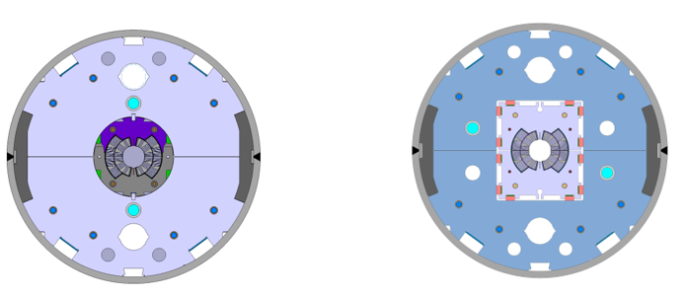
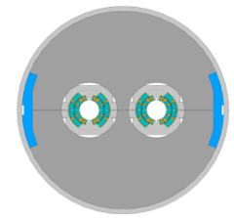
Tasks 4 and 5: Single and double aperture magnets
The effort to come depends vastly on the outcomes of the three previous tasks. To be discussed early 2025
The instrumentation and measurements effort can still be estimated pretty accurately.
Dedicated job “HFM : 12T SHORT MAGNET PRELIMINARY DESIGN” (600 h foreseen / 0 executed)

Slide 9
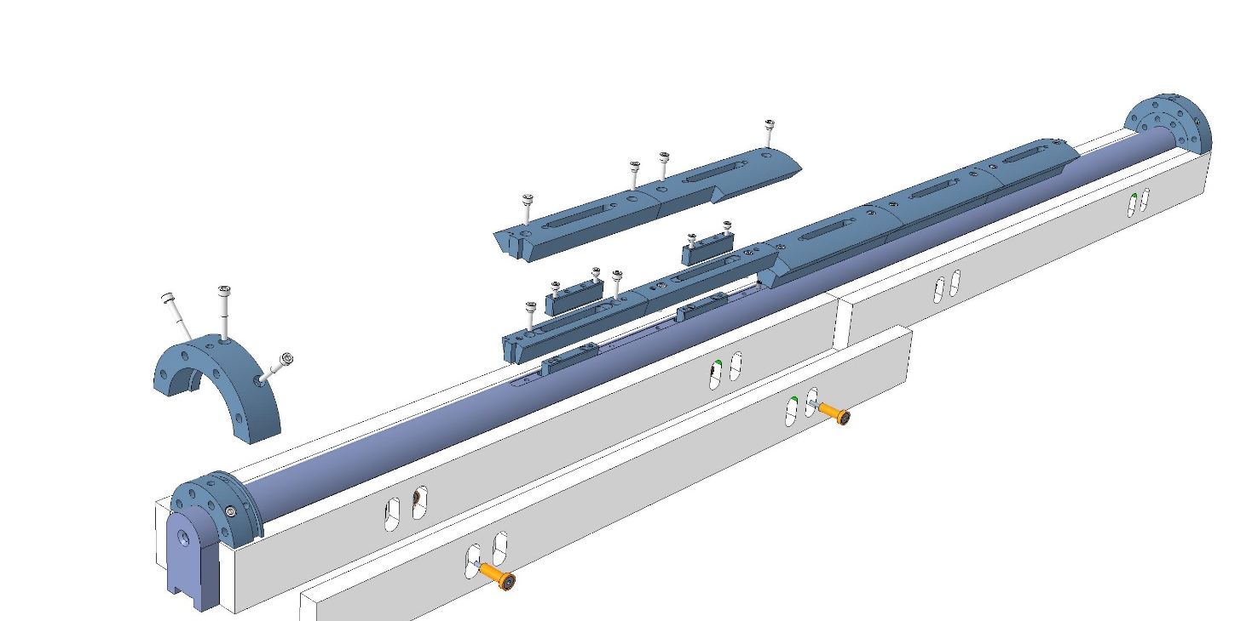
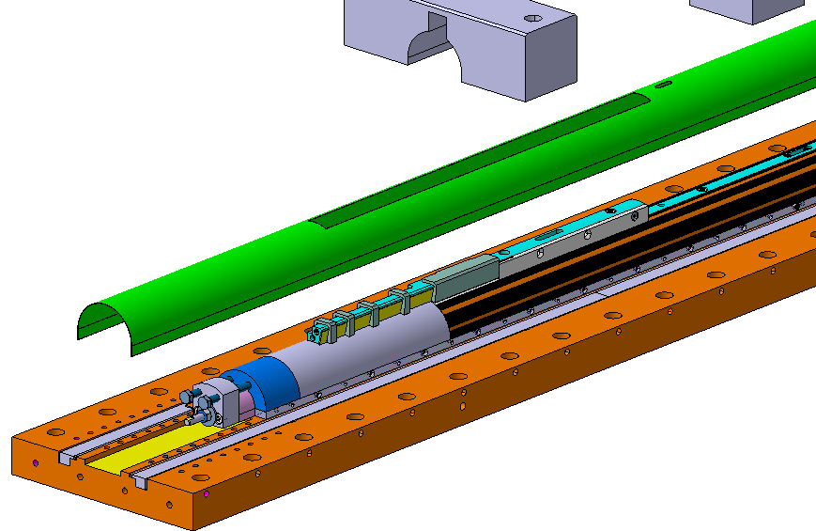
Task 6: Dedicated production tooling & processes
Substantial efforts devoted to this activity so far
Name | Status | Planned hours | Executed hours | Budget code | Responsible MME
Magnet head filler - Density study | In work | 150 | 17 | 36313 | L. Gentini
Winding-reaction-impregnation tool for 12 T | In work | 600 | 450 | 36314 | L. Gentini
UNIVERSAL SUPPORT FOR YOKE LAMINATION ASSEMBLY | In work | 160 | 17 | 36343 | L. Dassa

Slide 10
Roles and Organization
Follow-Up, Documentation and TE-MSC Interface: Ó. Sacristán
Task 1: Mechanical Mock Ups
Task 2: Stacks and coil mechanical properties
Task 3: Magnetic mirror test single aperture bench
FEM
N. Vejnovic, S.Gowrishankar
FEM
N. Vejnovic. L. Dassa
Measurements and Instrumentation
Ó. Sacristán
CAD*
O. Bahmane
CAD*
L. Dassa,
Task 4: Task 4 Single aperture model magnets
Task 5 - Double aperture magnet
Task 6 - Dedicated tooling & processes
FEM
Sup. interne TE-MSC
FEM S.Gowrishankar
N. Vejnovic. S.Gowrishankar, Fellow Te-MSC
FEM
Sup. Interne Te-MSC
CAD*
O. Bahmane, L. Gentini
CAD*
O. Bahmane, L. Gentini
CAD*
O. Bahmane, L. Gentini
Measurement: MML / Manufacturing: P. Moiret / Metrology: A. Cherif / Consulting: F. Carra, A. Bertarelli, M. Guinchard

Slide 11
Overall outlook
This outlook is based on the present understanding of the project. To be finetuned according to further discussions and periodically reviewed according to the technical decisions made
The important FEA workload in the last two quarters of 2024 and early 2025 can be partially alleviated with the input of TECH (S. Gowrishankar 80% short-mockups). Additional resources in this front for single and double aperture magnets to be identified ASARP
Cable stack measurements and short mock-ups are main drivers of decisions for the next stages. To be completed as soon as reasonably possible
The scope of the short mock-up campaigns must be carefully defined to get the necessary insights without overburdening the project
Efforts needed for tasks 4 and 5 are difficult to foresee at this stage as they depend vastly on the outcomes of the three previous tasks. Discussion early 2025

