Slide 1
SND@LHC Presentation 4/25
Alex Thornton

Slide 2
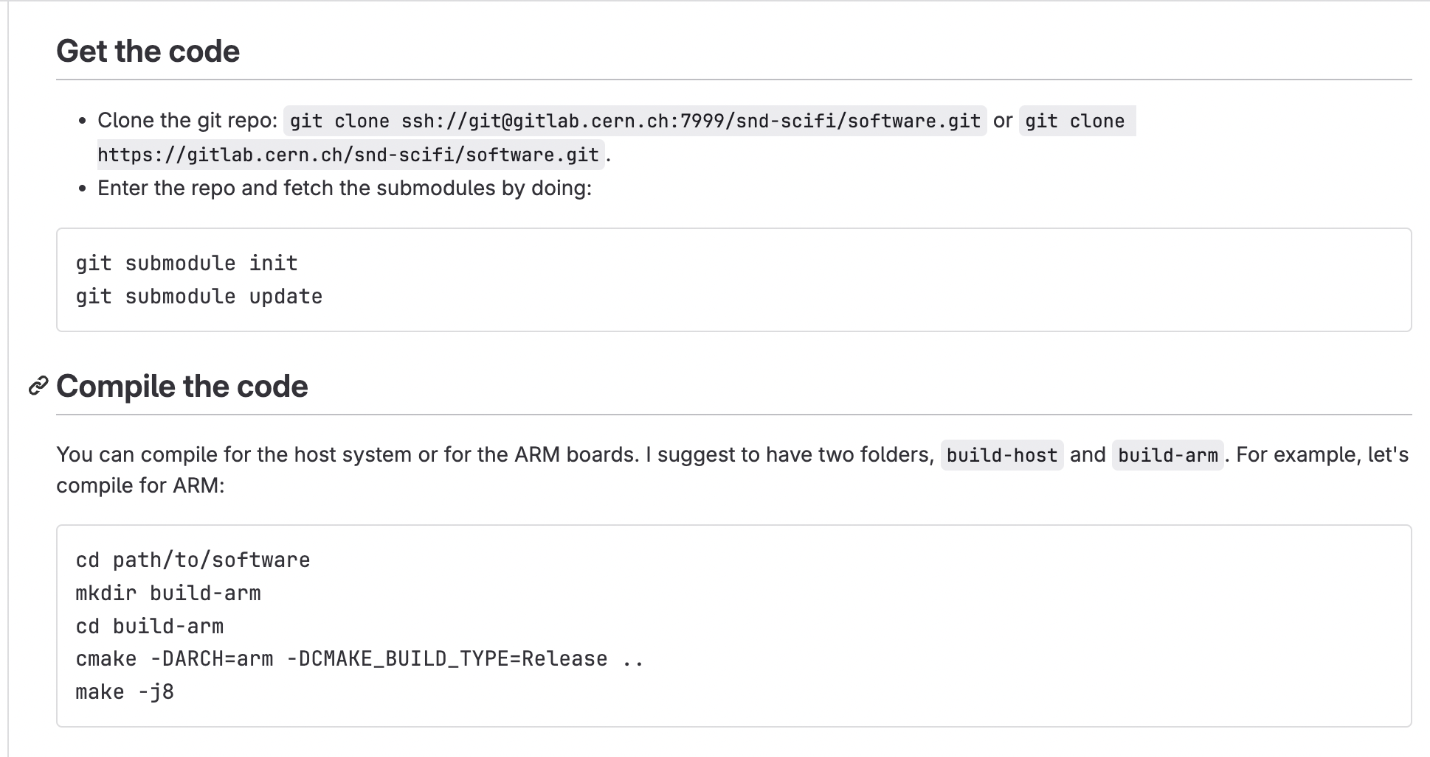
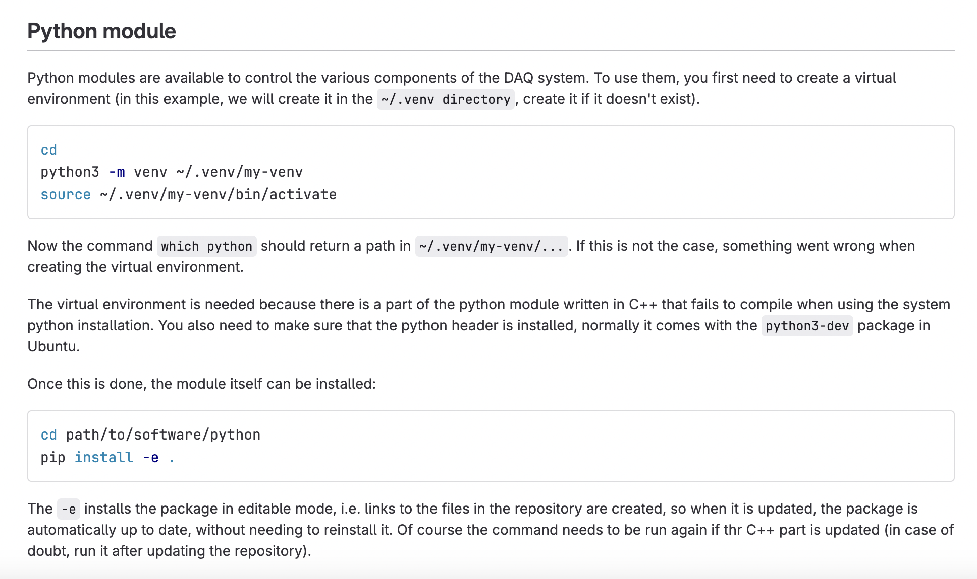
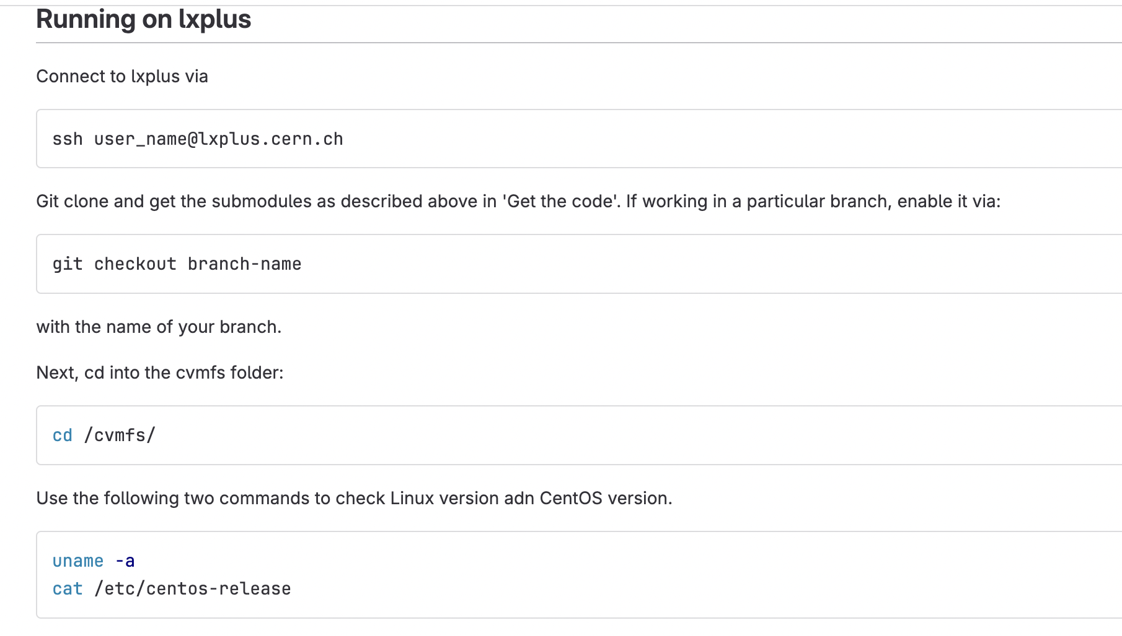
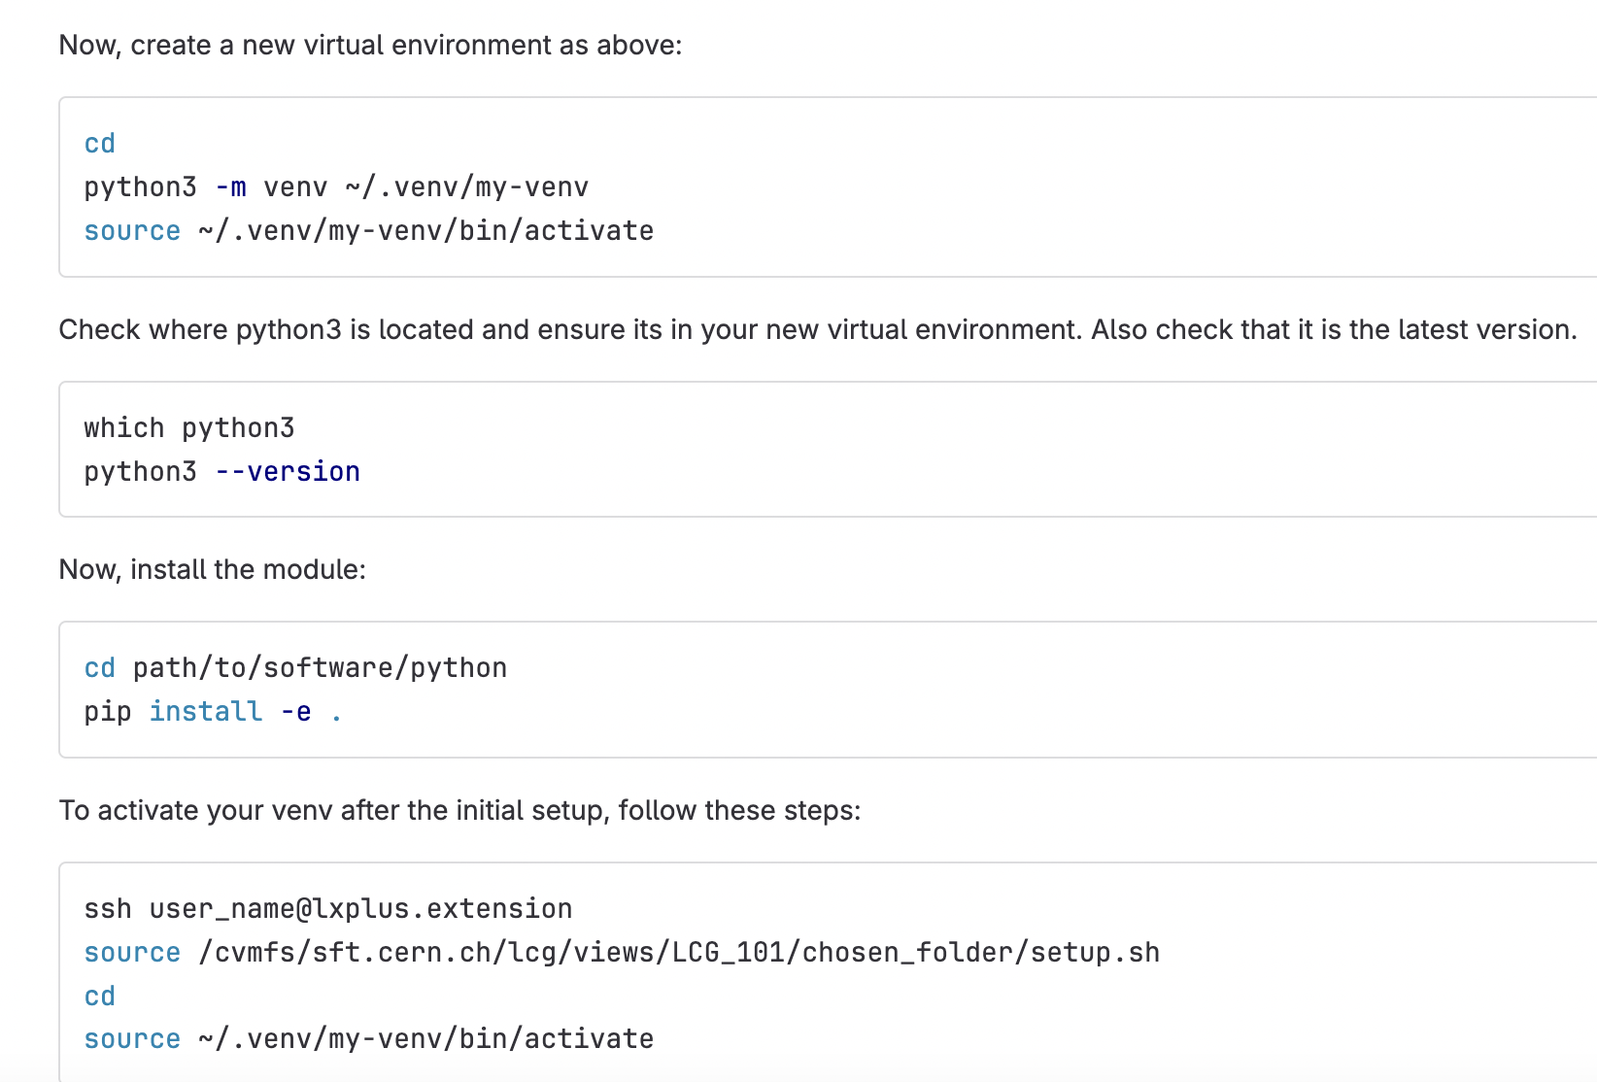
Setting up Gitlab

Slide 3
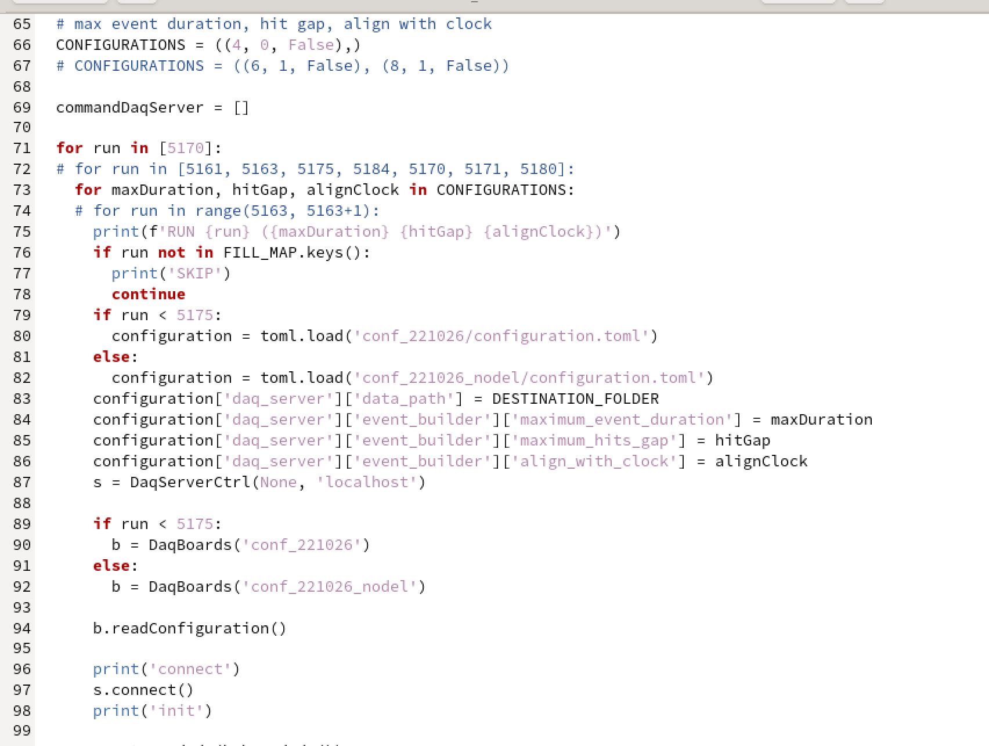
Script Code
Changing parameters in CONFIGURATIONS and then using previously event building code to analyze differences

Slide 4
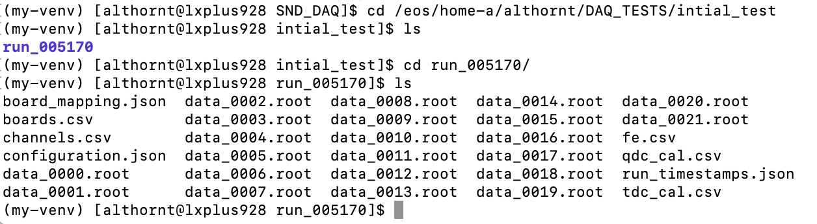
Script Outputting More Data Files Than Expected

Slide 5
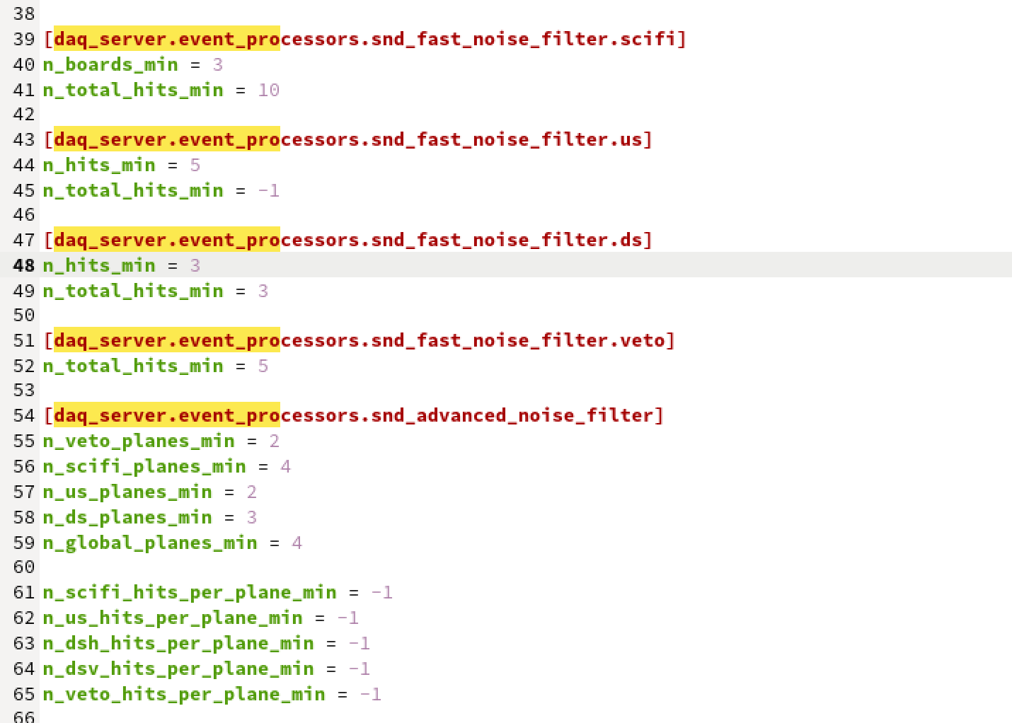
Noise Settings
According to the DAQ expert the difference in noise filters settings can drastically affect the amount of events and therefore data files.

Slide 6
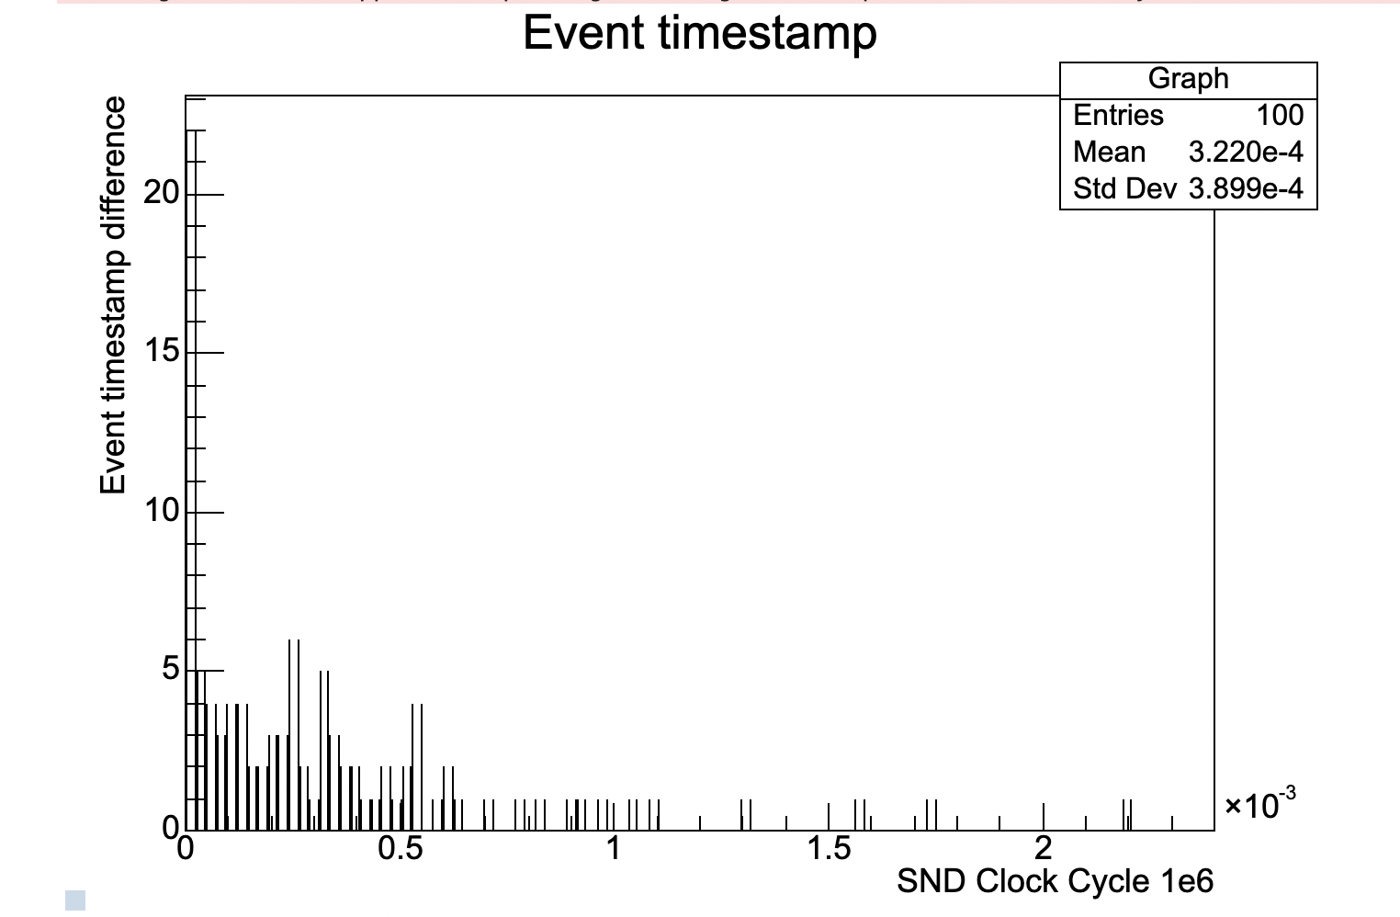
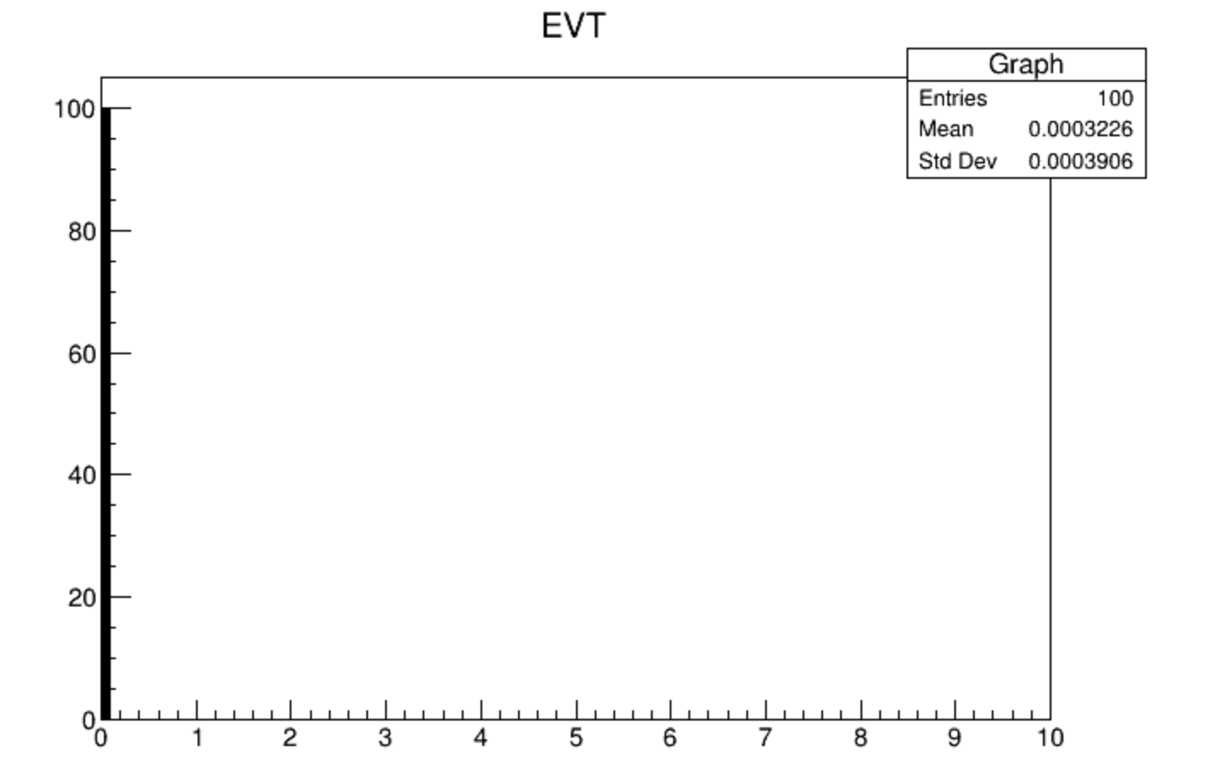
Event timestamp difference
See if the events that are close to one another are noise, make a 2D graph, event difference on x axis and sum of hits on all systems on y axis

