Slide 1
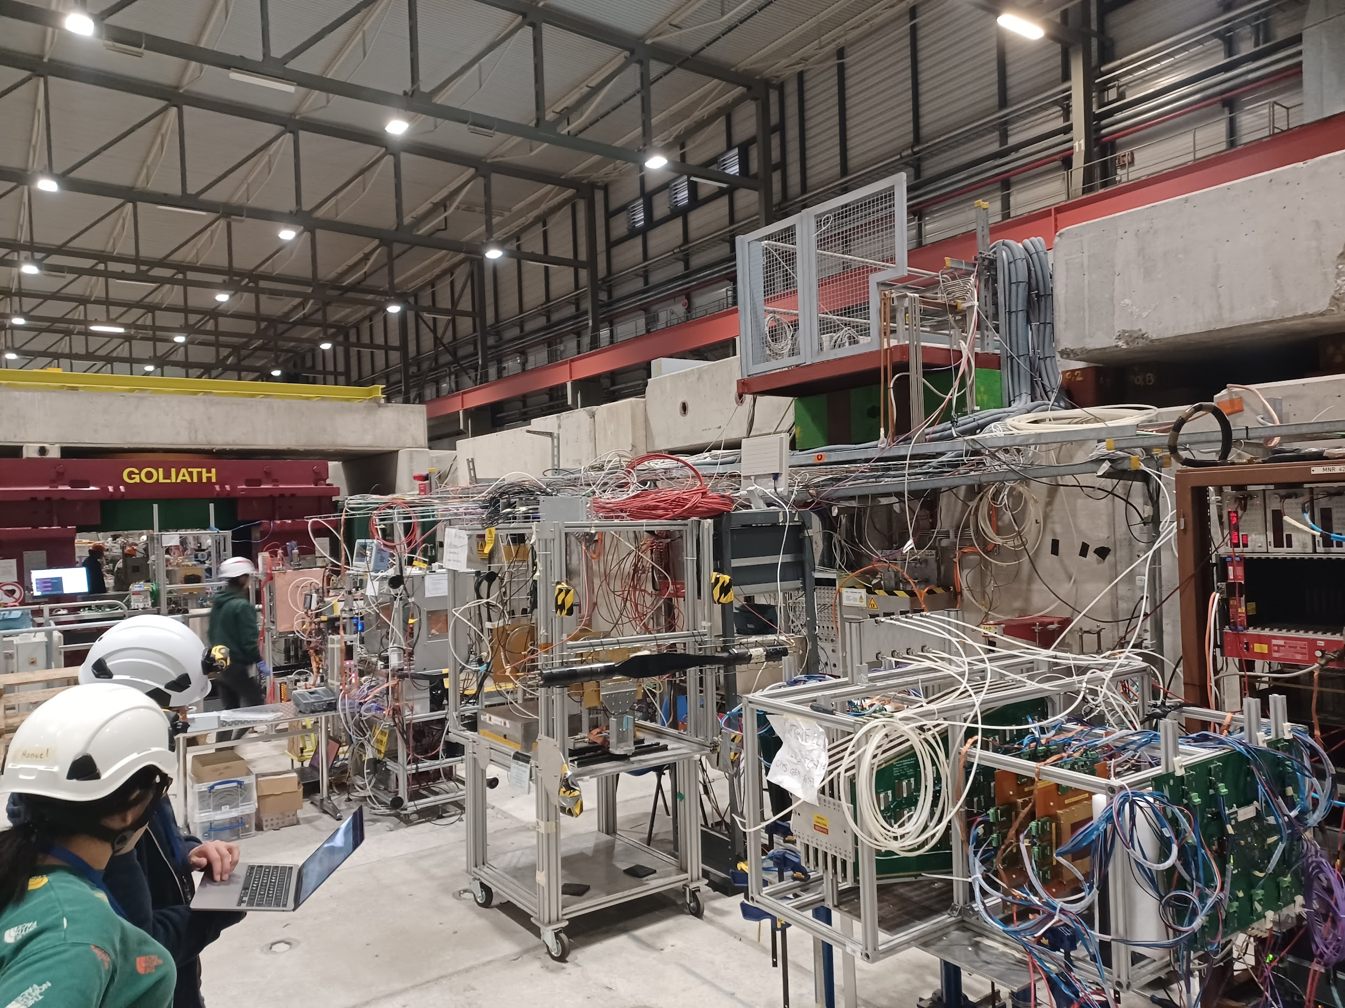
Testbeam Happened!!!
(our trackers broke)
ME0 stack
💖💖💖

Slide 2
Remember!
There are 2 output paths:
Timing Calibration:
The Latency Scan
Trigger
Lower resolution, but quick readout
Full resolution, but not enough storage for all of it!
Data

Slide 3
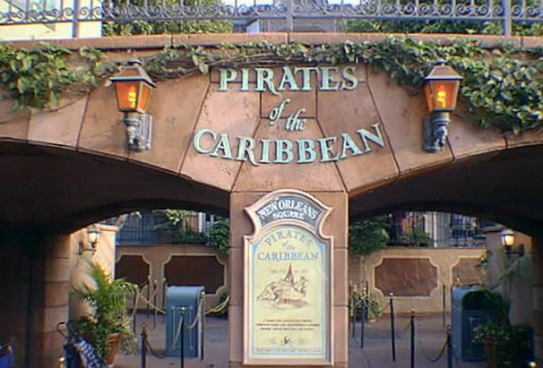
Consider a Metaphor:
Timing Calibration:
The Latency Scan

Slide 4
Consider a Metaphor:
Timing Calibration:
The Latency Scan
Data
Goes through
dark ride
Gets in Boat
Leaves Boat
Waits for n boats to pass
Trigger
Walks to Exit

Slide 5
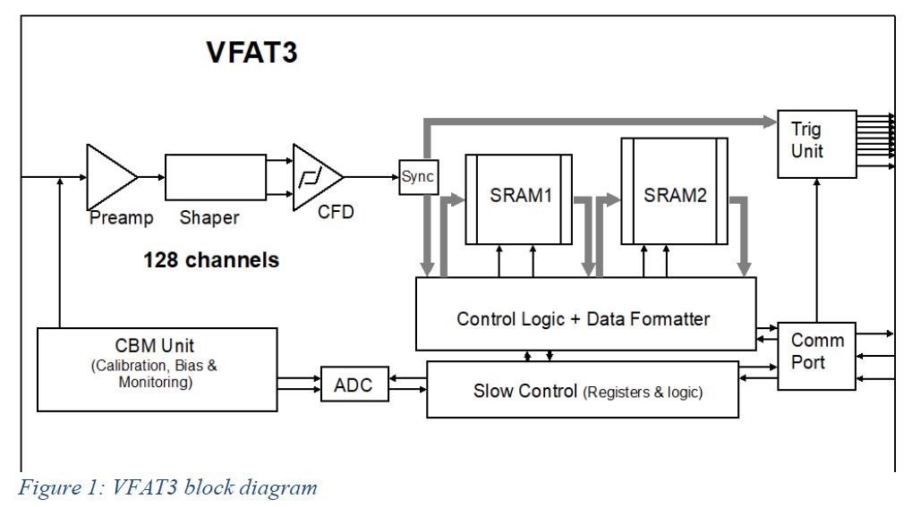
Reality:
Timing Calibration:
The Latency Scan

Slide 6
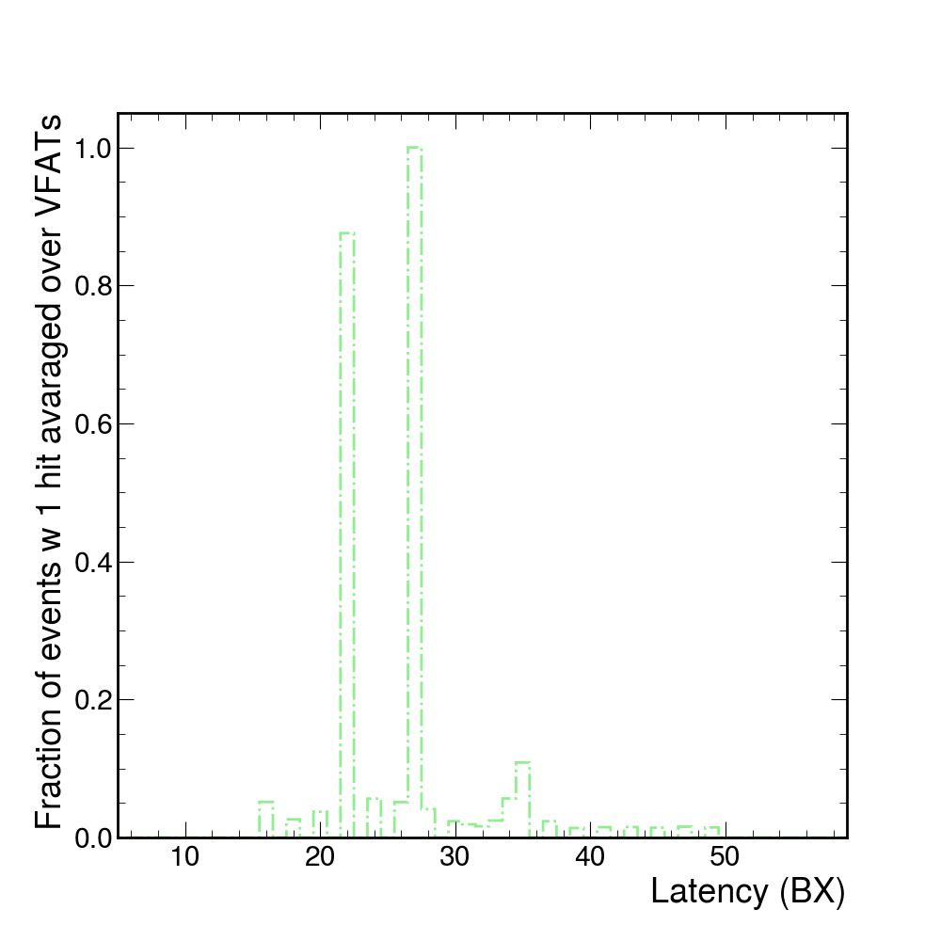
Testbeam Results:
Timing Calibration:
The Latency Scan

Slide 7
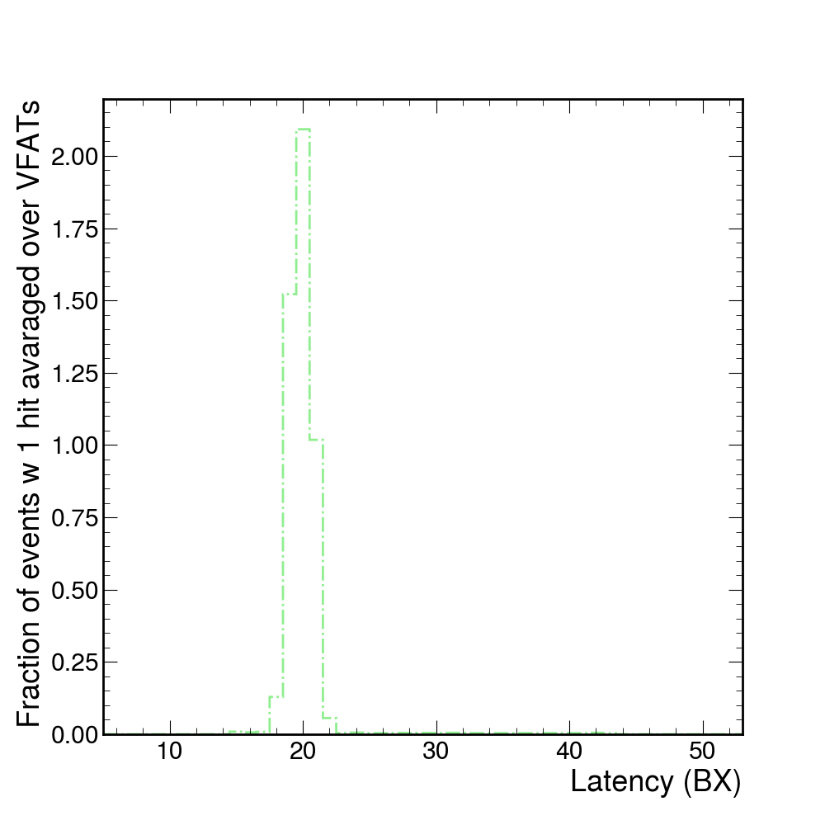
Testbeam Results:
Timing Calibration:
The Latency Scan

