Slide 1
CERN Project Updates
Jeevi Scarozza
4/27/24

Slide 2
Project Status
LHC Project: Running pre-trained model (Unet)
Computer Science Crash Course
Training and Finetuning Deeplab Model
Learning about model setup, and how to deploy efficiently
This part edit by "Insert > Header and Footer”

Slide 3
Status
Keras: Not a good model for severly imbalanced classes
Deeplab V3+ retraining with GPU
Last week: tried to train on Vscode but the model is too large
NNUnet Model (Gitlab): Automatically configures an entire segmentation pipeline

Slide 4

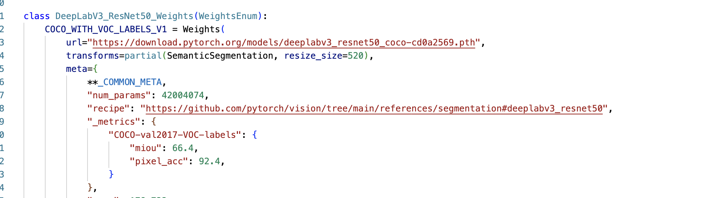
Python Classes

Slide 5
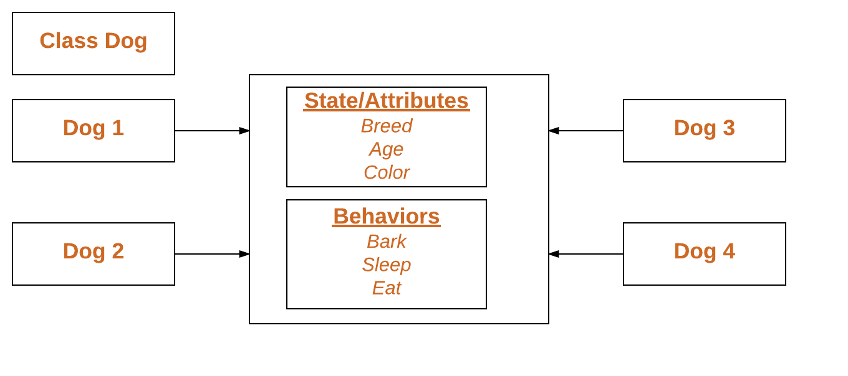
Class Example

Slide 6
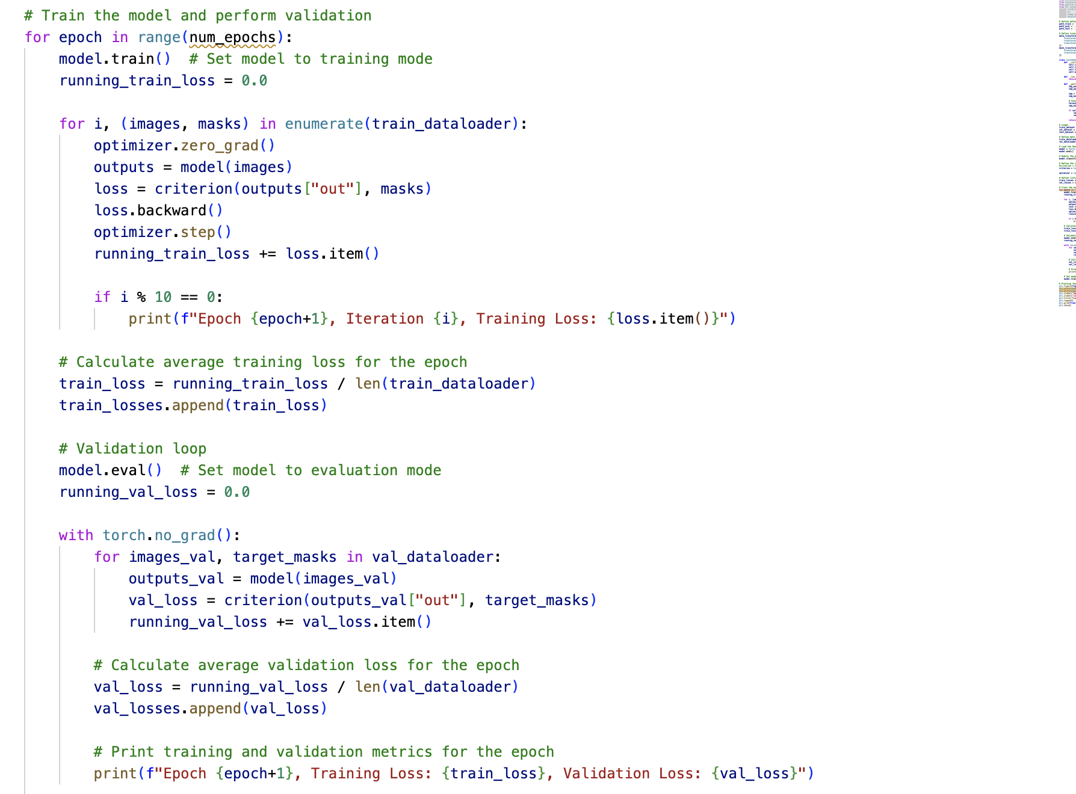
Training Deeplab Model

Slide 7
Pytorch Dataloaders
Dataloaders are used in training the model. You create one for each set (train, test, and val)
Data Transformation:
You can apply data transformations (e.g., normalization, resizing) using torchvision.transforms or custom transforms within the dataset class. These transformations are applied to each sample as it's retrieved.
To calculate train losses: create list,
Pass train data into the loop, calculate loss, backpropogation. Obtain that loss, and add to train loss list.
One epoch finished. Epoch train loss is the average of the losses.

Slide 8
Training the Model
Using BCE with logits loss
Binary vs. Multi-class Classification: torch.nn.BCEWithLogitsLoss (Binary Cross Entropy with Logits Loss) is suitable for binary classification tasks where each sample belongs to one of two classes.
Selecting learning rate: Fixed LR Grid Search: Train the model with different LR values (e.g., [0.001, 0.01, 0.1]) and evaluate Performance on a validation set to determine the optimal LR.
Impact of learning rate:
Too small of a learning rate could result in extremely slow training. Too large could result in convergence too quickly, leading to a less optimal model.

Slide 9
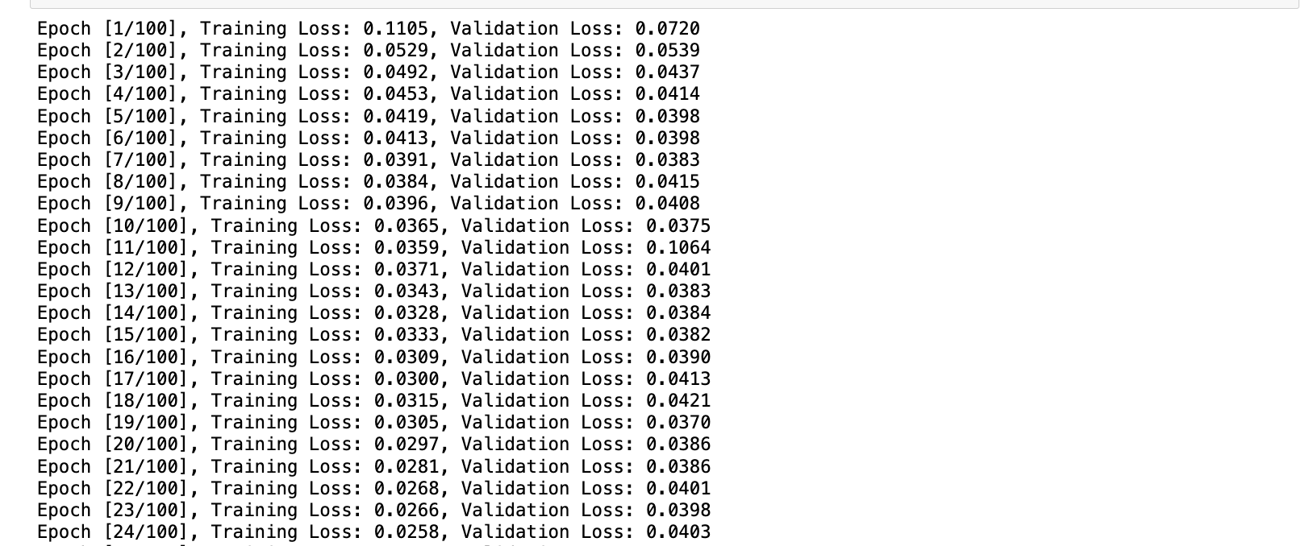
Training the Model and Implementing Early Stopping

Slide 10
Sources
https://arxiv.org/pdf/1505.04597.pdf
https://github.com/Dhananjay42/crackseg9k/tree/main/DeepLab
https://www.geeksforgeeks.org/python-classes-and-objects/

