Slide 1
Project Report 5
Investigating Four-Top Production with ATLAS
Dean A. Reiter
Advisors: Nedaa-Alexandra Asbah, Binbin Dong
April 25, 2024

Slide 2
Status Update
Successfully submitted jobs to the Grid (n-tuple production)
Finished adding variables to n-tuple processing code
  Currently validating new code
Preliminary research for top reconstruction study

Slide 3
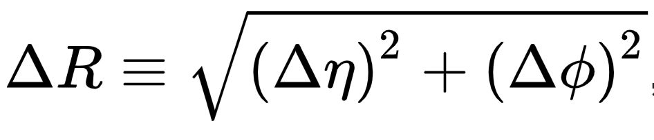
Custom N-tuple Variables
Code written and merged to master
  Angular separation (ΔR) between jet pairs
  Angular separation (ΔR) between b-jet pairs
  Sum of b-jet tagging quantile (related to b-tag working points)
Validating on larger sample data

Slide 4
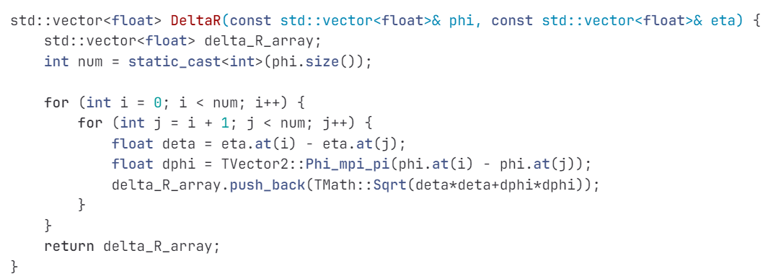
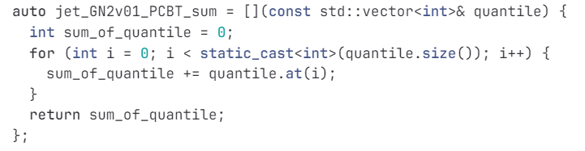
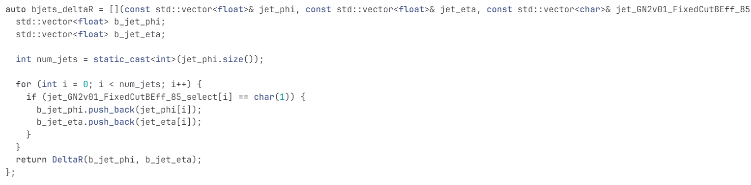
Sum of b-tag quantiles
Jet ΔR
B-jet ΔR

Slide 5
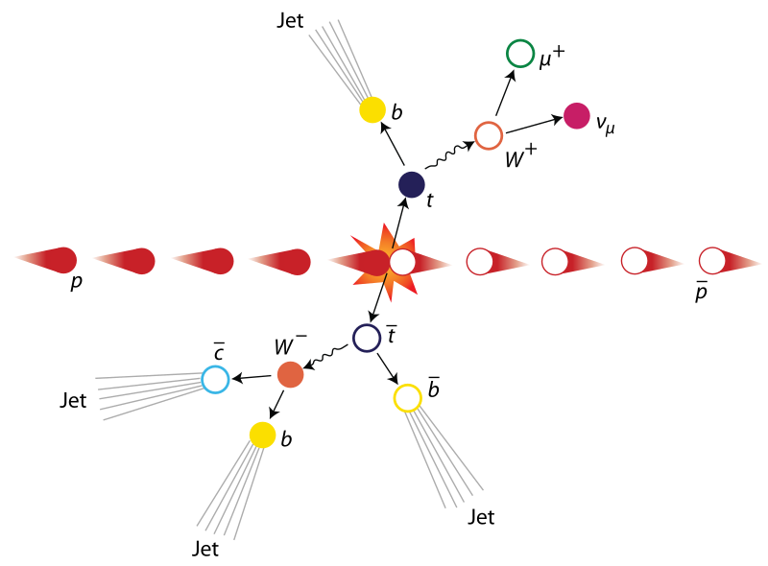
Recap: Top Quark Reconstruction
You can reconstruct a top quark by finding its decay products
Gives us more kinematic information to separate signal from background
  More input for multivariate analysis algorithm
Need to study whether this is feasible, effective

Slide 6
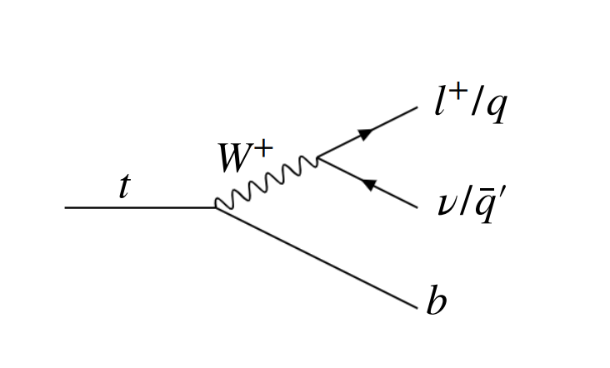
Recap: Top Quark Decay
Top quark decay is hadronic or leptonic
Hadronic
  3 jets (at least 1 b-jet)
Leptonic
  1 b-jet
  1 lepton (electron, muon, tau)
  1 neutrino

Slide 7
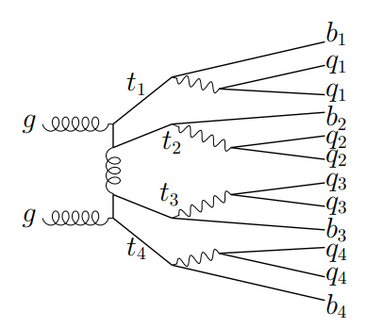
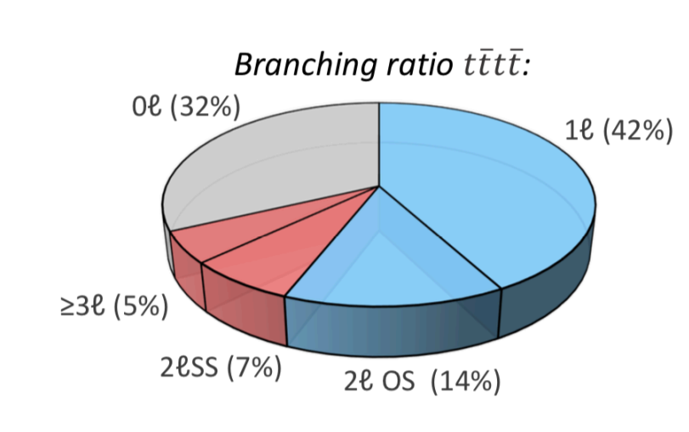
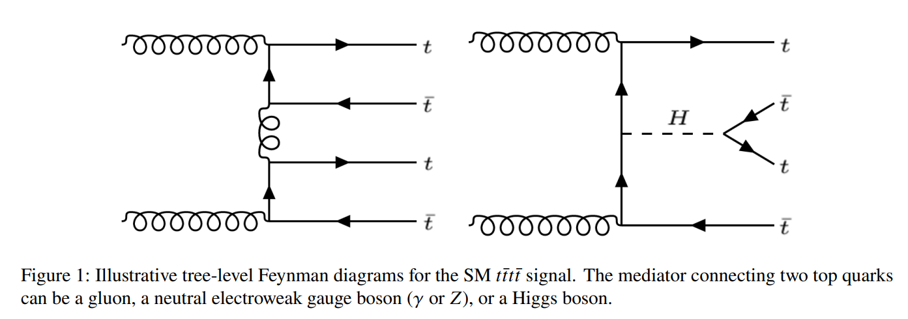
Recap: Four Tops
Much more complex topologies
Most 4 tops decay into all hadrons
2 and 3 lepton channels (3L, 2LSS) are cleanest
Ex: All hadronic (0L) channel

Slide 8

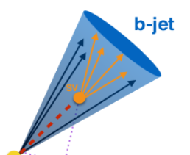
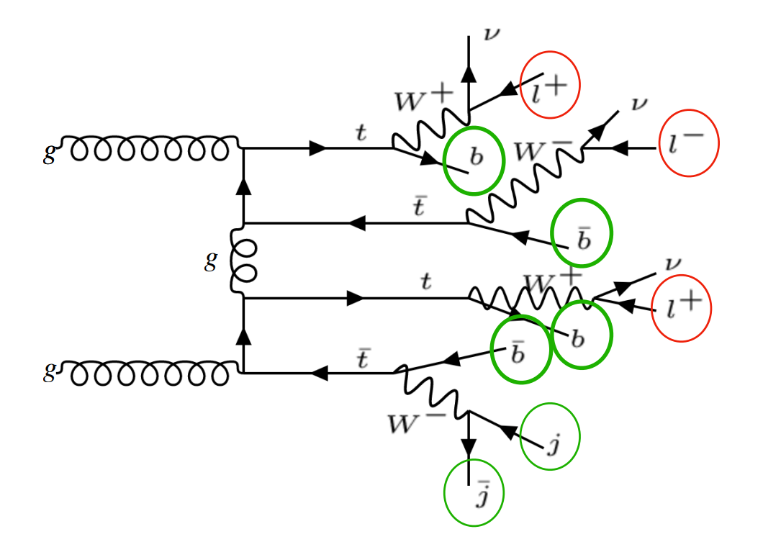
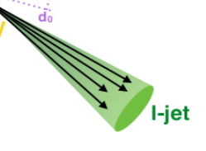



“Set Assignment Problem”
p_{T}^{miss}
Ex: 3-lepton (3L) channel

Slide 9
What are our final states?
2-Lepton Same Sign (2LSS)
3-Lepton (3L)
2 hadronic tops
2 leptonic tops
Final State
  2 Leptons (same charge)
  8 Jets
      At least 4 b-jets
  Missing energy
      2 neutrinos
1 hadronic top
3 leptonic tops
Final State
  3 Leptons
  6 Jets
      At least 4 b-jets
  Missing energy
      3 neutrinos

Slide 10
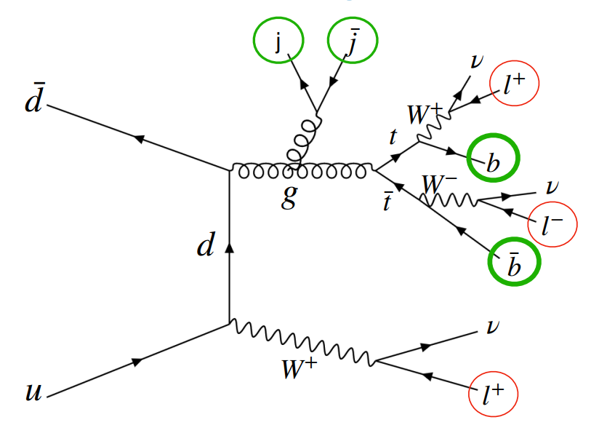
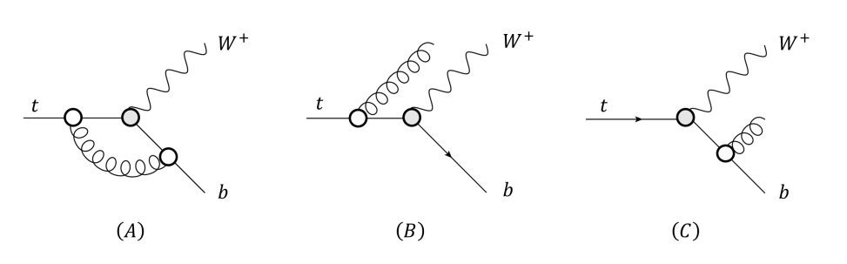
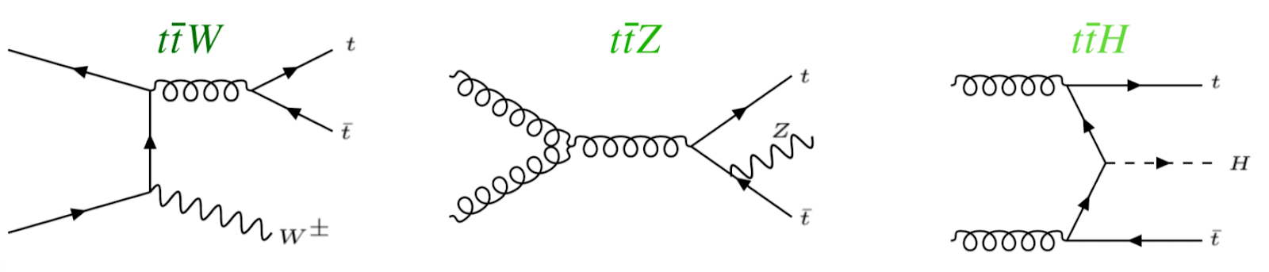
What are our backgrounds?
Largest backgrounds are ttW, ttZ, ttH
Can look like four tops signal
  Possibility of gluon splitting

Slide 11
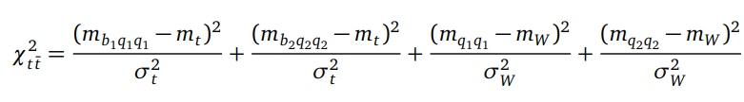
Hadronic Top Reconstruction
Chi-Squared Method
  Test every possible permutation of jets
      Permutations of 3 jets (including 1 b-jet) among all 6+, 8+ jets
              Note: For the W products, the quark and anti-quark are interchangeable
  Compare to known masses of W boson and top quark
Example of chi-squared equation for top-pair reconstruction
Equation must be modified
Suffers from combinatorial explosion problem - high compute

Slide 12
Hadronic Top Reconstruction, cont.
Kinematic Fitting
  KLFitter: https://doi.org/10.1016/j.nima.2014.02.029 (semi-leptonic tt)
Boosted Decision Trees
Deep Neural Networks
  https://arxiv.org/abs/1907.11181 (semi-leptonic tt)
Graph Neural Networks
  Briefly investigated in 2023 ATLAS four tops observation study
  Did not manage to increase sensitivity over background
  https://cds.cern.ch/record/2765538/files/ATL-COM-PHYS-2021-195.pdf
Other: SPA-NET
  Attention based network which preserves physical symmetries
  20% improved efficiency over chi-squared method
  Was able to reconstruct 0L tttt events
  https://arxiv.org/abs/2106.03898

Slide 13
Leptonic Top Reconstruction
Mass reconstruction is non-trivial
  System is kinematically unconstrained
  Missing transverse momentum is the sum from 2+ neutrinos
  Cannot determine momenta of individual neutrinos
Possible solutions (constraining m_{t} and m_{W})
      https://pdg.lbl.gov/2019/reviews/rpp2019-rev-top-quark.pdf
  Analytic solutions
  Neutrino weighting methods
      https://arxiv.org/abs/hep-ex/9808029
  Neutrino reconstruction with deep neural networks (2023)
      https://arxiv.org/abs/2307.02405
      Can recover full neutrino momenta in multi-neutrino final states

Slide 14
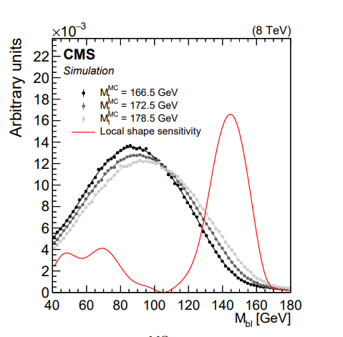
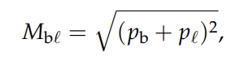
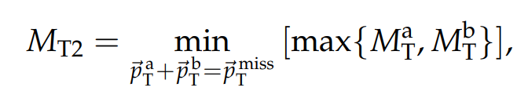
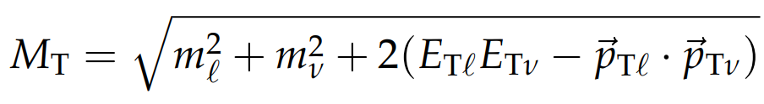
Leptonic Top Reconstruction, cont.
Other observables sensitive to top quark mass
  Invariant mass of bottom jet and lepton system is theoretically limited by top quark mass
  Other transverse-mass-like variables
  Maybe can be fitted to known distributions to reconstruct leptonic tops? Maybe can be used as discriminating variables
https://arxiv.org/abs/1704.06142

Slide 15
Other Ideas
Check for invariant masses of H and Z bosons in parallel with top reconstruction
  Remove possible background events

Slide 16
Next Steps
Continue research on permutation-based, kinematic fitting, and BDT methods
Continue research on leptonic tops, neutrino reconstruction
Work on hadronic top reconstruction algorithm
  First test on truth-matched top quark pair (tt) data

Slide 17
Questions?

Slide 18
Backup Slides

Slide 19
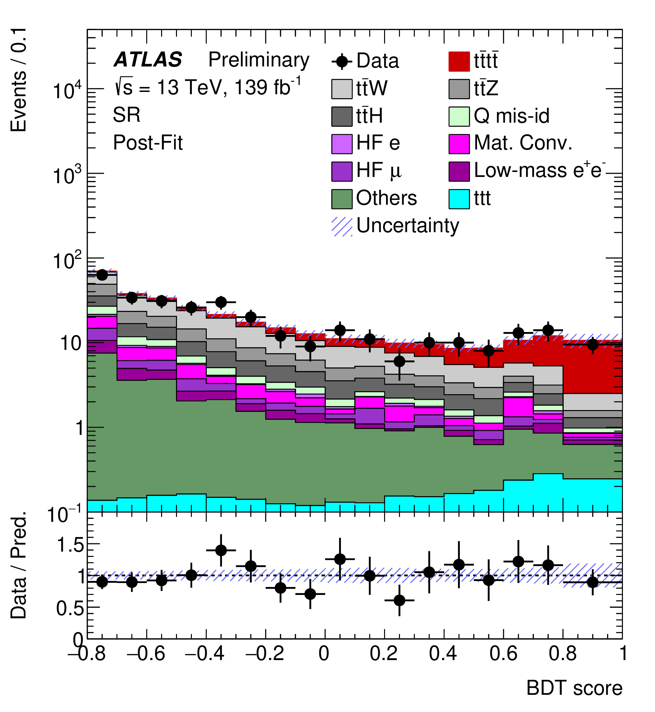
Past Observation of 4 Tops
2020/2023 Papers
Used Run 2 Data @13 TeV
Observed 4 Tops with ~ 6 sigma
Now looking at Run 3 Data @13.6 TeV
Need to update analysis framework and code
  Also helps prepare for HL-LHC

Slide 20

Example: $t\overline{t}$ Production

Slide 21
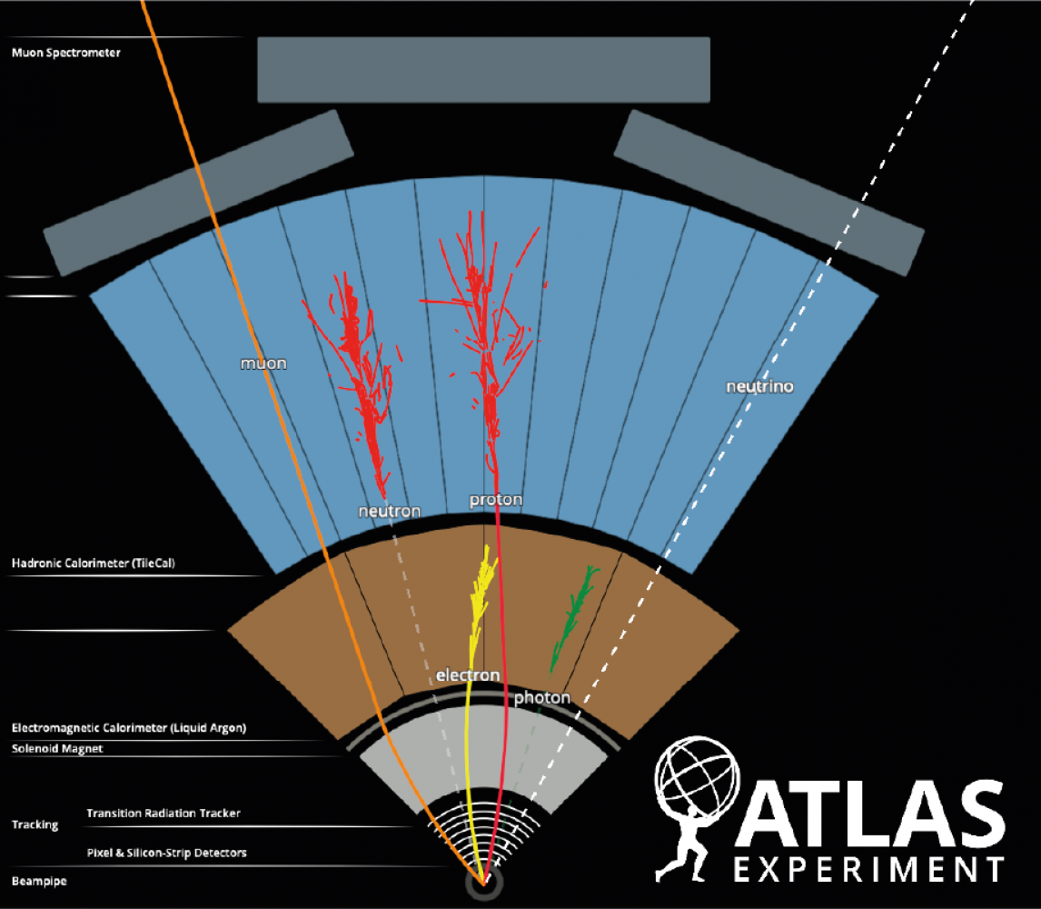
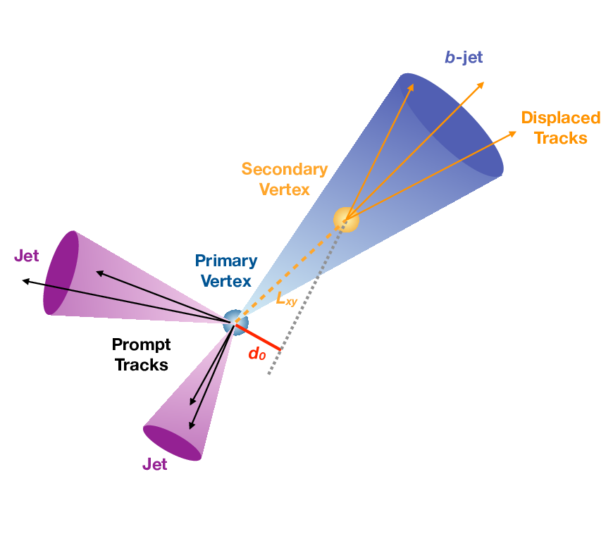
B-Jet Tagging vs Leptons

Slide 22
Four Tops

Slide 23
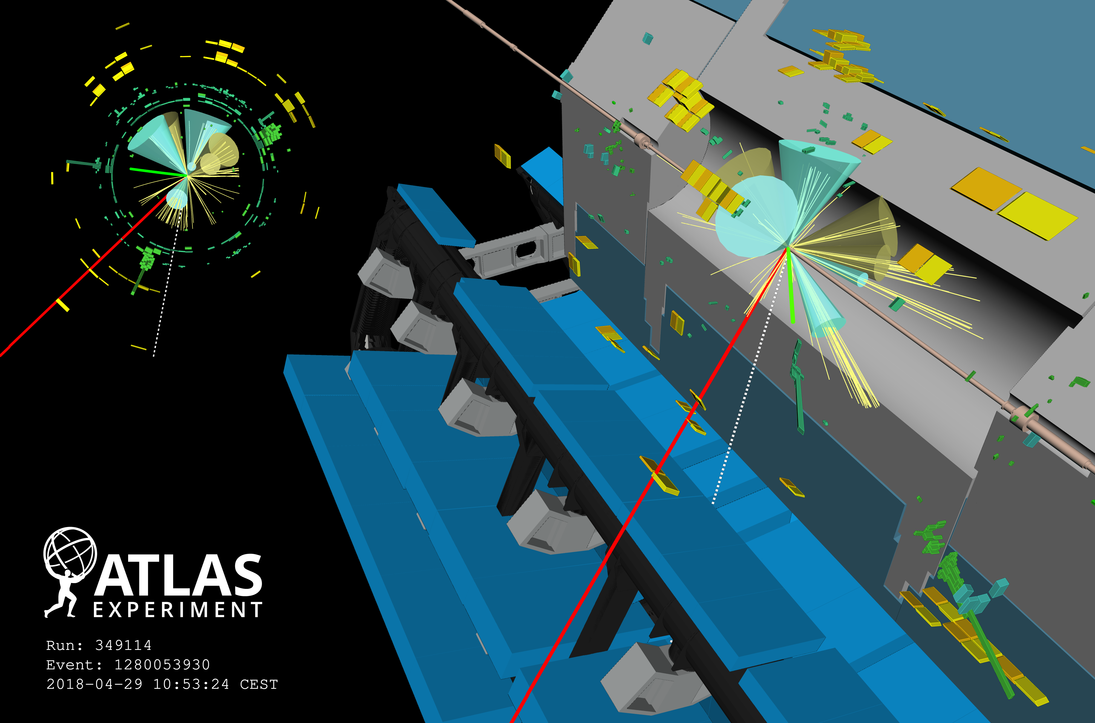
Notes:
Four-top candidate from 2018. Event display of a candidate four-top-quark event (Run 349114, Event 1280053930) with seven jets (four of them are b-tagged); two of the top quarks decay leptonically (one with a resulting muon, shown in red, and one with an electron, shown in green), and two top quarks decay hadronically. Green rectangles correspond to energy deposits in cells of the electromagnetic calorimeter, while yellow rectangles correspond to energy deposits in cells of the hadron calorimeter. The jets (b-tagged jets) are shown as yellow (blue) cones. The direction of the missing transverse momentum is indicated by a dotted line.

Slide 24
Branching ratios
Most 4 Tops decay into all hadrons
2 and 3 lepton channels (3l, 2lss) are cleanest

Slide 25
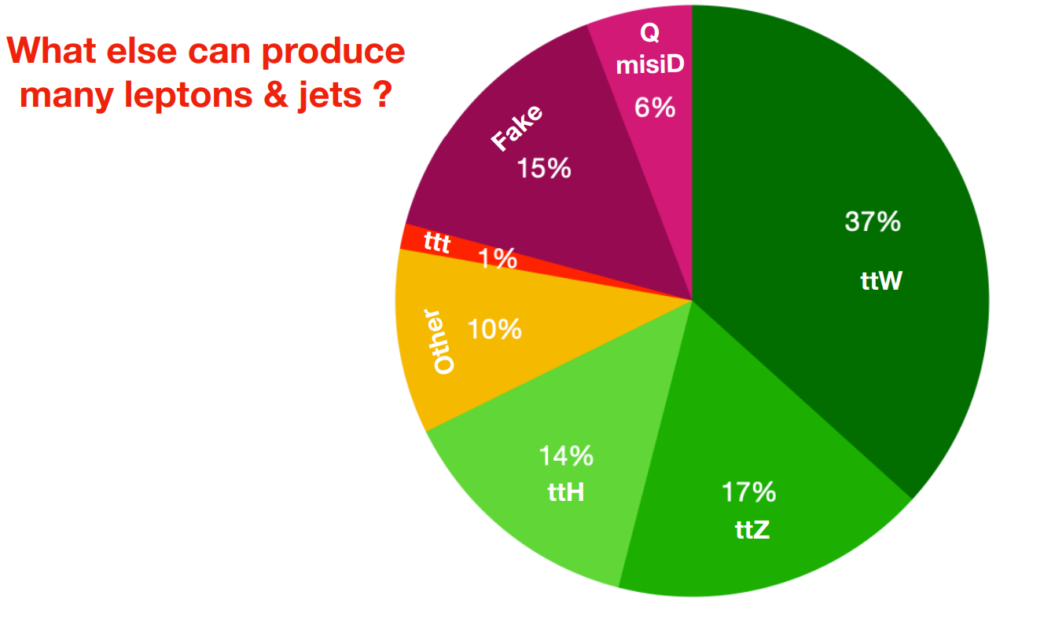
Backgrounds

Slide 26
Example of 3L Channel Signal

Slide 27
Example of 3L Background

Slide 28
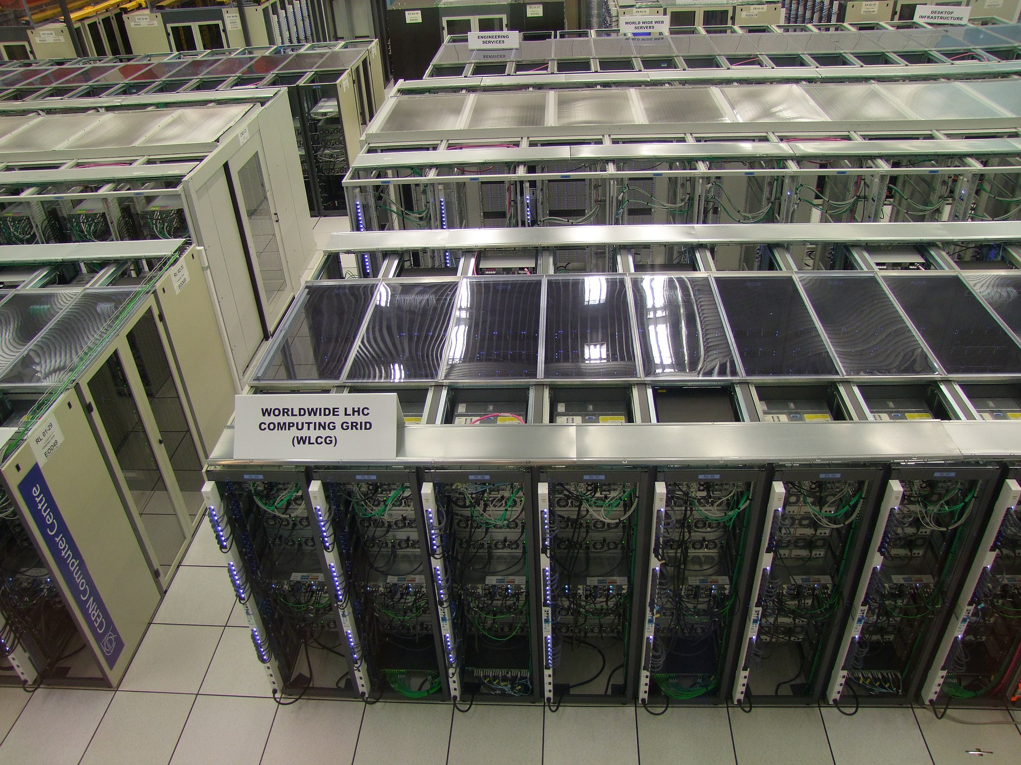
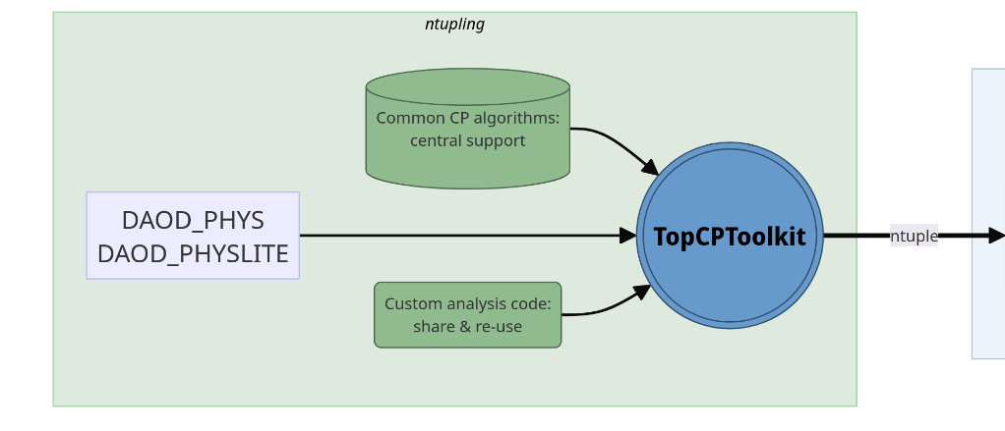
N-tuple Production
TopCPToolkit is n-tuple production framework written for all top quark related analyses
Practice submitting jobs to the Grid
Notes:
The Grid is CERN’s computer network

Slide 29
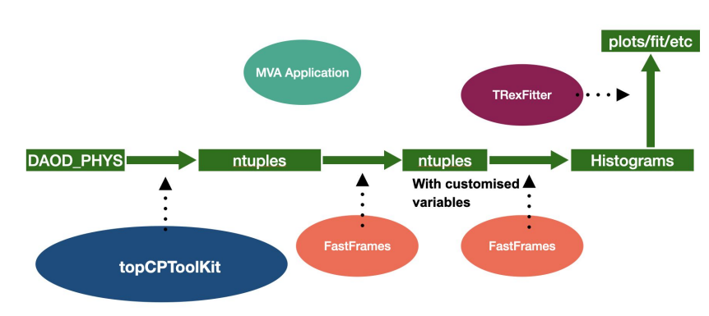
Recap: Analysis Framework
Data analysis pipeline has multiple stages
FastFrames code computes custom kinematic variables

Slide 30
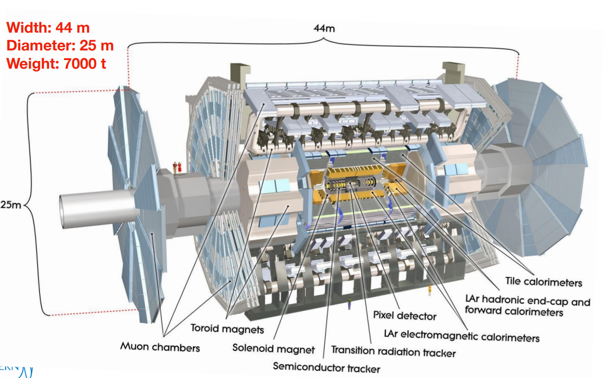
ATLAS Detector

