Slide 1
Nichrome Electrodes

Slide 2
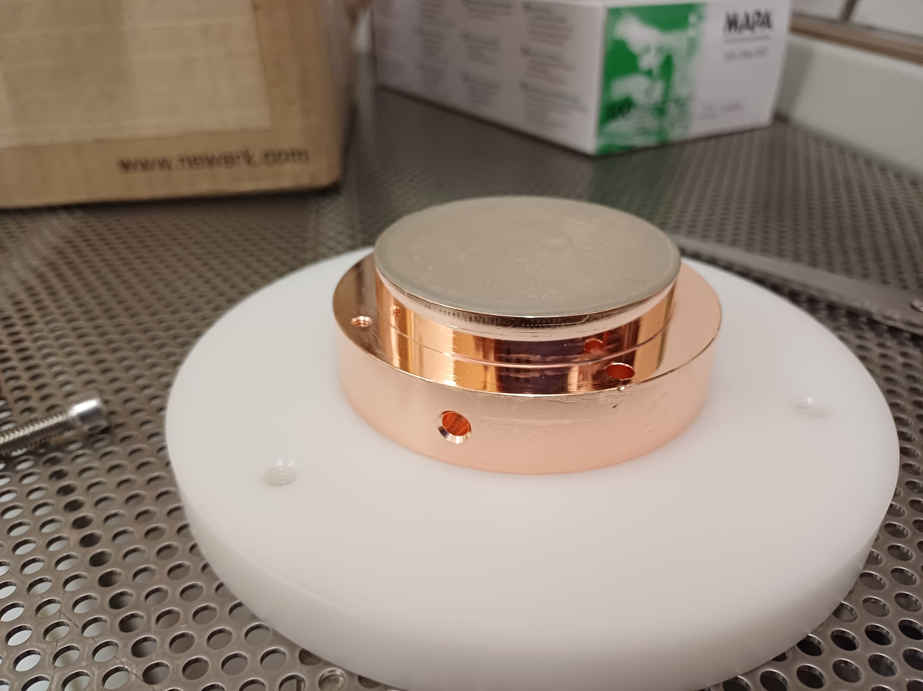
Received to CERN
Received electrode appeared in good shape.

Slide 3
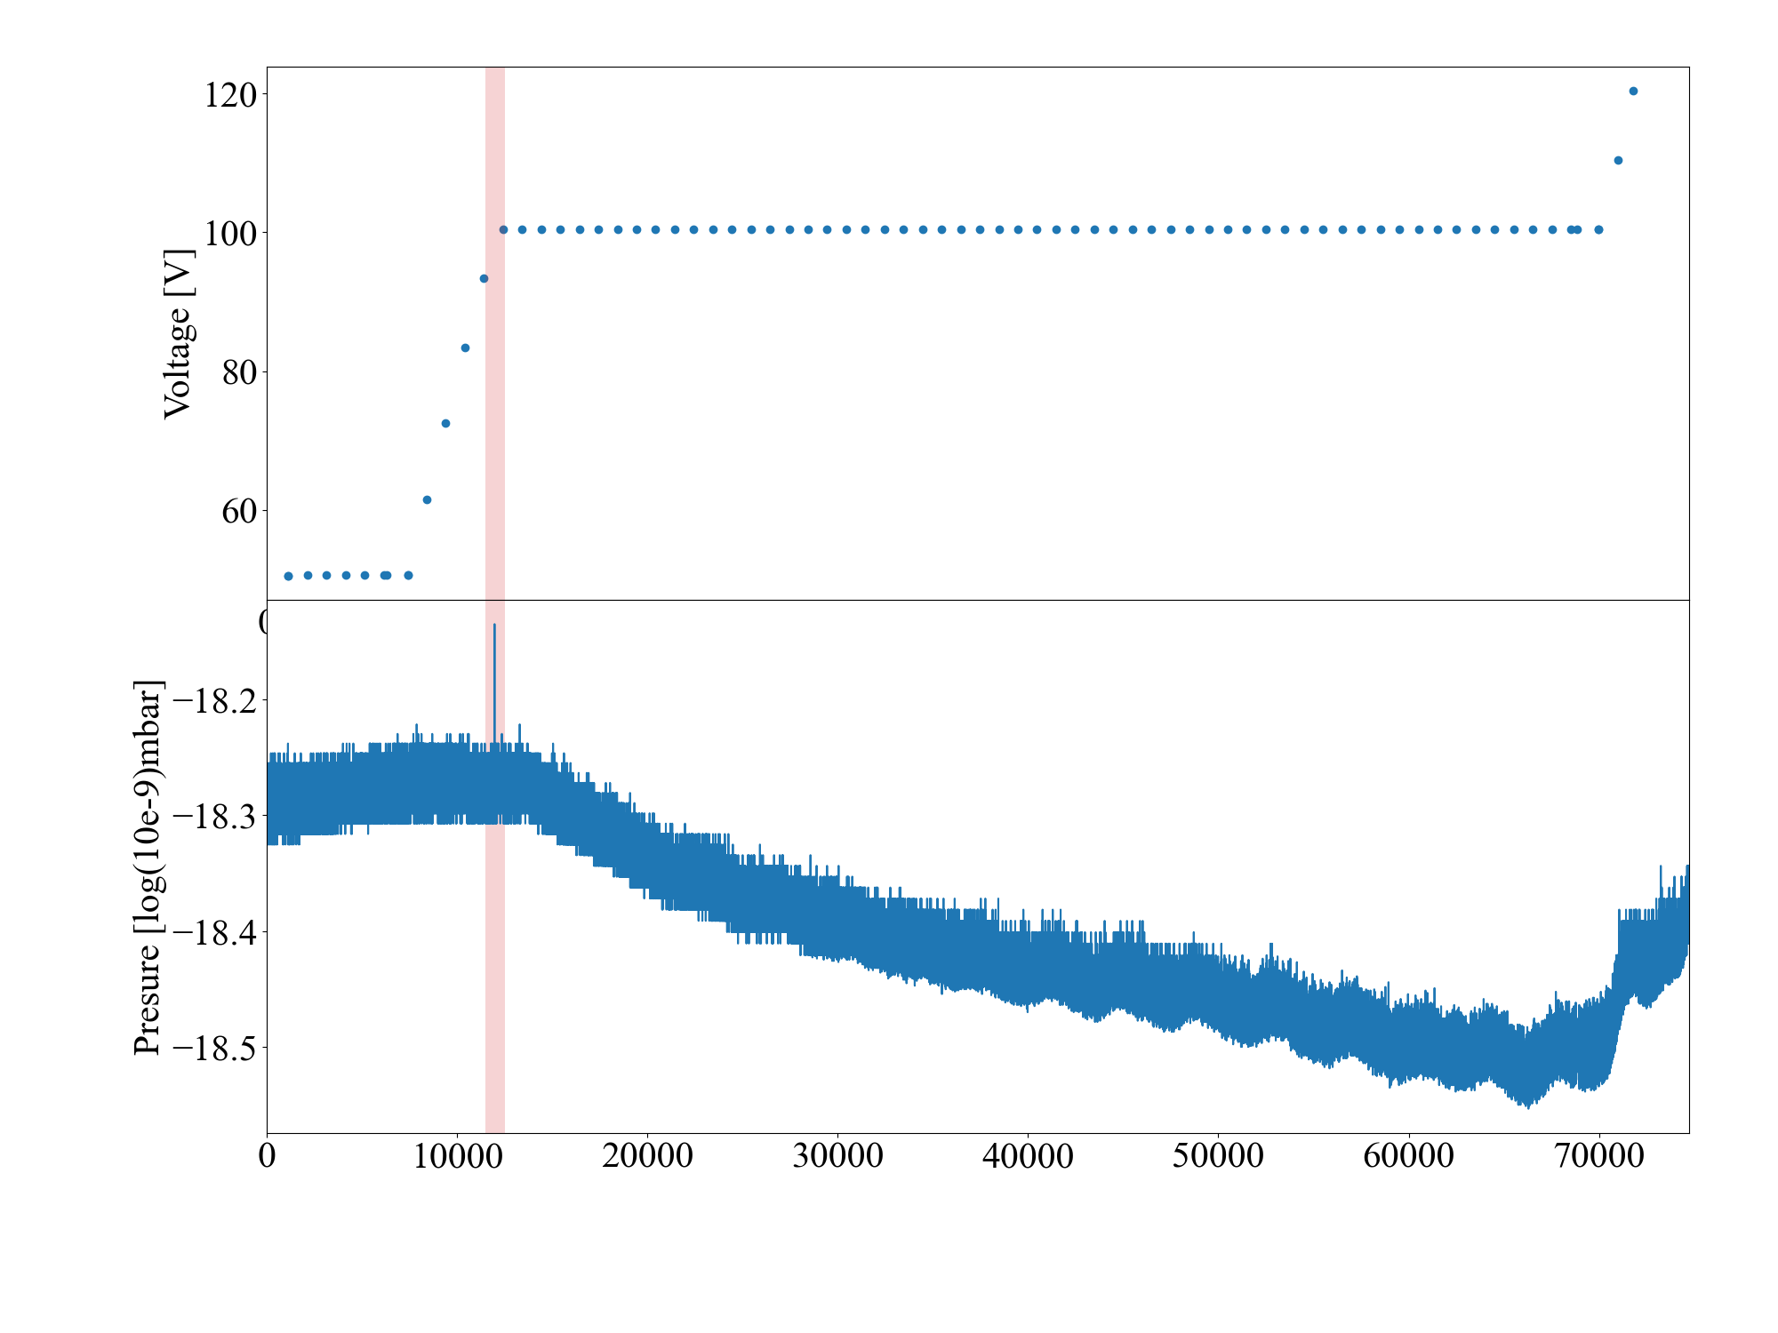
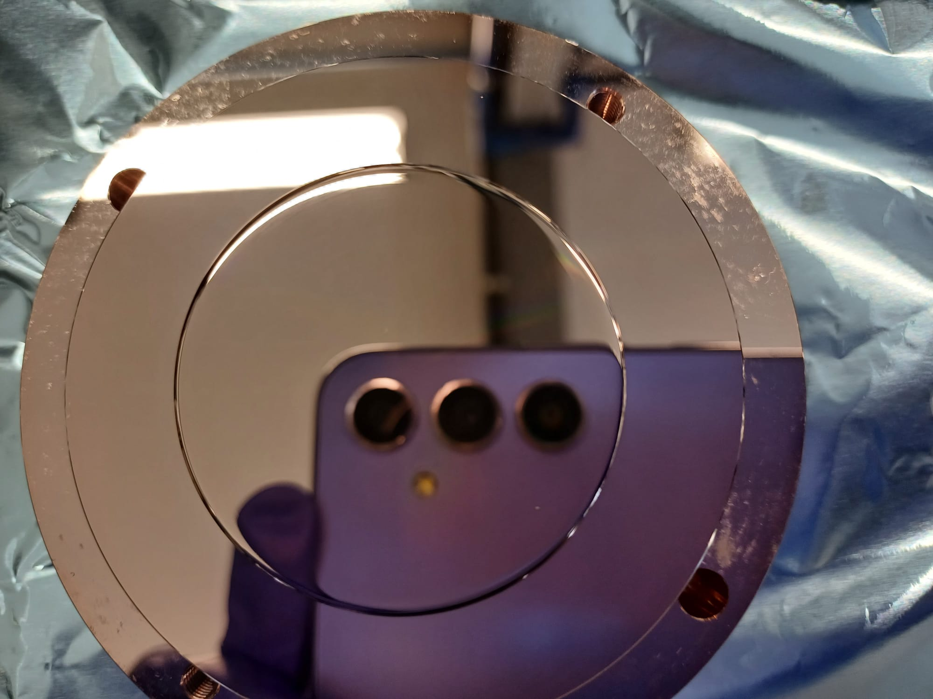
Short circuit during first conditioning, 50um
During our first condtioning trial, there became a short circuit at one point, turning the electrodes from a capacitor into a resistor.

Slide 4
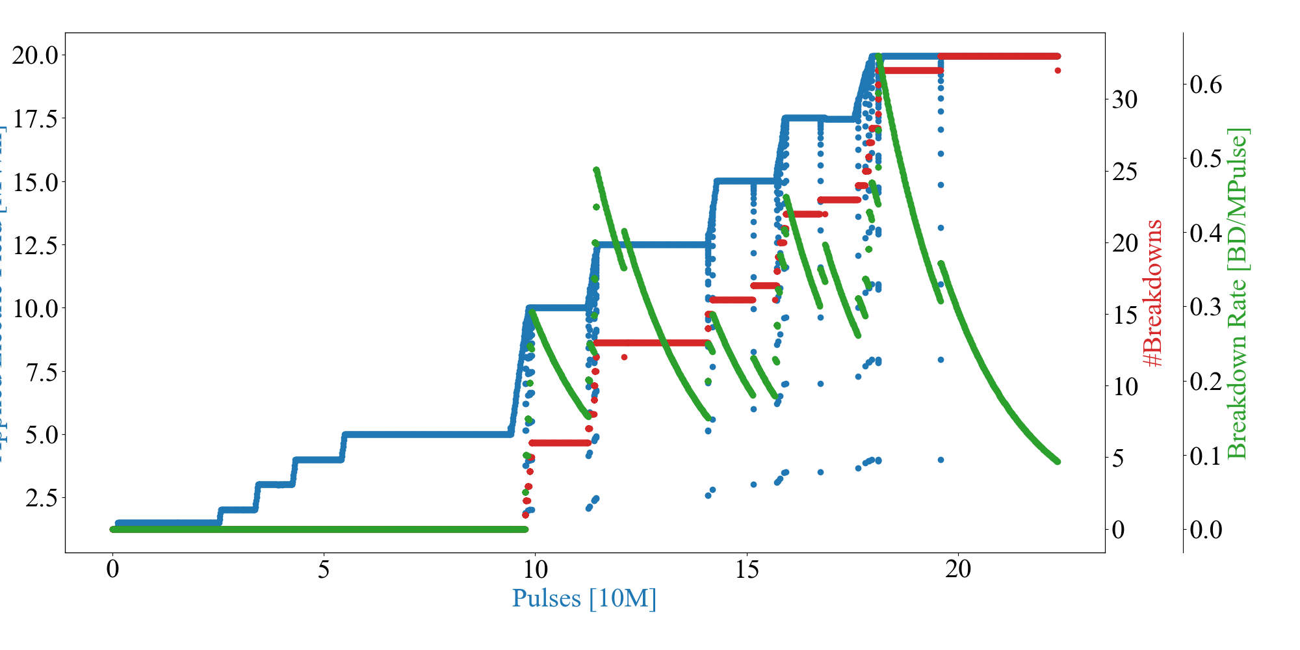
Change to 80um gap, current gap for conditioning
Carefully increasing the frequency from 100 to 500Hz, we are currently condtioning at 25MV/m (not shown) and are starting to locate the breakdowns.

Slide 5
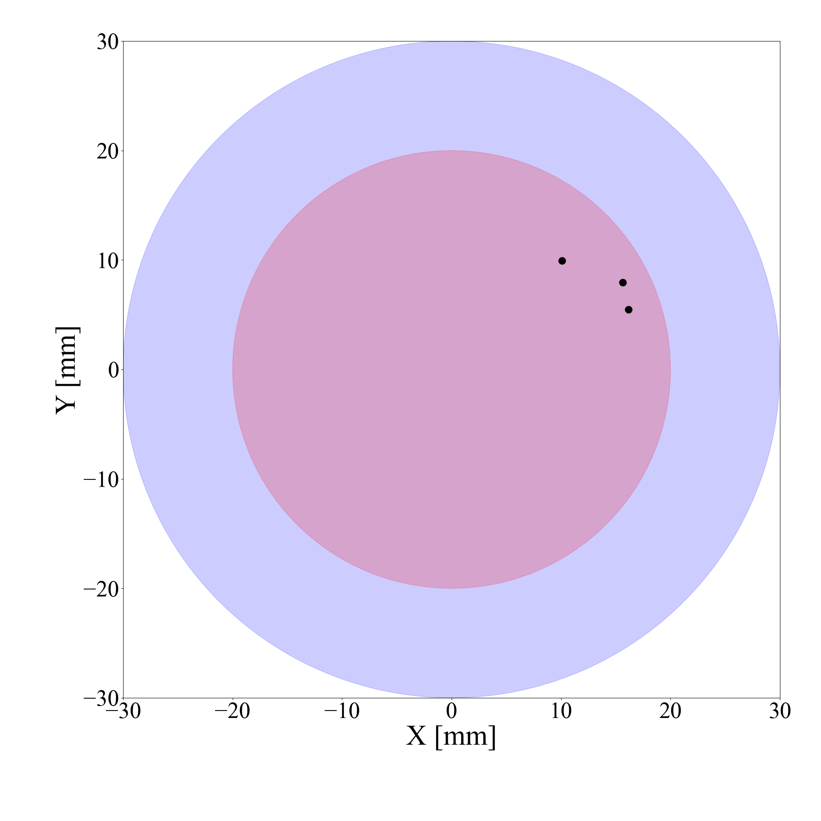
Breakdown Locations
So far, the breakdowns are observed in close proximity.

Slide 6
Summary
Continue conditioning
At 25MV/m.
Starting to locate breakdowns.
Comments:
The electrode can go far beyond what is required of it with regards to field holding. We also see the pressure be heavily linked with the applied voltage.

