Slide 1
HEARTS WP Leaders Meeting #5
14 May 2024
https://indico.cern.ch/event/1406848/
L.S. Esposito on behalf of WP3 team

Slide 2
WP3 Deliverables and Milestones
Deliv. No. | Deliverable name | Due date | Status
D3.1 | Numerical characterization of the CHARM beamline and of detector response | 2024-12-31 | Pending
D3.2 | Modelling of shielding materials and configurations for test setup standardisation | 2024-12-31 | Pending
D3.3 | GCR/SPE simulator optimizer software | 2024-12-31 | Pending
D3.4 | Demonstration of LET uncertainty reduction from simulations as a complement to experimental measurements | 2025-12-31 | Pending
D3.5 | Modelling of medium-complexity devices and response to different ion beams | 2025-12-31 | Pending
Miles.No. | Milestone name | Due date | Status
M11 | Release of G4SEE VHE ion tool | 2024-12-31 | Pending

Slide 3
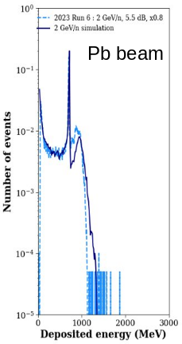
D3.1: Numerical characterization of the CHARM beamline and of detector response (CERN, M1-24)
Presented at HEARTS annual meeting:
  T08 beam line transport simulations: assessing beam transmission, loss locations
  Beam parameters at CHARM DUT location using simulations + Si diode measurements: energy/LET spread, secondary particle field, beam profile
Move to IRRAD: Invitation to move test location from CHARM to IRRAD Zone 1 (bypassing 30 m of air, instruments and vacuum windows)
  Assessment of effect of different air sectors along T08 beam line on beam transmission and properties at DUT location
  First bending dipole vacuum chamber will ease operability by allowing us to transmit a wider range of energies through the line with linear scaling of the magnets w.r.t beam rigidity
  FLUKA simulation studies ongoing:
    Implementing (temporary) vacuum sectors in IRRAD experimental area upstream of CHARM is not feasible
    Assessing key beam properties at IRRAD: “minimal” extracted beam energy, energy/LET spread, beam profile and transmission as function of optics
Andreas Waets

Slide 4
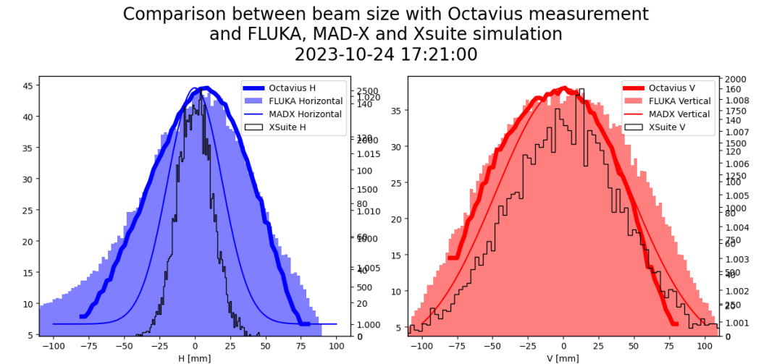
D3.1: Numerical characterization of the CHARM beamline and of detector response (CERN, M1-24)
CHARM
FLUKA simulation assessments of beam quality to be repeated for IRRAD Zone 1 location:
  Beam profile ↔Multi-wire proportional chamber
  Energy deposition ↔Si diode measurements
E. Johnson
Andreas Waets

Slide 5
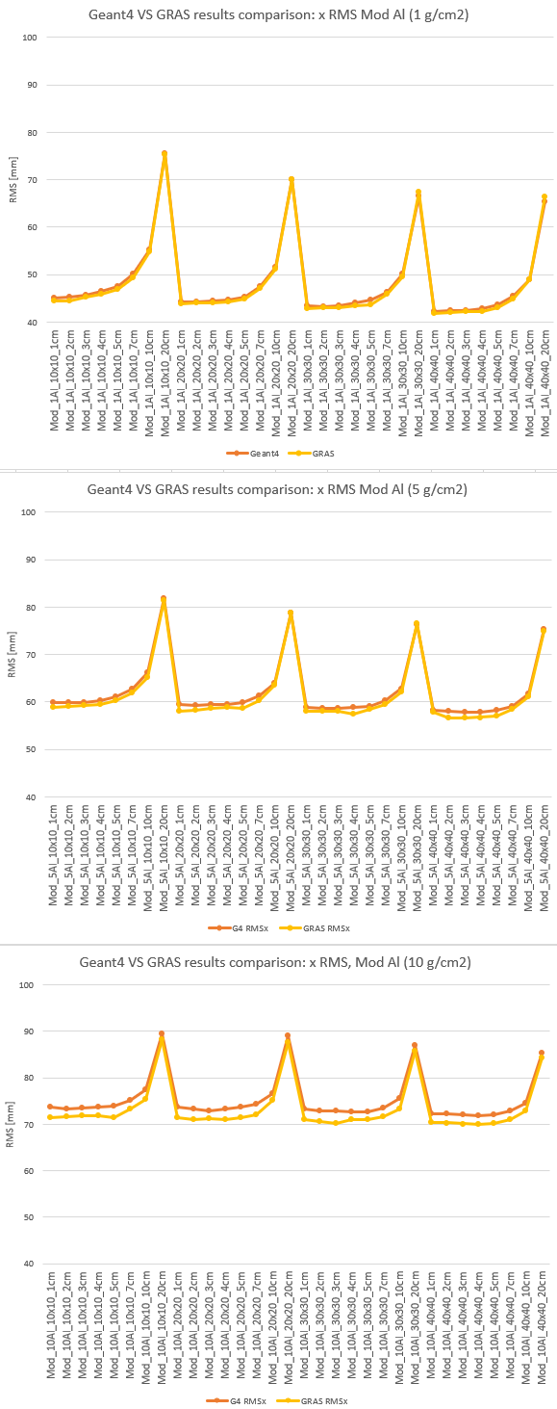
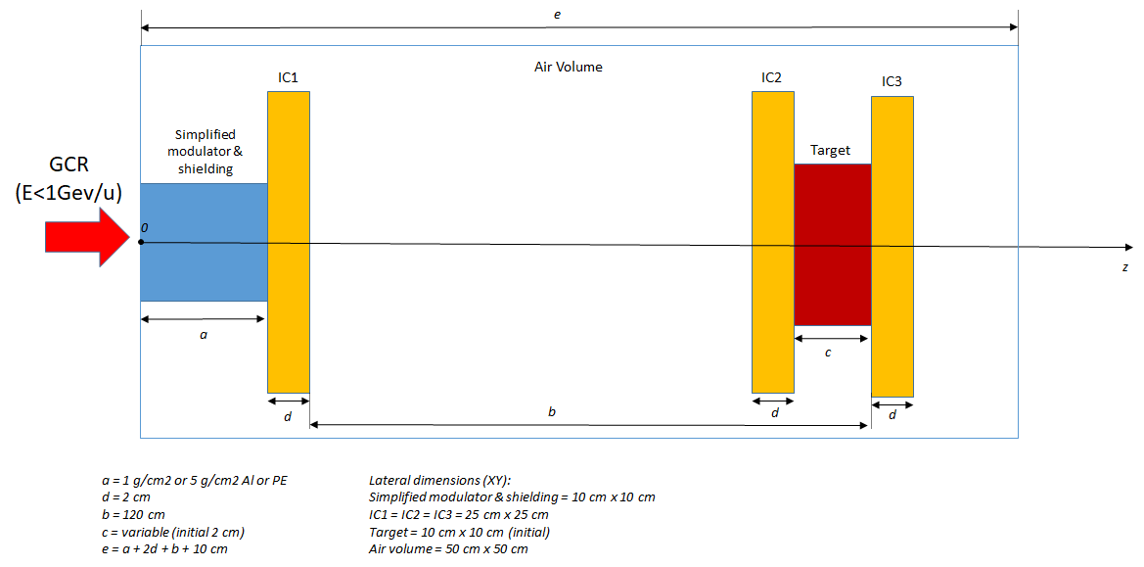
D3.2: Simulation of shielding materials and configurations for test setup standardization (GSI, TAS, M1-24)
Sensitivity analysis ( performed by TAS )
  results received a few days ago -> only a teaser for now
Christoph Schuy

Slide 6
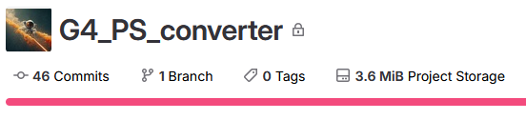
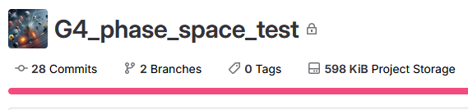
D3.2: Simulation of shielding materials and configurations for test setup standardization (GSI, TAS, M1-24)
Development of “GRAS / Spenvis”-like GCR simulator phase-space file
  instead of simulating several voxelized modulator geometries → “full” GCR simulator phase space as “general particle source”
Software available internally in GSI git
Will be made public as soon as testing is done
Christoph Schuy

Slide 7
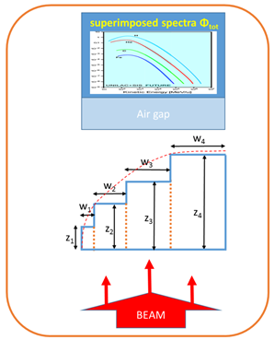
D3.3: GCR/SPE simulator optimizer software (GSI, M12-24)
Find material weights for given material thickness to reproduce target function
Complexity/Time demands of energy loss, nuclear fragmentation and scattering too high for MC-based optimization → iterative analytical optimizer with MC-Base data.
Material weights
Software GSI-internally available (based on C++/ROOT)
  currently optimized modulator geometries need scanning! → only applicable in Cave A
FAIR?
Material thickness
➔ To add all necessary functionality and make it more “user friendly”, severe changes to the codebase are necessary
Rewrite of main optimizer in pyROOT, Numpy, Scipy and Jupyter
  Basic interfaces and file formats will remain the same
Christoph Schuy

Slide 8
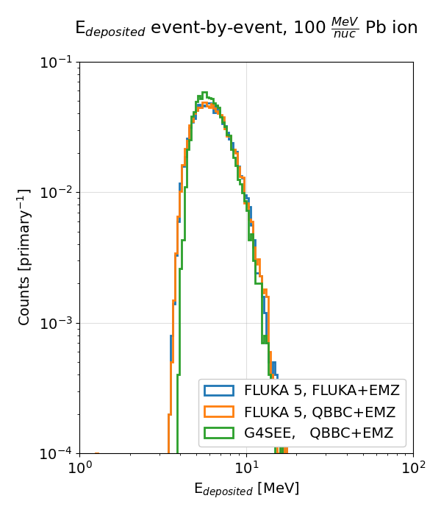
M11: Release of G4SEE VHE ion tool (CERN, M1-24)
New features are being tested and merged into public release:
  Particle LET scoring (with multiple options);
  Simplified Edeposition per nuclear reaction scoring;
  MSc thesis has been submitted recently
  (author: Eva Fialová, supervisor: Dávid Lucsányi)
Preparation of LET validation experiment with proton beam at PSI PIF facility
  Similar study is foreseen later but with heavy ions
In parallel, integration of SEE scoring features into
FLUKA v5 is ongoing
  Regular SEE benchmark simulations both with G4SEE and FLUKA, also for VHE heavy ions
Dávid Lucsányi

