Slide 1
HEARTS
Leaders Meeting #5
14 May 2024
https://indico.cern.ch/event/1406848/
S. Gerardin - UniPD

Slide 2

Tasks & Objectives
Project goal is to provide >100 MeV/n heavy ion beams to space users, to mimic the effects of Galactic Cosmic Rays (GCR) at ground level
  penetration levels large enough to enable electronics testing in air, without the need of special preparation and at board and box level
  essential for the exploitation of high-end microelectronics technology in space, for e.g. onboard Artificial Intelligence or Big Data processing applications
The suitability of the infrastructures for the testing and qualification of EEE devices (↑ TRL to 6-7) and electronic boards is a key aspect
Purpose of WP5: study of radiation effects induced by VHE heavy ions on a set of technologies representative of current state-of-the-art COTS electronics
  Comparison with standard-energy heavy ions.
  A hierarchical approach, based on three levels of complexity, will highlight different levels of details
2
2

Slide 3
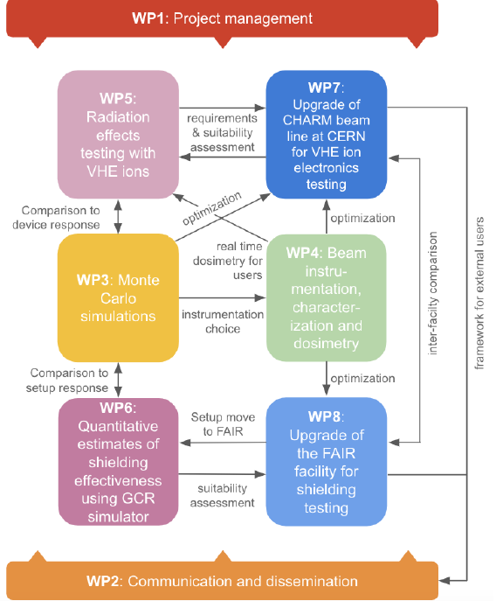
WP5 in the Project
WP5 is strongly interconnected with the other work packages
  WP3: comparison with simulation results
  WP4: beam dosimetry
  WP7: facility development
2
3

Slide 4
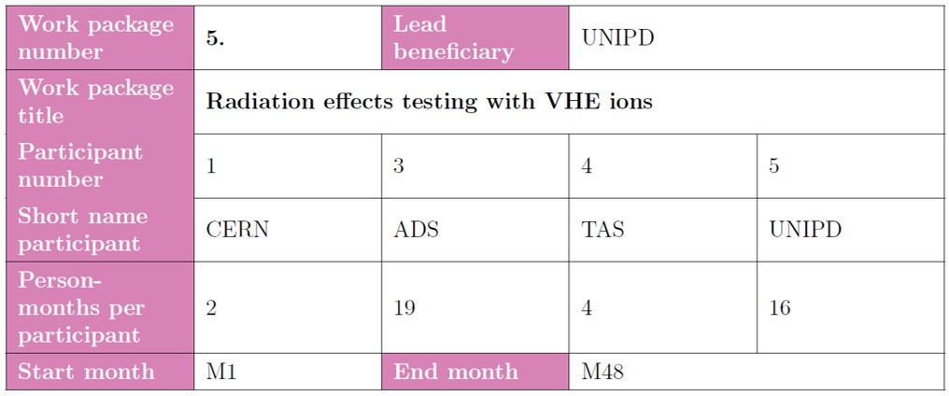
WP5 Key Personnel
Airbus DS/TESAT:
  R. Mangeret, M. Rostewitz
TAS:
  R. Mancini, S. Francola
UniPD:
  M.Bagatin, UniPD project leader
  S. Gerardin, WP5 leader
  A. Paccagnella, staff
CERN:
  M. Sacristan Barbero
2
4

Slide 5
WP5 Tasks
5.1 Final review of VHE ion beam requirements for SEE testing COMPLETED 
5.2 Analysis of ionization response in a PIN diode for beam quality assessments IN PROGRESS
From 1st year
    5.3 Suitability of the proposed VHE ion beams for 3D integrated device structures IN PROGRESS
    5.4 Validation of the VHE ion beams for industrial use with TRL 6-7 achievement IN PROGRESS
From 2nd year
        5.5 Qualification of high-complexity devices IN PROGRESS
        5.6 Board-level testing
From 3rd year
2
5

Slide 6
WP5 Timeline
2
6

Slide 7
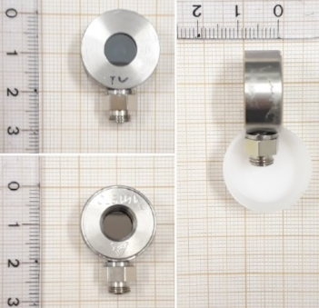
Task 5.2 - Analysis of Ionization Response in a PIN diode for Beam Quality Assessments: Description of Work
Partners: UNIPD, M1-24
PiN diode: simple and effective structure to study heavy ion beams. It provides precise measurements of energy deposition in semiconductor materials. Diagnostic tool to assess the quality of the provided beam in terms of purity and energy straggling (e.g. with degraders)
D5.2 (M24) Beam Quality
D5.5 (M48) Impact of beam energy in SEE testing
2
7

Slide 8
Task 5.2 - Analysis of Ionization Response in a PIN diode for Beam Quality Assessments: Status and Plans
UniPD is working to define the best experimental setup
  ESA involvement is no longer foreseen
  Mirion diodes, CAEN charge amplifiers and multi-channel analyzers are being considered: issue with sensitivity of charge amplifiers (5 mV/MeV) too large!
  We will discuss this with CERN
Large experimental data set is available with standard energy heavy ion beams, mostly collected with the ESA experimental setup
  Monte Carlo model of the diode is available (see also WP3)
Measurements are expected in the second half of 2024
TCAD simulations using Sentaurus will be performed by UniPD to study the transient currents induced by the heavy ions
D5.2 (M24) Beam Quality
D5.5 (M48) Impact of beam energy in SEE testing
2
8

Slide 9
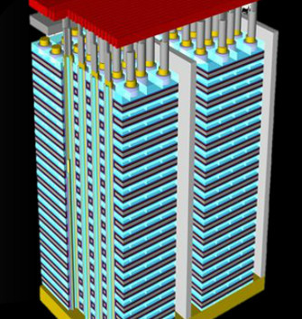
Task 5.3 - Suitability of the Proposed VHE Ion Beams for 3D Integrated Device Structures: Description of Work
Partners: UNIPD, M12-36
3D NAND Flash memories, the first and most successful example of 3D integration in the semiconductor industry, are an ideal test vehicle
Devices with hundreds of layers are now available and increasing, reaching tens of microns of thicknesss.
VHE heavy ions are extremely useful for these technologies
D5.3 (M36) Beam suitability for 3D structures
D5.6 (M48) SEE qualification guidelines for high complexity devices and board level testing
D5.5 (M48) Impact of beam energy in SEE testing
2
9

Slide 10
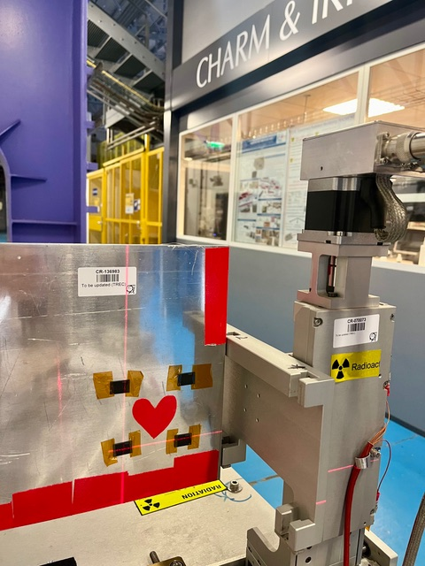
Task 5.3 - Suitability of the Proposed VHE Ion Beams for 3D Integrated Device Structures: Status
Four 3D NAND FG devices have been irradiated at CERN in October/November 2023
  Exposure in passive mode, possible thanks to the non-volatility of the memories
  Two LETs and two fluences
    MS33: E= 2GeV/n, LET = 11 MeV/(mg/cm²), Fluence 5E6 ions/cm²
    MS34: E= 2GeV,/n LET = 11 MeV/(mg/cm²), Fluence 1E7 ions/cm²
    MS35: E= 750 MeV/n + 15 mm PMMA degradation, LET = 30 MeV/(mg/cm²), Fluence 5E6 ions/cm²
    MS36: E= 750 MeV/n + 15 mm PMMA degradation, LET = 30 MeV/(mg/cm²), Fluence 1E7 ions/cm²
2
10

Slide 11
Task 5.3 - Suitability of the Proposed VHE Ion Beams for 3D Integrated Device Structures: Status (2)
Analysis of the four 3D NAND FG devices irradiated at CERN is ongoing
Error data track LET and fluence very well
Preliminary results on clusters and secondaries generated by VHE ions are available (examples below)
2
11

Slide 12
Task 5.3 - Suitability of the Proposed VHE Ion Beams for 3D Integrated Device Structures: Plans
Next steps
Complete analysis on irradiated FG 3D NAND devices and compare experimental results with simulations (see WP3)
Carry out a full irradiation campaign in the second half of 2024
  3D NAND Devices with Floating gate and Replacement Gate Technologies will be used
    Commitment by Micron to provide all the necessary information in time
  Exposure to different LETs
2
12

Slide 13
Task 5.4 - Validation of the VHE Ion Beams for Industrial use with TRL 6-7 Achievement: Description of work
Partners: Airbus DS/TESAT, CERN, M-12-36
VHE SEE testing on devices which have already been characterized by the ADS at standard-energy heavy ion test facilities (e.g., UCL, RADEF)
Previous tests carried out according to ESCC 25100 (package lid removal)
Broad range of technologies will be tested:
  High power diodes (Silicon or SiC)
  High power MOSFETs (Silicon or SiC)
  A stacked memory
    all the dies will be tested as opposed to only the top die as customary with standard energy ions
  Benchmark SRAMs from CERN
  High-complexity device
D5.4 (M36) Verification of beam parameter requirements
D5.5 (M48) Impact of beam energy in SEE testing
D5.6 (M48) SEE qualification guidelines for high complexity devices and board level testing
2
13

Slide 14
Task 5.4 - Validation of the VHE Ion Beams for Industrial use with TRL 6-7 Achievement : Status and Plans
Device types are to be selected according to HEARTS objectives, and, both heritage testing and device stock availability at Airbus DS and TESAT.
Device type selection aims at
  Covering different families, different Single Event Effect natures and different potential issues
  Allowing test results comparison between high energy and traditional SEE test facilities
  Allowing testing of “untestable” device reference
  Supporting test analysis guideline
Multiple test campaigns will be needed
D5.4 (M36) Verification of beam parameter requirements
D5.5 (M48) Impact of beam energy in SEE testing
D5.6 (M48) SEE qualification guidelines for high complexity devices and board level testing
2
14

Slide 15
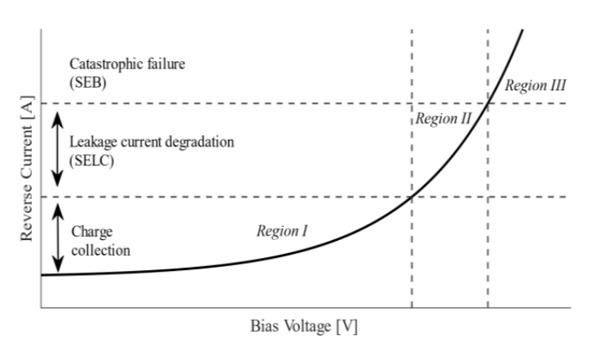
Task 5.4 - Validation of the VHE Ion Beams for Industrial use with TRL 6-7 Achievement : Status and Plans
First “family” will address power devices and SEB/SEGR
  Two different power device types and SEE mechanisms are planned to be tested
    SiC Diode
    Si/SiC Power Mosfet
  SiC diode is of particular interest
  since exhibiting a very specific
  behavior under HI exposure
D5.4 (M36) Verification of beam parameter requirements
D5.5 (M48) Impact of beam energy in SEE testing
D5.6 (M48) SEE qualification guidelines for high complexity devices and board level testing
2
15

Slide 16
Task 5.4 - Validation of the VHE Ion Beams for Industrial use with TRL 6-7 Achievement : Status and Plans
Second “family” oriented towards a memory
Device type not fully selected, could be NAND flash or DDR memory
  Will depend on available stock
Different type of SEE to be investigated since those devices exhibit sensitivity to multiple SEE
  SEL, SEU, MBU, row event, column event, SEFIs, stuck/weak bits
D5.4 (M36) Verification of beam parameter requirements
D5.5 (M48) Impact of beam energy in SEE testing
D5.6 (M48) SEE qualification guidelines for high complexity devices and board level testing
2
16

Slide 17
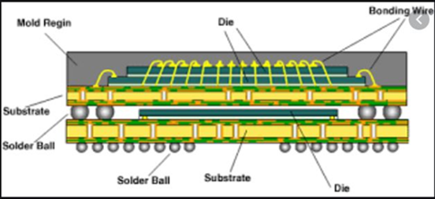
Task 5.4 - Validation of the VHE Ion Beams for Industrial use with TRL 6-7 Achievement : Status and Plans
Third “family” prone to a different approach
Device type will be selected according to the Airbus DS project needs (and stock availability)
  Device won’t necessarily benefit of previous SEE testing
  Device selection of interest w.r.t. beam specificities
D5.4 (M36) Verification of beam parameter requirements
D5.5 (M48) Impact of beam energy in SEE testing
D5.6 (M48) SEE qualification guidelines for high complexity devices and board level testing
2
17

Slide 18
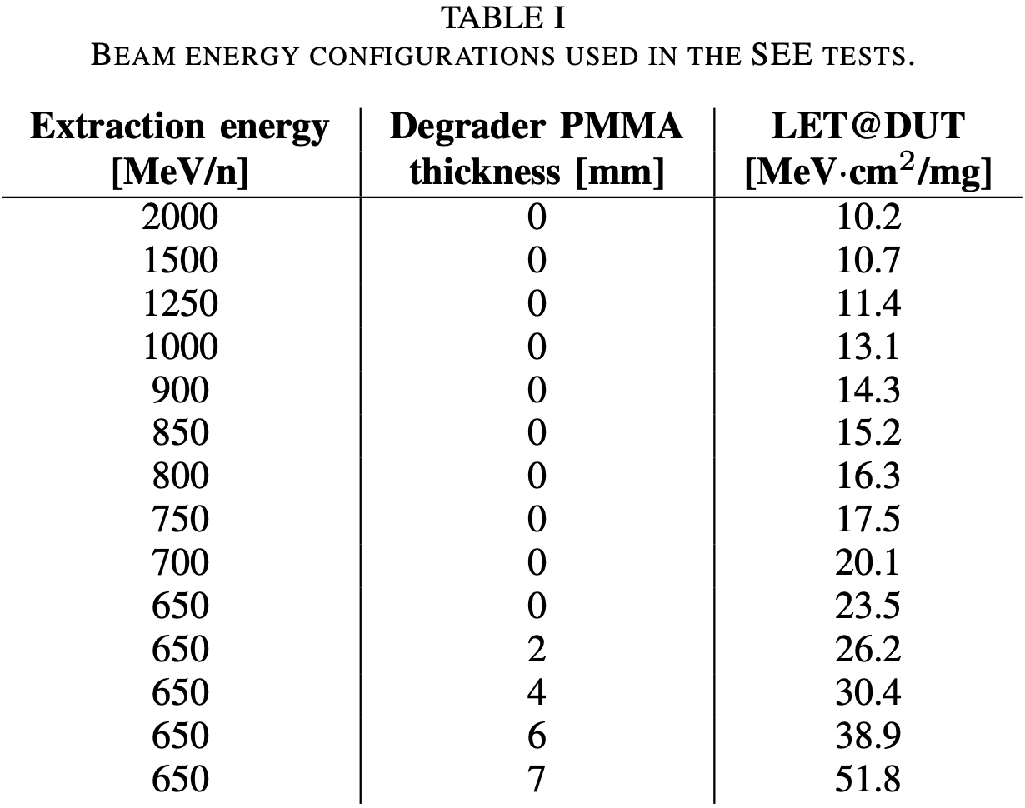
Task 5.4 - Validation of the VHE Ion Beams for Industrial use with TRL 6-7 Achievement : Status and Plans
CERN used a wide range of energies/LETs by means of the continuous tunability of the beam extraction energy and the LET booster (PMMA degrader).
Primary LETs from 10 to 24 MeV·cm²/mg and enhanced LETs up to 52 MeV·cm²/mg.
Contribution to NSREC 2024 Data Workshop with the SEE measurements (SEU, SEL, SEB).

Slide 19
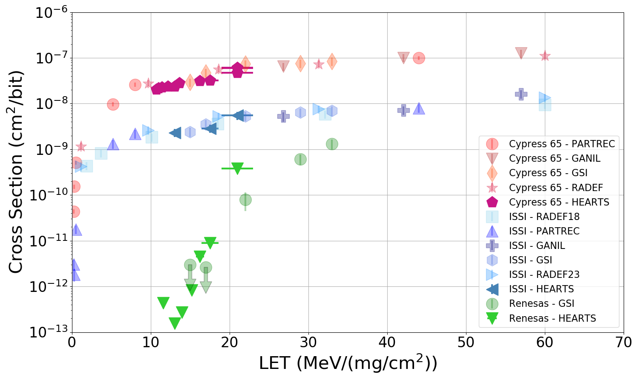
Task 5.4 - Validation of the VHE Ion Beams for Industrial use with TRL 6-7 Achievement : Status and Plans
CERN measured the SEU cross section of three benchmark SRAMs from Cypress, ISSI, and Renesas during the October 2023 run
A large amount of experimental data at other facilities is available for these samples
The data taken at HEARTS include only primary beam energies and no degradation runs.
2
19

Slide 20
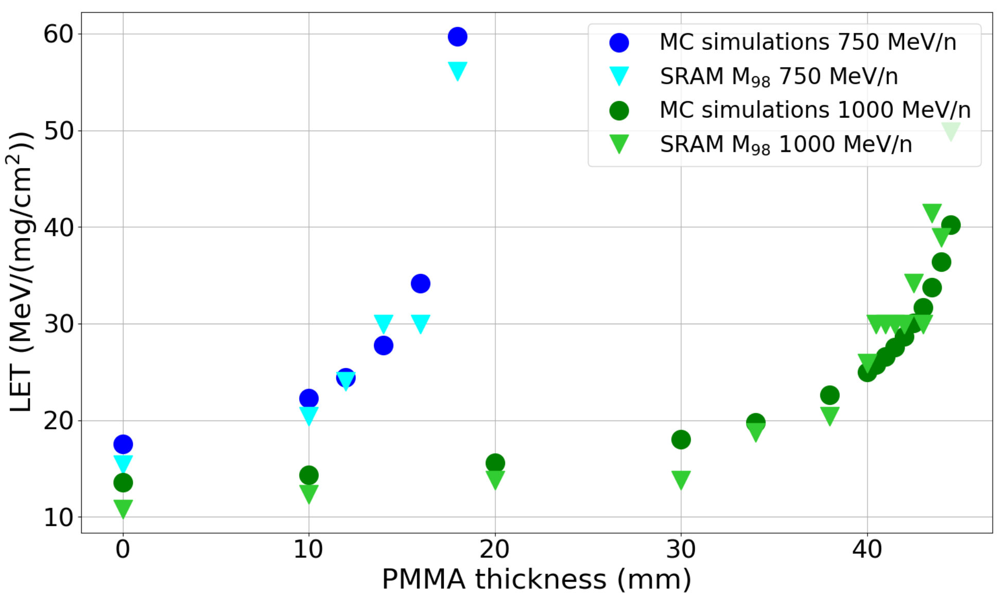
Task 5.4 - Validation of the VHE Ion Beams for Industrial use with TRL 6-7 Achievement : Status and Plans
MCU clustering algorithms allow correlating multiplicity distribution and beam LET.
Good correlation between degraded LETs obtained via MCU multiplicity study and FLUKA MonteCarlo simulations.
Accepted contribution for RADECS 2024.

Slide 21
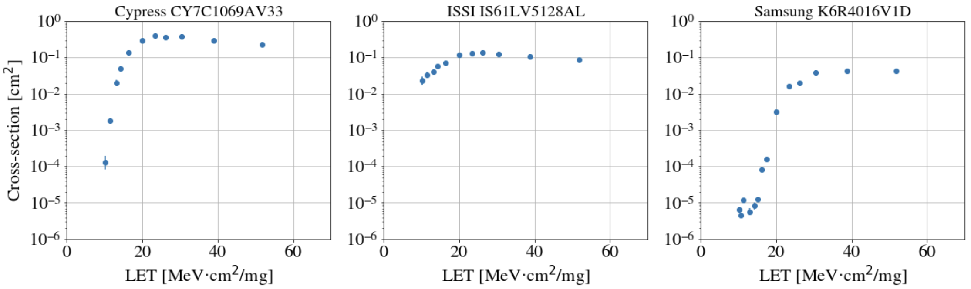
Task 5.4 - Validation of the VHE Ion Beams for Industrial use with TRL 6-7 Achievement : Status and Plans
Single Event Latchup has been measured as well for three 3 SRAMs (Cypress, ISSI and Samsung) during the same test campaign
2
21

Slide 22
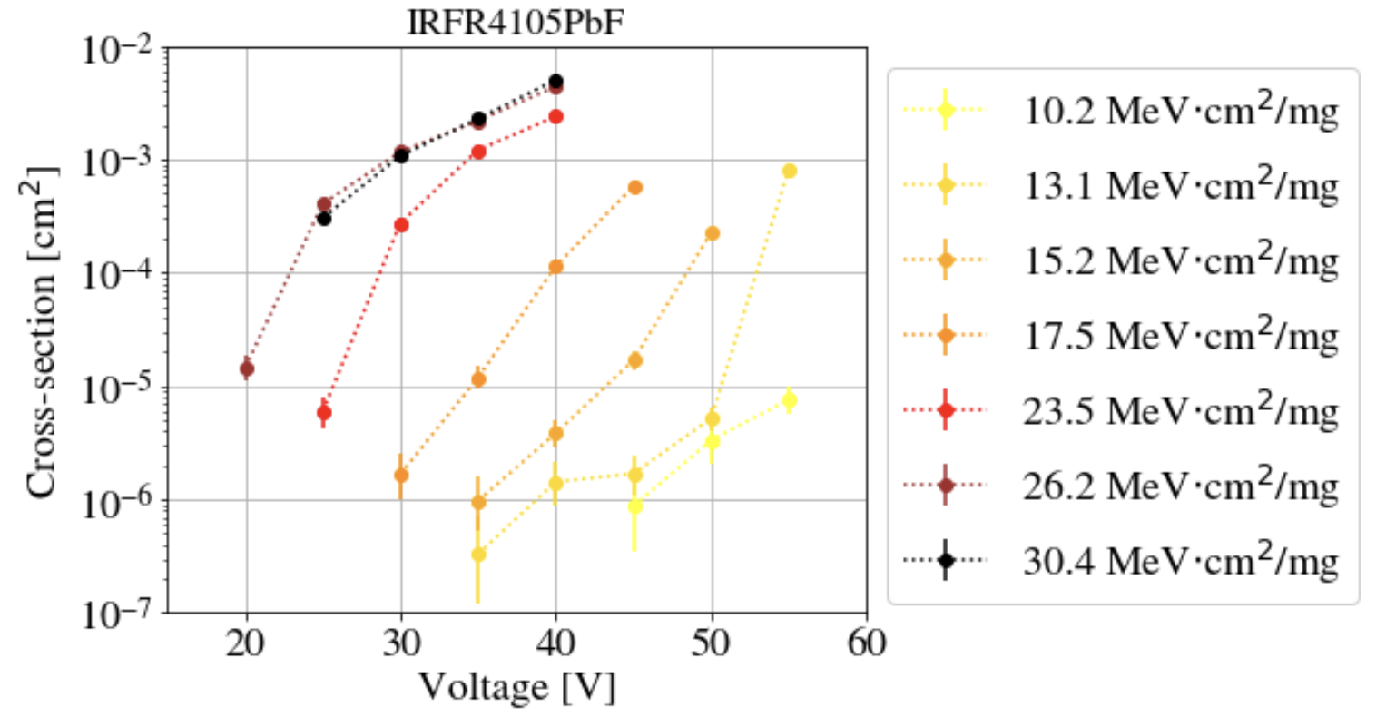
Task 5.4 - Validation of the VHE Ion Beams for Industrial use with TRL 6-7 Achievement : Status and Plans
Single Event Burnout of power MOSFETs (Infineon IRFR4105PbF 55V max.).
Increasing SEB cross-section as a function of LET and drain voltage.
Higher LET features lower voltage SEB onset.

Slide 23
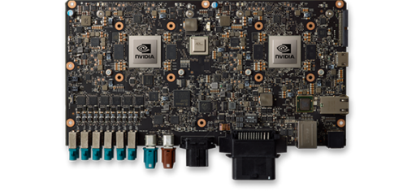
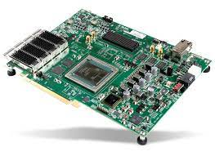
Task 5.5 - Qualification of High-complexity Devices: Description of Work
Partners: UNIPD, TAS, M24-48
Graphical Processing Units (GPUs) and Field Programmable Gate Arrays (FPGAs) are two key enablers for on-board artificial intelligence
Heavy-ion SEE qualification is very complex because of the very high power-consumption (standard energy ions require in-vacuum irradiations) -> in air irradiation is key
UNIPD will perform a test campaign on a GPU
TAS will perform a test campaign on a FPGA
The results will be used together to compile recommendations and guidelines about SEE testing with very high energy ion beams
D5.5 (M48) Impact of beam energy in SEE testing
D5.6 (M48) SEE qualification guidelines for high complexity devices and board level testing
2
23

Slide 24
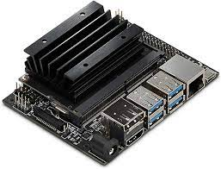
Task 5.5 - Qualification of High-complexity Devices: Status and Plans
UNIPD is selecting a suitable platform and perform preliminary test campaigns (using neutrons)
  NVIDIA Jetson line of AI accelerators appears as the most promising candidate
    CPU + GPU in one chip, with full framework for AI computing
  Preliminary tests carried out at ChipIr (UK) on some Jetson Nano boards
D5.5 (M48) Impact of beam energy in SEE testing
Jetson Nano board
D5.6 (M48) SEE qualification guidelines for high complexity devices and board level testing
2
24

Slide 25
Task 5.5 - Qualification of High-complexity Devices: Status and Plans
Device is to be chosen according to the need and availability of TAS projects.
Trade-off is between:
  High performance System-On-Chip (backside irradiation with fan-based cooling system).
  Optoelectronics that cannot be «opened» in the traditional way to be tested.
Device will be chosen during the next months
D5.5 (M48) Impact of beam energy in SEE testing
D5.6 (M48) SEE qualification guidelines for high complexity devices and board level testing
2
25

Slide 26
Task 5.6 - Board-level testing: Description of Work
Partners: TAS, M24-48
Board-level testing can enable the qualification of several devices by irradiating them simultaneously under the same beam.
In some cases, and thanks to the properties of VHE ion beams, it can even be envisaged to test more complex systems that are made of a few electronic boards stacked on top of one another.
The task will consist of testing electronic boards enabling power conditioning functionalities, which may be particularly sensitive to radiation.
The objective of the task will be that of defining a methodology for testing these kinds of boards with a VHE ion beam that will be integrated in the guideline.
D5.6 (M48) SEE qualification guidelines for high complexity devices and board level testing
2
26

Slide 27
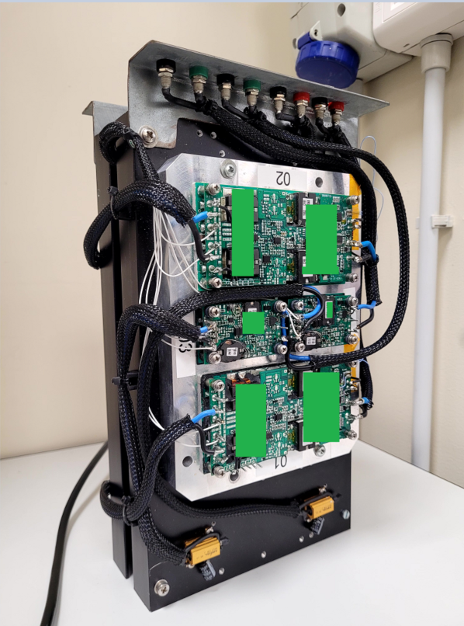
Task 5.6 - Board-level testing: Status and Plans
Device under trade-off for testing are DC/DC converters.
DC/DC converter with high power density w.r.t. footprint are not so common in the space market.
On the other hand they are a need in payload architecture where the same module type is implemented recursively to build large structures (like SAR for earth observation).
The first choice for this application are commercial DC/DC converters available in TAS.
D5.6 (M48) SEE qualification guidelines for high complexity devices and board level testing
2
27

Slide 28
Conclusions
Task 5.1 “Final review of VHE ion beam requirements for SEE testing” has been completed with delivery of 5.1
Tasks 5.2 “Analysis of ionization response in a PIN diode for beam quality assessments” is in line with planning and in the setup definition phase
Task 5.3 “Suitability of the proposed VHE ion beams for 3D integrated device structures” is ahead of schedule with some measurements already carried out
Task 5.4 “Validation of the VHE ion beams for industrial use with TRL 6-7 achievement” is ongoing. Data have been collected on benchmark SRAMs and device selection and plans are being finalized for new experiments
Task 5.5 “Qualification of high-complexity devices” is in the preparation stage
Task 5.6 “Board-level testing” is ongoing. Devices are being selected and test plans finalized
2
28

