Slide 1
Experience with the anomalous Dy
in Beam 2
Many thanks to the OMC team
and everyone during commissioning
Yannis Angelis
LNO Meeting, 17-04-2024

Slide 2
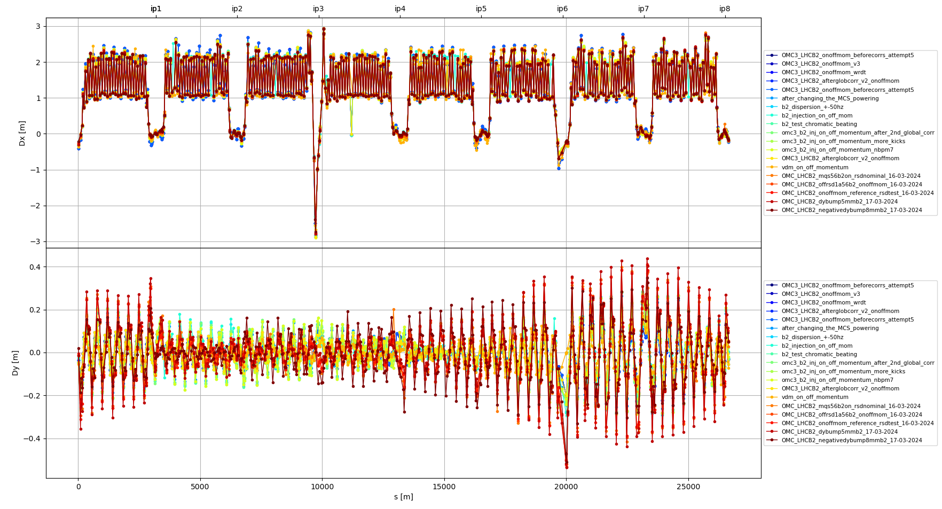
Comparison of Dy measurements @injection
Measurements with and without xing angles

Slide 3
Comparison of Dy measurements @injection
2024-03-08
Measurements with and without xing angles
2024-03-09
2024-03-10
2024-03-16
2024-03-17

Slide 4
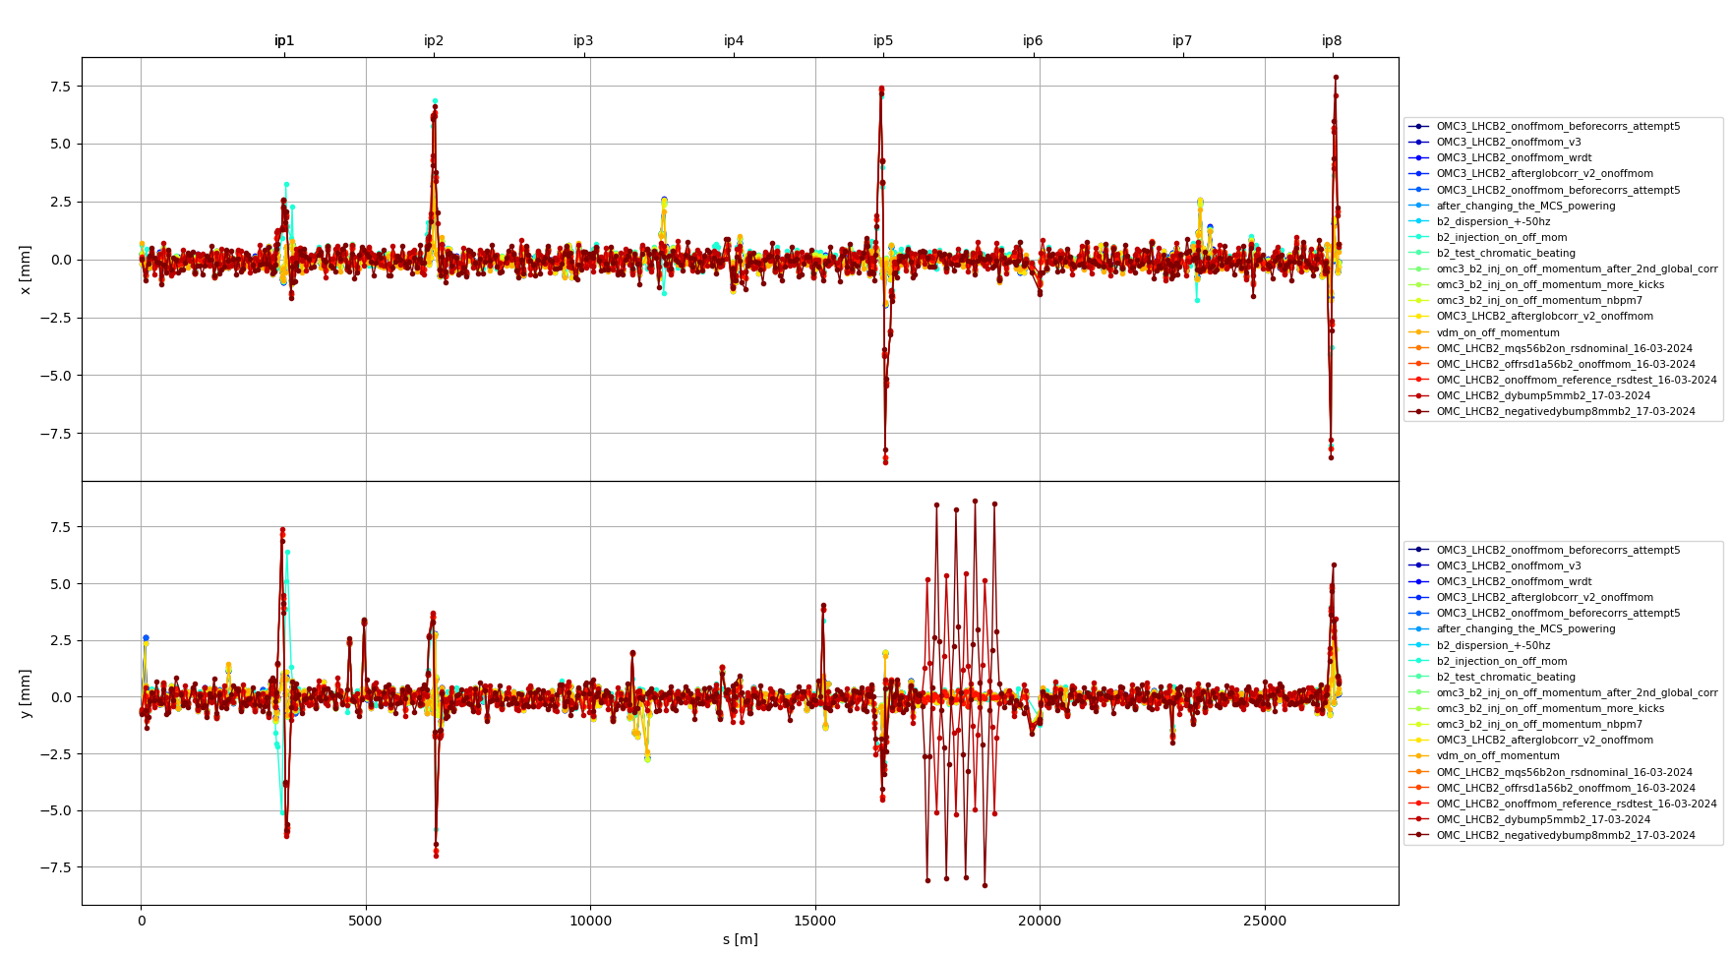
Comparison of Dy measurements @injection
Measurements with and without xing angles

Slide 5
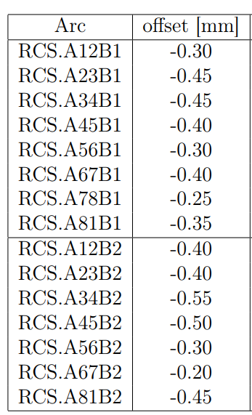
Tests attempting to affect Dy
Trimming MCS in A56 (10-03-2024, fill 9339)
MQS and MS powering tests (16-03-2024, fill 9371)
Bumps in sextupoles (17-03-2024, fill 9371)
CERN-ACC-NOTE-2021-0008
Table 2
Model used in the next slides:
Model created by omc3
misalignment of MCS
MCS strengths (values from 10-03-2024)
Dipole errors (a2, b3 from WISE)

Slide 6
MCS Powering Tests

Slide 7
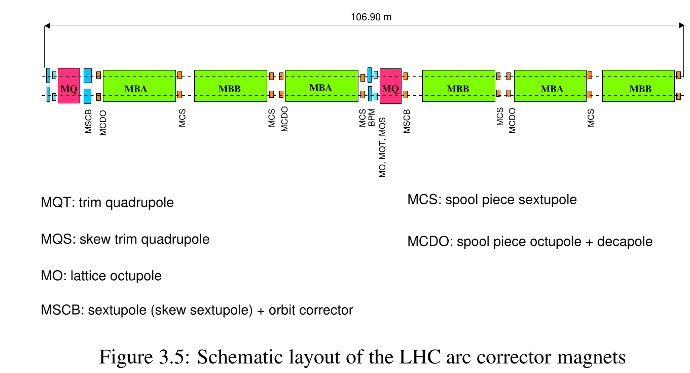
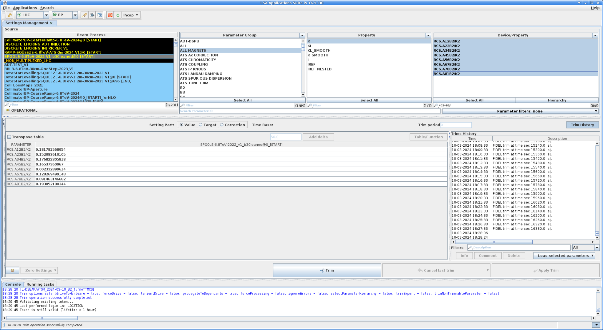
MCS Powering Test (10-03-2024)
LHC Design Report
From the logbook
https://logbook.cern.ch/elogbook-server/GET/showEventInLogbook/3983181
Trim MCS at A56
RCS.A56B2/K2: 0.1498 -> 0.0023
Re-balancing the rest of MCS

Slide 8
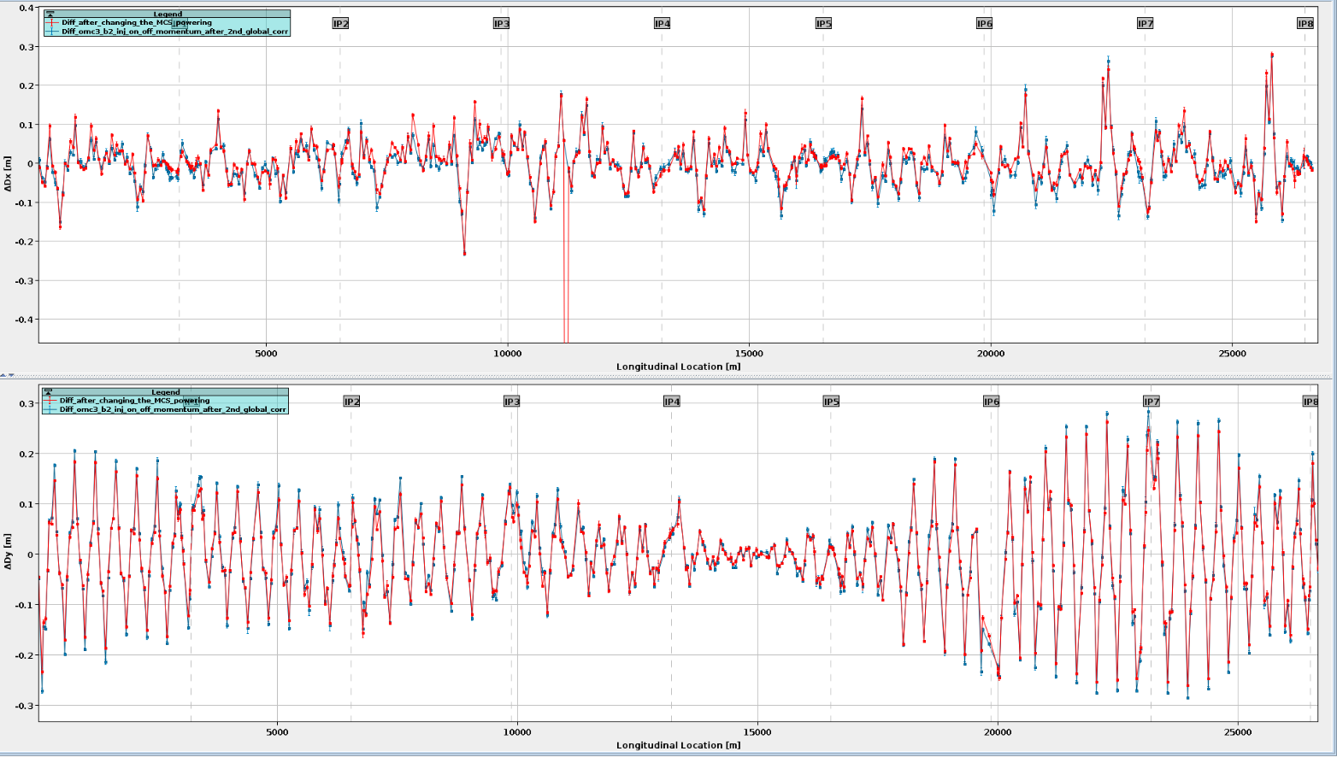
MCS Powering Test
https://logbook.cern.ch/elogbook-server/GET/showEventInLogbook/3983184
Before trim After trim

Slide 9
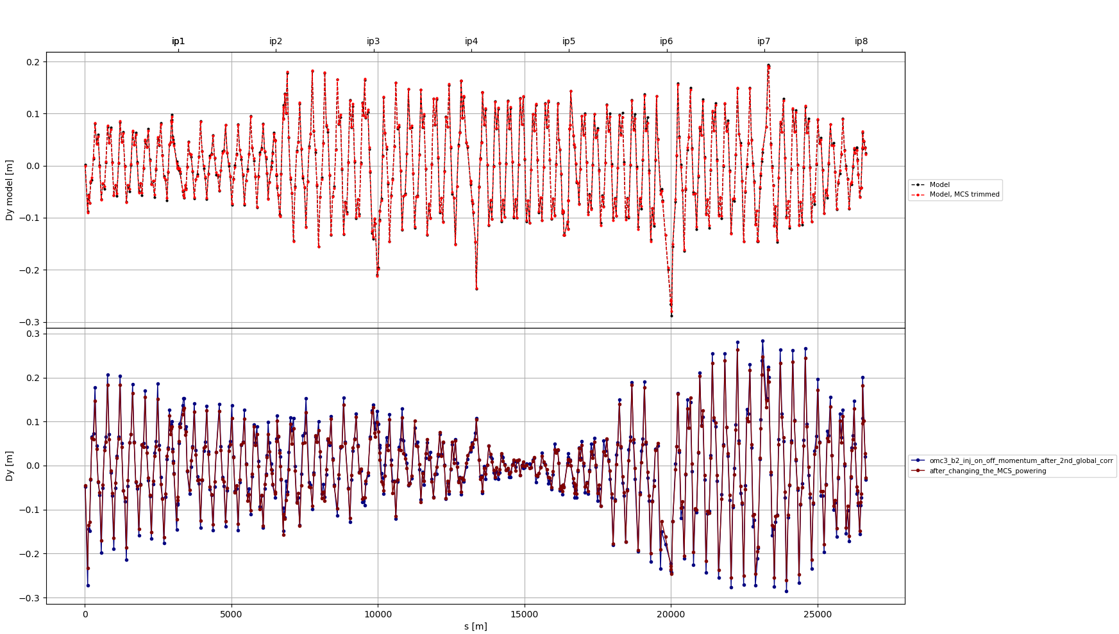
MCS Powering Test
kcs.a12b2 0.1606
kcs.a23b2 0.1310
kcs.a34b2 0.1557
kcs.a45b2 0.1442
kcs.a56b2 0.1498
kcs.a67b2 0.1072
kcs.a78b2 0.0704
kcs.a81b2 0.1720
Comparison of measurements and model
Trimmed MCS
kcs.a12b2 0.1817
kcs.a23b2 0.1521
kcs.a34b2 0.1768
kcs.a45b2 0.1653
kcs.a56b2 0.0023
kcs.a67b2 0.1283
kcs.a78b2 0.0915
kcs.a81b2 0.1931

Slide 10
MQS and MS powering tests

Slide 11
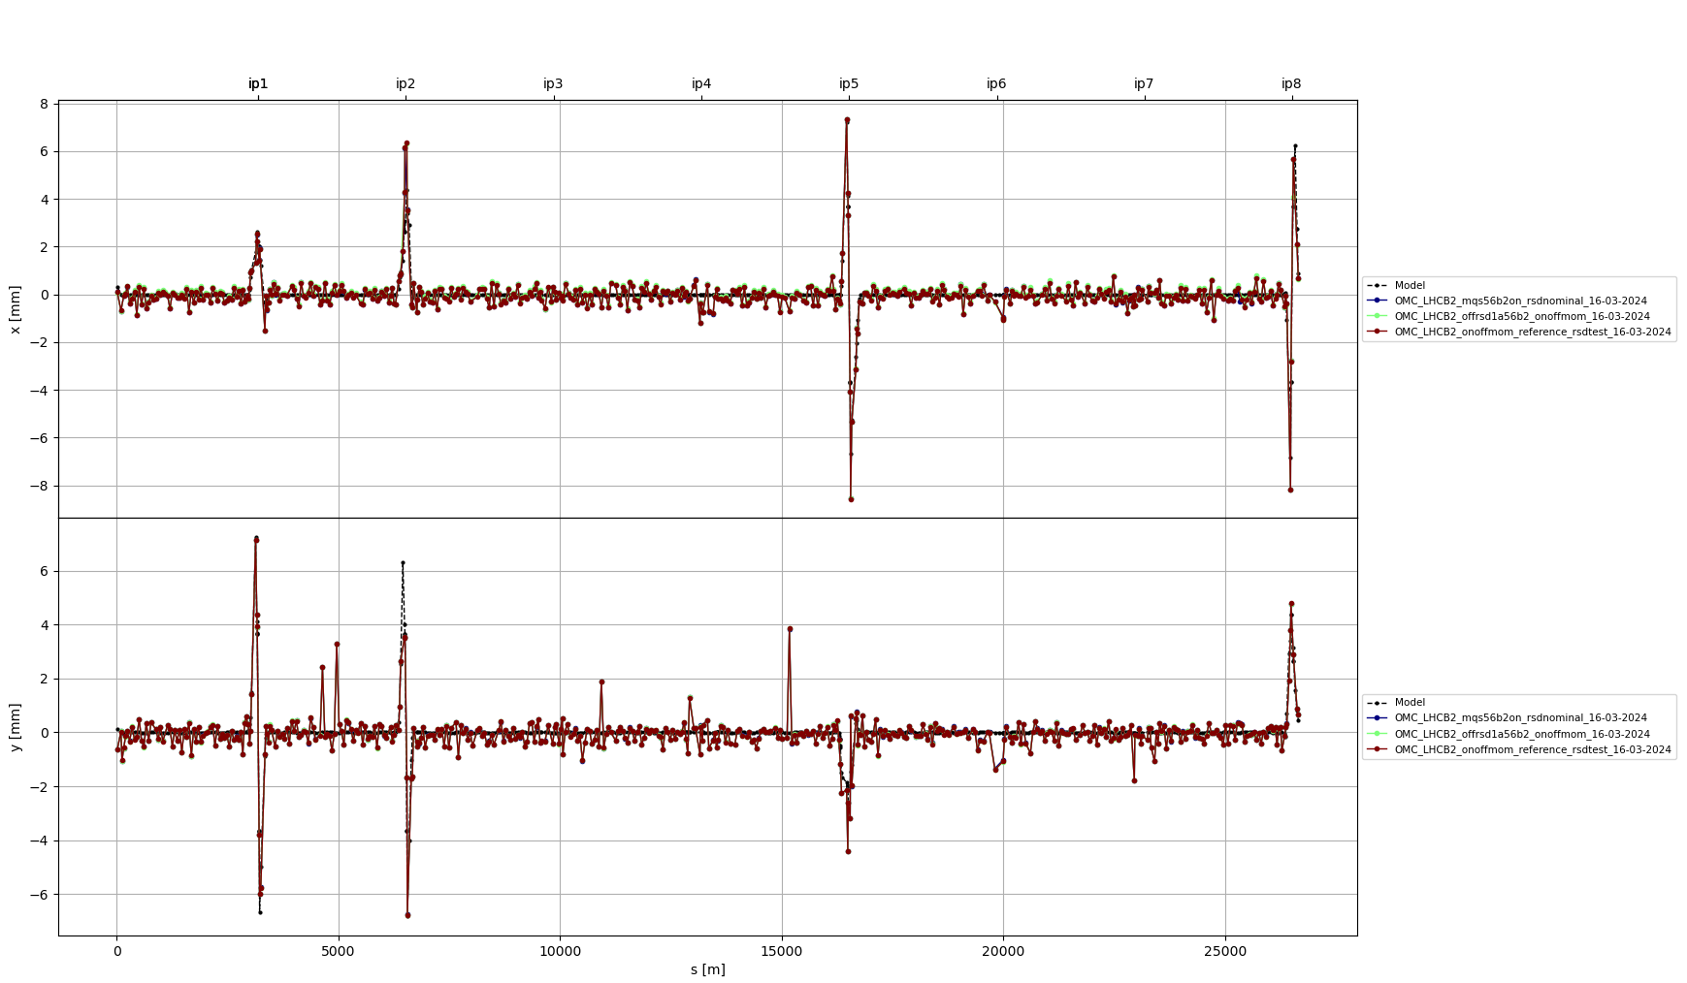
MQS and MS powering tests
Xing angles

Slide 12
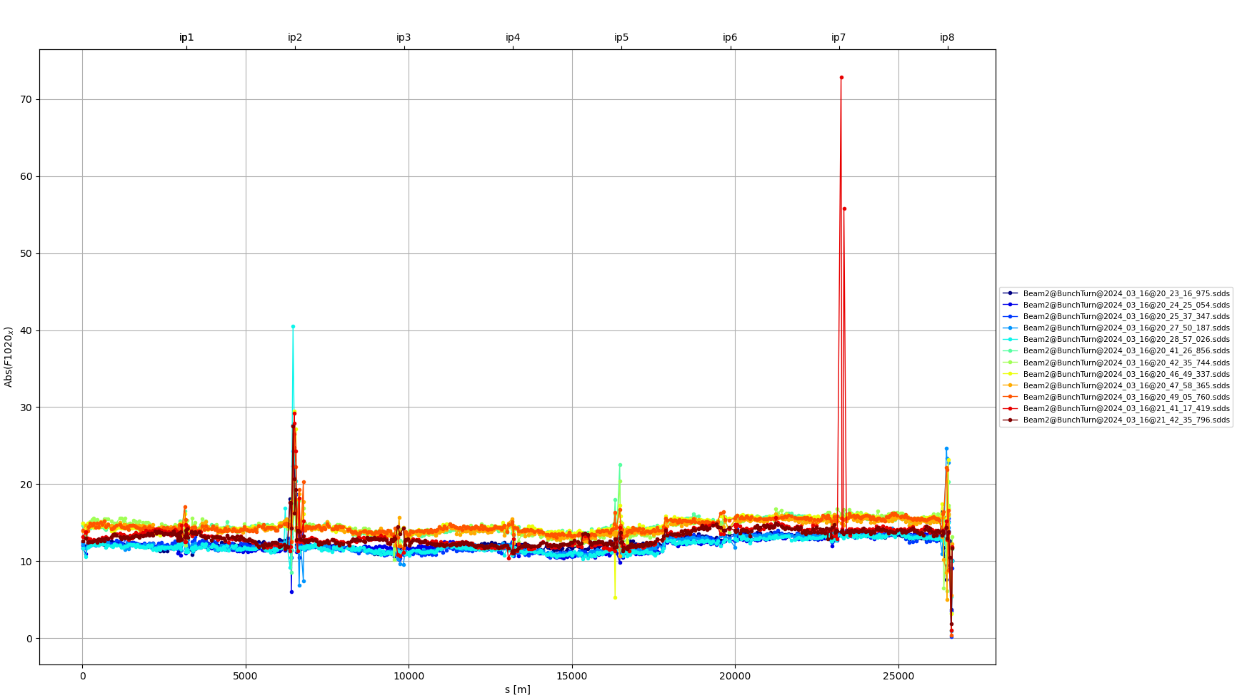
MQS and MS powering tests
Jump of RDT, coupling and Dy at ~same location
Turning off RSD.A56B2 (test misspowering of MQS between the jump)
Powering on MQS A56 to replicate the MS powering
Default settings
RSD1.a56.b2 off
MQS on, RSD nominal

Slide 13
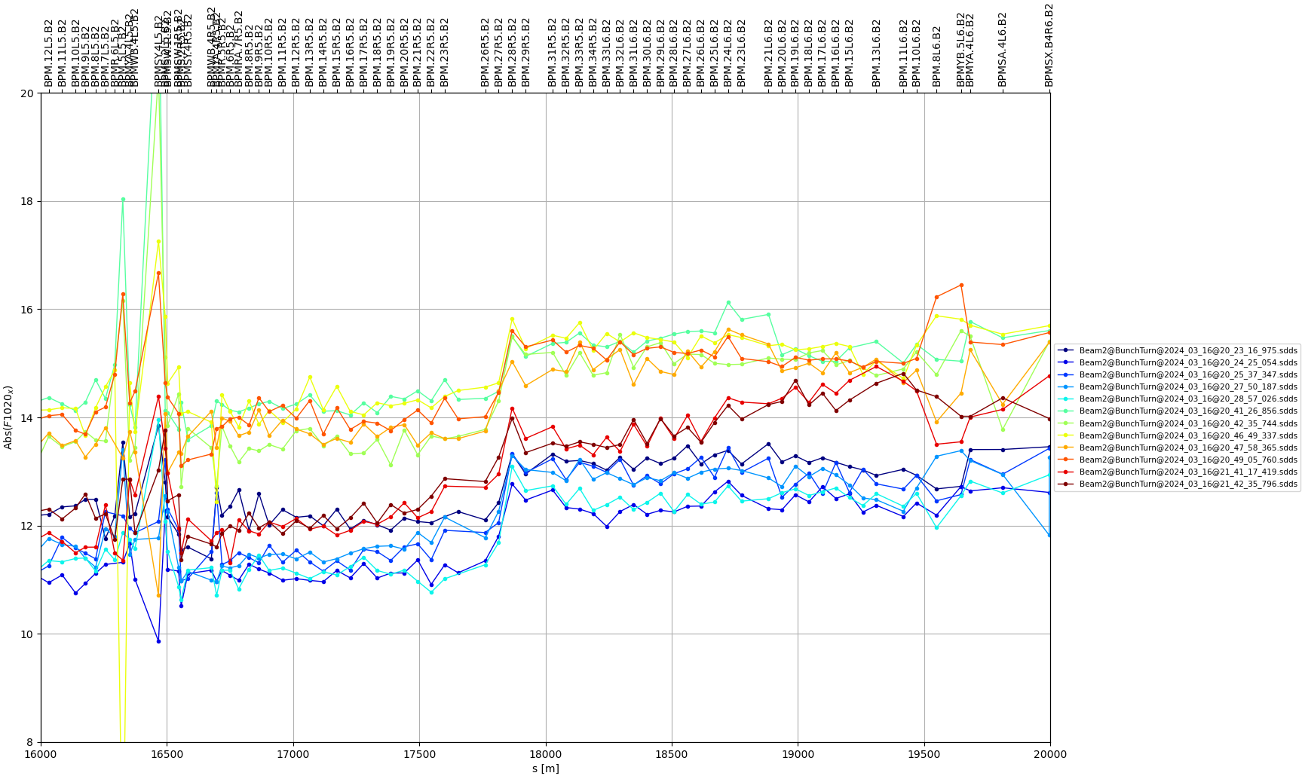
MQS and MS powering tests
Jump of RDT, coupling and Dy at ~same location
Turning off RSD.A56B2 (test misspowering of MQS between the jump)
Powering on MQS A56 to replicate the MS powering
Default settings
RSD1.a56.b2 off
MQS on, RSD nominal

Slide 14
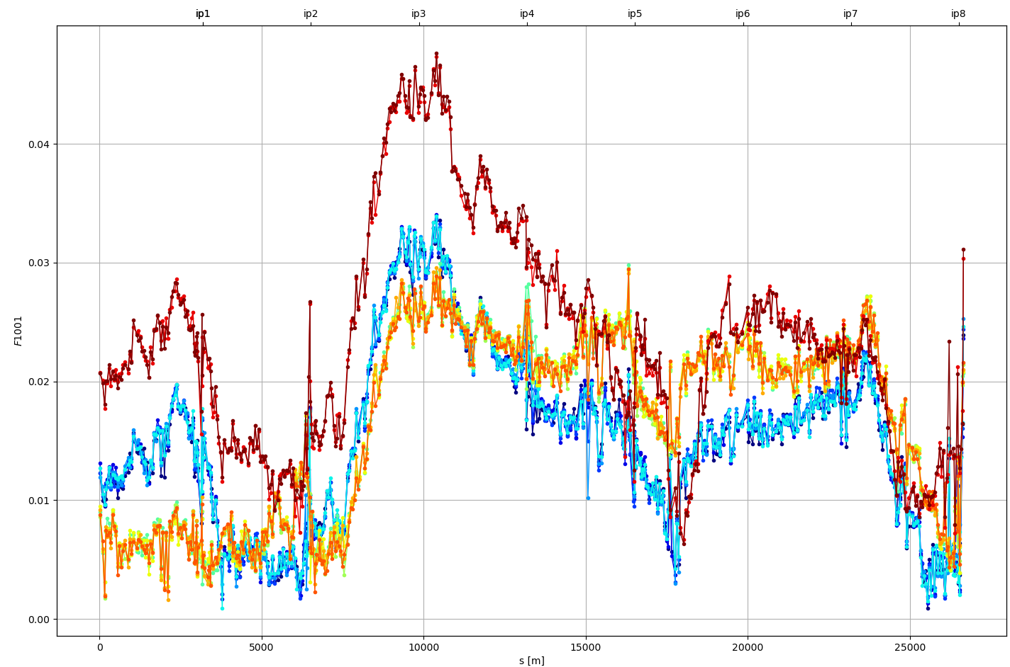
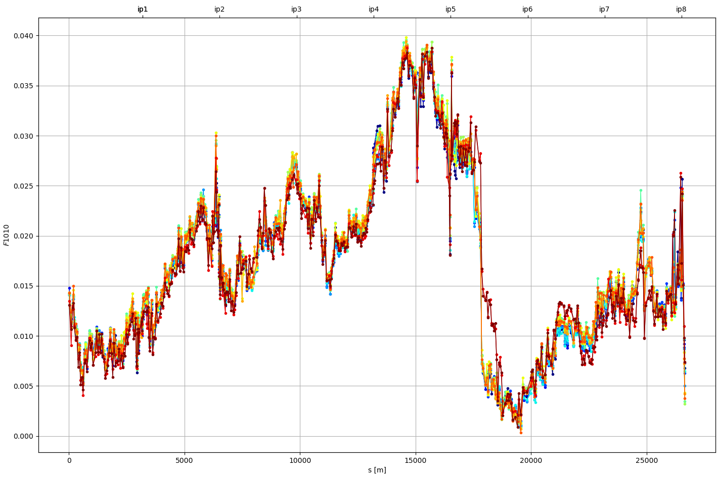
MQS and MS powering tests
Jump of RDT, coupling and Dy at ~same location
Turning off RSD.A56B2 (test misspowering of MQS between the jump)
Powering on MQS to replicate the MS powering

Slide 15
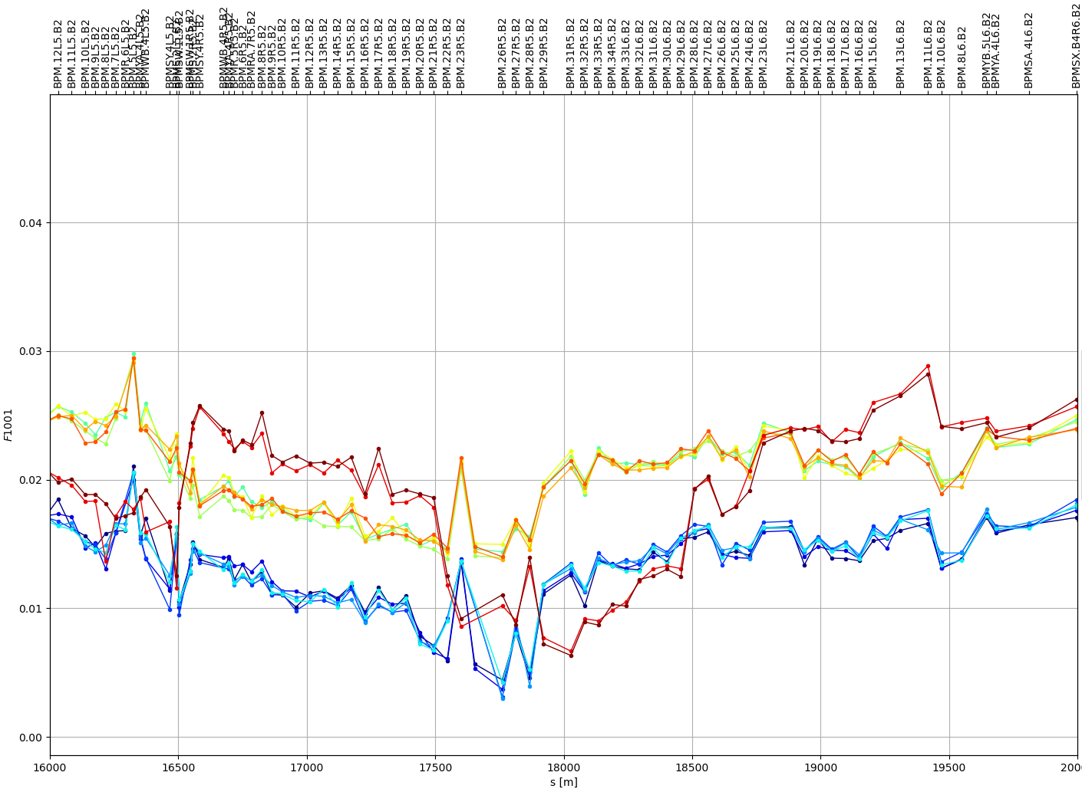
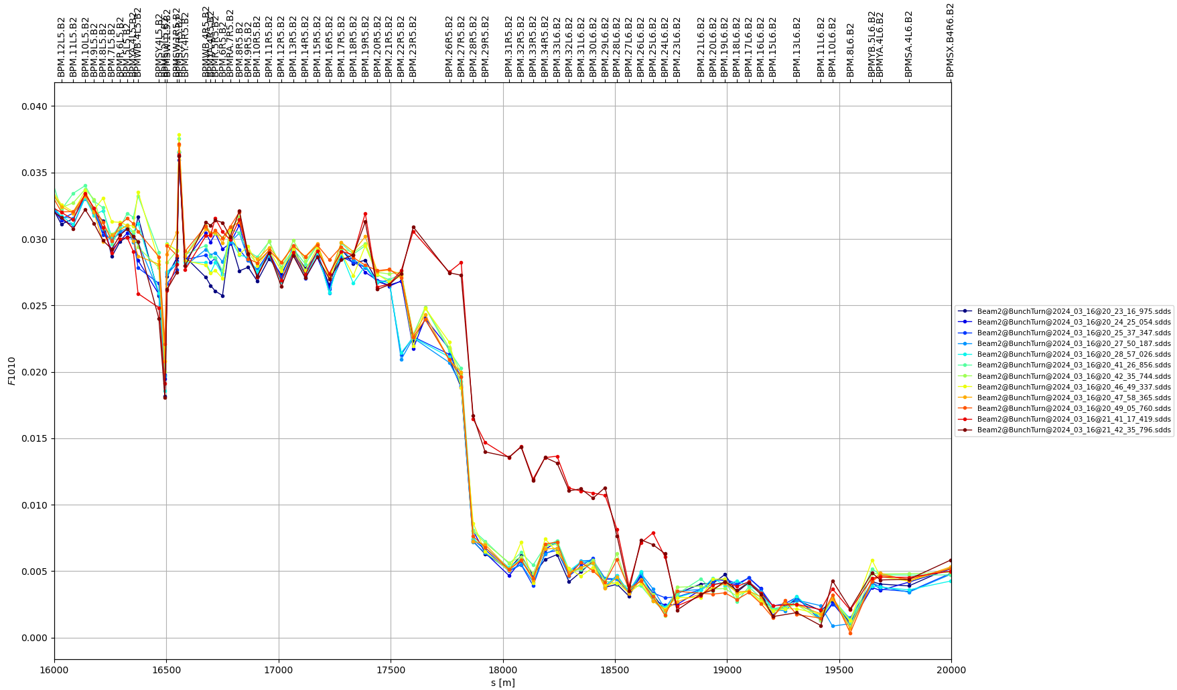
MQS and MS powering tests
Jump of RDT, coupling and Dy at ~same location
Turning off RSD.A56B2 (test misspowering of MQS between the jump)
Powering on MQS to replicate the MS powering

Slide 16
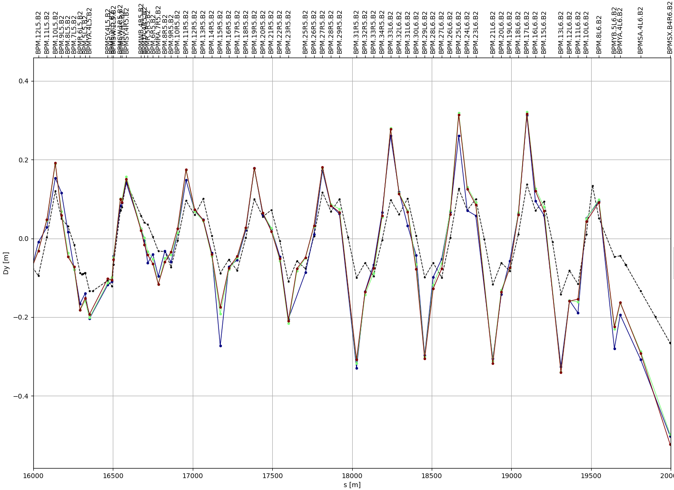
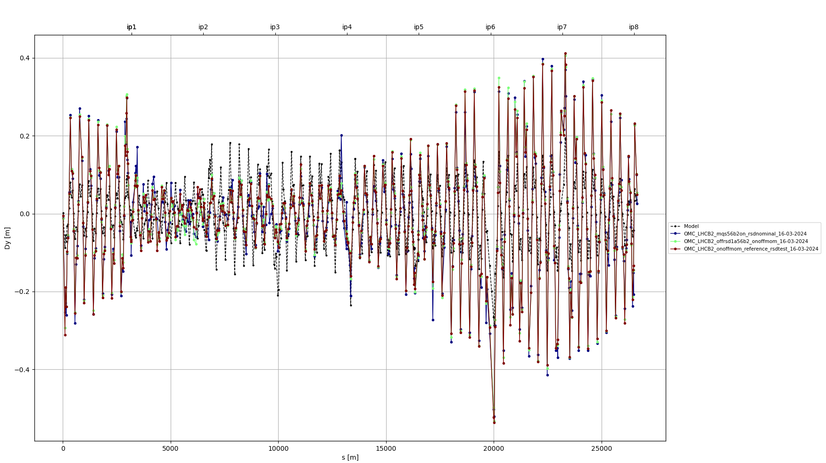
MQS and MS powering tests
MQS On, RSD1 Nominal
RSD1 off
Reference, RSD1 Nominal
MQS off

Slide 17
Orbit Bumps at sextupoles

Slide 18
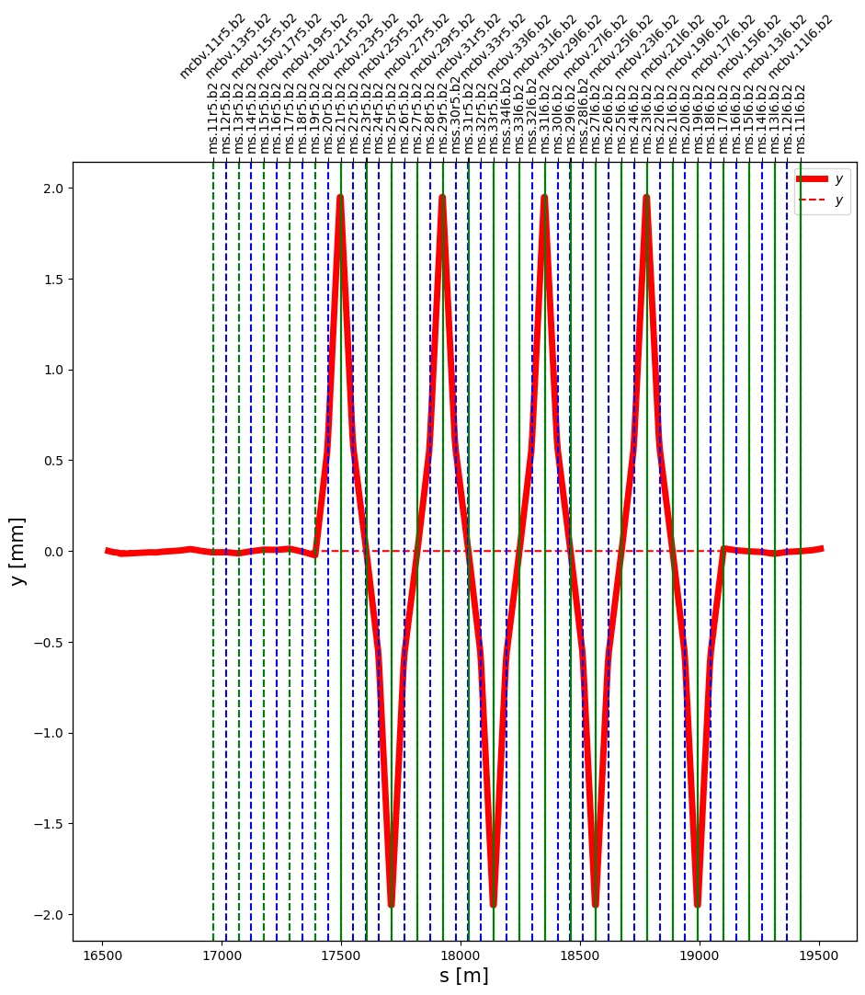
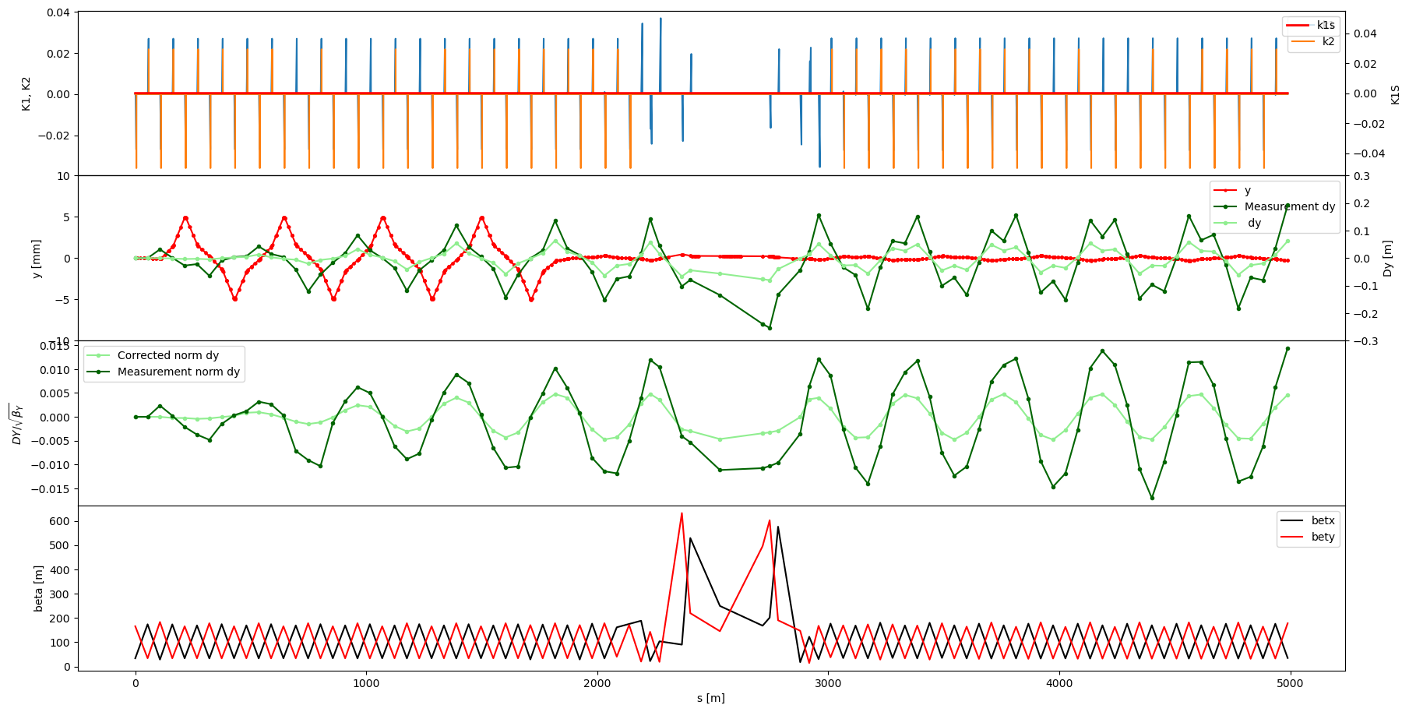
Orbit bumps at sextupoles
SBS: BPM.15R5.B2 : BPM.20L7.B2

Slide 19
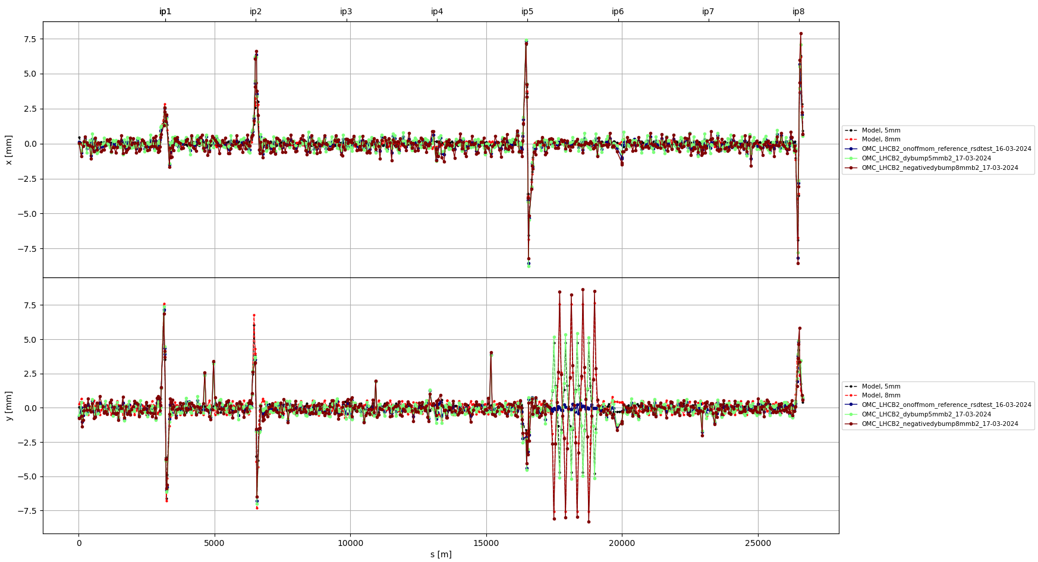
Orbit bumps at sextupoles

Slide 20
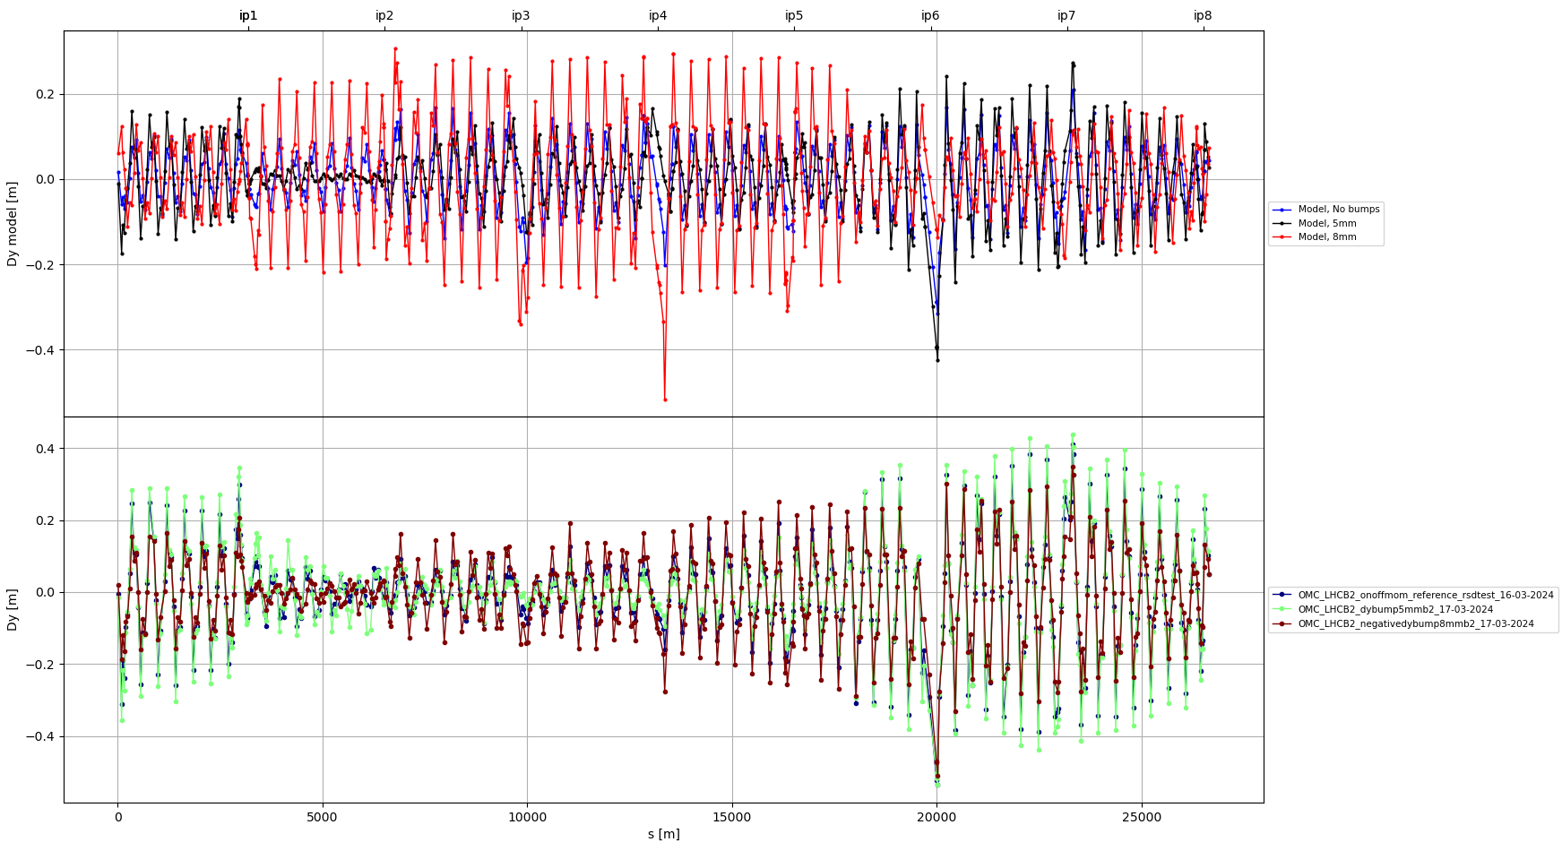
Orbit bumps at sextupoles
Model with no bumps, 5mm bumps and 8mm bumps
Reference from same fill
Knob @ 5 (5mm bumps)
Knob @ -8 (8mm bumps)

Slide 21
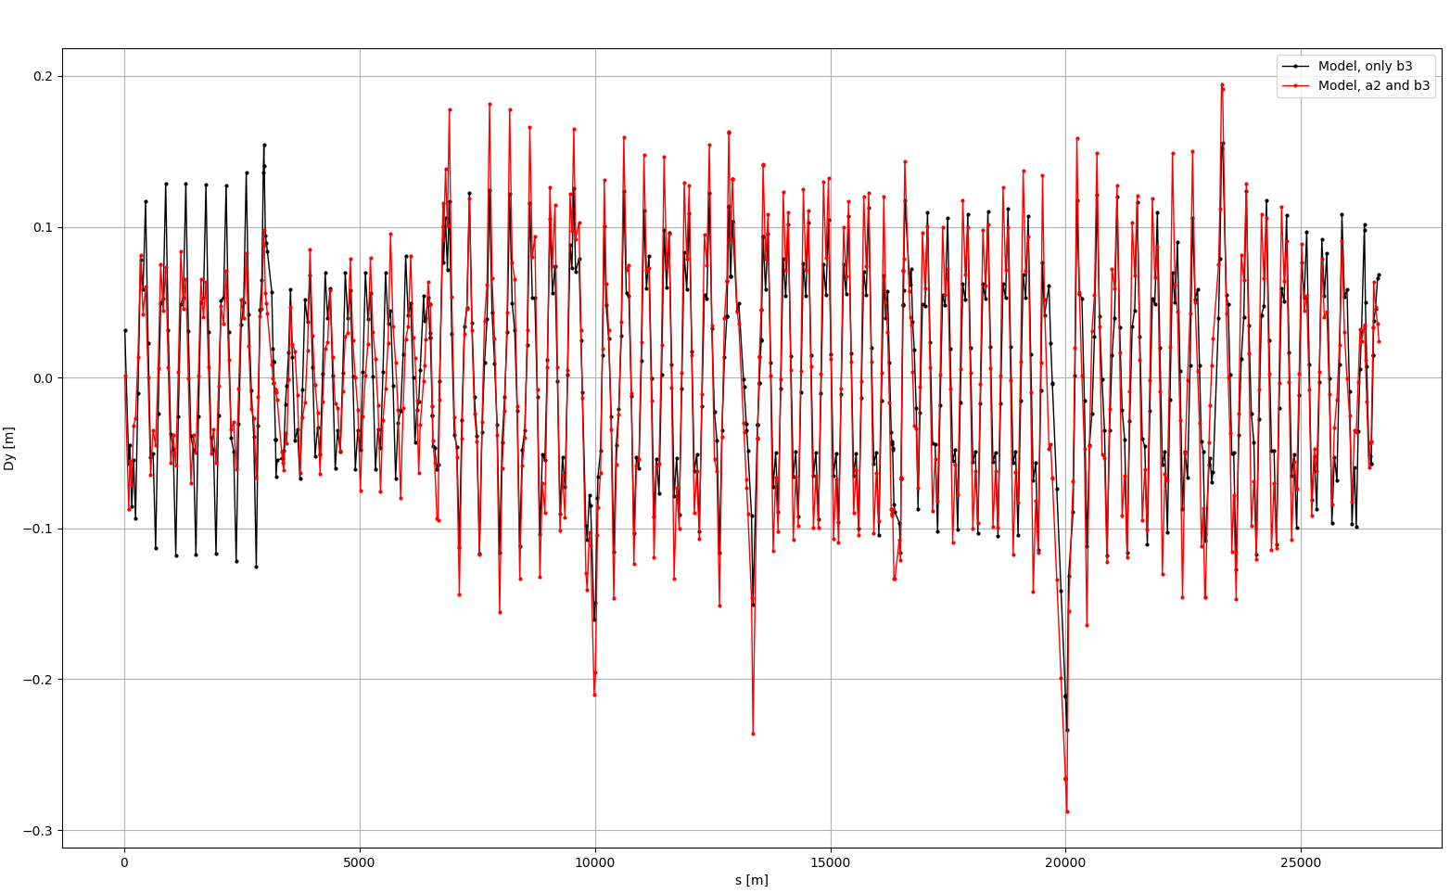
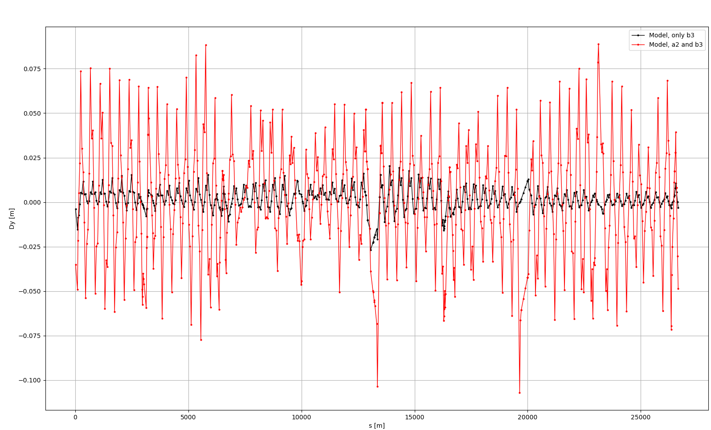
Attempts to replicate Dy in the model
Misaligned MCS in every arc
With separation knobs only
With separation and xing

Slide 22
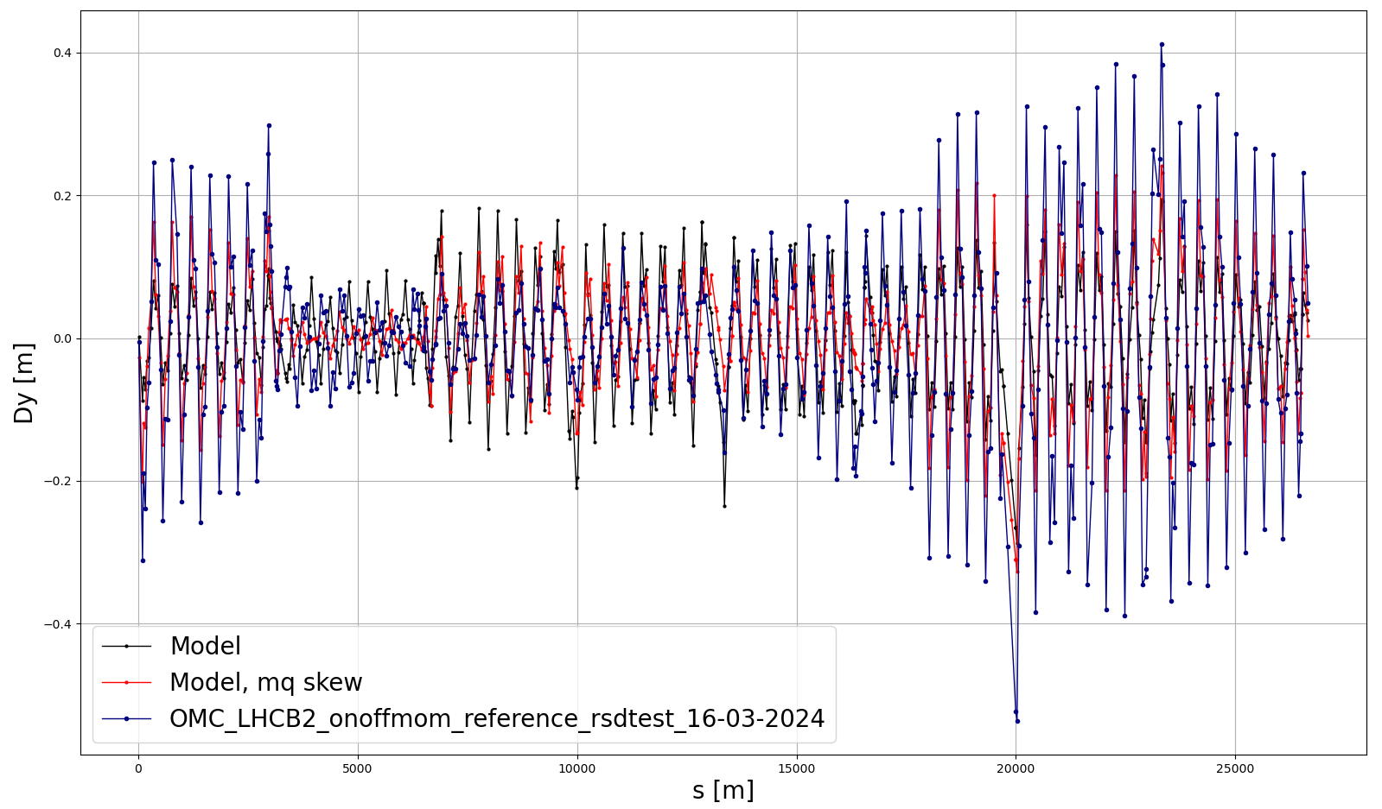
Attempts to replicate Dy in the model
MQ.29R5.B2->k1 = ~0.009
Model with misaligned MCS in every arc, b3 and a2
Model with MQ.29R5.B2->k1s = 0.0003
~ 16 mrad tilt

Slide 23
Conclusions
Source at BPM.27R5B2 - BPM.30R5B2?
MCS powering test
MQS and MS powering
Bumps @ sextupoles not efficient for correction

Slide 24
Extra slides

Slide 25
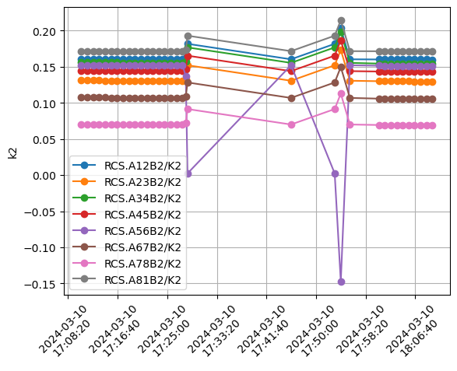
MCS Powering

Slide 26
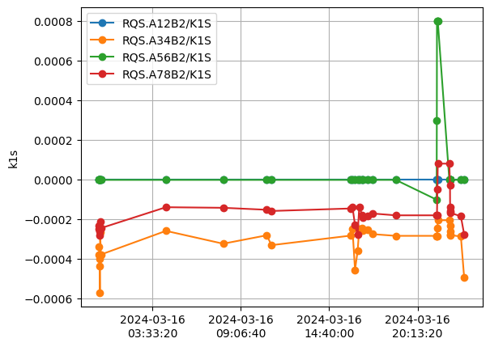
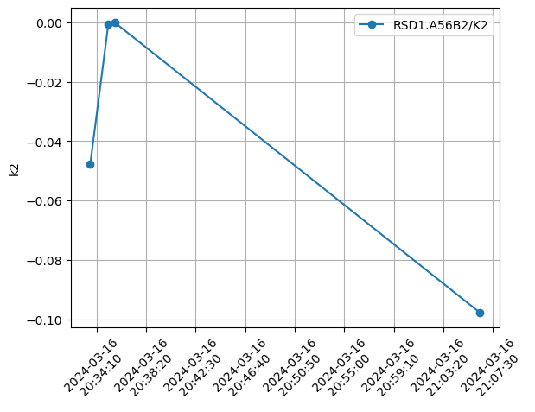
MQS powering
RSD1.A56B2 Powering

Slide 27
