Slide 1
HL-LHC optics cycle (part I)
MD 11243
R. De Maria, B. Lindstrom, T. Persson, R. Tomas, G. Iadarola

Slide 2
Preparation
Complete MD procedure: to do by the end of the week, teaming up with Tobias and Bjorn
Full Python reimplementation of my optics factory, including validation, plotting, matching, squeeze optimization, acc-models connection, LSA connection, LHC circuits model.
  State: well advanced, took a while, few thousands of lines of code and counting, took advantage of Xsuite for matching (flexibility, ergonomics, speed for complex matching)!
  Next steps: port non-linear interpolations squeeze and circuit simulation from pyoptics
Optics cycle preparation for MD1/MD2: what is the hard deadline?
  Integrate optimized HL-LHC IR7 and IR3 at flattop: done (see later)
  Integrate phase knobs as built-in phase at injection: to do
  Decide on beta* in IR1/5 at the end of the ramp to be compatible with TCDQ settings (see later): to do
  Make the ramp&squeeze: proof of principle done (see later)
Prepare for MD3-4-5:
  Prepare a squeeze for 6.6x preserve the TCDQ settings in 3.6 mm (limitation will be lifted in HL)

Slide 3
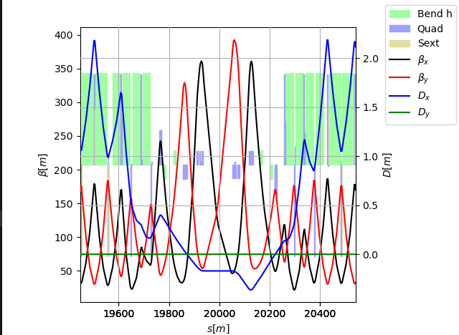
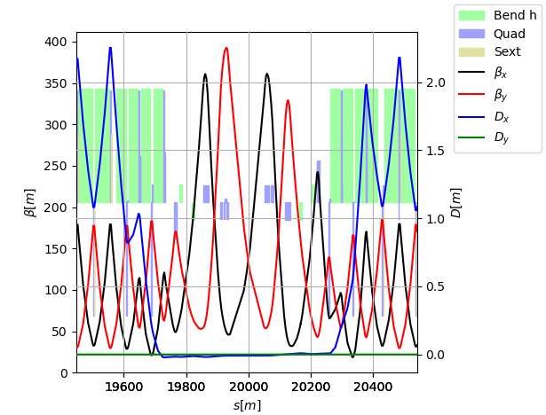
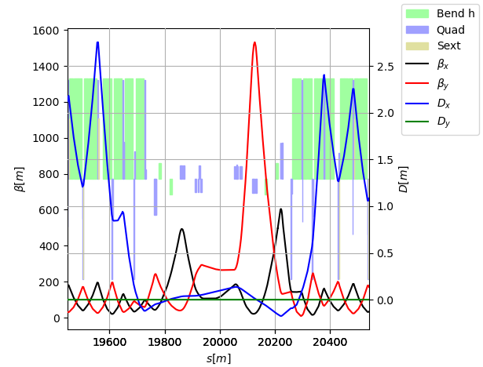
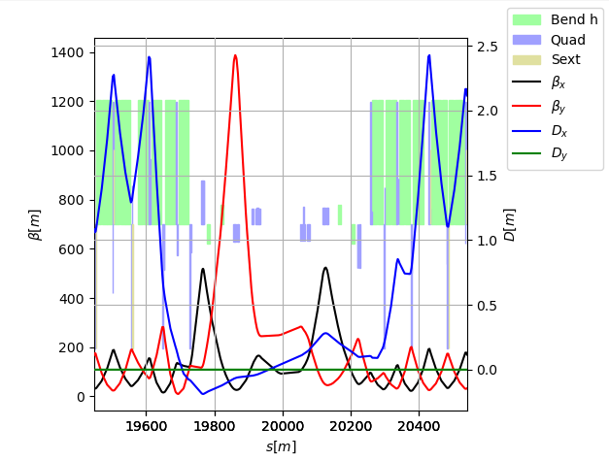
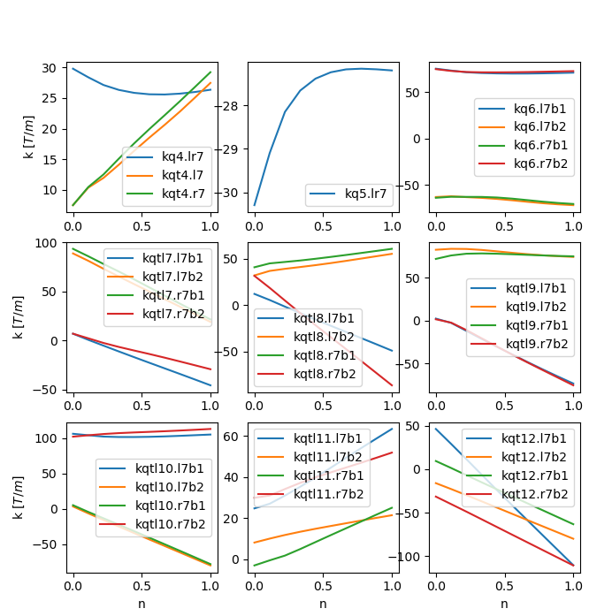
HL-LHC IR7 optics
The original IR7 for HL-LHC used RQTL8.L7B1 at 240A, since Arjan said it would be possible, in principle.
Presently, the circuit is commissioned at 200A:
it is impractical to recommission it now
It is not needed for the MD that aims at proving the operational feasibility of the optics transitions
Hardware commissioning test at 240A to be schedule sometime late 2024 - start 2025.
LHC injection
HL-LHC flat top

Slide 4
MD Collimation settings
Coll | Inj | Flat top (ATS 1x) beta15=2.5m | End of squeeze (ATS 6.6x) beta15=37 cm
TCP7 | 5.7 | 5.0 | 5.0
TCSG7 | 6.7 | 6.5 | 6.5
TCDQ/TCSP | 7.5 | 7.3 (3.6 mm) | 6.8-8.3 (tbc, 3.6 mm constant)
TCP3 | 8.0 | 15 | 15
TCSG3 | 9.3 | 18 | 18
TCLA7 | 10.0 | 10 | 10
TCLA3 | 12.0 | 20 | 20
TCT15 | 13.0 | 20 | 10 (ok with good TCT-MKD)
TCT8 | 13 | 18 | 18
TCT2 | 13 | 37 | 37
TCL4 | park | park | park
TCL5 | park | park | park
TCL6 | park | park | park
Gap of TCDQ in mm cannot be changed without access, excluded for the MD.
Squeezing V plane in IP5 is easier:
Constant beta at TCDQ and good TCT-MKD phase.
H plane is more limited. Beta at TCDQ tends to increase TCDQ gap approaching secondaries. MKD-TCT getting worse, loosing margin between TCDQ-TCT.
If we want ATS in V plane, squeeze would require increase beta* at flat-top to gain in TCDQ-TCT margin, but there is a limit somewhere around 3 m.
Work in progress…

