Slide 1



RF power for Eupraxia@SPARC_LAB
David Alesini, INFN-LNF, Frascati
on behalf of the TeX technical team and the EuPRAXIA@SPARC_LAB RF team

Slide 2

OUTLINE
1. EuPRAXIA@SPARC_LAB Project
X Band LINAC
X BaND RF Module
2. TEX FACILITY STATUS AND PERSPECTIVES
TEST OF X BAND ACCELERATING STRUCTURES
TEST OF THE RF COMPONENTS
3. S BAND INJECTOR

Slide 3
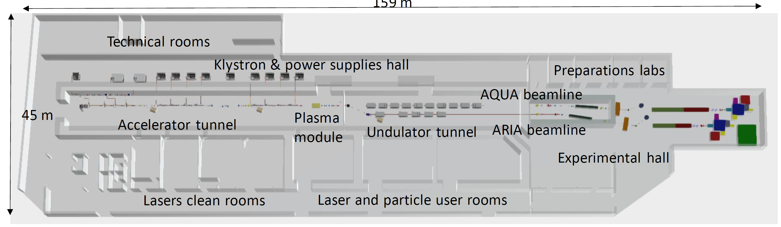
EuPRAXIA@SPARC_LAB Project
  The project EuPRAXIA@SPARC_LAB is the pillar of the European Project EUPRAXIA (http://www.eupraxia-project.eu/) and is project based on beam driven plasma wakefield acceleration (PWFA). It aims at constructing a FEL radiation source (λ_{FEL}=4 nm) combining:
    1 GeV RF X-band Linac with an high brightness S band photo-injector
    Plasma module for PWFA.
The project is currently in the preparatory phase of the Technical Design Report (end 2025).
A new building, now under executive design phase, will host the new Facility at LNF, the construction should start in September 2026.
160 m

Slide 4
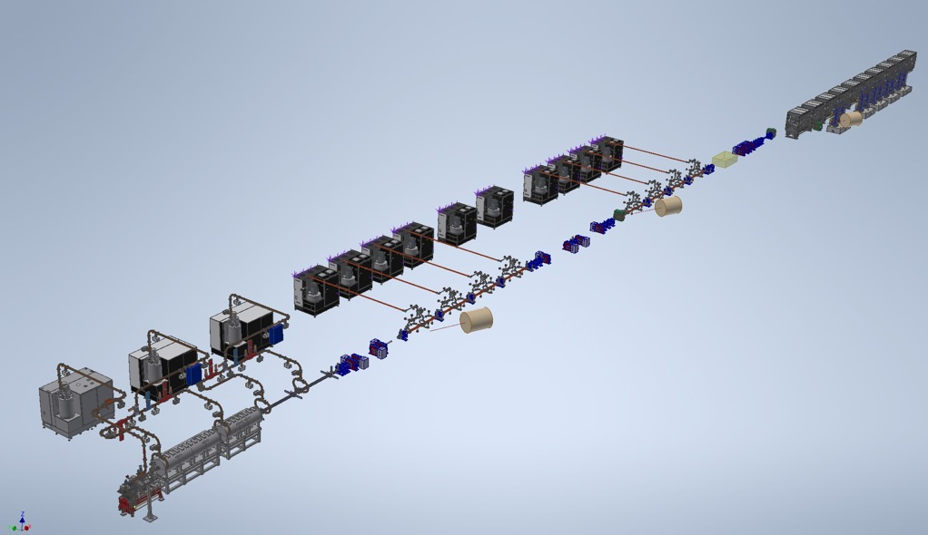
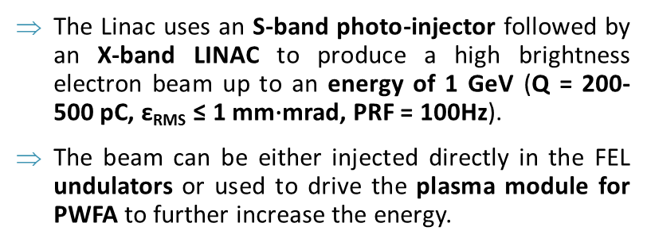
Overview of the LINAC
The Linac uses an S-band photo-injector followed by an X-band LINAC to produce a high brightness electron beam up to an energy of 1 GeV (Q = 200-500 pC, ε_{RMS} ≤ 1 mm$∙$mrad, PRF = 100Hz).
The beam can be either injected directly in the FEL undulators or used to drive the plasma module for PWFA to further increase the energy.
8+2 X-band (11.994 GHz)
K300 Modulator
Canon E37119
Undulators
Plasma module
S-band (2856 MHz)
3x E37314 60 MW Canon Klystron + Solid State modulator
X-band modules
X-band Booster
16x, 0.9m, TW accelerating structures that has to work at 60 MV/m
Photocathode RF gun
S-band Injector
photocathode RF Gun and 4x TW S-band structure. (Possible upgrade in C-band)
Courtesy of E. Di Pasquale

Slide 5
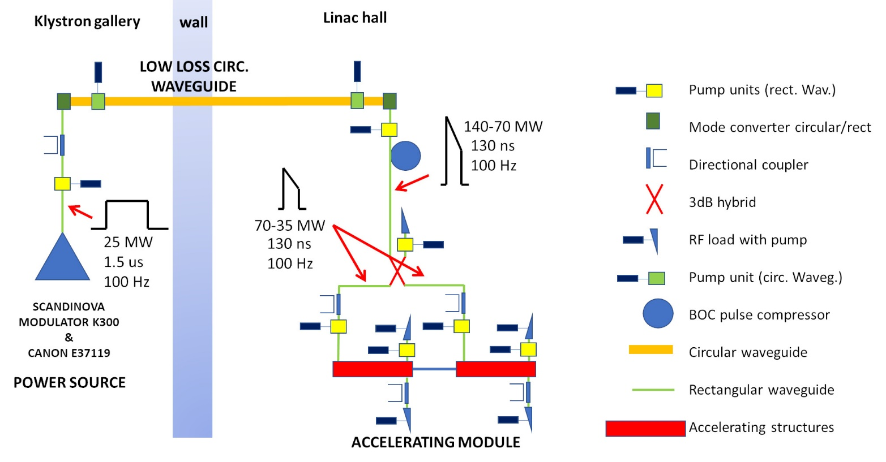
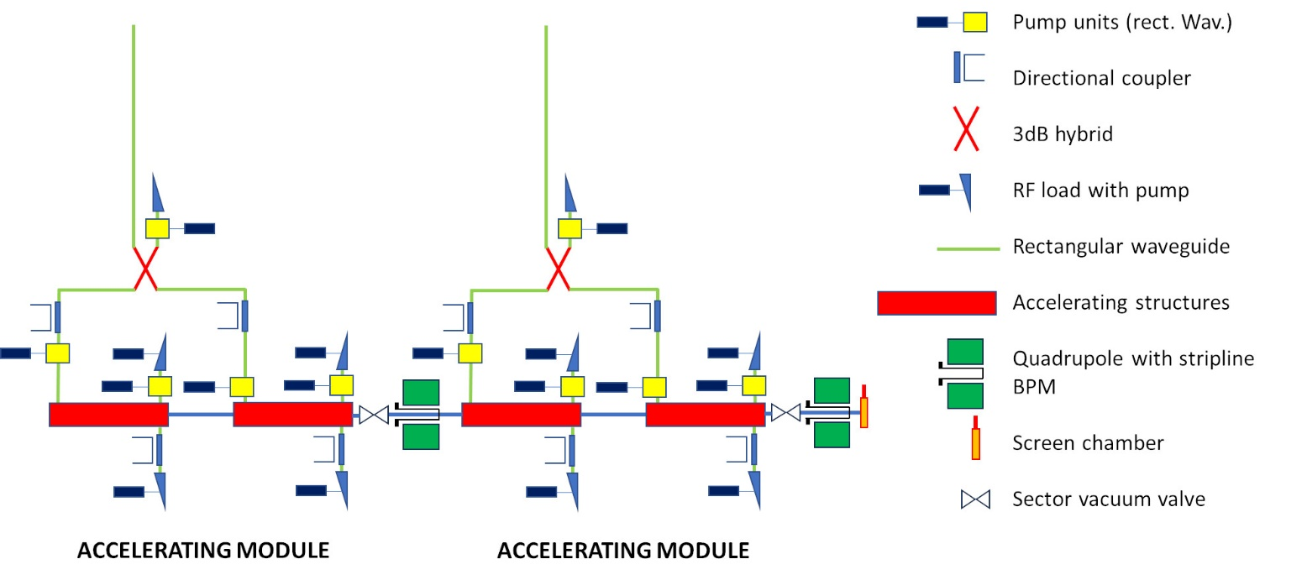
X-band RF Module Schematic Layout

Slide 6
X-band RF Module Layout
Mode converter
(INFN-SLAC design)
BOC pulse compressor
(PSI design or INFN brazing free)
Power Source: Solid State Pulsed Modulator (K300) + 25 MW Klystron (Canon E37119)
Spiral RF LOADS
(CERN Design)
circular waveguide
Pumping units
25 MW
1.5 us
100 Hz
140-70 MW
6 m
130 ns
100 Hz
Hybrid
(CERN design)
Transport line: Low loss Circular waveguide
X band structures
(INFN design)
70-35 MW
130 ns
100 Hz
DC
(CERN design)
Pumping units (CERN design)
NEXTORR Pumps
(SAES)
Accelerating module
2.3 m

Slide 7
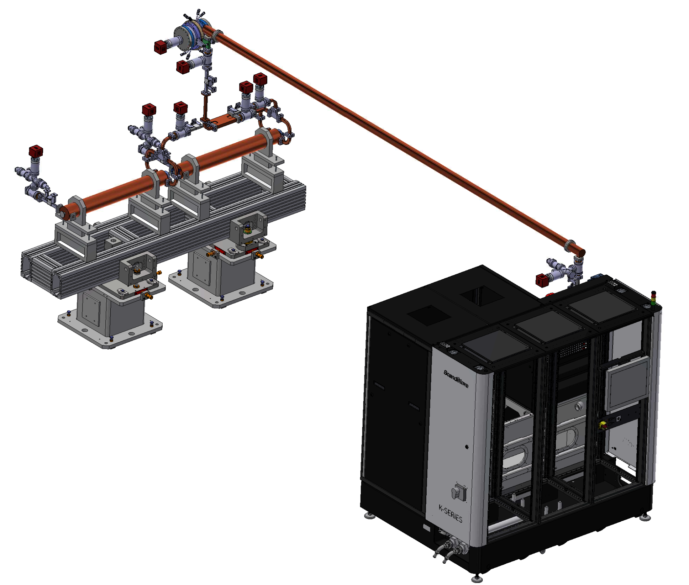
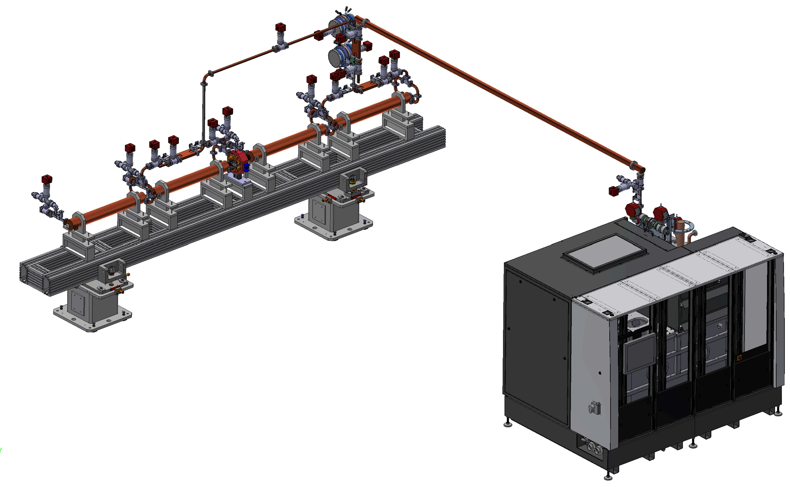
RF MODULE POWER SOURCES:
ORIGINAL OPTIONS
BASELINE
CANON
CPI
OPTION
1x BOC on one line
Higher flexibility
Lower Modulator power requirements
Possible upgrade at high rep. rate of the Linac (400 Hz)
2x BOC on one line
Less flexibility
Different LE and HE module layout
Lower power plants number
2x BOC
6 m
6 m
25 MW
50 MW
4.8 m
2.3 m
K400 Modulator
CPI VKX8311HE
(HIGH EFFICIENCY)
K300 Modulator
Canon E37119

Slide 8

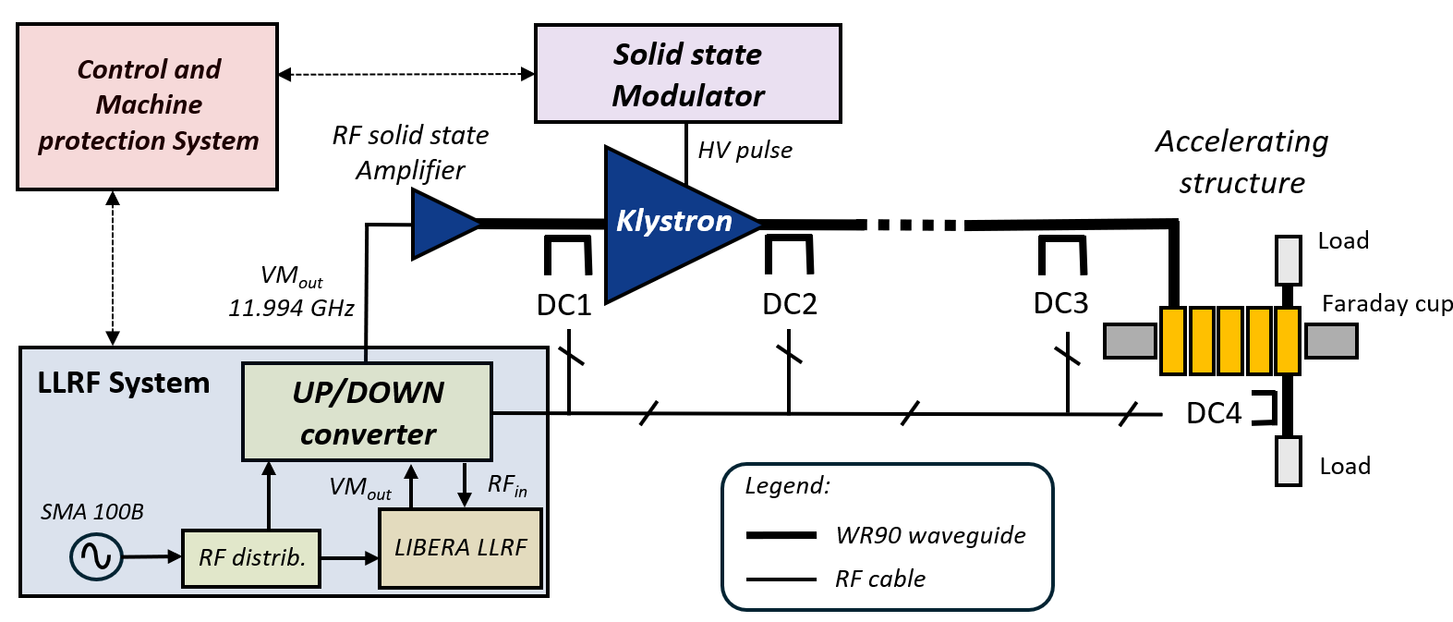
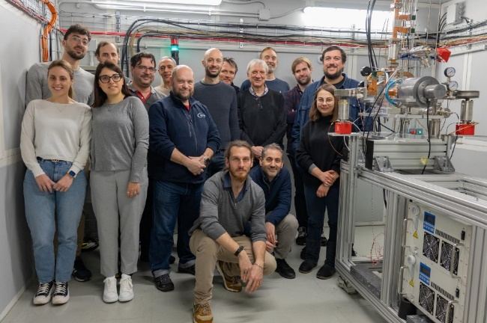
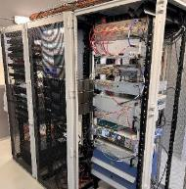
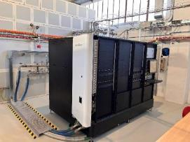
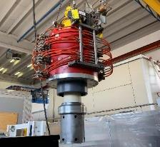
TEX Facility
The TEst-stand for X-band (TEX) is conceived for R&D and test on high gradient X-band accelerating structures, RF components, LLRF systems
It has been co-funded by Lazio region in the framework of the LATINO project (Laboratory in Advanced Technologies for INnOvation).
The setup has been done in collaboration with CERN (that provided the klystron) and it will be also used to test CLIC structures
The installation and commissioning of the whole system (Source and RF network, LLRF, vacuum and EPICS control system) have been completed by the end of 2022 [3,4,5].
Then started the testing activity:
LLRF system
Period | Device tested at high power
Jan. - Feb. 2023 | 3D printed Spiral RF loads and wg
May - Oct. 2023 | X-band T24 CLIC structure
Nov. - Dec. 2023 | X-band Mode converter and circular wg
Jan. - Feb. 2024 | X-band RF waterload from PSI
March 2024 | 20 cells first EuPRAXIA RF prototype
50 MW RF Source
VKX8311A Klystron
[3] F. Cardelli et al., 13th Int. Particle Accelerator Conf. IPAC22, Bangkok, Thailand, Jun. 2022, paper TUPOPT061
[4] L. Piersanti et al. “RF power station stabilization techniques and measurements at LNF” In Proc. IPAC24 - TUPR01.
[5] L. Piersanti et al. “Design and test of a klystron intra-pulse phase feedback system for electron linear accelerators” Photonics 2024, 11(5), 413.

Slide 9
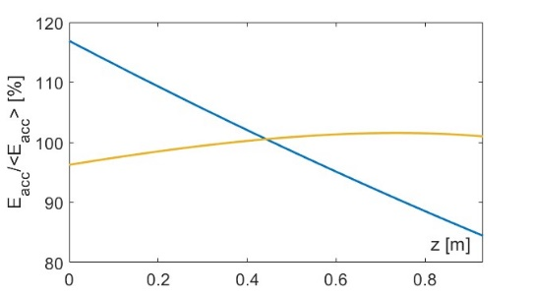
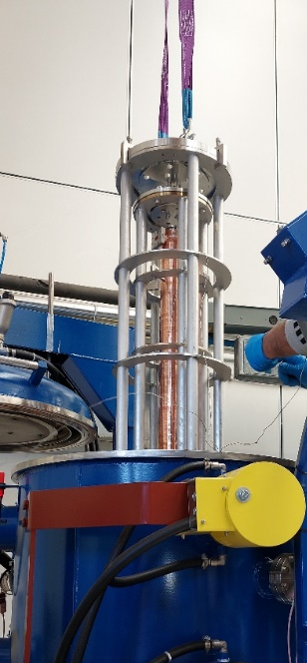
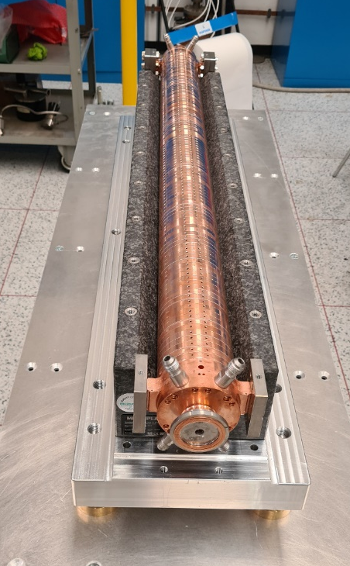
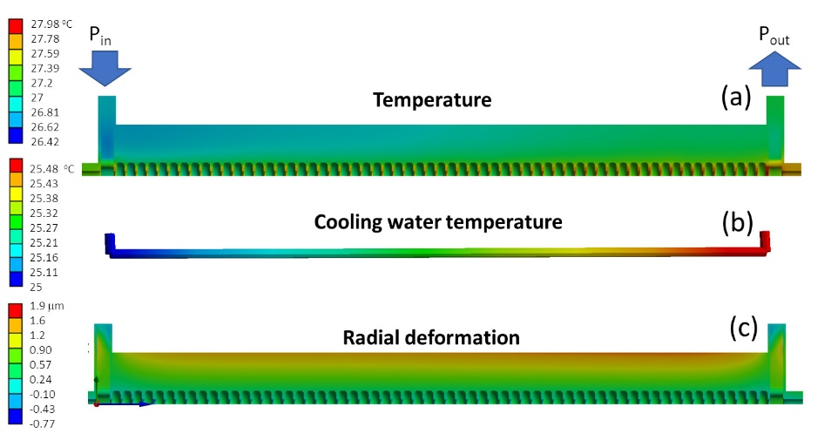
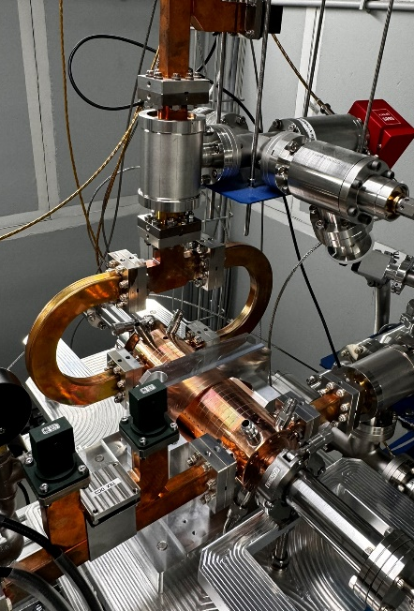
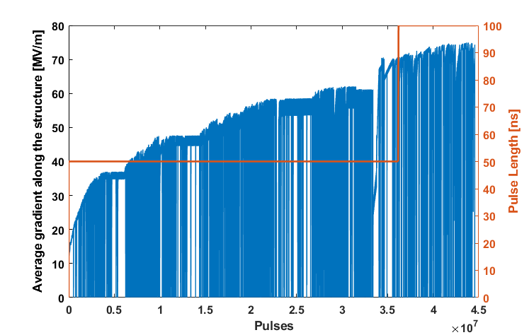
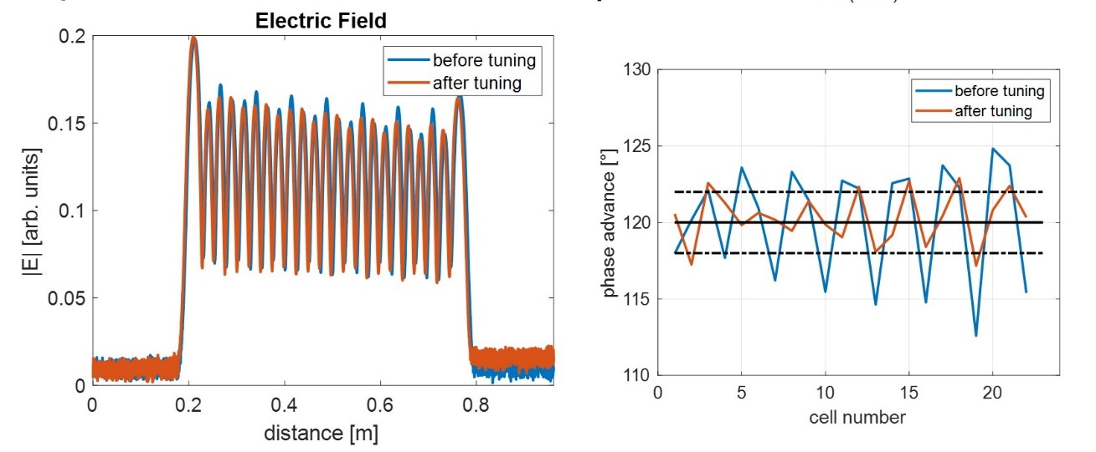
EuPRAXIA X-band structure power test
CI
PARAMETER | Value
 | CG | CI
Frequency [GHz] | 11.9942
Average acc. gradient [MV/m] | 60
Structures per module | 2
Iris radius a [mm] | 3.85 - 3.15 | 3.5
Tapering angle [deg] | 0.04 | 0
Struct. length L_{s} act. Length [m] | 0.94
No. of cells | 112
Shunt impedance R [MΩ/m] | 93-107 | 100
Effective shunt Imp. R_{sh_eff} [MΩ/m] | 350 | 347
Peak input power per structure [MW] | 70
Filling time [ns] | 130
Peak Modified Poynting Vector [W/μm²] | 3.6 | 4.3
Peak surface electric field [MV/m] | 160 | 190
Repetition Rate [Hz] | 100 (400)
CG
Cooling compatible with the 400 Hz operation

Slide 10
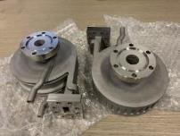
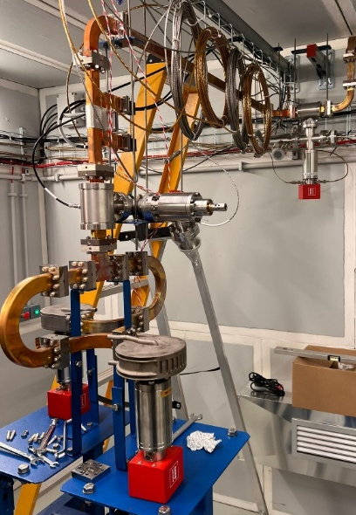
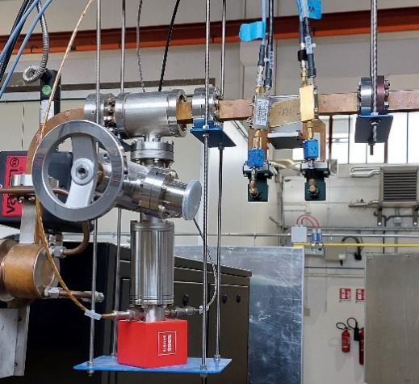
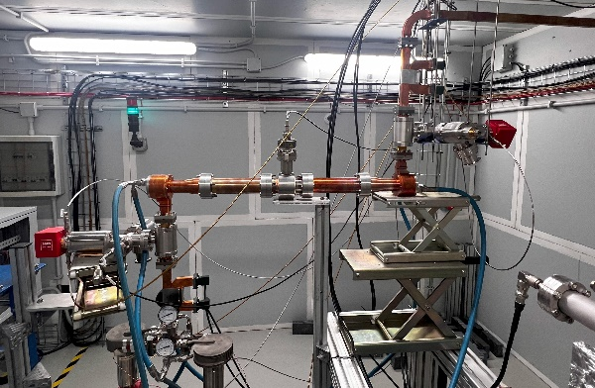
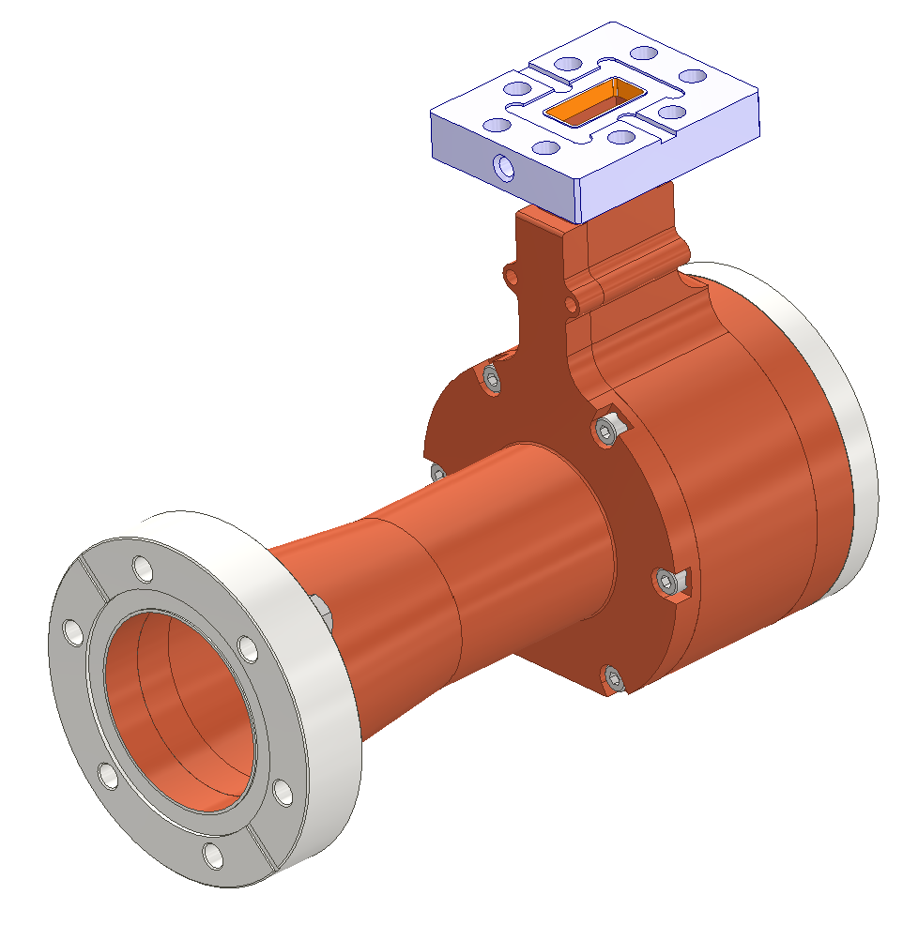
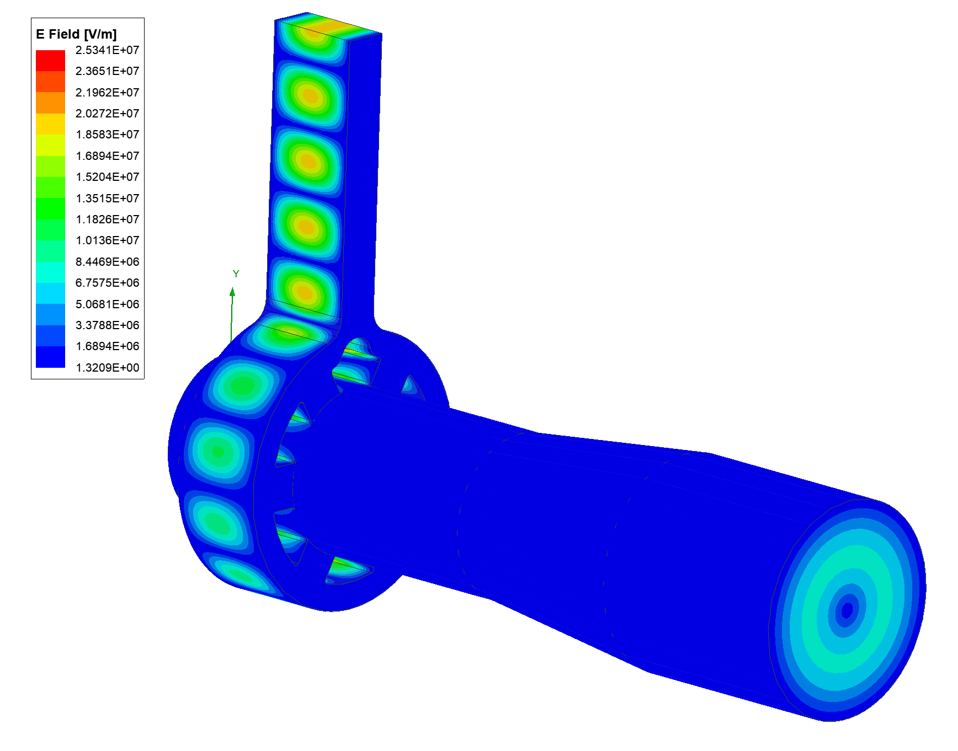
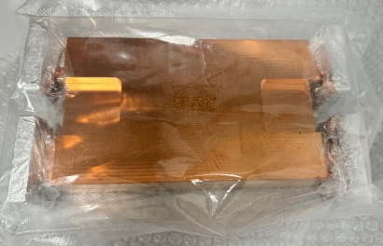
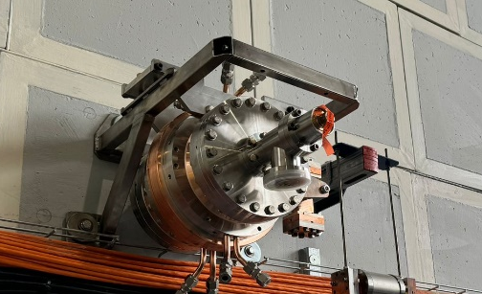
TEST AND REALIZATION OF X-band WAVEGUIDE COMPONENTS
COMPONENT | DESIGN BY | STATUS | LEVEL OF POWER TO BE TESTED FOR EUPRAXIA MODULE | TEST DONE SO FAR
Pump units (rect. Wav.) | CERN | Fabricated and installed @ TEX | 25 MW 1.5 μs and 70-35 MW 0.13 μs Compressed pulse 100 Hz | 45 MW, 1 μs, 50 Hz, P_{avg} = 2.25 kW
Directional coupler | CERN | Fabricated and installed @ TEX | 25 MW 1.5 μs and 70-35 MW 0.13 μs compressed pulse 100 Hz | 45 MW, 1 μs, 50 Hz, P_{avg} = 2.25 kW
Splitter | CERN | Fabricated and installed @ TEX | 70-35 MW, 0.13 μs Compressed pulse 100 Hz | 35 MW, 0.6 μs, 50 Hz, P_{avg} = 1 kW
RF load | CERN | Fabricated and installed @ TEX | 18-9 MW 0.13 μs compressed pulse 100 Hz | 17 MW, 0.6 μs, 50 Hz, P_{avg} = 0.5 kW
Mode converter circular/rect | INFN | Fabricated and Installed @ TEX | 25 MW 1.5 μs 100 Hz | 35 MW, 1 μs, 50 Hz, P_{avg} = 1.75 kW
Pump unit (circ. Waveg.) | INFN | Fabricated and Installed @ TEX | 25 MW 1.5 μs 100 Hz | 35 MW, 1 μs, 50 Hz, P_{avg} = 1.75 kW
3dB hybrid | CERN | Delivered | 140-70 MW 0.13 μs Compressed pulse 100 Hz
BOC pulse compr. | PSI | Delivered | 140-70 MW 0.13 μs Compressed pulse 100 Hz

Slide 11
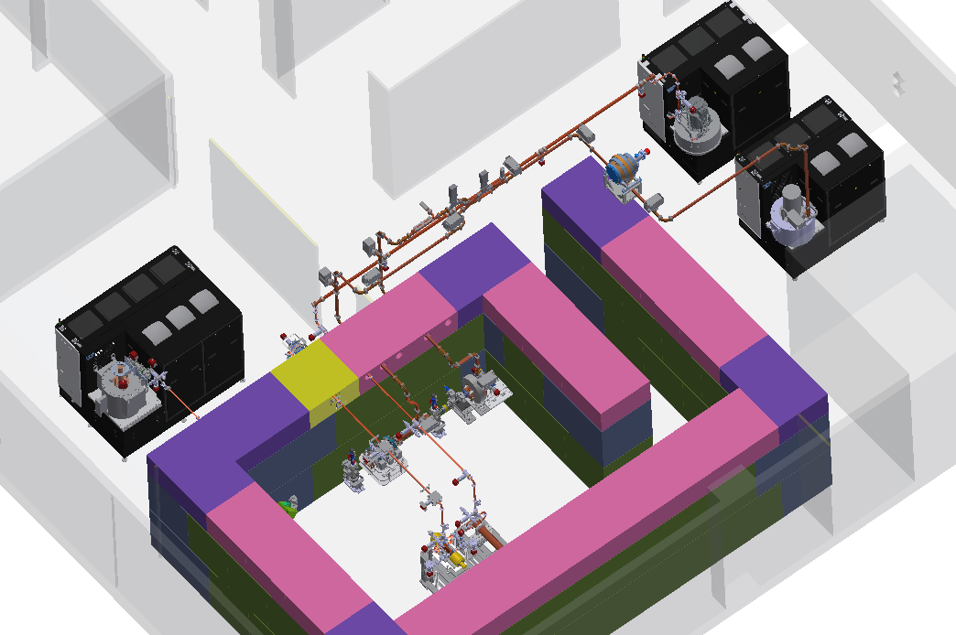
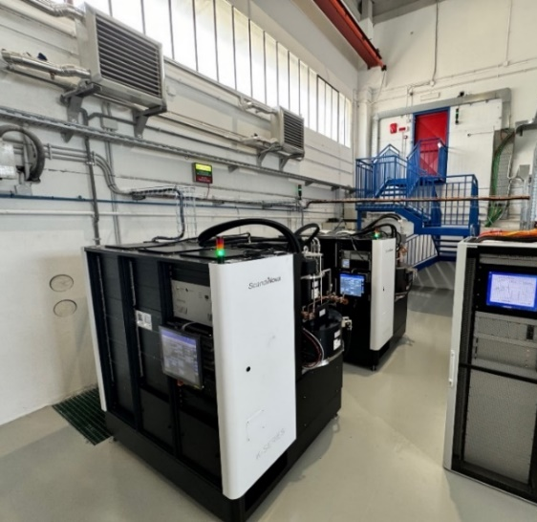
TEX Upgrade with new Power Sources
Currently, the test stand TEX is based on CPI VKX8311A Klystron on loan from CERN already commissioned and in operation.
Three other klystrons are being installed at TEX:
CANON X Band 25 MW, 400 Hz E37119
  Status:
    FAT of the klystron done @ CANON on a PFN modulator 11/2023, 25 MW, 10 Hz, t=1.5us
    FAT of the RF source @Scandinova 05/2024, full power in diode mode
    Modulator and klystron positioned at TEX
  CANON C Band E37217
  Status:
    FAT of the klystron done @ CANON on a PFN modulator 11/2023, 20 MW, 10 Hz, t=2.5us
    FAT of the RF source @Scandinova 05/2024, full power in diode mode
    Modulator and klystron positioned at TEX
CPI X Band 50 MW, 100 Hz High efficiency VKX8311HE
  Status:
  Tender has been done, realization phase (expected delivery from CPI Sept 2025)
Parameter | Unit | Canon E37119 | CPI VKX8311HE | CPI VKX8311 | Canon E37217
Frequency | MHz | 11994 |  |  | 5712
Vk beam voltage | kV | 312 | 415 | 420 | 280
Ik cathode current | A | 199 | 201 | 320 | 240
Peak RF output Power | MW | 25 | 50 | 50 | 20
Average RF output power | kW | 15 | 7,5 | 7,5 | 21
Modulator Average power | kW | 80 | 25 | 48 | 80
RF pulse length | μs | 1,5 |  |  | 2.5
Repetition Rate | Hz | 400 | 100 | 100 | 400
Gain | dB | 47 | 50 | 47 | 50
Efficiency | % | 40 | 55 | 38 | 40
Perveance | μp | 1.16 | 0.75 | 1.15 | 1
The commissioning of these sources and the waveguide networks is scheduled for January 2025, after the installation of the cooling and power systems that will serve these sources.
50MW, 50 Hz X-band Source
25 MW, 400 Hz X-band Source
20 MW, 400 Hz C-band Source

Slide 12



New RF Power Sources: Detailed Parameters

Slide 13


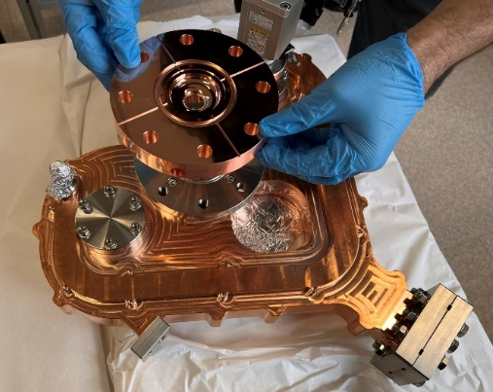
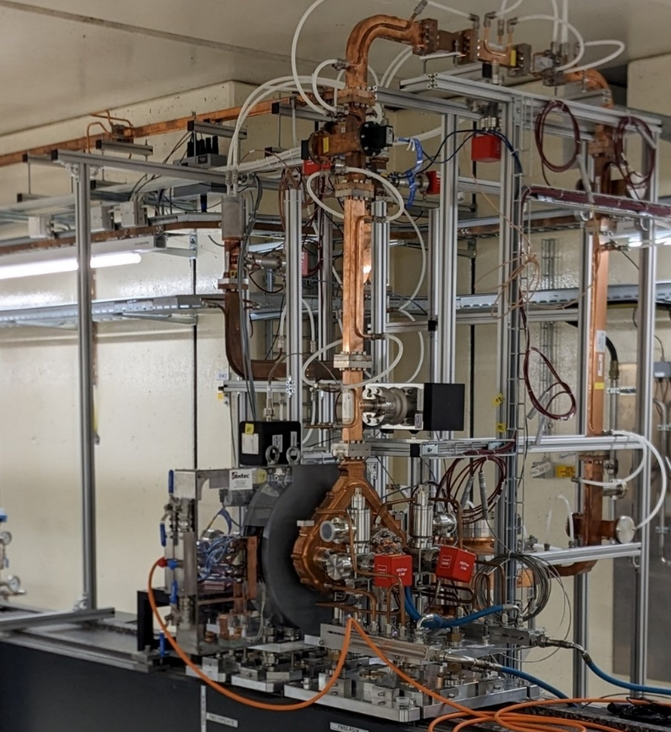

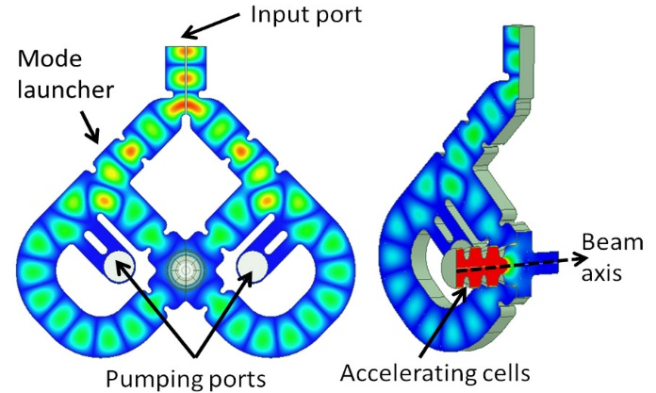
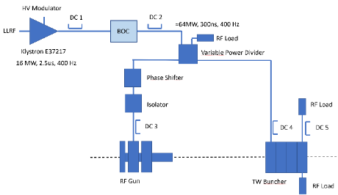
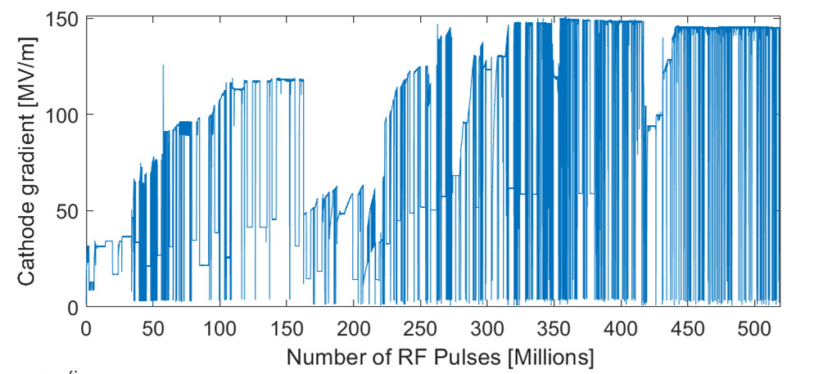
C-BAND GUN @ TEX
A new C band RF photo-gun with the brazing free technology has been designed, built, assembled and installed at PSI (with solenoid and vacuum chamber): I-FAST project.
The design is compatible with the 400 Hz operation
The high power tests showed ∼160 MV/m cathode peak field limited w/o gun limitation.
The C band gun will be installed in the TEX facility and used for high beam quality generation and experiments.
The possibility of a full C band injector for EUPRAXIA@SPARC_LAB is also being considered for the possibility to operate at 400 Hz.
[6] D. Alesini et al. “Design, realization and high power test of the new brazed free C-band Photo-Gun” In Proc. IPAC24 – THAN01

Slide 14
Overview of the LINAC
The Linac uses an S-band photo-injector followed by an X-band LINAC to produce a high brightness electron beam up to an energy of 1 GeV (Q = 200-500 pC, ε_{RMS} ≤ 1 mm$∙$mrad, PRF = 100Hz).
The beam can be either injected directly in the FEL undulators or used to drive the plasma module for PWFA to further increase the energy.
X-band (11.994 GHz)
K300 Modulator
Canon E37119
Undulators
Plasma module
S-band (2856 MHz)
3x E37314 60 MW Canon Klystron + Solid State modulator
X-band modules
X-band Booster
16x, 0.9m, TW accelerating structures that has to work at 60 MV/m
Photocathode RF gun
S-band Injector
photocathode RF Gun and 4x TW S-band structure. (Possible upgrade in C-band)
Courtesy of E. Di Pasquale

Slide 15
S BAND INJECTOR MECHANICAL LAYOUT
S-band K3
S-band K2
1.5m S-band structure
(35 MV/m)
S-band K1
1.5m S-band structure
(35 MV/m)
3m S-band structure
(21 MV/m)
3m S-band structure
(21 MV/m)
Courtesy E Di Pasquale

Slide 16
S BAND INJECTOR RF SCHEMATIC layout
30 MW
4 us
100 Hz
45 MW
4 us
100 Hz
S-band K1
S-band K2
S-band K3
DC
DC
DC
Pulse Compressor
Pulse Compressor
Isolator
Fixed Power Divider
Fixed Power Divider
Attenuator
Attenuator
Phase Shifter
Phase Shifter
65 MW (average) 0.9 us
39 MW (average) 0.9 us
Attenuator
Attenuator
65 MW (average) 0.9 us
39 MW (average) 0.9 us
16 MW, 1.5us
16 MW, 1.5us
DC
DC
DC
DC
DC
X-band structure (lienearizer)
RF Gun
3m S-band structure (21 MV/m)
2m S-band structure
(21 MV/m)
1.5m S-band structure
(35 MV/m)
1.5m S-band structure
(35 MV/m)

Slide 17
S BAND STRUCTURES PARAMETERS
PARAMETER | Structure lenght
 | 3 m | 2 m
Frequency [GHz] | 2.856
Average acc. gradient [MV/m] | 21 | 35
Number of Structures | 2 | 2
Iris radius a [mm] | 11.76 | 10.65
Tapering of structure | 2π/3 C.I.
No. of cells | 85 | 57
Shunt impedance R [MΩ/m] | 56 | 59
Effective shunt Imp. R_{sh_eff} [MΩ/m] | 109 | 114
Peak input power in the structure [MW] | 67.2 | 120
Input power averaged over the pulse [MW] | 38.6 | 69
Average dissipated power [kW] | 3 | 5.1
P_{out}/P_{in} [%] | 32
Filling time [ns] | 920
Peak Modified Poynting Vector [W/μm²] | 0.43 | 1
Peak surface electric field [MV/m] | 70 | 115
Unloaded SLED/BOC Q-factor Q₀ | 150000
External SLED/BOC Q-factor Q_{E} | 21000
Required Kly input power (w/o att.)[MW] | 12.1 | 21.5
RF pulse [µs] | 4
Rep. Rate [Hz] | 100
Klystron Canon E37314
PARAMETER | Value E37314
Frequency [GHz] | 2,856
Maximum ouput power [MW] | 60
Average power [kW] | 24
Efficiency (%) | 41
Gain (dB) | 53
Pulse Length (μs) | 4
Rep. Rate [Hz] | 100
Beam Voltage [kV] | 360
Beam current [A] | 412
Required klystron powers
(considering the waveguide attenuation):
K2 ⇒∼30-35 MW
K3 ⇒∼45-50 MW
K1: Modulator k300 + Klystron Canon E37314
K2&K3: Modulator k400 + Klystron Canon E37314

Slide 18
X-band Linearizing Cavity and POLARIX deflectors
2 X band klystrond dedicated to this

Slide 19
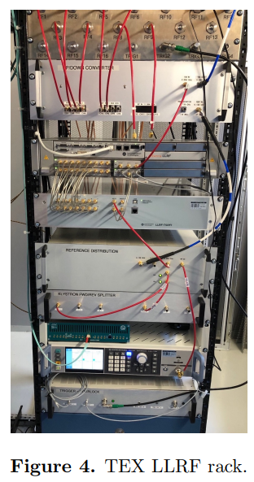

X-band/S-BAND LLRF activities
[1] L. Piersanti et al. “RF power station stabilization techniques and measurements at LNF” In Proc. IPAC24 - TUPR01.
[2] L. Piersanti et al. “Design and test of a klystron intra-pulse phase feedback system for electron linear accelerators” Photonics 2024, 11(5), 413.
Requirements phase jitter (compliant with BD requirements):
0.02 deg S band (S-band RF stability state of the art (PSI))
0.06 deg X band
We cannot develop the system in house because of the complexity, dimension, maintenance for a user facility.
2 industrial partners willing to participate to X-band LLRF R&D (Instrumentation Technologies - solid LLRF experience, Safran - new to high frequency applications);
The internal procedures for the tender for the production of the whole LLRF system should start by the end of 2024;
Detailed jitter studies on X-band power station carried out at TEX facility in February 2024 [1] (no klystron loop):
  Driver added jitter: <0.04 deg rms
  Klystron added jitter: <0.04 deg rms
  LLRF added jitter (tender spec.): <0.015 deg rms
  Estimated RF station jitter: <0.06 deg rms
Dedicated stability measurements will be carried out at SPARC in S band after the SABINA upgrade.
We believe also that with solid state modulator and klystron loops we can have an additional jitter reduction from new fast intra-pulse phase feedback system [2] to be evaluated for S-band and X-band stations at SPARC and TEX respectively.
Jitter compression down to 0.019 deg rms already demonstrated for C-band station at SPARC in Dec 2023.
Courtesy RF group

Slide 20
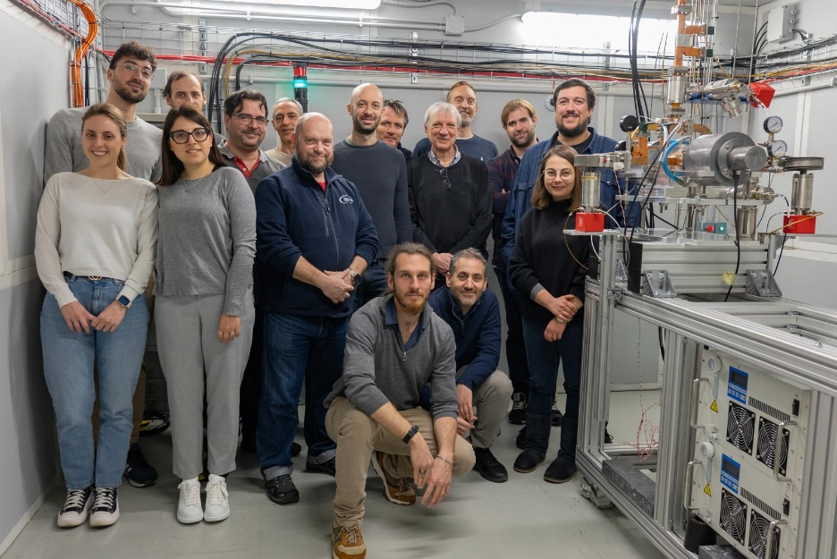
Highlights
  EuPRAXIA@SPARC_LAB is the next INFN-LNF facility. It is the beam driven pillar of the European EuPRAXIA project
  The new machine include 10 X band power stations: baseline CANON E37119
  TEX (Frascati Test stand for X-band) is of fundamental importance to validate all the X band components, structures
    A new X-band RF source based on the E37119 klystron (25 MW, 400Hzwill be commissioned at TEX in the next months, together with a C-band source for C-band photoinjector testing.
    A high efficiency klystron 50 MW VKX8311HE developed by CPI/CERN should be commissioned in end 2025.
  ⇒ Many X-band RF components of the EuPRAXIA RF module have been purchased and tested at nominal power other will be tested soon:
    The X-band BOC from PSI
    The hybrid
THANK YOU FOR YOUR ATTENTION!
  X-band structures: An intensive prototyping activity is ongoing exploiting the new vacuum furnace at LNF (Two full-scale mechanical prototypes, the 20 cells CI RF prototype, A full-scale 0.9m RF prototype for high power test is in production.
  For the S band Injector 60 MW CANON Klystron are foreseen
Aknowledgements:
INFN-LNF: F. Cardelli, S. Bini, B. Buonomo, S. Cantarella, G. Catuscelli, R. Clementi, L. Faillace, M. Ferrario, A. Gallo, C. Di Giulio, E. Di Pasquale, G. Di Raddo, G. Latini, A. Liedl, V. Lollo, L. Piersanti, S. Pioli, B. Serenellini, L. Spallino on behalf of the, INFN-LNF Accelerator Division and Technical Division
CERN: W. Wuensh, N. Catalan-Lasheras, A. Grudiev, G. McMonagle on behalf of the CLIC group
SLAC: V. A. Dolgashev

