Slide 1

RF Power for
Emilio Nanni
2nd Workshop on Efficient RF Sources
9/23/2024
Notes:
A lepton-collider Higgs factory, to precisely measure the couplings of the Higgs boson to other particles, followed by a higher energy run to measure the Higgs self-coupling, is widely recognized as a primary focus of modern particle physics. In this talk, we will present the study of a new concept for a high gradient, high power accelerator with beam characteristics suitable to study the Higgs boson, the Cool Copper Collider (C3), with the goal of minimizing the capital and operating costs. C3 is based on the latest advances in rf accelerator technology and utilizes optimized cavity geometries, novel rf distribution, and operation at cryogenic temperatures to allow the linear accelerator to achieve high accelerating gradients while maintaining the overall system efficiency. We will present the latest demonstrated performance of prototype accelerators and highlight the future development path for C3.

Slide 2
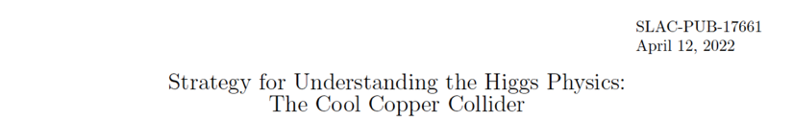
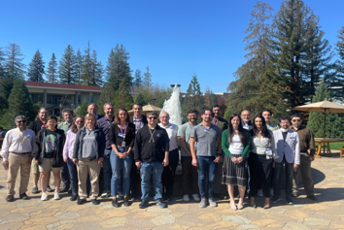
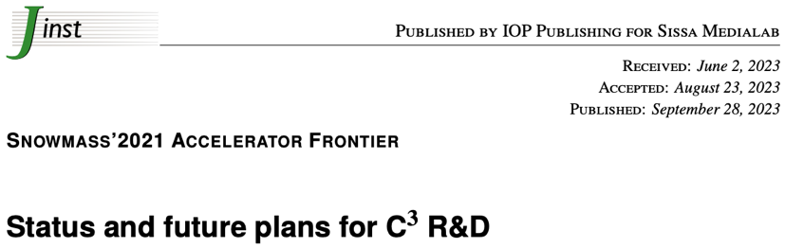

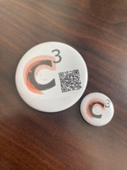
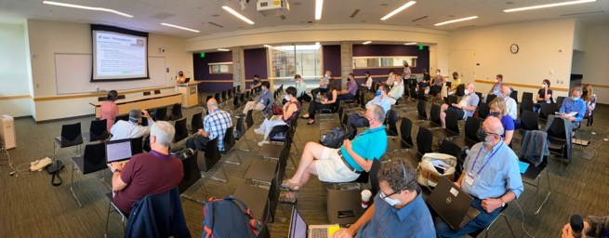
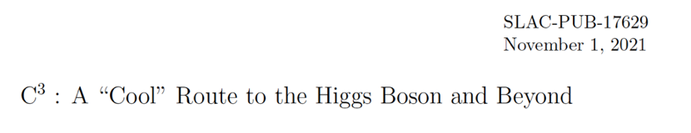
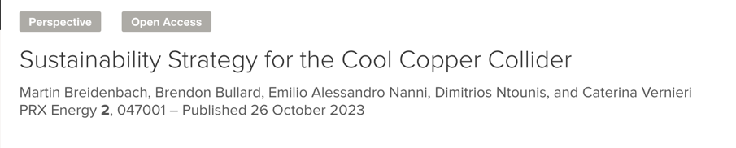
Acknowledgements
Community Events
https://web.slac.stanford.edu/c3/events
SLAC Feb. 12th-13th
https://indico.slac.stanford.edu/event/8577/
https://sites.google.com/view/ec4c3
Next C³ Meeting at NIKHEF, Amsterdam Oct. 7-8th ’24
Next Cold-Copper Meeting at Duke University, Jan. 13-14th ‘24
More Details Here (Follow, Endorse, Collaborate):
https://web.slac.stanford.edu/c3/
2nd Workshop on Efficient RF Sources

Slide 3
Exploring the Energy Frontier…

Slide 4
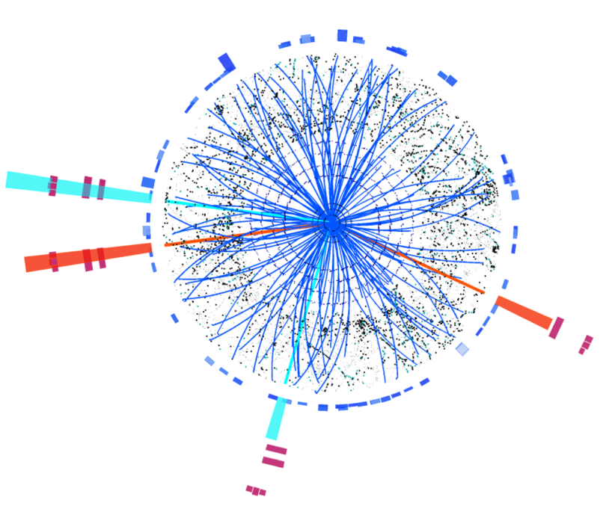
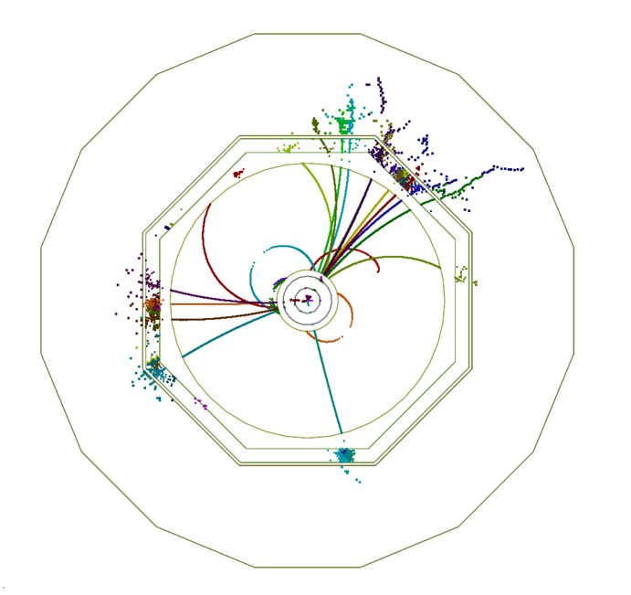
Why e⁺e⁻?
Initial state well defined & polarization ⟹ High-precision measurements
Higgs bosons appear in 1 in 100 events ⟹ Clean environment and trigger-less readout
pp/LHC
e⁺e⁻
2nd Workshop on Efficient RF Sources

Slide 5
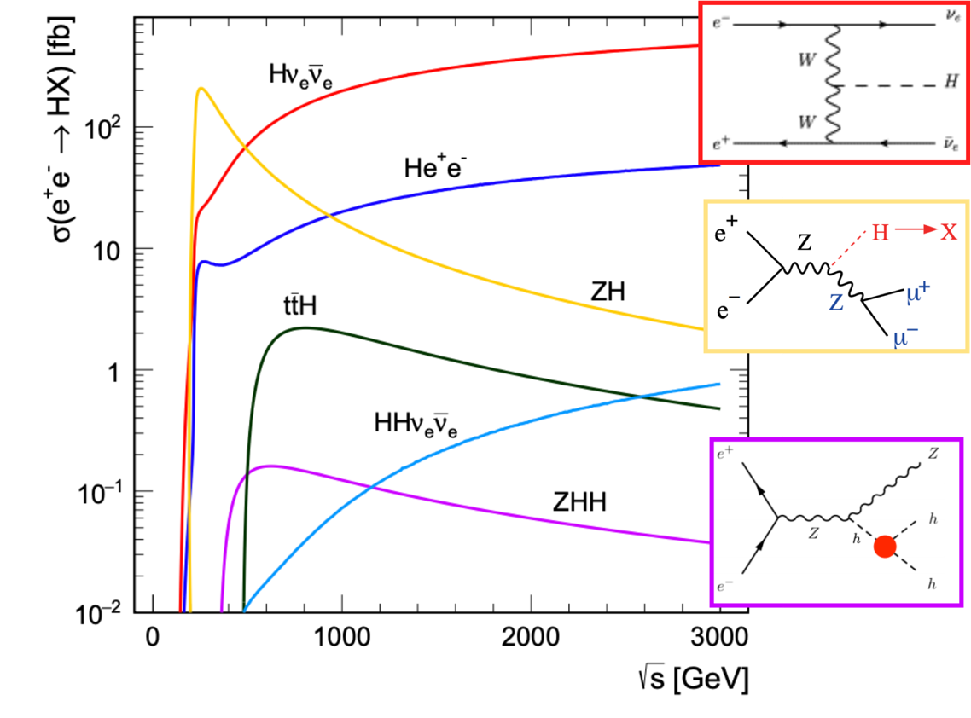
Higgs Production at e⁺e⁻
ZH is dominant at 250 GeV
Above 500 GeV
Hvv dominates
ttH opens up
HH production accessible with ZHH
2nd Workshop on Efficient RF Sources

Slide 6
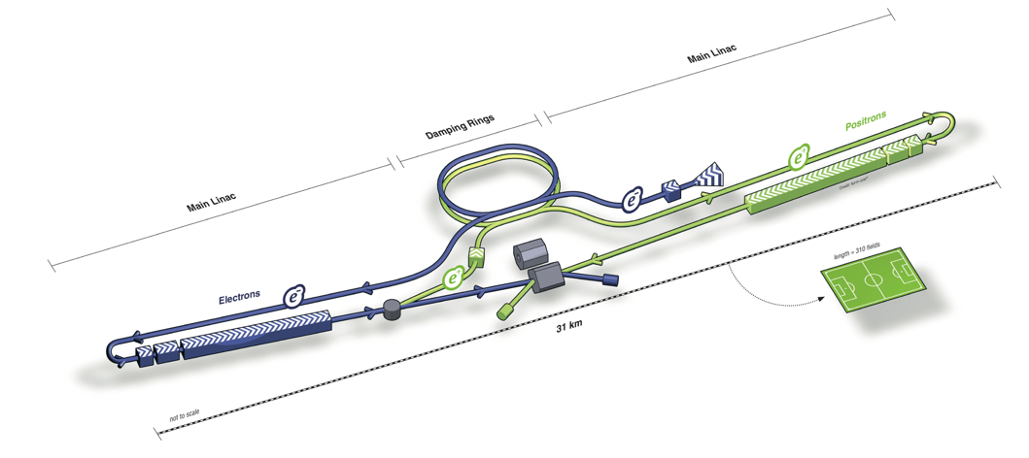
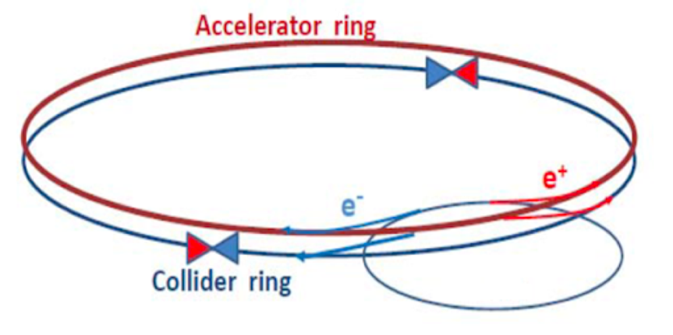
Linear vs. Circular
Linear e⁺e⁻ colliders: ILC, C³, CLIC
Reach higher energies (~TeV), and can use polarized beams
Relatively low radiation
Collisions in bunch trains
Circular e⁺e⁻ colliders: FCC-ee, CEPC
Highest luminosity collider at Z/WW/ZH
limited by synchrotron radiation above 350 – 400 GeV
Beam continues to circulate after collision
2nd Workshop on Efficient RF Sources

Slide 7
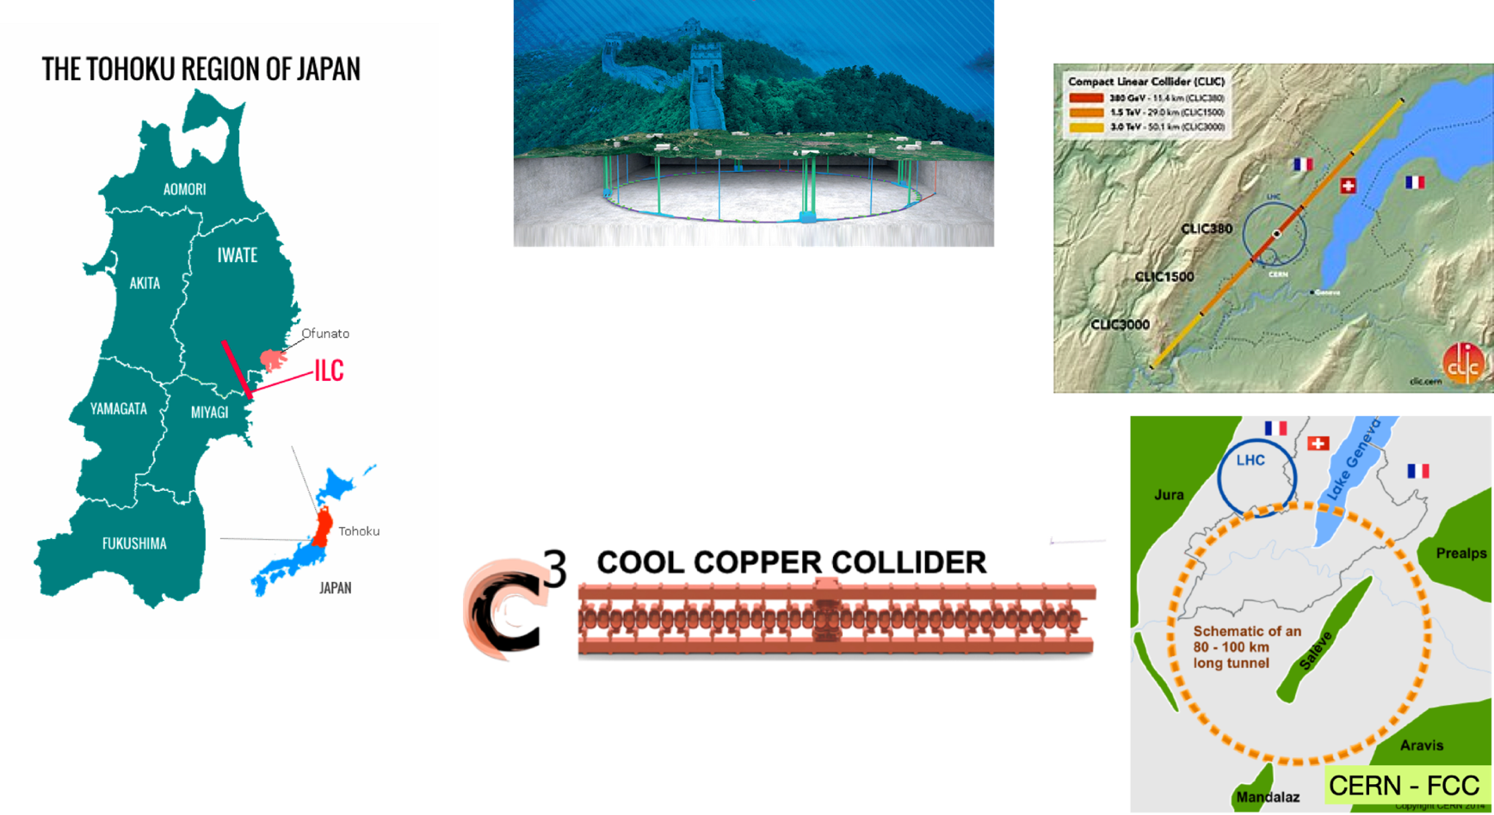

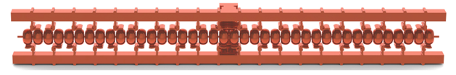
Various Proposals
CLIC 380/1000/3000 GeV
CEPC
240 GeV
FCC-ee
240/365 GeV
ILC
250/500 GeV
250/550 GeV
… > TeV
2nd Workshop on Efficient RF Sources

Slide 8
A novel route to a linear e⁺e⁻ collider…

Slide 9
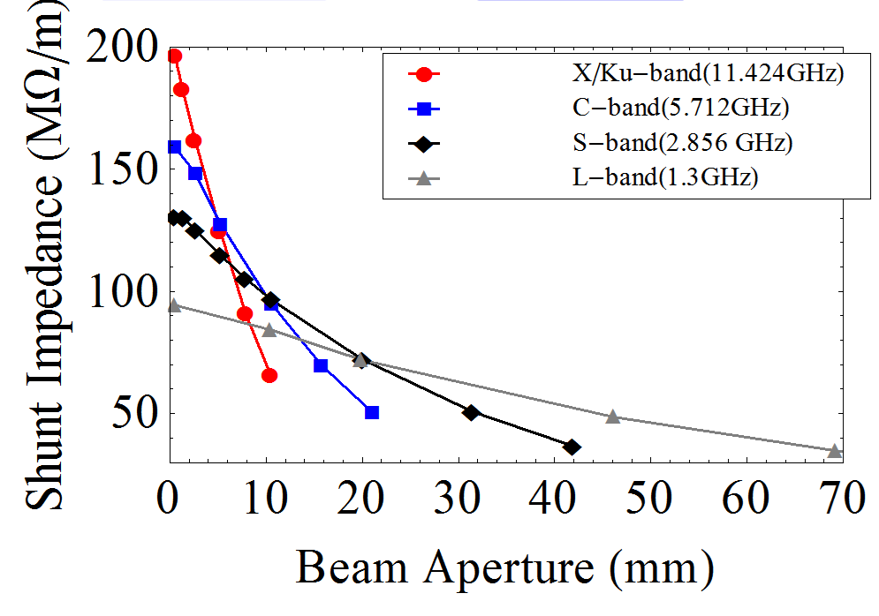
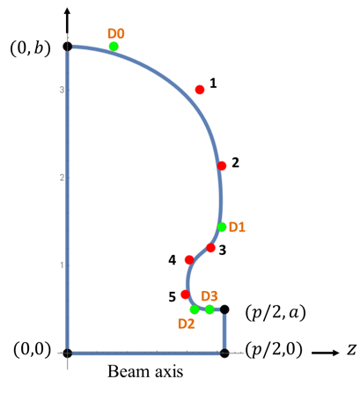
What Defines the Optimal Accelerator Cavity Geometry?
Performance depends on beam aperture which is driven by the bunch charge
Charge particle radiate wakefields that set the limit
Advanced Optimization Tools
Variable control points for splines define the cavity shape.
M. Nasr et al., IPAC’18
20% reduction in surface electric field for same shunt impedance
New Scaling Laws Determine the Best Performance for Accelerating Structures
2nd Workshop on Efficient RF Sources
Tantawi, Nasr

Slide 10
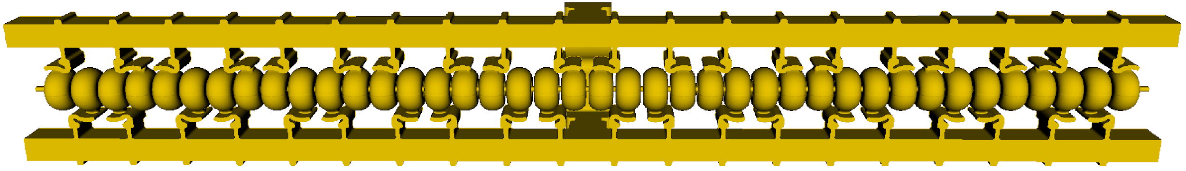
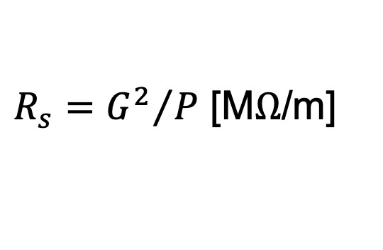

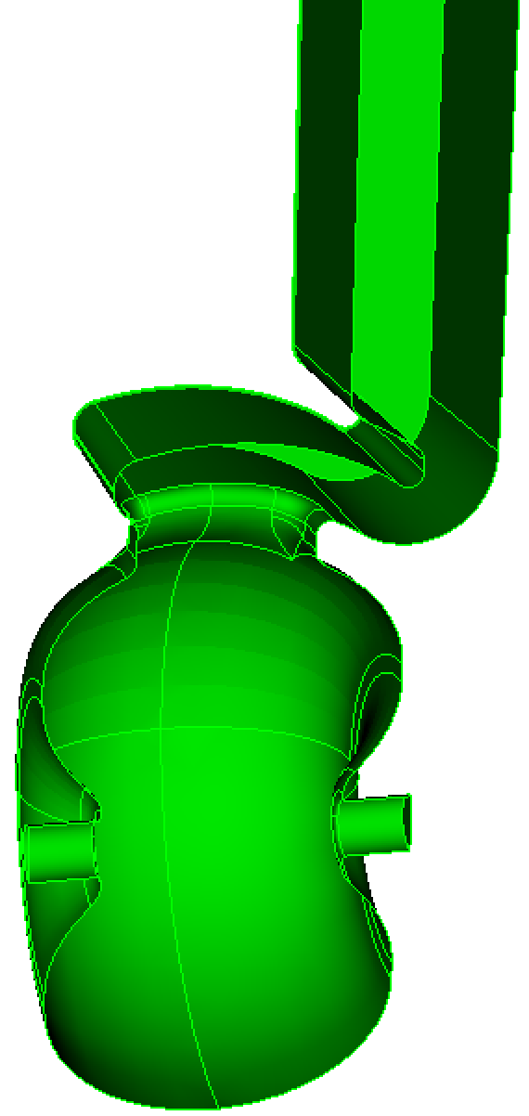
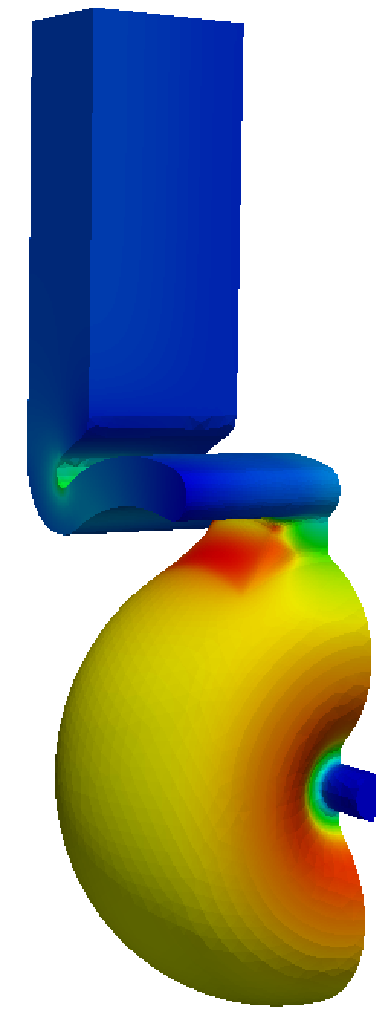
Breakthrough in the Performance of RF Accelerators
RF power coupled to each cell – no on-axis coupling
Full system design requires modern virtual prototyping
Vacuum space for rf cavities and manifold
Optimization of cell for efficiency (shunt impedance)
Control peak surface electric and magnetic fields
Key to high gradient operation
arXiv:1807.10195 (2018)
PRAB 23.9 (2020): 092001

Slide 11
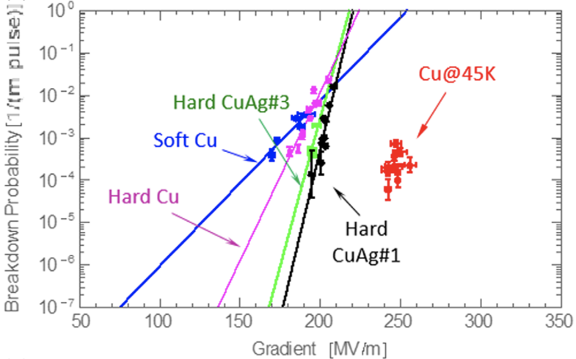
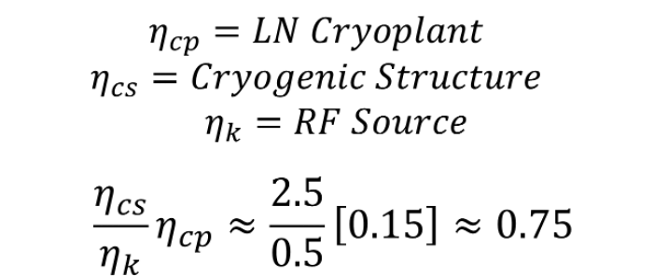
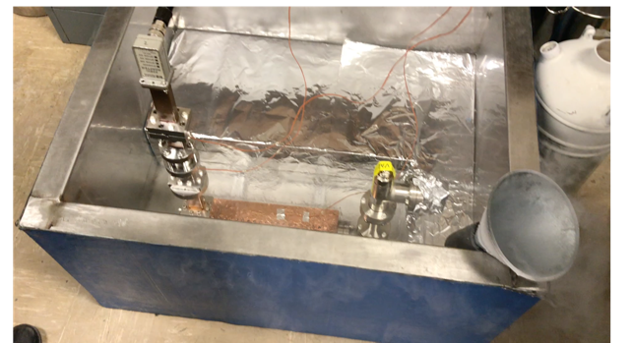
Cryo-Copper: Enabling Efficient High-Gradient Operation
Cryogenic temperature elevates performance in gradient
Material strength is key factor
Impact of high fields for a high brightness injector may eliminate need for one damping ring
Operation at 77 K with liquid nitrogen is simple and practical
Large-scale production, large heat capacity, simple handling
Small impact on electrical efficiency
Cryogenic temperature elevates performance in gradient
Material strength is key factor
Impact of high fields for a high brightness injector may eliminate need for one damping ring
Cahill, A. D., et al. PRAB 21.10 (2018): 102002.
2nd Workshop on Efficient RF Sources

Slide 12
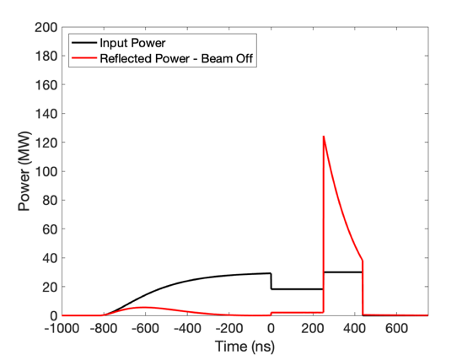
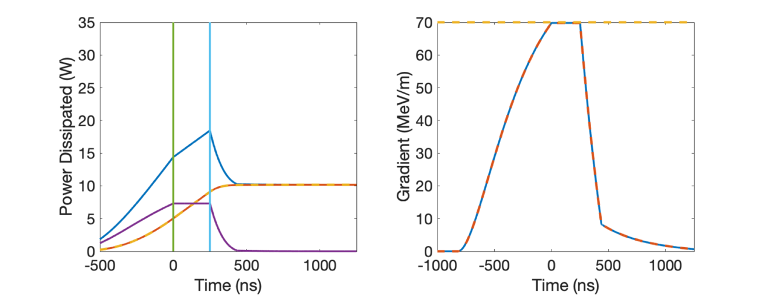
RF Power Requirements
70 MeV/m 250 ns Flattop (extendible to 1400 ns)
~2 microsecond rf pulse, ~30 MW/m
Conservative 2.3X enhancement from cryo
No pulse compression
Ramp power to reduce reflected power
Flip phase at output to reduce thermals
RF Power
One 65 MW klystron every two meters -> Matches CLIC-k rf module power
Gradient
Thermals
2nd Workshop on Efficient RF Sources

Slide 13

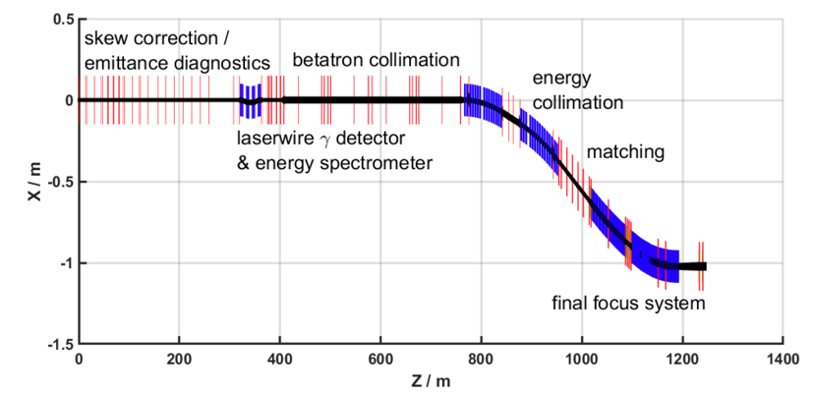
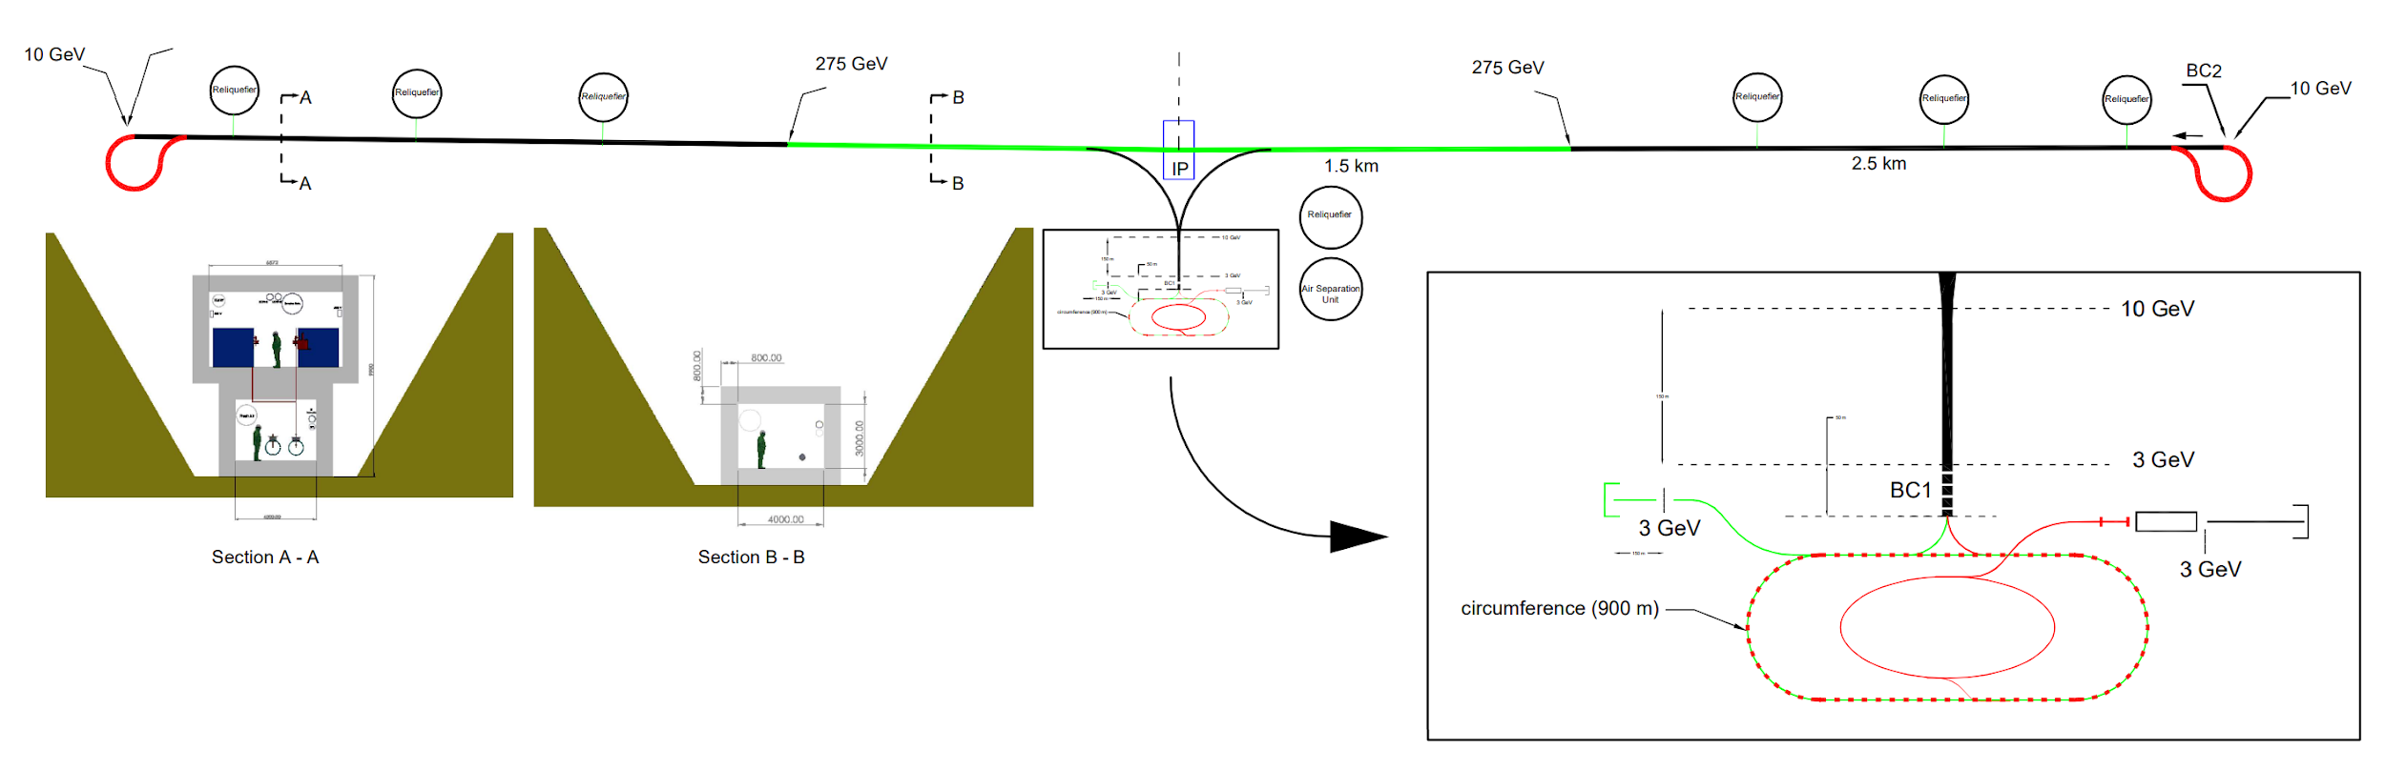
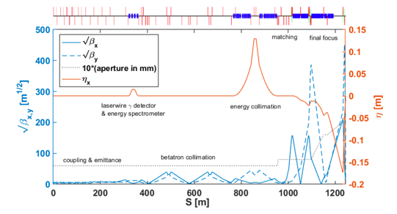
Accelerator Complex
8 km footprint for 250/550 GeV CoM ⟹ 70/120 MeV/m
7 km footprint at 155 MeV/m for 550 GeV CoM – present Fermilab site
Large portions of accelerator complex are compatible between LC technologies
Beam delivery and IP modified from ILC (1.5 km for 550 GeV CoM)
Damping rings and injectors to be optimized with CLIC as baseline
Costing studies use LC estimates as inputs
C³ - Investigation of Beam Delivery (Adapted from ILC/NLC)
C³ - 8 km Footprint for 250/550 GeV
2nd Workshop on Efficient RF Sources

Slide 14
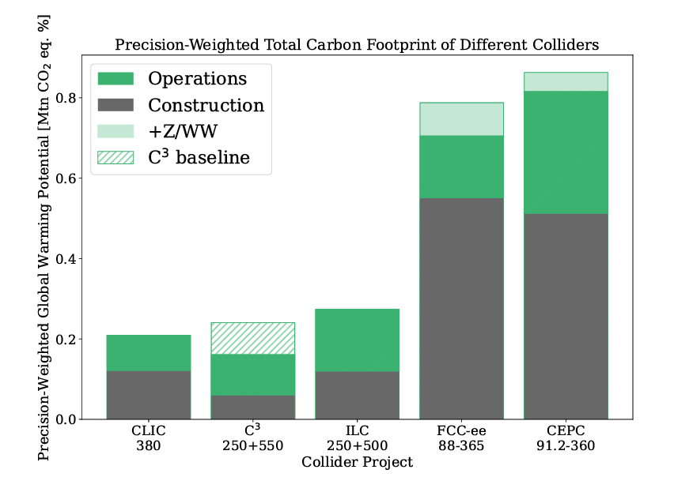
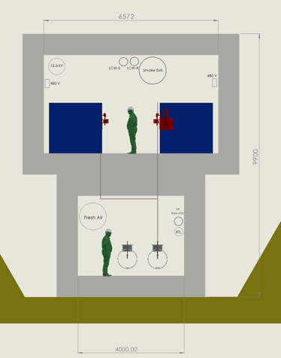
Power Consumption and Sustainability
Compact footprint <8 km for both underground and surface sites
  Underground – less constraints on energy upgrade
  Surface – lower cost and faster to first physics
Sustainability - construction + operations CO₂ emissions per % sensitivity on couplings
  Polarization and high energy to improve sensitivity
  Construction CO₂ emissions → minimize excavation and concrete
  Operations → limit power, decarbonization of the grid and dedicated renewable sources
250 GeV CoM - Luminosity - 1.3x10³⁴
Parameter | Units | Value
Reliquification Plant Cost | M$/MW | 18
Single Beam Power (125 GeV linac) | MW | 2
Total Beam Power | MW | 4
Total RF Power | MW | 18
Heat Load at Cryogenic Temperature | MW | 9
Electrical Power for RF | MW | 40
Cryoplant Electrical Power | MW | 60
Accelerator Complex Power | MW | ~50
Site Power | MW | ~150
Surface-Site Mockup
Precision-Weighted Carbon Footprint
PRX Energy 2.4 (2023): 047001
Notes:
Sustainability lcws talk and paper

Slide 15
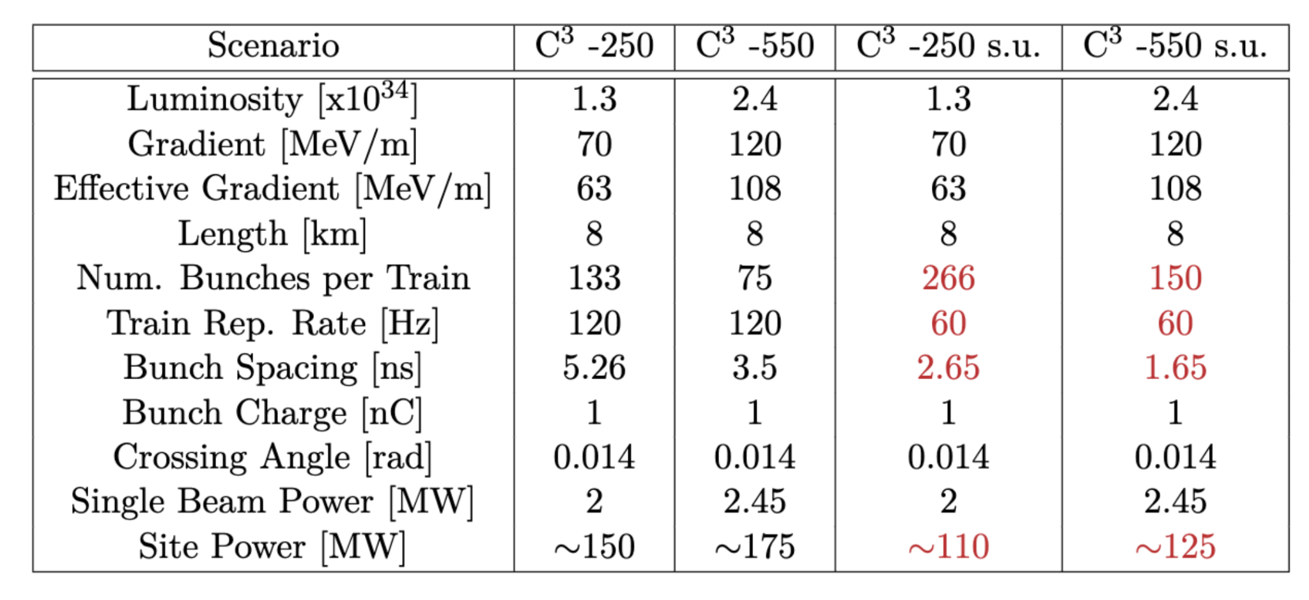
Table of Parameters
Updated parameters from LCWS 2024
2nd Workshop on Efficient RF Sources

Slide 16
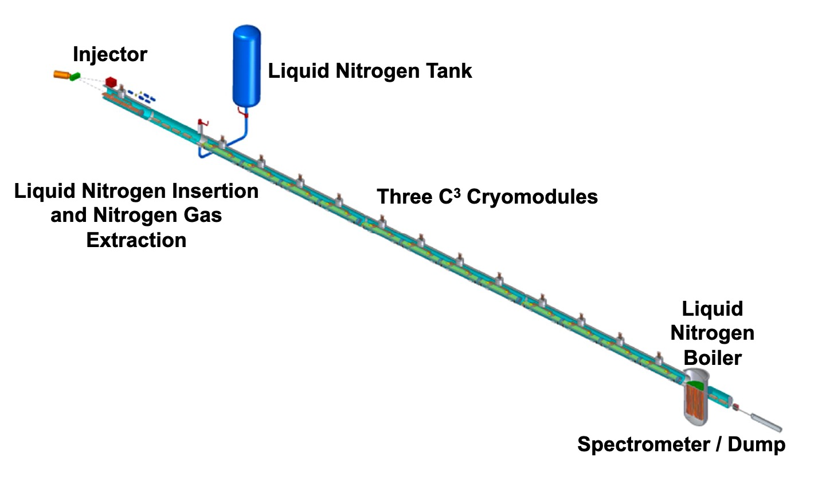
The Complete C³ Demonstrator
QCM
Stage 2:
Injector + Cryomodule
Demonstrate fully engineered cryomodule
~50 m scale facility
3 GeV energy reach
Answer technical questions needed for CDR

Slide 17
Ongoing R&D

Slide 18

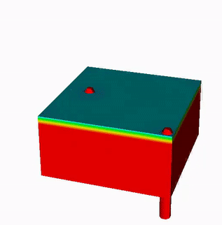
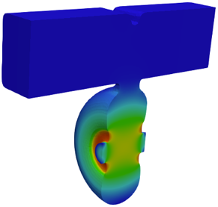
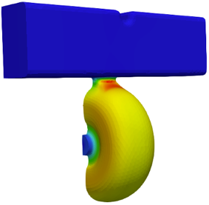
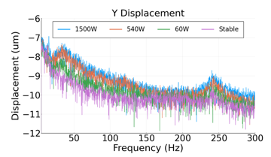
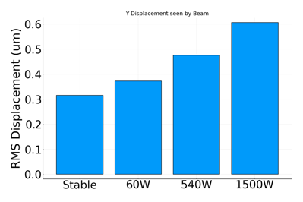


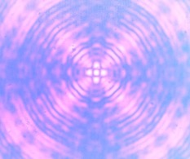
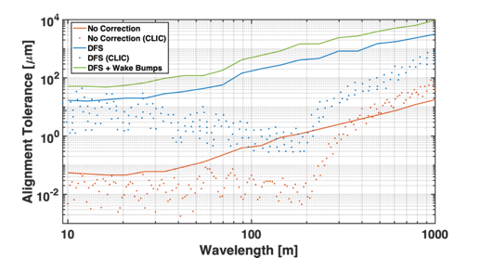
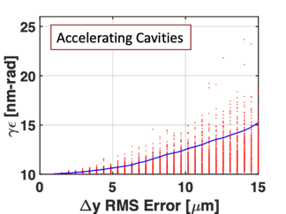
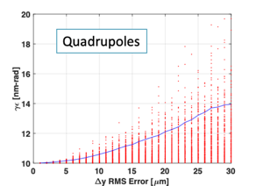
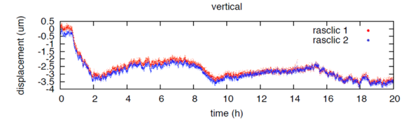
Alignment and Vibrations
Two-Phase Fluid Simulations
System level optimization essential for achieving performance
RF Structure Optimization
Vibration Measurements and Analysis
3.55 mm iris radius
2.0=E_{max}/E_{acc}
1.23=H_{coup}/H_{wall}
K. Shoele
Electric Field
Precision Short and Long Range Alignment
Magnetic Field
Z. George, V. Borzenets, A. Dhar, D. Palmer
H. Van Der Graaf
M. Shumail, Z. Li
Main Linac Beam Dynamics
Alignment Parameters | Units | Value
Raft Components | μm | 5
Short Range (~10m) | μm | 30
Long Range (>200m) | μm | 1000
Structure Vert. Vibration | μm | 9
Quad Vert. Vibration | nm | 15
BPM Resolution | μm | 0.1
BPM-Quad Alignment | μm | 2
100 nm resolution
Approved effort to test cold
White (C³), Schulte (CLIC)
https://arxiv.org/pdf/2307.07981.pdf
2nd Workshop on Efficient RF Sources

Slide 19
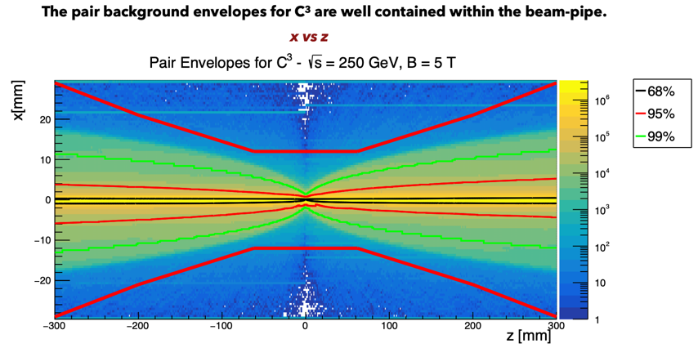
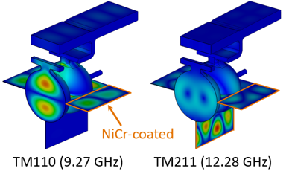
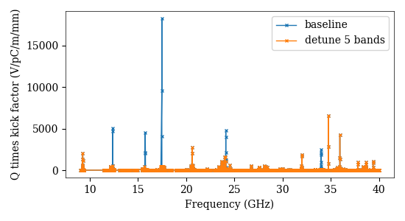
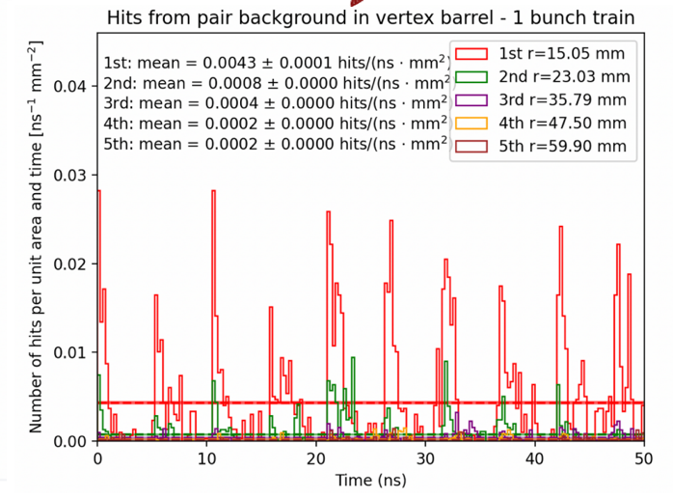
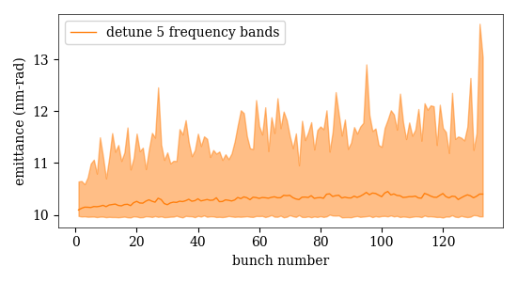
Beam Dynamics and Luminosity Studies
Compatible with ILC-like Detector
Studies ongoing towards ensuring target luminosity
Emittance Preservation with HOM Suppression
Ntounis, Gray, Vernieri
Damped / Damped-Detuned Spectrum
H. Xu et al., LANL
Wei-Hou Tan, Zenghai Li
See C3 talks at ECFA Workshop on e+e- Higgs/EW/Top Factories
https://agenda.infn.it/event/34841/
Opportunities to Collaborate: DR, Bunch Compressor, BDS, …
2nd Workshop on Efficient RF Sources

Slide 20
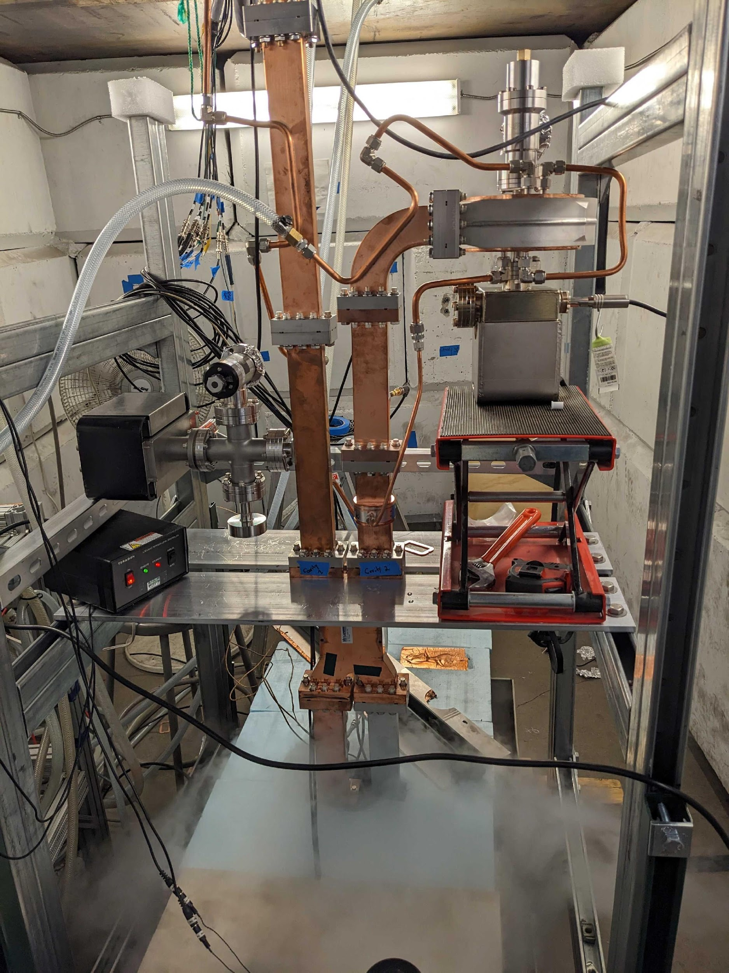
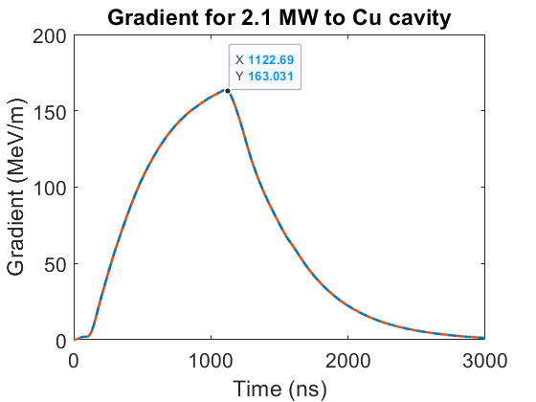
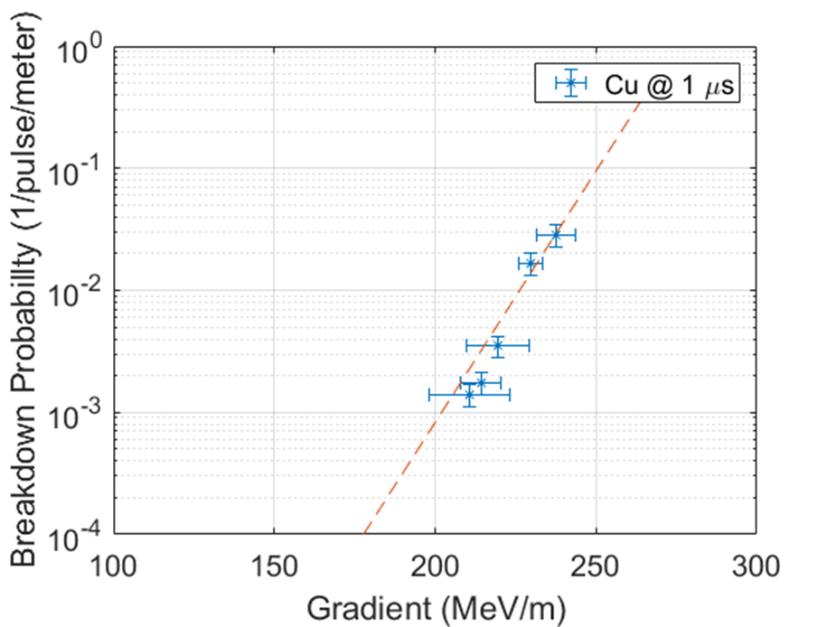
Single Cell Cryogenic High Gradient Tests
High power tested up to 5 MW per cavity with Cu and CuAg
CuAg proven to give higher gradient
  First demonstration of Cu and CuAg at C-band in cryo
    Corresponding to fields >200 MeV/m
2nd Workshop on Efficient RF Sources

Slide 21



Meter-long Linac Cryogenic High Gradient Tests
Conditioned Linac at Radiabeam up to 20 MW, 60 Hz, and 1 μs
Conditioning limited by klystron, not structure
Accelerometer measurements at max power showed sub-micron displacements, even with mechanical propagation from outside the bunker
2nd Workshop on Efficient RF Sources

Slide 22
RF Source R&D
Special Thanks to Brandon Weatherford, Erik Jongewaard, Mohamed Othman, Ann Sy and many others…

Slide 23

RF Sources Requirements for C³
50% [65%] RF Source Efficiency, 65 [80] MW peak power, 2 [1] $μ$s, 250 [550] GeV CoM, 60 Hz
Imposes requirement that circuit efficiency be pushed to ~70% or greater
Significant ongoing work (see next slides and this whole workshop)
Solenoidal electromagnet consumes too much power
XL4 solenoid consumes >20 kW average power
  Needs to go to near zero
  Periodic permanent magnets (PPM)as an appealing option
  Focus of Next Linear Collider (NLC) program
2nd Workshop on Efficient RF Sources

Slide 24



RF Sources Available vs. Near Term Industrial Efforts
RF sources and modulators capable of powering CCC-250 commercially available
Plan to leverage significant developments in performance (HEIKA) of high power rf sources – requires industrialization
2nd Workshop on Efficient RF Sources

Slide 25

High Efficiency Klystrons
Please See I. Syratchev’s Talk for Many Great Examples from Designs to Prototypes
https://indico.cern.ch/event/1101548/contributions/4635964/attachments/2363439/4034986/CLIC_PM_13_12_2021.pdf
2nd Workshop on Efficient RF Sources

Slide 26

75XP Series Klystrons as RF sources for C³
The SLAC 75XP is a PPM-focused, X-band klystron designed for 75 MW peak power
Motivated/funded by the Next Linear Collider (NLC) program
Years of engineering effort → attractive candidate for a potential C³ demonstrator
Specification | Target
Beam Voltage | 490 kV
Beam Current | 257 A
RF Output Power | 75 MW
Frequency | 11.424 GHz
RF Pulses | 1.5 µs @ 60 Hz
Saturated Gain | 55 dB
Bandwidth | 75 MHz
Efficiency | 55%
Design Features:
Large “DESY” HV gun insulator
7-cavity gain circuit
5-cell extended-interaction output
Isolated collector

Slide 27


75XP1 Test Results
The original 75XP-1 was built, and eventually reached 79 MW at 2.8 μs in test
Power levels exceeding 100 MW were measured at shorter pulse widths
RF Pulse Envelope at 75 MW
Peak RF Power vs Pulse Width
Gun and output oscillations were observed, but corrected after rework

Slide 28
Design Modifications for the 75XP3
The 75XP3 series was a full-tube design iteration of the 75XP1
Goal was to make a “design for manufacturing” in support of NLC:
Introduced clamp-on “clam-shell” magnet assemblies to allow pre-test
Removed the adjustable gun design / tightening of gun tolerances
Modified cavity spacings
Modified beam tunnel sizes / tailpipe and cooling
Gun coil assembly added for adjusting beam match into PPM stack during test
Implementation of dual-window output

Slide 29


Lessons learned from the 75XP Series
75XP series met specifications, and in some cases exceeded them (over 100 MW at < 500 ns)
Gun & output oscillations were a recurring but solvable challenge.
Key issues identified:
  75XP1, XP Diode, and 75XP3-2 were susceptible to gun oscillations
  Magnetic circuit is quite complicated (i.e., expensive & hard to build)
  At high duty, runaway condition with NdFeB magnets overheating
  Body current vs. gun coil current settings were a “bit touchy”

Slide 30
The 75XP4 Redesign
The next design iteration, 75XP4, was partially complete when NLC was cancelled
The goal was to make the 75XP4 more robust against 75XP3 failure modes:
Potential for gun and output oscillations
Complexity of PPM stack
Runaway conditions of overheating magnets near output
Design sensitivity of gun coils
High gradient RF breakdown in output
For the C³ demonstrator source, we simulated the design that was already completed, and made further changes to address past issues.

Slide 31


75XP4 Electron Gun
Gun re-modeled with & without magnets for beam trajectory and gradients
Simulations in both EGUN and MICHELLE, for use in TESLA & MAGIC sims
Correct perveance & beam size, gradients < 20 MV/m
Gun can was reshaped to de-tune previous oscillation modes
EGUN and MICHELLE models of gun in good agreement. ~260A @ 490 kV / 60% fill factor

Slide 32



75XP4 Magnet Modifications
75XP4 magnet stack is much simpler than the previous 75XP tubes
All NdFeB magnets replaced with SmCo – higher grades available today
Only 3 magnet variants – reduced from ~40 unique magnets
Nominal design will use wound-on solenoid gun coils
New design of slide-in off-axis pot coils is being simulated now
Simplified magnet stack model in Ansys Maxwell
Off-axis coils for easier assembly

Slide 33



75XP4 Cavities & OP redesign
Original output cavity design (coupler cell) at risk of RF breakdown
Output coupler cell was reoptimized to meet more modern RF breakdown criteria
Original design: Sharp edges and small radius nose led to high surface currents
New design: “Racetrack” coupler layout to minimize gradients and surface currents
RF pulse heating reduced by ~3x; cell impedance unchanged from original design
Output Pulse Heating Reduced from 152 K → 50 K
Old vs. New S₁₁ vs Freq.
Original (square) output cell
New (racetrack) output cell

Slide 34



75XP4 DC Beam Transmission
B-field Profile in TESLA
DC beam simulated in both TESLA and MAGIC 2D to check for beam transmission
Coil adjusted for cathode field that minimizes DC beam scalloping
No beam intercept observed in either simulation
Spent beam was exported for collector thermal modeling; no modifications needed
TESLA DC Beam
MAGIC DC Beam

Slide 35




MAGIC2D PIC Simulations
RF performance simulated in MAGIC 2D
72 MW achieved with 40 W drive; Gun coil & beam voltage may be adjusted in test
Will confirm models in CST Microwave Studio, TESLA-Z, and MAGIC 3D while build proceeds
Bunching section @ 50 ns: RF beam
Direction of Beam Travel
Convergence of output power vs time
Output structure: 72 MW power extraction, no intercept
RF Current / DC Current vs. z [mm]. Max 1.72

Slide 36





First prototype 75XP4 is under construction now

Slide 37
Thank you!
This work would not be possible without building on decades of past efforts from the former SLAC Klystron Department.
RF Source slide material from B. Weatherford talks at IVEC 2024 and LCWS 2024. Some material in this presentation was borrowed heavily from published SLAC-PUB articles and presentations by Daryl Sprehn, Arnie Vlieks, and Erik Jongewaard. Erik continues to be a fountain of knowledge for our department today.

Slide 38
Questions?

Slide 39
Backup

Slide 40


75XP3 Specifications
All specs identical to the 75XP1 except:
Pulse width target increased to 3.2 microseconds
(for a while…)
Compact Gun Redesign for 75XP3

Slide 41


75XP3 Diode
Gun/PPM/Collector Diode was built to validate new components for the 75XP3:
New beam tunnel size and focusing magnets
New compact gun and collector designs
Addition of gun coil assembly
Gun oscillation at 3.17 GHz corrected w/ loss collar
After loss collar added, 99.9% transmission, ran to full beam spec at 490kV / 3 µs / 120 Hz

Slide 42


Summary of 75XP3 Serial Numbers
RF, current, and voltage waveforms for 75XP3-4
75XP3-1 (first serial number):
First tube with clamped-on magnets
Result: OP Oscillation @ 11.7 GHz
  Arose due to a fabrication error. It is suppressed when output chain is assembled correctly
75XP3-2:
Also used clamped-on magnets
Result: Died from gun arc at 3.2 microsecond pulse width
  Smaller gun size had reduced safety factor; also, 3.2 µs was 2x original design target
  Also observed a gun oscillation
75XP3-3: Added gun loss ceramic
Result: Met specification
  75 MW @ 120 Hz / 1.6 µs
  NLC spec at this point was reduced back to 1.6 µs
  Some beam intercept
  No temperature monitoring due to clamp-on magnet stack
75XP3-4: Integral Pole Pieces
Result: Met specification again
  75 MW @ 120 Hz / 1.6 µs
  Beam loss was 1.3%
  Needed slight voltage increase to meet power
Power & gain vs. drive
42

Slide 43
Outlook

Slide 44
The Complete C³ Demonstrator
QCM
Stage 2:
Injector + Cryomodule
Demonstrate fully engineered cryomodule
~50 m scale facility
3 GeV energy reach
Answer technical questions needed for CDR
2nd Workshop on Efficient RF Sources

Slide 45


Quarter Cryomodule (QCM)
Vacuum insulation, raft length up to 2.5 m
Expected delivery Fall 2024
Outfit for alignment and vibration testing
Follow-on experiments with structures at high gradient and beam acceleration
Notes:
Sustainability lcws talk and paper

Slide 46



Synergies with Future Colliders
RF Accelerator Technology Essential for All Near-Term Collider Concepts
C³ Demo is positioned to contribute synergistically or directly to all near-term collider concepts
CLIC - components, damping, fabrication techniques
ILC - options for electron driven positron source based C³ technology
Muon Collider - high gradient cryogenic copper cavities in cooling channel, alternative linac for acceleration after cooling
AAC - C³ Demo utilized for staging, C³ facility multi-TeV energy upgrade reutilizing tunnel, 𝛾𝛾 colliders
FCC-ee - common electron and positron injector linac from 6 to 20 GeV
  reduce length 3.5X OR reduce rf power 3.5X
90% seeds < 8 um-rad with lattice errors
Planned test at Argonne
Tracking with Lucretia includes longitudinal and transverse wakes, chromatic effects etc
Error study is 100 seeds, 100 μm element offsets, 300 μrad element rolls (rms)
  No corrections applied
Vibrant International Community for Future Colliders is Essential
2nd Workshop on Efficient RF Sources

Slide 47
Conclusion
C³ can provide a rapid route to precision Higgs physics with a compact 8 km footprint
Higgs physics run by 2040
C³ time structure is compatible with SiD-like detector overall design and ongoing optimizations.
C³ can be quickly be upgraded to 550 GeV
C³ can be extended to a 3 TeV e+e- collider
With new ideas, the C³ lab can provide physics at 10 TeV and beyond
May be possible to do physics at an intermediate stage in the construction at 91 GeV
We do not consider this a part of our baseline, but we mention the possibility in case there is community interest for a Giga-Z (2 yrs) program
More Details Here (Follow, Endorse, Collaborate):
https://indico.slac.stanford.edu/event/7155/
2nd Workshop on Efficient RF Sources

Slide 48


Optimized Cavity Geometries for Standing Wave Linac
Small aperture for reduced phase achieves exceptional Rs
Cryogenic operation: Increased Rs, reduced pulse heating
Frequency | a/λ | Phase Adv. | Rs (MΩ/m) 300K | Rs (MΩ/m) – 77K
C-band (5.712 GHz) | 0.05 | π | 121 | 272
C-band (5.712 GHz) | 0.05 | 2π/3 | 133 | 300
X-band (11.424 GHz) | 0.1 | π | 133 | 300
2nd Workshop on Efficient RF Sources

Slide 49


Main Linac Structure Update
Next iteration of main linac module is undergoing design
Main goals are to address poor surface bonding along the irises and post-machining warping
This is being addressed through the addition of an additional strongback along the center of the structure
  Braze alloy will also be applied inside the structure close to the irises, with copper spacer to ensure braze material flow

Slide 50



NiCr Deposition Method
NiCr is typically sputtered for thin film applications
This is not viable for coating large damping slits
Potential solution is to electroplate layers of Ni and Cr and then use a hydrogen furnace to form NiCr
The RF loss of this fired sample was verified through S11 measurements of a resonant cavity

Slide 51

NiCr Application to Main Linac
This electroplating method provides a scalable solution for depositing NiCr on damping slits
Linac cavities would be rough machined along with slits, waveguides, etc
Electroplating would cover entire linac
Final machining removes NiCr layer from unwanted areas, leaving coated slits

Slide 52


Gaussian Detuning Provides Required 1st Band Dipole Suppression for Subsequent Bunch, Damping Also Needed
Dipole mode wakefields immediate concern for bunch train
4𝜎 Gaussian detuning of 80 cells for dipole mode (1st band) at 𝑓_{𝑐}=9.5 GHz, w/ ∆𝑓/𝑓_{𝑐}=5.6%
First subsequent bunch s = 1m, full train ~75 m in length
Damping needed to suppress re-coherence
2nd Workshop on Efficient RF Sources

Slide 53



Distributed Coupling Structures Provide Natural Path to Implement Detuning and Damping of Higher Order Modes
Individual cell feeds necessitate adoption of split-block assembly
Perturbation due to joint does not couple to accelerating mode
Exploring gaps in quadrature to damp higher order mode
Detuned Cavity Designs
Quadrant Structure
2nd Workshop on Efficient RF Sources

Slide 54





Implementation of Slot Damping
Kick Factor * Q
Need to extend to 40 GHz / Optimize coupling / Modes below 10⁴ V/pC/mm/m
NiCr coated damping slots in development
Kick Factor
Vacuum Space Model
Damping Slot Prototype
Tapered Slot
NiChrome
2nd Workshop on Efficient RF Sources

Slide 55


Rapid Construction with a Surface Site
“Cut and cover” construction
Precast concrete housing elements made on site
Limited waster material – reuse material to cover tunnel
Requires low density site e.g. Hanford
First level precast elements installation
Joint between base and
first level precast elements (Types A &C)
First level
precast element
Type C
Vertical pins
Gasket
2nd Workshop on Efficient RF Sources

Slide 56



Wakefield Resilient Meter-long Linac Structure
Increased beam aperture with no decrease in shunt impedance for reduced phase advance
Reduced phase advance structure has larger aperture but needs new manifold
Two fold symmetry possible by bifurcating feed
M. Shumail - NCRF Session: Wednesday 11:20

Slide 57






HOM Damping and Detuning
Detuning through nose cone profiles, damping through lossy thin slits
Frontend cell:
Gap1
R=113.67 MΩ/m
Middle cell:
Gap1-0.5mm
R=114.32 MΩ/m
Backend cell:
Gap1-1mm
R=114.38 MΩ/m
Z. Li - NCRF Session: Wednesday 11:00

Slide 58






NiChrome High Power Testing
Field emission study using electrodes and breakdown light detection
NiChrome a promising material for damping slits
Tested up to 47.5 MV/m, 1 kHz, and 1 microsecond
TWT tests for high power RF tests to begin soon
Very promising high power performance so far
V. Bjelland, W. Wuensch

Slide 59



Main Linac Beam Dynamics Studies
Studies needed to guide accelerator design and alignment tolerances with novel structures
Test Case: C³ is a cryogenic-cooled e⁺e⁻ collider concept with a distributed coupling accelerator structure
Multi-bunch simulation studies were conducted to identify long-range HOMs that deteriorate beam’s quality
Single bunch studies also used for studying alignment tolerances
W.H. Tan - Beam Dynamics Session: Wednesday 09:00

Slide 60



Vibration Characterization
Prototype C3 Linac with a resistive heater was used to test vibration within LN up to 2 kW
Displacement induced by heating LN remained below tolerances
Next tests within QCM to test displacements induced on quads
A. Dhar
https://www.osti.gov/biblio/2371576

Slide 61



Precision Alignment with Rasnik System
Uses Fresnel mask within liquid nitrogen for alignment down to 1 micron
Response time limited by refresh rate, currently using repurposed webcam sensors
Future purpose-built ASIC should be capable of 300 Hz, enabling real time measurements of vibrations
Mounting system for “Stick” assembly to mount within QCM being designed
H. Van Der Graaf - Applications Session: Wednesday 14:30

Slide 62




Injector Linac Characterization and Tuning
S-Band Linac Development for Efficient Acceleration of High Charge Bunches
S-Band structure assembly and tuning is complete
  Tuning procedure utilized iterative measurements with bead pulls and simulation in ACE3P
  Current design would maintain low emittance for up to 14 nC bunches while accelerating them at 18 MV/m
    Power draw would only be 5 MW for a meter-long 20 cavity linac
  Operating cold would allow for even higher gradients
    Second structure would be tuned with cryogenic tests in mind
A. Dhar - NCRF Session: Wednesday 16:00

Slide 63

What’s Next for the Energy Frontier?
Wish list beyond HL-LHC:
1. Establish Yukawa couplings to light flavor ⟹ needs precision
2. Establish self-coupling ⟹ needs high energy
For the next e⁺e⁻ Linear Collider
1. 5X the Beam Energy
2. 1000X the Luminosity (Effectively Beam Power Density)
2nd Workshop on Efficient RF Sources

Slide 64



C3 Cool Copper Collider
C³ Prototype One Meter Structure
C³ is based on a new rf technology
Dramatically improving efficiency and breakdown rate
Distributed power to each cavity from a common RF manifold
Operation at cryogenic temperatures (LN₂ ~80-K)
Robust operations at high gradient: 120 MeV/m
Scalable to multi-TeV operation
High Gradient Operation at 150 MV/m
High power Test at Radiabeam
Cryogenic Operation at X-band
2nd Workshop on Efficient RF Sources

Slide 65


Requirements for a High Energy e⁺e⁻ Linear Collider
Using established collider designs to inform initial parameters
Quantifying impact of wakes requires detailed studies
Most important terms – aperture, bunch charge (and their scaling with frequency)
Target initial stage design at 250 GeV CoM
2 MW single beam power
Luminosity
Machine | CLIC | NLC | C³
Freq (GHz) | 12.0 | 11.4 | 5.7
a (mm) | 2.75 | 3.9 | 2.6
Charge (nC) | 0.6 | 1.4 | 1
Spacing (𝜆) | 6 | 16 | 30/20
# of bunches | 312 | 90 | 266/150
Beam Power
https://clic-meeting.web.cern.ch/clic-meeting/clictable2010.html
NLC, ZDR Tbl. 1.3,8.3
2nd Workshop on Efficient RF Sources

