Slide 1




RF power sources for CEPC
Zusheng Zhou
On behalf of CEPC klystron R&D team
2nd Workshop on Efficient RF sources, 23-25 September 2024, Toledo, Spain

Slide 2
Content
RF power sources
  Design consideration
    Collider ring
    Booster ring
    Linac injector
  R&D Status
    650MHz/800kW klystron
    5720MHz/80MW klystron
    Energy recovery klystron
    PPM klystron
    Klystron energy dissipation protection
    Resonant ring
RF power source for SC cavity horizontal test

Slide 3
Design consideration for Collider RF sources
Considering klystron lifetime, power redundancy and cost, the 2 cavities will be powered with one CW klystron capable to deliver more than 800 kW.
High voltage DC power supply for high power and high efficiency klystron.
Distributions of RF power to the cavities, including waveguide, power divider, phase shifter, circulator and load.
Other Auxiliary PS, interlock and controls, LLRF, pre-amplifier are also included in RF power source system.

Slide 4
Design consideration for Collider RF sources
Requirement list:
Klystron | 96 | 650MHz/800kW
PSM Power Supply | 96 | 130kV/16A and 60kV/22A
Circulator | 96 | 650MHz/800kW
Load | 96 | 650MHz/800kW
Phase shift | 96 | 650MHz/800kW
Waveguide | 96 | Power divider/directional coupler
LLRF | 96 | Phase stabilization <0.1 degree, Amplitude stabilization <0.1%
Pre-amplifier | 96 | 650MHz/100W

Slide 5
Design consideration for Collider RF sources
Requirement list:
Klystron | 96 | 650MHz/800kW | Higher efficiency
PSM Power Supply | 96 | 130kV/16A and 60kV/22A | Mature product
Circulator | 96 | 650MHz/800kW | Mature product
Load | 96 | 650MHz/800kW | Mature product
Phase shift | 96 | 650MHz/800kW | Mature product
Waveguide | 96 | Power divider/directional coupler | Mature product
LLRF | 96 | Phase stabilization <0.1 degree, Amplitude stabilization <0.1% | Mature product
Pre-amplifier | 96 | 650MHz/100W | Mature product

Slide 6
Design consideration for Collider RF sources
Cost consumption
CEPC at 800 RMB/MWh and 6000 hours/year
Efficiency impact on operation cost (Only considering operation efficiency of klystrons)
Save Money
84 M RMB
1 year
76 M RMB
Excessive electricity bill, M RMB
PAST
1st tube
62%
NOW
2nd tube
78%
Efficiency, %
FUTURE
3rd tube
80%

Slide 7
Design consideration for Booster RF sources
Parameters | Values
Frequency | 1.3 GHz
Power | 25 kW
Gain | ≥65 dB
Bandwidth (1dB) | ≥ 1 MHz
Amplitude stability | ≤0.1% RMS
Phase stability | ≤0.1°RMS
Phase Variation | ≤10°
Harmonic | < -30 dBc
Spurious | < -60 dBc
Efficiency at 25kW | ≥45%
MTBF | ≥30000 h
Redundancy | 1 power module failure
Design consideration
  The Booster RF system consists of 1.3 GHz superconducting RF cavities. There are 12 cryo-modules for Higgs operation, each containing eight 9-cell superconducting cavities. These cavities need 96 set 1.3 GHz/25kW power sources.

Slide 8
Design consideration for Booster RF sources
Requirement list:
SSA | 96 | 1300MHz/25kW
Circulator | 96 | 1300MHz/25kW
Load | 96 | 1300MHz/25kW
Waveguide | 96 | Directional coupler
LLRF | 96 | Phase stabilization <0.1 degree, Amplitude stabilization <0.1%

Slide 9
Design consideration for Booster RF sources
Requirement list:
SSA | 96 | 1300MHz/25kW | Mature product
Circulator | 96 | 1300MHz/25kW | Mature product
Load | 96 | 1300MHz/25kW | Mature product
Waveguide | 96 | Directional coupler | Mature product
LLRF | 96 | Phase stabilization <0.1 degree, Amplitude stabilization <0.1% | Mature product

Slide 10
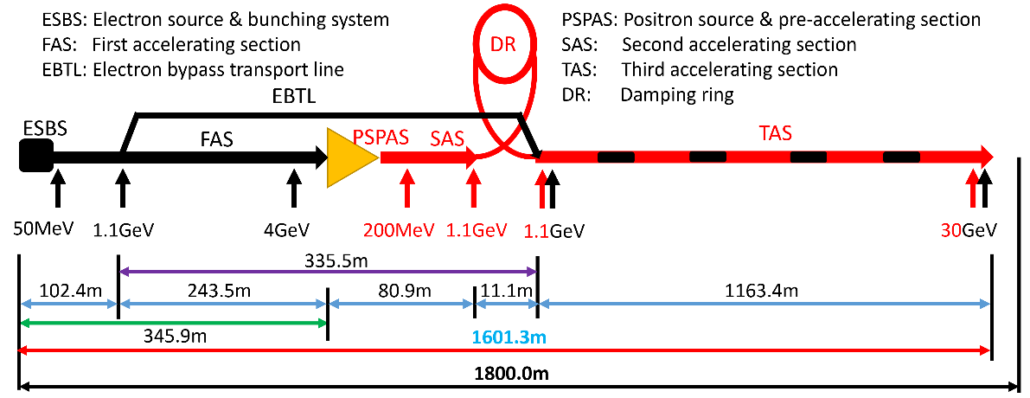
Design consideration for Linac RF sources
The main high power RF sources components are 33 units of 80MW S-band klystron, 236 units of 50MW C-band klystron and related modulators.
Type | QTY | Freq.(MHz) | Structure type
S-band klystron | 33 | 2860 | 1 1-to-1，standard-bunch 3 1-to-2，standard acc. structure. 8 1-to-2，large aperture acc. structure 21 1-to-4, standard acc. structure.
C-band klystron | 236 | 5720 | 1-to-2，standard acc. structure.

Slide 11
Design consideration for Linac RF sources
Requirement list:
S band klystron | 33 | 2860MHz/80MW
Modulator of S band klystron | 33 | 400kV/500A
C band klystron | 236 | 5720MHz/50MW
Modulator of C band klystron | 236 | 350kV/400A

Slide 12
Design consideration for Linac RF sources
Requirement list:
S band klystron | 33 | 2860MHz/80MW | Mature product
Modulator of S band klystron | 33 | 400kV/500A | Mature product
C band klystron | 236 | 5720MHz/50MW | Mature product
Modulator of C band klystron | 236 | 350kV/400A | Mature product

Slide 13
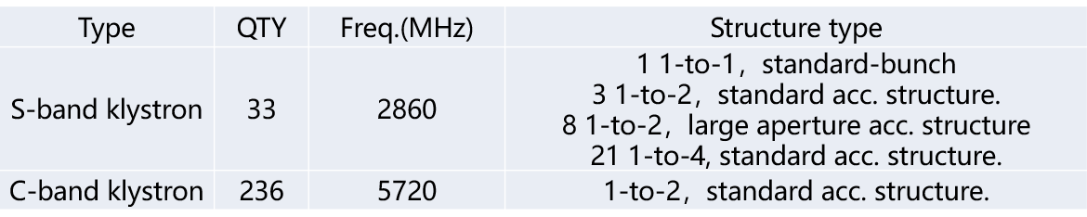
Design consideration for Linac RF sources
Why we develop C band 80MW klystron?
  Only C band of 50MW klystron is mature product in the world.
  1 klystron only power to 2 accelerator structures (CEPC Linac baseline).
  QTY of C band klystron is very large (236 set).
IF output power of C band klystron is up to 80MW, the quantity of klystron will be reduced by half. (1 klystron power to 4 accelerator structures).
CEPC Linac baseline

Slide 14
R&D Status

Slide 15
650MHz klystron R&D strategy and plan
3 or more klystron prototypes for klystron efficiency improvement
2016 | 2017 | 2018 | 2019 | 2020 | 2021
2022
2023
2024
Prototypes
Step1
1st
Step2
2nd
Step3
3rd
more
Efficiency: 60%
70%
80%

Slide 16
Design scheme
Scheme 1: Traditional way for >60% efficiency
Scheme 2: With high voltage gun (110 kV/9.1 A), low perveance (HE, >75%)
Scheme 3: MBK, 54 kV/20A electron gun (8 beams) (HE, >80%)
Parameter | Scheme1(1st prototype) | Scheme2(2nd) | Scheme3(3rd)
Freq. (MHz) | 650 | 650 | 650
Voltage (kV) | 82 | 110 | 54
Current (A) | 16 | 9.1 | 20(2.5×8)
Beam No. | 1 | 1 | 8
Perveance (µP) | 0.65 | 0.25 | 1.6(0.2×8)
Efficiency (%) | 65 | ~80 | >80
Power(kW) | 800 | 800 | 800(100×8)

Slide 17
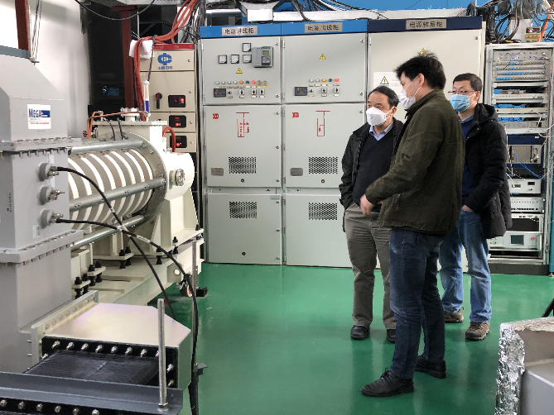
1st prototype milestone
Oct. 2017 Design report
Mar. 2020 High power test at IHEP
Parameters | Design | Test
Operating frequency (MHz) | 650 | 650
Beam Voltage (kV) | 81.5 | 80
Beam Perveance (μA/V^{3/2}) | 0.65 | 0.7
Efficiency(%) | 65 | 62
Saturation Gain(dB) | ≥45 | 47
Output power(kW) | 800 | 800
1 dB Bandwidth(MHz) | ≥1 | 1.8

Slide 18
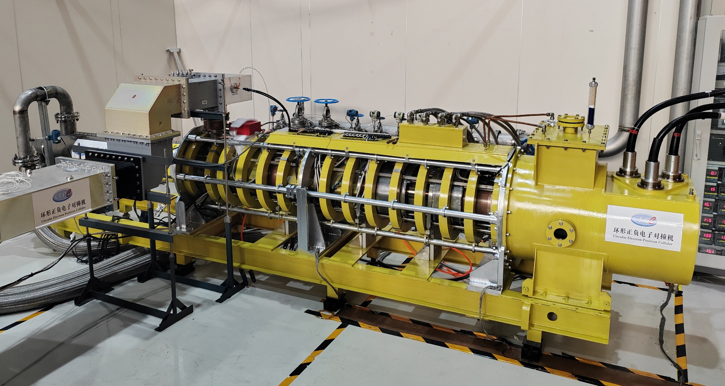
2nd prototype (HE design) milestone
Jan., 2021: Klystron manufacture started
Jul., 2022: CW 630kW with Eff. 70.5% (1st stage high power test)
Aug., 2024: CW 803kW with Eff. 78.5% (2nd stage high power test)

Slide 19
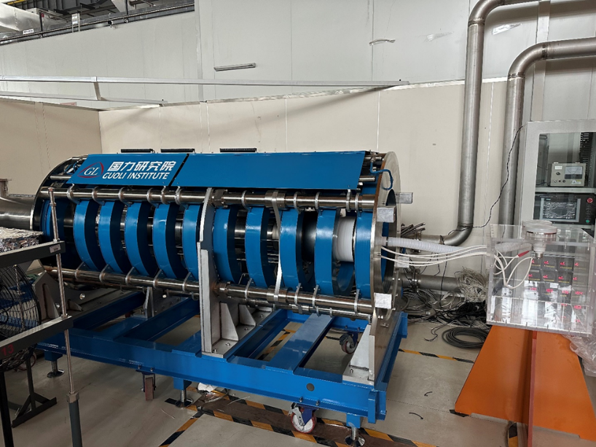
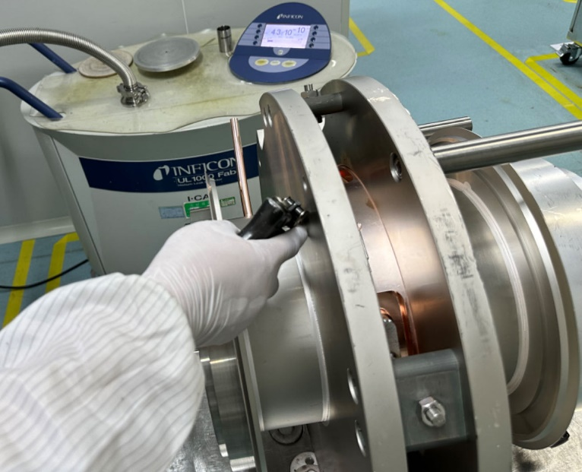
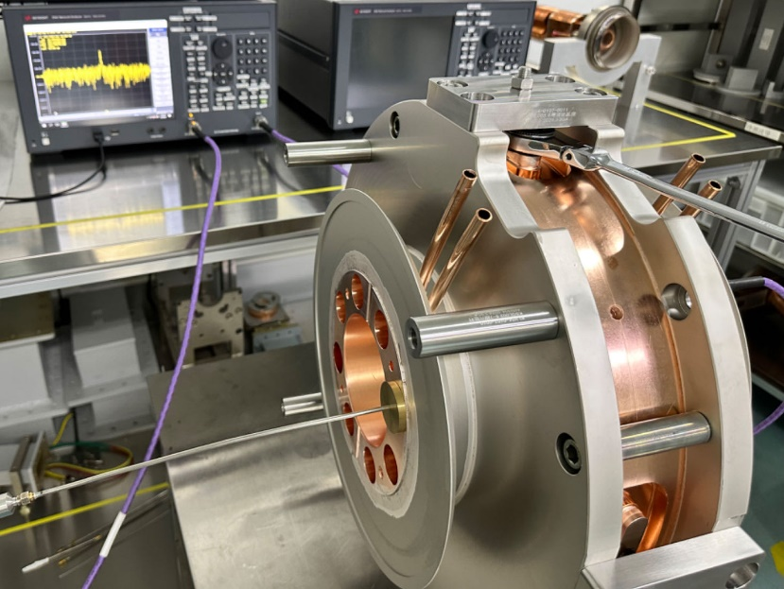
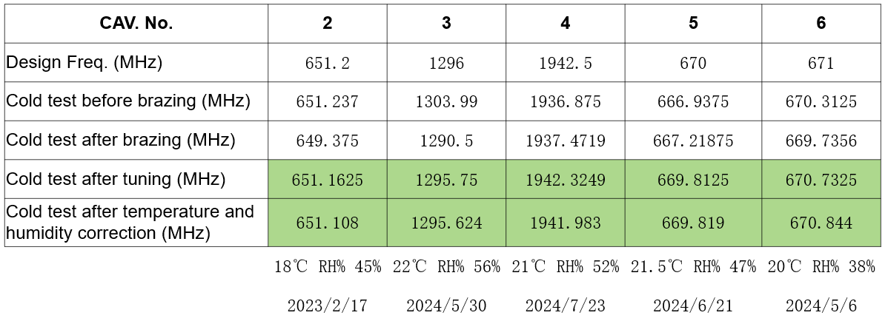
3rd prototype (Multi-beam design) milestone
Dec., 2021: Klystron beam tester manufacture started
Oct., 2023: Accomplishment of klystron beam tester high voltage conditioning and beam emission.
Sep. 2024: Klystron manufacture is in progress.
Dec. 2024: Klystron will be delivered to IHEP and started to high power test.

Slide 20
5720MHz klystron design

Slide 21
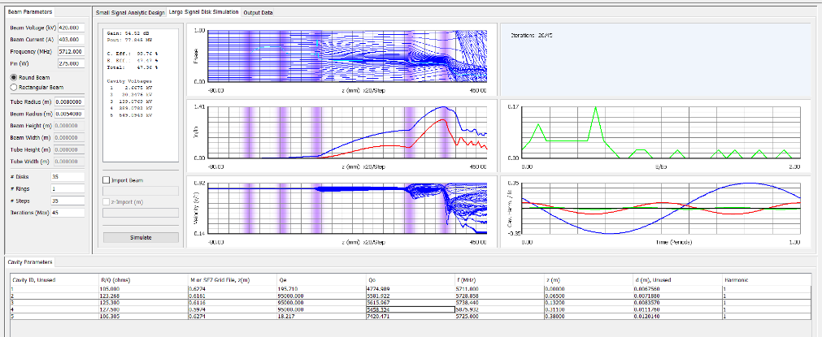
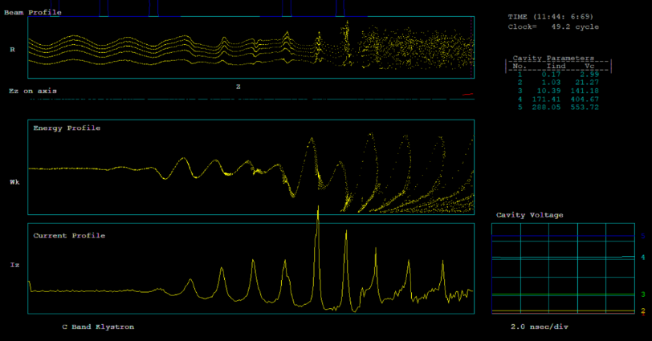
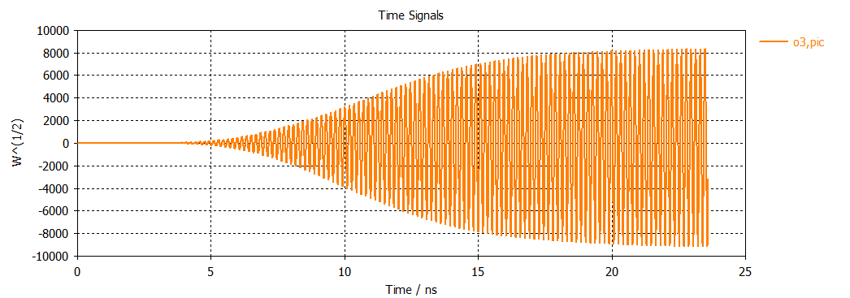
Design progress
Beam dynamics
Main parameters
Parameters | Value
Frequency | 5720 MHz
Output Power | 80MW
Pulsed width | 3us
Repetition rate | 100Hz
Gain | 54 dB
Efficiency | 47%
Beam voltage | 420 kV
Beam current | 403 A

Slide 22
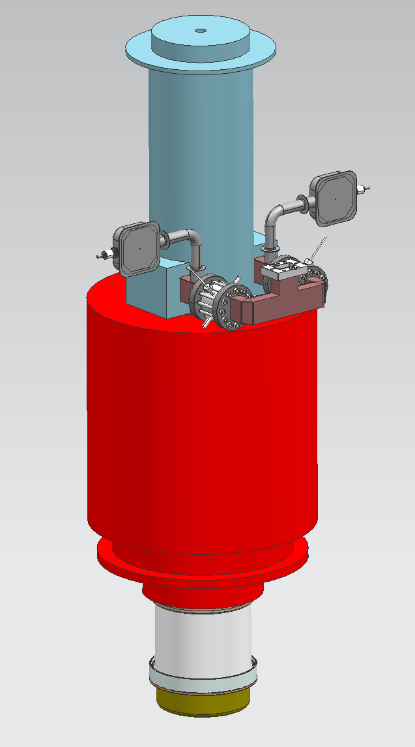
Fabrication progress
Mechanical and process design review @Aug.12
  The design scheme is feasible, meet the technical, and has the conditions for production implementation.
  C-band 80MW klystron enter the production stage.

Slide 23
Energy recovery klystron

Slide 24
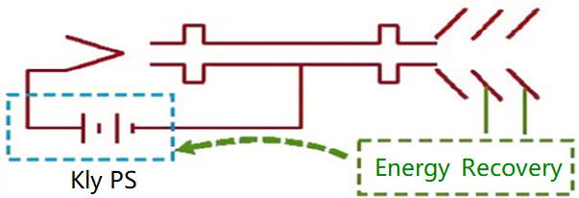
Energy recovery klystron(ERK)
If 60MW SR power (e+&e-) of CEPC, RF power demands 109.5MW, waster power is still about 49.5MW. (Klystron efficiency~65% @linear region and ~80%@saturate region).
The energy recovery klystron recovers energy from the spent electron beam by multi-depressed collector, thereby reducing the power demand from the grid and significantly lowering operation.
RF OUT
Typical klystron
Energy recovery klystron

Slide 25
Roughly theoretical analysis
Based on klystron efficiency at linear region-----65%
Final efficiency is the whole efficiency of RF power source system
ERK with single beam klystron
Stage No. | Final Eff. | Stage Voltage
Single stage | 72.92% | 17.3kV
Two stages | 79.38% | 17.2kV 113kV
Three stages | 82.95% | 16.7kV 33.9kV 113kV
ERK with MBK
Stage No. | Final Eff. | Stage Voltage
Single stage | 75.16% | 29.5kV
Two stages | 81.46% | 17.7kV 54kV
Three stages | 86.10% | 6.8kV 24.2kV 54kV

Slide 26
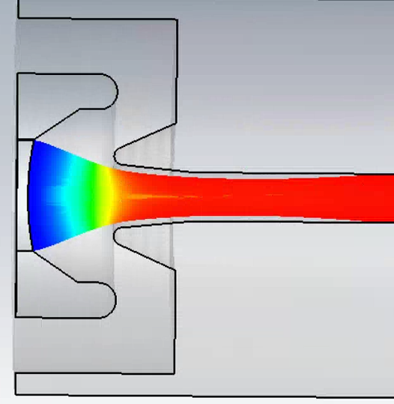
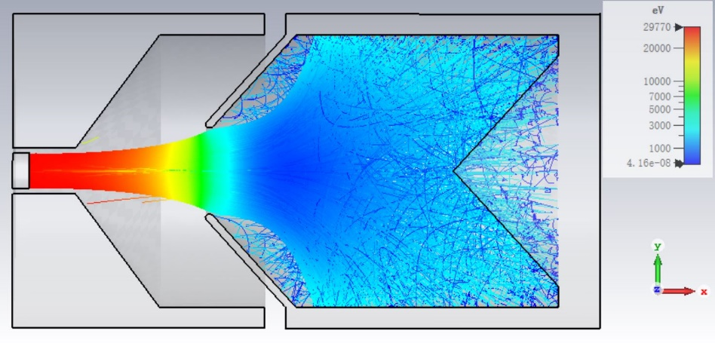
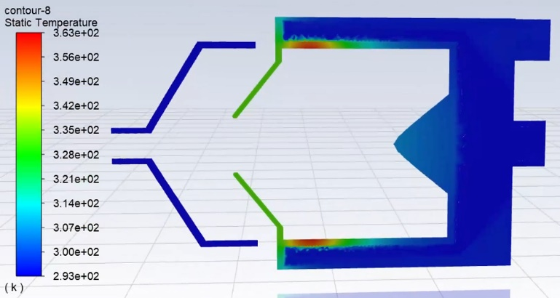
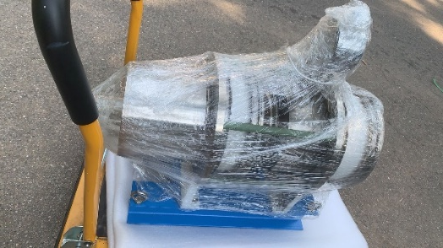
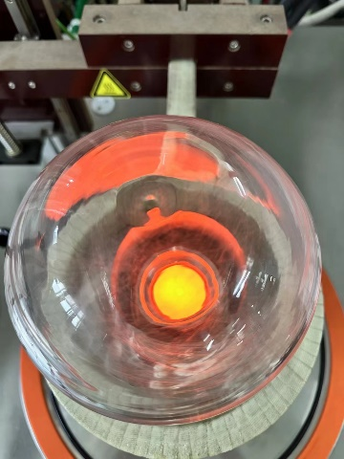
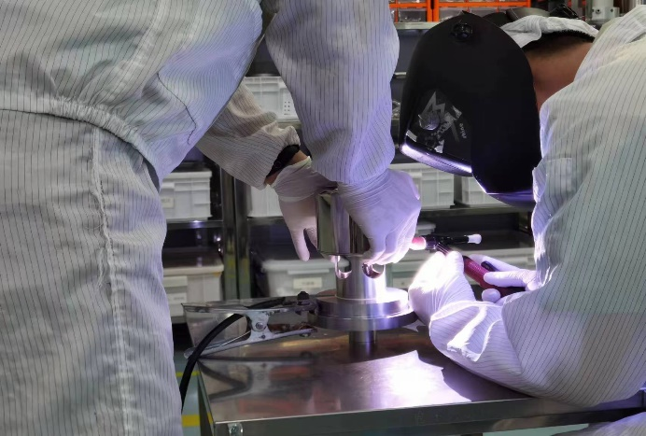
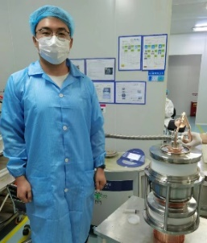
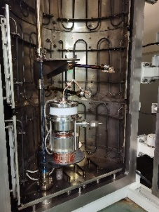
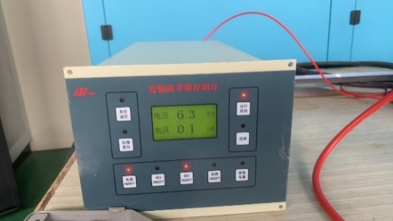
Depressed collector prototype
Milestone:
  Electronic gun design completed in June 2023
  Collector design completed in September 2023
  Cooling system design completed in October 2023
  Prototype ceramic insulation structure design completed in December 2023
  Mechanical mechanism design completed in December 2023
  Machining started in March 2024
  Overall assembly and exhaust completed in June 2024
  Arrived at IHEP on July 3, 2024
Verify the prototype electron gun
Collector beam optics
Thermal analysis of the water cooling system
Welding of the cathode and focusing electrode of the electron gun
Degassing furnace evacuation
Unboxing inspection upon arrival of the prototype
Vacuum condition of the prototype upon arrival
Cathode activation

Slide 27
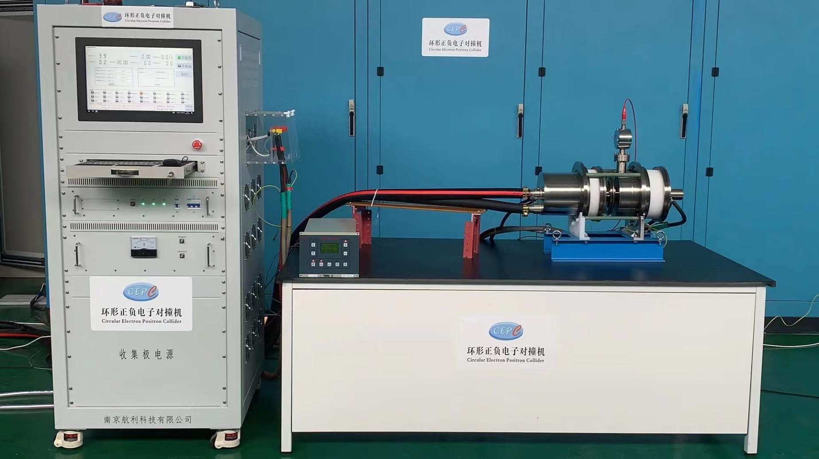
Depressed collector prototype
Test stand preparation:
  Completed cold high-pressure conditioning, vacuum normal
  Test platform setup completed (interlocking control for water, electricity, flow, temperature, ion current, etc.)
  Cathode filament power supply completed
  High-voltage testing in progress

Slide 28
PPM klystron

Slide 29
PPM advantage
Small volume, light weight, and does not require water cooling and power supply.
It saves the power consumption and cost of power supply, and on the other hand, it avoids the risk of power supply failure and water leakage.
 | E37212 | E37302A
Frequency(MHz) | 5712 | 2998
Output Power (MW) | 51 | 47
Beam Power (MW) | 118.3 | 123.5
Average Power (kW) | 35.5 | 24.7
Solenoid Power (kW) | 8.4 | 3.4
RF efficiency (%) | 43.1 | 38
Overall efficiency(%) | 34.9 | 33.5

Slide 30
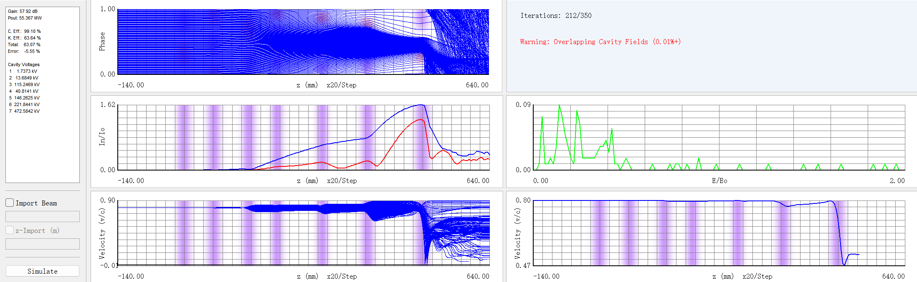
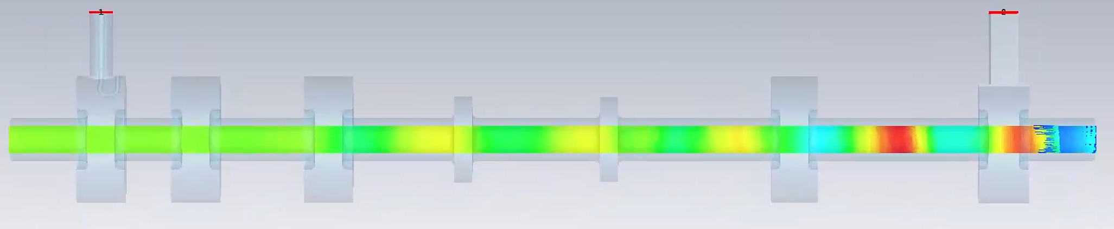
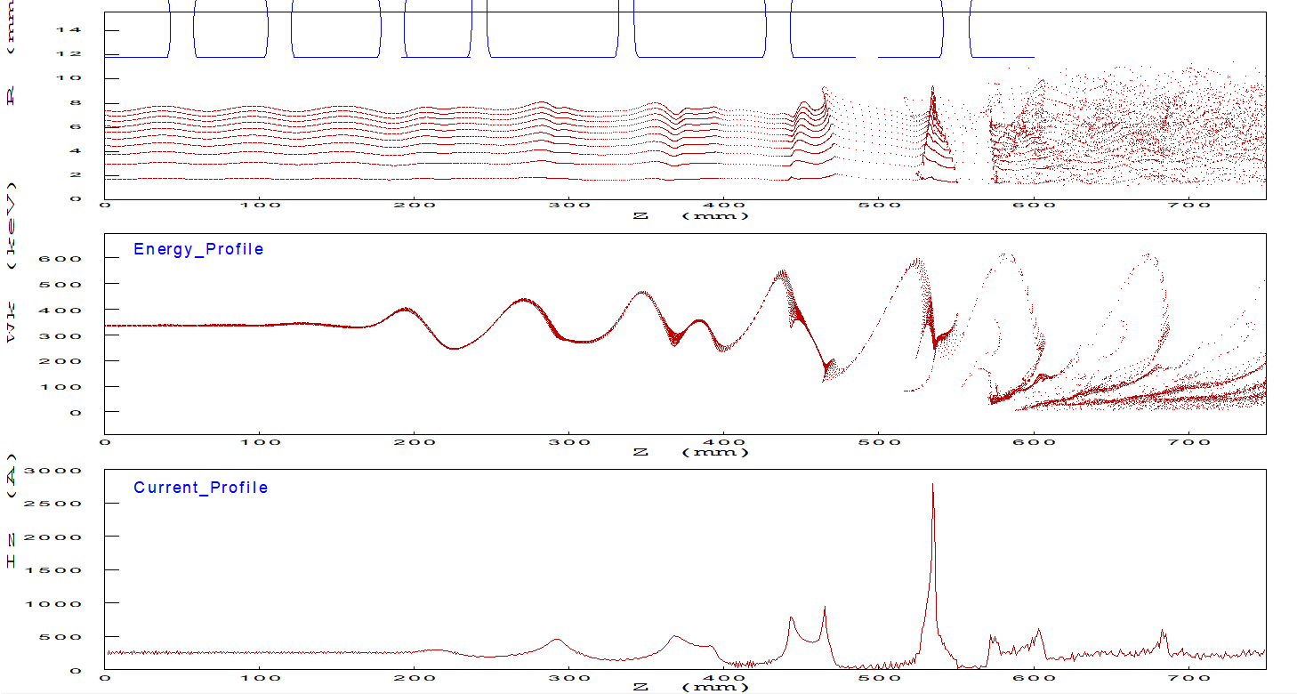
PPM klystron
On the basis of the S band klystron with high efficiency design, the electromagnetic focusing is being changed to PPM focusing structure.
Parameters | Value
Freq. (MHz) | 2856
Output power (MW) | ≥50
Eff. (%) | ≥55
Focusing structure | PPM

Slide 31
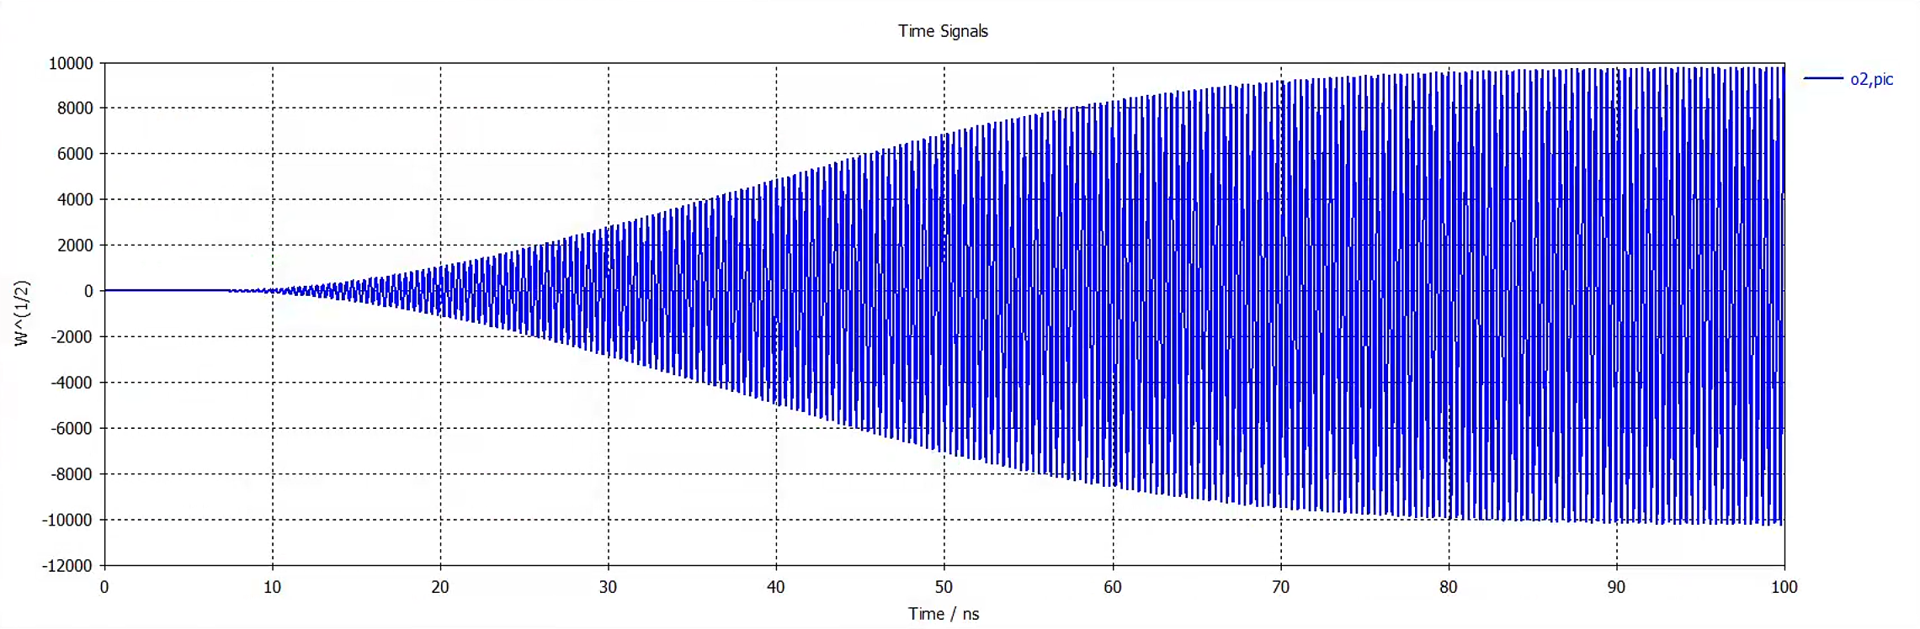
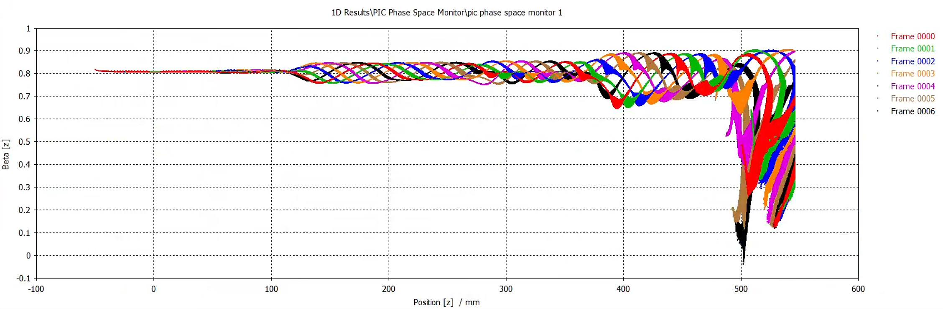
Design status
Simulation results
 | Output Power (MW) | Eff. (%)
Ajdisk | 55.4 | 63
EMSYS | 51.4 | 59
CST | 50.1 | 55

Slide 32
Klystron energy dissipation protection

Slide 33
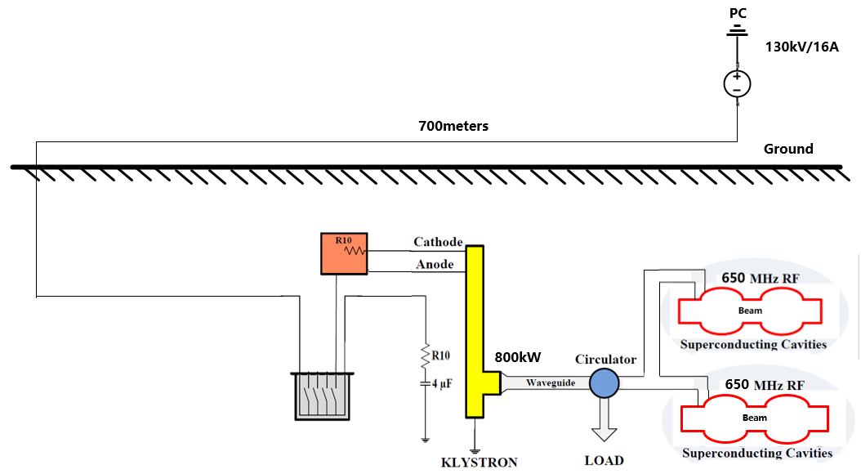
Klystron energy dissipation protection
CEPC Klystron is on the auxiliary tunnel and high voltage power supply is on the ground. The distance is about 700m.
  Klystron energy dissipation protection
  Voltage level: 130kV
  Protection time: ≦5us
Cable length | 12.5m | 50m | 80m | 100m | 200m | 300m | 600m | 1000m
Storage energy | 9.6J | 38J | 61J | 76J | 153J | 230J | 460J | 766J
Klystron layout at TDR

Slide 34
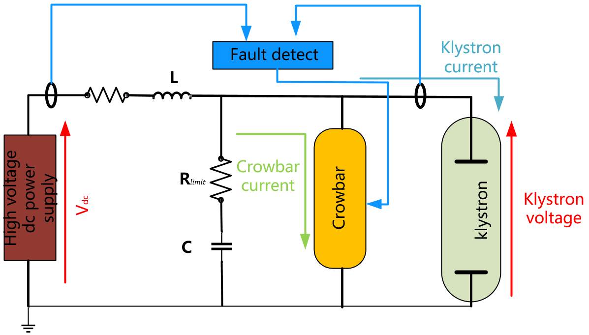
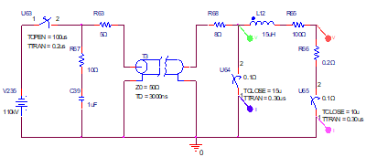
Design consideration
Connect crowbar in parallel at one end of the klystron to bypass and discharge the energy.
Complete the energy analysis of the distributed capacitance discharge of long-distance cables.
Complete system modeling and system simulation, energy calculation and verification method design.
Complete the design review and conduct experimental verification.
Schematic diagram of protection system
System modeling and simulation

Slide 35
Resonant ring

Slide 36
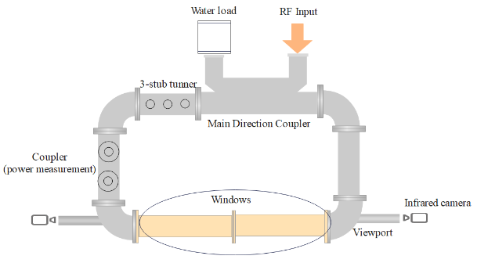
P band resonant ring
Development of 1.2 MW P-band Travelling Wave Resonant Ring (TWRR), This TWRR is capable of testing at 1.5 times the rated power of an 800kW klystron, significantly reducing the risk of the window broken during operation and also for cavities coupler.
TWRR layout

Slide 37
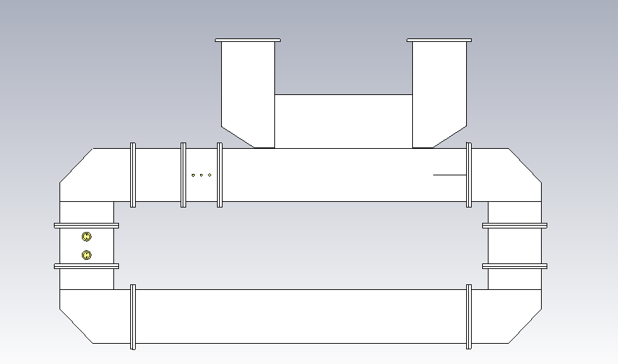
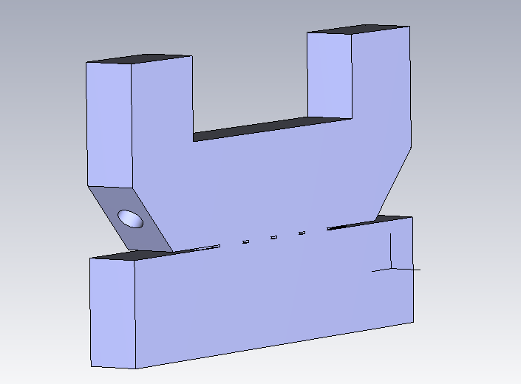
Design progress of TWRR
The length of TWRR is 9.8m with an available design of 10dB directional coupler. Power gain is about 25 times.
Port2(load)
Port1(RF input)
10dB DC
Port3
Port4
input RF wave
Fwd. RF wave
Model of P-band Travelling Wave Resonant Ring
Model of Main direction coupler

Slide 38
RF power source for SC cavity horizontal test

Slide 39
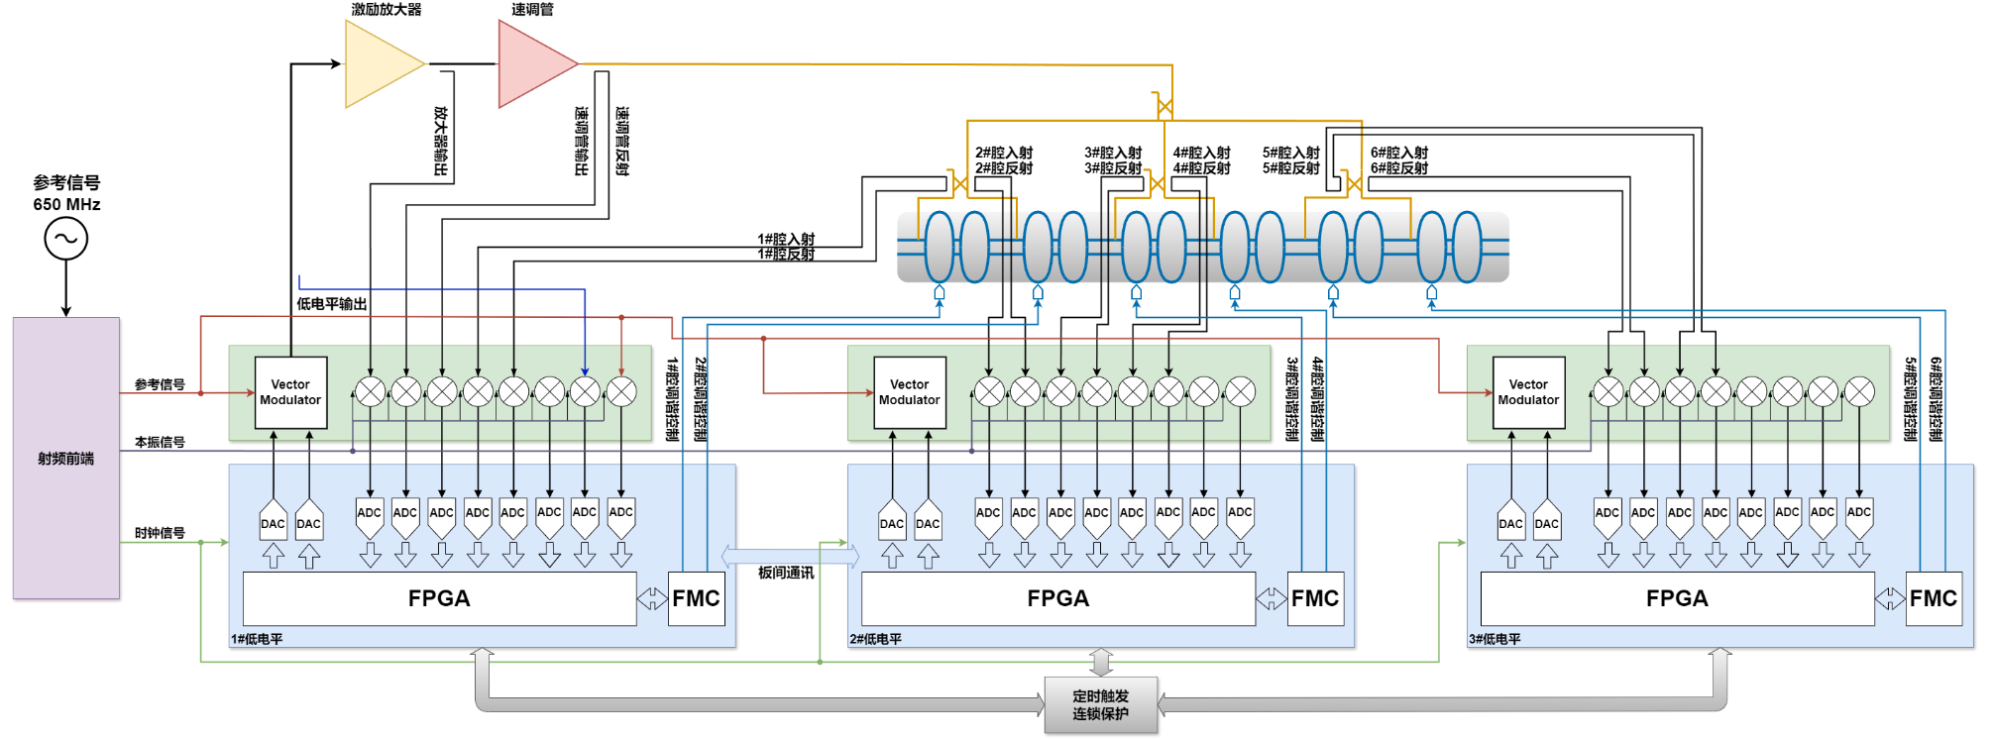
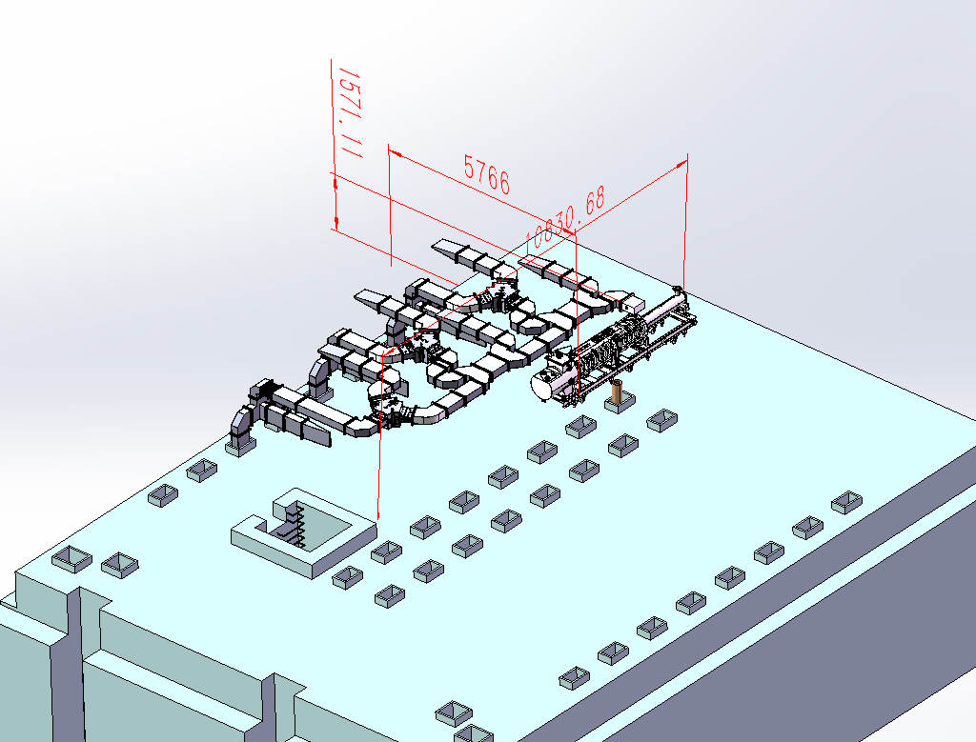
LLRF system and power distribution
Design consideration：
  The LLRF system is designed for a 650 MHz 2-cell superconducting cavity with 6 cavities driven by a single klystron power source.
  The system is based on a MicroTCA platform and includes three control boards.
  A vector-sum-based multi-cavity control algorithm is used to achieve synchronous control of the amplitude, phase, and frequency of the six cavities.

Slide 40
Key milestones from 2024-2027
Proposal preparation of RF power source for China’s 15th five year plan.(2025)
Mass production preparation for high efficiency klystron.(2024-2025)
  P band klystron and C band klystron
LLRF, klystron protection system and power distribution system will be implemented for horizontal test of superconducting cavity.(2024-2025)
Development of energy recovery klystron and PPM klystron is for exploration of a much higher efficiency klystron.(2024-2027)

Slide 41
Conclusion
The high power test of high-efficiency klystron prototype has been successfully completed, achieving a continuous wave (CW) output of 803 kW and an efficiency of 78.5%.
Mass production preparations are underway for high efficiency klystron and high power klystron.
Processing and high-power test of the MBK will be conducted this year.
Development of an energy recovery klystron based on both MBK and single-beam klystron technologies is progressing.
Efforts are also being made in the development of P-band and C-band resonant rings.
An auxiliary system for the horizontal test of superconducting cavities will encompass LLRF, klystron energy dissipation protection, power distribution and transmission systems.

Slide 42
Thanks for your attention!

