Slide 1

Ultimate efficiency in linear beam devices.
Electro-vacuum technologies for FCC_{ee}
I. Syratchev, CERN

Slide 2
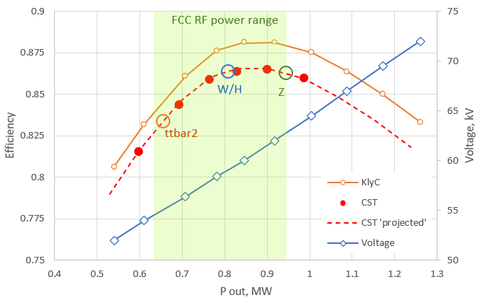
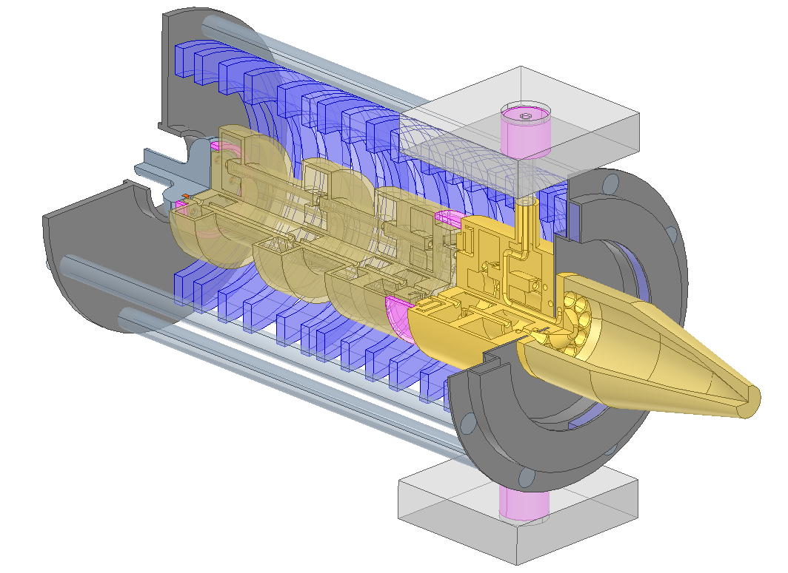
Novel 400 MHz, 1MW HE Two-Stages MBK for FCC_{ee}. Performance summary.
Efficiency vs. saturated RF power at different klystron voltages
Featured:
Very efficient. 86% @ Z,W,H and 83% @ ttbar2.
Compact. Total length <3m.
Low Voltage. Up to 64kV @ 1 MW.
High RF power gain. 43dB @ 1MW.
Broadband. 3.5 MHz @ -1dB.
Robust. Can handle mismatch up to -15dB.
For FCC_{ee}, such an efficiency improvement from conventional 65% to 85% will allow to save 38MW of the grid electric power. That is compatible to the electric power needed for the entire FCC_{ee} cryogenic system (40MW).

Slide 3
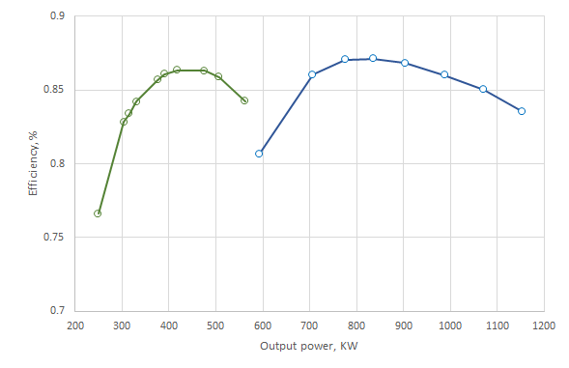
The new layout with one unique two-gaps cavity for Z,W,H poles, opens options of using one power source per single, or two cavities. Performance of the TS klystron is now optimized for both options with almost identical efficiency.
1 tube x 2 cavities
With reduced power per klystron:
Reduced by ~50% collector volume.
Improved beam extraction quality into collector.
Reduced by 10% RF circuit length.
Reduced from 62kV to 47 kV operating voltage.
Reduced power in solenoid
Improved x2 life- time.
Single RF output.
With chosen technology, cost saving will be rather modest – no more than 20% when moving from 1MW tube to 0.5MW tube.
Will need x2 more klystrons.
1 tube x 1 cavities
Bars show P/cavity + 15% power margin

Slide 4
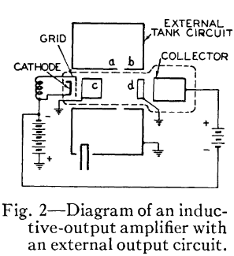
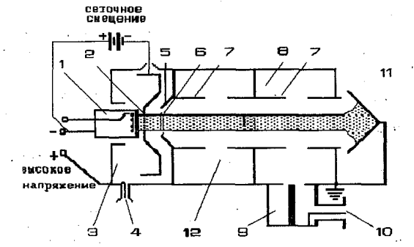
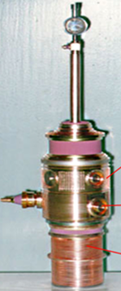
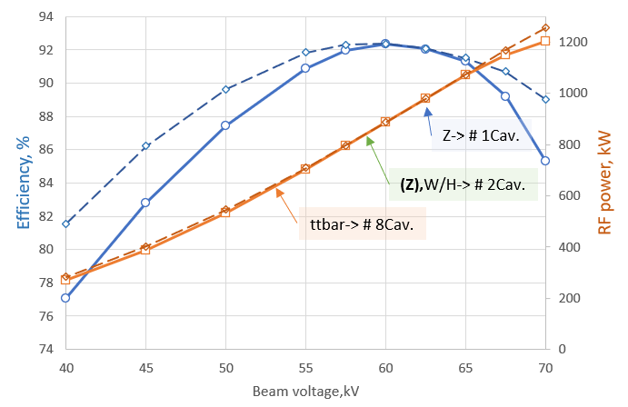
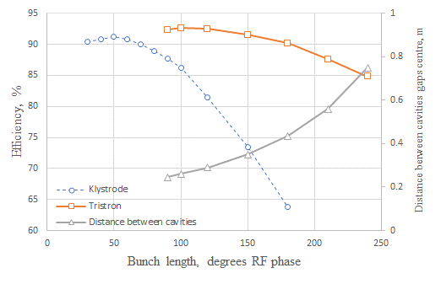
High Power Gridded Tubes
Tristron (A.D. Sushkov et. al. 1967)
MB Prototype tested in 1997, V. Tsarev:
1 MW, MB Tristron power-efficiency capabilities
IOT (A. Haeff, 1939)
Klystrode
(H. Priest and M.B. Shrader 1982)
FCC_{ee} 1MW, 400 MHz 10 beams gridded tubes performance (KlyC simulations)
Rectangular bunch shape
Injection: 10 x 120 degrees RF phase bunches (C Class)
CERN, 2024
"Il n'y a de nouveau que ce qui est oublié« . Marie Antoinette (1785)

Slide 5
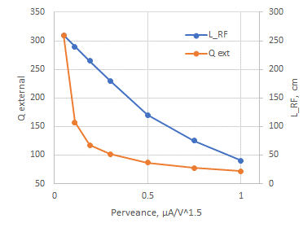
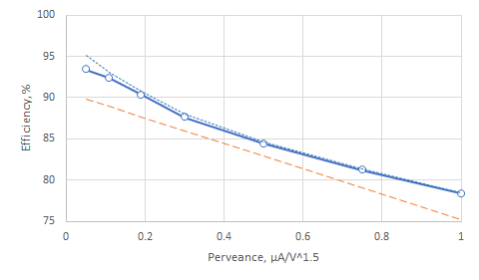
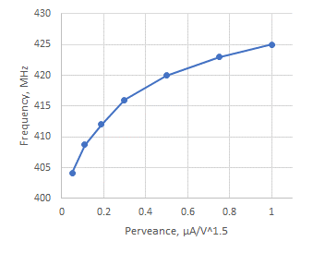
Tristron efficiency vs. beam perveance
Optimized for bunch length of 120 degrees RF phase and fixed beam power (960 KW)
0.906-0.15xμP
Penultimate cavity tuning
Overall, tristron demonstrated excellent performance in terms of the ultimate efficiency in a wide range of operating perveance.

Slide 6
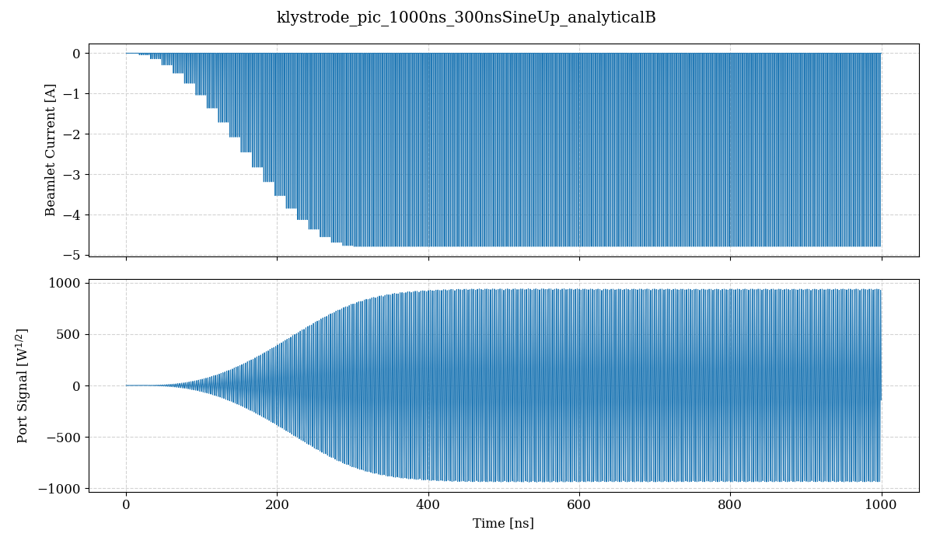
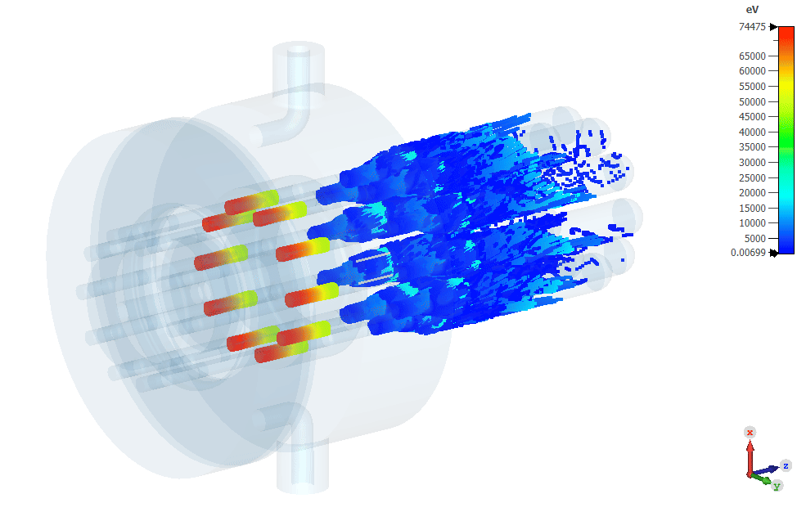
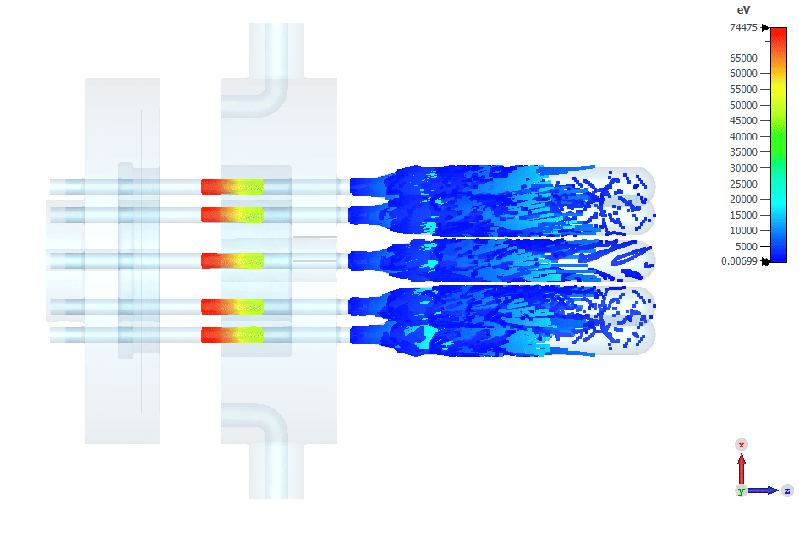
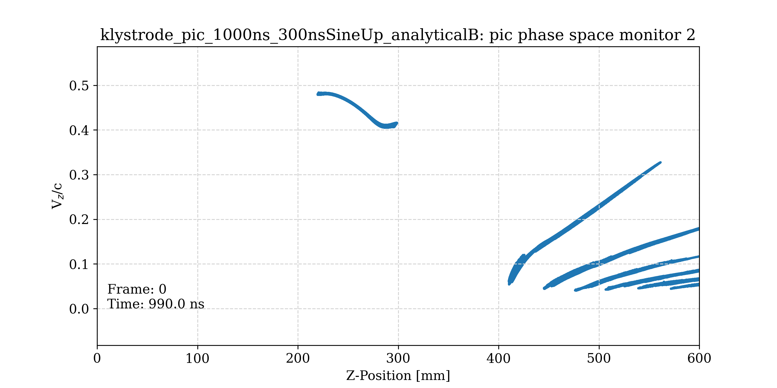
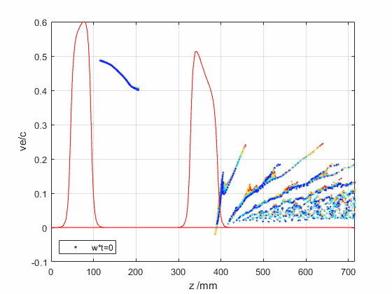
10 beams (1.6A, 60kV each)
Bz: 0.032T
Beam power 960kW
RF power: 880kW
Efficiency: 91.4%
Tristron 3D CST PIC simulations.
Direct benchmarking with CERN made fast 1.5D computer code KlyC
Bunched beam current (4.8A peak; 1.6A average)
120 degrees RF phase long bunches (C class)
X10 individual collectors, each 30 cm long.
Single output port RF signal (440kW)
Penultimate cavity
Output cavity
Bunches velocity modulation
91.4%
92.4%
CST
KlyC
L _{total} = 0.6m

Slide 7
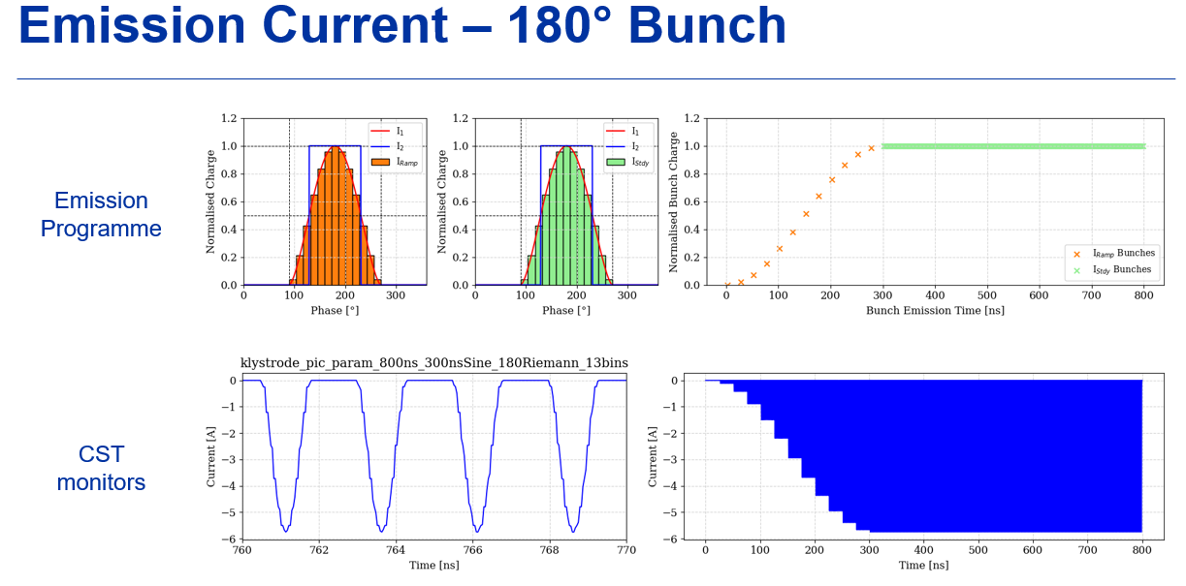

Realistic bunches in gridded tubes

Slide 8
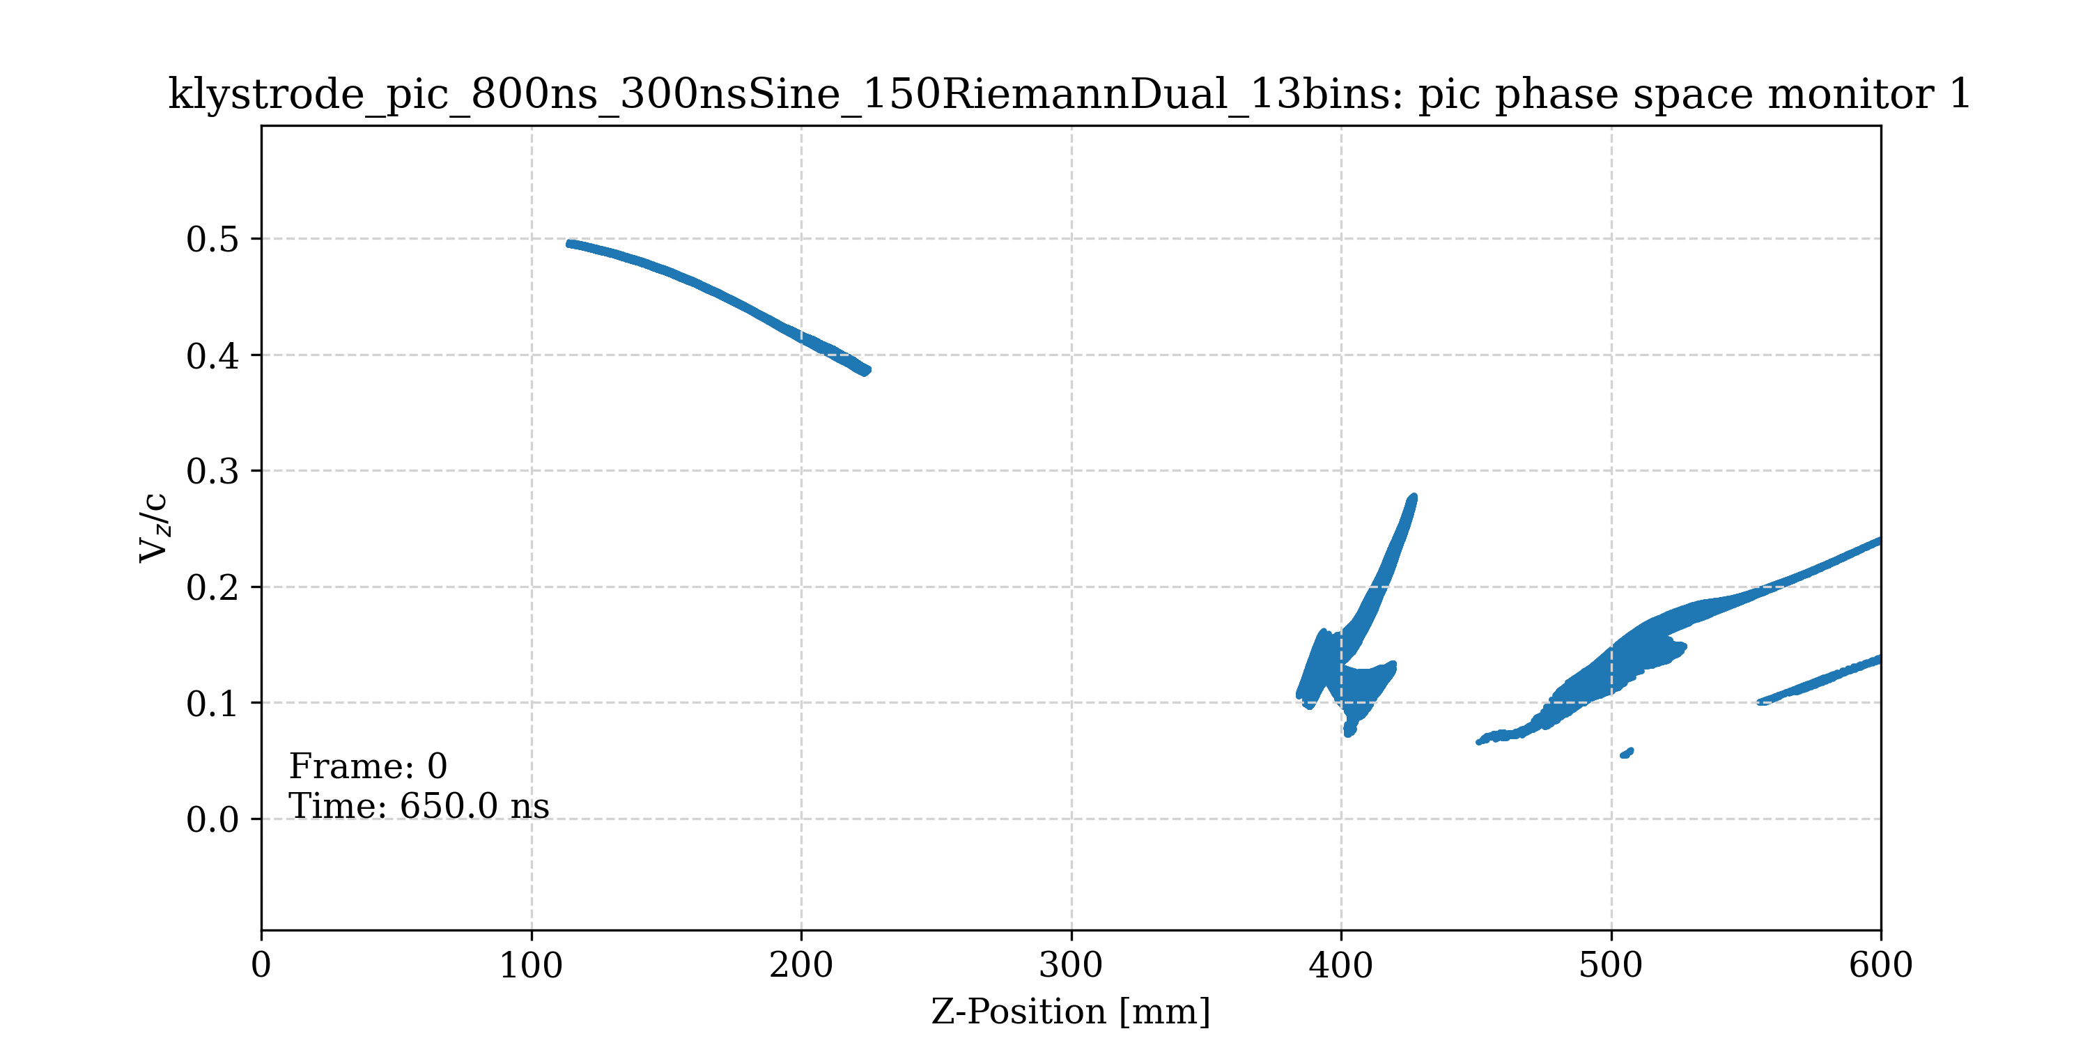
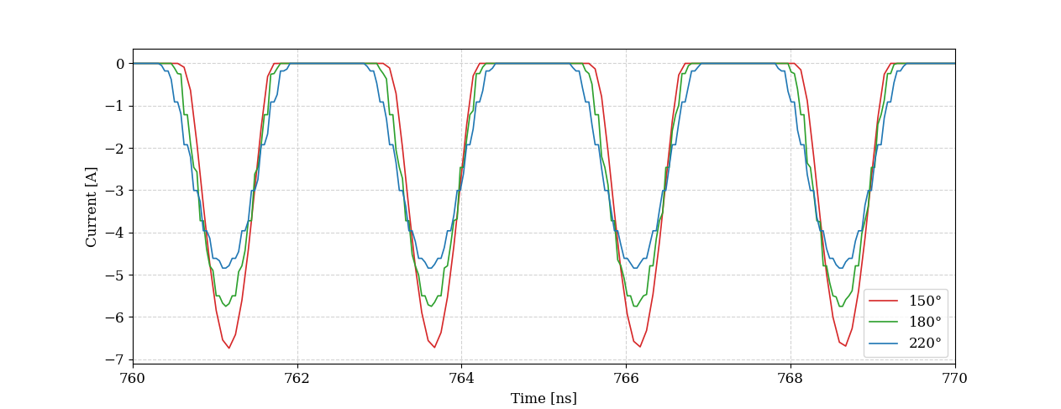
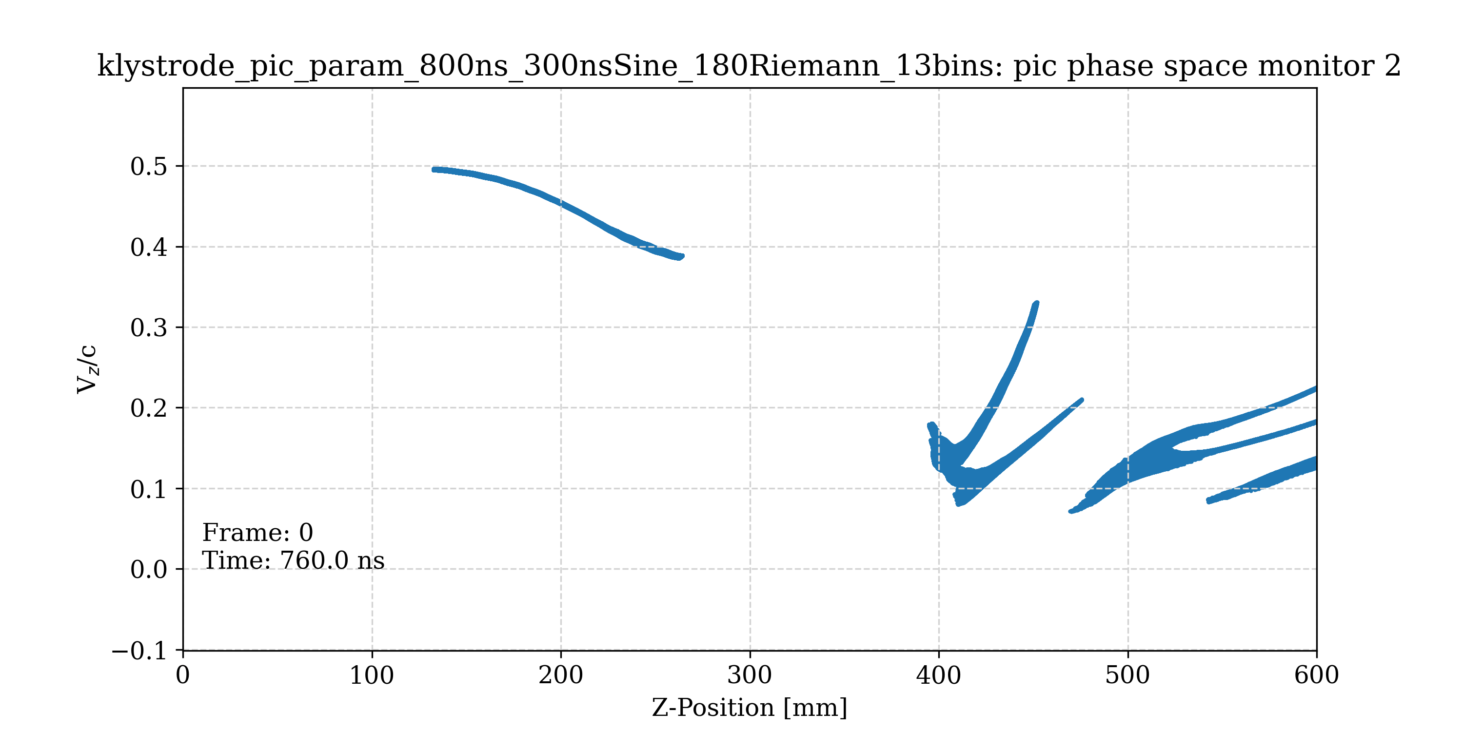
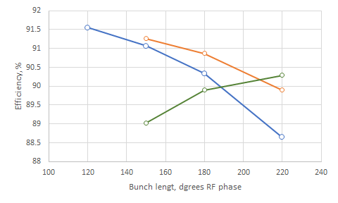
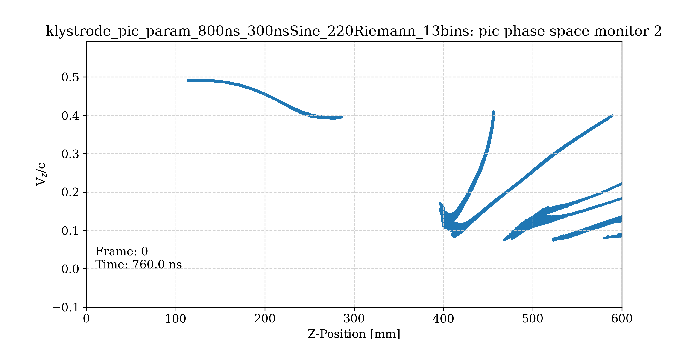
Realistic bunches in gridded tubes
Particles velocity modulation (L_{RF}=0.29m)
Average current 1.6A/beam
150⁰
180⁰
1MW, MB Triston efficiency (measured at RF port)
Distance between the cavities (L_{RF}) and penultimate cavity tunings were taken from the ones optimized in KlyC for rectangular bunch shape (see page 4). The is some space left for post-optimization
0.435m
220⁰
0.35m
L_{RF}=0.29m
C
B
AB

Slide 9
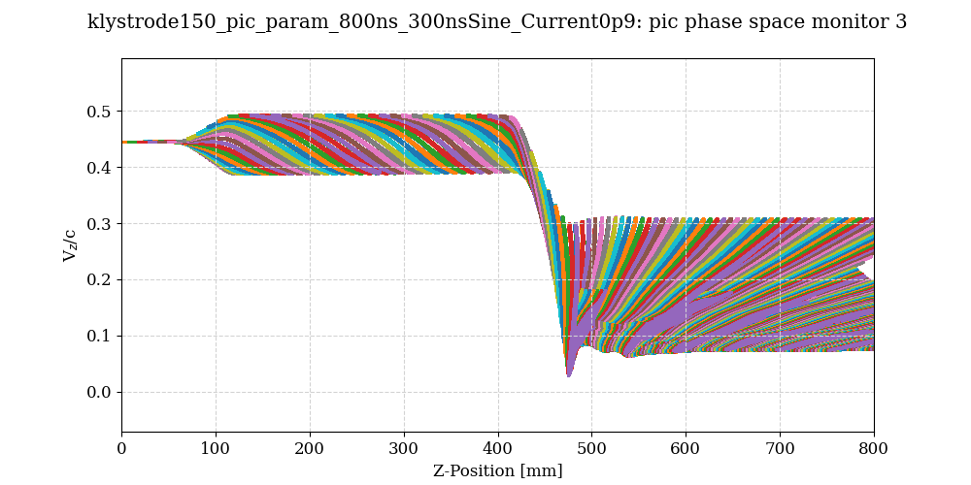
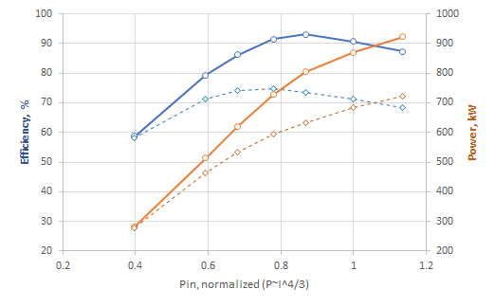
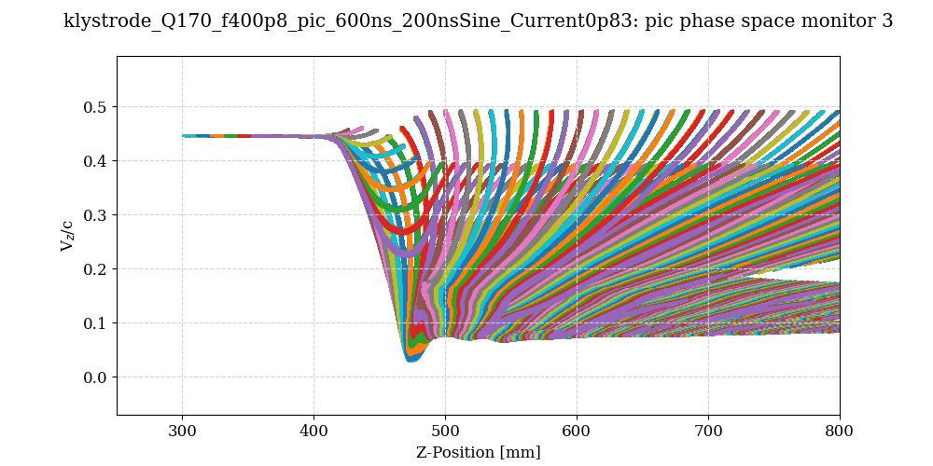
MB tristron vs. IOT power gain curves
B class (180 degrees bunches)
V beam=60kV
tristron
tristron
IOT
η_{max}=93%, 803kW (1.44A/beam)
IOT
η_{max}=74.6%, 600kW (1.33A/beam)

Slide 10
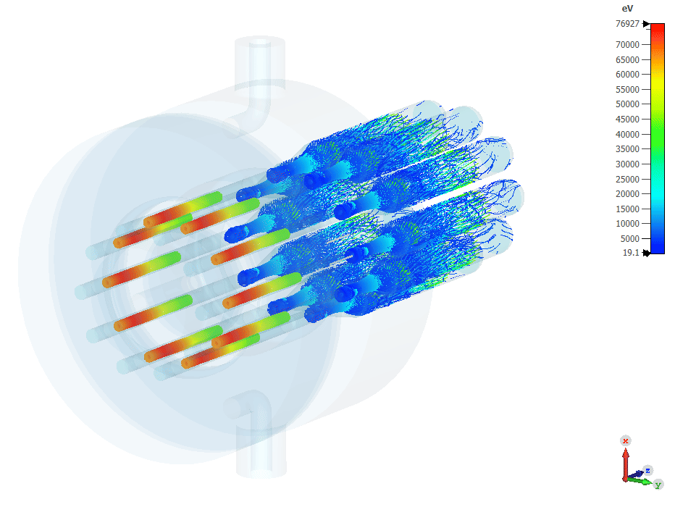
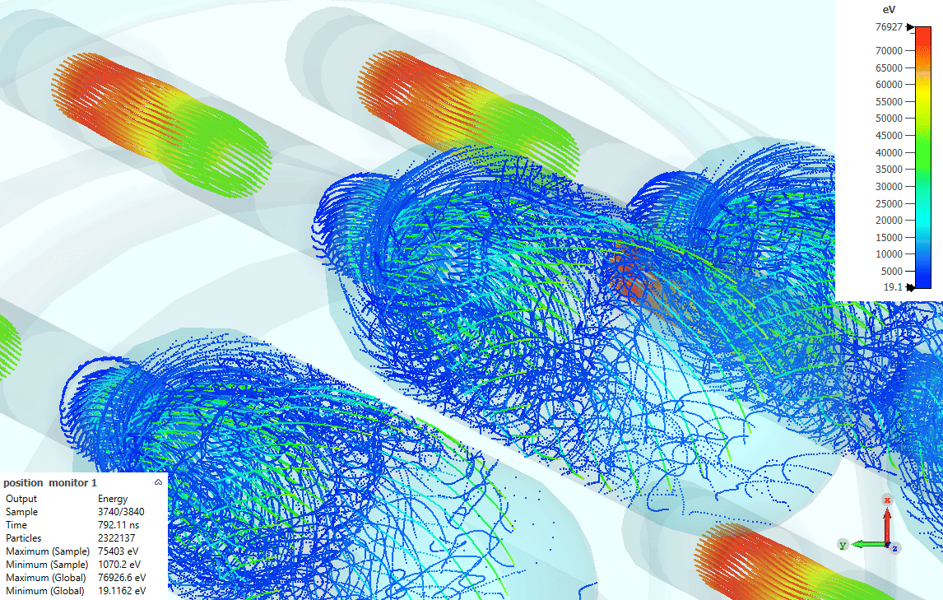
More particles animations (AB Class)

Slide 11
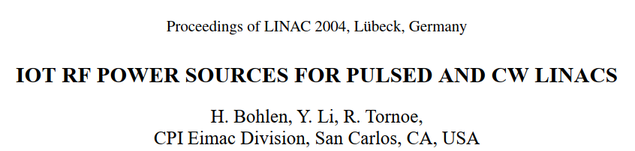
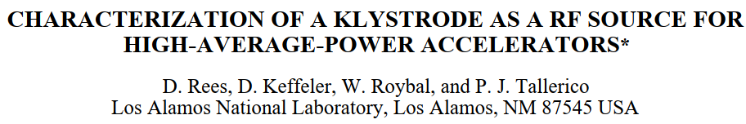
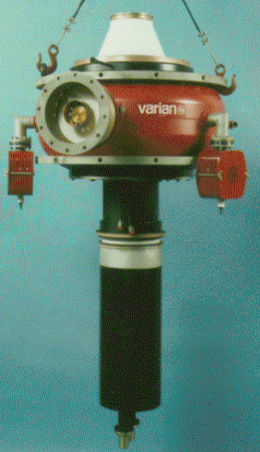
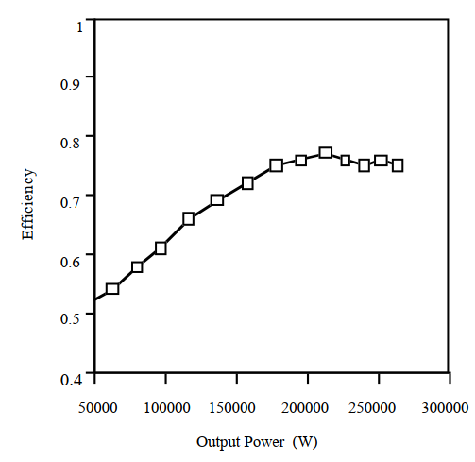
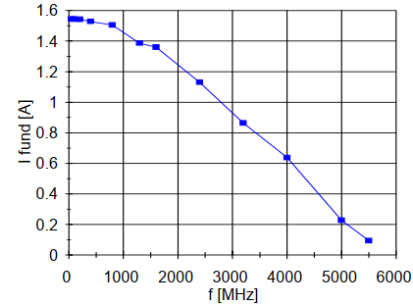
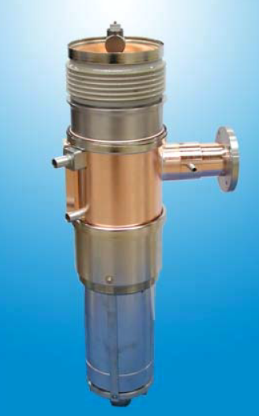
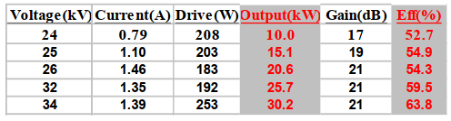
RF power limit in CW UHF/L-band gridded tubes
B Class
22 kV
“…We have approximately 664 high-voltage hours on the 250-kW CW klystrode at Los Alamos, and we have had to process the grid at least three times to remove material deposited on the grid by the cathode. We are afraid that the cathode is being overheated
by the RF drive power and that the result will be a reduced tube life…”
68kV x 4.9A
P dive=1.4kW
P gain= 22.5dB
250kW, 267 MHz CW “Chalk River” IOT
In the gridded tubes CW RF power level will be limited by:
The average beam current (current interception on the grid - direct heating).
Cathode overheating by the dive power (material deposition on the grid).
More?
In MB tubes, the current and drive power per beam can be controlled/adjusted by beams number. In the FCC_{ee} MB tristron designs:
- 10 beams, 60kV, Pout 880kW; beam current is 1.6 A, P dive/beam = 440W (P gain=23 dB)
- 10 beams, 47kV, Pout 440kW; beam current is 1.0 A, P drive/beam = 220W (P gain=23dB).
Both cases look like a feasible options.
30 kW CW L-Band (1.3GHz) IOT by CPI / Eimac

Slide 12
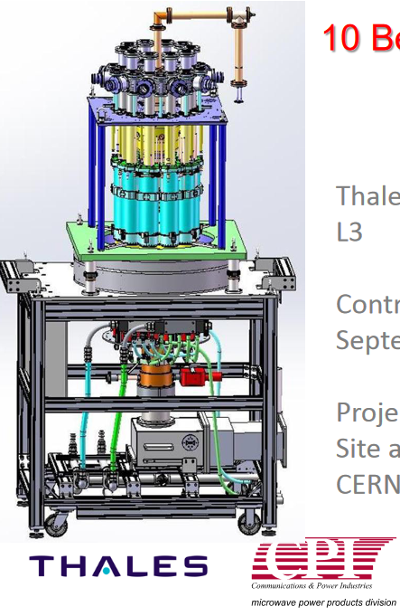
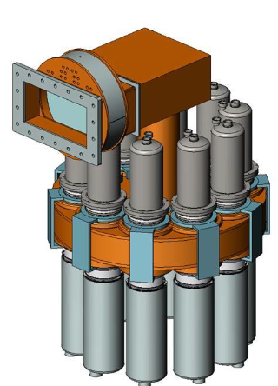
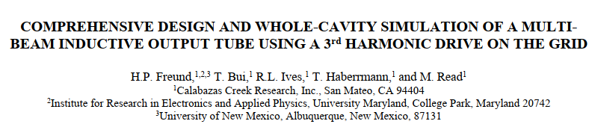
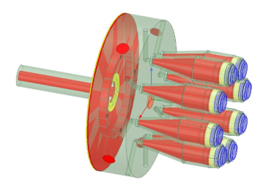

ESS MB IOT prototypes
MB input gridded cavity
From ESS MB IOT experience, input cavity can be rather expensive and complicated if composed of many individual cavities (coupled or not). It will be useful to investigate more compact and reliable solution with a ‘common’ volume (one of the concepts is shown above on the right).

Slide 13
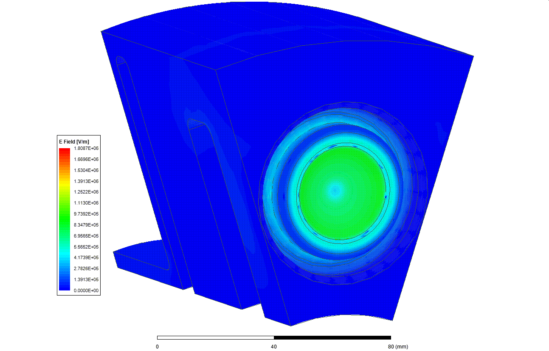
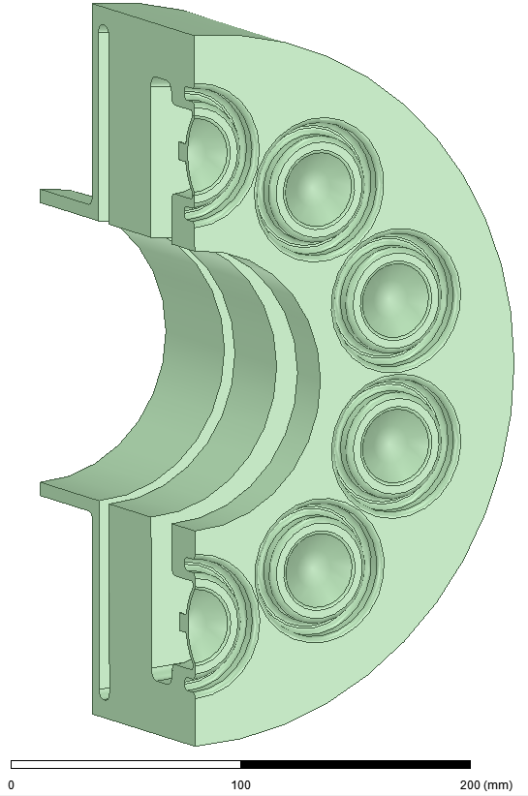
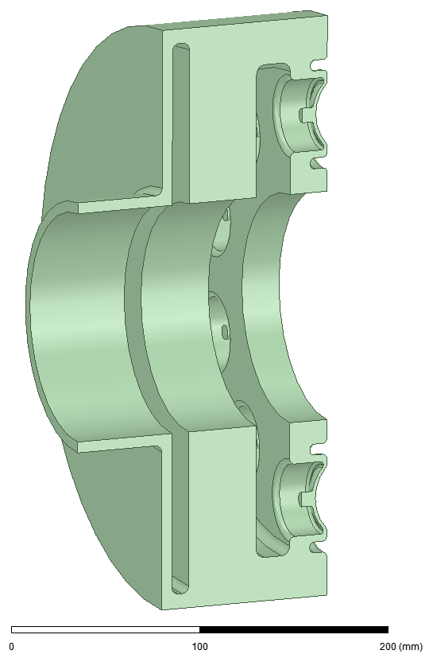
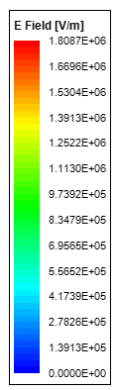
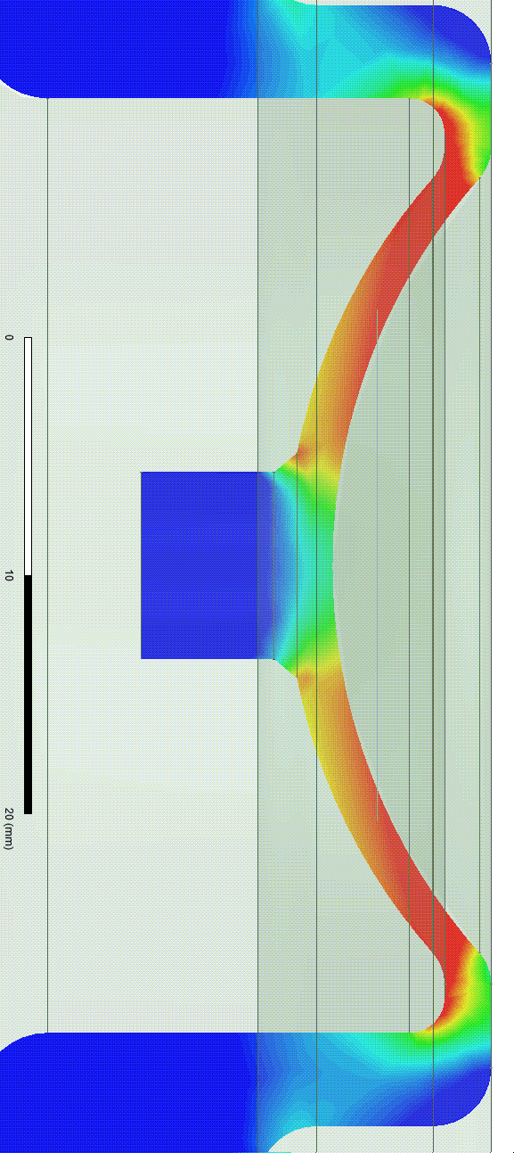
400MHz Double-gap coaxial compact cavity concept (CERN).
grid-cathode distance = 2mm
Pin
Vacuum volume is shown
With P_{RF}=880kW, assuming 23 dB power gain (Pin=4.4kW) and Qext=61.5, average gap field is ~0.7MV/m. With 2mm gap distance, the gap RF voltage is about 1.4 kV.
Q0=3080, Qext=61.5 (Ohmic losses ~2%)

Slide 14
The MB Triston has a remarkable potential as an FCC_{ee} RF power source, both in terms of power handling and attainable efficiency – above 90%.
Compared to its TS MBK counterpart operated in similar conditions, it has numerous advantages:
Very compact (shorter by factor 3) – less then 1m long.
Reduced power in solenoid (factor ~ 10) due to the lower magnetic field and shorter RF circuit
Very compact and simple collector (factor ~6 in volume).
Reduce by factor 10 cooling capacity need (Tristron will never be operated in DC diode mode).
The cost of MB Tristron will be about 0.5 (or less) of those for TS MBK.
Directly scalable to 200 kW, 800MHz.
Tristron development is already planned as a part of the future CERN-Thales collaboration.

