Slide 1
Multiple Beam IOT Development at Calabaza Creek Research, Inc.
R.L. Ives, H.P. Freund, T. Bui, M. Read, T. Habermann
*Work supported by the US DOE under SBIR Award No. DE-SC0019800

Slide 2
INDUCTIVE OUTPUT TUBES
Used as drivers for radio frequency accelerators and (formerly) TV transmitters as well
A prebunched beam generated in a gridded gun and accelerated by a DC potential is injected into the output cavity
The modulated beam is preconditioned to excite the resonant mode of the output cavity

Slide 3
GOAL AND APPROACH
GOAL – To develop a high efficiency IOT with a efficiency greater than 80%
APPROACH
Add 3rd harmonic drive on the grid in the multi-beam gun*
Enhance bunching in the gun(s) to improve efficiency
Use/Modify code NEMESIS to simulate the output cavity
Use innovative input coupler fordrive signals to the grids
Use metal grids to reduce cost and improve durability
* U.S. Patent 10734182: Ultra-high Efficiency Single-Beam and Multi-Beam IOTs (awarded 4 August 2020)

Slide 4
BACKGROUND/ADVANTAGES
Multi-Beam IOTs (MBIOTs) previously developed forthe European Spallation Neutron Source
    Operating Frequency = 705 MHz
    Peak Power = 1.2 MW
    Efficiency = 65%
IOTs inherently high efficiency RF sources
Significantly more compact than klystrons
Opportunities for significant system cost reduction
- improved operating efficiency
- lower cost fabrication
- lower voltage operation
- Class C operation

Slide 5
THE NEMESIS CODE*
Properties of NEMESIS: PIC-like
  Time-domain integration with leap-frog algorithm
  RF fields by integrating the circuit equations for the voltage followed by a Kosmahl & Branch algorithm to obtain the fields
    Poisson solver used for space-charge fields
  Electrons injected using a model of the bunch current and tracked with the 3D Lorentz force equations
  Electrons are ejected when they exit the cavity
Flow Chart
NEMESIS Validation
  Comparison with performance of the CPI K5H90W-2 IOT
  37 KV/1 – 4 A, tunable 650 – 805 MHz
  Comparison of output power over a range of currents yields good agreement
* H.P. Freund et al., IEEE Trans. Plasma Sci. 35, 1081 (2007)

Slide 6
EXTENSIONS TO NEMESIS
Three extensions to NEMESIS needed
  Model bunching including the 3rd harmonic
Extend injection model to azimuthally symmetric multiple (circular) beams around the symmetry axis
Both 2-D and 3-D Poisson solvers available
  2-dimensional (r,z) Poisson solvers for solid or annular cylindrical beam
  3-dimensional (r,θ,z) Poisson solver using the Petsc Package (Argonne Nat’l. Lab.) and parallelized

Slide 7
WHOLE-CAVITY SIMULATION
NEMESIS simulates the entire region enclosed by the output cavity wall, ncluding within each beam tunnel
Design Parameters
Cavity Wall
R_{tunnel}
Electron Beam | 8 beams
Voltage | 35 kV
Average Current | 7.25 A
Current Ratio | 0.15
Perveance | 1.1 mP
Cathode Radius | 0.825 cm
Cavity
Frequency | 700 MHz
Cavity Q | 40
R/Q | 80
Cavity Radius | 11 cm
Beam Tunnel Radius | 1.6 cm
Cavity Length | 9.144 cm
Gap Length | 3.9 cm
Performance
Input Power | 4 kW
Output Power | 200 kW
Gain | 17 dB
R_{cav}
Beam
Tunnel
R_{center}
L_{cav}
Beam Tunnel
2R_{tunnel}
Gap
R_{cav}
Beam Tunnel
l_{gap}
Beam Tunnel
R_{center}
Beam Tunnel
g_{center}

Slide 8
MBIOT PERFORMANCE
Simulations predict efficiencies exceeding 80% using the 3rd harmonic drive on the grid

Slide 9
PARALLELIZATION
NEMISIS parallelized using Microsoft MPI
  Substantial improvement in run times found on a 4-core laptop
NEMISIS being extended to single- and multi-beam klystrons

Slide 10
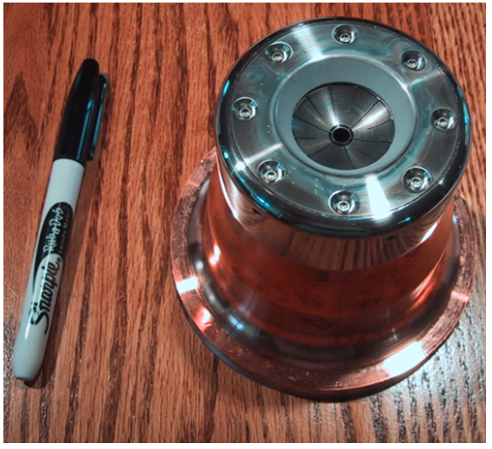
THE GUN
CPI K-2 Gun
BeamOptics Analyzer (BOA) Gun Simulation

Slide 11
METAL GRID DESIGN
Current IOTs use pyrolytic graphite (PG) grids
Difficult to fabricate
Expensive
Relatively low yield
MBIOT beam power distributed over multiple beams
Reduced power loading
Thermomechanical analysis predicts good performance
Potentially cheaper with higher yield
Beam Optics Analyzer (BOA) thermomechanical analysis with beam interception and cathode radiation

Slide 12
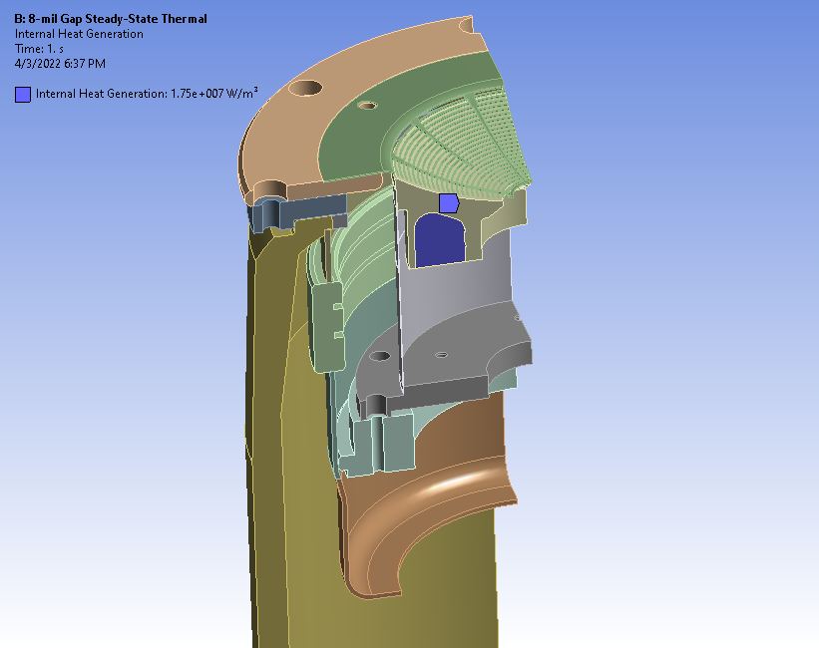
Thermal & Stress Analysis Model
ANSYS
Air Cooled: h=22 W/m²-ºC
Grid Loading: 7.4 W
Grid irradiated by emitter
Grid radiates to 150ºC sink
Emitter internally heated, 17 W/cm³
Radiation exchanges between surfaces

Slide 13
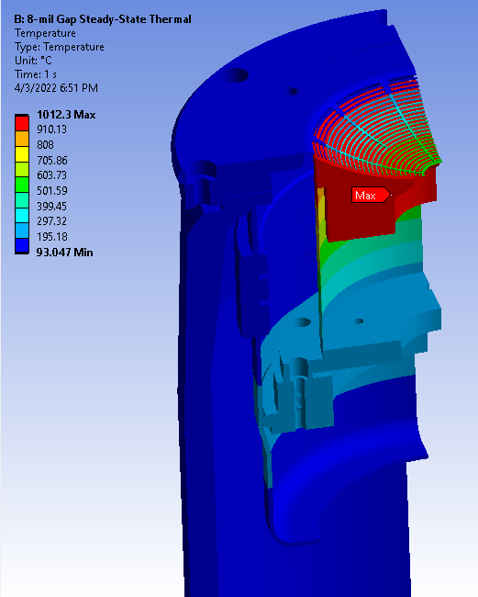
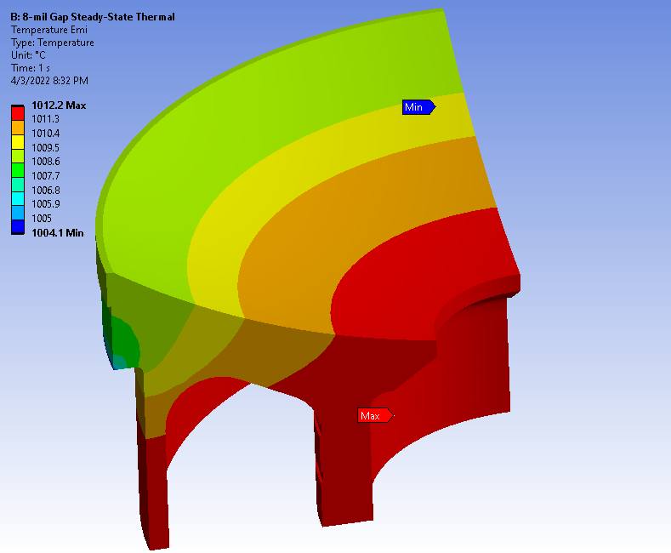
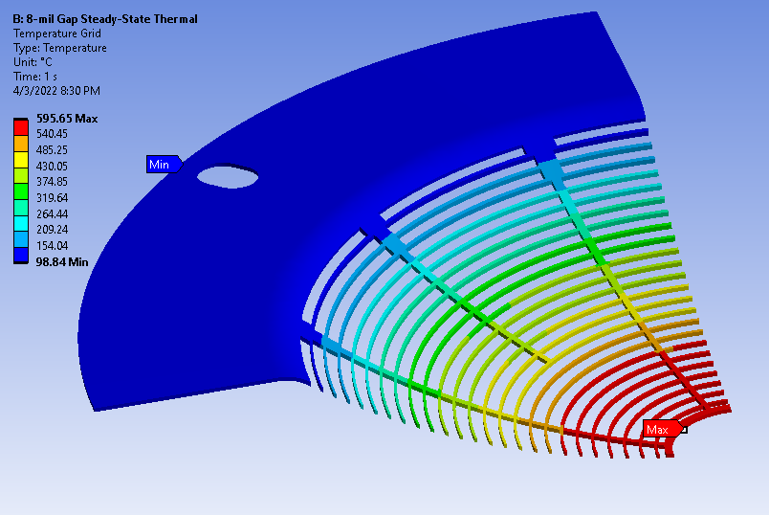
Temperatures
Emitter
Grid

Slide 14
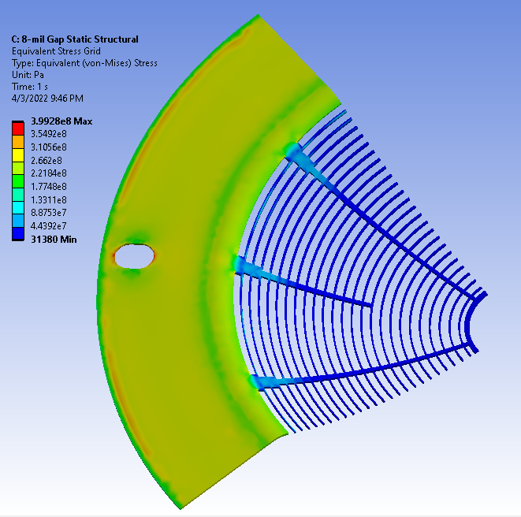
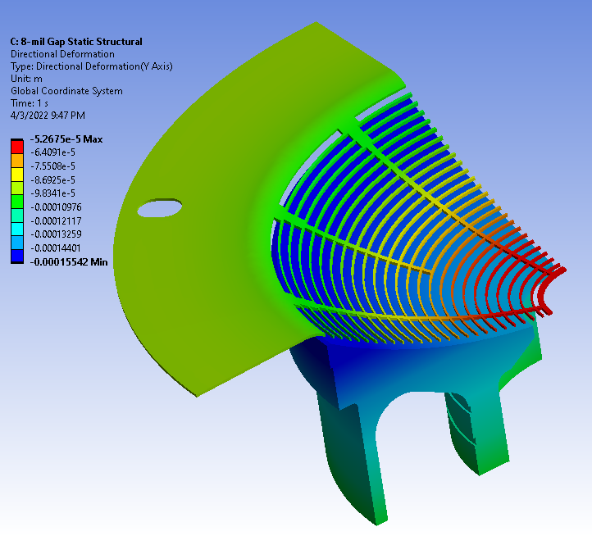
Thermal Stress & Axial Displacement
Highest stress is on the grid rim, but still below Moly tensile strength
At temperature, grid OD moves closer to the emitter 1.9 mils, ID closer 3.3 mils

Slide 15
Metal IOT Grid Fabrication
CCR was unable to identify any grid manufacturers able to make moly grids in the quantities required, except one
Test grids failed to meet specifications
There currently does not appear to be a vendor available to make moly IOT grids
Any guns for the MBIOT will be built using PG grids

Slide 16
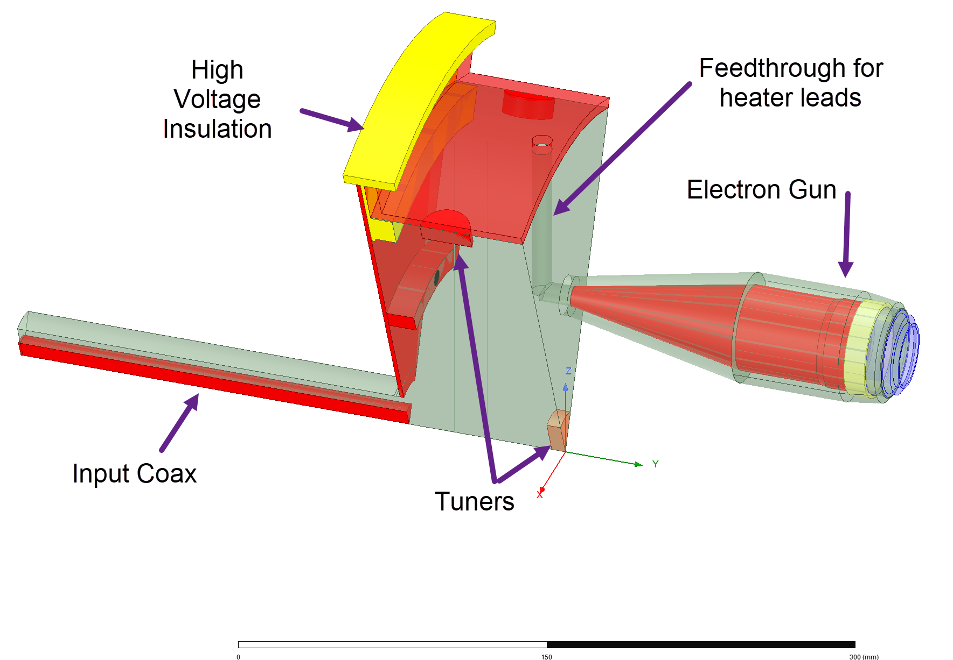
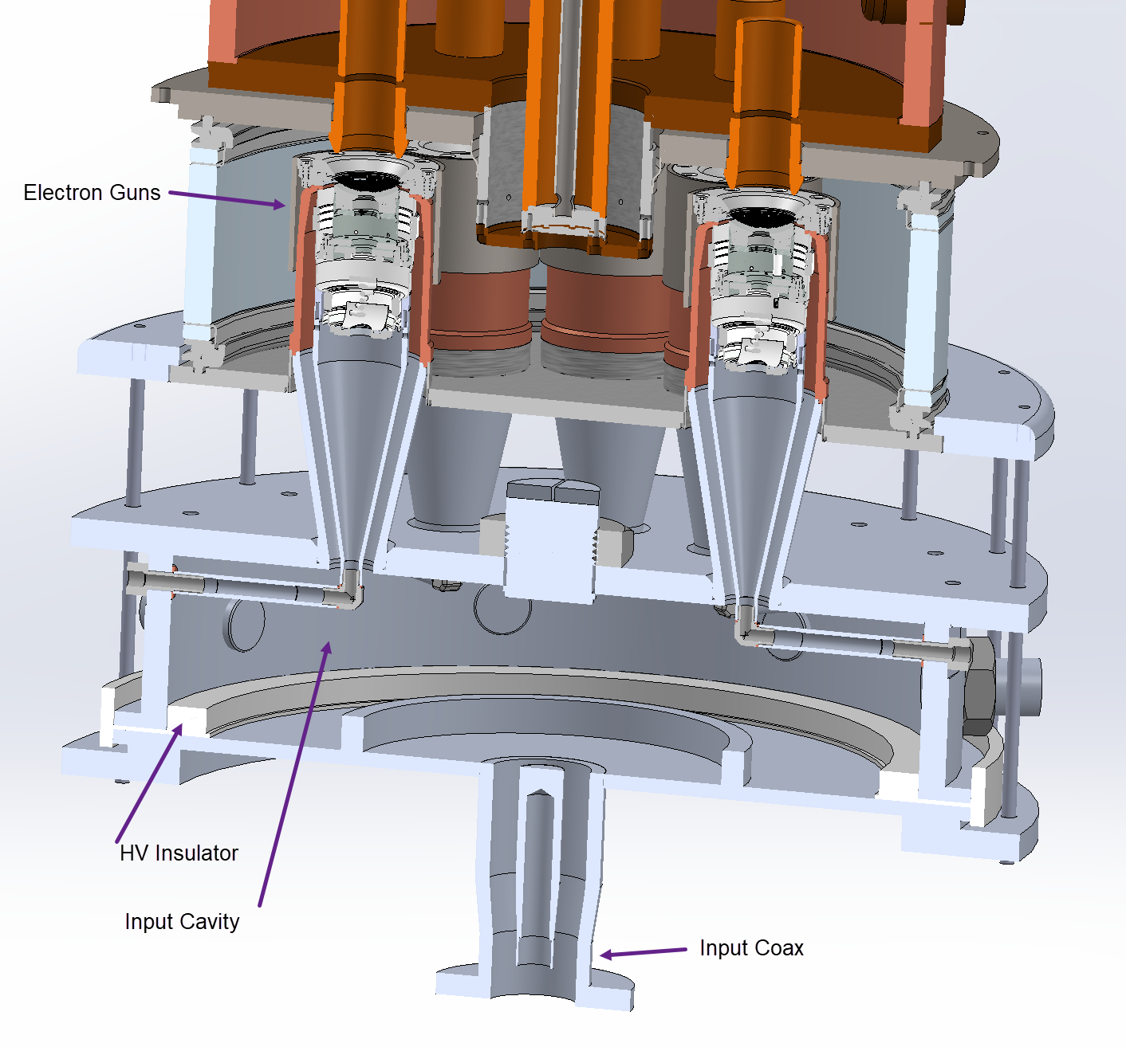
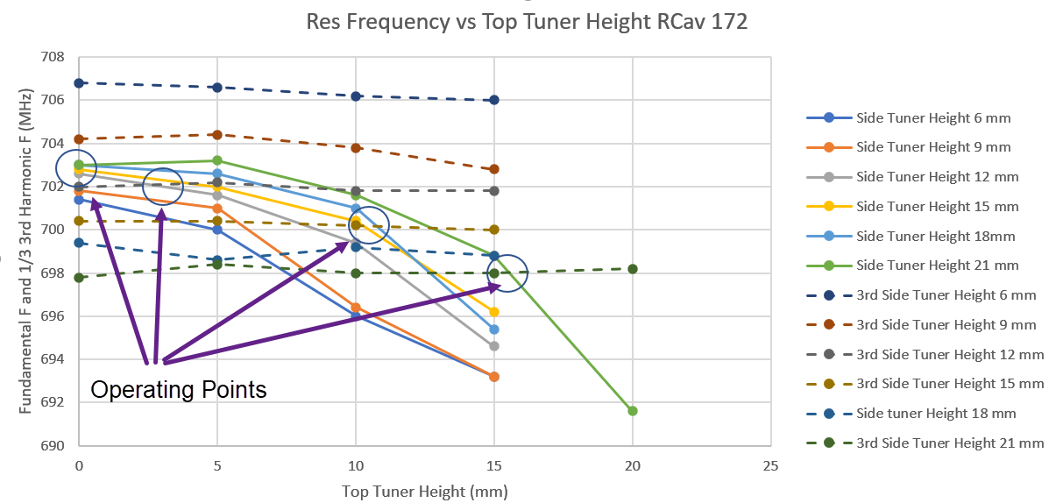
Input Coupler
Must transit both fundamental and 3rd harmonic
Bessel roots not evenly spaced, perturb fundamental w annulus, side and top tuners to get a range of 3x fundamental = 3rd harmonic
60 V grid voltage requires about 2 kW of drive
HFSS Model (1/8)
~ 5 MHz tuning range

Slide 17
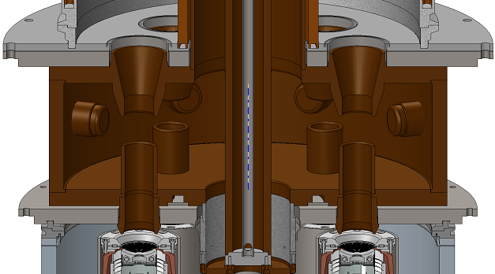
THE OUTPUT CAVITY

Slide 18
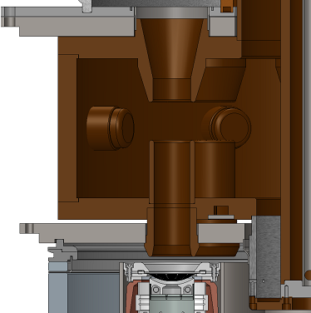
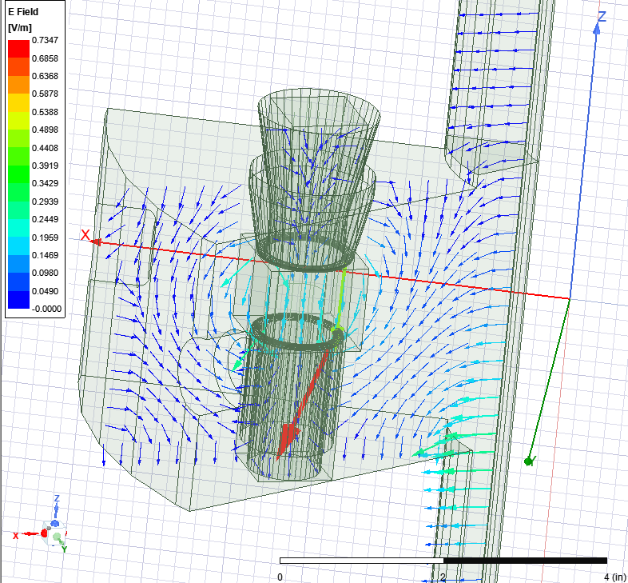
MBIOT OUTPUT CAVITY DESIGN
HFSS simulations achieved f=699 MHz, R/Q=188Ω, and Qe=140 (to be fine-tuned)
Coaxial design for better uniformity of RF fields within the beam region
Solidmodel of the output cavity
OP cavity 1/8th slice, HFSS electric field plot on plane through drift tubes

Slide 19
DEVELOPMENT STATUS
Program achieved several goals:
Improved simulation capability using NEMESIS
  Includes 3rd harmonic drive
  2d and 3d Poisson solvers
    Parallelized for improved performance
    Demonstrated potential improvement with 3rd harmonic drive
    Developed improved input coupler supporting fundamental and 3rd harmonic drive
    Failed to identify a vendor for metal (moly) grids
    Covid and supply chain issues prevented fabrication and test of prototype tube

