Slide 2
RF Power for ESS
PRESENTED BY Morten Jensen on behalf of the RF Group

Slide 3
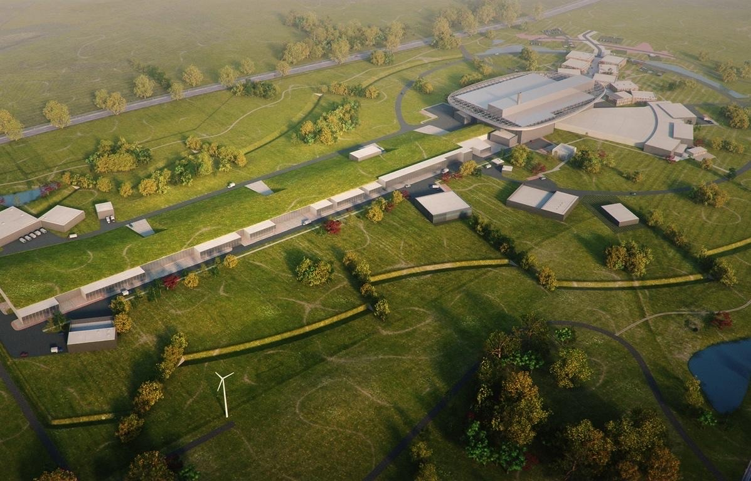
Content
Overview of the Facility
RF Systems and Status at ESS
Looking ahead

Slide 4
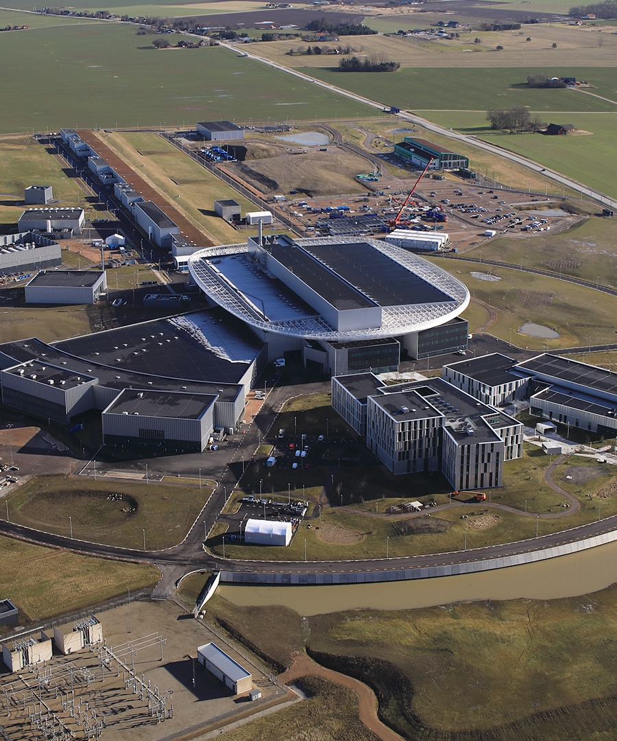
Overview of the Facility

Slide 5



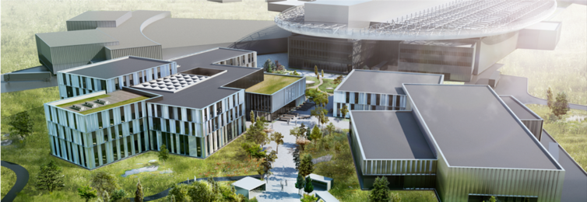
We’re building a global science hub in Lund
ESS, MAX IV, Science Village Scandinavia
Science Village
MAX IV
ESS
Notes:
Top left corner: MAX IV and below that the first building in Science Village, Space, with reception area, exhibition area and rooms for our visiting users. Bottom: the ESS Campus, ready in 2021
SVS: 18 ha: 425m*425m. Build volume 250 000 m3.
MAX IV: 14 beamlines financed, 2 of them have seen the beam so far. Some are financed by other countries.
Joint workshops are under discussion.
http://wasp-sweden.org/ Wallenberg autonomous systems program
SCIENTIFIC: this also serves to educate all partners involved. Some of these depend heavily on the science time of our staff.
Latest aerial view photograph: 14 February 2020

Slide 6
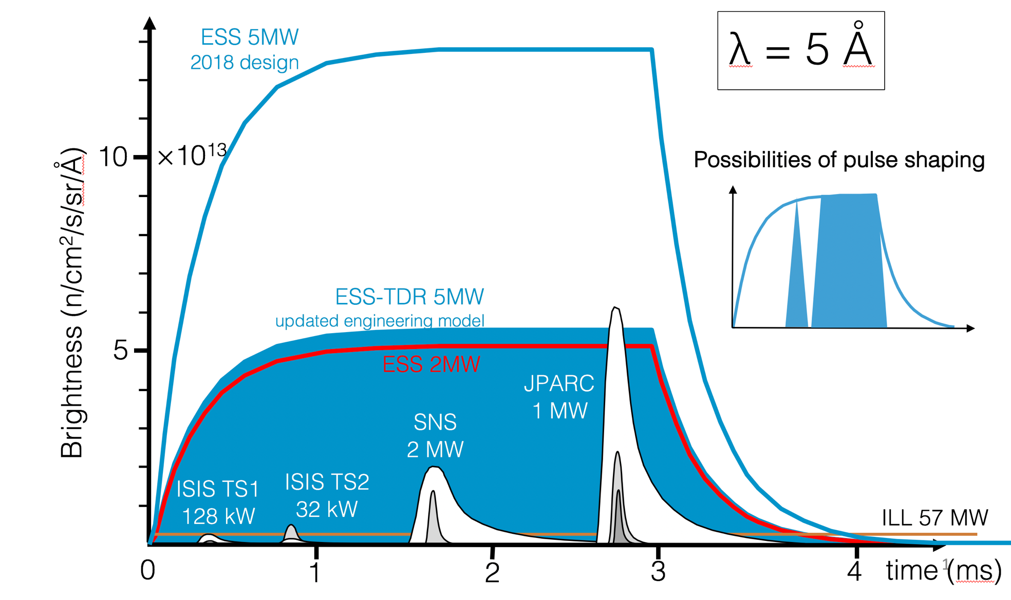
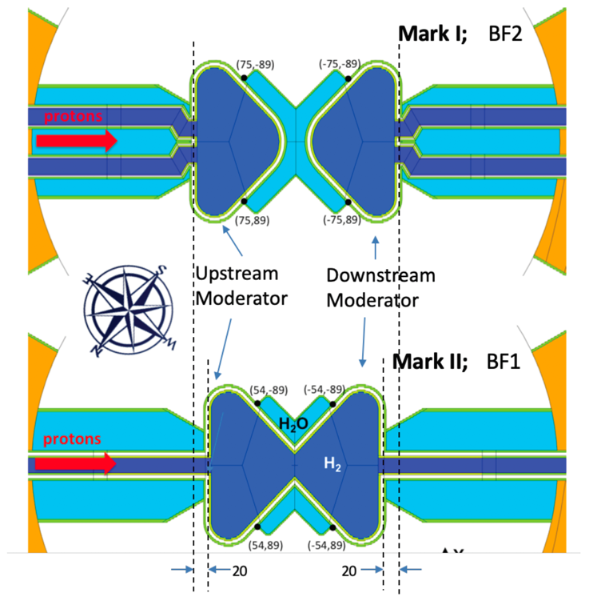
ESS Performance
Descoping in accelerator power (and instrument scope) due to budget restrictions compensated by moderator development
(Note that deferred scope can be added back later)

Slide 7
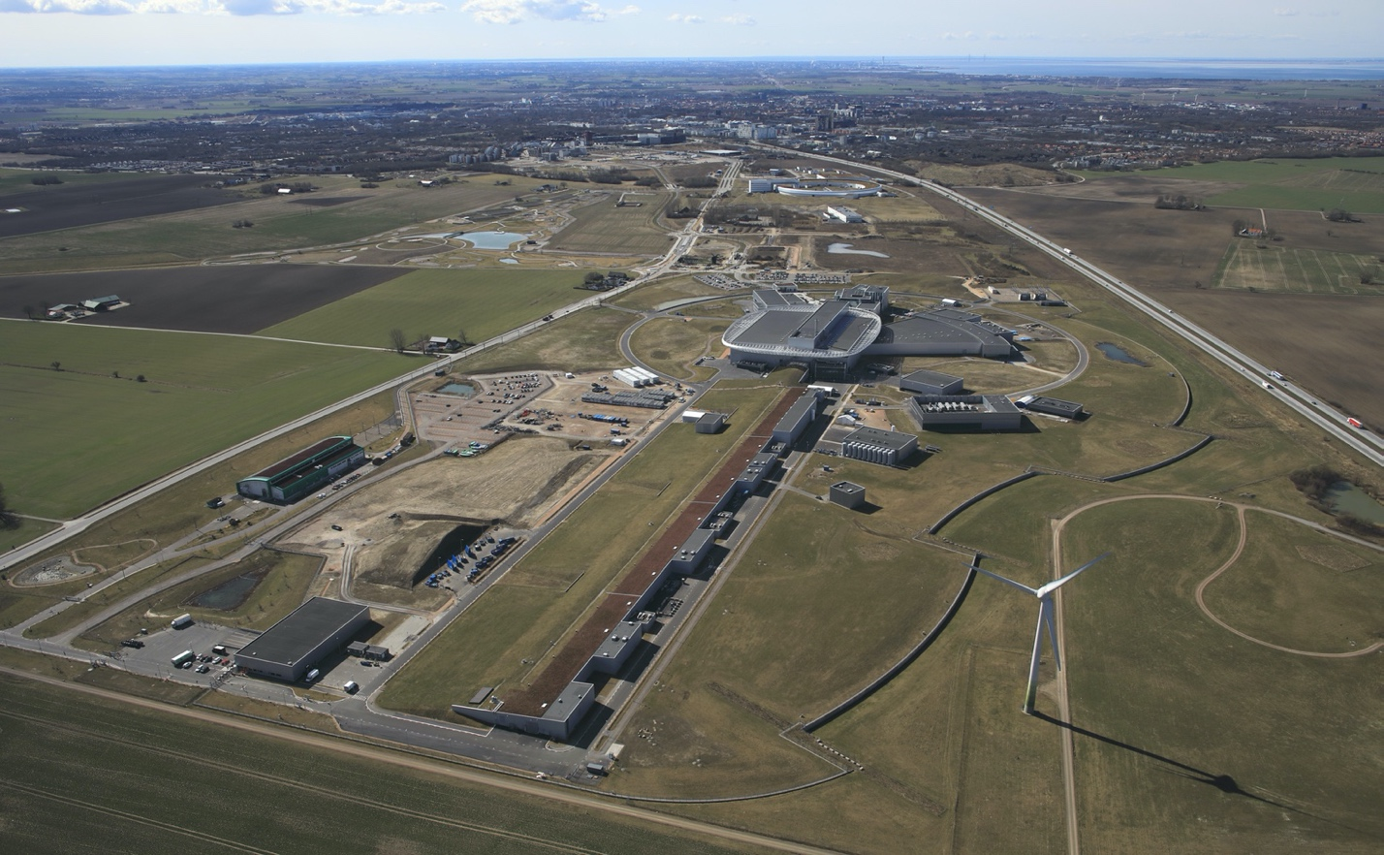
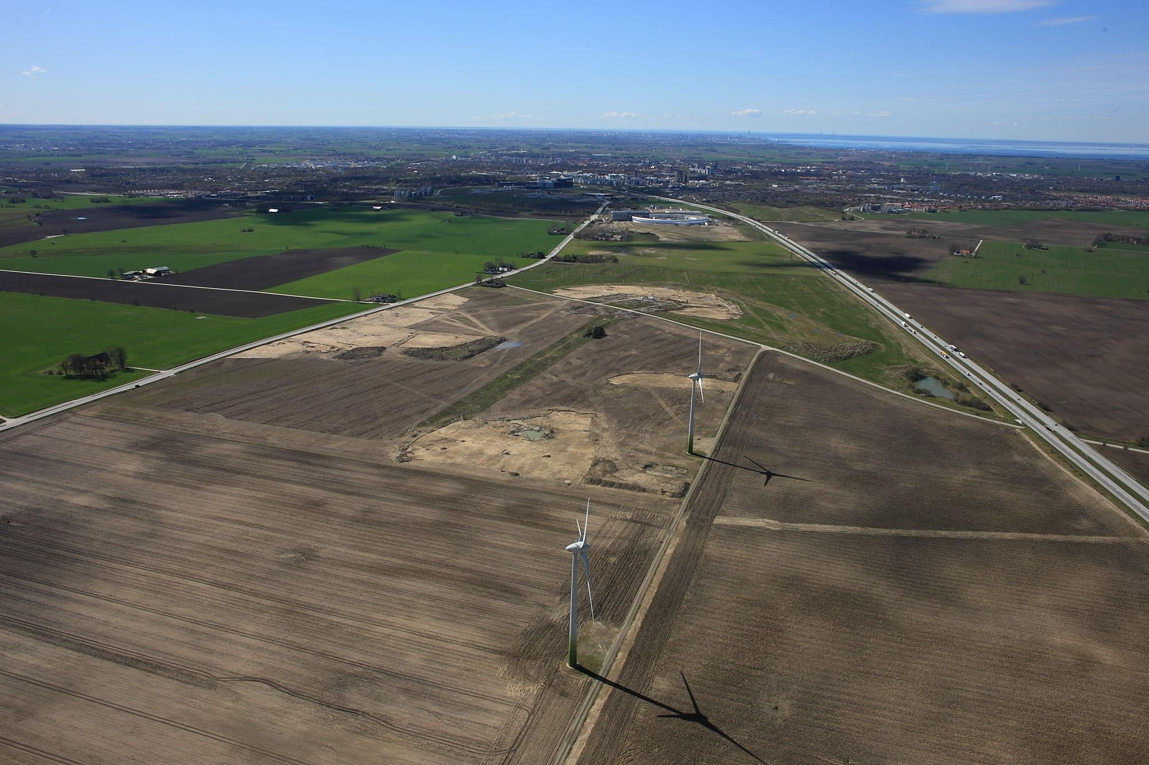
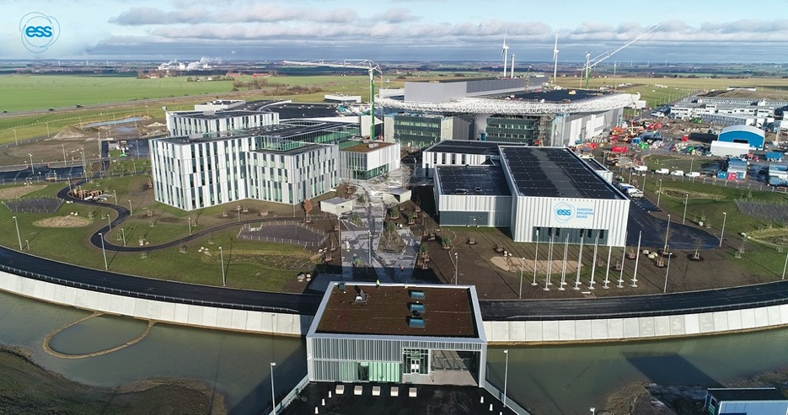
From Green Field to ESS
May 2014
April 2022

Slide 8
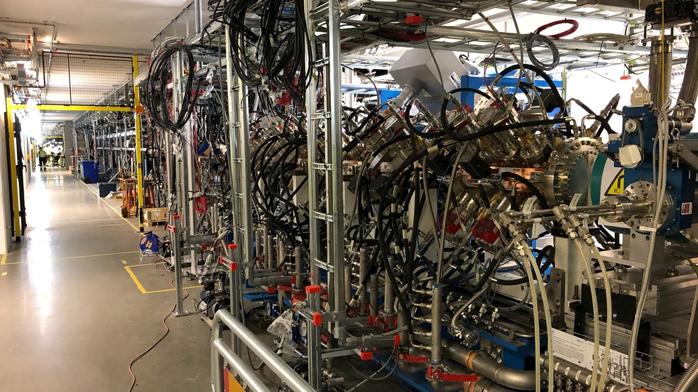
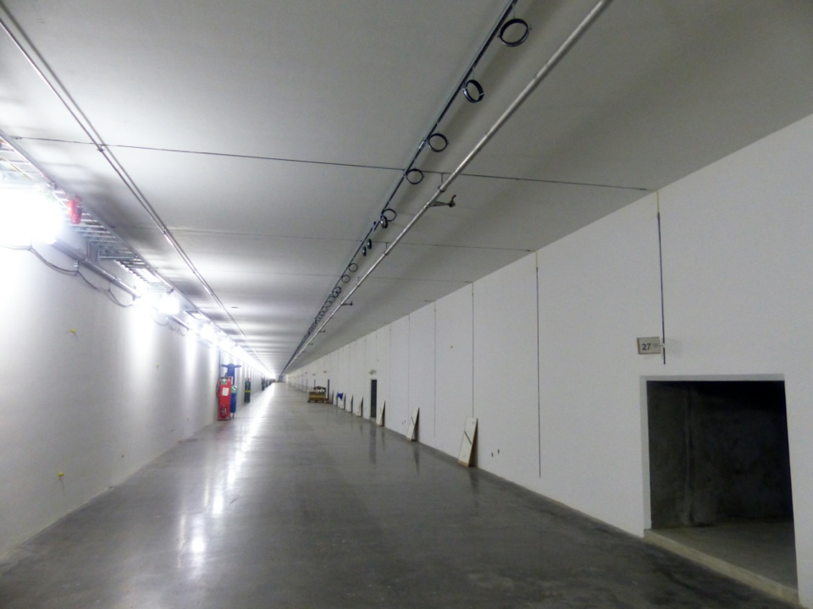
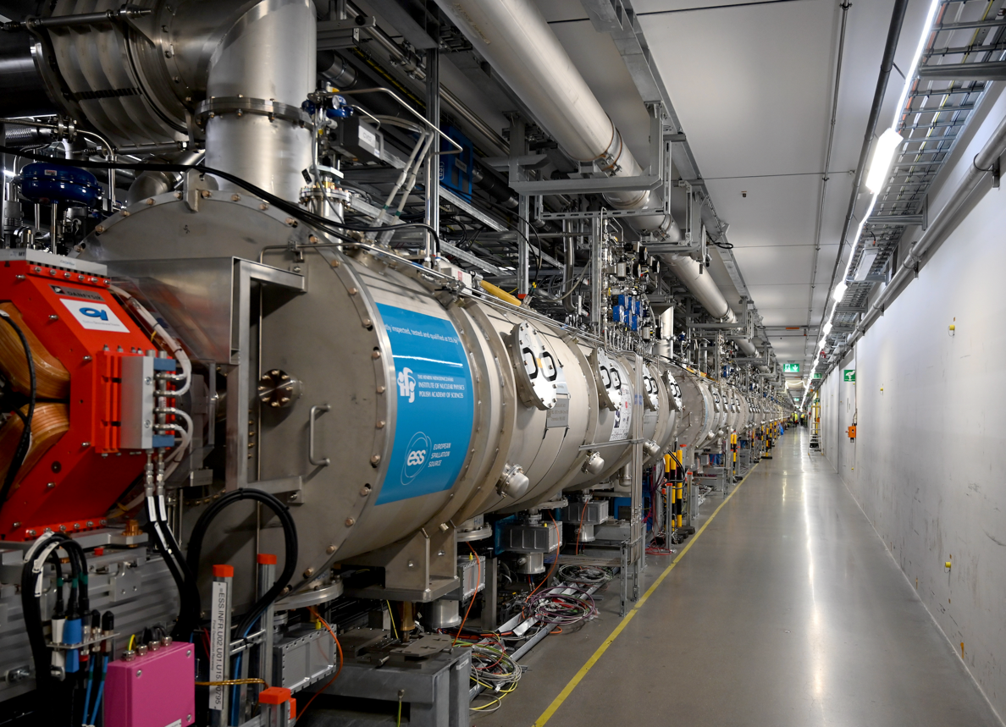
Tunnel view then and now

Slide 9
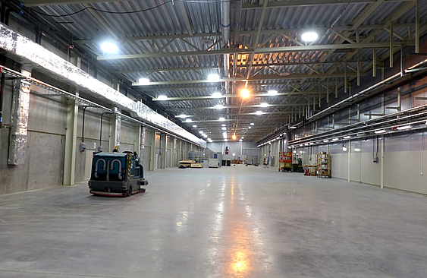
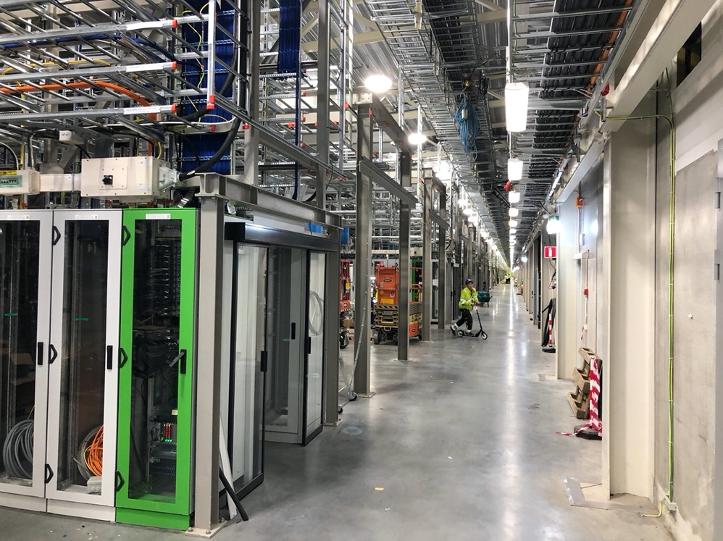
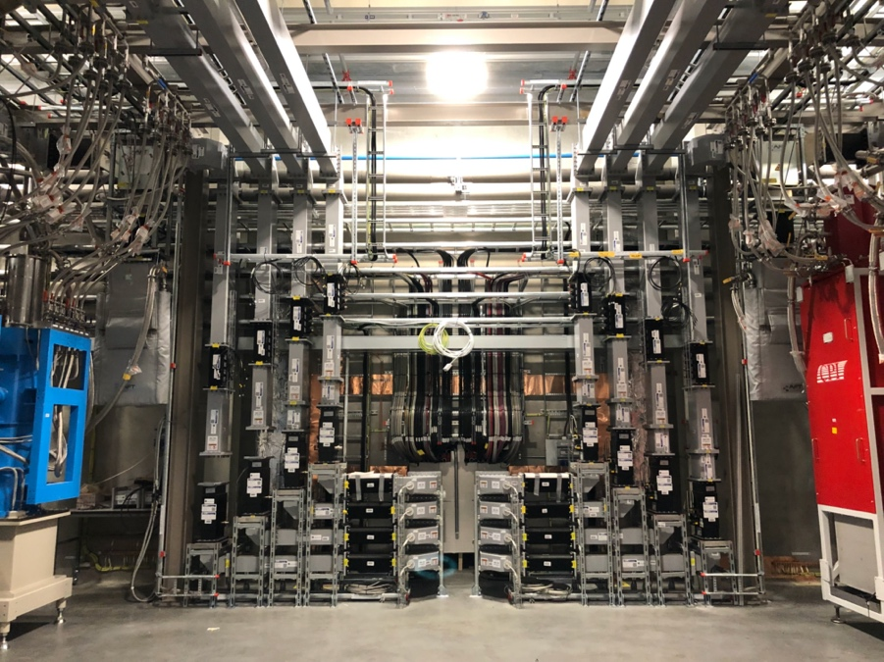
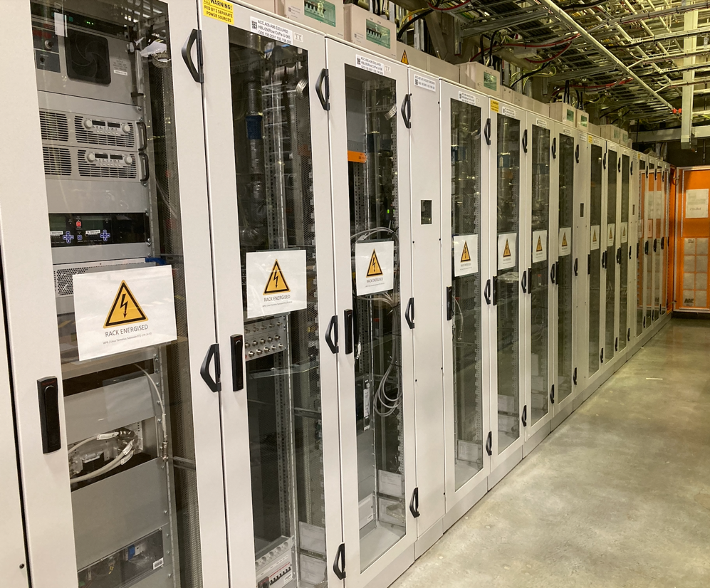
Klystron Gallery Then and Now

Slide 10
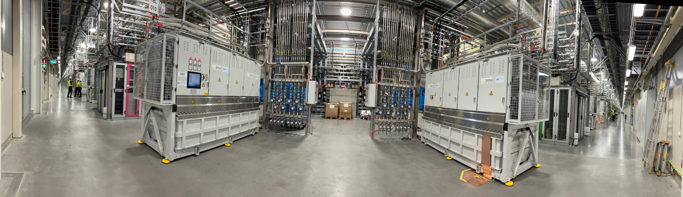
Total of 91 High power RF Systems, MO, and PRL incl all controls, interlock, aux and LLRF. Approximately 245 racks, > 21000 cables
180 degree view of Gallery

Slide 11
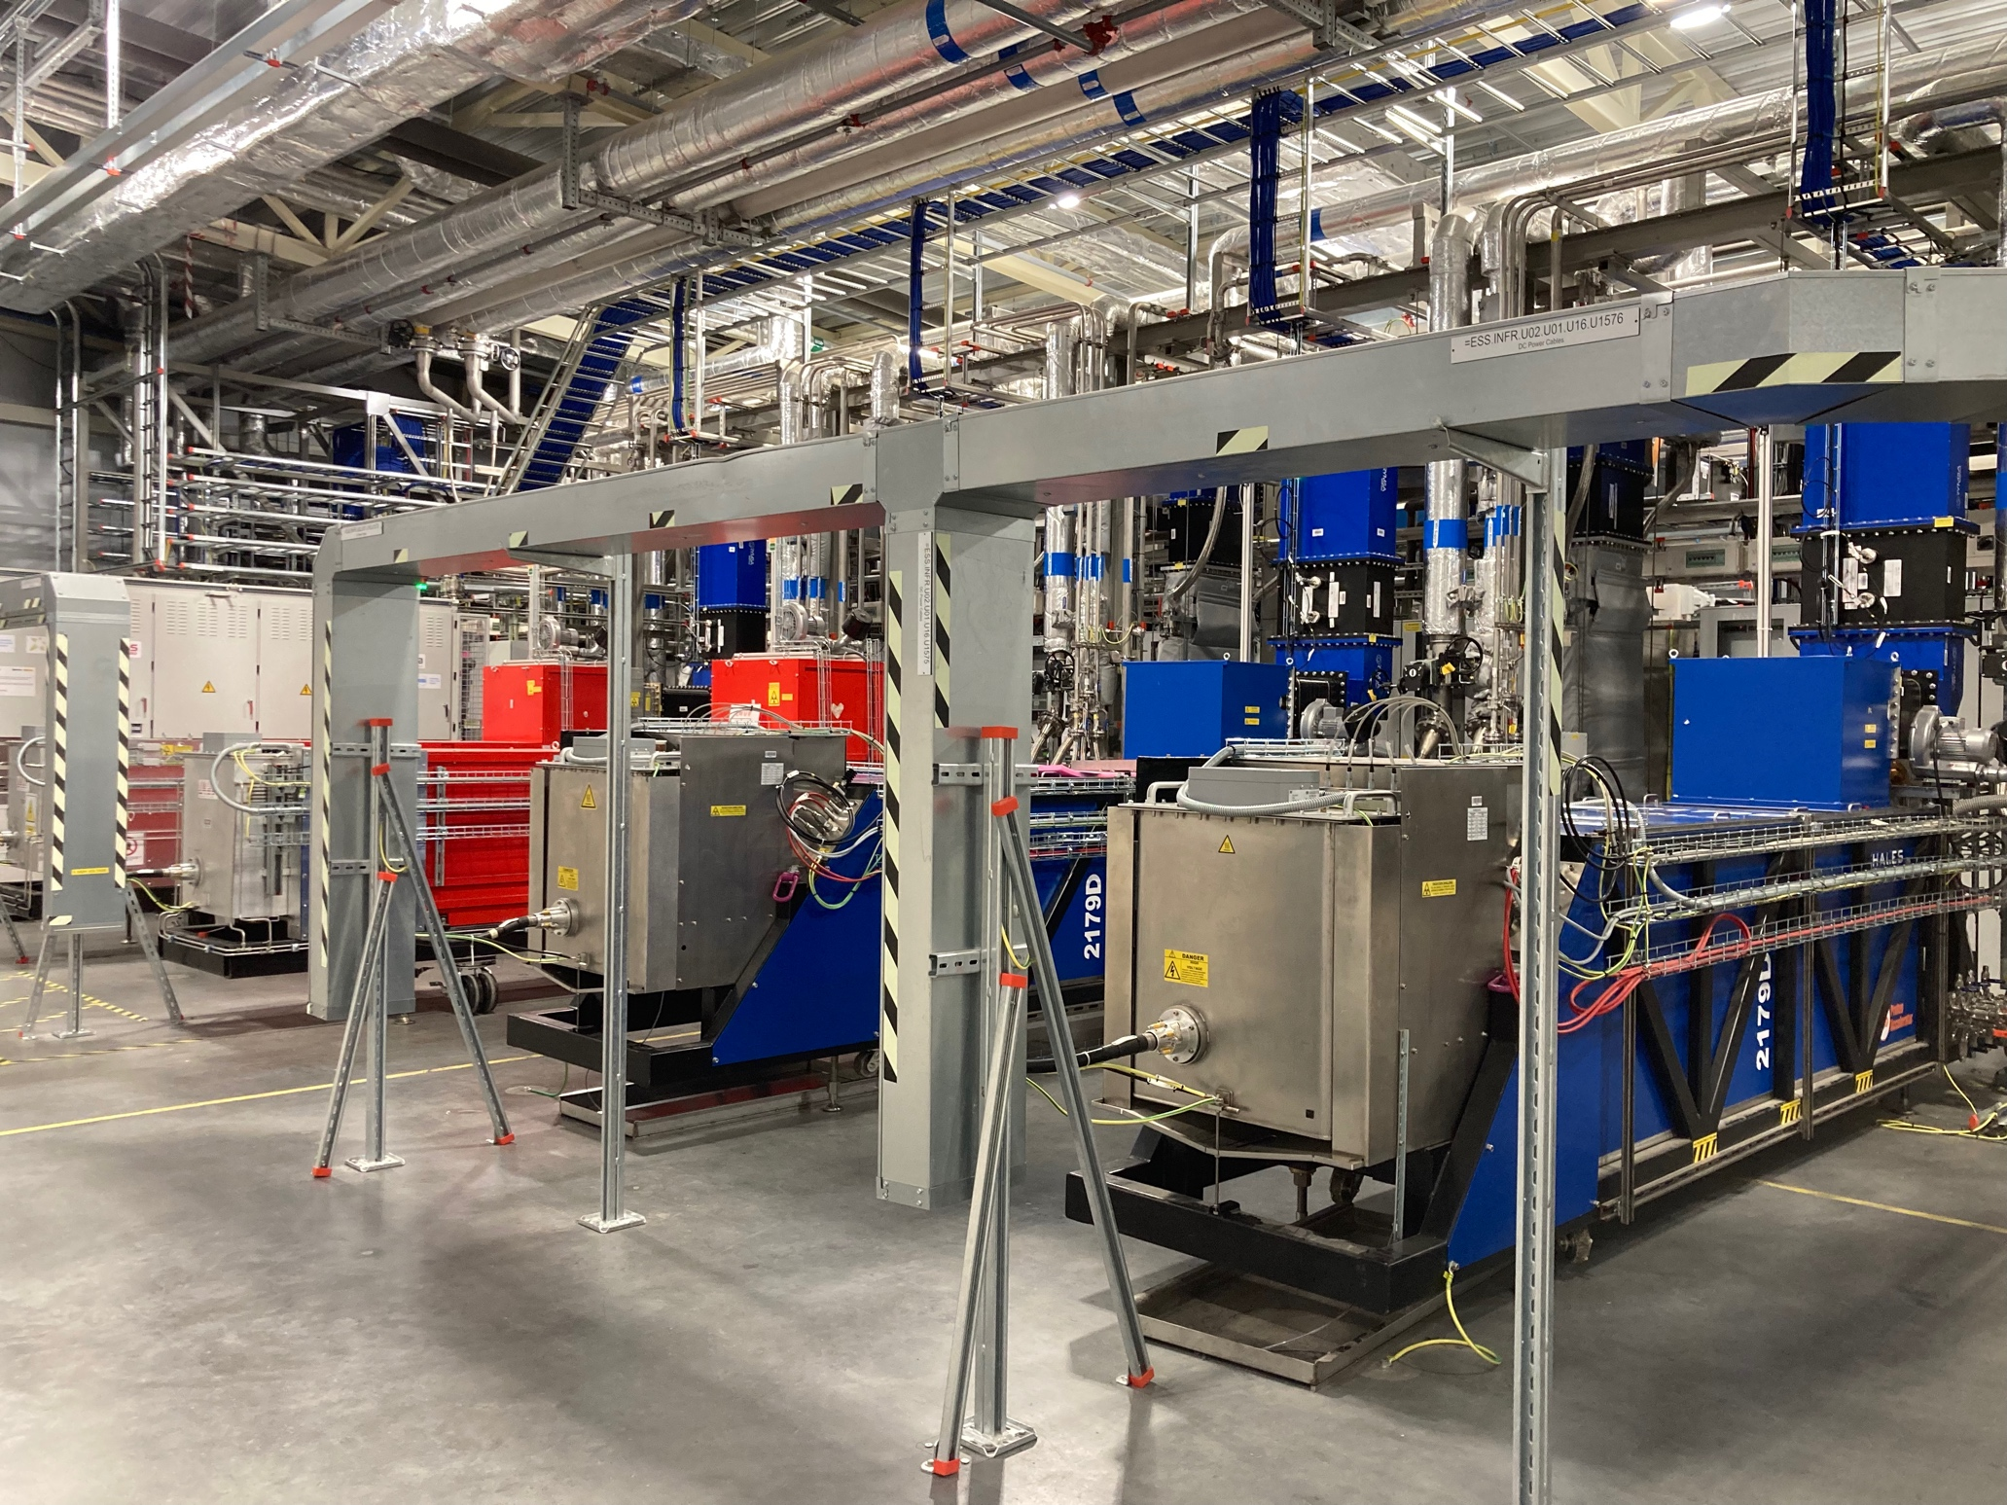
RF Systems at ESS

Slide 12
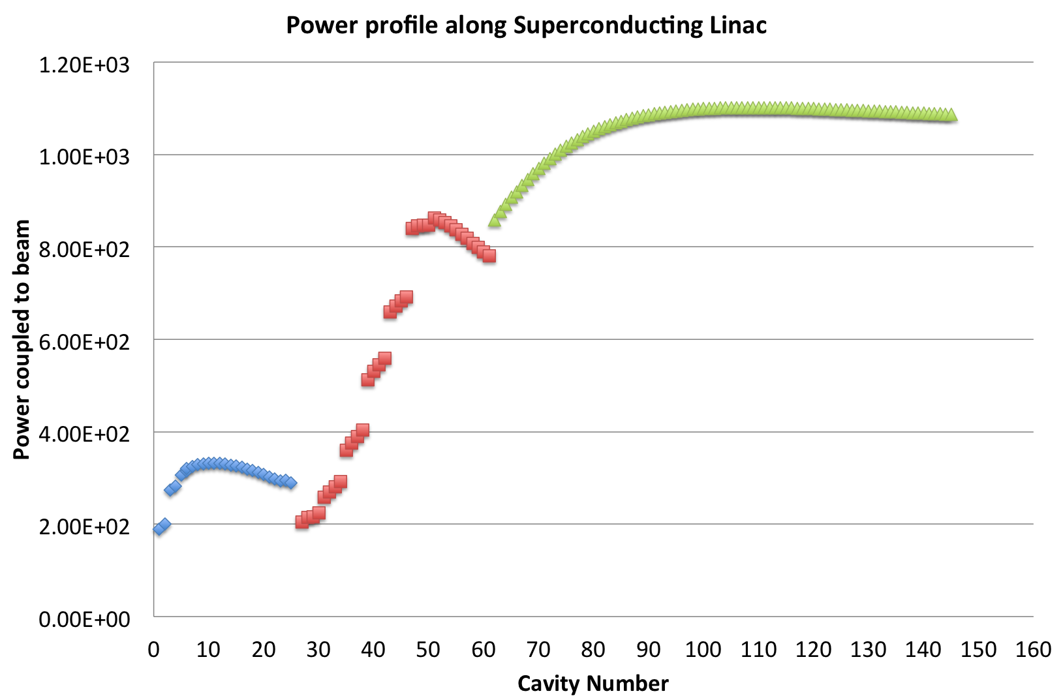
Power profile along superconducting linac
Large spread in power requirements
Use of optimal, available sources
MB/HB will use the same klystron despite different power demand
High Beta cavities
704 MHz
1.1 MW to beam
1.5 MW klystron
Spoke
352 MHz
Up to 330 kW to beam
2x200 kW tetrode
Medium Beta cavities
704 MHz
200-800 kW to beam
1.5 MW klystron
Warm Linac 352 MHz
RFQ & 5 DTL: 3 MW
3 MEBT: 30 kW

Slide 14

Typical RF System
PRL
Circulator
Beam
MO
LLRF
Cavity
Pre-Driver
High Power Amplifier
Load
Sub-System Auxiliary Supplies
Local system protection and control
EPICS Global control and operation

Slide 15
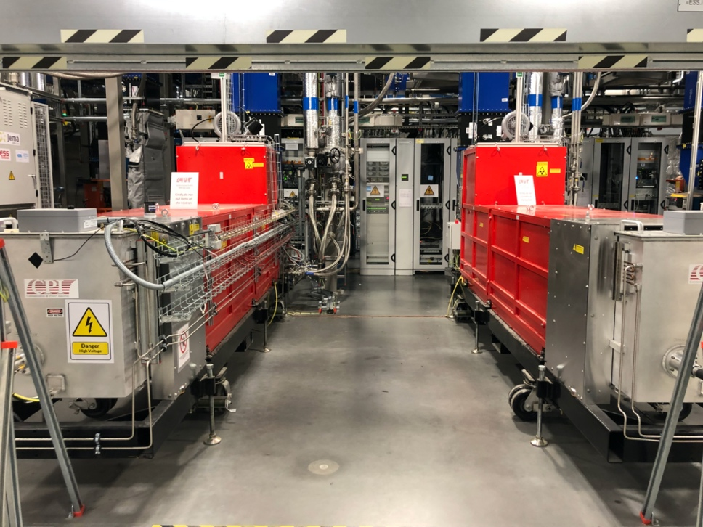
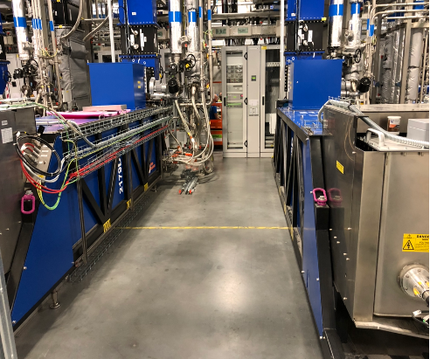
RF Systems in Normal Conducting Linac (NCL)
Normal Conducting Linac at 352 MHz includes:
1 RFQ 2.9 MW klystron
5 DTL tanks 2.9 MW klystron
TH2179D (DTL 5)
RF systems installed, tested and commissioned with beam
Nominal output power | 2.9 MW
Frequency | 352.21 MHz
BW | ≥ +/- 1 MHz
Pulse width | 3.5 ms
Repetition rate | 14 Hz
Perveance | 1.3*10⁻⁶
Efficiency | >52%
VSWR | Up to 1.2
Power Gain | ≥ 40 dB
Group Delay | ≤ 250 ns
Harmonic Spectral content | ≤ -30 dBc
Spurious Spectral content | ≤ -60 dBc
RFQ and DTL 1 klystrons
DTL 3 and DTL 4 klystrons
RFQ and DTL 1 klystrons

Slide 16
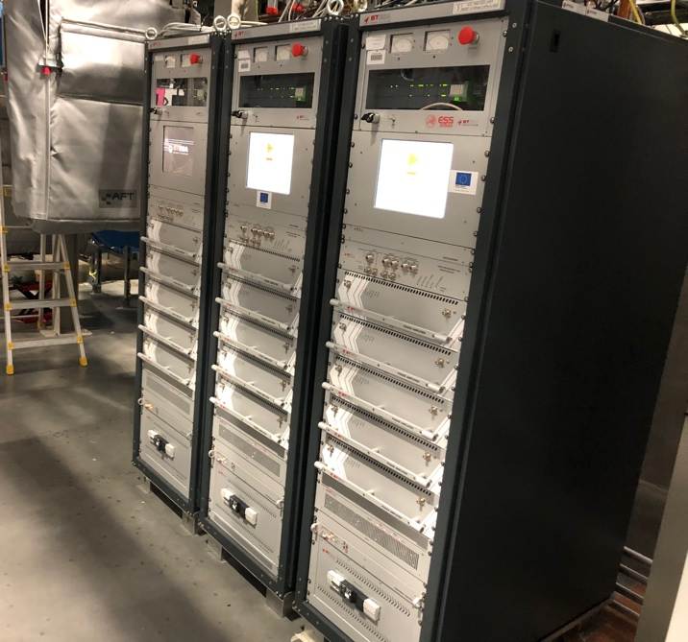
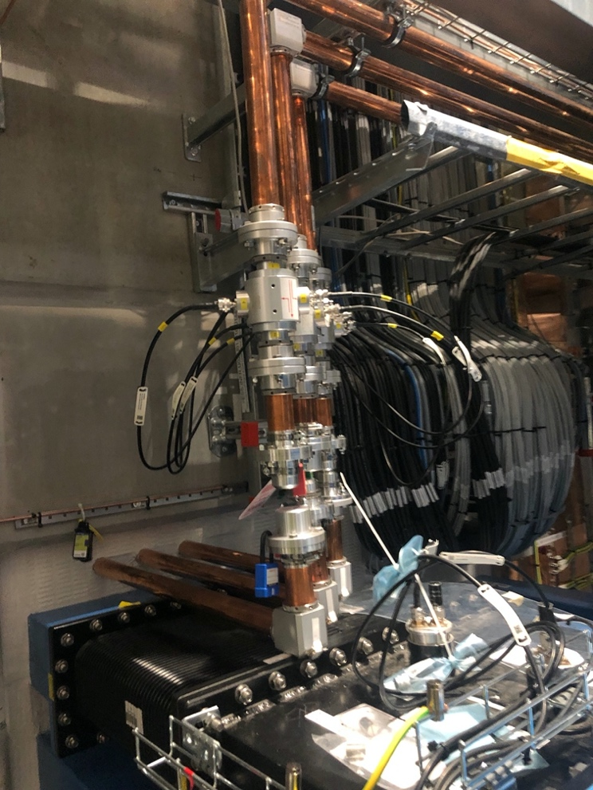
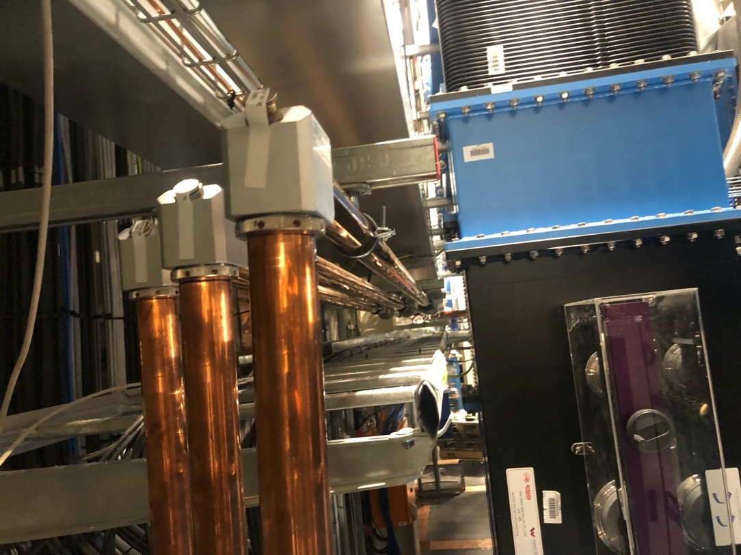
Three MEBT (Buncher Cavity) RF Systems
30 kW output
Frequency: 352 MHz Solid State Power Amplifiers
Consists of five hot-swappable RF modules combined
High Power Circulator and Load
Internal interlock system and state machine
Output line:
35 m, 1 5/8” coaxial line incl couplers and tuning
For more details please refer to:
The ESS MEBT 30 kW solid state amplifiers, B. Lagoguez,, CWRF 2022

Slide 17
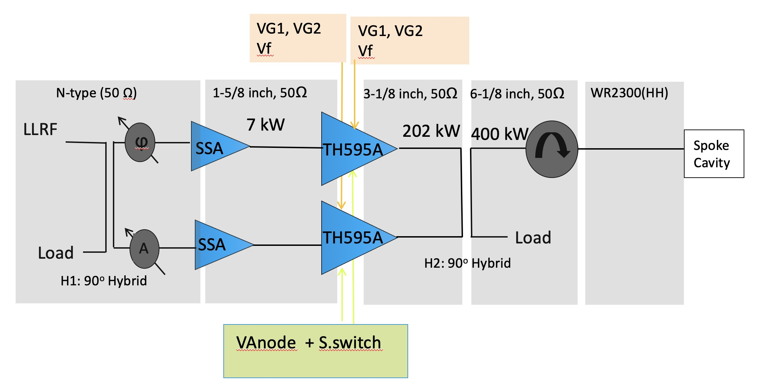
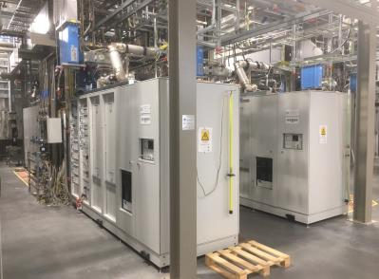
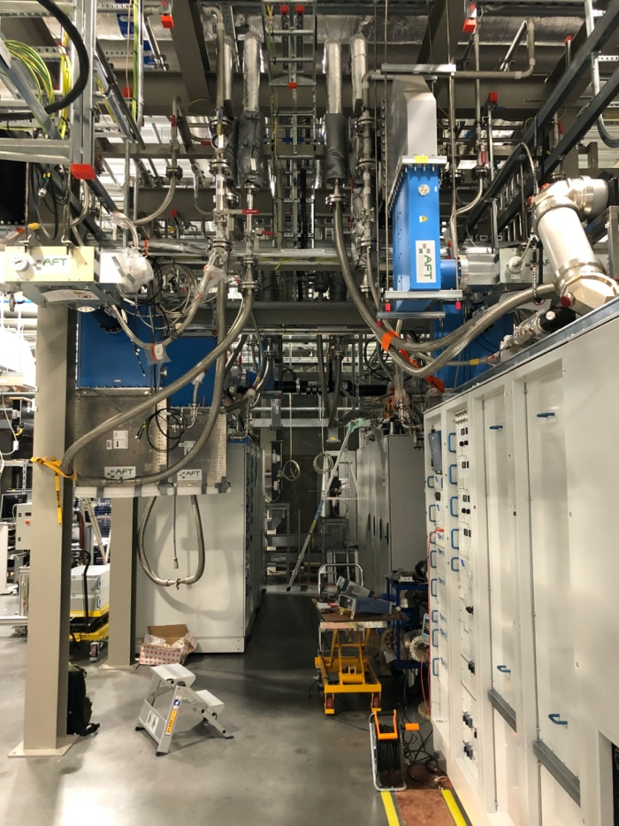
26 Spoke Systems
Amplification to 400 kW
Frequency: 352 MHz
26 Tetrode based amplifiers by combining two 200 kW Tetrodes.
LLRF, Interlocks, waveguides, loads and circulators etc.
For more details please refer to:
Radio Frequency Power Stations at ESS, R. Yogi, CWRF 2022

Slide 18
Medium and High Beta Linac
Responsible for the bulk of acceleration
Power to Beam plus Overhead for regulation:
Tight requirements for cavity field stability
LLRF has to compensate for perturbations:
  Beam current variation
  Microphonics
  RF variation (ripple, phase and amplitude)
Overhead need: 25%
36 Medium beta elliptical cavities:
84 High beta elliptical cavities (5 MW):
Phase 1: 2 MW capable (20 RF systems)
  Currently funded and in construction
Phase 2: upgrade to 3 MW (44 RF systems)
Phase 3: Upgrade to 5 MW (84 RF systems)
Nominal output power | 1.5 MW
Frequency | 704.42 MHz
BW | ≥ +/- 1 MHz
Pulse width | 3.5 ms
Repetition rate | 14 Hz
Efficiency | >63%
VSWR | Up to 1.2
Power Gain | ≥ 40 dB
Group Delay | ≤ 250 ns
Harmonic Spectral content | ≤ -30 dBc
Spurious Spectral content | ≤ -60 dBc

Slide 19
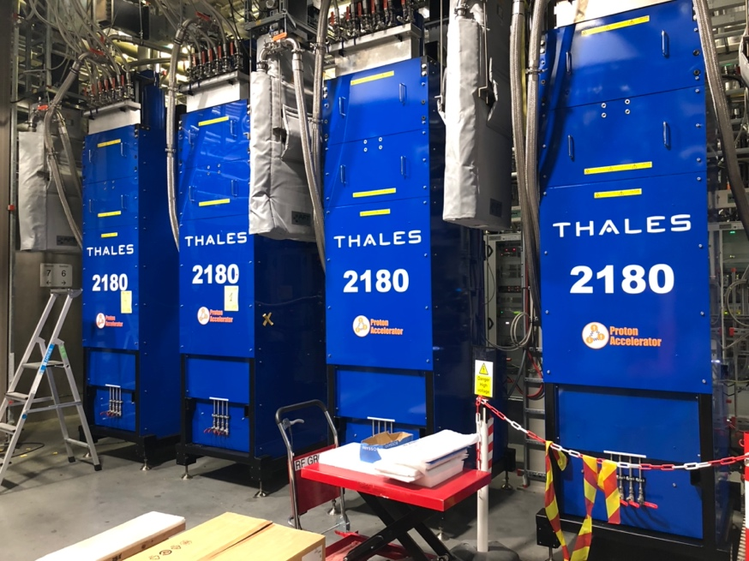
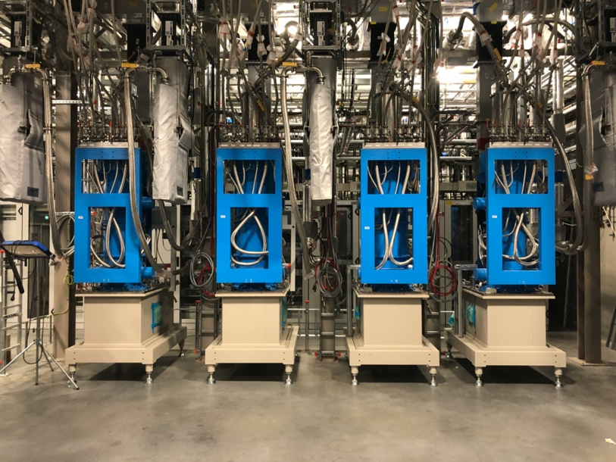
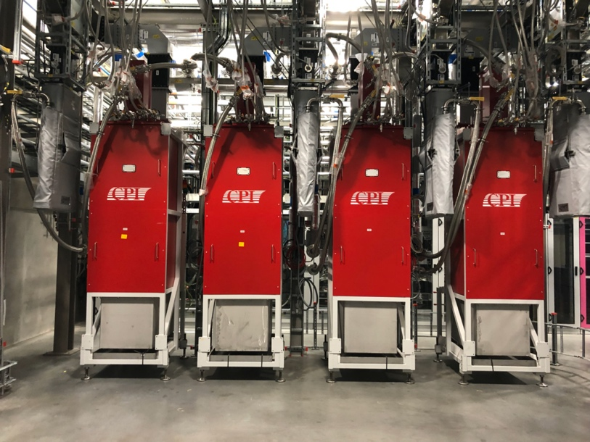
Medium and High Beta RF Sources
Medium Beta Installation
20 Canon Klystrons
12 CPI klystrons
4 Thales klystrons
High Beta Installation
19 Canon Klystrons
1 Thales klystrons
1 Canon Klystron
1 CPI klystron
1 Thales klystron
Test Stand 2 – CM testing
Spare klystrons
Klystrons not yet installed (Delivered or to be delivered)
6 CPI
1 Canon
13 Thales

Slide 20
G02 – Status of RF Systems Aug 2024
Ready for Beam on Target (RBOT) Baseline
#
Installation on-going
CELL 100/110
CELL 120
CELL 130
CELL 140
CELL 150A
RACKS
RACKS
B1
B2
B3
RACKS
RACKS
020-s1
010-s1
040-s1
030-s1
RACKS
RACKS
060-s1
050-s1
080-s1
070-s1
RACKS
RACKS
100-s1
090-s1
120-s1
110-s1
RACKS
RACKS
130-s1
RACKS
#
Installation complete ready for test
NCG + SPK
352.21 MHz
#
Low Power Tested
K1
K2
K3
K4
K5
K6
020-s2
010-s2
040-s2
030-s2
060-s2
050-s2
080-s2
070-s2
100-s2
090-s2
120-s2
110-s2
130-s2
#
High Power Tested
M1
M2
M3
#
Special test
K1
K2
Cell 150 – MBL-010
MBL-020 Cell 160 – MBL-030
MBL-040 Cell 170 – MBL-050
MBL-060 Cell 180 – MBL-070
MBL-080 Cell 190 – MBL-090
TS2
4
RACKS
RACKS
1
4
RACKS
RACKS
1
4
RACKS
RACKS
1
4
RACKS
RACKS
1
4
RACKS
M2
1
4
1
4
1
4
1
4
1
MB
704.42 MHz
3
2
3
2
3
2
3
2
3
2
3
2
3
2
3
2
3
2
M1
M2
M3
M4
M5
M6
M7
M8
M9
NCL: Klystron@3 MW
Bunchers: SSPA@30 kW
SPK: Tetrodes@400 kW
MB: Klystron@1.5 MW
HB: Klystron@1.5 MW
HBL-010 Cell 200 – HBL-020
HBL-030 Cell 210 – HBL-040
HBL-050 Cell 220 – HBL-060
HBL-070 Cell 230 – HBL-080
HBL-090 Cell 240 – HBL-100
HBL-110 Cell 250
RACKS
1
4
RACKS
RACKS
1
4
RACKS
RACKS
1
4
RACKS
RACKS
1
4
RACKS
RACKS
1
4
RACKS
RACKS
1
RACKS
4
1
4
1
4
1
4
1
4
1
4
HB
704.42 MHz
2
3
2
3
2
3
2
3
2
3
2
3
2
3
2
3
2
3
2
3
2
3
M1
M2
M3
M4
M5
M6
M7
M8
M9
M10
M11
2024 2 MW Capable
Post BOT Scope 3 MW

Slide 21
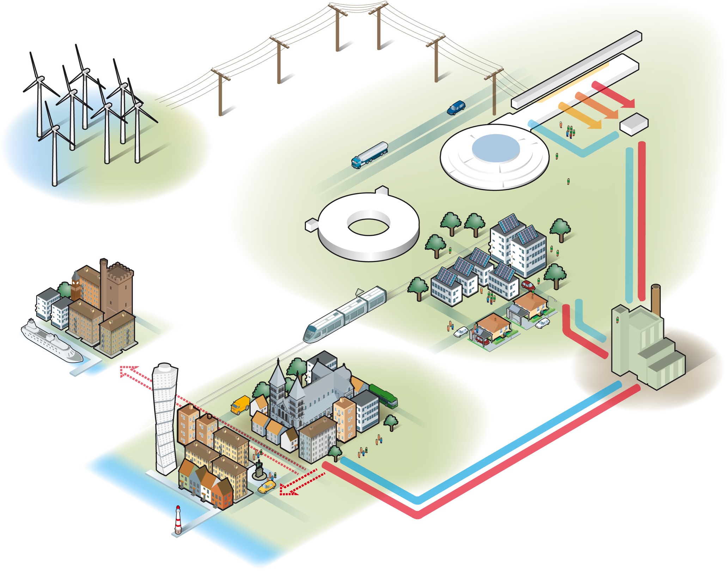
Efficiency Considerations

Slide 22
Medium and High Beta Linac
Energy efficiency optimisation
Klystron Efficiency at Saturation: 61-69 %
  CPI Klystrons: ≈ 61-65%
  Canon Klystrons: ≈ 63/69%
  Thales Klystrons: ≈ 63/66%
But klystrons saturate at maximum power
In actual operation, output power is much lower:
20-25% overhead needed for regulation
Power to beam and filling time
Result:
Efficiency at point of operation is low
≈ 45 %
Efficiency can be improved by:
Reduction in HV
Installation of output mismatch
Optimisation of solenoid
10 %
Please see Optimization of klystron operational efficiency at ESS, C. Marrelli et al, Vacuum Vol 220, Feb 2024

Slide 23
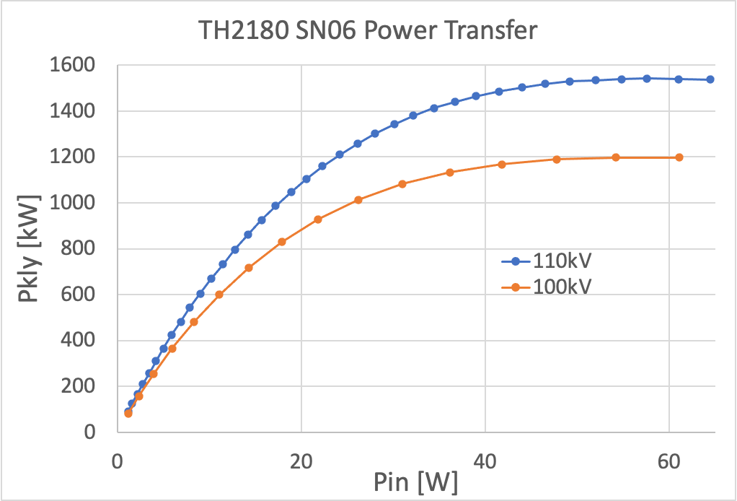
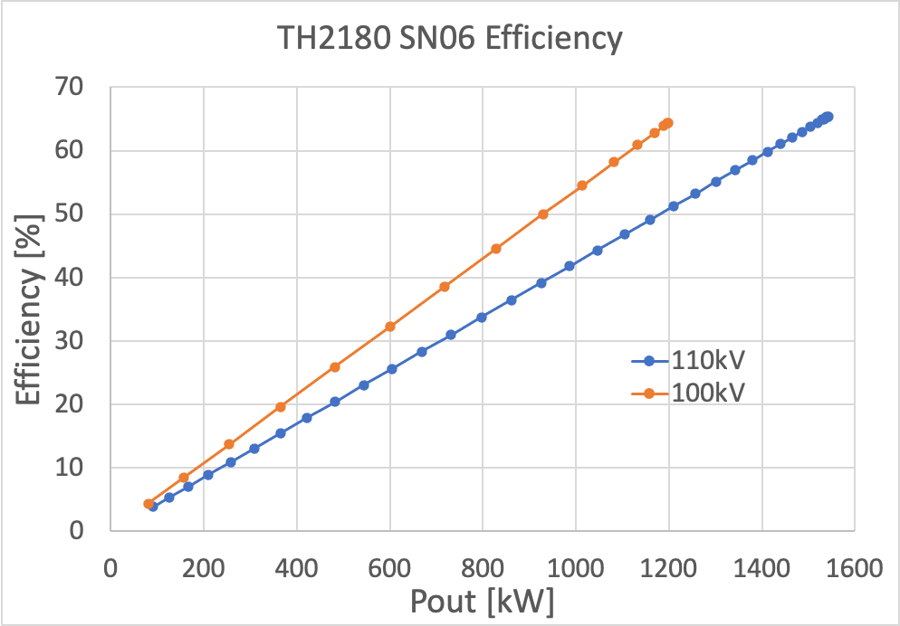
A Practical Example
Efficiency for operation below saturation
44%
34%
Operation at 800 kW
It is hard to achieve more than 45% (klystron RF efficiency) at point of operation
Not including further reduction due to Modulator efficiency, filament and solenoid consumption

Slide 24
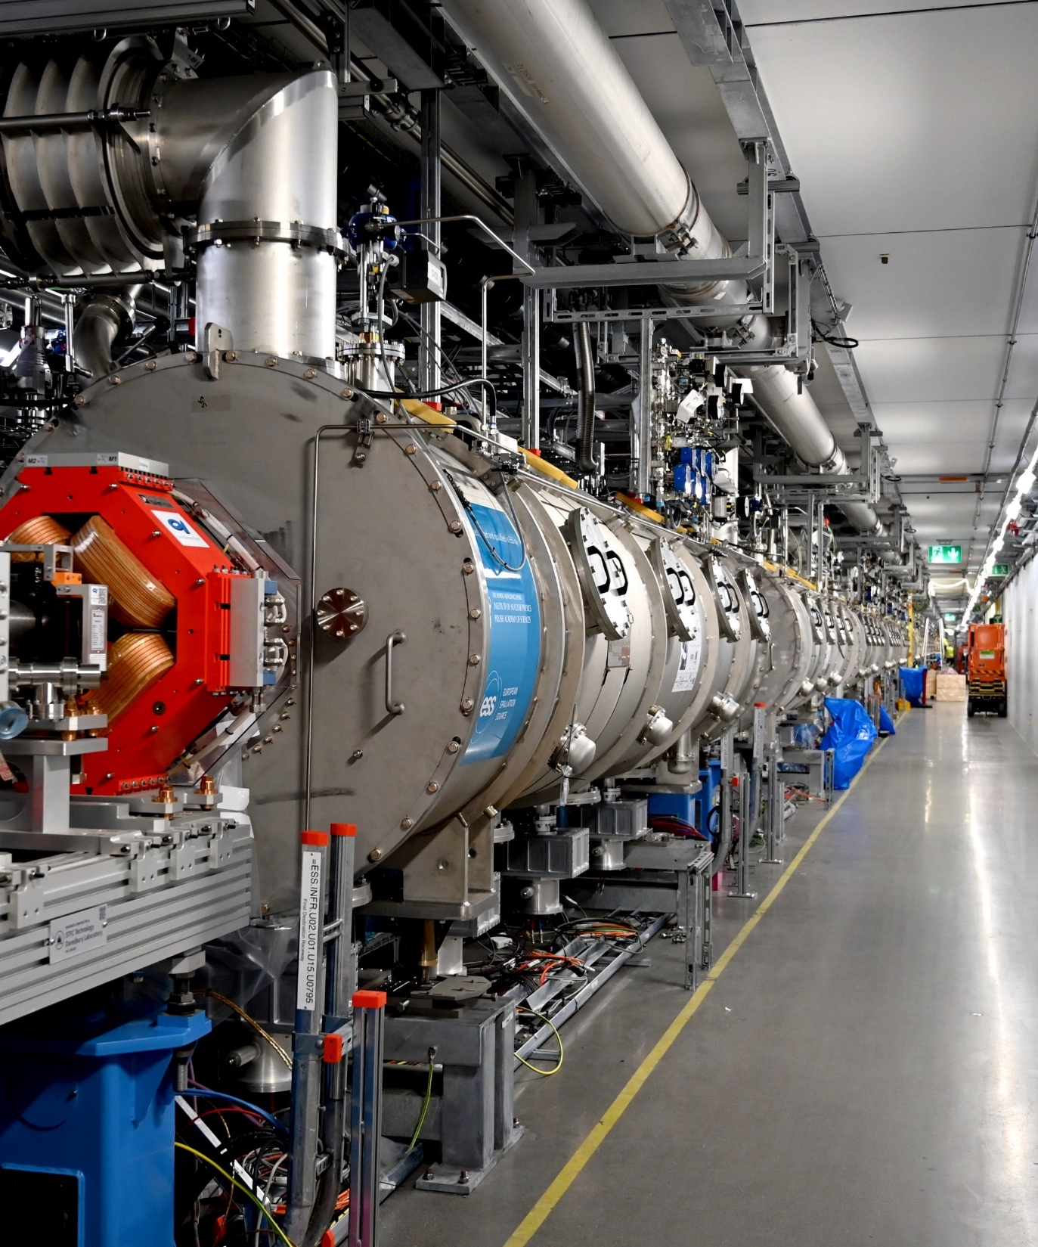
Looking Ahead

Slide 25
What will the future hold?
ESS construction project:
  2 MW capable average power on target
  6 NCL klystrons, 26 Spoke tetrode based systems, 56 MB/HB klystron systems
  2 MW to 3 MW upgrade
  Not formally funded, ie not part of initial scope for operation in 2028
  Would require another 24 additional 1.5 MW klystron systems
  Cryomodules, utilities and much of the RF system is already available
    Needs klystrons and klystron auxiliaries
  Upgrade cost relatively low!
  If approved shortly, the same technology is most likely and possibly the only practical solution

Slide 26
3 MW – 5 MW upgrade
  Will require significant investment
  Likely to be low priority while expanding the science capability
Opportunity to push for technological improvement
    New development – next generation?
    Time to consider gridded tubes?
    Time to consider higher risk, significant step up in performance
    Focus on operational power closer to saturation.
Some solutions could be ‘backwards’ compatible, eg HE klystron approach ie would support existing installation
  Reuse of magnets, possible klystron retrofit.
  Klystron retrofit of end-of-life klystrons when it happens.
But the efficiency of ‘standard’ klystrons will be limited when operated below saturation

Slide 27
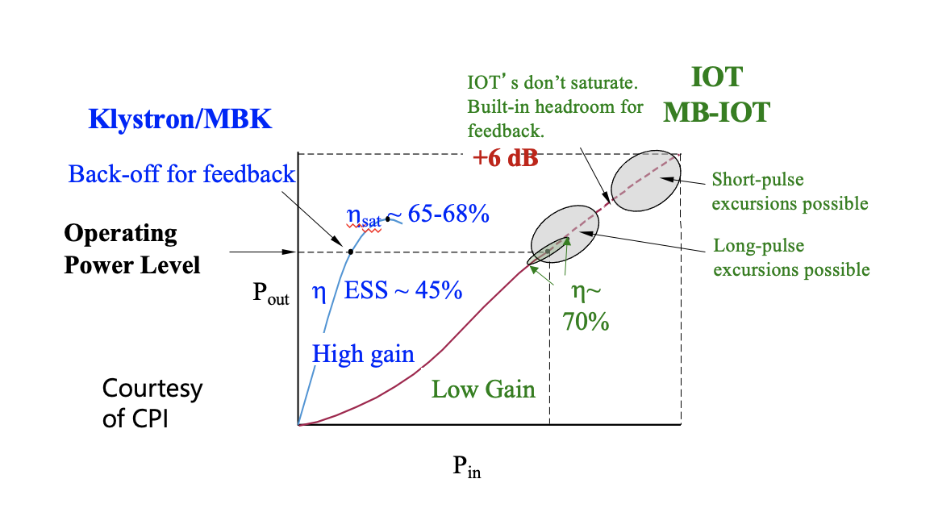
The advantage of gridded tubes
Back to the Future?
See WEXGBF1
IPAC 2018
M. Jensen
Klystrons: Back-off for feedback cost 30%
IOTs: Operate close to max efficiency

Slide 28
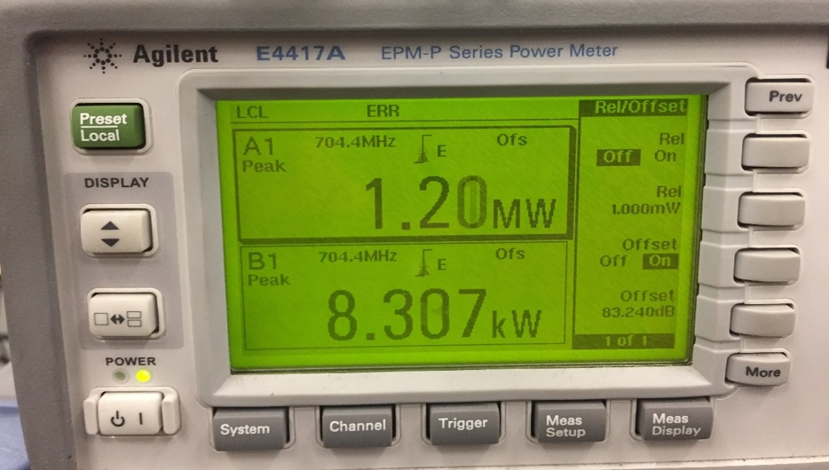
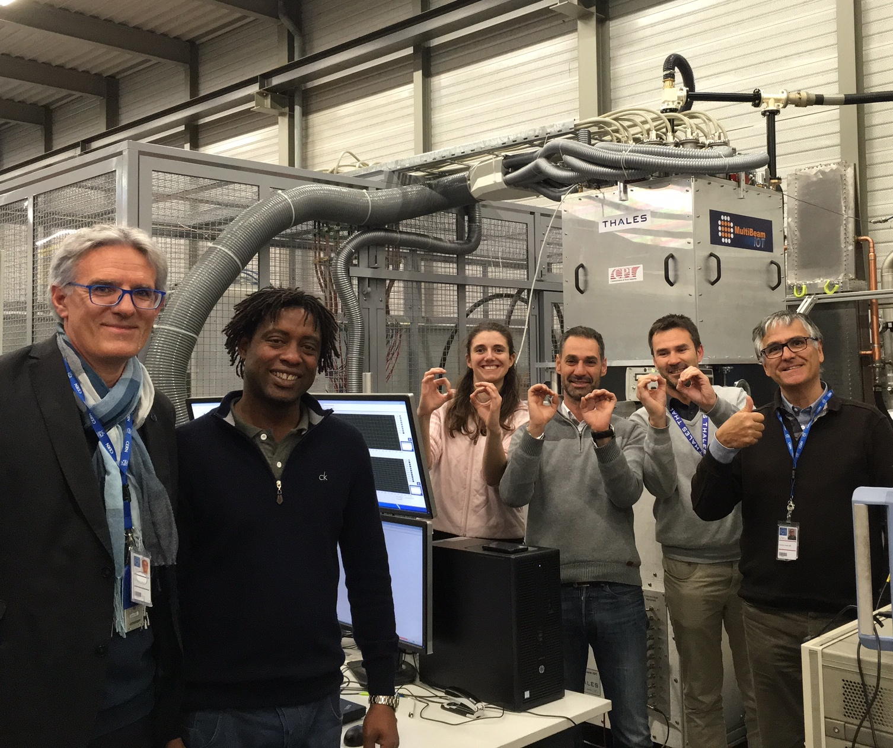
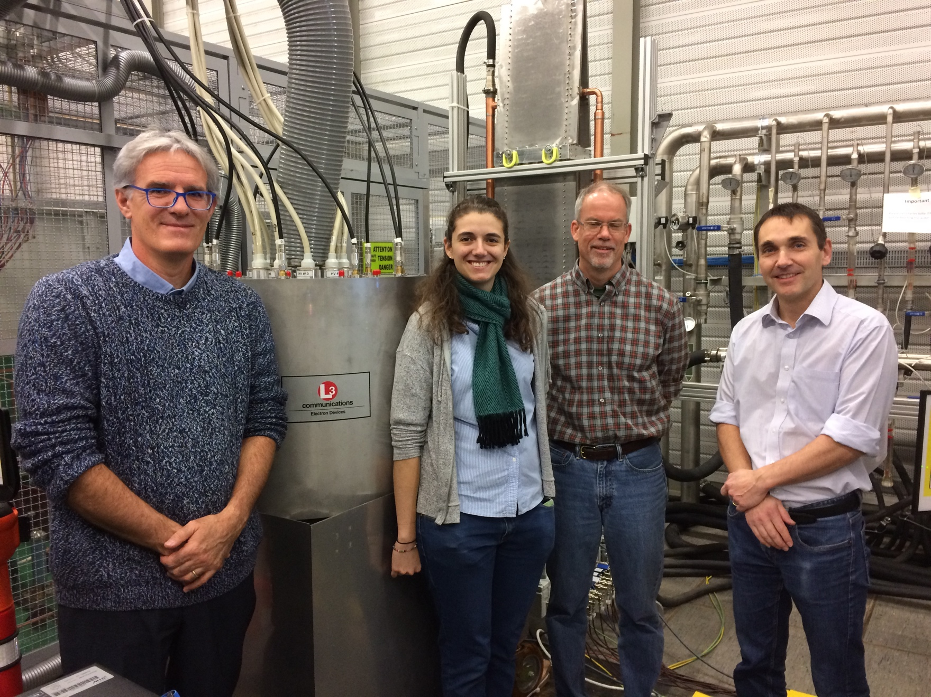
The Original ESS MB-IOT
World Record
MBIOTs were delivered and high power tested at CERN.
Both IOTs delivered 1.2 MW
Thales/CPI MBIOT
L3 MBIOT

Slide 29
Results of the 10-beam IOT
L3 MBIOT
Thales/CPI MBIOT
Efficiency
Efficiency
Output Power
Output Power
70 % efficient at 1.2 MV
Efficiency remains > 60% from 650 kW
High efficiency at point of operation even when overhead is required

Slide 30
That was 7 years ago!
ESS was under schedule pressure and it would require to be industrialised and optimised.
Ready for a new challenge? Can we do better?

Slide 31
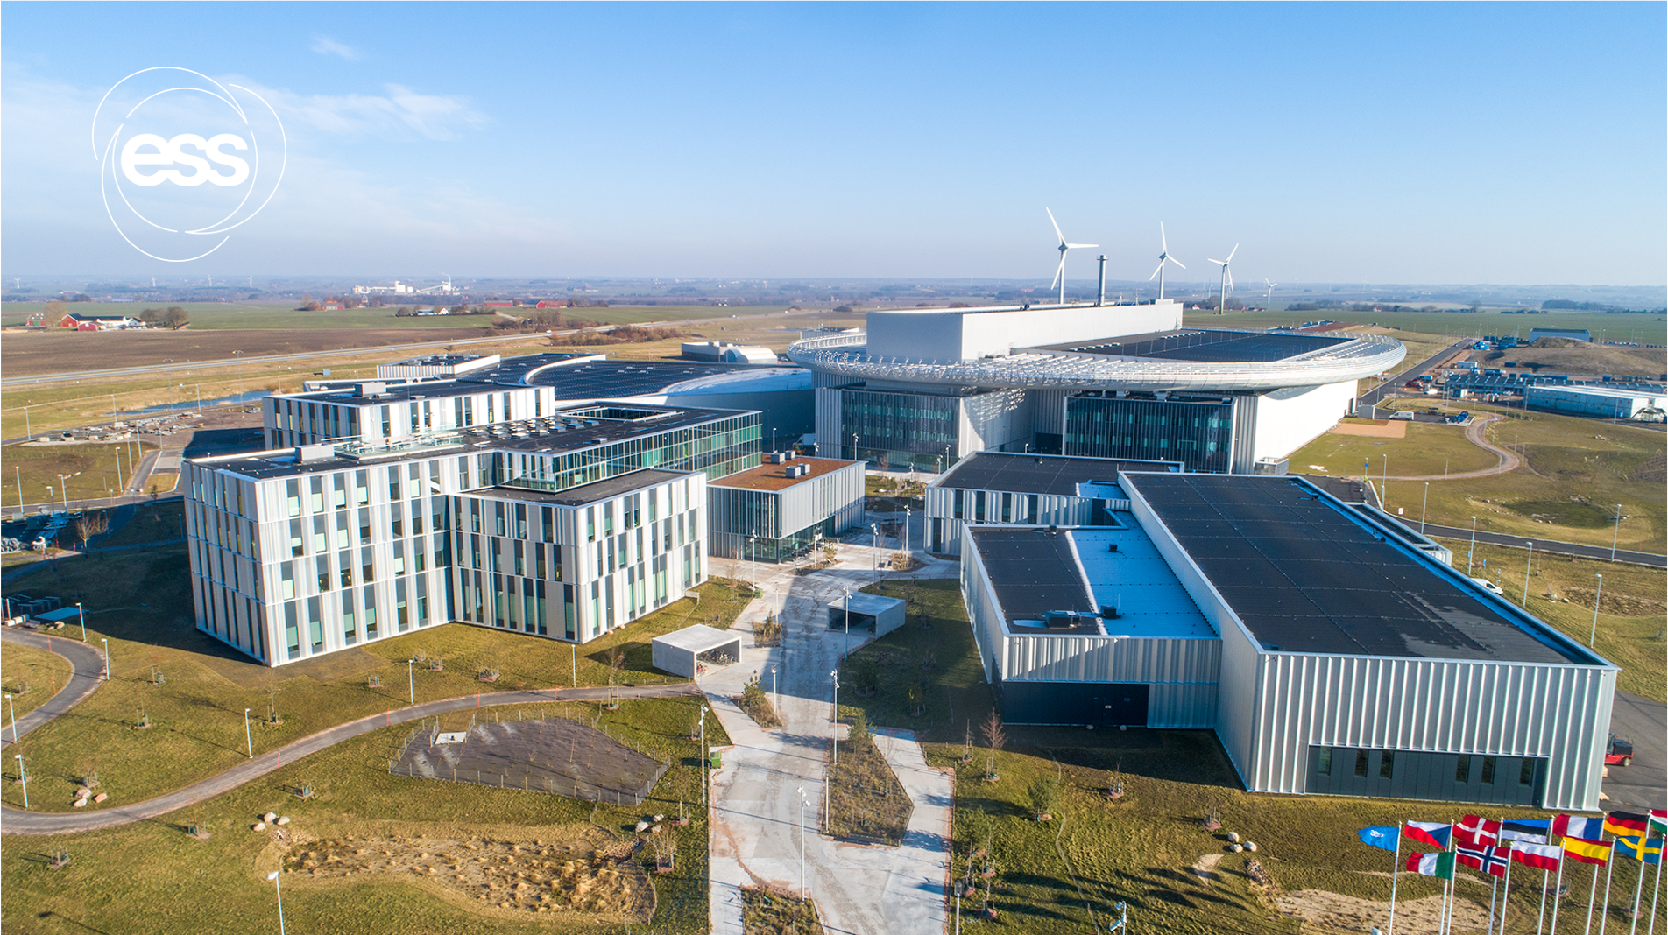
Thank you for your attention.
Any Questions?

