Slide 1
TH2167HE KLYSTRON FOR LHC
K. Haj Khlifa, A. Beunas, Thales AVS MIS
I. Syratchev, N. Catalan Lasheras, C. Marrelli, O. Brunner, CERN
Workshop on efficient RF sources,
Toledo, Spain, 23-25 September 2024

Slide 2
Outline
TH2167 upgrade objectives
Simulation results
Mechanical design & manufacturing
Measurement results
Conclusion

Slide 3
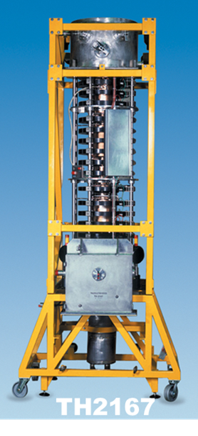
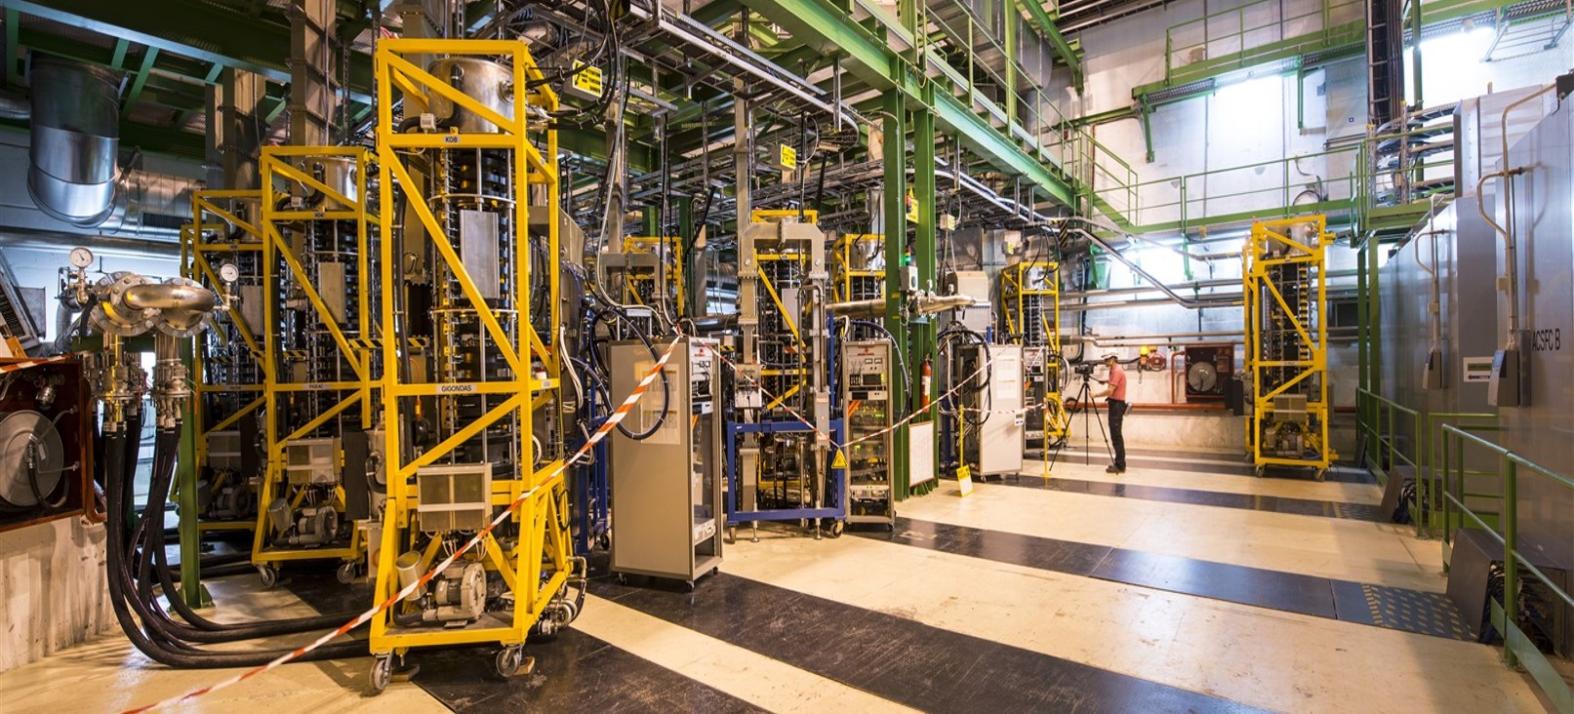
TH2167 upgrade objectives
30 TH2167 klystrons delivered to CERN (400 MHz, 300 kW CW at 58 kV, 8.4 A, ~60-62% efficiency)
Developed in 2002, with 16 units commissioned in 2008
High Luminosity LHC upgrade requires more RF power
Target: at least 350 kW per klystron at ~58 kV, 9 A
Efficiency needs to increase to a minimum of 67%.
This project has received funding from the European Union’s Horizon 2020 Research and Innovation programme under Grant Agreement No 101004730

Slide 4
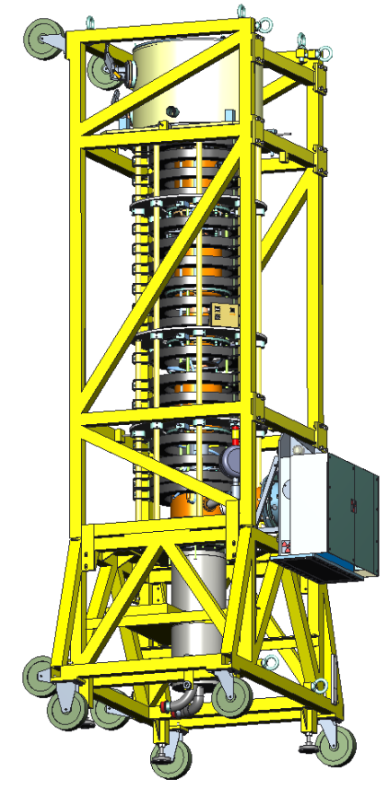
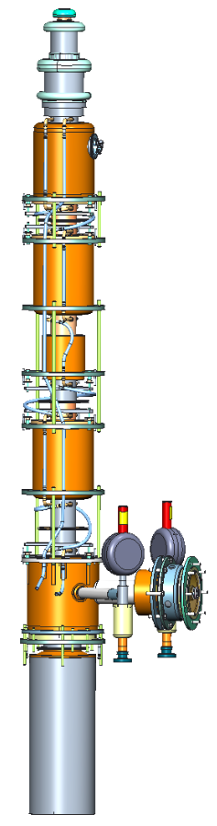

TH2167 upgrade objectives
Air tank
Main requirements
Parameters | Unit | TH2167 | TH2167HE
Frequency | MHz | 400.8
Power | kW | 300 | 350
Efficiency | % | 60-62 | > 67
Gain | dB | 37 | 36
Bandwidth | MHz | +/- 1 | +/- 0,7
Supporting frame
Klystron body
Parts redesigned for the high efficiency TH2167
Electromagnet
Coaxial to WR2300 waveguide transition

Slide 5
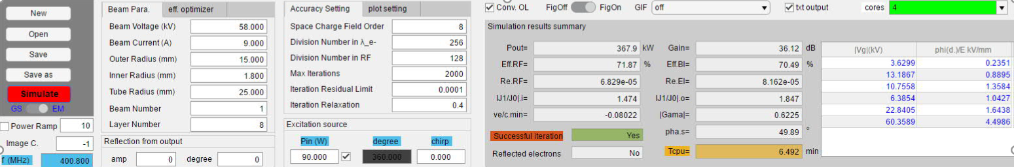
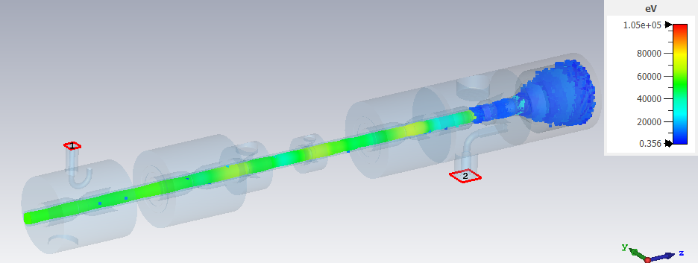
Simulation results
CERN DESIGN (by I. Syratchev & J. Cai)
  New interaction structure design with harmonic 3 cavity
  Baseline structure from KLYC and CST 3D simulations
  Predicted power is 368 kW at 58kV 9A with 70,5% efficiency and 36,5dB gain (at saturation)
  173 mm shorter than the initial structure
Courtesy of CERN

Slide 6
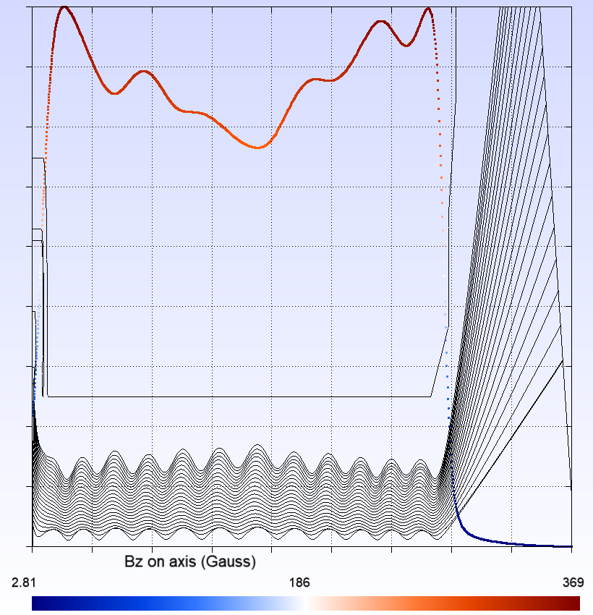
Simulation results
Electron beam
  Same beam as TH2167 generated from a triode gun; low convergence beam with 14,2 mm radius; ripple is about 14% (= (rmax-rmin) / (rmax+rmin)),
  Drift tube radius 25 mm
  Operating point at 57.7 kV x 9 A with a mod anode voltage of 31.2 kV; beam perveance is 0,65 µperv

Slide 7
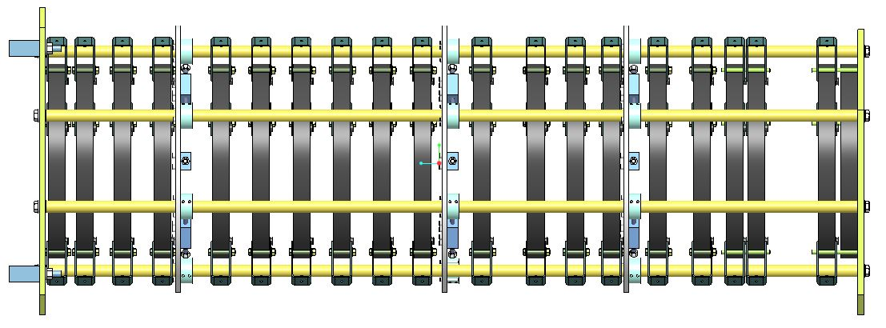
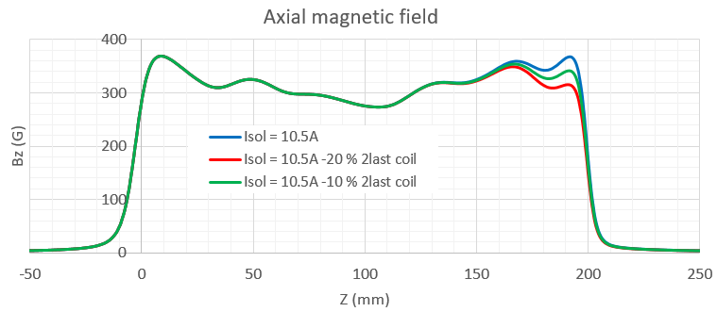
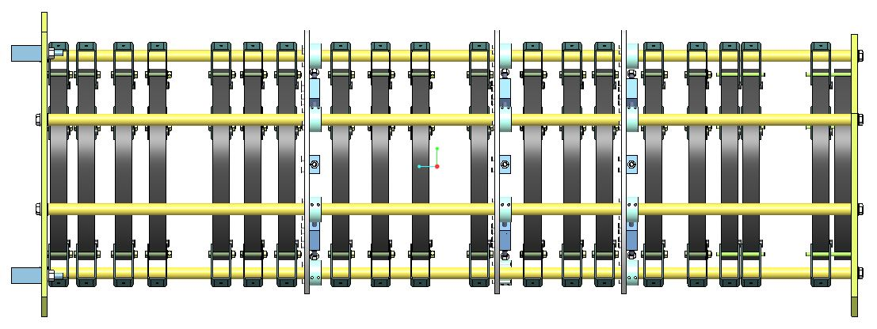
Simulation results
Electromagnet modifications
  Re-adjusted the position of some coils and supporting plates to allow the access to cavities tuners.
  increase coil current from 9,4 A to 10,5A
  second power supply added for the last two coils to optimize magnetic field profile close to the OP cavity,

Slide 8
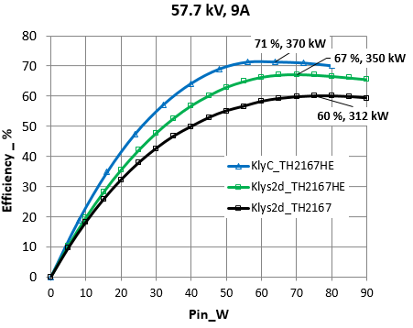
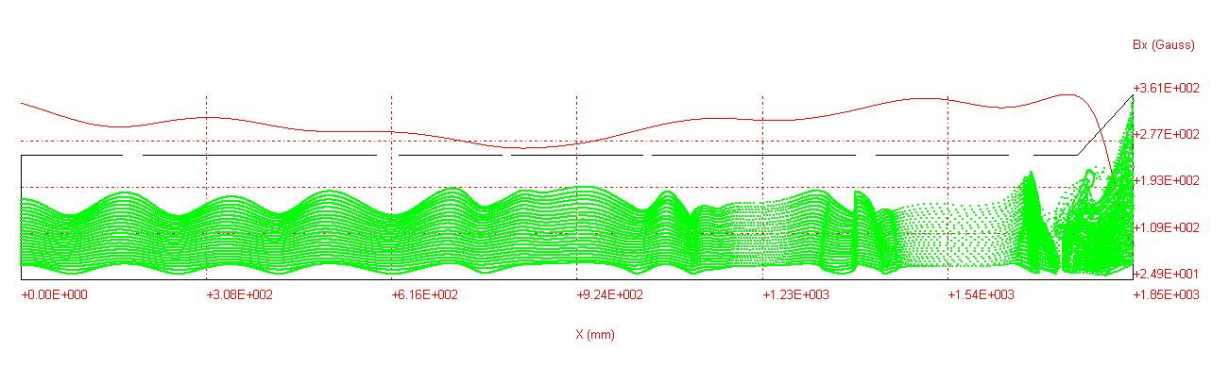
Simulation results
TH2167 Vs TH2167HE
  Beam wave simulation with KlyC & internal PIC code Klys2D
  TH2167_ Bz@Icoil=9.4 A, TH2167HE_ Bz@Icoil=10.5A
  Klys2d input data aligned with KlyC, coupling factor from HFSS simulation of cavities
  Predicted efficiency with Klys2d 67.3% (350kW saturated), 3 pts less than KlyC;

Slide 9
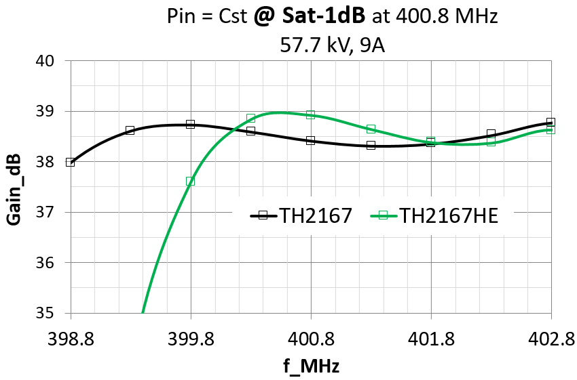
Simulation results
TH2167 Vs TH2167HE (Klys2d)
  Bandwidth is shorten at lower edge due to Harmonic 3 cavity
  The gain variation within +/- 0.7 MHz of the center frequency is less than 1 dB at Sat-1dB.
+/- 0. 7 MHz

Slide 10
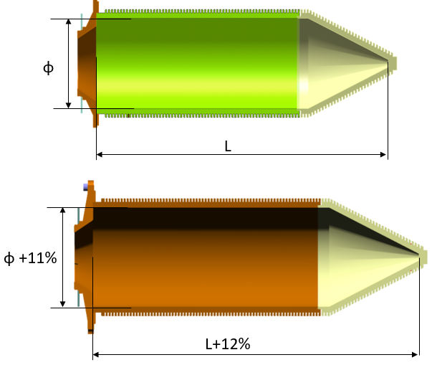
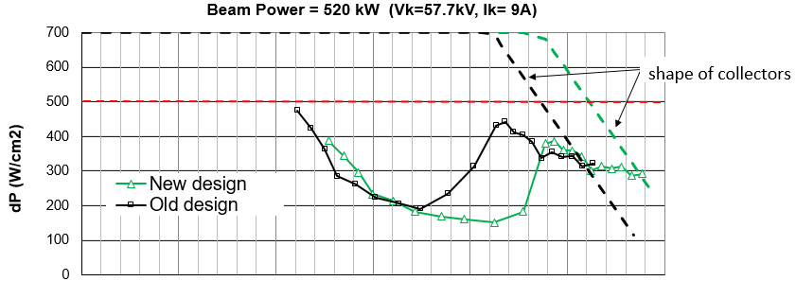
Simulation results
Collector resizing
  Increase inner diameter and length of the collector
  To have more margin in case we need to increase the beam power
length

Slide 11
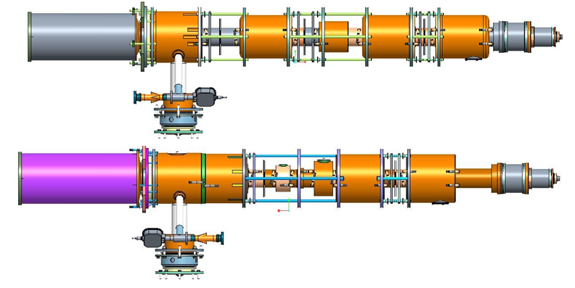
Mechanical design & manufacturing
Design changes (pumped tube)
TH2167
2nd harmonic
cavitiies
TH2167HE
3rd harmonic
cavitiy

Slide 12
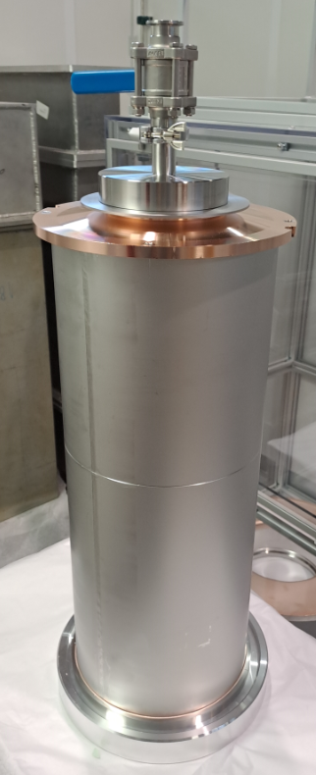
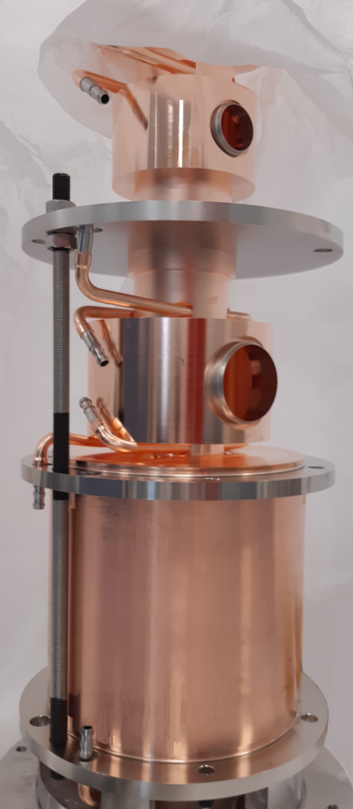
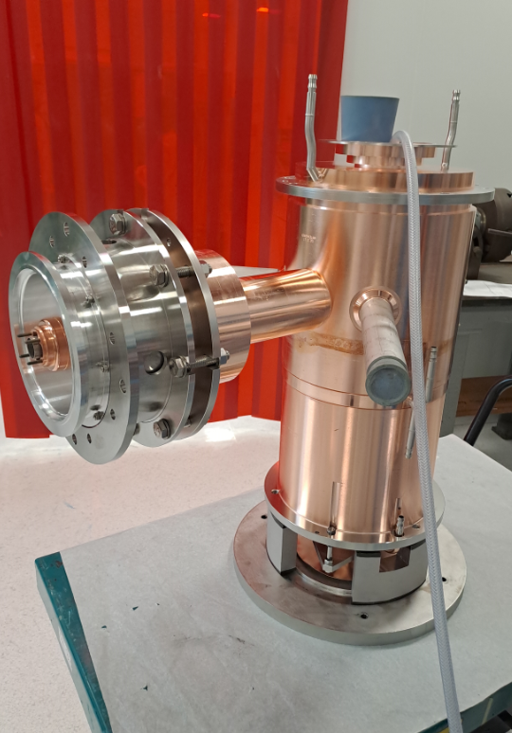
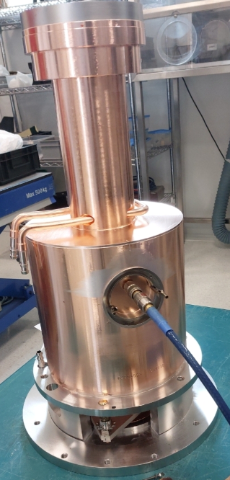
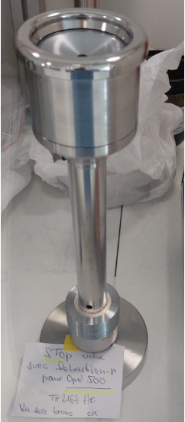
Mechanical design & manufacturing
Parts assemblies
Cavity H3
Cavity H2
Cavity n°2
gun
Input cavity
Intermediate cavities
penultimate and last cavities + window
collector

Slide 13
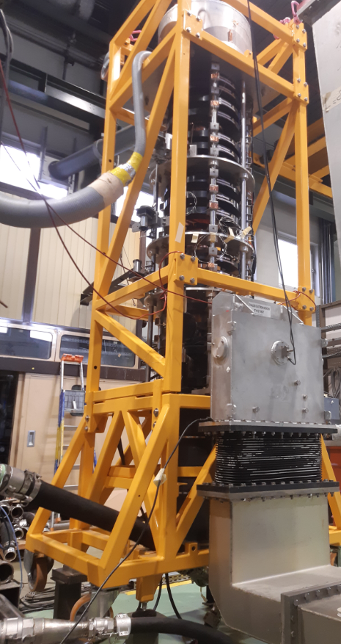
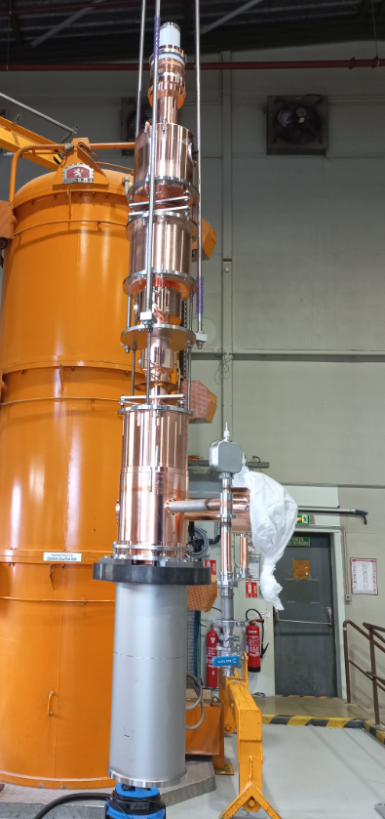
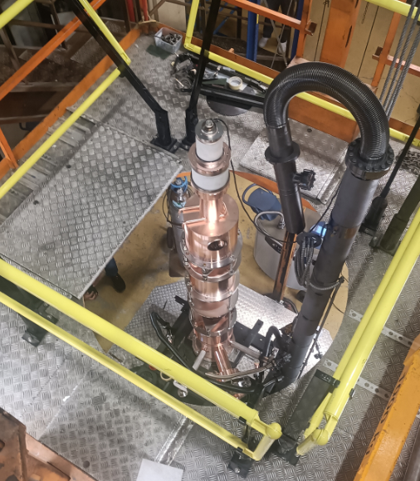
Mechanical design & manufacturing
Inside the baking & exhaust station

Slide 14
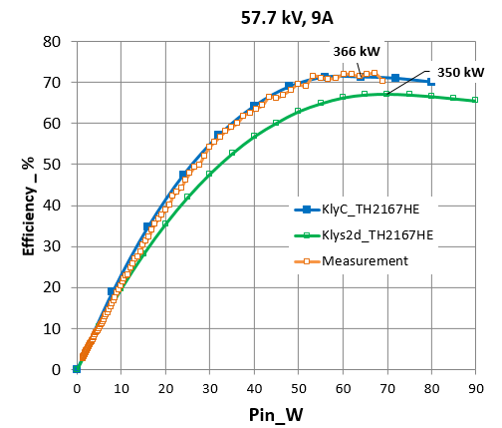
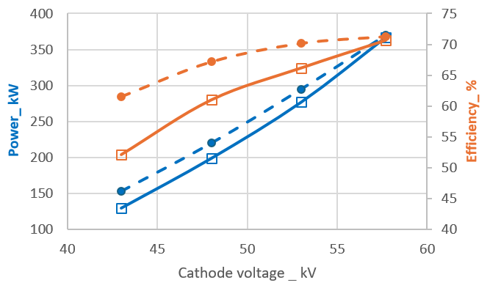
Measurement results
Measurement Vs simulations
Measurements
klyC
70 % efficiency measured @ 57.7 kV
Good agreement between Measurement and KlyC calculations @ nominal voltage
High efficiency (61%) maintained at 200 kW (mode I), 6 points higher than the TH2167
Discrepancies are mainly due to tube adjustments, not fully evaluated for retro-simulation yet.

Slide 15
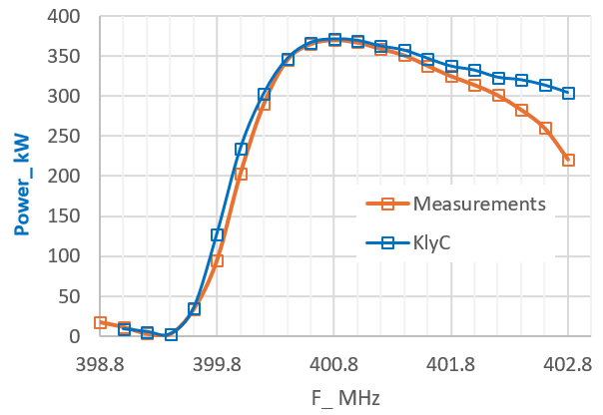
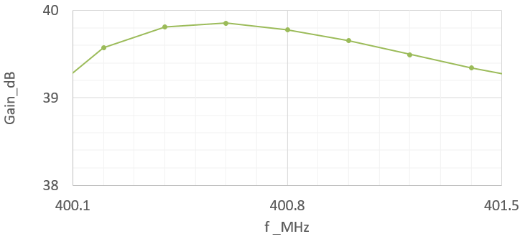
Measurement results
Measurement Vs Simulations (KlyC)
@ Pin=60W_57.7 kV, 9A
@ Psat-1dB_57.7 kV, 9A
The measured bandwidth zoom @ +/- 0.7 MHz
0.6 dB
Good agreement between measurement and KlyC calculations
The bandwidth is compliant

Slide 16
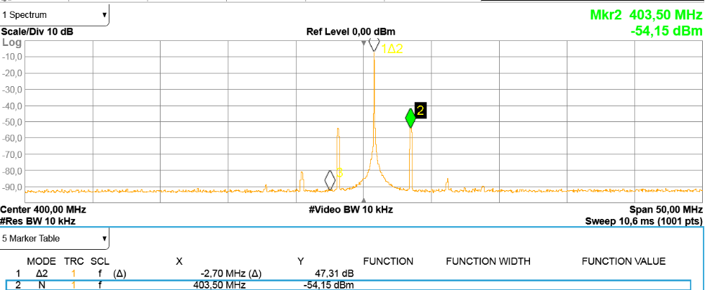
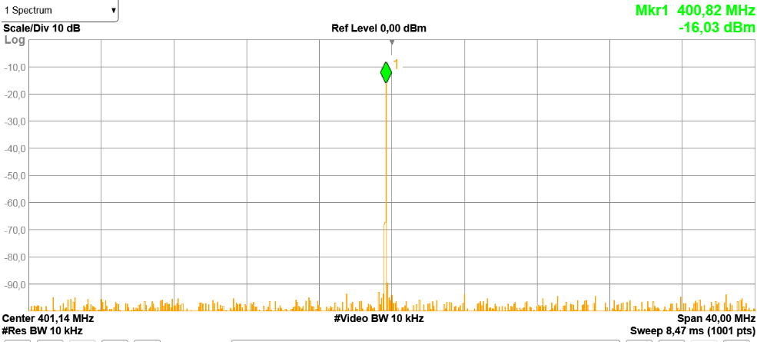
Measurement results
Side bands
  Sidebands appeared at 403.5 MHz before saturation.
  Attenuated and pushed after saturation by adjusting cavity 5
  Eliminated by adjusting the current of the main coils.
Before settings
After settings

Slide 17
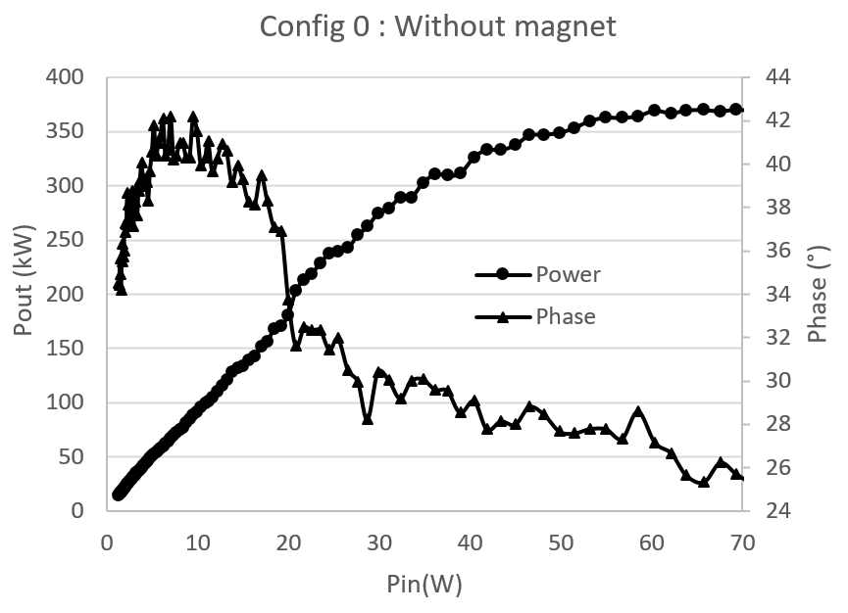
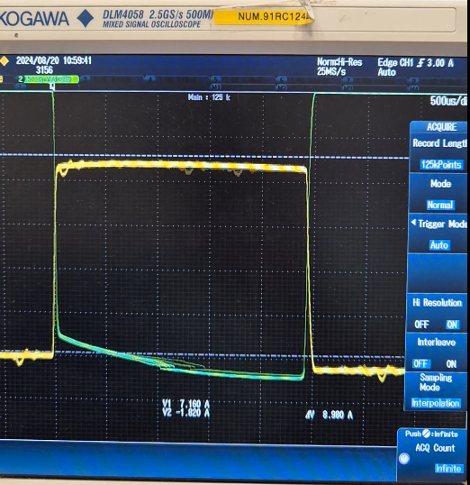
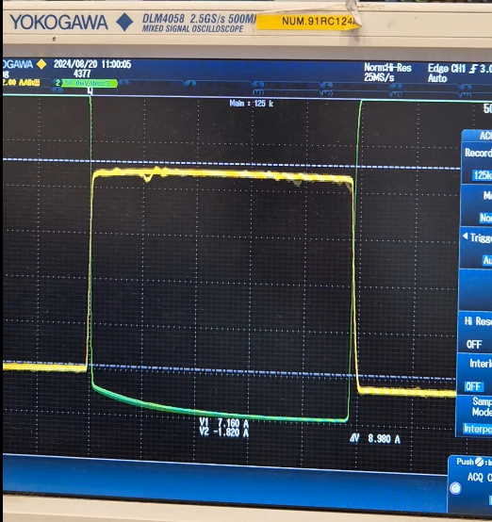
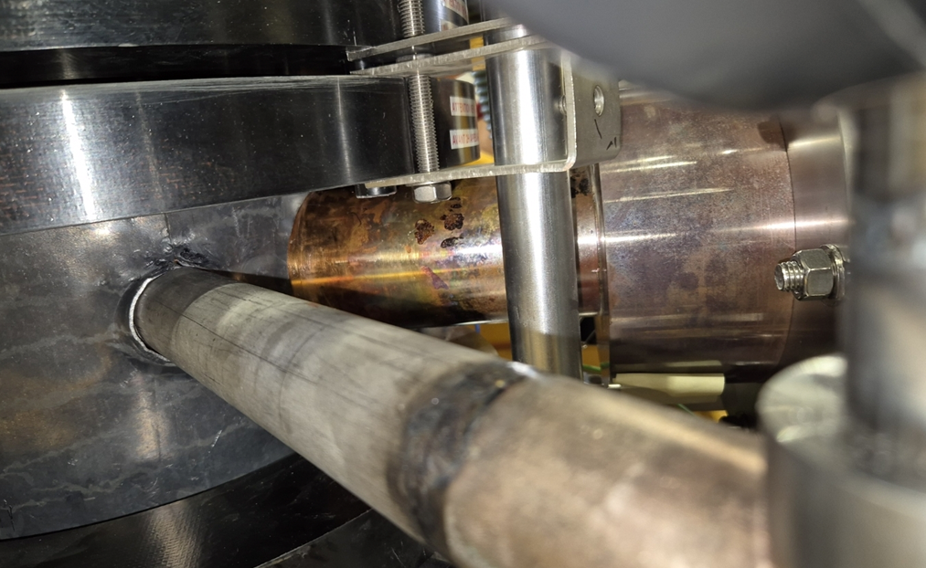
Measurement results
Multipactor: Disturbance of the transfer curve and the pulse signal.
@ 57.7 kV, 9A
Green: The output signal pulse
Yellow : cathode current pulse
Copper color →no overheating
Blue color
→ sign of overheating

Slide 18
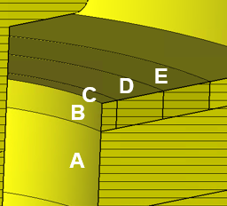
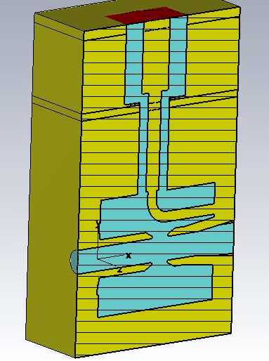
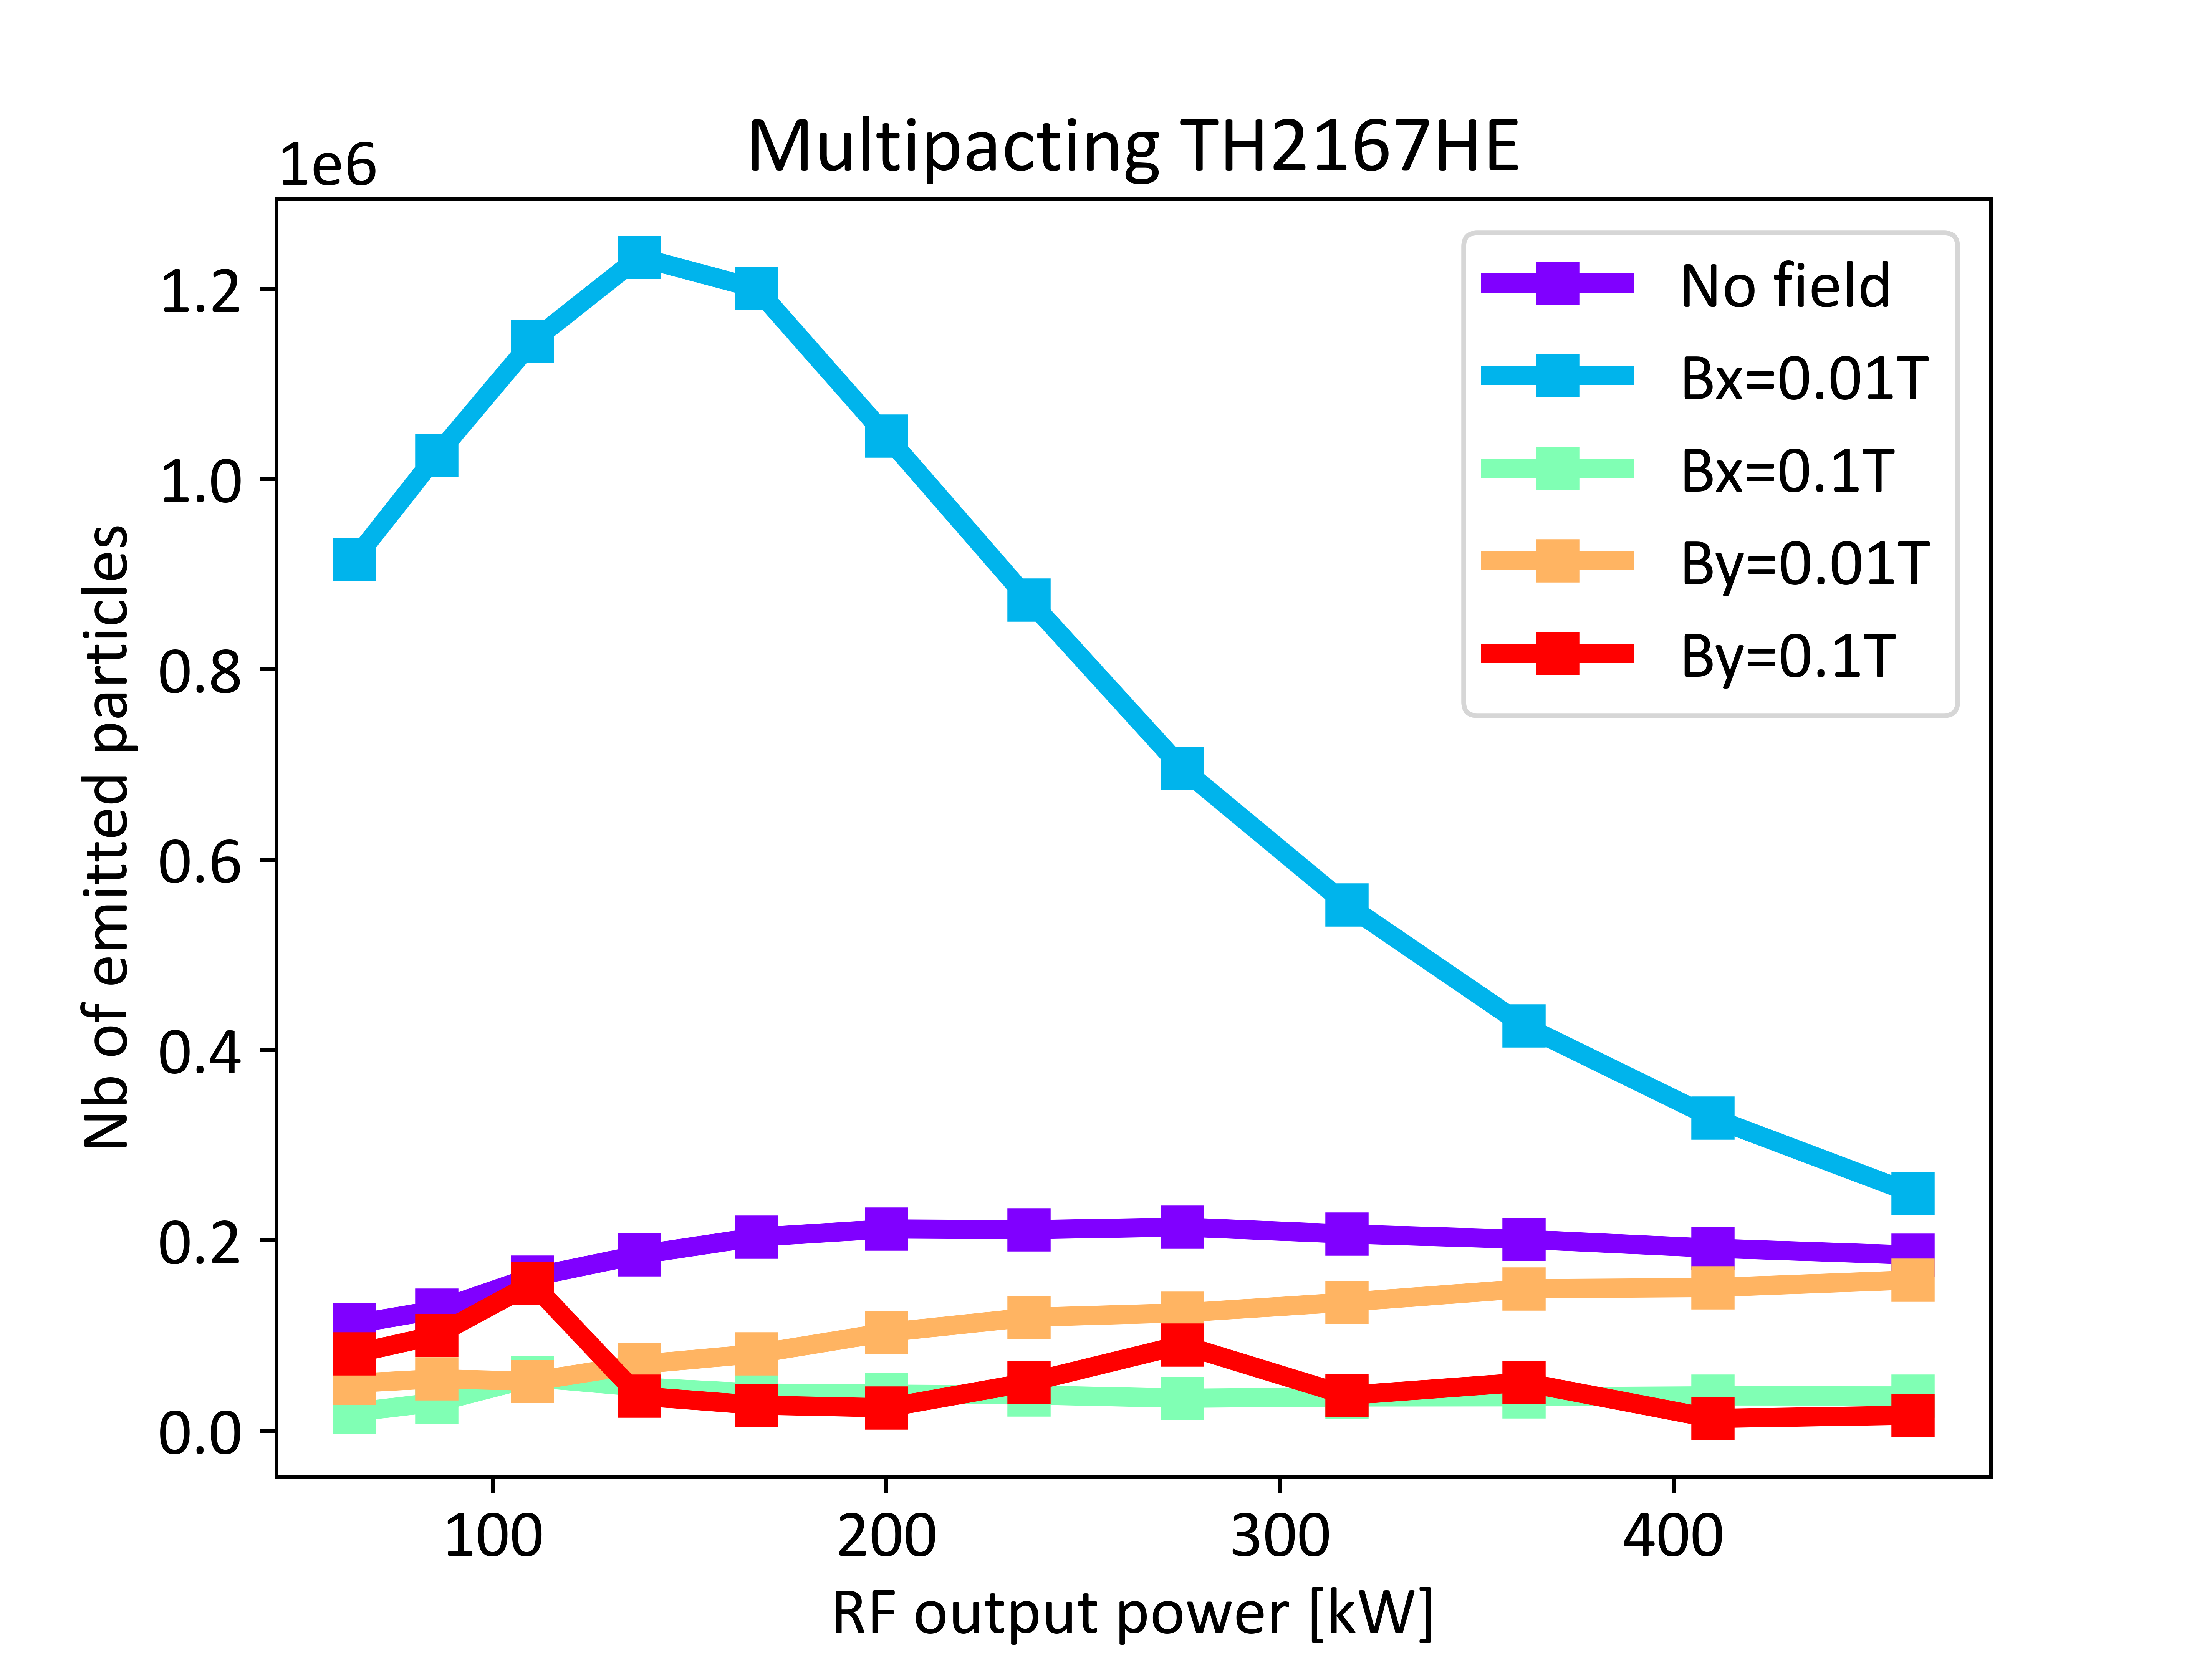
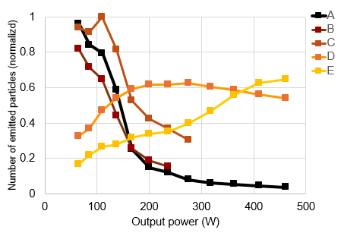
Multipactor: CERN simulation (F. Peauger)
With static magnetic field
y
x
  The Multipactor phenomenon was demonstrated through simulation
  Emissions would occur at surfaces A, B, and C
  It can be eliminated by applying a static magnetic field along the coaxial axis

Slide 19
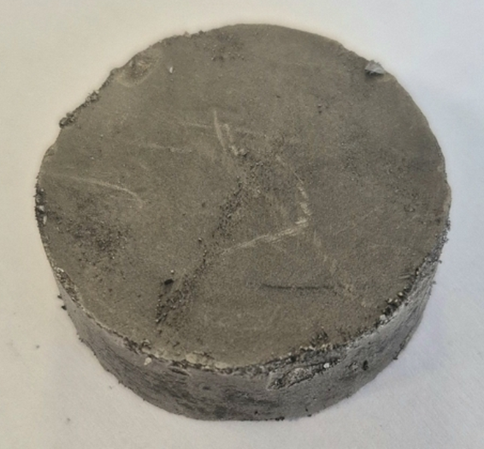
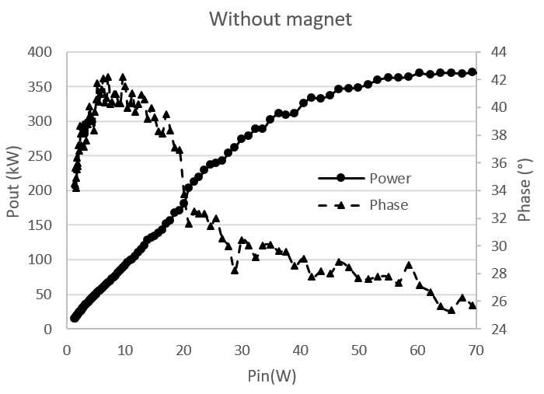
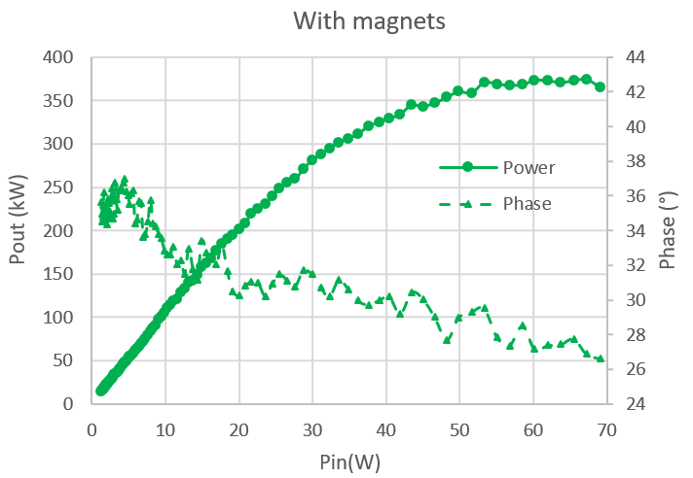
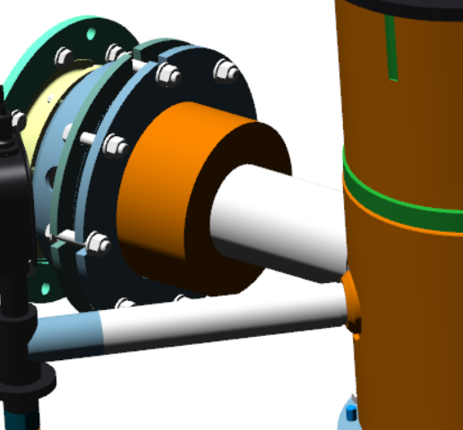
Measurement results
Multipactor: elimination of disturbances with a static magnetic field.
3 cm
S
N
Polarity of the magnet
N
Monotonous transfer curve
No more coax overheating

Slide 20
Conclusion
New klystron with 3rd Harmonic cavity designed by CERN and manufactured by Thales
The prototype achieves an efficiency of 70%, as calculated by the KLYC and CST codes.
The klystron will be delivered and tested at CERN to confirm the factory performances
Collaboration with CERN has been highly successful and very close, from design to testing
Significant advances in simulation, usable as a "digital tuning."

Slide 21
Merci
DE VOTRE ATTENTION

