Slide 1
Inductive Output Tube
A high efficient RF source for lower UHF band
State of the art and future scope
Chakib BELKHIRI
Patrick REYNAUD
Lucas HEYRMAN

Slide 2
Table of contents
01
02
03
Part 2
TH795 IOT performances
Part 3
New 400MHz trolley, design and modeling
Part 1
IOT background
04
05
06
Part 4 :
High Power Multibeam IOT
Part 5
Design perspectives
Part 6
Conclusion

Slide 3
Chapter 1 :
IOT background

Slide 4
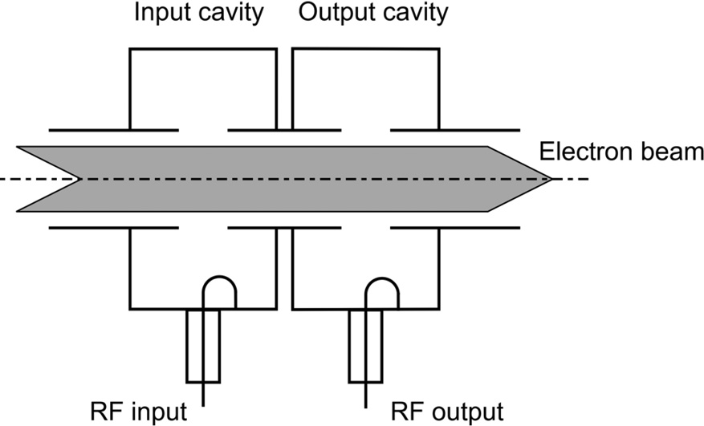
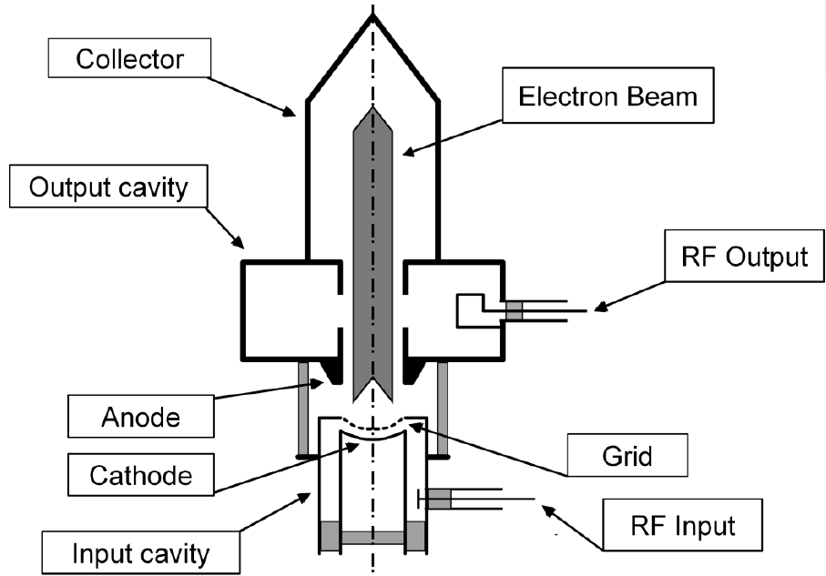
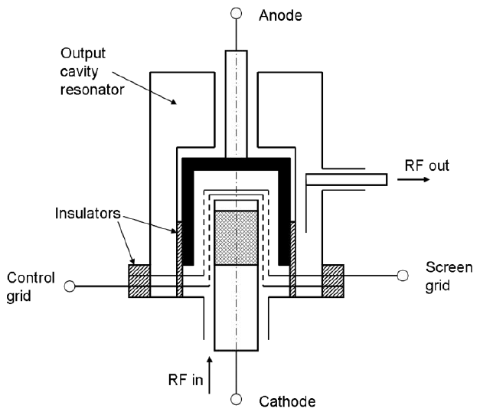
IOT is a Klystrode : A concatenation of Klystron and Tetrode
Limitations of the velocity modulation devices (Klystron) :
Drift space lenght → Fixed cavities position = Fixed voltage + bulky size
Continus beam current → RF efficiency decreases if output backoff
Inductive coupling output circuit
Density modulating input circuit
concatenation
Limitations of the density modulation devices (Tetrode)
Inter-electrodes capacitance → Low transition frequency + instability
Electron beam collector (Anode) is also a part of the output RF circuit

Slide 5
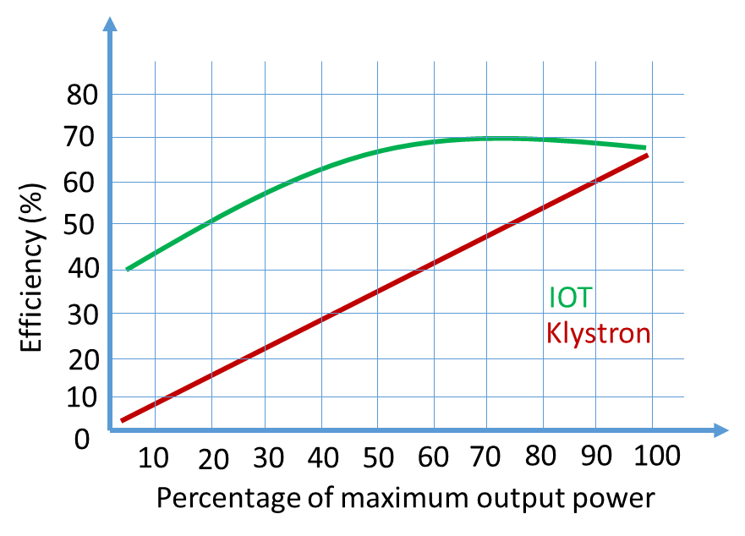
Comparison between IOT and Klystron
RF Input Cavity
Modulation Grid
Output Cavity
Anode
RF Input Cavity
Output Cavity
Cathode
Cathode
IOT Electron gun:
Electron bunchs created inside the cathode-grid space
Klystron Electron gun:
Electron bunching far from the cathode
Advantages :
IOT is more efficient over a large dynamic range
Acceleration voltage of an IOT can be tuned
IOT is less cumbersom
Limitations :
IOT exhibits less power gain
IOT provides less output power
Input RF voltage
Cathode current
Cathode current
Grid_Cathode voltage
Time
Time
IOT beam current:
Density modulated current. No current if no RF input
Klystron beam current:
DC current whatever the RF input power level

Slide 6
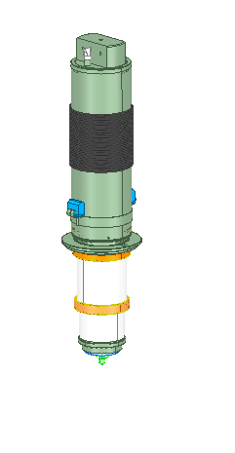
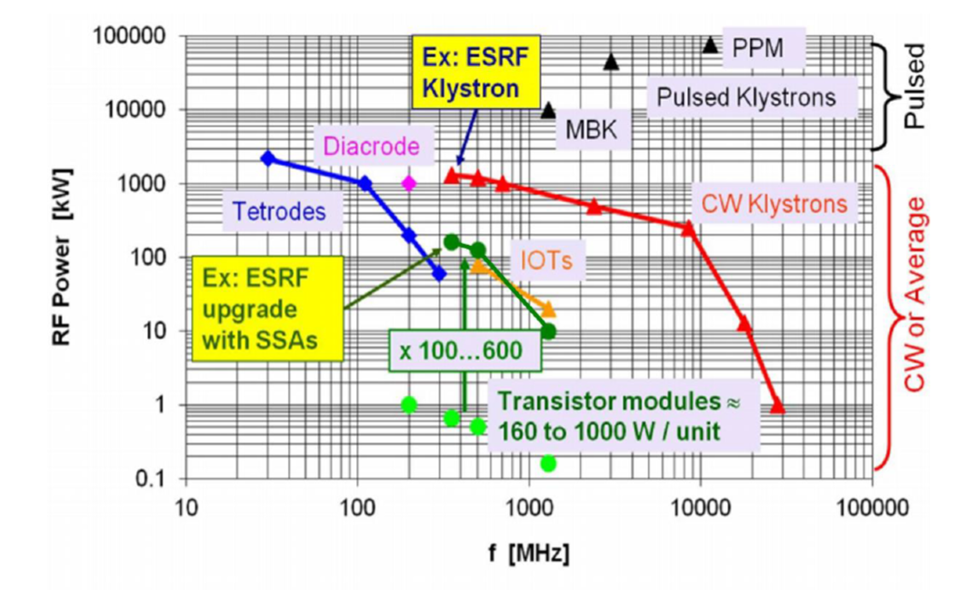
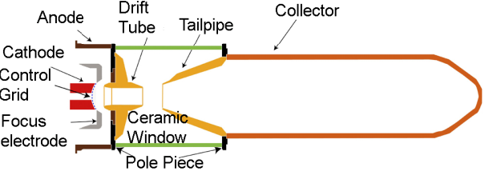

TH795: Features, Arrangement and Main components
High efficiencies, up to 70% in class-B operation
Good efficiency while operating with a backoff level
Linear AMAM response even at maximal efficiency
Linear AMPM response, suitable for phase loop control
About 23 dB power gain, 10 dB higher than tetrodes gain
Suitable for frequency range from 100 MHz to 1.5 GHz and power levels up to 500 kW CW and 1MW pulsed (case of Mutibeam IOT).
Lifetime > 50.000 hours (CERN SPS200, 60 kW @ 800 MHz )
More than 200 IOTs already manufactured and deliverd by thales over the last 25 years

Slide 7
Chapter 2 :
TH795 IOT performances

Slide 8
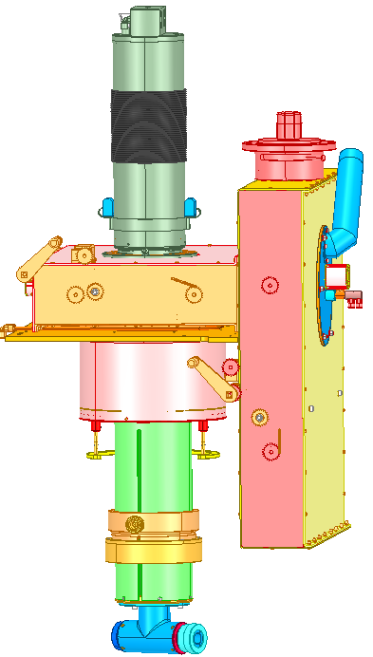
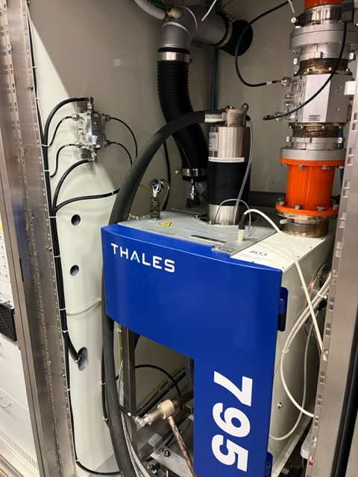
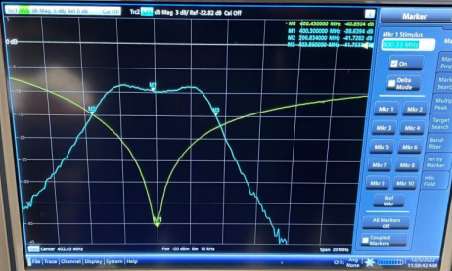
TV broadcast & Scientific Applications
Wide frequency range (470-860MHz tuned cavities)
CW mode (up to 80kW)
Two coupled output cavities (8MHz BW)
Double coaxial stub input matching circuit

Slide 9
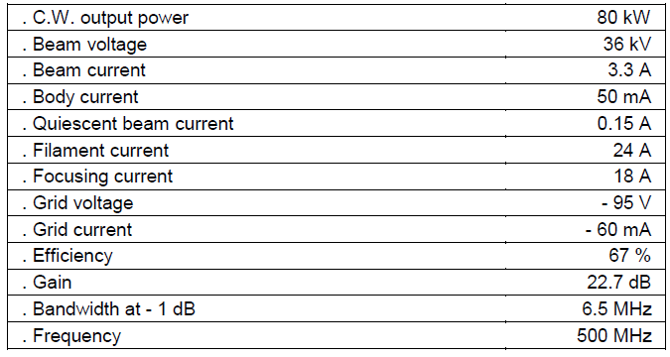
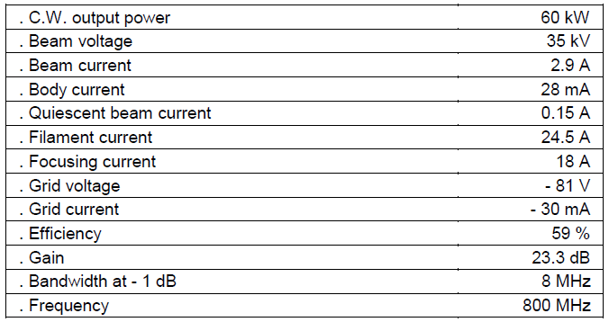
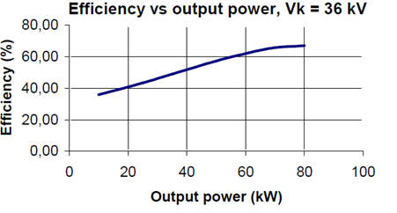
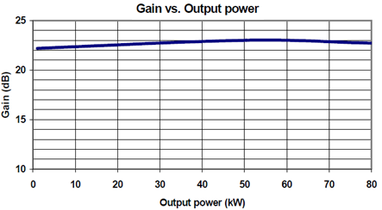
TH795: Achieved performances for a Continuous Wave operating mode
Class B amplifier up to 80kW and 67% Efficiency @500MHz
Class B amplifier up to 60kW and 59% Efficiency @800MHz

Slide 10
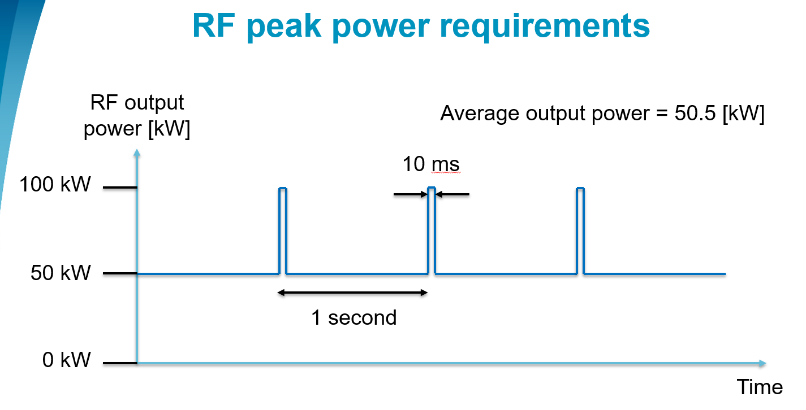
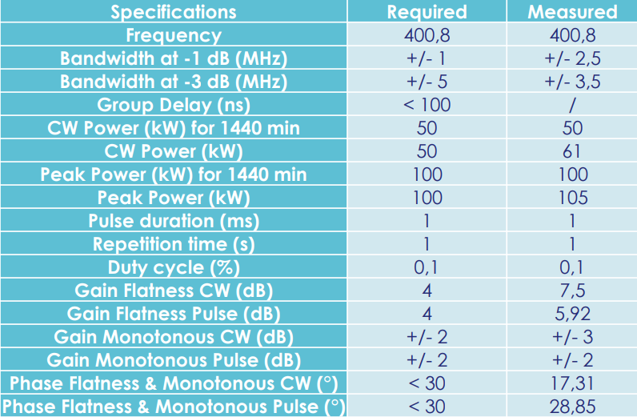


TH795: Achieved performances for a CW+pulsed operating mode
(Linear collider applications for CERN :
LHC_Crab Cavity project )
Achieved performances :
IOT : CW (60 kW) + Pulse mode (105 kW)
Cavity/Trolley : new design @ 400 MHz developed in collaboration with CERN

Slide 11
Chapter 3 :
New 400 MHz Trolley,
Design and modeling

Slide 12
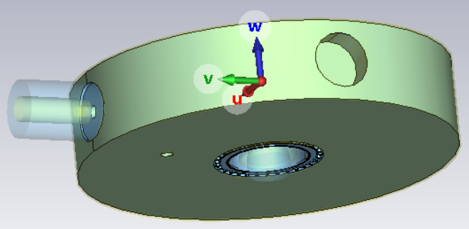
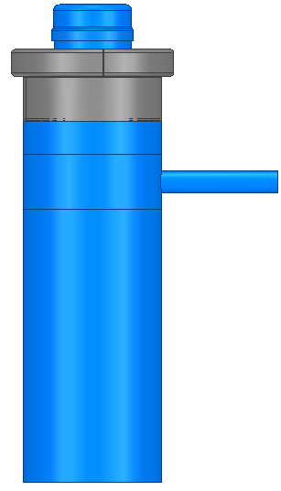
New compact cavities for scientific applications: Features
The trolley contains the set of input and output cavities, the focussing and the cooling components
Narrow band, single frequency (400MHz)
Cylindrical (single pillbox) output cavity capable of handling up to 100kW power level in pulsed mode
Single stub input matching circuit
Less cumbersome and less expensive than TH18795 (old double resonance cavities)
Need to simulate the IOT beam characteristics.
Output cavity
Input cavity

Slide 13
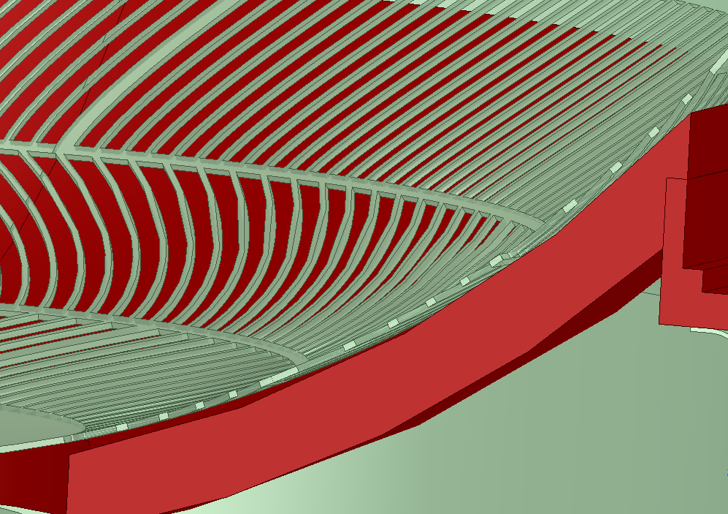
Design & modeling
3D simulations (CST Tracking and PIC) :
  Small cathode-grid space → high mesh density → very slow convergence
  PIC solver does not support space charge source, only Tracking solver allow it but no RF signal can be simulated in this case.
  2D simulations (CANON-IOT… )
  Alternative tools to evaluate the end to end electron beam behaviour
  Analytic model (quasi static Triode model)
  Fast evaluation algorithm but less accurate at high power level
Design approach :
  Input stage :
    Analytical model and cold 3D (HFSS) simulations to evaluate the matching elements characteristics (stub length)
    Analytical model to evaluate the beam current characteristics (Average and peack beam current as well)
    2D or 3D solver to confirm the beam radius and the quasi static Ik = f (Vg, Va) characteristics
  Output stage:
    Cold 3D (HFSS) simulations to optimise the output cavity size (Resonance frequency, Output coupling, Q0, QL and R/Q0)
    Analytical model to estimate the peak beam current needed to achieve a given output power based on the cavity characteristics
    CST PIC solver to confirm the output power level based on the bunched current calculated via the analytical model.
Grid – Cathode Distance = 280µm

Slide 14
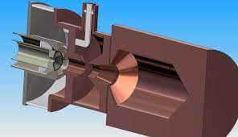
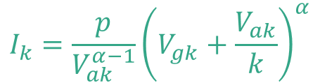
Input stage: Electron gun modelled as a Common-Grid Triode valve
$$I_{k}=\frac{p}{V_{ak}^{α−1}}{\left(V_{gk}+\frac{V_{ak}}{k}\right)}^{α}$$
Ik
I_{kp}
Ikp
R_{in}
Ik
Vg₀
Vcoff
V0
Vmax
θ0
Vgk
θ0/2
θ0/2
θ0
A
Cathode
Real transfert curve
Ideal transfert curve
Vg0 Grid biasing voltage (amplification class dependent)
θ
Vcoff Pinch off voltage (grid treshold voltage to switch on/off the beam
G
K
Vgk=Vg0+VRF
V0 Approximation of Vcoff considering a linear behavior
Vmax Peak RF voltage applied on the grid

Slide 15
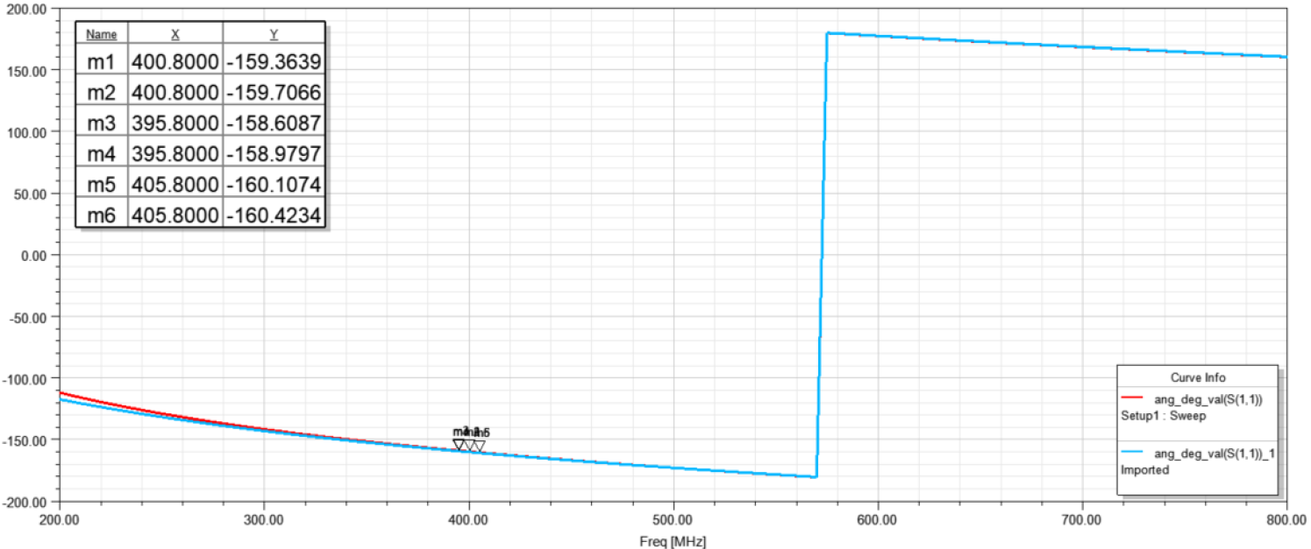
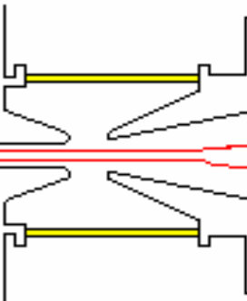
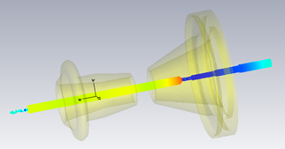
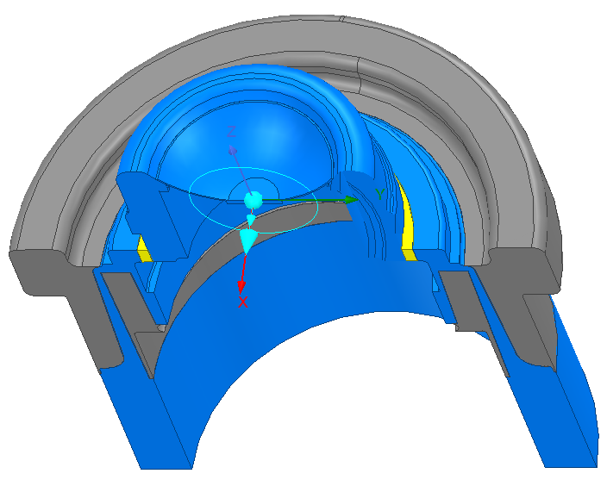
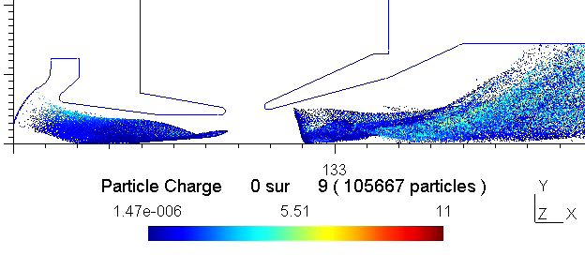
Cavities design and optimisation : Analytical model and 3D simulations
B=2b
Equivalent circuit seen
at the Cathode Grid interface
g
S11
C
HFSS
Rin
A=2a
L
R₀
C
I_{b}
CST
R_{L}
L
Equivalent circuit seen
at the output cavity gap
ADS
S11
CANON-IOT
(Thales)

Slide 16
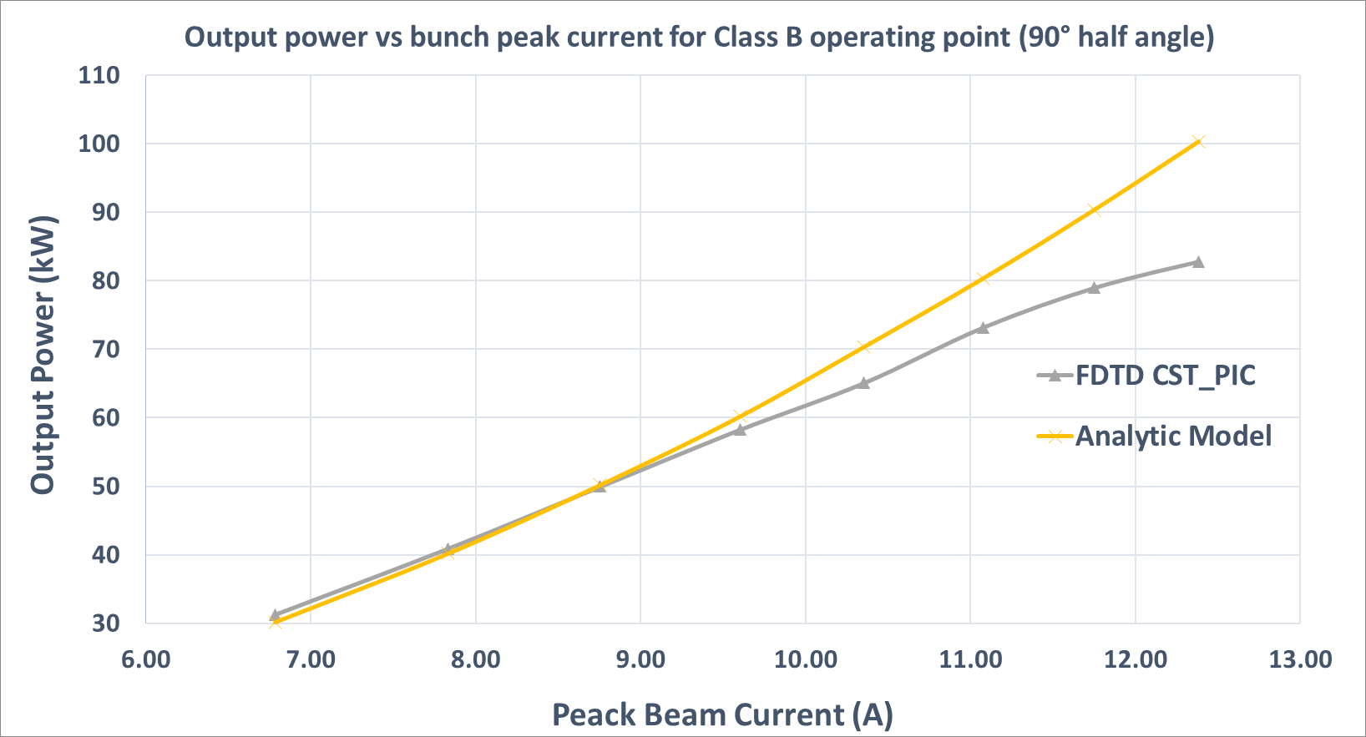
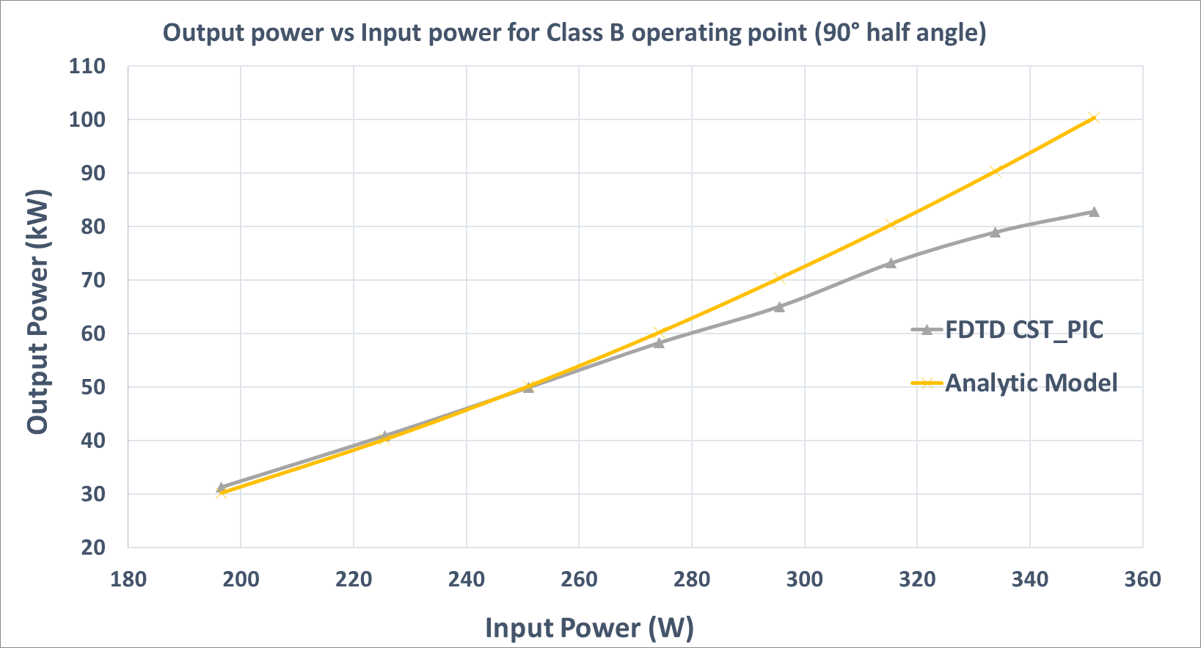
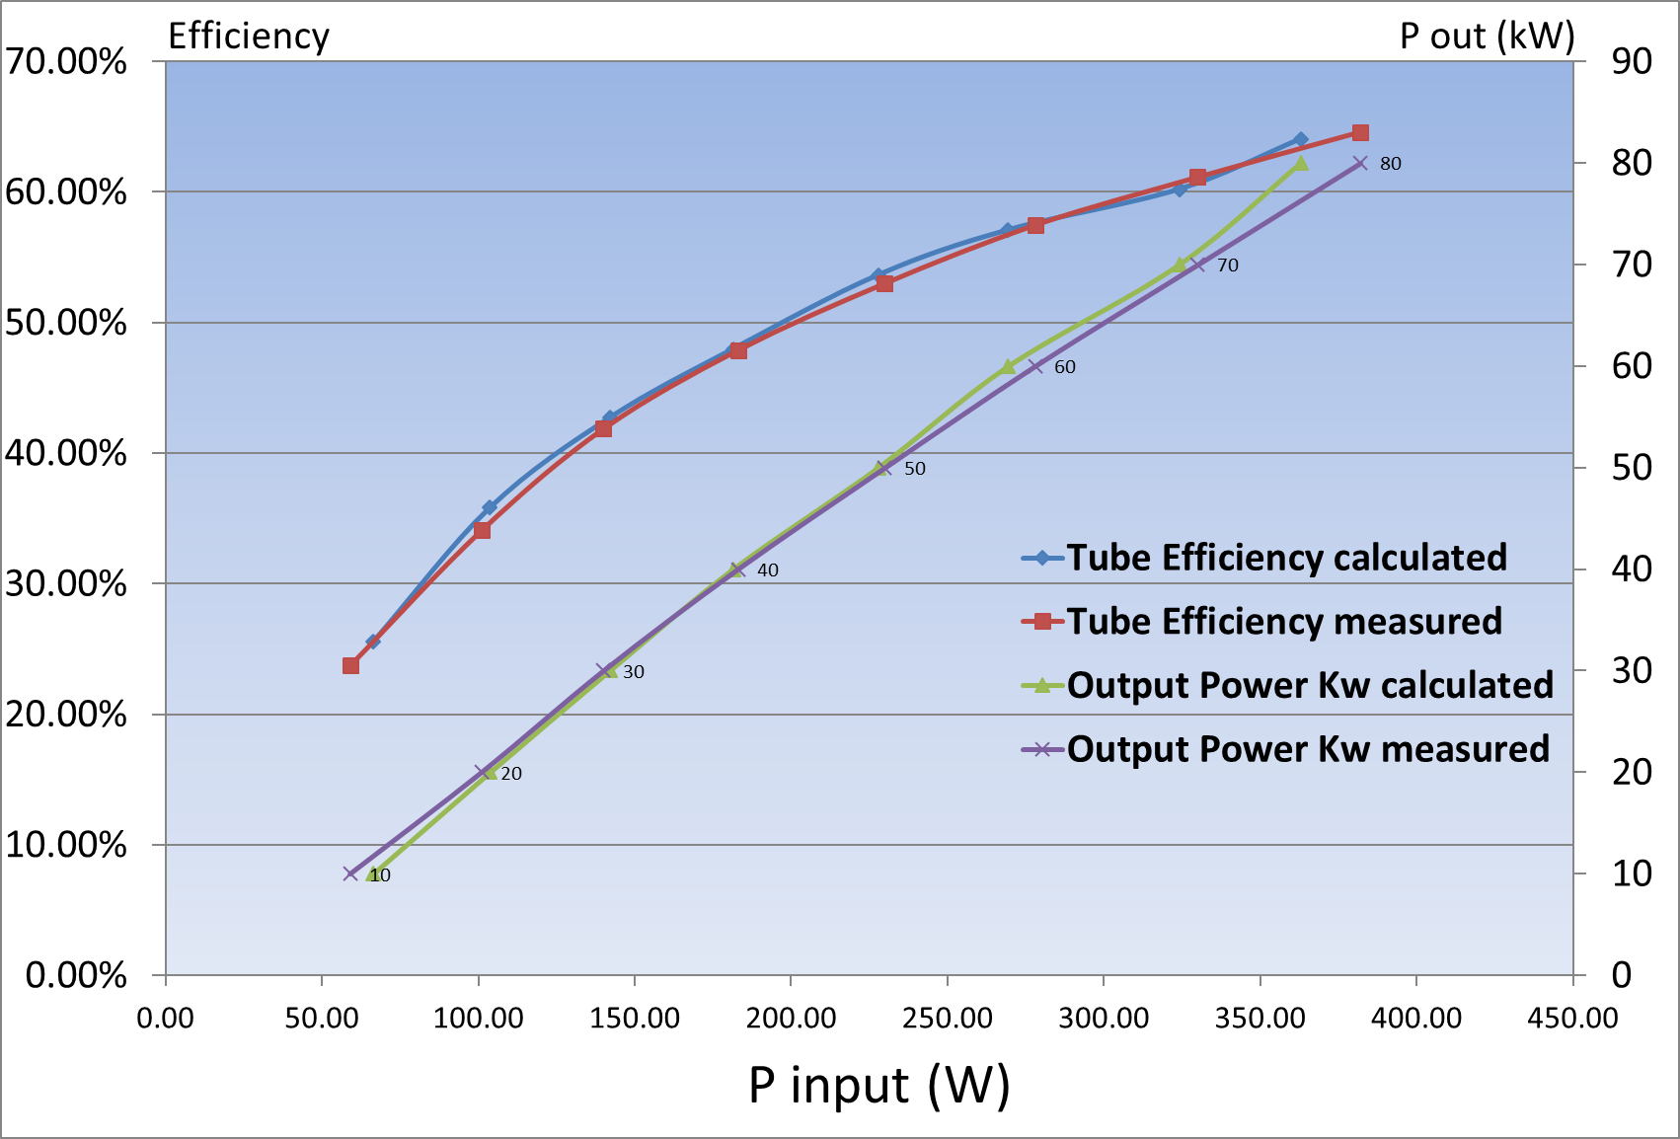
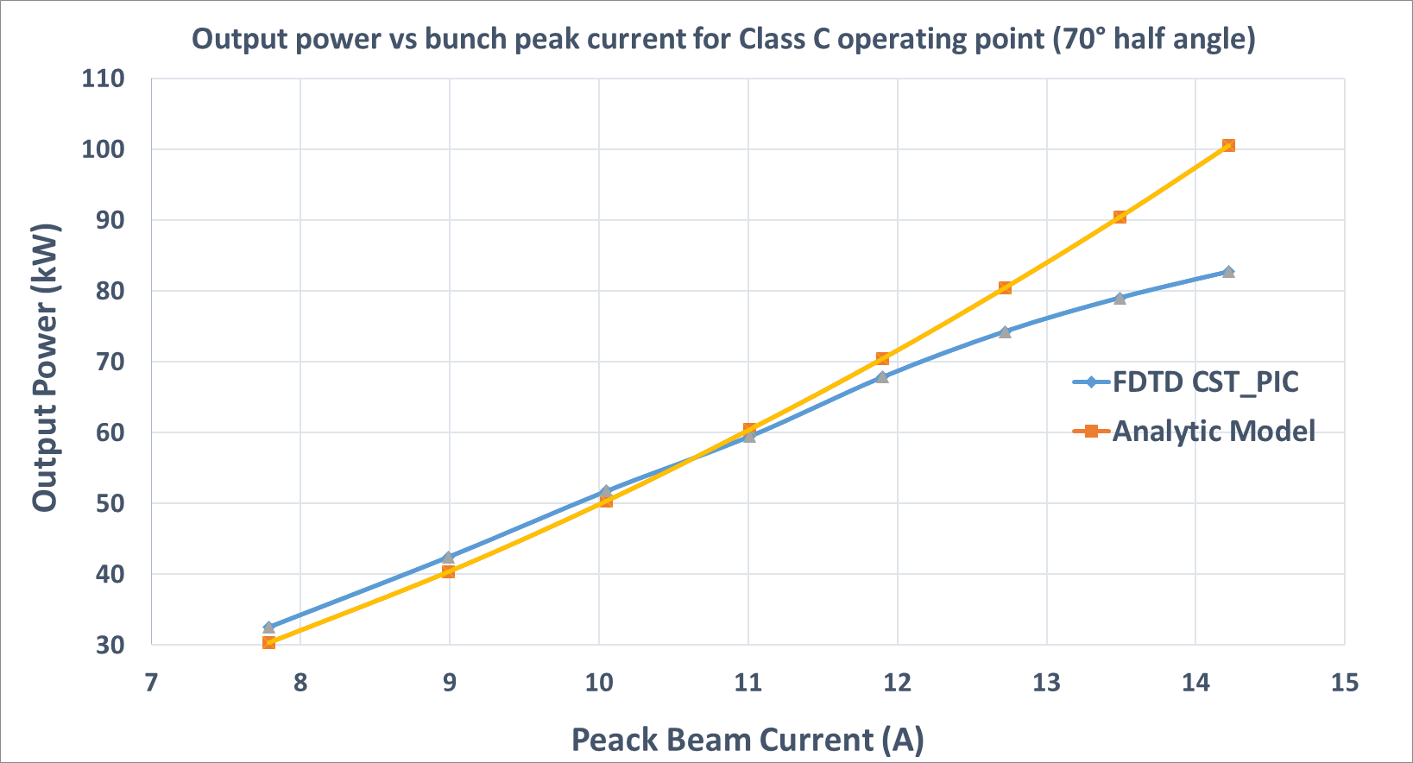
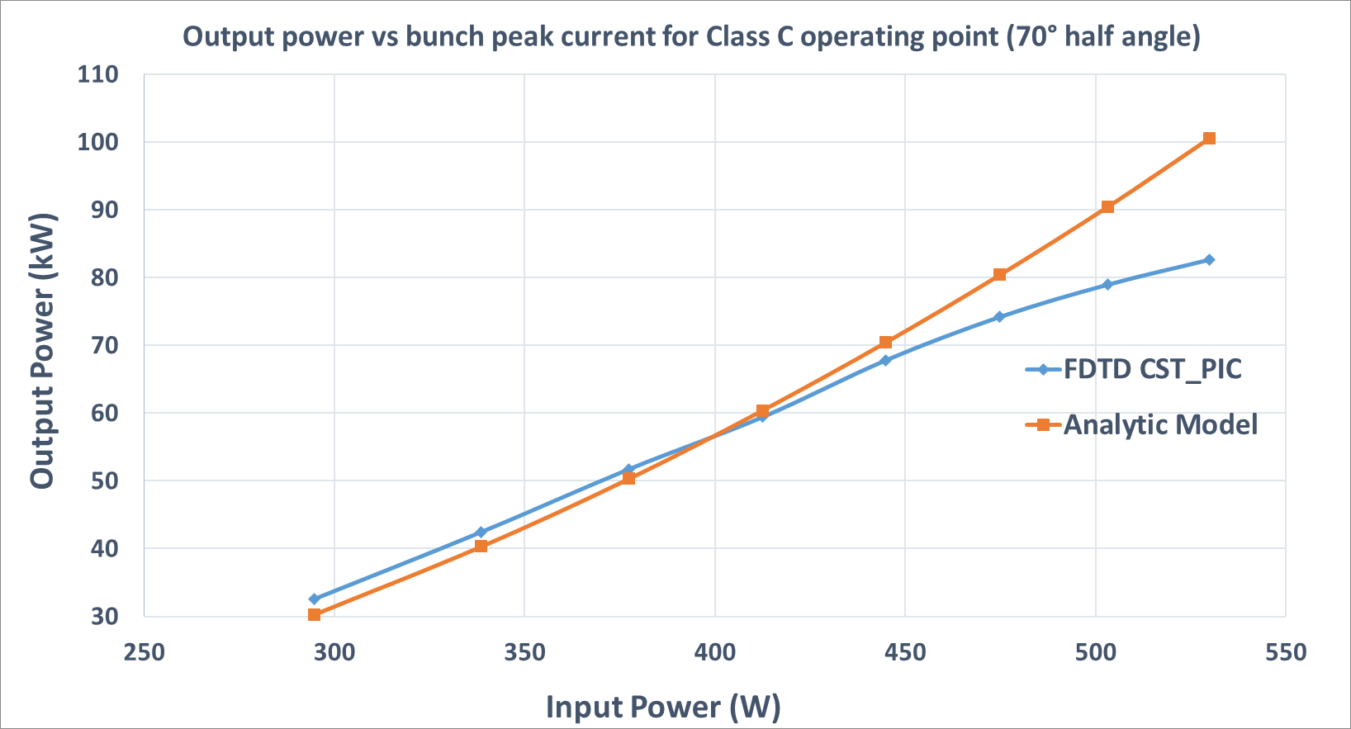
Comparison of the analytical model versus simulations and measurements
Comparison of the output power levels :
  Good agreement up to 75kW
  Space charge (not considered by the analytical model) limits the Beam-cavity interaction efficiency beyond 75kW
Measured and calculated (analytical model) output power level and RF efficiency for a TH795 IOT in CW operating mode @ 500MHz

Slide 17
Chapter 4 :
High Power Multibeam IOT

Slide 18
Multi Beam IOT for high power requirement : principle and motivation
The maximum power of a single-beam IOT is limited at 150kW over long pulse when operating below 50 Kv
* RF voltage developed between cathode and grid is limited by the cathode-grid spacing
* Cathode voltage is limited by the insulating capability of the by pass capacitors
A High output power requires either a high Anode-Cathode voltage or a high beam current…or both
P_{out} = I_{beam} x V_{ka} x Efficiency
High Anode_Cathode voltage → constraints of RF voltage & DC bloc isolation
High beam current → Cathode emission limitation, Lifetime, and low beam-cavity interaction efficiency due to the space charge limitation for high perveance beam
Two solutions to get a high power (MW) at low (V_{AK} , I_{beam}) :
1) Combining outputs of several IOTs :
Insertion as well as return losses of the combiner, phase shift control and combiner size (facilities room availability) are the major limitations
2) Enhancing the single IOT output power level by multiplying the number of individual electron beams that are tunneled and modulated via the same grid and exciting the same output cavity

Slide 19

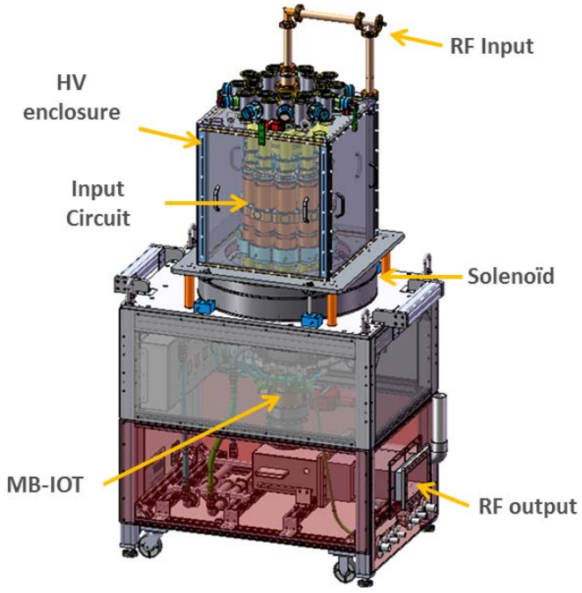
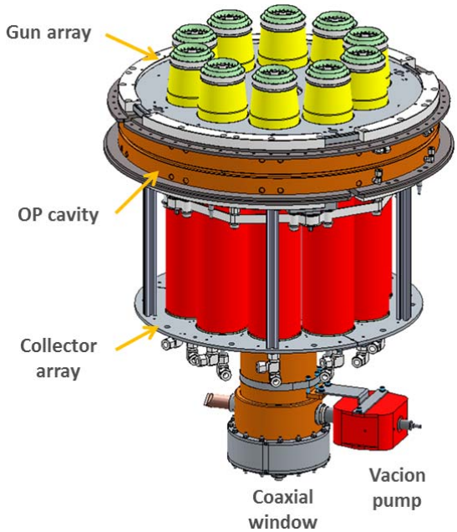
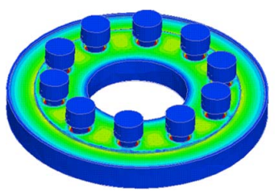
Multi Beam IOT developed for ESS (Thales and CPI collaboration)
(Linear collider applications :
Spallation source )
Input stage (10 guns)
Output stage (coaxial output cavity)
MB-IOT installed at CERN test stand

Slide 20
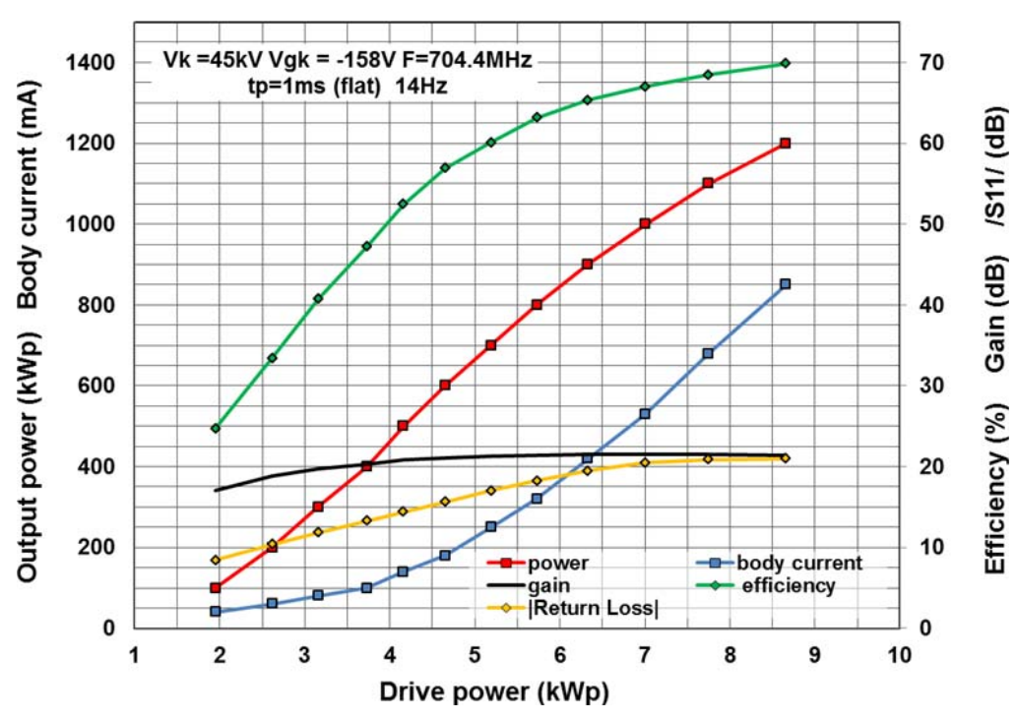
Multi Beam IOT : Achieved performances in pulsed mode
Paremeter | ESS specification | Achieved performances
Frequency | 704.2 MHz | 704.2 MHz
Peak power | >1.2 MW | 1.2 MW
RF pulse length | Up to 4 ms | 1ms flat @14Hz
RF duty factor | Up to 5% | 5.5%
Beam voltage | < 50kV | 45kV
Beam current | <45A RMS | < 40A @ 1.2MW
Efficiency | > 60% | 70%
Gain | > 20 dB | 21.5 dB
Bandwidth (-1dB) | > 2 MHz | 4.7MHz
Tube lifetime | > 50 kHrs | -
70% efficiency @ 1.2MWp
21.5dB power gain
-20dB return loss @ 1.2MWp
<850mA body current
Monotone AMAM characteristic (no saturation bend)

Slide 21
Chapter 5 :
Design perspectives

Slide 22
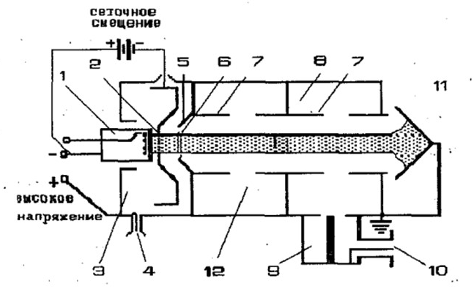
High Efficiency & High power source (Thesis) : Hybrid Multibeam Klystron-IOT
Multi beam & Multi stages device: adding a second cavity…
Targeted performances: P > 1MW CW η > 90%
See Igor Syratchev presentation (Gridded tubes / Tristron)
B class 10 beams
(180 degrees bunches)
V beam=60kV
η = 93% @ 800kW

Slide 23
Chapter 6 :
Conclusion

Slide 24
Conclusion
Despite its relative lower output power level and gain, compared to a klystron, the IOT is still an attractive high power amplifier for the scientific applications operating in the lower UHF band
Since four decades, Thales has been developing and manufacturing high power and high efficient IOTs capable of delivering up to 1MW (MBIOT) in pulsed mode with up to 70% efficiency.
Currently designed IOTs by Thales are intended to the scientific community, and used within the particle colliders operating at CERN.
As part of its partnership with CERN and academic research organizations, Thales is still innovating in the field of RF sources in order to improve their performances in terms of power and efficiency.

Slide 25
Contact
Chakib BELKHIRI
Patrick Reynaud
RF Design and Development Engineer
Product Engineering Manager
+33 6 50 86 57 99
+33 7 88 90 80 29
chakib.belkhiri@thalesgroup.com
Patrick-thn.reynaud@thalesgroup.com

