Slide 1

High Efficiency Klystrons for HL-LHC
C. Marrelli, P. A. Arias, O. Brunner, N. Catalan Lasheras, D.S.Guillen, Z. U. Nisa, I. Syratchev (CERN)
J. Cai (UESTC)
A. Baig (STFC)
A. Beunas, K. Haj Khlifa (Thales)
2nd Workshop on Efficient RF Sources
23-25 September, Toledo, Spain

Slide 2
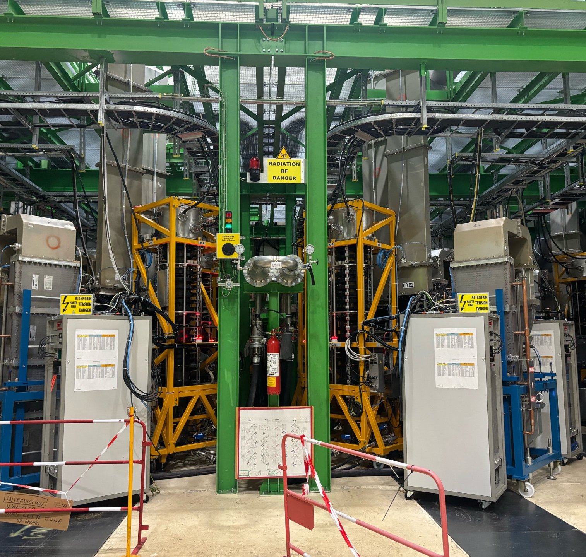
Outline
LHC RF system
HL-LHC requirements
HE klystrons for HL-LHC
TH2167HE status and future plans

Slide 3
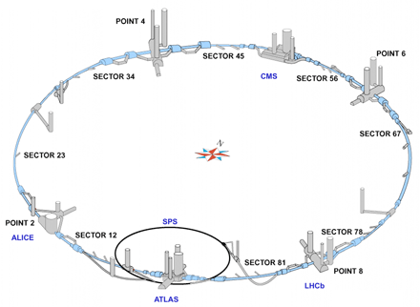
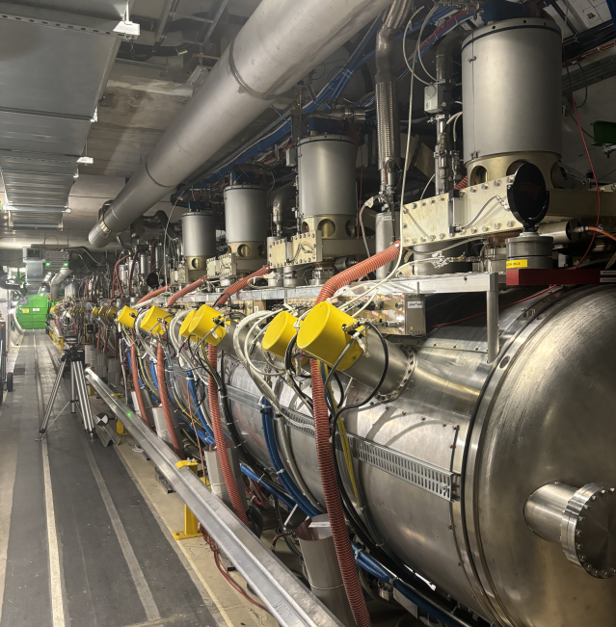
LHC RF SYSTEMS
16 Superconducting cavities (400.8 MHz, CW) installed in the tunnel in Point4, ≈150 m underground
4 Power converters (100 kV, 40 A) from LEP on the surface, one per cryomodule (4 cavities/cryomodule)
Power distributed to 4 HV bunkers underground, each equipped with 4 modulators + fast protection system
LLRF systems in 2 Faraday cages underground
1 LLRF system, 1 klystron / 1 cavity scheme
Additional beam control equipment located on the surface

Slide 4
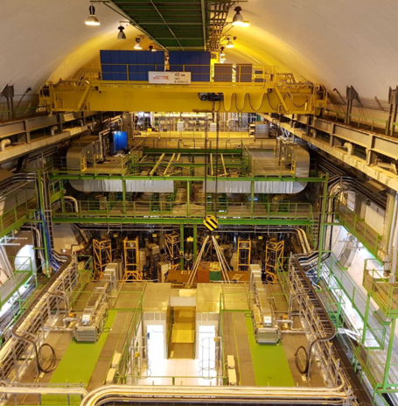
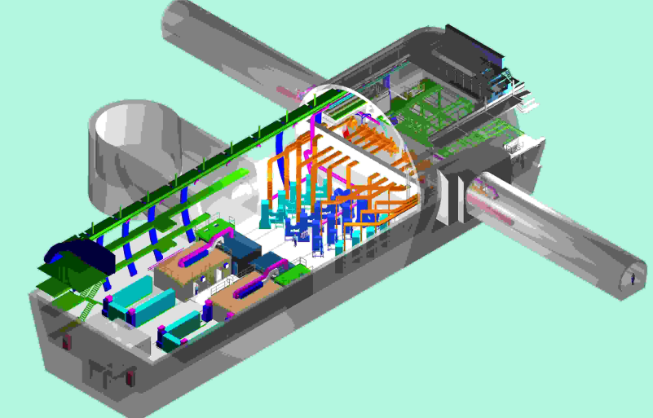
UX45 cavern
LLRF Faraday Cages
Cavities
HV Bunkers
Klystrons + RFDS

Slide 5
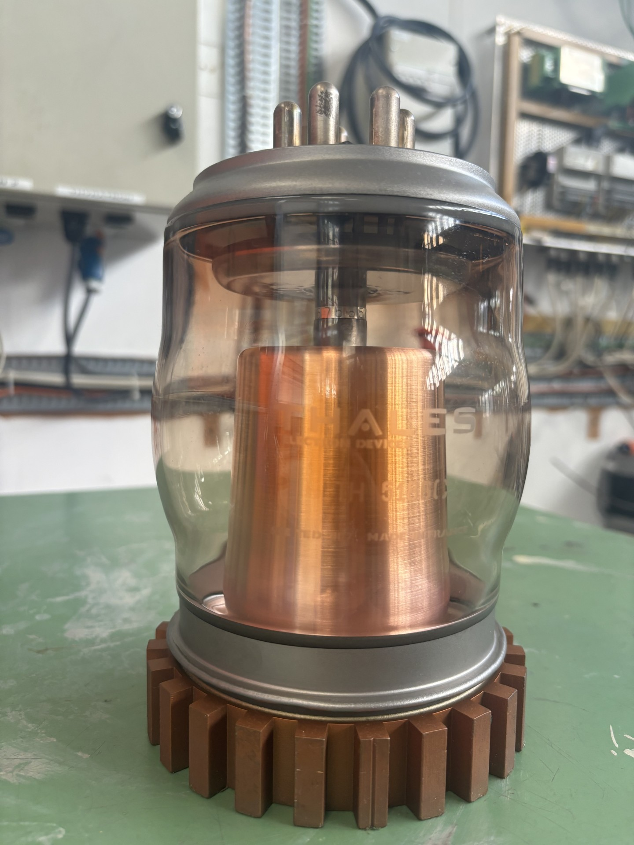
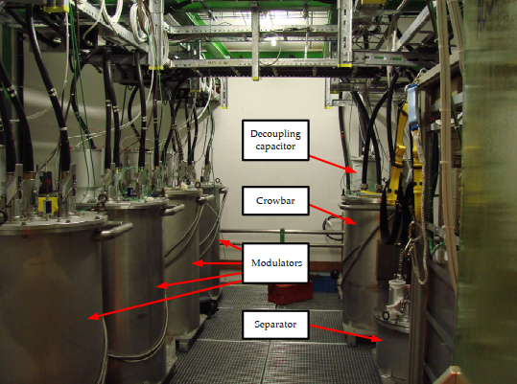
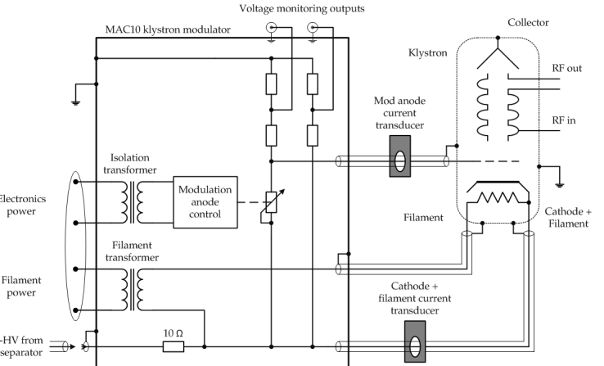
HVPS for LHC klystrons
Power from Power converter distributed to 4 modulators (MAC10) per bunker, providing modulating anode and cathode voltage/current.
1 crowbar (Thyristor) and smoothing capacitor in each bunker
Tetrode TH5186 used to control the anode voltage

Slide 6
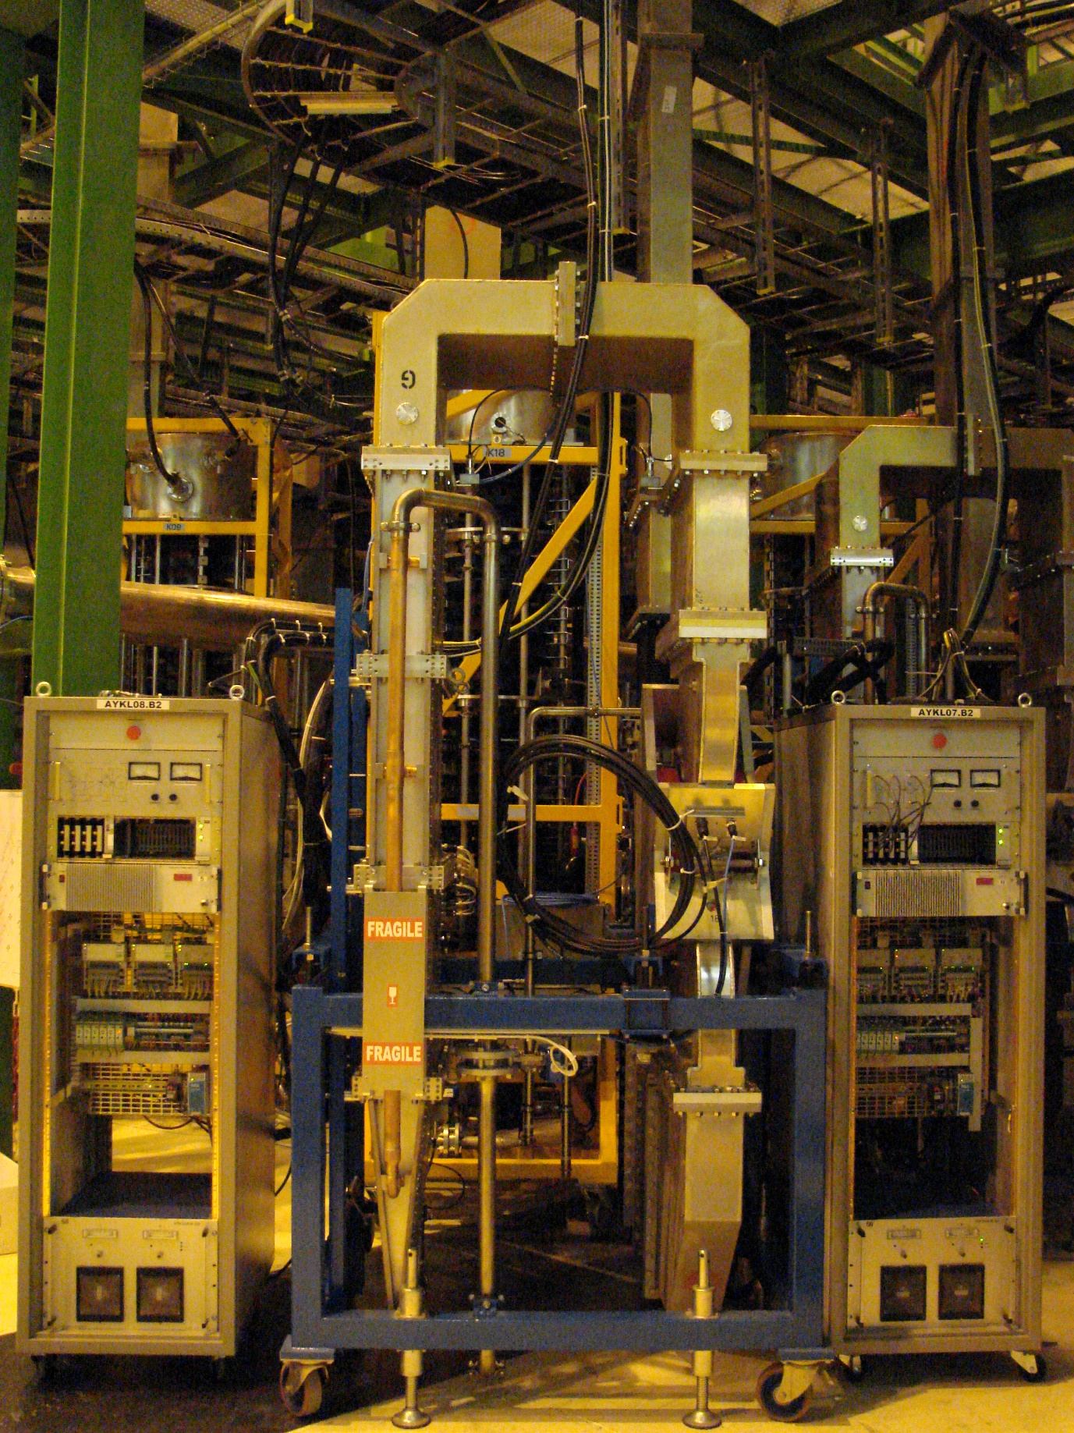
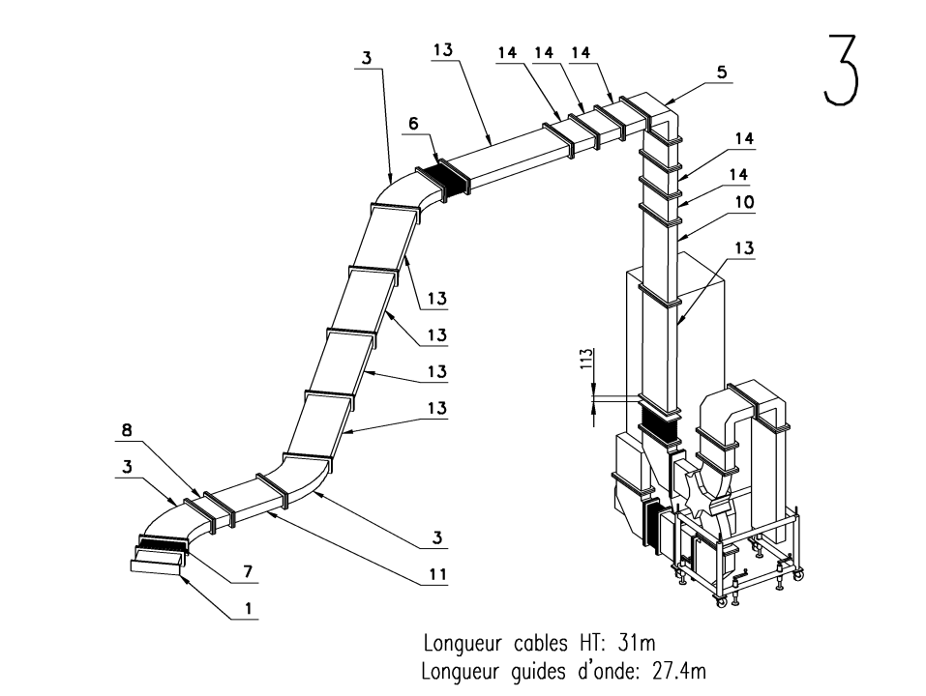
LHC RF System: RFDS
All RFDS in WR2300 HH, to individual cavities
Lines with different lengths (19 to 30 m)
1 klystron – 1 circulator + load (ferrite) per cavity
Circulators and loads rated for 330 kW power
Circulator equipped with TCU to provide stable match for the klystrons (RL≤28 dB)

Slide 7
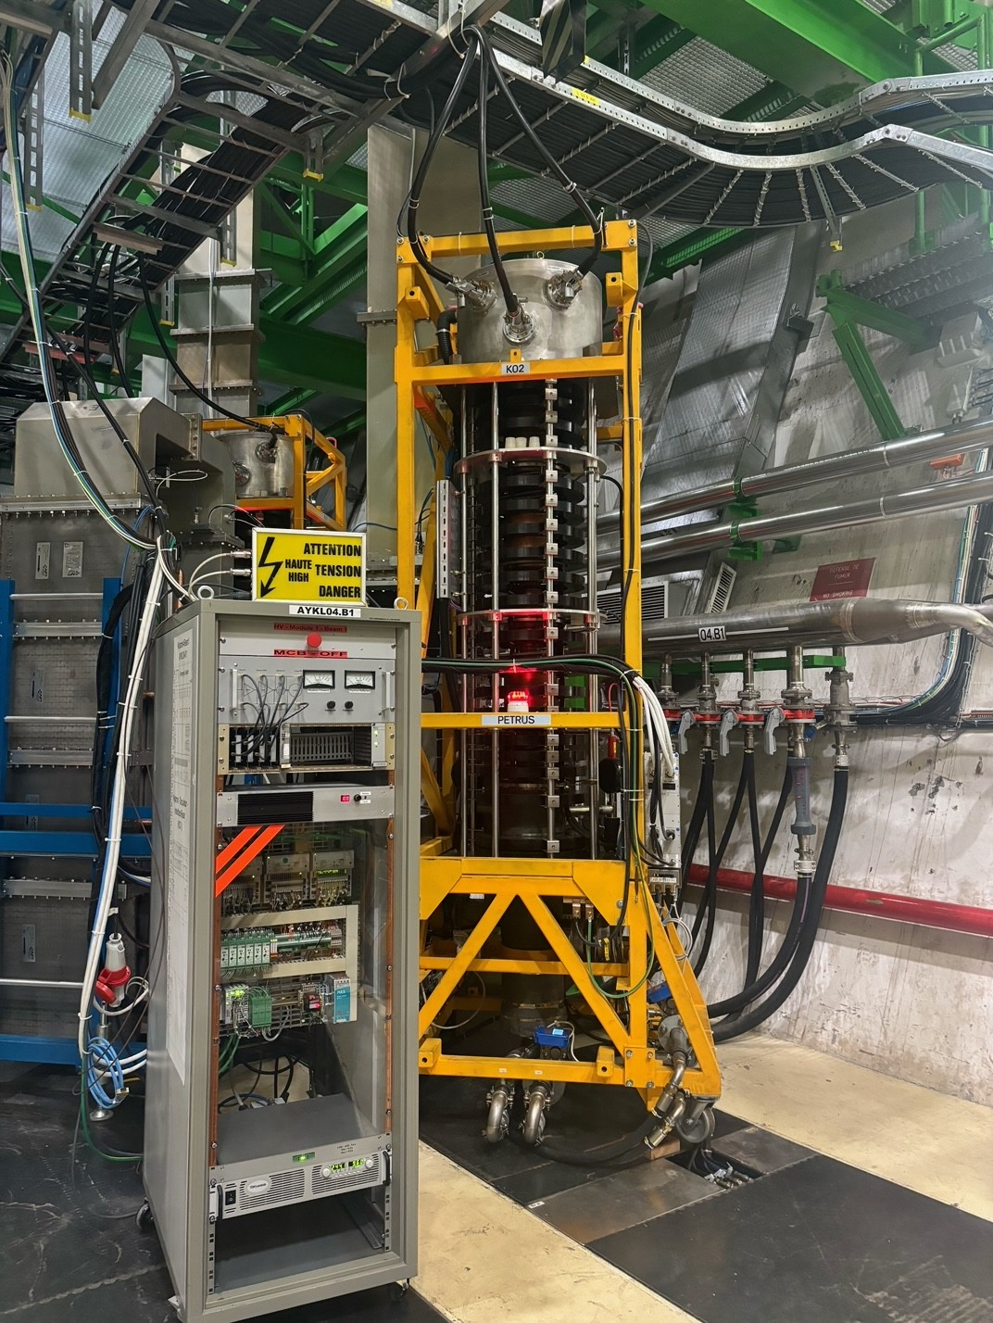
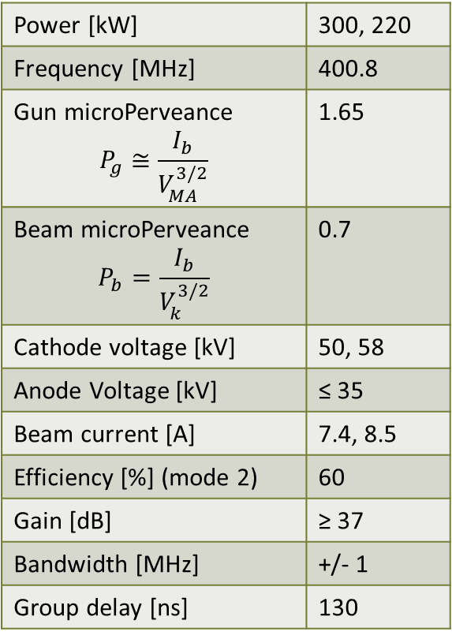
LHC klystrons
Power [kW] | 300, 220
Frequency [MHz] | 400.8
Gun microPerveance $$P_{g}≅\frac{I_{b}}{V_{MA}^{3/2}}$$ | 1.65
Beam microPerveance $$P_{b}=\frac{I_{b}}{V_{k}^{3/2}}$$ | 0.7
Cathode voltage [kV] | 50, 58
Anode Voltage [kV] | ≤ 35
Beam current [A] | 7.4, 8.5
Efficiency [%] (mode 2) | 60
Gain [dB] | ≥ 37
Bandwidth [MHz] | +/- 1
Group delay [ns] | 130
Thales TH2167, 400.8 MHz, 300 kW CW
Vertical orientation, triode gun with air tank on top
5 cavities, including 1 second harmonic
Original specifications included 3 modes of operation: 46, 54, 58 kV (200, 300, 330 kW), only 2 used today (50 kV, 58 kV)
Output cavity coupled with water cooled loop to coaxial window + T-bar transition to WR2300

Slide 8
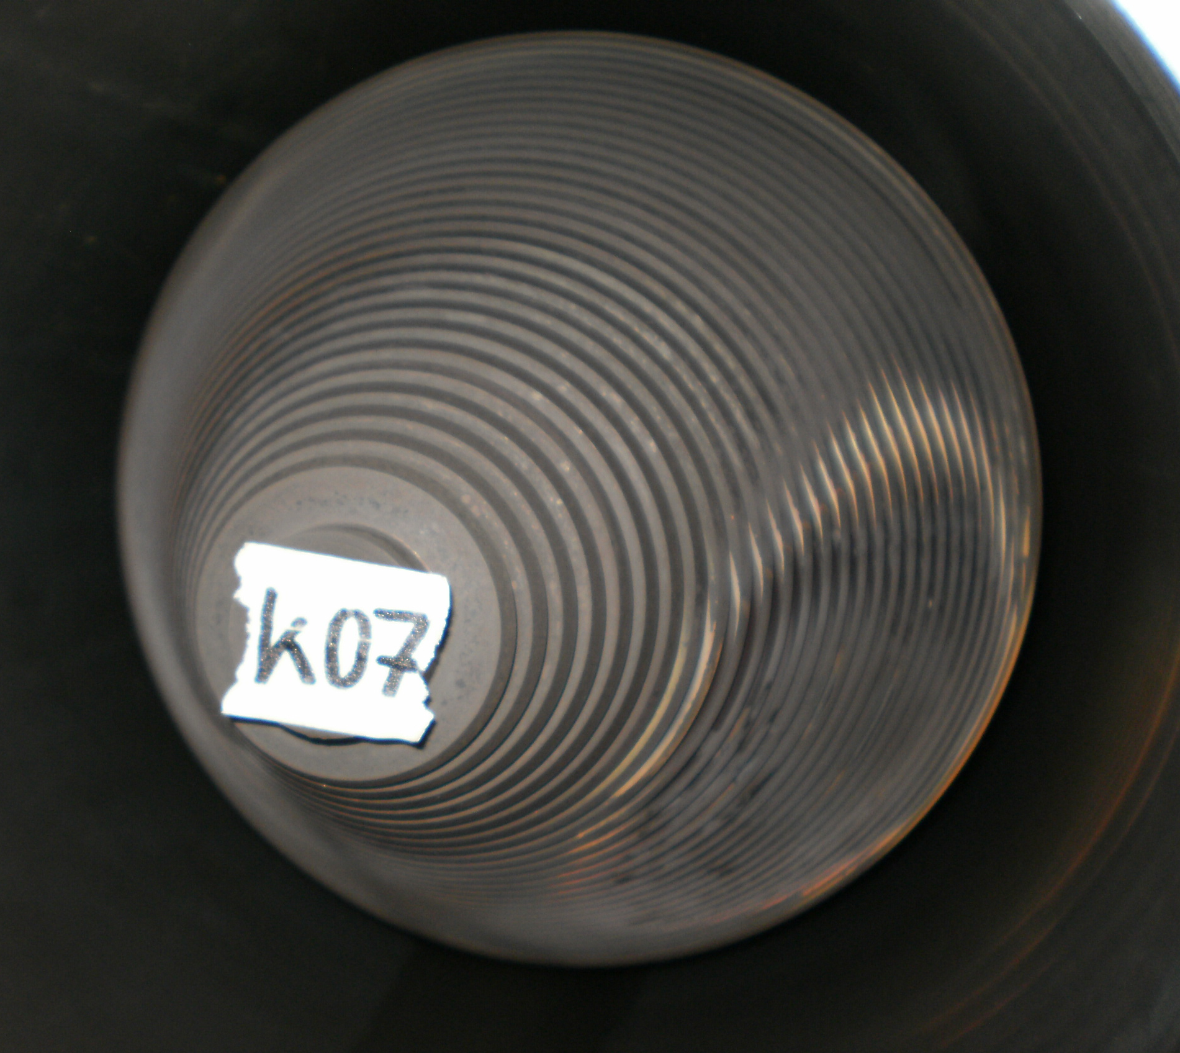
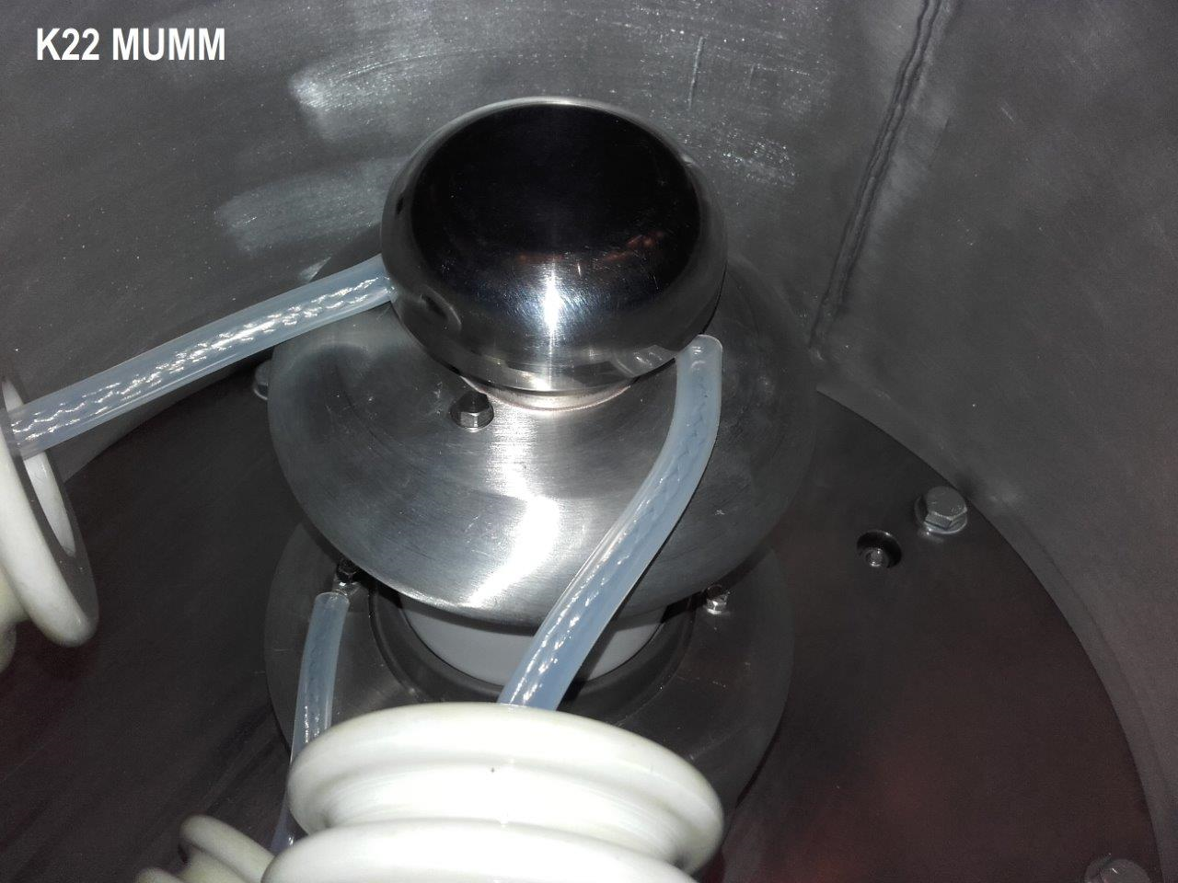
LHC klystrons: main (past) issues
16 klystrons installed in LHC + 13 spares (3 underground) and 1 in SM18 test stand
Collector issue (before 2010): 1 klystron broken due to vacuum leak after 16000 hours due to collector failure; overheating damages observed on all klystrons
  Cooling jacket redesigned and replaced (2010-2014)
  Operating point changed (from 54 kV, 9 A to 58 kV, 8.5 A)
  Multipacting observed on S/N 2 at low output power (60-90 kW) on output coaxial. Corrected with extra cooling.
  “Minor” issues: gun arcing, solenoid connector overheating, shorted filament…

Slide 9
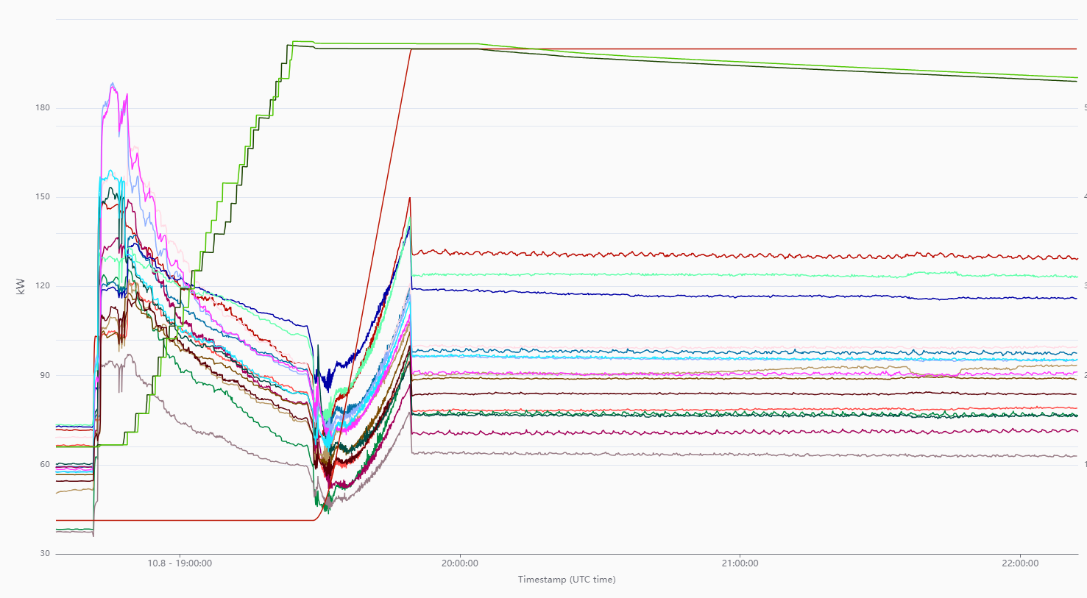
LHC klystron operation
The LHC “cycle”:
Most power required during injection: klystrons at 58 kV, 8.5 A
Collisions
Energy
Injection
Ramp
Beam intensity
Kly FWD power
Power peaks due to beam loading compensation not visible in the plot!
Klystron HV at 58 kV
Klystron HV at 50 kV

Slide 10
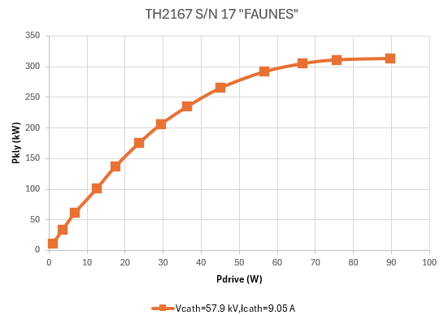
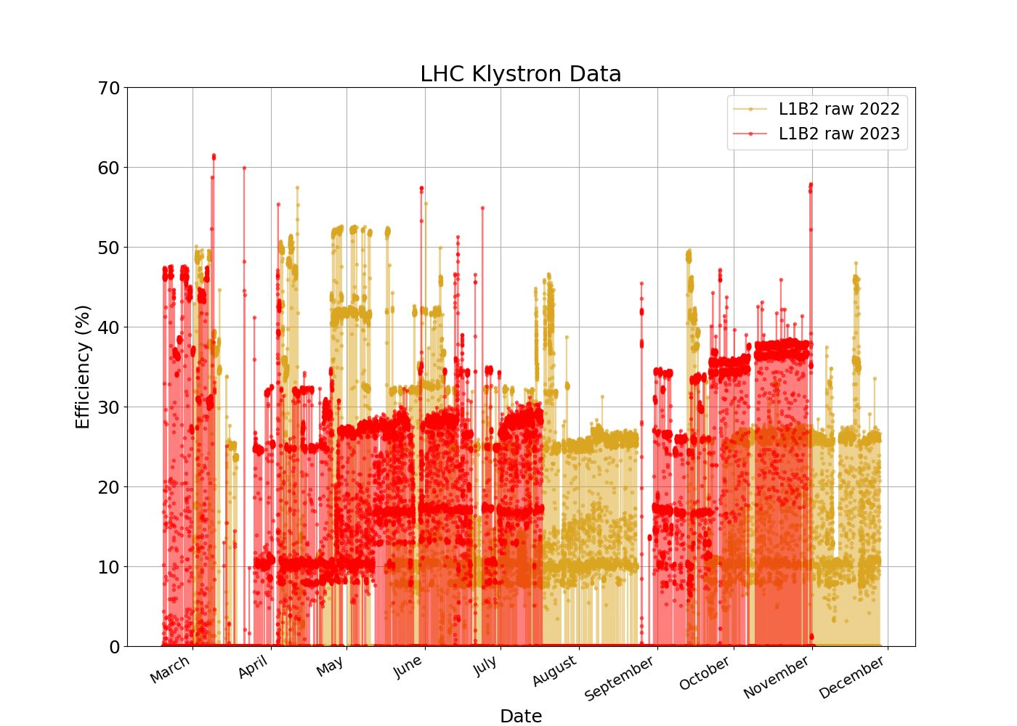
LHC klystrons: current performances
Klystron efficiency (at saturation) on average around 60%
Klystron efficiency at operation point…less than 40%
Can we do better (in terms of efficiency?)
…reducing HV helps;
Impact of RFDS and circulator to be further investigated
Running in saturation and regulating with mod-anode???....

Slide 11
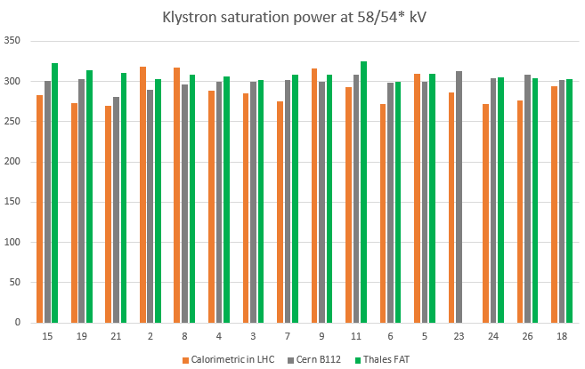
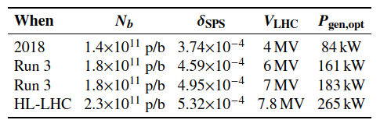
HL-LHC
Beam intensity to reach 2.3*10¹¹ p/b after LS3 (2030)
Capture of higher intensity beams from SPS challenging …many klystrons hit saturation limit during injection (half-detuning scheme);
With present system 2.0*10¹¹ p/b capture possible with cavity pre-detuning + Q_{L} / frequency adjustment for individual cavities -> no margin!
For 2.3*10¹¹ p/b required peak power from the klystrons could reach 340 kW!
As it is today, LHC RF System is not ready for High-Luminosity

Slide 12
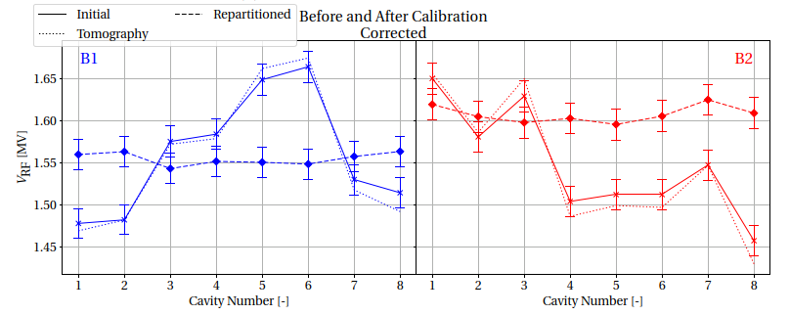
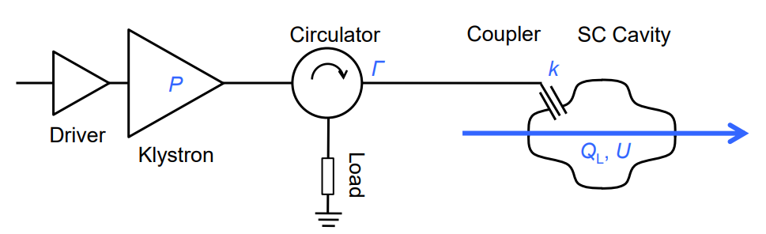
LHC Power Limitations: ongoing studies
Power calibration and Q_{L} measurement campaign
  Cavity voltage -> calibrated with beam, good accuracy (≈3%)
  Cavity Q_{L}
    measurement with beam affected by bunch length change during measurement time (10-17 min);
    measurement from voltage decay influenced by Circulator S22 and waveguide match -> to be checked
  Cavity FWD and RFL power
    RF measurements have limited accuracy due to coupler directivity + uncertainty on calibrations -> to be re-checked;
    calorimetric measurements available for Klystron FWD power but needs better measurement of cathode current

Slide 13
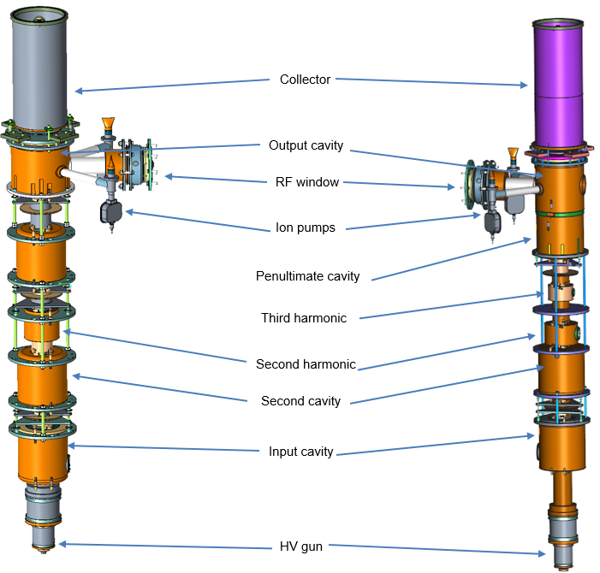
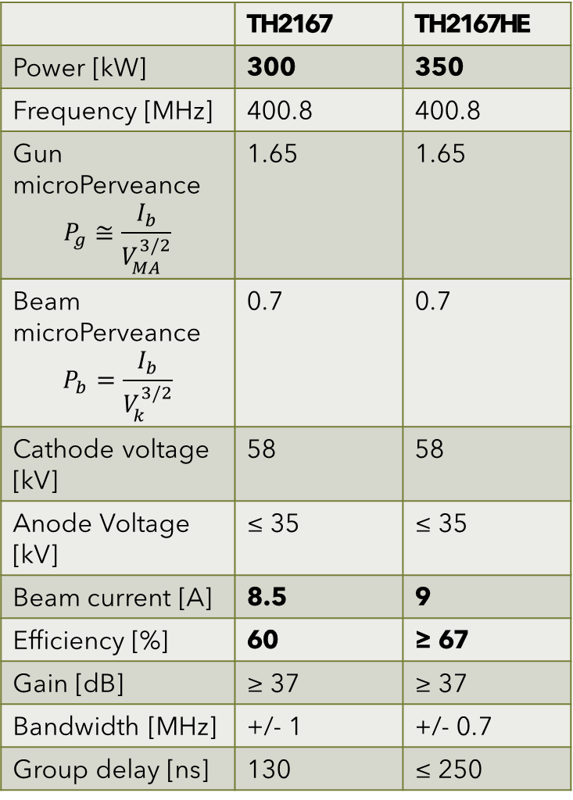
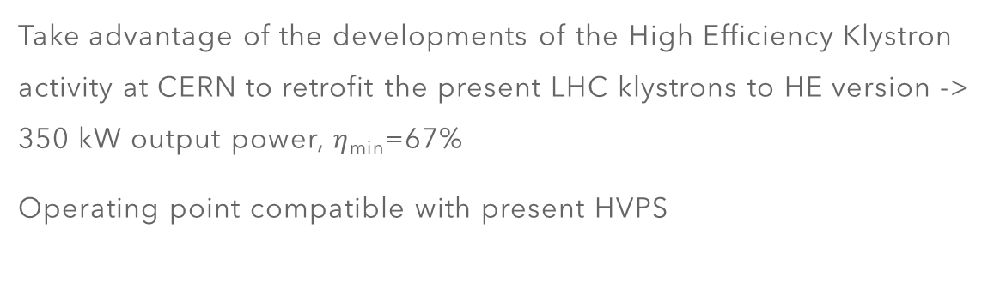
HE klystrons for CERN
 | TH2167 | TH2167HE
Power [kW] | 300 | 350
Frequency [MHz] | 400.8 | 400.8
Gun microPerveance $$P_{g}≅\frac{I_{b}}{V_{MA}^{3/2}}$$ | 1.65 | 1.65
Beam microPerveance $$P_{b}=\frac{I_{b}}{V_{k}^{3/2}}$$ | 0.7 | 0.7
Cathode voltage [kV] | 58 | 58
Anode Voltage [kV] | ≤ 35 | ≤ 35
Beam current [A] | 8.5 | 9
Efficiency [%] | 60 | ≥ 67
Gain [dB] | ≥ 37 | ≥ 37
Bandwidth [MHz] | +/- 1 | +/- 0.7
Group delay [ns] | 130 | ≤ 250
Take advantage of the developments of the High Efficiency Klystron activity at CERN to retrofit the present LHC klystrons to HE version -> 350 kW output power, $η$_{min}=67%
Operating point compatible with present HVPS
Prototype developed in collaboration with Thales in the framework of IFAST WP 11.2
TH 2167
TH 2167 HE

Slide 14
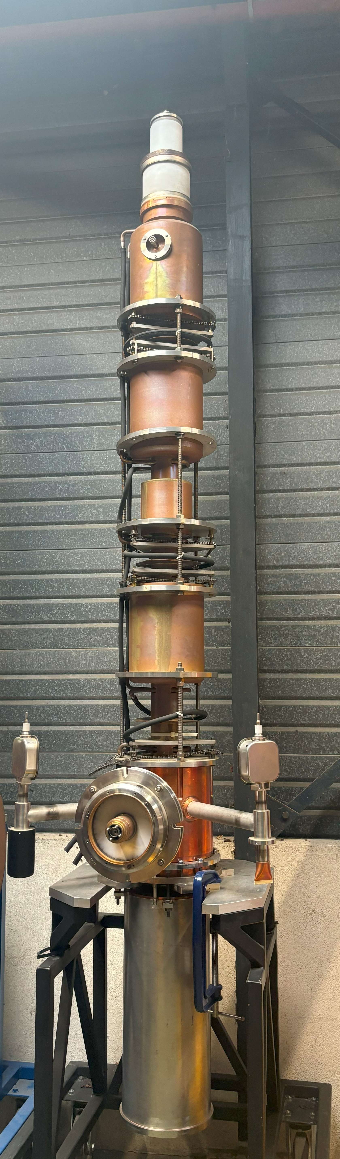
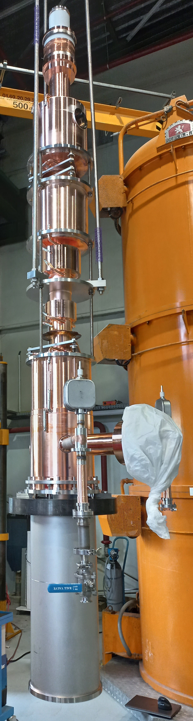
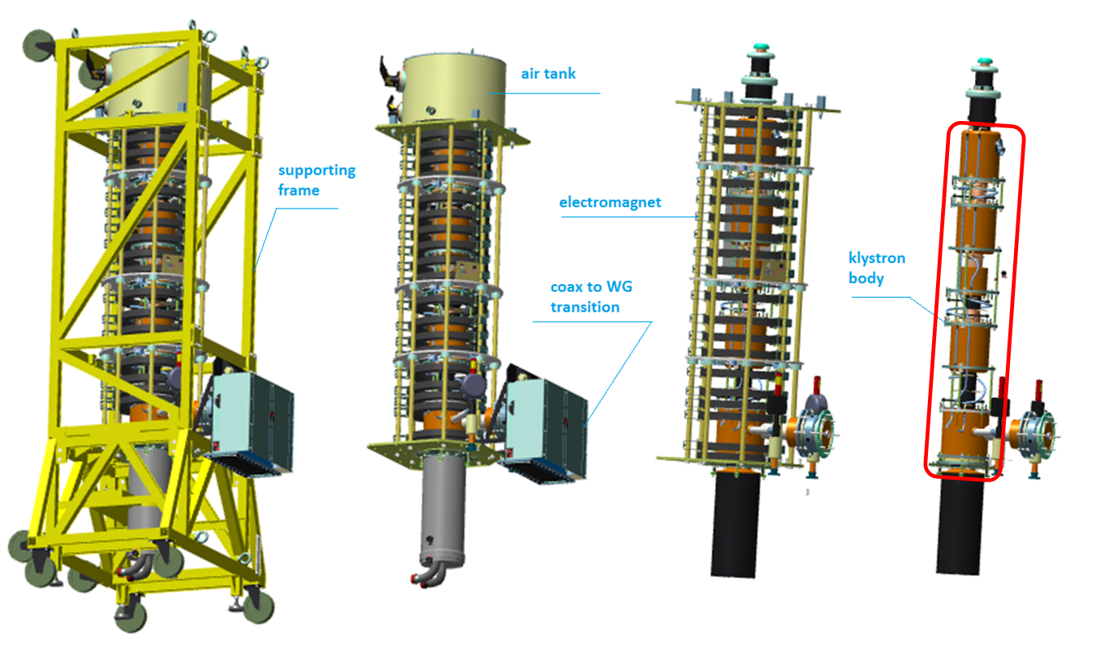
From TH2167 to TH2167HE
TH2167
TH2167HE
Solenoid slightly modified (displacement of 3 coils, two power supplies)
Modified collector/boiler to increase safety margin
Frame modified to accommodate the new tube
X-rays shielding modified to meet the new RP standards
Replacement of the interaction circuit with new CSM design from CERN: 6 cavities, including one 2nd and one 3rd harmonic
Same circuit length
Same triode gun as the TH2167, compatible with modulator
Operating point for 350 kW at 58 kV, 9 A
Same output circuit as TH2167
Re-use frame, gun tank, HV connectors, electromagnet and coax to WG transition from existing klystrons.

Slide 15
Bunching methods for High Efficiency
Bunching techniques for High Efficiency Klystrons
Core Oscillation Method (COM):
core of the bunch periodically contracts and expands (space charge guided process)
Outsiders monotonically go to the center of the bunch
Long interaction length
Bunch Align Collect (BAC) method:
Tuning of the cavities (inductive+capacitive) creates “artificial” oscillations
Large number of cavities

Slide 16
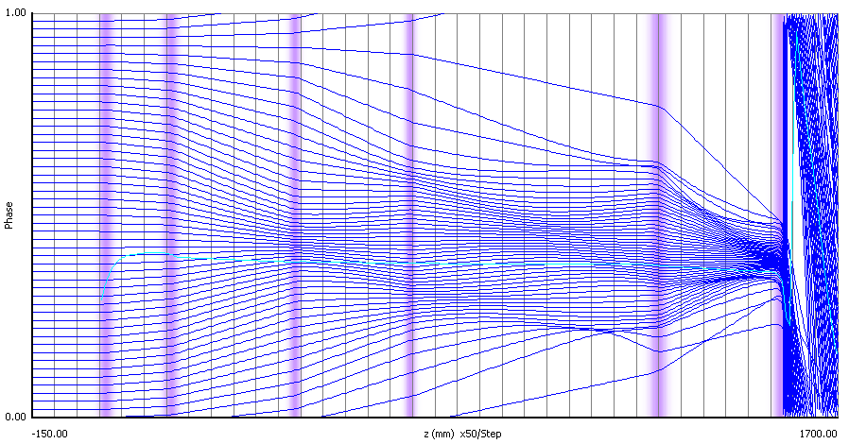
Core Stabilization Method (CSM)
“Harmonic” bunching:
Harmonic cavities used to introduce non-linear components in the electron transit time from input cavity to output; 2nd harmonic cavities have been used since the 70s (E. L. Lien), but higher harmonics had never been used.
The harmonic cavities push peripheral particles towards the center of the bunch, while the core forms sub-bunches (depending on the number of harmonics used). For higher harmonic number the core is stabilized around the center.
This process allows to get very good bunch saturation over a short interaction distance.
2nd Harmonic
3rd Harmonic

Slide 17
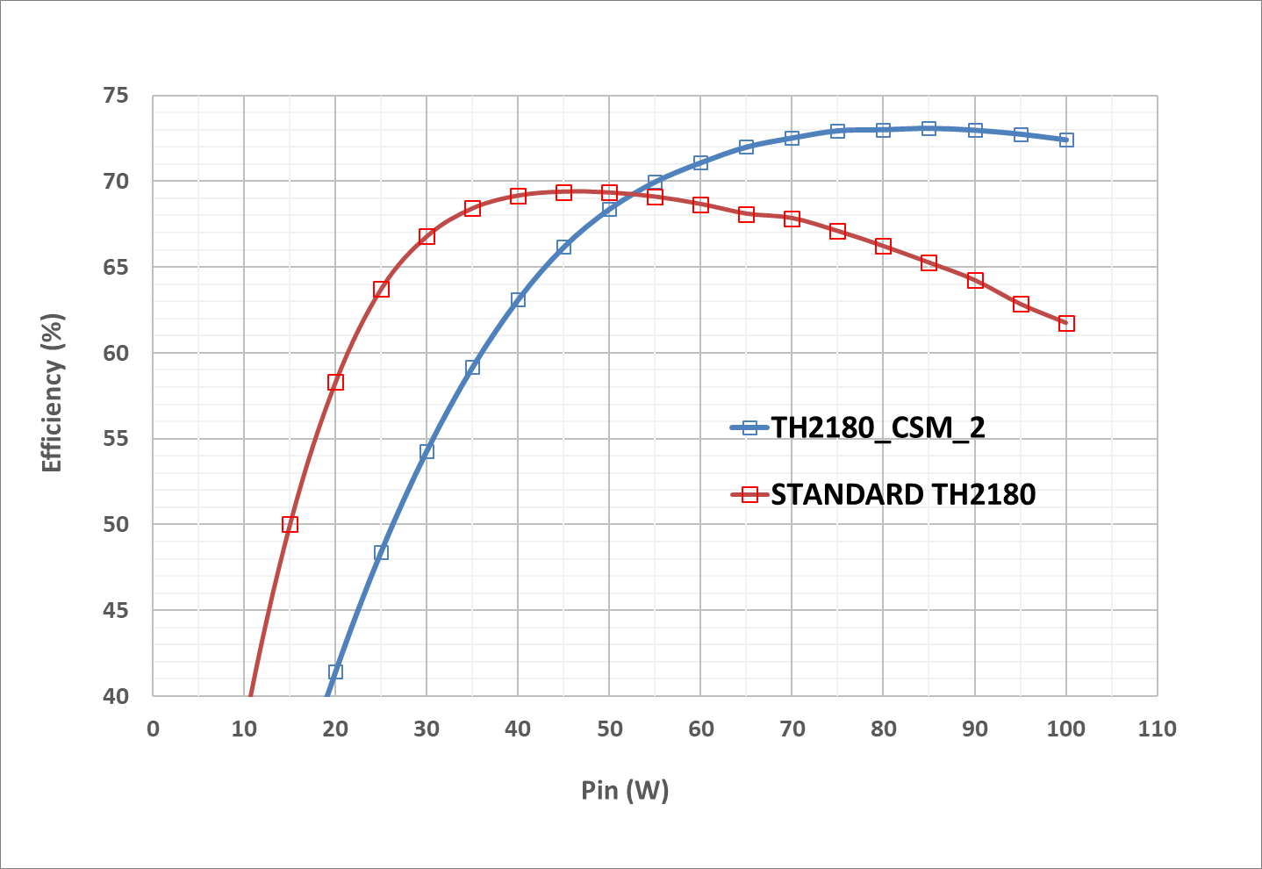
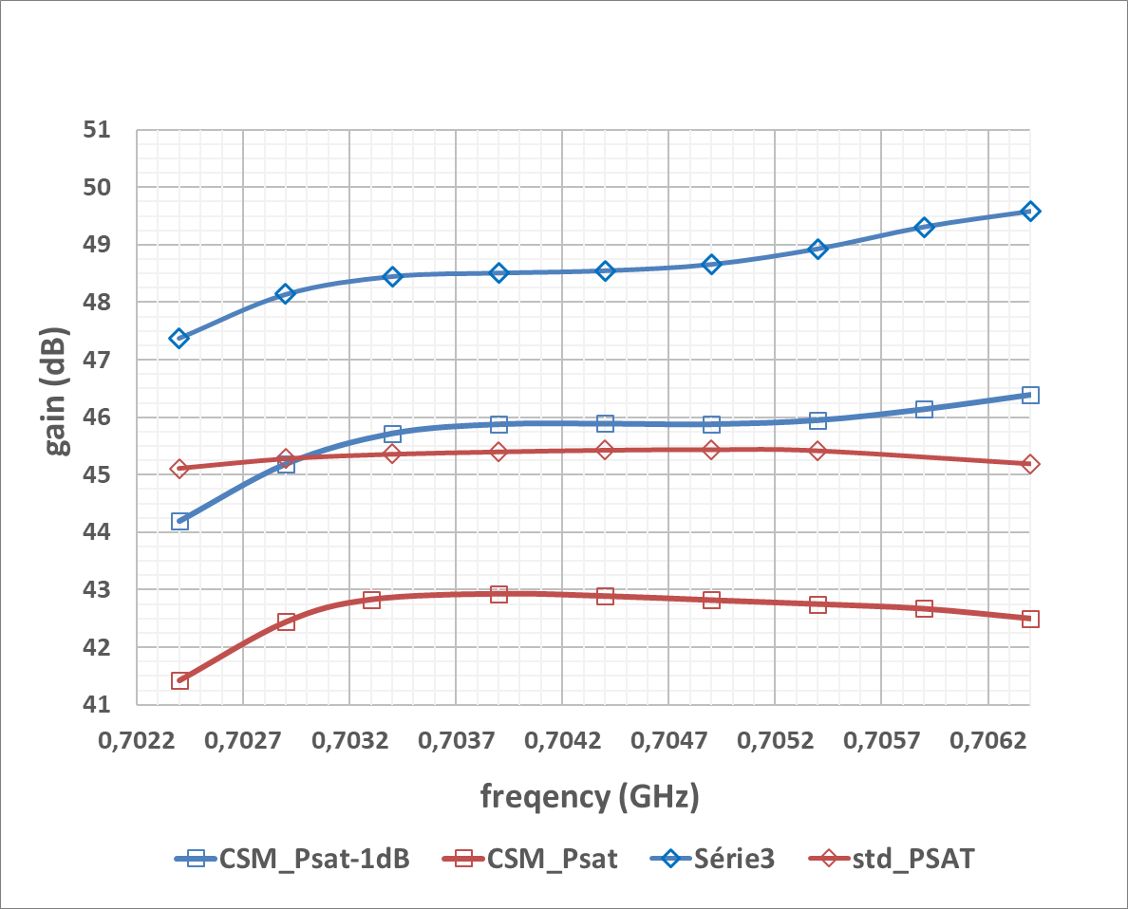
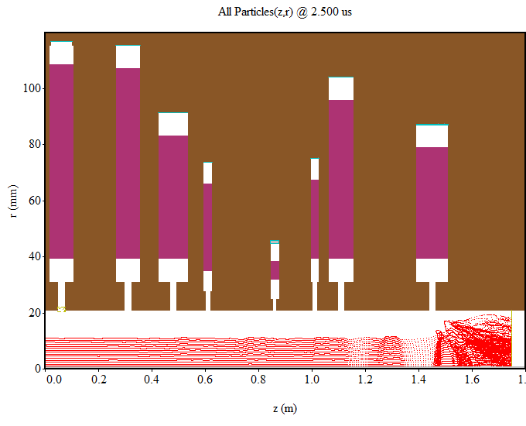
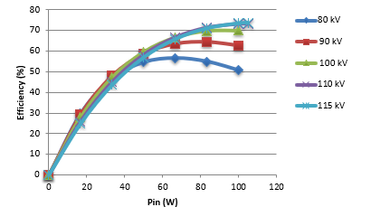
Previous CSM studies
Only simulation work!
HE design for ESS 1.5 MW, 704 MHz klystrons at Thales (compatible with existing modulator).
Efficiency (Klys2D): 73%
HE design for ESS 1.5 MW, 704 MHz klystrons at ESS (compatible with existing modulator).
Efficiency (KlyC, Magic2D): 73%

Slide 18
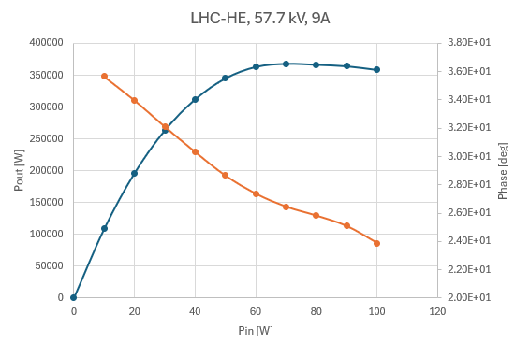
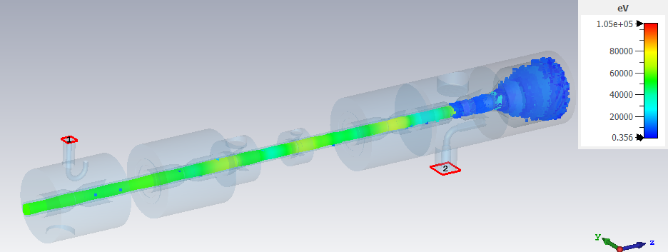
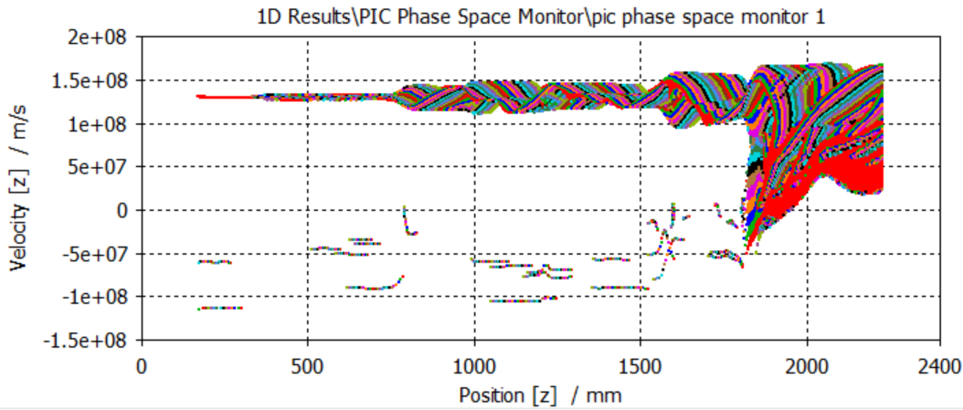
CSM for LHC
Design at CERN:
Simulation and optimization done with KlyC, showing 70% efficiency at saturation
Beam imported in CST TRK to simulate beam transport, focusing (field distribution from 3D B-field simulation) and collector power dissipation
PIC CST simulations: beam transport under imported B-field, RF interaction with measurement of body losses, intercepted and reflected electrons to cathode, body, collector, in order to calculate balanced efficiency.
Cavity tuning in PIC done with short bunched beam train
Predicted efficiency in CST:70%
Stability and performances checked for different input power levels, frequency, magnetic field
Option to adjust current on the last two coils to control body dissipation and reflected electrons
Pin=70W
Courtesy of I.Syratchev, Z. U. Nisa, A. Baig
True reflected
Body interception

Slide 19
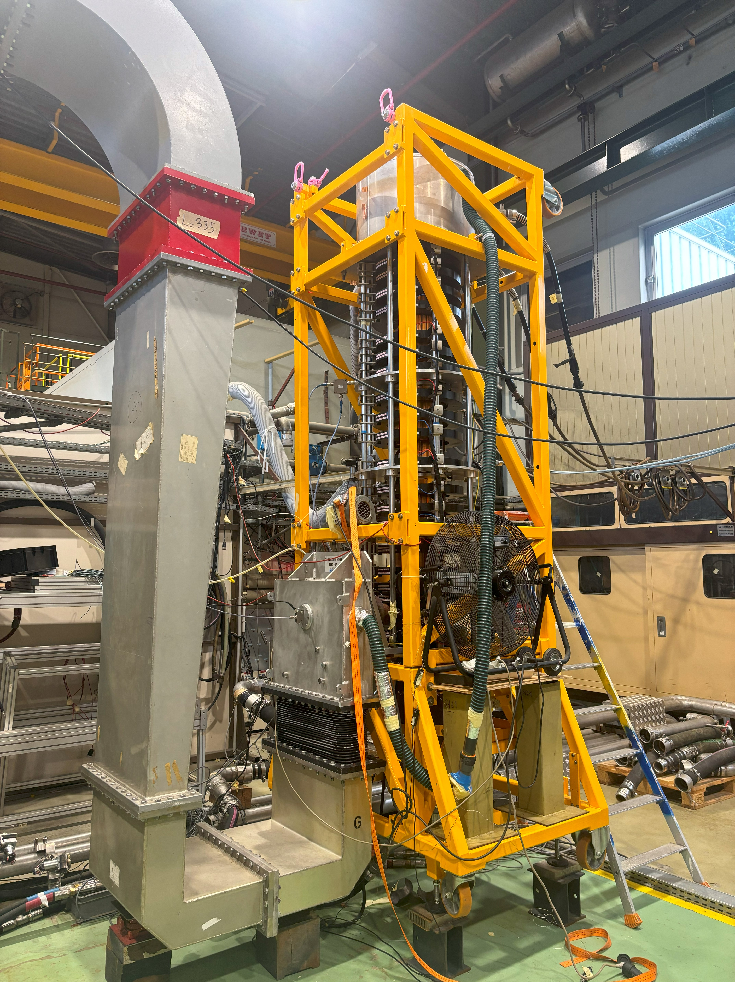
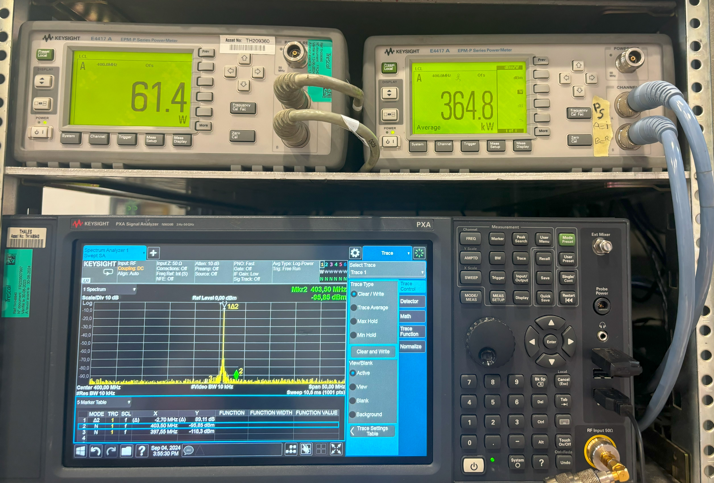
TH-2167 HE
Manufacturing started in 2022 after validation of CERN design at Thales
TH2167 S/N 01 “St. Paul” was sent back to Thales after being removed from LHC due to poor vacuum; parts have been re-used for the HE prototype.
Tube currently under test at Thales
Simulated efficiency confirmed by tests
Repeated iterations of measurements and simulations: BW, power and phase transfer curves accurately reproduced by KlyC
More details on manufacturing and factory testing in tomorrow’s presentation by Thales!

Slide 20
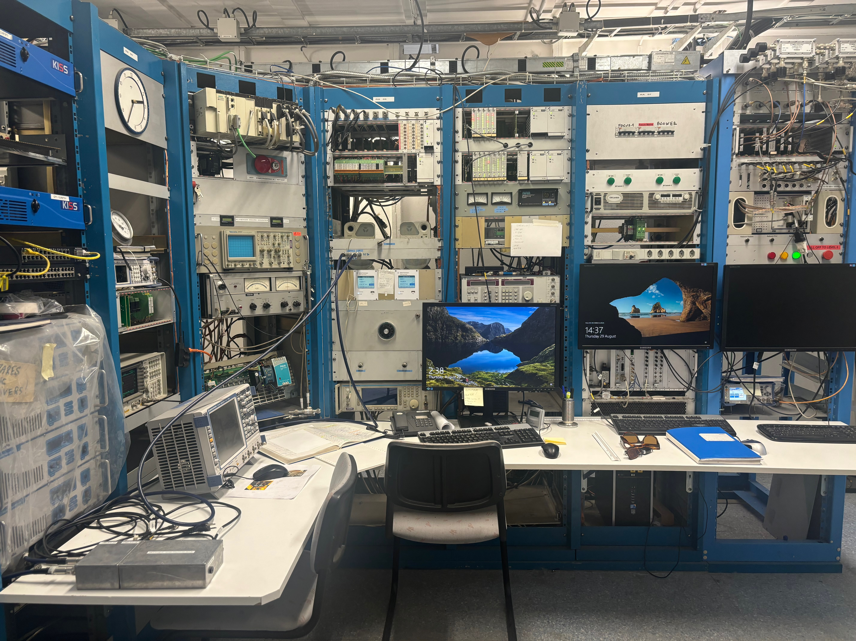
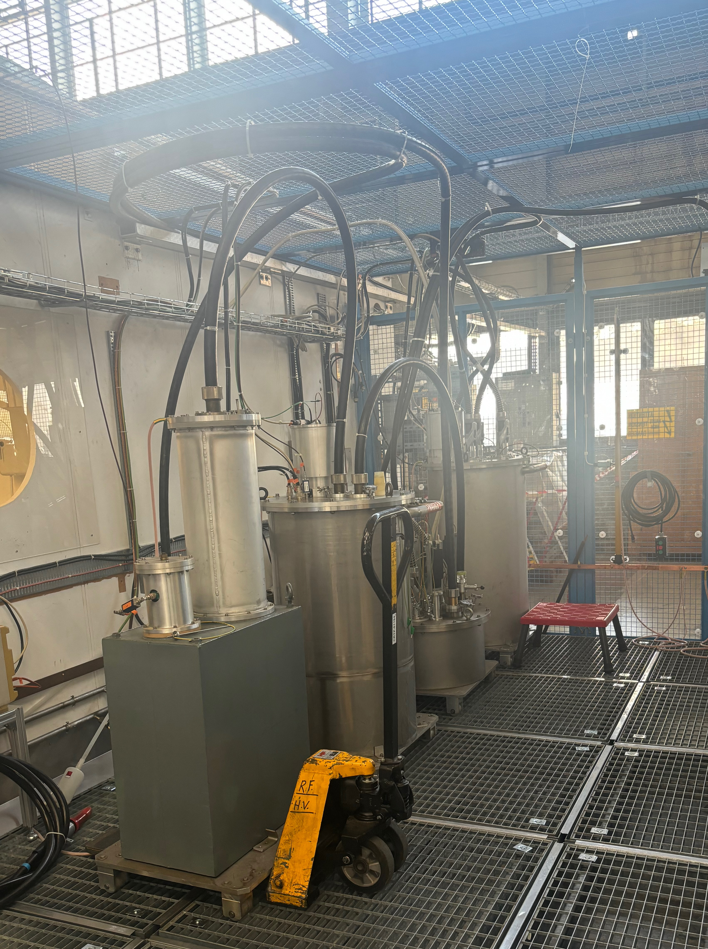
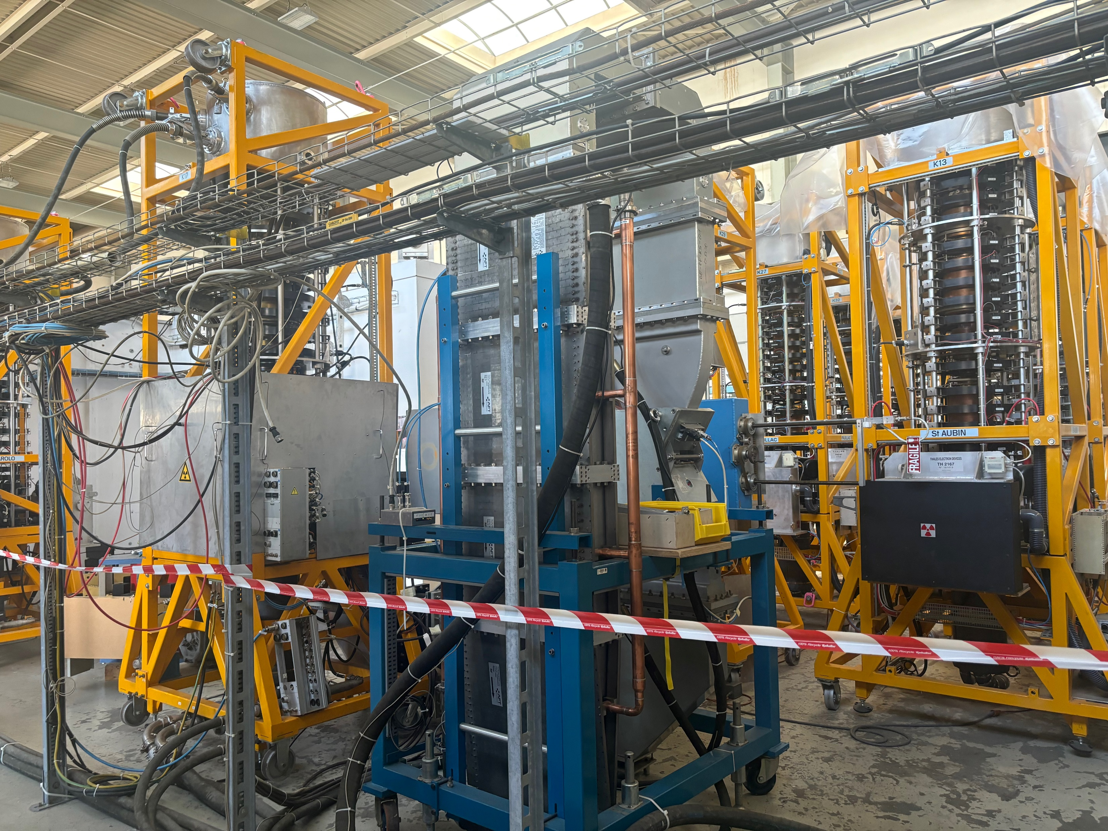
Next Steps
FAT at Thales in October 2024
01
Delivery to CERN and installation in the TH2167 test stand
02
Phase 1: test on present test stand to confirm factory performances and compare with TH2167
03
Renovation of the test stand
04
Phase 2: testing on renovated test stand: focus on efficiency measurements and soak test
05
Production of series klystrons and installation during LS3
06

Slide 21
References
A. Mikkelsen, Digital measurement system for the LHC klystron high voltage modualator, CERN-THESIS-2014-033.
Technical specification for the Supply of 400 MHz, 300 kW_{CW} Klystrons for LHC, July 2000.
Thales Electron Tubes and Devices, TH 2167 CW klystron amplifier Operating Instructions.
B.E. Karlsen-Baek et al., LHC MD 6944: RF Voltage Calibration, CERN-ACC-NOTE-2024-0008
H. Timko et al, Advances on LHC RF Power limitation studies at injection, HB2023, Geneva, Switzerland.
V. C. R. Hill, G. Burt, D. Constable, C. Lingwood, C. Marrelli and I. Syratchev, Particle-in-cell simulation of second and third harmonic cavity klystron, 2017 Eighteenth International Vacuum Electronics Conference (IVEC), London, UK, 2017, pp. 1-2, doi: 10.1109/IVEC.2017.8289626.
A. Beunas, CSM Klystron for LHC, 1st Workshop on Efficient RF Sources, Chateau de Bossey, 4-6 July 2022.
C. Marrelli, High Efficiency klystrons for ESS, 20th International Vacuum Electronics Conference (IVEC), April 2019.
N.C. Lasheras et al., High Efficiency Klystrons from a dream to reality, IPAC 2024.
J.C. Cai, I. Syrachev, KlyC: 1.5D Large Signal Simulation Code for Klystrons, IEEE Trans. on Plasma Science, vol.47, no.4, pp.1734-1741, April 2019.
Thales Electron Tubes and Devices , TH2167HE Design Report, 2022.
Z. Un Nisa, A. Baig, I. Syratchev, TH2167HE klystron analysis in CST, 2022.

Slide 22
Thank you!
This project has received funding from the European Union’s Horizon 2020 Research and Innovation programme under Grant Agreement No 101004730

