Slide 1




Status of FCC_{ee} 400 MHz 1 MW Two-Stage Multibeam Klystron
Zaib Un Nisa for CERN & ULAN HE klystron team

Slide 2
RF power sources for particle accelerators
UHF/L-band (0.3-1.3GHz)
S-band (3GHz)
Proposed layouts of almost all future colliders suggest operating them in CW or Pulsed regimes in a frequency range from 0.3GHz-1.3GHz (UHF/L-band). In this frequency range new technological solution for high efficiency (HE) RF power source can be scaled for different HEP applications.
That reduces the short-term development scope to a single HE demonstrator. In this context High-Lumi LHC and FCC_{ee} were identified as primary objectives for such a development.
Injectors
User facilities:
Spallation sources
Storage rings&
Light sources
X-FEL
Large scale Particle
Accelerators:
LHC
ILC
CLIC
FCC
Muon_C
CEPC
HALHF
C-band (6GHz)
C-cube
X-band
(12 GHz)
Beam instrumentation
Compact facilities:
Medical
Technological
Industrial
(*SCRF)
Ka-band (30GHz+)
CW, Pulsed.
Klystron, IOT, tetrode, SSPA.
Exotic concepts
Very high gradient linacs
Pulsed.
Klystron.
CW, Pulsed.
Klystron, Gyro-devices.

Slide 3
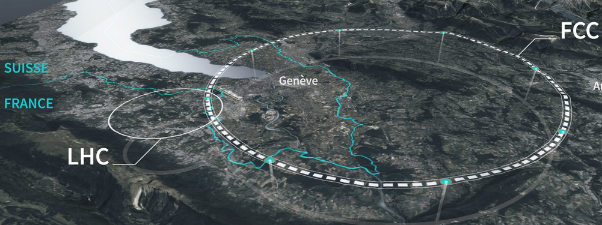
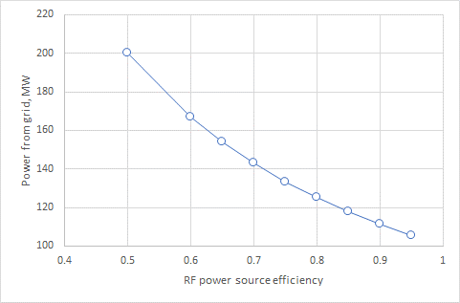
Grid power required for the large-scale HEP Accelerators (FCC_{ee})
400 MHz, 1 MW klystron for FCC_{ee}
State of the art
2020 and before
HEK project target
2026/27
https://fcc.web.cern.ch/overview
To operate FCC_{ee}, 100 MW Continues Wave RF power is needed to accelerate particles and to compensate for the energy lost into synchrotron radiation.
Improving klystron RF efficiency from 65% in the best existing commercial devices to 85% in the new HE tubes will:
Save 32.2 MWh -> 253 GWh (7000h/year) -> 2.53TWh over 10Y.
Reduce cost and power consumption of power converters and cooling system (environmental impact).

Slide 4
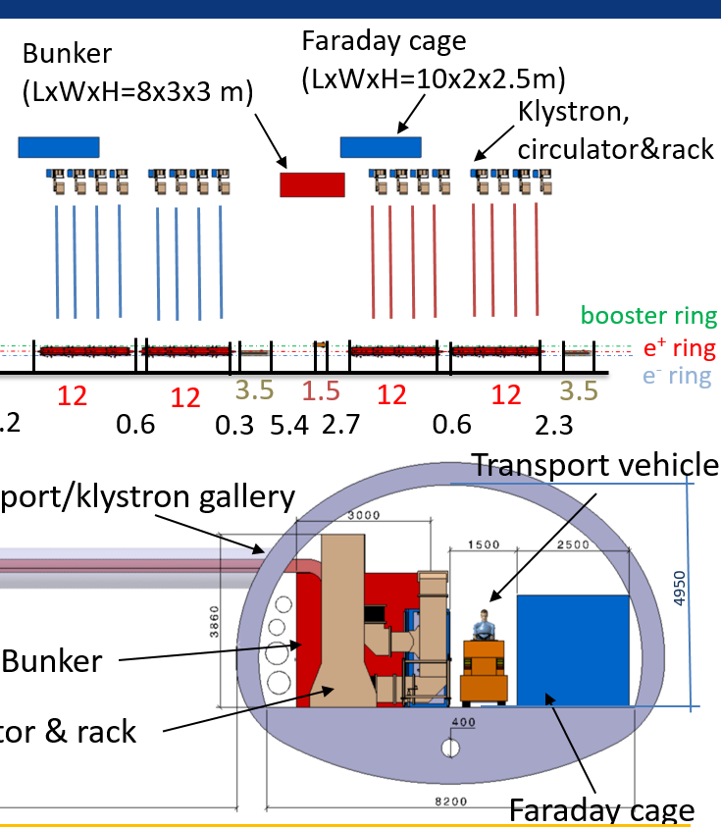
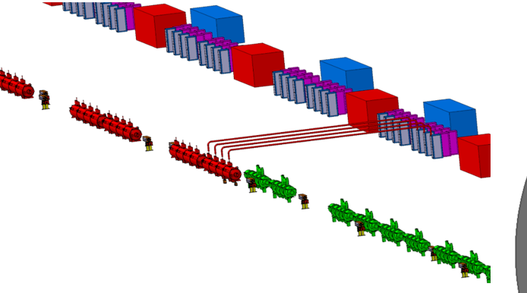
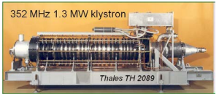
FCC_{ee} (Z) accelerator tunnel integration
Bunker:HV
Klystrons
1.3MW CW, 352MW, 100kV, 20A, eff.=63%.
5.5m
Each Klystron should deliver 1MW @ 400MHz.
Preferably, klystron should be placed vertically in the tunnel.
The total length of Klystron should be about 3m.
The efficiency of Klystron is targeted >80%.

Slide 5
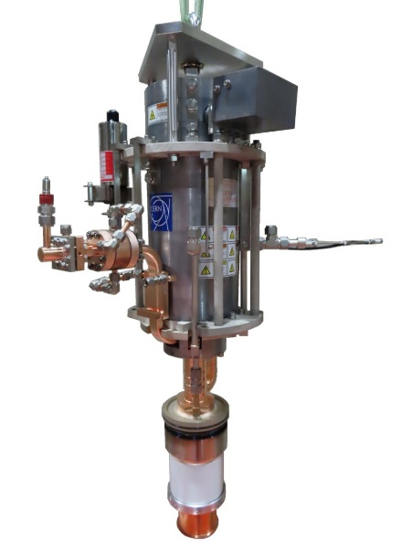

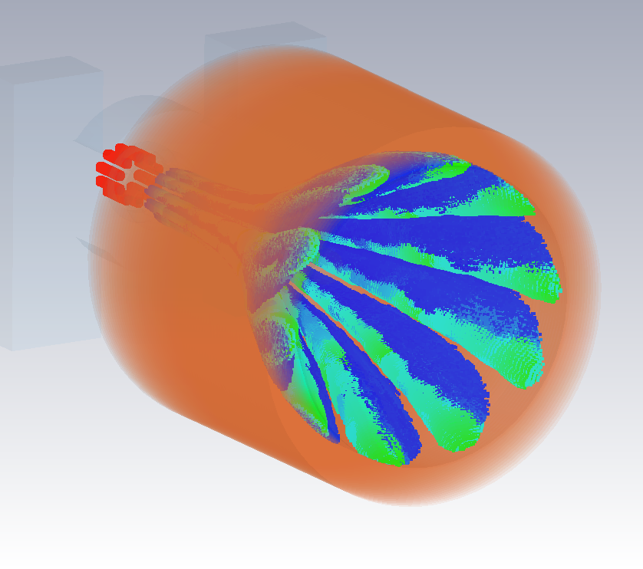
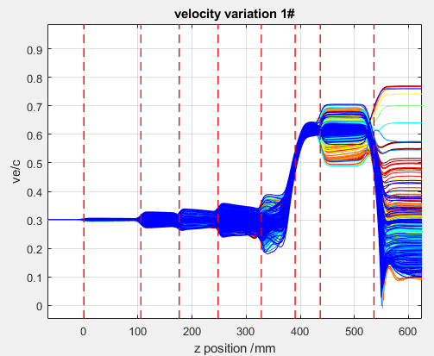
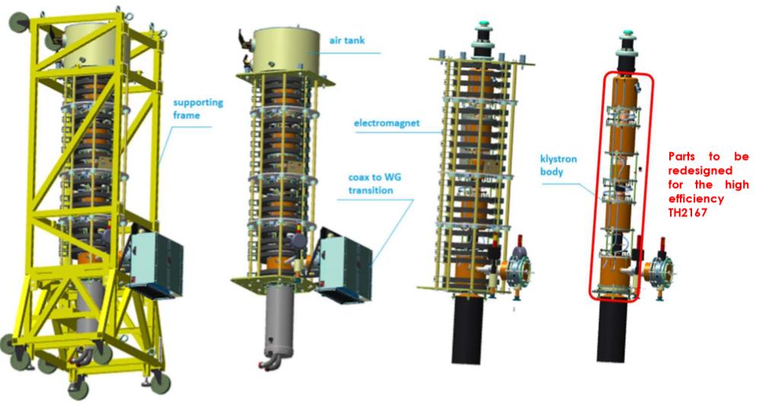
High efficiency klystrons projects at CERN
High Efficiency klystrons activity was initiated at CERN in 2014. In 2021 it was transformed into a CERN’s project.
Objectives: Development, design, fabrication and testing of the new HE klystrons for application in various particle accelerators.
Selected topic
First commercial X-band 10 MW HE (56%) klystron.
CERN-Canon collaboration.
Task 2: HE LHC 400 MHz klystron
Retrofit upgrade of Thales klystron (60% to 70%) in close collaboration with industry.
A base line option for HL-LHC.
Task 3: Novel two-stage klystron technology with 80%+ RF production efficiency
Design, fabrication and testing of the 400 MHz 1MW CW klystron for FCC in collaboration with industry.
Promote this new technology towards CLIC, ILC and Muon_C.
Task 4: High efficiency X-band pulsed klystrons in the power range 10-50MW
Strong Collaboration with industry (Canon, CPI and Thales).
Important for multiple projects (CompactLight, DEFT, EUPRAXIA etc.).
Great show case for CERN’s technology and contribution to worldwide society.
Task 1: Design & simulations
Maintenance and distribution of the CERN made klystron code KlyC.
High level expertise in using commercial tools like CST PIC, HFSS etc.

Slide 6




Two-Stage Multi Beam Klystron (TS MBK) technology in UHF/L-band
Specific features
Commercial HE MBK
Efficiency 65%
GOOD FOR:
Bunching at a low voltage (high perveance). Very compact RF bunching circuit.
Bunched beam acceleration and cooling (reducing Δp/p) along the short DC voltage post-accelerating gap.
Final power extraction from high voltage (low perveance) beam. High efficiency.
V
V₁+V₂
Additional advantages:
For pulsed tubes, the second HV stage can be operated in DC mode. Thus, simplifying the modulator topology. (cost/volume) and increasing the modulator efficiency.
Simplified feedback for the first stage pulsed voltage. Improved klystron RF phase and amplitude stability.
TS HE MBK
Efficiency 85%+
HV insulators
Drawbacks:
Stage 1
V₁
Reflected electrons from the output cavity and collector shall be avoided at any cost.
RF radiation into DC gap must be sealed.
Requires special HV isolated RF feedthrough to inject RF signal into input cavity.
Large bore (∅400mm) ceramic insulator on the 2nd stage.
V₂
Post accelerating gap
Stage 2

Slide 7
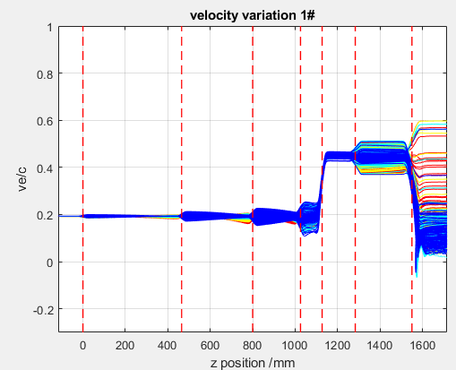
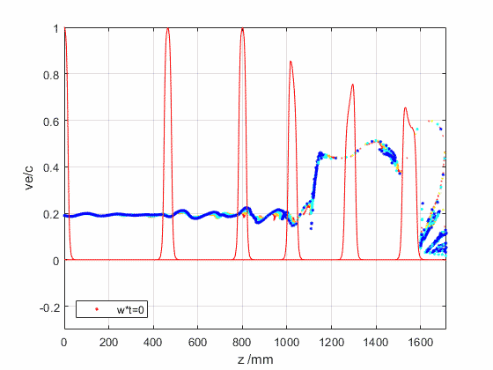
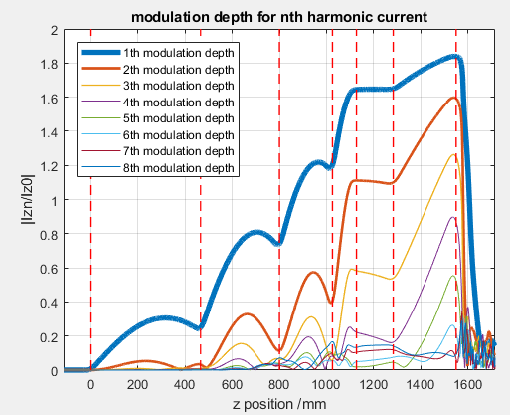
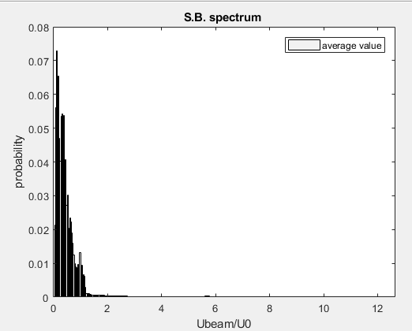
FCC 400 MHz, CW TS MBK klystron design (KlyC)
Input parameters:
Frequency: 400 MHz
N beams: 10
RF power: 0.6-1.2MW
Perveance total: 0.11
Total HV: 55-65 kV
RF Efficiency: > 80%
Power gain > 40 dB
Total length: <3m
KlyC
(FCCee H-pole)
0.845 MW
0.108 (1st: 1.5)
60 (10+50) kV
88.1%
41.5
1.55m (RF)
HE featured:
4 cavities COM bunching circuit (1st stage).
RF bunching/linearization in DC gap by rotating/compressing bunch in the phase space).
Optimized congregation in the penultimate cavity.
‘Long’ gap in the output cavity allows control of the bouncing electrons (no reflected electrons) in a wide RF power/Voltage range/

Slide 8
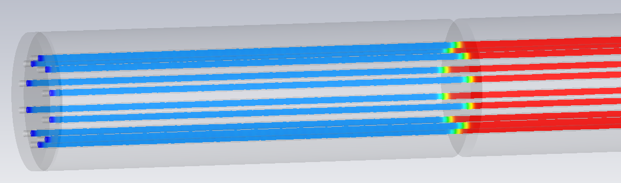
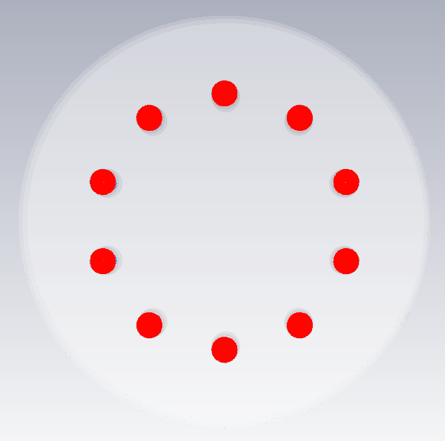
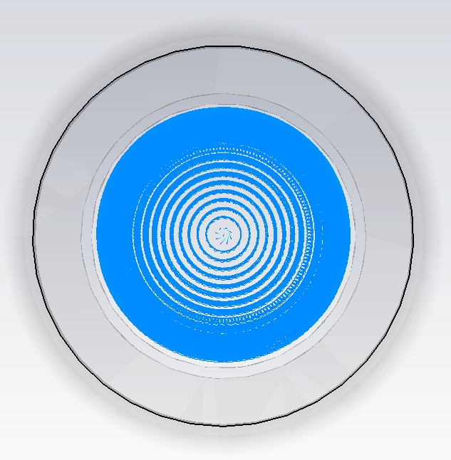
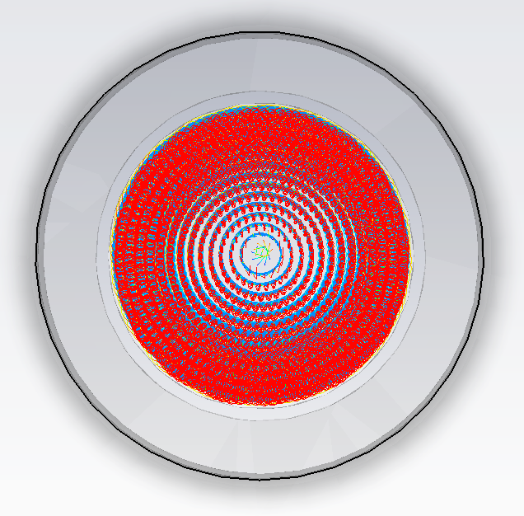
Beam Optics of TS HE MBK Gun in TRK Solver
Current=17.8 A ,Perveance= 1.6 μA/V^{3/2}, Beam Radius= 7.06 mm
3D Magnetic field is imported from CST solenoid project.
3D effects brought by the MB topology are fully considered.
TRK
Z = 600 mm
Z = 1480 mm (Output cavity gap position)

Slide 9
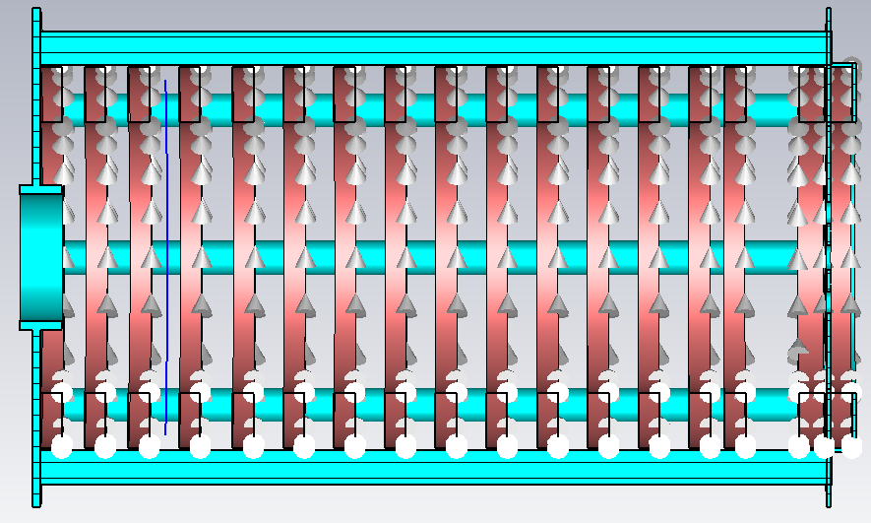
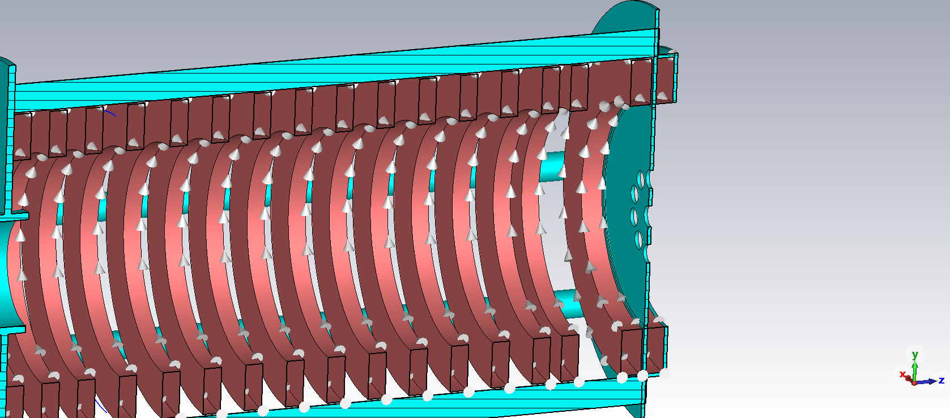
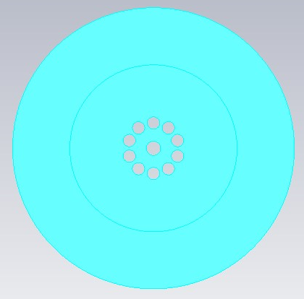
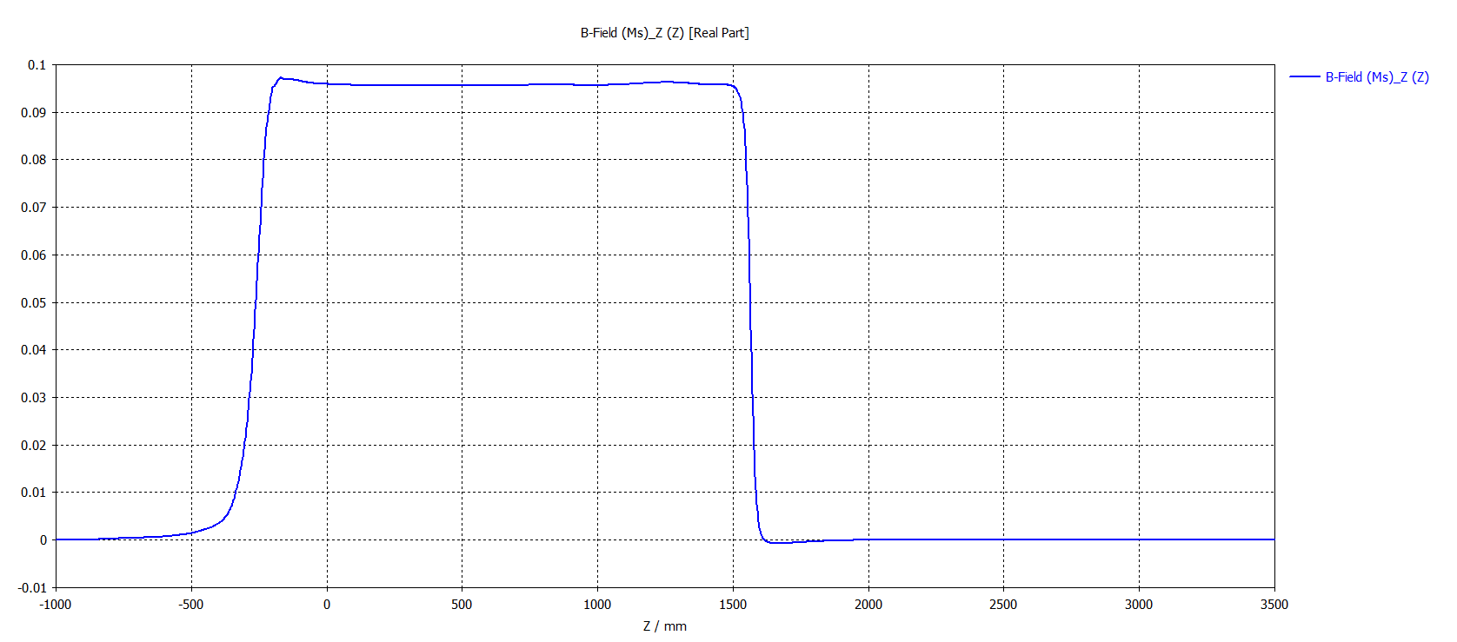
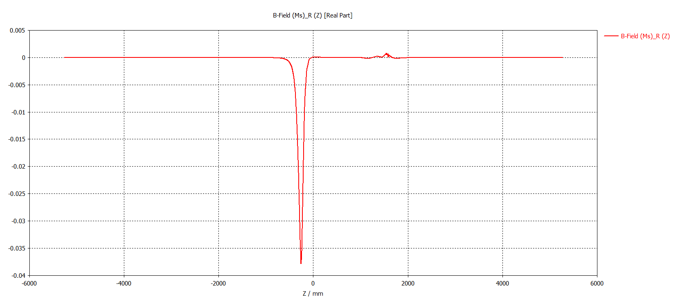
Solenoid Design in CST Software
Magnetic Field = 0.095 T
Power Consumption= 8.08 kW
Using ρ value for Al (3.05E-08 )
Power Consumption= 14.35 kW
The ending pole-piece with 10 holes and a coaxial at the centre on a rear view of the solenoid
Whole structure of solenoid together with the position of the collector coil
Plot of Bz value along the z-axis generated from solenoid
Plot of transverse magnetic field 𝐵t along the z-axis
The 𝐵t value of the focusing magnetic field is limited under 0.5 Gauss from the cathode to exit of output-cavity.

Slide 10
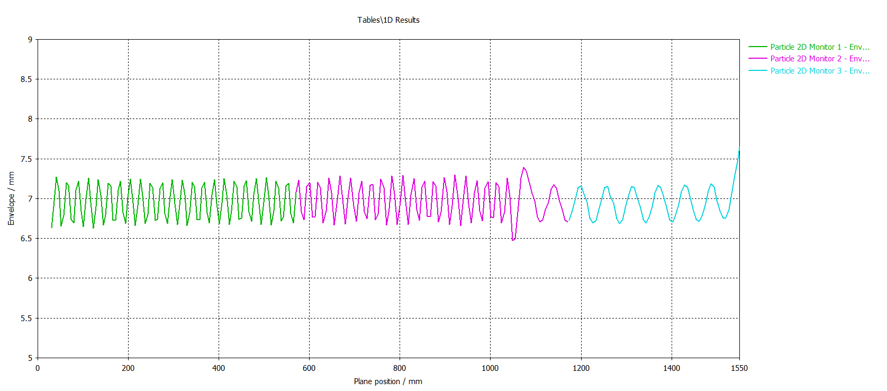
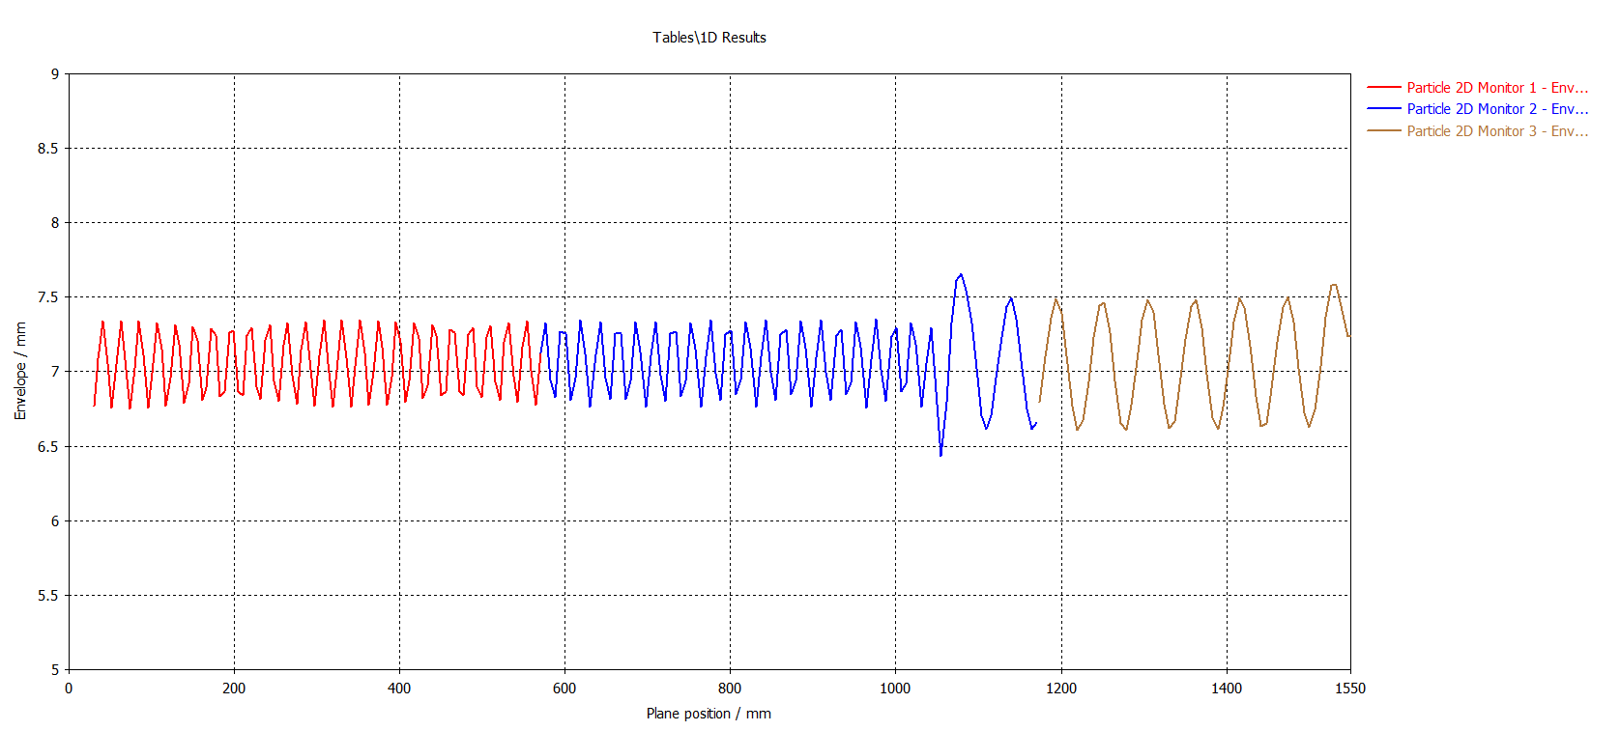
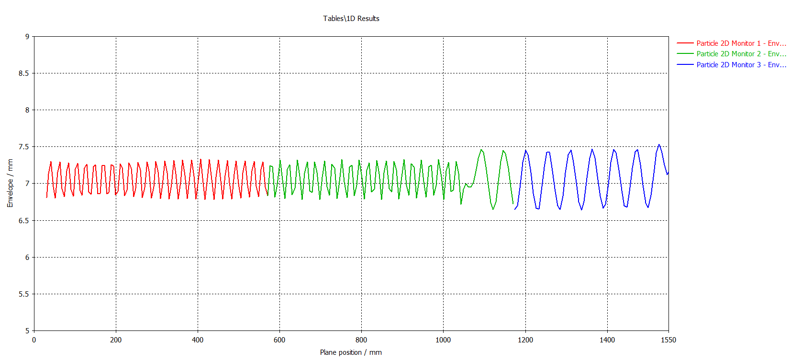
TRK simulation of TS HE MBK Gun at Different Voltages
TRK simulation of TS HE MBK Gun for Z, WH and ttbar Machines using same Magnetic field 0.095 T.
1st Stage Voltage, V1 = 10.75 kV
2nd Stage Voltage, V2= 53.75 kV
Current = 1.78 A
Perveance = 1.6 μA/V^{3/2}
Z
1st Stage Voltage, V1 = 10.0 kV
2nd Stage Voltage, V2= 50.0 kV
Current = 1.6 A
Perveance = 1.6 μA/V^{3/2}
WH
1st Stage Voltage, V1 = 9.40 kV
2nd Stage Voltage, V2= 46.20 kV
Current = 1.456 A
Perveance = 1.6 μA/V^{3/2}
tt bar

Slide 11
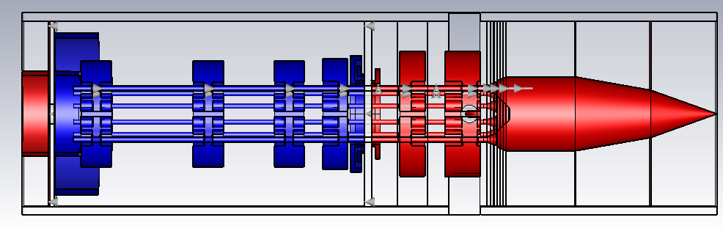
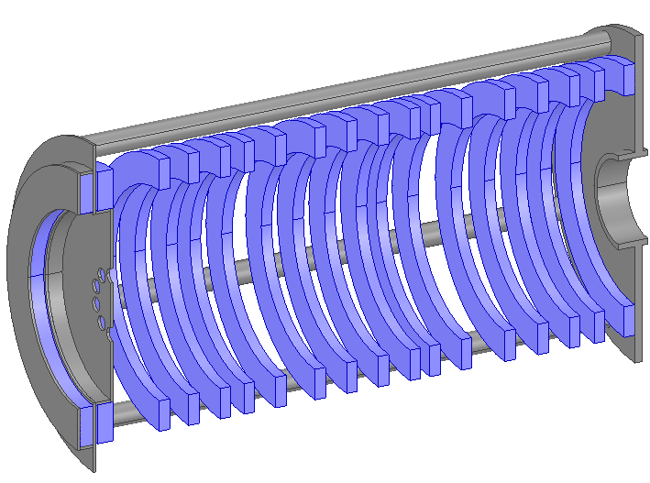
Setting up CST3D PIC simulations
Special coaxial input coupler (at ground)
DC gap
1st stage at a floating voltage
2nd stage at ground
1st stage beam injection
Rejectors
Output ports are used only for monitoring the power envelope and frequency spectrum. Efficiency is calculated by direct integration of the beam power at emission plane, integrated beam losses on the collector part and Ohmic losses in the output cavity:
Solenoid is simulated in CST separately and magnetic filed 3D map is imported into PIC simulations directly.
η=P _{spent beam} (1-Q_{ext}/Q₀)/( Ix U)

Slide 12
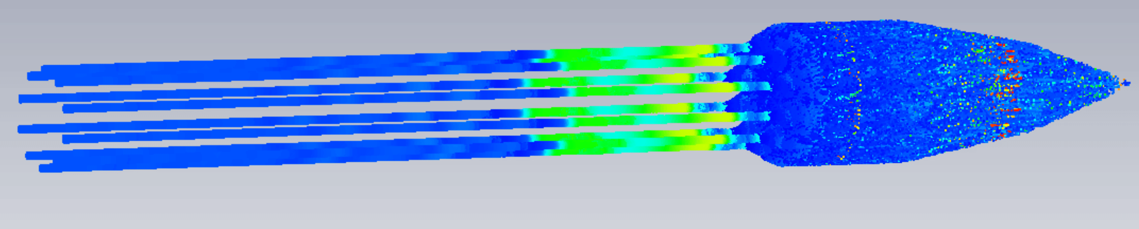
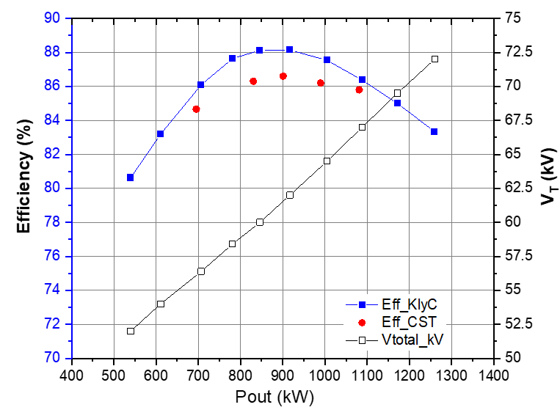
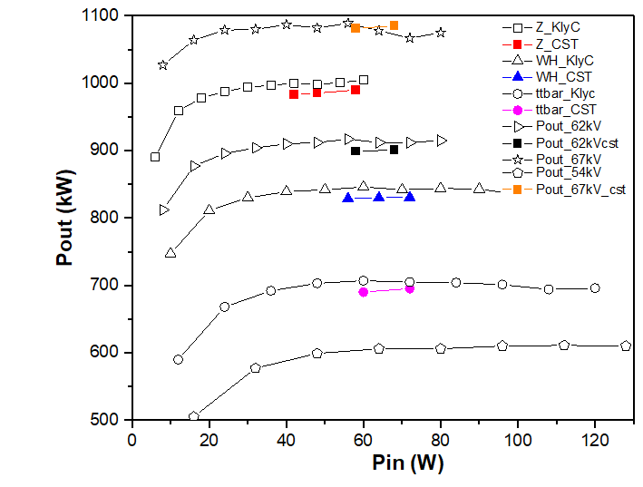
FCC 400 MHz, CW TS MBK RF performance summary (CST3D PIC)
1MW in saturation

Slide 13
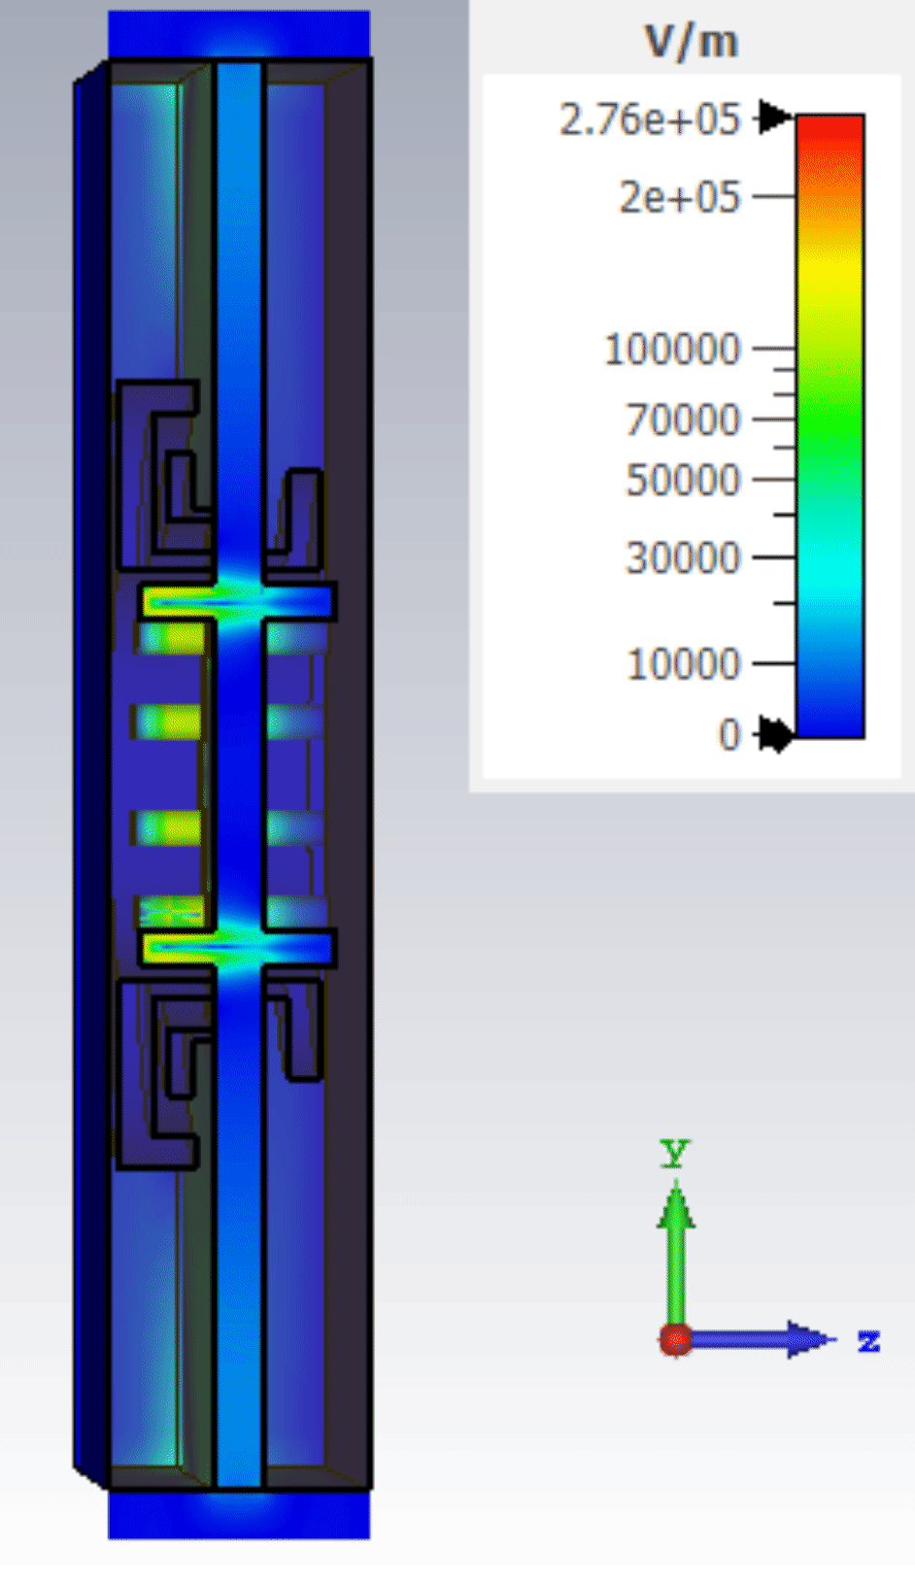
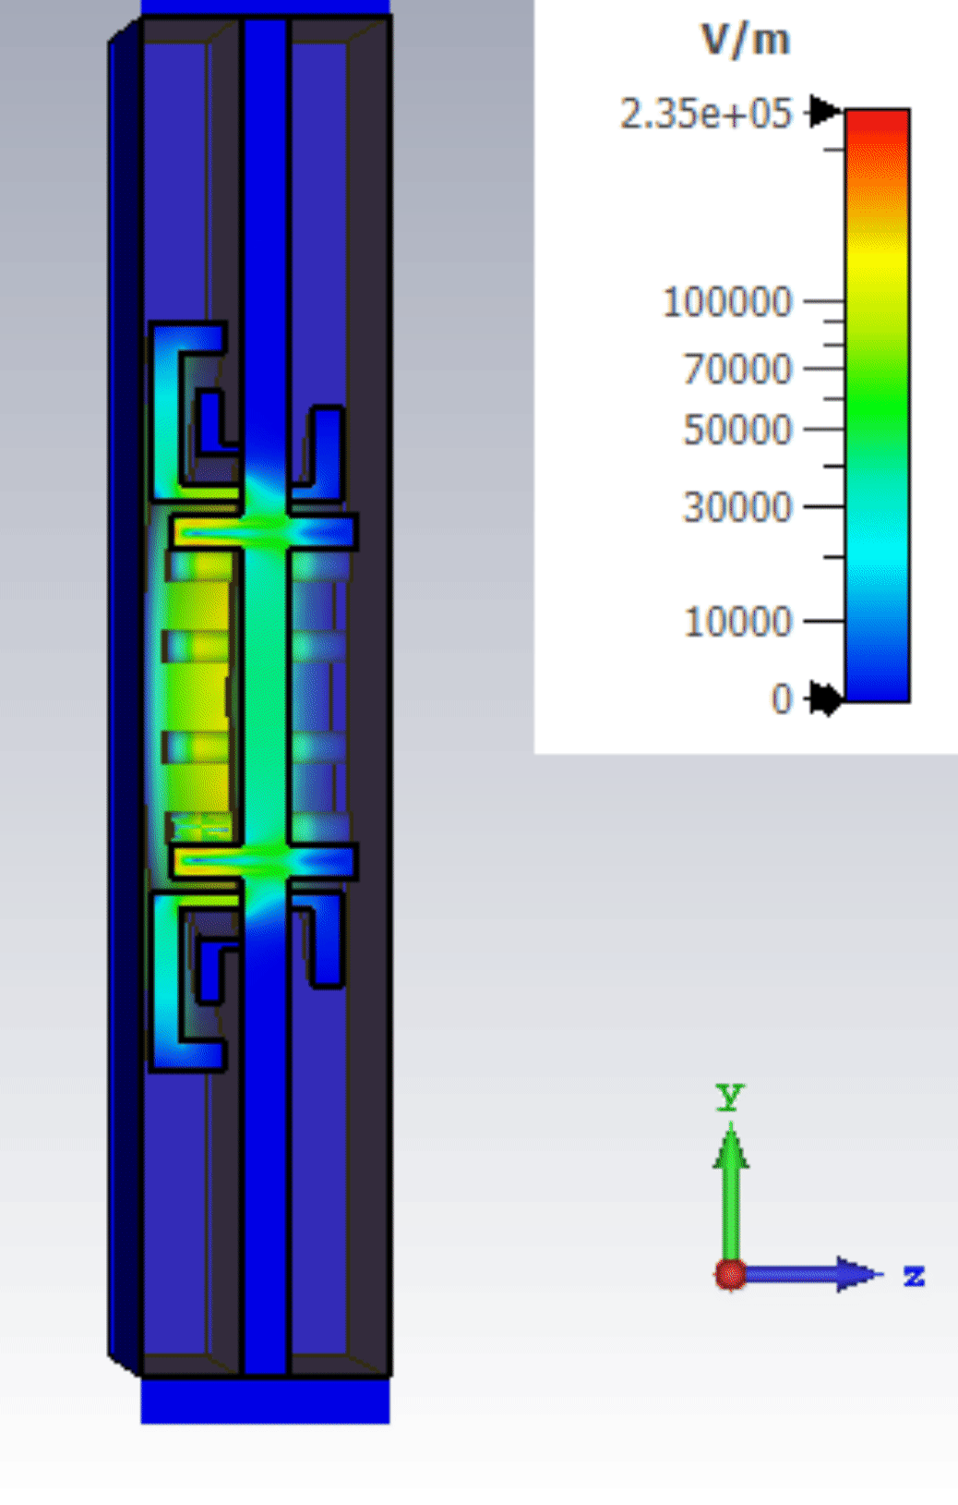
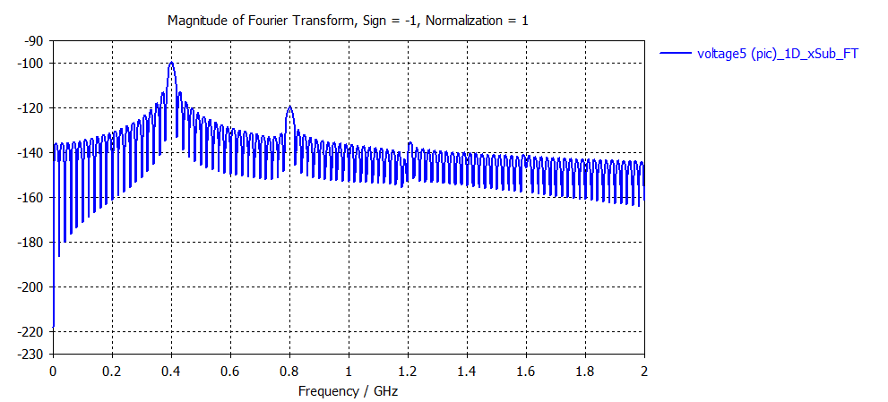
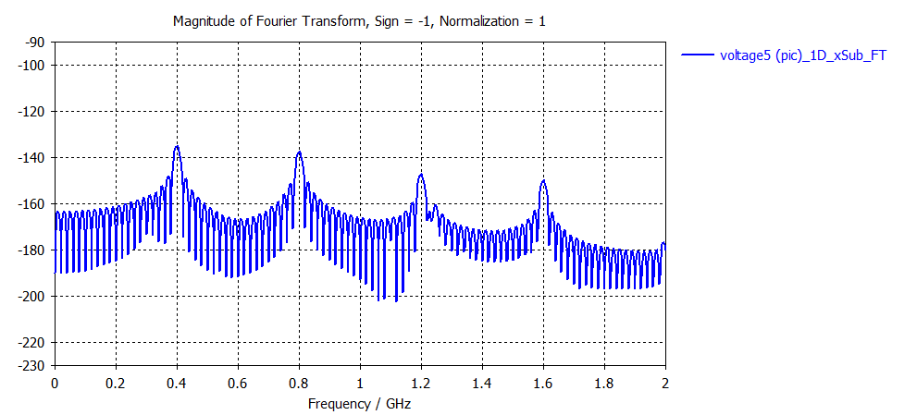
Suppression of RF radiation into DC gap (concept)
15.3kW
13.5 W
Spectra of RF radiation into DC gap
‘open’
By using 3 radial resonant choke rejectors, total radiation into DC gap is suppressed by >30dB
Illustrated case uses bunched beam at 0.96 MW (16Ax60kV)/ H-pole
-36 dB
‘open’
1-8 dB
-5 dB
2nd Workshop on efficient RF sources, 23-25 Sept. 2024, Toledo, Spain
13

Slide 14
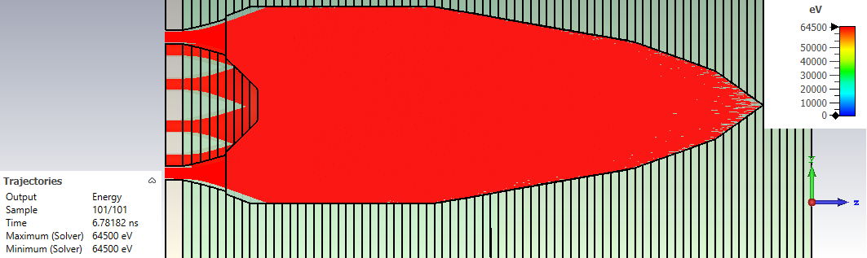
TS MBK collector baseline design
CST3D TRK simulations
307.3 mm
932 mm
 | Voltage | Current | dP/dS (max)
ttbar | 56.4 kV | 14.56 A | 211 W/cm²
WH | 60 kV | 16 A | 258 W/cm²
Z | 64.5 kV | 17.8 A | 285 W/cm²
Collector was optimised to maintain power loss density on the surface < 300 W/cm² for DC operation
14

Slide 15
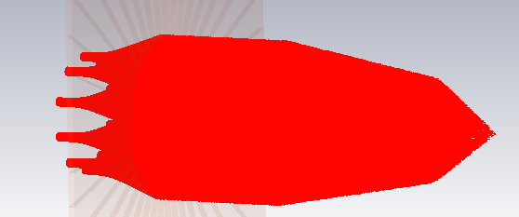
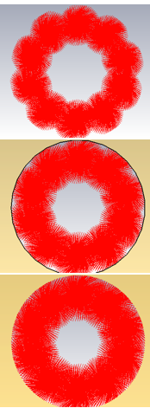
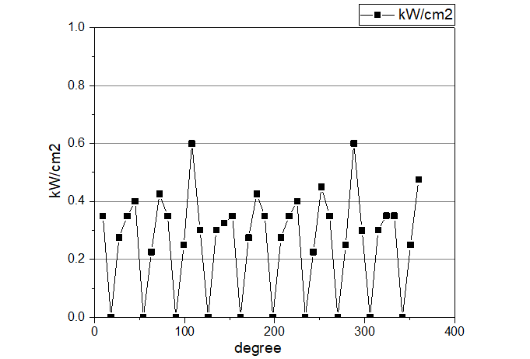
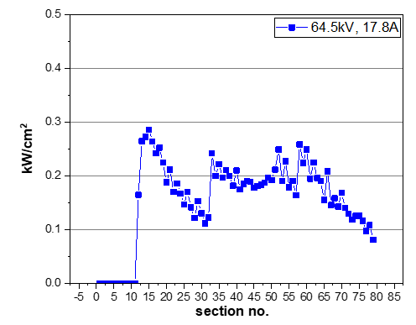
Specifics of MBK collector.
Azimuthal beam losses distribution.
9 degrees/sector
Section
#15
#16
#17
Averaged power over the section
L section=12.5mm
Azimuthal peak power density is about 400W/cm² . We will need to:
Increase collector diameter by 10-20% (307mm -> 340/360mm).
Lengthen the input taper part so that first impact will happen at a grazing angle.

Slide 16
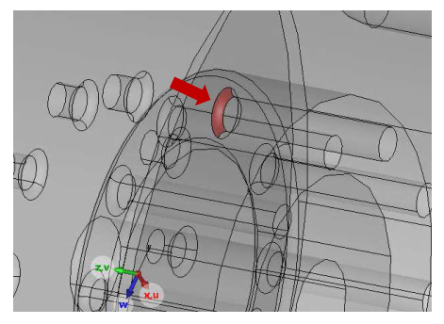
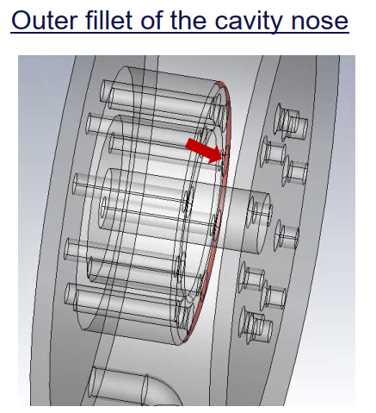
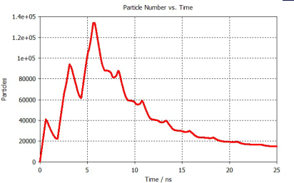
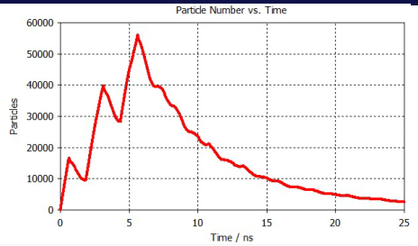
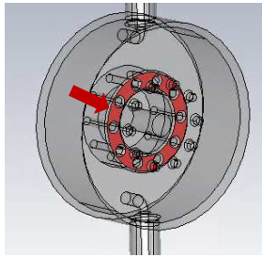
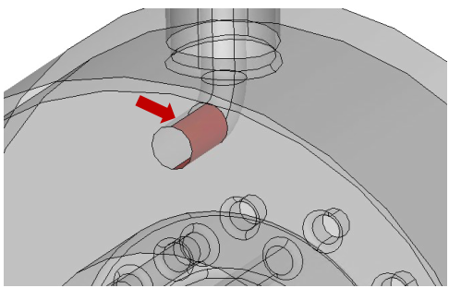
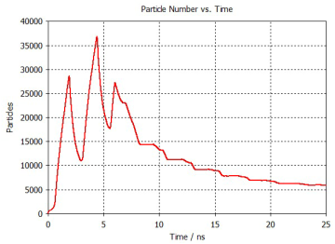
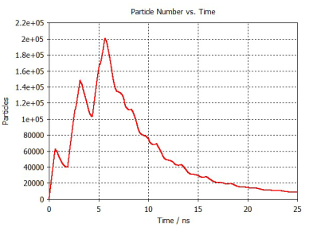
Multipacting Simulation at 1 MW RF
Courtesy: Franck Peauger
Inner fillet of one beam hole
Outer fillet of the cavity nose
Flat Part of the nose
RF Loop

Slide 17
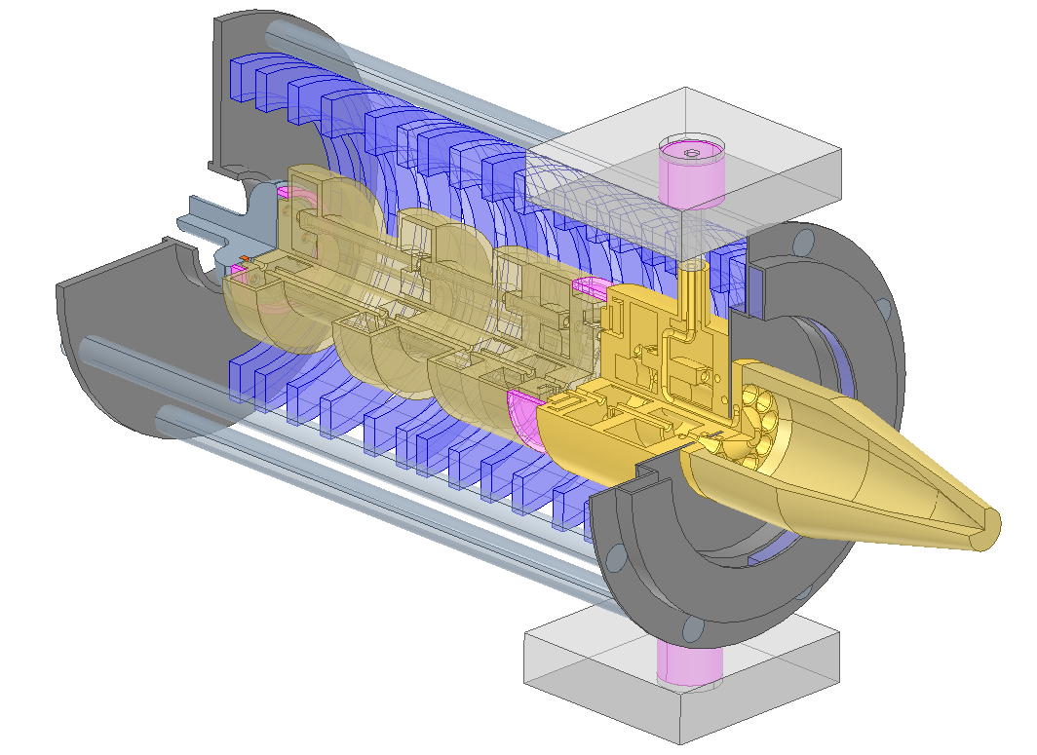
400 MHz HE Two-Stages MBK for FCC_{ee}. Integration.
2.95 m

Slide 18
FCC TS MBK Summary and outlook
The reduction of energy consumption in the future large-scale accelerators, like FCC, is of a great importance.
Novel two-stage (TS) klystron technology was introduced recently. It enables compact solution in UHF band, with potential to increase the efficiency from 65% in existing commercial tubes up to 80%.
Such a 400 MHz, 1.0 MW TS MBK klystron for FCC is now under development at CERN as a part of the High Efficiency Klystrons project.
RF circuit, beam optics and special axillaries, like HVRFT and DC accelerating gap rejector, have been evaluated and confirmed in simulation the tube conceptual feasibility with potential to reach target efficiency of >85%.
The next step will be integration of beam optics and RF circuit, followed by technological development and prototype fabrication in collaboration with industrial partner.
Multipacting effect has been checked.

Slide 19

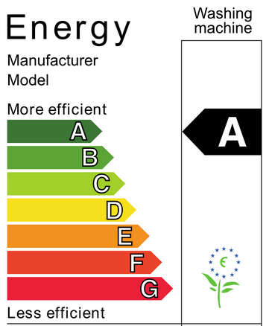
80%
70%
60%
50%
Project leader: Igor Syratchev
Project team @CERN: Zaib Un Nisa, Nuria Catalan Lasheras.
Project team@ Lancaster: Lee Millar, Graem Burt.

