Slide 1
Klystron focusing based on permanent magnets
J. Lucas, I. Pompa

Slide 2
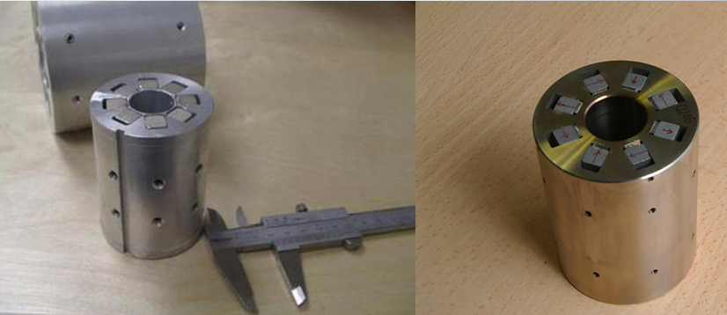
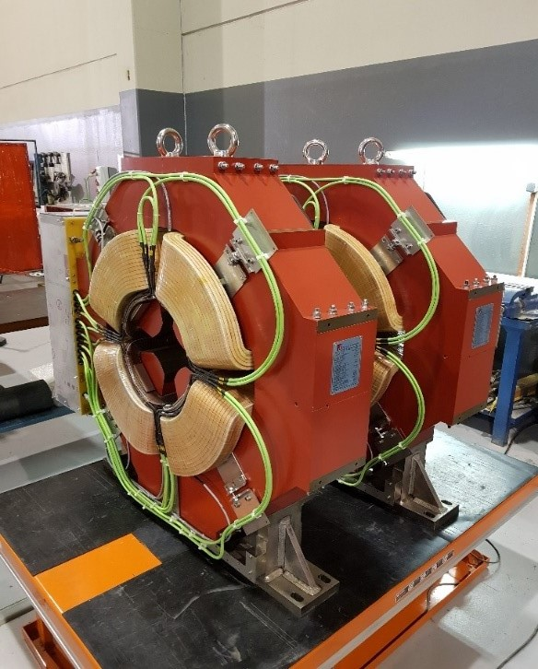
Who we are?
ELYTT Energy is a small company manufacturing electromagnetic systems mostly for the accelerator and fusion sectors. We are located in northern Spain near Bilbao and have a technical and commercial office in Madrid.
We cover the complete range of normal conducting, superconducting and permanent magnets.
Hallbach quadrupoles for Linac4 at CERN (our smallest magnet)
Normal conducting quadrupoles for IFMIF

Slide 3
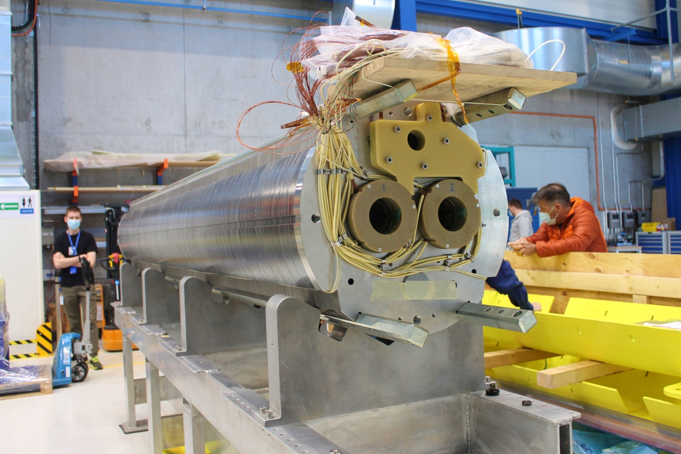
Who we are?
Superconducting quadrupole (4 m long) for the LHC High Luminosity Upgrade.

Slide 4
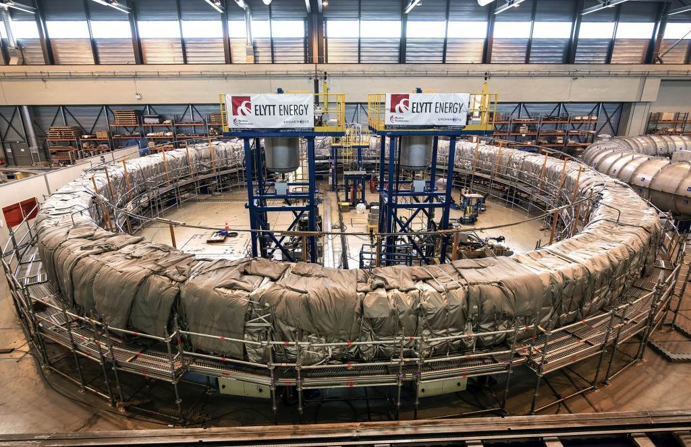
Who we are?
Impregnation of an ITER PF coil performed by ELYTT Energy (our largest magnet)

Slide 5
Contents
Main differences between solenoidal focusing using permanent magnets and electromagnets.
The building blocks: field generated by radial and axial magnets
Implementation of the PM focusing for a klystron.
Simulation of the beam dynamics.
Integration of the input and output waveguides.
Suggested solution for the field next to the collector region.
Effect of the permanent magnet block errors.
Conclusions.

Slide 6

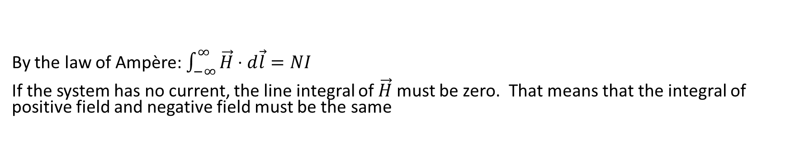

Main differences between electromagnets and permanent magnets. Ampère law.
By the law of Ampère:$\int_{−∞}^{∞}{\vec{H}⋅d\vec{l}}=NI$
If the system has no current, the line integral of $\vec{H}$ must be zero. That means that the integral of positive field and negative field must be the same
Permanent magnet and iron
Electromagnet
PM+IRON
+I
$$\int_{−∞}^{∞}{\vec{H}⋅d\vec{l}}=0$$
$$\int_{−∞}^{∞}{\vec{H}⋅d\vec{l}}>0$$
Bz
Bz
z
z
-I
PM+IRON
The field reversal is unavoidable

Slide 7
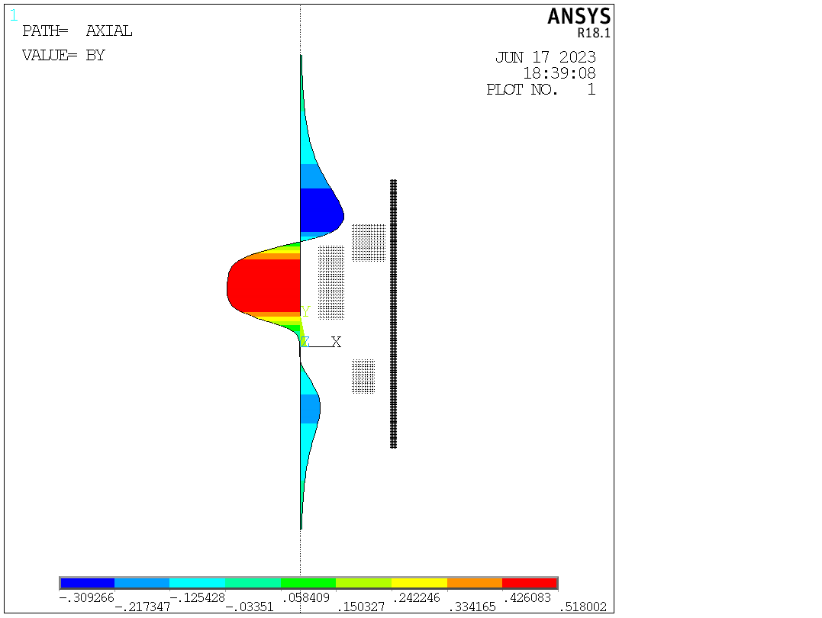
Example of the importance of the Ampère law.
In this example, we can see how the positive field lobe is preceded and followed by two lobes of negative field.
The law of Ampère does not impose where the lobes of field reversal will be located and they can be displaced to a region where they do not impact the beam dynamics.
Boosting the field reversal
Beam direction
Ferromagnetic shield
Cancel field and derivative at a point

Slide 8

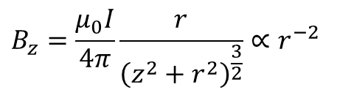


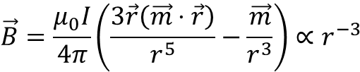
Effect of the distance to the source of field.
Field generated by a current loop
$$B_{z}$$
I
r
The second important difference is that the field generated by a magnetic moment decays faster with distance that the field generated by transport current. This has two important consequences:
Permanent magnets are good at generating intense fields over small volumes
The permanent magnet has to be located as near as possible to the region where we want to create the field.
$$B_{z}=\frac{μ_{0}I}{4π}\frac{r}{{\left(z^{2}+r^{2}\right)}^{\frac{3}{2}}}∝r^{−2}$$
Field generated by a magnetic moment
$$\vec{m}$$
r
$$\vec{B}$$
$$\vec{B}=\frac{μ_{0}I}{4π}\left(\frac{3\vec{r}\left(\vec{m}⋅\vec{r}\right)}{r^{5}}−\frac{\vec{m}}{r^{3}}\right)∝r^{−3}$$

Slide 9
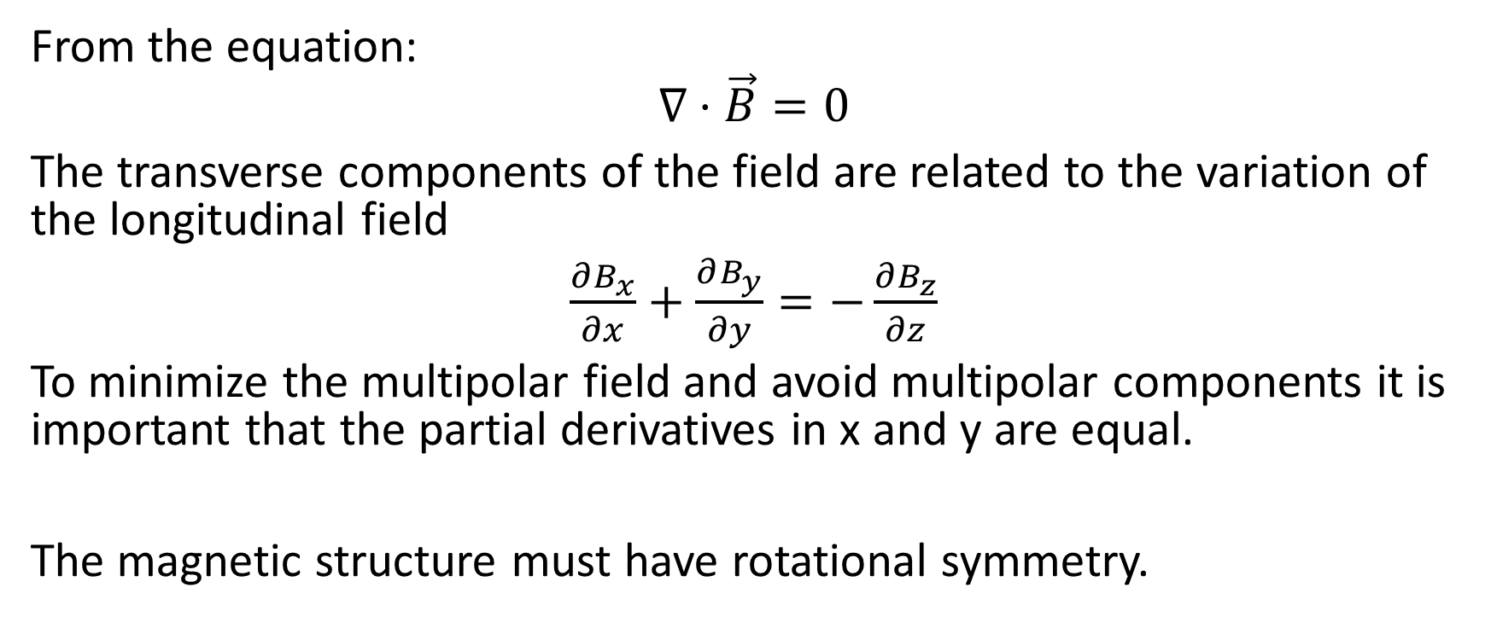
Importance of having an axial symmetric field
From the equation:
$$∇⋅\vec{B}=0$$
The transverse components of the field are related to the variation of the longitudinal field
$\frac{∂B_{x}}{∂x}+$ $\frac{∂B_{y}}{∂y}=−\frac{∂B_{z}}{∂z}$
To minimize the multipolar field and avoid multipolar components it is important that the partial derivatives in x and y are equal.
The magnetic structure must have rotational symmetry.

Slide 10
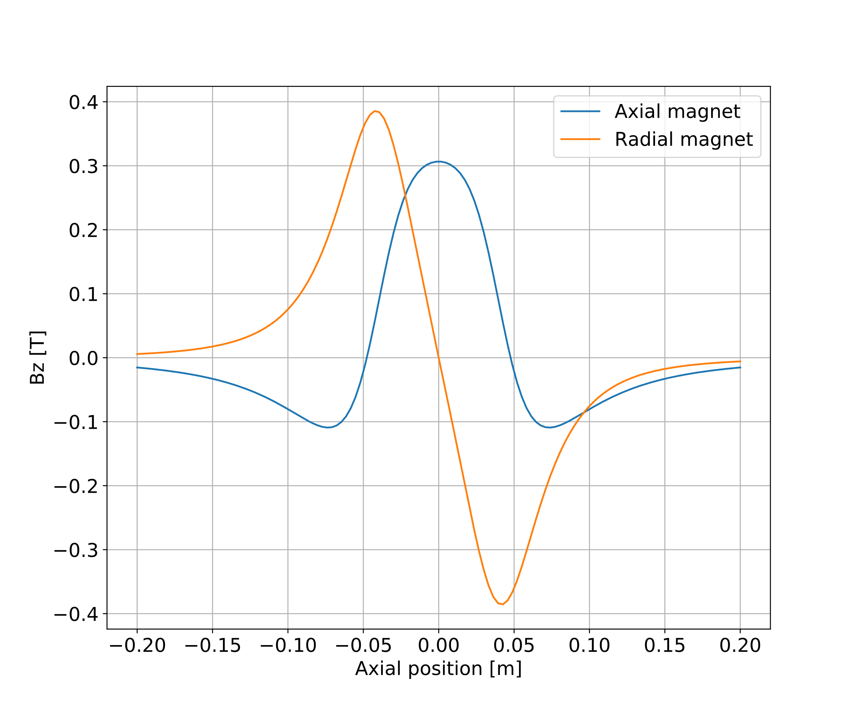
Radial and axial magnets
Radial
magnet
Axial
magnet
Beam axis
Beam axis
The main building block of the magnet system, are radially and axially magnetized permanent magnet blocks.
We can see here, the effect of two blocks of the same dimension centered on the origin.

Slide 11
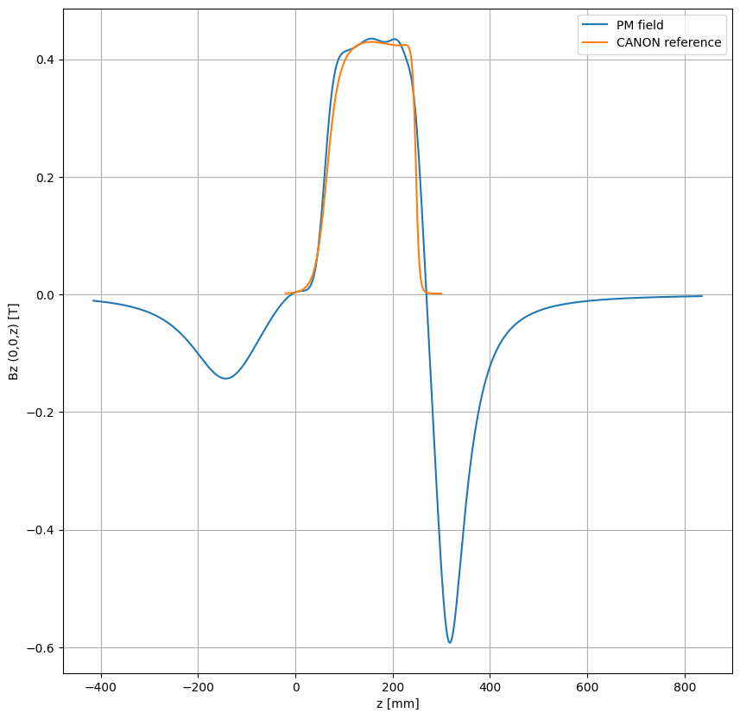
Reconstructing a typical field with PM
Bunching region
Extraction cavity
Input cavity
With our previous knowledge, we can now try to superpose the field created by axial and radial magnets to reproduce the axial field created from a existing electromagnet.
We can see that the field on the main transport region is well reproduced, but we have the effect of the field inversions before the cathode and beyond the extraction cavity.
Matching section
Collector region
Cathode

Slide 12
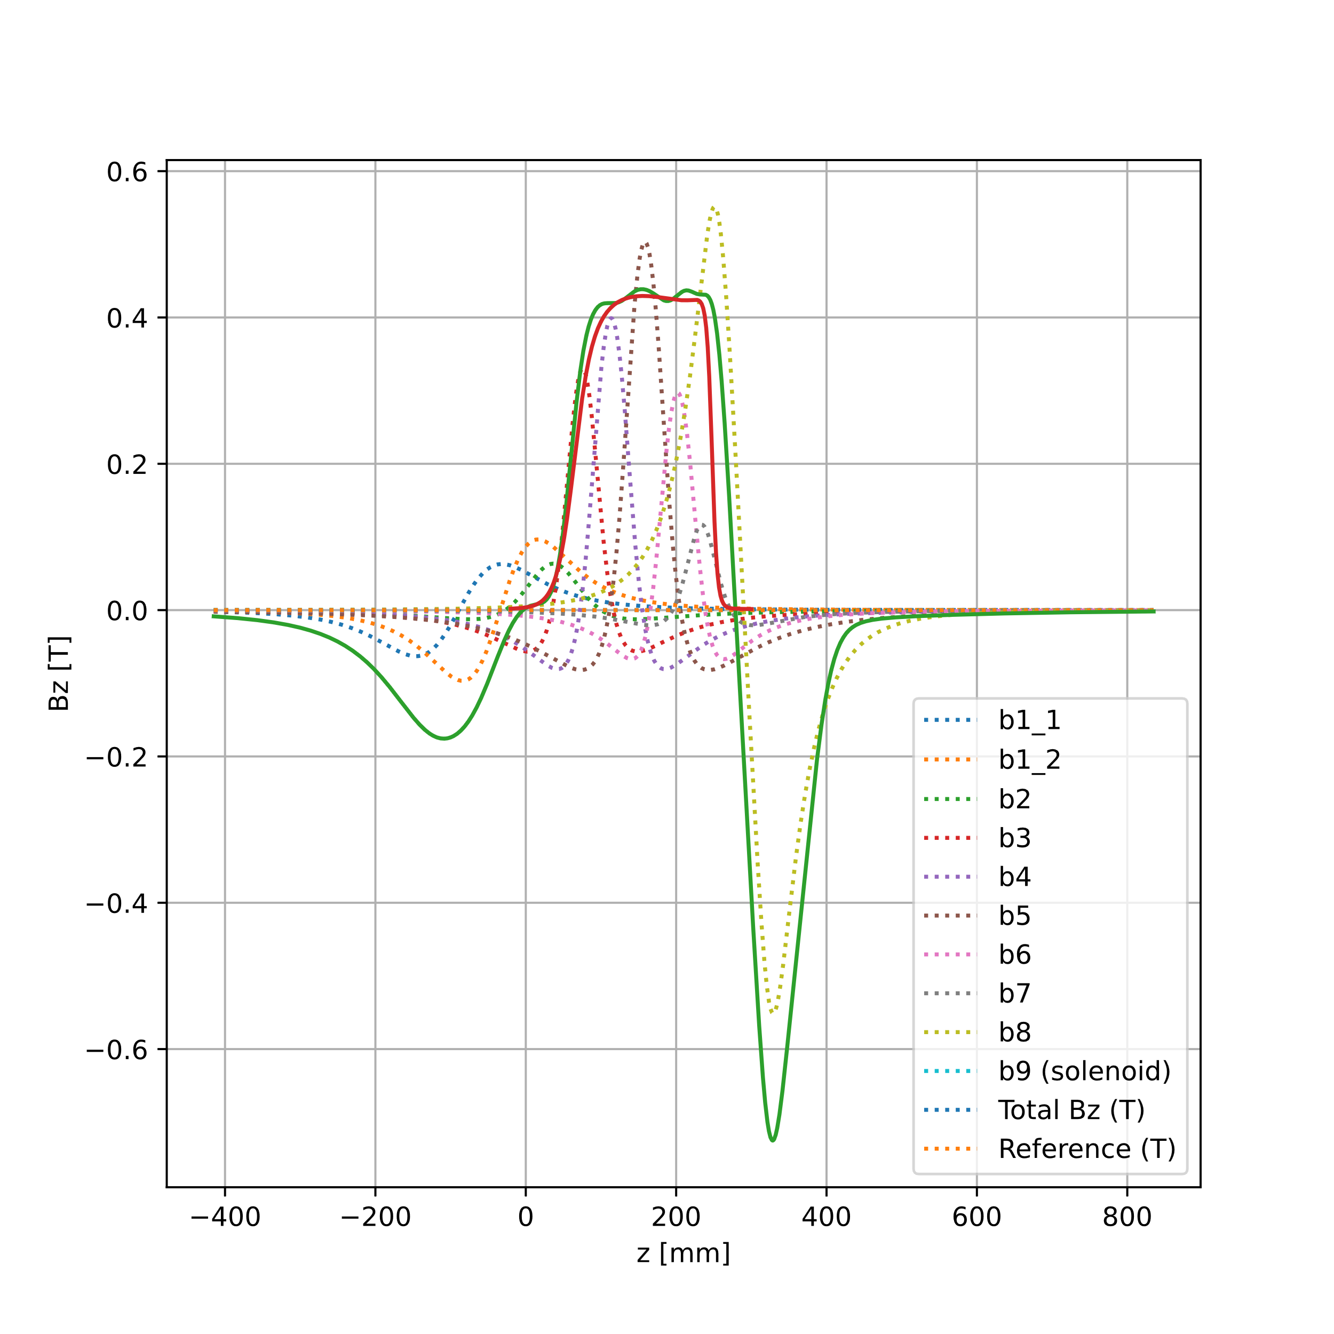
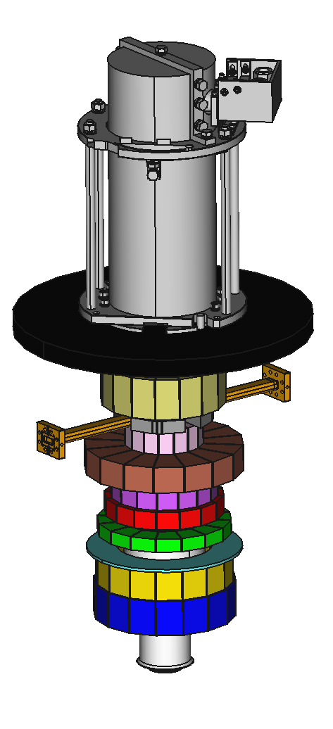
Synthesis of the desired field
Final field
reversal region
Cathode
Ferromagnetic plate
B8 (Radial)
B7
B6
On air
B5
Axial
B4
B3
B2
Solenoid
B1_2 (Radial)
In oil
B1_1 (Radial)

Slide 13
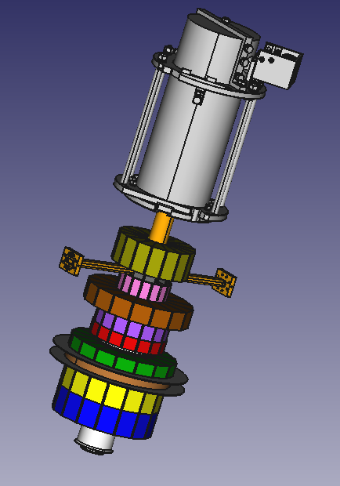
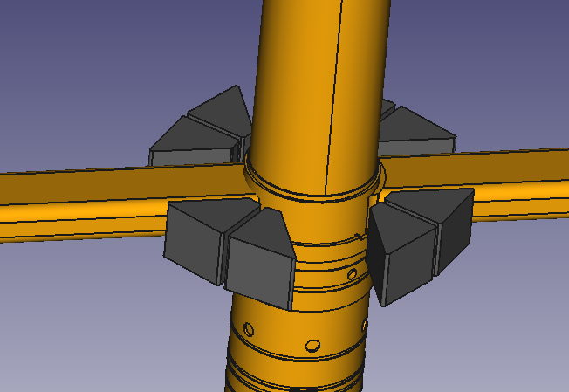
Magnet configuration of the previous field
This is the magnet configuration that creates the field of the previous slide.
We have opted for discrete blocks of uniform magnetization to create the axial and radial rings.
This solution is cheaper and allows for magnet block sorting to minimize the magnetization module and angular errors.

Slide 14
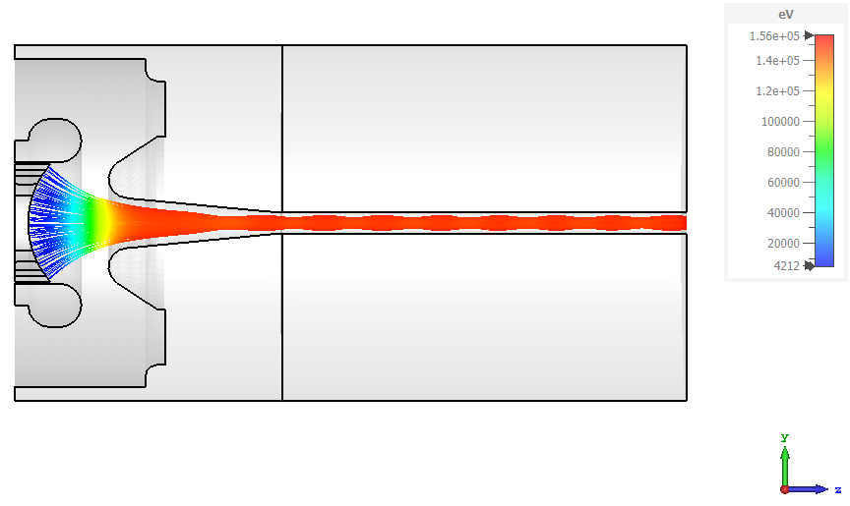
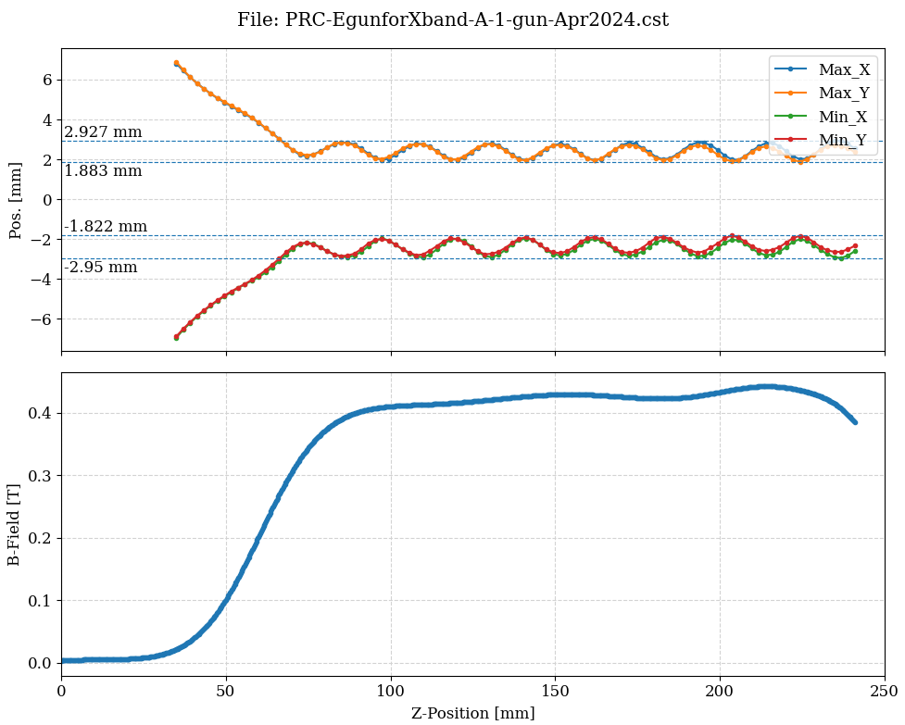
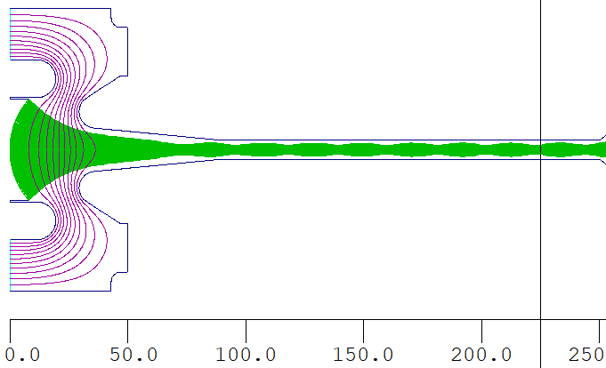
Beam simulation.
Both DGUN and CST simulations probe that the synthesized field has a 100% transmission for the desired beam.
CST
DGUN

Slide 15
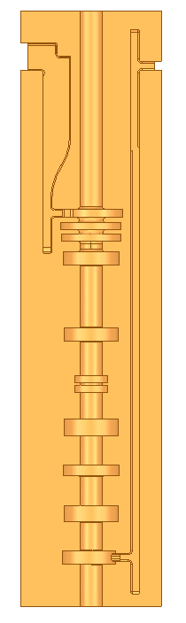
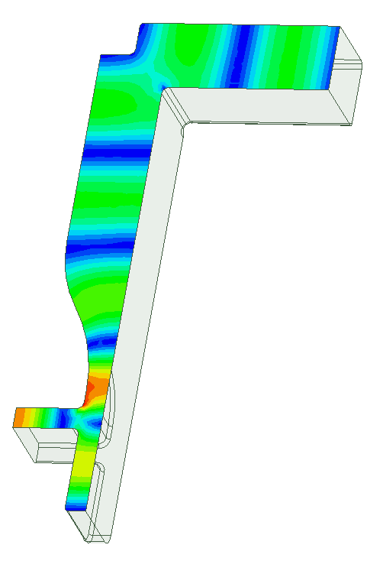
Input and output waveguides
e-beam
RF out
RF in
To produce an intense magnetic field in the desired volume requires the magnets to be as near to the tube as possible. This conflicts with the usual approach in which the waveguides are placed along the tube in parallel to it.
A tube optimized for the PM focusing would have the input and output waveguides integrated in the bulk of the copper structure.
The water cooling can be placed at 90° of the waveguides.
As a simpler alternative, the output waveguide can be maintained at the position of the output cavity and the input waveguide can be placed at the same plane. This is our preferred solution, as the space inside the tube downstream the output cavity must be used for the beam expansion during the beam reversal.
Courtesy I. Syratchev

Slide 16
Field reversal region near the collector
The field reversal happens near the center of the last radial block. Therefore the beam expansion must be kept small enough to be allocated inside the tube.
We have calculated analytically the beam behaviour in the region of the field reversal to estimate the beam expansion and the necessary transport channel mechanical aperture.
From the point of view of RF this expansion must be located at several decay lengths below cut-off frequency from the output cavity.

Slide 17
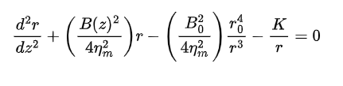
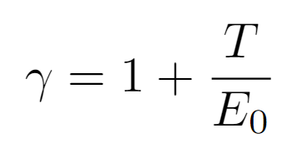
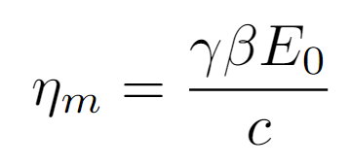
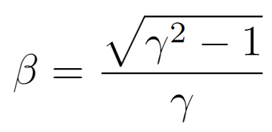
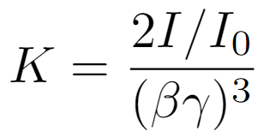
Analytical model
Field at cathode
The analytical model, although it only works well for laminar flow gives a very good indication of the behaviour of the beam near the field reversal, where the value of the field gets small over a short length.
We have used it to calculate the trajectories of the beam after the output cavity as a function of the particle energy, which is very dependent on the phase the particle arrives to the cavity.
Cathode radius
Local axial field
Beam radius
Generalized perveance
Axial position
Magnetic rigidity

Slide 18
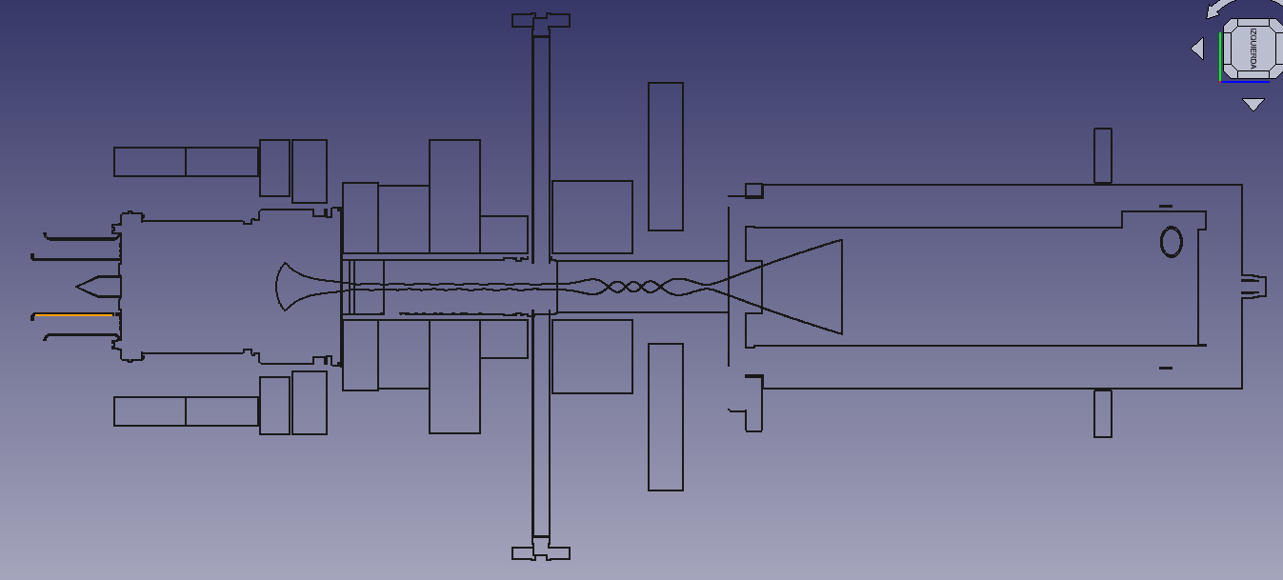
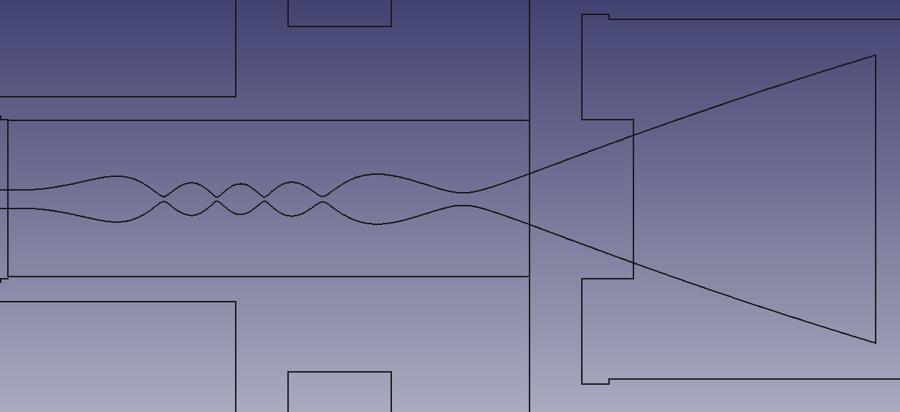
Full length simulation.
Here, we can see a full length transmission of the beam until the collector.
Zero field plane
Ferromagnetic shielding plate
14.32 mm
13.2 mm
Output cavity plane

Slide 19
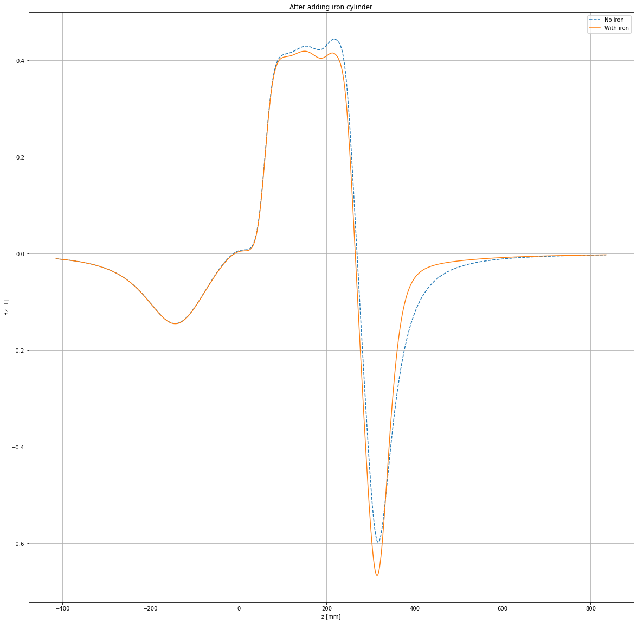
Importance of the ferromagnetic plate next to the collector
The field after the last PM block should be shielded to avoid an unnecessary length of focusing due to the reversed field.
A sharper transition also helps to reduce the size of the beam during the field reversal.
With shield
Without shield

Slide 20
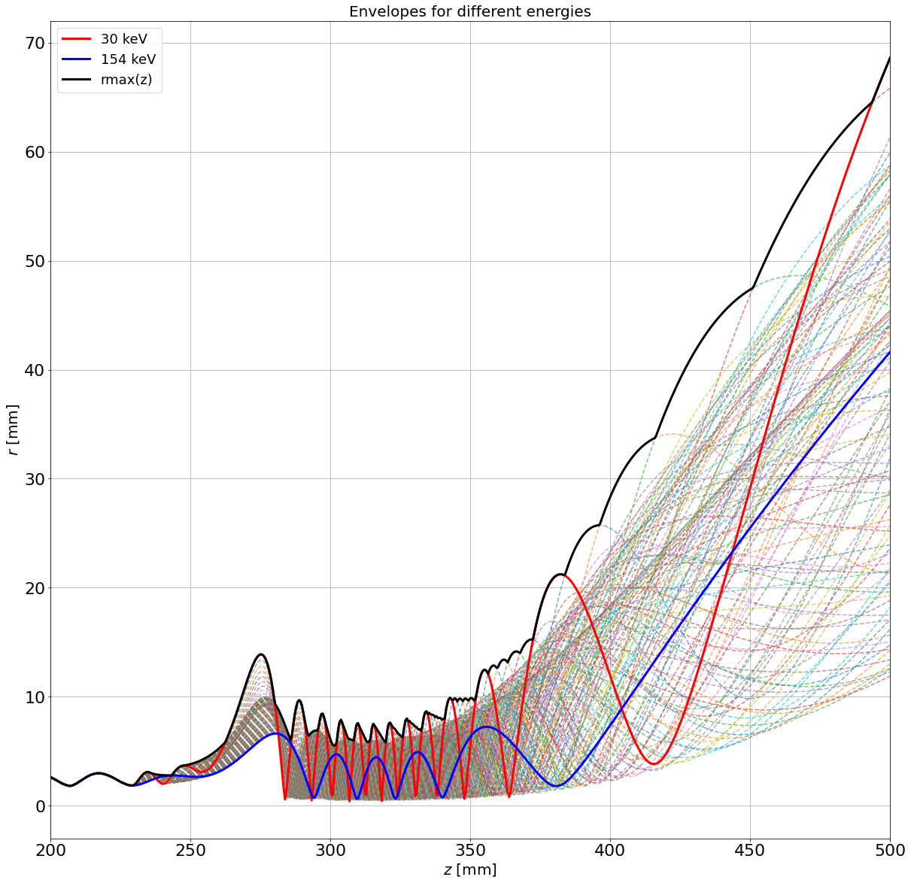
Effect of the beam energy near the collector
We have calculated all the trajectories from the output cavity with the beam energy changing in steps of 1 keV.
The envelope of envelopes is compatible with the tube radius in the field inversion region, and it is possible to enlarge the tube after the last ferromagnetic plate.
Field inversion

Slide 21
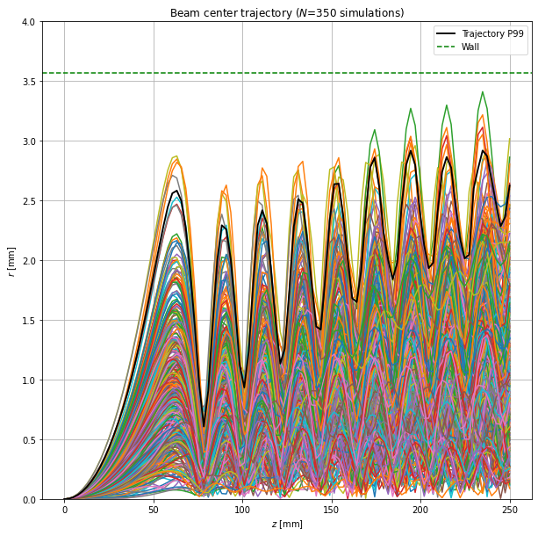
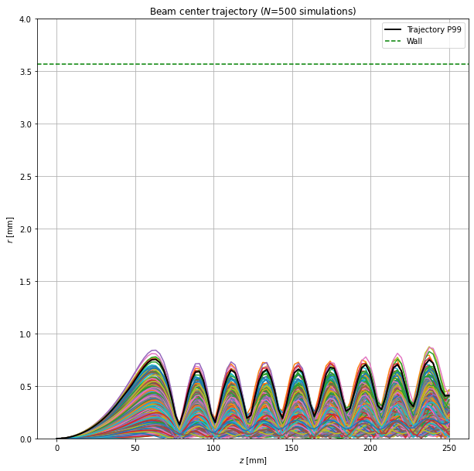
Effect of the permanent magnet tolerance
We have performed many Montecarlo simulations to check the effect of the permanent magnet tolerance on the beam steering. We have considered that the magnets have a magnetization error (1-σ) of 5% and an angular deviation (1-σ again) of 1°.
With these parameters, we perform a magnetic analysis and a ray tracing of the beam centroid (the transversal components that appear due to the imperfect magnets are the transmission killers).
The conclusion is that the unsorted tolerance is not compatible with a 100% transmission.
It is necessary to measure the individual magnets and perform a sorting of them oriented to cancel the transversal components.
The results are confirmed by CST.
Radial offset of the beam centroid
UNSORTED
SORTED

Slide 22
Conclusions
The restrictions created by the PM are:
  Necessity of a field inversion on both sides of the magnetic structure
  The magnetic structure must be almost in contact with the tube
  The field must be symmetric to minimize the transversal components
All the restrictions can be solved but require a dedicated tube. Both systems must be designed together.
The beam can survive the field inversion with a radius not larger that the typical output cavity.
Standard magnet blocks are not good enough to be used without sorting.

