Slide 1
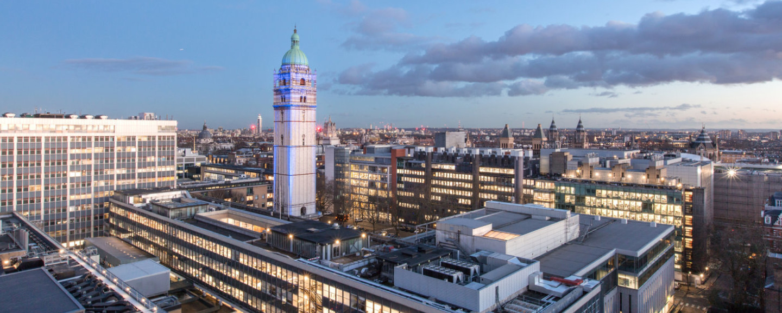
PHYSTAT’s “Stats meets ML”
9th – 12th Sept 2024
Introductory Remarks
Louis Lyons

Slide 2
PHYSTAT https://phystat.github.io/Website/
Events about statistical issues in Particle Physics analyses, and in Astro/Cosmo.
Started in 2000 with “Confidence Limits Workshop” at CERN
Workshops, Seminars, Informal Reviews
Website has slides and video of meetings
Recently including ML.
This meeting: Statistical issues connected with using ML techniques in HEP and Astro analyses

Slide 3
Mon | Tues | Wed | Thurs
 | 9.00 Welcome 9.15 ML in PP KASIECZKA 10.00 #5 Transformers for HEP, Spinner | 9.00 ML BALDI (Remote) 9.45 Benchmarks Thiyagalingam 10.10 #73 Weak Lensing, Autenrieth | 9.00 Mis-Modelling: HELD 9.45 #53 Bayesian evidence, Polanska
 | 10.30 Coffee | 10.35 Coffee | 10.15 Coffee
 | 11.00 ML in A/C WANDELT (Remote) 11.45 Gr Waves DAX | 11.00 SBI GHOSH 11.45 Unfolding MIKUNI | Continuation of Interp 10.45 Kuusela 11.15 Peiris 11.45 Eller 12.10 Golling
 | 12.30 Lunch | 12.30 Lunch/Poster session | 12.35 Lunch
2.00 Astro/Cosmo for others TSAPRAZI 2.25 Part Phys for others WINTERBOTTOM 3.00 ML MAKINEN | 2.00 Interpretability THALER 2.45 Anomaly session ZHANG | 2.00 Unfolding Plehn 2.25 #79 Linear SBI, Handley 2.50 Decorrelation Chakravarti 3.15 Generative WINTERHALDER | 2.00 Highlights LOUPPE 2.45 Highlights KUUSELA
3.45 Coffee | 3.30 Coffee | 4.00 Coffee | 3.30 Coffee
4.15 Types of ML in Astro/Cosmo JEFFREY 4.55 Types of ML for Part Phys LANGFORD 5.35 End | Anomaly Session, cont 4.00 GROSSO 4.45 Aarrestad 5.10 #74 Anom-aware ML for DM, Scaffidi 5.35 #51 Feldman-Cousins, Villarreal 6.00-7.15 Poster Session/Drinks | 4.30 #67 Fairness, Rieger 4.55 Systematics CRANMER (Remote) 5.40 #54 Syst-aware NN, Monsch 6.05 End 7.00 for 7.30 Dinner at Ognisko | 4.00 Highlights LUCIE-SMITH 4.45 Highlights HEINRICH 5.30 Closing Discussion
Themes: Optional Talks Range of ML Interpretability
Anomaly session Highlights Poster Session
ABSTRACTS as CONTRIBUTED TALKS:
These 8 are shown with their Abstract number e.g. #5

Slide 4
Apart from lectures…..
2 Poster sessions: Welcome Drinks (today) and Wednesday lunch
2 prizes (democratic voting)
Lunches today and Thursday
Coffee breaks
Dinner at Ognisko, Wednesday 7pm
Wear badges for entry.
World Scientific Publishing stand (Arja and Leigh)
Possible Proceedings, Book, ……..

Slide 5
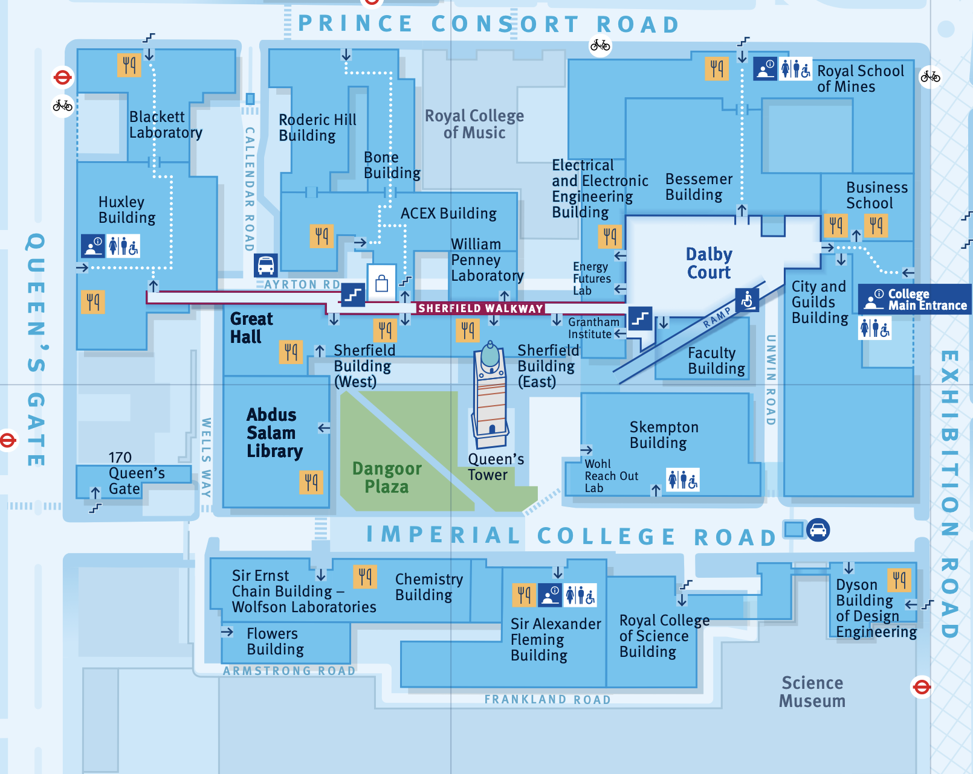
Route to Lunch locations at Imperial
Beware: Map is only 2D (World in multi-D)
Find a local

Slide 6
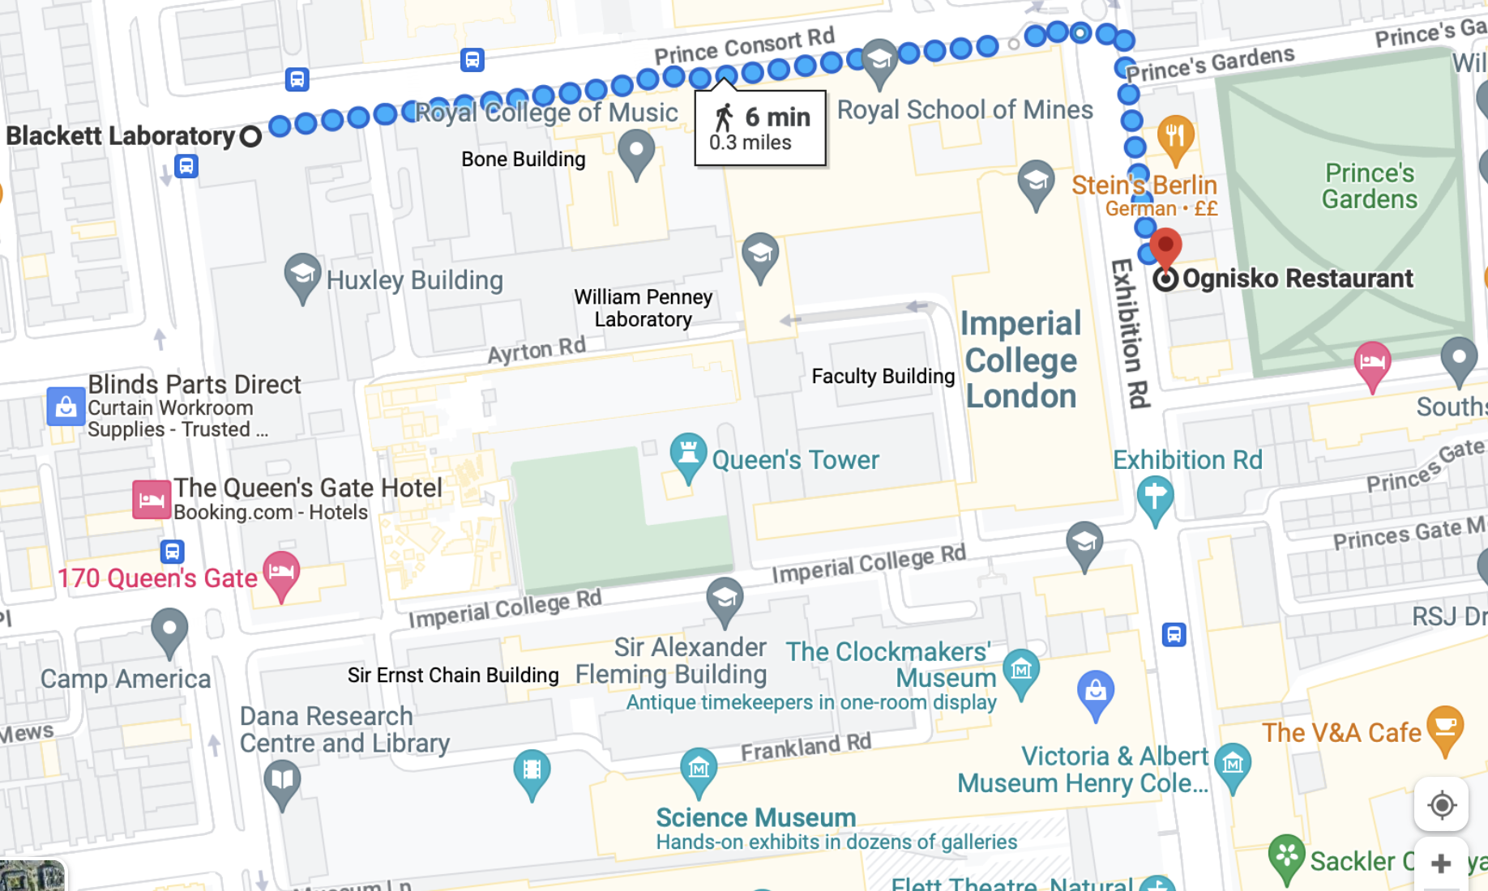
Route to Dinner at Ognisko
55 Exhibition Rd

Slide 7
Practical Info https://indico.cern.ch/event/1407421/page/33592-social-programme-practical-information
What to do in neighbourhood: Parks, Museums, Albert Hall, …..
Eating in Imperial (lunchtime) or nearby
London transport
Leaving cases: Room 521
Mattermost
Zoom:https://cern.zoom.us/j/62711864233?pwd=ix1gZYHWUydmgoyF2DRftA0cKl71nA.1
Connecting your computer: Use Wifi with eduroam, or ask us for a guest account

Slide 8
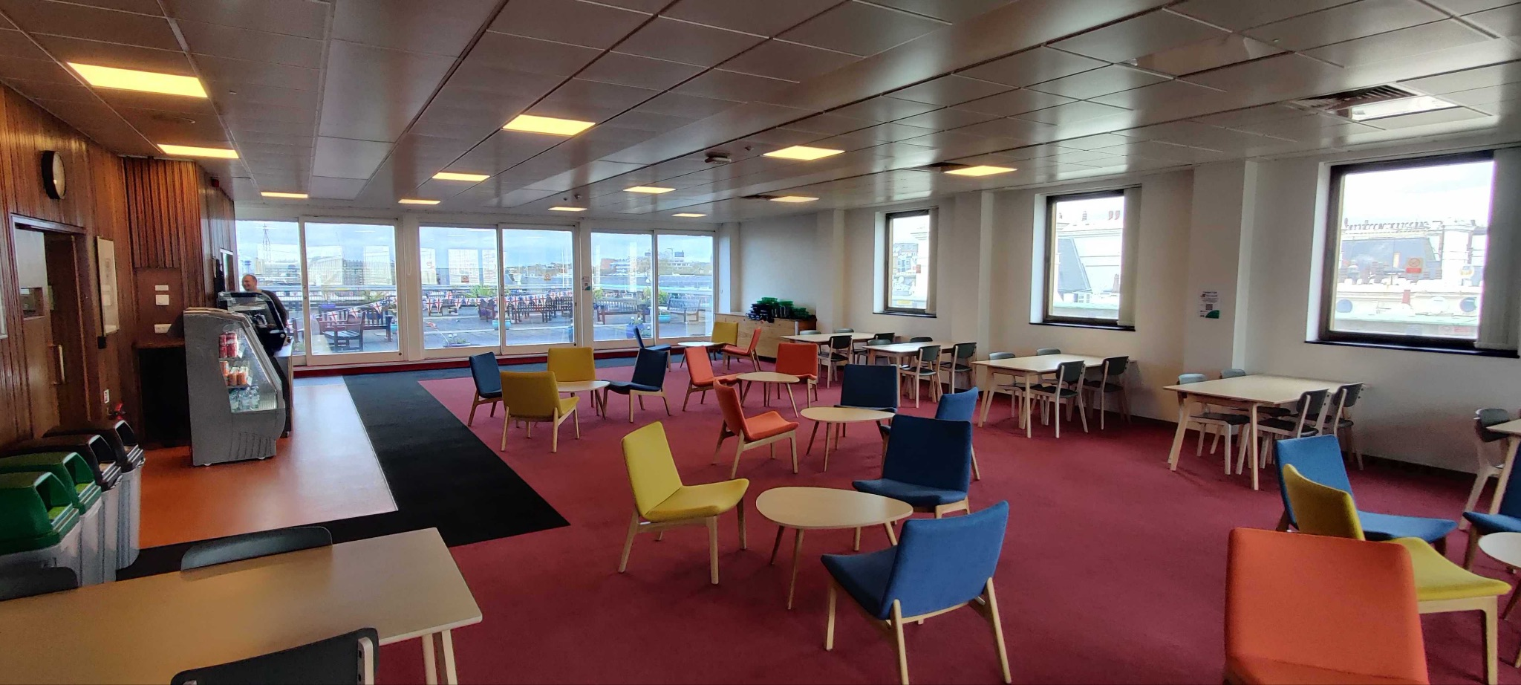
More Practical Info
Help:
LOC and AV helpers (identifiable by orange bands for badges)
Administrative office 542
Emergency 24 hour Imperial security number: 020 75891000
Emergency fire briefing - in the event of a fire alarm please follow the emergency exit signs to leave the lecture theatre. The Assembly Point is on Queen’s Gate:
Up stairs to level 2, exit building, go left 30 metres, go left on Queen’s Gate 20 metres.
Toilets: Next to lifts on each floor

Slide 9
THANK YOU
IMPERIAL for hosting meeting
LOC: Rob Bainbridge, (Chair), Matteo Agostini, Sunita Aubeeluck, Paula Consiglio, Jon Langford, Benedict Maier, Lucas Makinen, Marvin Pfaff, Nick Wardle, Danny Winterbottom
Marvin’s Audio/Visual team
PROGRAMME COMMITTEE: (see Poster)
SPONSORS:
Institute for Particle Physics Phenomenology, Durham (IPPP)
Science and Technology Facilities Council's High Energy Physics branch (STFC HEP)
Science and Technology Facilities Council's Computing branch
Imperial College's Particle Physics Community
Imperial College's Centre for Inference and Cosmology
Institute of Physics' High Energy Particle Physics and Astroparticle groups
World Scientific Publishing
ALL OF YOU: For coming, and >400 remote registrants.

Slide 10
Enjoy the meeting

