Slide 2
Progress on ISAAC
J. García Matos, C. Martins, F. Toral (CIEMAT)
J.C. Pérez (CERN)

Slide 3
Outline
Reminder: ISAAC goals & constraints
ISAAC 2D design
ISAAC 3D design

Slide 4
ISAAC mechanical design: goals & constraints
ISAAC: Investigating Superconducting Assembly to Address Common coil mechanics
Main goal: learn for the 14 T model with existing coils, mostly on mechanics
  Existing RMC coils made at CERN with MQXF strand are selected
  Mechanics & assembly as simple as possible
  Provide ≈14 T in the aperture (100% load)
  Decrease vertical Lorentz force F_{y} to achieve low vertical preload: free horizontal movement when coils are energized, without friction
Assembly with bladder and keys, slight preload just to keep contact between parts
Aluminium shell also contributes to hold the forces
Goal: To have a horizontal coil displacement due to the EMF below 0.5 mm to:
  Reduce the impact on field quality (0.5 mm -> 1% less field in the aperture)
  Reduce the possibility of sudden coil movements (to avoid quenches)

Slide 5
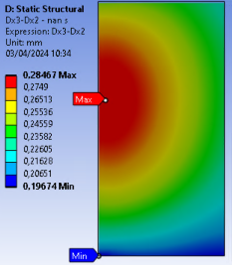
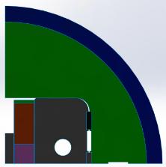
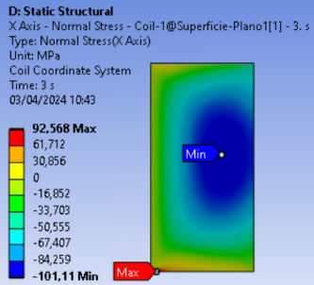
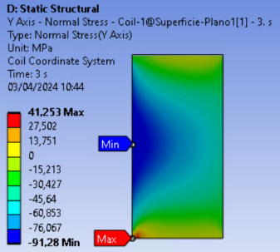
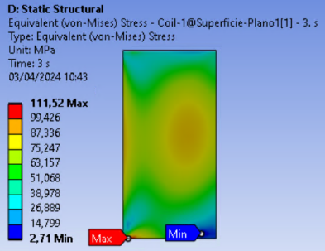
ISAAC 2D Mechanical design (I)
All parts in contact @ room temperature (20ºC). Cooling up to 1.9K
34mm aperture (compatible with 50mm changing middle & main yokes)
Max. Horizontal Coil Displacement (X) due to EMF below 0.5 mm: 0.29 mm
Max Stress @ Coil (Cooling + EMF) below 150 MPa:
  Max X Stress @ Coil: 93 MPa (-101 MPa)
  Max Y Stress @ Coil: 41 MPa (-91 MPa)
  Max VM Stress @ Coil: 112 MPa
Y
X
Coil Displacement due to EMF

Slide 6
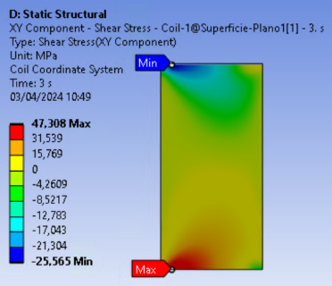
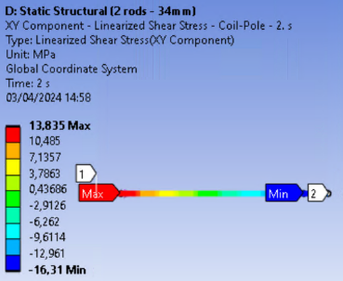
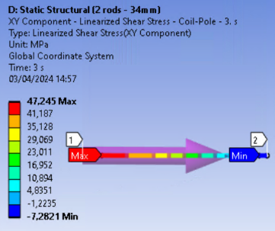
ISAAC 2D Mechanical design (II)
Concerns about the Shear Stress @ Pole – Coil transition (Cooling + EMF): 47.3 MPa: Detachment of the coil with respect to the pole
Y
X
Cooling
Cooling + EM

Slide 7
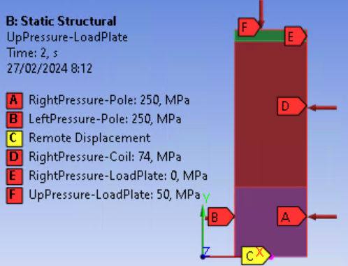
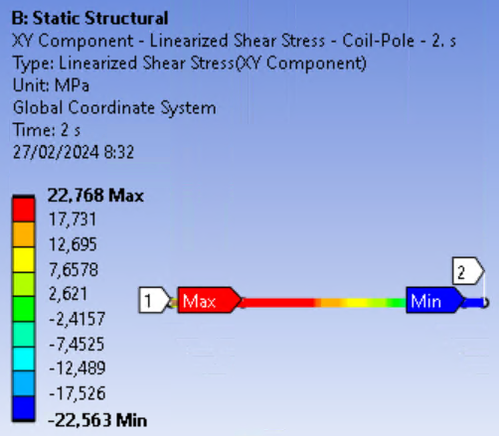
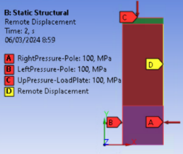
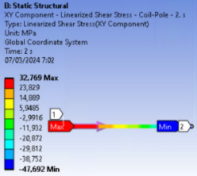
ISAAC 2D Mechanical design (III)
RMC coil Ansys Mechanical analysis without magnet components (Only Coil configuration):
  Different thermal contraction:
  Pole (Titanium): 1.7 mm/m
  Coil (Nb3Sn): 4 mm/m
  With 250 MPa at Pole + 50 MPa Vertical:
  Very low shear stress at cooldown
  23 MPa with EMF
  With 100 MPa at Pole + 100 MPa Vertical: 48 MPa
  (cooling + EMF)

Slide 8
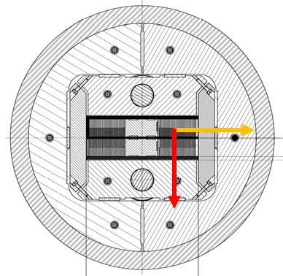
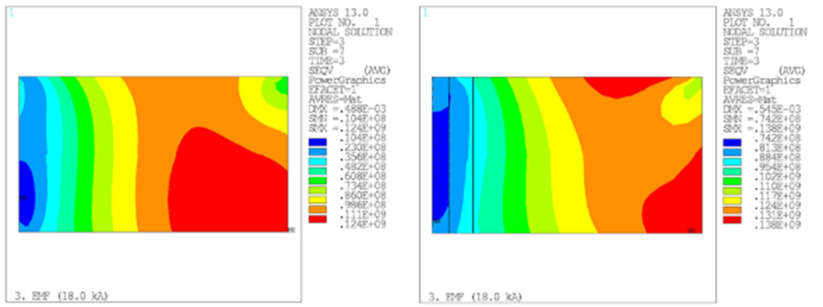

ISAAC 2D Mechanical design (IV)
RMC coil Ansys Mechanical analysis @CERN (Block Coil configuration):
  X Normal Stress btw -73 & 24 MPa
  Y Normal Stress btw -146 & 15 MPa
  Equivalent VM Stress btw 10 & 138 MPa
  Information on shear stress not found (Ansys APDL script analysis ongoing)
  Detachment btw coil components observed after magnet tests
  Rotated Block Coil cross-section

Slide 9
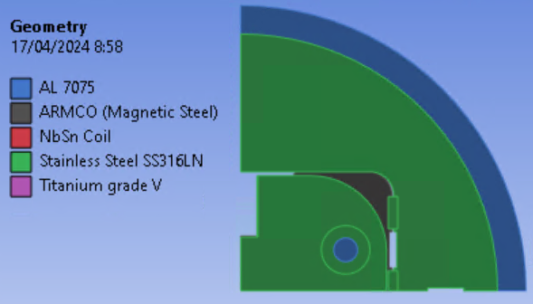
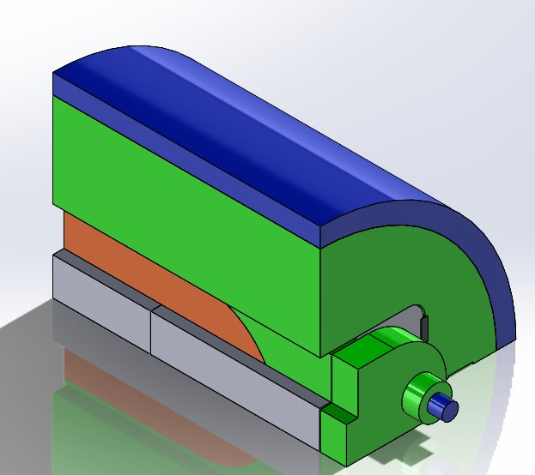
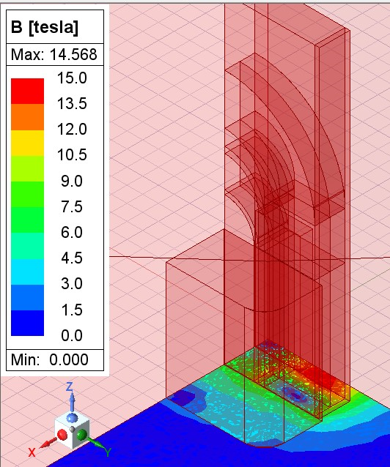
ISAAC 3D Mechanical Design
All parts in contact @ room temperature (20ºC). Cooling up to 1.9K
34mm aperture
Nominal current: 19340 A
Aperture Field: 13.8 T
Total EMF: 1.7 MN
  EMF(x): 1.7 MN
  EMF(y): 0.4 MN
  EMF(z): 0.2 MN

Slide 10
Conclusions
ISAAC 2D design: Concerns about “unavoidable” shear stress in coil contact with pole (about 50MPa).
3D magnetic and mechanical design ongoing.
We will check if the test results are consistent with the magnetic and mechanical simulations.

