Slide 1
RFQ2 Verification Measurements
L. Millar, A. Grudiev
SY-RF-MKS
RFQ2 Meeting - 04/2024

Slide 2

RFQ2 Measurements – Building 2002

Slide 3
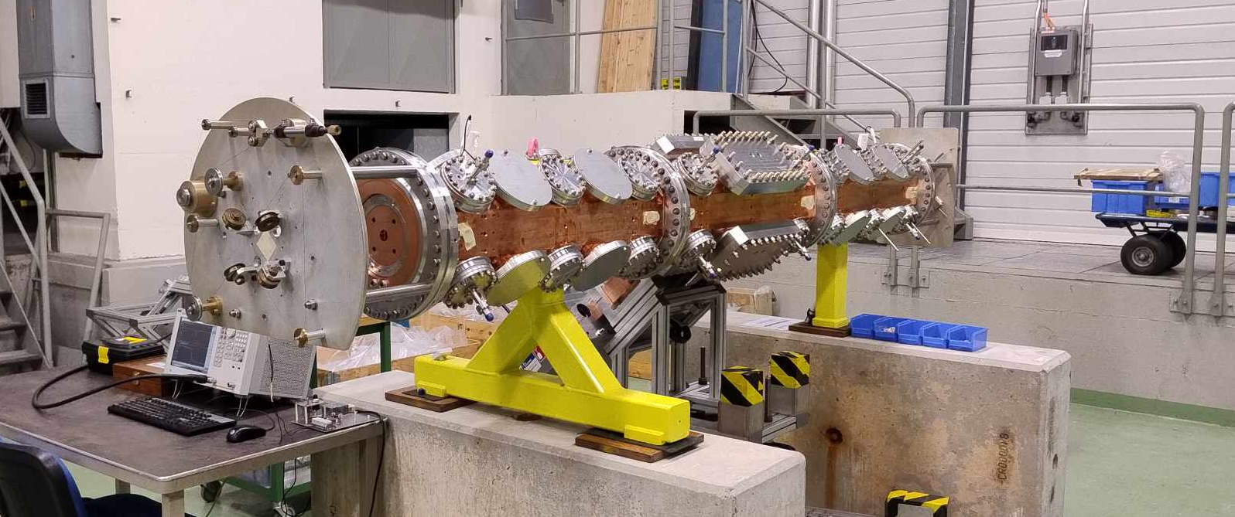
Bdg. 2002

Slide 4
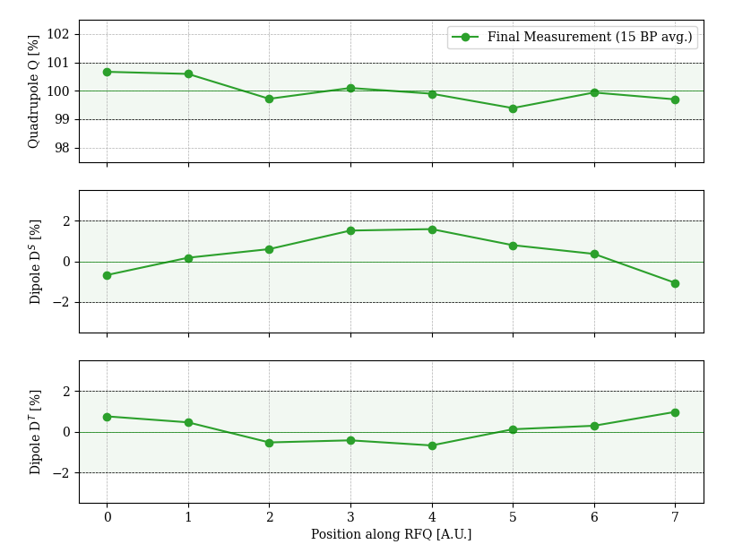
Bdg. 2002 – Field Profile
Final measurement:
Q: 100 ± 0.667%. ✅
Dipole 1 (Ds): ± 1.584 %. ✅
Dipole 2 (DT): ± 0.978 %. ✅
f0 = 352.2229 MHz @ 25° in vacuum. ✅

Slide 5
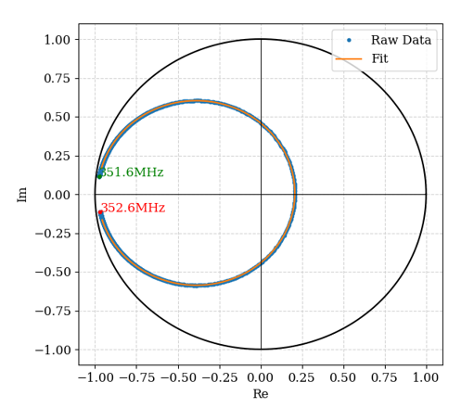
Bdg. 2002 – Q Factor
Results for the 352.2 MHz operating mode (circle fitting method):
Q₀ = 6185 (~8.7% lower than RFQ1 = 6772)
Q_{ext} = 4141 (~2.57% lower than RFQ1 = 4250)
β = ~1.494

Slide 6
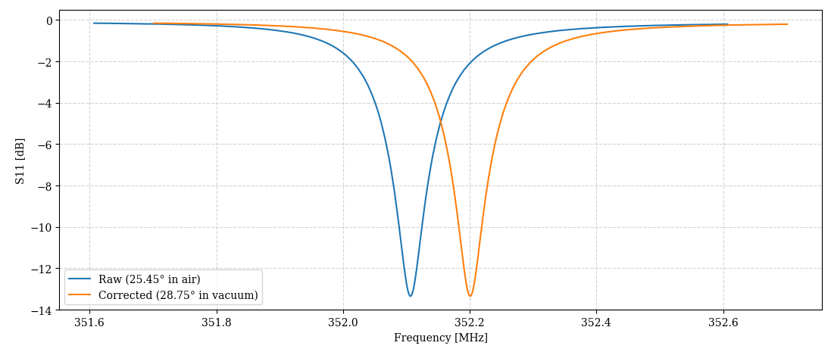
Bdg. 2002 – Frequency in air
22.9 kHz error ➔ ~28.8 °C in vacuum.
Min. at 352.105 MHz

Slide 7
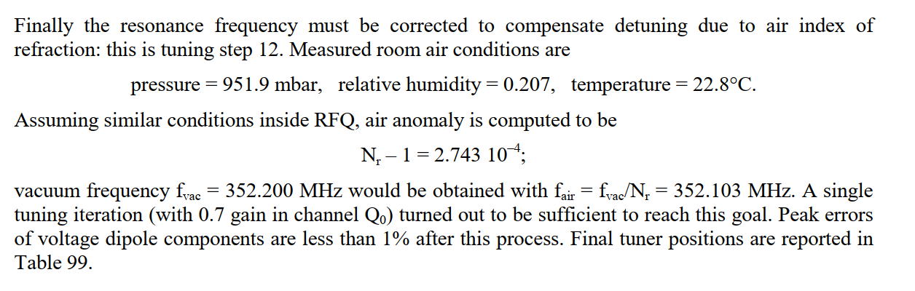
Bdg. 2002 - Frequency Check
RFQ1 was measured at 22.8°C (2.65°C colder than in bdg. 2002). Their target was 352.103 MHz at 26 °C.
Ignoring humidity, we achieved their target (352.103 MHz) at 25.45 °C.
→ Suggests we must operate at ~26 + 2.65 °C in vacuum.
A good double-check and aligns with the numbers on the previous slide.
Page 177 of RFQ1 report.

Slide 8
Bdg. 2002 – Antennas in air
Antenna No. | 1 | 2 | 3 | 4 | 5 | 6 | 7 | 8 | 9 | 10 | 11 | 12 | 13 | 14 | 15 | 16
Transmission at f₀ [-dB] | 51.56 | 50.706 | 51.214 | 50.4 | 51.904 | 51.954 | 52.602 | 52.188 | 51.716 | 51.580 | 52.148 | 52.586 | 52.295 | 52.925 | 52.886 | 51.873
Antennas measured in air (waveguide to N-type adaptor was required).
Mean transmission: -52.03 dB
Max transmission: -50.40
Min transmission: -52.92 dB
Range: 2.52 dB

Slide 9
RFQ2 Measurements – Test Area

Slide 10
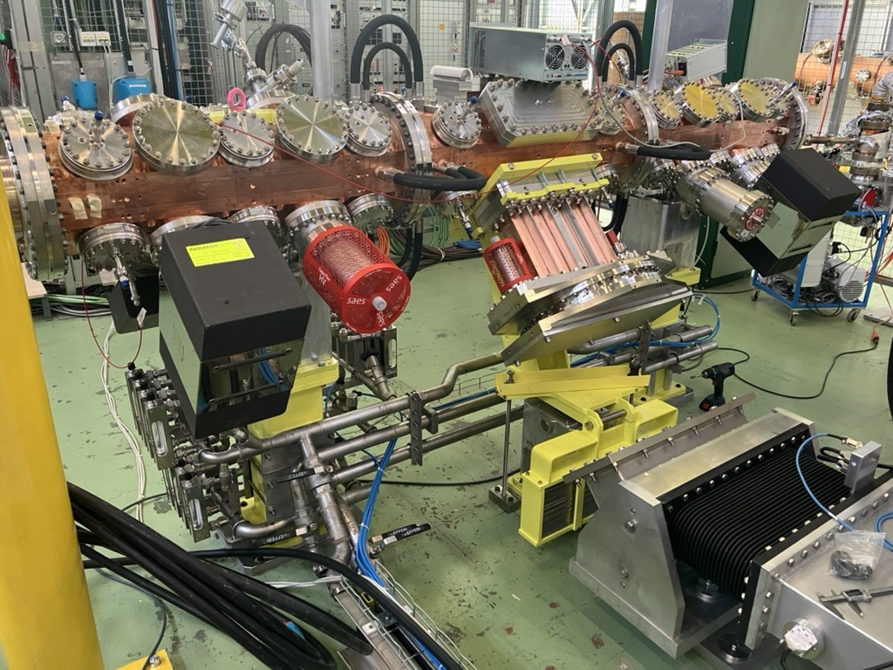
Test Area
Downstream

Slide 11
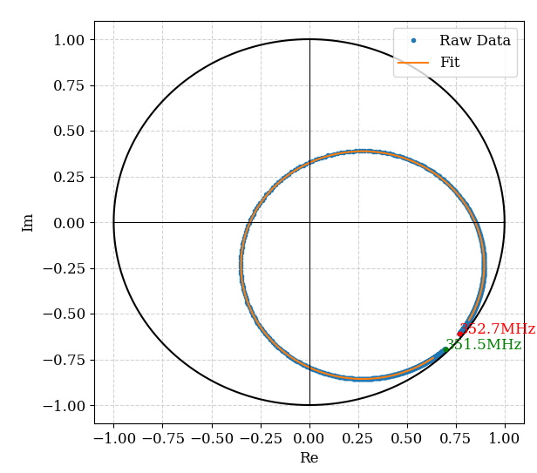
Test Area - Q Factor
Results for the 352.2 MHz operating mode:
Q₀ = 6912 (2% higher than RFQ1=6772)
Q_{ext} = 4195 (1.3% lower than RFQ1=4250)
β = ~1.65
Overall, the quality factor has “improved” and is now much closer to that of the first RFQ.

Slide 12
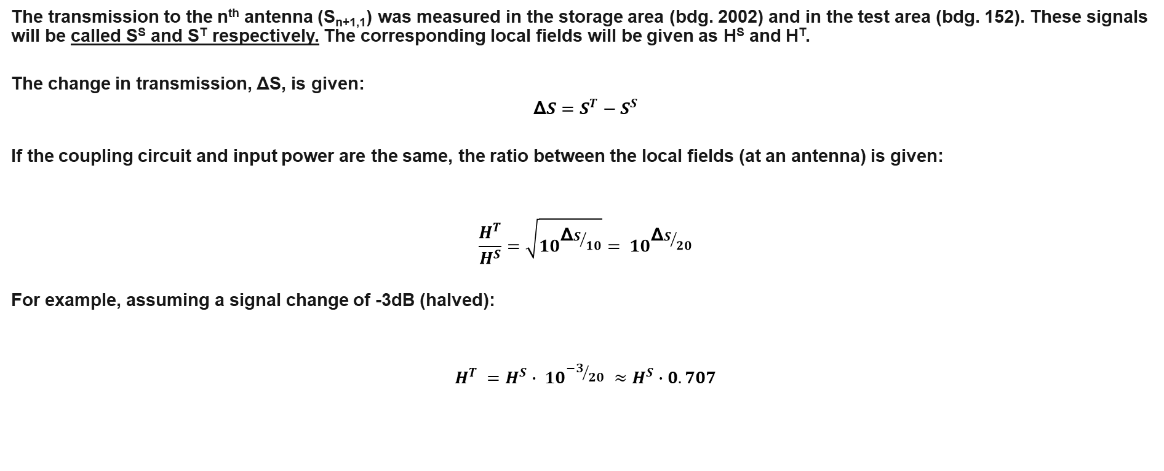
Antenna Signal Comparison
The transmission to the n^{th} antenna (S_{n+1,1}) was measured in the storage area (bdg. 2002) and in the test area (bdg. 152). These signals will be called S^{S} and S^{T} respectively. The corresponding local fields will be given as H^{S} and H^{T}.
The change in transmission, ΔS, is given:
$$\text{Δ}S=S^{T}−S^{S}$$
If the coupling circuit and input power are the same, the ratio between the local fields (at an antenna) is given:
$$\frac{H^{T}}{H^{S}}=\sqrt{{10}^{{\text{Δ}S}/{10}}}= {10}^{{\text{Δ}S}/{20}}$$
For example, assuming a signal change of -3dB (halved):
$$H^{T} =H^{S}∙ {10}^{{−3}/{20}} ≈H^{S}∙0.707$$

Slide 13

Antenna Signal Comparison
Accordingly, the percentage change in the local field at the antenna, ΔH, can be calculated:
$$\text{Δ}H\left[\%\right]=100∙\left({1 − 10}^{{\text{Δ}S}/{20}}\right)$$
A signal change of -3dB (halved) would then correspond to ΔH = 29.3%.
$$100∙\left(1−\sqrt{{10}^{{\text{−3}}/{10}}}\right)=29.3$$

Slide 14
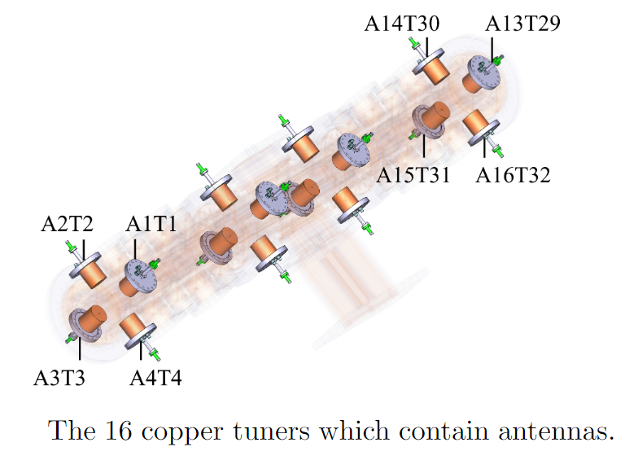
Antenna Locations

Slide 15
Antenna Signal Comparison
Antenna No. | 1 | 2 | 3 | 4 | 5 | 6 | 7 | 8 | 9 | 10 | 11 | 12 | 13 | 14 | 15 | 16
Bdg. 2002 [-dB] | 51.56 | 50.706 | 51.214 | 50.4 | 51.904 | 51.954 | 52.602 | 52.188 | 51.716 | 51.580 | 52.148 | 52.586 | 52.295 | 52.925 | 52.886 | 51.873
Test Area [-dB] | 51.765 | 51.942 | 50.888 | 50.577 | 51.477 | 51.631 | 52.203 | 51.662 | 50.48 | 51.354 | 51.704 | 51.841 | 51.892 | 52.192 | 52.499 | 51.81
ΔS21 [dB] | -0.227 | 0.742 | 0.325 | -0.203 | 0.396 | 0.297 | 0.38 | 0.503 | 1.21 | 0.2 | 0.423 | 0.715 | 0.374 | 0.707 | 0.371 | 0.044
Corresponding Δ Field at antenna [%] | -2.579579 | 8.91809 | 3.81258 | -2.310025 | 4.66464 | 3.47847 | 4.47202 | 5.96196 | 14.9476 | 2.3293 | 4.9905 | 8.58004 | 4.39988 | 8.48008 | 4.36383 | 0.50785
A significant change in all antenna signals has been observed. In all but two, the coupling has increased.
Note that a bias is likely due to the change in coupler, this has not been accounted for as only absolute values are quoted here.

Slide 16
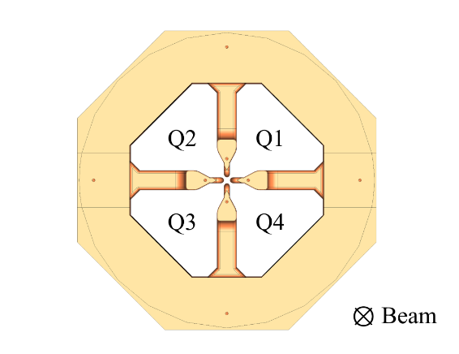
Change in Field Profile
Calculated field change for antennas in each quadrant.
Note: Coupler on Q4.
The Q4 and Q2 field profiles (q4,q2 on the right) have curved in opposite directions – could this be caused by a change in support?
Calculated from ΔField values on previous slide. Line q1 contains the measurements from the antennas in quadrant Q1 (A1, A5, A9, A13). Line q2 is the antennas in quadrant Q2, i.e., A2, A6, A10, A14.
Notes:
The different lines correspond to the change in field profile in that quadrant.
q1 = A1, A5, A9, A13
q2 = A2, A6, A10, A14
q3 = A3, A7, A11, A15
q4 = A4, A8, A12, A16

Slide 17
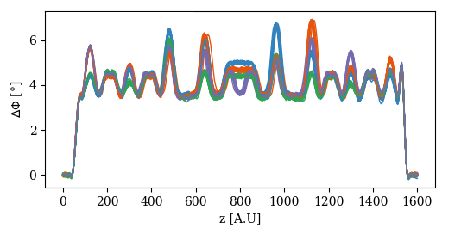
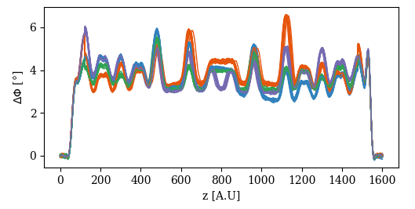
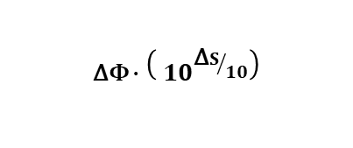
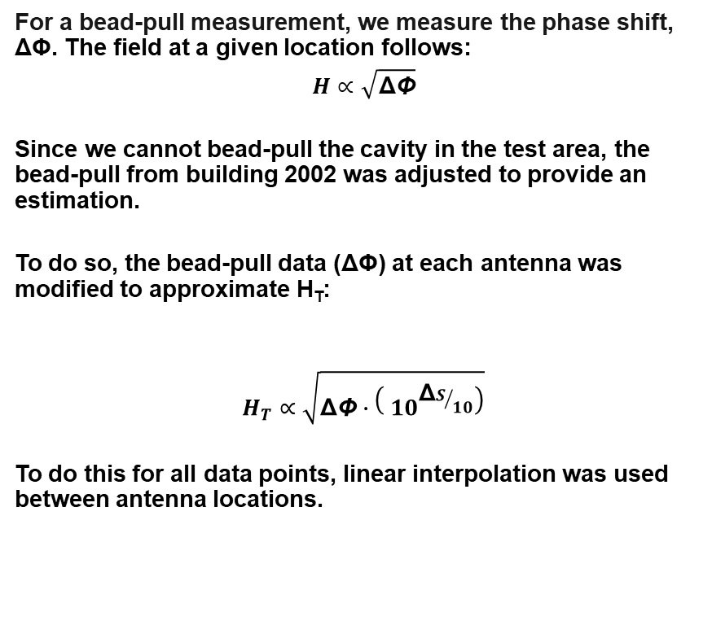

Change in Field Profile
Antennas 1-4
For a bead-pull measurement, we measure the phase shift, ΔΦ. The field at a given location follows:
$$H∝\sqrt{\text{Δ}\text{Φ}}$$
Since we cannot bead-pull the cavity in the test area, the bead-pull from building 2002 was adjusted to provide an estimation.
To do so, the bead-pull data (ΔΦ) at each antenna was modified to approximate H_{T}:
$$H_{T}∝\sqrt{\text{Δ}\text{Φ}∙\left({ 10}^{{\text{Δ}S}/{10}}\right)}$$
To do this for all data points, linear interpolation was used between antenna locations.
Bead pull in 2002 ($\text{Δ}\text{Φ}$).
$$\text{Δ}\text{Φ}∙\left({ 10}^{{\text{Δ}S}/{10}}\right)$$

Slide 18
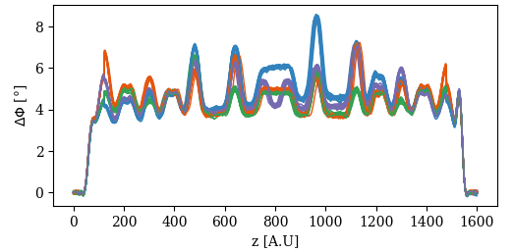
Change in Field Profile
Discontinuity since the signal edges were not considered (outside the range of the antennas).
A1-4
A5-8
A9-12
A13-16
Final bead pull.
Calculated bead pull based on antenna measurements.
Notes:
The last bead-pull in building 2002 was adjusted using the antenna positions, the changes in signal strength, and linear interpolation (i.e., the plot on the previous slide).

Slide 19
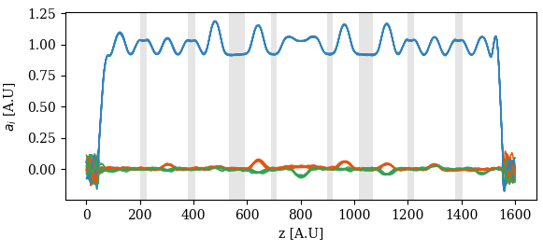
Change in Field Profile
After adjusting the bead-pull data, the sum and difference of the quadrants is calculated to obtain:
Q = (Q1 - Q2 + Q3 - Q4) / 4
1st dipole = (Q1 - Q3) / 2
2nd dipole = (Q2 - Q4) / 2
All are then normalized to the “flat-top” average of Q. Due to the way these components are calculated, any systematic errors cancel out.
Ideally, there would be no dipole components and a flat quadrupole component.
Sampling windows shown in grey.

Slide 20
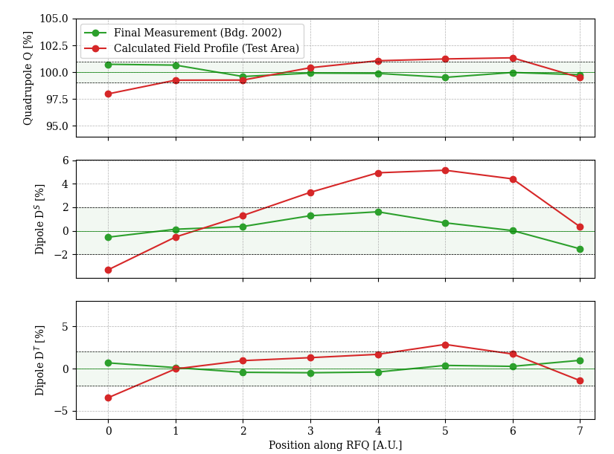
Change in Field Profile
Calculated field profile:
Q: 100 ± 2.03%. ❌
Dipole 1 (DS): ± 5.143 %. ❌
Dipole 2 (DT): ± 3.46 %. ❌
f0 = 352.1553 MHz @ 25° in vacuum. ❌
Working frequency now 17.2° (f₀ = 352.2 MHz), outside the 20-30° range of the water circuit.

Slide 21
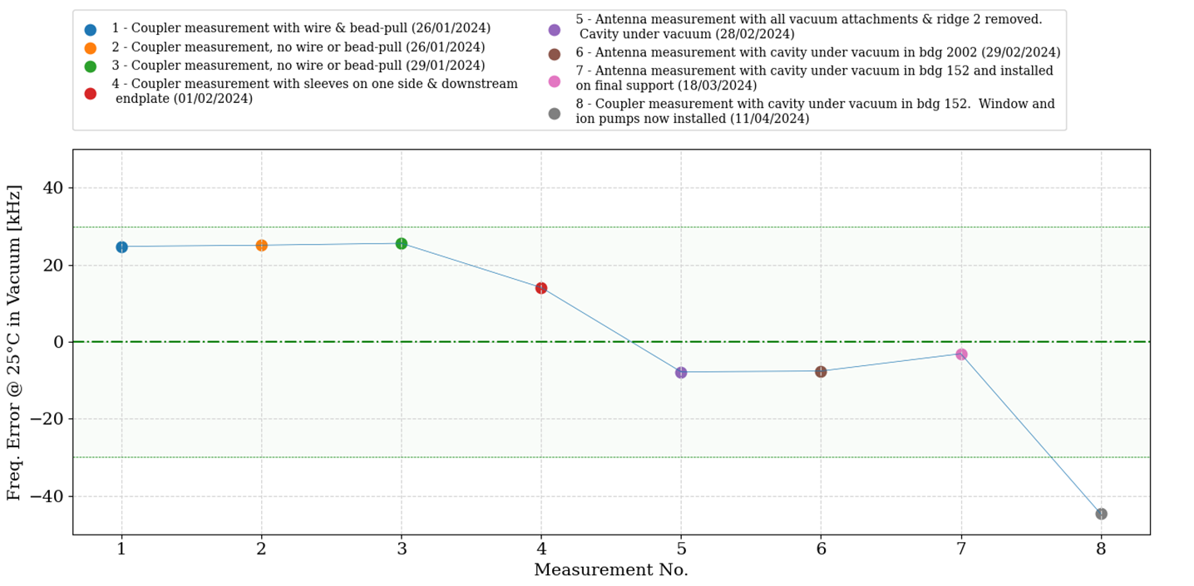
Frequency Evolution

Slide 22
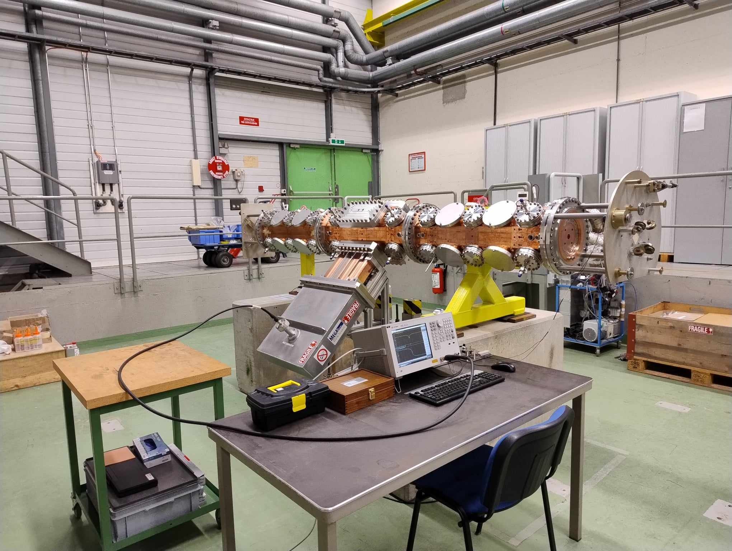
Frequency Evolution with Photos

Slide 23
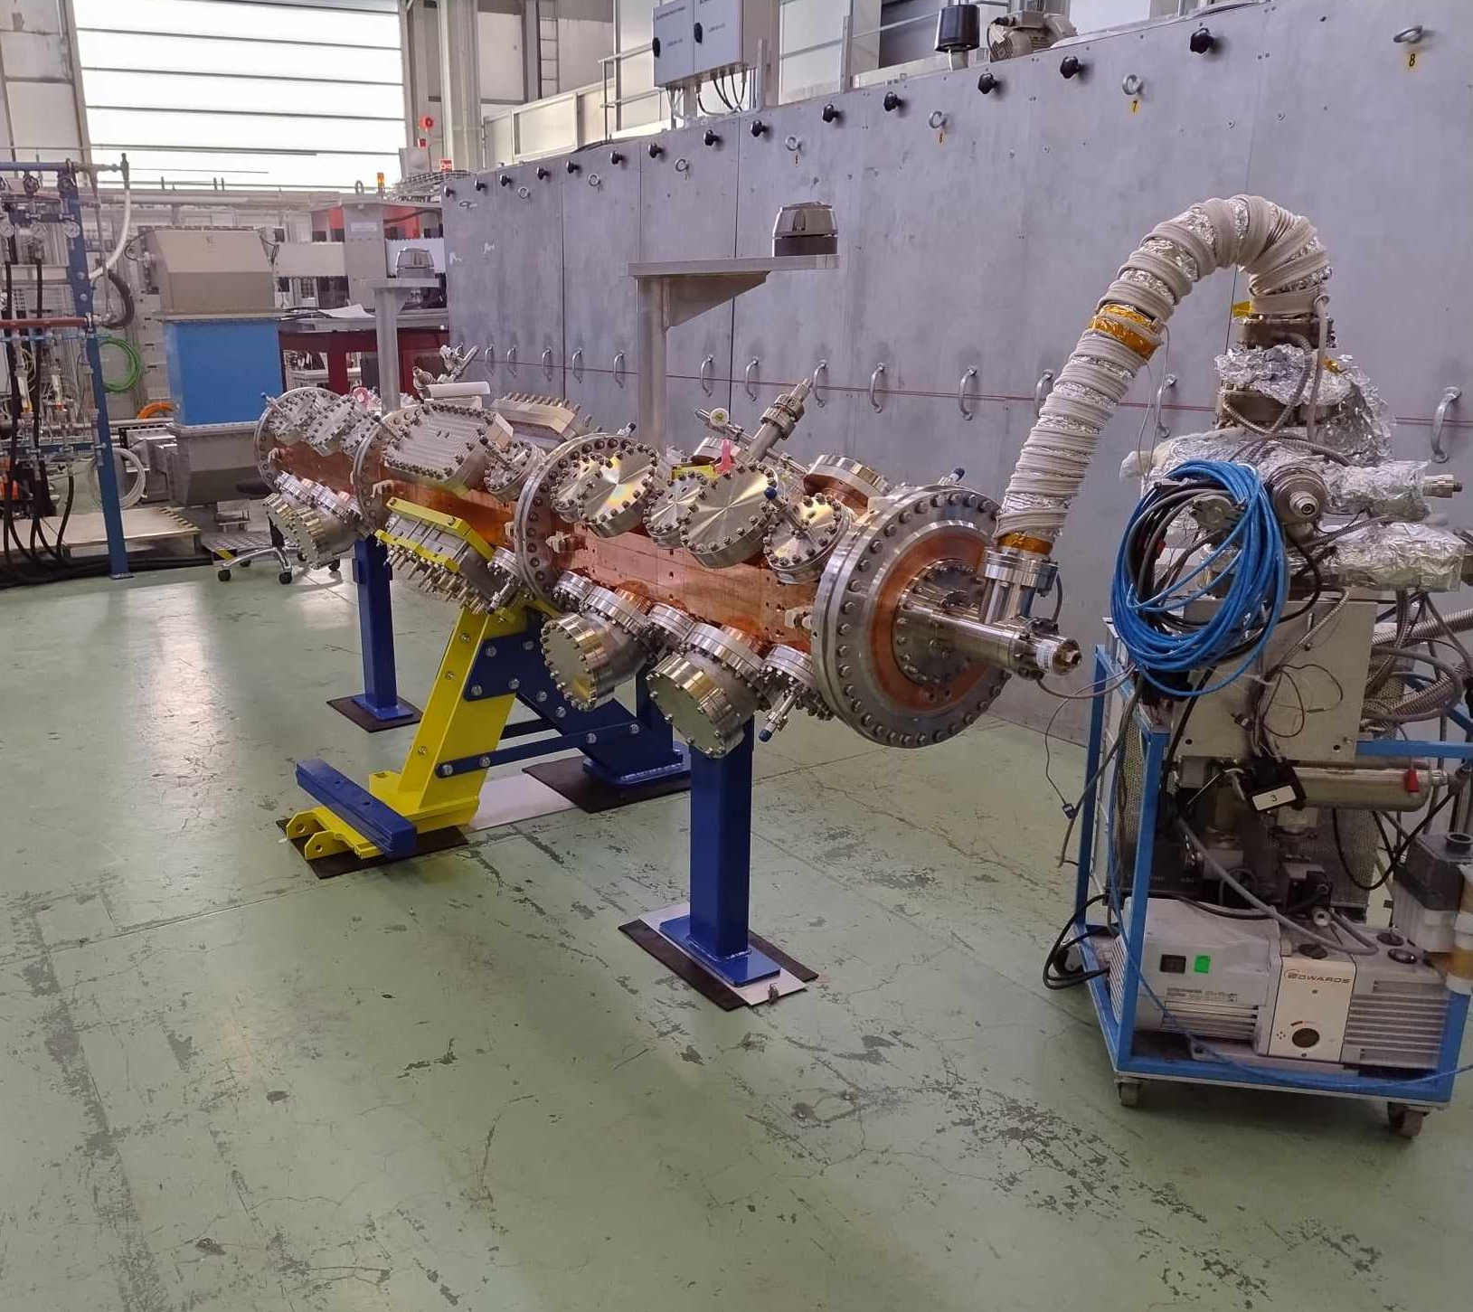
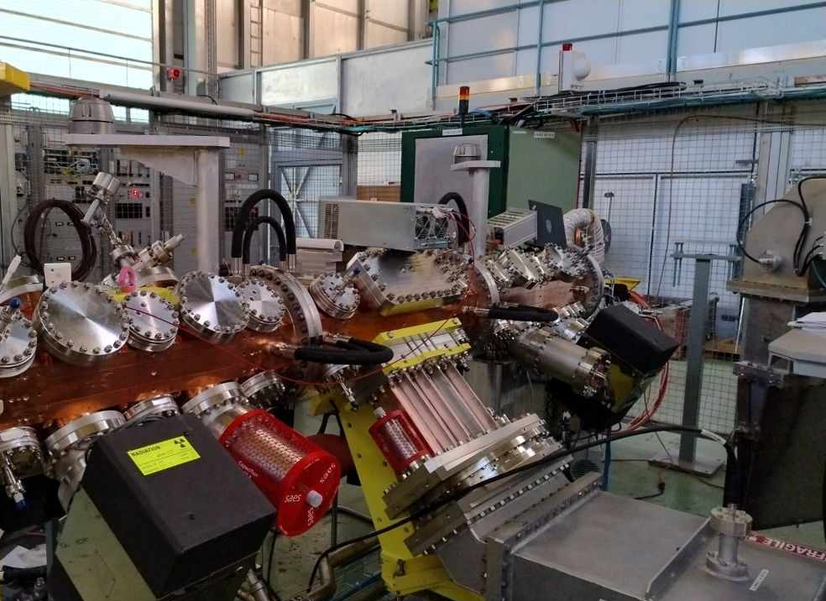
Frequency Evolution with Photos

Slide 24
Discussion
A few things to note:
Points 4+5: The sleeves (on vacuum flanges) were added in building 2002 (ridge 2 and the waveguide to N-type adaptor was still installed).
Points 6-7: There was no major change during transport (to building 152) or when the new support was added.
Point 8: The cavity was then installed in building 152 with:
  The final ridge 2, not the one used for measurement.
  The vacuum pumps.

Slide 25
Q Evolution
Q₀ = 6202
Q_{ext} = 4123
β = 1.5
Q₀ = 6258
Q_{ext} = 4154
β = 1.51
Q₀ = 6912
Q_{ext} = 4195
β = 1.65
No coupler installed; frequency taken from antenna-to-antenna measurements.

Slide 26
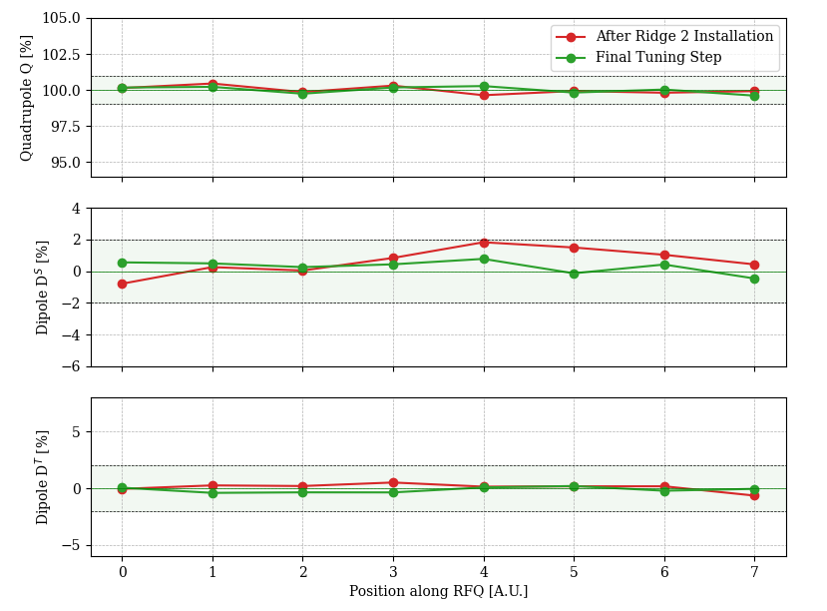
Q Evolution during Tuning
Q₀ = 6114
Q_{ext} = 4095
β = 1.49
Q₀ = 6101
Q_{ext} = 4077
β = 1.5

Slide 27
Effect of Field Profile on Q₀
Plots taken from previous meetings on 09/06/2023 (https://indico.cern.ch/event/1295632/) and 23/06/2023 (https://indico.cern.ch/event/1300068/).
The objective is to ascertain how much the field profile can affect Q.

Slide 28
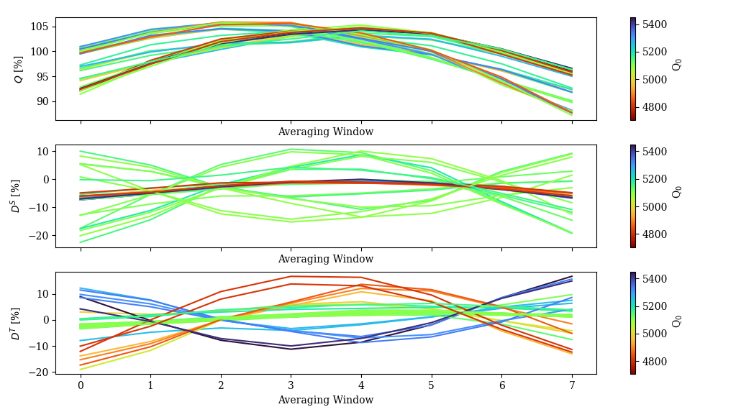
Effect of Field Profile on Q₀
Taken from 23/06/2023 (https://indico.cern.ch/event/1300068/).
Gradient visible here, corresponds to q2 and q4.

Slide 29
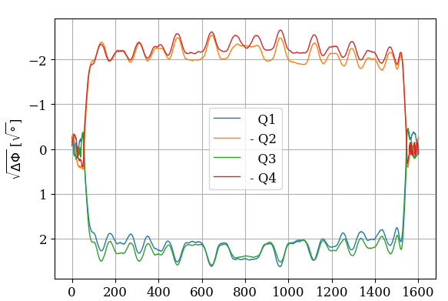
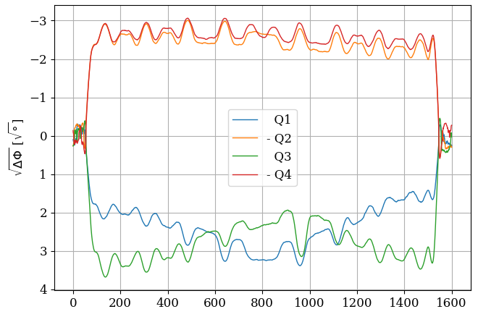
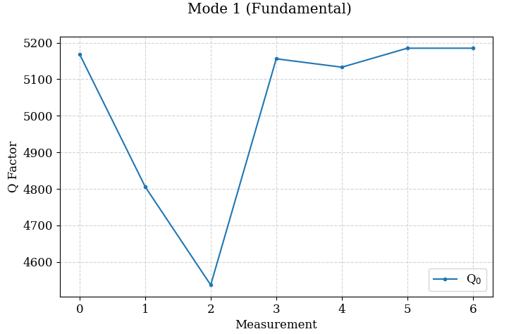
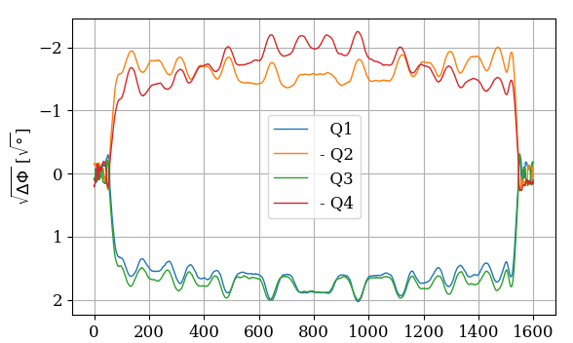
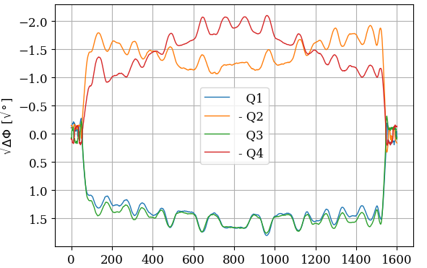
Effect of Field Profile on Q₀
Example taken from 23/06/2023 (https://indico.cern.ch/event/1300068/).
0
1

