Slide 1
RFQ2 Bdg. 152 Measurements
L. Millar
SY-RF-MKS
RFQ2 Meeting – 22/04/2024

Slide 2

Survey Measurements

Slide 3
Survey Measurements
#1 | RUN3 supporting UV (b2002) | Radial X [µm] | Beam direction Y [mm] | Vertical Z [µm] | Roll angle [mrad] | Radial RMS [µm] | Vertical RMS [µm] | Scale factor BF estimation
 | T1_US | 1 | 0 | 78 | 0.69 | 17 | 16 | 1.000125
 | T1_DS | -41 | 1020.01 | -64 |  | 17 | 16
 | T2_US | 23 | 1020.087 | -62 | 0.19 | 12 | 8 | 1.000079
 | T2_DS | 56 | 2046.087 | -61 |  | 12 | 8
 | T3_US | -3 | 2046.265 | -52 | 0.24 | 23 | 19 | 1.000107
 | T3_DS | -21 | 3058.055 | 72 |  | 23 | 19
#2 | RUN4 supporting UV (b152) | Radial X [µm] | Beam direction Y [mm] | Vertical Z [µm] | Roll angle [mrad] | Radial RMS [µm] | Vertical RMS [µm] | Scale factor BF estimation
 | T1_US | 2 | 0 | 56 | 0.49 | 10 | 10 | 0.999993
 | T1_DS | -35 | 1020.12 | -34 |  | 10 | 10
 | T2_US | 27 | 1020.113 | -24 | 0.06 | 17 | 10 | 1.000010
 | T2_DS | 52 | 2046.179 | -31 |  | 17 | 10
 | T3_US | 5 | 2046.218 | -23 | 0.10 | 23 | 13 | 0.999998
 | T3_DS | -31 | 3058.146 | 41 |  | 23 | 13
#3 | RUN4 supporting AP (b152) | Radial X [µm] | Beam direction Y [mm] | Vertical Z [µm] | Roll angle [mrad] | Radial RMS [µm] | Vertical RMS [µm] | Scale factor BF estimation
 | T1_US | 2 | 0 | 54 | 0.51 | 17 | 16 | 1.000011
 | T1_DS | -42 | 1020.118 | -35 |  | 17 | 16
 | T2_US | 22 | 1020.109 | -26 | 0.09 | 13 | 7 | 1.000000
 | T2_DS | 57 | 2046.178 | -36 |  | 13 | 7
 | T3_US | -10 | 2046.236 | -16 | 0.19 | 26 | 20 | 0.999996
 | T3_DS | -24 | 3058.153 | 55 |  | 26 | 20

Slide 4
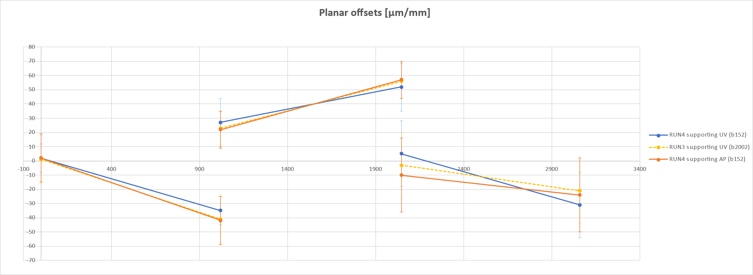
Survey Measurements

Slide 5
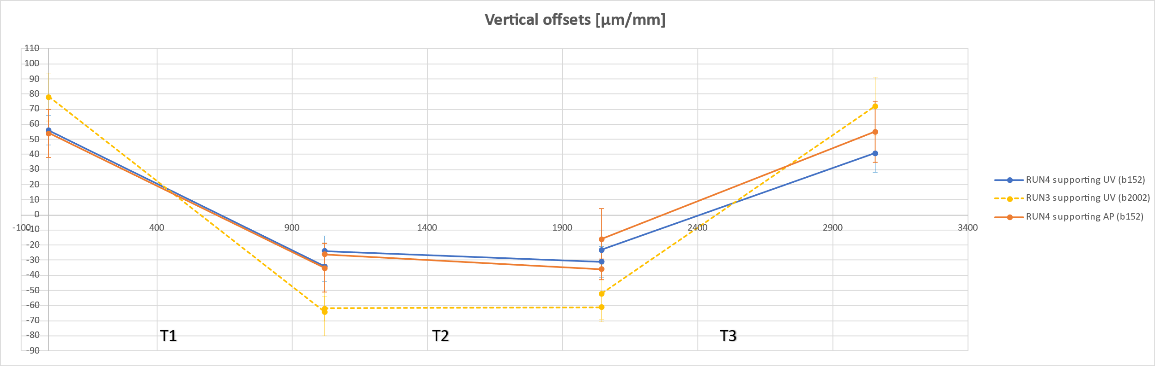
Survey Measurements

Slide 6
Frequency Evolution

Slide 7
Notes
Cavity remeasured in air on 19/04/2024. Unfortunately, no RF measurements were performed before on 18/04/2024 immediately prior to venting.

Slide 8

Frequency Correction
The following correction is applied to measurements in air:
$$f_{corr}=\frac{f_{meas}∙\sqrt{ε_{r}}}{1−α_{T}∙\left(T_{meas}−T_{ref}\right)}$$
The following is applied to measurements with the cavity under vacuum (ε_{r} =1):
$$f_{corr}=\frac{f_{meas}}{1−α_{T}∙\left(T_{meas}−T_{ref}\right)}$$

Slide 9
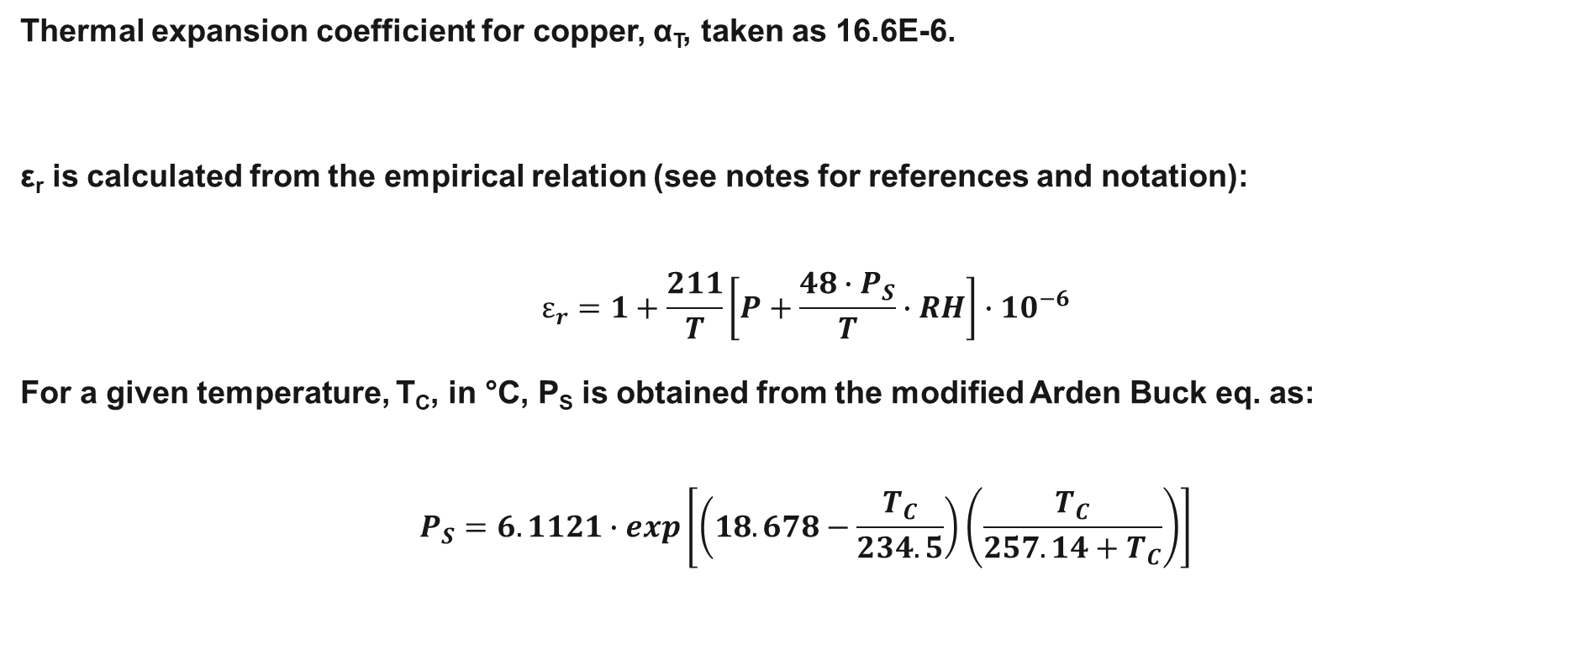
Frequency Correction
Thermal expansion coefficient for copper, α_{T}, taken as 16.6E-6.
ε_{r} is calculated from the empirical relation (see notes for references and notation):
$$ε_{r}=1+\frac{211}{T}\left[P+\frac{48∙P_{S}}{T}∙RH\right]∙{10}^{−6}$$
For a given temperature, T_{C}, in °C, P_{S} is obtained from the modified Arden Buck eq. as:
$$P_{S}=6.1121∙exp\left[\left(18.678−\frac{T_{C}}{234.5}\right)\left(\frac{T_{C}}{257.14+T_{C}}\right)\right]$$
Notes:
RH is the relative humidity (%).
P is the pressure of the air (mmHg) (assumed to be 760).
PS is the pressure of saturated water vapour (mmHg) at the temperature, T, in Kelvin.
TC is the temp in degrees Celsius.
REFS:
F. Cverna. ASM Ready Reference: Thermal Properties of Metals. ASM International, 2002. url: https://api.semanticscholar.org/CorpusID:107873170.
J. W. Broxon. ‘The Dielectric Constant of Air at High Pressures’. In: Physical Review 37 (1931), pp. 1338–1344. url: https : / / api . semanticscholar . org / CorpusID :
121254373.
A. G. Galka et al. ‘Microwave Cavity Sensor for Measurements of Air Humidity under Reduced Pressure’. In: Sensors 23.3 (2023). issn: 1424-8220. doi: 10 . 3390 /s23031498. url: https://www.mdpi.com/1424-8220/23/3/1498.
M. Zarnik and D. Belaviˇc. ‘An Experimental and Numerical Study of the Humidity Effect on the Stability of a Capacitive Ceramic Pressure Sensor’. In: Radioengineering
21 (Apr. 2012), pp. 201–206.
B. R. I. LLC. Model CR-1A Hygrometer with Autofill Operating Manual. http://www.hygrometers.com/wp- content/uploads/CR- 1A- users- manual- 2009- 12.pdf.
Accessed: 2023-03-01.

Slide 10
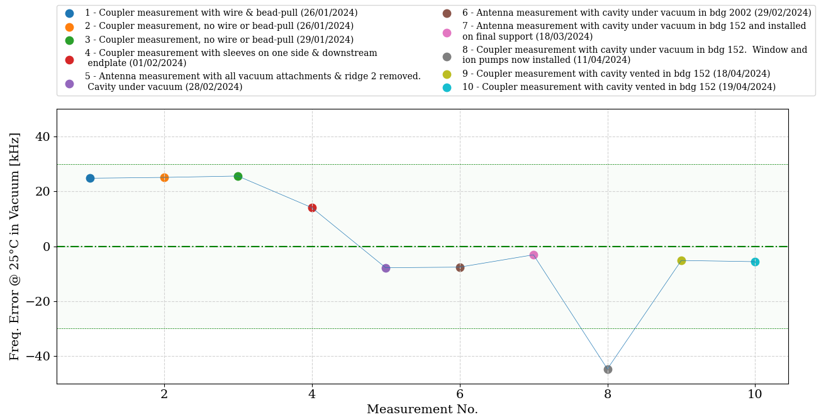
Frequency Evolution
Very strange result.

Slide 11
Frequency Evolution Table
Ten of the last measurements shown (those on the previous frequency plot). Full spreadsheet updated regularly and available on CERNbox (also contains notes for each measurement, e.g., the status of the cavity, its support, vacuum system): https://cernbox.cern.ch/s/GH50jWEpJYe4MzL

Slide 12
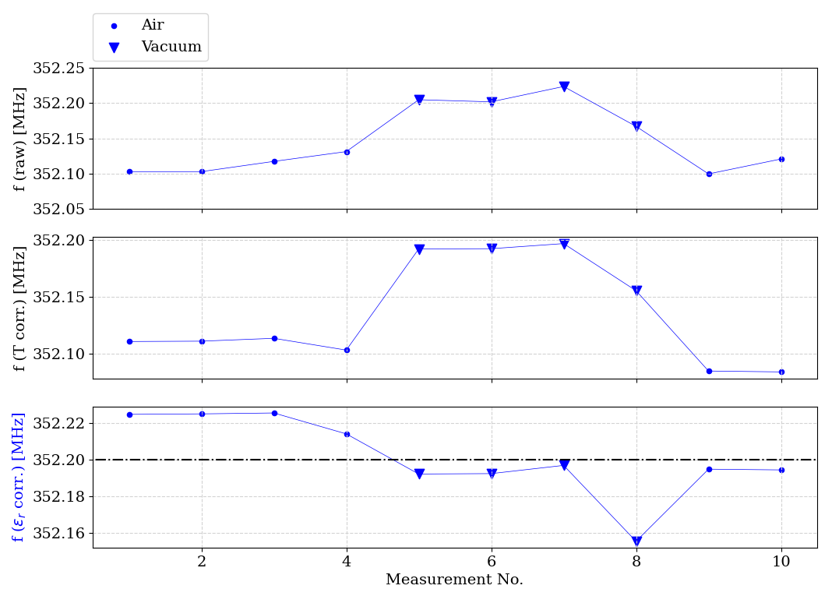
Frequency Evolution Plot
Raw data.
Corrected for cavity temperature.
Corrected for ε_{r} (applies to measurements in air).

Slide 13
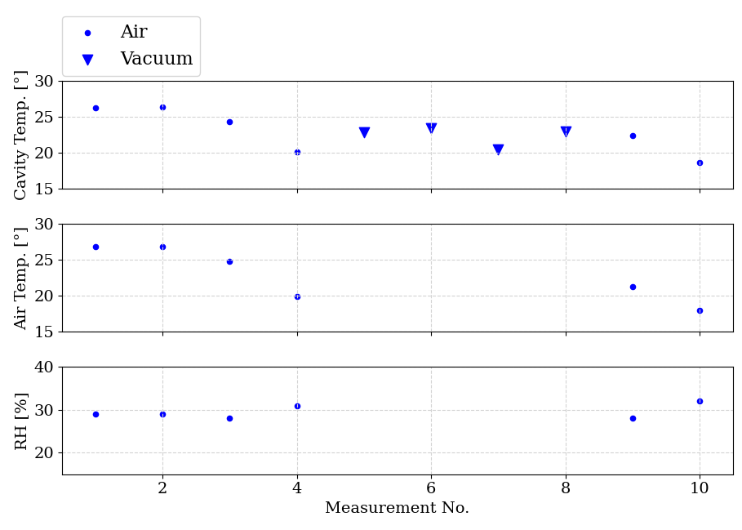
Temp/Humidity Evolution Plot

Slide 14
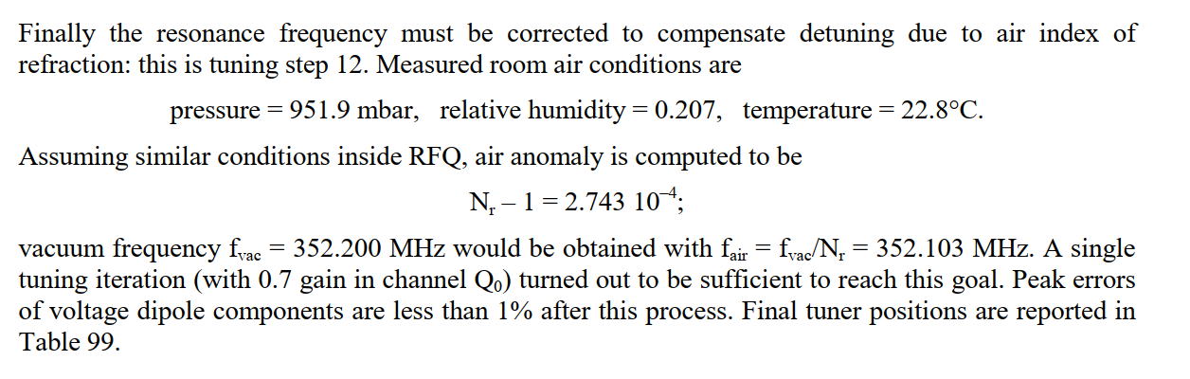
Frequency Check
RFQ1 was measured at 22.8°C. Their target was 352.103 MHz at 26 °C.
In short, air accounts for ~100 kHz shift at out working frequency.
Page 177 of RFQ1 report.

Slide 15
Q Evolution

Slide 16
Q Evolution
Q₀ = 6202
Q_{ext} = 4123
β = 1.5
Q₀ = 6258
Q_{ext} = 4154
β = 1.51
Q₀ = 6952
Q_{ext} = 4168
β = 1.67
Q₀ = 6912
Q_{ext} = 4195
β = 1.65
No change after venting.
No coupler installed; antenna-to-antenna measurements.

Slide 17
Antenna Measurements

Slide 18
Antenna Signal Comparison
Changes from venting are smaller than those observed previously.

Slide 19
Antenna Signal Comparison
Calculated field change after venting the RFQ in building 152.
Changes from venting are relatively small (<1%). Much smaller than those observed when moving the RFQ from building 2002 to building 152.

