Slide 1
RFQ2 Discussion
L. Millar
SY-RF-MKS
RFQ2 Meeting – 04/2024

Slide 2

Situation Report
Building 2002:
The RFQ was tuned.
Successful leak test (Ridge 2 was removed, vacuum port attachments added).
RFQ frequency checked with the antennas, a decrease of 33.41 kHz was observed (corresponds to ~5° in temperature).
Building 152:
RFQ transported to building 152 and placed on the final support. No further frequency change since building 2002.
RFQ was moved to high-power test location. Pumps, the final ridge 2, and the window were installed. The cavity was placed under vacuum.
Measurements performed with WG-Coax coupler indicate that Q₀ is higher, f₀ is even lower, and the field profile is out of spec compared to when it was in bdg. 2002.
Survey measurements were performed (results shared previously).

Slide 3
Situation Report
To summarise:
We can live with the new Q₀ and Q_{ext}.
The frequency is out of range when the cavity is pumped down (very strange).
The field profile is no longer in spec.

Slide 4
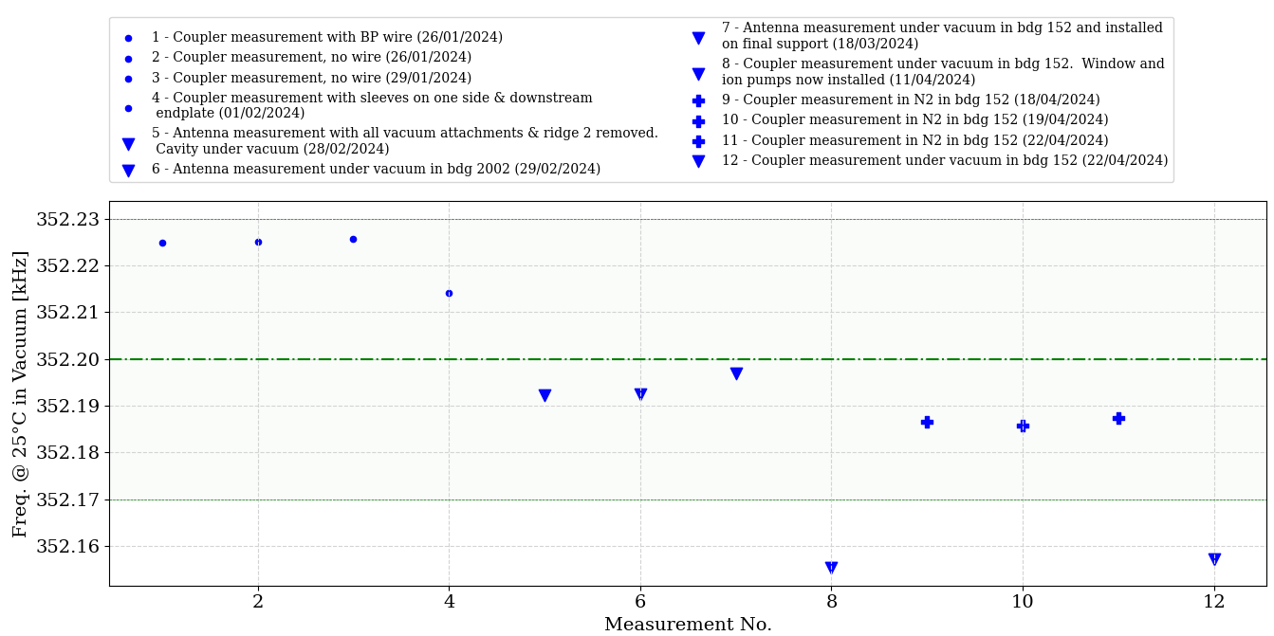
Frequency Evolution
Compensated for cavity frequency, why does pumping down reduce f₀???
Notes:
Full spreadsheet updated regularly and available on CERNbox (also contains notes for each measurement, e.g., the status of the cavity, its support, vacuum system): https://cernbox.cern.ch/s/GH50jWEpJYe4MzL

Slide 5
Frequency Evolution
Q₀ = 6202
Q_{ext} = 4123
β = 1.5
Q₀ = 6258
Q_{ext} = 4154
β = 1.51
Q₀ = 6952
Q_{ext} = 4168
β = 1.67
Q is stable, changes from venting are negligible.
Q₀ = 6912
Q_{ext} = 4195
β = 1.65

Slide 6
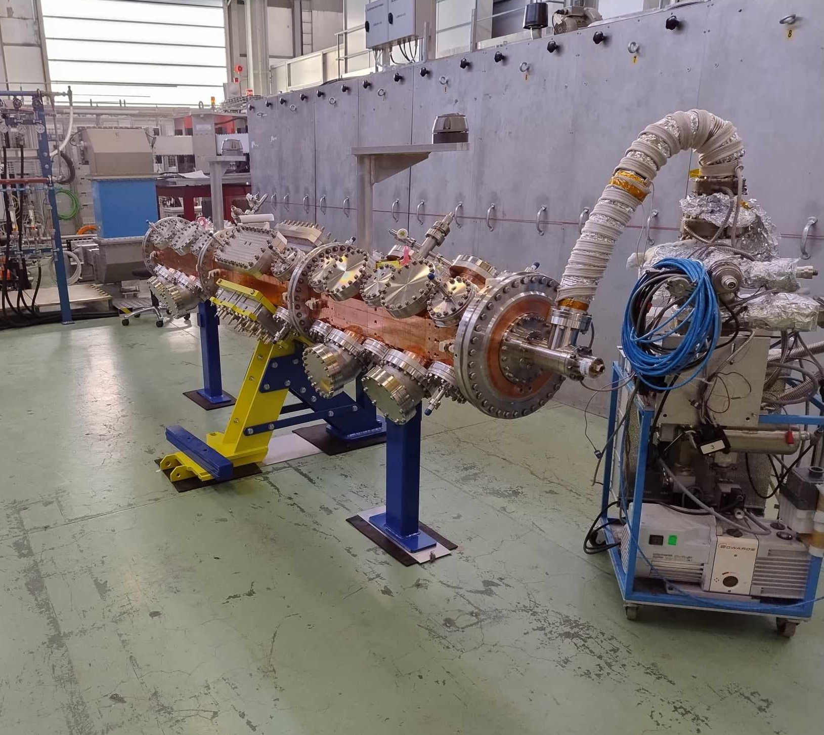
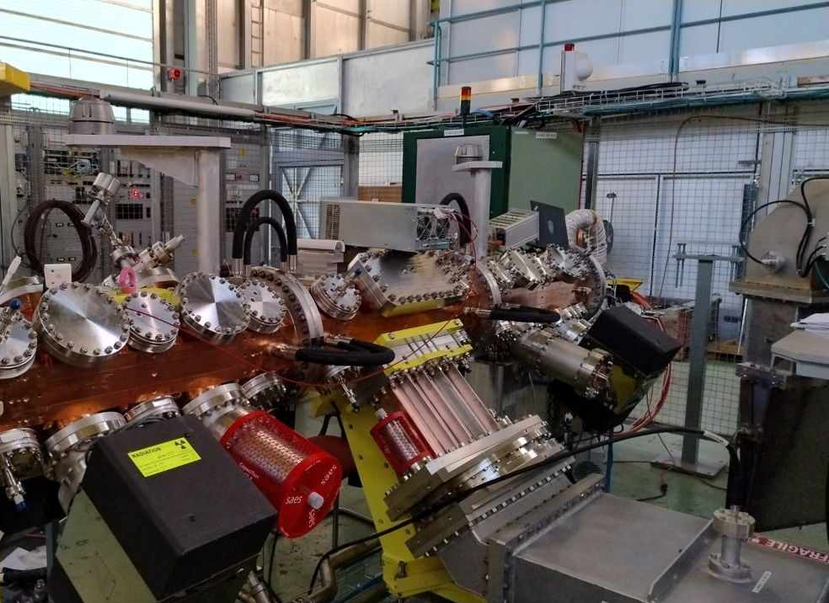
Frequency Evolution with Photos

Slide 7
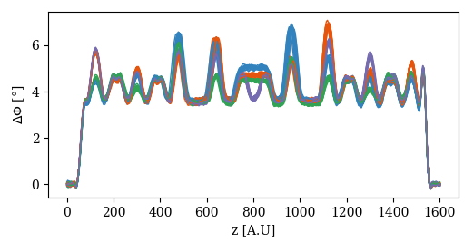
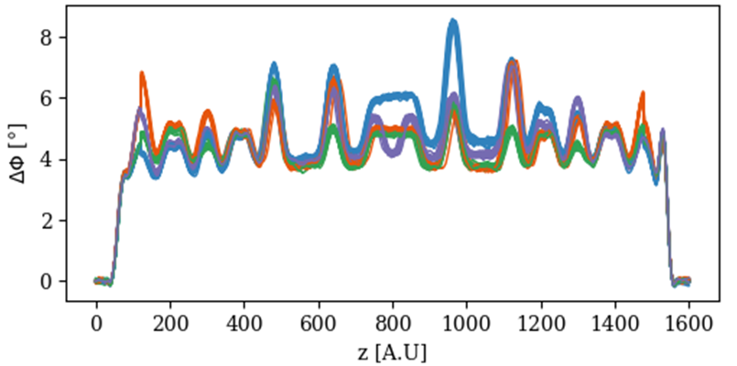
Field Profile Comparison

Slide 8
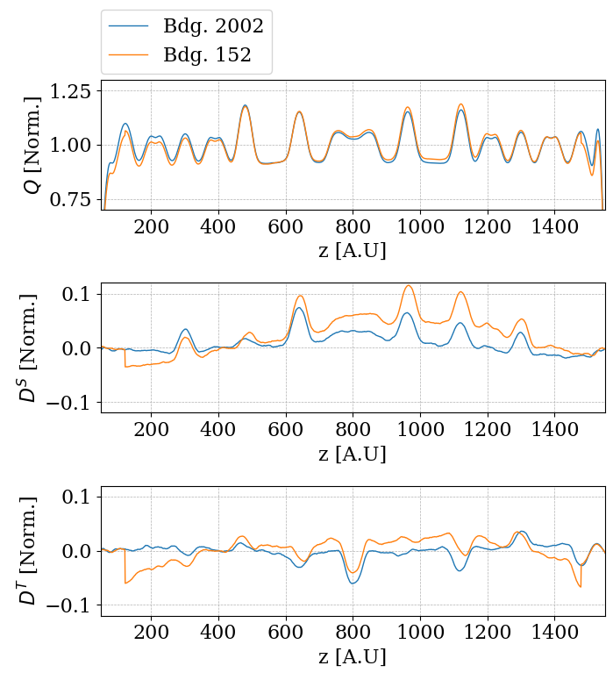
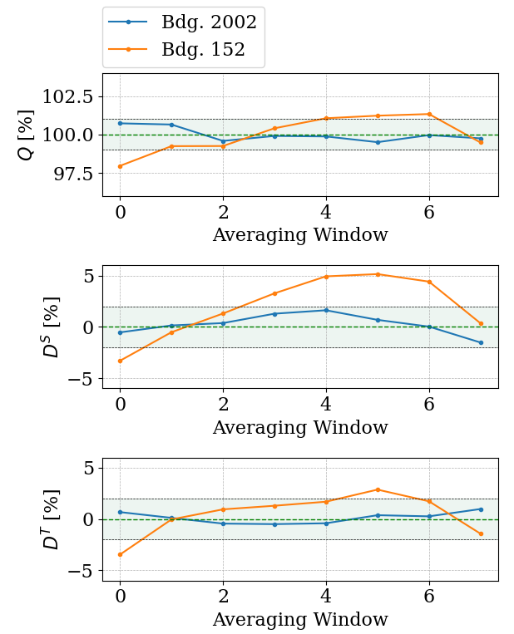
Field Profile Comparison

Slide 9
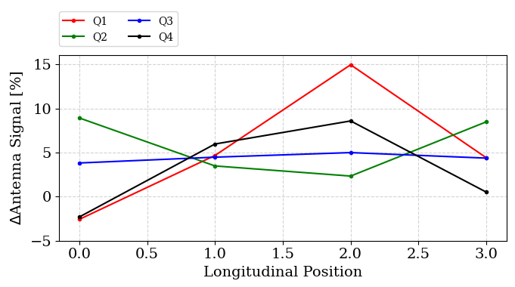
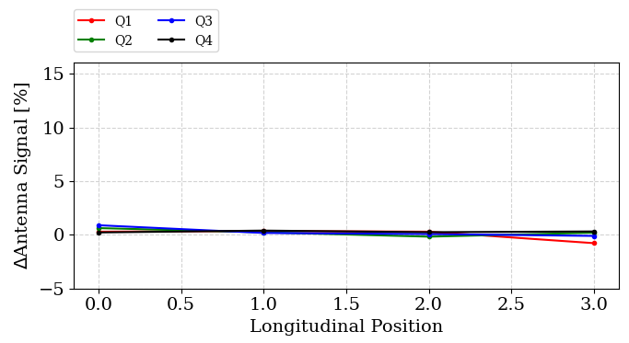
Antenna Signal Comparison
From bdg. 2002 to 152 test position (point 3 to 8).
Vacuum to nitrogen in bdg. 152 (point 8 to 9).

Slide 10
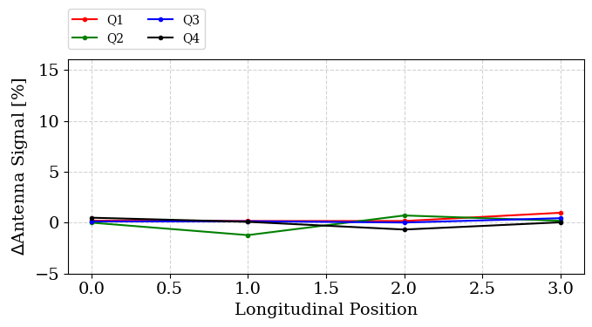
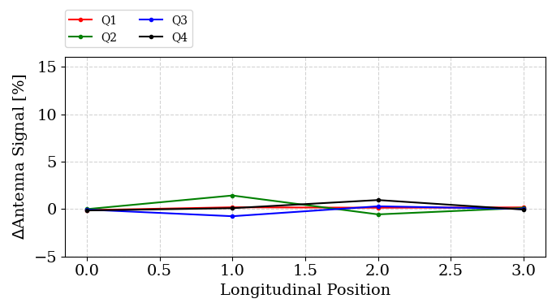
Antenna Signal Comparison
In nitrogen 19/04 – 22/04 (point 10 to 11).
Nitrogen to vacuum on 22/04/2024 (point 11 to 12).
Conclusion: Changes from venting are small (~1% or less), much less than those observed when moving the RFQ from building 2002 to building 152.

Slide 11
Discussion – Next Steps

Slide 12
Operations Since Tuning
In order, the following changes/operations have taken place (bdg. 152, building 2002):
Sleeves and flanges installed on pumping ports.
Ridge 2 (not the final one) removed.
Cavity placed under vacuum.
Cavity transported from building 2002 to building 152.
Cavity installed on final support.
Pumps, ridge 2 (the final one), and window installed.
Cavity placed under vacuum.
Cavity filled with nitrogen.
Cavity pumped down again.

Slide 13
Operations Since Tuning
In order, the following changes/operations have taken place (bdg. 152, building 2002):
Sleeves and flanges installed on pumping ports.
Ridge 2 (not the final one) removed.
Cavity placed under vacuum.
Cavity transported from building 2002 to building 152.
Cavity installed on final support.
Pumps, ridge 2 (the final one), and window installed.
Cavity placed under vacuum.
Cavity filled with nitrogen.
Cavity pumped down again.
Frequency measurements performed after these steps.

Slide 14
Operations Since Tuning
In order, the following changes/operations have taken place (bdg. 152, building 2002):
Sleeves and flanges installed on pumping ports.
Ridge 2 (not the final one) removed.
Cavity placed under vacuum.
Cavity transported from building 2002 to building 152.
Cavity installed on final support.
Pumps, ridge 2 (the final one), and window installed.
Cavity placed under vacuum.
Cavity filled with nitrogen.
Cavity pumped down again.
Frequency and field (antenna) measurements performed after these steps.
→ We cannot say when the change in field profile occurred.

Slide 15
Article: Sleeves on Vacuum Ports
1. Sleeves on vacuum ports.
Justification:
Measurements showed a change in frequency when they were installed. The only measurement we have where one variable was change.
Possible actions:
Remove chemically active pumps (must be removed anyway if cavity is opened, e.g., for bead-pull), then remove a sleeve/flange and measure the effect.

Slide 16
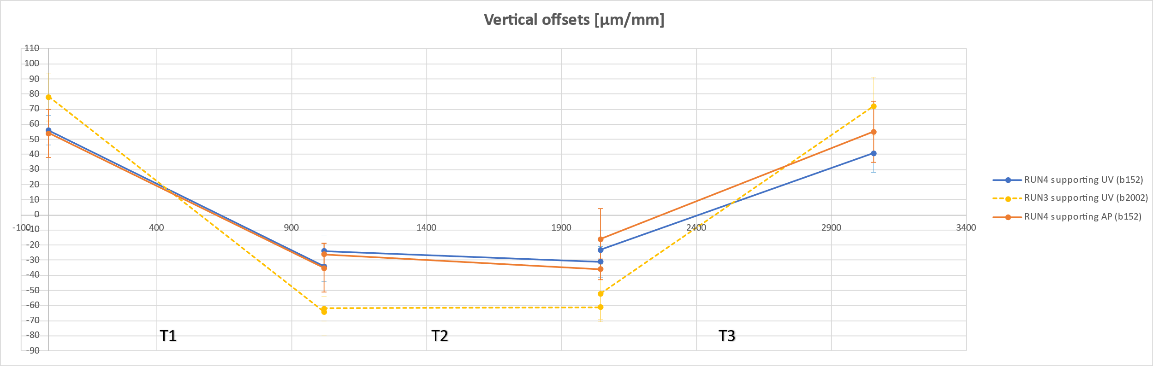
Article: Cavity Installed on Final Support
5. Cavity installed on final support.
Justification:
However, survey measurements have shown a change in the sag. The effect of the pumps is also included.
No change in frequency was observed when it was first installed, and it is not clear how much this affected the field.
Possible actions:
Change load on the RFQ.

