Slide 1


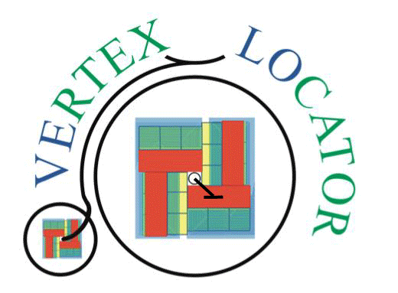
VELO U2 cooling substrates
Oscar Augusto on behalf of the VELO Upgrade 2 group

Slide 2
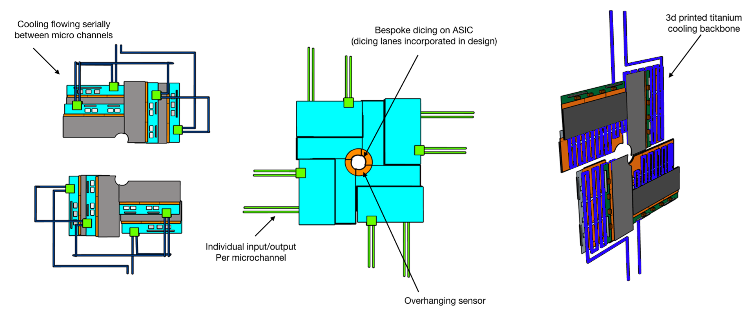
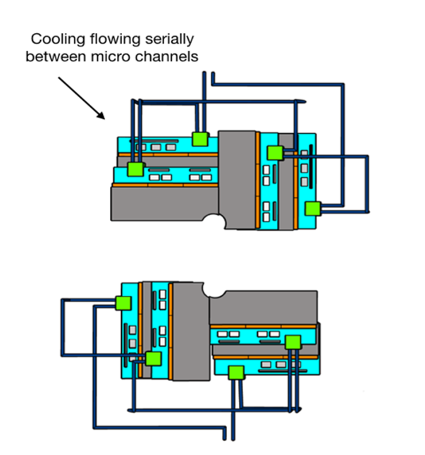
VELO Module/Cooling concepts (FTDR)
Smaller microchannel coolers to reduce the overall cost
More challenging to integrate (interface between pipes and coolers)
Cooling structure could be potentially re-used (NA62 talk)
Better cooling performance
Cheaper and more flexible design
Easier to integrate (cooling plant)

Slide 3
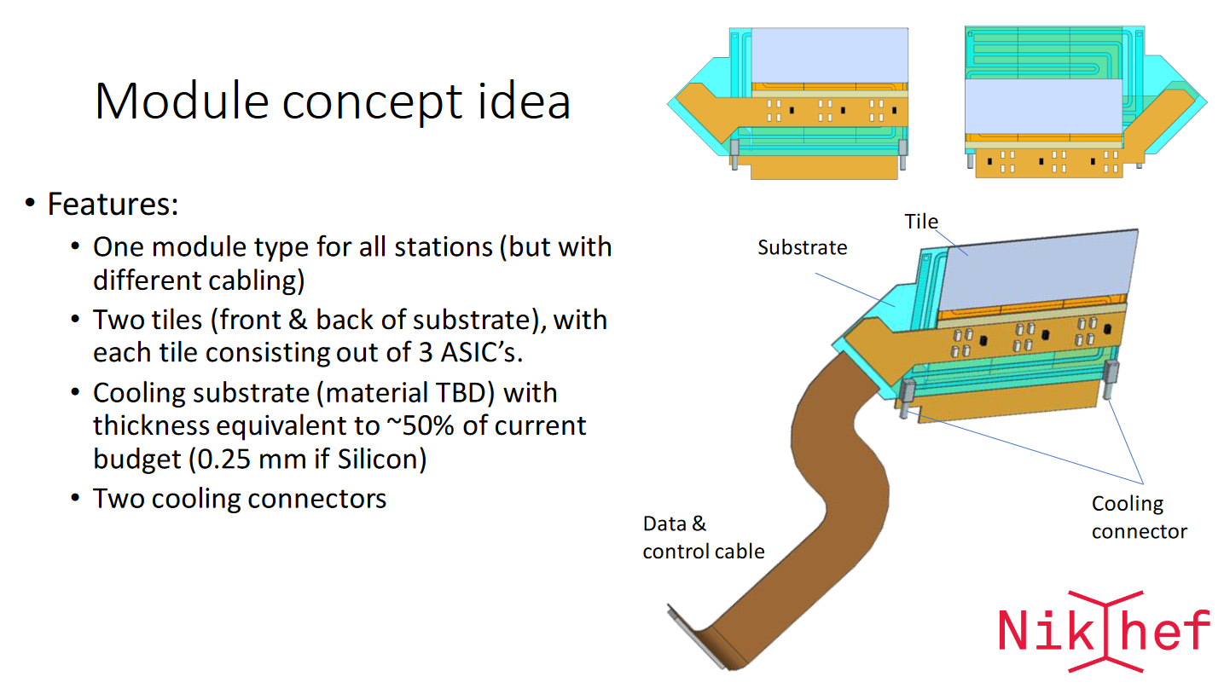
VELO Module/Cooling concepts (NIKHEF)
Kazu/Yutaro presentation

Slide 4

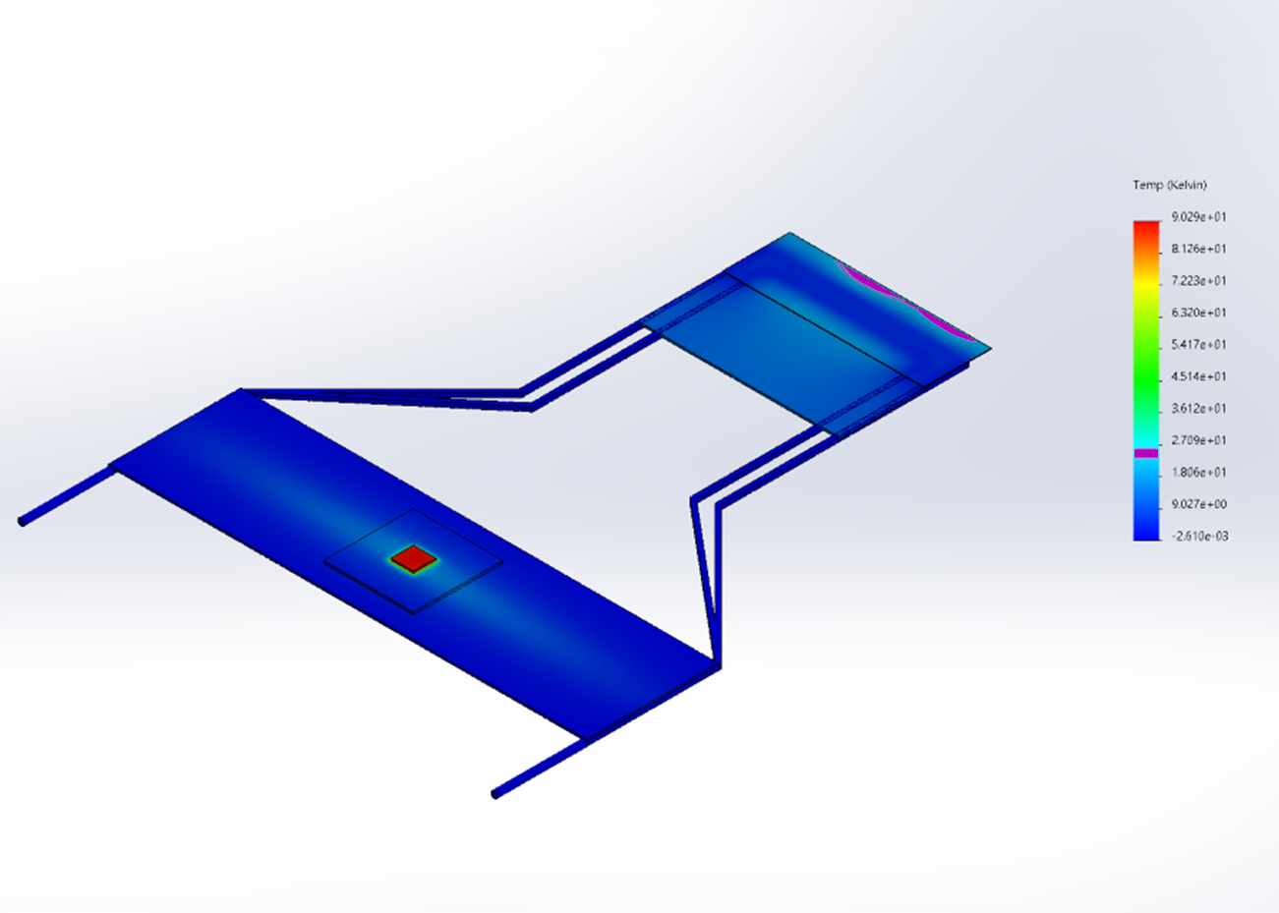
3D metal
Exploration phase
Considering evaporative $CO_{2}$ as baseline solution
Considering evaporative CO_2 as baseline solution
Power dissipation of up to $2W/cm^{2}$
Power dissipation of up to 2W/cm^2
Largest variation of temperature on the sensor part around $25℃$ (with respect to the inner side wall)
Largest variation of temperature on the sensor part around 25℃ (with respect to the inner side wall)
Alternative strategy to cooldown off-chip electronics would have to be improved (cooling routing lines)
U-like design
Different designs submitted to the Royce Institute (Sheffield)
More aggressive designs (larger $ΔT$) would require lower operating temperature (Krypton?) to keep the max. sensor temperature $<−20℃$
More aggressive designs (larger ΔT) would require lower operating temperature (Krypton?) to keep the max. sensor temperature <−20℃
At the moment, considering different designs which could lead to a material budget reduction compared to plan-Z
U-like design

Slide 5
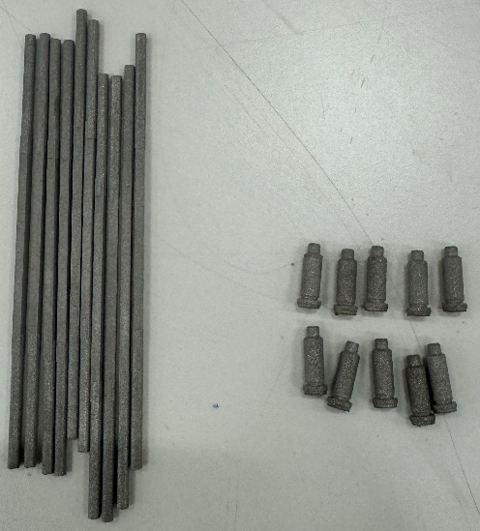
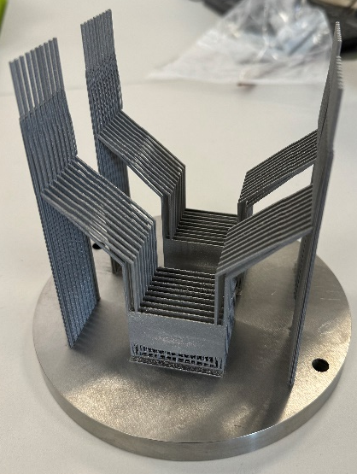

3D metal: LHCb VELO
Different designs
Squared tube and connector prototypes
X-ray tomography via NXCT
U-shaped design
X-ray 2D tomography (one projection)
Printing distortion and blockage
New round of printing:
Filling factor being improved
Different printing parameters to improve distortions and fill factor
Half of the samples will be electro-polished (easier integration?)
Samples are being post-processed
0.5mm
Fill factor
1.0mm

Slide 6
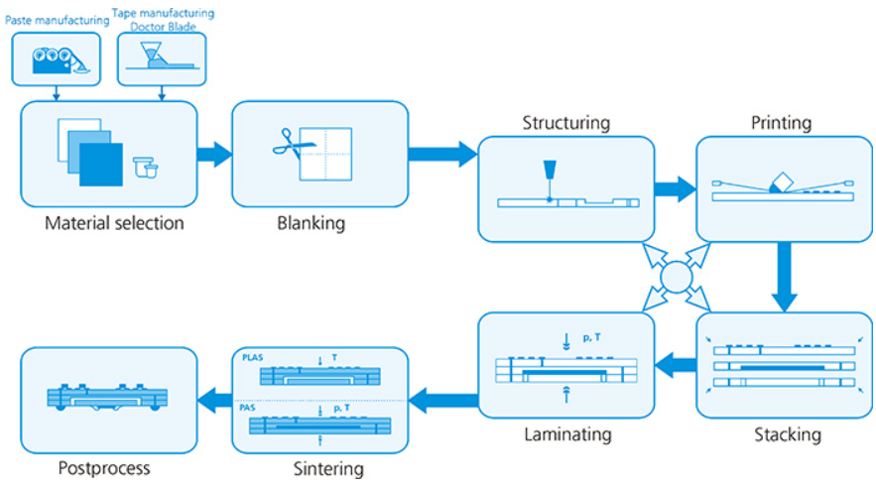
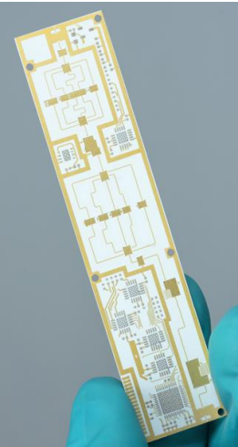
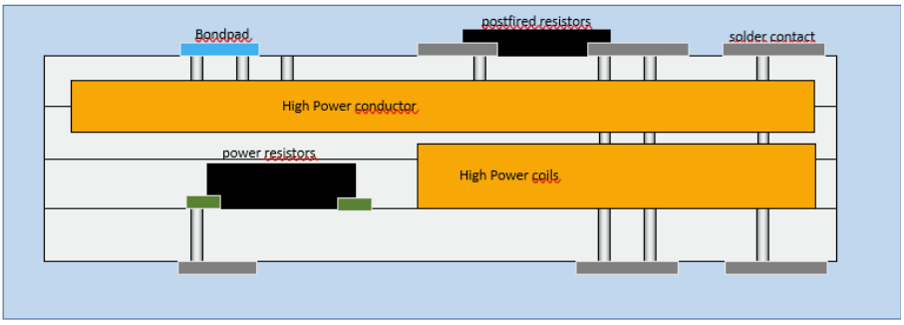
Ceramics
Why?
Robustness, reliability, stability in ultra-high-vacuum
Manufacturing at IKTS Fraunhofer (Germany)
Possible to embed conductive layers in between ceramics layers and metalize the surface
Potential to integrate electronics or high conductivity elements
Mechanically robust and compatible with high ultra vacuum
Different base materials: YSZ, $Al_{2}O_{3}$, … including SiC and AlN
Different base materials: YSZ, Al_2 O_3, … including SiC and AlN
Manufacturing based on several layers
©Fraunhofer IKTS

Slide 7
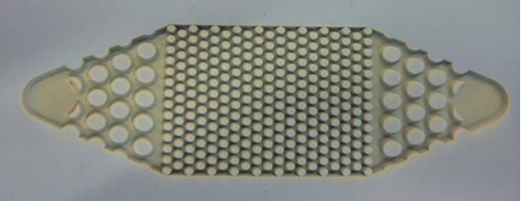
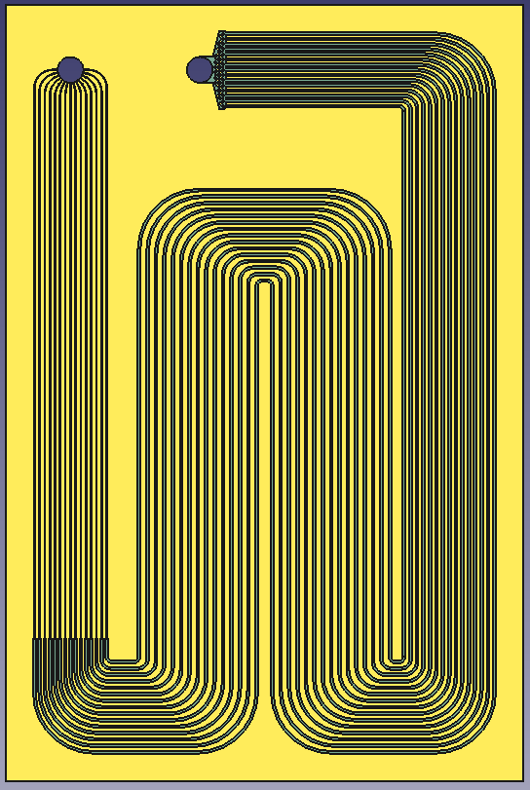
Ceramics
Experience with fluidic applications
First prototype based on the early VELO Upgrade I CERN design
Initial channel with $70μm$ width (restrictions)
Initial channel with 70μm width (restrictions)
Channels height $100μm$
Channels height 100𝜇𝑚
Overall dimensions: $40×60mm^{2}$
Overall dimensions: 40×60mm^2
Based on LTCC
Possible to move to SiC or AlN
$Al_{2}O_{3}/Glass$ $\sim 1:1$
Al_2 O_3/Glass ~1:1
HTCC at a later stage ($Al_{2}O_{3}$ $\sim 96\%$)
HTCC at a later stage (Al_2 O_3 ~96%)
©Fraunhofer IKTS
Restrictions
Input
Output
40 mm
Main
channels
60 mm

Slide 8
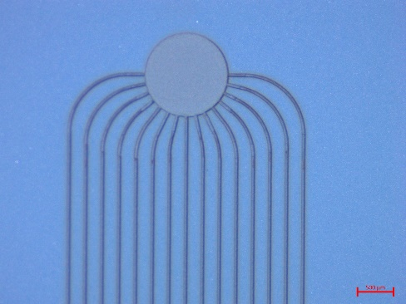
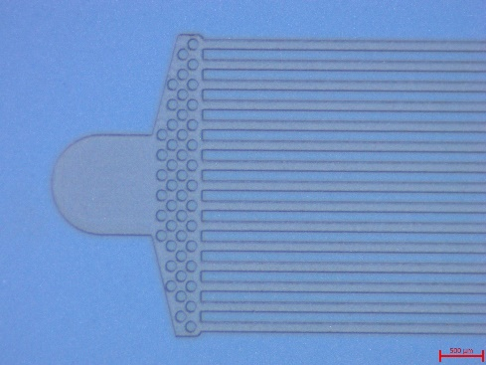
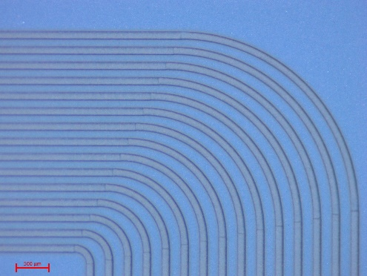
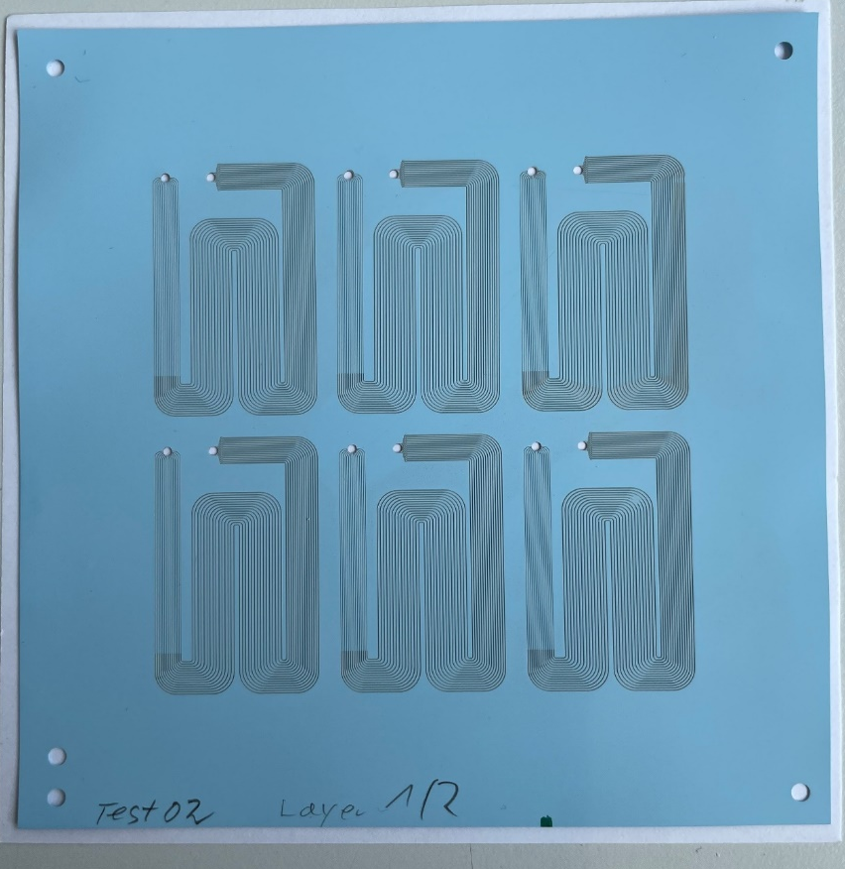
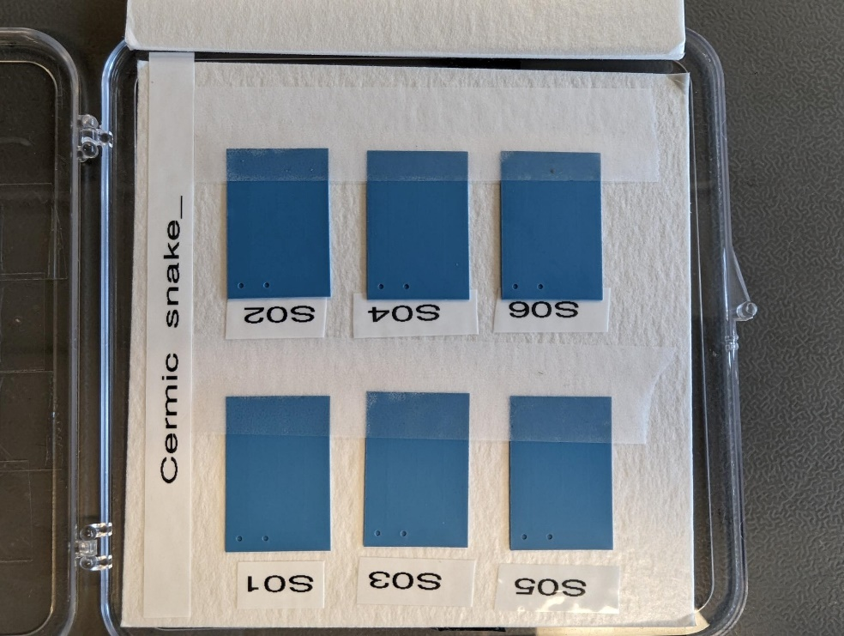
Ceramics: Goal and status
Very encouraging first manufacturing round!!!
Goal:
Manufacture first samples (IKTS)
Second round being prepared
Validate initial prototypes to high pressure, leak tightness and cooling performance
Benchmark: LHCb VELO Upgrade 2 requirements (High pressure 186 bar, leak tight (vacuum operation) and excellent thermal performance
Miniaturized version (2x smaller in-plane)
Expected 35um and 100um width restrictions and main channels respectively!
IKTS Fraunhoffer ©
IKTS Fraunhoffer ©
IKTS Fraunhoffer ©
Fraunhoffer ©
First samples in-house
(eagerly waiting to be tested)

Slide 9
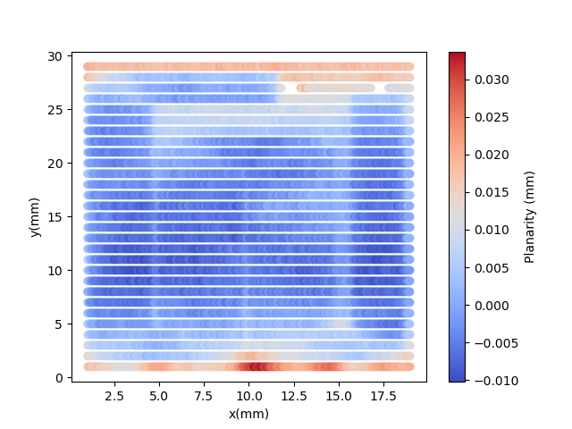
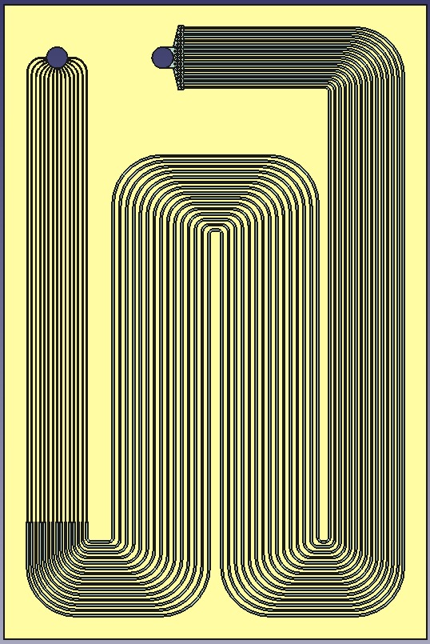
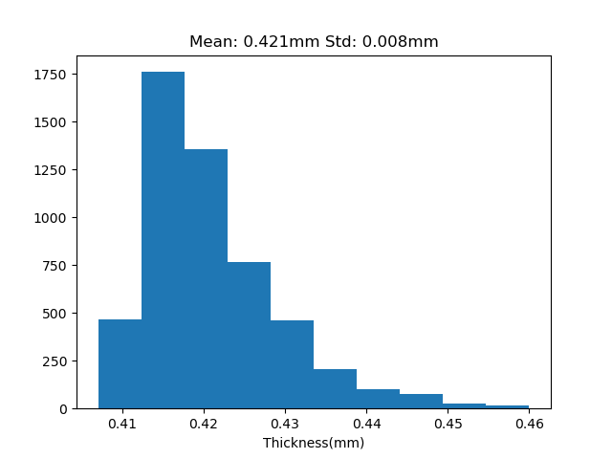
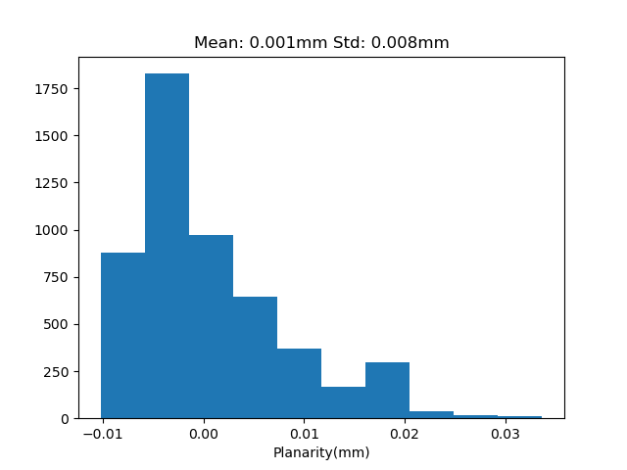
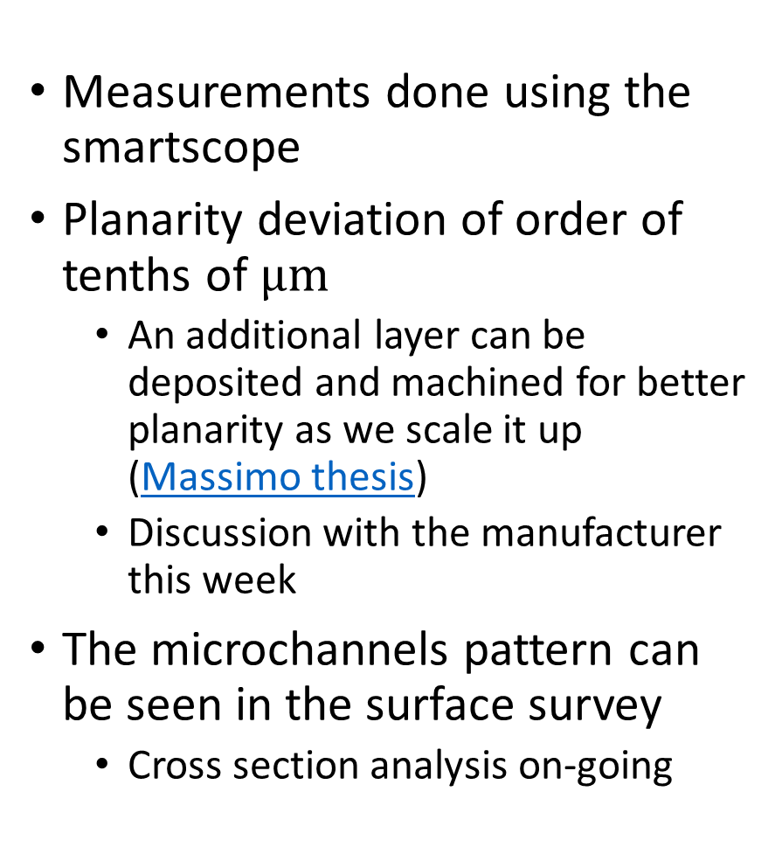
Metrology
Measurements done using the smartscope
Planarity deviation of order of tenths of $μm$
  An additional layer can be deposited and machined for better planarity as we scale it up (Massimo thesis)
  Discussion with the manufacturer this week
The microchannels pattern can be seen in the surface survey
  Cross section analysis on-going

Slide 10

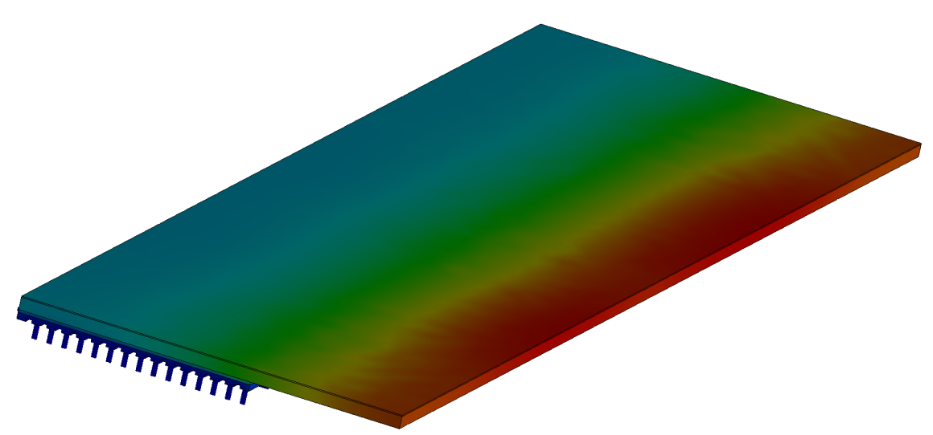
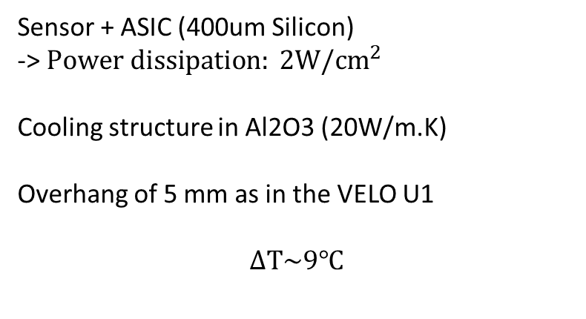

Simplified FEA
$$ΔT(℃)$$
Sensor + ASIC (400um Silicon)
-> $Power dissipation: 2W/cm^{2}$
Cooling structure in Al2O3 (20W/m.K)
Overhang of 5 mm as in the VELO U1
$$ΔT\sim 9℃$$

Slide 11
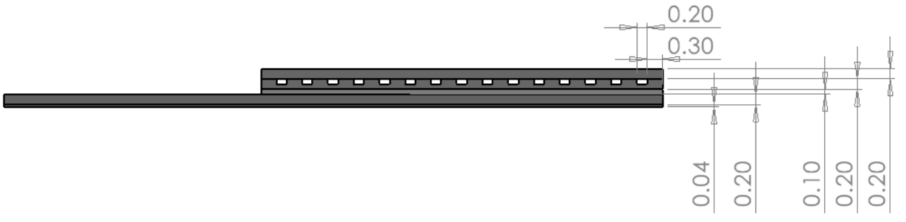
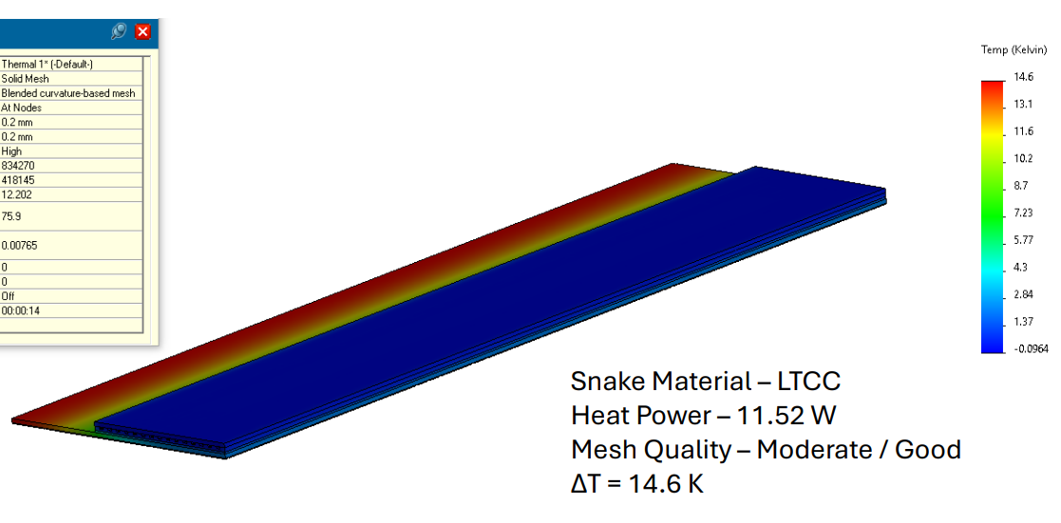

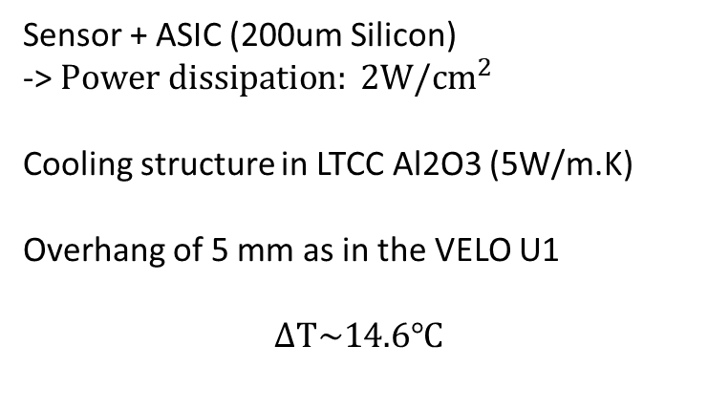
FEA (Alumina LTCC)
Sensor + ASIC (200um Silicon)
-> $Power dissipation: 2W/cm^{2}$
Cooling structure in LTCC Al2O3 (5W/m.K)
Overhang of 5 mm as in the VELO U1
$$ΔT\sim 14.6℃$$
$$ΔT(℃)$$

Slide 12
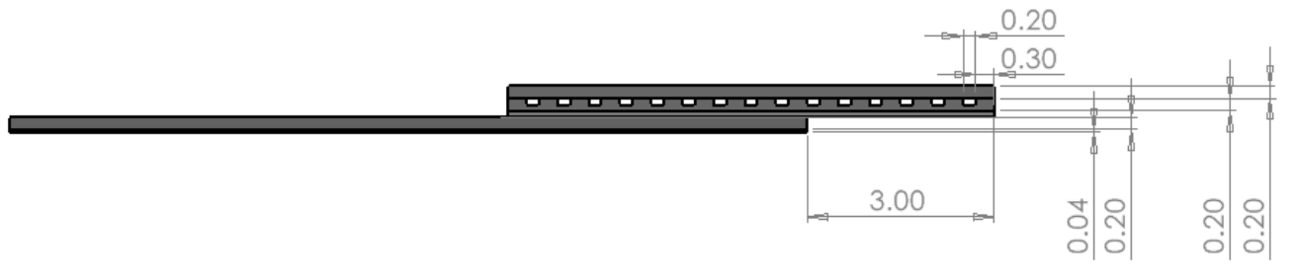
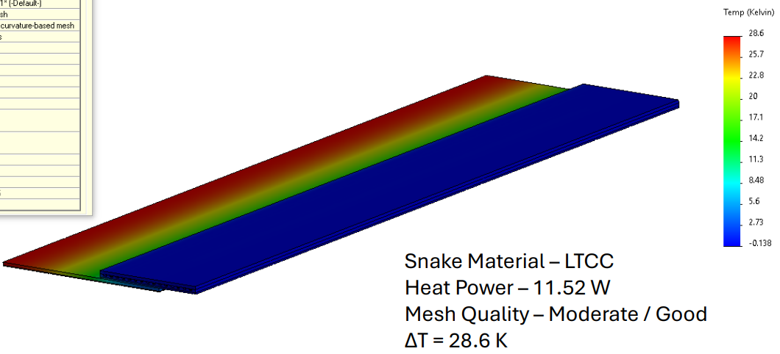

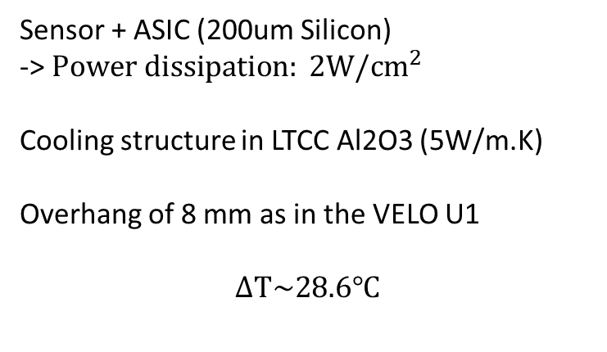
FEA (Alumina LTCC)
Sensor + ASIC (200um Silicon)
-> $Power dissipation: 2W/cm^{2}$
Cooling structure in LTCC Al2O3 (5W/m.K)
Overhang of 8 mm as in the VELO U1
$$ΔT\sim 28.6℃$$
$$ΔT(℃)$$

Slide 13


Slide 14
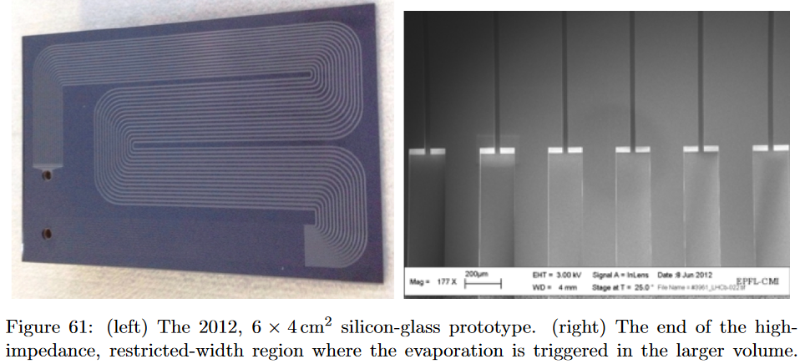
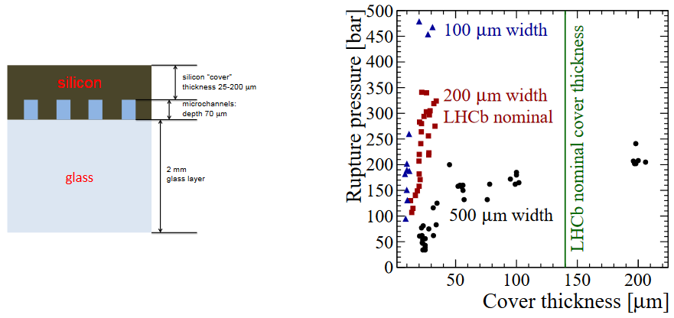
VELO U1 TDR
VELO Upgrade I TDR
Cooling substrate at baby prototypes level
  SNAKEI, 40 mm x 60 mm
  Main channel 200 um x 70 um (Restriction 30 um x 70 um)
Robustness tests running
  High pressure and cycling

Slide 15
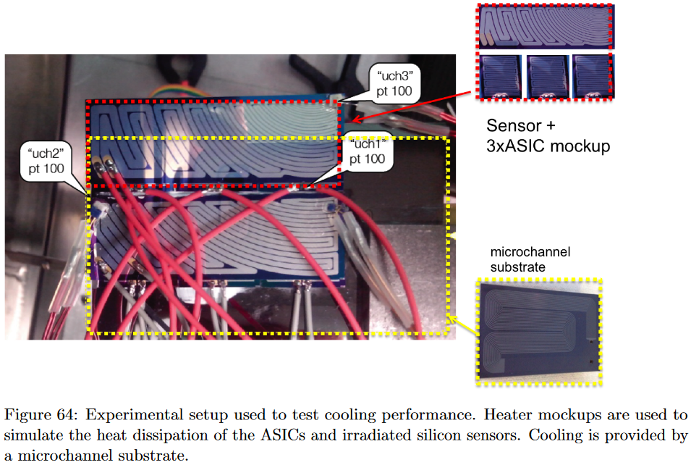
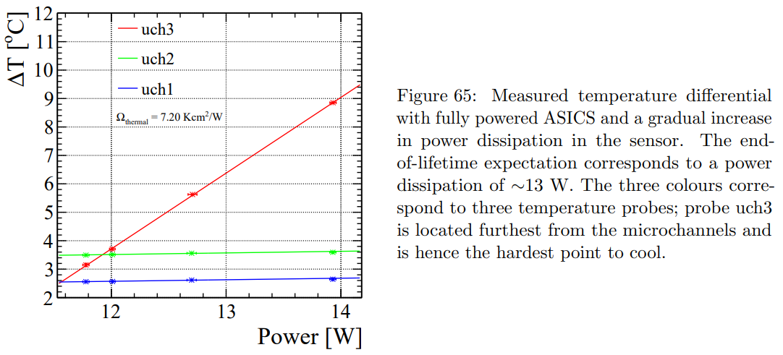
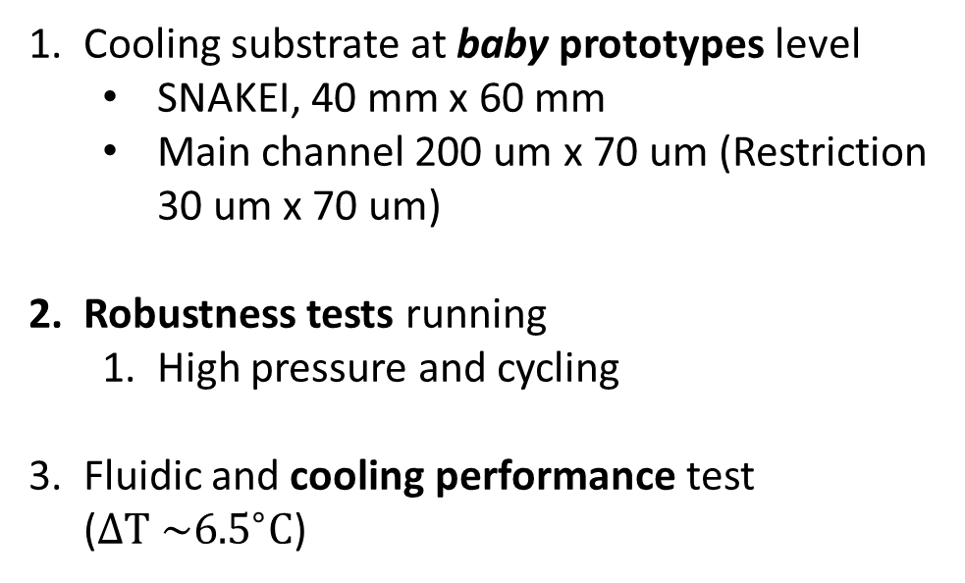
VELO U1 TDR
VELO Upgrade I TDR
Cooling substrate at baby prototypes level
  SNAKEI, 40 mm x 60 mm
  Main channel 200 um x 70 um (Restriction 30 um x 70 um)
Robustness tests running
  High pressure and cycling
Fluidic and cooling performance test ($ΔT \sim {6.5}^{∘}C$)

Slide 16
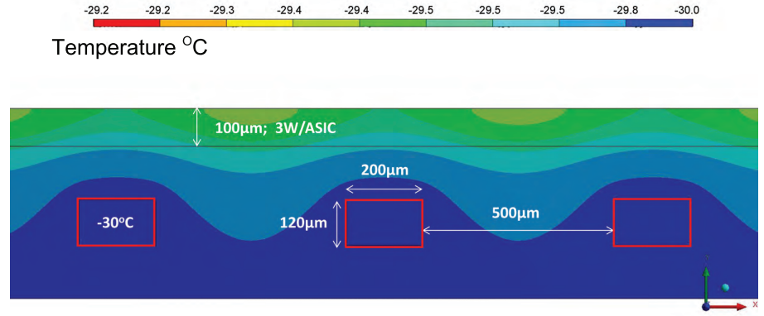
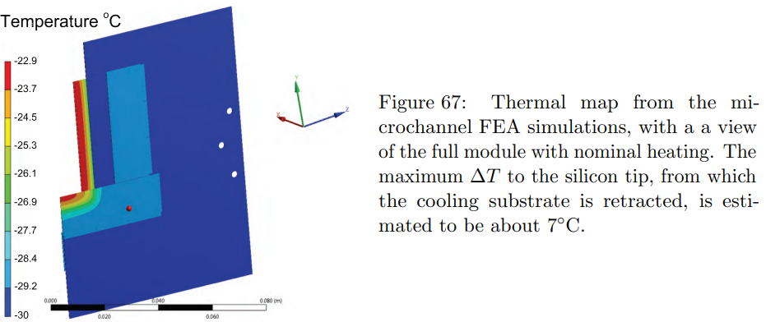
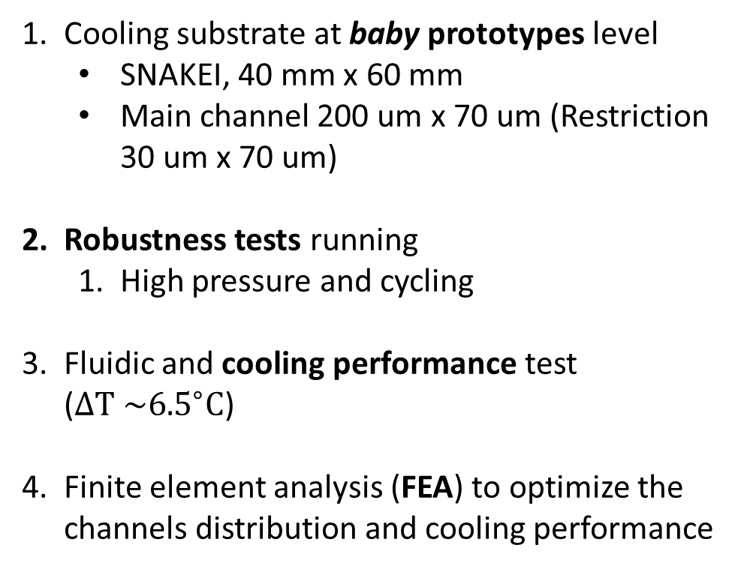
VELO U1 TDR
VELO Upgrade I TDR
Cooling substrate at baby prototypes level
  SNAKEI, 40 mm x 60 mm
  Main channel 200 um x 70 um (Restriction 30 um x 70 um)
Robustness tests running
  High pressure and cycling
Fluidic and cooling performance test ($ΔT \sim {6.5}^{∘}C$)
Finite element analysis (FEA) to optimize the channels distribution and cooling performance

Slide 17
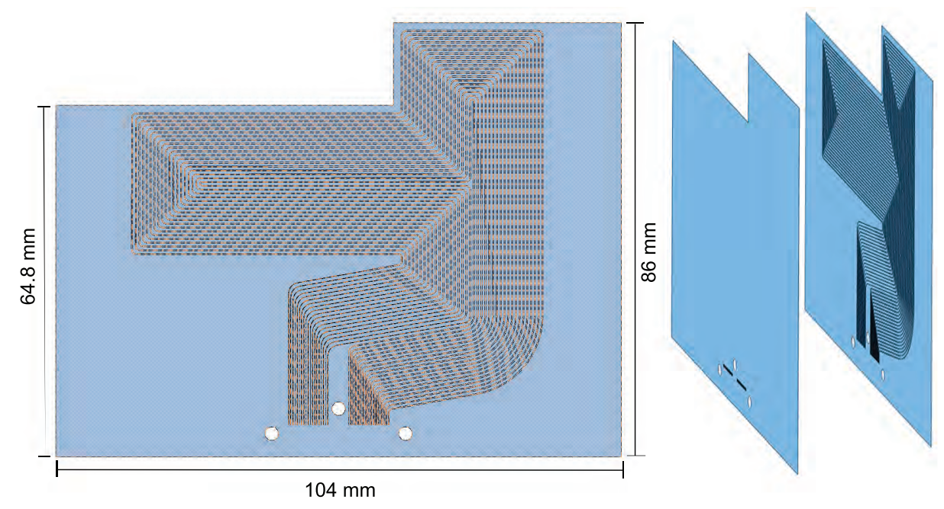
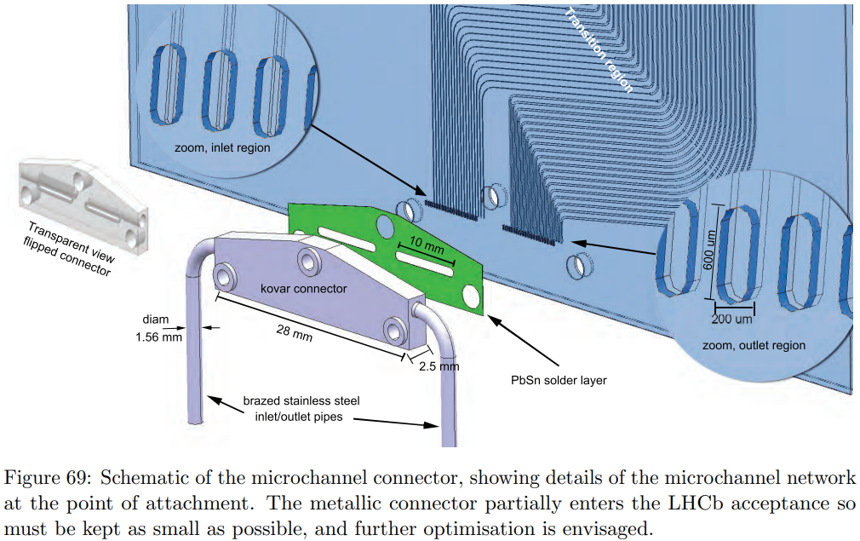
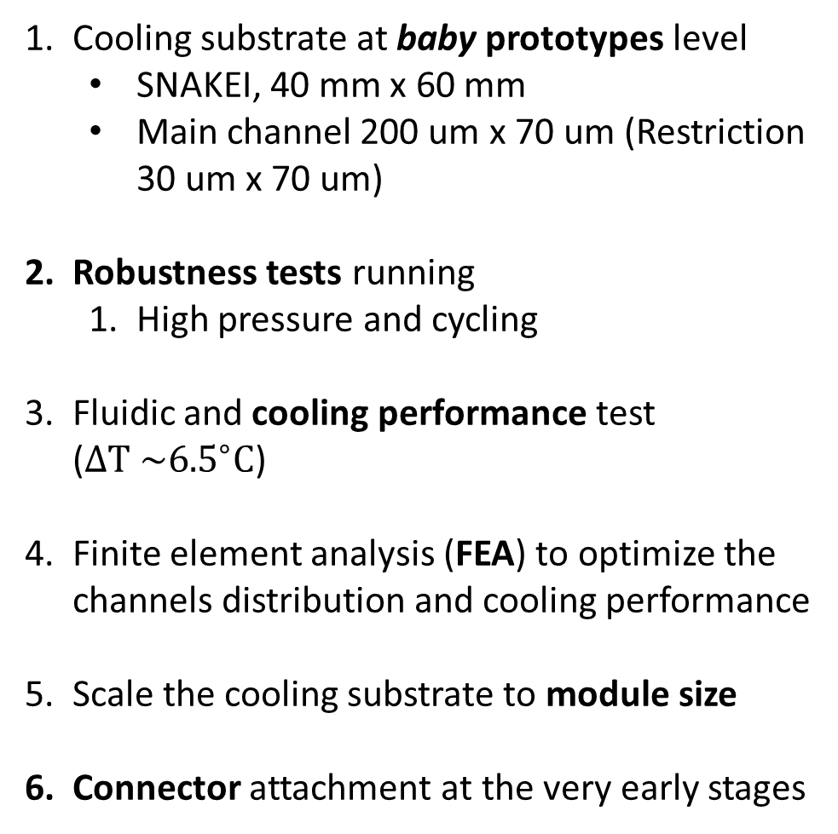
VELO U1 TDR
VELO Upgrade I TDR
Cooling substrate at baby prototypes level
  SNAKEI, 40 mm x 60 mm
  Main channel 200 um x 70 um (Restriction 30 um x 70 um)
Robustness tests running
  High pressure and cycling
Fluidic and cooling performance test ($ΔT \sim {6.5}^{∘}C$)
Finite element analysis (FEA) to optimize the channels distribution and cooling performance
Scale the cooling substrate to module size
Connector attachment at the very early stages

Slide 18
VELO U1 TDR
VELO Upgrade I TDR
 | Ceramics | 3D metal
Baby prototypes | Thinner channels were already manufactured Nominal samples by End/July | Samples produced show distortion and fill factor issues Second round should have better fill factor (TBC)
Robustness tests | Miniaturized connector glueing at the moment (based on the CERN design) – High pressure test in-house New connector for nominal size Cyclic tests | Connector is required (see last row)
Cooling performance | Heaters ordered and vacuum tank/CO2 in place (To be recommissioned) | In principle, same heaters/set-up can be used
Cooling FEA | On-going (large contribution due to the overhang) | On-going (large contribution due to the overhang)
Module scaling and Mod0 | Aiming for timepix4 prototype by mid/2025 (40 mm x 60 mm – nominal size) | Pursuit another manufacturer in parallel (Terms and conditions?)
Connector | IKTS has experience with integration, soldering, Hyperbar bonding (CPPM), brazing(?) | More samples are required (smoother finishing would be beneficial)

Slide 19
Summary
Scaling up towards the final design (highly dependent on the geometry – not defined yet!)
Cooling plates
Ceramic plates
Miniaturized samples in-house (20 x 30 mm²)
Nominal dimension expected by end of July ($40×60 mm^{2}$) – compatible with the first prototypes specs (timepix4 single board)
Nominal dimension expected by end of July (40×60 mm^2) – compatible with the first prototypes specs (timepix4 single board)
Robustness validation (high pressure / cyclic tests?)
Connector being assembled
Finite element analysis of the sample ( including design optimization)
Connector: different approaches can be considered
IKTS integration, soldering, hyperbar bonding (CPPM), brazing, …

Slide 20
Summary
Cooling plates
3D metal printing
First run shows fill factor issue and distortions
Additional samples produced to understand better the printing (straight samples)
Second run should have better fill factor
Connector R&D requires more samples
Another manufacturer to be identified (Alloyed, BA systems, ?)
Smoother surface is desirable
Thank you for your attention

Slide 21
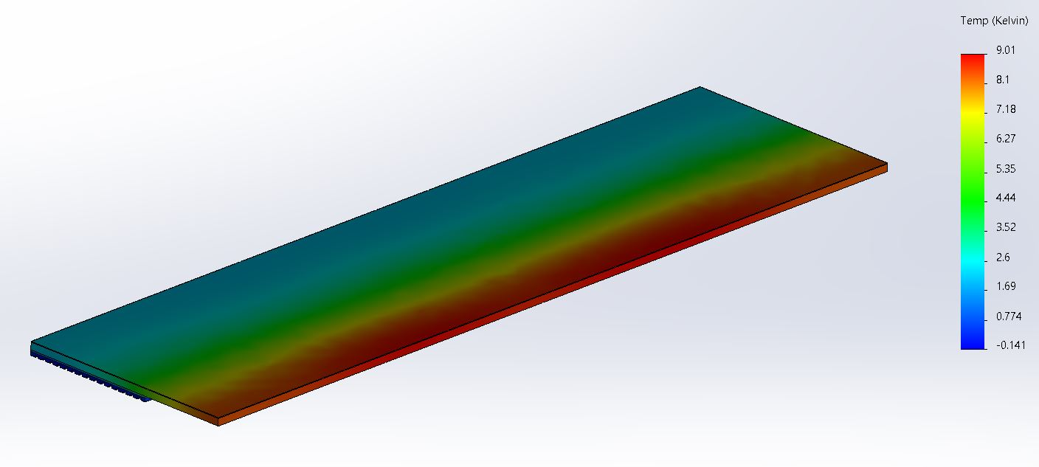
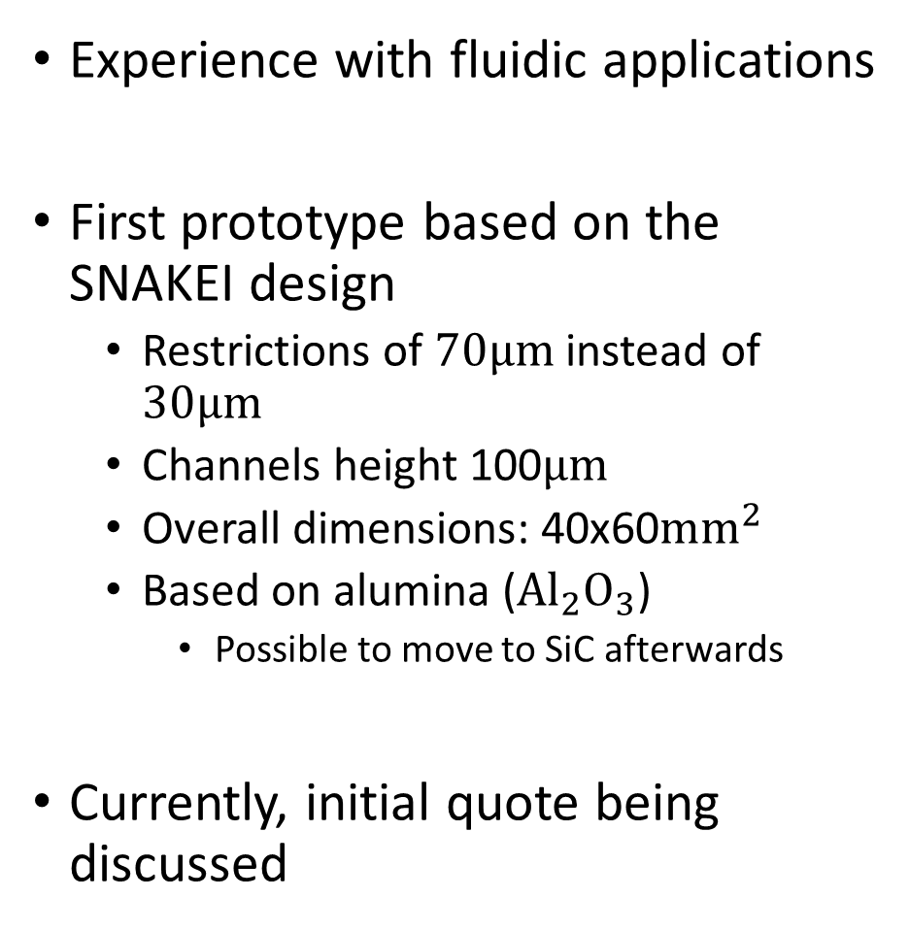
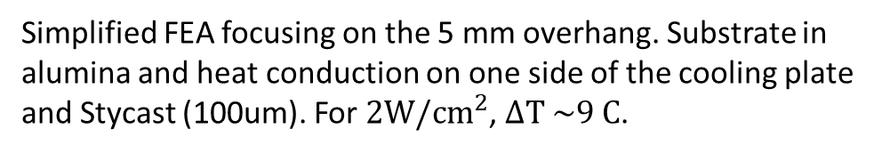
Ceramics 3D printing
Experience with fluidic applications
First prototype based on the SNAKEI design
  Restrictions of $70μm$ instead of $30μm$
  Channels height 100$μm$
  Overall dimensions: 40x60$mm^{2}$
  Based on alumina ($Al_{2}O_{3}$)
    Possible to move to SiC afterwards
Currently, initial quote being discussed
©Fraunhofer IKTS
SNAKEI based design to optimize printing parameters/test feasibility
Simplified FEA focusing on the 5 mm overhang. Substrate in alumina and heat conduction on one side of the cooling plate and Stycast (100um). For $2W/cm^{2}$, $ΔT \sim 9 C$.

Slide 22
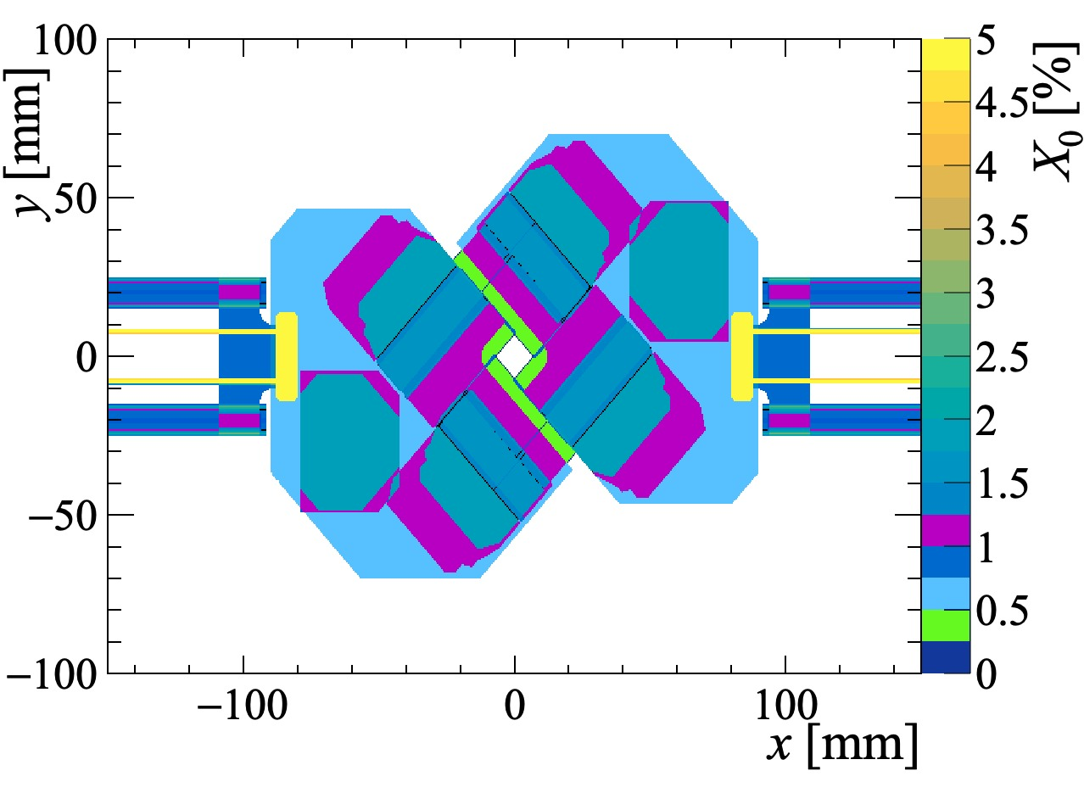
Cooling material budget (U1)
Not all services are present (no cables)
Material budget for perpendicular incidence
Inner most region has only the contribution from the sensor+ASIC (~0.4% X0)
Second innermost region contains the contribution from sensor, cooling plate and glue layer
(~1.0% X0)
VELO U1 cooling material budget

Slide 23
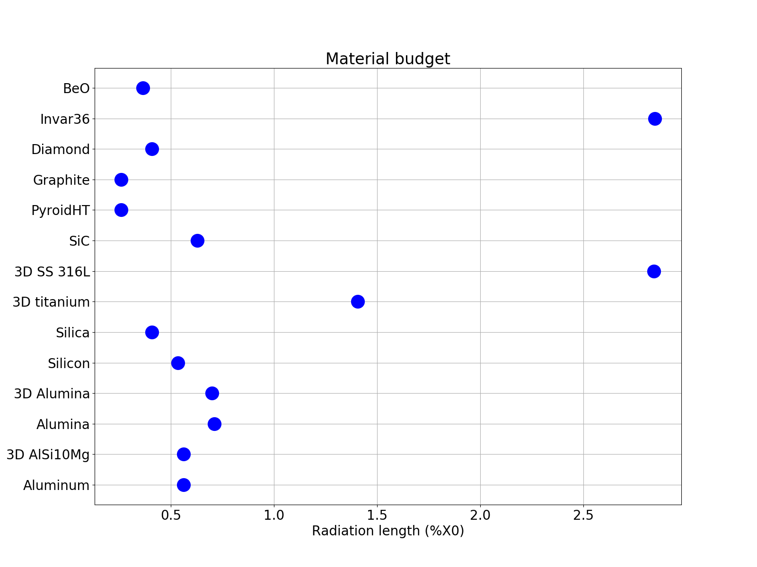

Materials considerations ($500μm$)

Slide 24
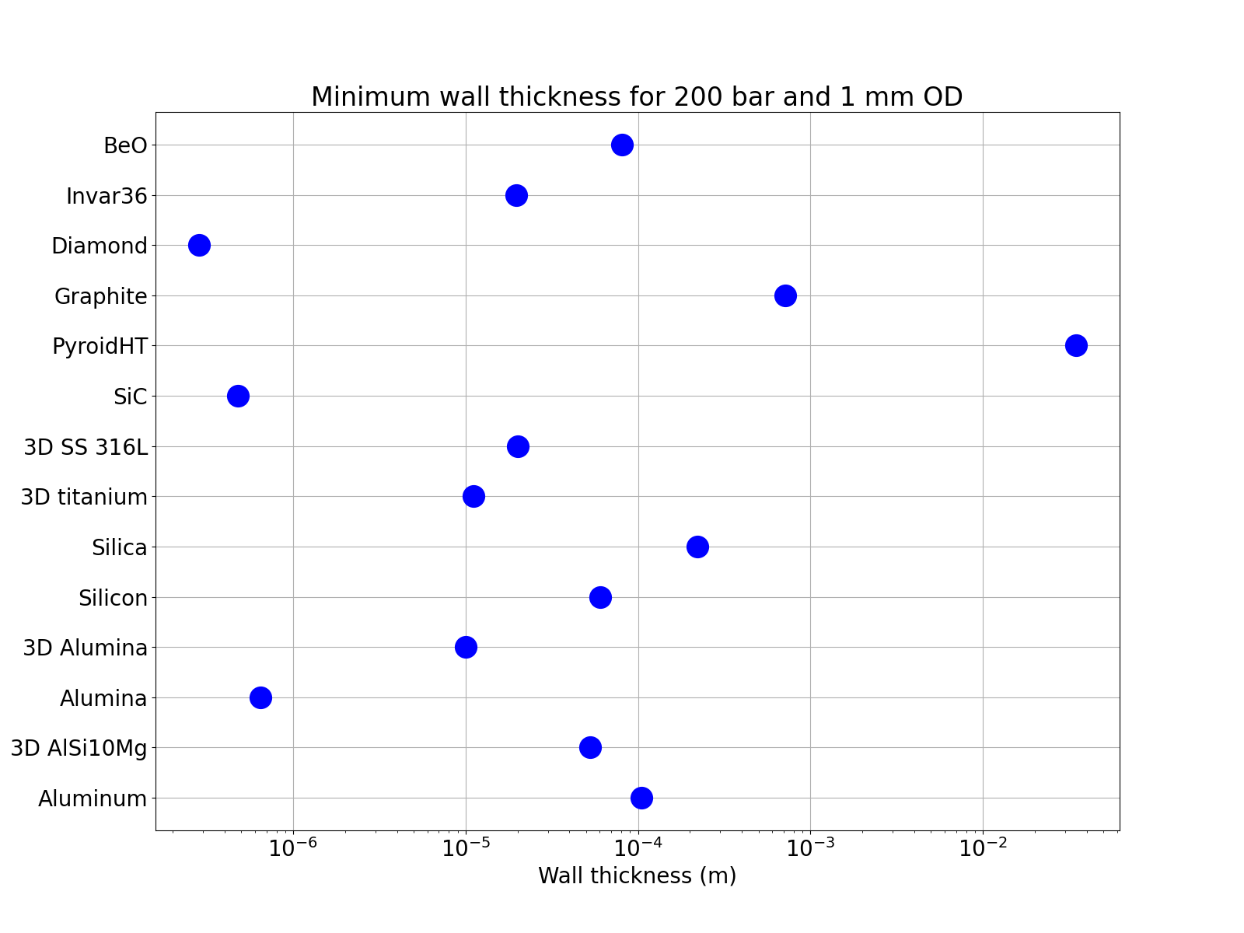
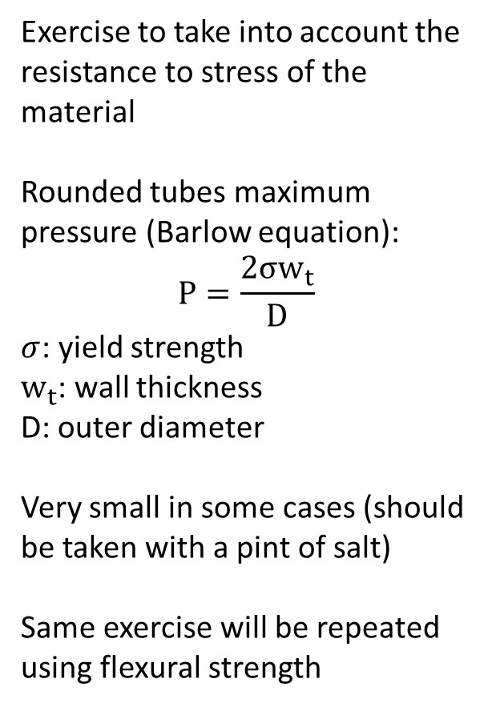
Materials considerations (Minimum wall, OD 1 mm / 200 bar)
Exercise to take into account the resistance to stress of the material
Rounded tubes maximum pressure (Barlow equation):
$$P=\frac{2σw_{t}}{D}$$
$σ$: yield strength
$w_{t}$: wall thickness
D: outer diameter
Very small in some cases (should be taken with a pint of salt)
Same exercise will be repeated using flexural strength

Slide 25
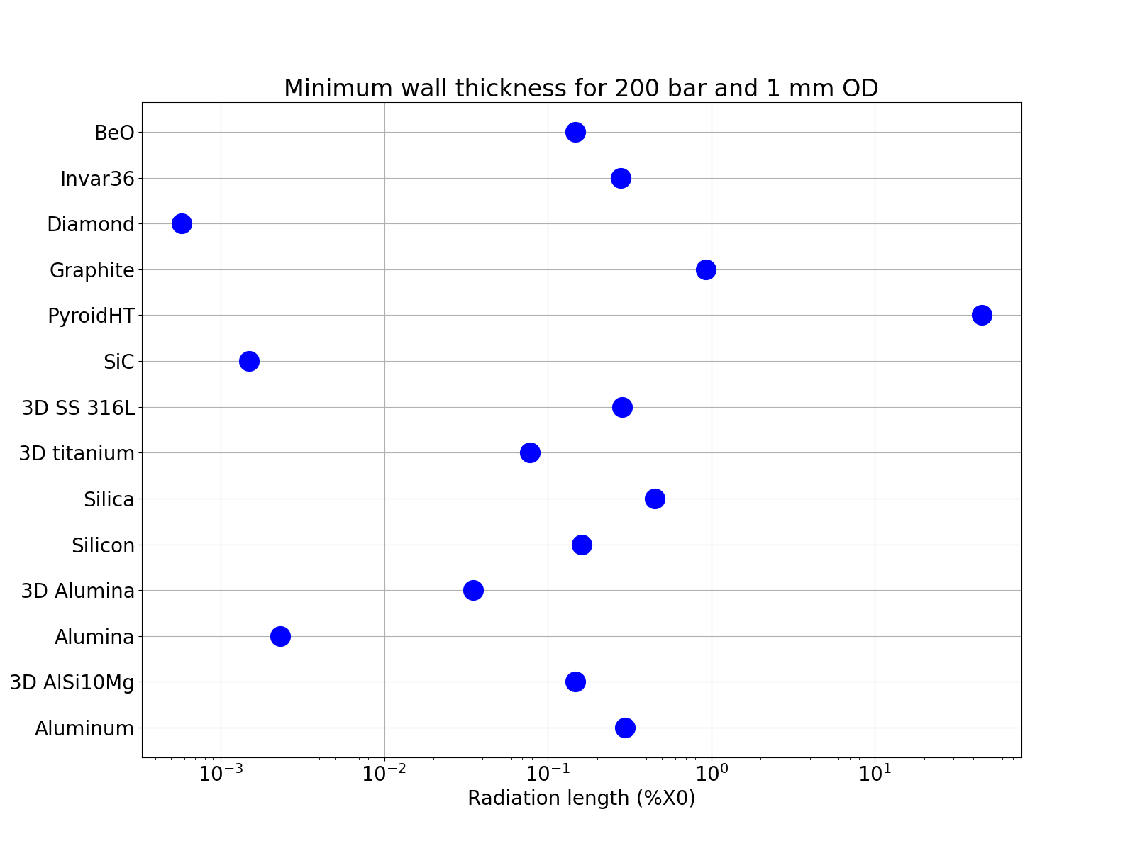
Materials considerations (Minimum wall, OD 1 mm / 200 bar)
This is just an initial exercise for the selection of materials
Indicates that diamond/ceramics would be good candidates for the substrate
Taking into account the capacity to deal with high pressure and material budget
Those number should still take into account thermal conductivity and thermal expansion mismatch
Preference for Diamond, SiC, (3D) Alumina, 3D titanium and BeO

Slide 26
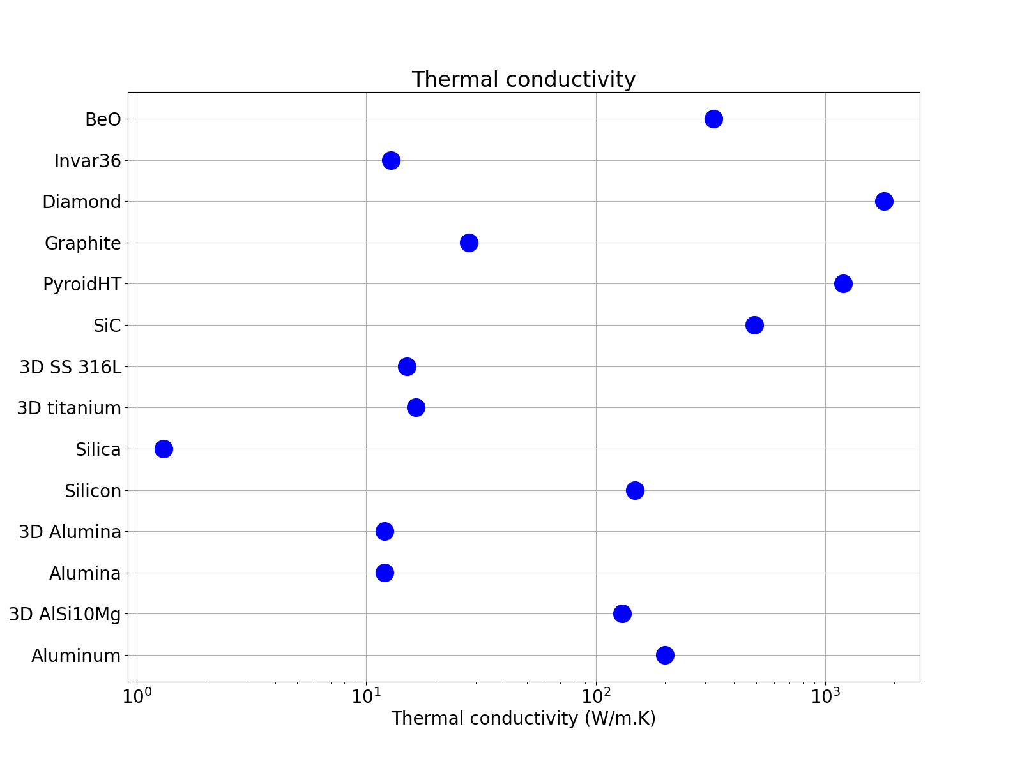

Materials considerations (Minimum wall, OD 1 mm / 200 bar)
Kapton
Preference for BeO, Diamond, Graphite, PyroidHT, SiC, Aluminum, Si and 3D AlSi10Mg based on thermal conductivity
To be as inclusive as possible, all possibilities below Kapton thermal expansion or below 10ppm/K (?)

Slide 27
Materials considerations
Material budget
Thermal conductivity
3D AlSi10Mg
Diamond
Si
Graphite/
Pyroid HT
BeO
SiC
3D
titanium
(3D) Alumina
Invar36
Thermal expansion

Slide 28

Metal 3D printing
Sensor tile
Collaboration with the Royce Institute (UK) based on Selective Laser Melting
Revisit the plan-Z alternative and try to further reduce the material budget contribution
  Main motivation: design flexibility and replaceability/price
Three prototypes manufactured with different wall thicknesses (250 um, 150um and 100um)
  To be tested for high pressure, leak tightness, …
  A quarter of a module approach (sensor, hybrid and GBTx region)
Hybrid
GBTx

Slide 29

Metal 3D printing (FEA)
Ti cooling tubes: with 250 um wall thickness
Two cooling tubes under the silicon tile (similar to U1)
  Silicon tile (400 um thick)
  12 W (2x higher than U1)
Hottest region of the tile $\sim {25}^{∘}C$
  About 3x higher than the plan-Z U1 measurements (around 8C)
On the same model, TPG or graphene layer (1200 W/m.K) was considered to remove the heat of the GBTx
  GBTx on top of Kapton/stycast layer (600um total, 1.25W/m.K)
  Simulated as silicon 0.5x0.5cm and 5W
  High $ΔT \sim {90}^{∘}C$
Silicon tile
GBTx
Kapton/Stycast
TPG/PyroidHT

Slide 30

3D metal printing + Pyroid HT (Very preliminary FEA)
Soldered interface
(NanoFoil?)

Slide 31

VELO U1 (TDR stage)
VELO Upgrade I TDR
Production of cooling/fluidic prototypes
Robustness tests
Cooling performance
Cooling performance

Slide 32

VELO Module/Cooling concepts (CERN)
Jan Buytaert (CERN)

Slide 33

VELO Module/Cooling concepts (Oxford)
Malcolm and Adam (Oxford)

Slide 34

Simplified FEA

Slide 35

VELO Module/Cooling concepts (NIKHEF)
Kazu/Yutaro presentation

Slide 36

VELO Module/Cooling concepts (NIKHEF)
Kazu/Yutaro presentation

Slide 37

VELO Module/Cooling concepts (CERN)
Jan Buytaert (CERN)

Slide 38

VELO Module/Cooling concepts (CERN)
Jan Buytaert (CERN)

Slide 39

VELO Module/Cooling concepts (Oxford)
Malcolm and Adam (Oxford)

Slide 40

VELO Module/Cooling concepts (NIKHEF)
Kazu/Yutaro presentation

