Slide 1

RICH simulation for Upgrade 2
LHCb-UK meeting
S.Easo
09-07-2024

Slide 2
Introduction
For the RICH system in Upgrade 2, many options are being considered
These are categorized in the scoping document
These may evolve as more information regarding photon detectors and other components, comes to light.
In principle, the programs can be tailored for simulating each of these options in detail.
However, it may not be practical to proliferate the number of options to pursue.
The RUN5 simulations are based on the software developed for RUN3 in recent years.
This presentation:
Description of the simulation framework to study the various options
Results in terms of resolutions and yields, from some of the options
Caveats: Issues that beset the simulation studies
Plans

Slide 3
Overview of software used
For simulating the RICH system in Upgrade 2 :
‘Detector’ package for creating detector descriptions
‘Gaussino + Gauss’ for detector simulations
Developing digitization software
Starting to set up the reconstruction sequence to process the simulated data
All done within the DD4HEP framework.
All the software developed for RICH in
RUN5 so far, are available in various MR.
In parallel to these :
Different optical configurations for the RICH system are starting to be explored
The usage GPUs is being planned for RUN5
Software for RICH in RUN4 is being developed. Some of these would be useful for RUN5 also
Not covered today
Example: usage of Opticks + OptiX for simulations

Slide 4
Detector configurations
The ‘Detector’ package enables to maintain multiple geometry versions in the same branch.
For the RICH, for now, three labels are created as the versions for RUN5, along with the corresponding folders.
(This is in addition to the three that is created for RUN3).
(a) Rich_Run5_v3: SiPM + geometry update , for now.
This presentation: Optics update for RICH1 as described in the FTDR.
(b) Rich_Run5_v4: SiPM and nominal Run3 geometry as indicated in the FTDR, for now.
(c) Rich_Run5_v5 : Facilitate RICH + TORCH studies.
TORCH envelope and master volumes created inside RICH2
Known ‘unknowns’:
Hardware structure to install photon detector assemblies in the RICH for Upgrade 2
For now, using the same structure as that in RUN3: with PDM , ECR and ECH etc.
For now, each ‘MaPMT’ volume is repurposed to use as SiPM
For configuring 1 mm pixel size :
Use 25 X 25 pixels in ‘R-type MaPMT’ and 50X50 pixels in ‘H-type MaPMT’.

Slide 5
Detector configurations
Large magnetic shielding structure in RICH1 :
For now, removed in ‘Rich_Run5_v3’, to study potential increases in Mirror ROC
Properties of detector components :
Minor changes in the inputs in recent years for RICH1, after the FTDR studies.
In mirror reflectivities, properties of quartz, optics etc.
Photon detectors:
Started with SiPM, as this was used for the FTDR studies.
Usage of MCPs : Presentation today, from Lais
PDE for SiPM:
Many tables were received (from Rok. et.al.) based on developments at FBK
For now, plan to use a ‘nominal table’

Slide 6
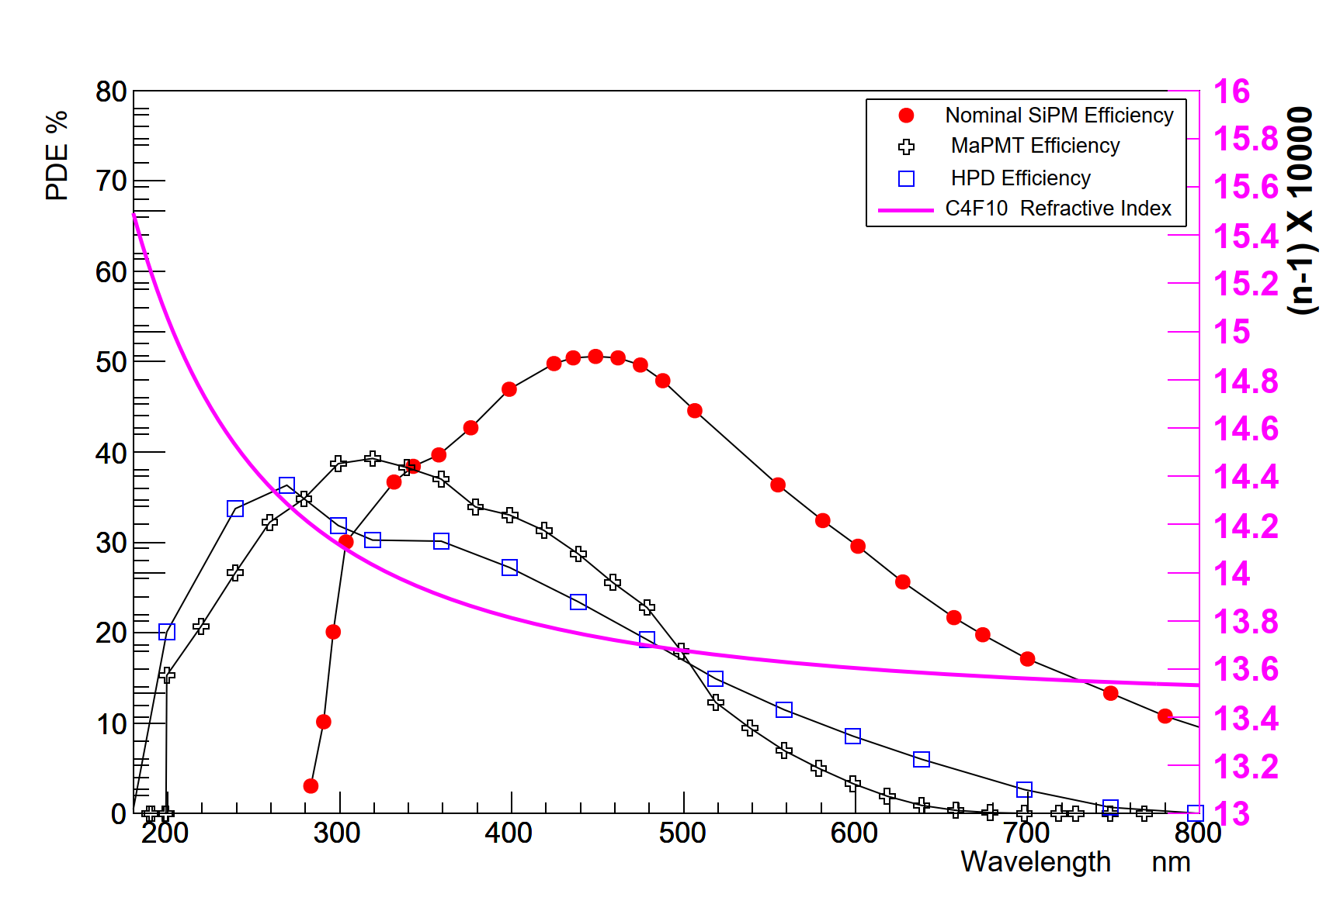
Photon detector : SiPM
SiPM configurations:
For now, using 1 mm pixel size everywhere
Wavelength cuts, used so far :
micro-lensing planned for the future
Other pixel sizes are planned to be configured
400 nm, 300 nm and 180 nm
The 180 nm cut, corresponds to having ‘no cut’
No cut applied for MaPMT configurations.
Red Curve : ‘Nominal SiPM’ : This is used as a ‘baseline’, for now.

Slide 7
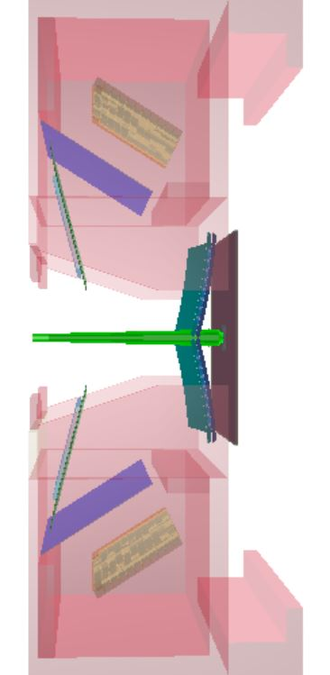
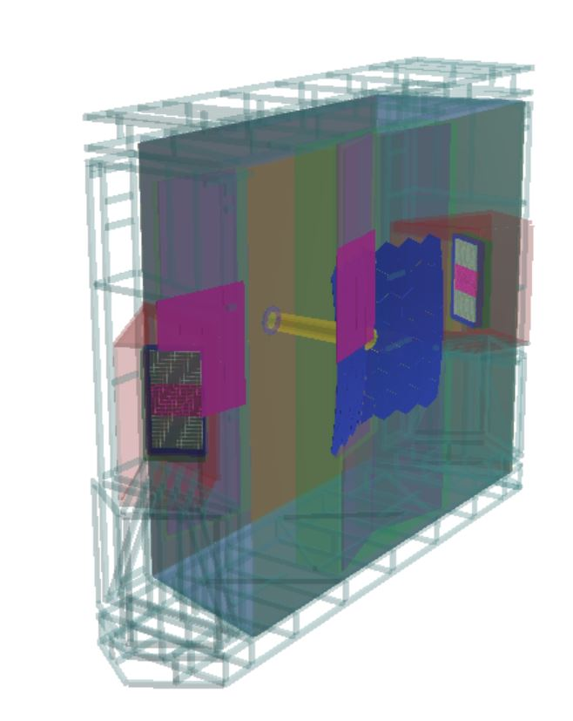
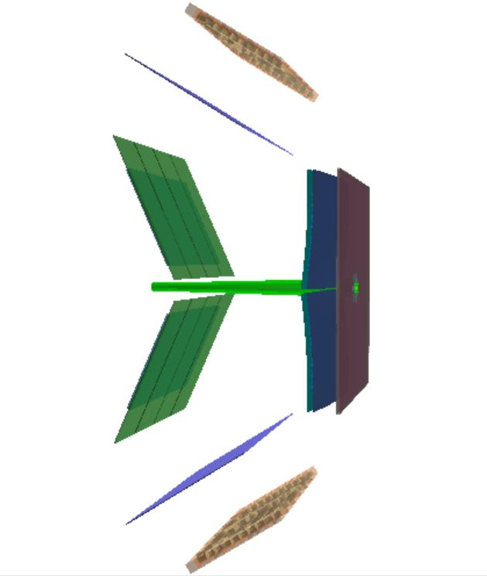
RICH pictures : DD4HEP
RICH2: Nominal RUN3 optics
used for RUN5 studies
RICH1: Upgraded RICH1 optics as in the FTDR
( Rich_Run5_v3 )
RICH1 : Nominal RUN3 optics
used for RUN5 studies (Rich_Run5_v4)

Slide 8
Simulation configuration
For the RICH system, using the detector configurations listed in the previous pages.
For all other LHCb detectors, the ‘full RUN5-setup’ was not available in master branches.
Hence using the ‘ default RUN3’ configuration.
Gauss and Gaussino:
RICH system is used with the latest available versions of :
VP, UT, FT, Ecal and Hcal
Using default values for gas pressure, temperature etc. (Gauss was not using the full ‘conditions database’ features ).
Usage of SiPM with large number of channels and the introduction of TDC for RICH, requires a 64-bit channel ID
This new feature is planned to be implemented.
The full simulation of the readout in Boole requires simulated data with spill-over. This is not yet supported in Gaussino.
RICH in RUN3 vs RUN5 :
Today: Resolutions and yields using particle gun events in the best regions of the RICH system.
Hit distributions from running PYTHIA minimum bias events in nominal RUN3 beam setup.
RUN3 simulations based on DD4HEP, kept ‘stable’ in a package named GaussPhotonics
New features needed for RUN5 introduced in a package named GaussOptix

Slide 9
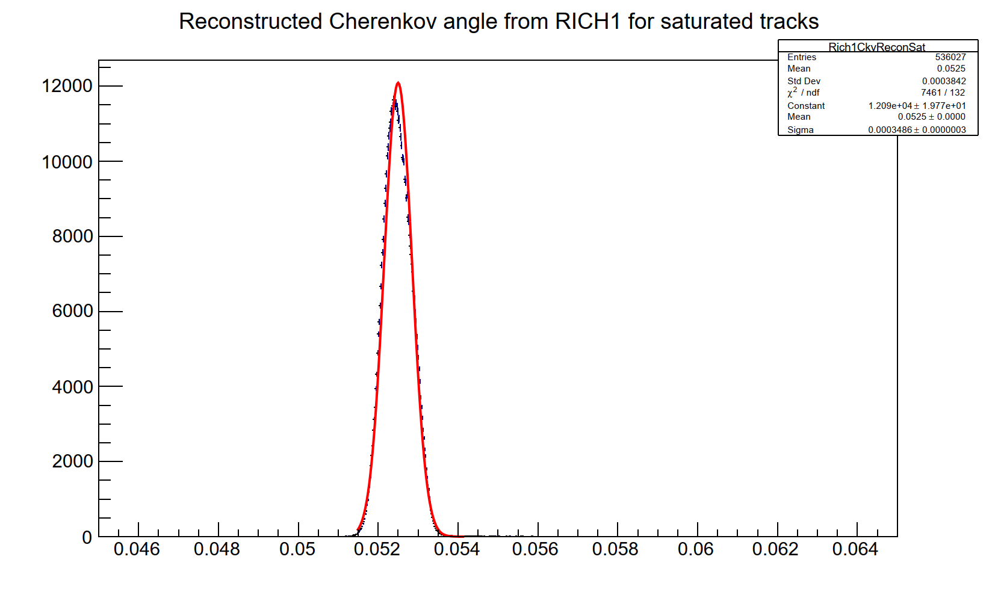
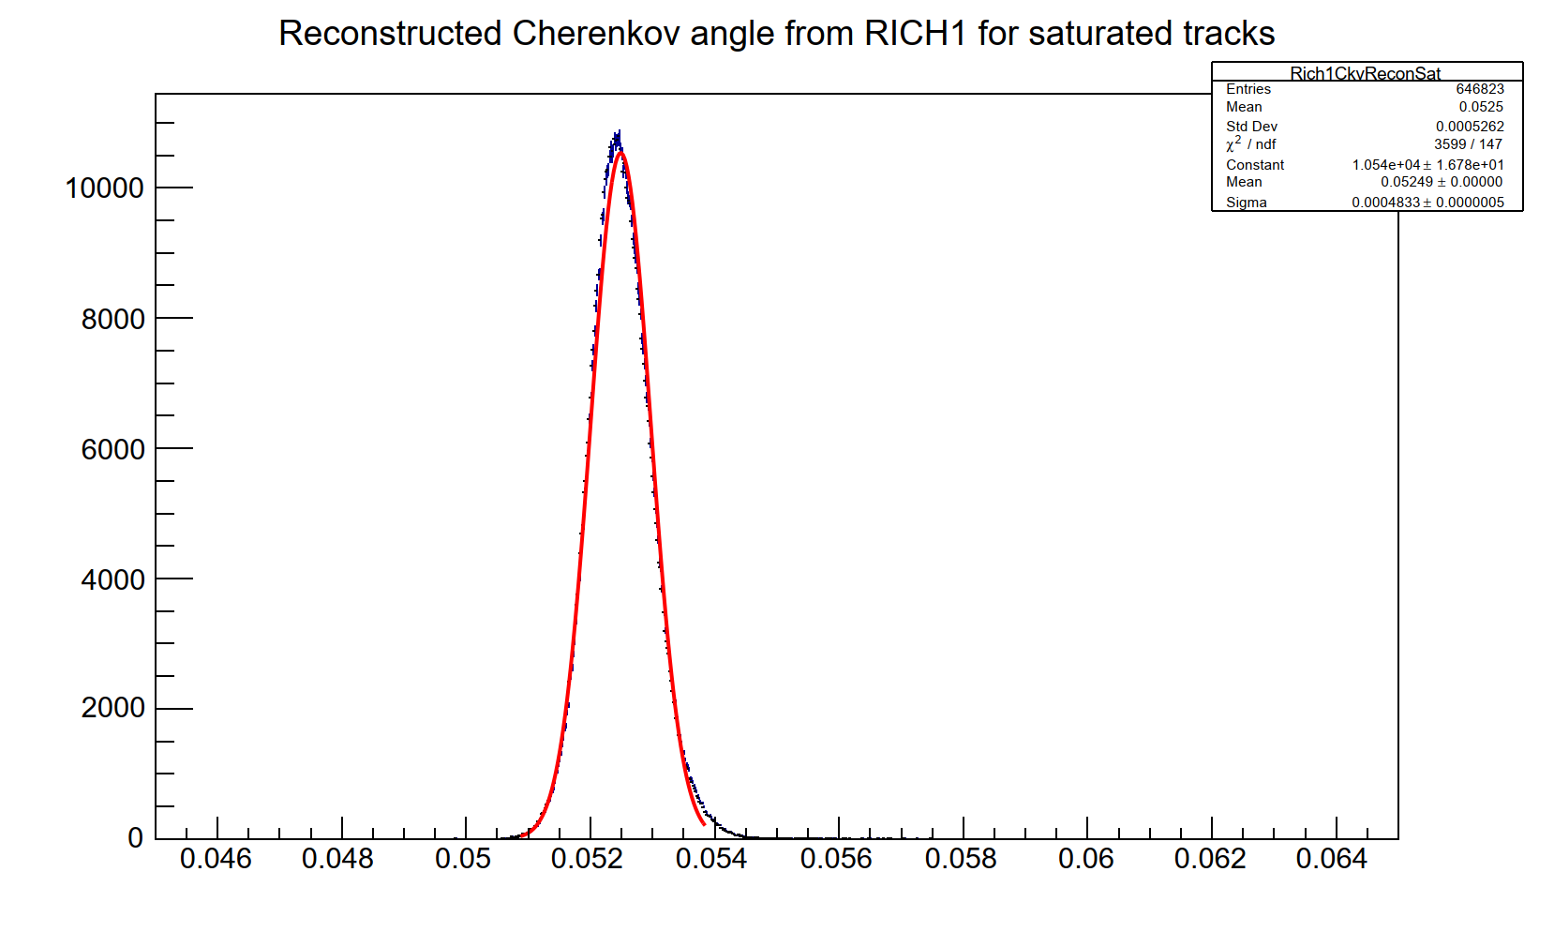
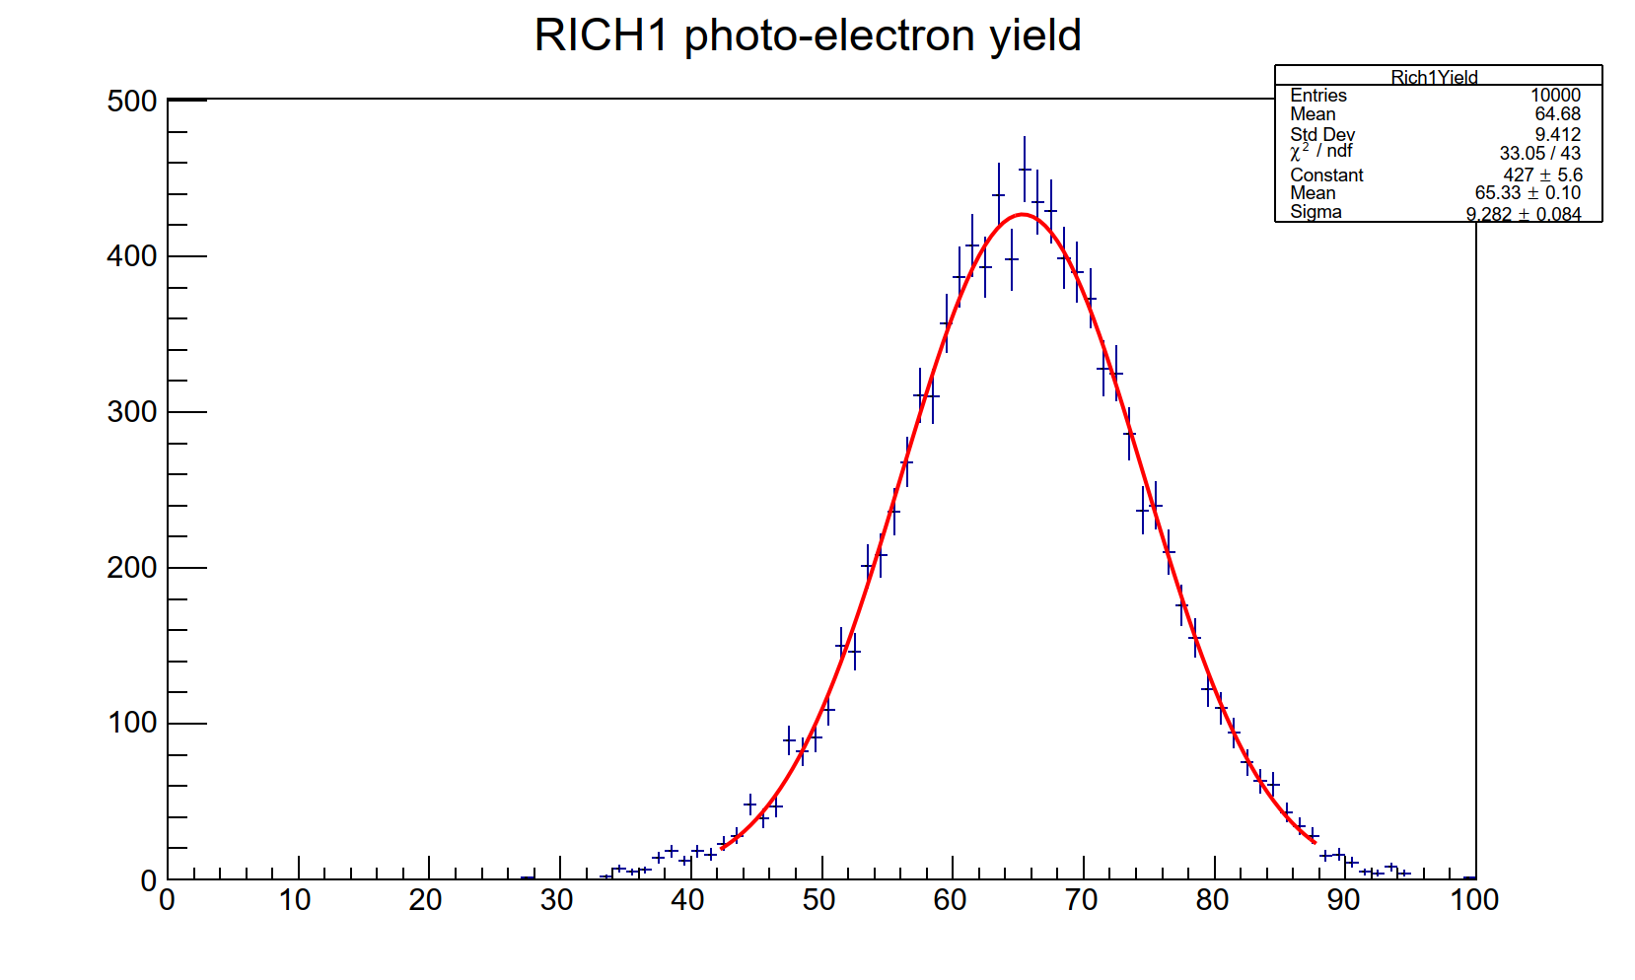
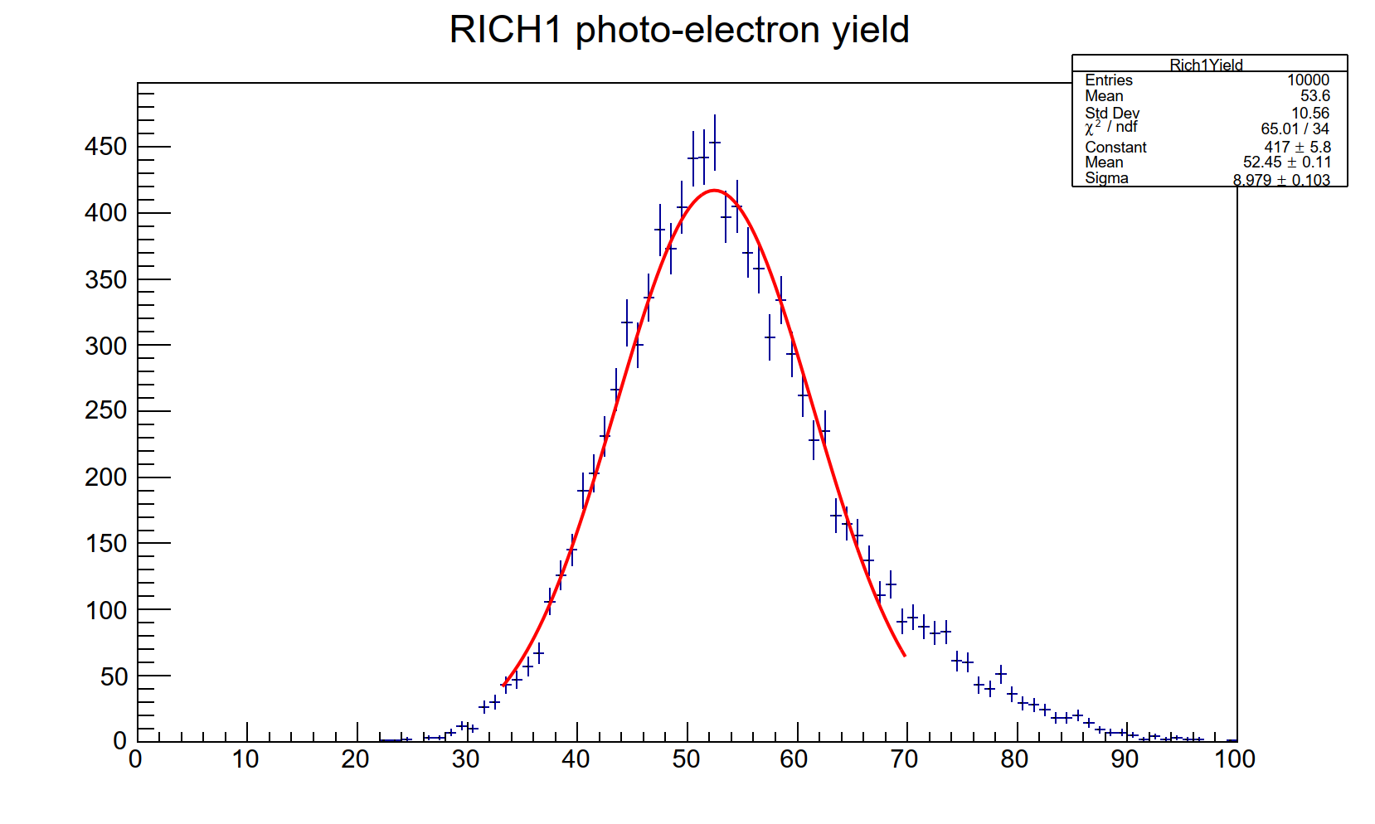
RICH1 : resolutions and yields with SiPM
RICH1: Overall
Width=0.35 mrad
RICH1: Overall
Width=0.48 mrad
rad
rad
RICH1: Yield
Mean=65
RICH1: Yield
Mean=52
Nominal SiPM, 300 nm wavelength cut-off,
Nominal Run3 geometry
Nominal SiPM, 300 nm wavelength cut-off,
Upgraded RICH1 geometry as in FTDR
Simulated data reconstructed at the end of Gauss

Slide 10
RICH1 Resolutions : Summary
RICH1 SiPM Nominal PDE 400 nm cut in photon wavelelngth | Overall mrad | Chromatic mrad | Emis.Pt mrad | Pixel mrad | Yield
Nominal RUN3 geometry | 0.39 | 0.11 | 0.37 | 0.16 | 33
Upgraded Optics (FTDR) | 0.24 | 0.11 | 0.13 | 0.16 | 27
RICH1 SiPM Nominal PDE 300 nm cut in photon wavelength | Overall mrad | Chromatic mrad | Emis.Pt mrad | Pixel mrad | Yield
Nominal RUN3 geometry | 0.48 | 0.28 | 0.37 | 0.17 | 65
Upgraded Optics (FTDR) | 0.35 | 0.28 | 0.13 | 0.16 | 52
RICH1 SiPM Nominal PDE No cut in photon wavelength | Overall mrad | Chromatic mrad | Emis.Pt mrad | Pixel mrad | Yield
Nominal RUN3 geometry | 0.50 | 0.36 | 0.37 | 0.17 | 70
Upgraded Optics (FTDR) | 0.41 | 0.38 | 0.13 | 0.16 | 57

Slide 11
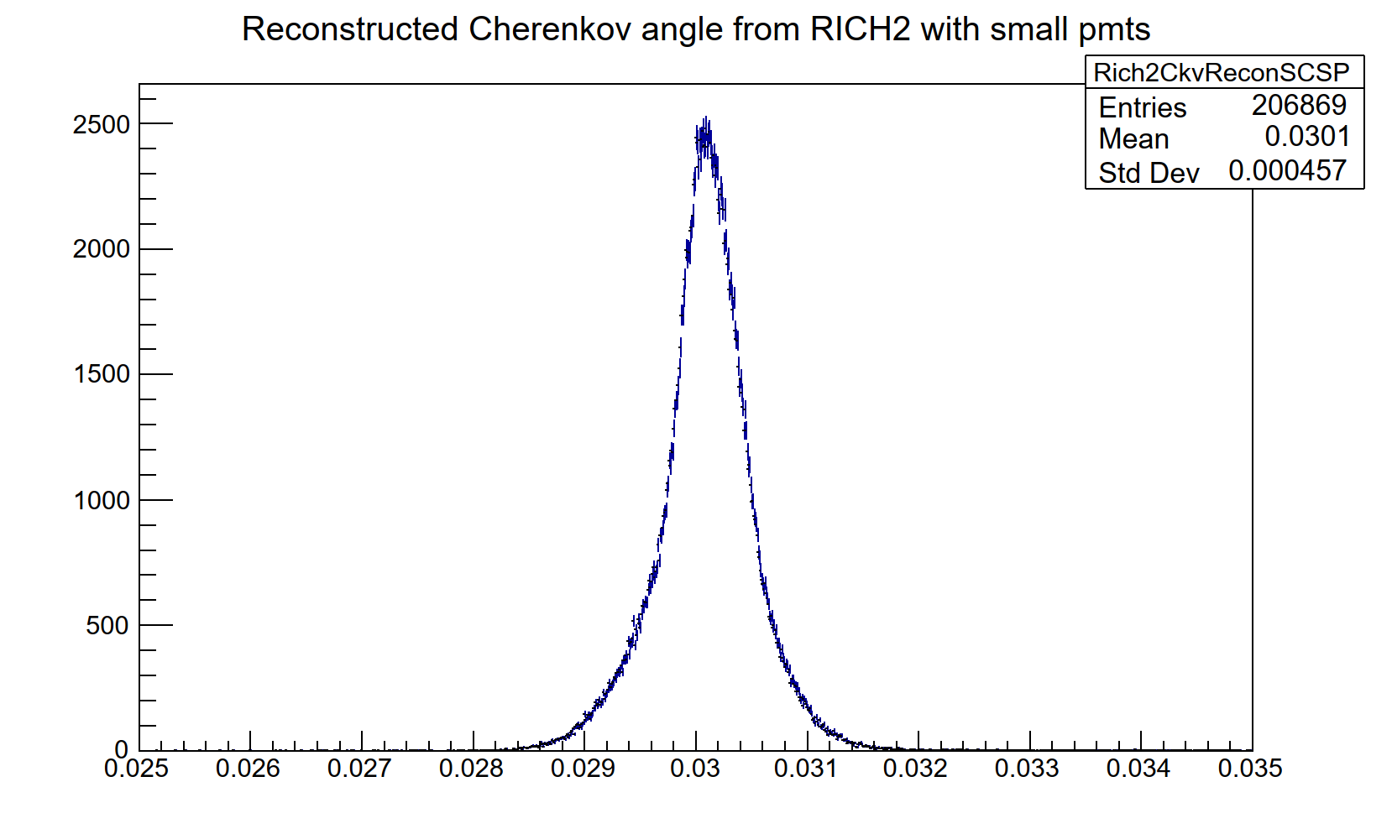
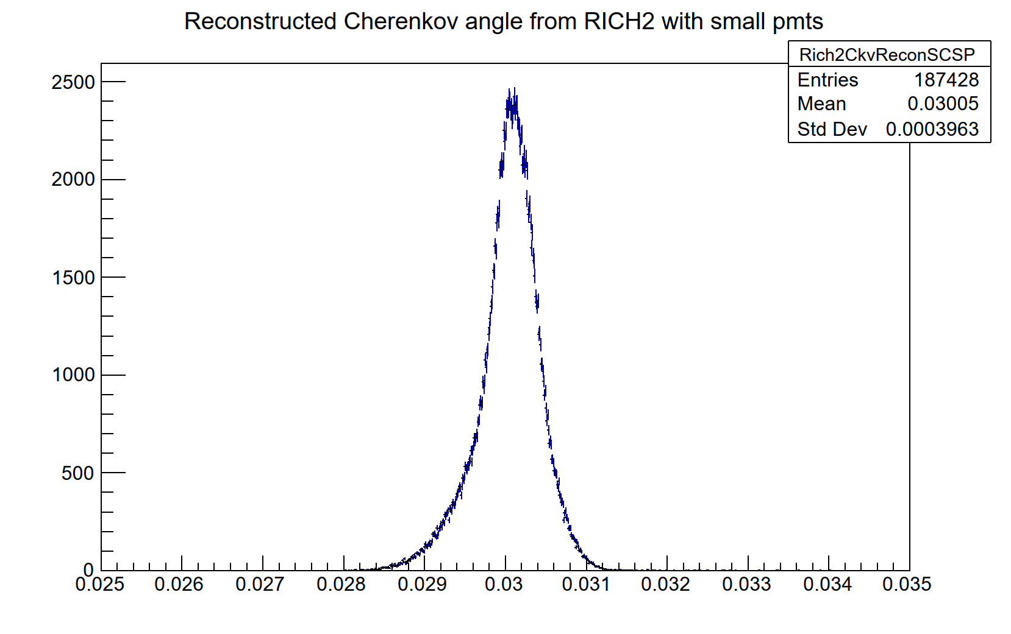
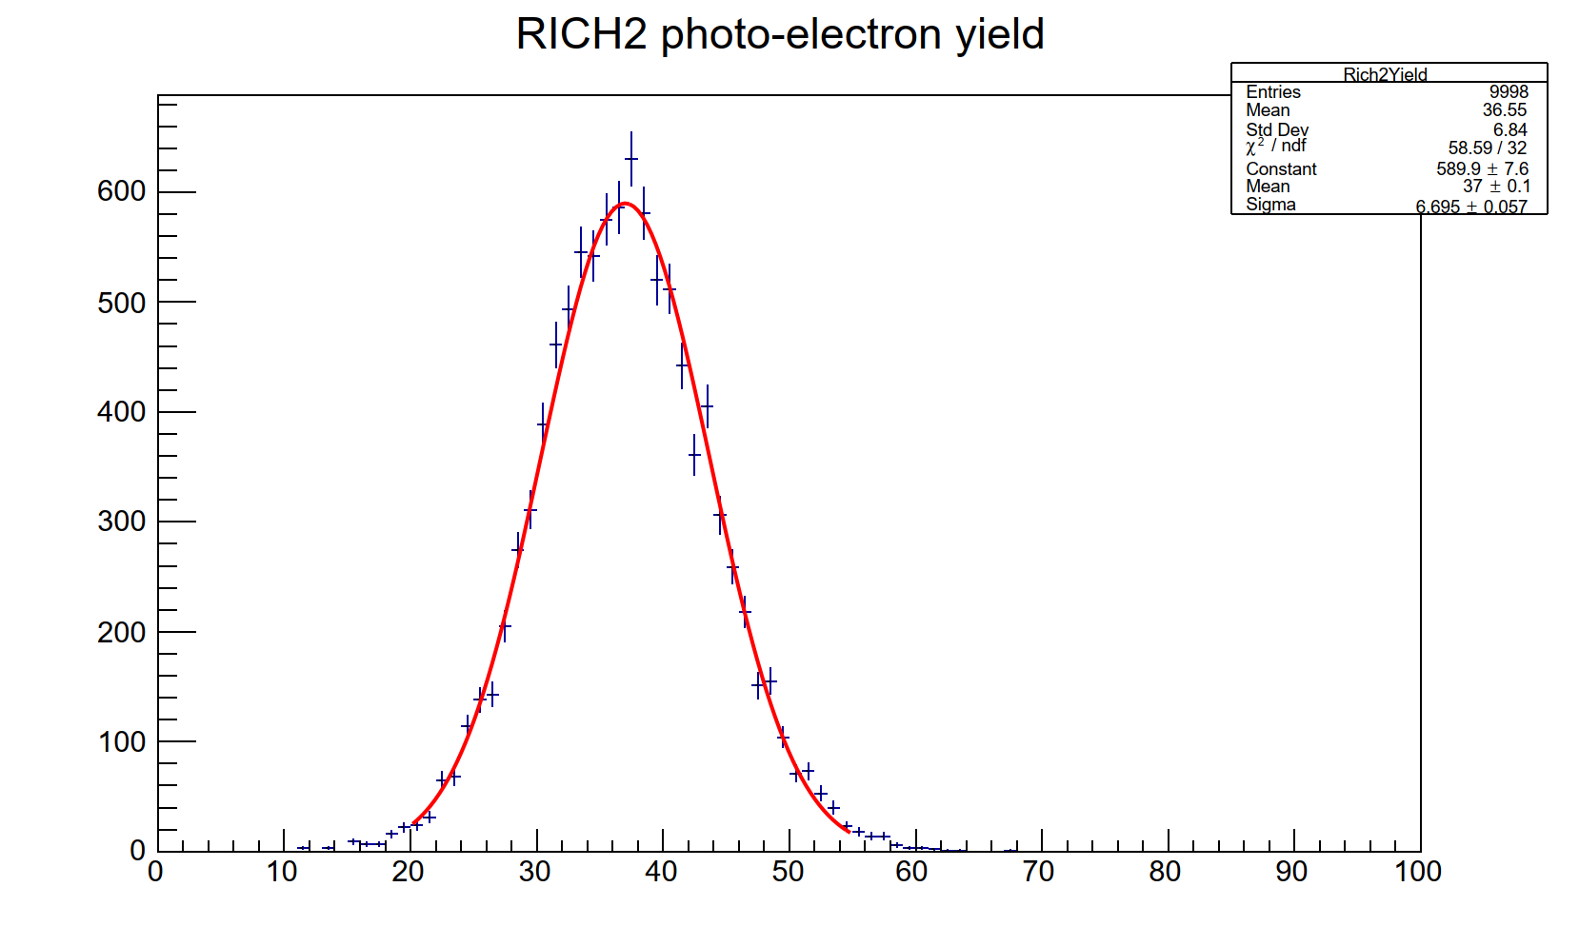
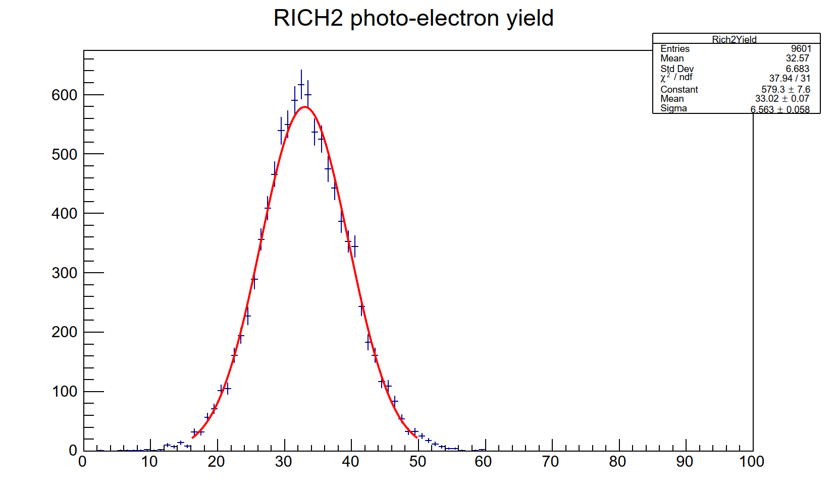
RICH2 : resolutions and yields with SiPM
RICH2: Overall
Width=0.46 mrad
RICH2: Overall
Width=0.40 mrad
rad
rad
RICH2: Yield
Mean=37
RICH2: Yield
Mean=33
Nominal SiPM, No wavelength cut-off
RICH2: RUN3 nominal geometry
All plots with 1 mm pixel size
Nominal SiPM, 300 nm wavelength cut-off
RICH2: RUN3 nominal geometry

Slide 12
RICH2 Resolutions : Summary
RICH2 Nominal RUN3 geometry SiPM : Nominal PDE | Overall mrad | Chromatic mrad | Emis.Pt mrad | Pixel mrad | Yield
400 nm cut in photon wavelength | 0.38 | 0.09 | 0.35 | 0.07 | 16
300 nm cut in photon wavelength | 0.40 | 0.19 | 0.36 | 0.07 | 33
No cut in photon wavelength | 0.46 | 0.29 | 0.36 | 0.07 | 37
Similar results for RICH1 and RICH2 in the RUN3 configuration, are listed in backup pages

Slide 13
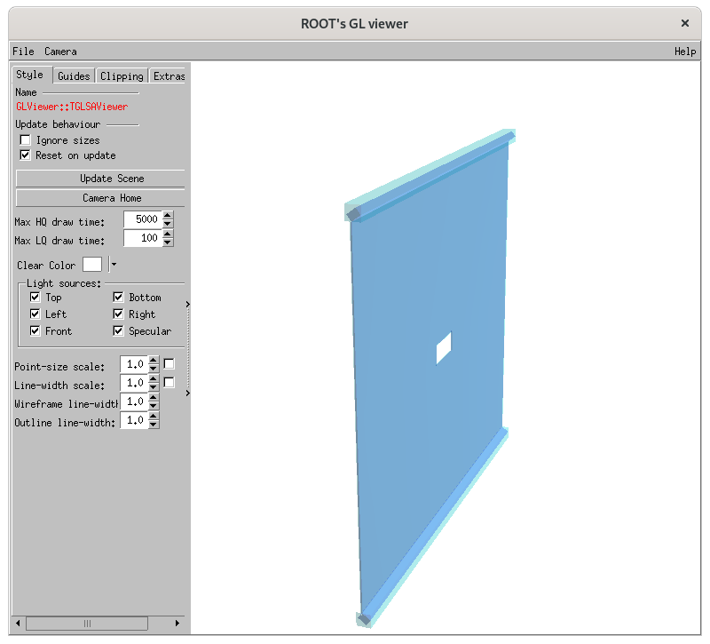
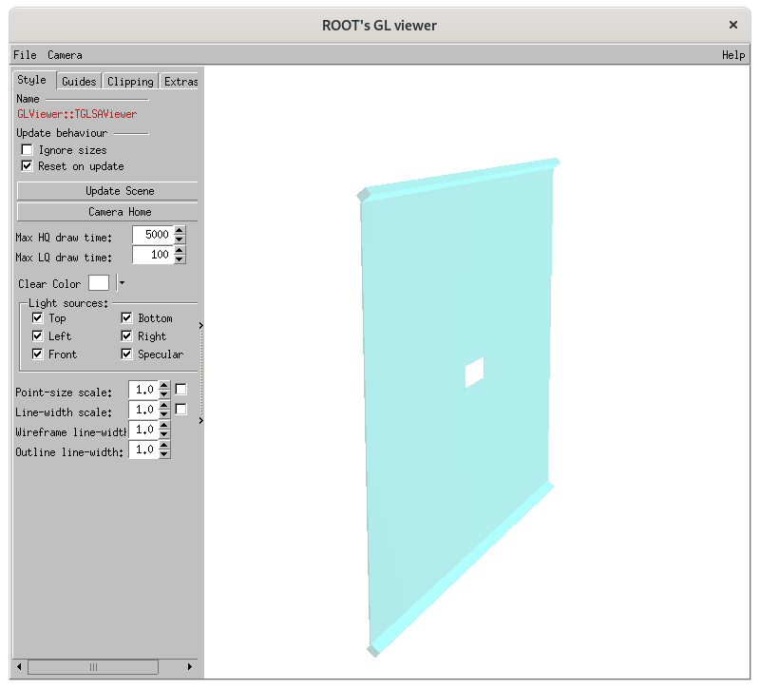
TORCH Support
The dimensions and shape of the TORCH master volume, were provided by Michal Kreps.
This contains the quartz plate region and the focusing blocks.
The TORCH envelope was created based on this information
‘TORCH master’ volume
‘TORCH master’ inside the ‘TORCH envelope’

Slide 14
TORCH inside RICH2
In order to get the space for the TORCH, many structures inside the RICH2 were sliced off.
Upstream end of the RICH2 gas volume
The envelopes of the gas enclosure at the two lateral sides.
The ‘beam tube lock’ at the upstream end was removed.
The RICH2 entrance window was cut the top and bottom to get space for the TORCH focusing block.
The upstream edge of the ‘flat mirror support’ was also sliced off.
The RICH2 optics was kept unchanged.
More pictures in backup pages
For now, TORCH envelope and master volumes are made of ‘air’.
Hence very little effect from material budget, for now.

Slide 15
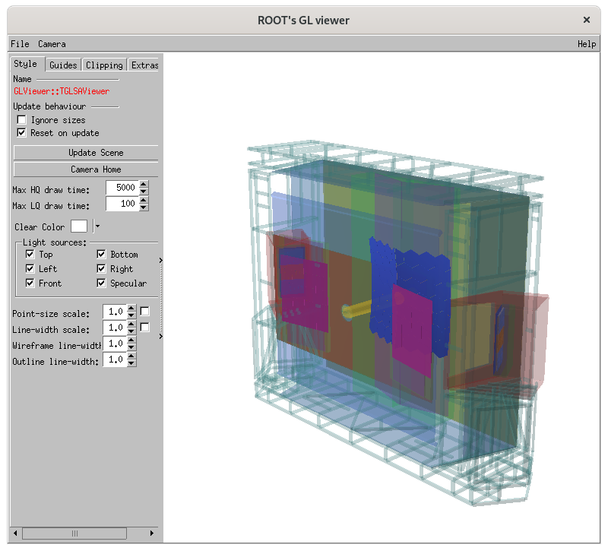
RICH2 with
TORCH envelope
Rich_Run5_v5 version

Slide 16
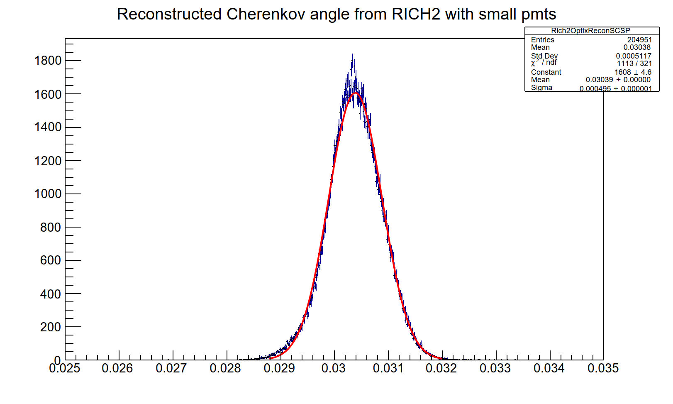
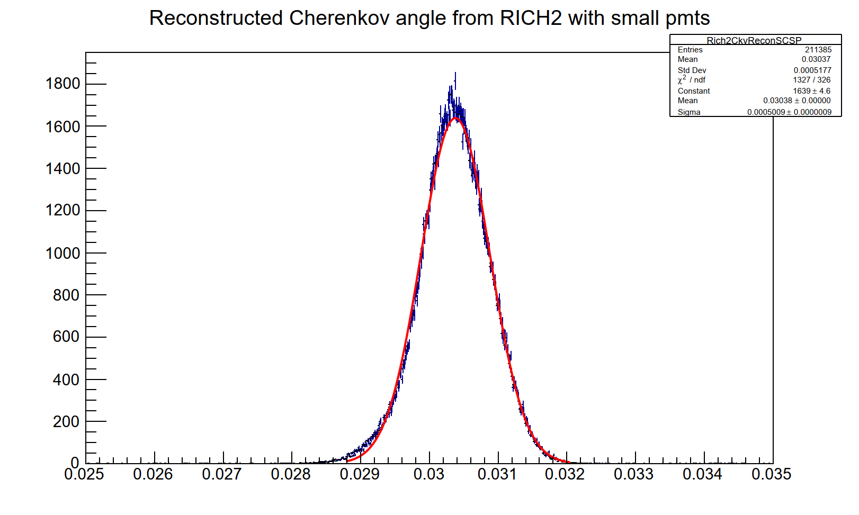
RICH2 resolutions : TORCH envelope
Overall
Overall
Width=0.50 mrad
Width=0.50 mrad
rad
rad
RICH: Rich_Run5_v5 :
RICH2 with TORCH envelope
RICH: trunk :
RICH2 in RUN3 configuration
Negligible effect on RICH2 overall resolution, from inserting the TORCH envelope.
All plots created using particle Gun with 80 GeV/c muons in the good acceptance region.

Slide 17
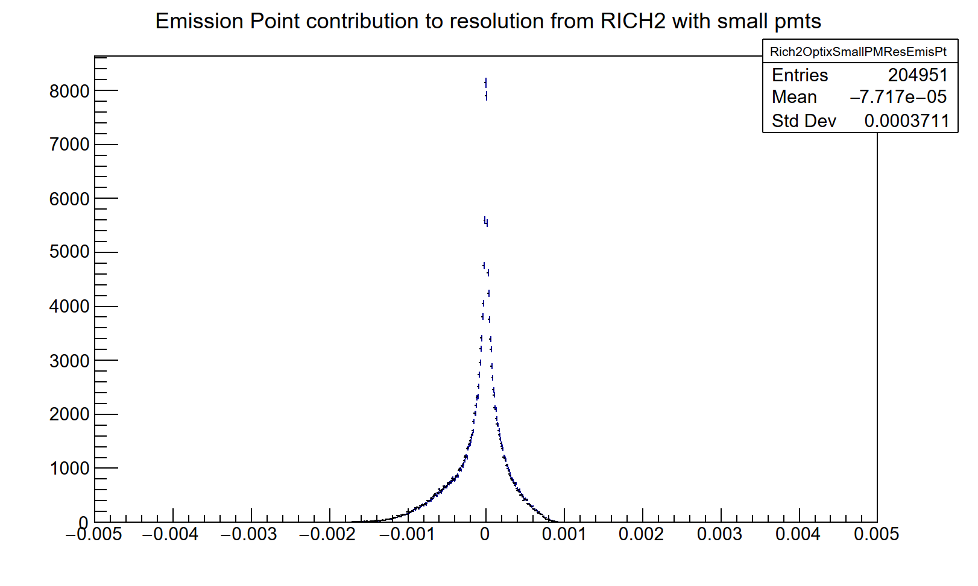
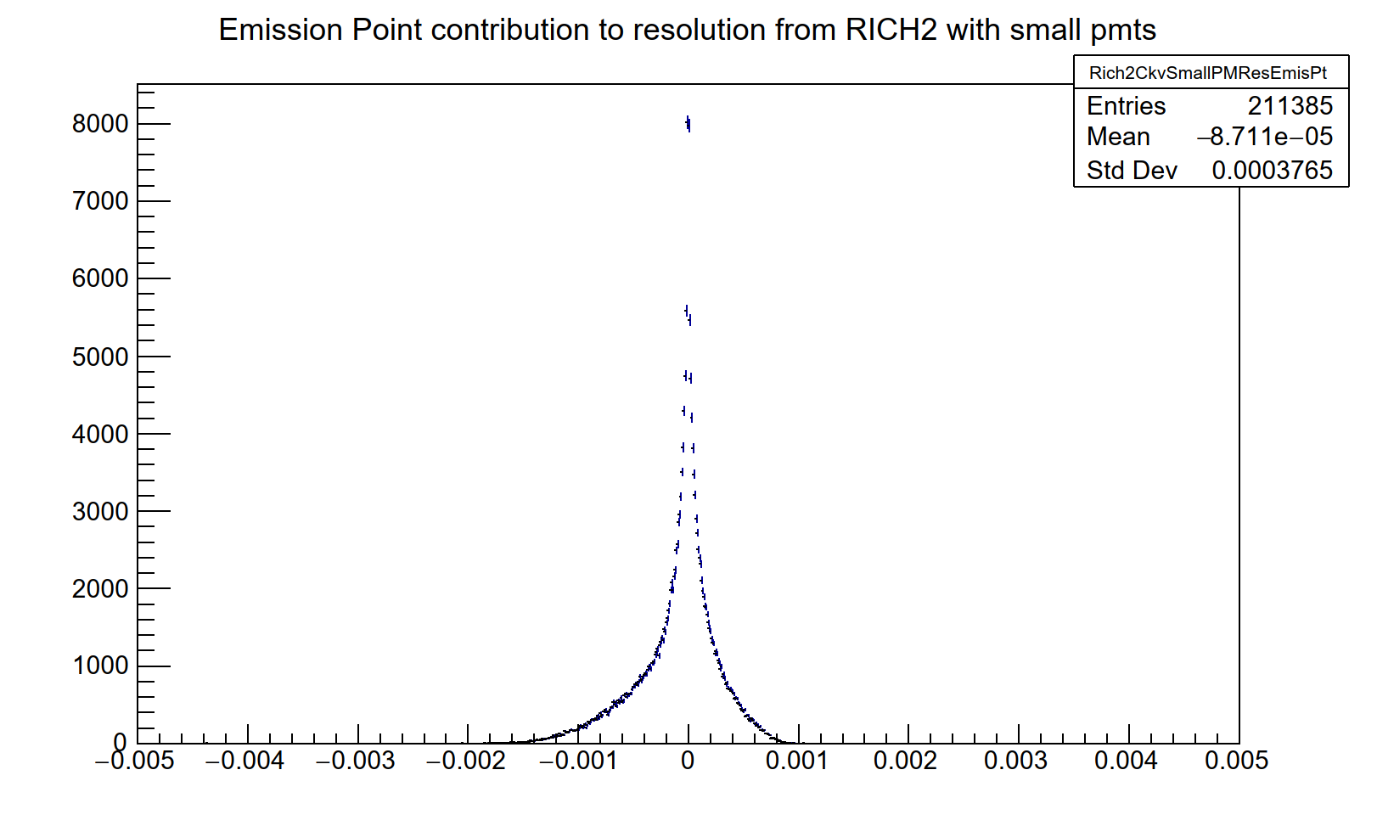
RICH2 resolutions : TORCH envelope
Emiss. Pt.
Emiss. Pt.
Width=0.38 mrad
Width=0.37 mrad
rad
rad
RICH: Rich_Run5_v5 :
RICH2 with TORCH envelope
Rich: trunk :
RICH2 in RUN3 configuration
Negligible effect on RICH2 emission point error, from inserting TORCH envelope.
All plots created using particle Gun with 80 GeV/c muons in the good acceptance region.

Slide 18
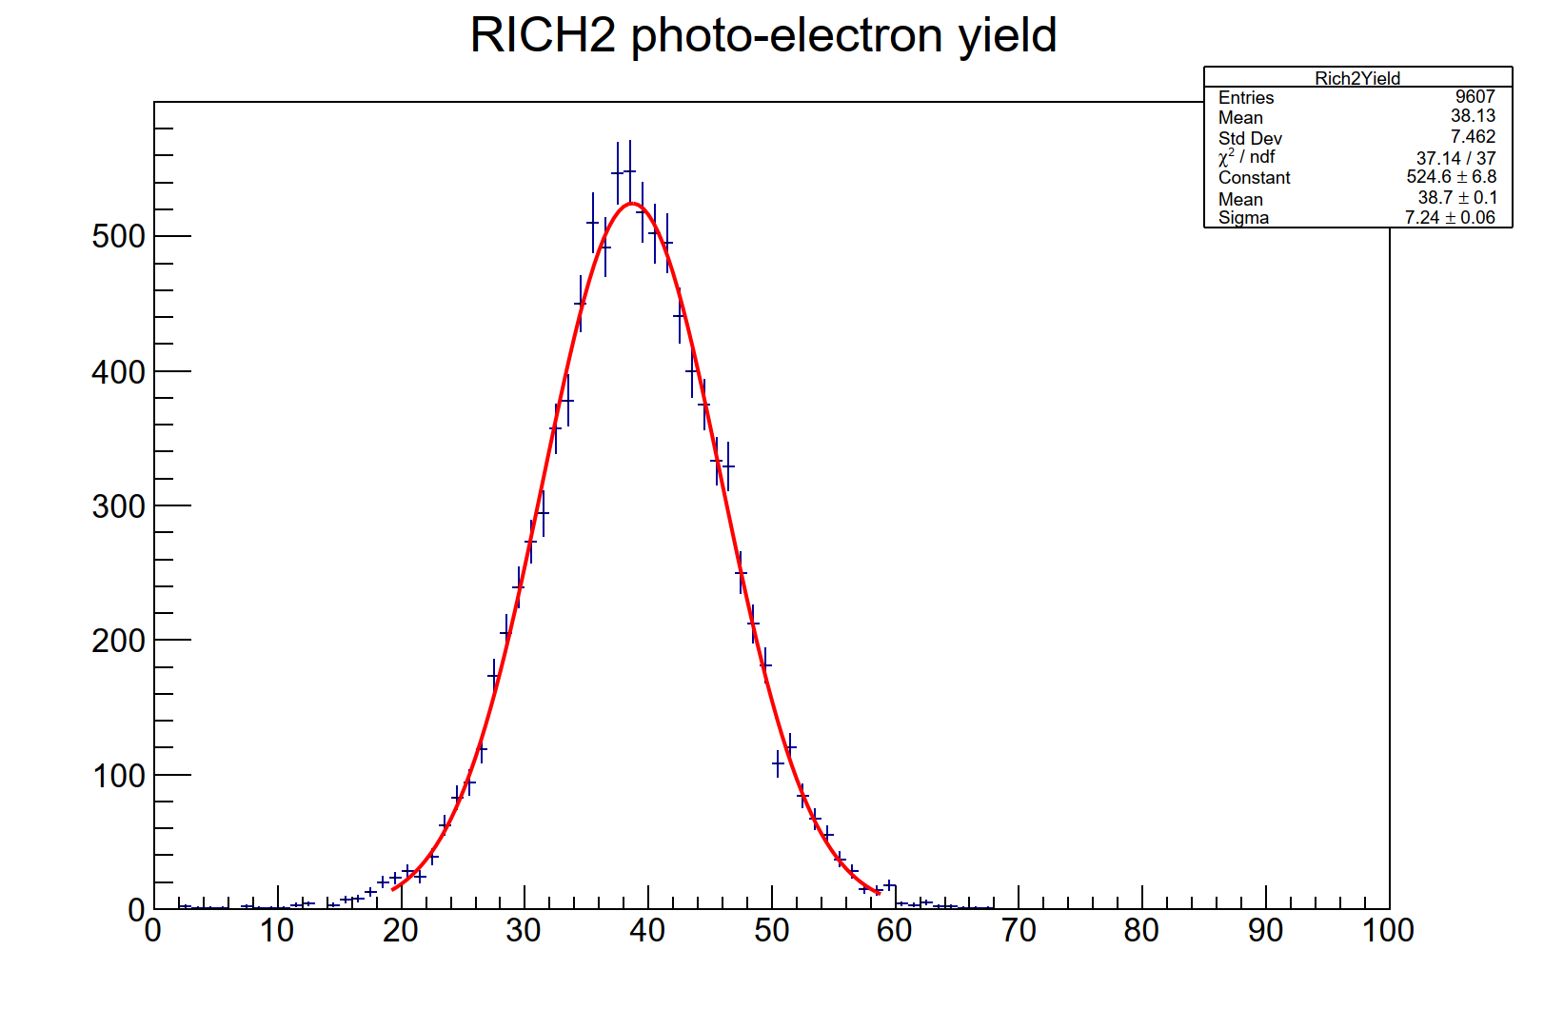
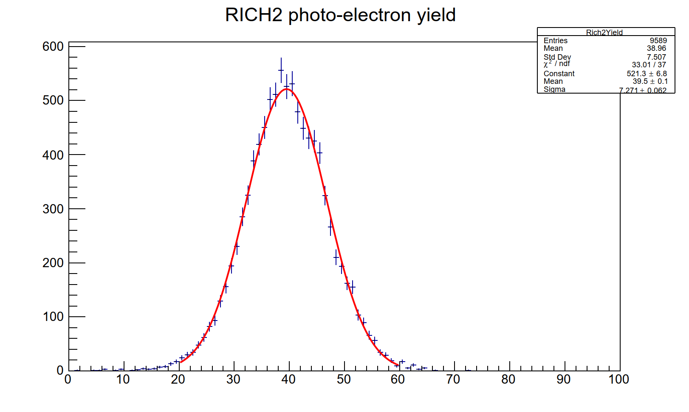
RICH2 yield : TORCH envelope
Yield
Mean=39
Yield
Mean=40
RICH: Rich_Run5_v5 :
RICH2 with TORCH envelope
Rich: trunk :
RICH2 in RUN3 configuration
Negligible effect on RICH2 yield, from inserting theTORCH envelope.

Slide 19
Summary of TORCH support
RICH2 Nominal RUN3 geometry with MaPMTs | Overall mrad | Chromatic mrad | Emis.Pt mrad | Pixel mrad | Yield
Rich_Run5_v5: With TORCH envelope | 0.50 | 0.34 | 0.37 | 0.20 | 39
Nominal RUN3 | 0.50 | 0.33 | 0.38 | 0.20 | 40
Resolutions quoted are with small MaPMTs
All these are implemented in the Rich_Run5_v5 version of the geometry.
All the necessary information to use this program is provided to the TORCH colleagues.
We wait for them to implement the internal structures of TORCH and to run the simulation program with TORCH.
Once the corresponding simulated data are created by them,
the subsequent step would be to try to run the reconstruction program using RICH+TORCH

Slide 20
RICH simulation using minimum bias events
This was done in Gauss for :
RUN3 configuration
RUN5 configuration with SiPMs
Data from the RUN3 configuration was used in the development of Boole
Boole:
RICH system is used with latest available versions of : VP, UT, FT and the Calorimeters
For now, using RICH software developed for RUN3 digitization (CLARO chip, SIN effects etc.)
In the future, we would like to simulate the features of the FastRICH chip,
that will be used for RUN4 and RUN5
For quick studies , the current framework also has the option to effectively bypass Boole simulations
Reconstruction for PID using Boole output : Work in progress

Slide 21
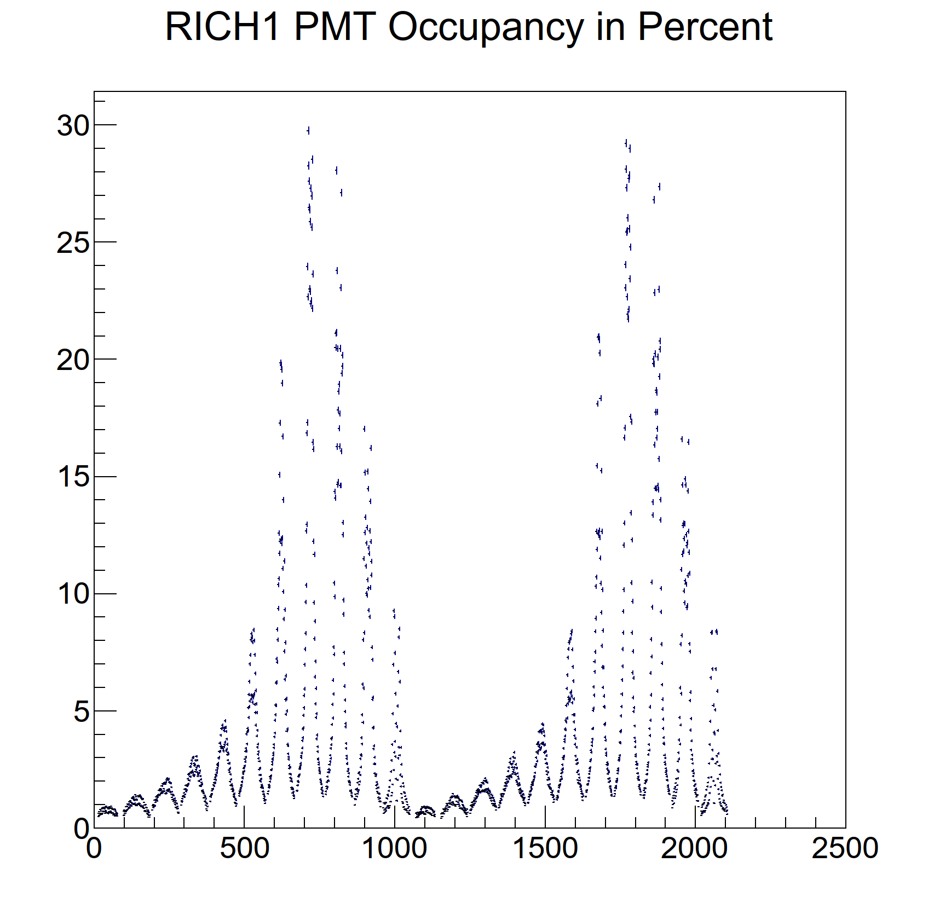
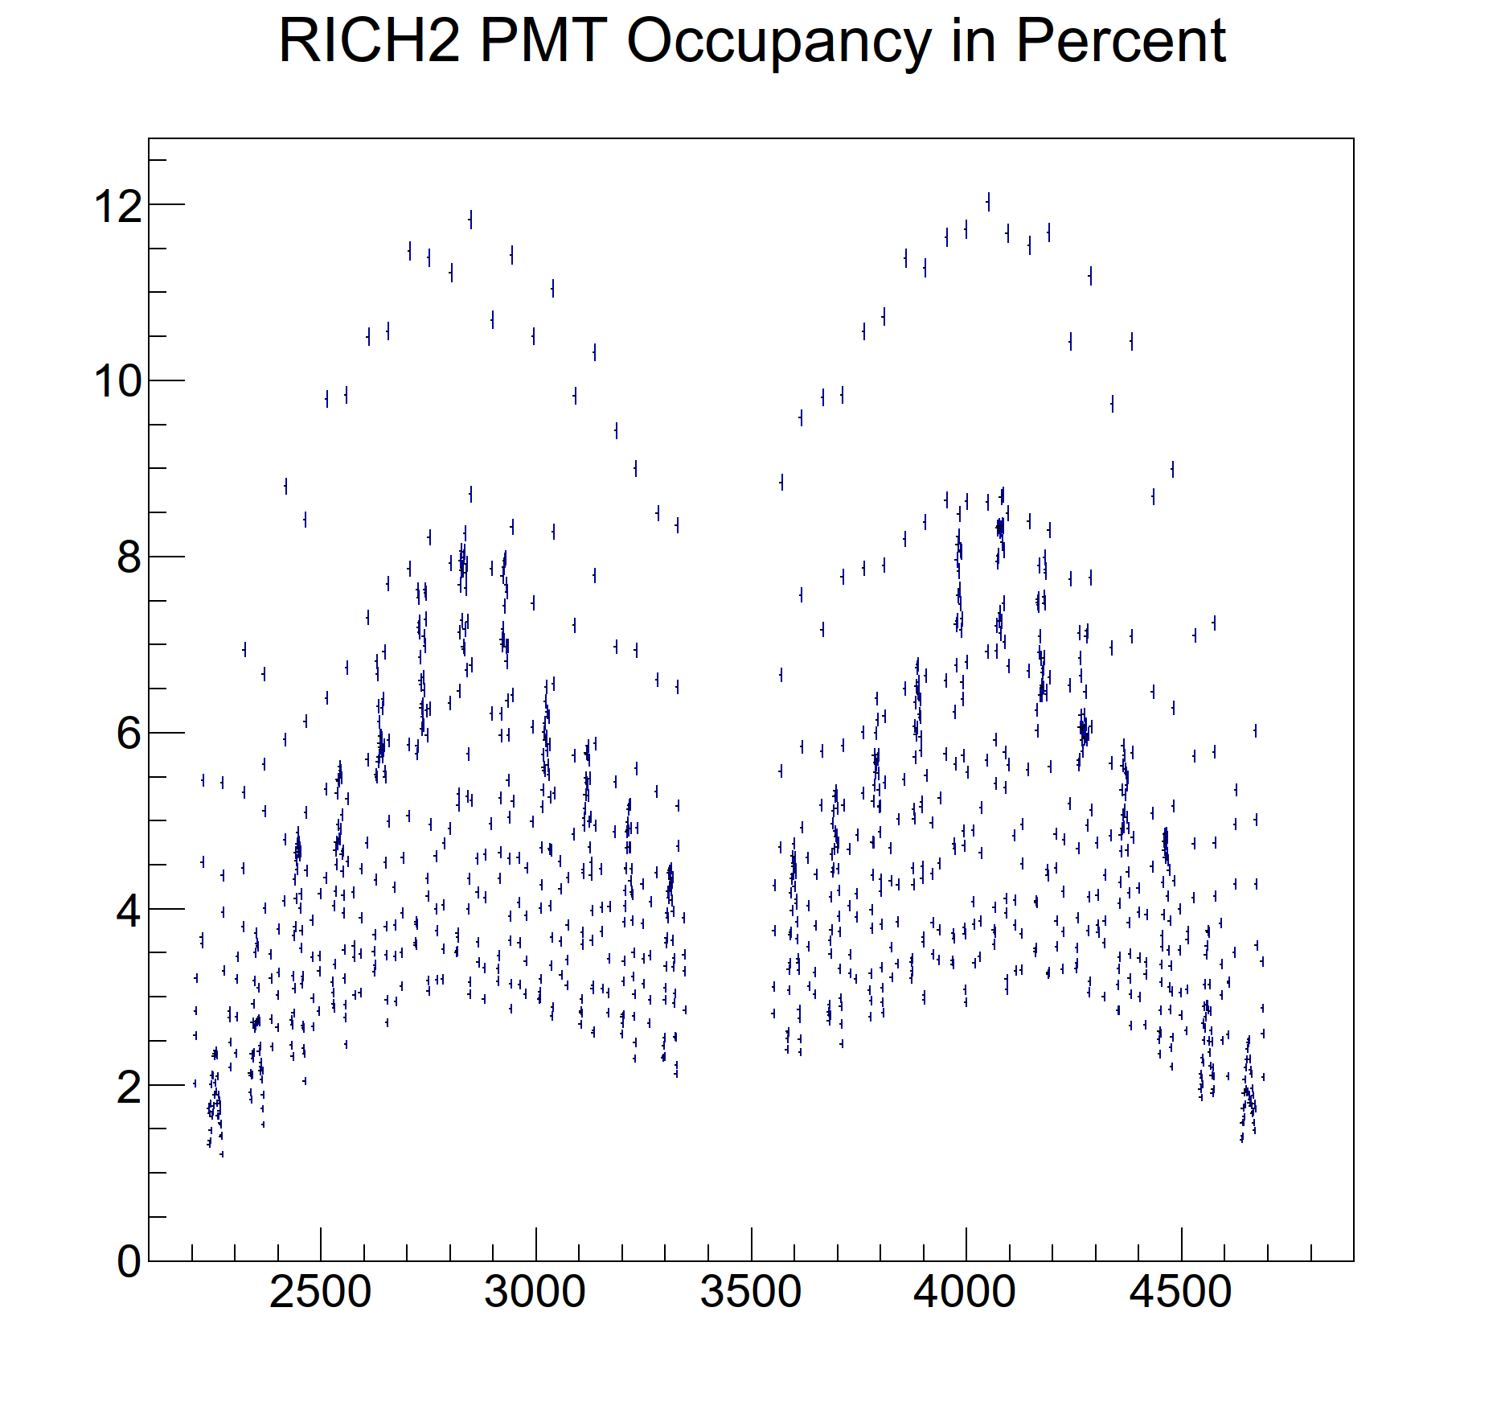
RICH occupancy : RUN3
pmt number
pmt number
RICH in Run3 configuration
Occupancy = number of hits in a Mapmt * 100 / 64

Slide 22
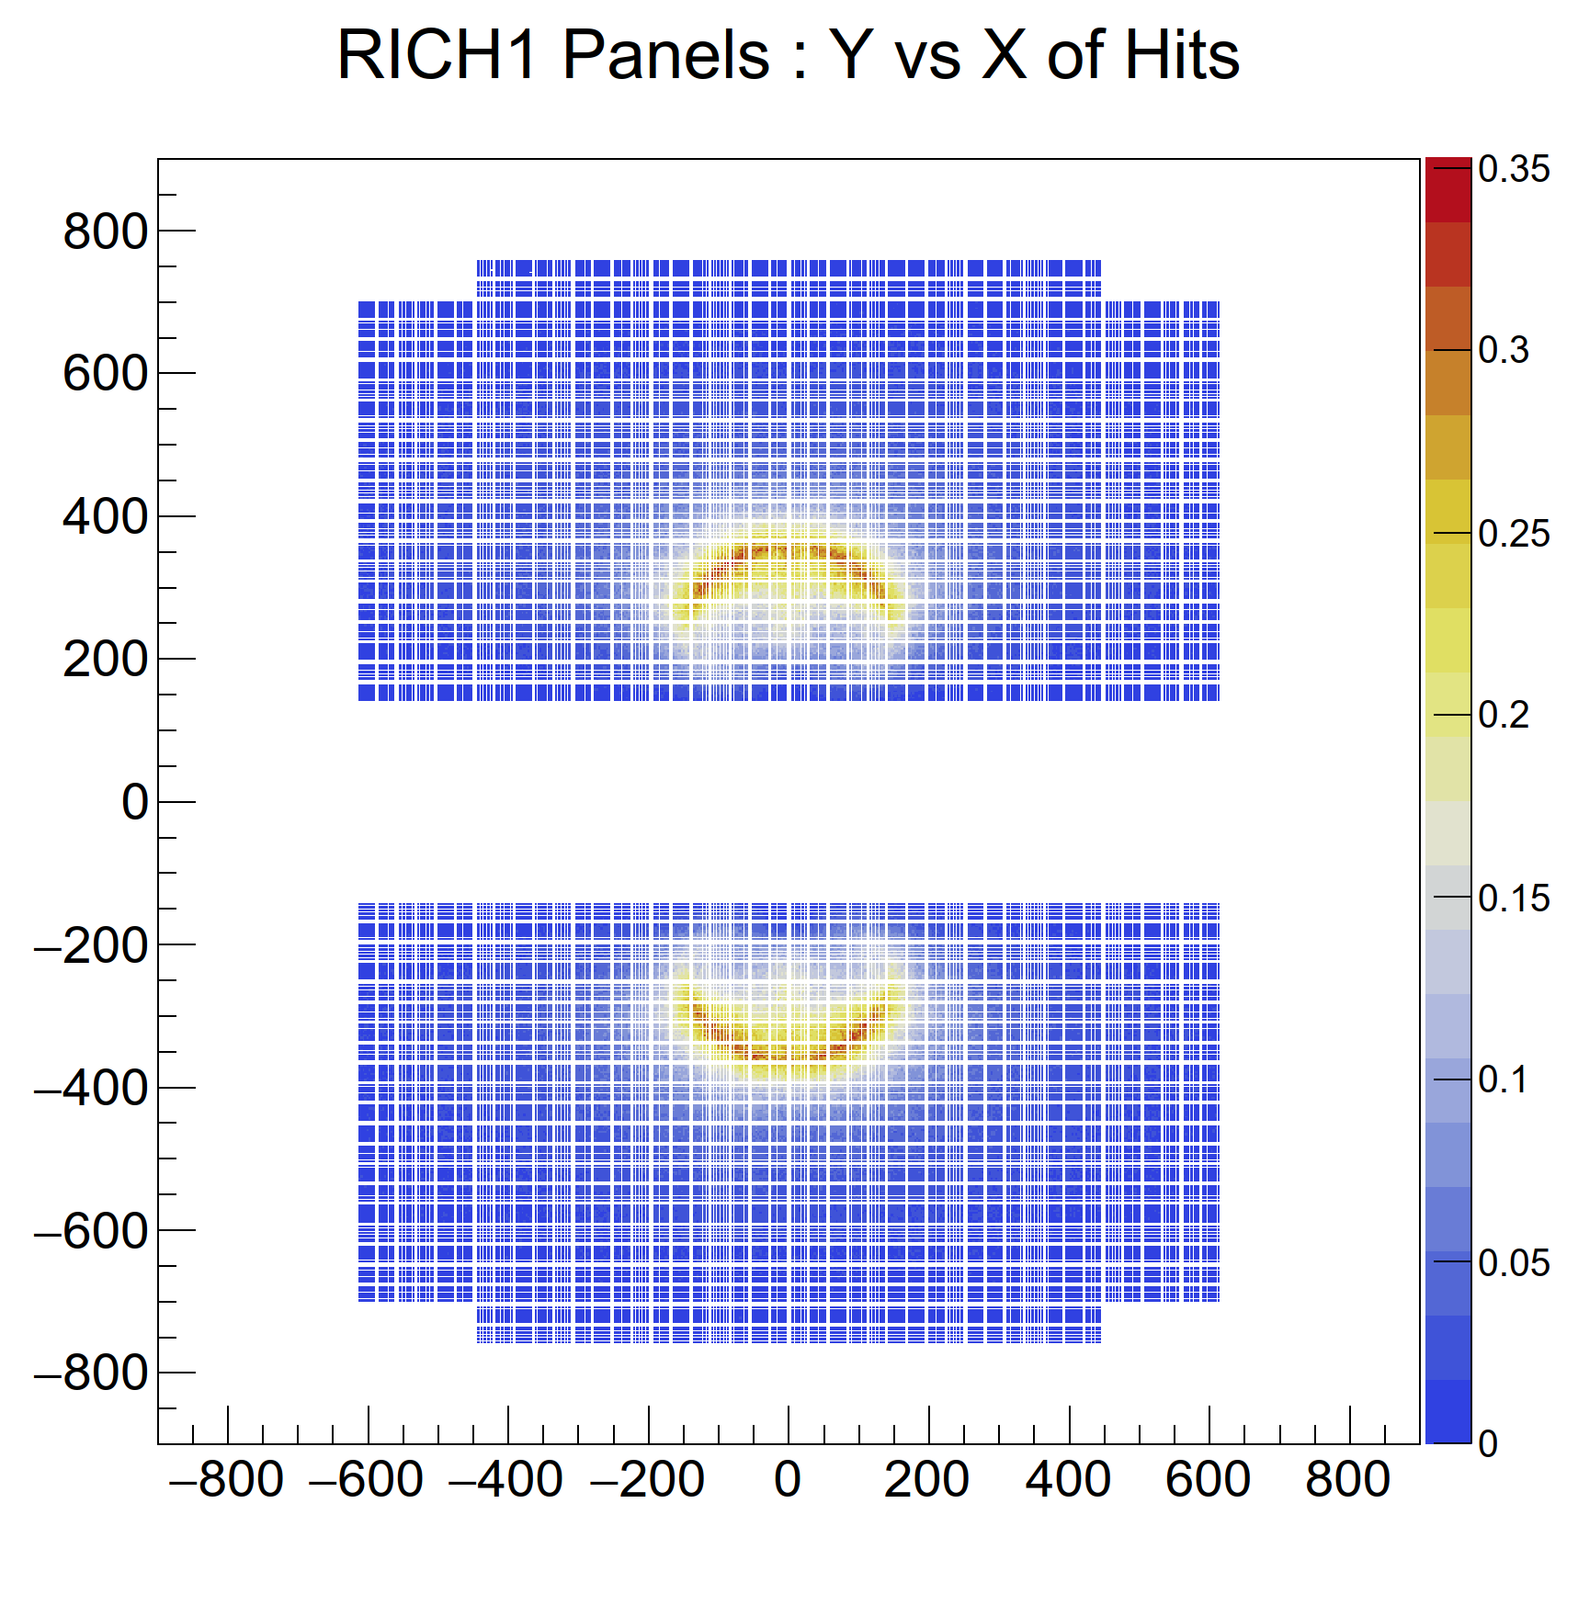
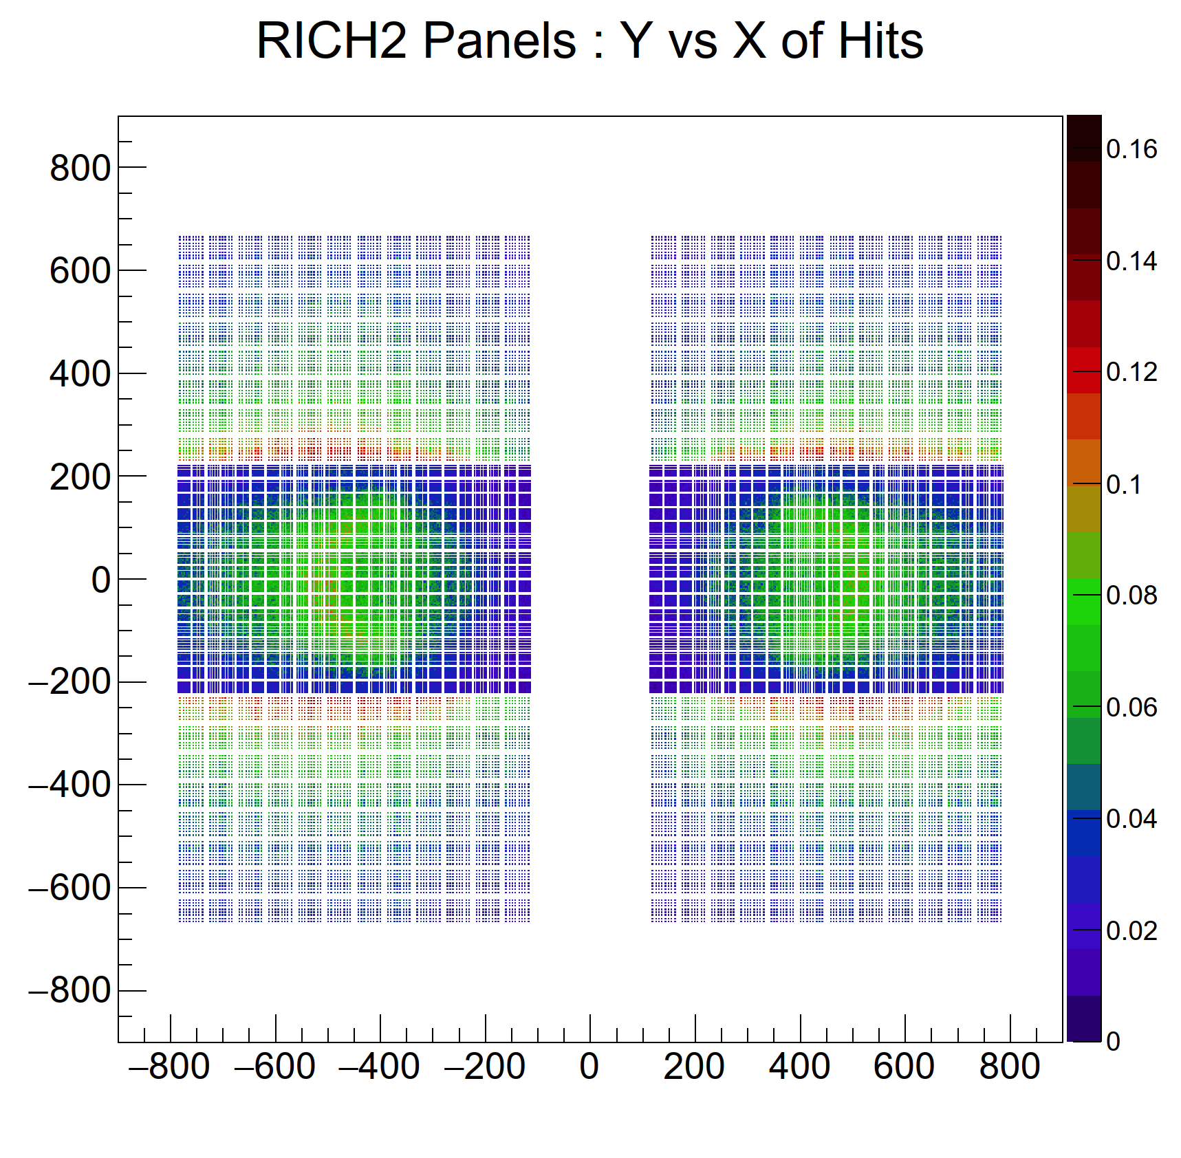
Distribution of hits in RICH for RUN3 from Gauss
mm
mm
mm
mm
All plots from minimum bias MC events and nominal RUN3 luminosity
The information obtained from the 1d occupancy plots can also be inferred from here

Slide 23
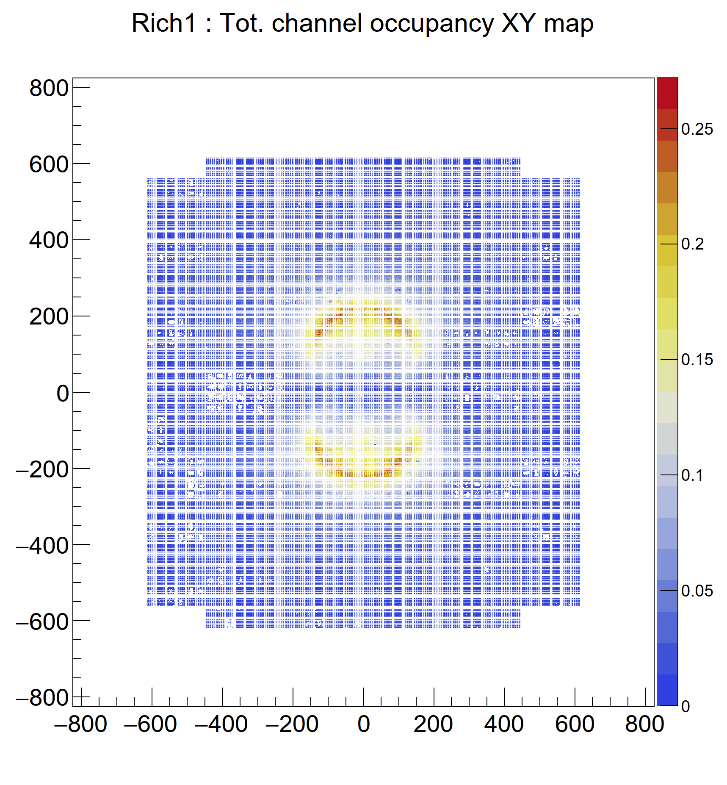
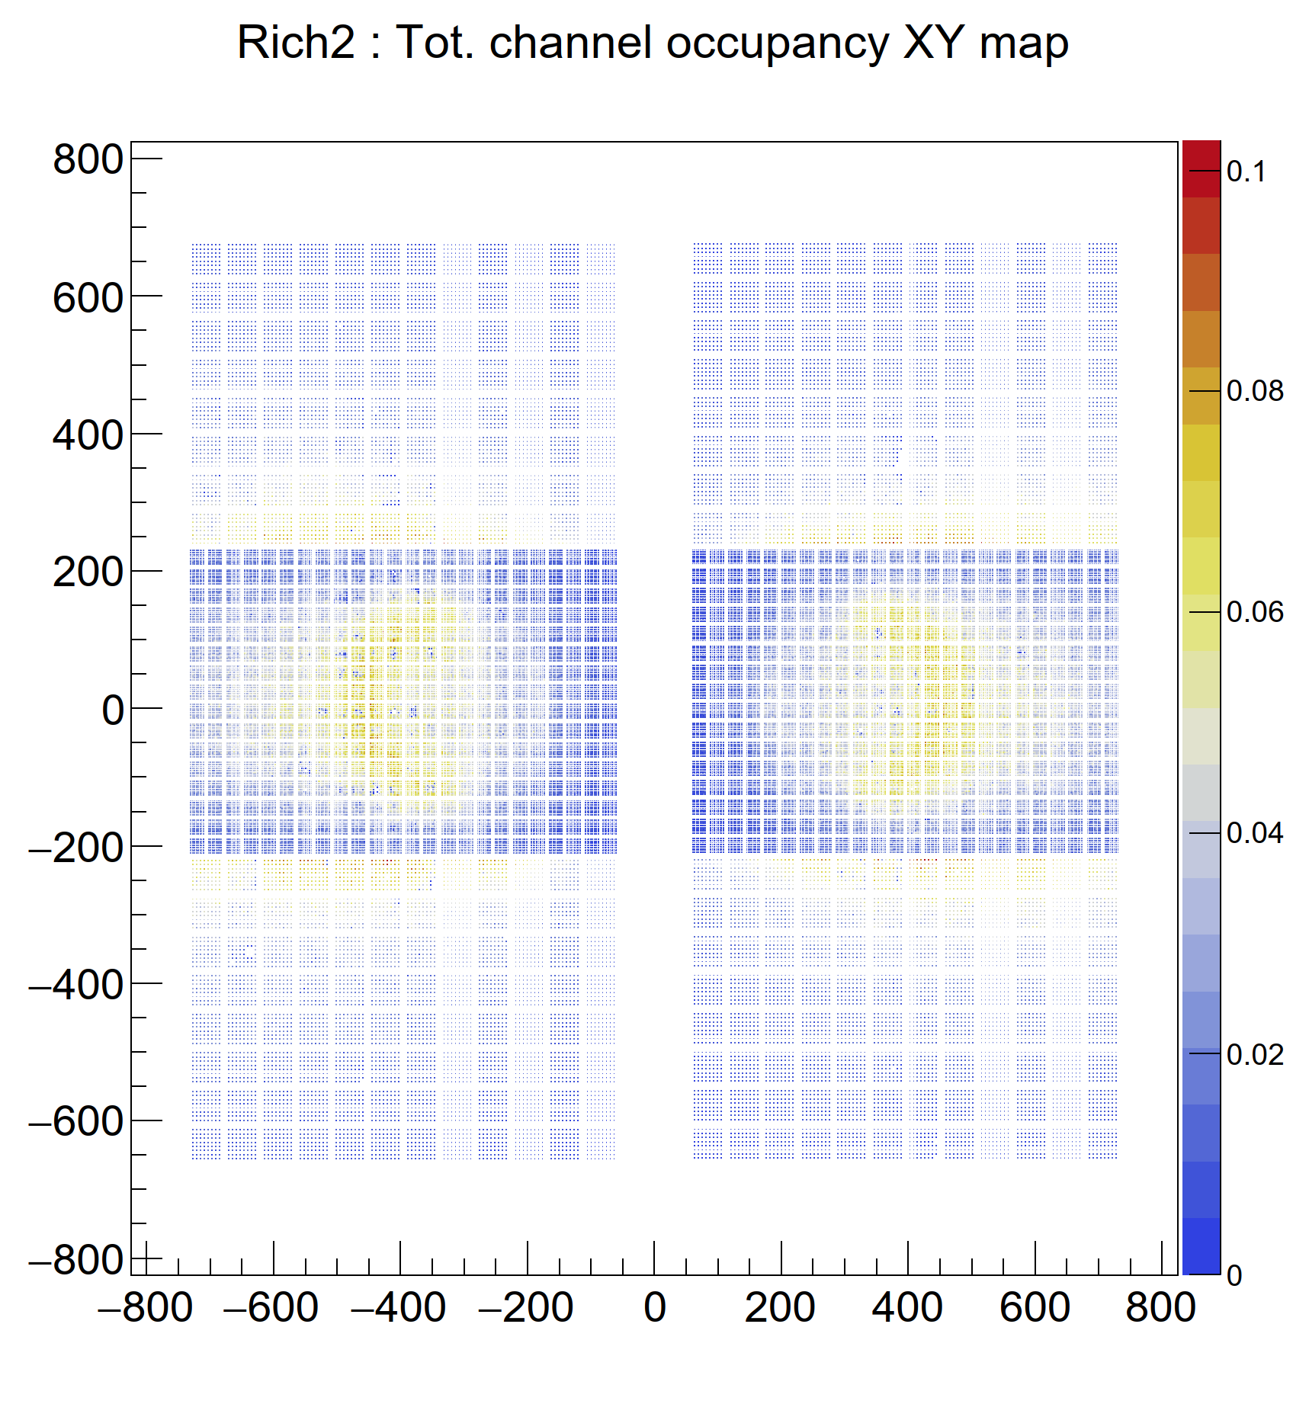
Example of the distribution of hits from Boole : RUN3
DB updates of PD properties
from Edoardo, Giovanni.
Boole studies from Ollie.
mm
mm
mm
mm
The PMT occupancy at a
time-window cut of 9 ns is shown here for illustration
Boole creates data in terms of xdigi files that are ready to be used in Reconstruction.

Slide 24
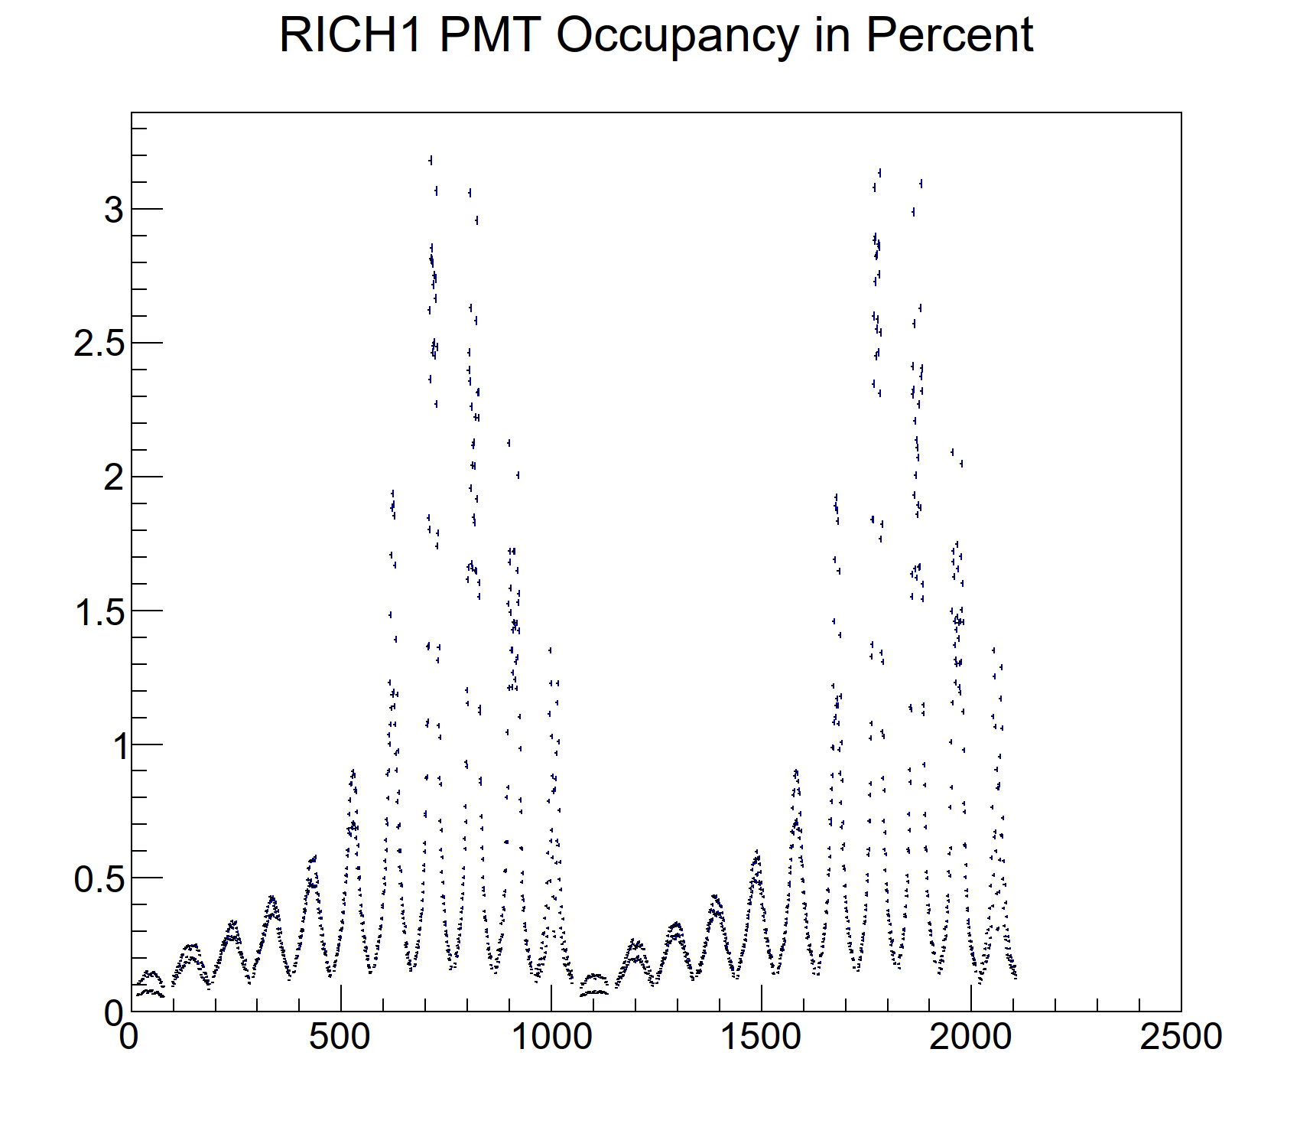
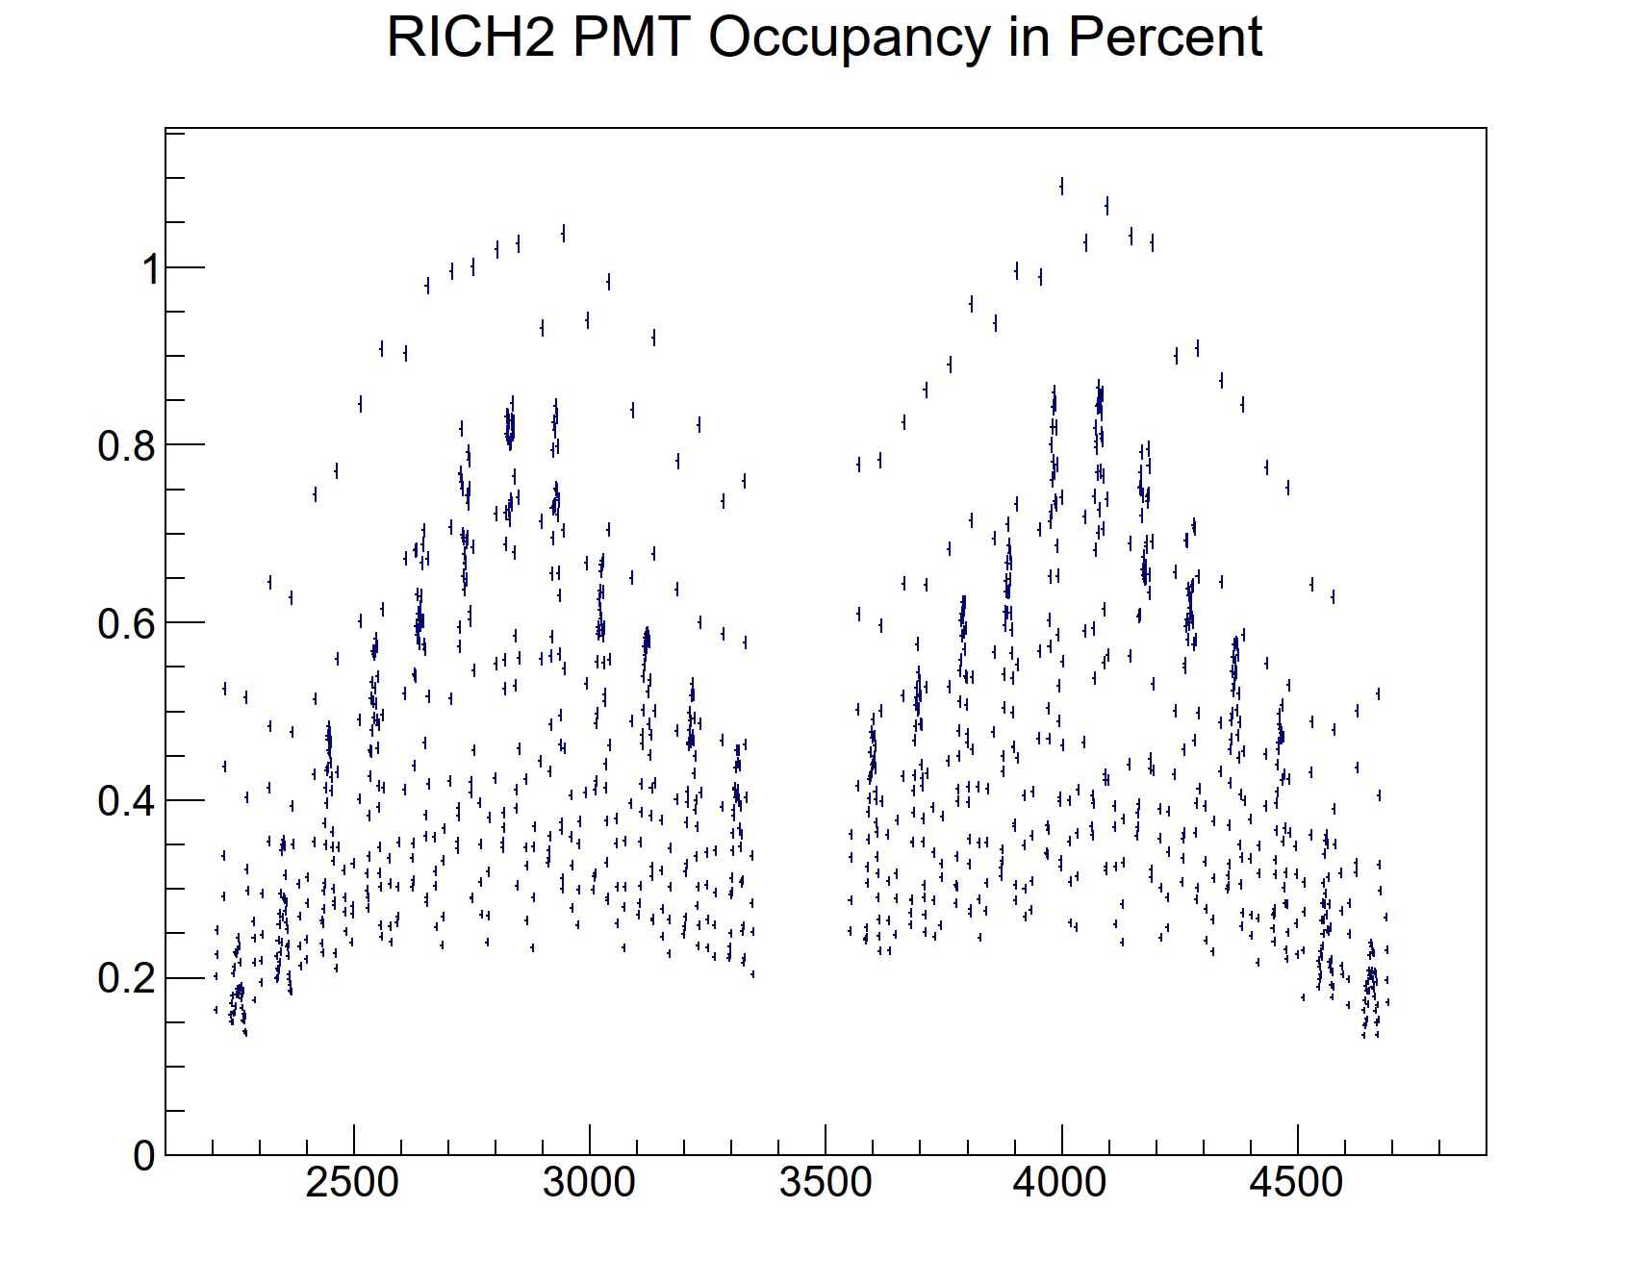
RICH occupancy : Example for RUN5
RICH1 PD Occupancy in Percent
RICH2 PD Occupancy in Percent
PD number
PD number
Rich-Run5-v3 configuration
No wavelength cut
Distributions from Gauss

Slide 25
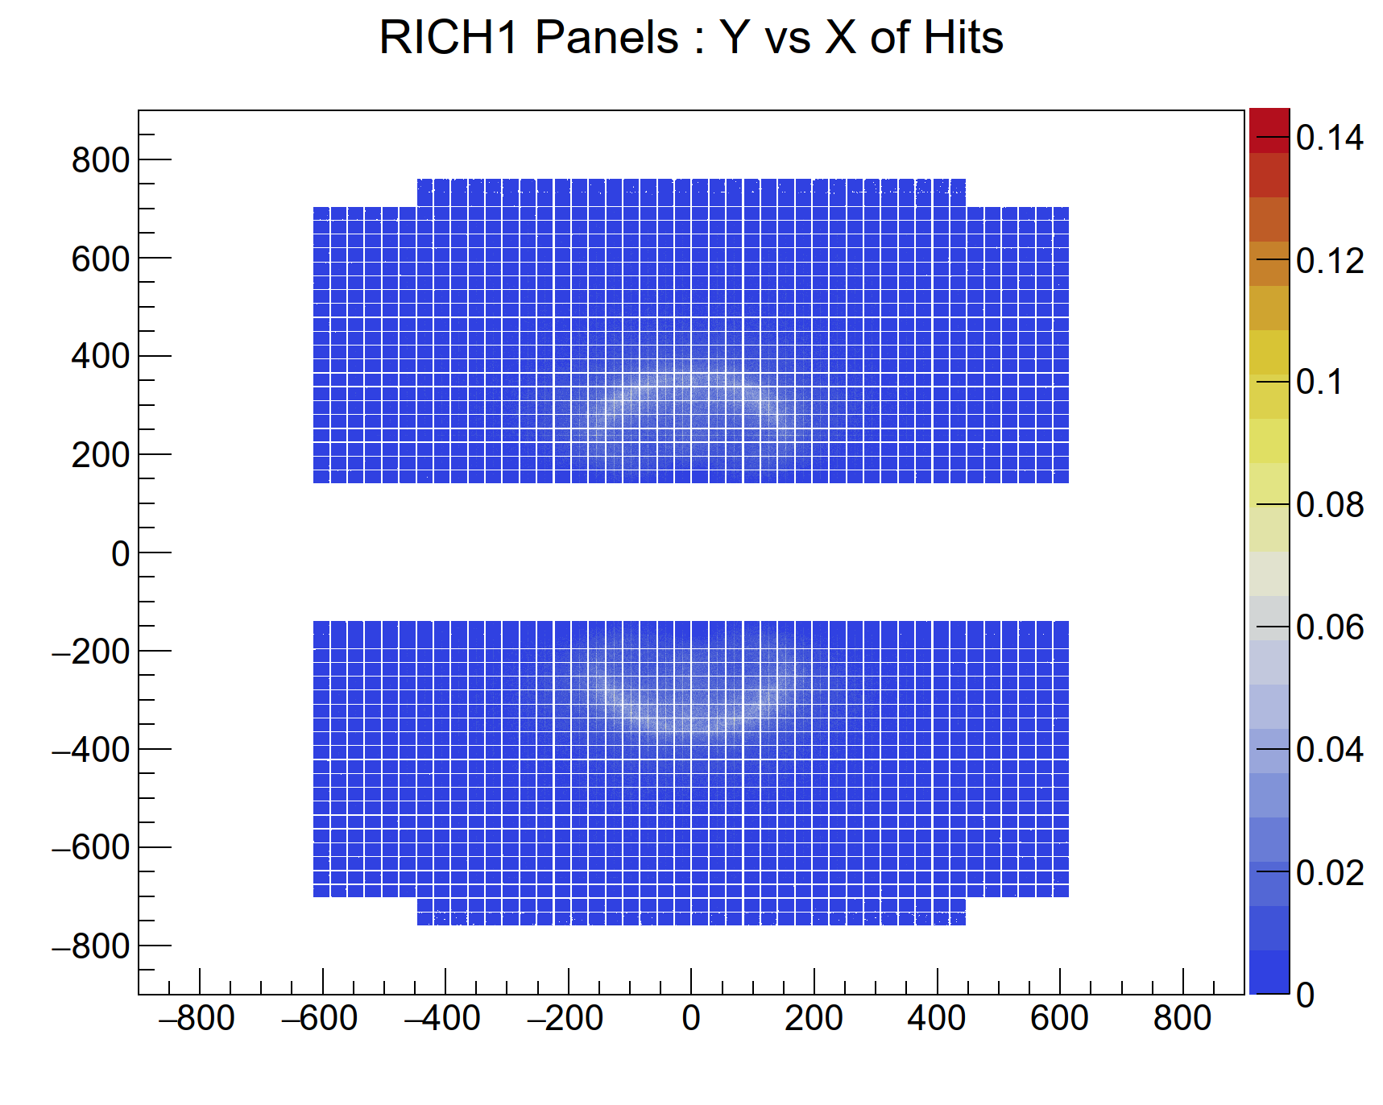
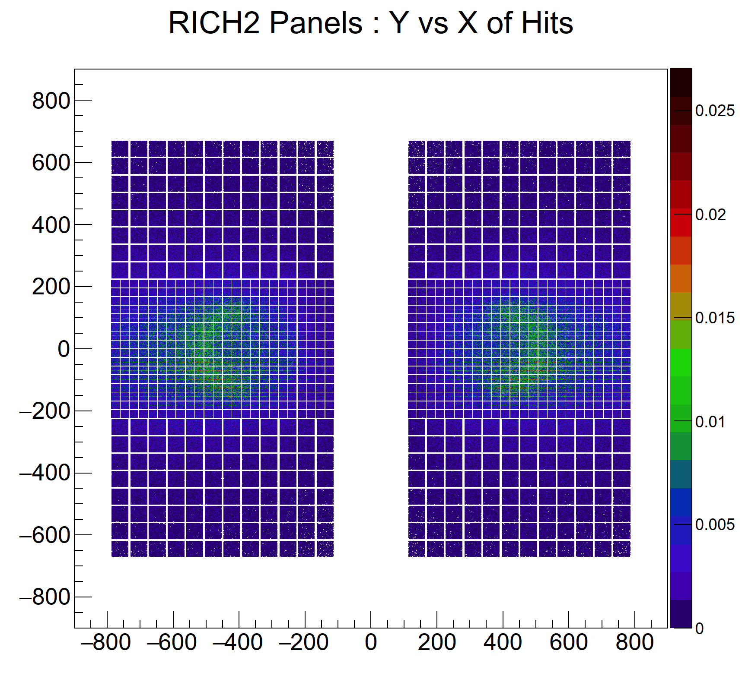
Example of distribution of hits in RICH for RUN5
mm
mm
mm
mm
Rich-Run5-v3 configuration
No wavelength cut
Distributions from Gauss

Slide 26
Summary
Several options envisaged for the RICH system in Upgrade2
Simulation of some of these options started using the new software framework
Results in terms of resolutions and yields obtained for some of these options.
They were used for the scoping document.
Support for TORCH is provided.
A first version of the readout simulation is developed for the RUN3 configuration.
It can form the basis for simulating the RUN5 readout.
Plans :
Reconstruct the data for determining the PID performance
Implement the options that are being discussed in recent months

Slide 27
BACKUP PAGES

Slide 28
RICH: Summary of Run3 resolutions and yields
RICH1 MaPMT for RUN3 | Overall mrad | Chromatic mrad | Emis.Pt mrad | Pixel mrad | Yield
Nominal RUN3 geometry | 0.82 | 0.59 | 0.38 | 0.46 | 62
RICH2 Small MaPMT for RUN3 | Overall mrad | Chromatic mrad | Emis.Pt mrad | Pixel mrad | Yield
Nominal RUN3 geometry | 0.50 | 0.33 | 0.37 | 0.20 | 39
RICH2 Large MaPMT for RUN3 | Overall mrad | Chromatic mrad | Emis.Pt mrad | Pixel mrad | Yield
Nominal RUN3 geometry | 0.66 | 0.33 | 0.44 | 0.41 | 39
RICH2 resolutions close to those in real data
Work in progress for RICH1 alignment
RICH2 yields are combined yields for small and large PMTs
These resolutions do not include contributions from the tracking system

Slide 29
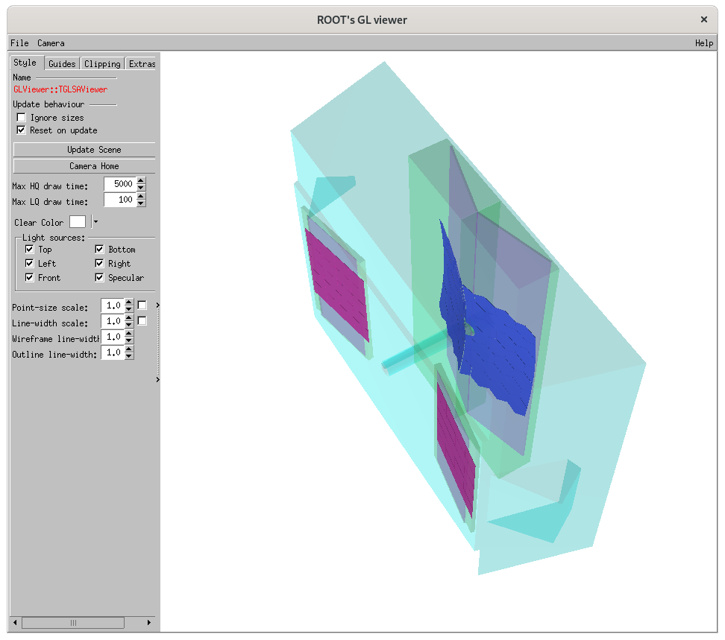
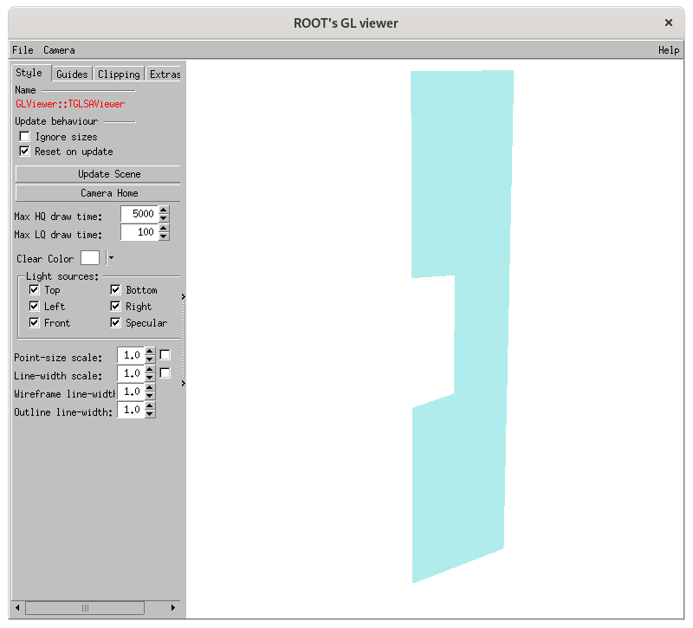
TORCH Support
RICH2 gas enclosure with TORCH
Side wall of gas enclosure with TORCH

Slide 30
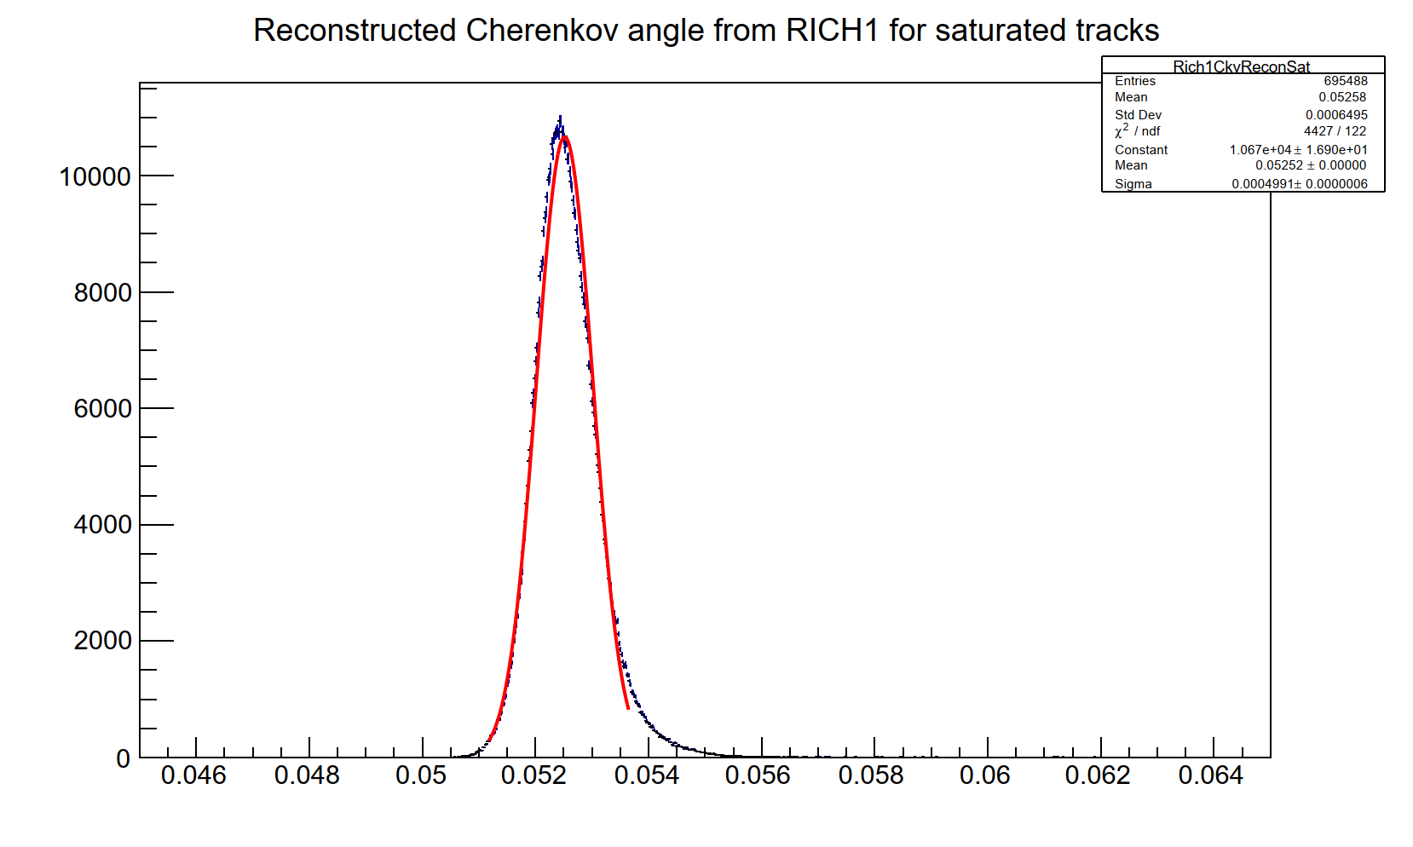
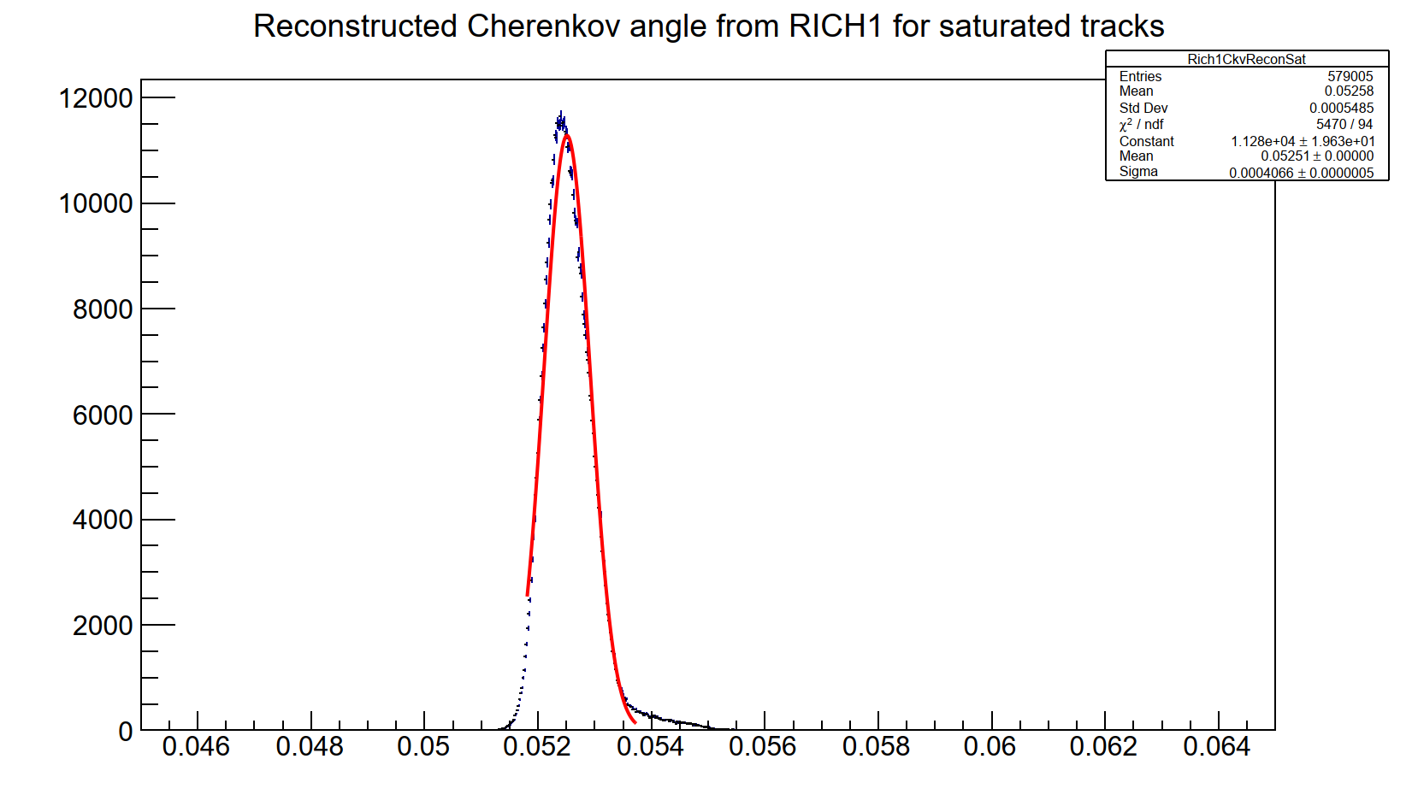
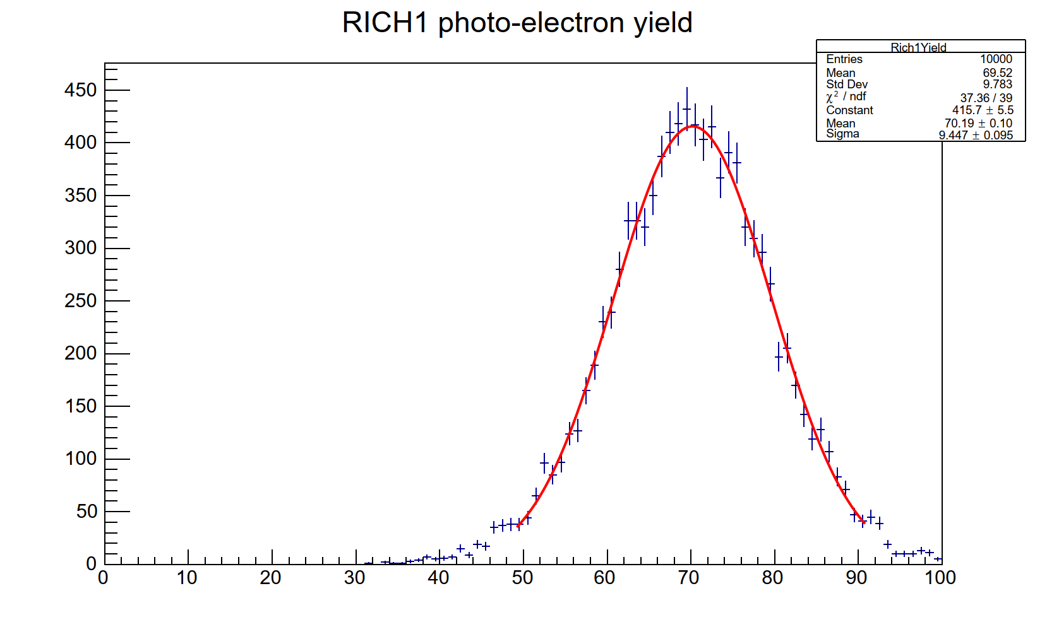
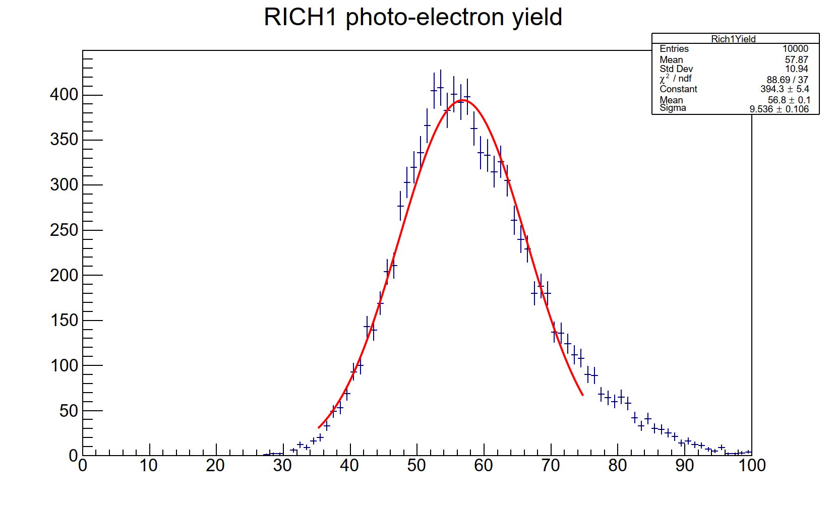
RICH1 : resolutions and yields with SiPM
RICH1: Overall
Width=0.50 mrad
RICH1: Overall
Width=0.41 mrad
rad
rad
RICH1: Yield
Mean=57
RICH1: Yield
Mean=70
Nominal SiPM, No wavelength cut-off
RICH1 RUN3 nominal geometry
Nominal SiPM, No wavelength cut-off,
Upgraded RICH1 geometry as in FTDR
All plots with 1 mm pixel size

Slide 31
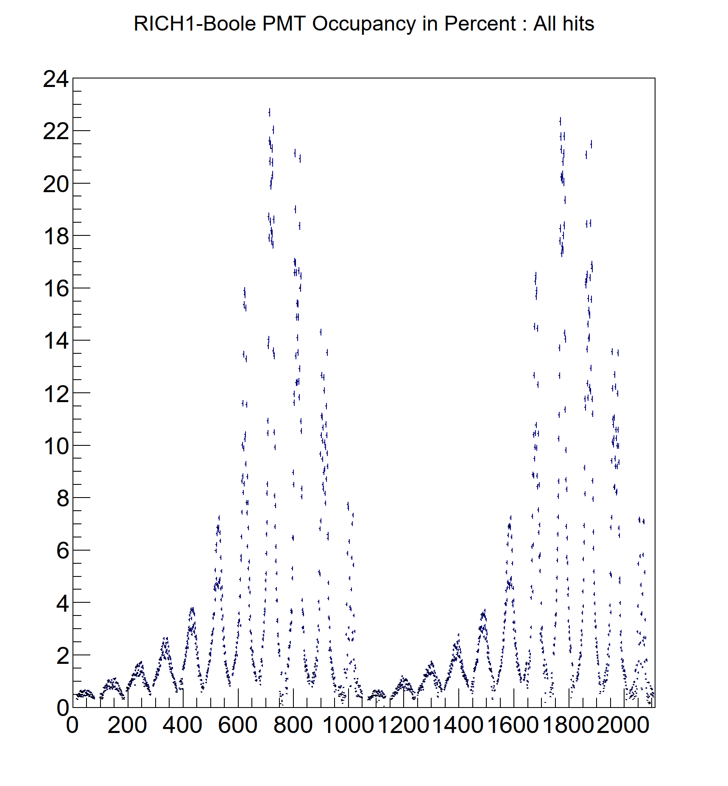
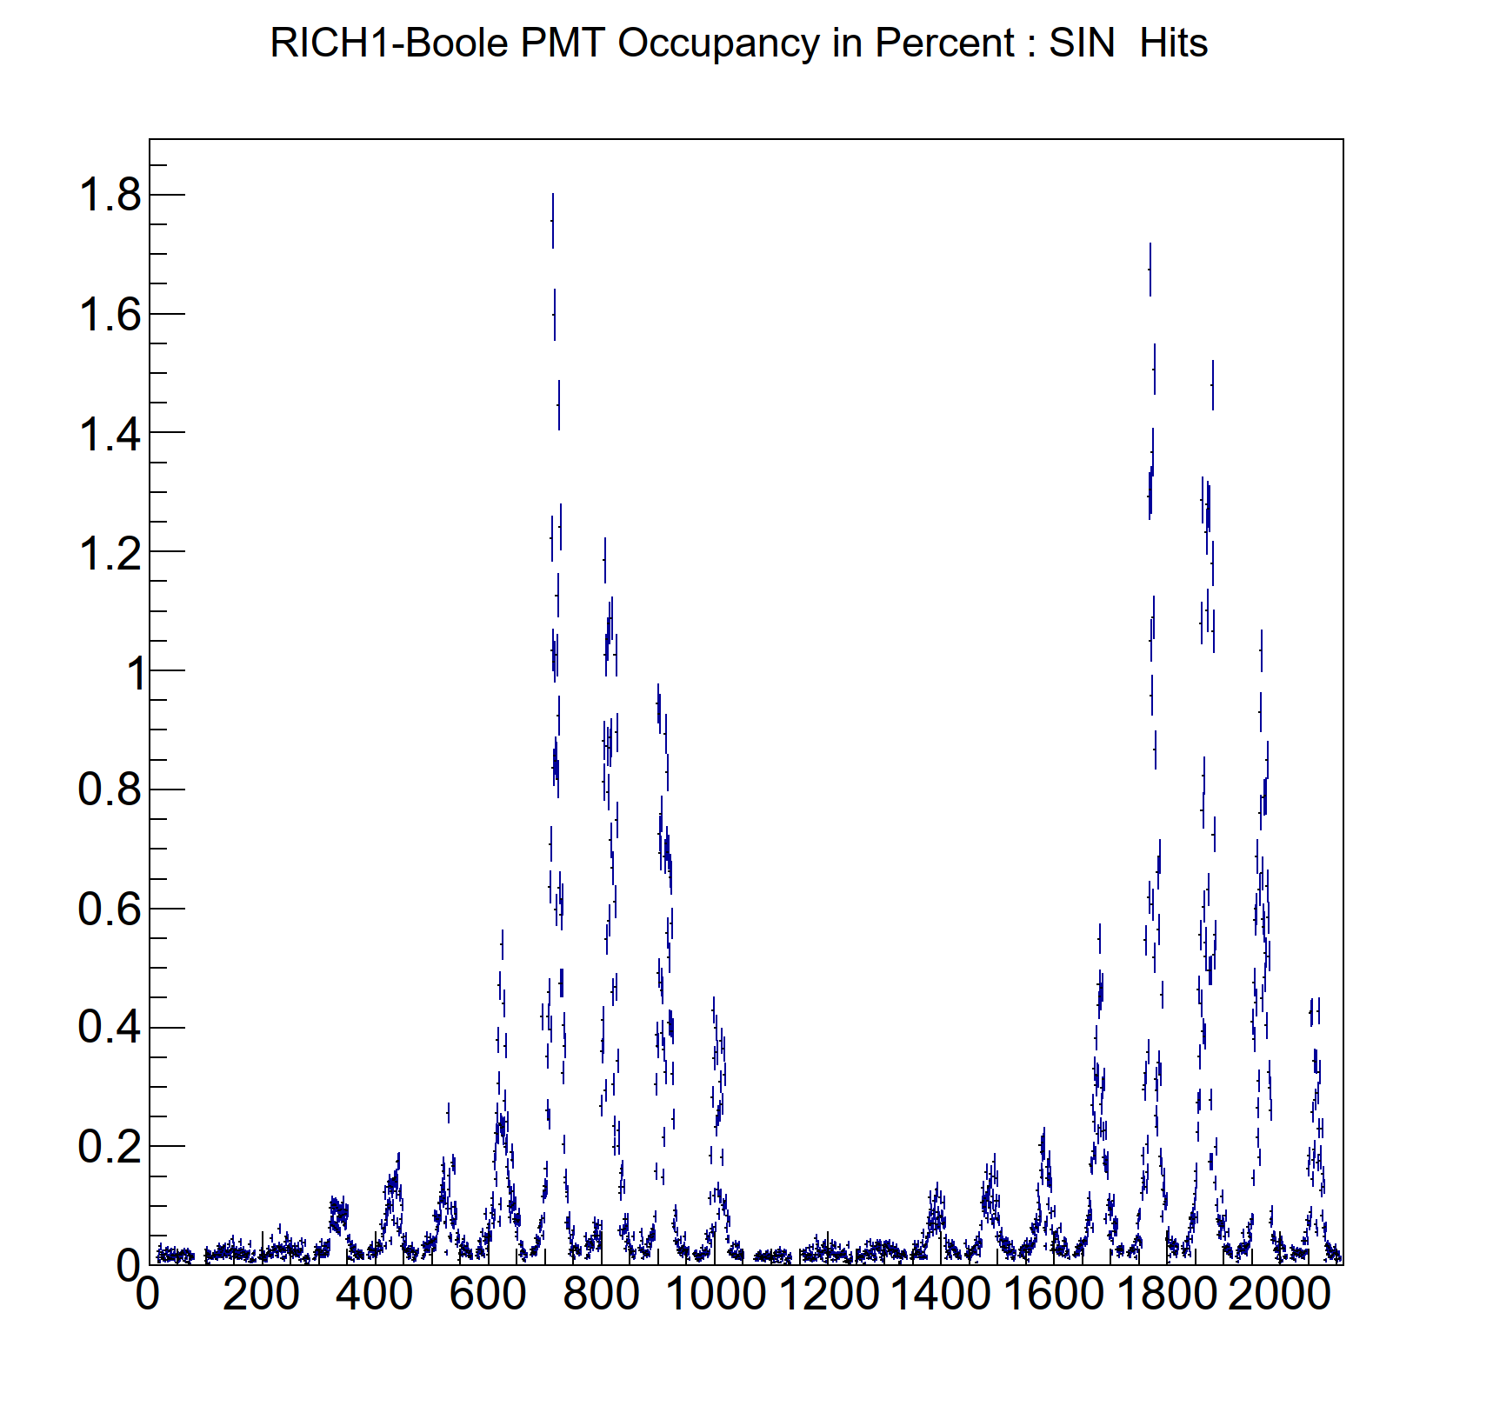
Example of distribution of hits from Boole :RUN3
DB update from Edoardo, Giovanni
Boole studies from Ollie
Boole simulates the readout of
MaPMTs and CLARO chip
The tuning of SIN and other
features of the readout will need
simulated data with spill-over
It is also planned to
resurrect and use
the simulation of PV-time for this.
Pmt number
Pmt number
The PMT occupancy at a
time-window cut of 9 ns is shown here for illustration
Study planned to optimize the time-window cut.

Slide 32
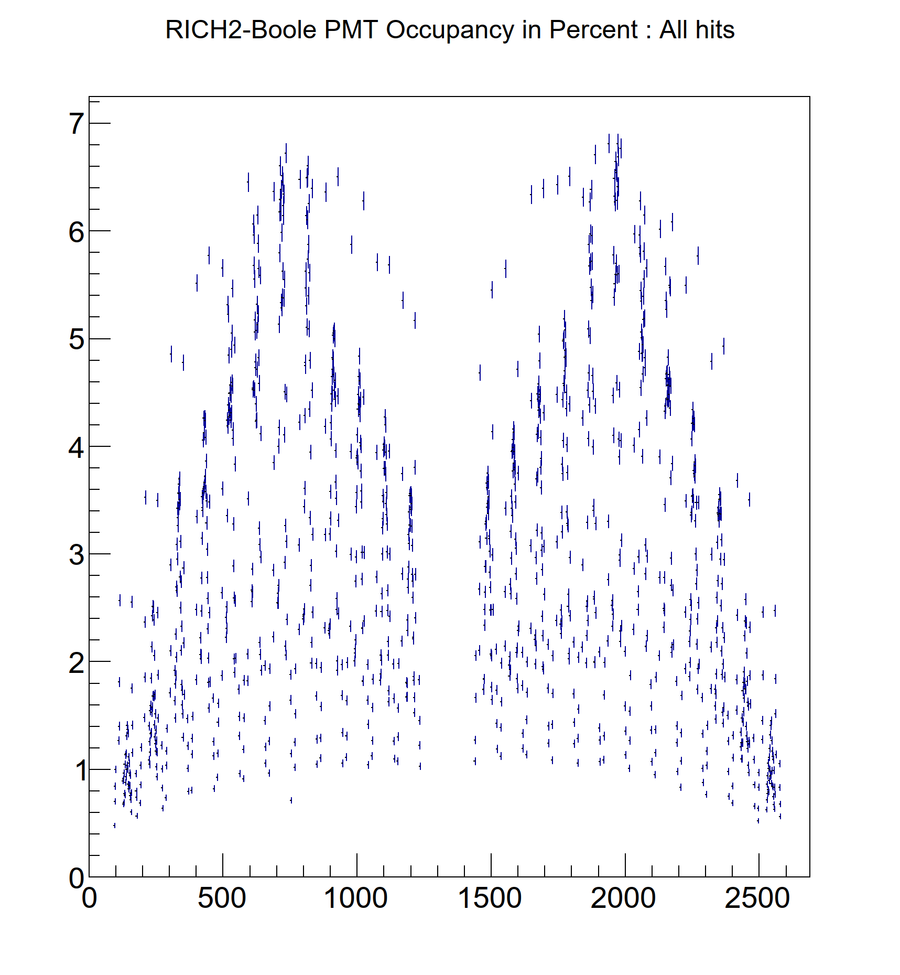
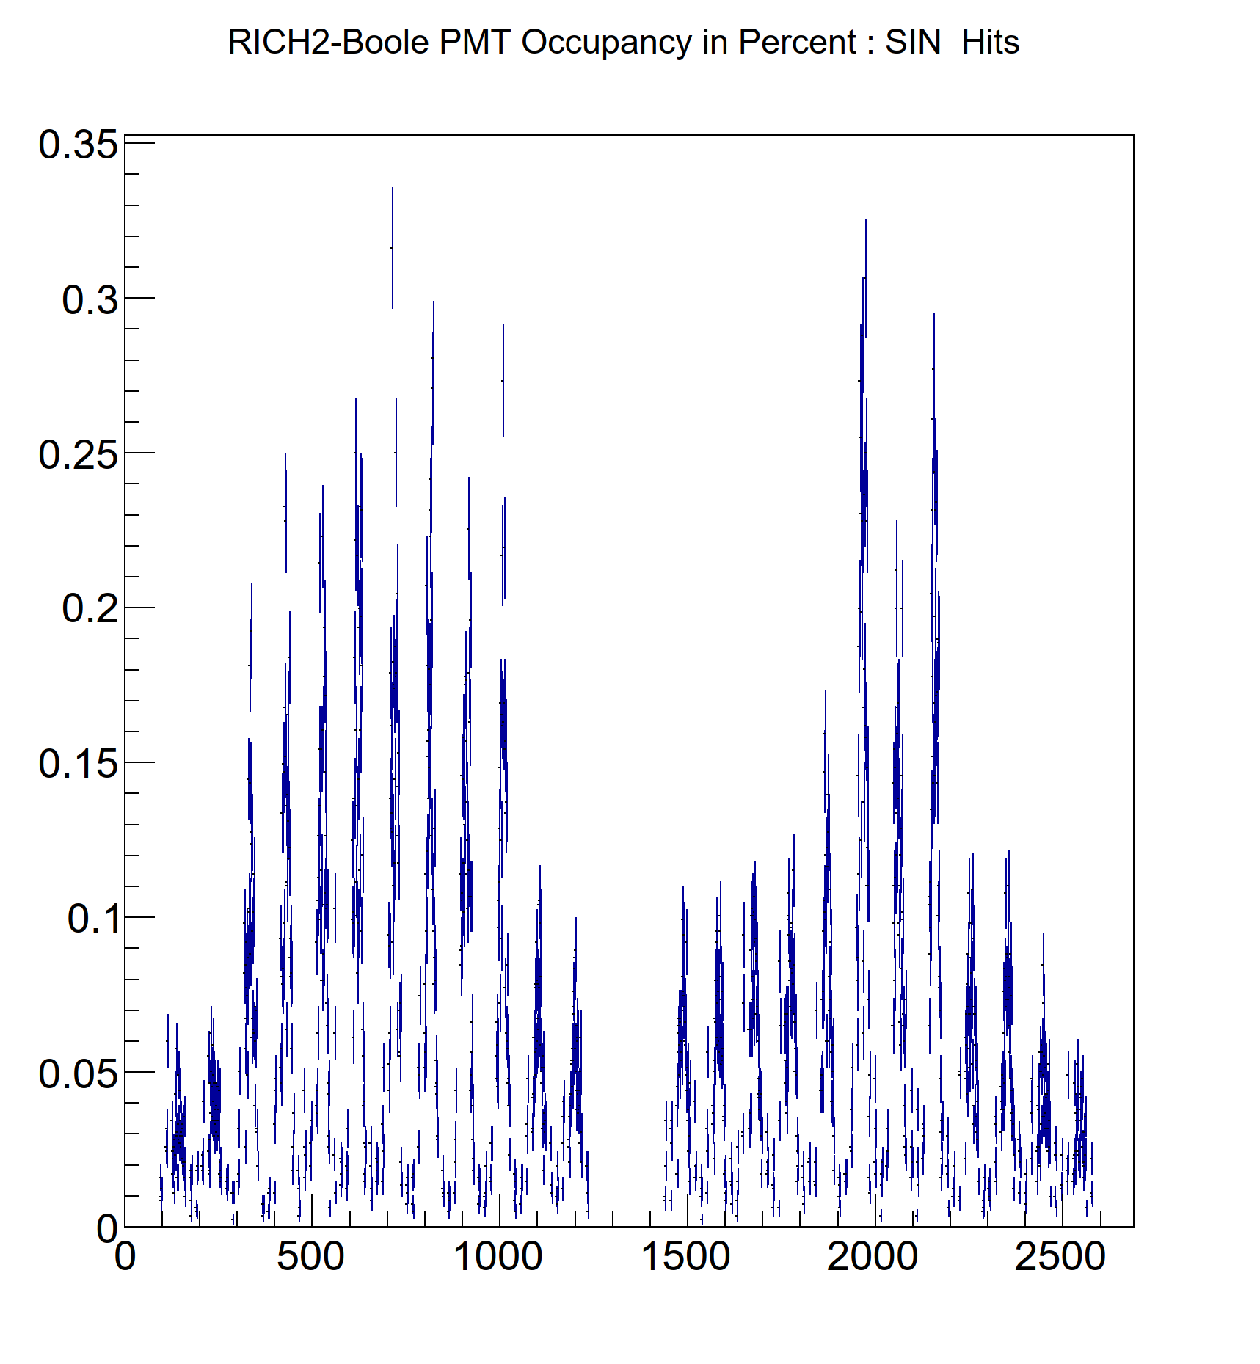
Example of distribution of hits from Boole :RUN3
DB update from Edoardo, Giovanni
Boole studies from Ollie
Pmt number
Pmt number
The PMT occupancy at a
time-window cut of 9 ns is shown here for illustration
Study planned to optimize the time-window cut.

