Slide 1
1st Accelerators Technology
Sector Workshop
Engineering Design Tools and Processes
Project Management Methodologies and Tools
Chair: Mike Lamont
Interconnecting knowledge, experience, methods,
people & data to foster learning & collaboration

Slide 2
Defining and executing cryogenic systems for DUNE
Caroline Fabre
on behalf of the CERN Neutrino Platform and Fermilab partners
Credits: Johan Bremer; Michel Chalifour; Filippo Resnati
Notes:
The CERN Neutrino Platform contributes to a globally coordinated programme of neutrino research. This effort includes supporting state-of-the-art cryogenic systems associated to large-scale liquid argon Time Projection Chamber detectors (TPC).
Effort lead by:
F. Resnati in EP/NU for the cryostat and physics aspects
J. Bremer in TE/CRG for the cryogenics aspects
Michel Chalifour: architect of our management plan

Slide 3
Content
The DUNE project
Technical challenges and prototyping
Working in a collaboration
Cryogenic systems: from the definition to the execution
Engineering activities & methodology
Management activities
QA activities in contract execution
Conclusion
Notes:
First part: present the project and its challenges
Second part: how we run this project within a collaboration frameworks;
+ our PM practicies

Slide 4
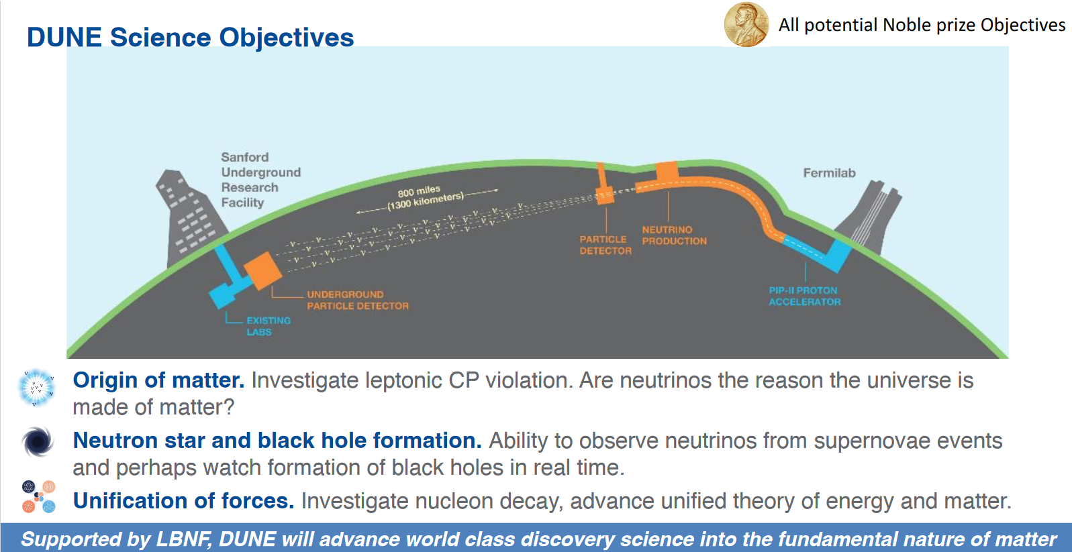
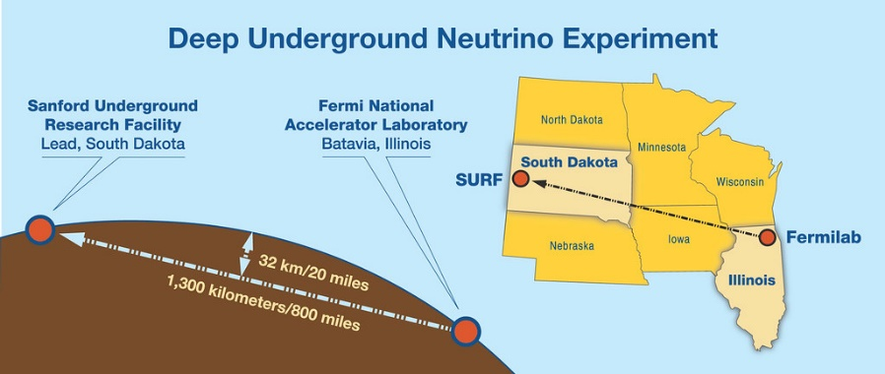
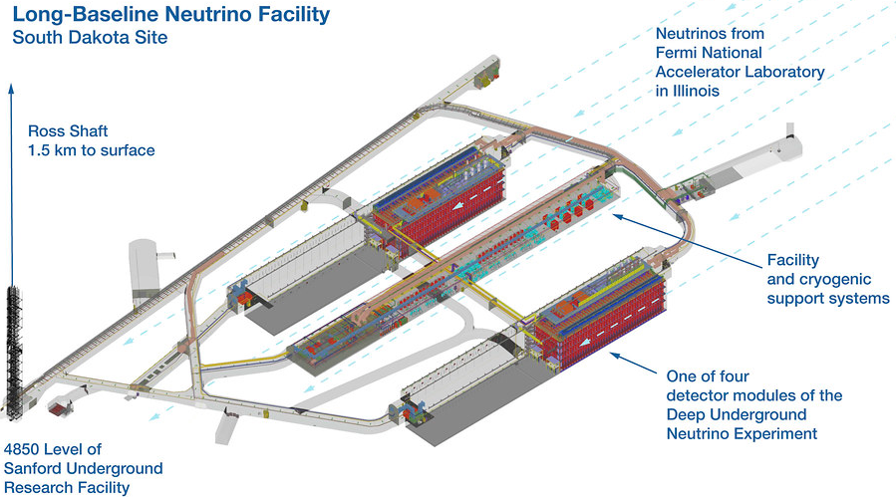
The DUNE project
© LBNF-DUNE
© LBNF-DUNE
Neutrino beam from Fermilab to Sandford lab
- straight through the earth, no tunnel necessary -
International collaboration
to investigate on neutrino oscillations
Liquid argon-based detector w 70 kT total argon mass
70 m
© LBNF-DUNE
Notes:
Comments:
An international collaboration (DUNE) has been set-up to perform a comprehensive investigation on neutrino oscillations. Idea: Shoot a neutrino beam from Fermi Lab to Sandford Lab, covering a distance of 1300 km and detect neutrinos with a liquid argon based detector with a total argon mass of 70 kTon. The detectors will be placed in caverns at 1.5 km below the surface in an old Gold Mine.
Why so Deep Underground → this is to shield from cosmic particules and reduce noise level
Why a dense noble liquid as active medium → this is to convert neutrinos (non-charged particules) into measurable particules
One piece of complexity: everything to be constructed of modular components that can be transported to the underground caverns via a 1.4 m × 3.6 m cross section shaft for assembly in situ.
Background info:
https://edms.cern.ch/ui/file/2795431/3/LBNF_and_Far_Site_Cryogenics_Overview_Rev_2.pdf
Link to videos
• https://www.youtube.com/watch?v=nv13DswIKr8
• https://www.youtube.com/watch?v=zoxjRsIzd4k
• https://www.youtube.com/watch?v=AYtKcZMJ_4c

Slide 5
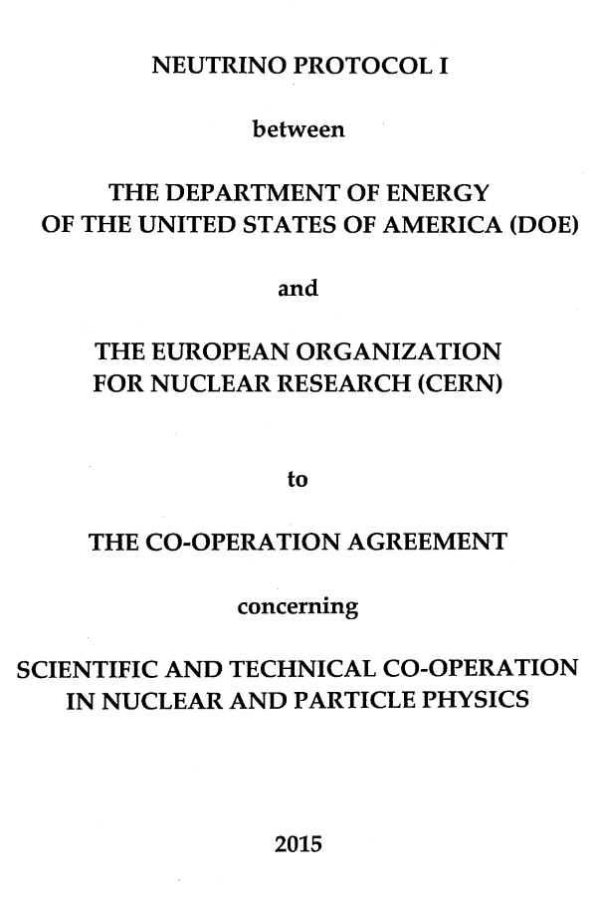
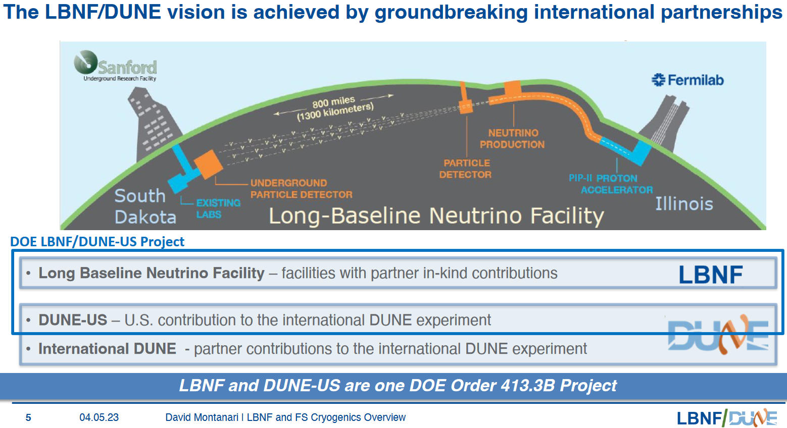
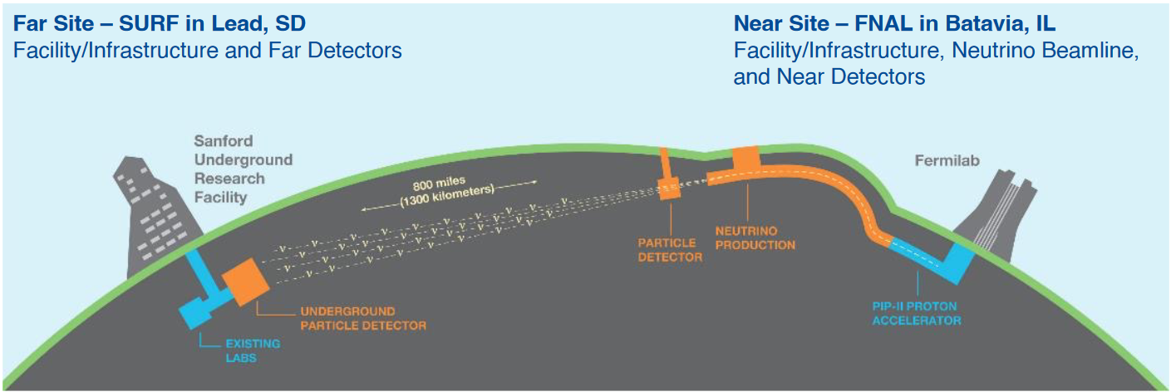
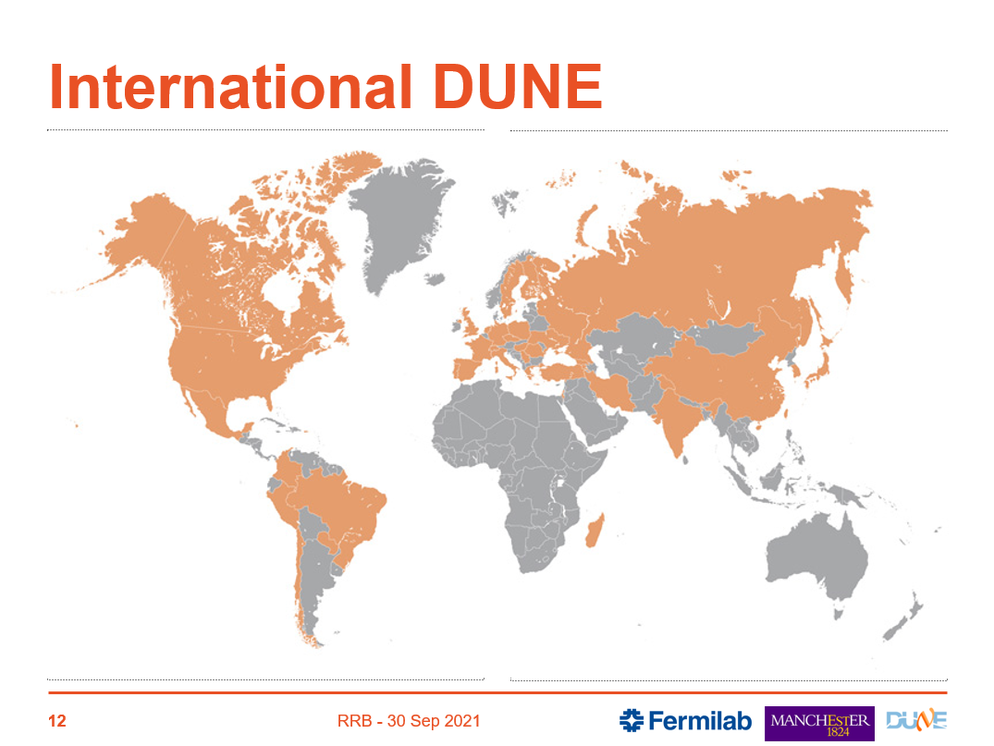

Co-operation framework between CERN and US-DOE
The CERN Neutrino Platform project:
To provide a test facility at CERN for large detector prototypes and demonstrators (protoDUNE)
To support activities related to the construction and operation of the Fermilab SBN program (ICARUS, SBND)
To contribute to the design, construction and operation of DUNE
Collaboration statistics
(as of July 2022)
  1,402 collaborators, 47% U.S./53% non-US
  206 institutions from 37 countries including CERN
edms: 1730038
© LBNF-DUNE
as recommended by the 2013 European Strategy for Particle Physics
Notes:
Comments:
In 2015 a protocole was set to define the framework for co-operation in the field of neutrino physics
On the one hand NP…
On the other hand the LBNF (Long Baseline…) project which will provide infrastructure in the form of a deep underground scientific laboratory @SURF
and a Fermilab accelerator complex that will deliver high-intensity neutrino beam for DUNE.
And finally the DUNE project itself which will be guided by an international collaboration
(Provide items, funded directly or indirectly by all participants.)

Slide 6
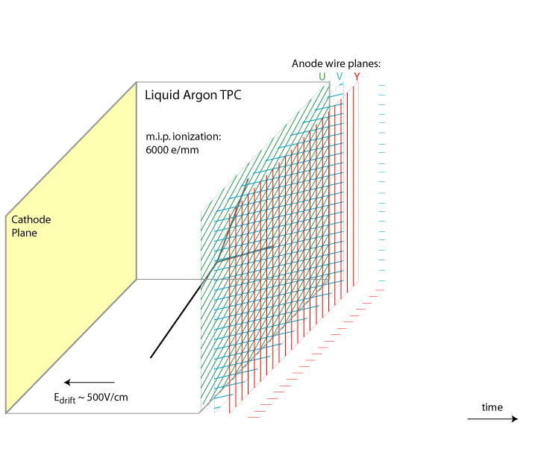
Detection principle
Liquid Argon Time Projection Chamber:
Neutrino interacts with argon atoms
Secondary particles liberate valence electrons
Electrons are collected to the anode wires
Scintillation light is detected by photo-multipiers
→ Reconstruct 3D image of the interaction
© LBNF-DUNE
Notes:
Comments:
Transition:
For this operational principle to function one need:

Slide 7
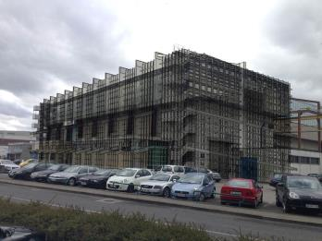
Requirements
To guarantee a «long» free electron life-time : > 3 (10) ms
To put a 300 kV HV field
To have a uniform reaction over the sensitive volume
To preserve detector properties
To guarantee highest safety levels for use in underground caverns
Very pure argon : < 100 (30) ppt O2 equiv. purity)
No boiling over the sensitive volume
A limited T° difference over the detection volume < 1 K
Continuously operated over long periods
Contain the argon under all circumstances
62 m
15 m
14 m
4 cryostats
LAr: 12 500 m³ – 17 kton
x 500 compared to ATLAS LAr calorimeter
CERN building 156
Notes:
Transition:
For this operational principle to function one need:
Comments:
Purity: to give an idea we go from 2 mm drift gap in the liquid argon calorimeter we have in ATLAS up to 3.6 to 6 m in DUNE.
From parts per million to parts per trillion.
…
5 storey building
Size: to give an idea we go up with a factor 500 in volume/mass compared to ATLAS calo
Transition:
All this brings a number of challenges for detector, for cryostat and for cryogenics and required a number of developments
Background info:
TDR pp113: https://iopscience.iop.org/article/10.1088/1748-0221/15/08/T08009/pdf

Slide 8
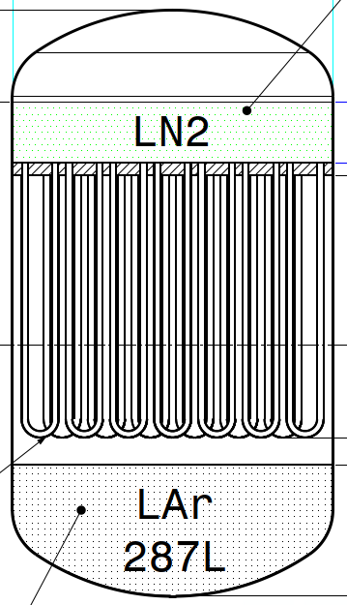
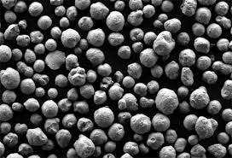
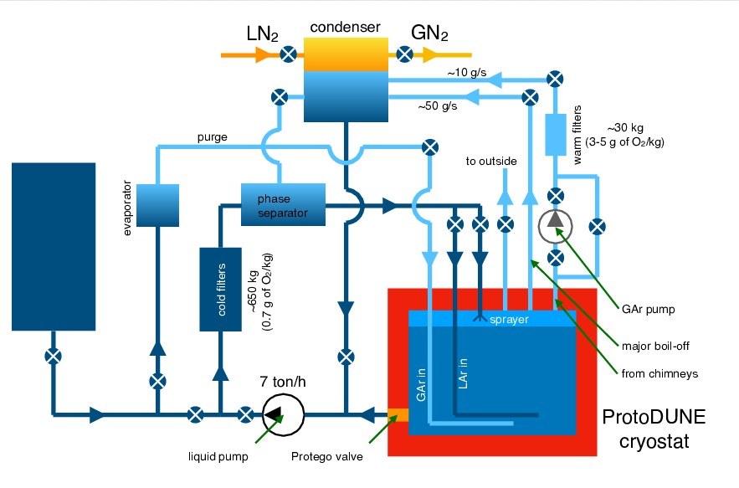
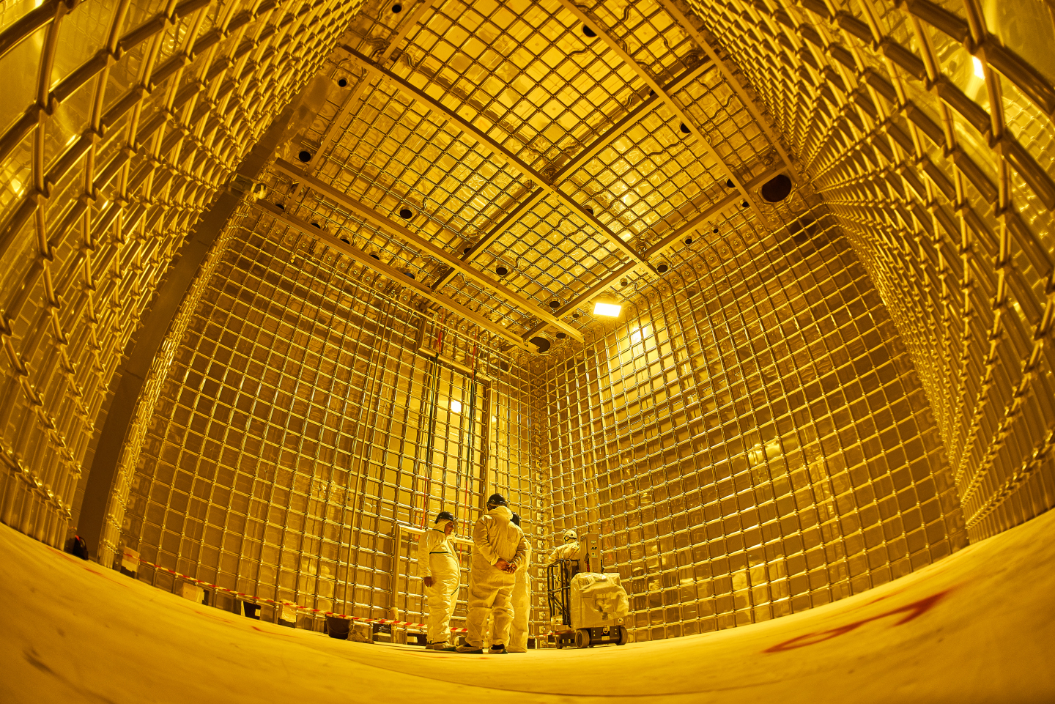
Developments for cryostat and cryogenics
The argon purification principle
circulation
on active copper pellets
The shell and tube heat-exchanger: simple, robust and reliable
The membrane cryostat principle developed from a qualified technique for LNG tankers
Principle
inherited from NA48
1.2 mm
Purification @ 87 K: oxidation of Cu-226 (Cu coated Al₂O₃)
800 mm
Mark III concept
GTT intellectual property
Regeneration @ 420 K: reduction w 2.5% H₂ in Ar
The pre-ODH alarms
© LBNF-DUNE
Credits: F. Resnati
The cryogenic system principle
© CERN
NP04 cryostat before detector integration
Notes:
Transition:
All this brings a number of challenges for detector, for cryostat and for cryogenics and required a number of developments
Comments:
Cryostat:
Seen the detector size and the underground installation: a non-vacuum insulated cryostat option is preferred
Purification experience was non existing: had to be developed based on circulation on active copper pellets
For safety: pre-ODH alarms
Transition:
To validate these principles an extensive prototyping program has been set up.
Background info:
https://gtt.fr/technologies/markiii-systems
https://gtt.fr/fr/actualites/la-technologie-membranes-gtt-retenue-pour-equiper-un-important-projet-de-recherche

Slide 9
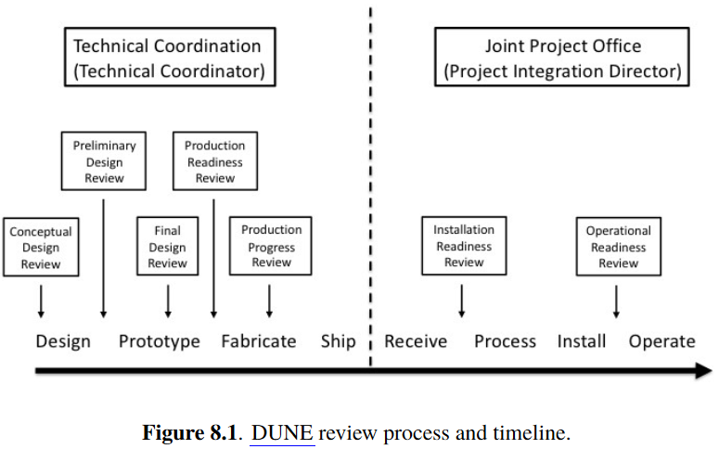
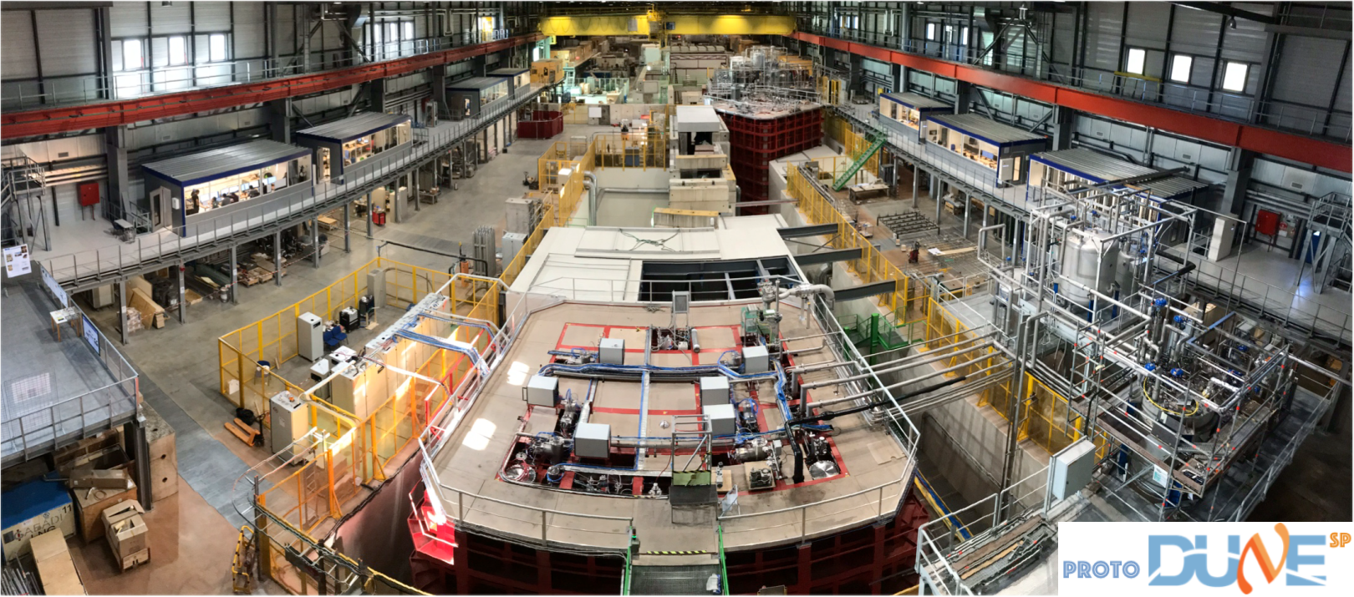
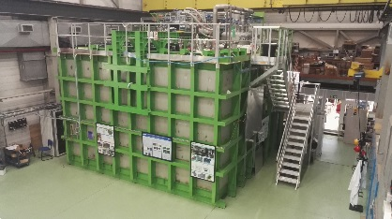
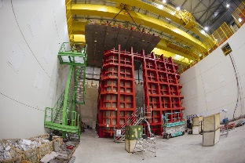
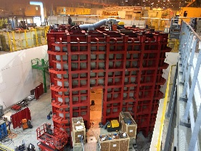
Prototyping
2019
2023
LBNF cryogenics design developed by Fermilab
based on the principles developed at ProtoDUNE by NP
including the Return of Experience
through continuous interactions of the NP and LBNF teams
and formal participation to reviews
2020
TDR
@CERN
REx on technical, organizational & safety aspects
The EHN1 experimental area
Source: DUNE TDR 2020; https://iopscience.iop.org/article/10.1088/1748-0221/15/08/T08009/pdf
ProtoDUNE-HD
ProtoDUNE-VD
@CERN
@Fermilab
@CERN
@CERN
26 T
Program finished
(CERN)
35 T
Program finished
(Fermilab)
740 T
Cool-down in June 2018
(NP04, CERN)
740 T
Cool-down in Dec. 2018
(NP02, CERN)
Notes:
Transition:
To validate these principles an extensive prototyping program has been set up.
Comments:
The ProtoDUNE HD and VD are the last in a row of this program.
They have been tested in a charged particle beam in a dedicated test station at EHN1 test beam from 2018 to 2021
(Cryogenic system can be seen on the right: set of vacuum insulated valve boxes and transfer-lines)
The prototyping program was carried out in parallel & as part to the LBNF design phase
such that the lessons learned could be fitted into the design
With the main outcome being the issue of the DUNE TDR in 2020
Through… and this is a key message on this slide… continuous interactions and formal participation to reviews
Transition:
This brings me to what it means for us working in a collaboration.
Background info:
Detector module at 1:1 scale with an extrapolation of about 1:20 in total LAr mass
Constructed from modular parts of same size as for DUNE access shaft
REx technical: chimney pump removed, mechanical filter added…
REx organizational: effective interaction between separate project responsibles for construction of detector and infrastructure components and the onsite CERN team in charge of the overall installation to minimize issues
REx safety: integration of installation safety issues into early stage of the design review process

Slide 10
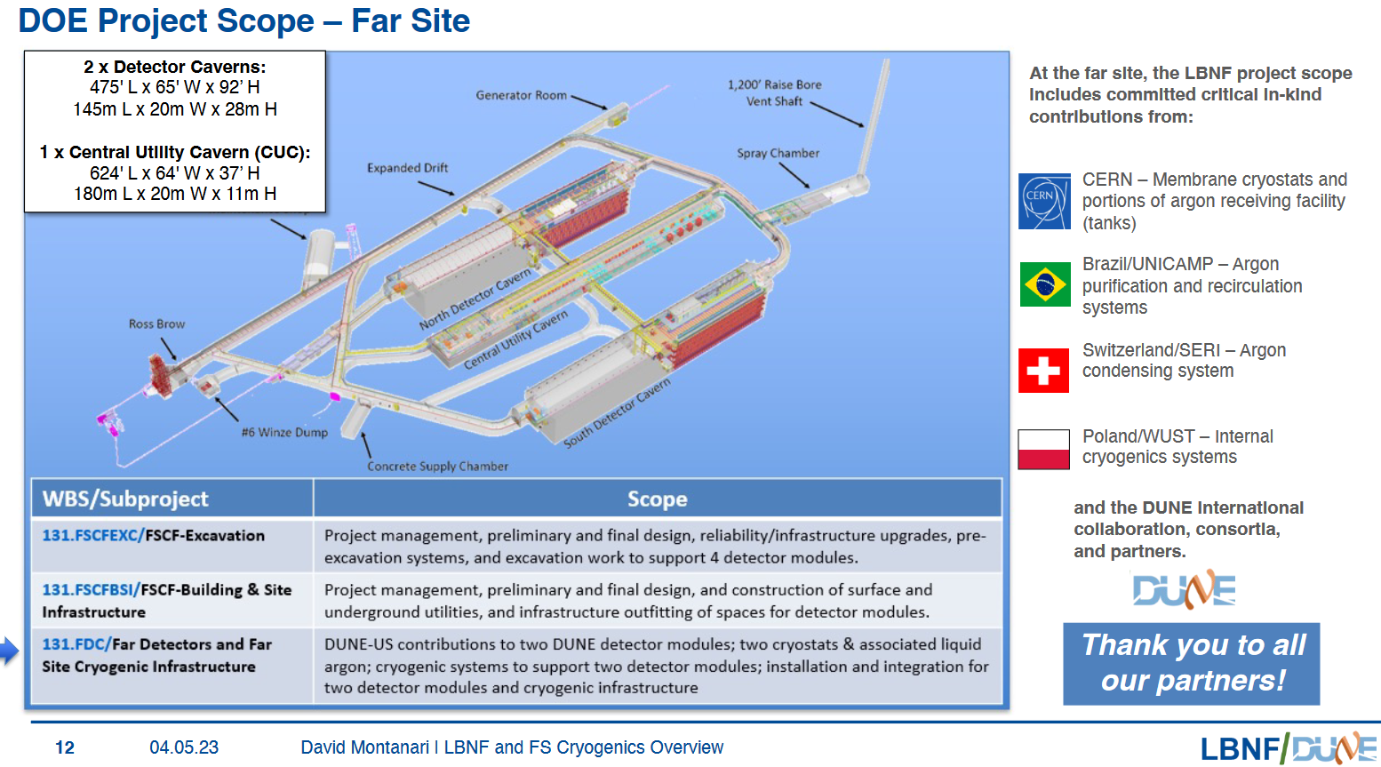
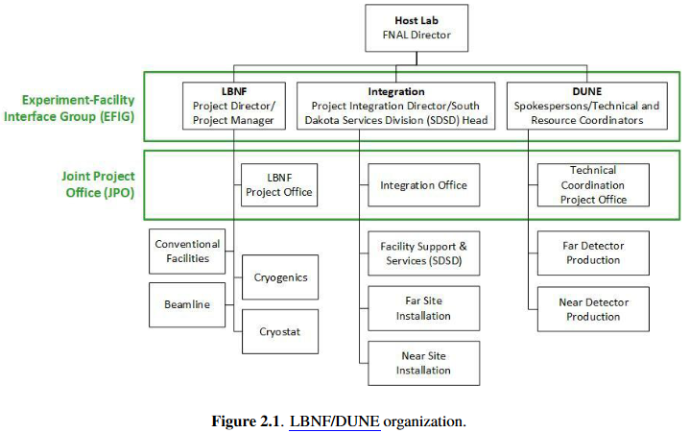
Working in a collaboration
with
CERN-NP personnel
FD-1 = HD
FD-2 = VD
1st time large scale delivery to a host lab outside CERN via in-kind contribution
Share of expertise started 2013
Responsibility
What is needed for the equipment to be accepted in a US-lab ? (see next slides)
How do we integrate into the project organization?
FD-1 = HD
2018
Trading of scope in progress 2024
Source: DUNE TDR
Notes:
Transition:
What does it mean for us working in a collaboration ?
Comments:
NP is responsible for the design, production and installation of 2 cryostats with ressouces from (EP-NU)
+ is responsible for the design and production of Proximity Cryogenics Condensation System (installation not included) (ATS/TE-CRG-CL)
Collab means:
- share of expertise. Refer to Rex in previous slide
- means also responsibility
- At the same time what is needed to be accepted: see over next slides the framework and validation steps for this
Joint Project Office for the 3 parallel projects. Ensures consitency.
Find personnel sitting at CERN: safety, system eng, CAD designer

Slide 11
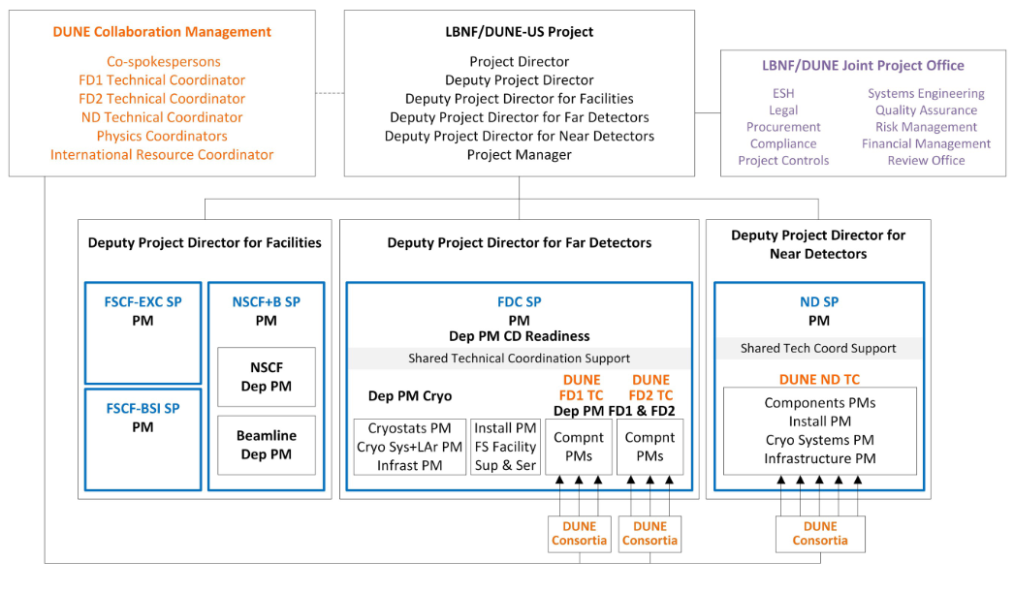
CERN/NP in the LBNF-DUNE-US Project
Codes/standards equivalencies
Our main interface
Weekly meetings
Ensures we comply with LBNF/DUNE QA & Safety
Participates to reviews
Source:
edms 2795431
Notes:
Comments:
We have one single point of contact for interacting with the upper project org.
+ our own NP internal project structure (see back-up slide)
Safety: CERN and DOE have worked to establish a code equivalency
which allows each party to accept in-kind deliveries manufactured according to either European or American standard
Covers: pressure vessels, CE-marked pressure piping, CE-marked safety valves, structures…
Transition:
This is for the framework
Now about the workflow to produce our cryogenic system

Slide 12
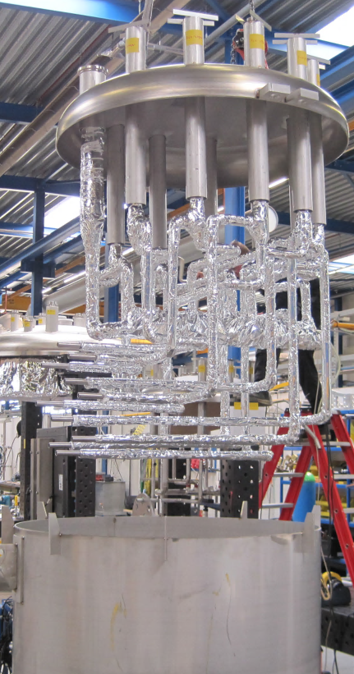
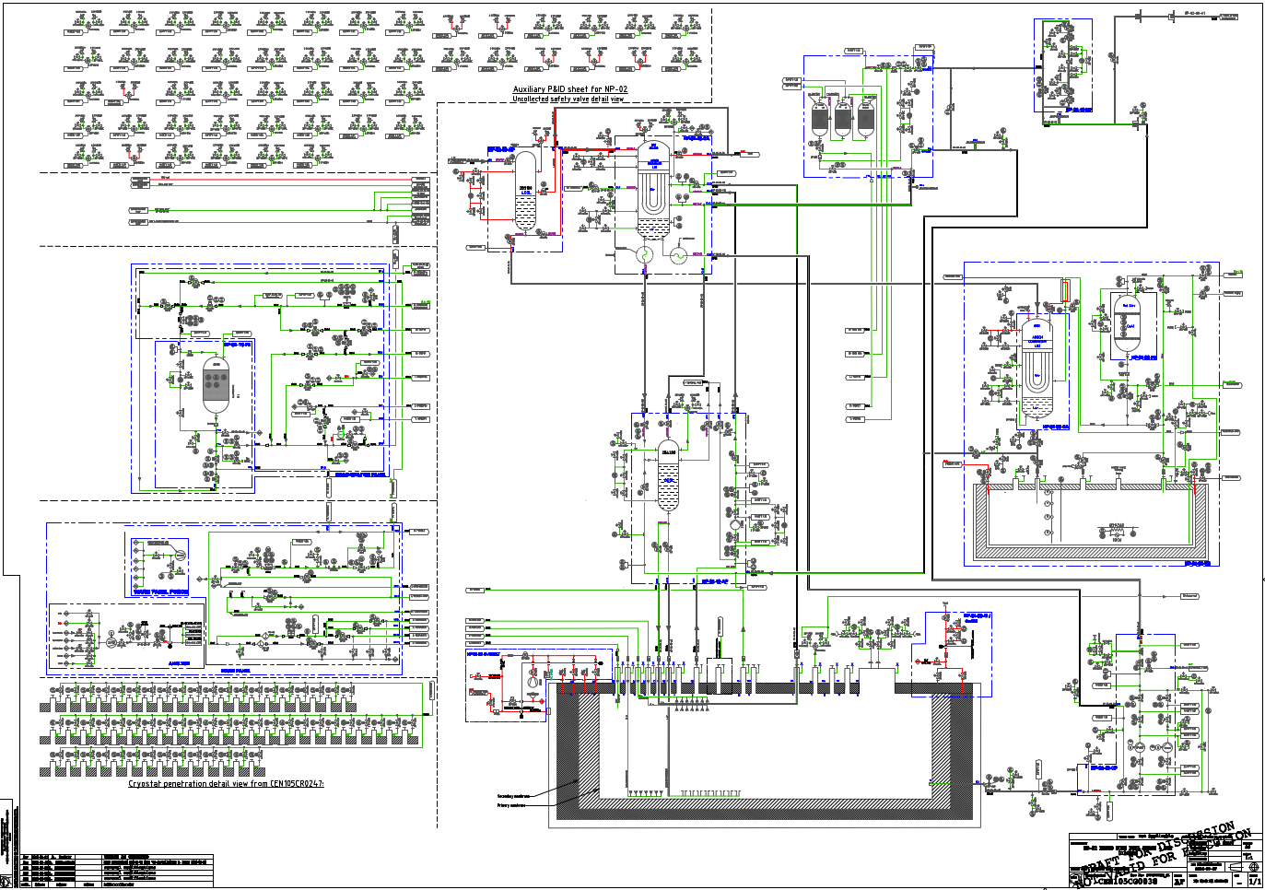
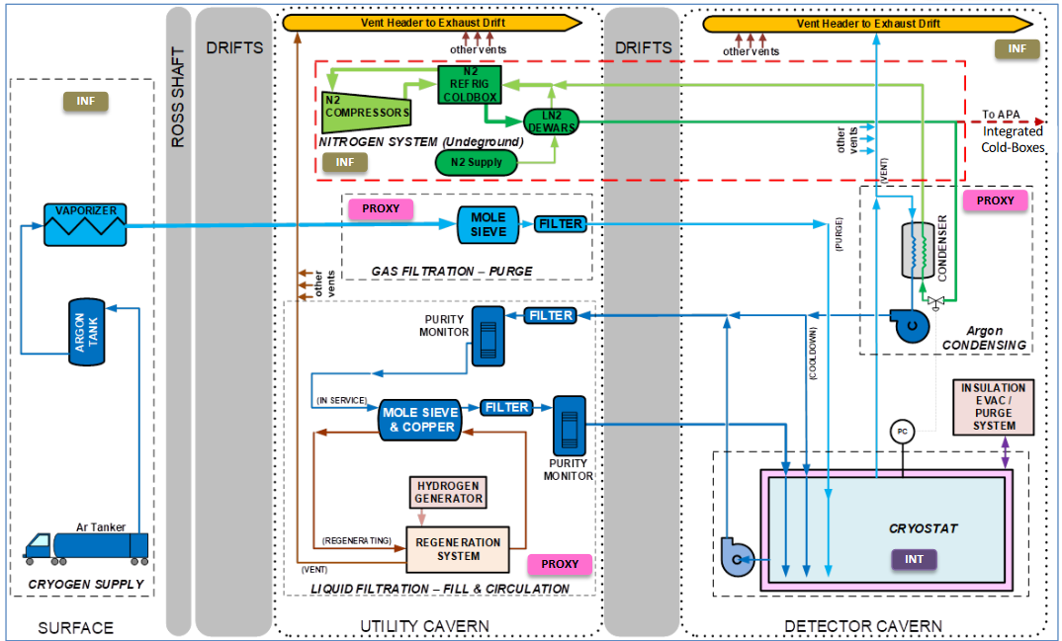
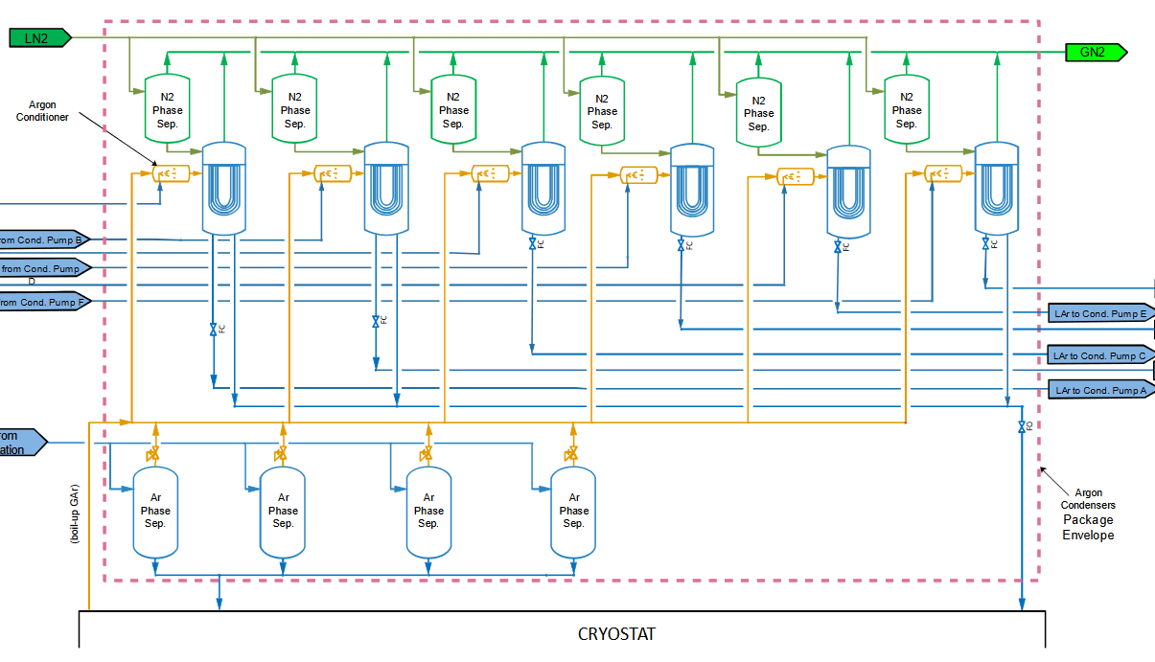
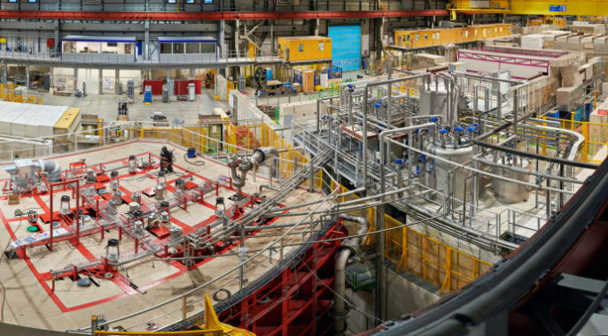
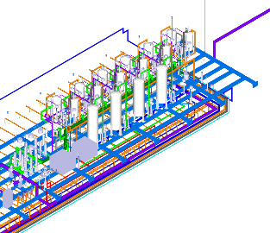
Cryogenic systems
a set of vacuum insulated valve-boxes and interconnecting transfer-lines
including instrumentation, filters, pumps, heat exchangers …
for liquid argon and liquid nitrogen @ temperatures ranging from 80 K to 420 K
ProtoDUNE cryogenics @ CERN
Scaling up
DUNE cryogenics @ SURF
several similar units working in parallel
22 valve boxes
~700 m transfer-lines
w diam. up to DN250
~ 135 cryogenic valves
ranging DN40 to DN150
From concept
in size and complexity
© Fermilab
The installed cryogenic system @ EHN1
To functional equipment
© CERN-PHOTO-201812-336-2
Condensers system 3D on cryostat mezzanine
Notes:
Transition:
This is for the framework
Now about the workflow to produce our cryogenic systems
Comments:
First: what do we mean by cryo system ?

Slide 13

From the definition to the execution
Conceptual
Design Phase
Preliminary
Design Phase
Detailed/Final
Design Phase
Fabrication
Phase
Installation
Phase
Acceptance
Phase
Purchase and Production
Basic design
Freedom to structure our sub-project
Management and development plan based on standard practices
Builds on the team past experience on similar cryo projects
Approach: adopt a methodology and a level of formalism appropriate to efficiently deliver the cryogenic system, with the allocated resources
© LBNF-DUNE
Notes:
Transition:
highlight some phases of the sub-project lifecycle to show our engineering and management activities.
Comments:
This is where we usually go into industrial consultation
Within the top project structure we have the freedom to structure our sub-project ;

Slide 14
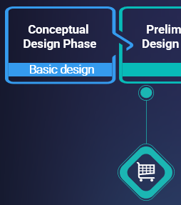
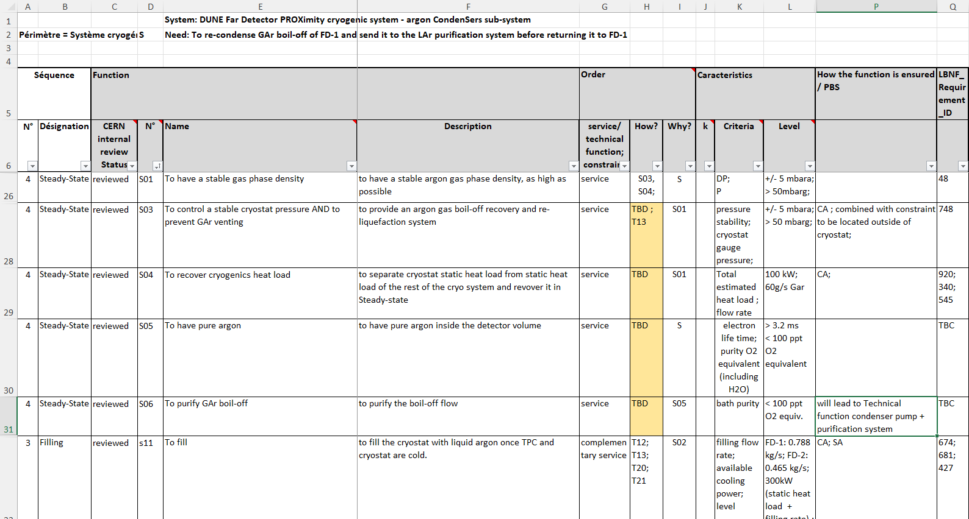
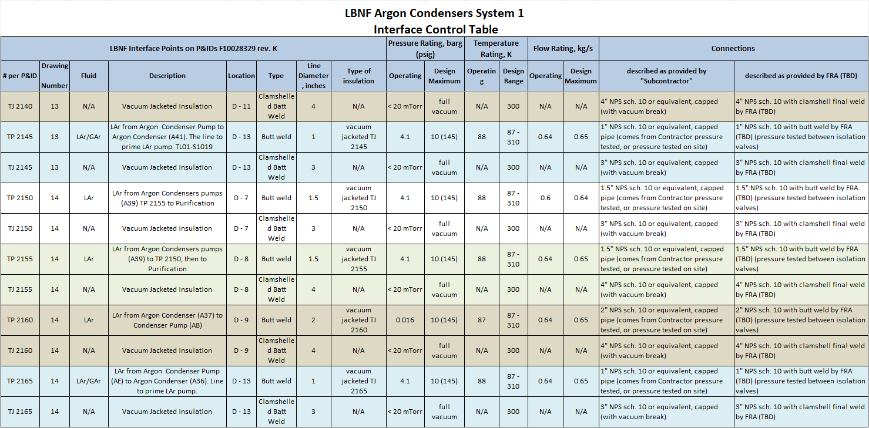
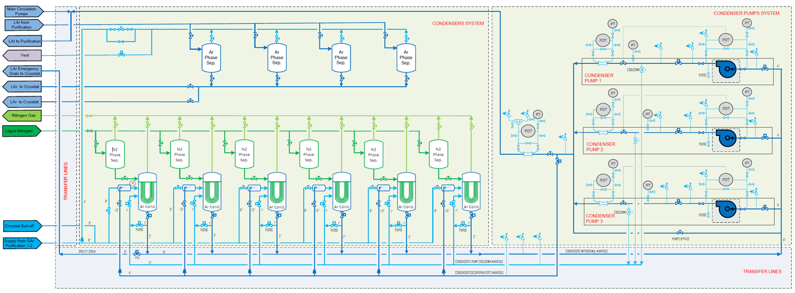
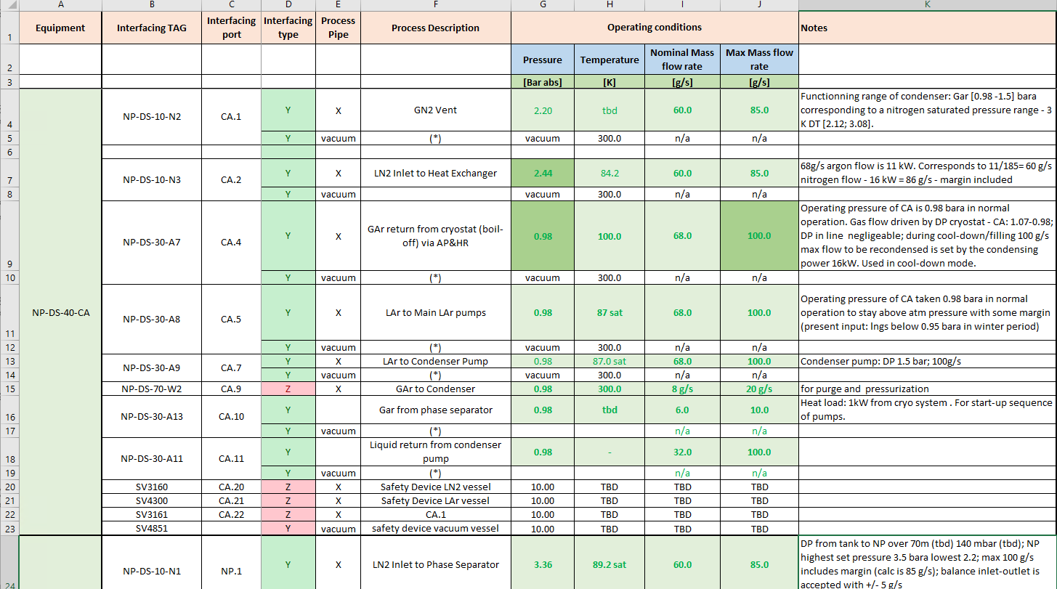
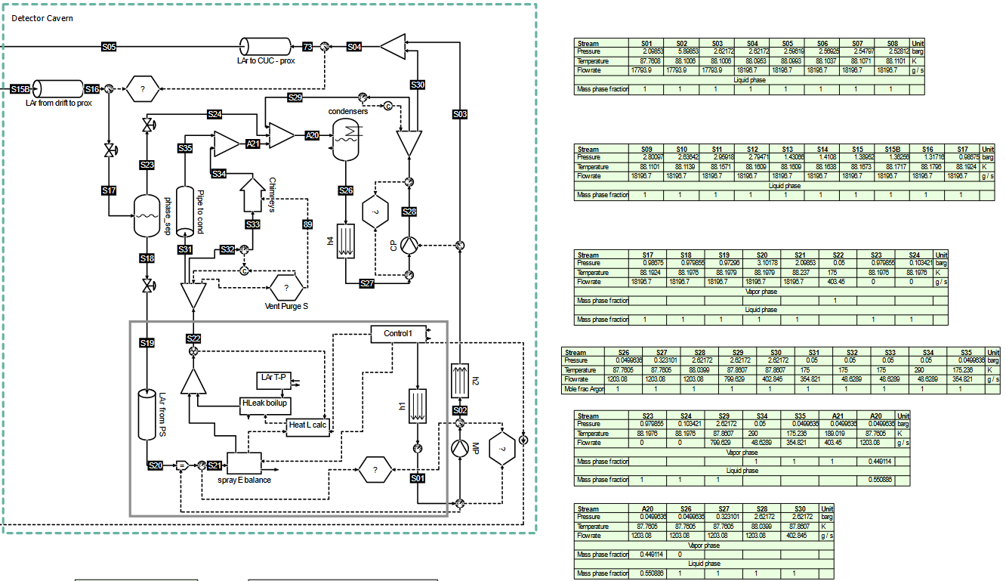
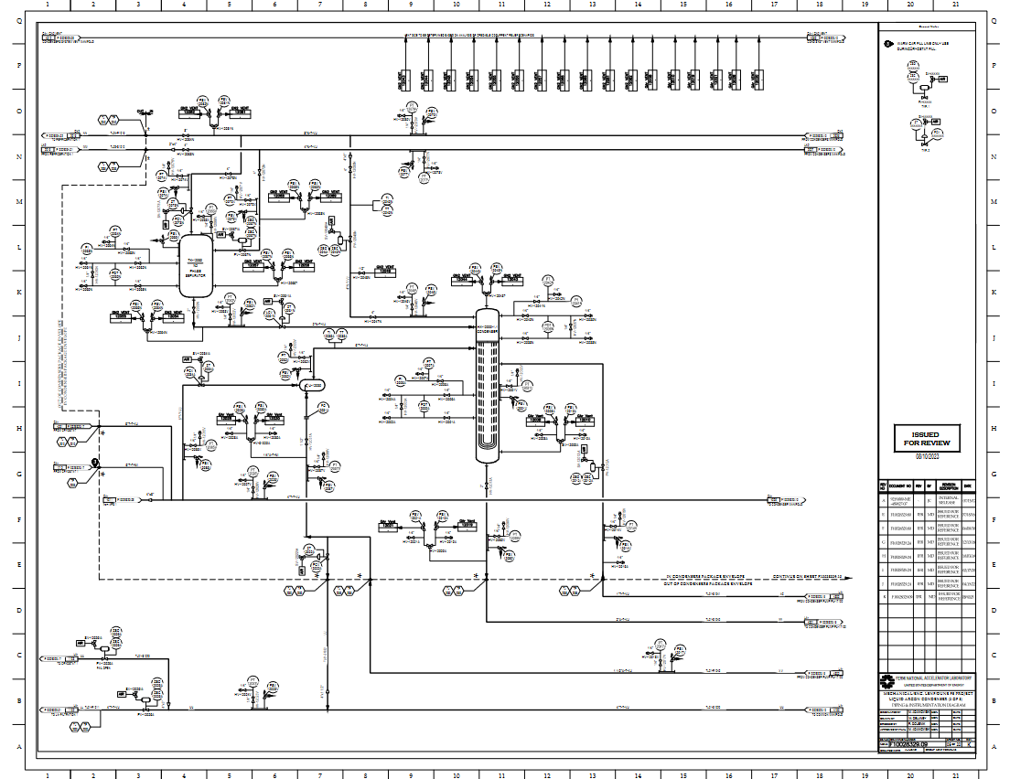
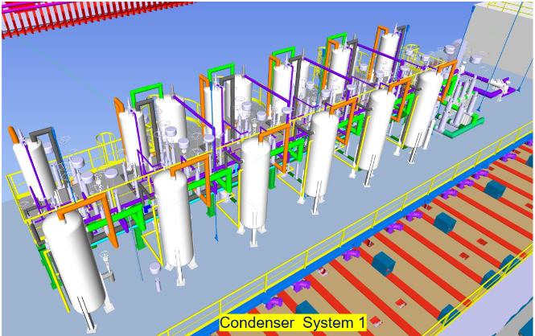
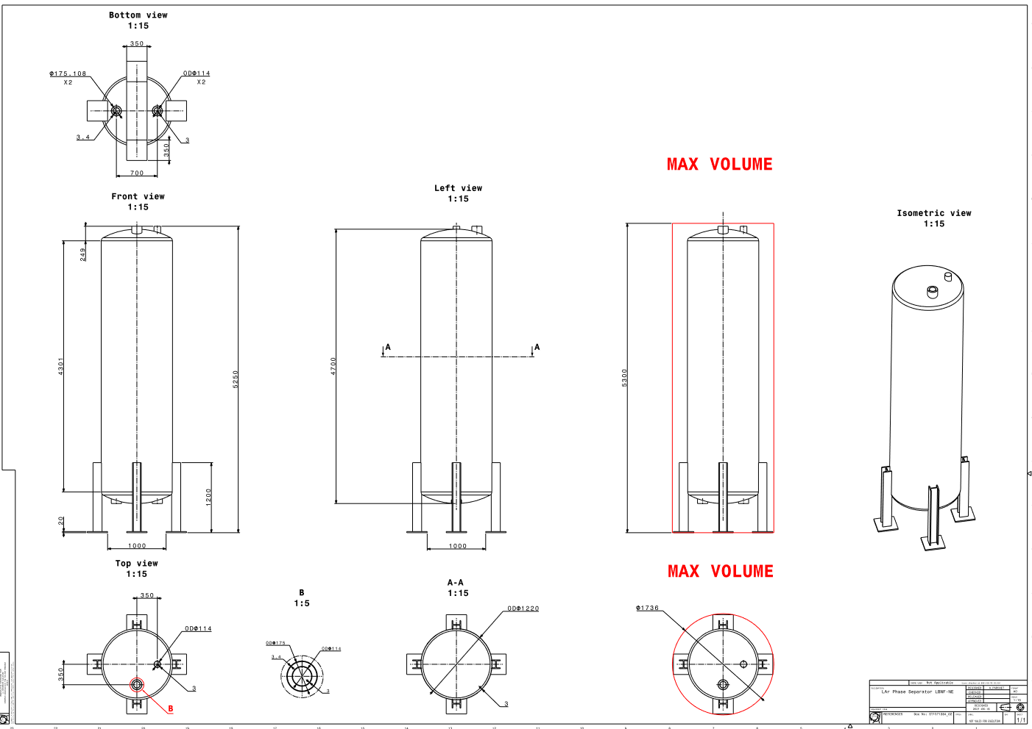
Engineering activities & methodology (1/2)
Expression of need:
Requirements → Functional Analysis
ICD / Interface Sheets
Block diagram / PFD
Mass and energy balance
© Fermilab
NP/LBNF joined P&ID review; HAZOP / FMECA
More than just a concept
ProtoDUNE REx: functional vs technical specs
P&IDs
3D
2D
Notes:
Transition:
Here is the workflow of our engineering activities in the basic design phase, i.e. project definition
Comments:
Requirements
and constraints : example → shaft limitation requires modular elements for assembly underground
ProtoDUNE REx fitted into DUNE requirements as technical design choices for instance
FA sets the frame for the definition of the controls logics
Interfaces: mechanical, thermal, process, electrical, cleanliness, tests …
Product Assurance formalism: P&ID reviews ; HAZOP / FMECA
As already mentionned : continuous interaction between the CERN / Fermilab teams

Slide 15
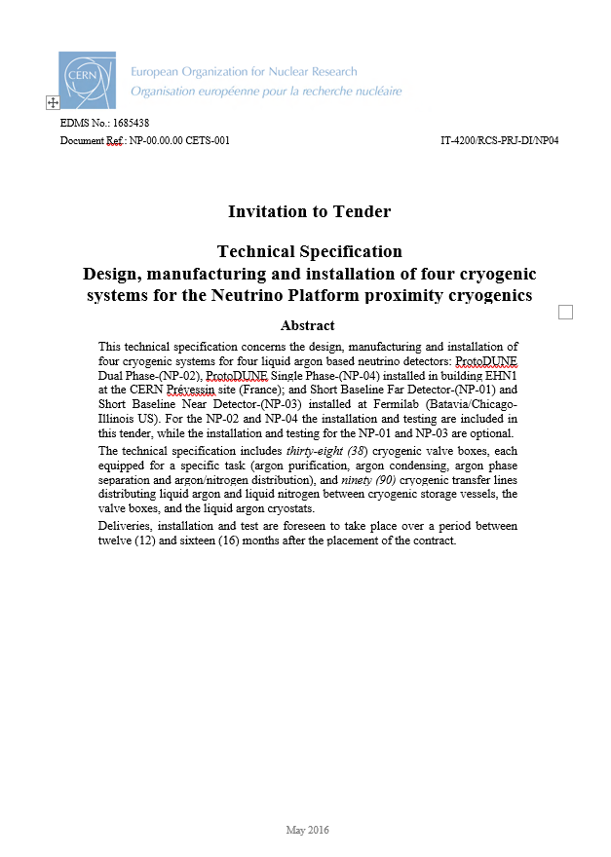
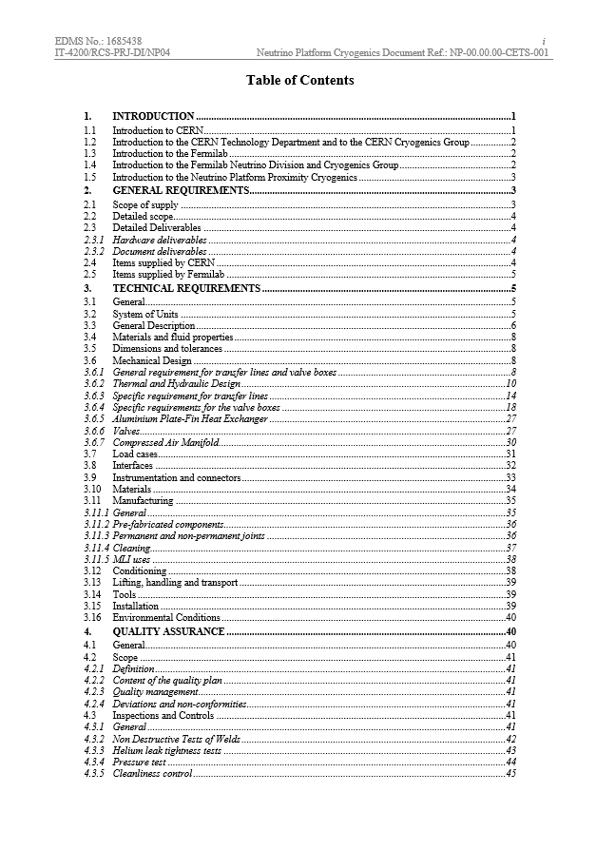
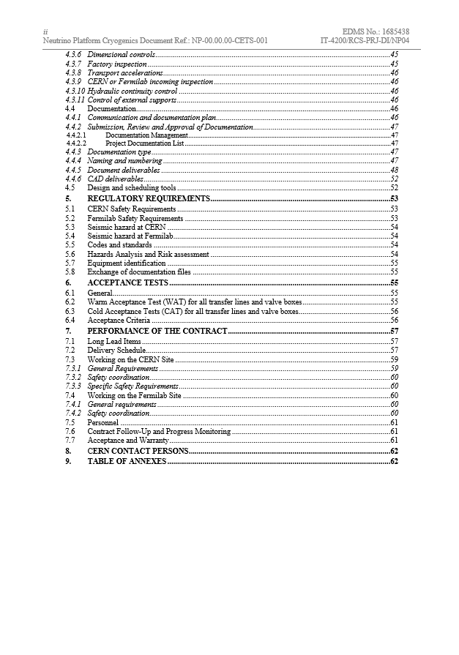
Engineering activities & methodology (2/2)
Technical specification
NP responsibility
PRR / spec committee
w participation of LBNF partners
Validate requirements
Sets the ground for acceptance by LBNF
→ Ready for industrial consultation
Notes:
Transition:
At this stage we have all info to produce a technical specification.
Comments:
Spec is NP responsibility
Validate requirements against higher level requirements

Slide 16
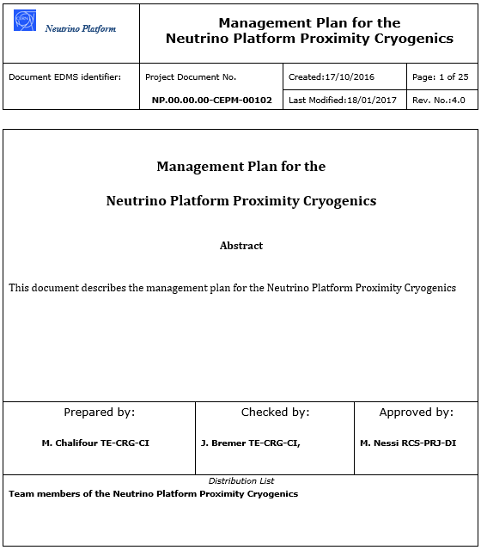
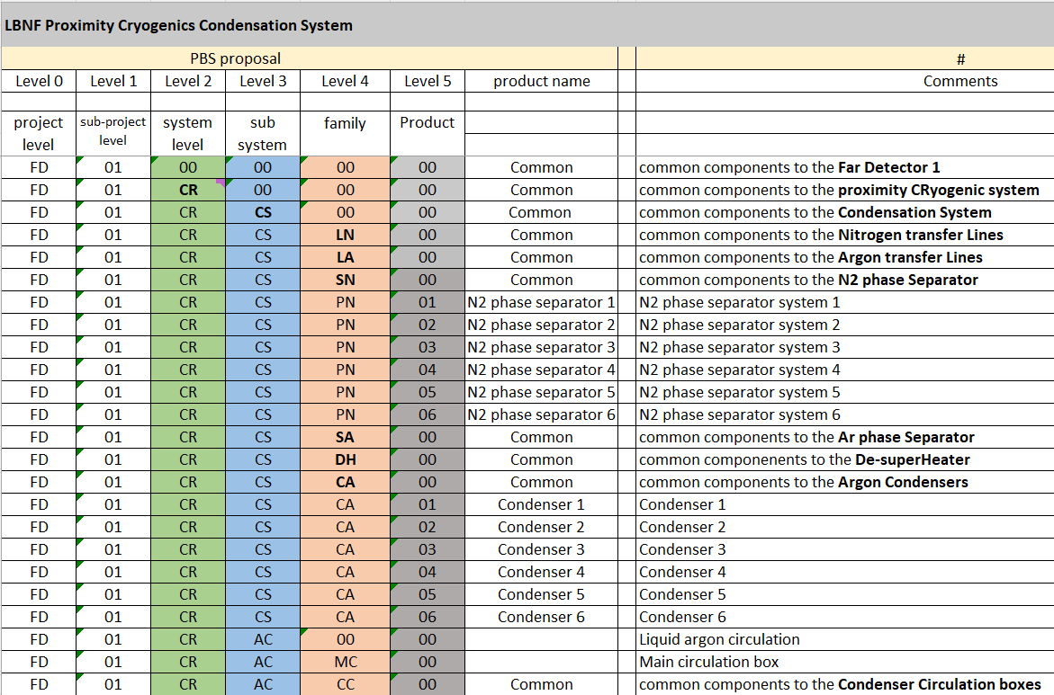
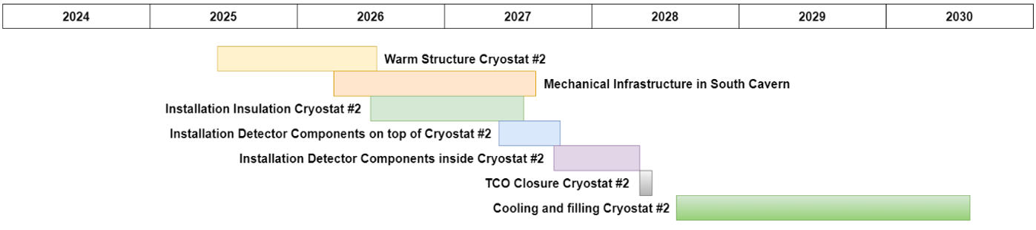
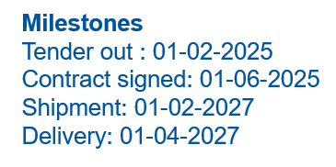
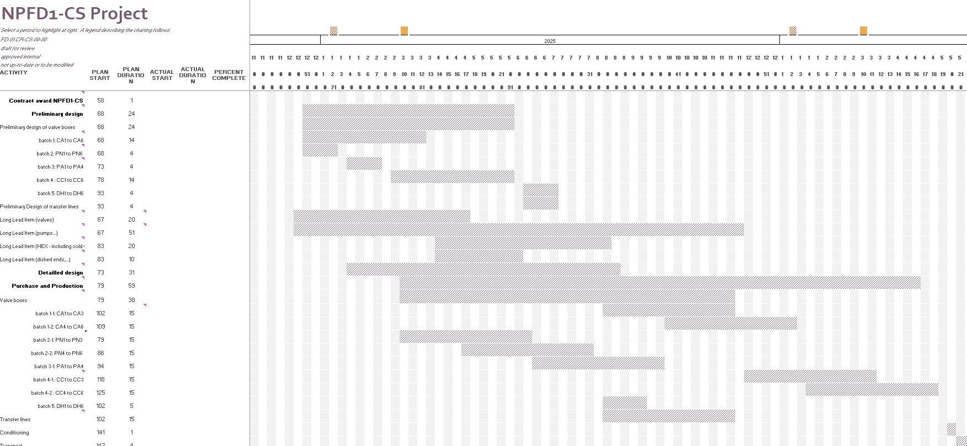
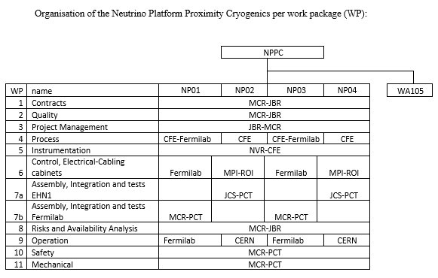
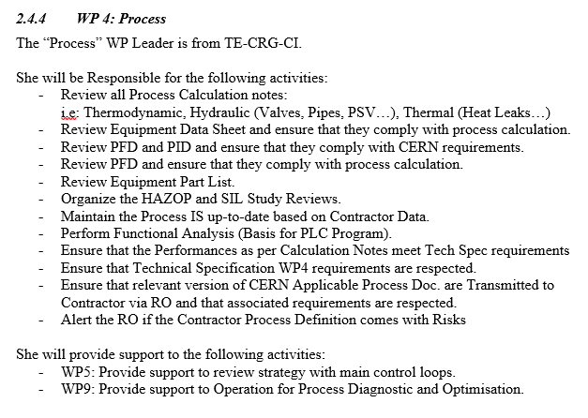
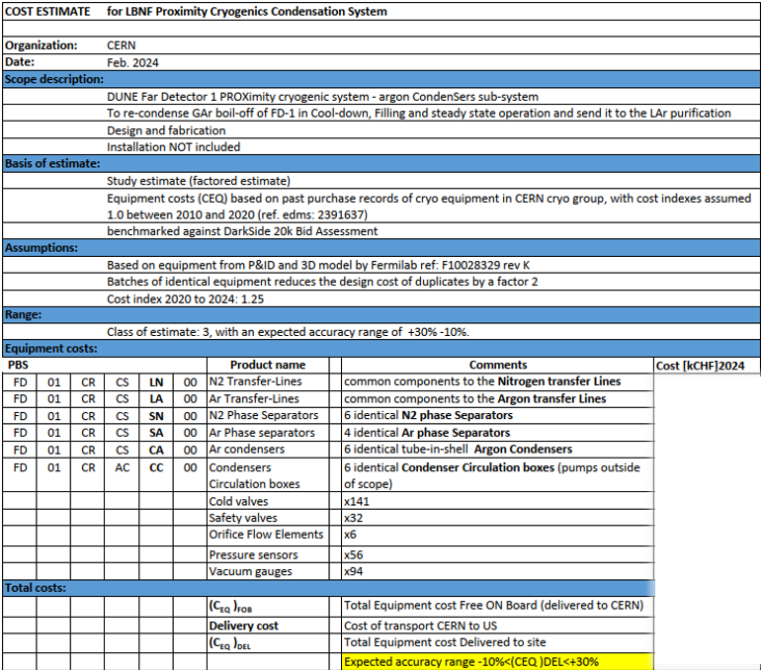
Management activities
PBS
Management Plan
Milestones
WBS to be updated
OBS
WP Leader Roles and Responsibilities
Cost estimate
Simple tools, sufficient to handle sub-project of this scale
Notes:
Transition:
In parallel we also work out the management plan.
Comments:
OBS: not only mechanical and assembly activities; includes as well intrumentation, controls (ProtoDUNE only)
WP description: precisely defines roles and responsibilities ; + support to other WP
Cost estimate:
Relies on tool developped in the CRG group valid for this scale of equipment: refer to Andrew’s presentation: analysis of past orders since 2010, identification of influencing factors and correlations ; benchmarked against ProtoDUNE and DS20k offers analysis; cost index
Tools: No pre-existing templates → excel based developped to our need

Slide 17
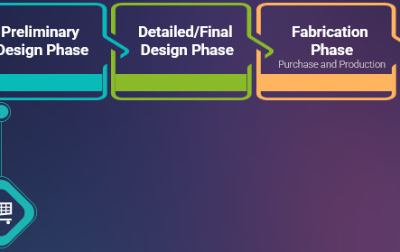
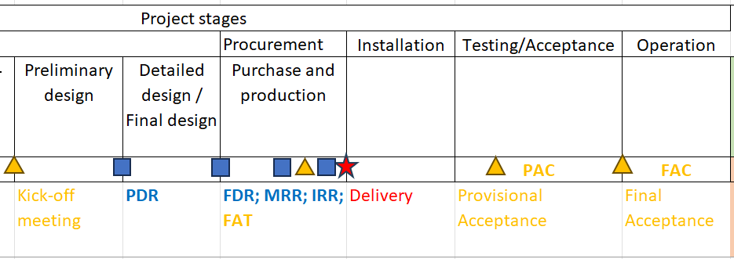
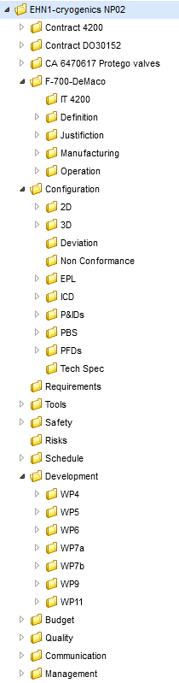









QA activities in contract execution
Documentation deliverable at each Milestone defined in specs
Deviations requests: joined examination by NP/LBNF
Reviews and acceptance tests are Hold Points → verification of compliance w requirements
Witnessed by NP/LBNF
Credits: T. Baroncelli
Doc list
© LBNF-DUNE
Notes:
Transition:
Now moving to the contract execution phase
Comments:
QA is verification against requirements
Joined reviews and inspections
Regular intermediate site visits

Slide 18



Conclusion
Run medium size sub-project with:
standard PM practices;
methodology and level of formalism appropriate to efficiently deliver the cryogenic system, with the allocated resources;
simple tools;
continuous interactions within a collaboration framework (both for including REx and for acceptance by LBNF)
Methodology is a tool; People make it happen !
@CERN
The metal structure of the first cryostat in the harbour (Spain)
Photo: Matthew Kapust, Sanford Underground Research Facility
https://news.fnal.gov/2024/02/excavation-of-colossal-caverns-for-fermilabs-dune-experiment-completed/
First cryostat filling is foreseen to begin in Q2 2028…
and complete 1 year later, after argon delivery by 1000 road trucks !
Notes:
Transition:
What I have shown in this presentation is
Comments:
Methodology: project definition / project verification
Collaboration: continuous interaction and formal participation to reviews

Slide 19
BACK-UP SLIDES

Slide 20



Cryogenics expertise for liquefied rare gases detectors
Cryogenics as active “medium” of detectors
for particles energy measurements
like Liquid Ionization Chambers
Module of the accordion shaped electromagnetic calorimeter being assembled
Reconstructed 3D image of the neutrino interaction
Electrons shower
Calorimeters
Time Projection Chambers
Requirements | ATLAS | ProtoDUNE | DarkSide-20k | DUNE
to maximize the number of events → a large volume of a dense noble liquid | 100 m³ LAr | 560 m³ LAr | 500 m³ LAr | 4 x 12 000 m³ LAr
to have a uniform reaction over the sensitive volume → a limited T° difference over the detection volume | 88.3 K DT < 700 mK | 87.5 K DT < 500 mK | 87.5 K | 87.5 K DT < 1 K
to put a HV field over the sensitive argon volume → a subcooled bath to prevent bubbles | 2 kV field 2 mm drift gap | 18 kV 3.6 m drift gap | - | 300 kV 6 m drift gap
to guarantee a sufficiently long free electron lifetime → a pure liquid (oxygen equiv. purity) | > 0,15 ns < 2 ppm | > 3 ms < 100 ppt | > 3 ns < 100 ppb | > 10 ms < 30 ppt
to reduce the noise level (cosmic particles) → in underground areas | -100 m @ CERN | -10 m @ CERN | - 1.4 km @ LNGS | - 1.5 km @ Sandford Lab
to preserve detector properties → continuously operated over long periods | Since 2005 17 years | 2019 1 year | 2024 years | beg 2028 years
Commonalities
Scaling in size and complexity
Notes:
Builds on NA 48 experience started in 97, still operating

Slide 21



Perspectives towards DUNE proximity cryogenic system
This is how everything has to go down: personnel and material !
Notes:
e

Slide 22


Neutrino Platform Organization
EDMS: 2733743

