Slide 1
1st Accelerators Technology
Sector Workshop
Engineering Design Tools and Processes
Project Management Methodologies and Tools
Chair: Mike Lamont
Interconnecting knowledge, experience, methods,
people & data to foster learning & collaboration

Slide 2
Project Management Methodologies and Tools - PM1
Melania Averna
Lukasz Burdzanowski

Slide 3
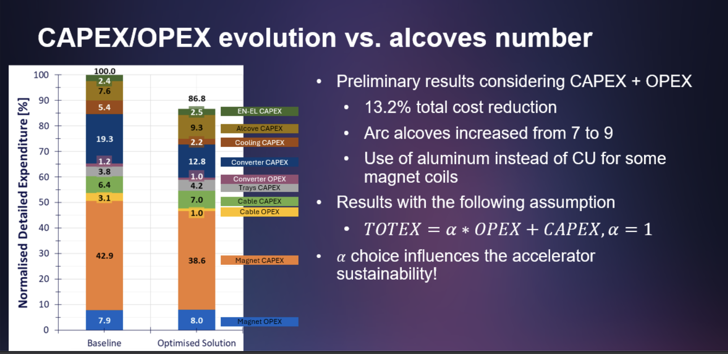
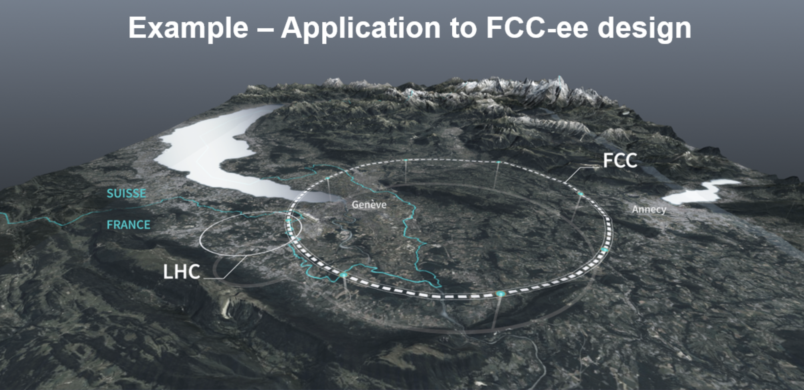
Enhancing Technical Project Management through System Optimisation – Application to FCC-ee design
Optimisation - essential to cost savings and to streamline project priorities
Efficiently working together - key to succeed in large projects
Gestalt "the whole is greater than the sum of its parts"

Slide 4
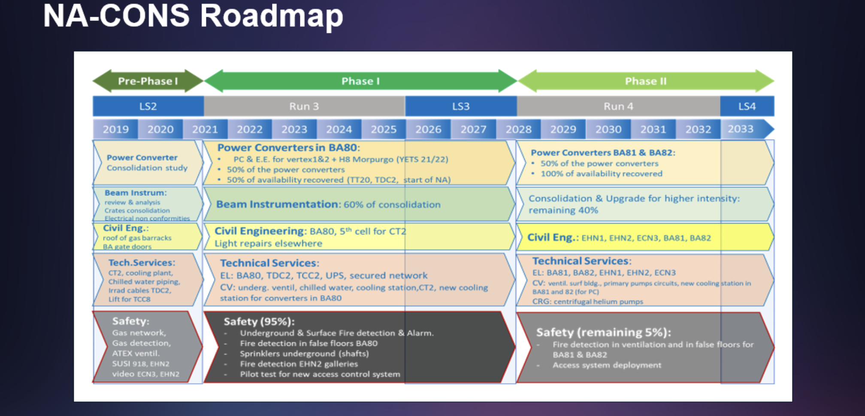
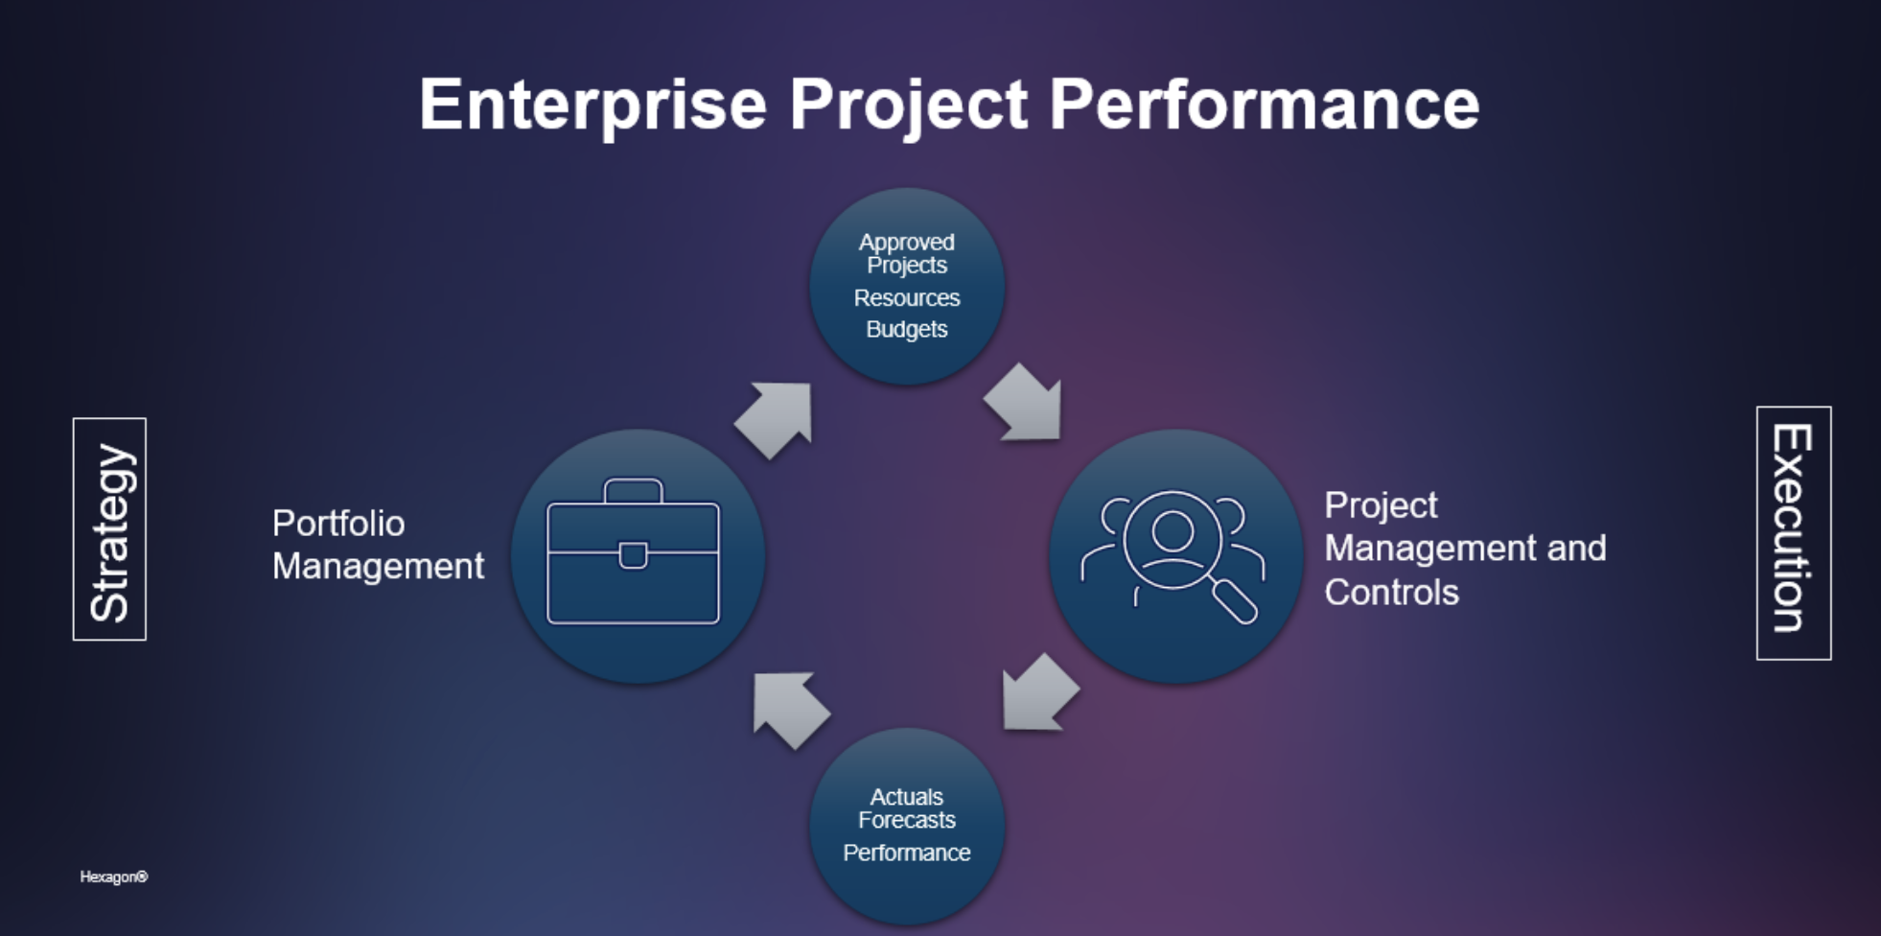
Showcasing North Area consolidation project management and its evolution
Extensive scope & high complexity
Coordination
Tools: EVM, PLAN, MS Office
Way Forward
Enhanced PM by an integrated solution
Opportunity – EVM replacement initiative

Slide 5
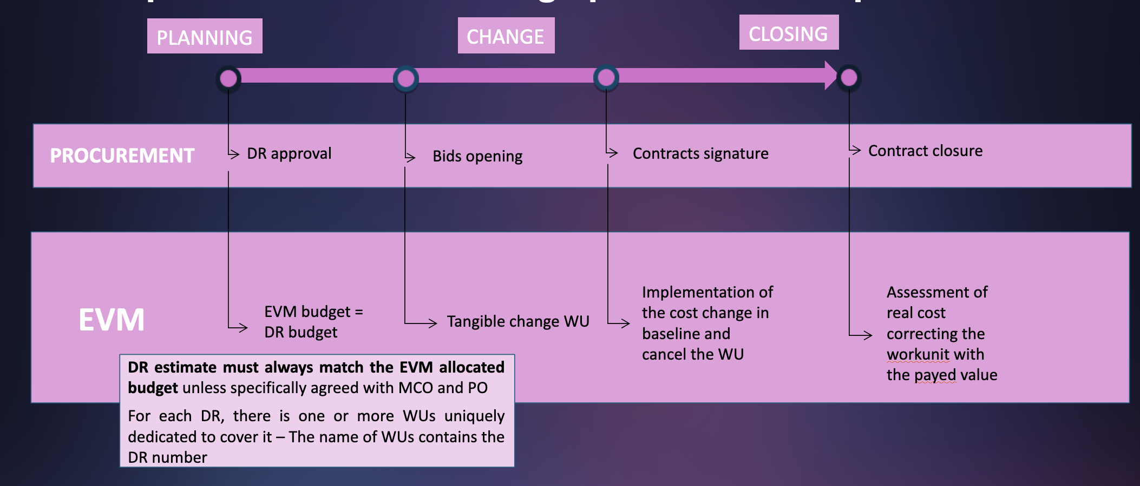
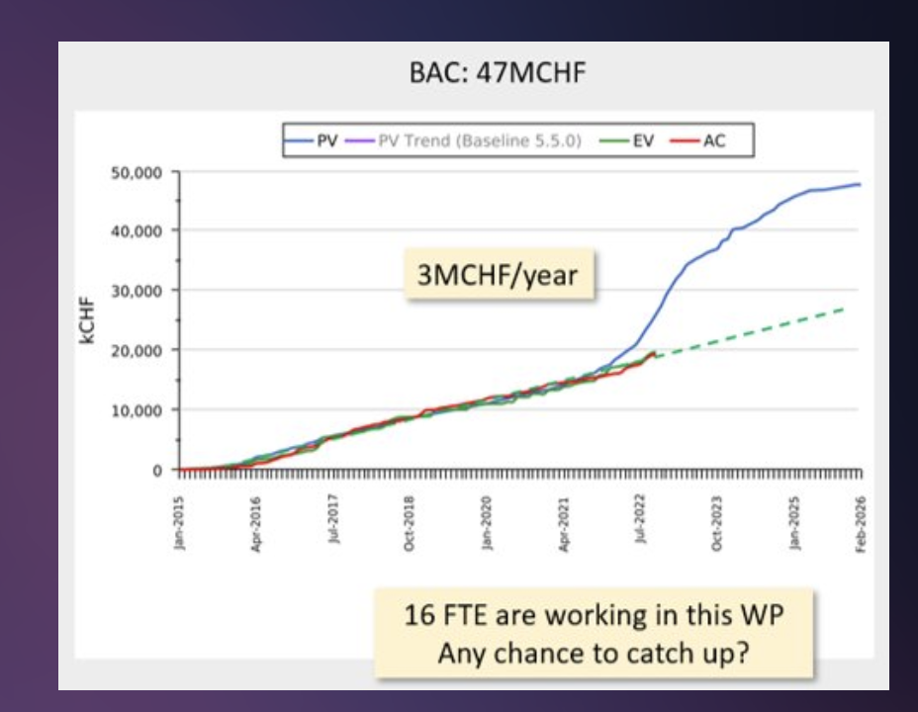
Tracking budget, procurement and risk for High Luminosity LHC
EVM:
essential in planning, monitoring, management of change and activities close out
effective in analyzing and reporting – anticipating problems
Cons:
  requires good input data. Correcting - time and resource consuming
  EVM & CET link is not optimised: laborious manual process
  Strong WPs and the MCO team collaboration to ensure effective operation and accurate results.

Slide 6
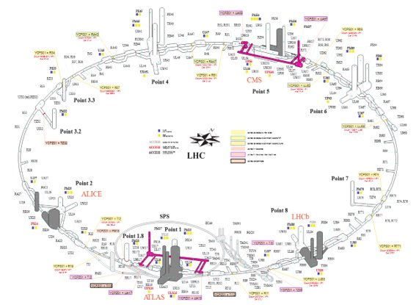
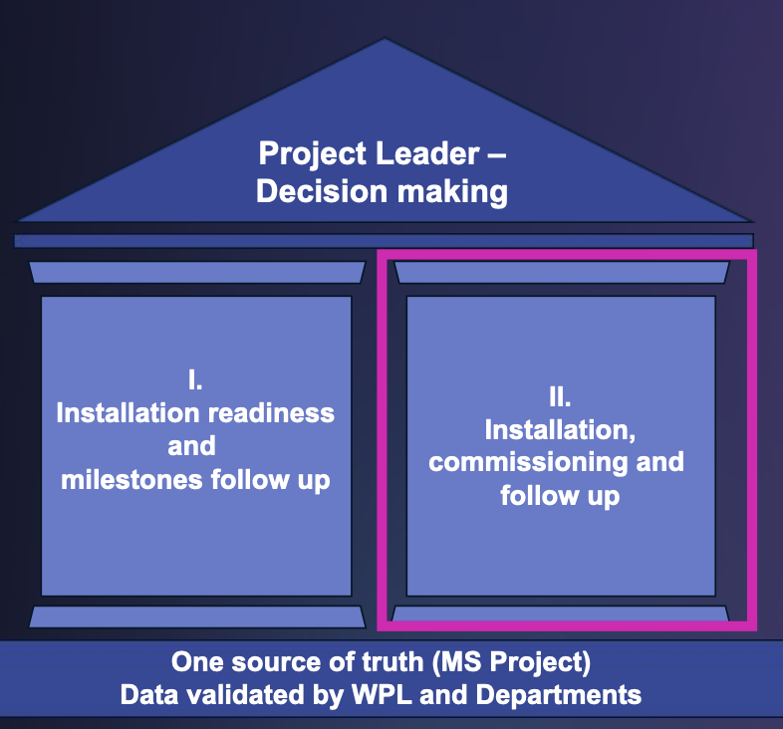
Coordinating the High Luminosity LHC project
Sophisticated integration of systems, equipment, and services within the LHC
Significant step forward for the LHC coordination
Reliable methodology and specialized tools for large-scale scientific projects
Lessons learnt from Long Shutdowns
Expertise, flexibility, accountability and communication Together is better.​

Slide 7
Summary of Project Management Methodologies and Tools, part 1
Large projects - key to success
system optimisation, effective coordination, team collaboration
Methodology and Tools available (EVM, PLAN and MS Office)
  EVM planned to be discontinued – opportunity for an integrated tool
  Quality of data impacts the quality of decisions
Gestalt "the whole is greater than the sum of its parts"​

