Slide 1
1st Accelerators Technology
Sector Workshop
Engineering Design Tools and Processes
Project Management Methodologies and Tools
Chair: Mike Lamont
Interconnecting knowledge, experience, methods,
people & data to foster learning & collaboration

Slide 2
Engineering design tools and processes for cryogenics
Andrew Lees (TE-CRG-ME)
Notes:
Thanks for this introduction
I represent ME section of Cryo group
I will:
Explain briefly cryogenics at CERN
How ME fits into this
Tool and method we use to perform our work

Slide 3
Cryogenics
Gas | Boiling point (K) @ P_{atm} | Inventory at CERN (t) | Consumed per year (t)
Krypton | 119.8 | 24 | -
Methane | 111.6 | - | -
Oxygen | 90.2 | - | -
Argon | 87.3 | 1800 | -
Nitrogen | 77.4 | - | 7100
Neon | 27.1 | - | -
Hydrogen | 20.3 | < 1 | -
Helium | 4.2 | 160 | 35
The branch of physics dealing with the production and effects of very low temperatures (https://en.oxforddictionaries.com/definition/cryogenics; Oxford Dictionaries)
All scientific and technological disciplines dealing with temperatures below 120 K (http://dictionary.iifiir.org/search.php; International Dictionary of Refrigeration)
Key enabling technology for accelerators and physics experiments
Notes:
Cryogenics → Branch of physics dealing with the production and effects of very low temperatures
Specifically below 120 K
A number of cryogens with boiling point below 120 K → Table shows those used at CERN → Dominated by Argon, Nitrogen and Helium
Key enabling technology → Often linked to superconductivity → But also as part of detectors (e.g. Neutrino Platform)

Slide 4
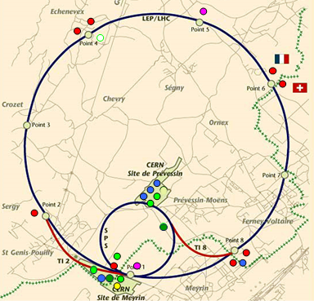
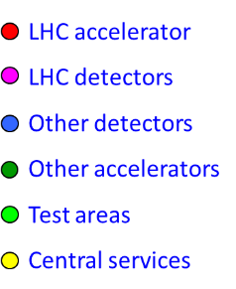
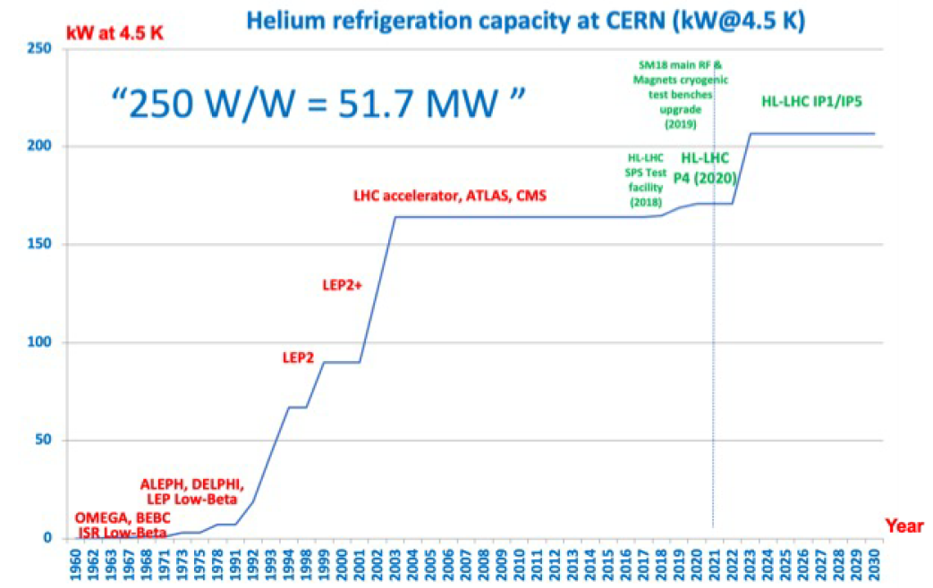
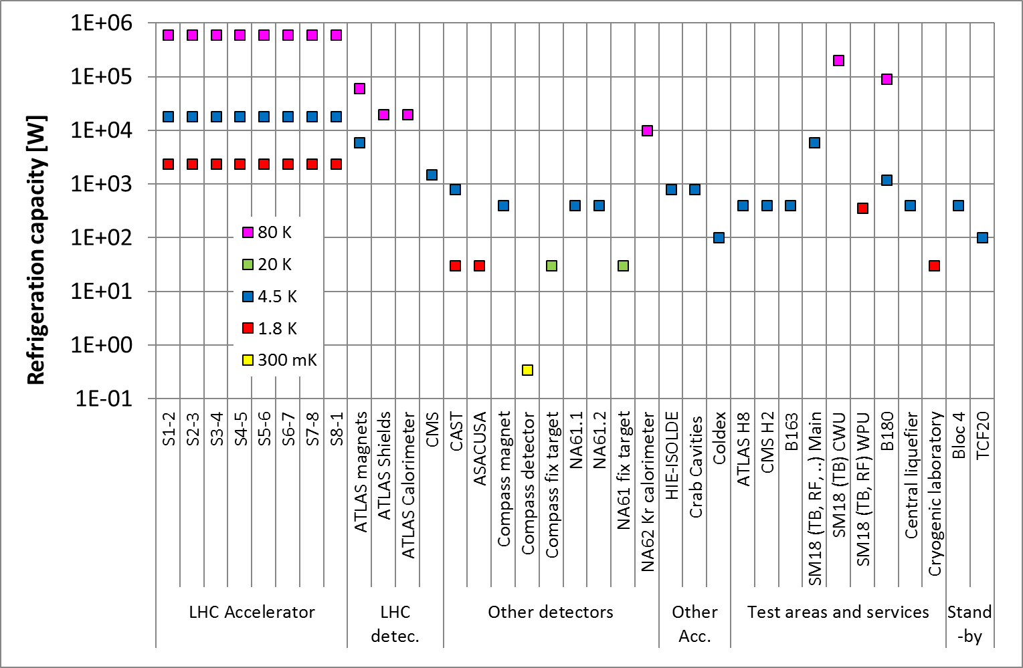
Cryogenics at CERN: Overview
    8 cryoplants
    8 Cryogenic sectors
    56 DFBs , 5 SC links
LHC Accelerator
LHC
LHC Detectors
Other Detectors
LHC
Detectors
Other Accelerators
    ATLAS SR+MR, PCS, ANRS
    CMS
Test Areas
Central Services
    2 refrigerators/liquefiers
    2 cooldown-warmup units
    Magnet test benches
    RF test benches
    HL-LHC IT String
LHC 140 t of helium cooled to 1.9 K
SM18
    Central liquefier B165, Cryolab
    Central purifier B253
    B163
    HIE ISOLDE
    WAT/B180 (FAIR S-FRS tests)
Meyrin
    Vertex NA61.1, NA61.2
    NA62
    COMPASS/AMBER
    ATLAS H8
    CMS RD5
    Neutrino Platform
North Area
SPS
    BA6 (CC)
    BA4 (Coldex)
Cryogenic capacity of TE-CRG cryogenic facilities
Notes:
Distributed all over CERN site
Largest systems link to the LHC → 140 t LHe at 1.9 K
Other main cryogenic areas → SM18, Meyrin site, NA and SPS
Refrigeration capacity → High capacity (especially for LHC) → Very large diversity (mW to kW) (log scale) (HL-LHC = 207 kW @ 4.5 K)
Significant increase 1970s → First with LEP than LHC → Next big increase with HL-LHC

Slide 5
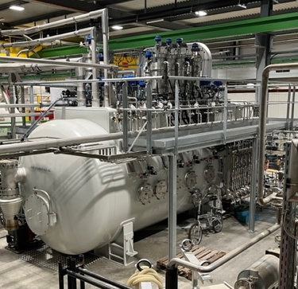
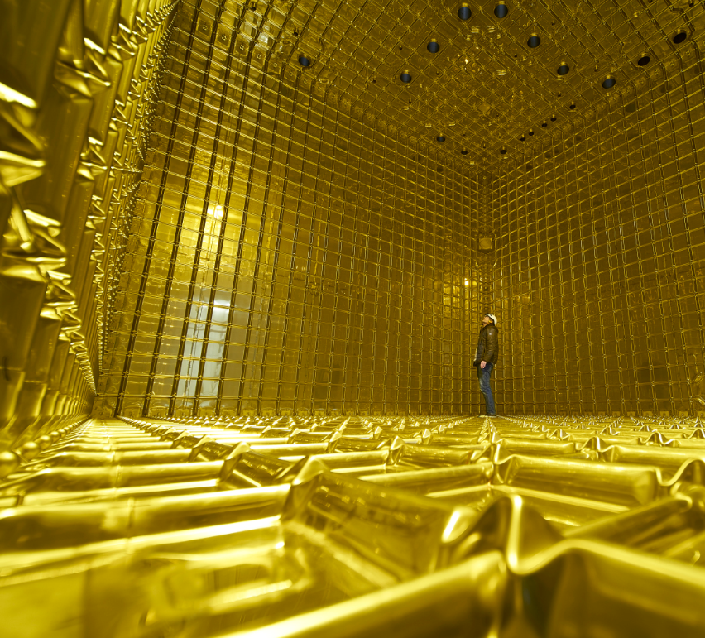
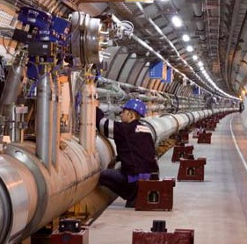
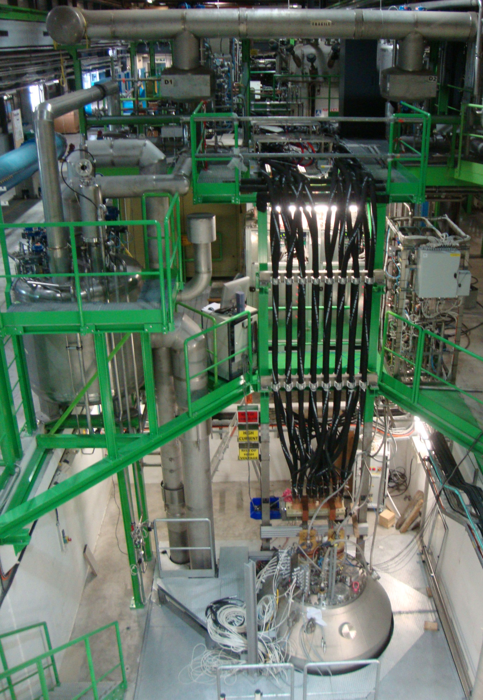
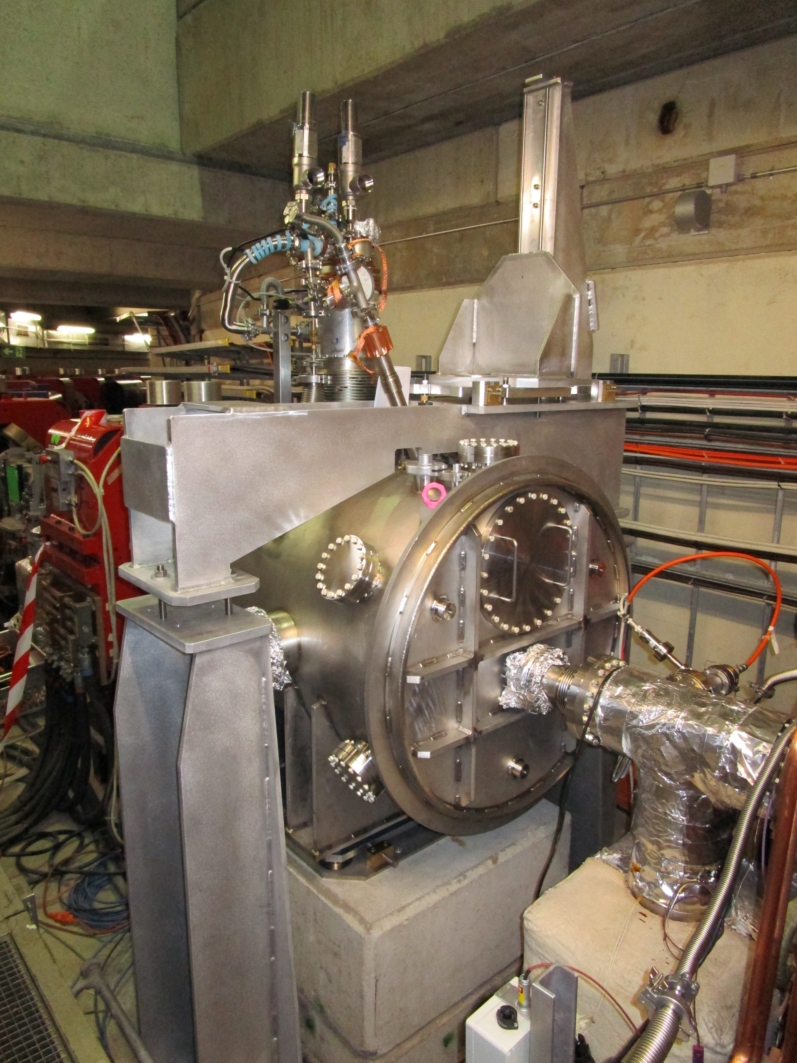
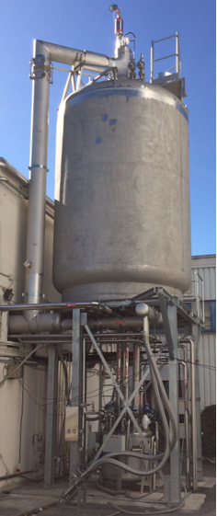
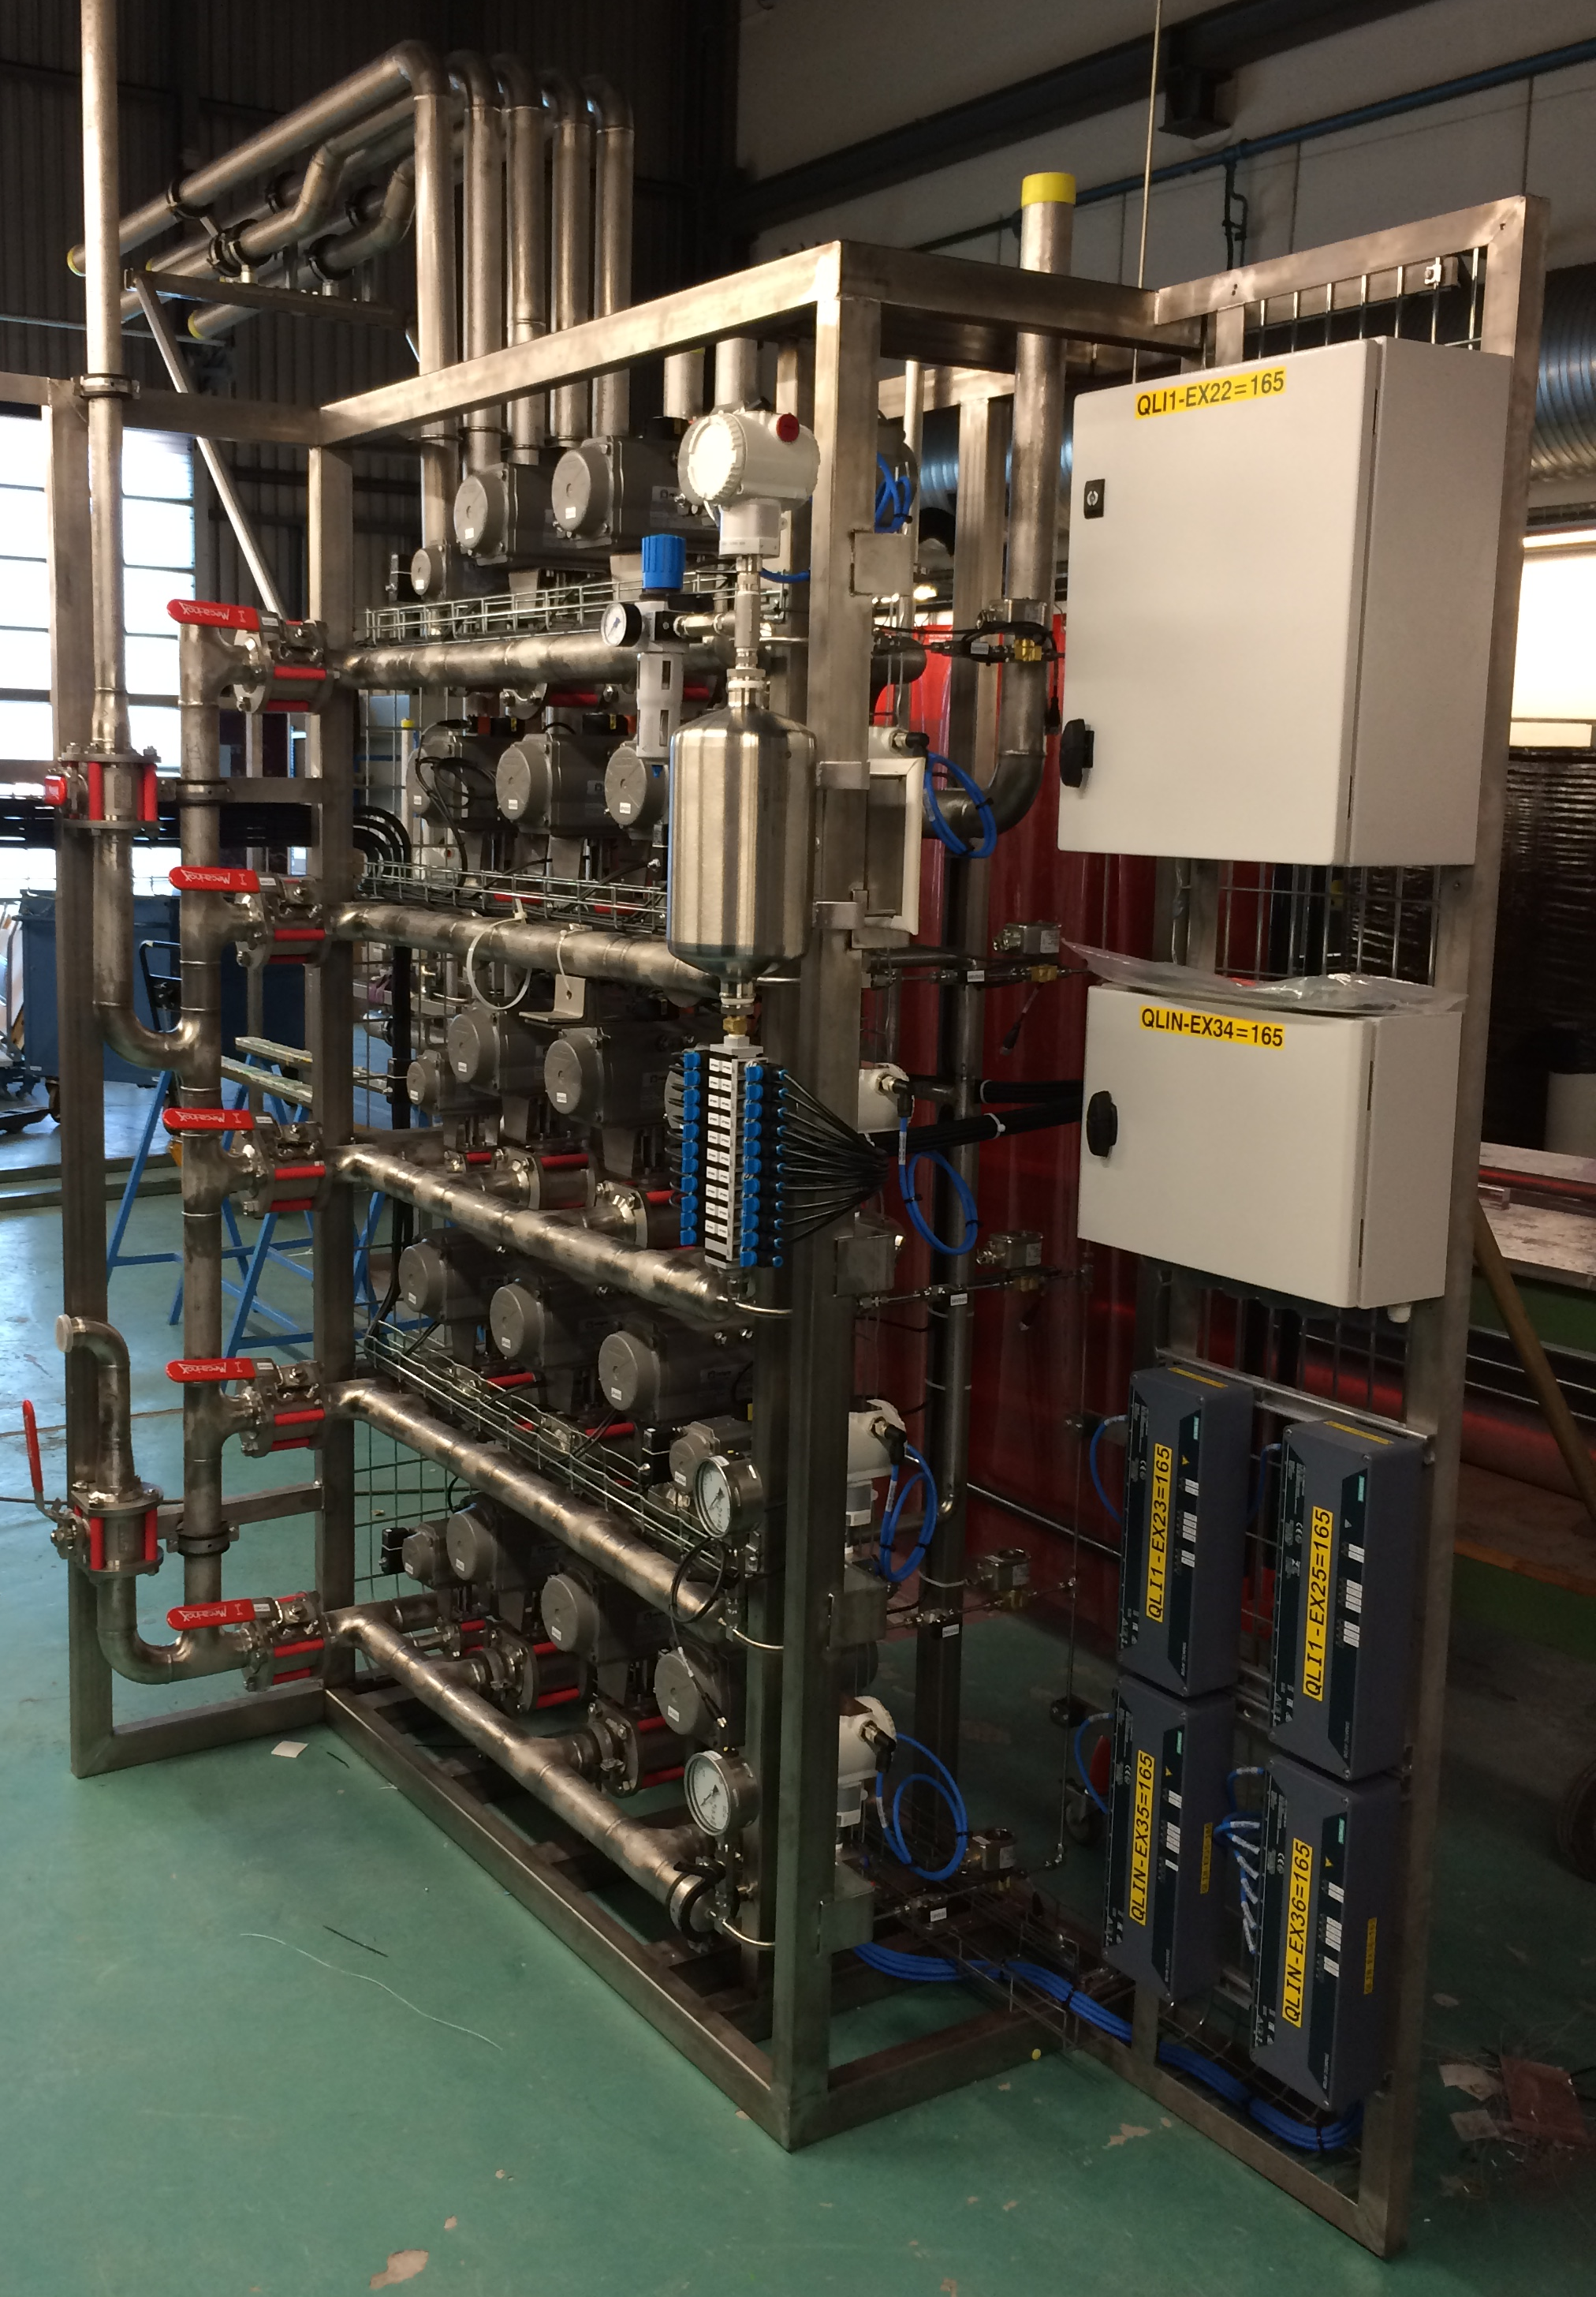
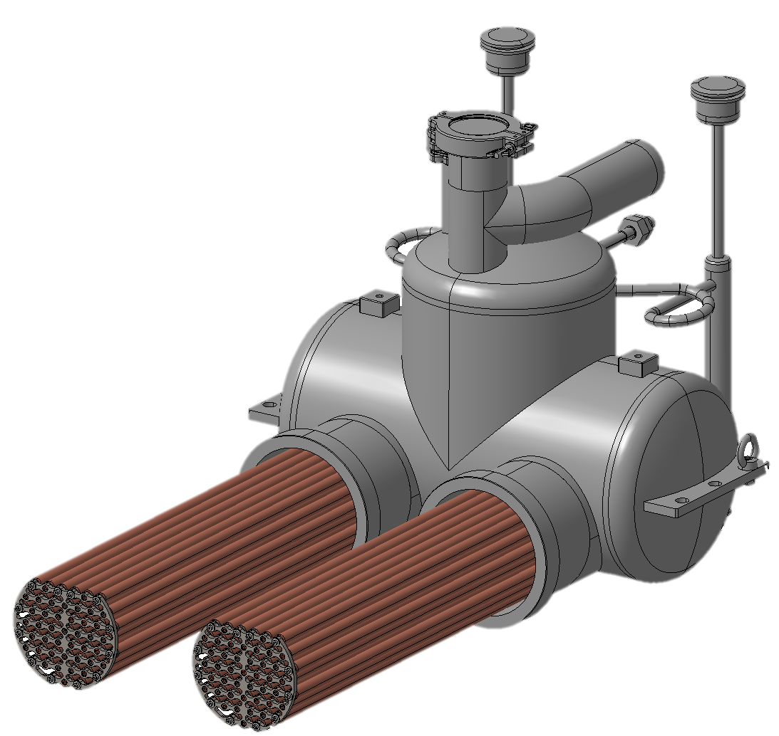
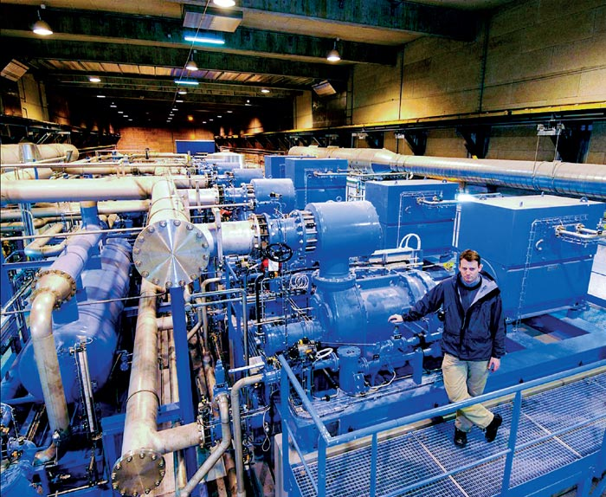
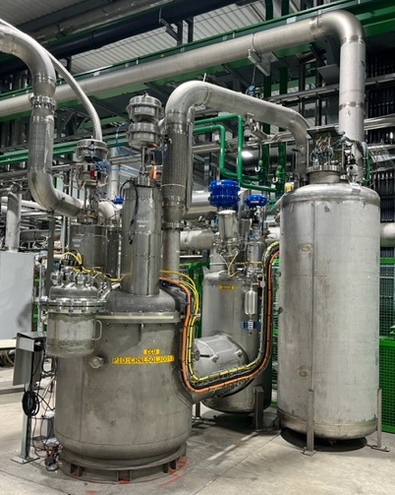
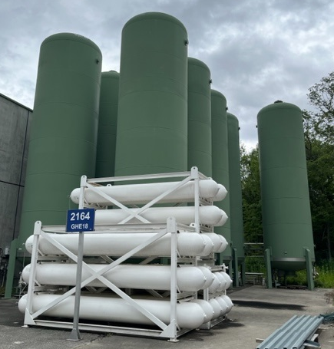
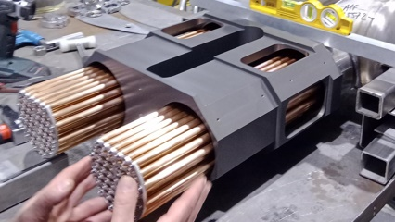
Cryogenics at CERN: Equipment
Design of cryogenic machines and the architecture used to cool them
Refrigeration
Experiments & Accelerators
Cryogenic Distribution
Cold Storage
Large and complex systems which incorporate a broad variety of equipment
    To design, build and operate, multiple disciplines must be mastered:
    Thermo-hydraulic and process
    Mechanics, design and layout
    Instrumentation, electronics & control
    Project management
    Maintenance, operation and logistics
SM18 36 g/s LHe Refrigerator
Neutrino Platform
CCC Cryostat Antiproton Decelerator
LHC Cryogenic Distribution (QRL)
SM18 Cluster D Cryogenic Distribution
Compression
Warm Infrastructure
He II Cooling
SM18 IT String Cold Compressor
HL-LHC D2 Magnet He-II Heat Exchanger
B163 20m³ LHe Dewar
LHC LHe Compressor system Pt 4
SM18 GHe Storage
B165 Warm GHe Management Panel
Notes:
Defining aspect of cryogenic systems
Cryo Group involved in designing cryo machines and the architecture used to cool them
Large and complex systems incorporating diverse equipment
Multiple disciplines to be mastered

Slide 6
The Cryogenics Group (TE-CRG) at CERN
TE-CRG-CL
Cryolab
J. Bremer
TE-CRG-IC
Instrumentation & Control
M. Pezzetti
Design, construction, commissioning, operation and maintenance of the cryogenic systems for CERN accelerators, detectors and cryogenic test facilities
Low-temperature developments and tests at the Central Cryogenic Laboratory
Supply of cryogenic fluids on the CERN site
Consultancy and support in cryogenic design and cryogenic instrumentation.
TE-CRG-ME
Mechanical & Engineering Support
A. Perin
TE-CRG
Cryogenics
GL. D. Delikaris
DGL. J. Bremer
TE-CRG-ML
Methods & Logistics
F. Ferrand
TE-CRG-OP
Cryogenics Operation
B. Bradu
TE-CRG-GLO
Group leaders Office
D. Delikaris
Notes:
The organisation of the sections in Cryo Group is aligned to these disciplines

Slide 7
Projects in the Cryogenics Group
Function & Concept
    Functional requirement
    R & D (CRG-CL)
    Process flow diagram & Piping and Instrumentation Diagram (CRG-ME, CRG-CL)
    Process definition & Functional analysis (CRG-OP, CRG-IC & CRG-ME, (CRG-CL)
Procurement
    Technical specification (CRG-ME, CRG-CL & CRG-IC)
    Costing (CRG-ME, CRG-CL & CRG-IC)
    Contract placement (IPT)
Installation
    Site management (CRG-OP, CRG-ML, CRG-ME & CRG-IC)
    Inspection (CRG-ME, CRG-IC, HSE, EN-MME & BE-GM)
Operation & Maintenance
    Operation (CRG-OP & CRG-ML)
    Support (CRG-ME & CRG-IC)
    Logistics (CRG-ML)
CRG project
Design
    Mechanical design and integration (CRG-ME)
    Thermo-mechanical (CRG-ME)
    Dynamic process simulation (CRG-OP & CRG-ME)
    Electricity, control and instrumentation (CRG-IC)
Manufacture & Contract
    Mechanical (CRG-ME & EN-MME)
    Electrical & Instrumentation (CRG-IC)
    Contract follow-up (CRG-ME, CRG-IC, CRG-CL & IPT)
    Quality assurance (CRG-ME, CRG-IC, CRG-CL & EN-MME)
Commissioning
    Pressure test (CRG-ME, HSE)
    Leak test (CRG-ME & TE-VSC)
    Functional tests (CRG-OP, CRG-ML, CRG-ME, CRG-CL & CRG-IC)
Notes:
When we have project in CRG, the project responsible can rely on the sections to support his project
The diagram shows the way the section combine to support the project
Two take aways from the diagram:
Team effort → The sections input throughout the project’s to support the project responsible
ME section involved from concept to Operation and maintenance

Slide 8
Cryogenics at CERN: TE-CRG-ME
    TE-CRG-ME specialties:
    Cryogenic process
    Thermo-mechanical engineering
    Design and integration
    Project management and supplier follow-up
    Mechanical field-work and construction
TE-CRG-CL
Cryolab
J. Bremer
TE-CRG-IC
Instrumentation & Control
M. Pezzetti
Design, construction, commissioning, operation and maintenance of the cryogenic systems for CERN accelerators, detectors and cryogenic test facilities
Support for low-temperature developments and tests at the Central Cryogenic Laboratory
Supply of cryogenic fluids on the CERN site
Consultancy and support in cryogenic design and cryogenic instrumentation.
TE-CRG-ME
Mechanical & Engineering Support
A. Perin
TE-CRG-ME
Mechanical & Engineering Support
A. Perin
TE-CRG
Cryogenics
GL. D. Delikaris
DGL. J. Bremer
TE-CRG-ML
Methods & Logistics
F. Ferrand
    Challenges:
    Design and manufacture of complex cryogenic equipment in line with relevant regulation
    Large variety of equipment and technology
    Complex environment → Location and access constraints
TE-CRG-OP
Cryogenics Operation
B. Bradu
TE-CRG-GLO
Group leaders Office
D. Delikaris

Slide 9
Cryogenic Engineering Tools & Methods
    Standardised methods available to the section/group:
    Based on rules, standards and past practice at CERN
    Streamlined engineering approach:
    Improved efficiency, confidence in results and accessibility
    Best practice guidelines for CRG-ME projects but not rigid set of rules
    Each section in Cryogenics Group has developed and uses a set of tools to perform their work, this presentation focuses on the tools used by TE-CRG-ME.
Subject |  | Guideline | Checklist | Tool | Report Templates | Library
Cryogenic Process | P&ID Symbols for CRG | X |  |  | X
 | Control valve sizing | X | X | X | X
 | Pressure drop | X | X |  |  | X
 | Ecosim. dynamic simulation |  |  | X |  | X
Thermo-mechanical engineering and design | Design and Layout |  |  | X
 | Mechanical Analysis |  |  | X
 | Protection against overpressure | X |  | X | X
 | Application of pressure codes | X | X
Mechanical Intervention | Standard CRG components |  |  |  |  | X
 | Standard CRG methodology | X
Notes:
Each section in CRG has developed tools to perform their work → This presentation focuses on ME
From our experience we have developed tools and methods based on rules, standards and CERN past practice
Aimed to streamline our engineering approach
Improve efficiency and give confidence in results
The tools are applied as best practice guidelines for mechanical section → not a rigid set of rules
Centred around 3 specific areas:
Cryogenic process
Thermo-mechanical engineering and design
Mechanical intervention

Slide 10
Cryogenic process

Slide 11
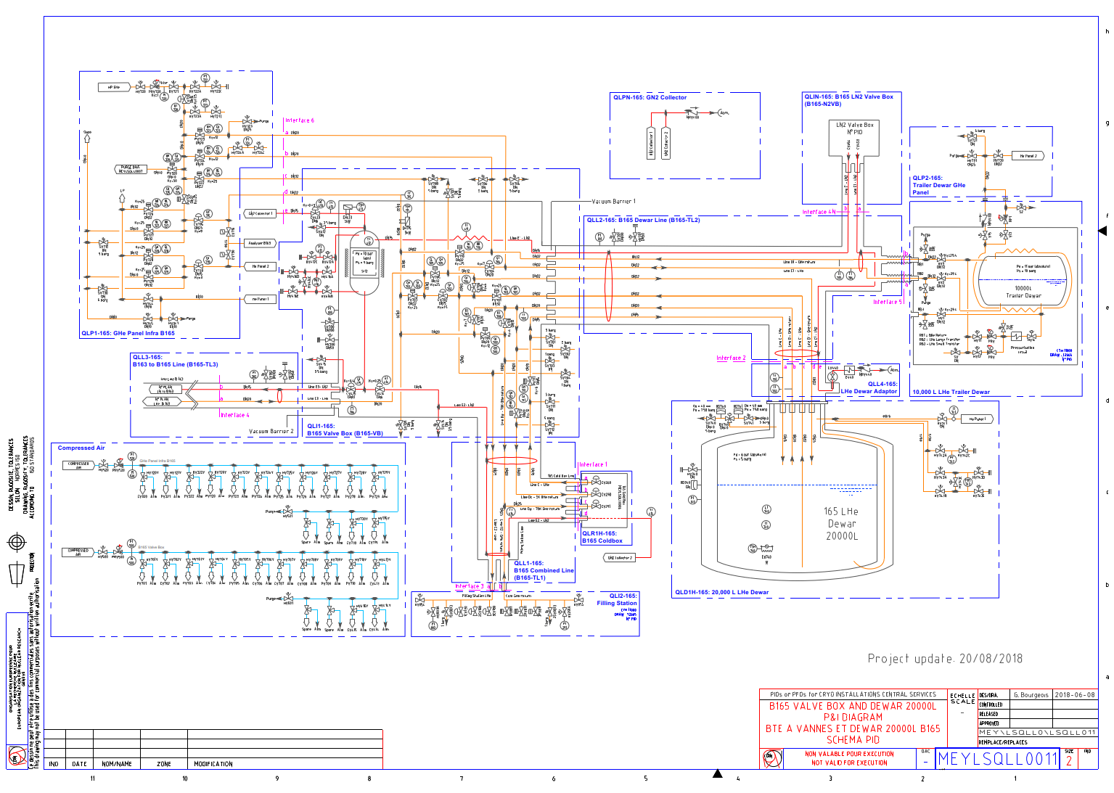
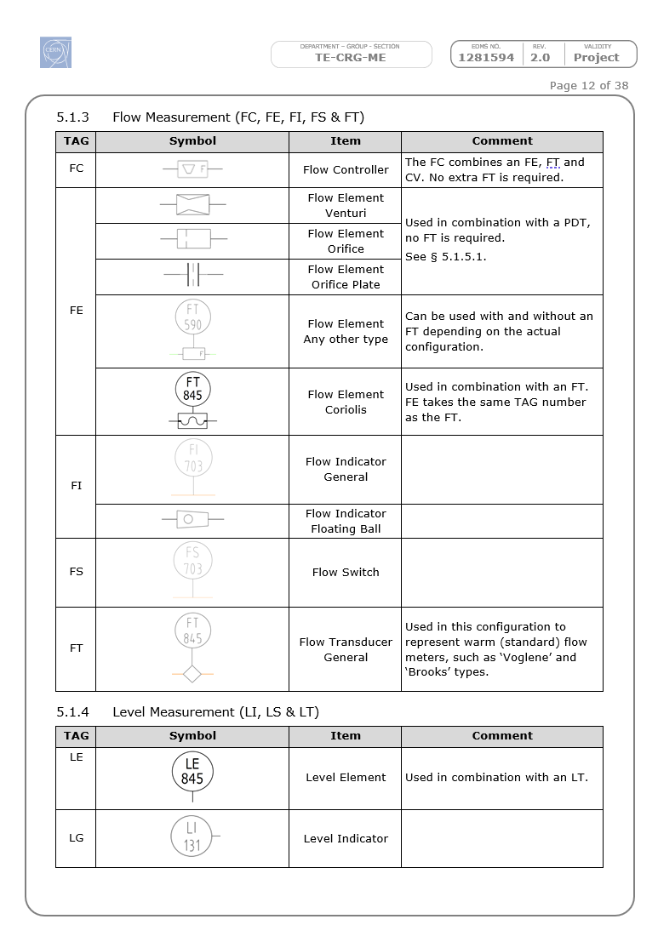
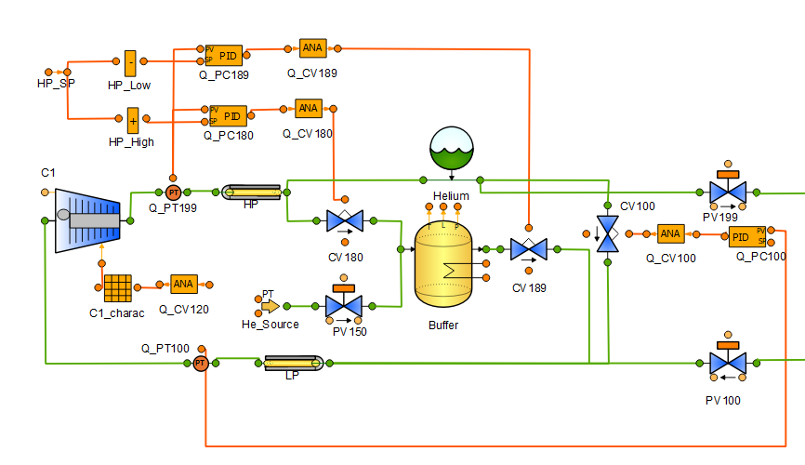
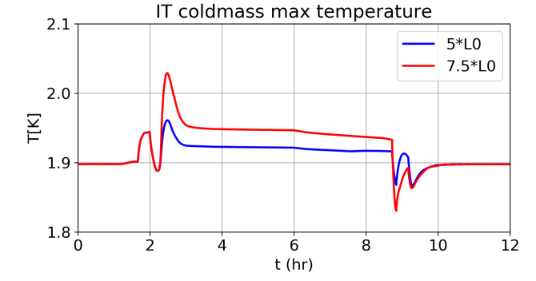
Cryogenic process
    Piping & Instrumentation Diagram (P&ID):
    The basis of all cryogenic projects!
    Produced using AutoCAD → now BricsCAD with PLM
    Guideline → Standardise the symbols used on P&ID across CRG (EDMS 1281594)
    P&ID Standard:
    Mixture of ISO norms and CERN legacy
    Could be extended to any similar equipment
    Used throughout Project:
    During the design phase to study and define thermo-hydraulic behaviour
    During the commissioning phase to validate control strategies
    During the operation phase to train new operators and verify control improvements
    Cryogenic Dynamic thermo-hydraulic simulation with EcosimPro:
    Commercial software used in combination with “CRYOLIB” cryogenic library
    “CRYOLIB” was initially developed at CERN in 2006 and commercialised today (KT agreement)
Credits: B. Bradu (TE-CRG-OP)

Slide 12
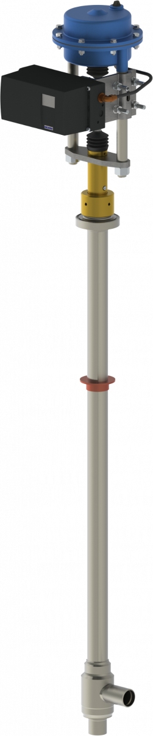
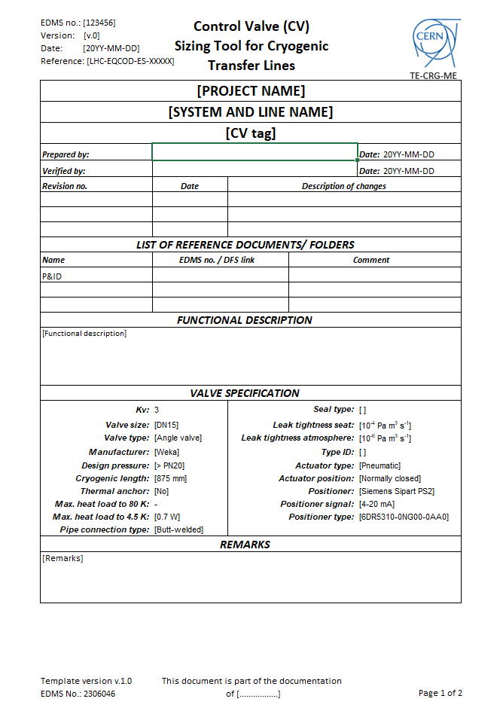
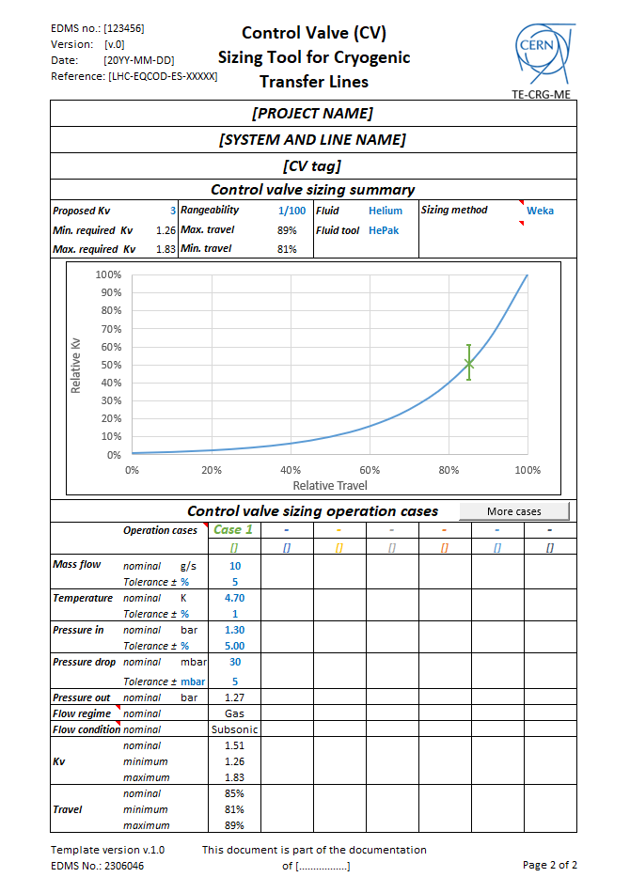
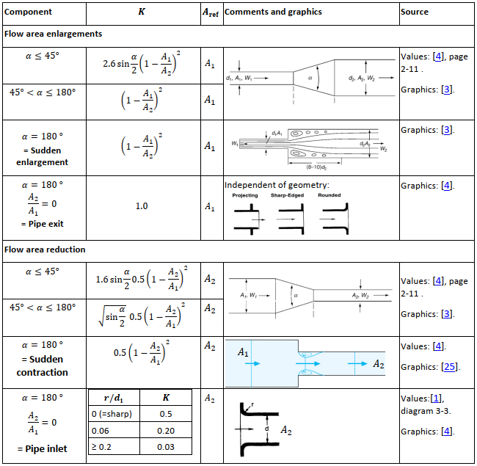
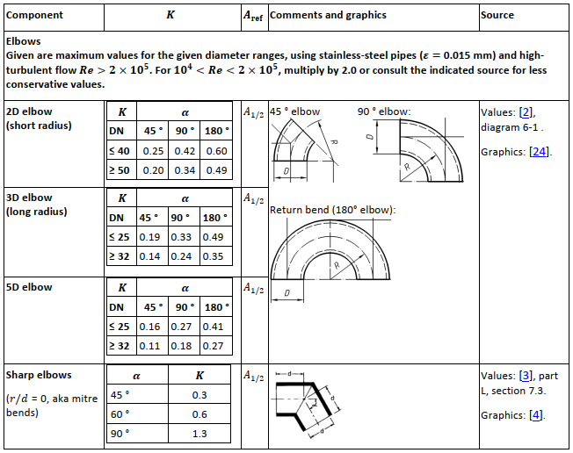
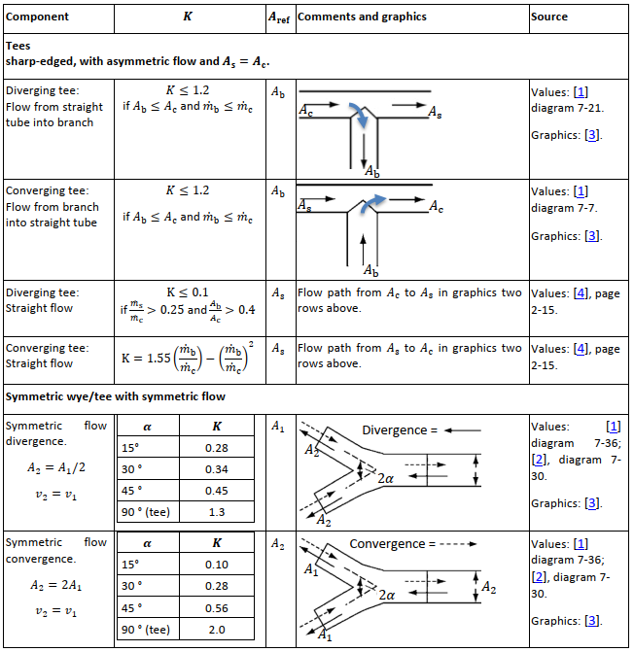
Cryogenic Process
    Pressure drop calculations & control valve sizing:
    Fundamental part of process design
    Guideline → Standardises TE-CRG-ME methodology (EDMS 2376016)
    Checklists → To ensure methodology is correctly applied (EDMS 2306030)
    Sizing tool → To aid calculation (EDMS 2306046)
    TE-CRG-ME tool kits are based around:
    Guidelines → bringing together procedures from norms and standards, CERN best practice and manufacturer guidelines.
    Checklist → helping to guide engineer through the design process
    Tools → to simplify calculation
Credits: A. Wanninger & A. Perin
Notes:
A fundamental aspect of cryogenic process is pressure drop calculations and control valve sizing
Here we have developed a tool kit to help standardise the methods used in the section.
Theis too kit is a good example of our approach……..
Guidelines → bringing together procedures from norms and standards, CERN best practice and manufacturer guidelines.
Checklist → helping to guide engineer through the design process
Tools → to simplify calculation

Slide 13
Thermo-mechanical Engineering and Design

Slide 14
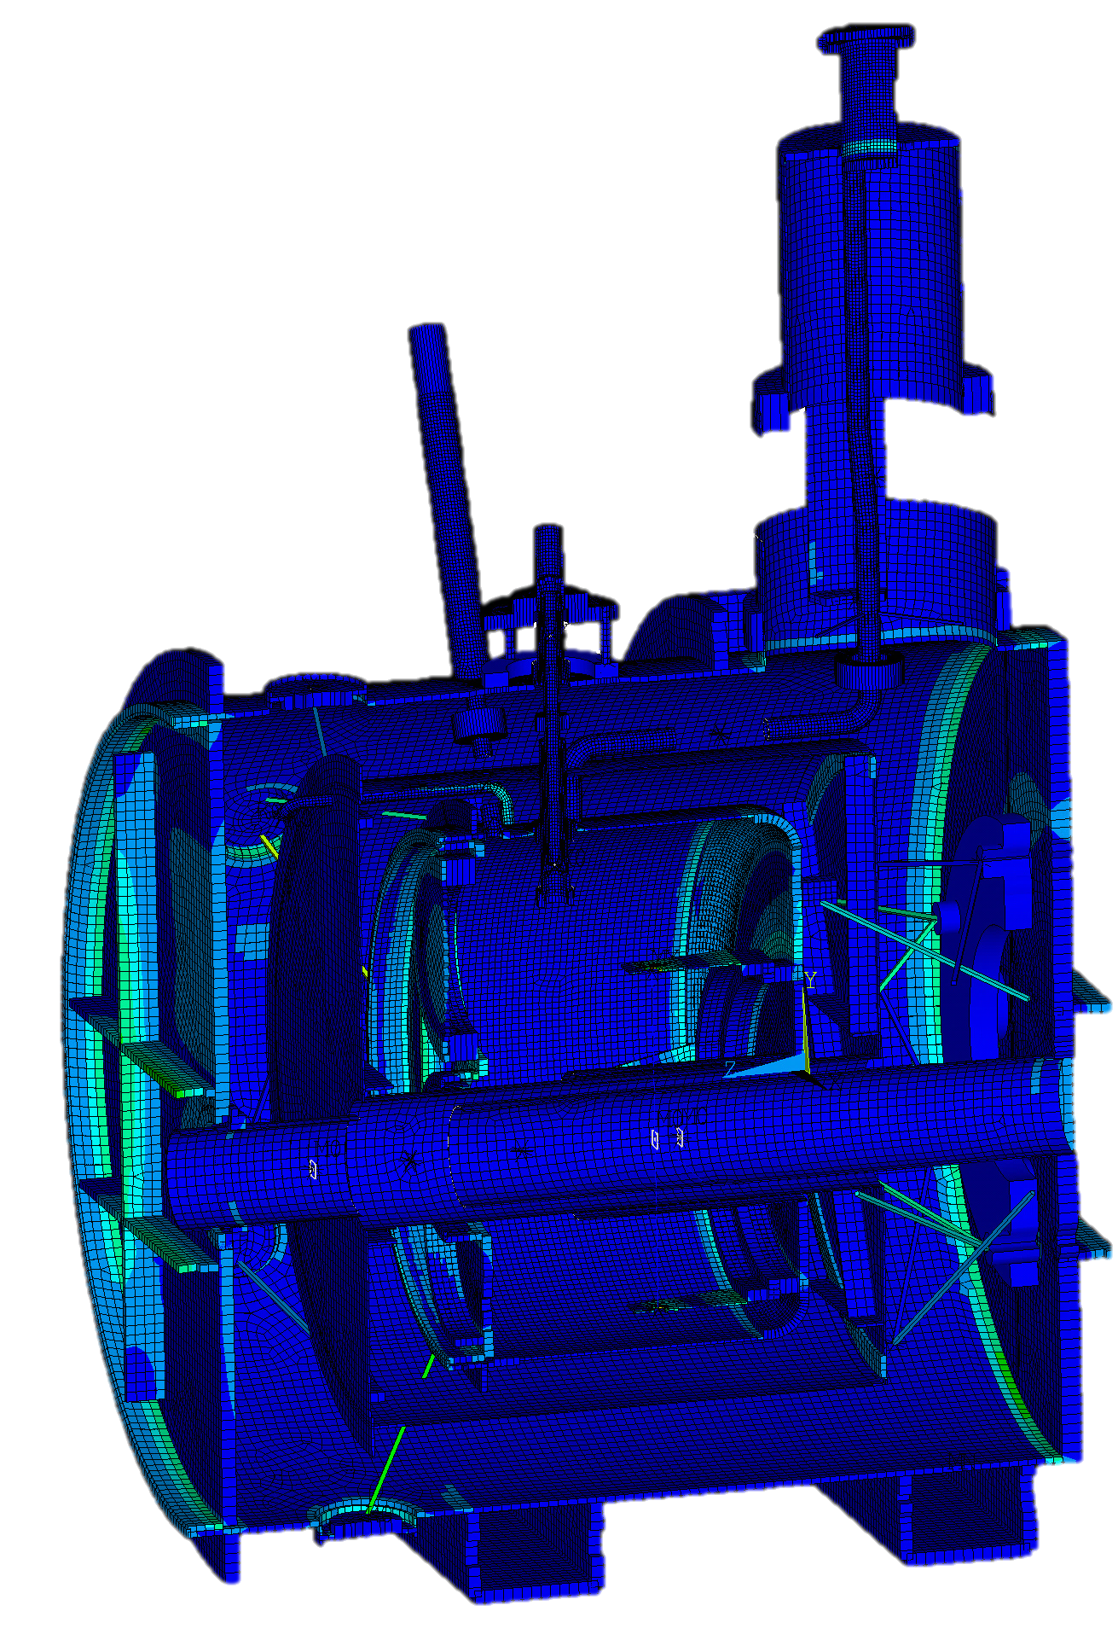
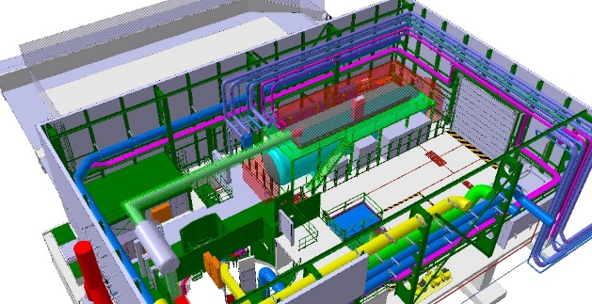
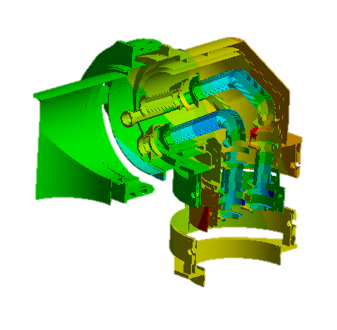
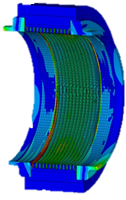
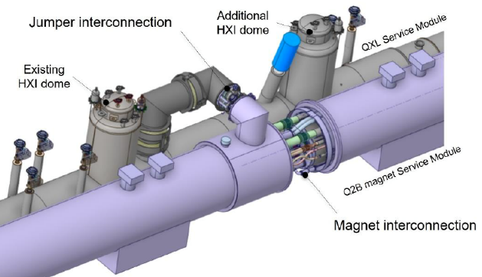
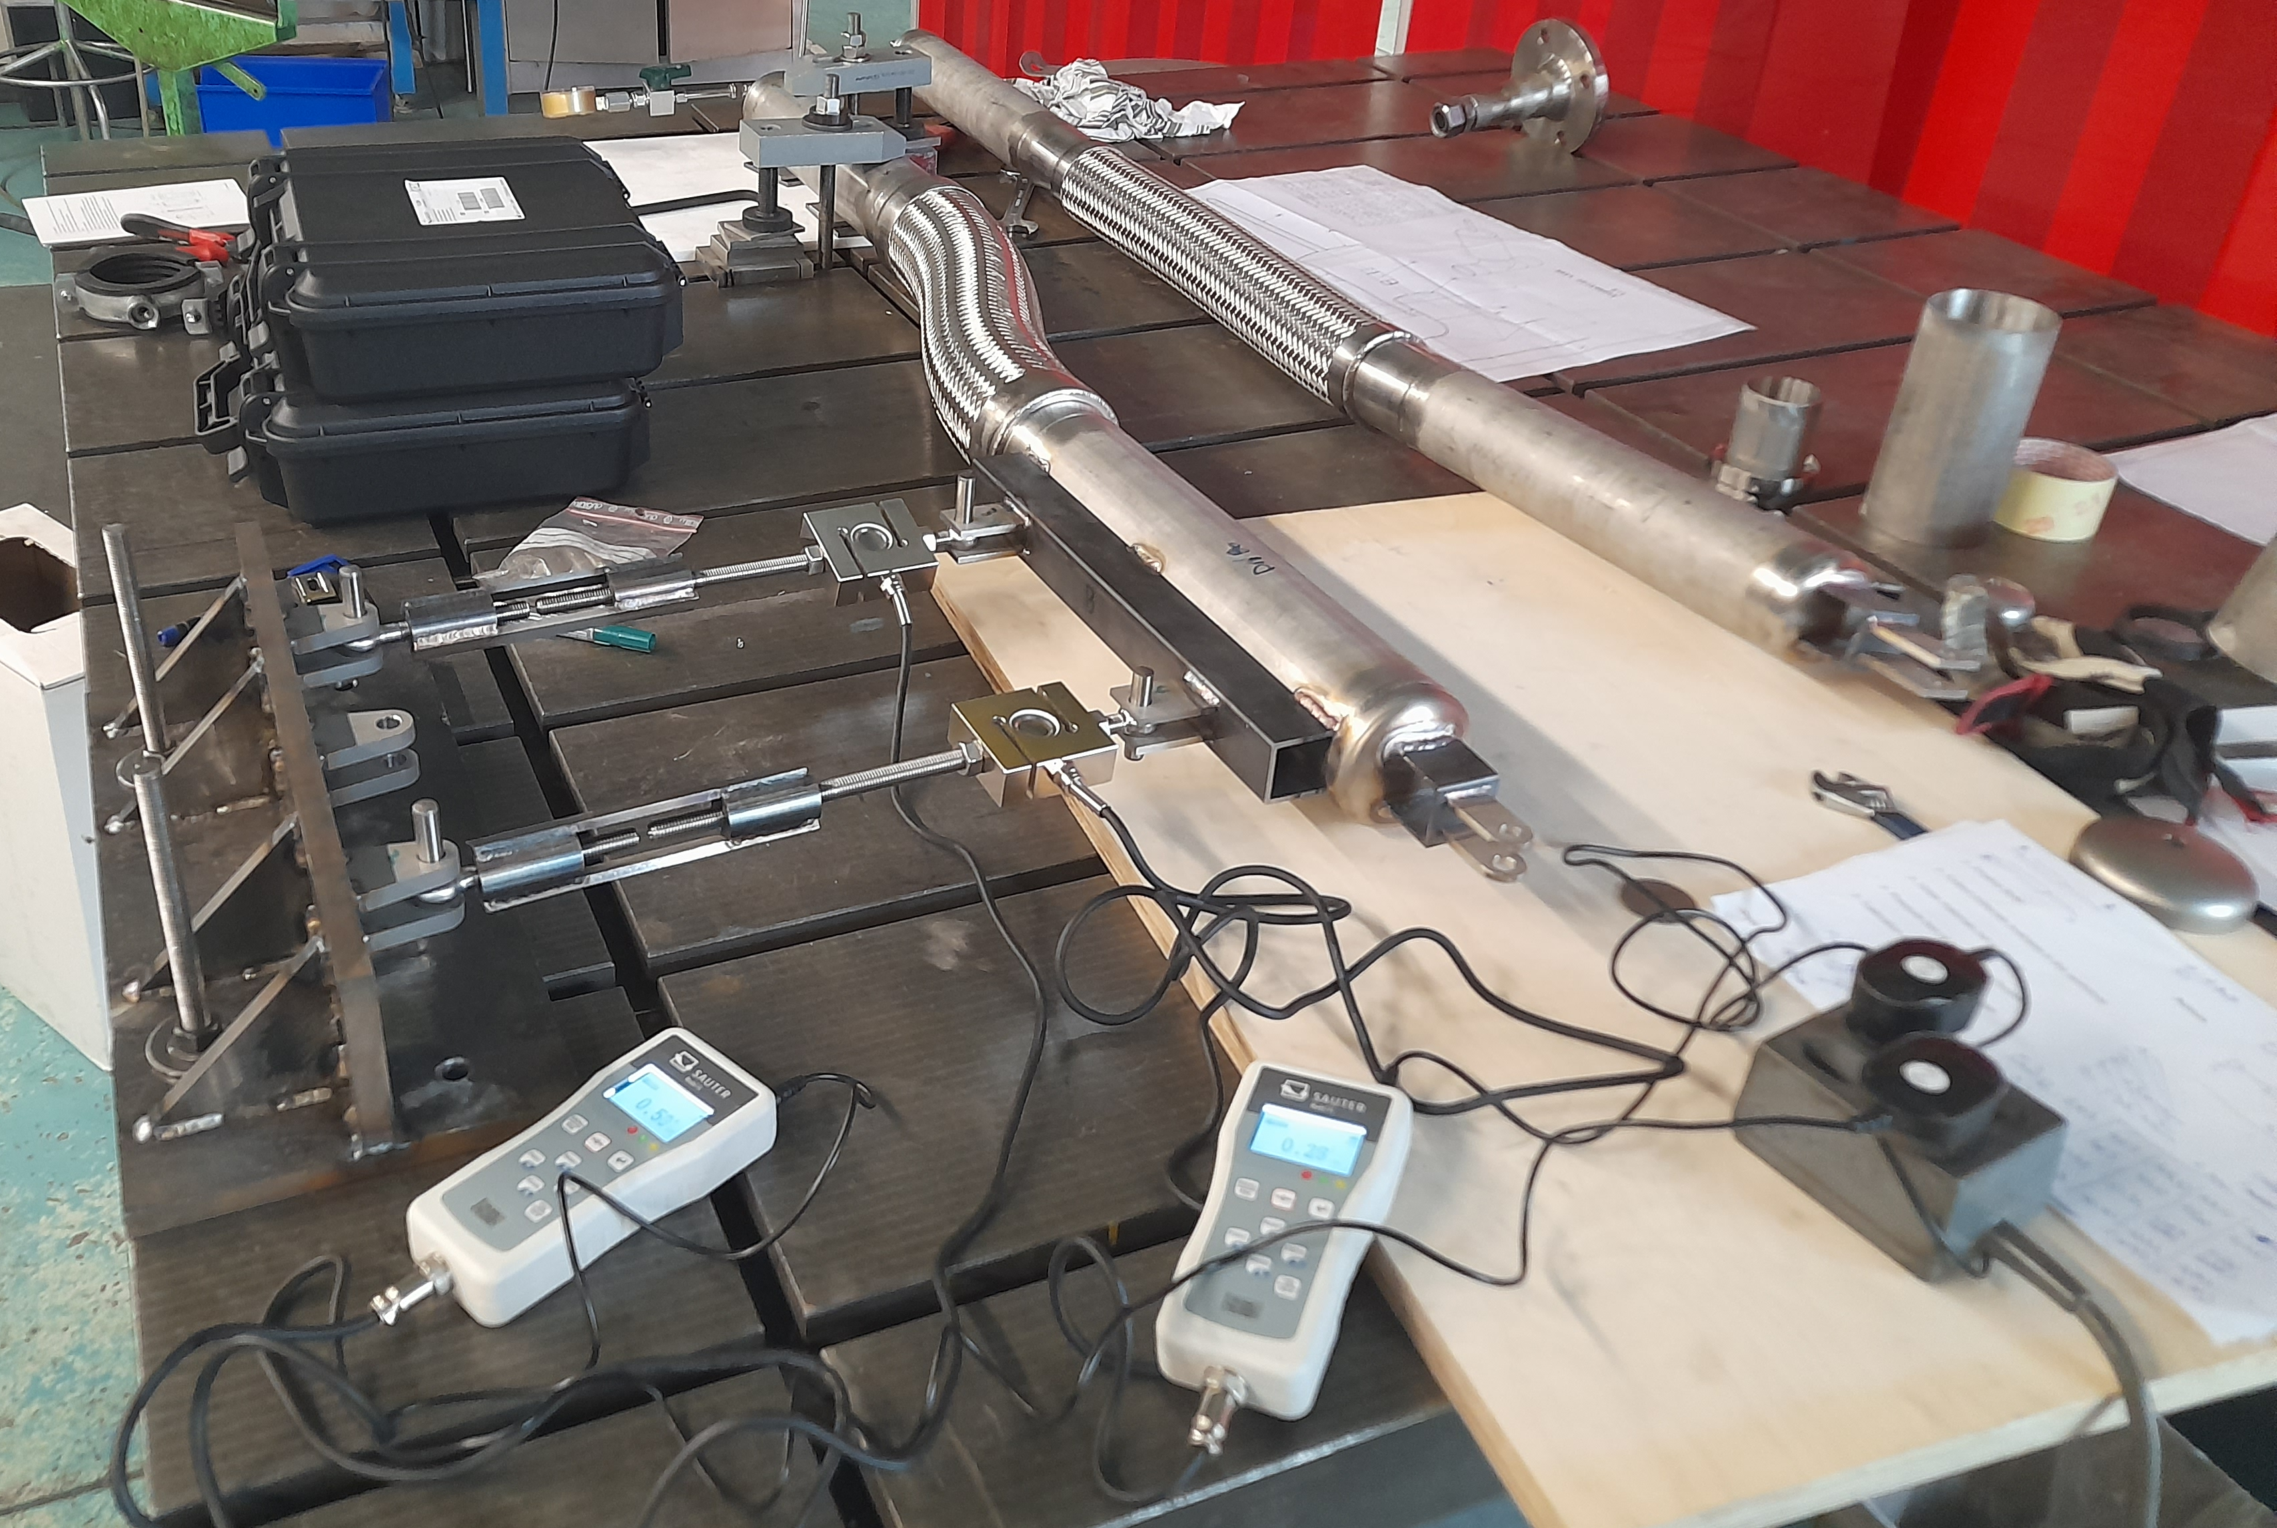
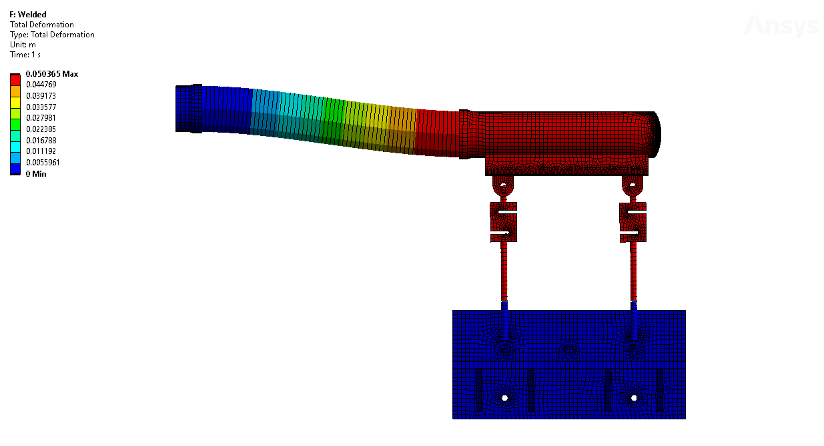
Thermo-mechanical Design & Analysis
    Integration, studies and component design:
    3D Design tools → Catia V5 with SmarTeam
    Transition to PLM in collaboration with CAD Services
    Thermo-mechanical Analysis
    Finite Element Analysis tool → ANSYS
    Development of complex mechanical systems e.g., CCC Cryostat / HL-LHC QXL Jumper
    Component benchmarking studies e.g., flexible hose stiffness study
DFBA Gimble Bellows Analysis
HL-LHC SD Refrigerator Integration
HL-LHC QXL Jumper Analysis
CCC Cryostat Antiproton Decelerator
HL-LHC QXL Jumper Study
Flexible hose stiffness study
Notes:
3D CAD Modelling:
Tool is Catia V5 with SmarTeam → CERN Standard
We will transition to PLM as planned
Analysis:
Tool is ANSYS
Significant experience in the section → Development of complex machines, code verification and component benchmarking

Slide 15
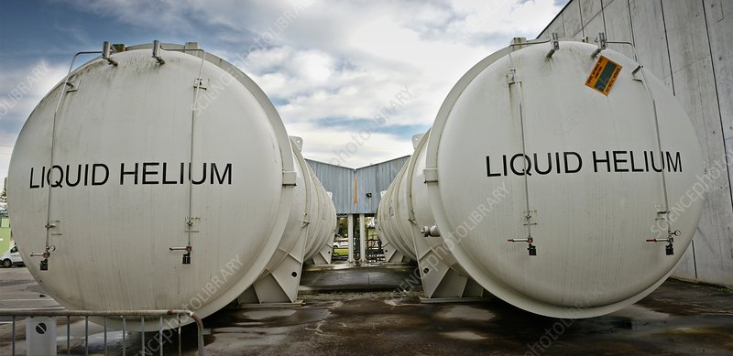
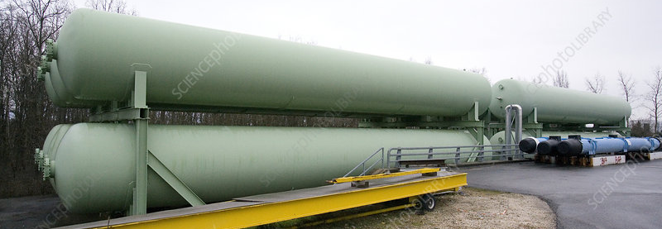
Cryogenic Pressure Equipment
    Safety sensitive equipment → Highly regulated for design, production and maintenance
LHC Pt 18 GHe storage:
    Volume / pt = 250m³ x 12 = 3000 m³
    Design Pressure = 24 bar
    PED Category = IV
    Stored energy at design pressure = 7.760 GJ (Equivalent to 1.67 t of TNT)
LHC Point 6: 2 x 117 m³ LHe Storage tanks
LHC Point 18: 12 x 250 m³ GHe Storage tanks
    European Pressure Equipment Directive (PED)
Harmonised standard
Other standards
CERN HSE
General
EN 764-7, ISO 4126-7
ASME code,
API, AD 2000
Safety systems and devices
    Risk assessment → SG OHS-0-0-1
    Pressure equipment → GSI-M-2
Cryogenic
ISO 21013-, EN 13648
CGA, EIGA
General
EN 764, EN 13445,
EN 13480
ASME code,
AD 2000
Mechanical Design
Cryogenic
EN 13458
CGA, EIGA

Slide 16
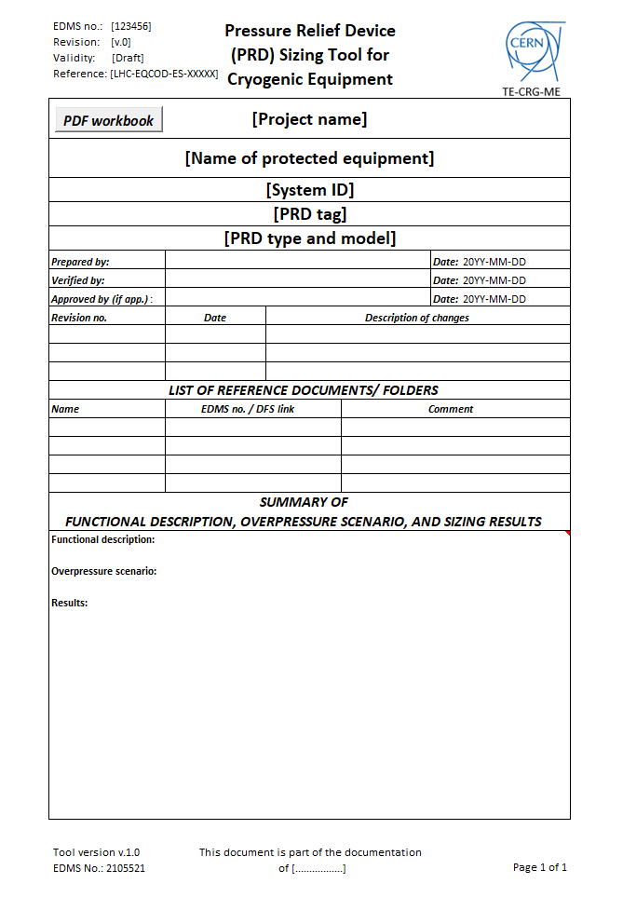
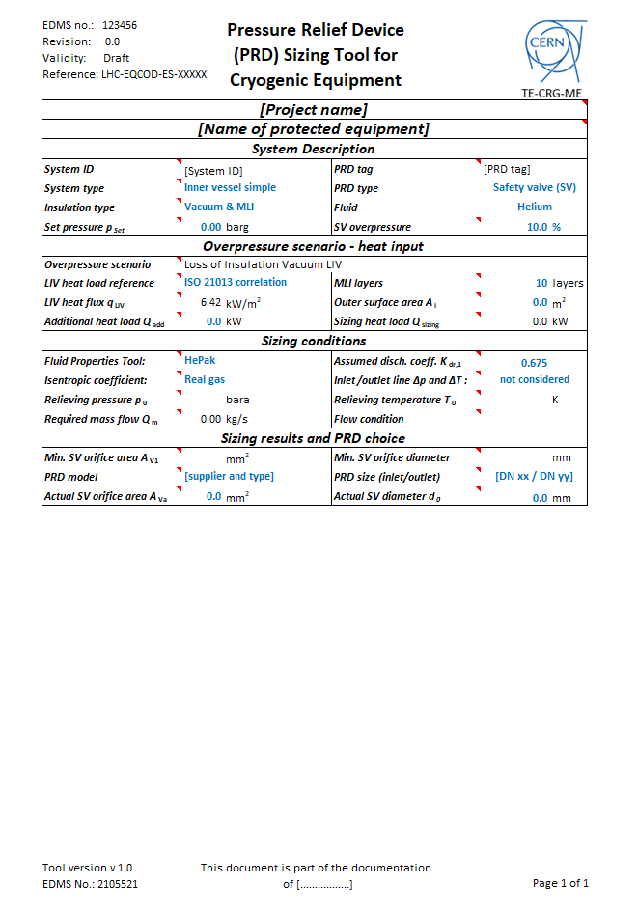
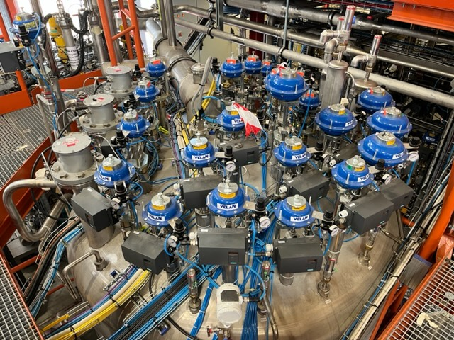
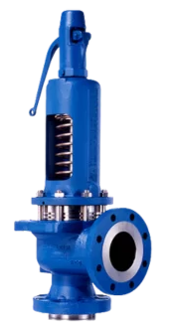
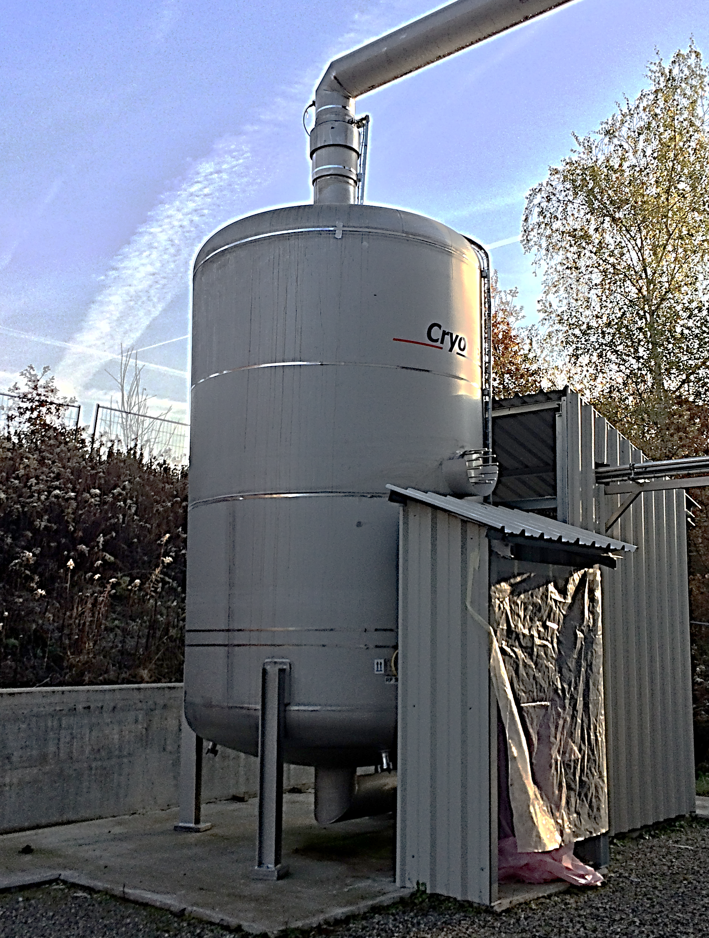
Cryogenic Pressure Equipment
    Protection against overpressure:
    Guideline → Standardises TE-CRG-ME methodology (EDMS 2105567)
    Checklist → To ensure methodology is correctly applied (EDMS 2105522)
    Sizing tool → To aid calculation (EDMS 2105521)
    Mechanical design:
    Guideline → Standardises TE-CRG-ME methodology (EDMS 2402943)
    Checklist → To ensure methodology is correctly applied (EDMS 2402959)
    Designed to accompany and engineer through the design, manufacture and testing of pressure equipment, to avoid missing crucial aspects.
    These tools do not replace the norms, they are designed to assist the engineer to comply with existing codes and standards.
    Important tool for young engineers in their understanding of the PED and harmonized standards.
B163 Cryogenic Valve Box
SM18 HFM Quench Buffer:
15 m³ @ 5 bar @ 5 K
Credits: A. Wanninger & A. Perin

Slide 17
Cryogenic Construction Methods and Components

Slide 18
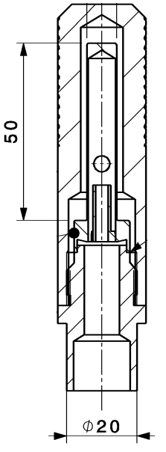
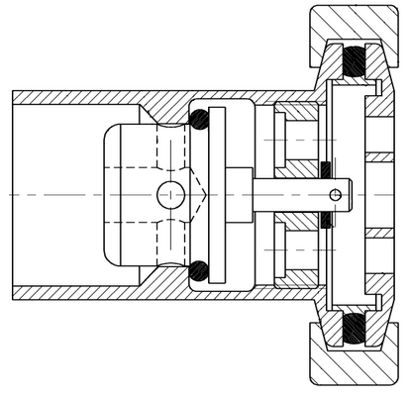
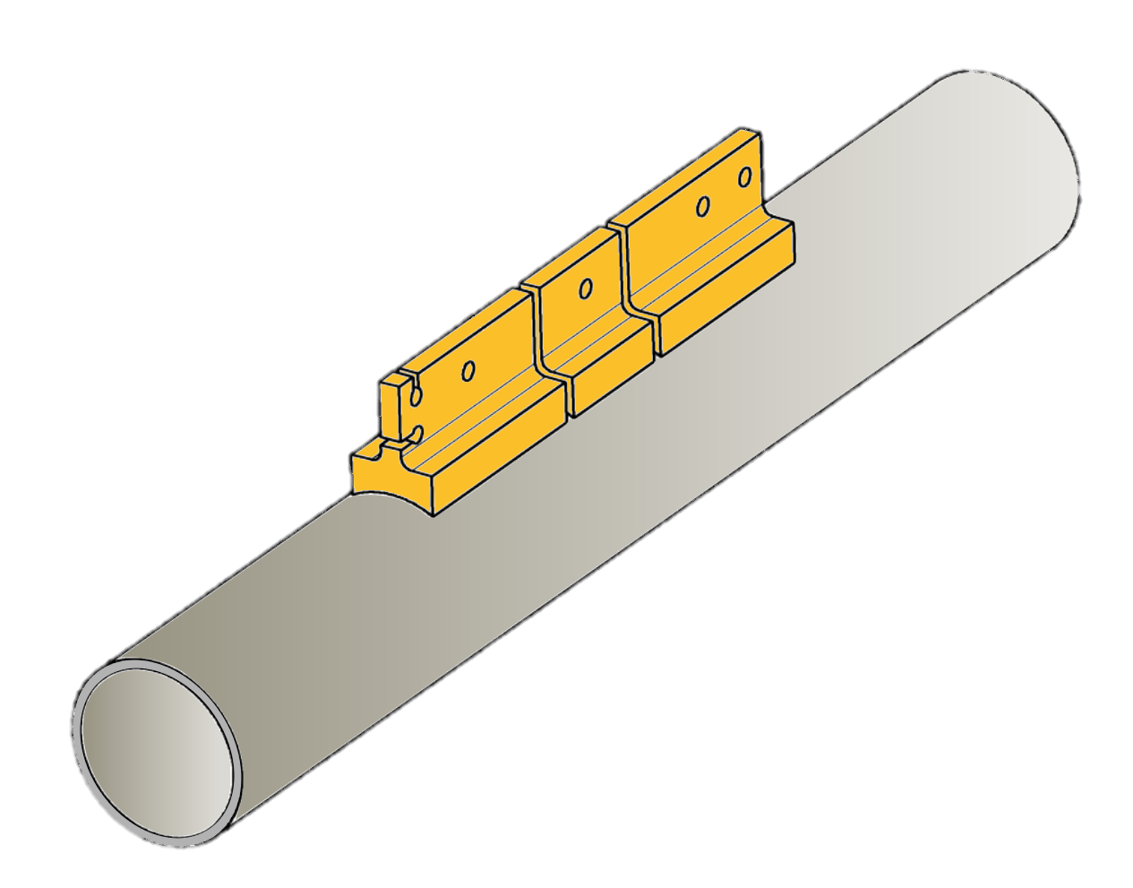
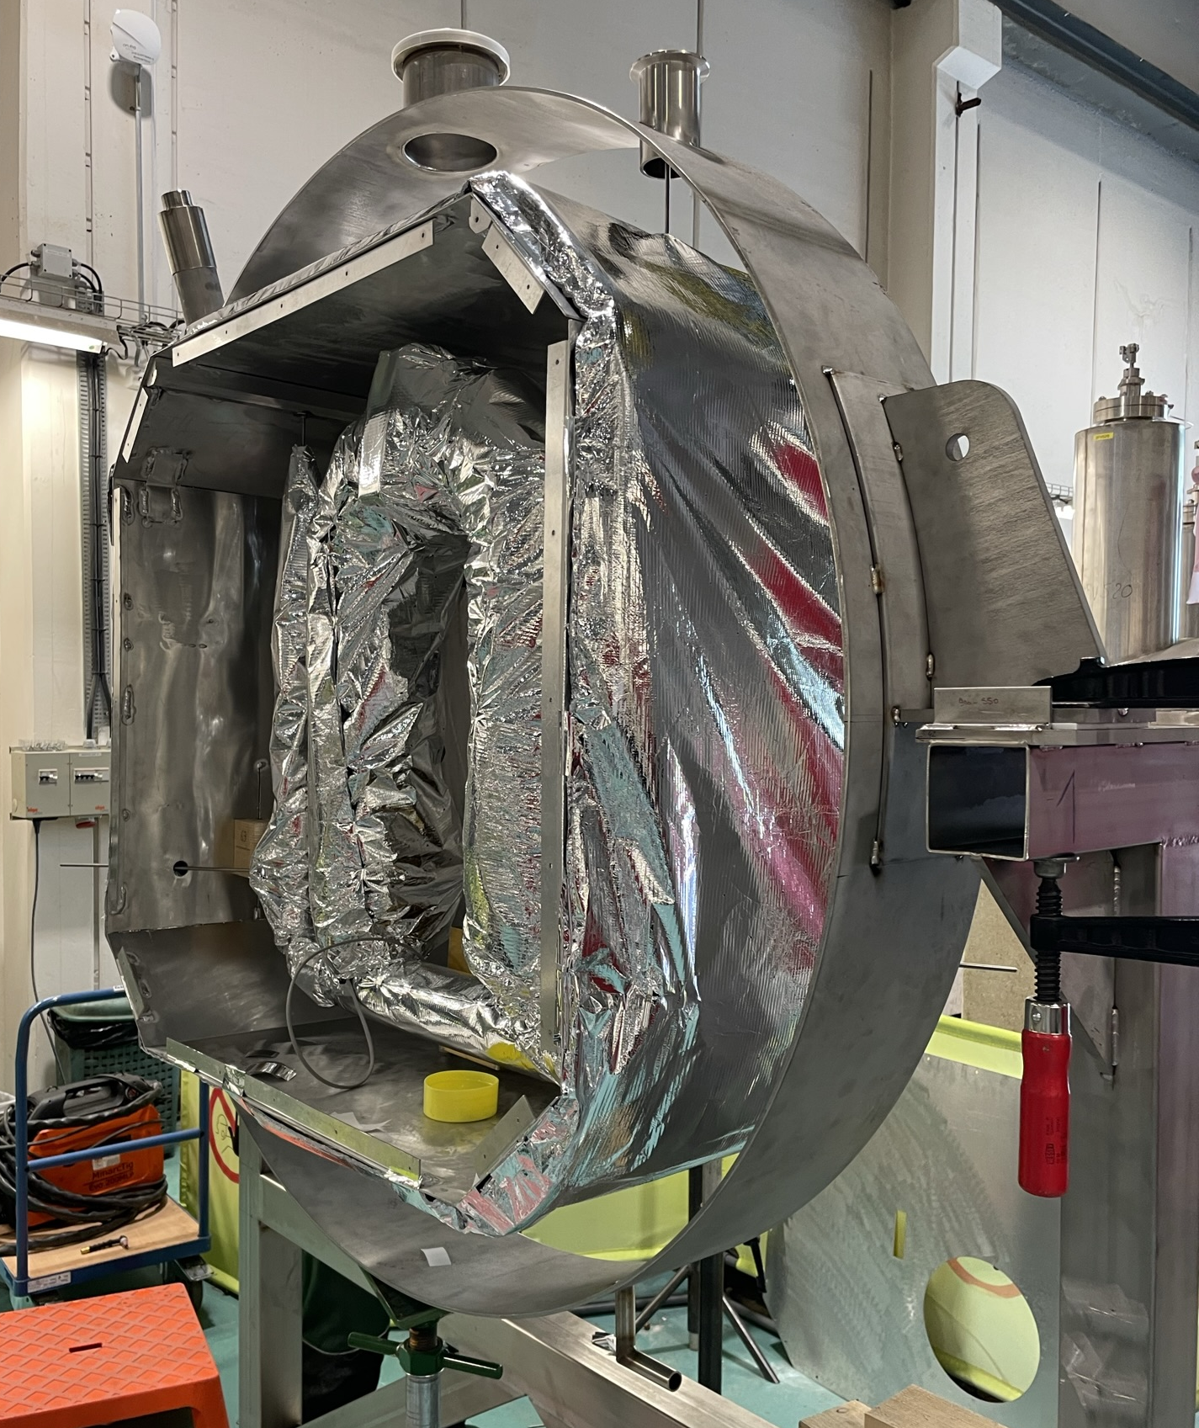
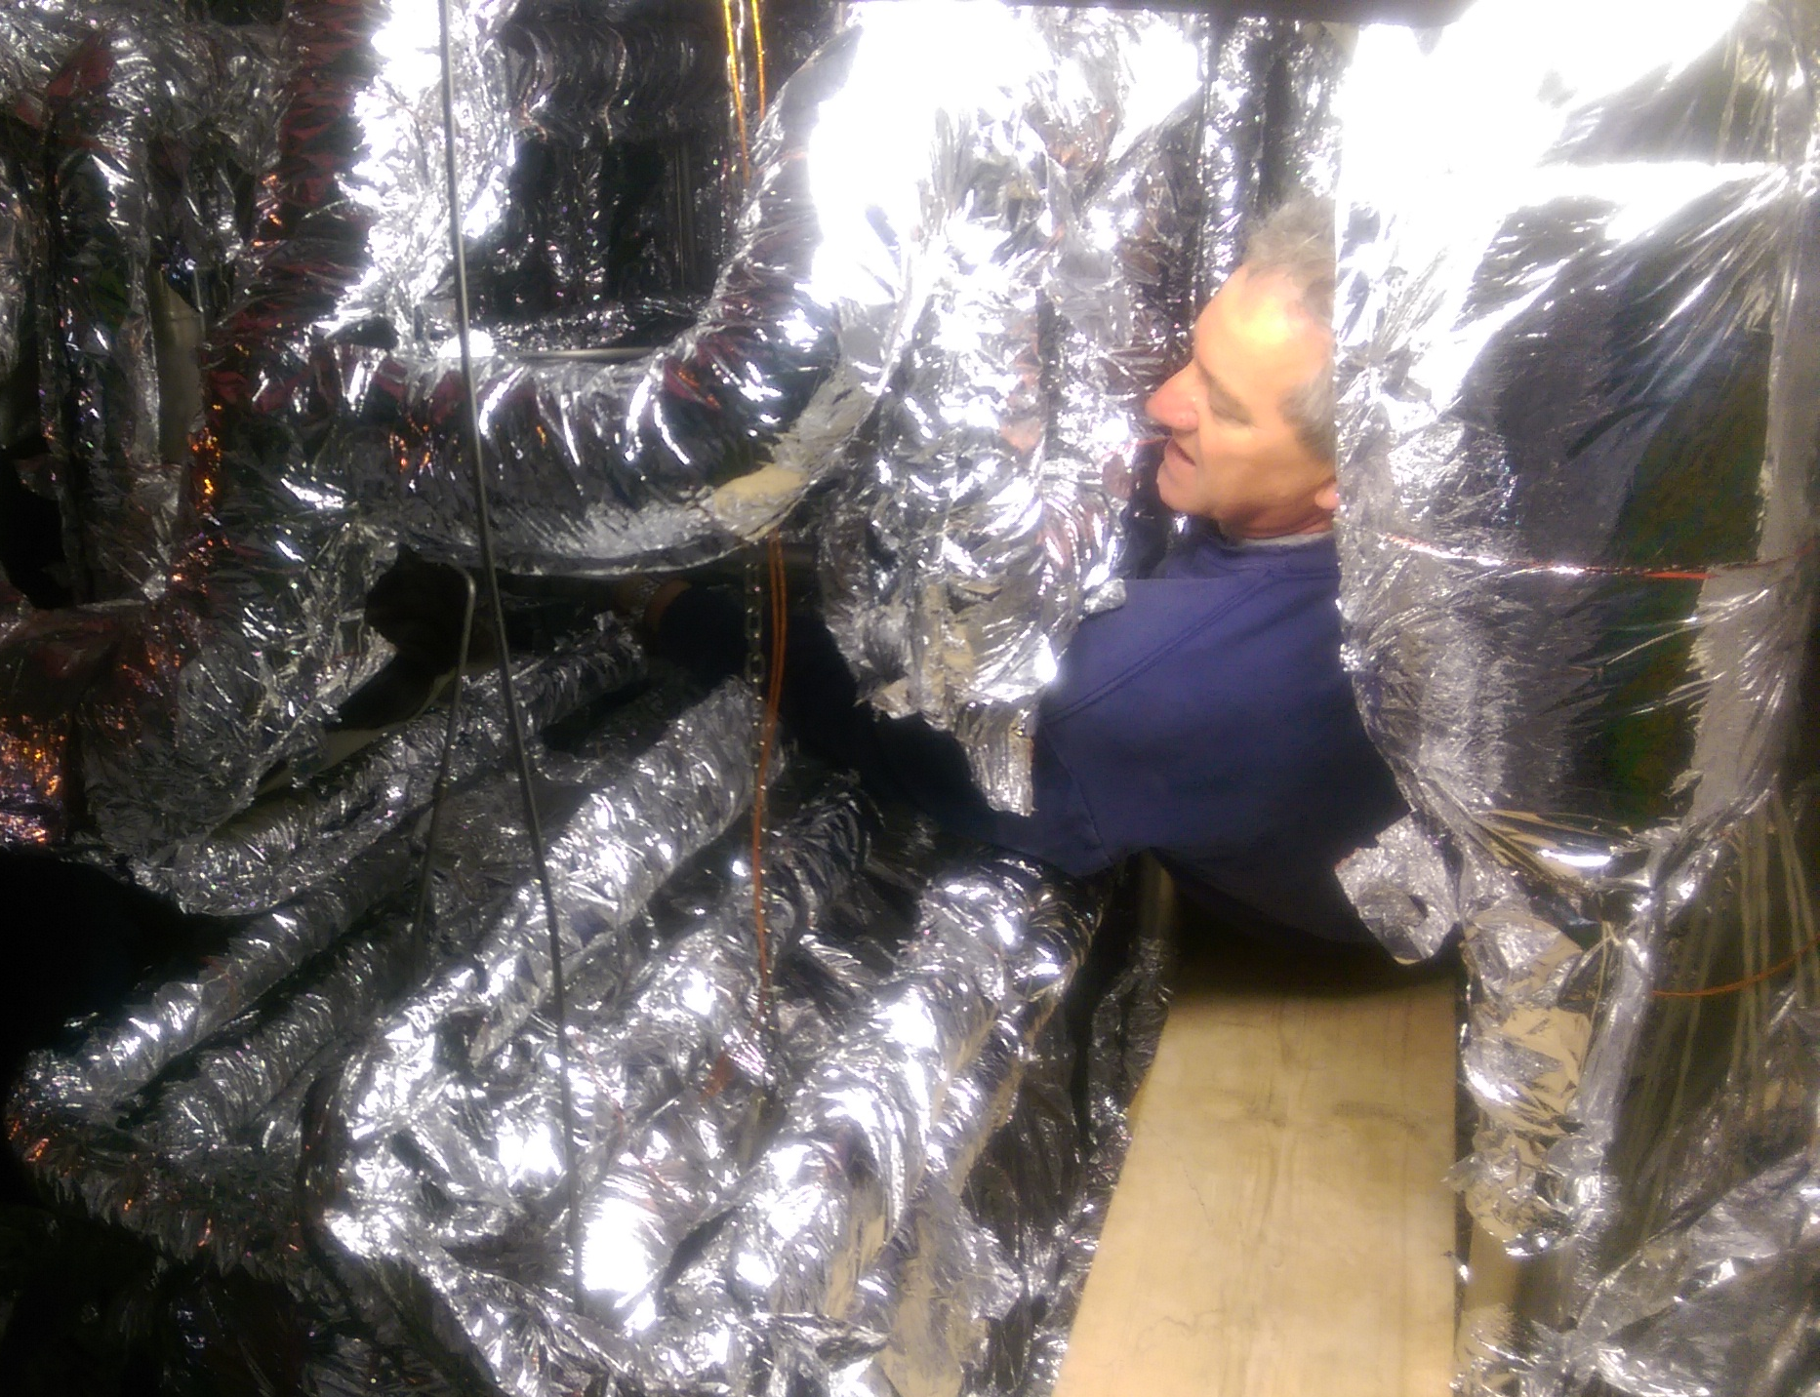
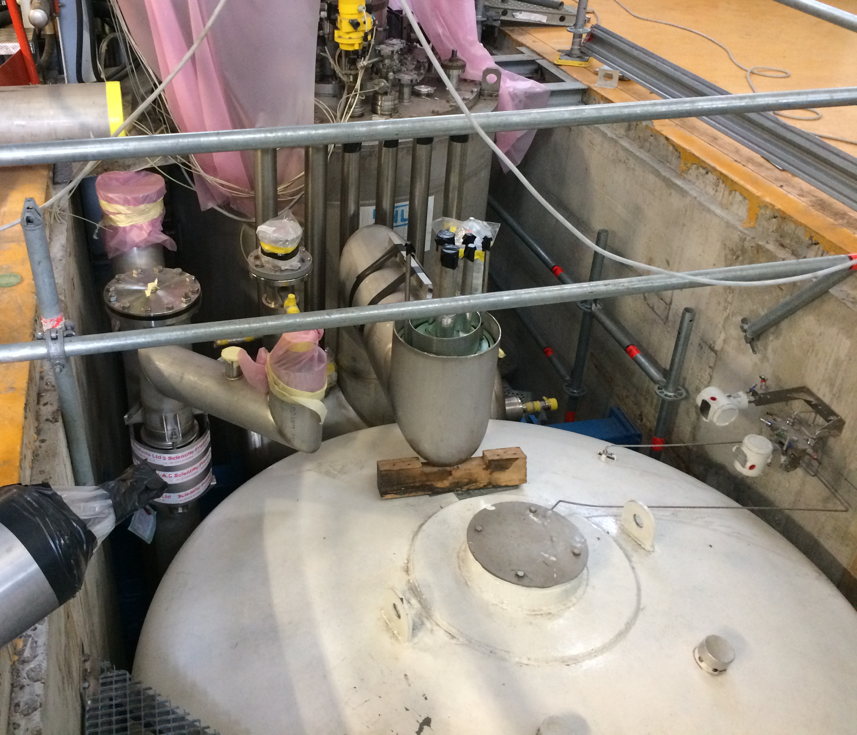
Cryogenic Construction Methods and Components
    Standard CRG Components, designs and methods:
    Thermalised pipe supports for cryogenic temperature sensors
    Pumping ports for transfer lines
    Spinning rotor vacuum pressure gauge
    He Guard systems for low pressure circuits
    Mechanical integration cryogenic instrumentation
    The development of our cryogenic library is ongoing.
    These standard components and designs are available for use outside CRG.
Spinning rotor vacuum gauge
Cryogenic Temperature sensor pipe support
Transfer Line Pumping Port
    Mechanical interventions on Cryogenic Systems:
    Management of complex access constraints and confined spaces.
    Significant experience using Multi-Layer Insulation
    In-house manufacture of cryogenic systems
    Mechanical support for CRG systems
    Mechanical support activities are managed using INFOR EAM:
    Spare part management
    Work requests and follow-up
Constrained work in SM18 6 KW Coldbox
IT String Flow Meter Box
B163 cryogenic system and LHe Dewar

Slide 19
Conclusion
    To fulfil our role in the cryogenics group at CERN, TE-CRG-ME has developed tools, guidelines and standards in the areas of:
    Cryogenic process
    Thermo-mechanical engineering and design
    Cryogenic construction methods and components
    Our aim is to continue to develop a wide-ranging tool kit to provide tools and reference designs for most aspects of cryogenic engineering
    Current areas of development:
    Tool kits are by nature in continuous evolution
    We aim to include future developments and trends in cryogenic applications
      Different temperatures
      Different cryogens and cooling mechanics
Notes:
To fulfil our role in the cryogenics group at CERN, TE-CRG-ME has developed tools, guidelines and standards in the areas of:
Cryogenic process
Thermo-mechanical engineering and design
Cryogenic construction methods and components
Our aim is to continue to develop a wide-ranging tool kit to provide tools and reference designs for most aspects of cryogenic engineering
Current areas of development:
Tool kits are by nature in continuous evolution
We aim to include future developments and trends in cryogenic applications
Different temperatures
Different cryogens and cooling mechanics
-----------------------------------------------------------------------------------------------------------------
Experience building equipment to PED Cat.I (no notified body) → conformity and testing with HSE
PED Cat.II to Cat.IV purchased externally (CE Marking) or built in collaboration with EN-MME → CERN conformity and testing with HSE
Future areas
He-II → Include experience form LHC and current systems in guidelines
Forced flow cooling
Turbo Brayton → Cooling to 20 K

Slide 20
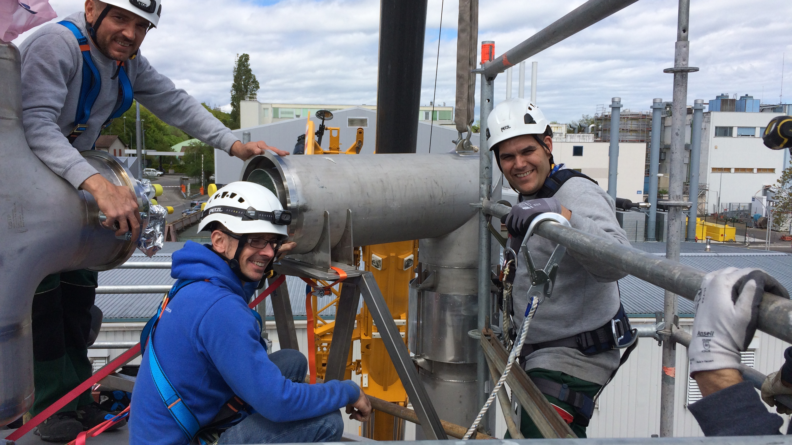

Thanks for Listening
Credit: CERN

Slide 21
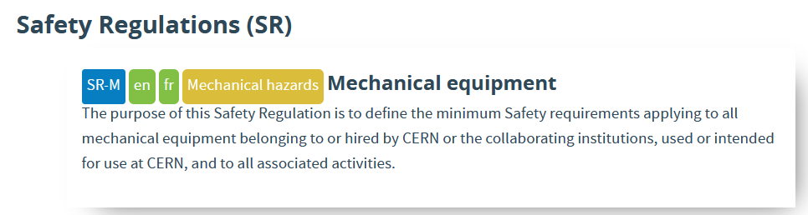
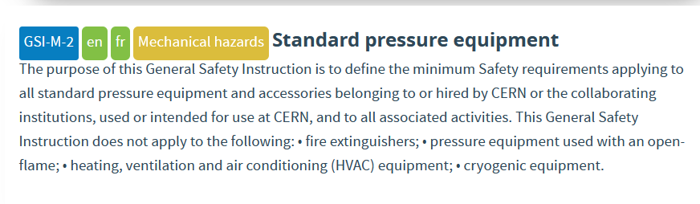
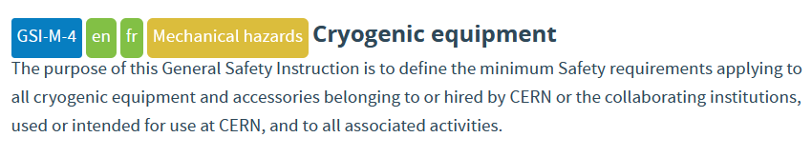







Pressure Equipment
    HSE regulations relevant to Cryogenic pressure equipment
    Safety Regulations (SR)
    General Safety Instructions (GSI)
    Specific Safety Instructions (SSI)
    Safety Instructions (IS)
    Safety Guidelines

