Slide 1
Possible P42 Modifications for HI-ECN3
WP2 Meeting
L. Nevay, D. Banerjee, J. Bernhard, L. Dyks, F. Metzger
26th April 2024

Slide 2
Introduction
Vacuum completion in TCC2
TAX functions and requirements (HI-ECN3)
H6/H8 cycle in T4
H6/H8 wobbling reminder
Safety device for dumping the beam
Bumping onto the target
Next steps

Slide 3
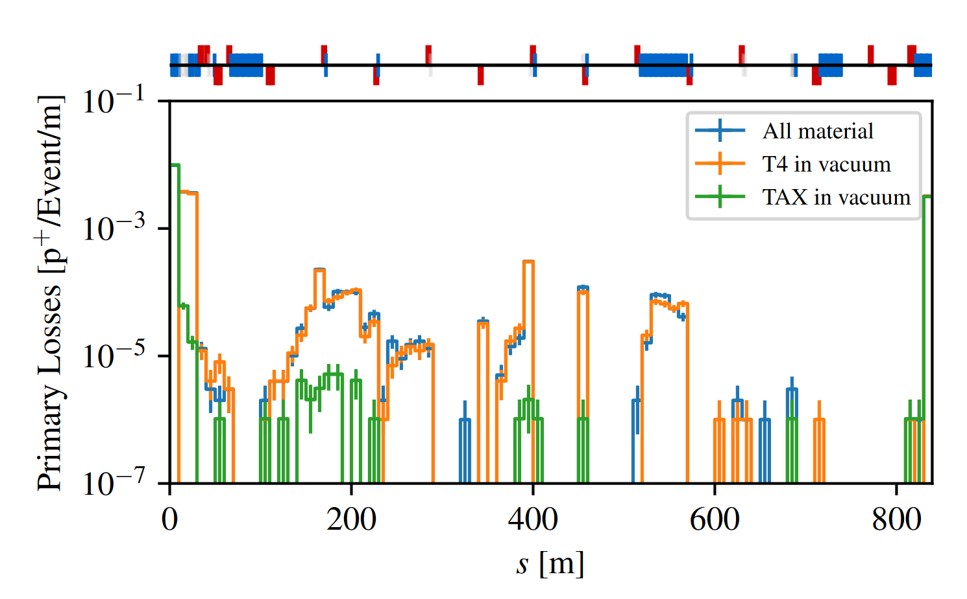
Vacuum Completion in TCC2
In the T4 target region there are sections of air and a few windows
With the higher intensity beam requirement, can we reduce the material in the beam?
  less scattering → fewer losses along the line (even far from the T4 region)
Different TAX holes are used to modulate the intensity
in P42 and for HI-ECN3 this will be done by the machine
Assumption: air cannot be removed inside T4
The next largest source of material is the air in the TAX
  ~4m of air + 2x vacuum windows
  assuming the VXSS vacuum chamber is replaced
Proposal: continuous vacuum from after T4 → TCC8
  TAX in vacuum with larger aperture and perhaps tungsten inserts
P42 Pencil beam with different material
See: https://doi.org/10.1016/j.nimb.2021.11.021 for discussion on inelastic scattering on the inside of the inserts
L. Dyks

Slide 4
TAX Functions & HI-ECN3 Requirements
Function
HI-ECN3 Requirement
Different holes → reduce intensity
  balance needs of P42 and H6/H8
Define the acceptance of P42
Absorb secondaries produced in T4
Dump proton beam
  act as EIS-b for access to TCC8 and ECN3
Not necessary if intensity modulated by
SPS
Necessary if left-over protons after T4
go to P42
Necessary
An EIS-b device should be present

Slide 5
H6/H8 Cycle in T4
TAX
The T4 intensity is driven by
the desired intensity at T10
For H6/H8 we need around
25 - 35 x10¹¹ pps to serve all
test beam users
  NA60+ LOI would imply more
For H6/H8 it would be
interesting to have different
wobbling settings
  there are scenarios not shown here
  where the left-over protons hit the TAX
The wobbling magnets are currently DC currently
  note there is significant risk in a failure scenario if they are pulsed
H6
TBIU
T4
H8
aperture
TBID
+400 GeV
horizontal plane
two common wobbling scenarios in T4
(TBIU/D shown aligned to axis)

Slide 6
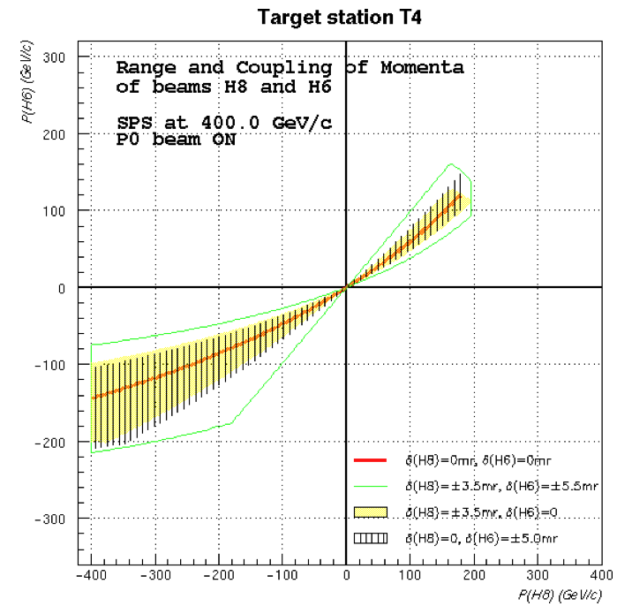
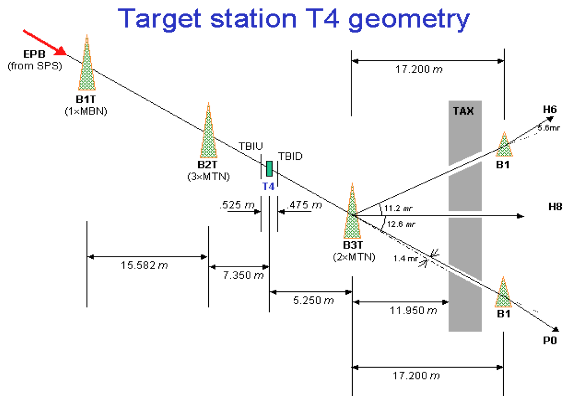
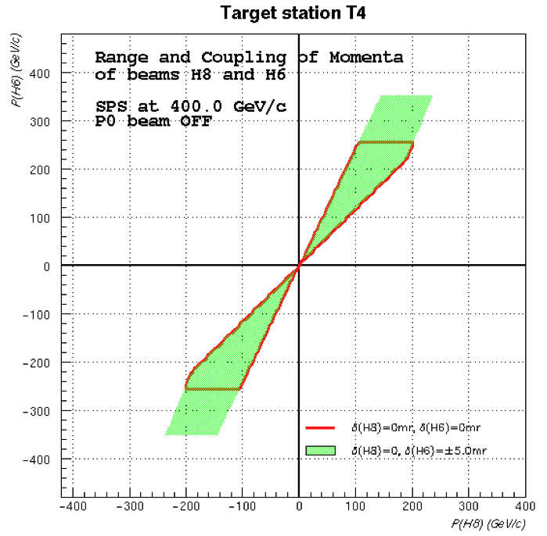
T4 Wobbling Reminder
The wobbling gives the right position
and angle at the target such that each
beamline gets a certain momenta
These are the momenta if we do not have the protons going to P42
These are the momenta if we have the protons going to P42
The protons must either go into P42 or hit the TAX in specific places so as not to leak through the various apertures

Slide 7
H6 / H8 Cycle Options
Requires study
This is a solution that works well in the East Area
Could we put another bend after B3 and have a shorter VXSS?
  this B4 would be the only pulsed wobbling magnet
  off during HI-ECN3 cycle → DC wobbling remains; vertical bump to miss target
  on during H6 / H8 cycle → protons absorbed in TAX; higher momentum secondaries for H6/H8
Or could we work with 1x MTN in DC
and pulse the second only
Consequences:
  protons dumped in TAX (< 40 x 10¹¹)
  TAX needs a less tight aperture
  SHIP loses those (few) protons
  downstream collimation simpler
  higher momentum for H6 / H8
  improved user sharing with H2/H4
  options may be limited depending on
  vacuum flange positions
With full PPM operation of the MTNs we can have problems such as magnetic history and the need for de-gauss cycles
B1
B2
?
B3
horizontal plane

Slide 8
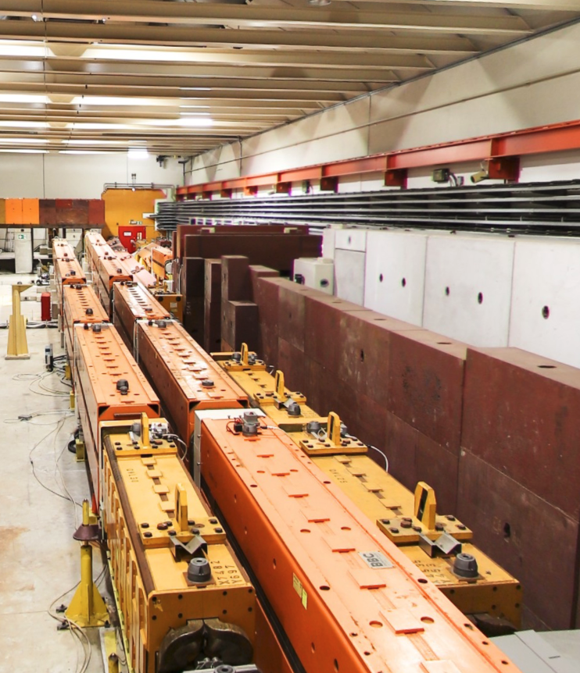
EIS-b Device
Possible space after QNL.0430054?
If the TAX does not move, there must be a device / dump for safety
Could the TIDGV be moved into TCC2?
Could we bump over the TIDGV for normal operation?
If such a dump were in TCC2 the downstream muons would
be lower and in the ground
Otherwise, we would request the TAX move and have vacuum
TIDGV

Slide 9
Safety and Bumping
Current baseline is to bump around the target on the HI-ECN3 cycle
Propose we keep the HI-ECN3 cycle un-bumped and align target to a gap
Bump the H6/H8 cycle onto the target
Requires study
H6/H8 beam
If bumper fails, then we are actively
bumping a much less intense beam
HI-ECN3 beam
target gap is 40mm
The bump would not be enough to
steer clear of the hole in the TAX
targets
Investigate what small angle we
could tolerate for the H6/H8 beam
at the target

Slide 10
Next Steps
TAX in vacuum that does not need to move
  ask for investigation for TAX vacuum possibility in TCC (NACONS + HI-ECN3)
Investigate location in TCC2 for possible dump → check with M. Lazzaroni
Investigate H6/H8 wobbling with extra bend / split power in B3T
  viability from magnet / power supply perspective
  can vacuum be continuous or are windows needed
  where would proton beam land in TAXs
  what range of momenta in H6/H8 → worth it?
Bumping onto target
  calculate bump in MADX
  identify shift in H6/H8 (implies realignment vertically of first few elements on beam line)

