Slide 1
Leveraging AI in UNICOS CPC
Loreto Gutiérrez Prendes

Slide 2
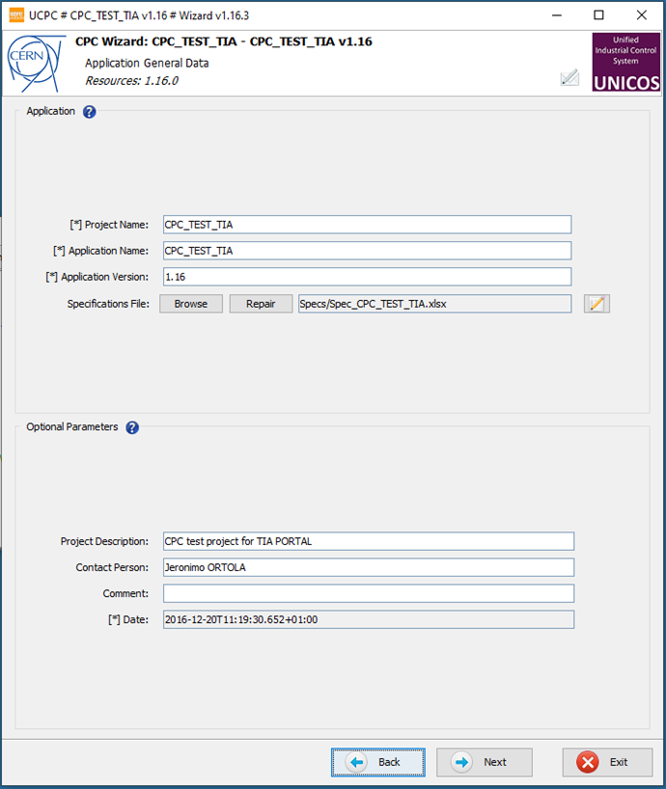

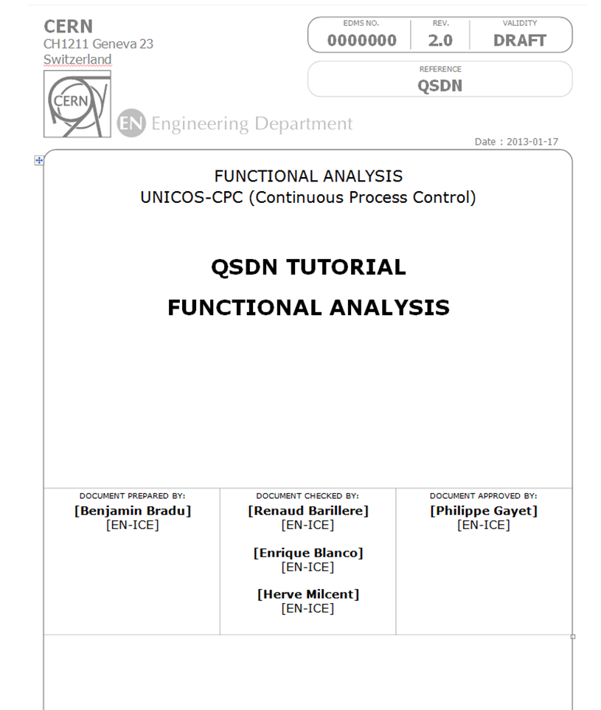

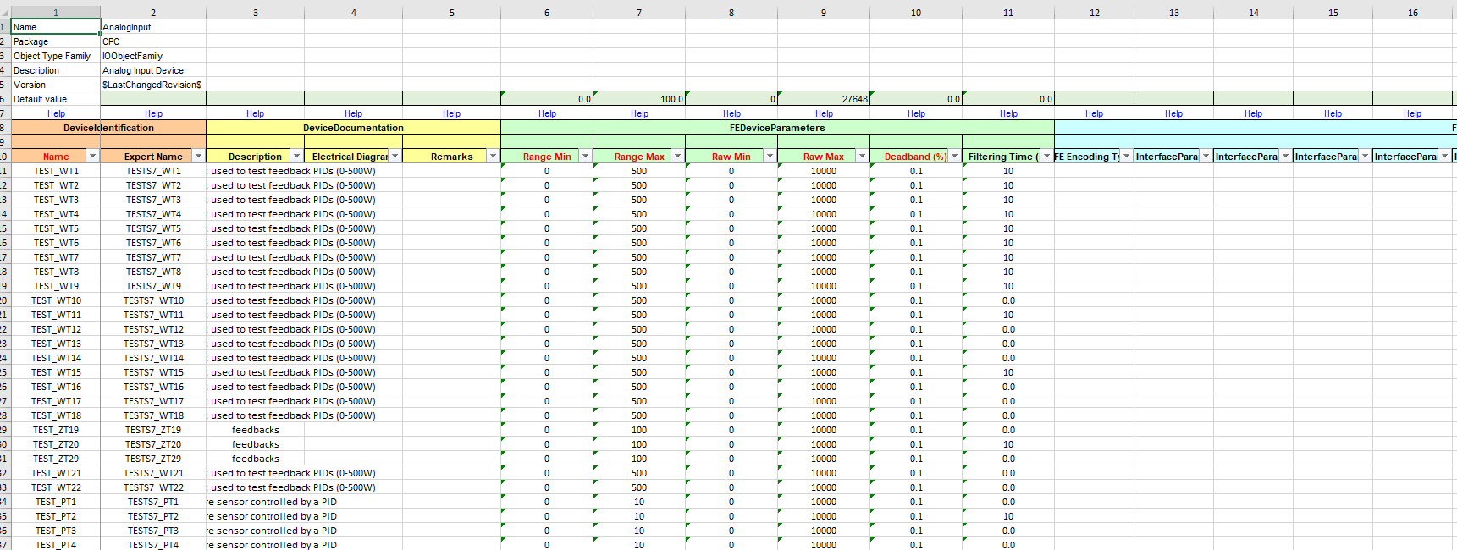

UNICOS-CPC engineering workflow
UAB CPC wizard
PLC Instances
PLC logic
HMI tags
WinCC OA object instances
Comm resources
SCADA set-up (synoptics)
System requirements
Instrumentation
Electrical diagrams
P&ID
Process decomposition
Functional Analysis
Process
Modelling
Specification
Specs
Process logic
Application generation
(UAB)
Deployment
Functional Units
Functional Analysis
UNICOS-CPC specs
Logic Templates
Application resources
Application

Slide 3


Introducing AI in UNICOS-CPC

Slide 4
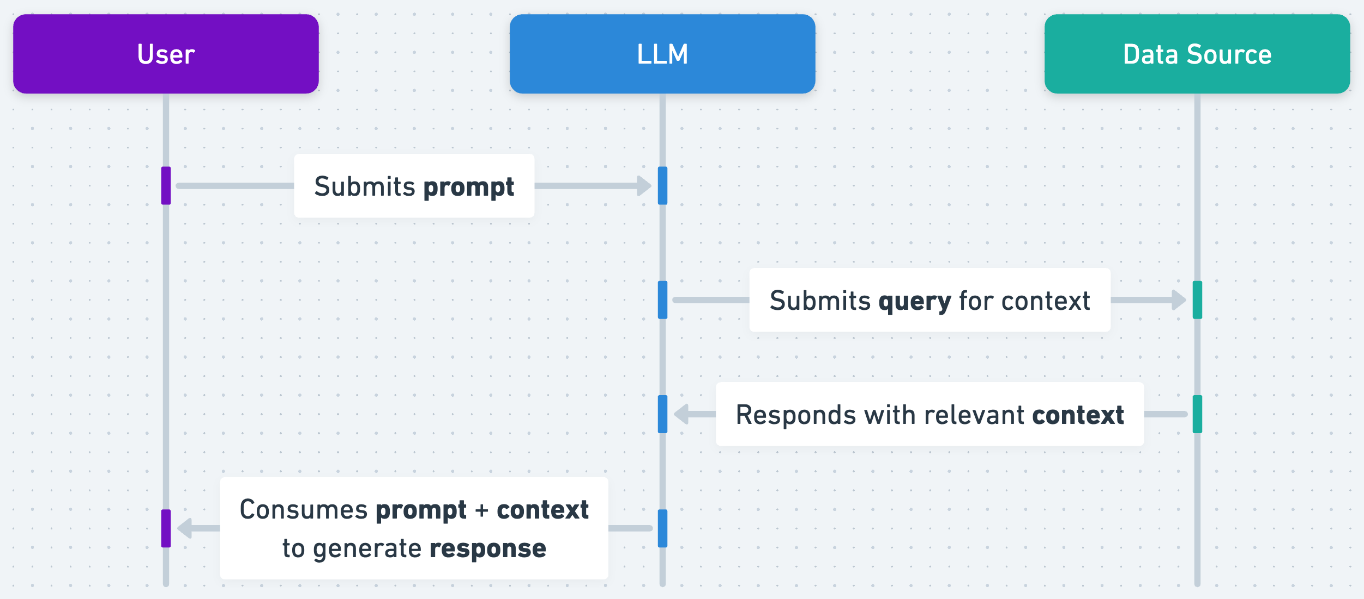
Methods to teach the LLM about UNICOS CPC
Fine-tuning: Modify the model permanently with custom information, producing a new model. Costly solution (if not open-source). Limits the model’s reusability.
Retrieval-Augmented Generation (RAG): RAG is valuable for use-cases where the model needs knowledge which is not included in the information the model has learned from
3. Prompt-engineering: Submit prompts to the LLM in a way that maximizes the quality of the model’s answer. Context can be included with every prompt so that the model knows the details of our system.
Source: https://help.openai.com/

Slide 5

Prompt engineer GPT4 about UNICOS CPC: provide context
Application examples
UNICOS Model
UNICOS CPC documentation (web)
AF (Functional Analysis)
Specs file
Device type definitions
Attribute definitions

Slide 6
Process input context
UNICOS model XML device type definitions and attribute descriptions
  Can be fed directly to the model as they are plain text.
UNICOS CPC documentation Remove irrelevant information
  Most of it an be fed directly to the model as it is plain text.
  Images have to be omitted as the model does not take images via the API yet. We can either use the model in another form to describe the images in text or do it ourselves.
Functional Analysis (AF) Use pandoc to convert .docx to .md
  Images have to be omitted as the model does not take images via the API yet. A lot of information is held in images in some AFs, like the relationship between units, or the PID (Process and Instrumentation Diagram). This information is hard to convert into words.

Slide 7
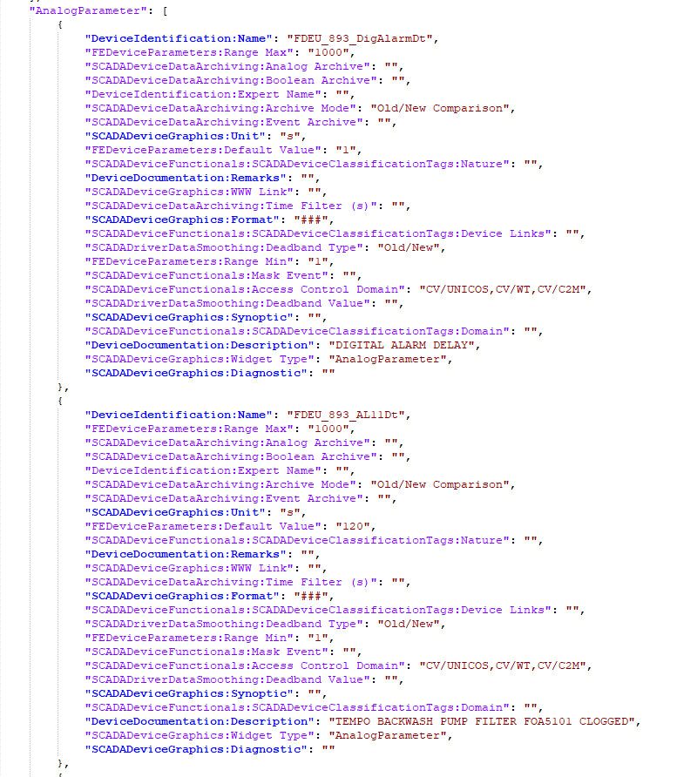
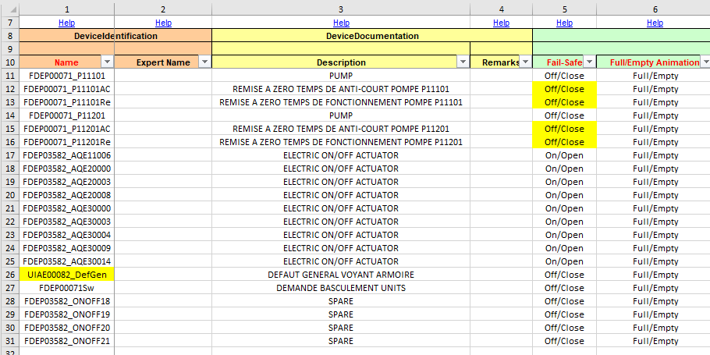
Process input context
How?
Specs file From .xlsx to plain text (JSON) UNICOS CPC Expert Template
Problems:
JSON file is too large (~100k lines for large app) – rethink format? Use RAG?
GPT 4 - turbo limited to 128k tokens (1 token ~ 4 chars). Large contexts make the model ‘hallucinate’ and partially ignore the information in the middle.

Slide 8



GPT4 for UNICOS CPC
1st prompt
This is the UNICOS CPC Context and some examples
I’m a UNICOS CPC expert now, how can I help you?
2nd prompt
Please, transform this functional analysis to a UNICOS specification
I have generated the following JSON file from your AF…
3rd prompt
The alarms are not configured properly; you need to focus on…

Slide 9
GPT4 for UNICOS CPC
GPT 4 Limit: 8k tokens
GPT 4-Turbo Limit: 128k tokens
1st prompt
This is the UNICOS CPC Context and some examples
I’m a UNICOS CPC expert now, how can I help you?
2nd prompt
This is the UNICOS CPC Context and some examples +
I’m a UNICOS CPC expert now, how can I help you? +
Please, transform this functional analysis to a UNICOS specification
I have generated <this JSON file> from your AF…
3rd prompt
This is the UNICOS CPC Context and some examples +
I’m a UNICOS CPC expert now, how can I help you? +
Please, transform <this functional analysis> to a UNICOS specification +
I have generated <this JSON file> from your AF… +
The alarms are not configured properly; you need to focus on…

Slide 10
Challenges / Future work
Context is currently too large to feed at every prompt, so prompt engineering on its own might not be optimal. RAG or fine tuning may be more adequate. Still prompt (AF) and the answer (JSON spec) remain huge.
Explain more in detail to the model how we pass from the AF to the specs, as passing all the information in raw format has not worked well. Explain the structure of the AF (e.g. each chapter corresponds to a PCO), provide the IOList (like they do in Cooling&Ventilation with CoVeET)… or even reuse these tools built by the operation groups that already automate the generation of the base specs.
Find small applications with meaningful examples. Likely use custom made applications with a few examples for every device type, instead of real applications that have hundreds of objects which are all the same. Provide an additional database where the model can search for extra example when it needs to (RAG).
Use open-source models to test out fine-tuning “for free”.
Find a solution for the information lost in the images that cannot be directly interpreted by the model.

