Slide 2
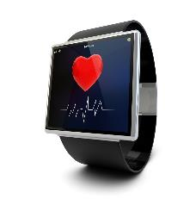
Monitoring & Analysis of the Symptoms of Parkinson’s Disease on a Large Scale
- The Kuranos KT Project
Lars V. Jørgensen
For the Kuranos team
BE Seminar 26 April 2024
The rest of the Kuranos Dream Team:
Manuel Gonzalez Berges
Emiliano Piselli
Samuel Simko (Summie 22)
Anna Ferrari (Fellow 2019-2023)

Slide 3
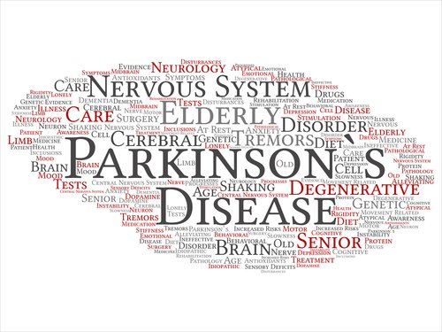
Outline
Background on PD
Background on recent break-thru’s
Competition
The Kuranos Idea
Current Stand of Things

Slide 4
Background
Parkinson’s is the second most common neuro-degenerative disease (second only to Alzheimer’s).
Worldwide >10 million patients.
Patients show many symptoms.
There is no cure ….. yet!
The disease mainly hits the elderly ; ~1% of people over 65 years of age are affected.
As the populations age, this might become a bigger problem.

Slide 5
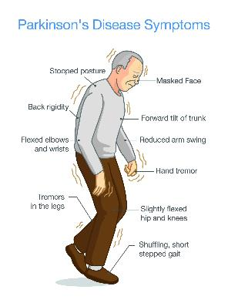
Symptoms of Parkinson’s
Motor symptoms
  Tremors
  Bradykinesia (slowness of movement)
  Dyskinesia (sudden uncontrolled movements)
  Rigidity
  Posture and postural instability (balance).
  As the populations age, this might become a bigger problem.
  Freezing
  Reduced amplitude of movement
Non-motor symptoms
  Constipation
  Sleeping problems

Slide 6
Cause and treatment
The cause of Parkinson’s is believed to be a loss of dopamine producing nerve cells in the Substantia Negra region of the Basal Ganglia in the brain.
This area is responsible for basic muscle control.
This lack of dopamine cannot be easily replaced as dopamine cannot cross the blood – brain barrier.
The main line of drugs to treat the symptoms of PD is Levidopa/Carbidopa, which both are able to cross the blood-brain barrier and once inside the brain partially turn themselves into dopamine.
Note that this is treatment of the loss of dopamine – NOT treatment of why dopamine producing cells are being lost.
The loss of dopamine producing cells are believed to be caused by build-up of alpha-synuclein in this part of the brain.
There is at most a very weak genetic component to PD

Slide 7
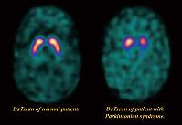

Fast pace of new discoveries over the last 10 years
The push from the Michael J Fox Foundation.
  Being diagnosed with PD at 29 in 1991, he started the foundation in 2000 and it has been exceptionally good at fund raising and supporting research around the world – to the tune of >1 billion $ over the last decade.
  A number of similar foundations around the world have similarly stepped-up fundraising and research grants.
  Until about 2010 diagnosis was based on ruling out other causes of the symptom and finally by the effect Parkinson’s drugs had on the symptoms!
  2011 DaT-scan was approved. Dat-scan (Dopamine-Transport scan) is a SPECT (Single Photon Emission Computer Tomography) based on the radioactive tracer Ioflupane (¹²³I)

Slide 8
Fast pace of new discoveries over the last 10 years
PPMI – Parkinson’s Progression Marker Initiative
  Without an objective method for measuring the progression of the disease, it is difficult to test new drugs that might slow the progression.
  MJFF announced the discovery of the first biological progression marker in 2023!
Serendipity and the gut. Accidental discovery that most PD starts in the gut!
A vaccine against PD now in phase three trial since early 2023.
The smell of PD and the Scottish nurse.
Repurposing existing drugs has been crucial.
DBS – Deep Brain Stimulation
The Michael J Fox Foundation help draft The Bill to End Parkinson’s – A 10-year program with better coordination and an additional 1 billion $ from the government to be added to the 1.5 billion Mr. Fox will put in the pot. This will also be coordinated with other sources from around the world.

Slide 9
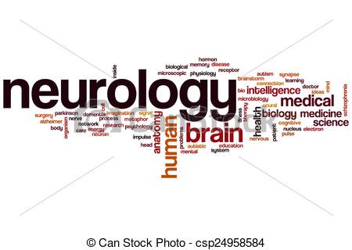

Motivation
“When I started in neurology 30 years ago, I started by measuring and characterizing Parkinson’s tremors – what makes you think you can do it better now?”
Pierre Burkhard – Head of neurology department at HUG
After diagnosis Parkinson’s patients typically see their attending neurologist every ~6 months, where the neurologist, together with the patient, make a subjective assessment of the symptoms as a basis for decisions on change of drugs or dosis.
Being geeks, we were at first perplexed by the lack of a method to objectively measure and track the most common motor symptoms. …and sensors are much better now than 30 years ago!!!
A thorough search online only yielded a few very outdated devices only for sale to clinics.
9

Slide 10
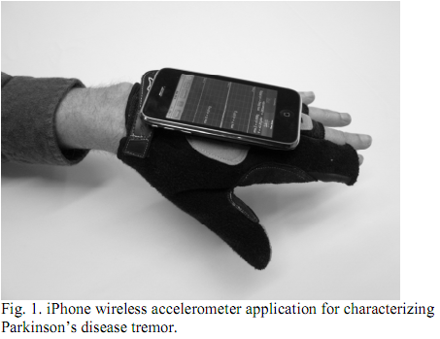
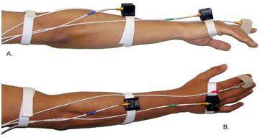
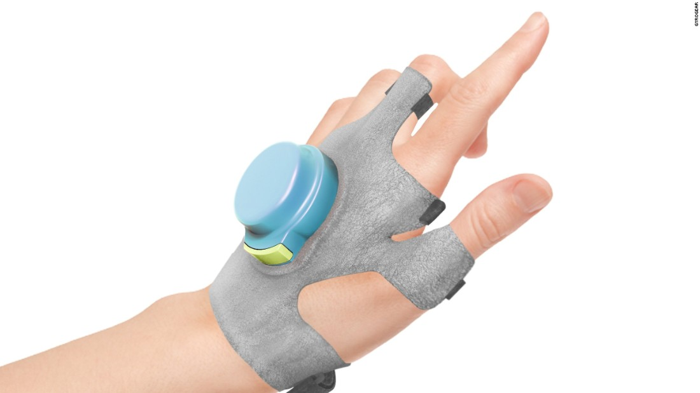
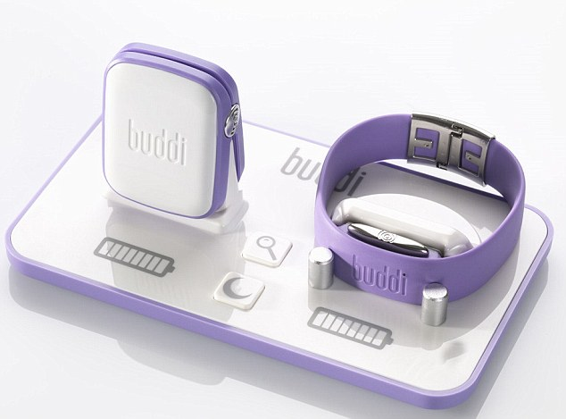
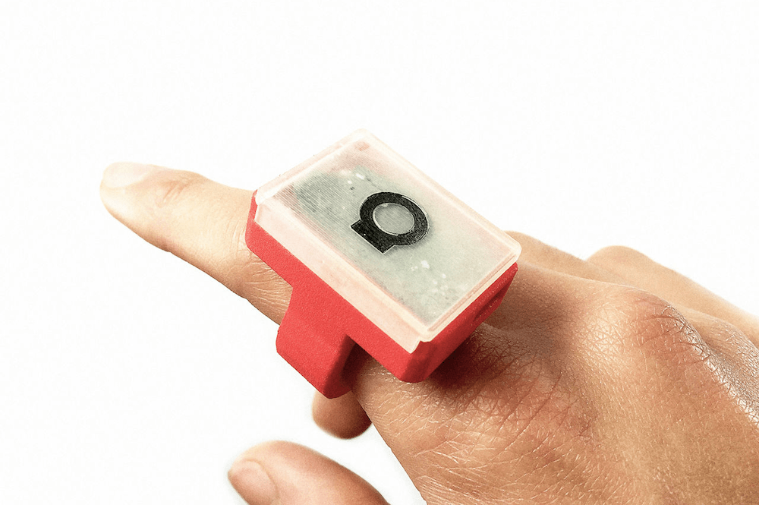
What was available in 2018?

Slide 11
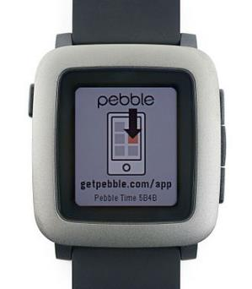
The Pebble Time problem!
The Michael J Fox Foundation ran three-year trial to have Pebble Time together with their app for Pebble Time certified as a medical instrument – this is necessary under US law (and lots of other countries laws) to make a medical decision based on measurements made by this device
Pebble Time was chosen because of its unique technology (color e-ink, long battery lifetime)
Pebble goes bankrupt – hardware discontinued

Slide 12
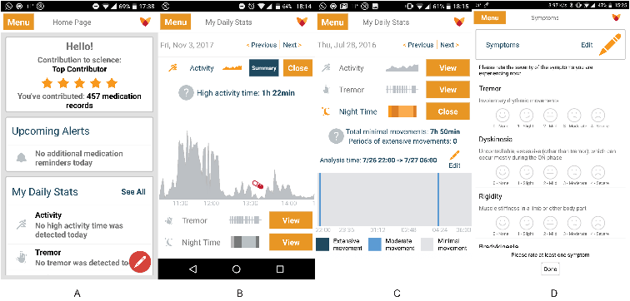
More lessons from Fox Insight

Slide 13
More lessons from Fox Insight
Patient-neurologist app very good.
Very extensive questionnaire is only part of the effort still continuing !
Trying to have a smartwatch solution medically certified is probably a futile effort.
…. But nothing stops you from trying to track your own symptoms and using this as a base for discussion with your neurologist!
… and remember currently medication only reducing symptoms!

Slide 14
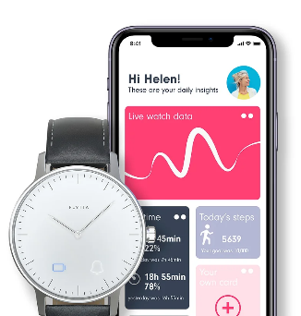
Kuranos – the original idea
Build our own hardware!
Very low power consumption.
Long battery life time.
Competition from Australia
Competition from Germany
Change of emphasis – no hardware
‘Making smart watches is NOT a CERN competency!’

Slide 15
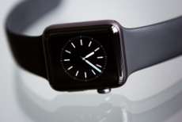
New goal for Kuranos
Change of emphasis – no home-made hardware!
Use commercial hardware – Apple, Fitbit and Garmin.
Building smart watches not a CERN competence. Analyzing large amounts of data IS a CERN competence.
Analyzing heterogeneous data IS also a CERN competence (e.g. ATLAS does not throw all their old data away after installing new tracker)
Kuranos collect data for the patients own use and for research and analysis by methods for Big Data, Machine Learning and A.I.
KURANOS
Building DAQ systems and associated data storage
solutions IS also a CERN Competence

Slide 16
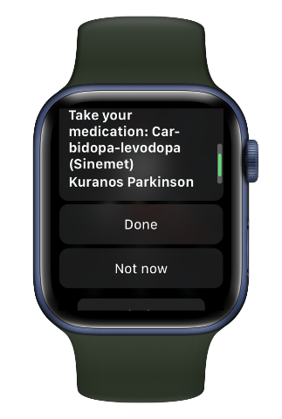
KURANOS
To encourage as many patients as possible to purchase and use their smart watch and Kuranos App, they have to have direct benefit from the measurements themselves.
This means that we have to make a databases with the individual datasets, where the patient and/or attending neurologist can log in to see a rough analysis of the patient's data – has the tremors become less or more since changing to a new drug? How much exercise does the patient do? How does the patient sleep? Probably something similar to Fox Insight.
This should help the neurologist (and patient) to decide on the best drugs to use and thus a better quality of life for the patient and with more targeted drugs, the health insurance company may also save money!
This might mean that the patient can purchase the smart watch and get reimbursed from their health insurance.
Collect as much data as possible. This implies a simple interface – most patients over 65 years !!!!

Slide 17

The big idea – the big database!
Beyond the patient database, we would like to ask the patients permission to add their data to a big anonymized database and use Machine Learning and A.I. to try to unexpected correlations in the data that could lead to new insights and perhaps that crucial piece of information that will guide us towards a cure!!
>10 million Parkinson’s patients worldwide.
Expected to increase as population ages.
Maybe 100,000 patients using our App ?????????
OBS: Not medically certified!
Available for all to download e.g. App Store!
Big database tagged with sensor package used – we can upgrade the sensor package as technology evolves!
Leveraging CERN competences and expertise to help find a cure!
KURANOS

Slide 18
Testbench Apple
KURANOS
a.k.a. Samuel Simko’s summer at CERN
Test the ideas on one of the platforms – we chose Apple!
Apple Watch, Iphone and Mac Mini purchased.
NB! Fitbit and Garmin normally connects directly to computer without the need for smart phone to relay the data!
In 2022 we had a CERN OpenLab summerstudent, Samuel Simko. His task was to try to get as far as possible on this list of tasks:
Create an Apple Watch application to acquire motion and health data.
Store the centralized data using the CERN EOS disk storage system
Create a dashboard where symptoms can be monitored
Perform preliminary analysis using existing datasets.

Slide 19
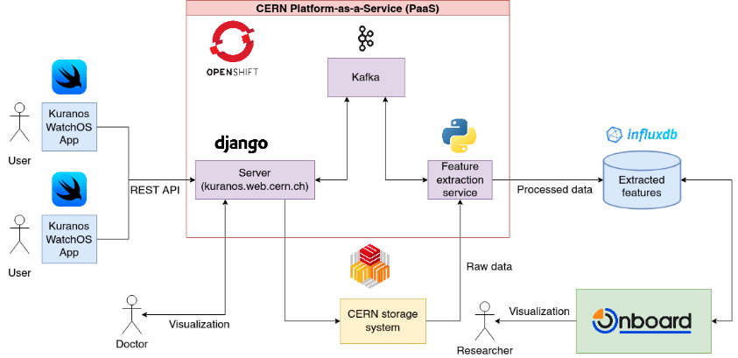
Architecture and technologies
KURANOS

Slide 20
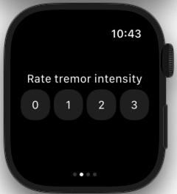
Data Acquisition from an Apple Watch
KURANOS
An app for the Apple Watch was developed using SwiftUI.
Collected data included:
Acceleration, orientation of the watch, blood oxygen level, etc.
Step count, walking speed, walking asymmetry percentage, stair ascent speed, etc.
User entered information: Medicine intake, tremor rating etc.

Slide 21
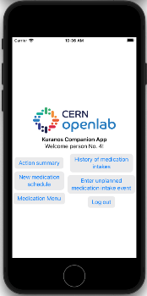
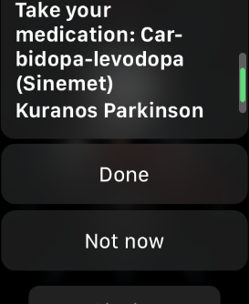
Companion app and visualization
KURANOS
The companion app (left) and Medication alarm (right)

Slide 22
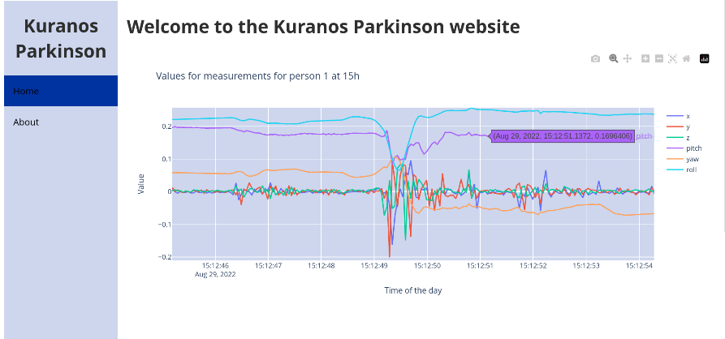
KURANOS

Slide 23
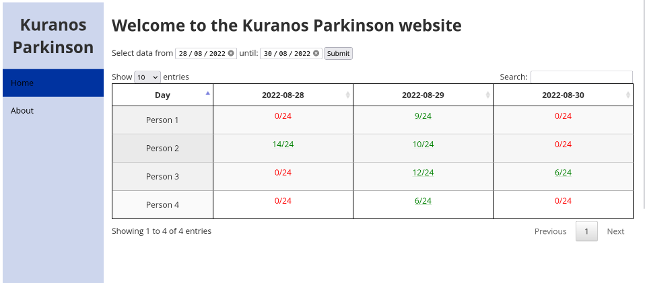

Slide 24
Next step?
We have KT-MA grant money left over to hire a technical student for 6 months.
Task: Extend and polish what we have and try to record and analyze real data to show our unique idea of the big database works.
Next step thereafter is to try to find new partners and collaborators to make the ideas real. 3-5 persons at CERN will not be enough!

Slide 25
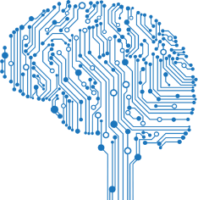
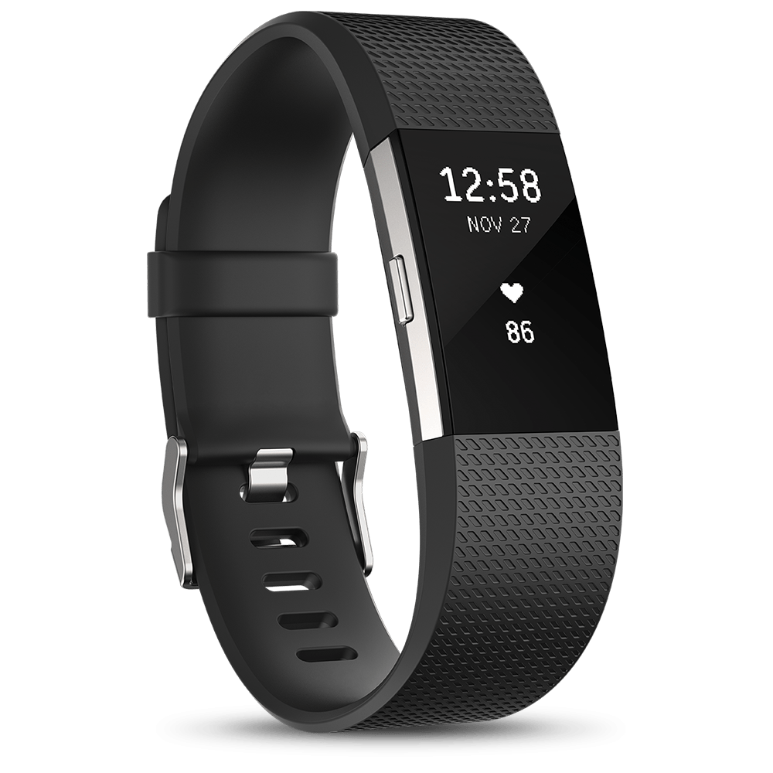
Thank You!
“Improving healthcare through technological innovation and artificial intelligence”
KURANOS
The Kuranos Dream Team:
Manuel Gonzalez Berges
Emiliano Piselli
Samuel Simko (Summie 22)
Anna Ferrari (Fellow 2019-2023)

