Slide 2
Welcome to the 15th thematic CERN School of Computing
(and the 1st School on Machine Learning)
Alberto Pace, school director

Slide 3


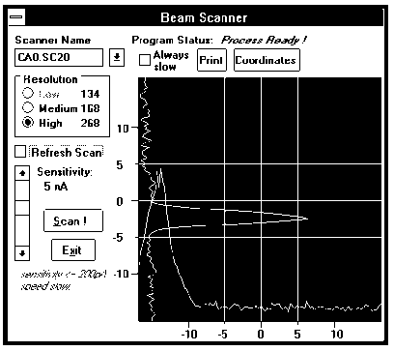
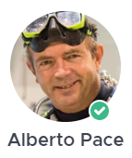
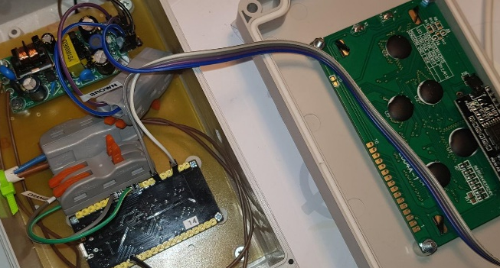

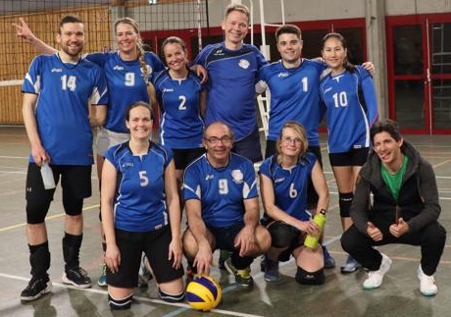

Who am I ? Alberto – your school director
Electronic Engineering (Politecnico di Milano), at CERN since 1986
I have led 5 groups and various sections at CERN, currently the IT-CD group. I have many years experiences in computing services, infrastructure, software engineering, accelerator control and accelerator operation.
I am passionate of mathematics, electronics, volleyball, scuba diving and sailing
p-adic numbers
https://youtu.be/tRaq4aYPzCc

Slide 4



CERN’s mission
Innovation
Education
CERN
uniting people
The CERN School of Computing is here …
Research
?
Discovery
Accelerating beams
(accelerators)
Detecting particles
(experiments)
Large-scale computing (Analysis)

Slide 5
A statement from Ivica …
https://www.facebook.com/1334424117/posts/10232249117833997/?mibextid=rS40aB7S9Ucbxw6v
“Another reason for your optimism is the fact that you go to school every day to learn something new. I know you are usually not exactly thrilled about going and being in school, but consider the following arguments. For thousands of years, millions of people have tried to understand various things about nature and society. Some of them spent their entire lives trying to understand the basic laws of nature, what our planet looks like, how the universe looks like, how stars, planets, people etc were created. You learn most of these things in a few hours of teaching and working at school or at home. From that perspective you know more after a few years of school than some of the greatest scientists in human history. And you find out more and more every day.”

Slide 6
A school with a long history
The school was created in 1970, 2023 will be the 44th edition
This is the 15th edition of the Thematic School
The school has visited 22 countries
  all member states (except Bulgaria, Slovak Republic)
  + Croatia, Cyprus, India
88 different nationalities
3294 students have followed the school

Slide 7
Mandate and mission
Create a common culture in scientific computing among young scientists and engineers involved in particle physics or other sciences, as a strategic direction to promote mobility and to facilitate the development of large computing-oriented transnational projects.
  http://cern.ch/csc
Participants come from worldwide laboratories and universities with typically 20 to 30 different nationalities (61 different nationalities in the past 10 years).
  http://cern.ch/csc/alumni

Slide 8
Bridging science and computing
The unprecedented technological evolution in computing has profited directly to several scientific research projects, in particular in high energy physics
  Computing is today the main strategy for many sciences to boost their research productivity
It is nowadays essential that:
  Scientists master computing technologies as the main tool for their research
  Computer scientists understand the scientific domain of the investigation to deliver computing services that meet the needs of the research project

Slide 9
An additional side effect …
… knowledge transfer of (CERN) skills and (CERN) know-how in computing to academic, national laboratories, research institutes, institutional and industrial circles in Member States and other countries
  With direct or potential applications up to all spheres of the society (as exemplified with the Web, and the Grid).

Slide 10



The CERN Schools of computing
The Main School
  Two weeks, ~ 60 participants (64 this year)
  Multiple topics on scientific computing
The Thematic schools
  Goes more in depth on a particular topic
  Smaller participation, shorter duration (one week), clear goals
  Last year, two schools 23 + 30 participants
  This school: 33 participants, 24 institutes, 21 nationalities
The Inverted school
  It is frequent to find among students real experts on specific topics, and the cumulated knowledge of the students exceeds the one of lecturers.
  At the end of each school, we invite students to propose some lectures, and we organize an “inverted” school. “Where students turn into teachers”
  In 2024, the 15th edition had 12 lecturers and more than hundred participants

Slide 11
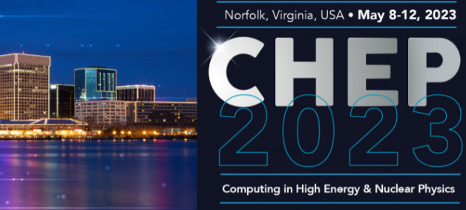
The School Academic Dimension
The school …
  … is not a conference
  … is not a place for lecturers to present their work, promote their projects
  Does not replicate of common training available at home institutes, or in member state’s universities
  Does not delivering “technical training” courses
Focus on persistent knowledge, less notions
and knowhow
Training
Programme
C++
Java
Oracle SQL
Oracle Forms
Python

Slide 12
Focus on Knowledge
Knowledge versus Knowhow
Knowledge | Knowhow
Articulated to other knowledge of the learner | Generally stand-alone information
By nature, when taken by the learner, different between learners | Initially, the same for every learner
Transferable, adaptable to other environments | Transfer requires effort
When taken by the learner, persistent | Will be forgotten if not practiced
Requires related knowledge pre-exist | Limited pre-requirements

Slide 13
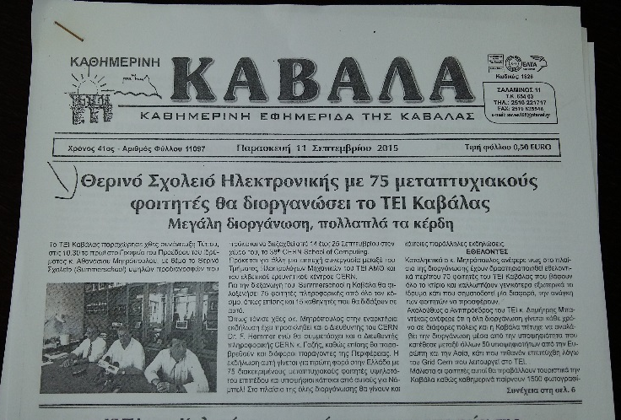
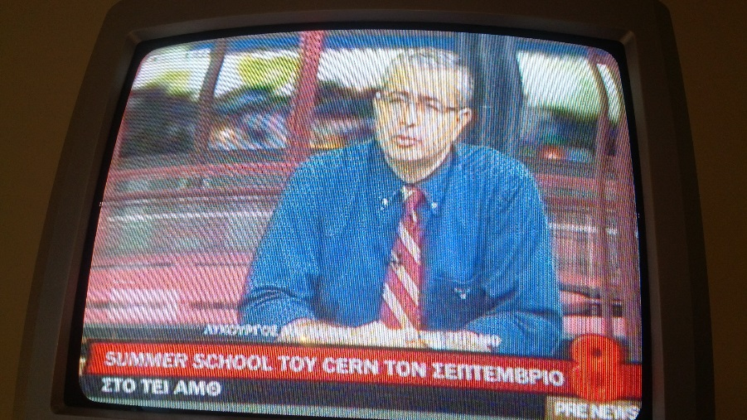
An outreach opportunity
For the local organizers

Slide 14
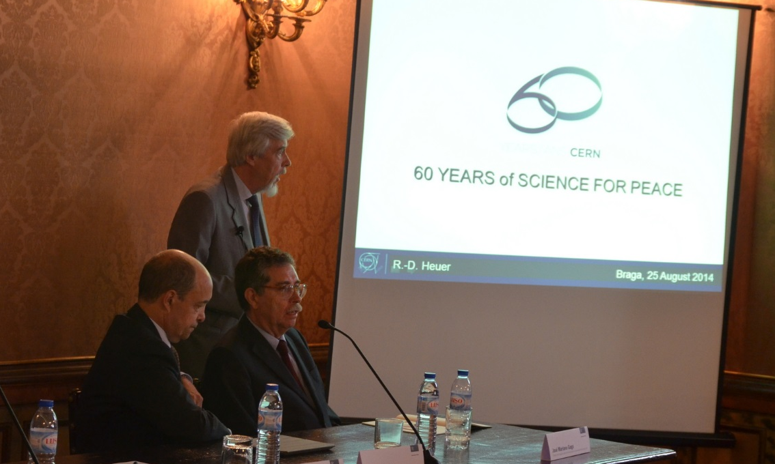
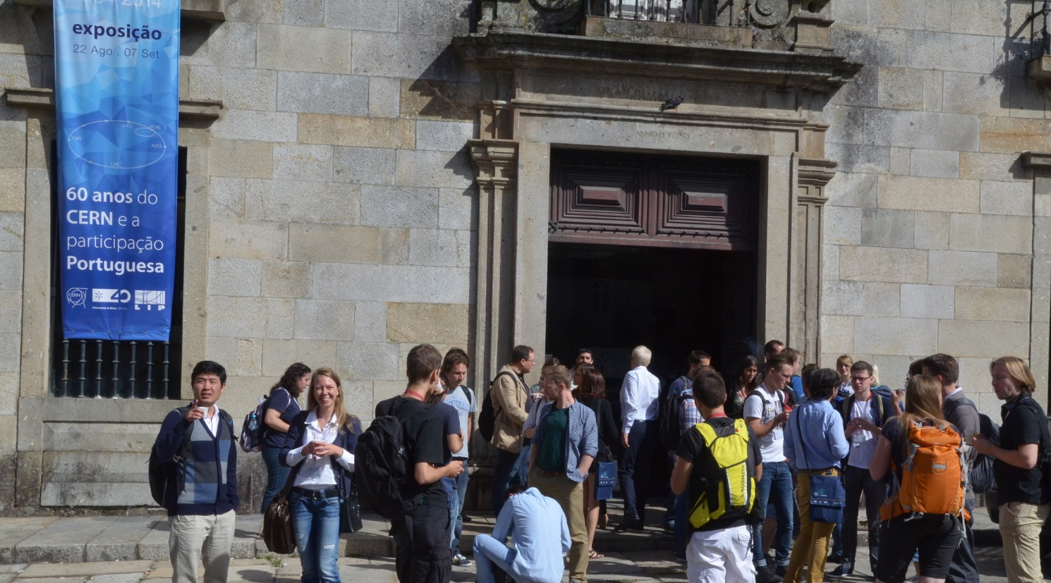
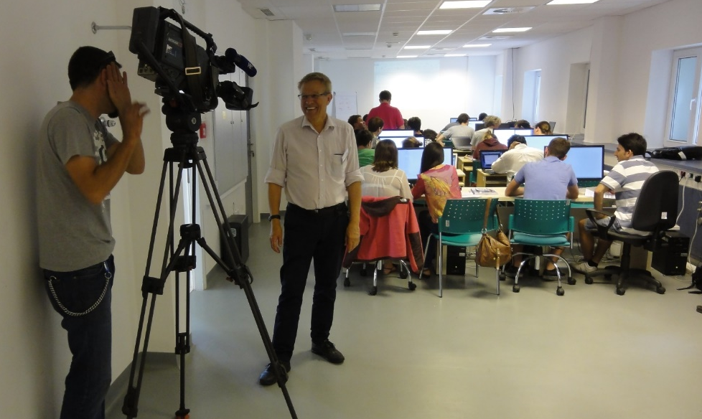
An outreach opportunity
For CERN

Slide 15
The school governance
… is discussed at the School Advisory Committee
  http://csc.web.cern.ch/advisory-committe
  Includes several fulltime university professors
  from different countries
  Two meetings per year

Slide 16
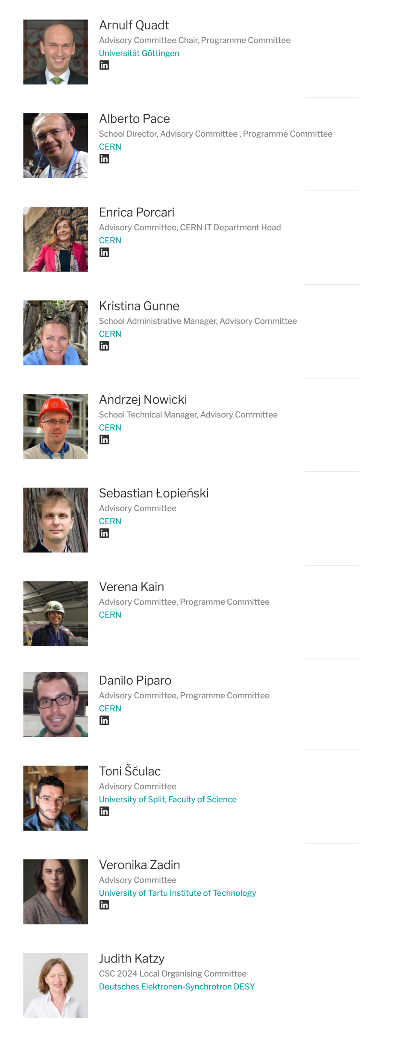
The School Advisory Committee

Slide 17
Thematic CSC 2024 on Machine Learning

Slide 18

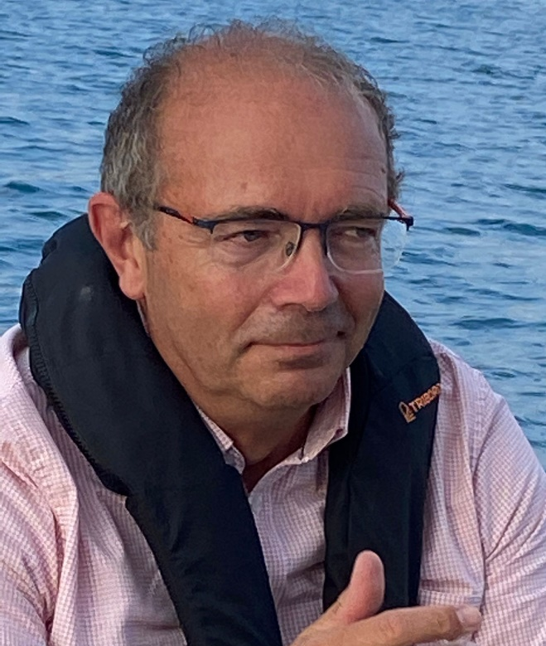
CSC Organizers
Kristina Gunne
Administrator
Andrzej Nowicki
Technical Manager
Alberto Pace
Director
… and the MEDILS staff !

Slide 19
The school learning process
Mandatory
Learning process
  Lectures
  Exercises
  Exam
Meet special persons,
Build trusts with colleagues across the world
  Lunches, dinners, coffee breaks, evenings
  Excursions
  Music events
  Sport programme
Optional

Slide 20
The school learning process
Mandatory
Learning process
  Lectures
  Exercises
  Exam
Meet special persons,
Build trusts with colleagues across the world
  Lunches, dinners, coffee breaks, evenings
  Excursions
  Music events
  Sport programme
Optional

Slide 21
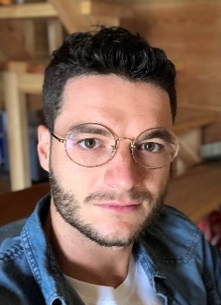
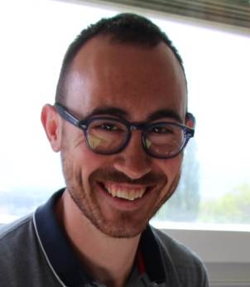
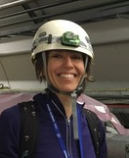
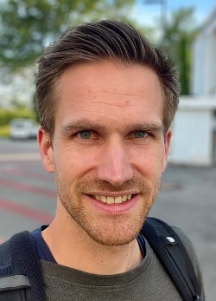
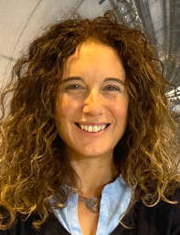
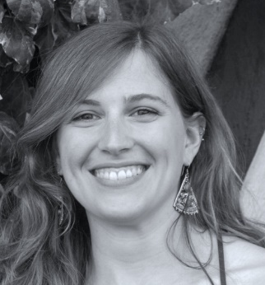
Academic Programme
Theme: “Machine Learning”
  Track 1: A summary of Machine Learning Methods
    Introduction to data analysis, Classical Machine Learning, Introduction to deep learning, Advanced deep learning
    Toni Šćulac, Francesco Vaselli
  Track 2: Machine Learning in Accelerator Technologies
    Machine Learning for particle accelerators, Bayesian Optimisation, Reinforcement Learning
    Verena Kein, Michael Schenk
  Track 3: Machine Learning in Data Analysis
    Introduction to Machine Learning for HEP, Anomaly detection and real time applications, data reconstruction, generative Models, Systematics in ML
    Sofia Vallecorsa, Ilaria Louise

Slide 22
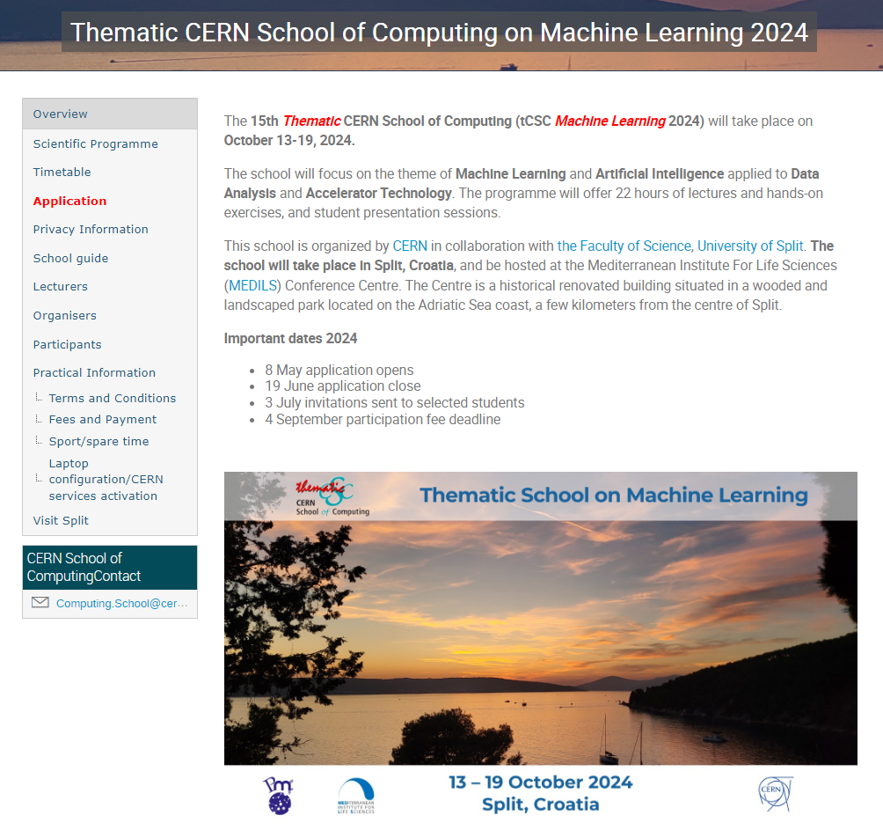
The School site is on indico
https://indico.cern.ch/event/1407896/
Check it regularly for updates

Slide 23
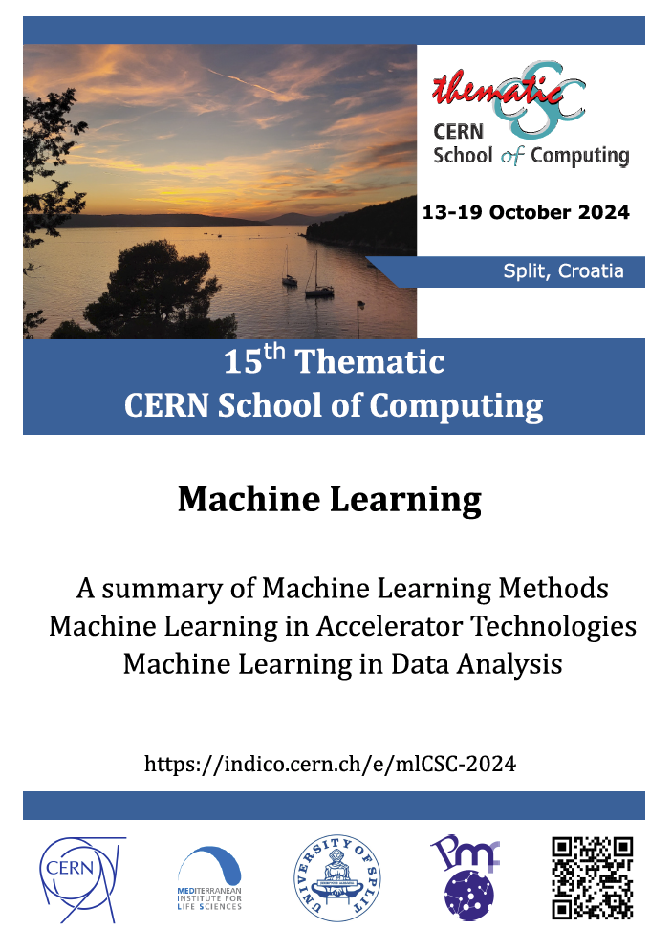
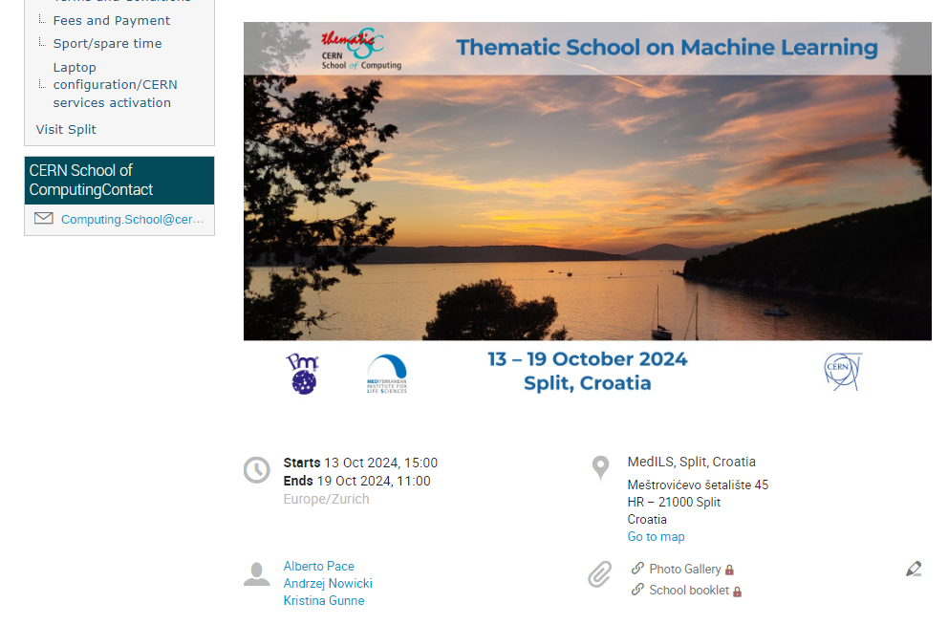
School booklet
Printed version for those who asked for it
Electronic version (PDF) Linked
from school main page on Indico
  https://indico.cern.ch/event/1407896/
Contains pictures and short biographies
of all participants

Slide 24
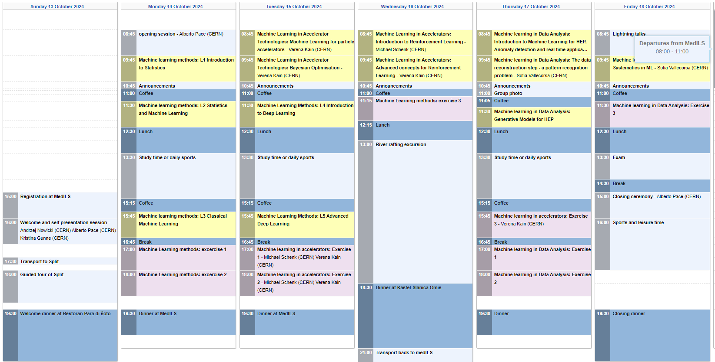
The tuition programme

Slide 25
The school learning process
Mandatory
Learning process
  Lectures
  Exercises
  Exam
Meet special persons,
Build trusts with colleagues across the world
  Lunches, dinners, coffee breaks, evenings
  Excursions
  Music events
  Sport programme
Optional

Slide 26
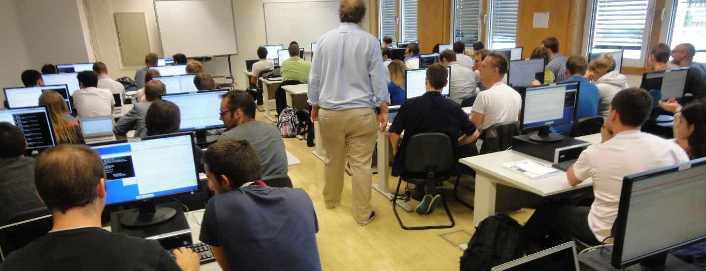
The School culture in “exercises”
The school has an entire computing infrastructure for exercises. Remotely accessible to the students
  The quality of the computing infrastructure is a shop window for CERN
Students works in pair (2-student teams). If possible:
  1 student with physics background
  1 student with computing background

Slide 27
The school learning process
Mandatory
Learning process
  Lectures
  Exercises
  Exam
Meet special persons,
Build trusts with colleagues across the world
  Lunches, dinners, coffee breaks, evenings
  Excursions
  Music events
  Sport programme
Optional

Slide 28
The exam
A serious and difficult exam, which delivers the diploma
Evaluate knowledge in two fields
  Physics
  Computing

Slide 29
An exam part of the learning process
The test statistic is usually a single number whose value ...
  ... reflects an agreement between the data and the hypothesis.
  ... is equivalent to the mean value of the data sample.
  ... must be equal to the most probable value of the distribution in question.
  ... is never larger than the difference between values of variances of two competing hypotheses.

Slide 30
An exam part of the learning process
The test statistic is usually a single number whose value ...
  ... reflects an agreement between the data and the hypothesis.
  ... is equivalent to the mean value of the data sample.
  ... must be equal to the most probable value of the distribution in question.
  ... is never larger than the difference between values of variances of two competing hypotheses.

Slide 31
An exam part of the learning process
In the process of hypotheses testing, we often define the null and the alternative hypotheses. The most robust final results are obtained for ...
  ... the acceptance of the alternative hypothesis.
  ... the rejection of the difference between null and alternative hypothesis.
  ... the acceptance of the ratio of null and alternative hypothesis.
  ... the rejection of the null hypothesis.

Slide 32
An exam part of the learning process
In the process of hypotheses testing, we often define the null and the alternative hypotheses. The most robust final results are obtained for ...
  ... the acceptance of the alternative hypothesis.
  ... the rejection of the difference between null and alternative hypothesis.
  ... the acceptance of the ratio of null and alternative hypothesis.
  ... the rejection of the null hypothesis.

Slide 33
The school learning process
Mandatory
Learning process
  Lectures
  Exercises
  Exam
Meet special persons,
Build trusts with colleagues across the world
  Lunches, dinners, coffee breaks, evenings
  Excursions
  Music events
  Sport programme
Optional

Slide 34
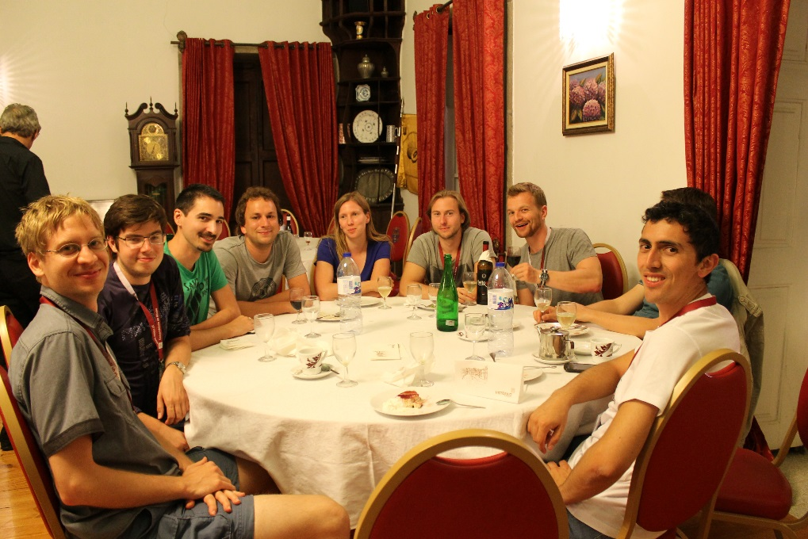
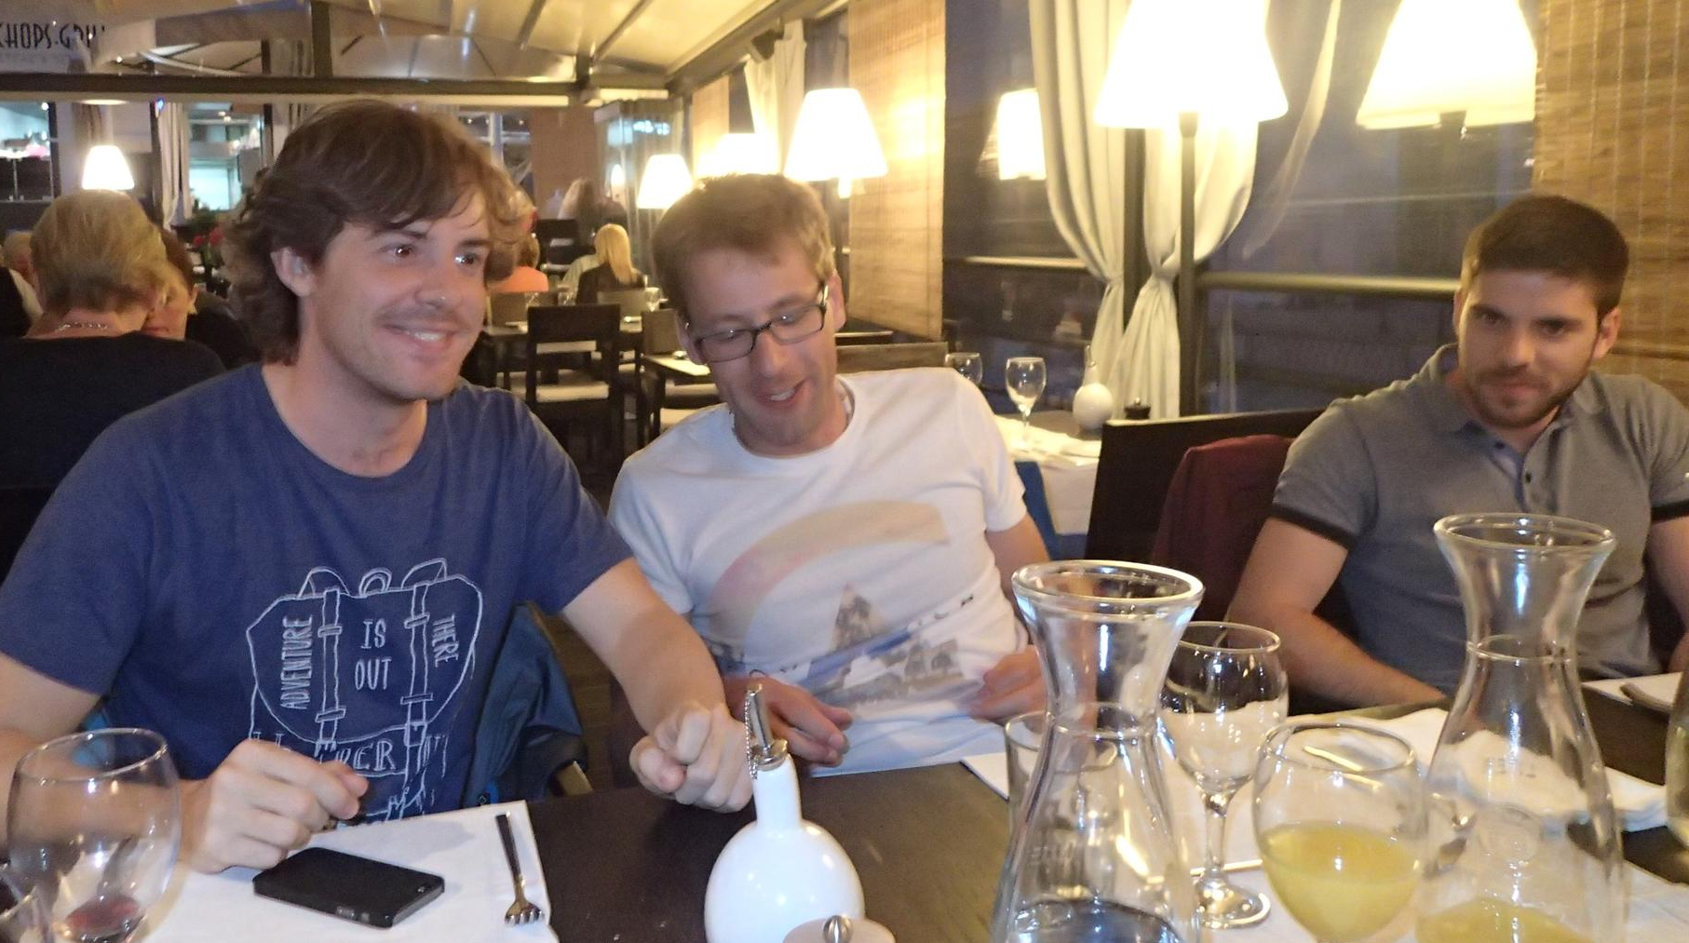
Lunch and Dinners
Mix of Students + lecturers
Tables of 8 - 12 persons

Slide 35
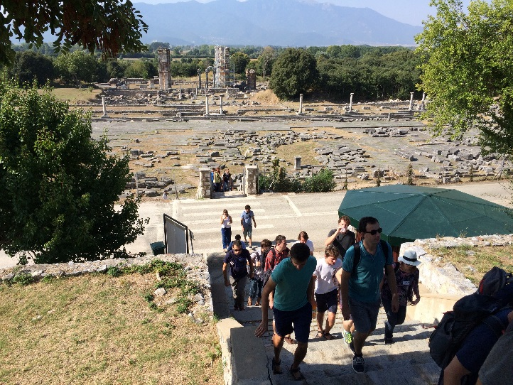
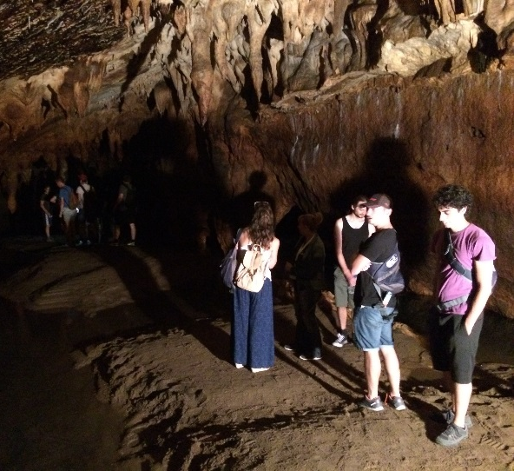
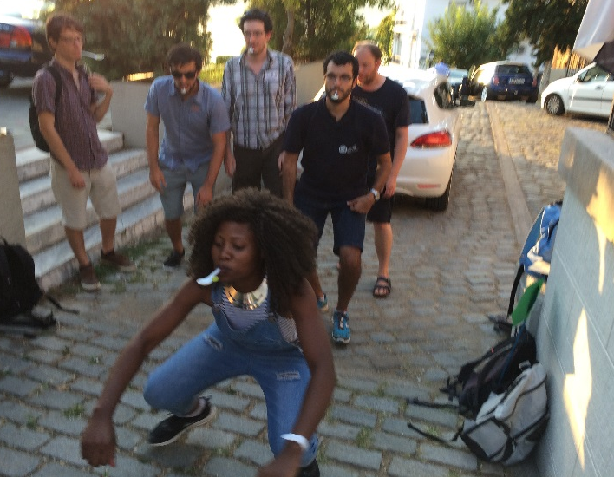
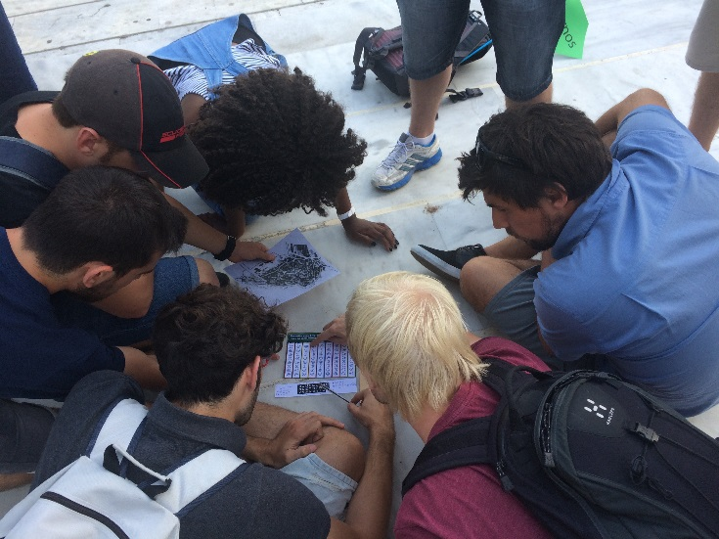
(Optional) Social programme
Excursions
  Culture
  History
  Nature
  Social games

Slide 36
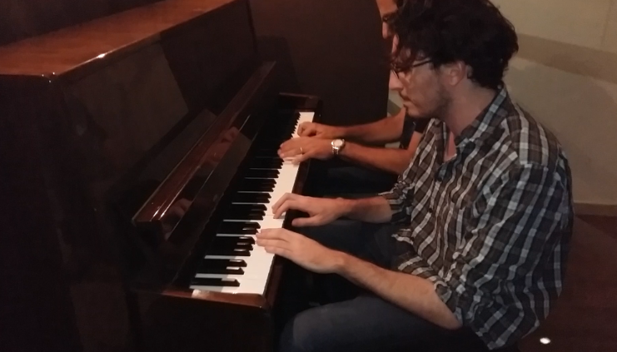
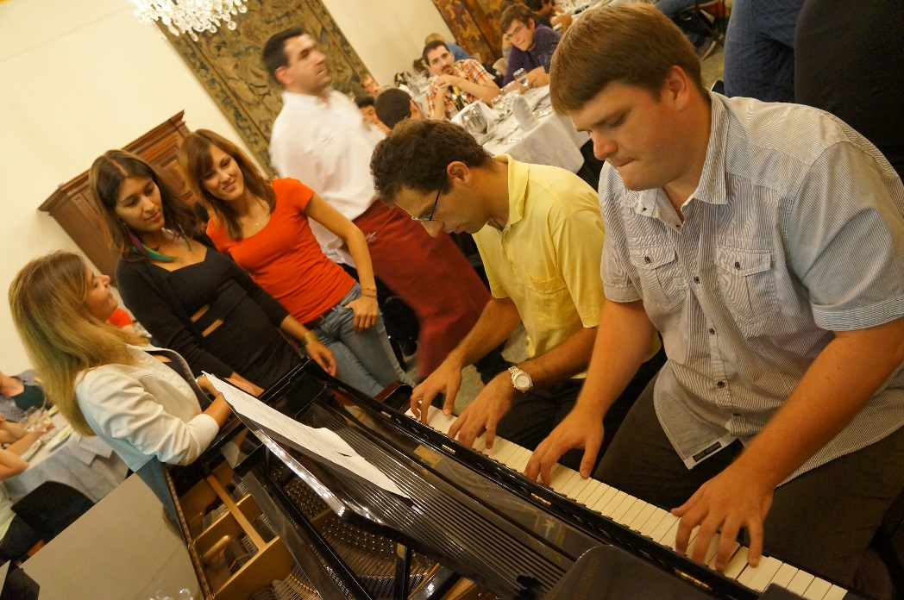
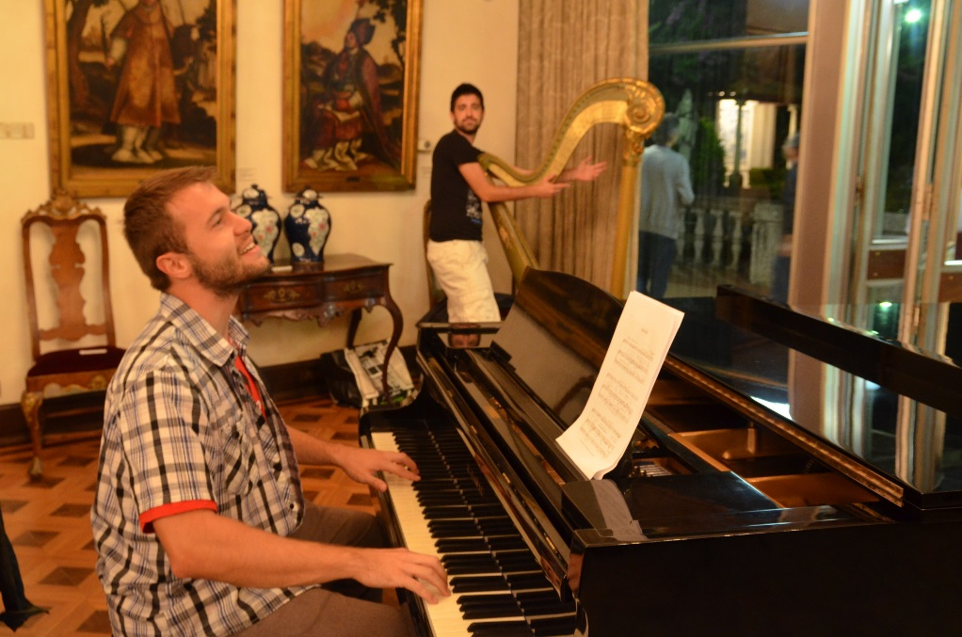
(Optional) Music events
Many students have
hidden talents
Music values are universal
across all cultures

Slide 37
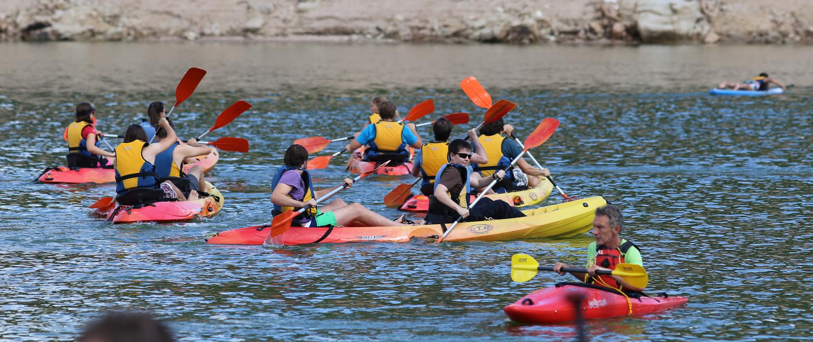
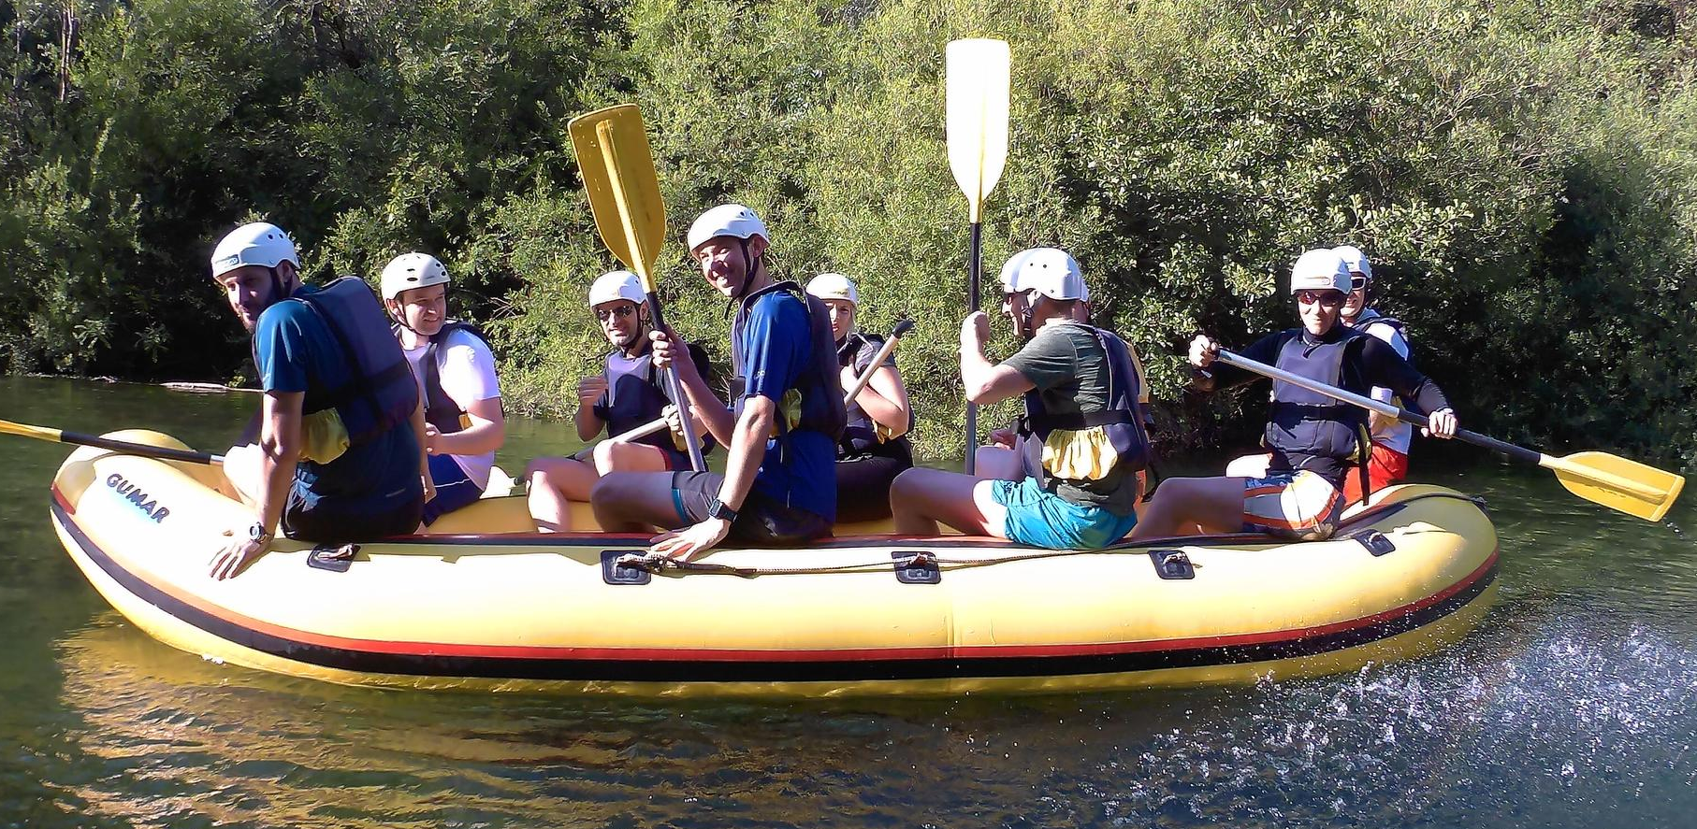
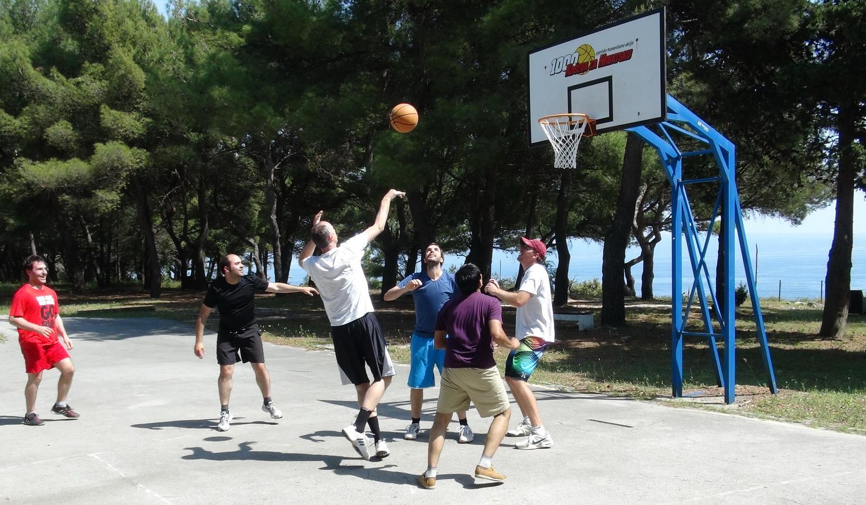
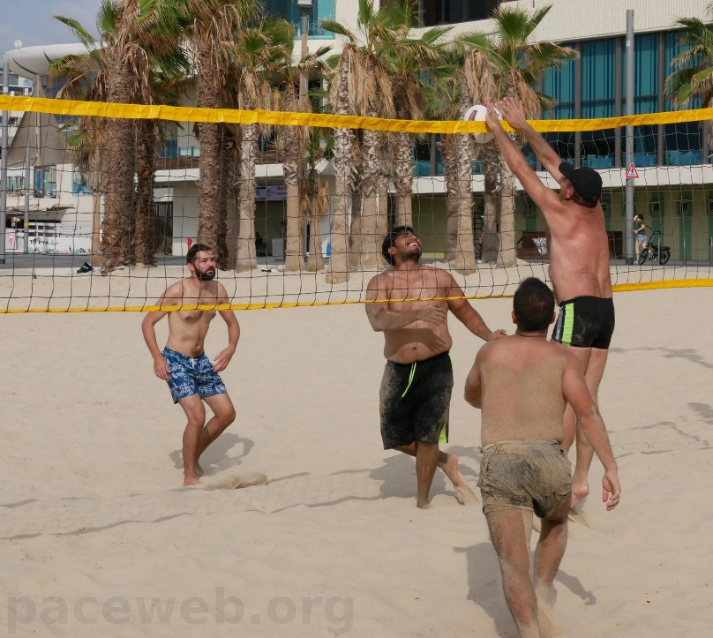
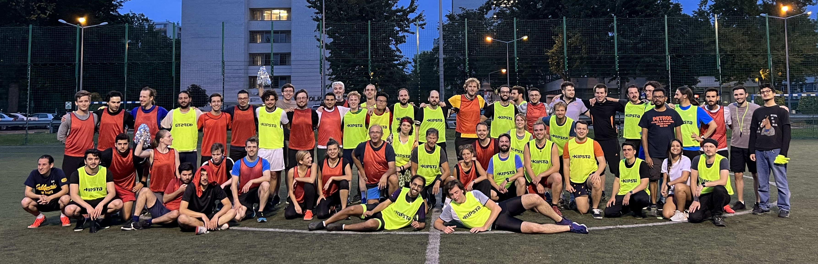
Optional Sports ….

Slide 38
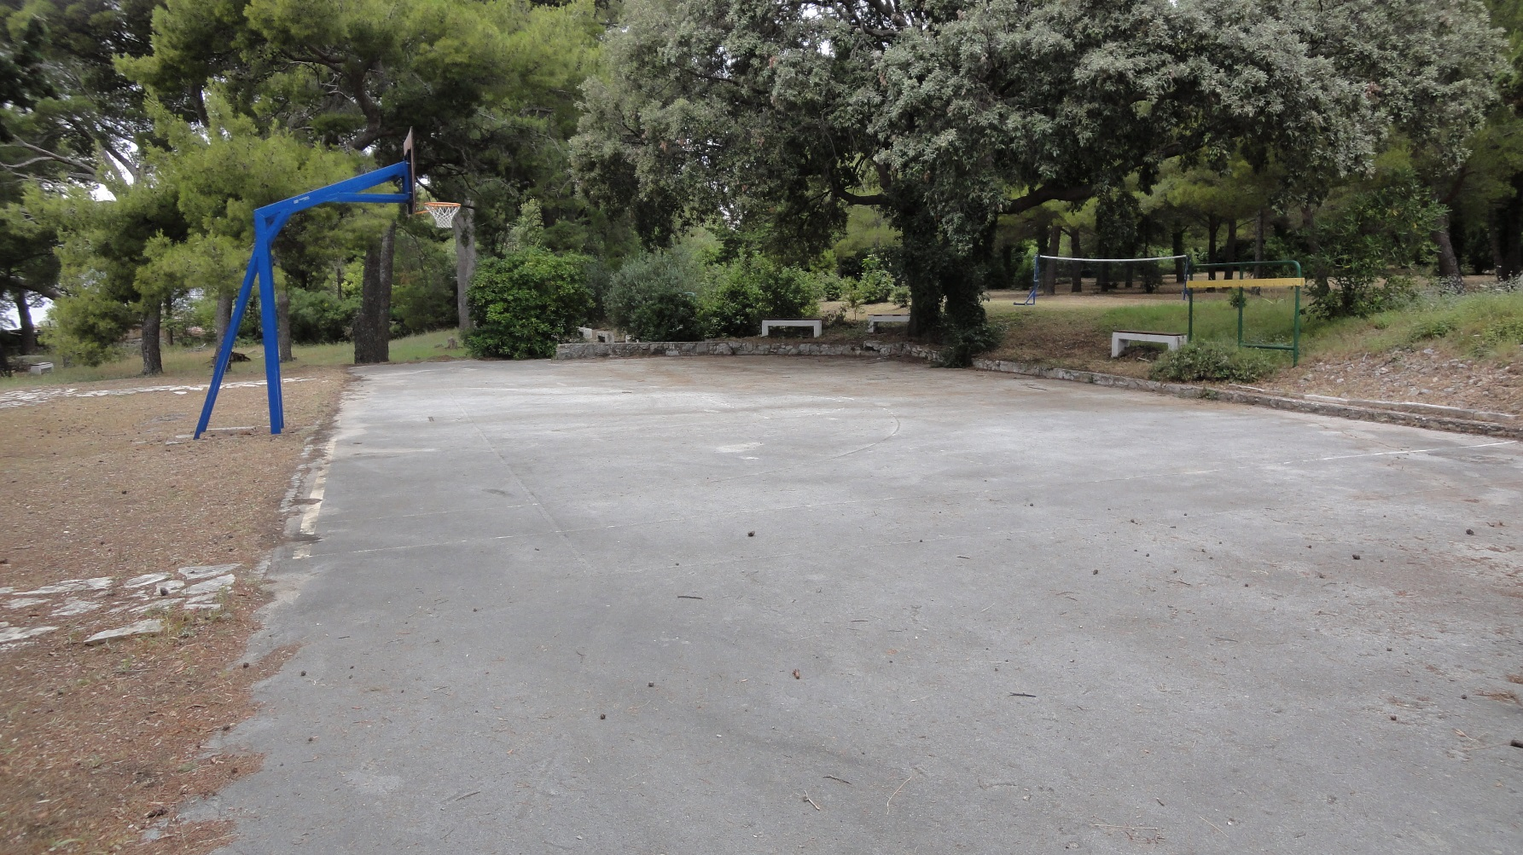

This school
Basket

Slide 39
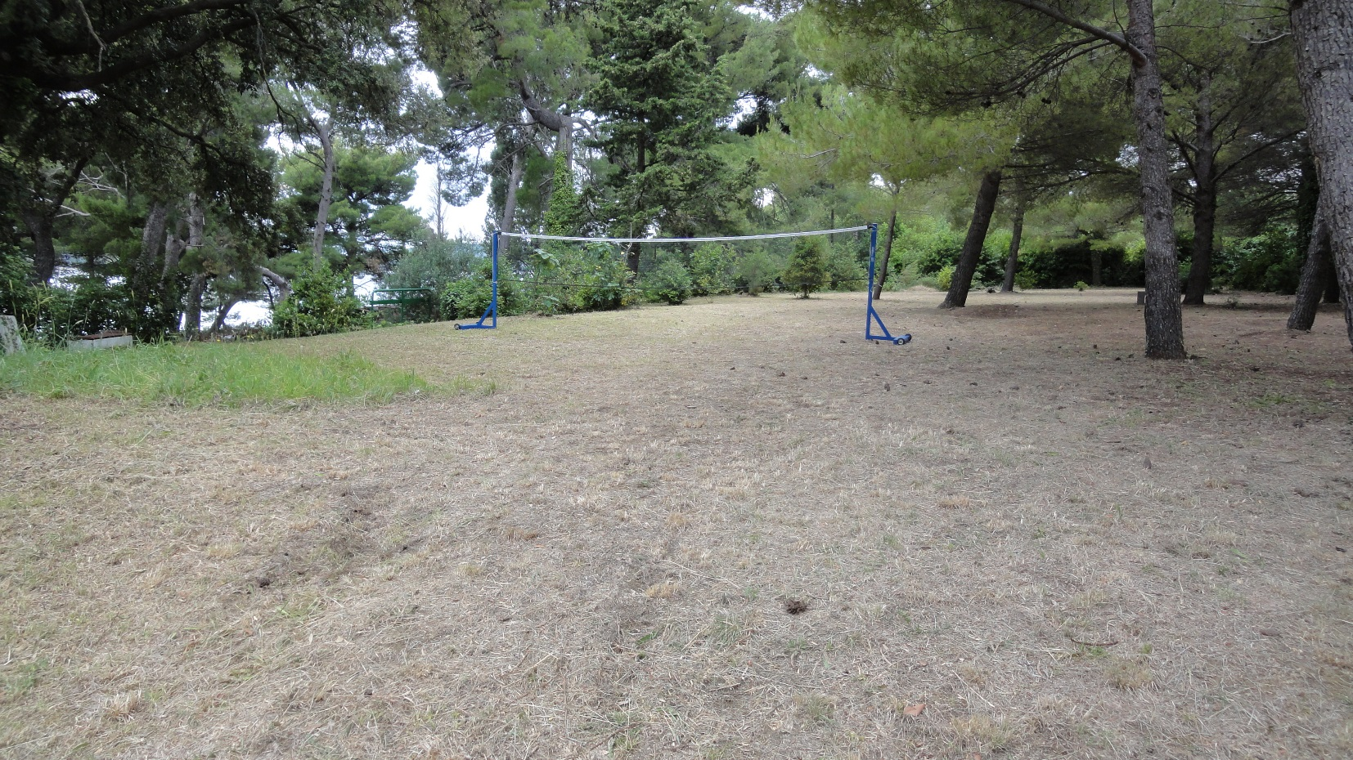
This school
Badminton

Slide 40
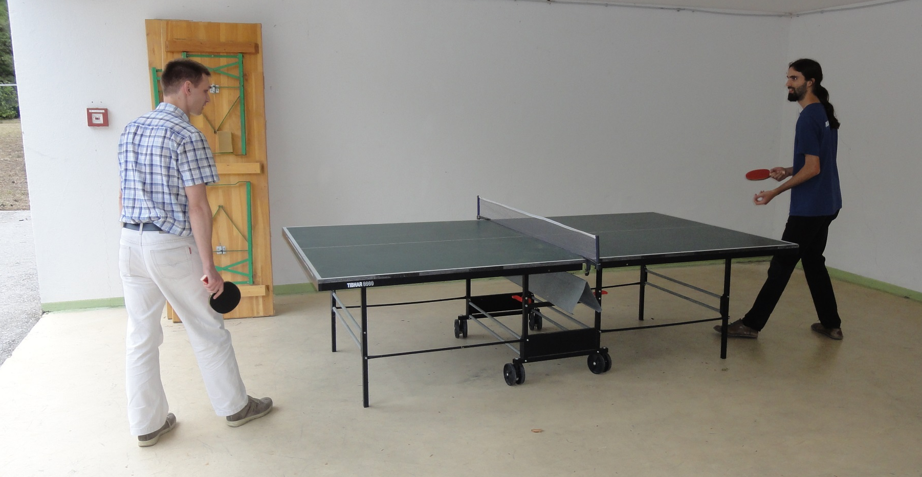
This school
Table tennis

Slide 41
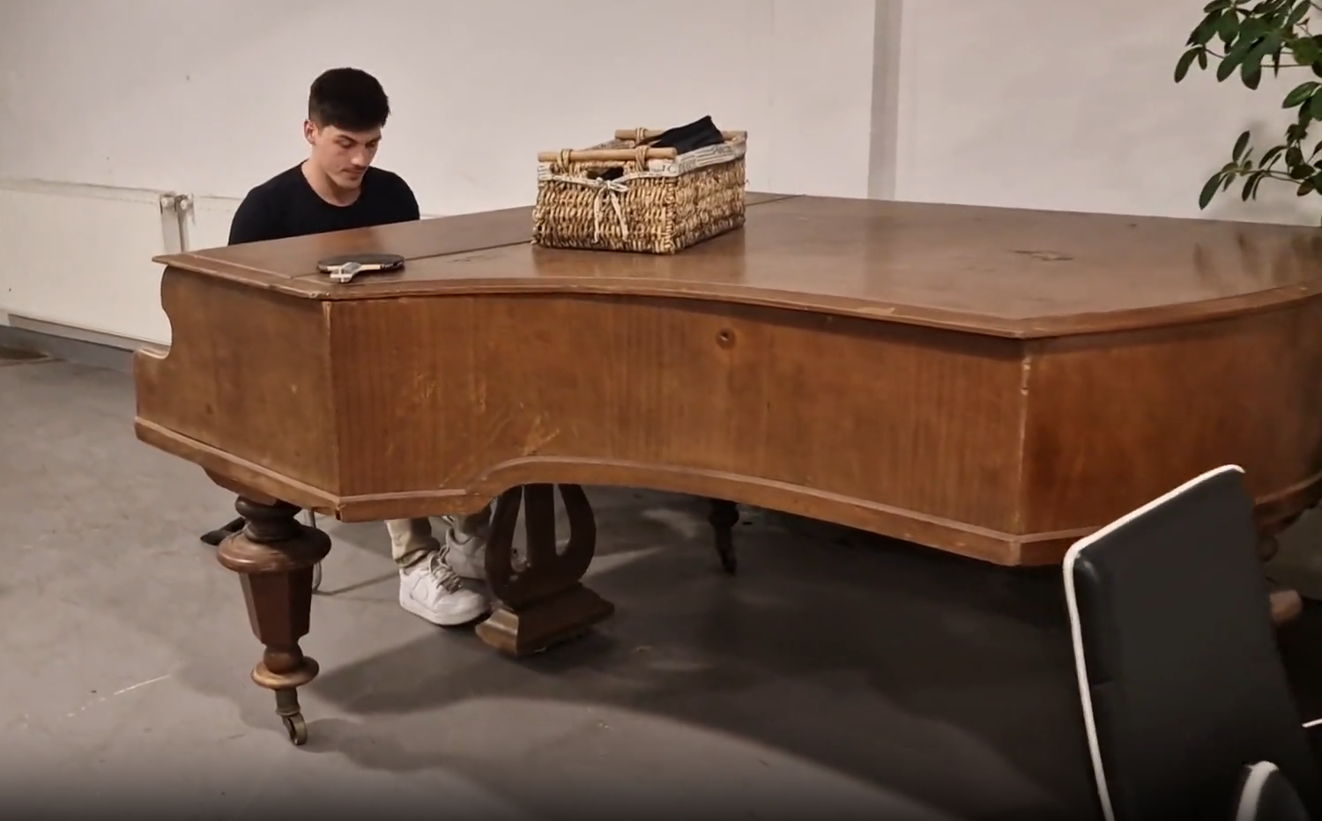
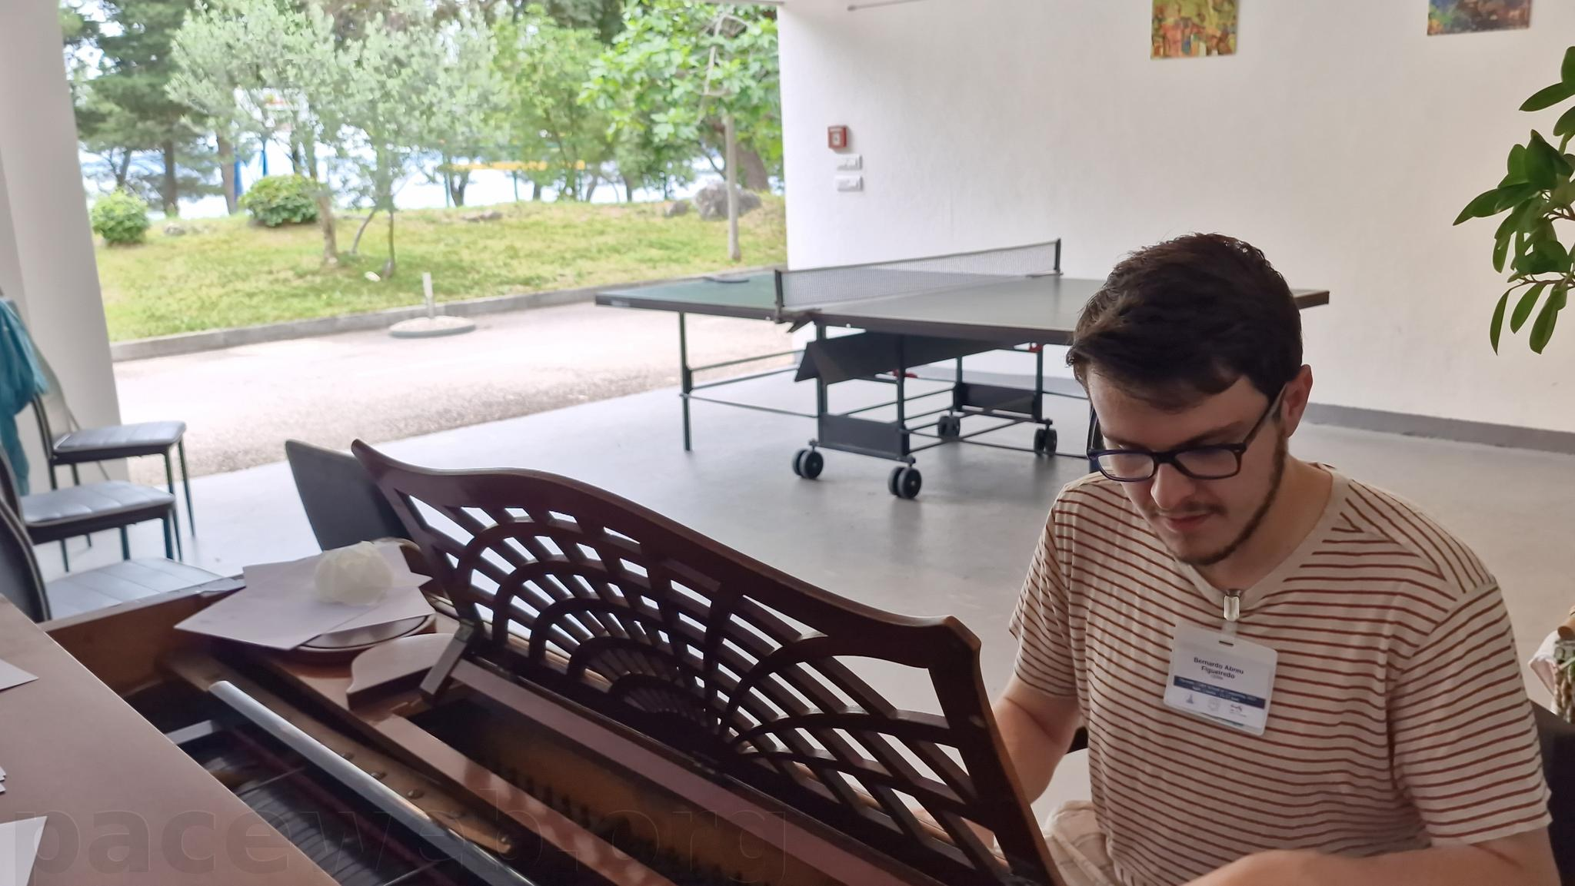
This school
Music

Slide 42
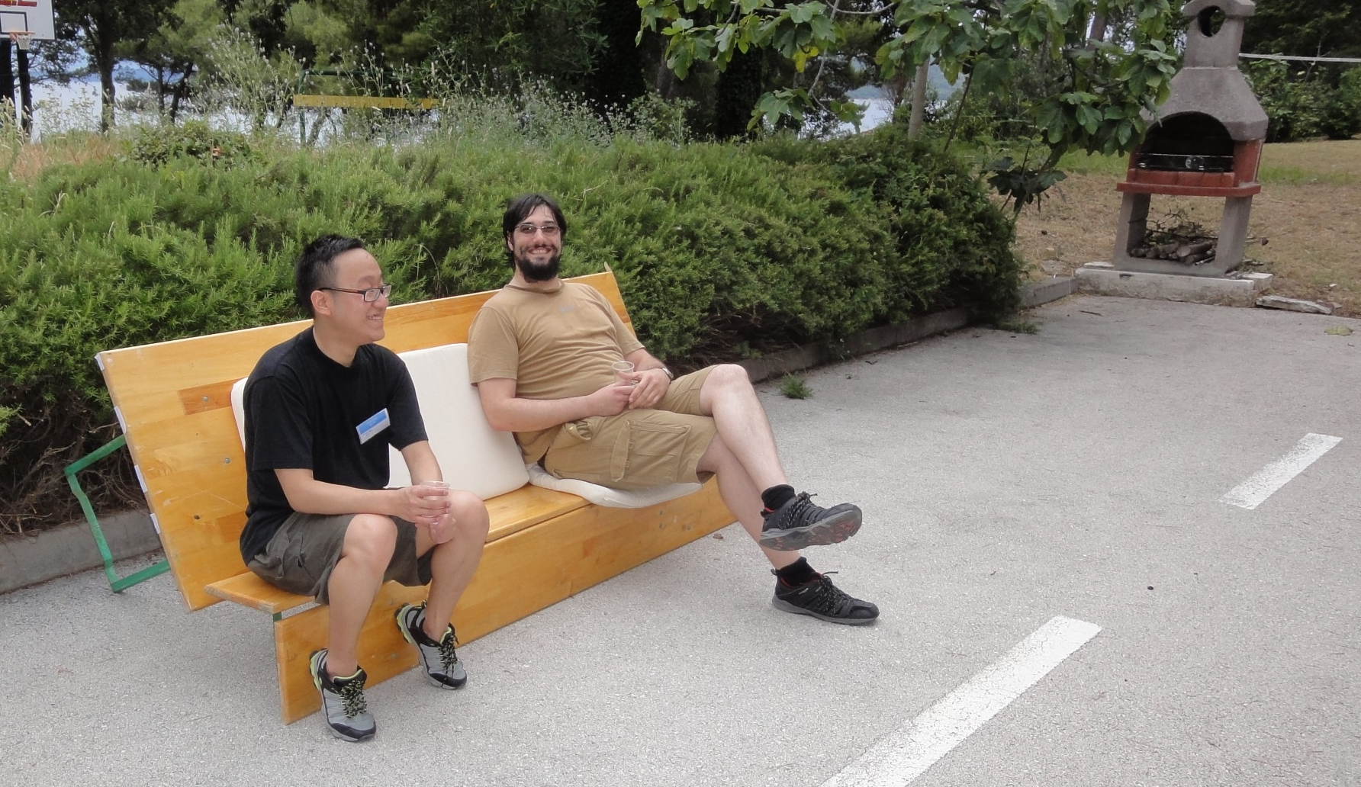
This school
Farniente

Slide 43
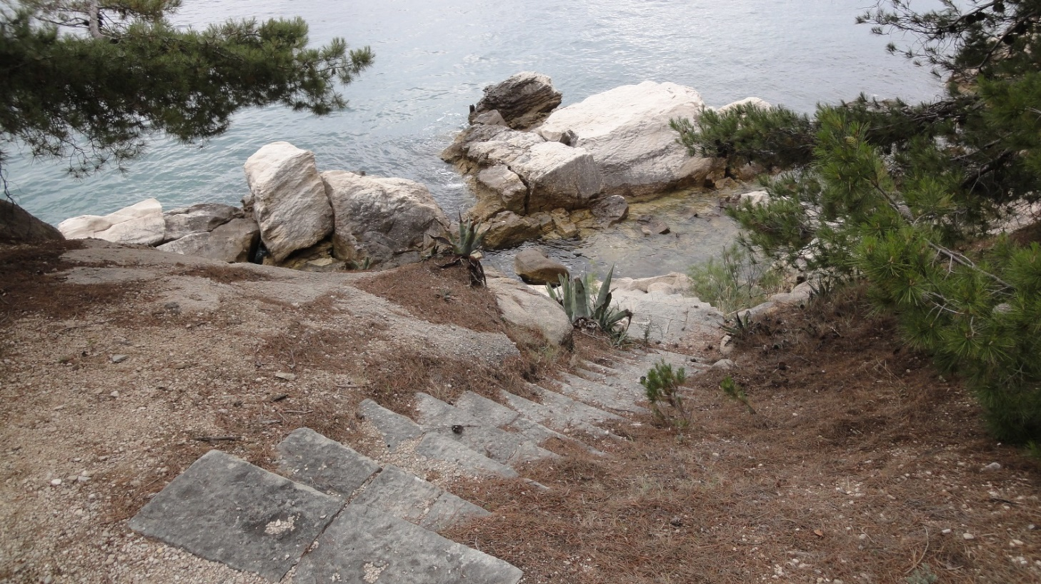
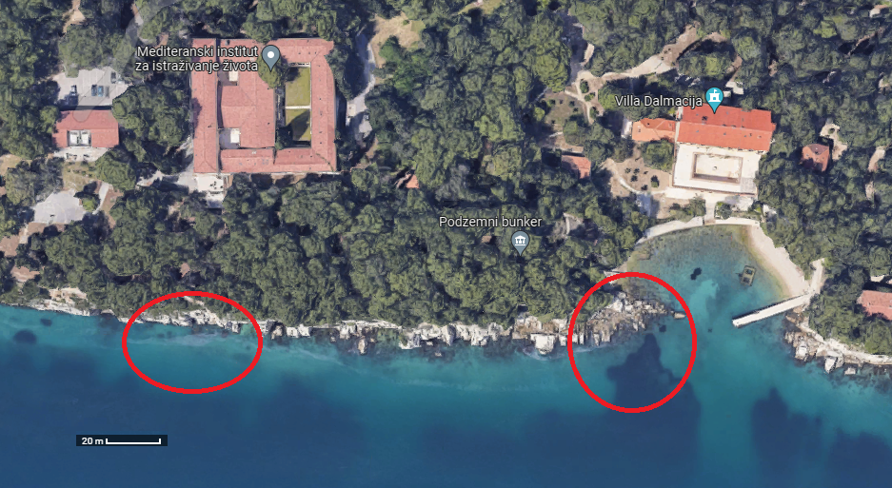
This school
Swimming and sun bathing
Careful when you jump from the cliff in the sea
  Then you will have to swim ~ 100 meters to come out
The rocks to walk on to get in and out of the water are extremely sharps
  Wear shoes is possible

Slide 44
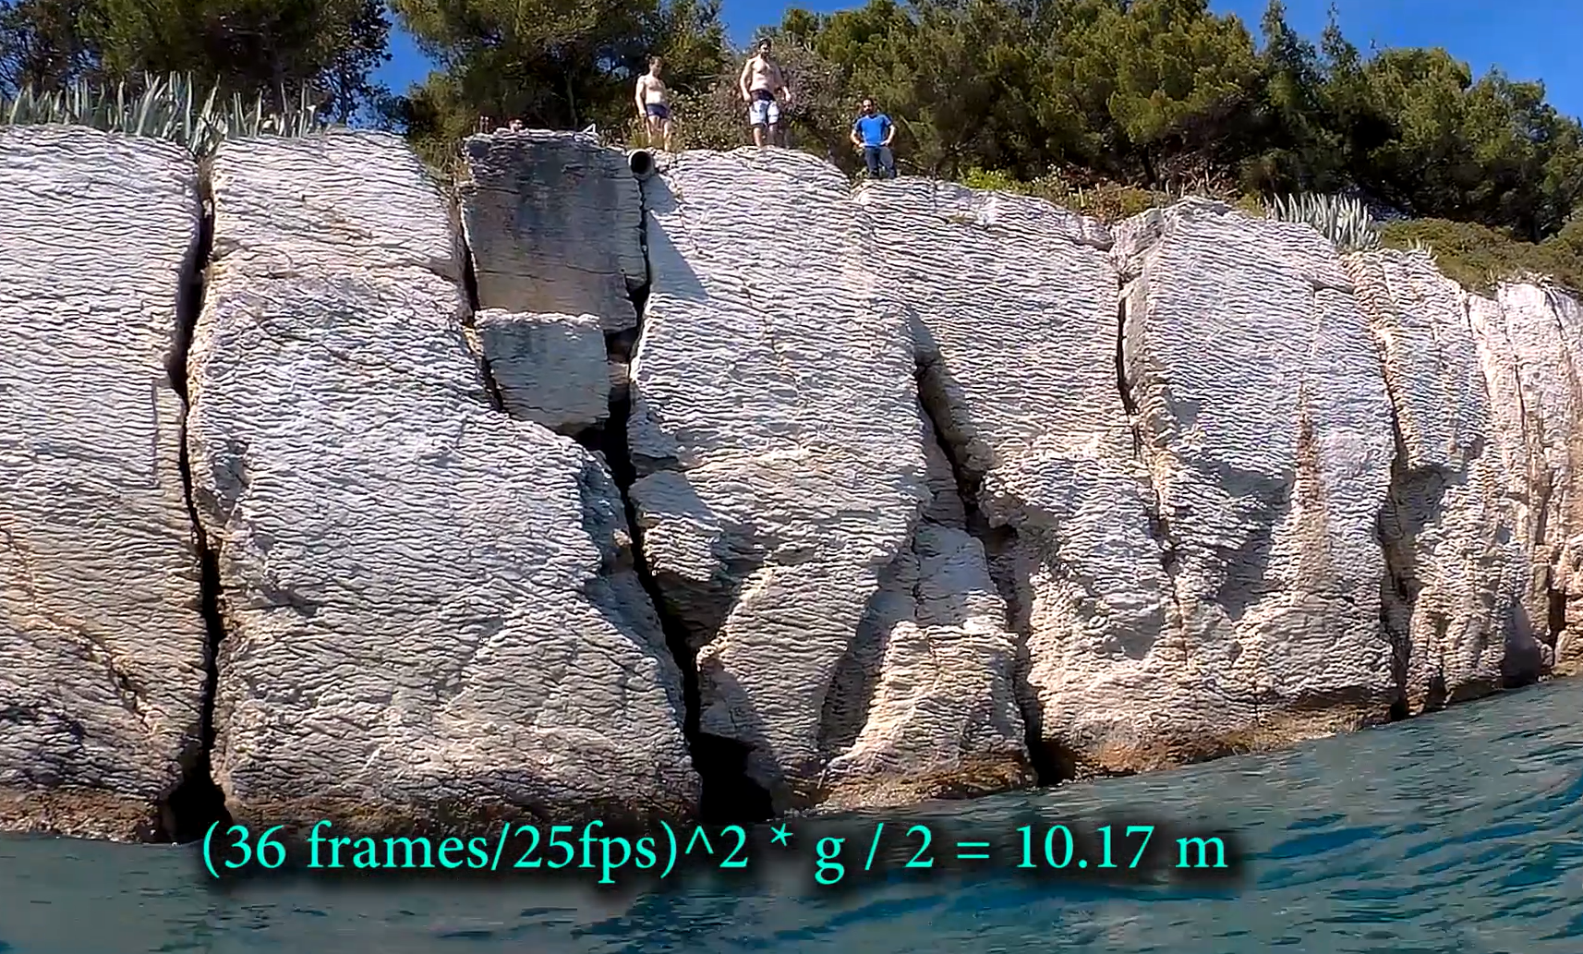
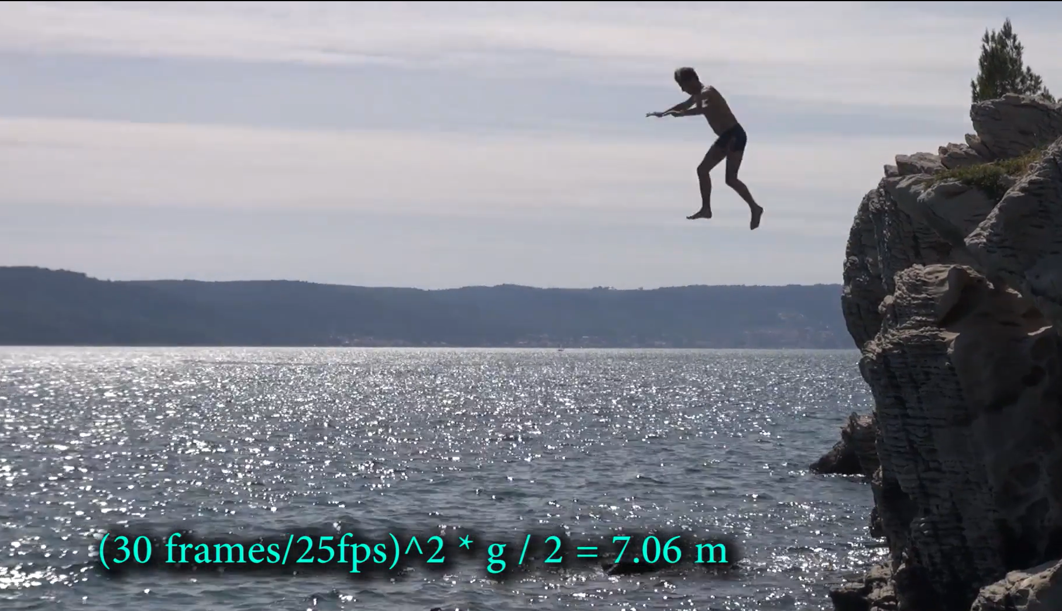

Slide 45
School rules …

Slide 46
School rule #1
Participate
  Attendance at all lectures and exercises is mandatory
  You should attend all meals and coffee breaks
  Taking part in social and sports events is optional
    You must let us know whether you participate or not

Slide 47

School rule #2
Be on time
Check what the schedule says:
  “Lecture starts at 9:00” => You must be in the room before 9:00
  Sign the presence sheet beforehand – it will be removed at 9:00
  “The bus leaves at 18:00” => It will leave at 18:00
If you’re late, we won’t wait
https://www.youtube.com/watch?v=1dZveoBfiww
Spaceballs, Mel Brooks, 1987

Slide 48
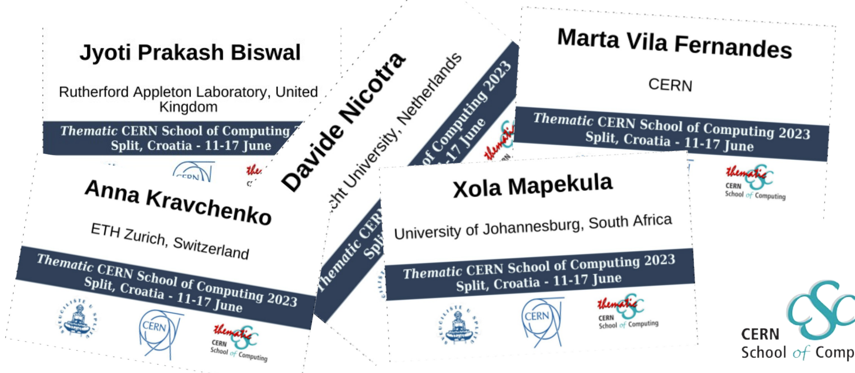
School rule #3
Wear your badge
  At least until I have learnt all your names !

Slide 49

WhatsApp group
Unofficial communication channel
We recommend you to join the group
Autojoin link:

Slide 50
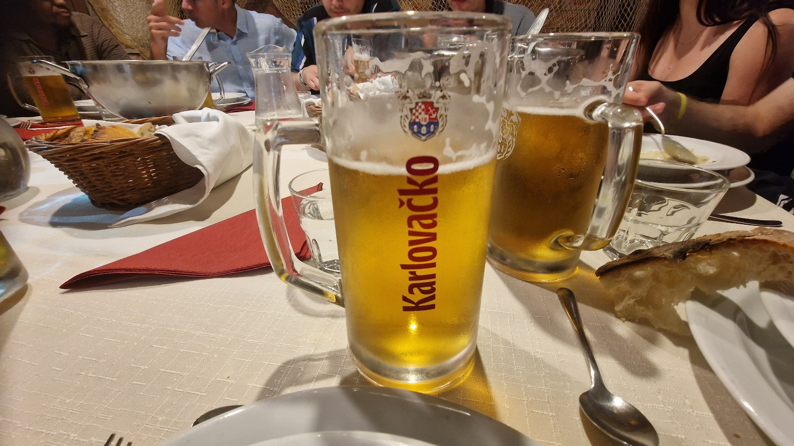
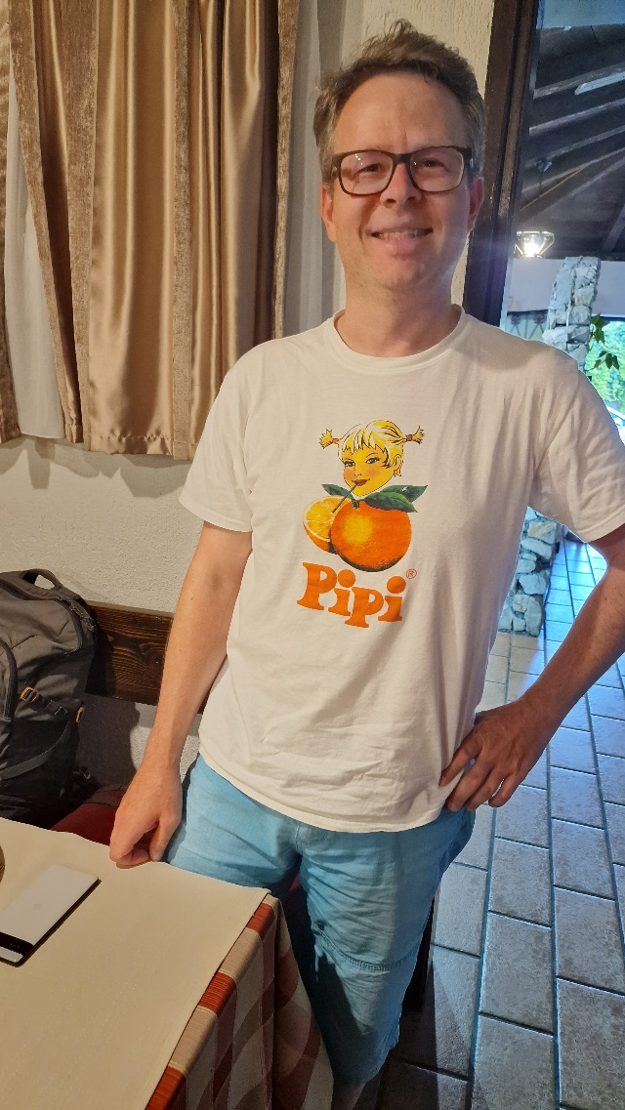

Drinking yellow liquid in Split

Slide 51
the participants give the most value to the school !
Why ?

Slide 52
For example, this school
58 applicants, 28 nationalities
  Austria, Azerbaijan, Cameroon, China, Colombia, Croatia, Czechia, Denmark, France, Germany, Hong Kong, India, Italy, Lithuania, Mexico, Norway, Pakistan, Palestina, Poland, Romania, Russia, Serbia, Sweden, Taiwan, Tunisia, Türkiye, Ukraine, United Kingdom.
Selected 33, 21 nationalities
  Austria, Azerbaijan, China, China, Croatia, Croatia, Czechia, Denmark, Germany, Hong Kong, India, Italy, Lithuania, Norway, Romania, Serbia, Sweden, Taiwan, Tunisia, Ukraine, United Kingdom.

Slide 53
The 40 applying institutes
University of London, Higher School of Economics, University of Bucharest, Academia Sinica, Taiwan, AGH University of Cracow, CERN, Helmut-Sch`midt-University, Deutsches Elektronen-Synchrotron (DESY), University of Zagreb, Humboldt University of Berlin, INFN- Sezione di Bari, Information Technology School (ITS), Institute of High Energy Physics (HEPHY) Vienna, Instituto de Fisica Corpuscular (IFIC), Univ. de Valencia (UV), Istituto Nazionale di Fisica Nucleare (INFN), Sezione di Napoli, Karlsruhe Institute of Technology, Middle East Technical University, Physikalisches Institut, Heidelberg University, Qauid_e_Azam university , islamabad , pakistan, TATA Consultancy Services, Technical University of Vienna, Theoritical and Compytional lab at Universiti Sains Malaysia, TRANSMUTEX SA, UNAM, Universidad Iberoamericana, Università Degli Studi di Firenze, University of Bologna, Department of Physics and Astronomy, University of Bonn, Physical Institute, University of Bucharest, Bucharest Romania | Horia Hulubei National Institute of Physics and Nuclear Engineering, University of California San Diego, University of Cambridge, University of Glasgow, University of Hamburg, University of Manchester, University of Milano-Bicocca, University of Novi Sad, University of Science and Technology of China, University of Yaounde, Vega IT, Vrije Universiteit Brussel (Free University of Brussels),

Slide 54








































































Slide 55
So …
We have quite some diversity
But where is the value?

Slide 56
Excerpts from reference letters
I consider … to be among the top 20% of PhD students I have encountered throughout my career.
Compared to other students at comparable stages of their studies, … is one of the top10% of my students.
… clearly ranks among the top 5-10% of students in the HEP community, both compared to students I have supervised and compared to students I worked with
… belongs to the best 5% of our students.
Compared to other students at comparable stages of their studies, … is one of the top 5% of my students.

Slide 57
Who are the CSC participants ?
You are young, diverse, come from many countries, from different institutes …
You have all an outstanding potential and a passion for both computing and science.
You will work together one weeks to widen your skills but also establish lifetime links with other participants and research institutes across the world that will be useful throughout your future career.
This is what gives the highest value to the school

Slide 58

It is a small world …
All top scientists knows each other very well

Slide 59

CSC 2024, Hamburg, Germany

Slide 60

tCSC 2024on Machine Learning, Split, Croatia
Are you ready to write history ?
School photo:
Thursday at 11h00

Slide 62
Announcements
Monday 14

Slide 65
Announcements
Tuesday 15

Slide 68
Announcements
Wednesday 16

Slide 71
Announcements
Thursday 17

Slide 74
Announcements
Friday 18

