Slide 1

Status of MuCol
CERN, 19 June 2024
R. Losito, CERN

Slide 2
Introduction
MuCol has 30 Participants
  12 Beneficiaries
  18 Associates
  Europe, US and Asia represented
Budget committed in the 1st year:
  23%
Main goals of MuCol are:
  Enhance of EU contribution to the IMCC
  Preparation of the input for the European Strategy of Particle Physics by addressing the most urgent feasibility issues

Slide 3
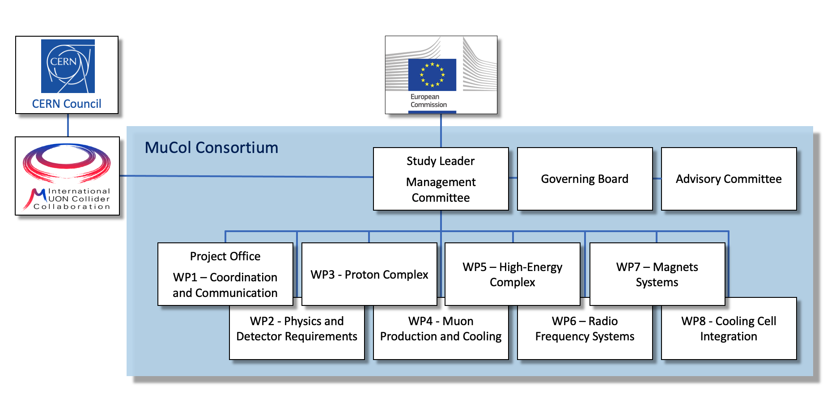
Introduction

Slide 4
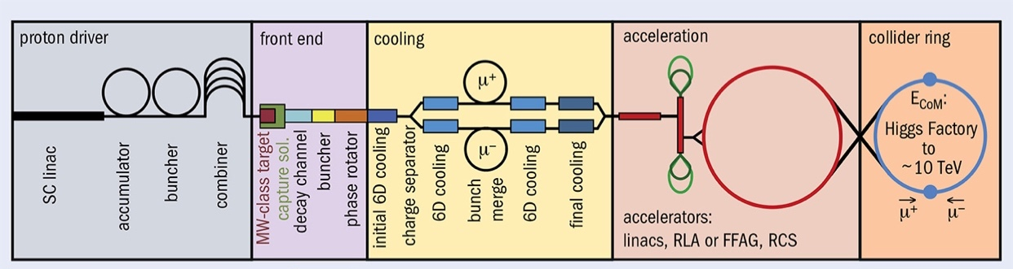
Introduction
WP3
WP4
WP5
Protons
Production
Of Muons
Cooling
Acceleration
Collision

Slide 5
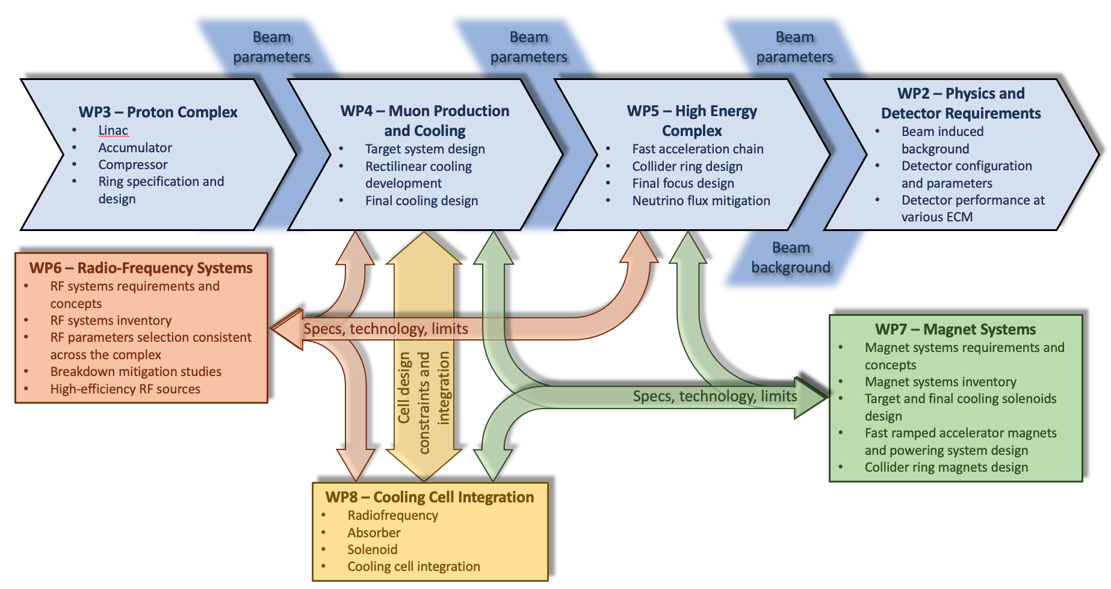
Introduction

Slide 6
WP1
Coordination and Communication
  Ensures respect of deadlines (D+M)
  Coordinates communication
  Coordinates publications
  Hosts the Gender Advisor
  Prepares site specific parameters and studies

Slide 7
WP1
Deliverables & Milestones Achieved
  Deliverables
    Data management Plan
    Communication and Dissemination Plan
    ESPPU report n.1
    Presentation of Cooling Cell Conceptual design
  Milestones
    Website available
    Kick-off meeting
    Tentative Parameters
    Training on Detectors Design and Physics performance tools
    First Annual Meeting
    Workshop on MDI and IR region
    Mini-Workshop on pulsed magnets

Slide 8
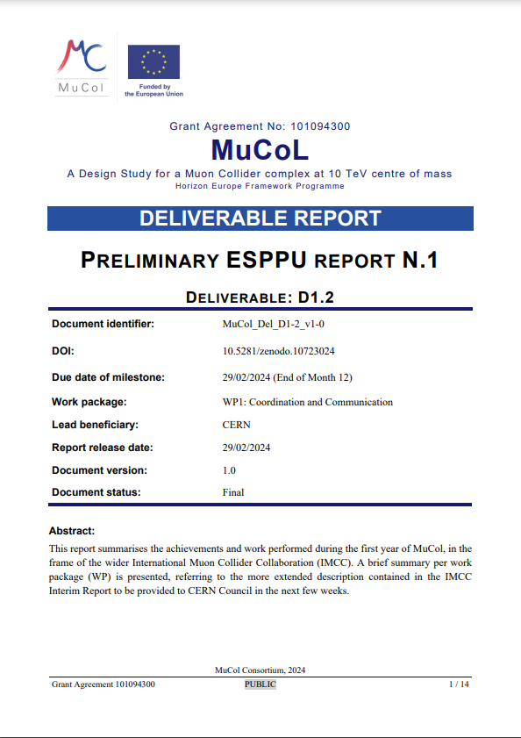
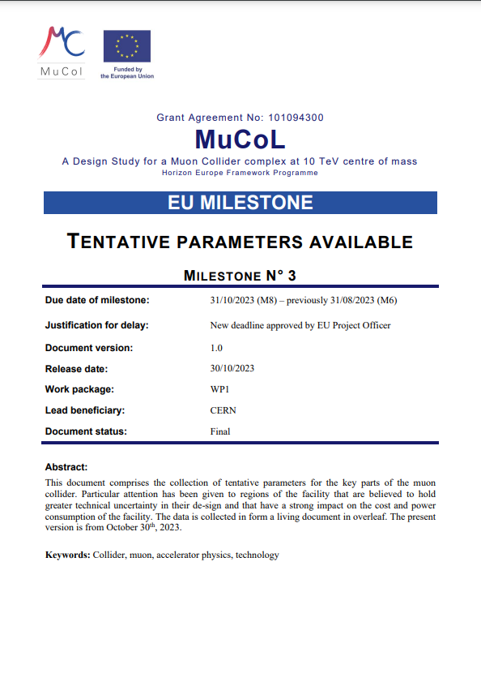
Notable deliverables/milestones

Slide 9
WP2 activities description
Task 1: Design of detector configurations at √s=3 TeV and √s=10 TeV with the optimised interaction regions (UNIPD)
  Study beam-induce background effects on the detector with different interaction region configurations. Activities performed in collaboration with WP5
Task 2: Design and implementation of event reconstruction algorithms in 5D at √s=3 TeV and √s=10 TeV (DESY)
  Develop event reconstruction algorithms by using 5D information: space, energy and time
Task 3: Evaluate detector performance at different collision energies by using major physics processes (INFN)
  Use results obtained in task 1 and 2 to evaluate detector performance by inspecting tmajor physics processes

Slide 10
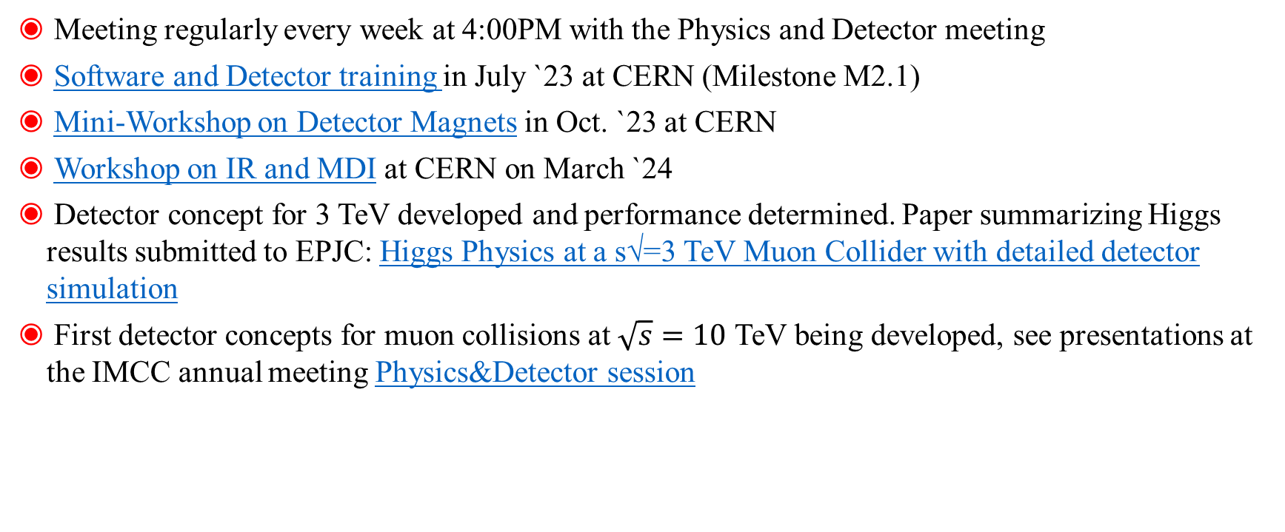
WP2 status
Meeting regularly every week at 4:00PM with the Physics and Detector meeting
Software and Detector training in July `23 at CERN (Milestone M2.1)
Mini-Workshop on Detector Magnets in Oct. `23 at CERN
Workshop on IR and MDI at CERN on March `24
Detector concept for 3 TeV developed and performance determined. Paper summarizing Higgs results submitted to EPJC: Higgs Physics at a s√=3 TeV Muon Collider with detailed detector simulation
First detector concepts for muon collisions at $\sqrt{s}=10$ TeV being developed, see presentations at the IMCC annual meeting Physics&Detector session

Slide 11
WP2 deliverables, milestones, hiring
Deliverables
Beam-induced background and detector configuration – UNIPD - DATA – Public - 30
Detector performance by using physics processes - DESY- Report - Public – 36
Milestones
Training on detectors design and physics performance tools - Training material - 6
Workshop on MDI and IR design - Indico site - 13
Release of simplified detector performance model - website - 18
Workshop on detector design and physics performance with a public lecture on Muon Collider - Indico - 25
Publication of report of detector performance with major physics process at several ECM - Article - 48
Name | Status | Institute | Topic
Lorenzo Valla | PhD | LIP | Tau lepton reconstruction studies
Saurabh Saini | PhD | Sussex | Detector design and performance studies
Luca Castelli | PhD | Sapienza | MDI studies
Carlo Giraldin | Student | UniPD | Calorimeter reconstruction optimization
Leonardo Palombini | Student | UniPD | Electron reconstruction studies
Davide Zuliani | Postdoc | UniPD | Detector design and BIB studies
Heng Yang | Postdoc | CEA/INFN | Tau lepton reconstruction optimization

Slide 12
WP3
Task 3.1 - collect the parameters that can be used for a future design of a high-power H- linac to be used as the driver of the proton complex including source type, preliminary acceleration layout, beam dynamics and stability considerations and chopping schemes.
Task 3.2 - provide a self-consistent collection of parameters to be used in the design of a future compressor ring. A preliminary design of the ring will be developed including accumulation and compression strategy, preliminary lattice and injection and extraction considerations. Further R&D needs will be outlined. Preliminary study of intensity-based effects such as space charge, single-bunch and impedance effects will be carried out for the compressor ring.

Slide 13
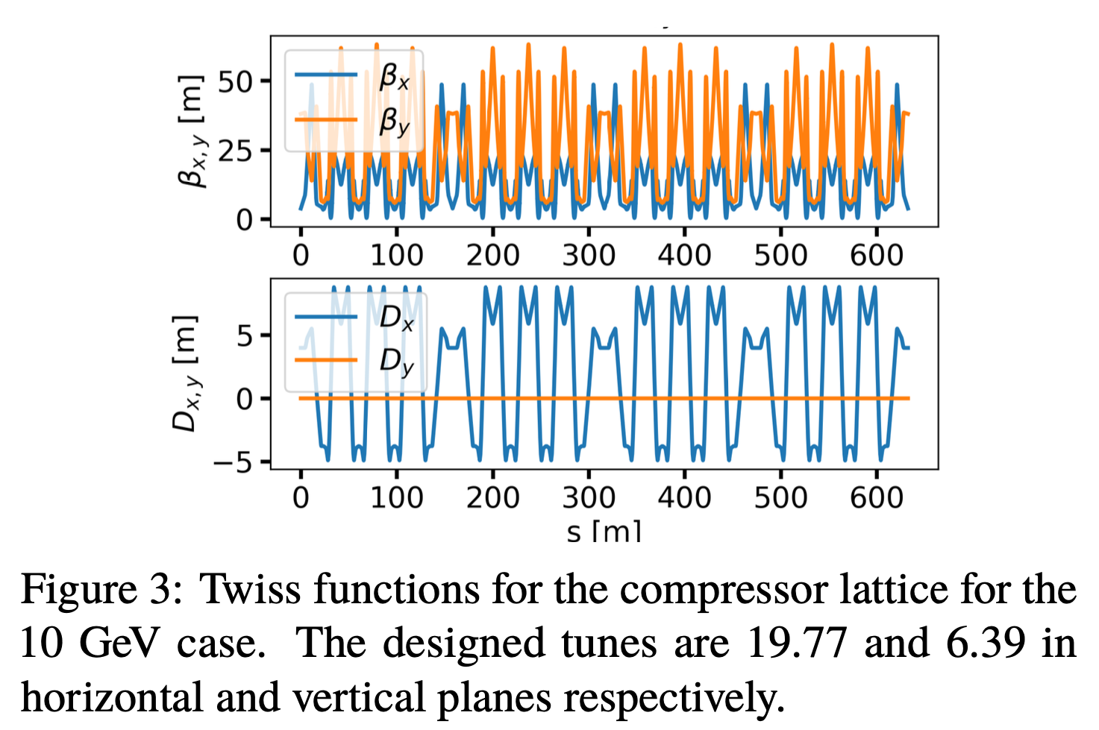
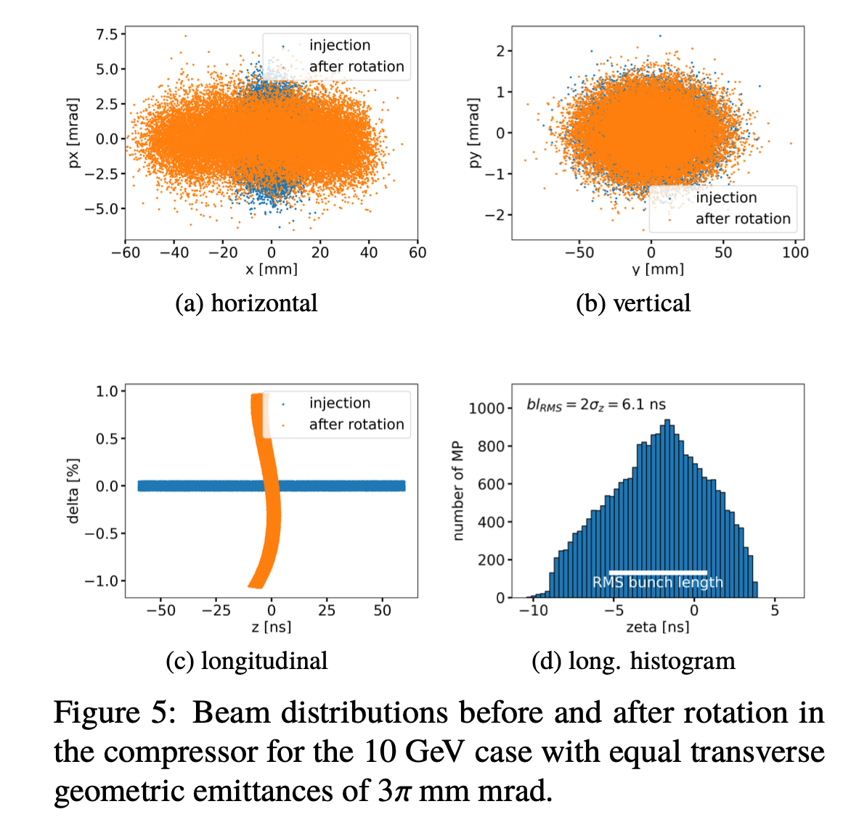
Present Status and Advancement
Work done:
Work ongoing:
Linac scaling up to 10 GeV and verification of H- stripping effects
Compilation of results from LINAC4 new H- source
Calculation of tune shifts in the accumulator ring for both 5 and 10 GeV cases
Design of a 10 GeV compressor lattice and simulations for both 5 and 10 GeV cases of tune shift at injection and extraction
First studies of transport and final focusing of a compressed beam to target
Article presented at IPAC’24 on initial design of a proton complex for 2 MW and 5 GeV and 10 GeV final energies.
Re-working studies and simulations for a 4 MW case for both Linac, Rings and transfer line to target
Working on the preliminary parameters list and costing

Slide 14
Milestone, Deliverables and Hiring
Tentative Parameters (M3) list and Preliminary report (D1.2) and working on a preliminary parameter list (M5) [WP has only the final report D3.1 as a stand alone deliverable at month 45]
Hired a Postdoc for 24 months to work on the project (Sofia Johannesson started February 2024)

Slide 15

WP4 Scope
Muon production and beam preparation essential for high luminosity
  Target and surroundings produce extremely high initial flux
  Muon cooling reduces beam size (emittance) to enable extreme focusing for collisions
Establish a baseline for the muon target and cooling system
  Take into account known technological limits
  Highlight areas where further R&D is required
Task 4.1: Cooling system development
  Design of beam cooling taking into account state-of-the-art in technology
Task 4.2: Target system development
  Design of target and pion yield assessment
Task 4.3: Code development
  Update BDSIM code to model cooling channels

Slide 16
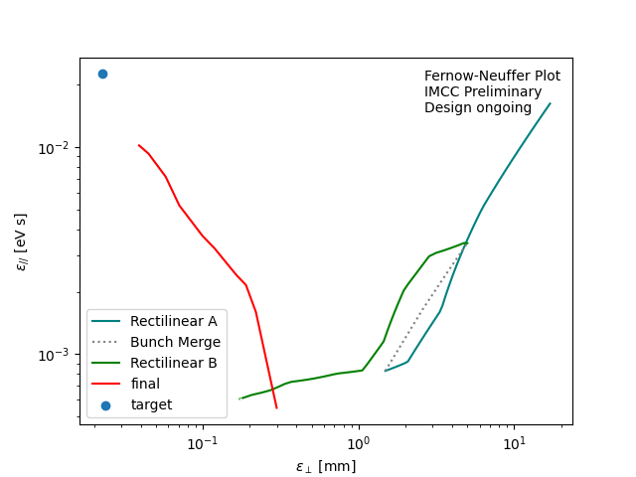
Task 4.1
Cooling system has been optimised following previous Muon Accelerator Programme studies in US
  Improvement in achieved flux, with lower final emittance
  Optimisation continues in order to meet the target parameters

Slide 17
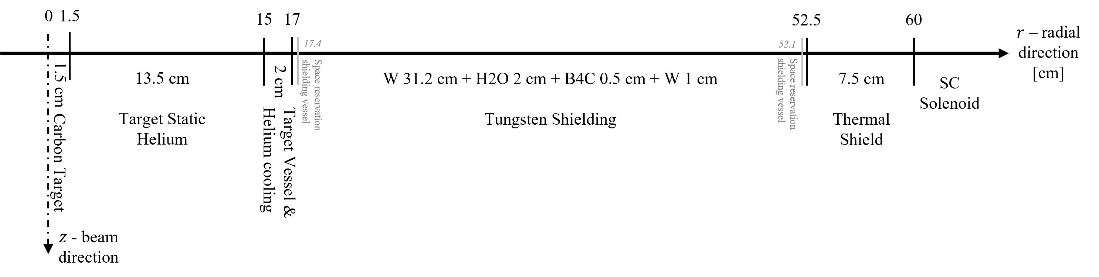
Task 4.2
Target radial build prepared for 2 MW beam
  Target cooling system to manage high instantaneous and average proton flux
  Shielding requirement to protect high-field focusing magnet
  Yield estimates
Considering feasibility of 4 MW target
  Manage risk that cooling system throughput is insufficient
  Places greater demands on the target and associated shielding

Slide 18
Task 4.3
Implement simulation of rectilinear cooling system in BDSIM code
  Europe-led software tool providing accelerator simulation
Developed partial implementation
  Superposed RF cavities, solenoids and absorbers all possible to simulate
  Superposition of dipole will follow
  Status presented at IPAC2024 conference
  On track for Deliverable D4.1 due March 2025
R. Kamath, C. Rogers and P. Jurj, "Simulating a 6D cooling channel in BDSIM", in Proc. IPAC'24, Nashville, TN, May 2024, pp. 1047-1049.
doi:10.18429/JACoW-IPAC2024-TUPC20

Slide 19
Staff Status
Chris Rogers (existing UKRI staff, WP management, Task 4.1 & 4.3)
Rui Franqueira Ximenes (existing CERN staff, Task 4.2)
Chris Densham (existing UKRI staff, Task 4.2)
Dan Wilcox (existing UKRI staff, Task 4.2)
Recruited another UKRI staff to commence autumn 2024 (Task 4.2)
Rebecca Taylor (CERN fellow, Task 4.1)
Bernd Stechauner (CERN & Vienna Tech. Univ. PhD, Task 4.1)
Paul-Bogdan Jurj (Imperial College RA, Task 4.1 & 4.3)
Rohan Kamath (Imperial College & UKRI PhD, Task 4.1 & 4.3)
All funded in-kind

Slide 20
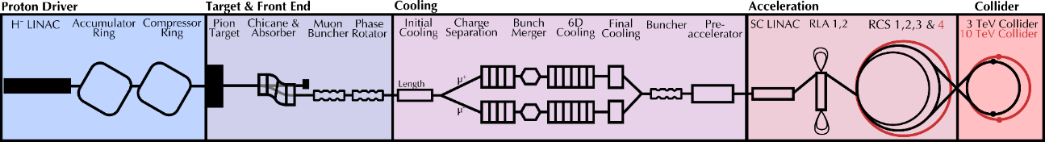
WP5 goal and scope
Design of the acceleration complex
  Pulsed synchrotrons
  Alternative based on FFA
Design of the collider to get the target luminosity
  Interaction region + shielding design
  Machine detector interface
  Background to experiment
Limitations due to collective effects.
How to handle the radiation due to muon decay and other beam losses

Slide 21
WP5 status
A multi-physics tool for the RCS has been developed and includes RF, powering, dipole, and cost considerations. All the RCS chain is being optimized to minimize the total cost by keeping the beam losses low enough. First optics and first tracking studies of the RCS have been released. We can already exclude/retain some dipole designs.
Stability studies for the RCS require a large, distributed RF system on a comparable scale to the ILC and low impedance.
Design of 10 TeV collider has significantly progressed but still work remains to reach nominal beam parameters.
Evaluation of Neutrino radiation at surface has also been addressed.
Radiation load and protection studies have started for the collider and RCS. First requirements on the shielding are being investigated. The evaluation of the Neutrino radiation at surface has also been addressed.

Slide 22
WP5 deliverables, milestones, hiring
Past and next Milestones (no deliverables scheduled until 31/03/2025):
  Workshop on MDI and IR design https://indico.cern.ch/event/1353612/ Done ☑
  Mini-Workshop on pulsed magnets https://indico.cern.ch/event/1388830 Done ☑
  Tentative optics of the collider ring and pulsed synchrotrons → 30/09/2024
  Tentative design of the interaction region → 31/10/2024
  Tentative design of the FFA → 31/03/2025
Name | Status | Institute | Topic
Lisa SOUBIROU | PhD | CEA | RCS design
Erik KVIKNE | Technical | CERN | RCS vacuum chamber
David AMORIM | Fellow | CERN | Collective effects
Jerzy MANCZAK | Fellow | CERN | Neutrinos and target area
Daniele CALZOLARI | PhD | CERN | Machine-Detector Interface
Stefano MARIN | Fellow | CERN | Radiation studies for RCS magnets
Marion Vanwelde | Post-doc | CERN | Collider optics design
Kyle Capobianco-Hogan | Post-doc | BNL | RCS lattice design
Kyriacos SKOUFARIS | Post-doc | CERN | Collider optics design

Slide 23
WP6: RadioFrequency Systems
Task 6.1: Baseline concept of the RF system for acceleration to the High Energy Complex (linked to WP5)
  Optimal cavity powering parameters for static beam loading compensation calculated for RCS 1-4.
  Calculated power as a function of the external quality factor.
  The impact of transient beam loading on the powering and the transmission rate of the muons is under investigation.
  Power calculations are integrated into the RCSparameters Python package to allow for a global optimization.
  Optimized the TESLA HOM coupler for the default TESLA geometry to determine quality factors for beam dynamics studies.
  Other damping options for the HOMs are under investigation.
  The impact of counter-rotating beams on the dynamics are being studied.

Slide 24
WP6: RadioFrequency Systems
Task 6.2: Baseline concept of the RF system for the Muon Cooling Complex (Linked to WP4 & 8)
  The RF system for cooling is a large system, made of 7000 to 8000 RF cells, therefore optimisation of coupling, requirement from RF source and peak field can lead to substantial savings
  RF will work in strong solenoidal magnetic field that enhance breakdown phenomena. Task 6.2 and 6.3 feed each other.
  The work is strongly related to developments of WP4 and the design of a cooling cell made by WP8.

Slide 25
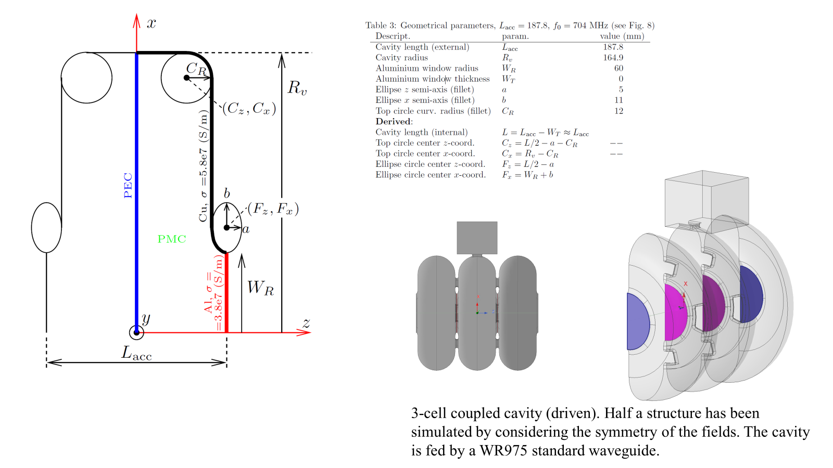

Slide 26
WP7 - Magnets
WP7 takes care of all aspects of magnet specification, conceptual design and supporting R&D, as necessary to the selection of suitable technology
WP7 is divided in four tasks, covering the collider complex, from muon production (Task 7.2), through muon acceleration (Task 7.3), to muon collision (Task 7.4)
The variety of magnets is extraordinary:
  Solenoids with high- (20 T) to ultra-high-field (40 T)
  Pulsed (+/-1.8 T, 4000 T/s) accelerator dipole magnets
  High field (16…20 T) and large aperture (100…300 mm) collider dipoles and quadrupoles
WP7 has advanced well, defining magnet design and development targets (specifications, see next slide) jointly with beam physics and other technologies such as cryogenics, vacuum, shielding, RP
The work has generated many presentations and publications at international conferences (MT, ASC) and workshops (CCA, LTSW, MEM, ISS), also related to the high relevance of magnet technology for a muon collider towards other scientific and societal applications

Slide 27
Magnet development targets
Complex | Magnet | Aperture (mm) | Length (m) | Field (T) | Ramp rate (T/s) | Temperature (K)
Target, decay and capture channel | Solenoid | 1200 | 19 | 20 | SS | 20
6D cooling channel | Solenoid | 90…1500 | 0.08…0.5 | 4…15 | SS | 4.2/20
Final cooling channel | Solenoid | 50 | 0.5 | > 40 | SS | 4.2
Rapid cycling synchrotron | NC Dipole | 30x100 | 5 | ± 1.8 | 4200 | 300
Rapid cycling synchrotron | SC Dipole | 30x100 | 1.5 | 10 | SS | 4.2/20
Collider ring | Dipole | 160 | 10 | 12 | SS | 4.2/20
 |  | 100 |  | 16

Slide 28
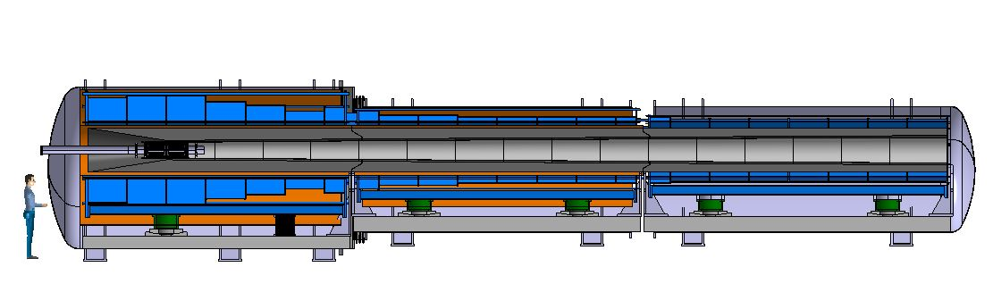
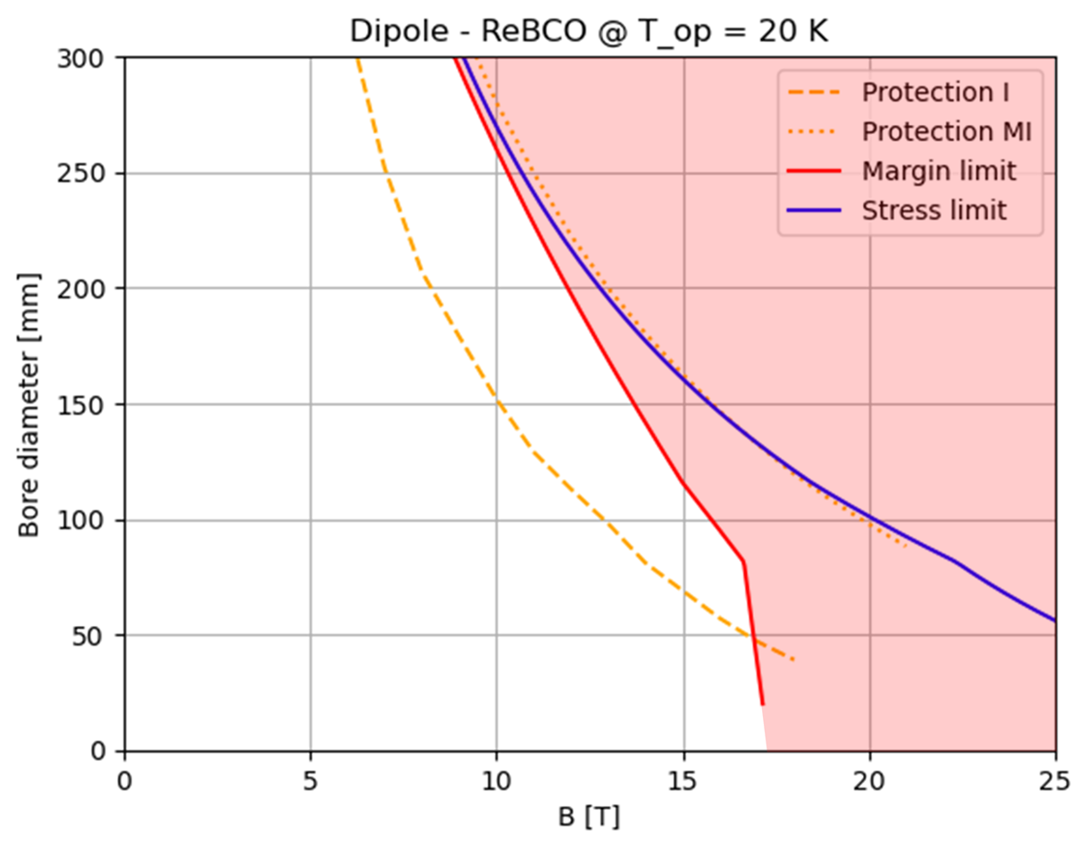
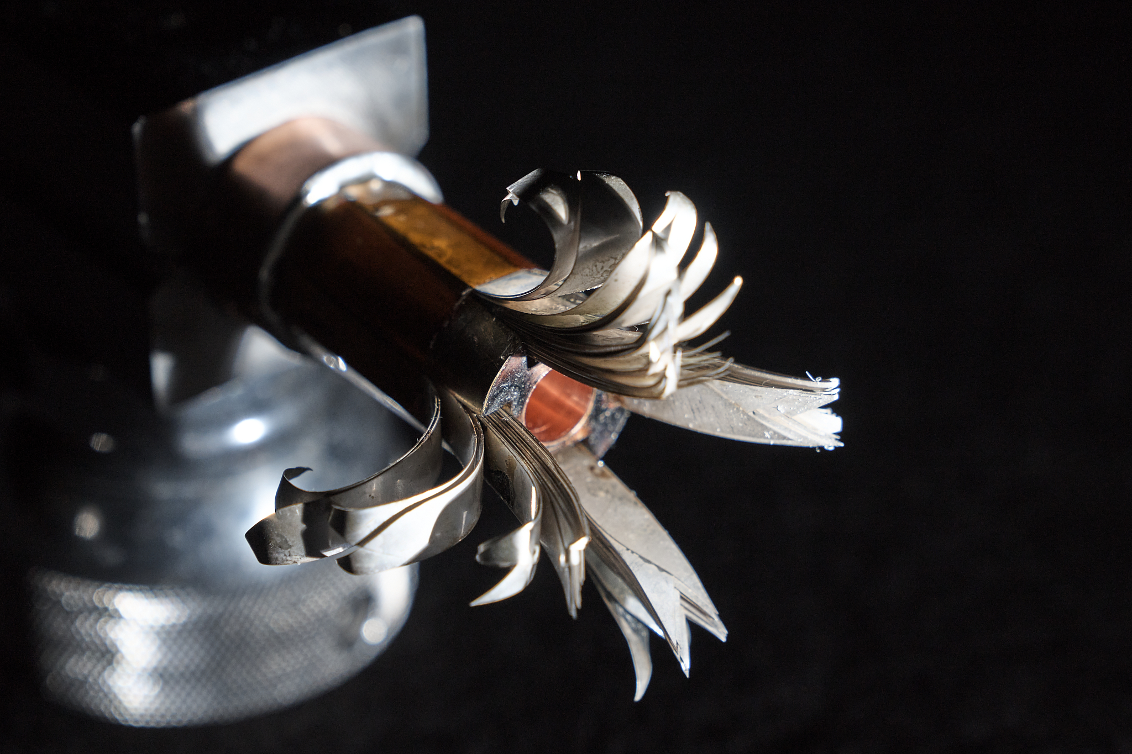
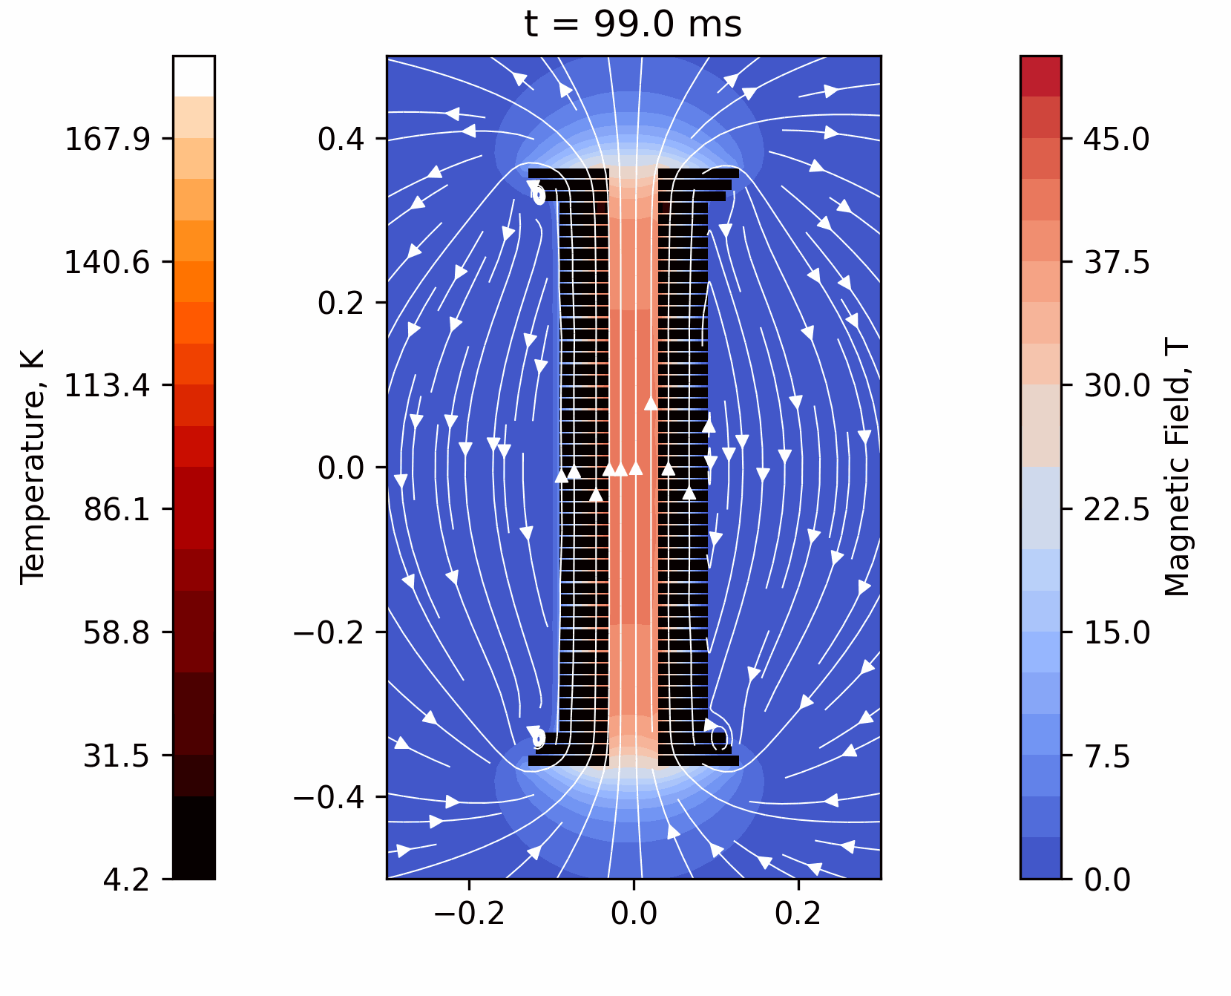
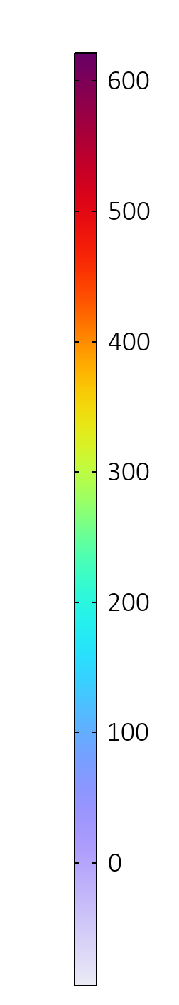
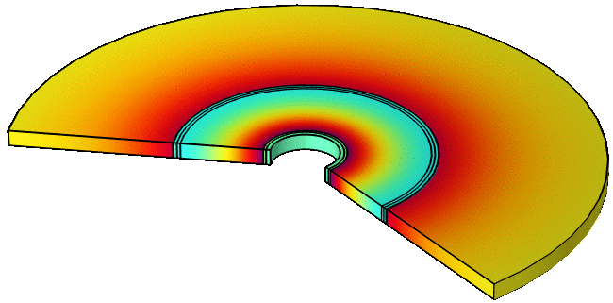
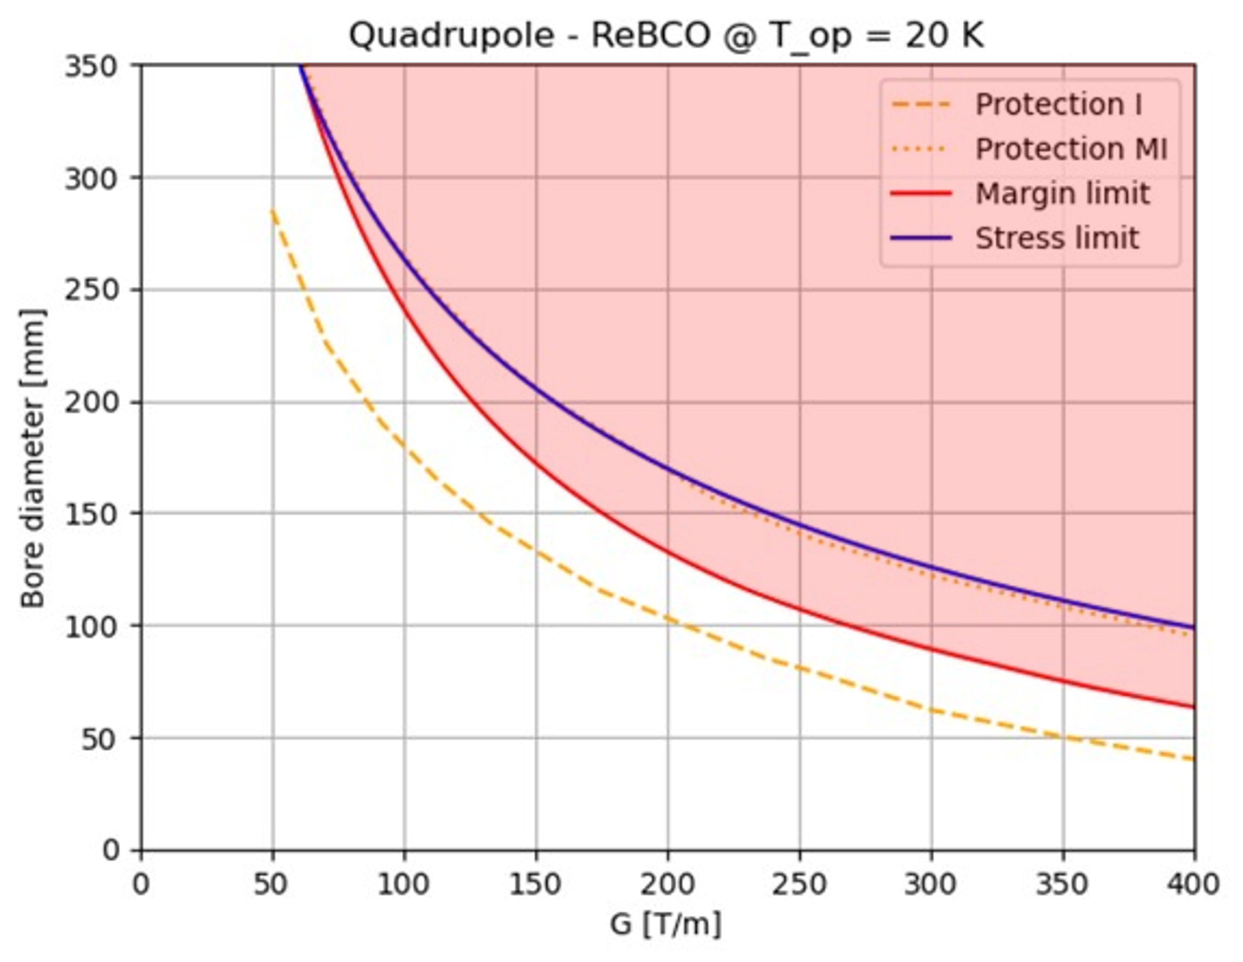
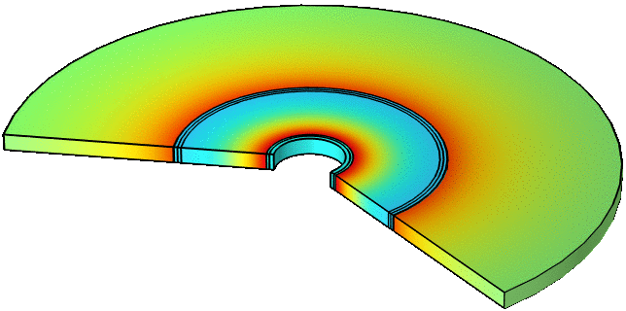

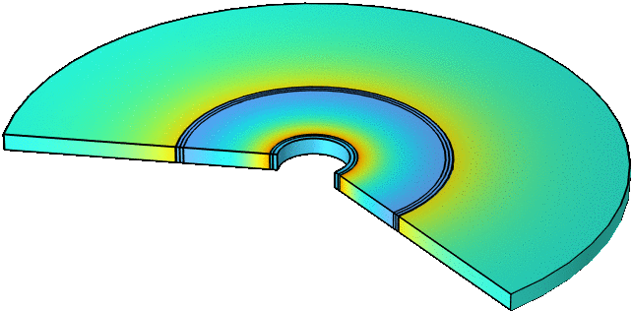
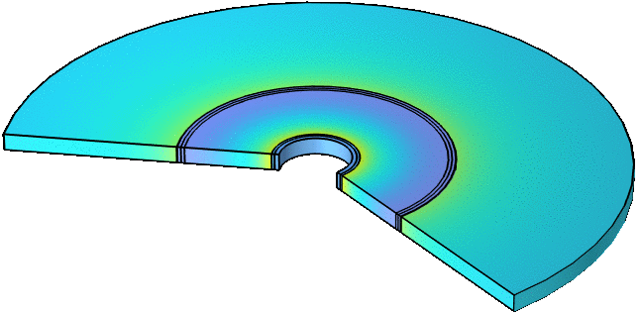
Magnet conceptual designs and technology advances
Muon production: target solenoid
HTS conductor
Operating current: 61 kA
Operating temperature: 20 K
20 T target solenoid conductor R&D
40 T final cooling solenoid quench analysis
Collider magnets limits

Slide 29
WP7
Institute | Months funded | Comments
TUDA | 15 | D. Moll, hired in September 2023. The person is presently paid with other funds. He will be funded by MuCol from Sep 2024 to Dec 2025.
CEA | 18 | The position should be opened in the near future.
INFN | 32 | INFN-Milano and UMIL: J. Pavan, B. Baggi, G. Giordano, L. Balconi, F. Mariani, G. Scarantino INFN-Genova: D. Novelli, T. Maiello
UMIL | 8 | See WP8
UTWENTE | 14 | S. Otten
PSI | 36 | They hired a PhD student.
UNIGE | 24 | Currently the work for MuCol is carried out with internal resources. They will hire somebody from 2025.
SOTON | 42 | Hiring in progress
CERN |  | S. Fabbri, G. Vernassa, D. Rinaldoni, M. A. Hafiz, M. Gast
UNIBO | 0 | R. Miceli, C. Bartoli

Slide 30
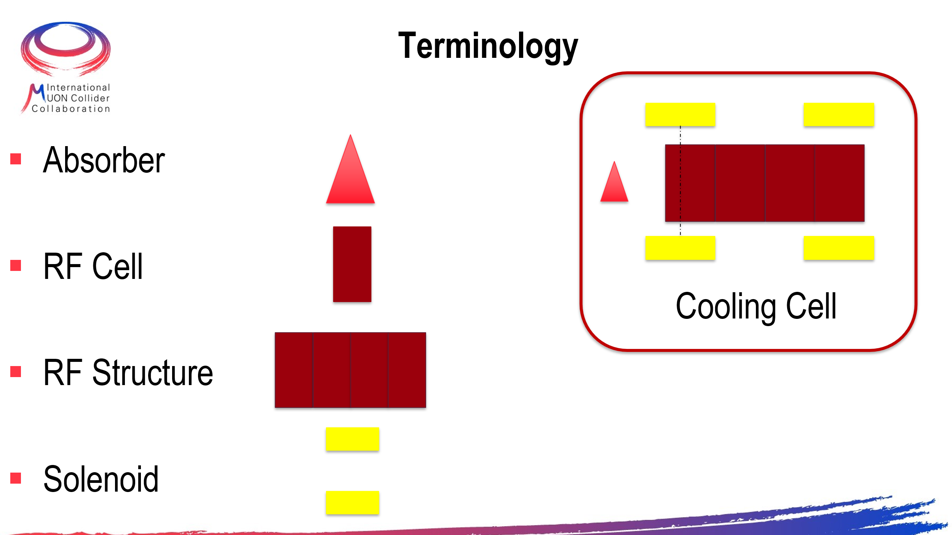
WP8: Cooling cell

Slide 31
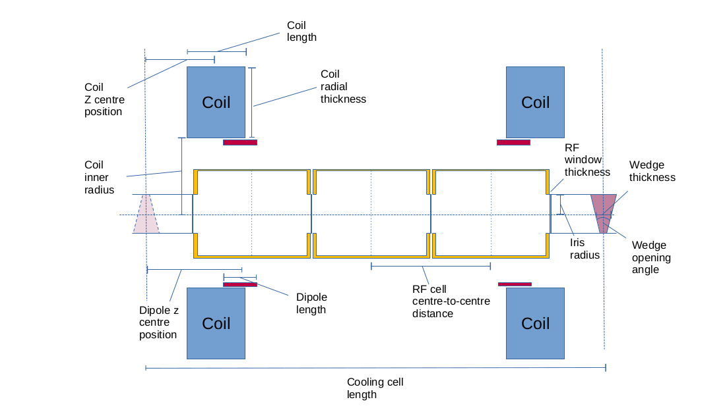
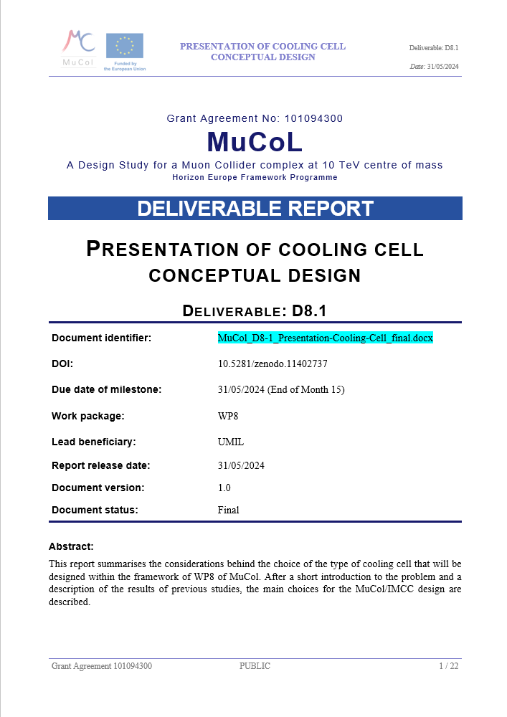
WP8: Cooling cell

Slide 32
WP8 students
Davide Batia (Unimi)
Beatrice Baggi (Unimi)
Giovanni Giordano (INFN and POLIMI)
Carmelo Barbagallo (CERN)

