Slide 1

Importance of hydrogen absorbers for high-density muon beams
Bernd Stechauner, CERN and TU Wien

Slide 2
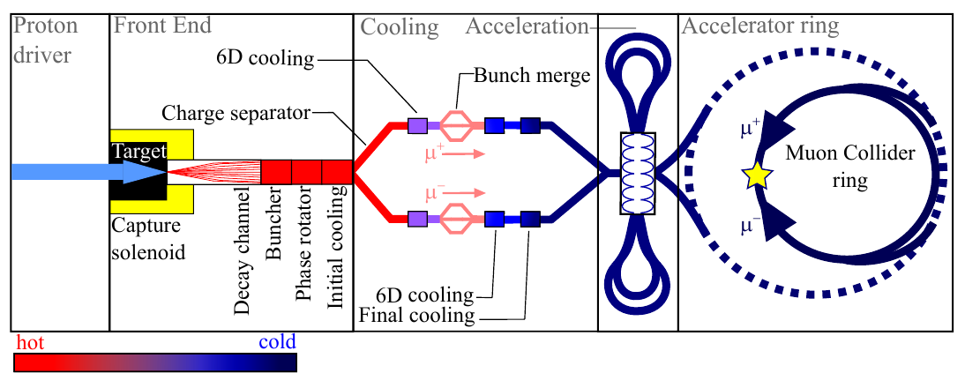
Final cooling
The final cooling is the last stage before muons are accelerated to very high energies.

Slide 3
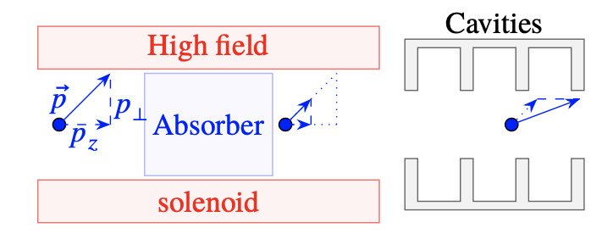
Ionization cooling and the concept of a final cooling cell
A final cooling cell consists of:
  a high field solenoid,
  an absorber,
  and an RF cavity system.
Goal: hot beam to cold beam.
Cold beam: dense and low transverse momenta.
Higher probability to create rare or unknown events in the interaction point later.

Slide 4
Heat deposition
The less beam energy the more energy is stored in material. (Effect used in hadron therapy.)
The most efficient absorber is liquid hydrogen.
The muon beam penetrates the material with low energy (MeV range).
Charged particles in matter deposits their energy.

Slide 5
Study of hydrogen gas absorbers
The temperature increases in liquid hydrogen up to 100K.
This is equivalent to a pressure increase of several hundreds of bars.
No liquid hydrogen confinement resists those conditions.
Solutions
Usage of long absorbers with low hydrogen gases.

