Slide 1


Development of simulation code for the initial acceleration stage of the Muon Collider
Paula Desiré Valdor (CERN and University of Groningen), Andrea Latina (CERN), Alexander Gerbershagen (University of Groningen).

Slide 2
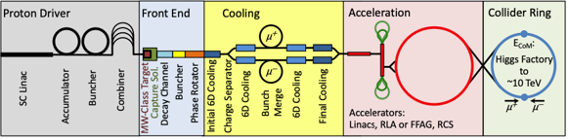
Muon Collider initial acceleration stage:
Challenges
The acceleration of muons is characterized by several challenges:
At rest, muons have a lifetime of the order of magnitude of microseconds. This lifetime increases when muons are accelerated to velocities close to light. Then, to get a stable beam, the initial acceleration must be performed as fast as possible.
Furthermore, after the cooling, the particles are characterized by several conditions which complicate their manipulation and acceleration:
Are grouped in very long bunches.
Have a very large energy spread.
Have large transversal and longitudinal emittances.

Slide 3
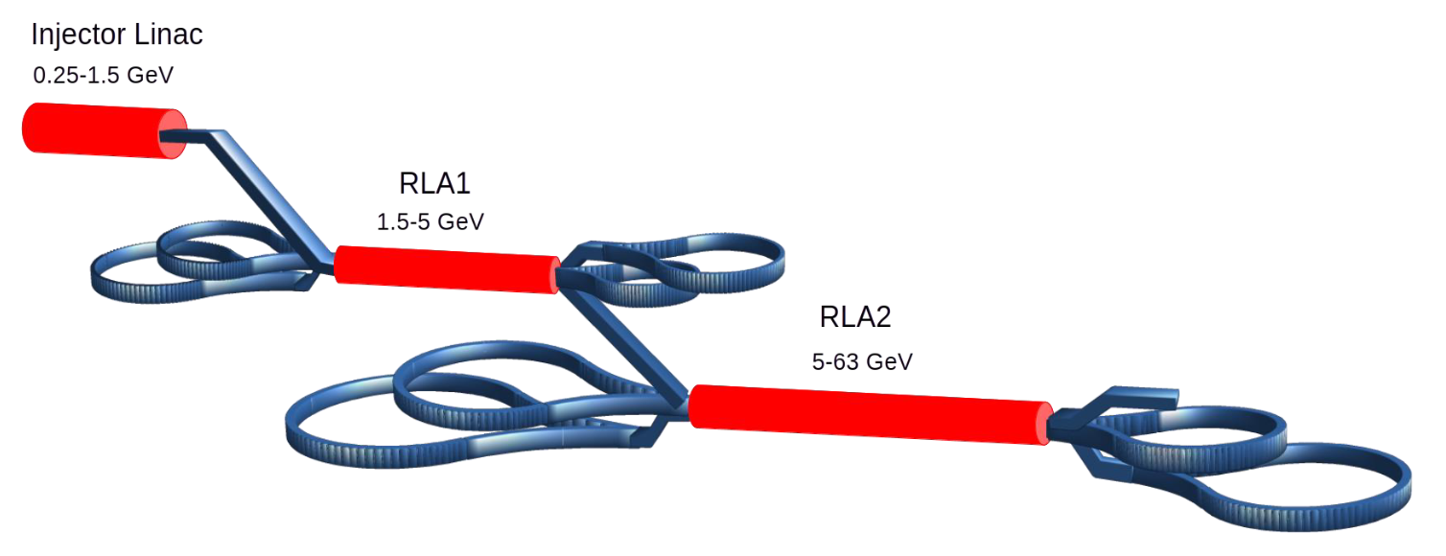
Muon Collider initial acceleration stage::
Design from 250 MeV to 63 GeV
The most profitable design to handle optimally these issues is the following:
Single pass linac:
Maintains phase-space volume and accelerates the muons up to sufficient relativistic velocities for an efficient acceleration in the RLAs.
Two recirculating linacs (RLAs) with multiple passes + droplet arcs:
The RLAs are a compact and cost-saving option to use superconducting RF cavities, that will allow a fast and compact acceleration.
There are multiple droplet arcs because each of them has a fixed energy, and there must be an arc after each RLA pass.

Slide 4
Code development
There are few codes which can simulate correctly the recirculating topology that can be found in the RLAs and all of them assumed electrons at ultrarrelativistic velocities. However, Muon Collider initial acceleration requirements need to simulate non-ultrarrelativistic and decaying muons.
WORK DONE
Update of PLACET2, a code developed at CERN that can handle recirculating topologies so it can simulate:
Particles of any specie (electrons, muons...).
Decaying particles.
Particles which any velocity, which drastically affects the dynamics.
Bunches of any charge.
Wide benchmarking of the updates.
WORK IN PROGRESS
RLA beams are expected to have high-intensity → Importance of collective effects (how the particles in the beam are affected by another).
Current work: Implementation of Intrabeam Scattering, particle-to-particle collisions produced by Coulomb interaction.

Slide 5
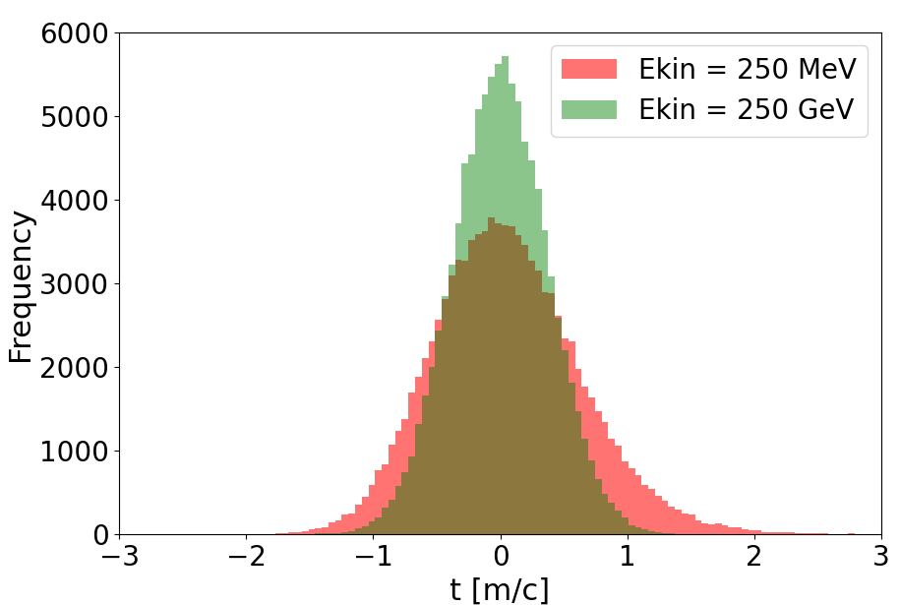
A result: The importance of considering non-ultrarrelativistic regime
The following example done with PLACET2 illustrates the importance of differentiating between non-ultrarelativistic and ultrarelativistic dynamics.
The same initial particles passed a 100m-long structure (the real initial acceleration complex is even longer).
Their longitudinal coordinate after, was plotted in an histogram.
Red: 250 MeV muons, the ones to be found in the initial acceleration stage (non-ultrarelativistic).
Green: 250 GeV muons, that have ultrarelativistic dynamics, the only regime that could be simulated before this work.
There is a huge difference!

Slide 6
Development of simulation code for the initial acceleration stage of the Muon Collider / P.Desiré / CERN and University of Groningen

