Slide 1

Transverse beam stability studies in the high energy complex
Part of Work Package 5 (High-Energy Complex)
D. Amorim, E. Kvikne, E. Métral
Thanks to F. Batsch, J. S. Berg, F. Boattini, L. Bottura, X. Buffat, C. Carli,
A. Chancé, H. Damerau, M. Gast, A. Grudiev, I. Karpov, T. Pieloni,
D. Schulte, K. Skoufaris, L. Thiele

Slide 2
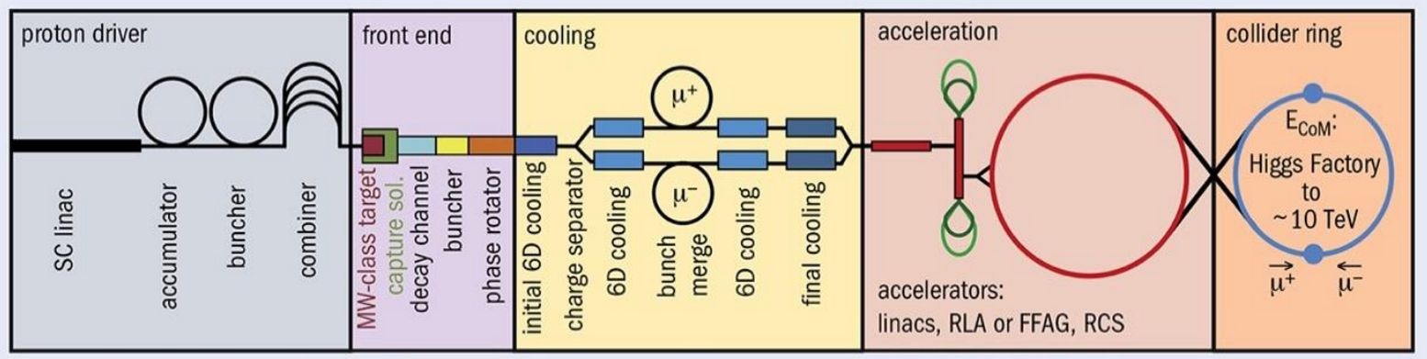
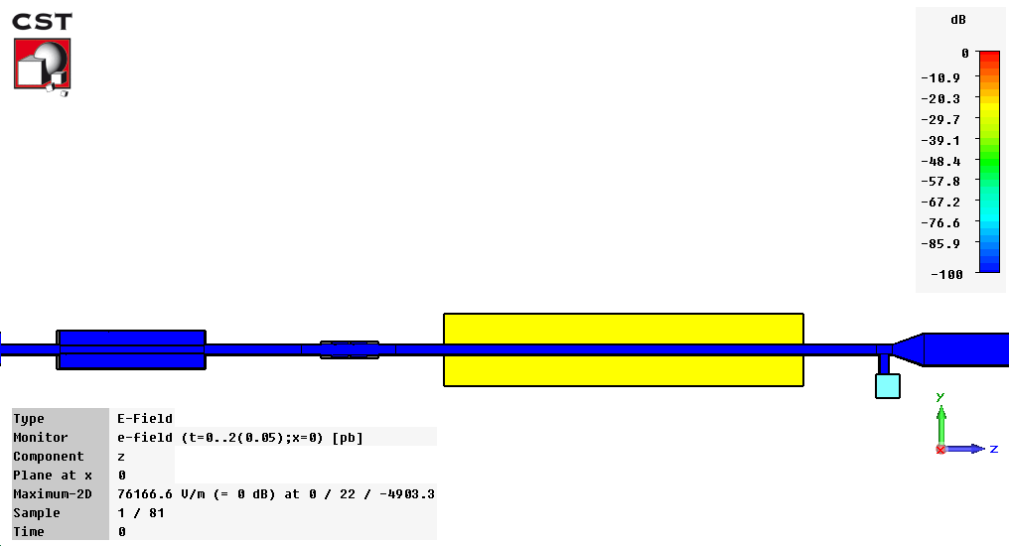
Beam stability challenges in the high energy complex
Fast acceleration is required to counter-balance the muon decay
  Many RF cavities are required in the RCS: 400 in RCS 2, 3000 in RCS 4
Parasitic electromagnetic fields are generated when the beam passes through accelerator devices (RF cavities, vacuum chambers, monitors…)
  These parasitic fields can make the beam unstable, or heat-up some devices
  This can lead to emittance blow-up, intensity losses or equipment damage
For each accelerator, a beam coupling impedance model can be developed to represent these parasitic fields
Machine parameters | RCS 1 | RCS 2 | RCS 3 | RCS 4 | Collider 10 TeV
Circumference [km] | 6 | 6 | 10.7 | 35 | 10
Beam momentum at injection [GeV/c] | 63 | 313.8 | 750 | 1500 | 5000
Energy increase per turn [GeV] | 14.7 | 7.9 | 11.3 | 63.6 | 0
Pumping port
+ transition
Kicker
Magnet
BPM
B. Salvant, CST simulation
2

Slide 3
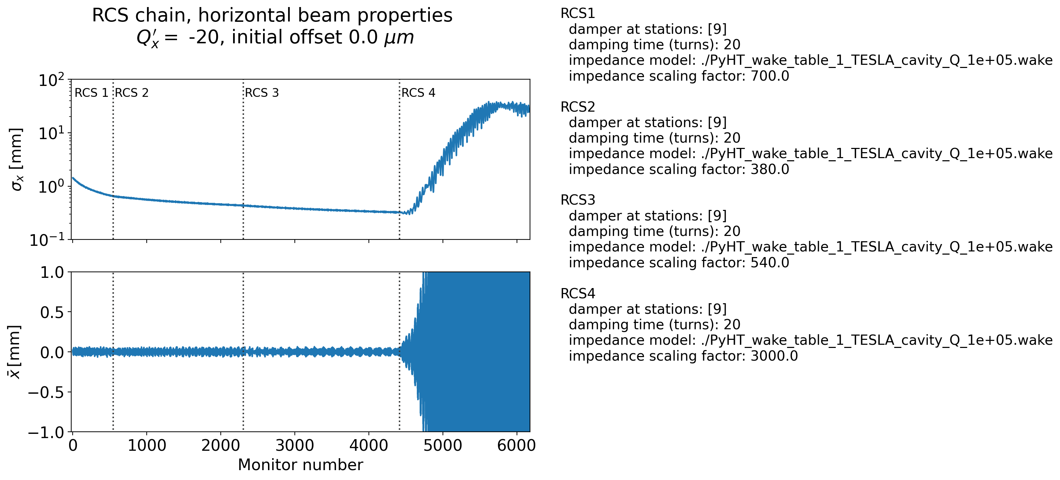
Transverse instabilities can strongly degrade beam properties
Impedance models are developed for the four RCS and the collider
  In the RCS, the main instability drivers are the RF cavities and the vacuum chambers
  In the collider it is the superconducting magnets vacuum chamber
Multiparticle tracking simulations are then performed to evaluate transverse beam stability limitations
  A muon beam is tracked through the chain of
  four RCS
  The impedance model of each machine is included
  in simulations
  Beam properties are evaluated at the end of the chain
Example of a simulation where the beam becomes unstable in RCS 4

Slide 4
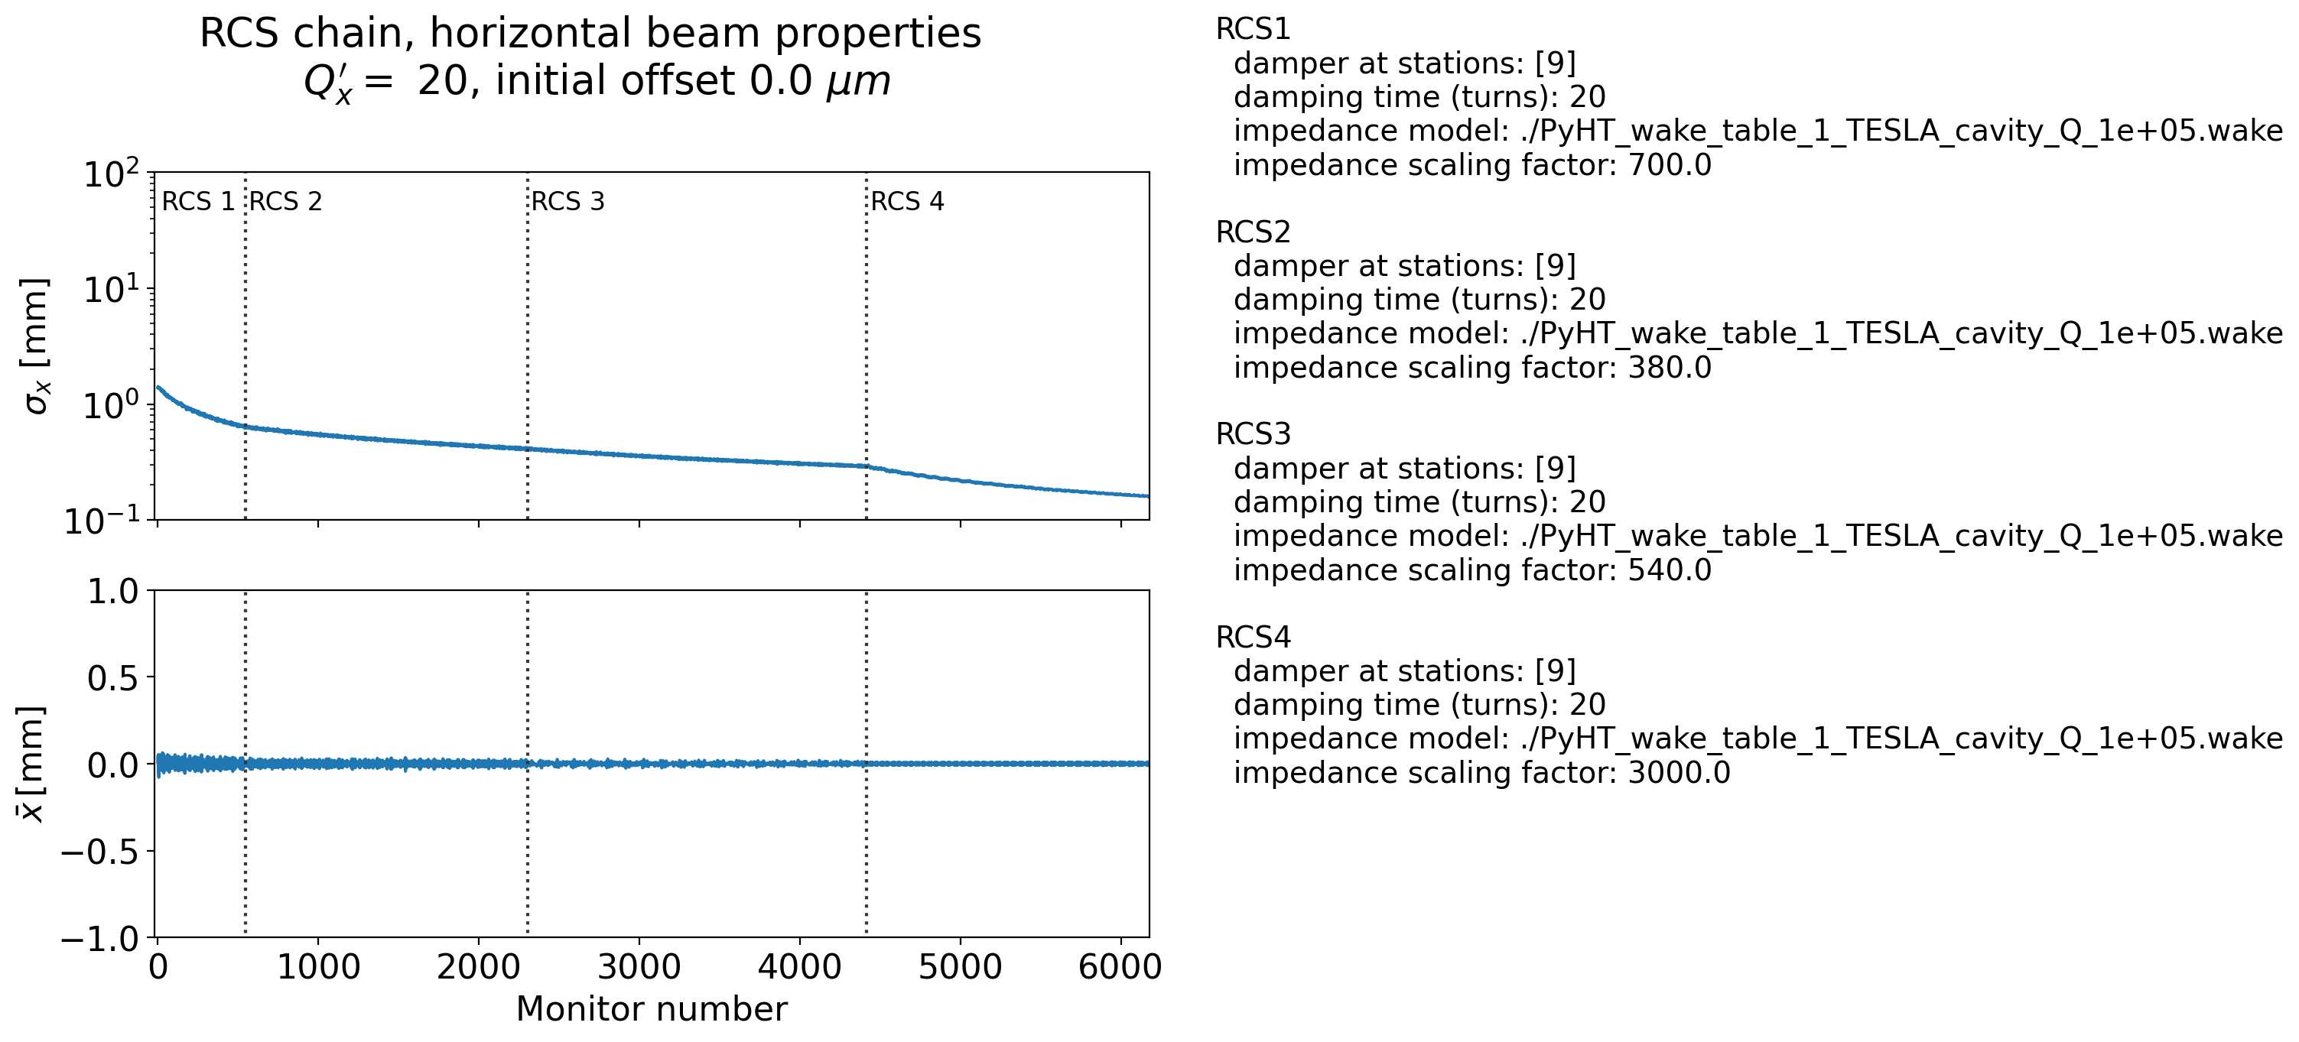
Mitigation measures can be added to ensure beam stability
Instability mitigation mechanisms are also investigated in simulations
  Chromaticity → impact on the machine lattice and magnet requirements (sextupoles are needed)
  Transverse damper
Specific effects like the muon decay or the distributed RF system in the RCS have been modelled in simulations
Additional effects, such as beam-beam, are being included to refine beam stability predictions
The transverse instability in RCS 4 is mitigated by introducing positive chromaticity (Q’=+20)

