Slide 1

HTS Winding and Junction
Technology Development for the MC Cooling Cell Solenoids
WP7 – Magnets
WP8 – Cooling Cell Integration
Giovanni Giordano, Lucio Rossi, Stefano Sorti, Lorenzo Balconi, Giuseppe Scarantino, Marco Statera.
UMIL & INFN

Slide 2
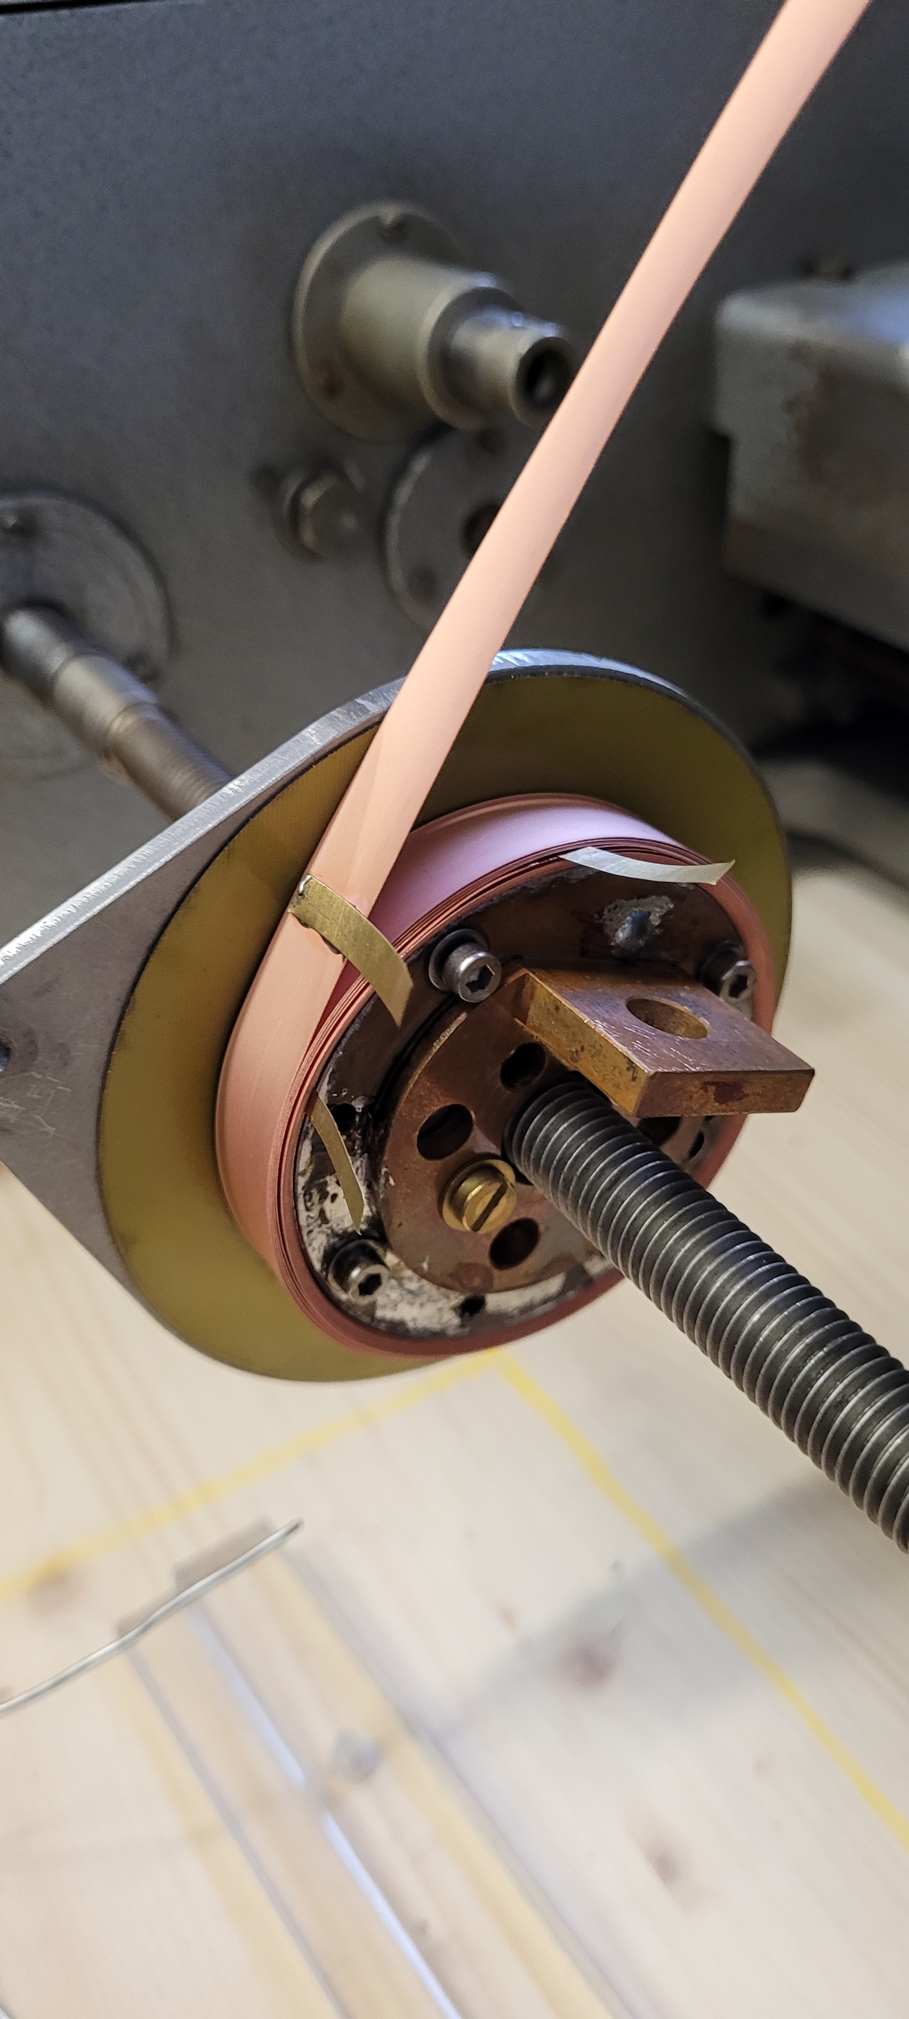
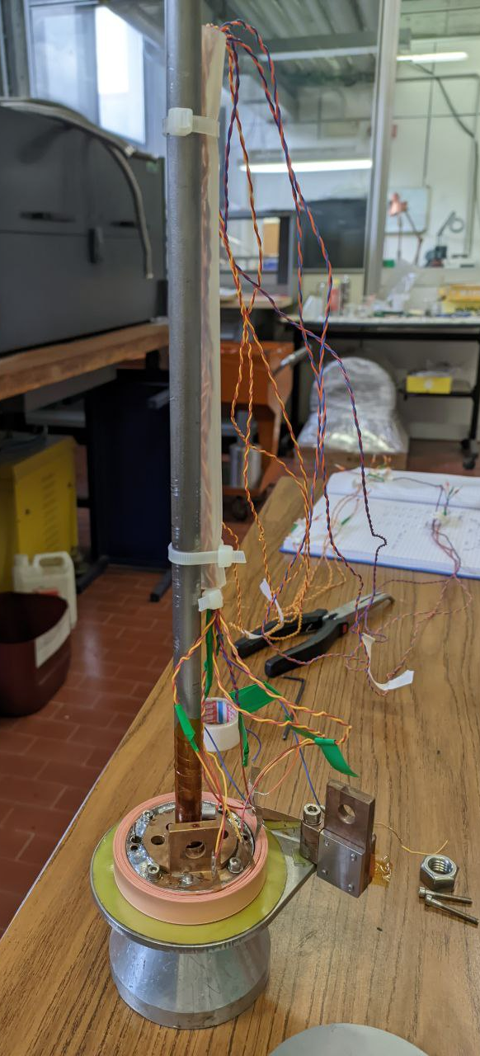
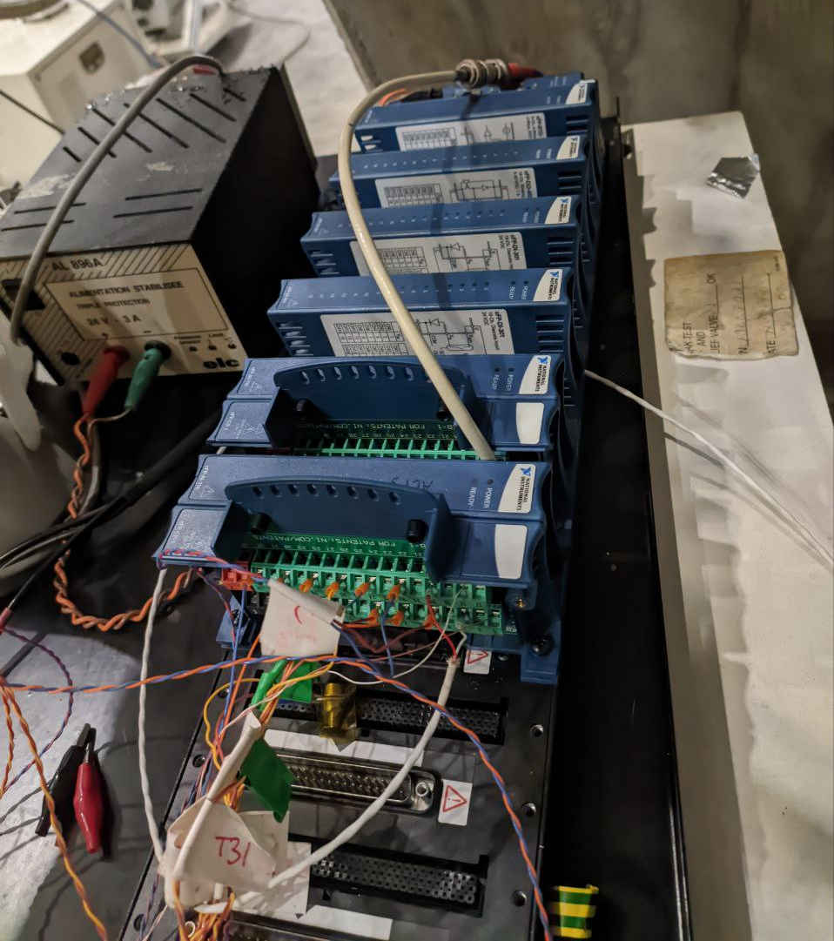
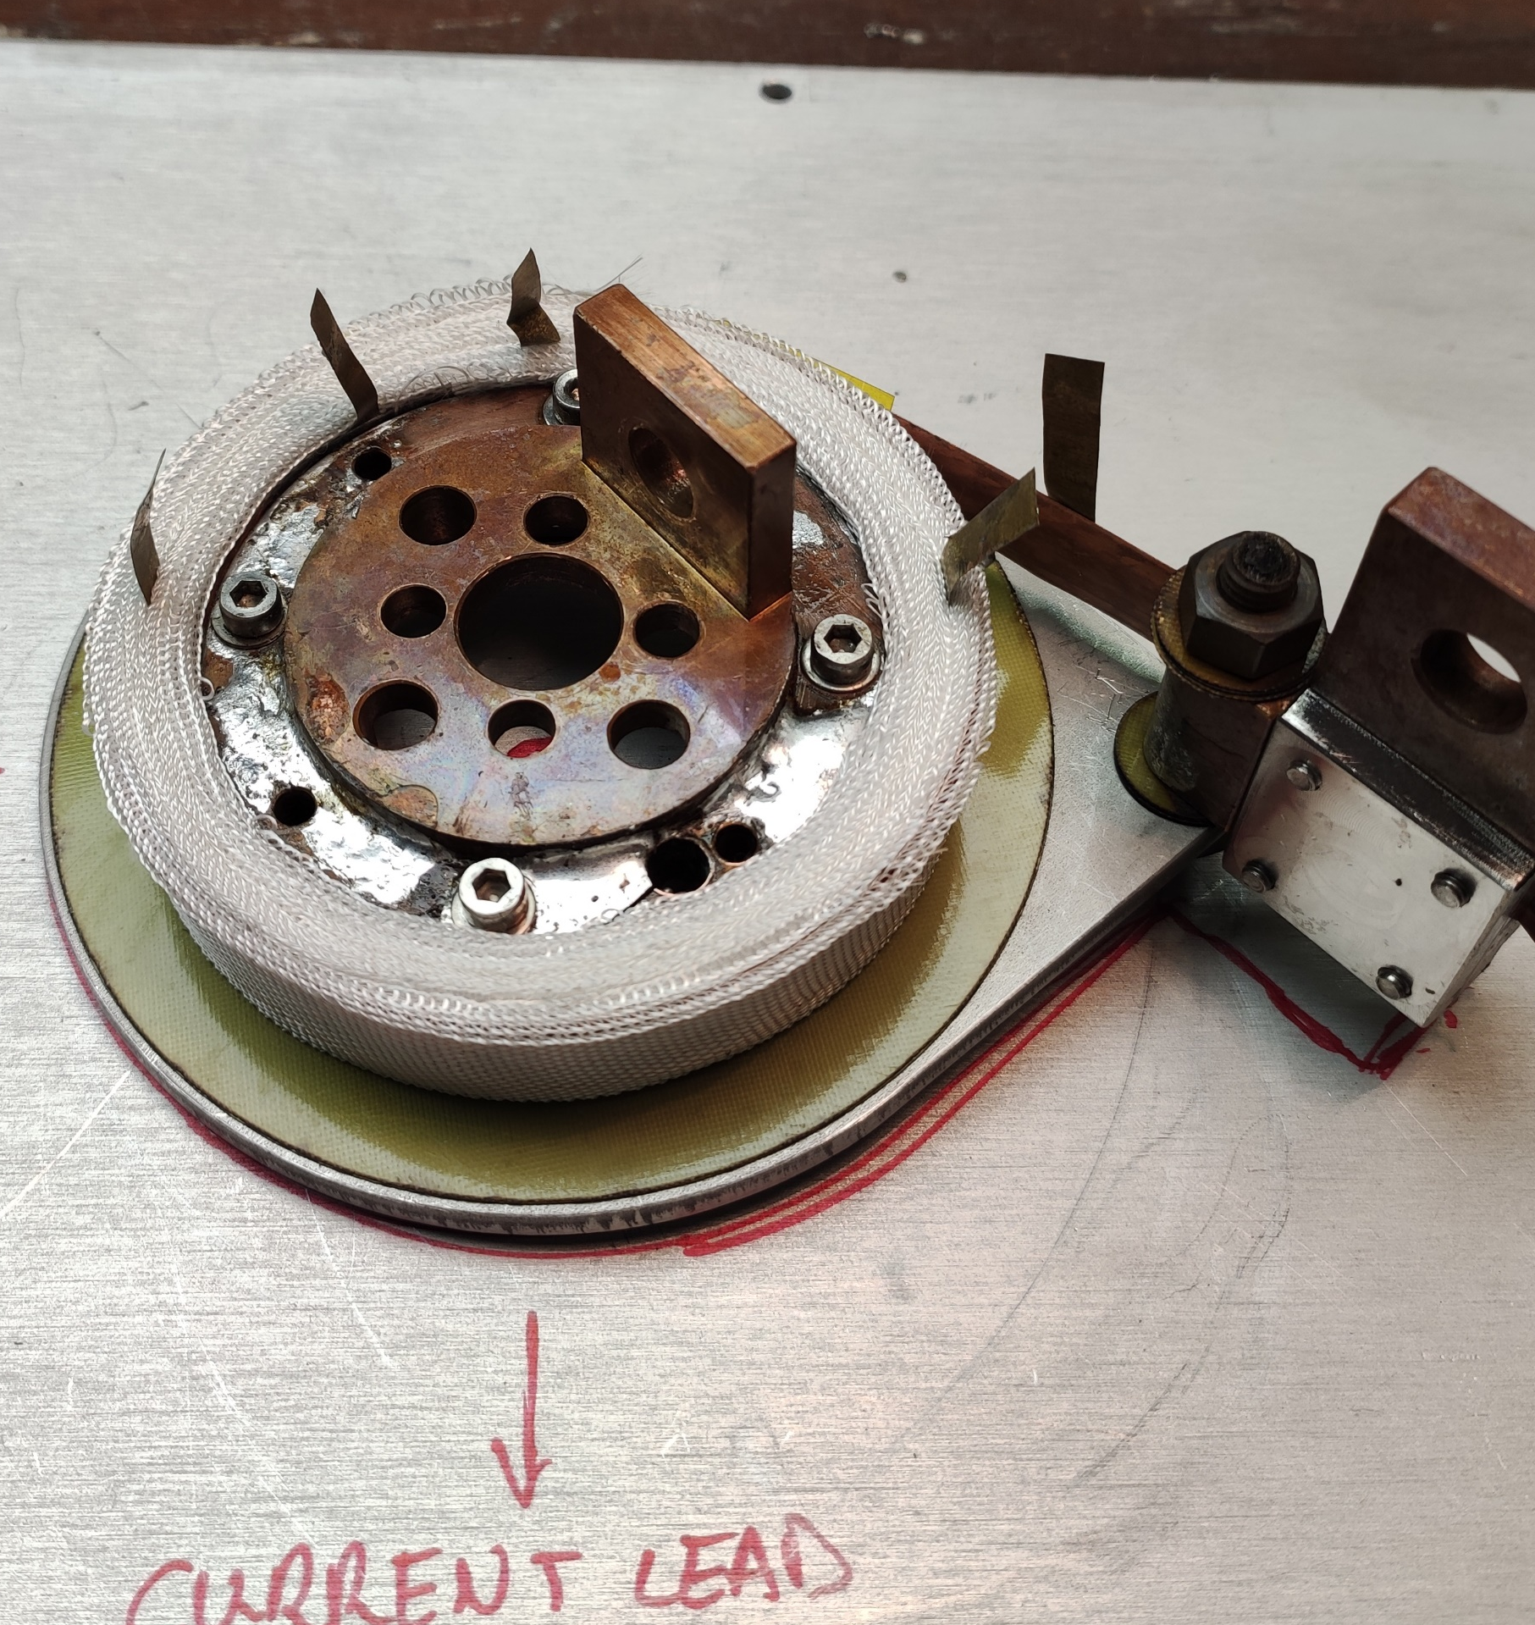
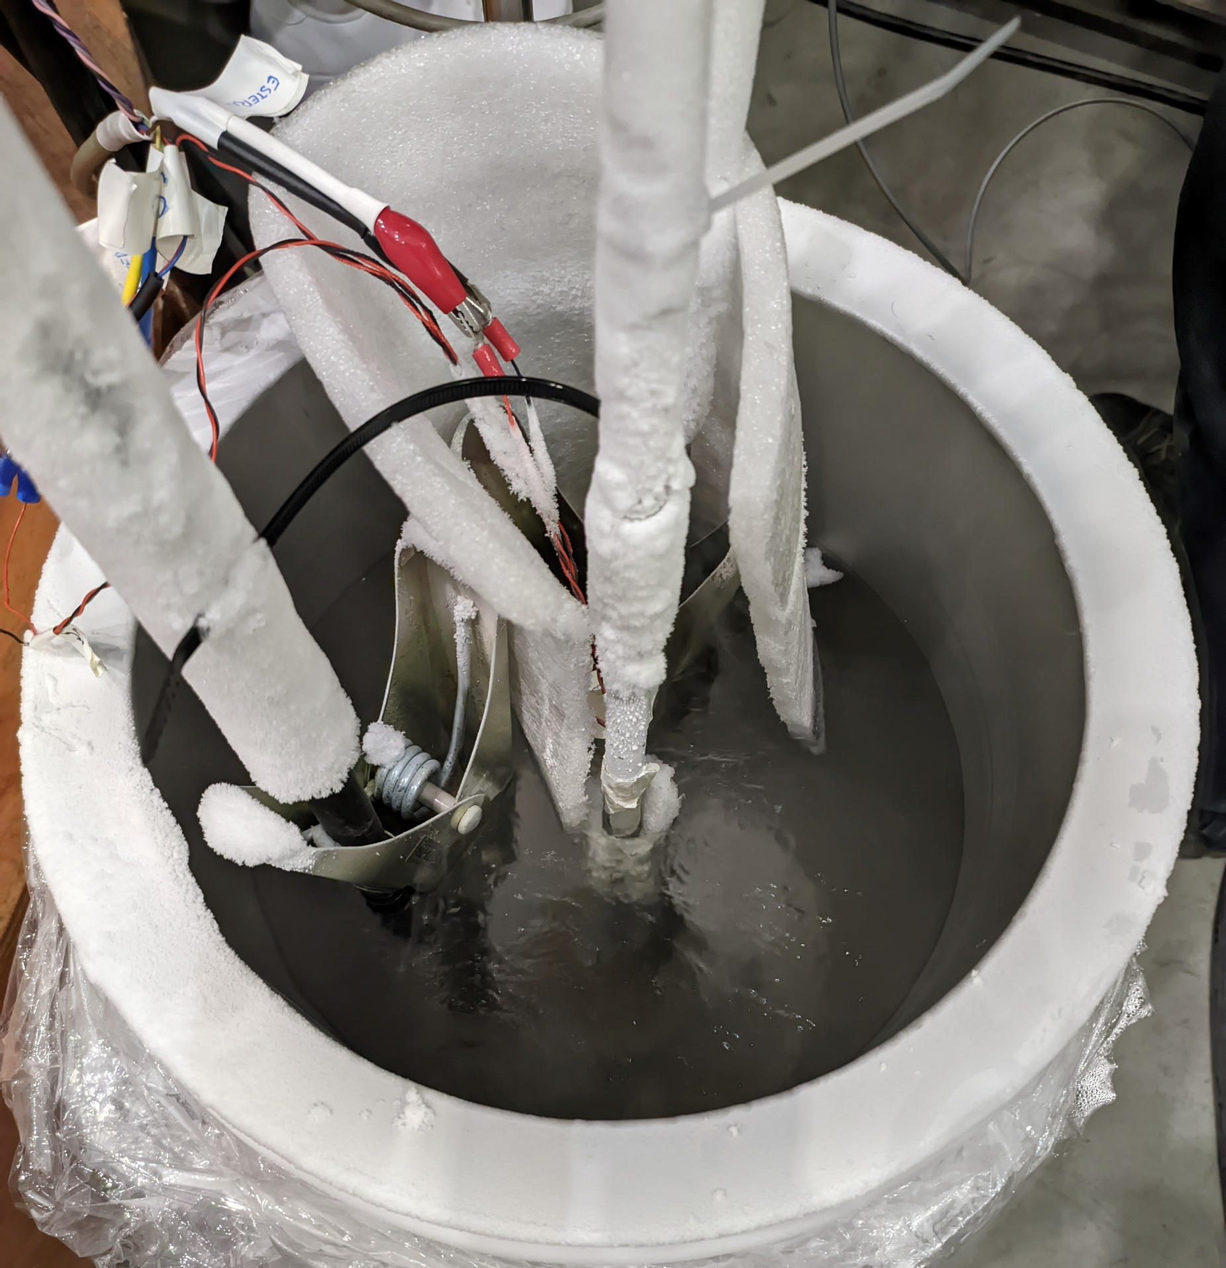
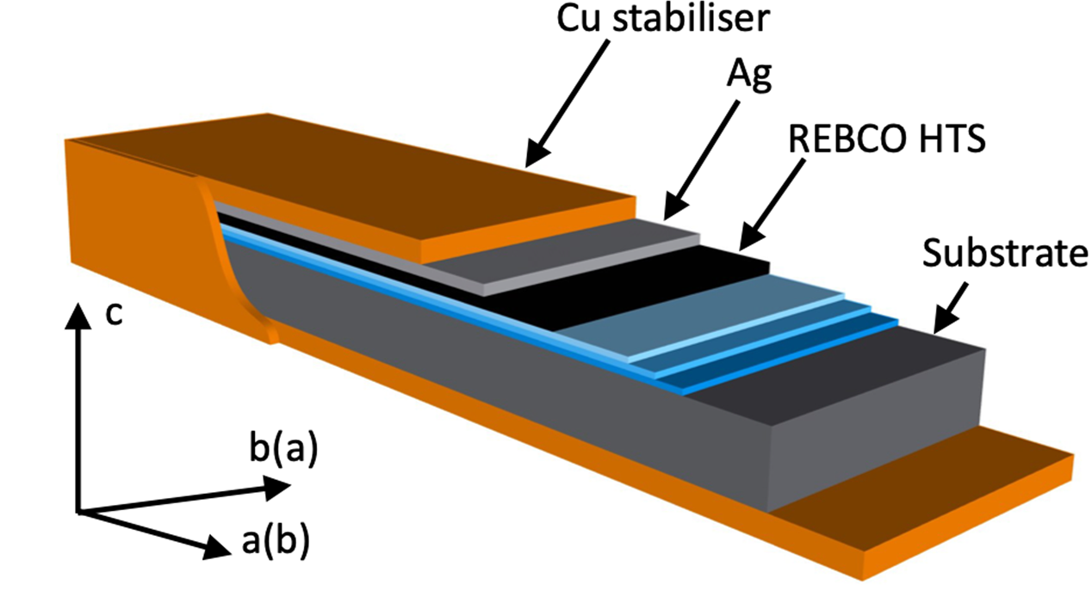
ReBCO HTS: an Enabling Technology
Winding technology
Insulated VS non-insulated coils
Winding tension
Contact resistance
Quench protection
Charge time

Slide 3
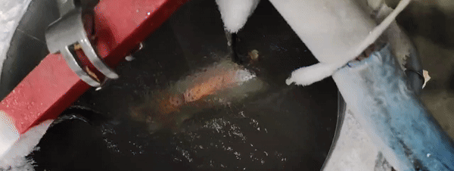
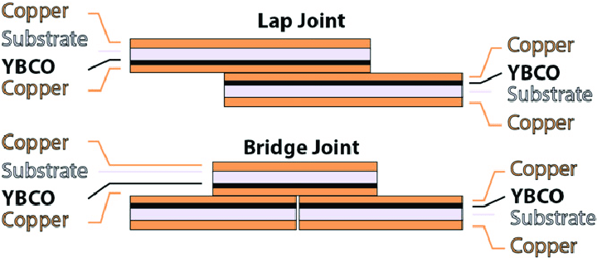
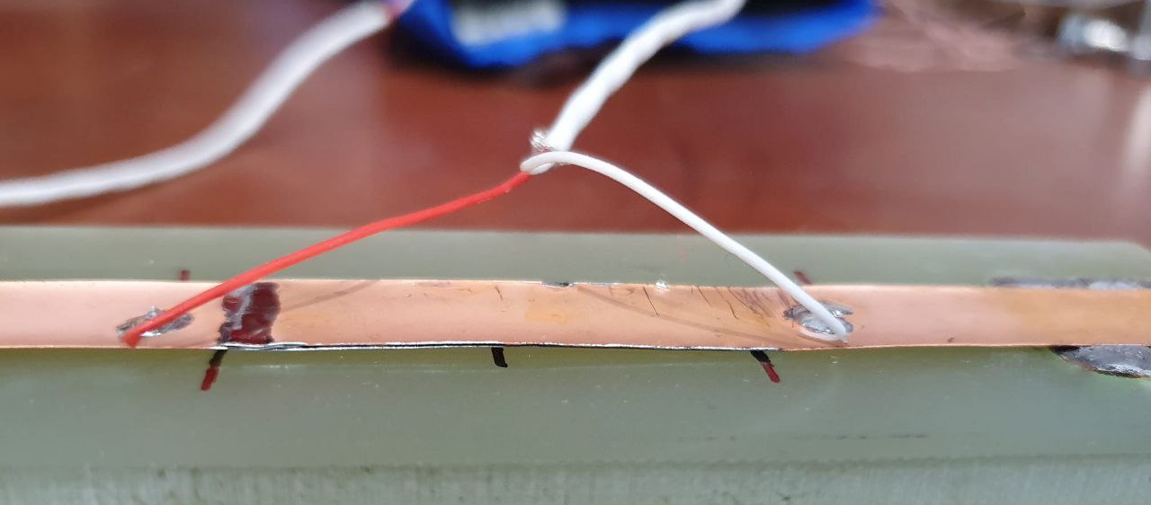
Junction Testing
Splicing is needed
External and internal splicing
Splicing geometry
Brazing alloys
Welding technologies

Slide 4
Some Results
Non insulated coil – norm. Transient
Junction Resistive Baseline

