Slide 1
Polarization status at the Electron Ion Collider
Kiel Hock
FCC week
Vienna, Austria
May 19-23, 2025

Slide 2
Co-authors
Haixin Huang, Henry Lovelace III, Sergei Nagaitsev, Vadim Ptitsyn, Vahid Ranjbar, Vincent Schoefer, Erdong Wang
Brookhaven National Laboratory
Joseph Devlin, Eiad Hamwi, Georg Hoffstaetter, Matthew Signorelli
Cornell University

Slide 3
Overview
Introduction
Electron Polarization
Polarization in the Rapid Cycling Synchrotron
Polarization in the Electron Storage Ring
Hadron Polarization
Polarization in the Alternating Gradient Synchrotron
Polarization in the Hadron Storage Ring
Summary

Slide 4
Introduction

Slide 5
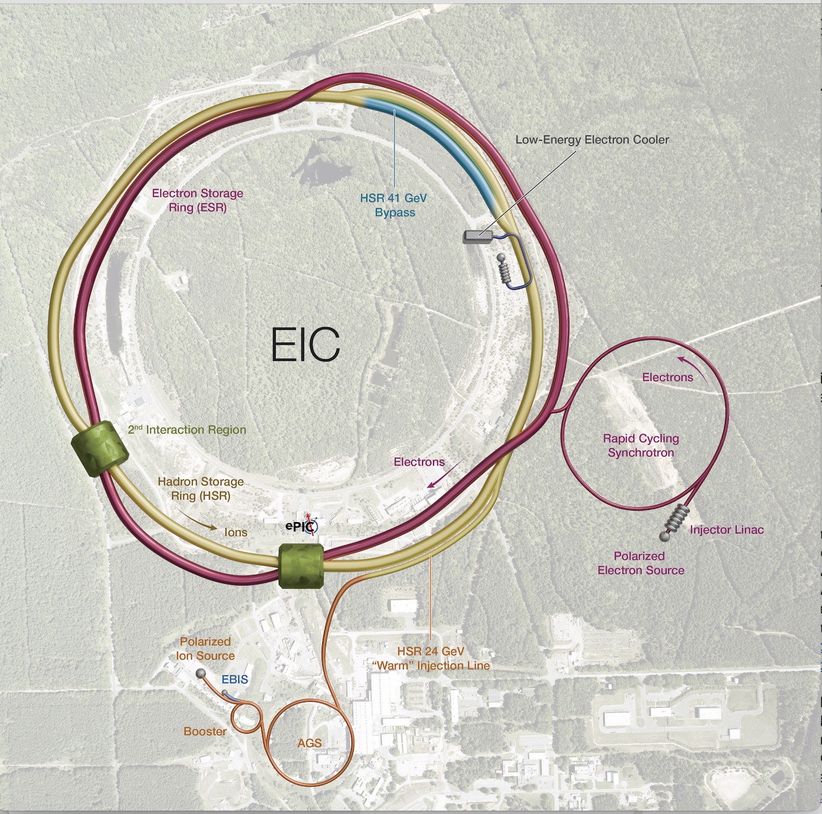
The Electron Ion Collider
The Electron Ion Collider will be the first polarized electron-hadron (proton and light ion) collider.
The EIC will be built at the existing RHIC accelerator complex
  Hadrons will use the existing infrastructure (ion sources, Booster and Alternating Gradient Synchrotron(AGS)).
  The new polarized electron source and the Rapid Cycling Synchrotron (RCS) will be external, and the Electron Storage Ring (ESR) will be installed inside the existing RHIC tunnel.
Convergence to a final design
  The Rapid Cycling synchrotron has been moved outside of the existing RHIC tunnel.
  The Hadron storage ring (HSR) now consists of only the yellow RHIC ring
    Except for the 41 GeV bypass, an inner blue arc to match revolution frequencies of electrons and hadrons at low energy.

Slide 6
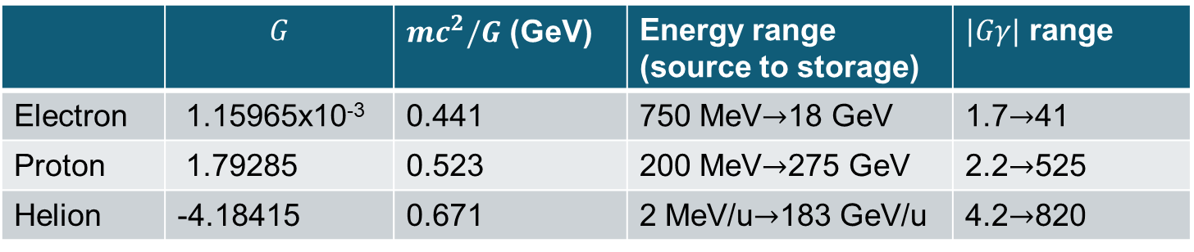
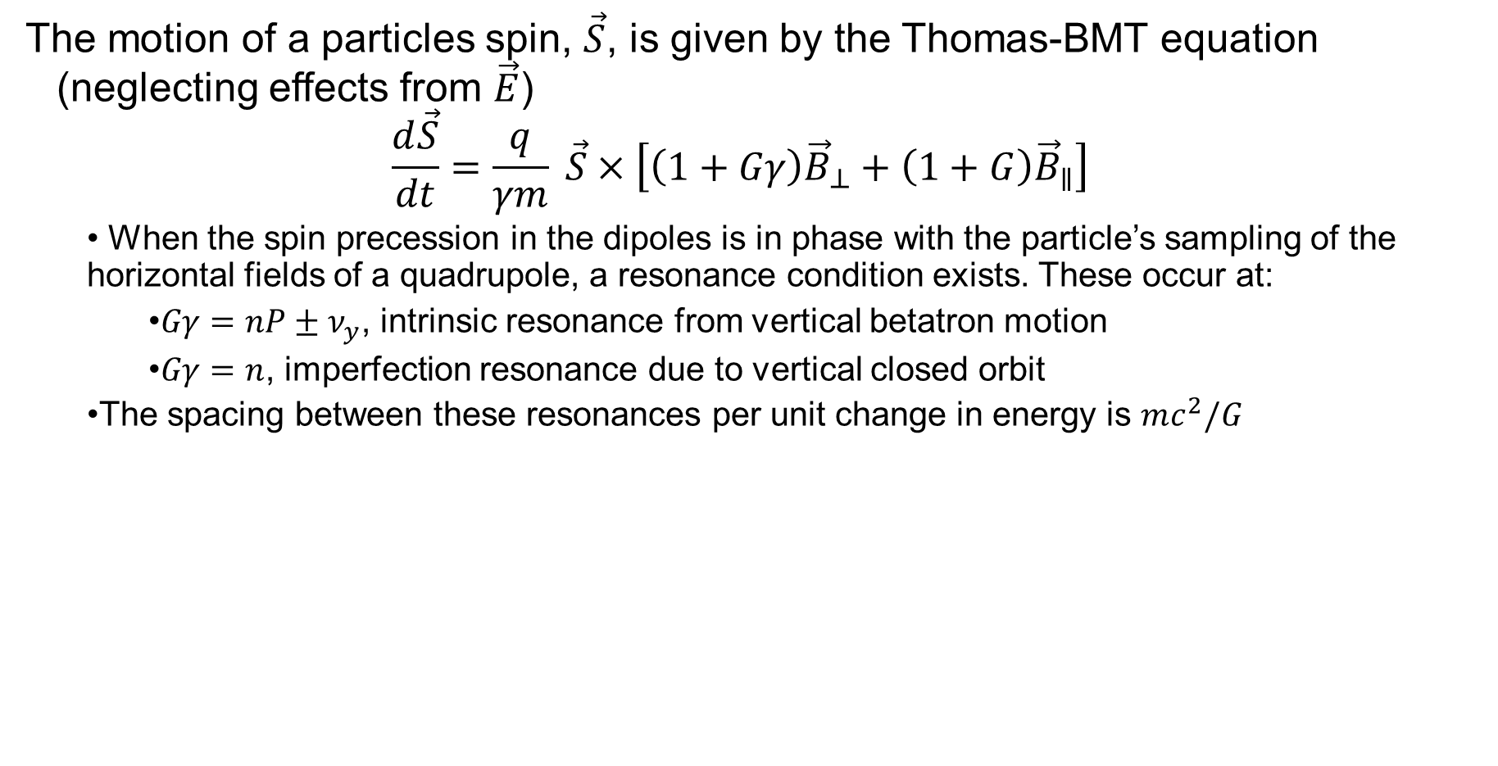
Spin Dynamics
The motion of a particles spin, $\vec{S}$, is given by the Thomas-BMT equation (neglecting effects from $\vec{E}$)
$$\frac{d\vec{S}}{dt}=\frac{q}{γm} \vec{S}×\left[\left(1+Gγ\right){\vec{B}}_{⊥}+\left(1+G\right){\vec{B}}_{∥}\right]$$
  When the spin precession in the dipoles is in phase with the particle’s sampling of the horizontal fields of a quadrupole, a resonance condition exists. These occur at:
    $Gγ=nP±ν_{y}$, intrinsic resonance from vertical betatron motion
    $Gγ=n$, imperfection resonance due to vertical closed orbit
  The spacing between these resonances per unit change in energy is $mc^{2}/G$
 | $$G$$ | $mc^{2}/G$ (GeV) | Energy range (source to storage) | $|Gγ|$ range
Electron | 1.15965x10⁻³ | 0.441 | 750 MeV$→$18 GeV | 1.7$→$41
Proton | 1.79285 | 0.523 | 200 MeV$→$275 GeV | 2.2$→$525
Helion | -4.18415 | 0.671 | 2 MeV/u$→$183 GeV/u | 4.2$→$820

Slide 7
Electron Polarization
Electron polarization overview
RCS polarization
ESR polarization

Slide 8
Electron Polarization Overview
V. Ranjbar
Pre-injector: Front End → delivers up 1 nC of bunch charge with 88% polarization
  Source already exists need to build buncher and transport line to LINAC
Pre-injector: S-Band LINAC → accelerates 1 bunch to 750 MeV
  Capable of being cycled up to 28 times per acceleration cycle (30Hz):
BAR (Beam Accumulator Ring)→ to achieve 28 nC/bunch in the RCS we will use an accumulator ring
RCS will accelerate from 750 MeV to 5 and 10 GeV energy delivering one bunch of 7 nC every second. This will fill ESR in under 20 mins.
Path to 18 GeV :
6 additional RF installation

Slide 9
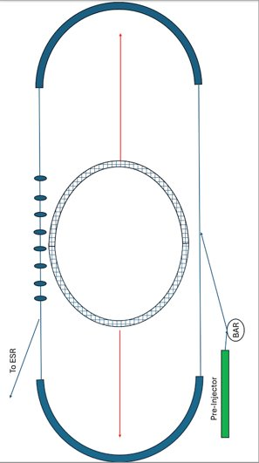
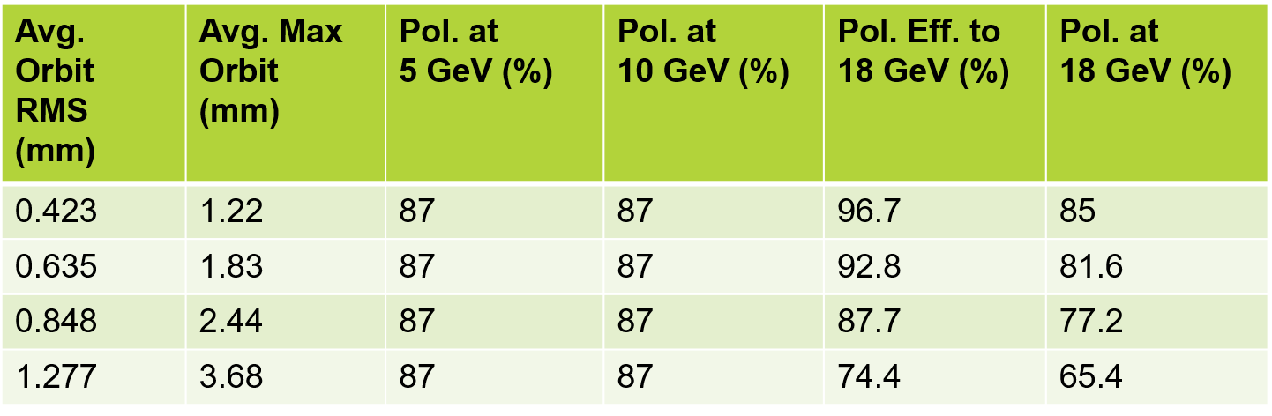
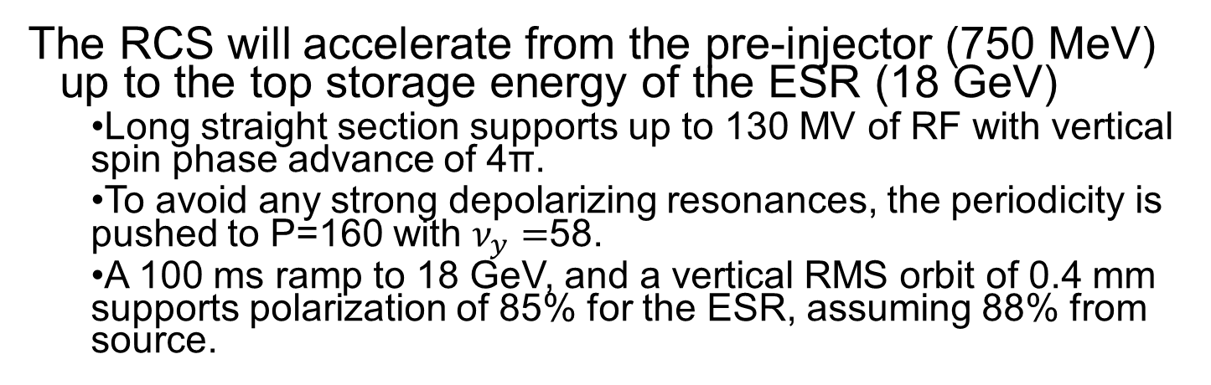
RCS Polarization
V. Ranjbar
The RCS will accelerate from the pre-injector (750 MeV) up to the top storage energy of the ESR (18 GeV)
  Long straight section supports up to 130 MV of RF with vertical spin phase advance of 4π.
  To avoid any strong depolarizing resonances, the periodicity is pushed to P=160 with $ν_{y}=$58.
  A 100 ms ramp to 18 GeV, and a vertical RMS orbit of 0.4 mm supports polarization of 85% for the ESR, assuming 88% from source.
See V. Ranjbar et al. “Spin resonance free electron ring injector” PRAB, 2018.

Slide 10
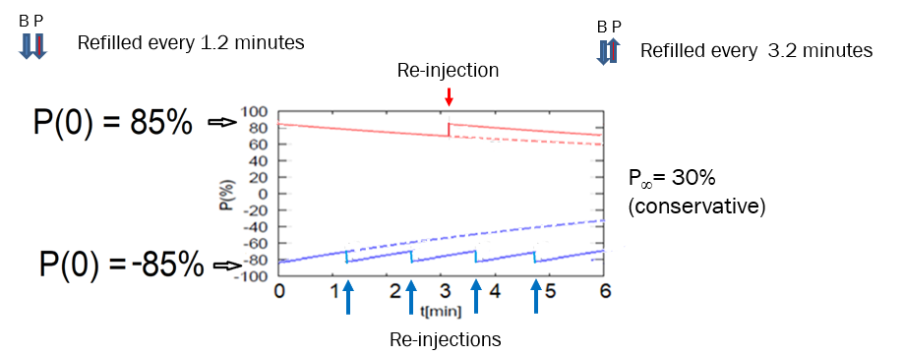
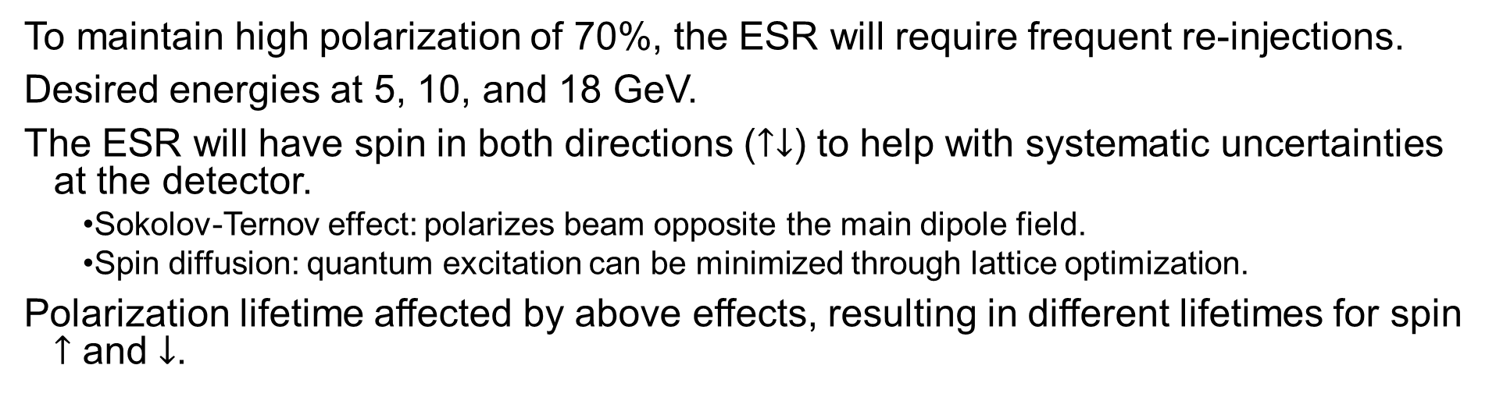
ESR Polarization
To maintain high polarization of 70%, the ESR will require frequent re-injections.
Desired energies at 5, 10, and 18 GeV.
The ESR will have spin in both directions ($↑↓$) to help with systematic uncertainties at the detector.
  Sokolov-Ternov effect: polarizes beam opposite the main dipole field.
  Spin diffusion: quantum excitation can be minimized through lattice optimization.
Polarization lifetime affected by above effects, resulting in different lifetimes for spin $↑$ and $↓$.
18 GeV

Slide 11
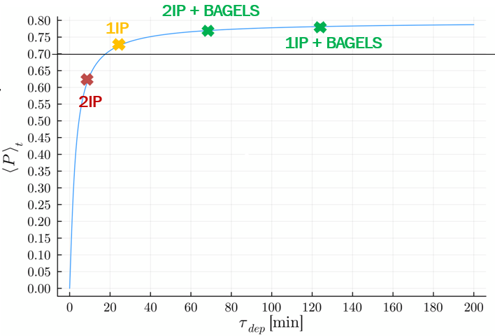
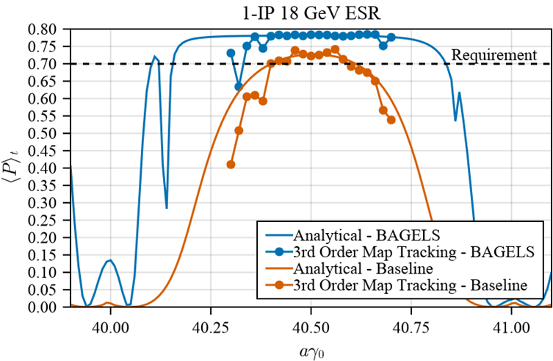
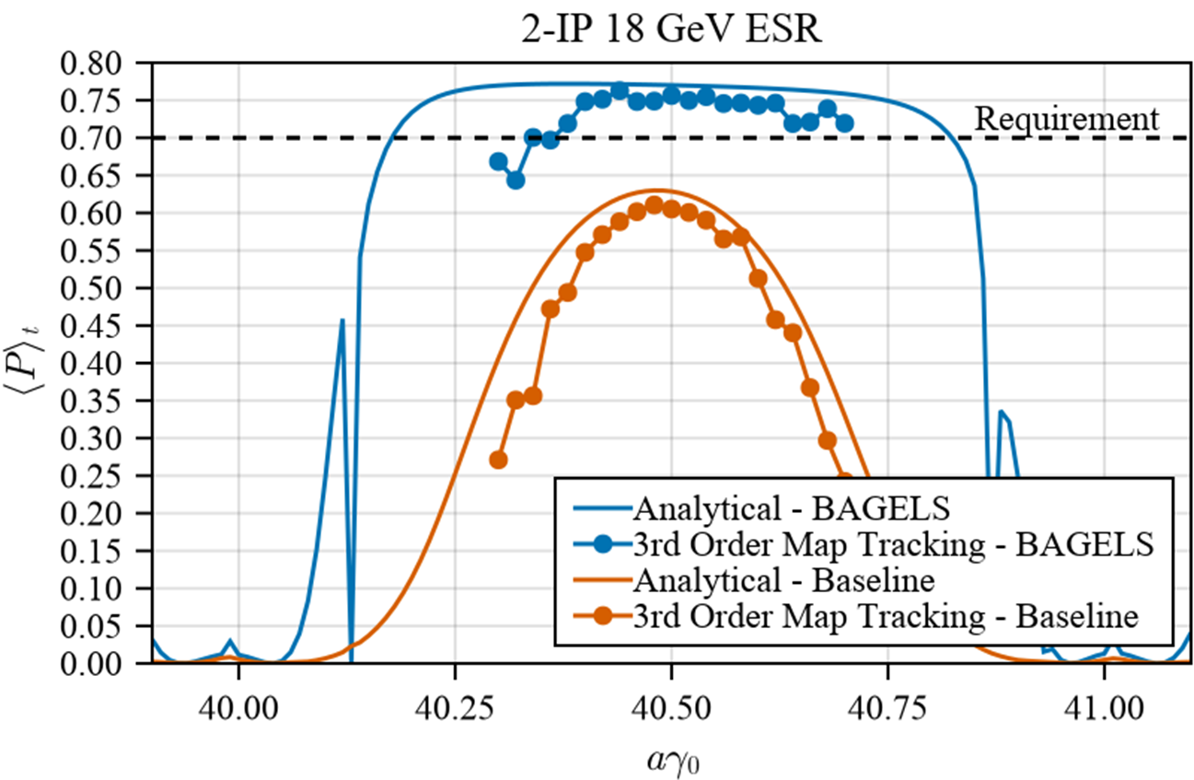

ESR Polarization
M. Signorelli
Choice of unit bump: “Opposing $2πn$-bumps” for no delocalized coupling & no delocalized vertical dispersion
Best Adjustment Groups for ELectron Spin (BAGELS) algorithm developed to minimize $∂\hat{n}/∂δ$ around the ring.
Turning only 4 knobs until polarization is maximal:
Max orbit excursion < 1.4 mm
Polarization requirements now exceeded for both 1- and 2-IP 18 GeV lattices
See M. Signorelli and G. Hoffstaetter, “BAGELS for simultaneous polarization, orbit, and optics control in electron storage rings. PRAB, 2025

Slide 12
Hadron Polarization
Hadron polarization overview
AGS polarization
HSR polarization

Slide 13
Hadron polarization overview
Polarization preserving devices:
  Booster: harmonic correctors (imperfection resonance correction) and an AC dipole (intrinsic resonances)
  AGS: a superconducting and normal conducting helical dipole that rotate proton spin 10+6% of 180º
  HSR: will have six snakes (where RHIC has two in each ring).
Polarized protons:
  The polarized proton source provides polarization up to 7×10¹¹ at 80% polarization.
  In the Booster, the bunch is shaped through scraping to optimize polarization transmission.
  The AGS will need to provide 3×10¹¹ protons/bunch with 75-80% polarization, assuming zero loss in the HSR.
  Currently, the AGS can provide 3×10¹¹ protons/bunch with 65% polarization.
Polarized helions:
  Polarized helions are expected to be available in 2026
  The source is expected to provide up 2×10¹¹ ions/pulse with 80% polarization.
Both protons and helions need near 100% polarization transmission in the injectors and HSR to support EIC requirements.
2 Siberian Snakes/ring
Spin flipper
Absolute Polarimeter (H jet)
RHIC pC Polarimeters
PHENIX
STAR
Spin Rotators
(longitudinal polarization)
Spin Rotators
(longitudinal polarization)
LINAC
BOOSTER
Pol. H⁻ Source
Helical Partial
Siberian Snake
200 MeV Polarimeter
AGS
AGS Polarimeter
Strong AGS Snake

Slide 14
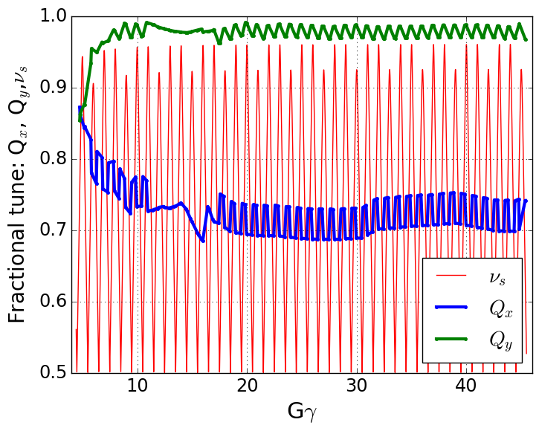
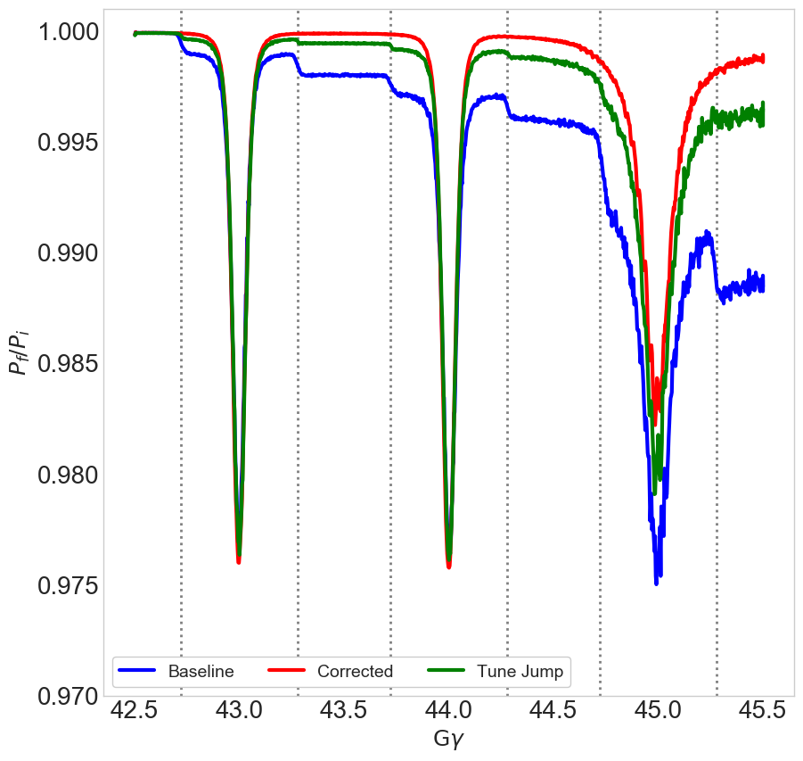

AGS Polarization, protons
V. Schoefer
With the two partial snakes, protons have a small spin-tune gap for the vertical betatron tune to be placed in, avoiding vertical depolarizing resonances.
  A total of 82 weak horizontal resonances are crossed.
  A fast tune jump to cross these resonances faster, minimize the polarization loss, an 8-10% gain over baseline polarization.
For direct correction of the snake resonance driving term, 15 skew quadrupoles have been installed.
  A total of 82 weak horizontal resonances are crossed.
  Up to 15% gain over baseline polarization.
  Used operationally for RHIC Run24.
Tune jump
0 dp/p
tune jump
+dp/p spread
$$\left\langle P_{n}\right\rangle$$
No
mitigation
Plot by Y. Dutheil
ε_{x}= ε_{y} =2 μm (rms norm)
ε_{long} = 0.8 eV-s
See V. Schoefer, “Using betatron coupling to suppress horizontal intrinsic spin resonances driven by partial snakes” PRAB, 2021

Slide 15
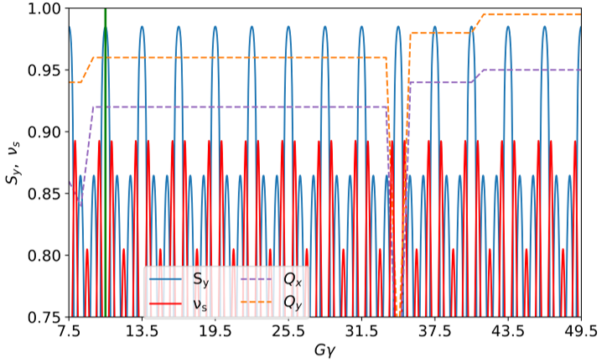
AGS Polarization, helions
Due to the higher G of helions, the rotation from each snake is more, allowing both tunes to be placed inside the spin-tune gap
To maximize the polarization and intensity transmission early in the AGS cycle, beam will be extracted from Booster at |Gγ|=10.5.
This is due to greatly reduced optical defects from
the snakes, which decay exponentially with
energy.
|Gγ|=10.5
  Polarization transmission is expected to be near 100% with both betatron tunes inside the spin-tune-gap.
    This is only supported above |Gγ|=10.5.
  Studies following the source completion can give insight on additional upgrade for protons.

Slide 16
HSR Snakes
Protons
To preserve polarization of protons and light ions up to their maximum energy, there will be 6 full snakes
  Each snake consists of four dipoles, with the outer and inner coils powered independently, I_{out} and I_{in}.
  To minimize the orbit matching requirements, I_{out}<I_{in}.
  Protons can satisfy a precession axis from 0 to 45 degrees.
  Helions can satisfy all possible angles, due to its higher G.
Helions

Slide 17
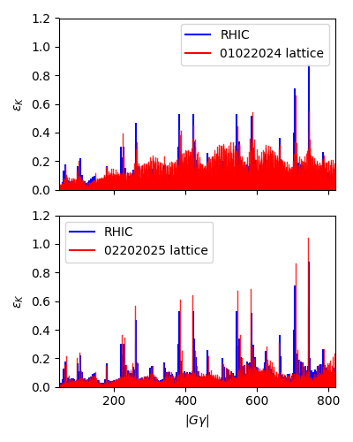
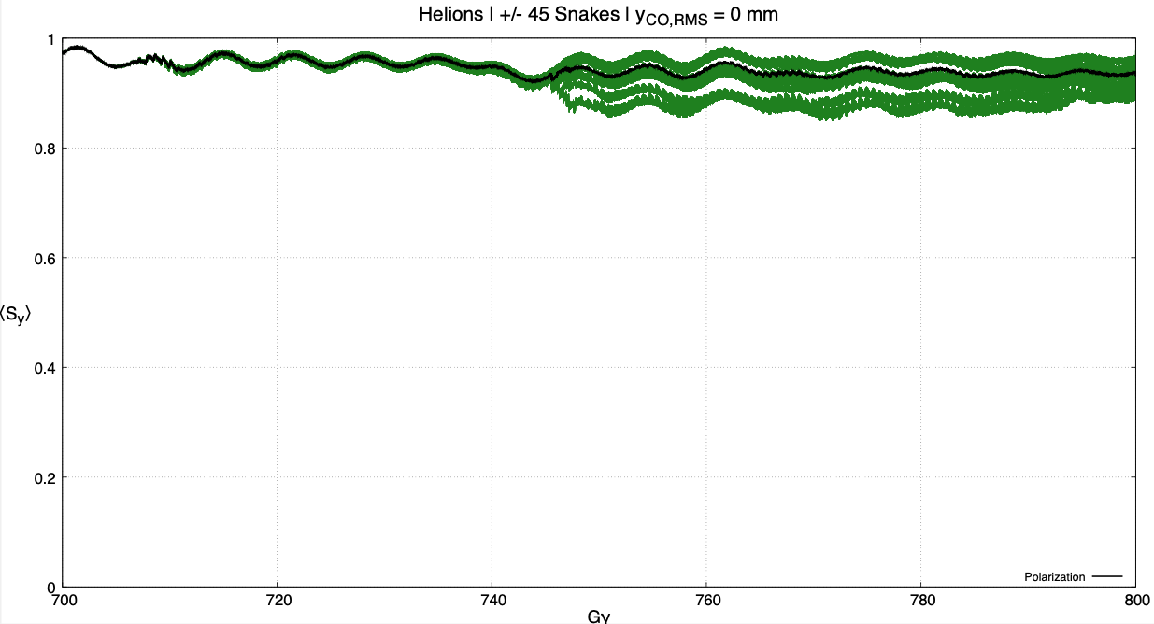
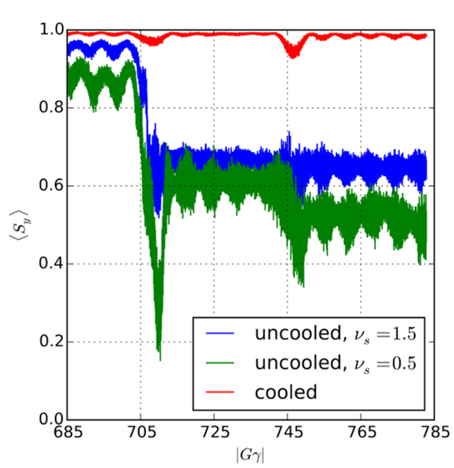



HSR polarization transmission
Polarized protons at E=275 GeV→Gγ=525
  Good polarization transmission from 23.8 to 275 GeV.
Polarized helions at the equivalent E=183 GeV/u →|Gγ|=820
  Simulations with the 01022024 lattice showed pre-cooling necessary for good polarization transmission up to top energy.
    Uncooled polarization transport showed a strong dependence on the chosen snake precession axis.
    Phase trombone to improve spin match with IP improved performance with uncooled emittances.
  New lattice shows reduced resonance strengths for non-systematic resonances.
  Preliminary simulations for the 02202025 lattice show good transmission up with uncooled emittances up to top energy.
Simulations with 1,000 particles from 01022024 lattice
Preliminary simulations from E. Hamwi and J. Devlin, 02202025 lattice,
$$ε_{x},ε_{y}=2.5, 2.5 μm$$
$$ε_{x},ε_{y}=2.5 μm$$
$$ε_{x},ε_{y}=2.5 μm$$
$$ε_{x},ε_{y}=2.0, 0.5 μm$$

Slide 18
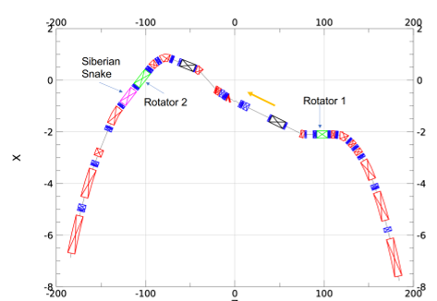
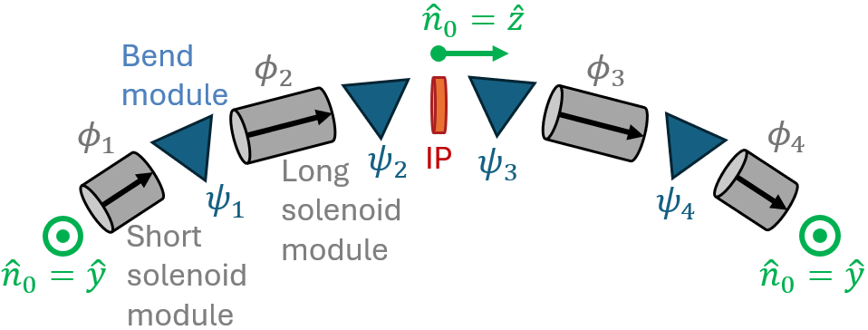
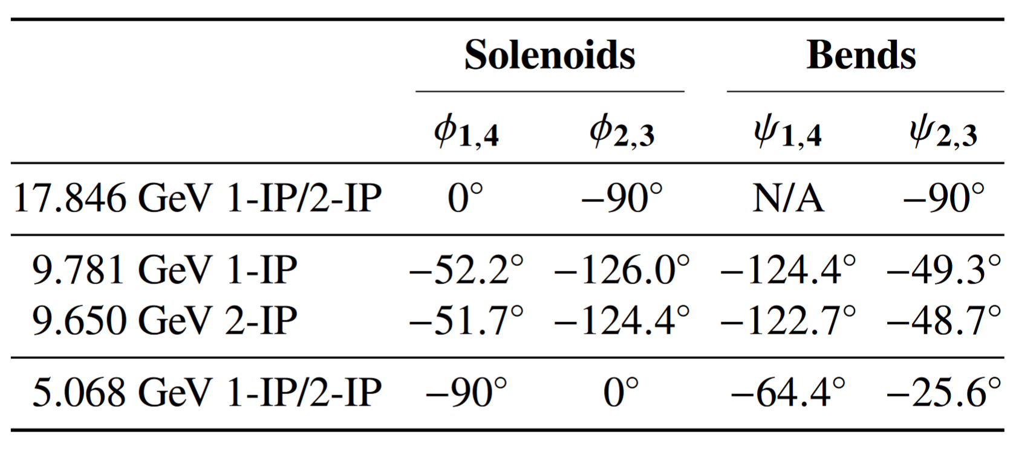
IR Design and Rotators
In the HSR:
  To minimize synchrotron radiation in the IR, the ESR lacks bends near the IP.
  To accommodate the straight electron trajectory, the HSR has several strong bends near the IP.
  As a result, the rotator magnets are placed 17 mrad and 61.35 mrad from the IP (compared to RHIC at 3.675).
  The RHIC rotator magnets can satisfy longitudinal polarization for protons at 41, 100, and 275 GeV.
In the ESR:
  Longitudinal polarization at the IP is satisfied at 5 and 10 GeV.
  The BAGELS algorithm satisfies the longitudinal spin-match at 18 GeV.
HSR IR with rotators
ESR Rotators
See V. Ptitsyn and J. Berg, “EIC Hadron Spin Rotators”, IPAC2022, 2022

Slide 19
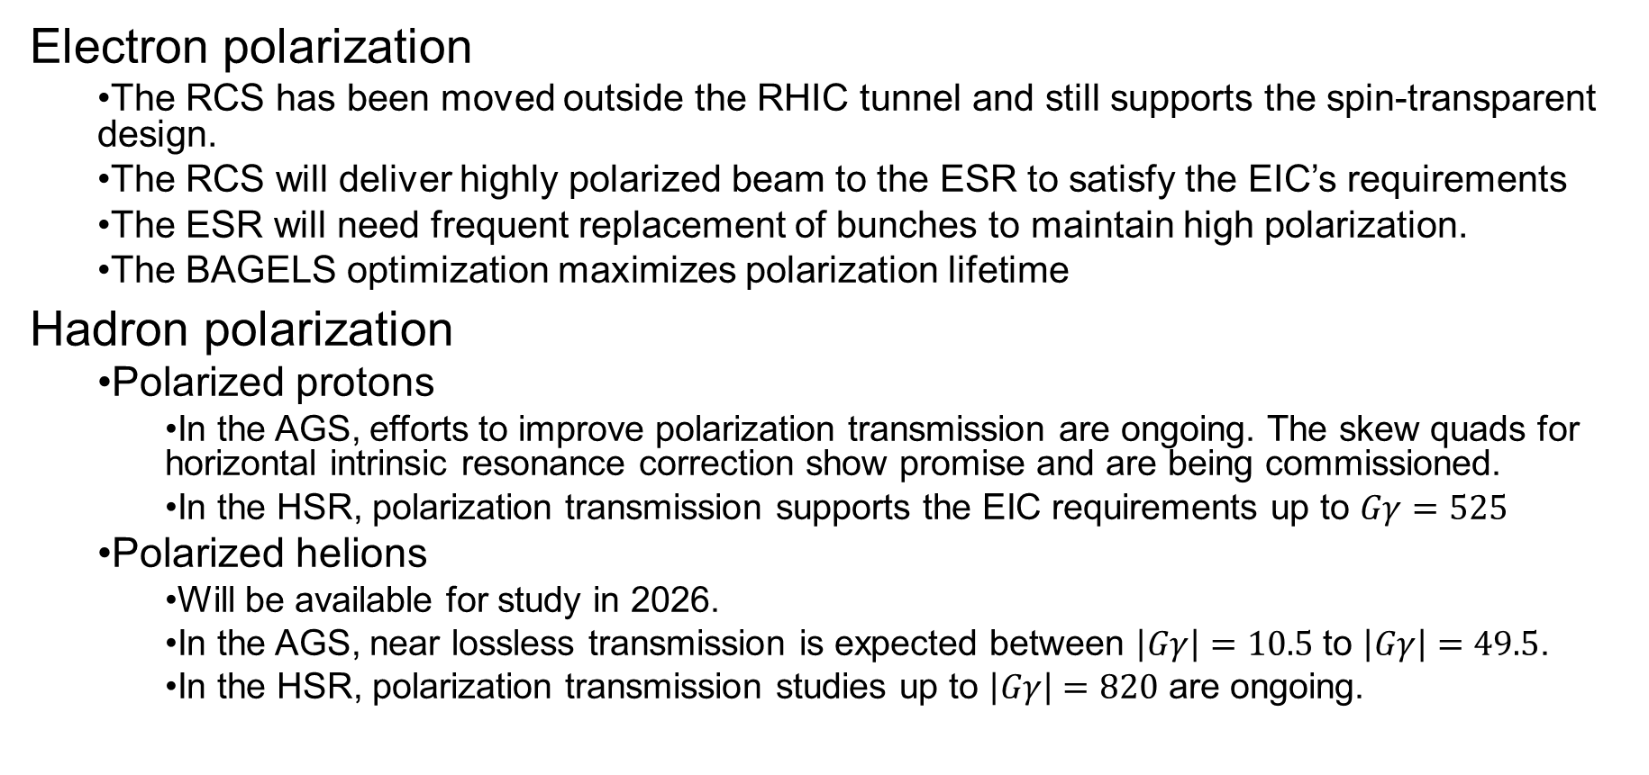
Summary
Electron polarization
  The RCS has been moved outside the RHIC tunnel and still supports the spin-transparent design.
  The RCS will deliver highly polarized beam to the ESR to satisfy the EIC’s requirements
  The ESR will need frequent replacement of bunches to maintain high polarization.
  The BAGELS optimization maximizes polarization lifetime
Hadron polarization
  Polarized protons
    In the AGS, efforts to improve polarization transmission are ongoing. The skew quads for horizontal intrinsic resonance correction show promise and are being commissioned.
    In the HSR, polarization transmission supports the EIC requirements up to $Gγ=525$
  Polarized helions
    Will be available for study in 2026.
    In the AGS, near lossless transmission is expected between $\left|Gγ\right|=10.5$ to $\left|Gγ\right|=49.5$.
    In the HSR, polarization transmission studies up to $\left|Gγ\right|=820$ are ongoing.

Slide 20
Thank you
Questions?

