Slide 1
Compton polarimeters and fit procedures
TAMAZIRT juba (IJCLab Orsay)

Slide 2
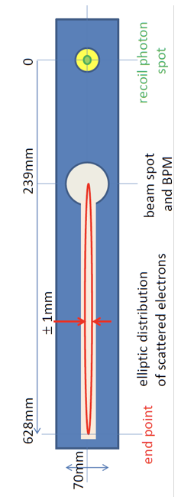
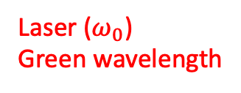


Compton polarimeter layout
Updated
x
Updated interaction region in EPOL support document for the Feasibility study: large laser-electron crossing angle
X₀
Scattered photons
$$∝\frac{B}{E_{0}}$$
Laser ($ω_{0}$)
Green wavelength
X₁
Electron beam
Blondel et al., arXiv:1909.12245; Muchnoi, INST 17 P10014 (2022)
Dipole (field B)
$$∝Bω_{0}$$
Lowest energy scattered electrons
Interaction region
X₂
about 100m
New concept (N. Yu Muchnoi) to measure all polarization parameters → 3D polarimeter

Slide 3
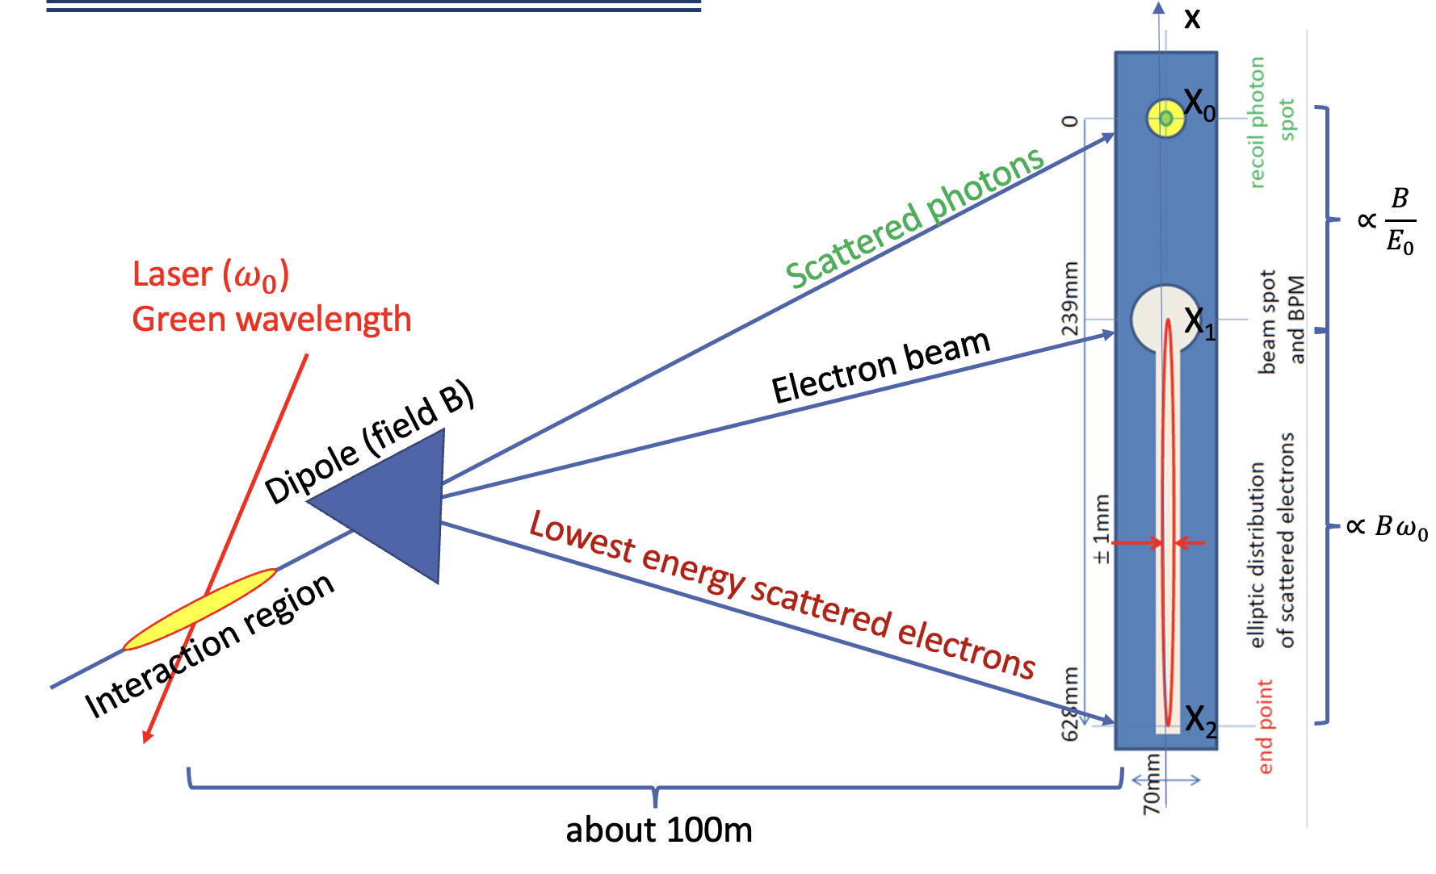
Reminder of key goals
Direct measurement of beam energy from geometry of scattered particles in observation plane
Center of mass energy calibration using resonant depolarization on pilot bunches
Relative and relatively fast monitoring of beam energy from geometry in the measurement plane → useful when pilots cannot be polarized ?
Control systematic uncertainty (<10⁻⁴) on colliding bunch polarization at detector’s IPs by providing upper limit on e- beam polarization paramters at Compton IP

Slide 4
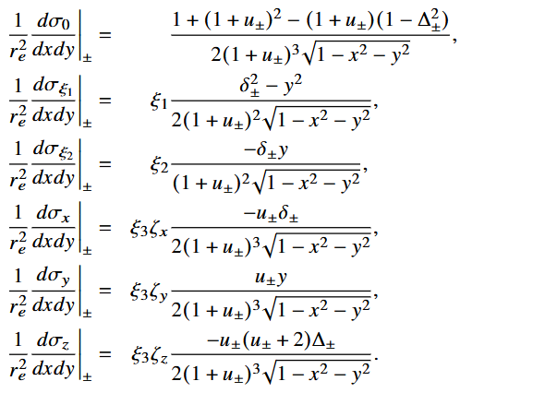
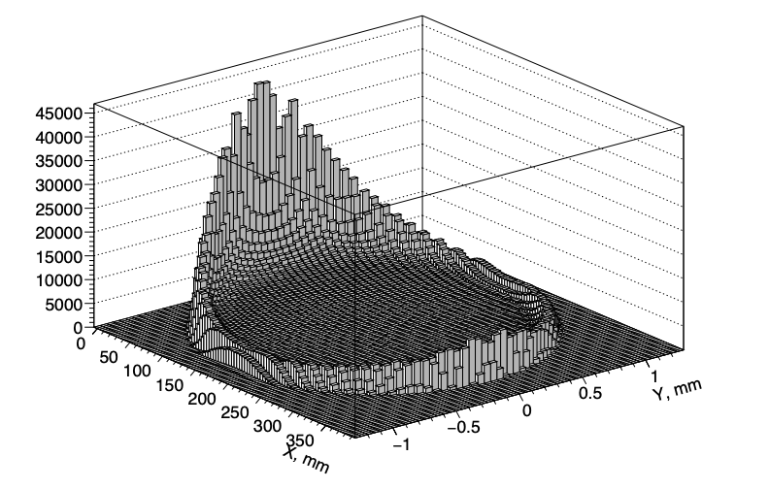

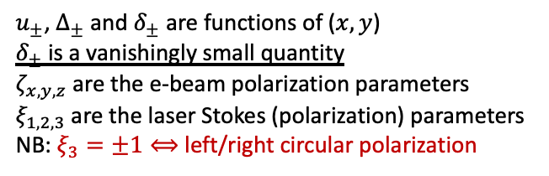
Differential cross-section
Besides realistic detector and system design and validation, accurate parameter extraction is needed
Electrons are located on an ellipsoidal surface which parameterization can be transformed into a unit disk over which the expression of the differential cross section is more convenient
Example electron distribution
Muchnoi, INST 17 P10014 (2022)
$u_{±}$, $Δ_{±}$ and $δ_{±}$ are functions of ($x,y$)
$δ_{±}$ is a vanishingly small quantity
$ζ_{x,y,z}$ are the e-beam polarization parameters
$ξ_{1,2,3}$ are the laser Stokes (polarization) parameters
NB: $ξ_{3}=±1⟺$ left/right circular polarization
NB: $1/\sqrt{1−x^{2}−y^{2}}$ gets very large on circle limits

Slide 5
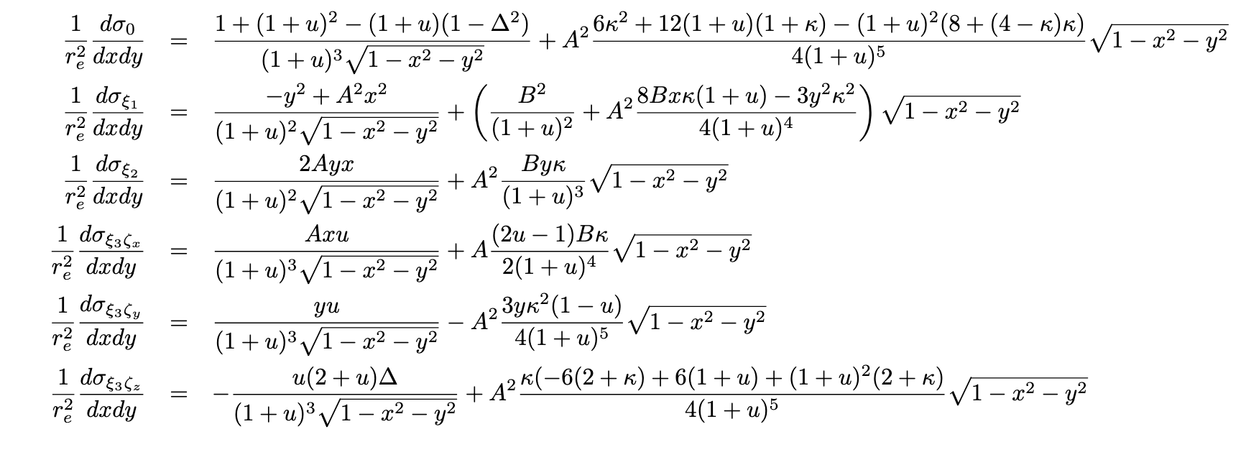

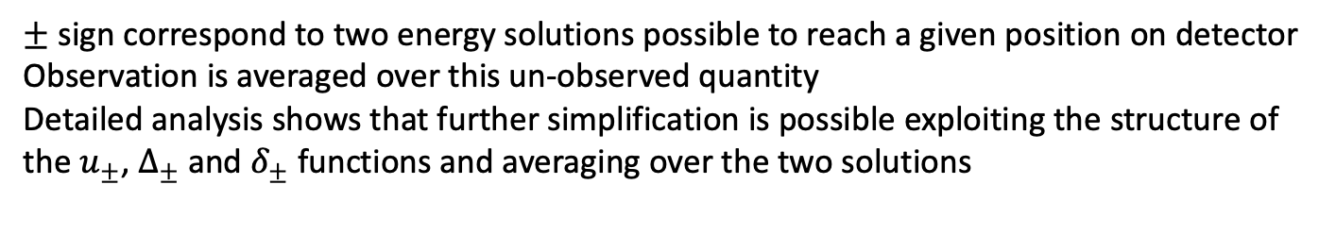
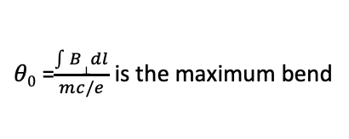

Further simplification
Improved
$±$ sign correspond to two energy solutions possible to reach a given position on detector
Observation is averaged over this un-observed quantity
Detailed analysis shows that further simplification is possible exploiting the structure of the $u_{±}$, $Δ_{±}$ and $δ_{±}$ functions and averaging over the two solutions
With
The terms in green are neglected in the simmulation !!
A=$\frac{1}{\sqrt{1+γ^{2}θ20}}$
B=$\frac{γθ0}{\sqrt{1+γ^{2}θ20}}$
Small terms but kept in the simulation
$θ0$ =$\frac{\int{B⊥dl}}{mc/e}$ is the maximum bend

Slide 6
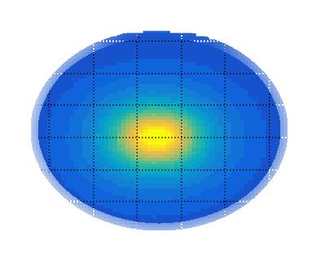
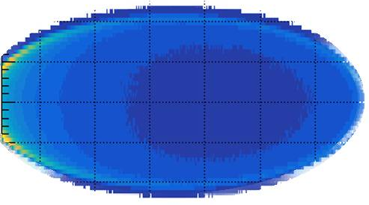
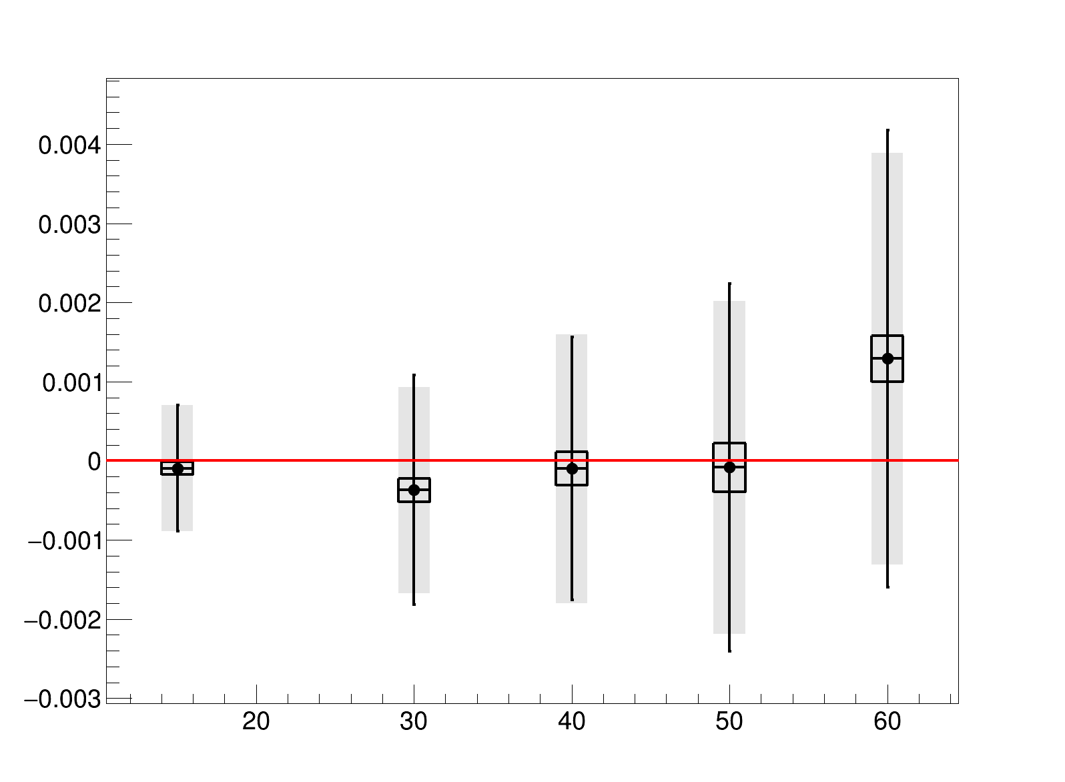
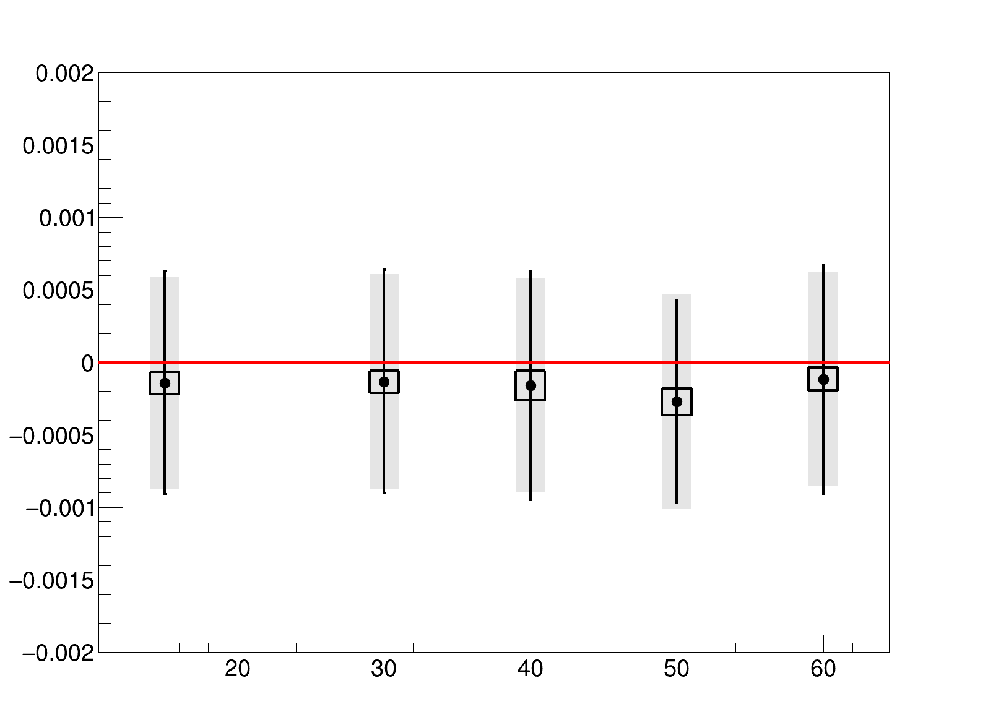





Detector integration
Updated
Study at Z⁰ pole
Toy: 100 experiments of 1min data taking
High-energy end of the scattered electron cannot be measured (spatially superimposes on main beam…)
finite cut-off for detector integration
Study impact on parameter extraction
Y
X0
average and standard deviation of fit central values
Statistical uncertainty of average of fit central values
average of single fit uncertainties
x
beam pipe
x2
See Poster at FCC Physics Week, Jan. 2025
40mm
15mm
60mm
30mm
50mm
$$X_{beam}$$
Polarization parameters not affected
$E_{fit}−$ $E_{gen}$ [GeV]
$${(ξ_{3}ζ_{y})}_{fit}−{(ξ_{3}ζ_{y})}_{gen}$$
Expected growth of uncertainty on direct energy extraction (x2.5 from 15 to 60mm)
$X_{beam}$ [mm]
$X_{beam}$ [mm]
Choose 40mm as baseline

Slide 7
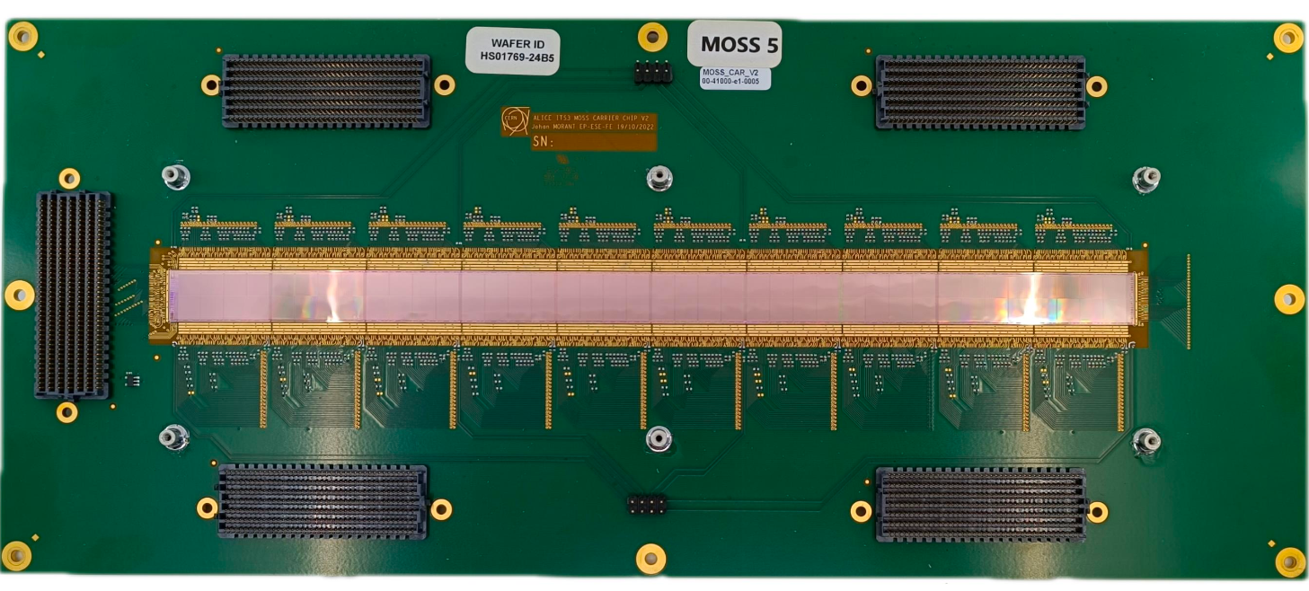
Simulations with a realistic geometry
New baseline scenario
Already available design that may fulfill the needs → ALICE MOSS prototype sensor
NB: just one of the possibilities, for illustration purposes
pixellisation:
nX=21020 horizontal pixels
nY=320 vertical pixels
arXiv:2502.13591
pixel
18µm
18µm
Dead zones
Simulation updated to account for dead columns, and possible rebinning in X and Y directions
Effective beam size on detector of 500µm in horizontal direction
Merge pixels in horizontal size to spare computation time w/o significant loss of precision

Slide 8
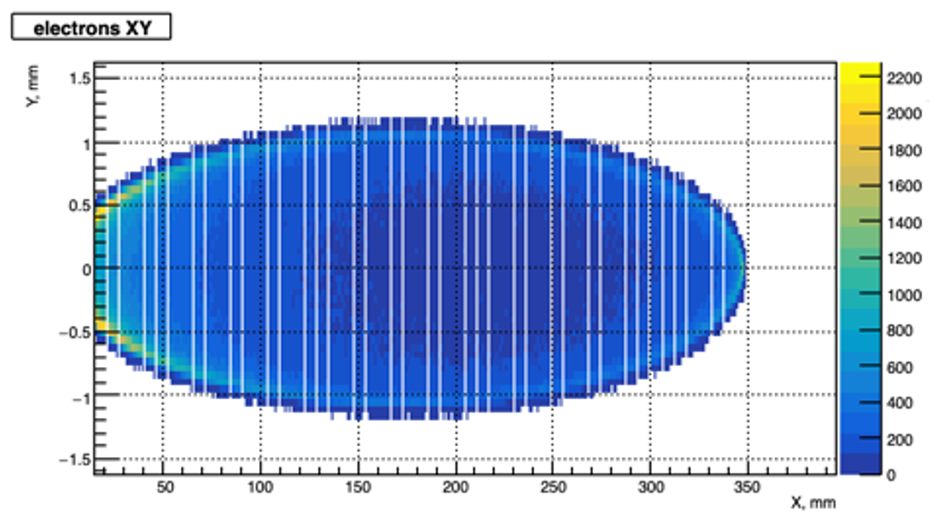
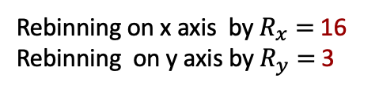
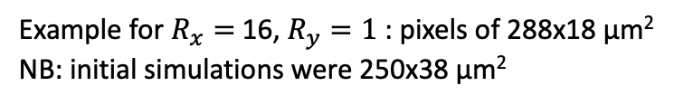
Simulation implementation
New baseline scenario
Rebinning applied at fit level to save simulation time
Rebinning on x axis by $R_{x}=$16
Rebinning on y axis by $R_{y}=$ 3
Configurable as option before fit
320 pixels (16)
320 pixels (16)
Typical simulation output
80 nYpix (3)
dead zone 34 pixels (2)
dead zone 34 pixels (2)
warning! 5 rows of dead pixels instead of 2 for better visualisation
1320 nXpix with
60 dead zones
Example for $R_{x}=$16, $R_{y}=1$ : pixels of 288x18 µm²
NB: initial simulations were 250x38 µm²

Slide 9
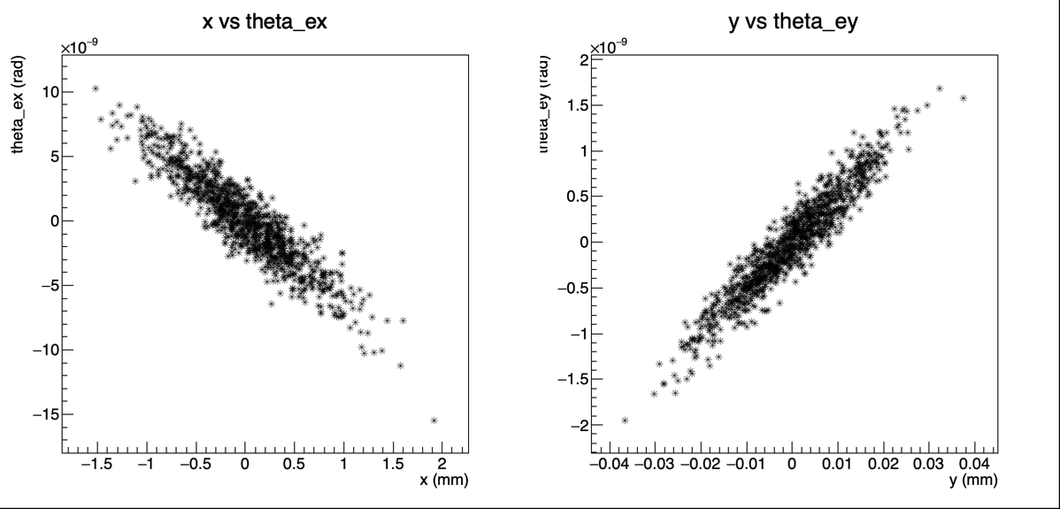
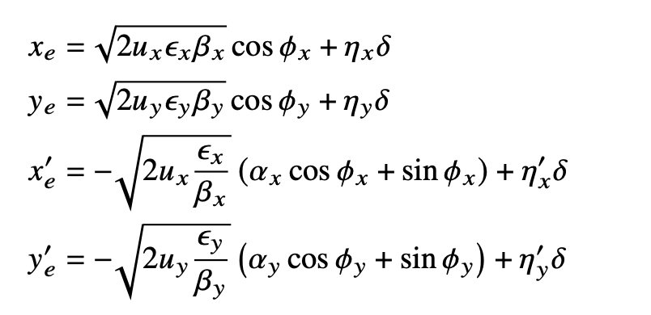
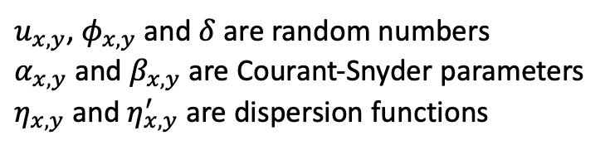
Phase space correlations
Improved
Beam phase space correlation not implemented initially in Nickolai’s software
Electron sampling according to the electron beam size
See Charlet et al. JINST 18 (2023) P10014 for instance
Example result
$u_{x,y}$, $φ_{x,y}$and $δ$are random numbers
$α_{x,y}$and $β_{x,y}$ are Courant-Snyder parameters
$η_{x,y}$and $η_{x,y}^{′}$ are dispersion functions

Slide 10
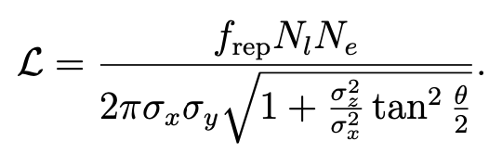

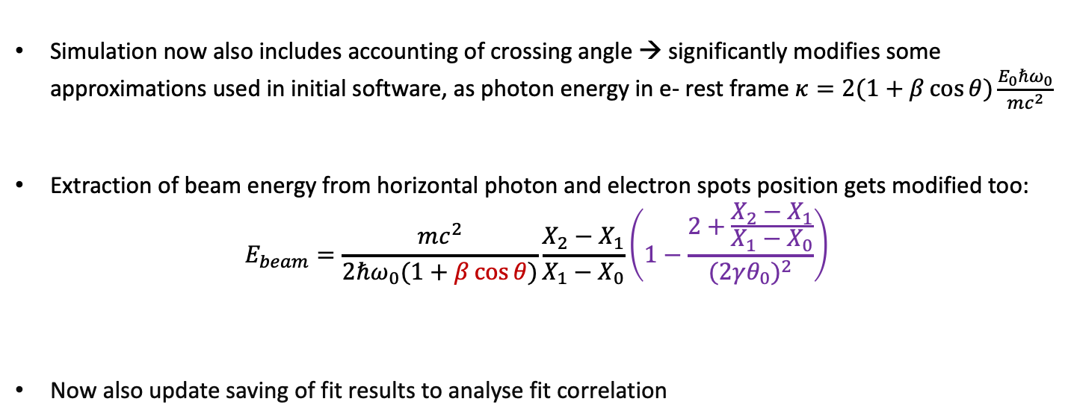
Luminosity and crossing-angle
Improved
Simulation was using a fixed number of events instead a computation of expected number of scatters from luminosity and total cross-section
$$σ_{x,y,z}=\sqrt{σ_{e,x,y,z}^{2}+σ_{l,x,y,z}^{2}}$$
Laser-electron beam crossing angle
Simulation now also includes accounting of crossing angle → significantly modifies some approximations used in initial software, as photon energy in e- rest frame $κ=2(1+β\cos{θ})\frac{E_{0}ℏω_{0}}{mc^{2}}$
Extraction of beam energy from horizontal photon and electron spots position gets modified too:
$$E_{beam}=\frac{mc^{2}}{2ℏω_{0}(1+β\cos{θ})}\frac{X_{2}−X_{1}}{X_{1}−X_{0}}\left(1−\frac{2+\frac{X_{2}−X_{1}}{X_{1}−X_{0}}}{{(2γθ_{0})}^{2}}\right)$$
Now also update saving of fit results to analyse fit correlation
$\text{E}\text{0}$ initial electron energy; $ℏω_{0}$intial photon energy; $β L$orentz factor
$θ_{0}$ bending angle
Correction to account for scattered electrons at high energy

Slide 11
Input parameter table
Input parameter | Value
Dx (horizontal dispersion) | 28.6572 mm
Dy (vertical dispersion) | 0.0000 mm
Dpx (horizontal angular dispersion) | -0.0021
Dpy (vertical angular dispersion) | 0.0000
εx (emmitance on x) | 0.0007 mm*rad
εy (emmitance on y) | 19*10⁻⁷ mm*rad
βx (beta function on x) | 392.6665 m
βy (beta function on y) | 62.06445 m
Αx (alpha function on x) | 2.3819
Αy (alpha function on y) | -3.1232
𝛥 ( Energy spread) | 10⁻ ³
θo (Bending angle) | 0.0021 rad

Slide 12
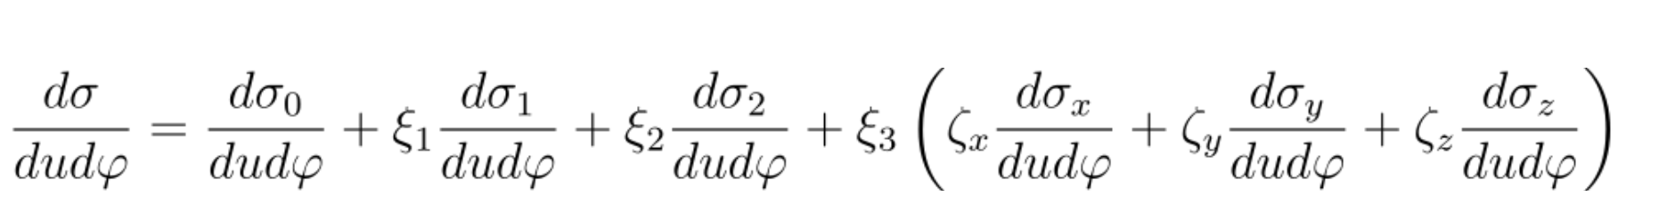
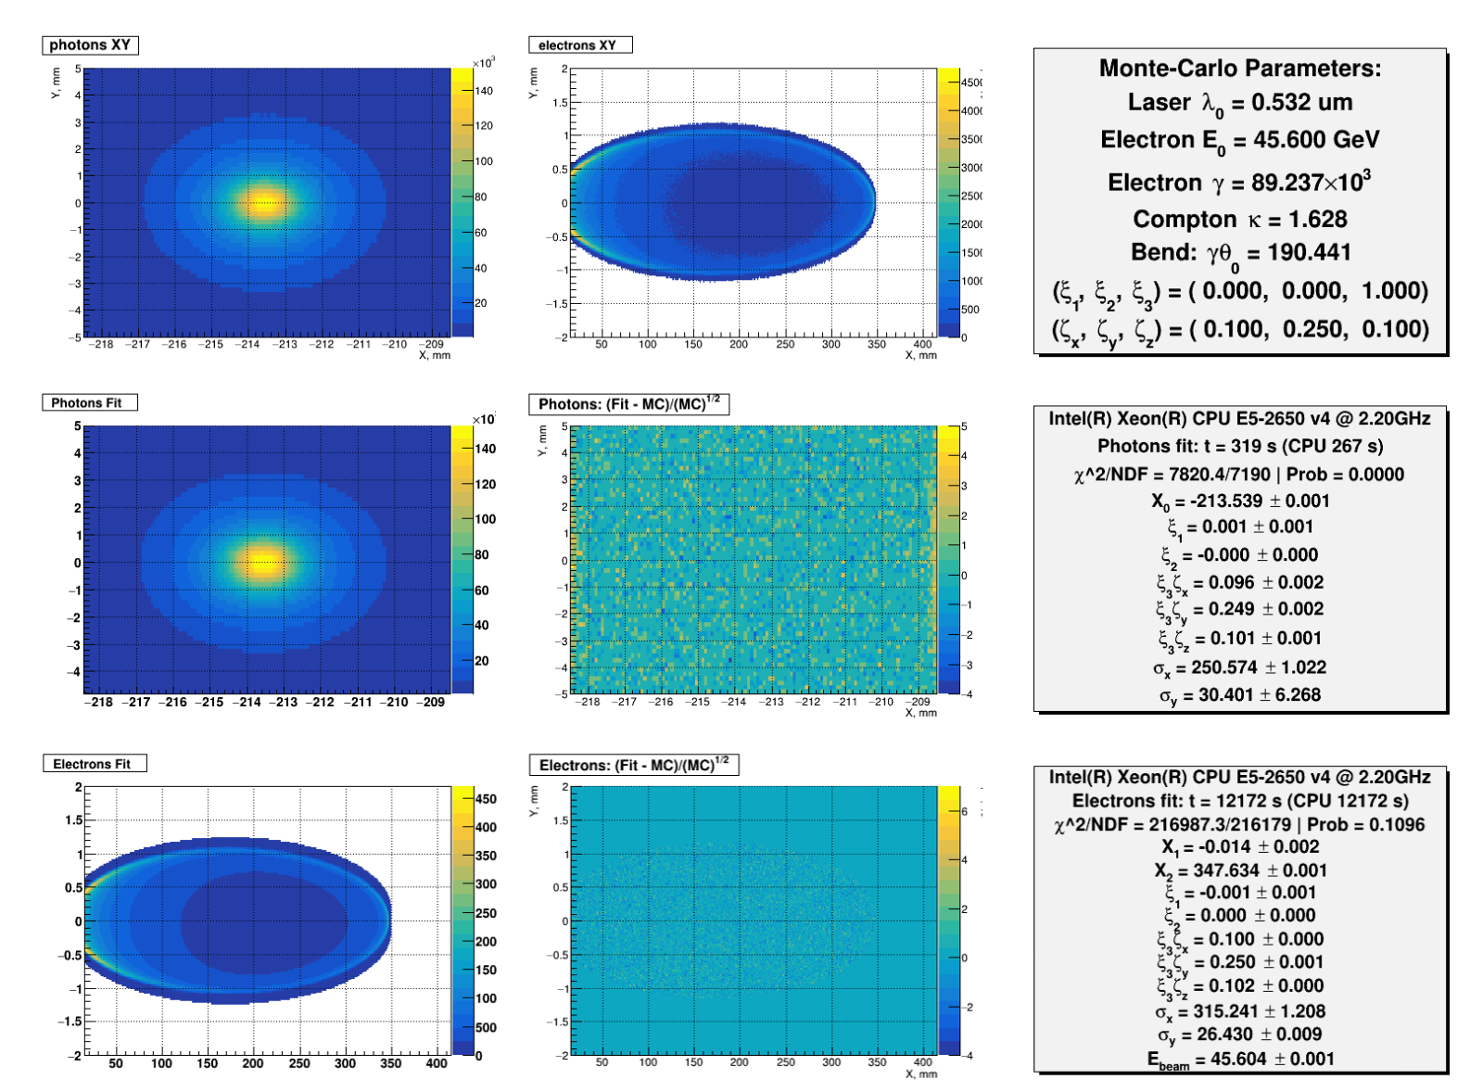
Typical result – fit of Distributions
Typically obtained in 30s for a single bunch
Based on measurement of scattered particles transverse distributions (pixelized detectors)
Blondel et al., arXiv:1909.12245; Muchnoi, INST 17 P10014 (2022)
All components extracted with ~0.001 precision in few seconds
Beam energy may be extracted too! → redundancy with RDP

Slide 13
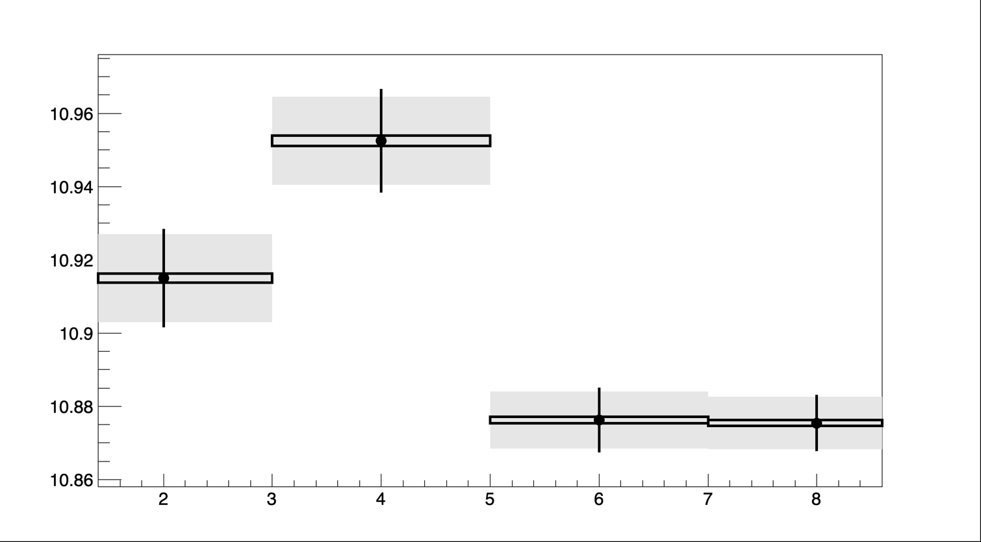
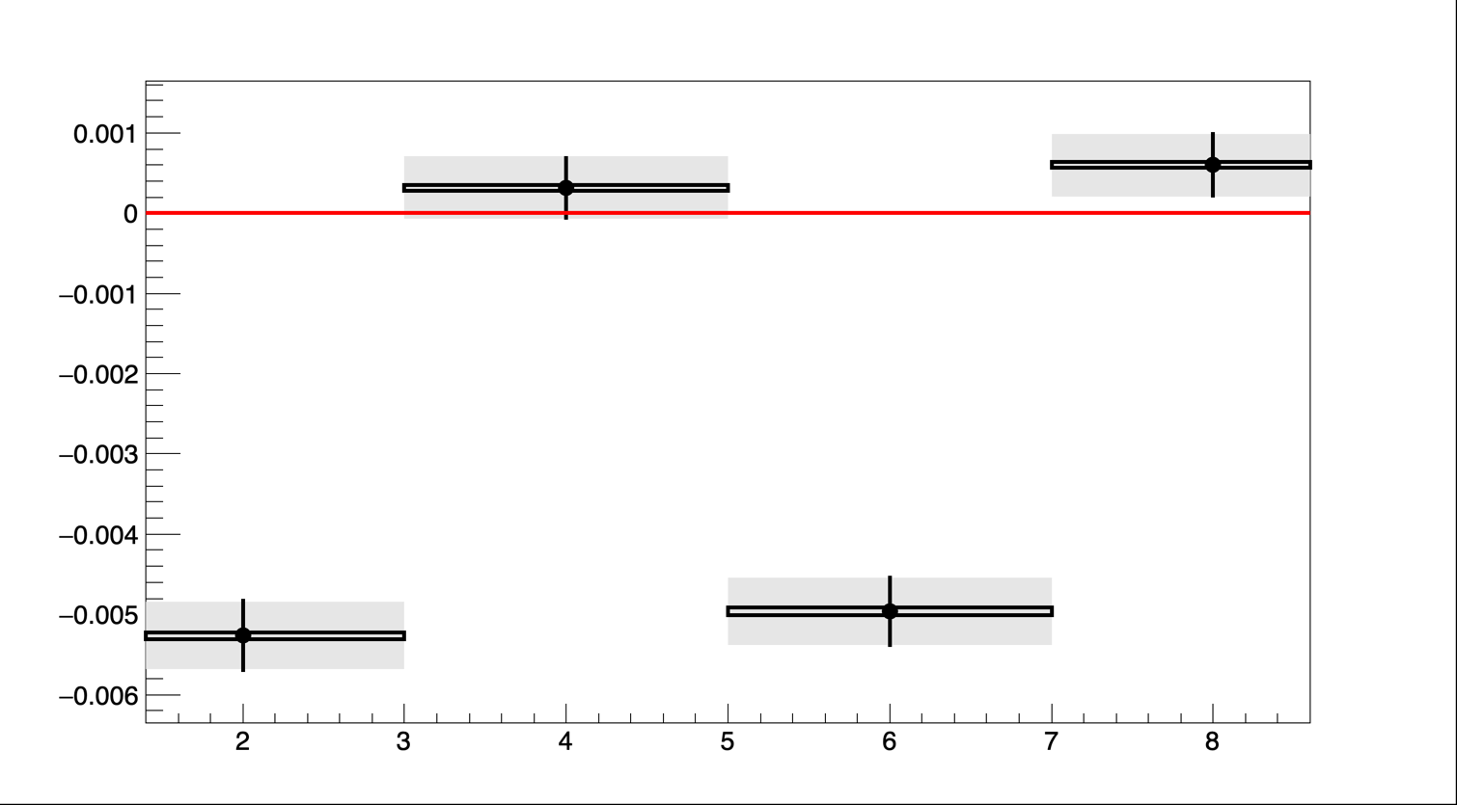
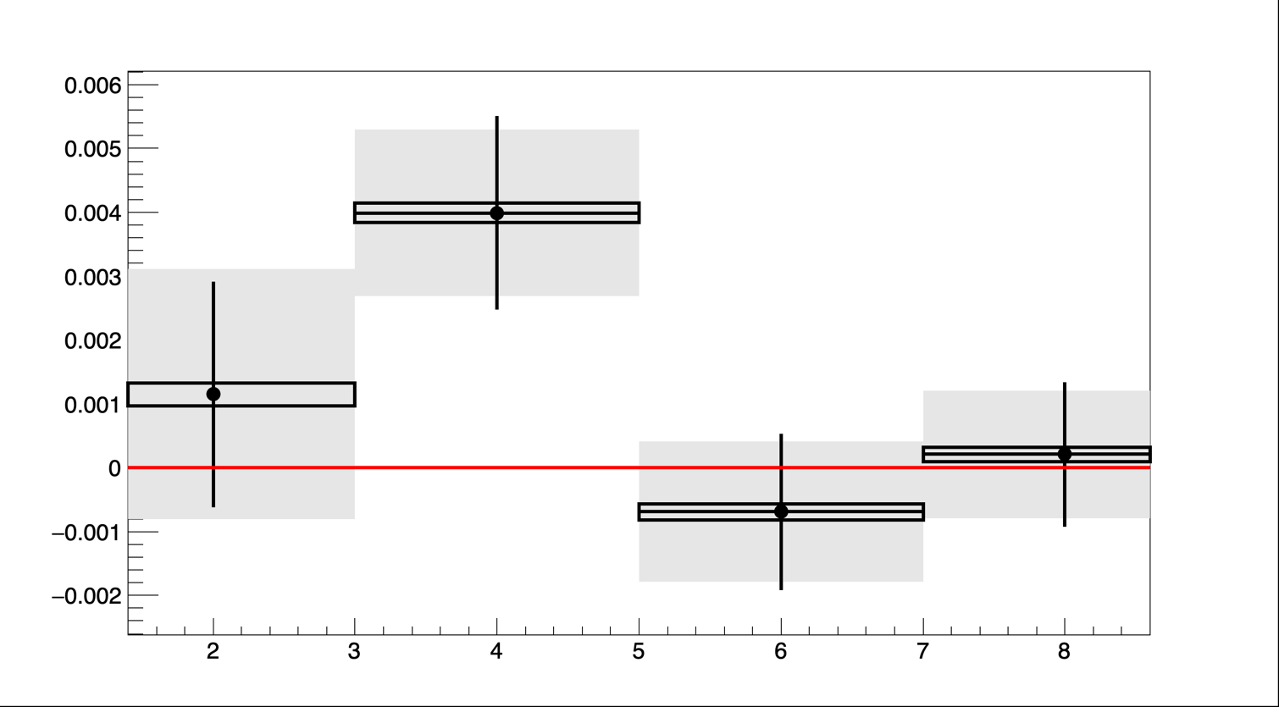



Some results
Unexpected behavior but $σ_{y}≪$pixel size
σyfit
$R_{y}=$3
$$R_{y}=1$$
Θ=0.13
Θ=0
Θ=0.13
Θ=0
PZ1fit-PZ1exp
Impact of crossing angle
not understood at this stage
Efit-Ebeam [Gev]
Much better behavior
Prefer 18um vertical pixel size (Ry=1) otherwise too large
wrt effective vertical beam size on detector.
Residual effect of crossing angle on ellipse position
and polarization still to understand

Slide 14
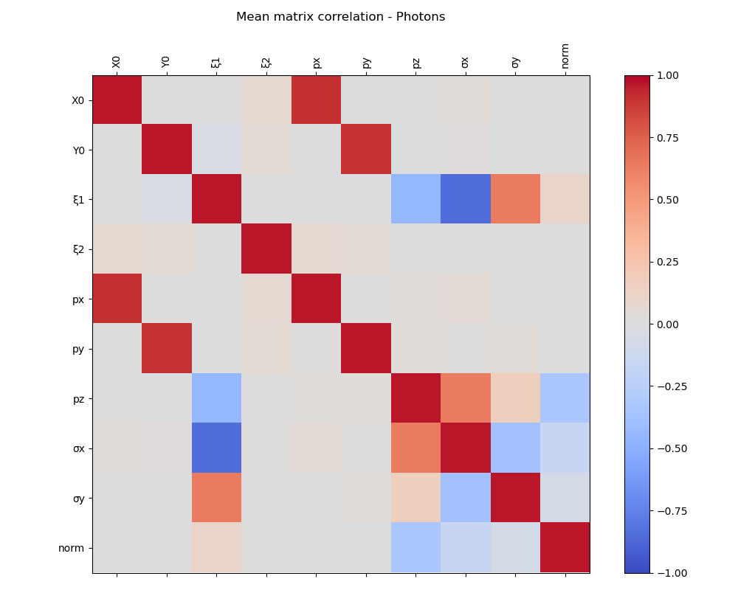
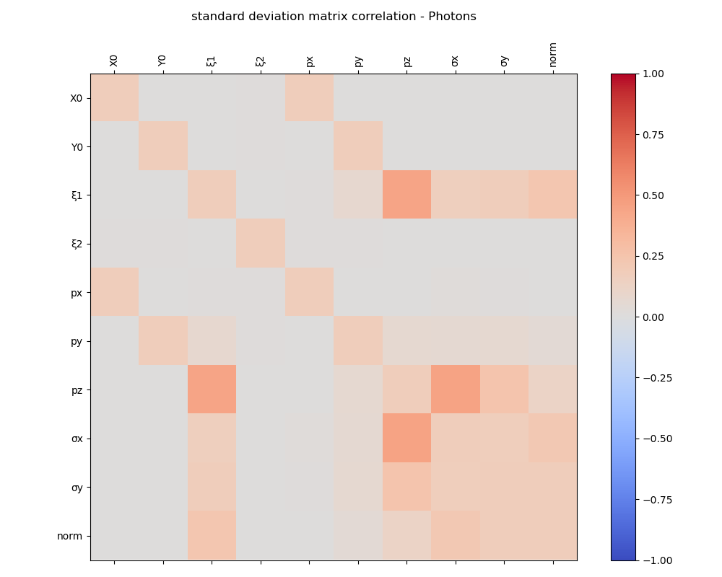
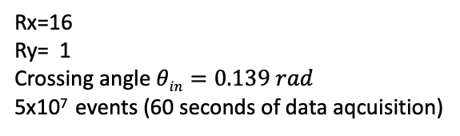
Fit correlation matrix (photons)
Average of correlation coefficients over 100 exps.
Rx=16
Ry= 1
Crossing angle $θin=0.139 rad$
5x10⁷ events (60 seconds of data aqcuisition)
??? Investigations
on going
Standard deviation
Correlations of ξ₁ and beam sizes σₓ_{,y} and longitudinal polarization as they all affect scattered photon spatial distribution
Longitudinal polarization affects total cross-section and thus normalization

Slide 15
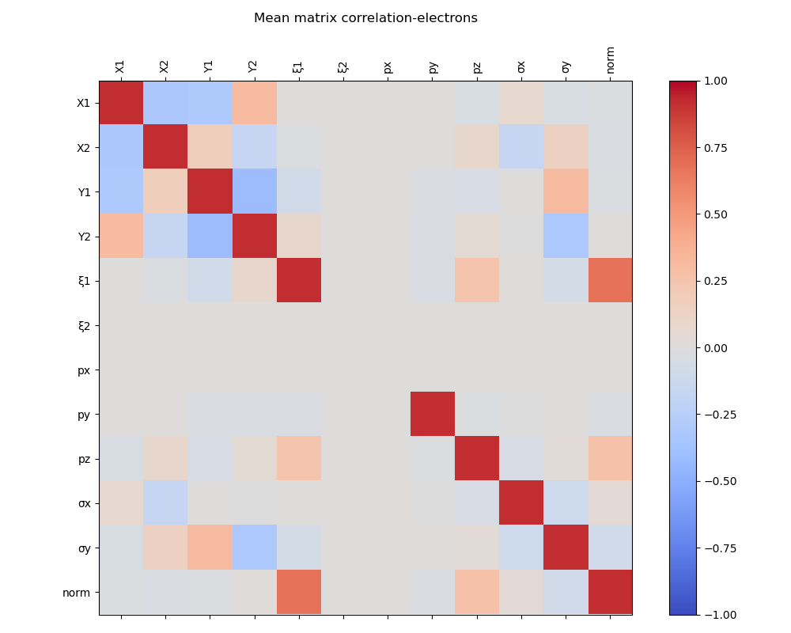
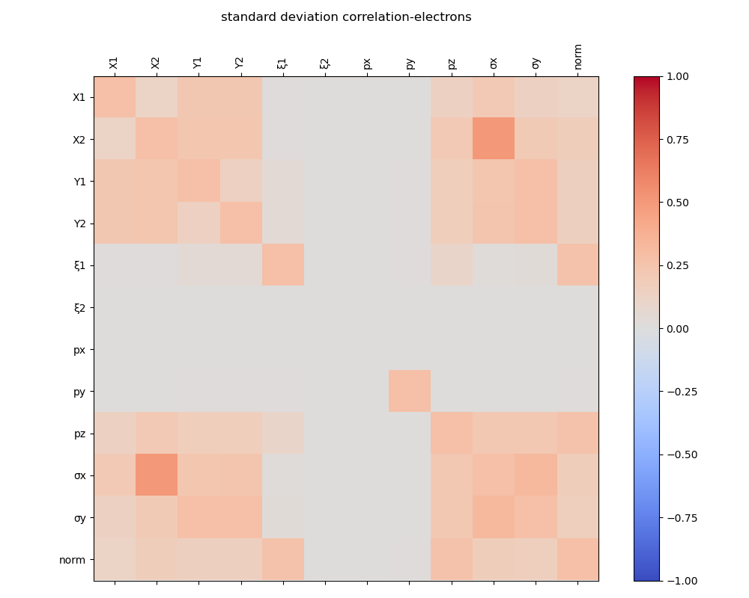
Fit correlation matrix (electrons)
Average of correlation coefficients over 100 exps.
Rx=16
Ry= 1
Crossing angle $θin=0.139 rad$
5x10⁷ events (60 seconds of data aqcuisition)
Standard deviation
Ellipse parameters correlated with beam sizes
Correlations of ξ₁ and longitudinal polarization
Longitudinal polarization affects total cross-section and thus normalization
Next step: simultaneous fit of electrons and photons

Slide 16
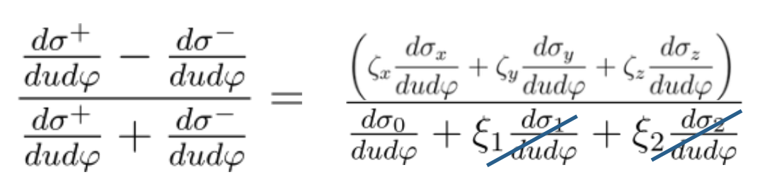
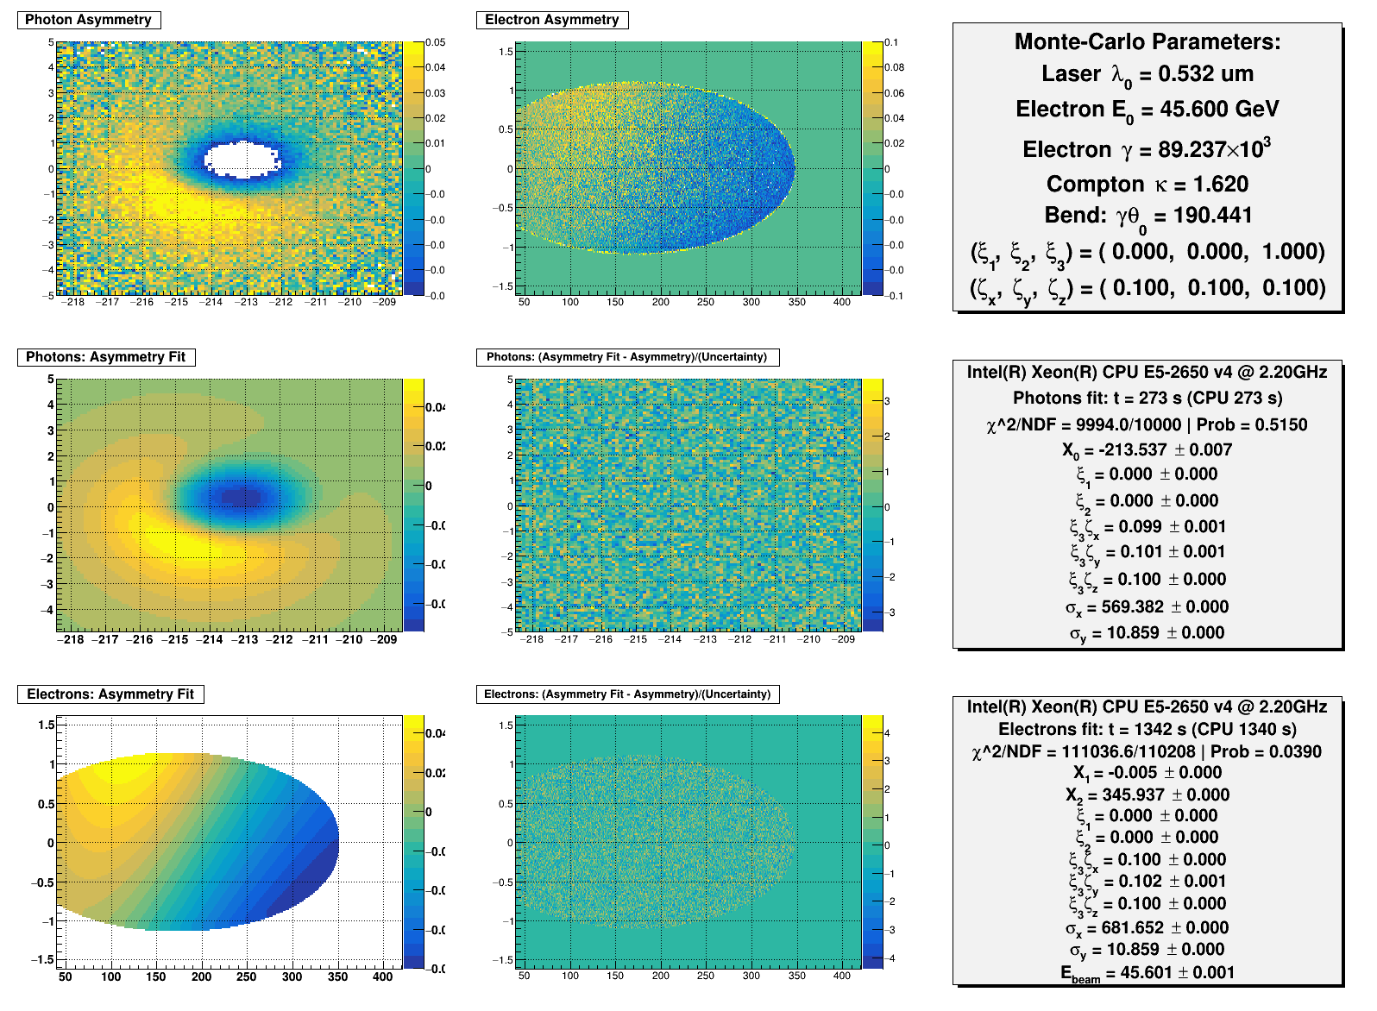

Asymmetry
for
Asymmetry induced by laser helicity flip improves robustness
against systematic uncertainties in transverse polarization extraction.
$$±ξ3$$
Reproductible and well known laser helicity flip is required

Slide 17
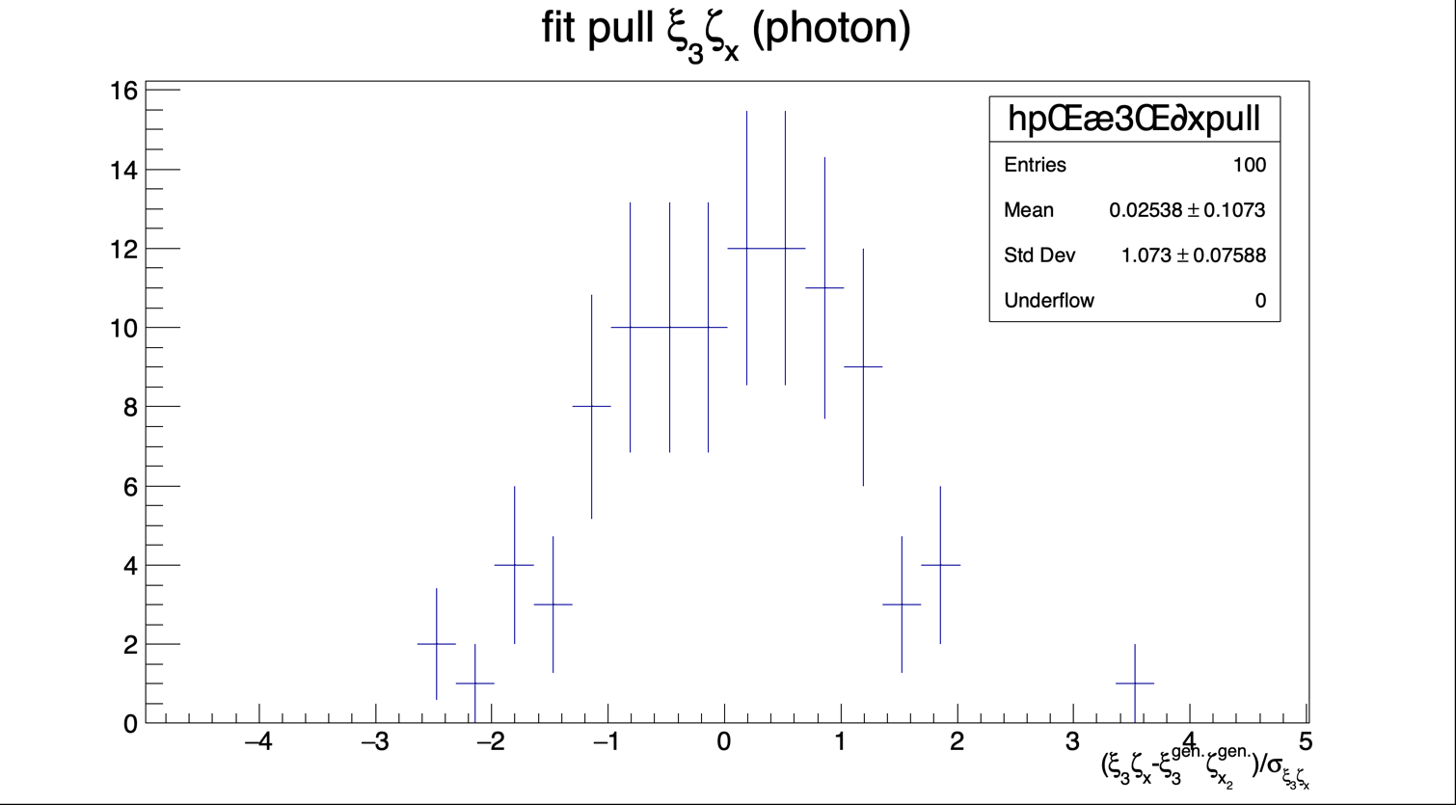
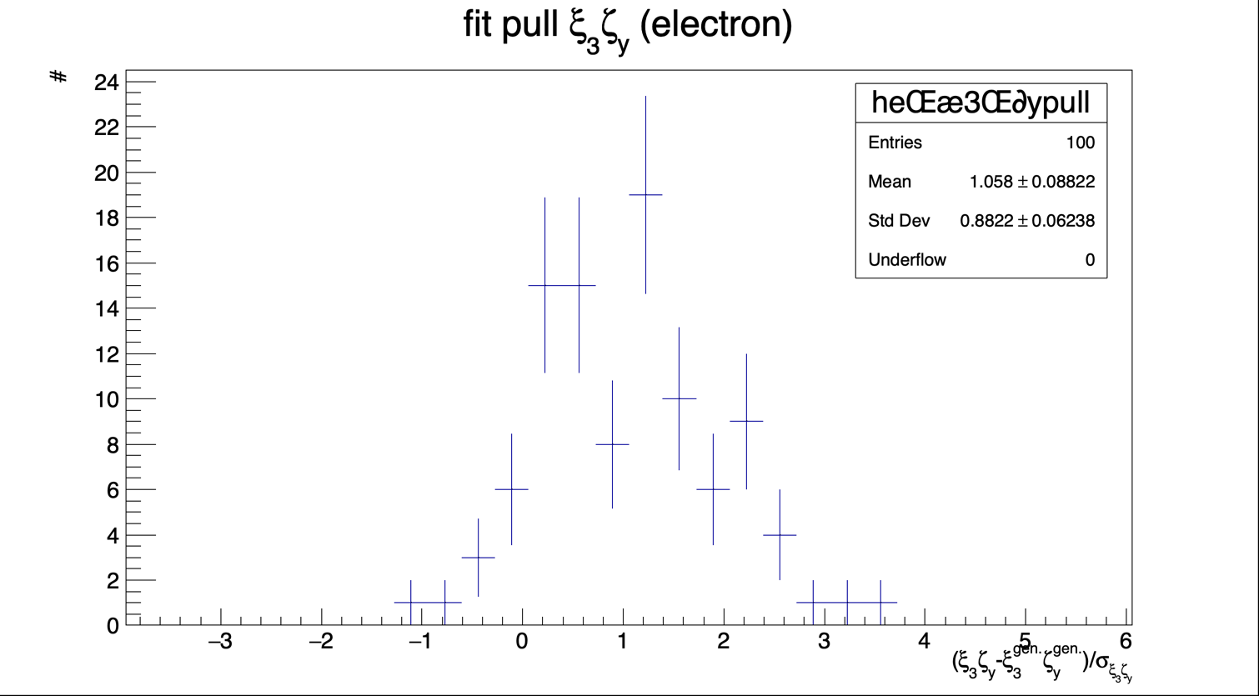
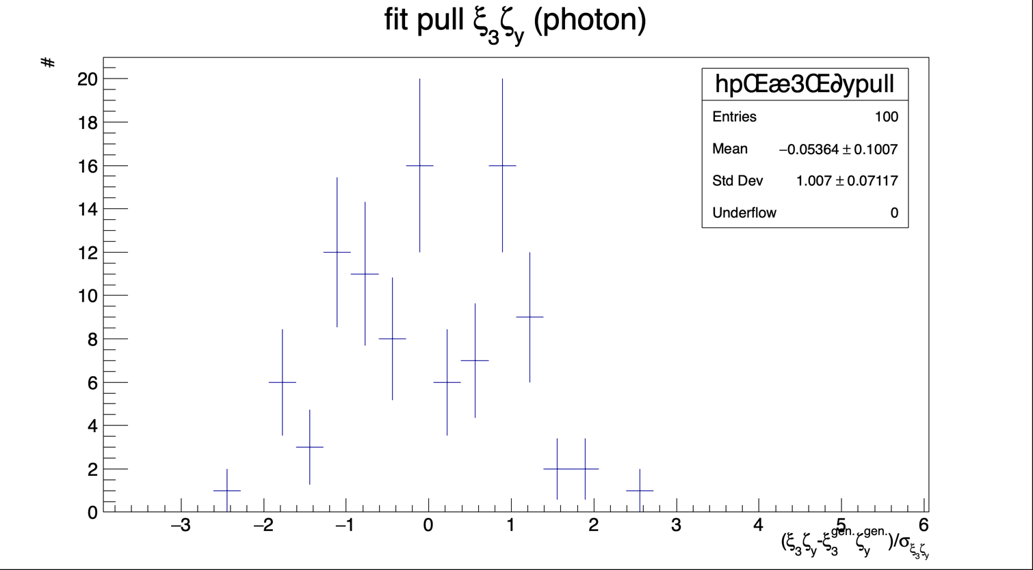
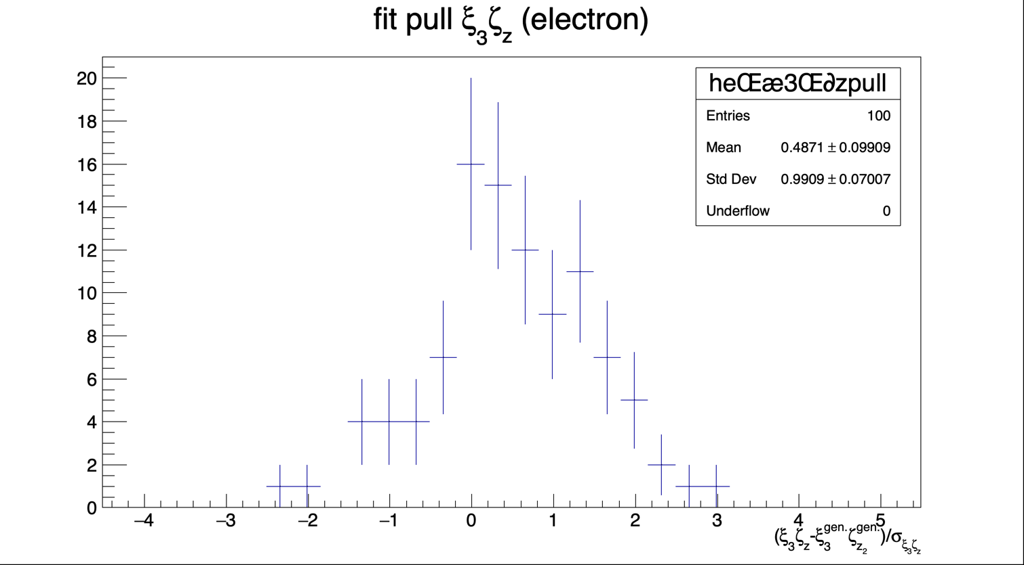
Asymmetry
The position and spatial resolution parameters are fixed, as the fit is found to be largely insensitive to their variation.
No bias at the 10^-4 level except for 𝛇_y (7x10^-4) to be investigated.
Next step evaluate how uncertainties in these fixed parameters might affect the systematic errors
NB: systematics related to fixed parameters to be looked at.

Slide 18
Conclusion & prospects
Now the software allows for more realistic simulation and accounting of phase space correlations,
actual luminostiy and laser-electron beams crossing angle
Studies related to pixel size to be performed again with these parameters
Small vertical pixel size seem essential, 18um looks good at this stage
Impact of laser-electron crossing angle to be understood. Large bias on longitudinal polarization not explained.
Prospects and ongoing steps:
Some previous analyses should be revisited using small vertical pixel size.
possibly perform a simultaneous fit of electrons and photons to improve parameter extraction
On longer term start to end simulation of the Compton interaction up to detection and parameter extraction

Slide 19
THANK YOU FOR YOUR ATTENTION

Slide 20
backup

Slide 21
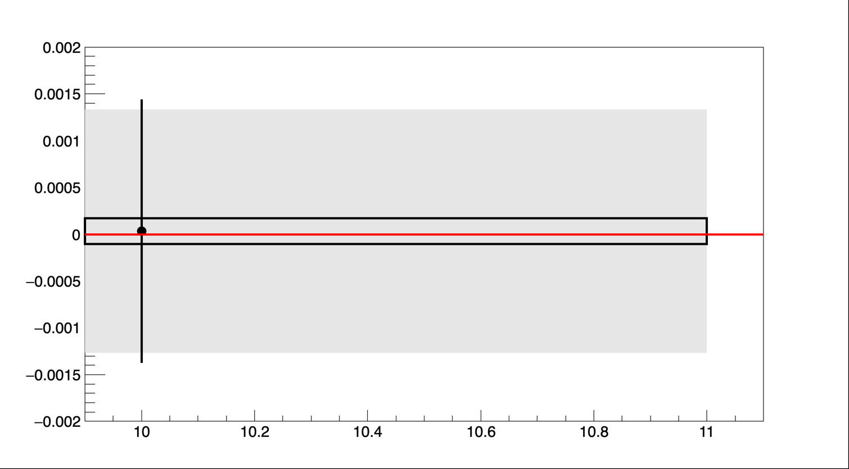
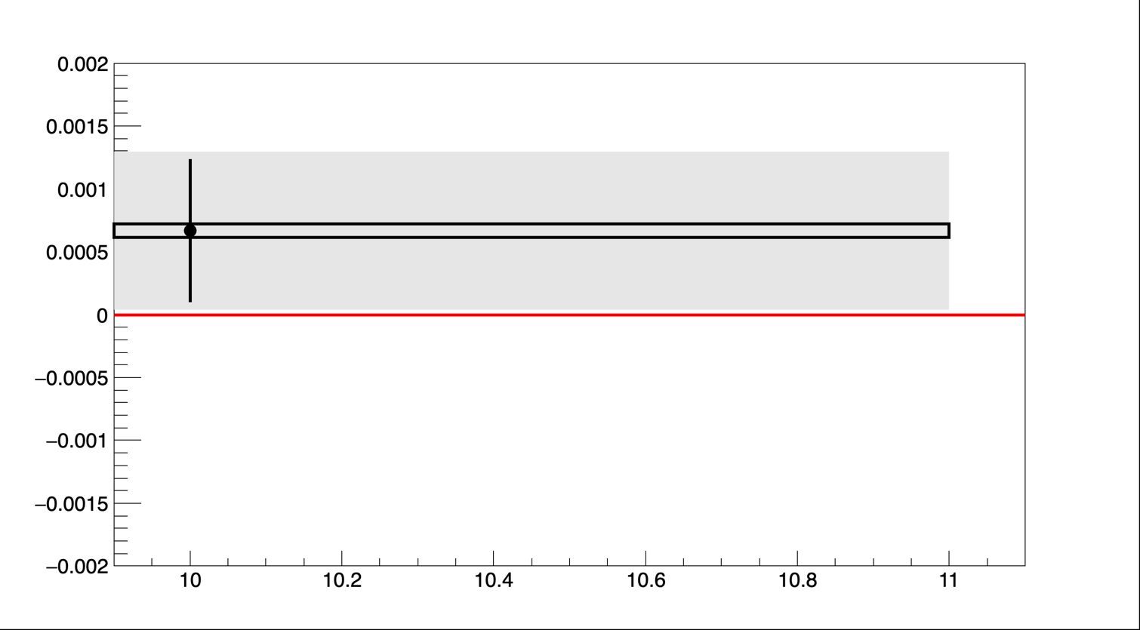
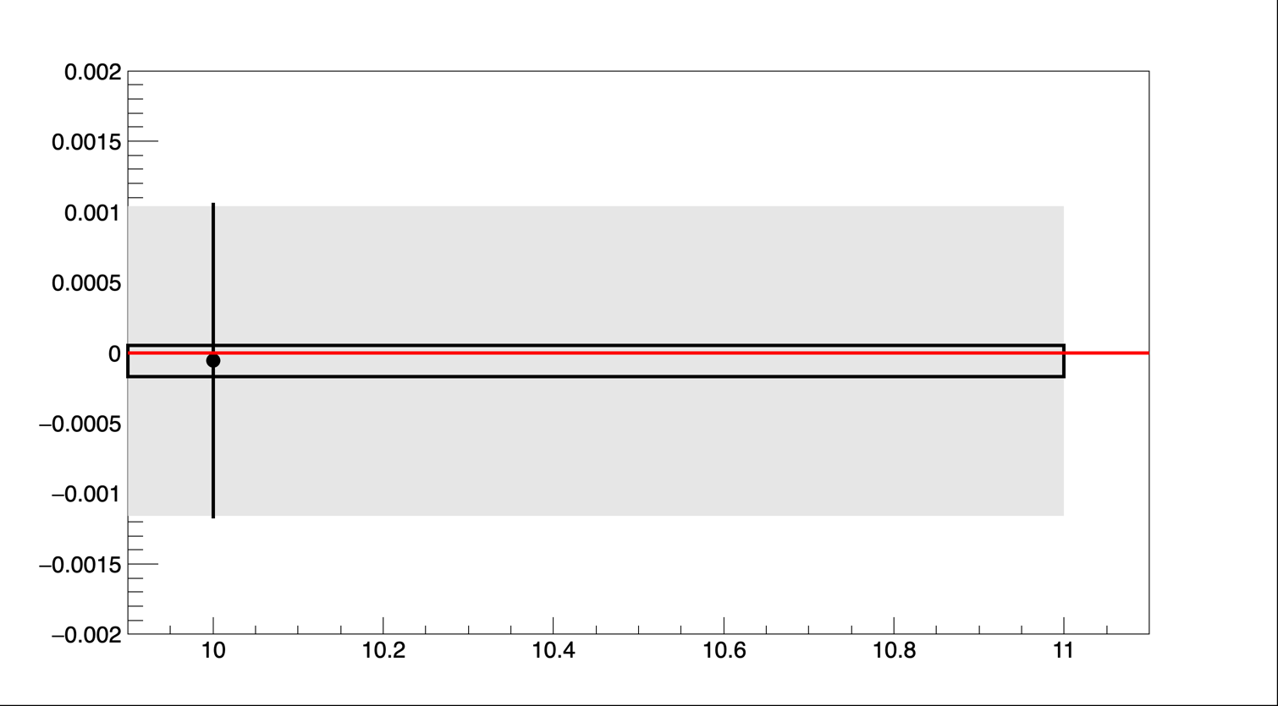
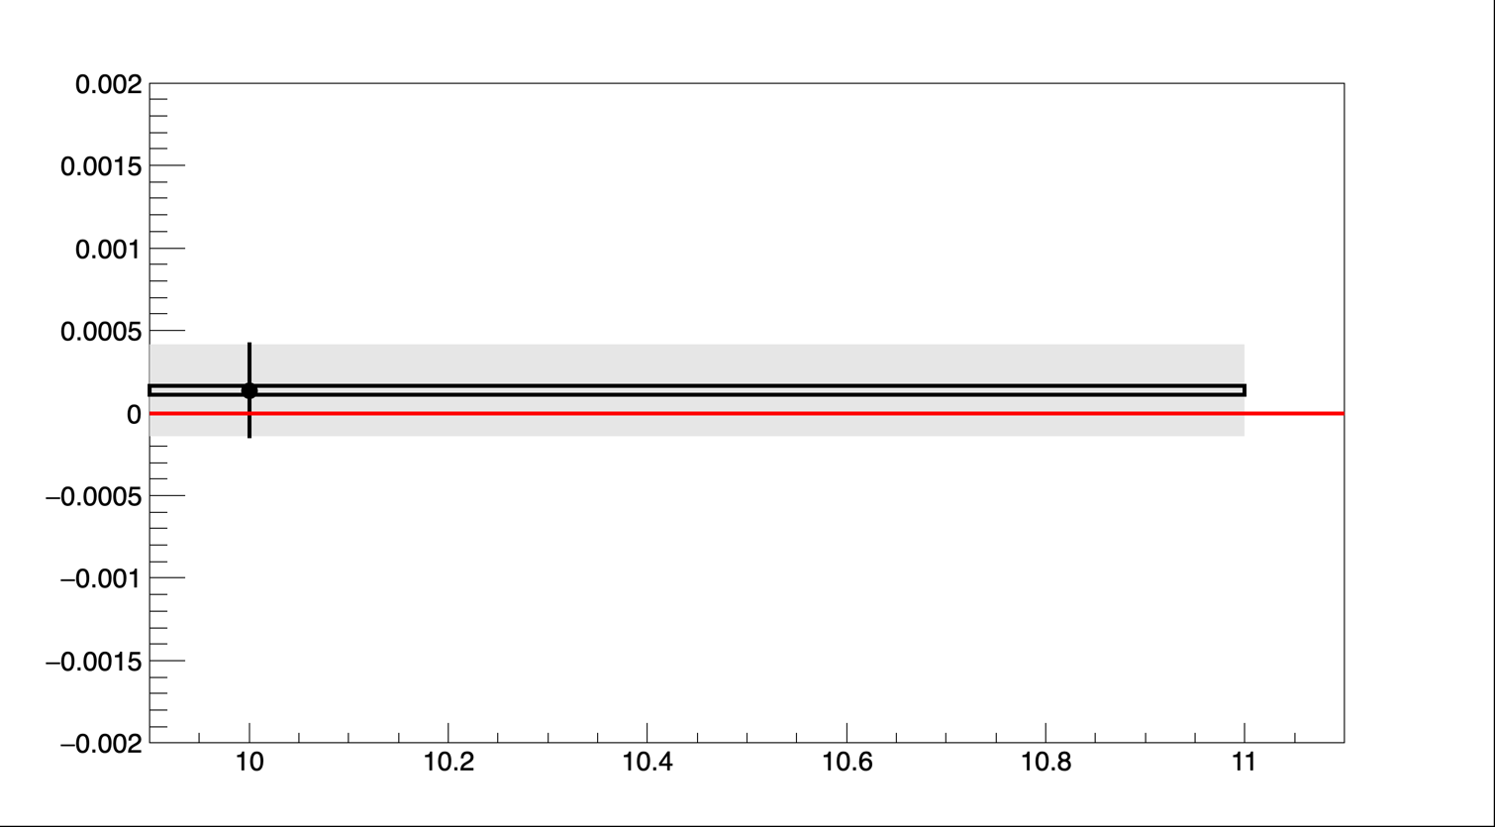
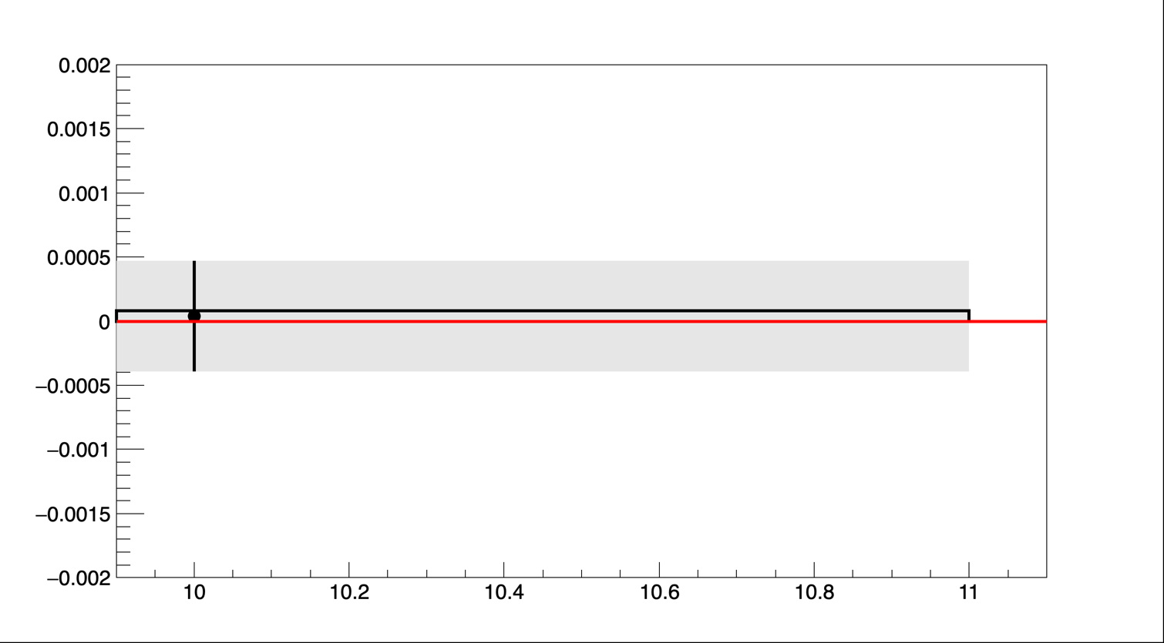
Asymmetry scan
pPX
epy
pPY
epz
pPz

Slide 22
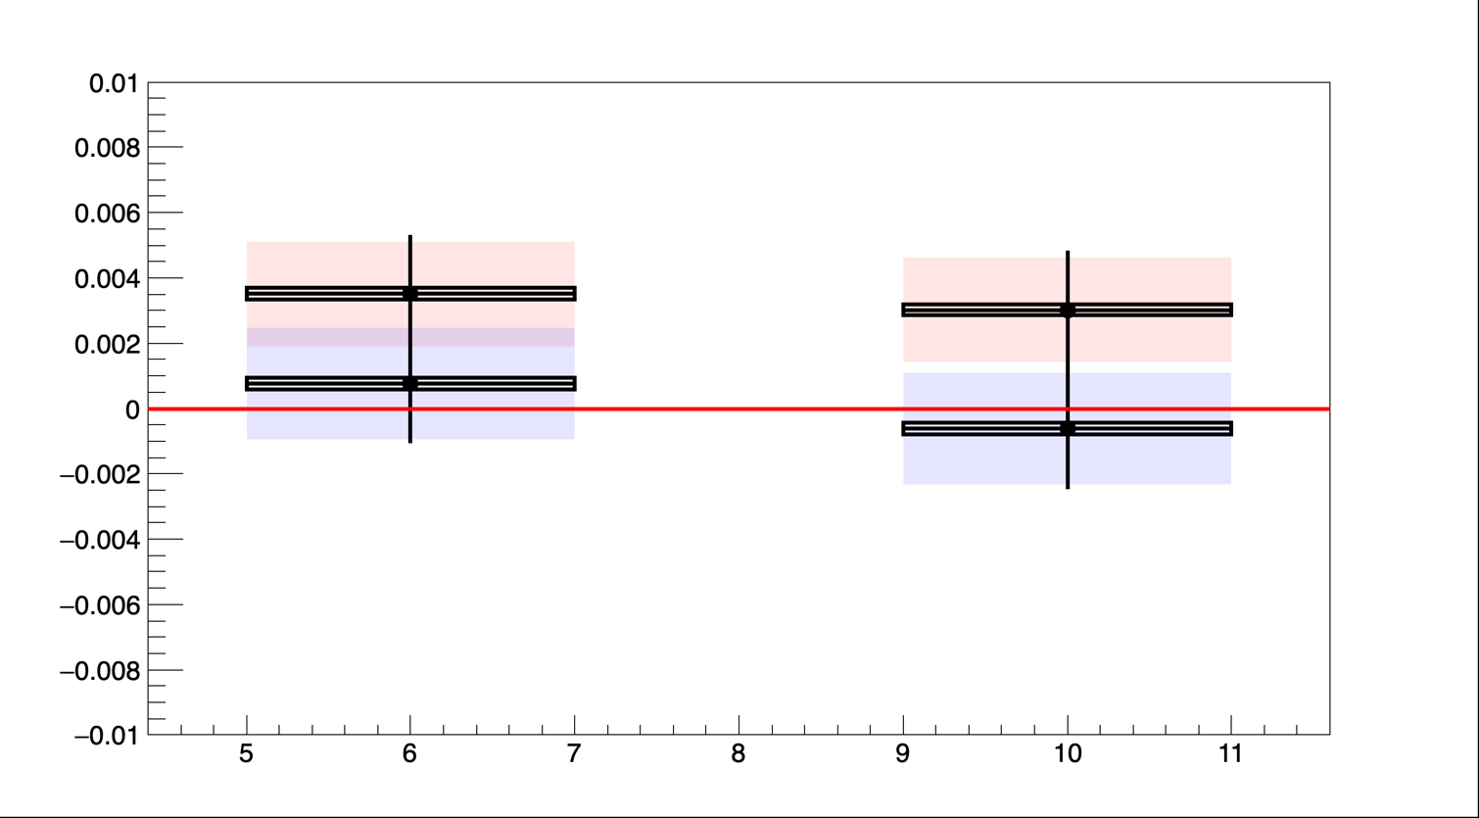
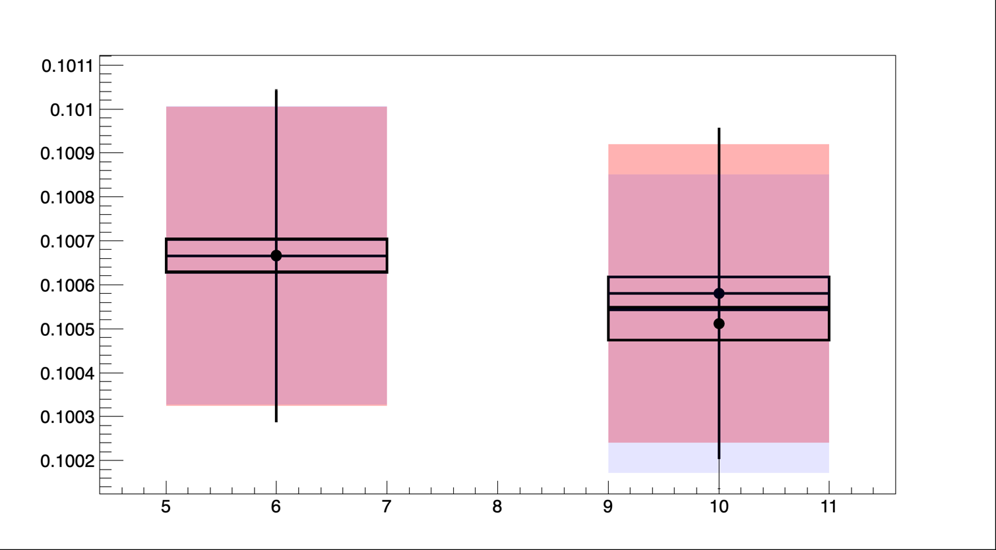
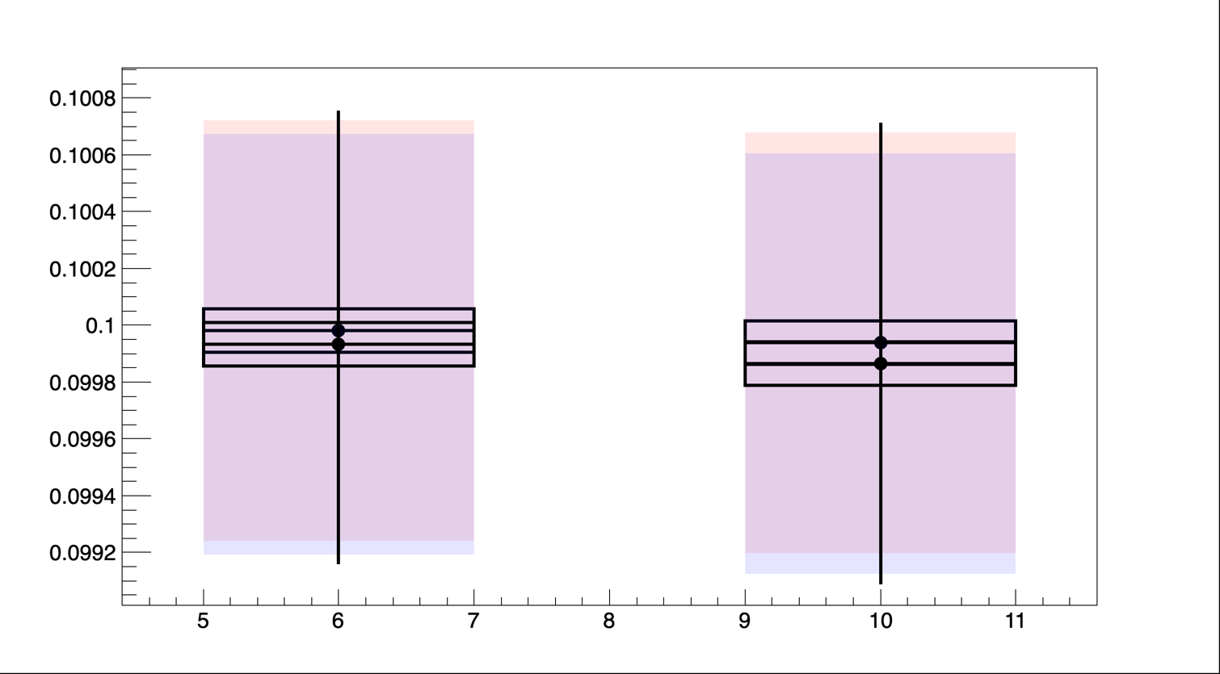
Simulation on Monolithic pixel sensor
E_{fit}-E_{gen.}[Gev]
𝛏3𝝵z fit- 𝛏3𝝵z gen
R_{y}=2
Ry=3
Rx
Rx
𝛏3𝝵y fit- 𝛏3𝝵y gen
Beam energy extraction (ellipse coordinates)
is significantly affected by the pixel size (few per-mil level)
    Interesting correlation with vertical pixel size ! (why ?)
Significant effect on longitudinal polarization too (why situation improves when pixel area increases ?)
Much smaller impact on vertical polarization (small fraction of per-mille)
Rx

Slide 23
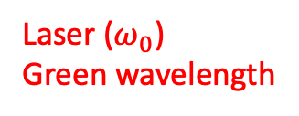
Compton polarimeter initial layout
x
Laser ($ω_{0}$)
Green wavelength
X₀
Scattered photons
$$∝\frac{B}{E_{0}}$$
X₁
Electron beam
Blondel et al., arXiv:1909.12245; Muchnoi, INST 17 P10014 (2022)
Dipole (field B)
$$∝Bω_{0}$$
Lowest energy scattered electrons
Interaction region
X₂
about 100m
New concept (N. Yu Muchnoi) to measure all polarization parameters → 3D polarimeter

Slide 24
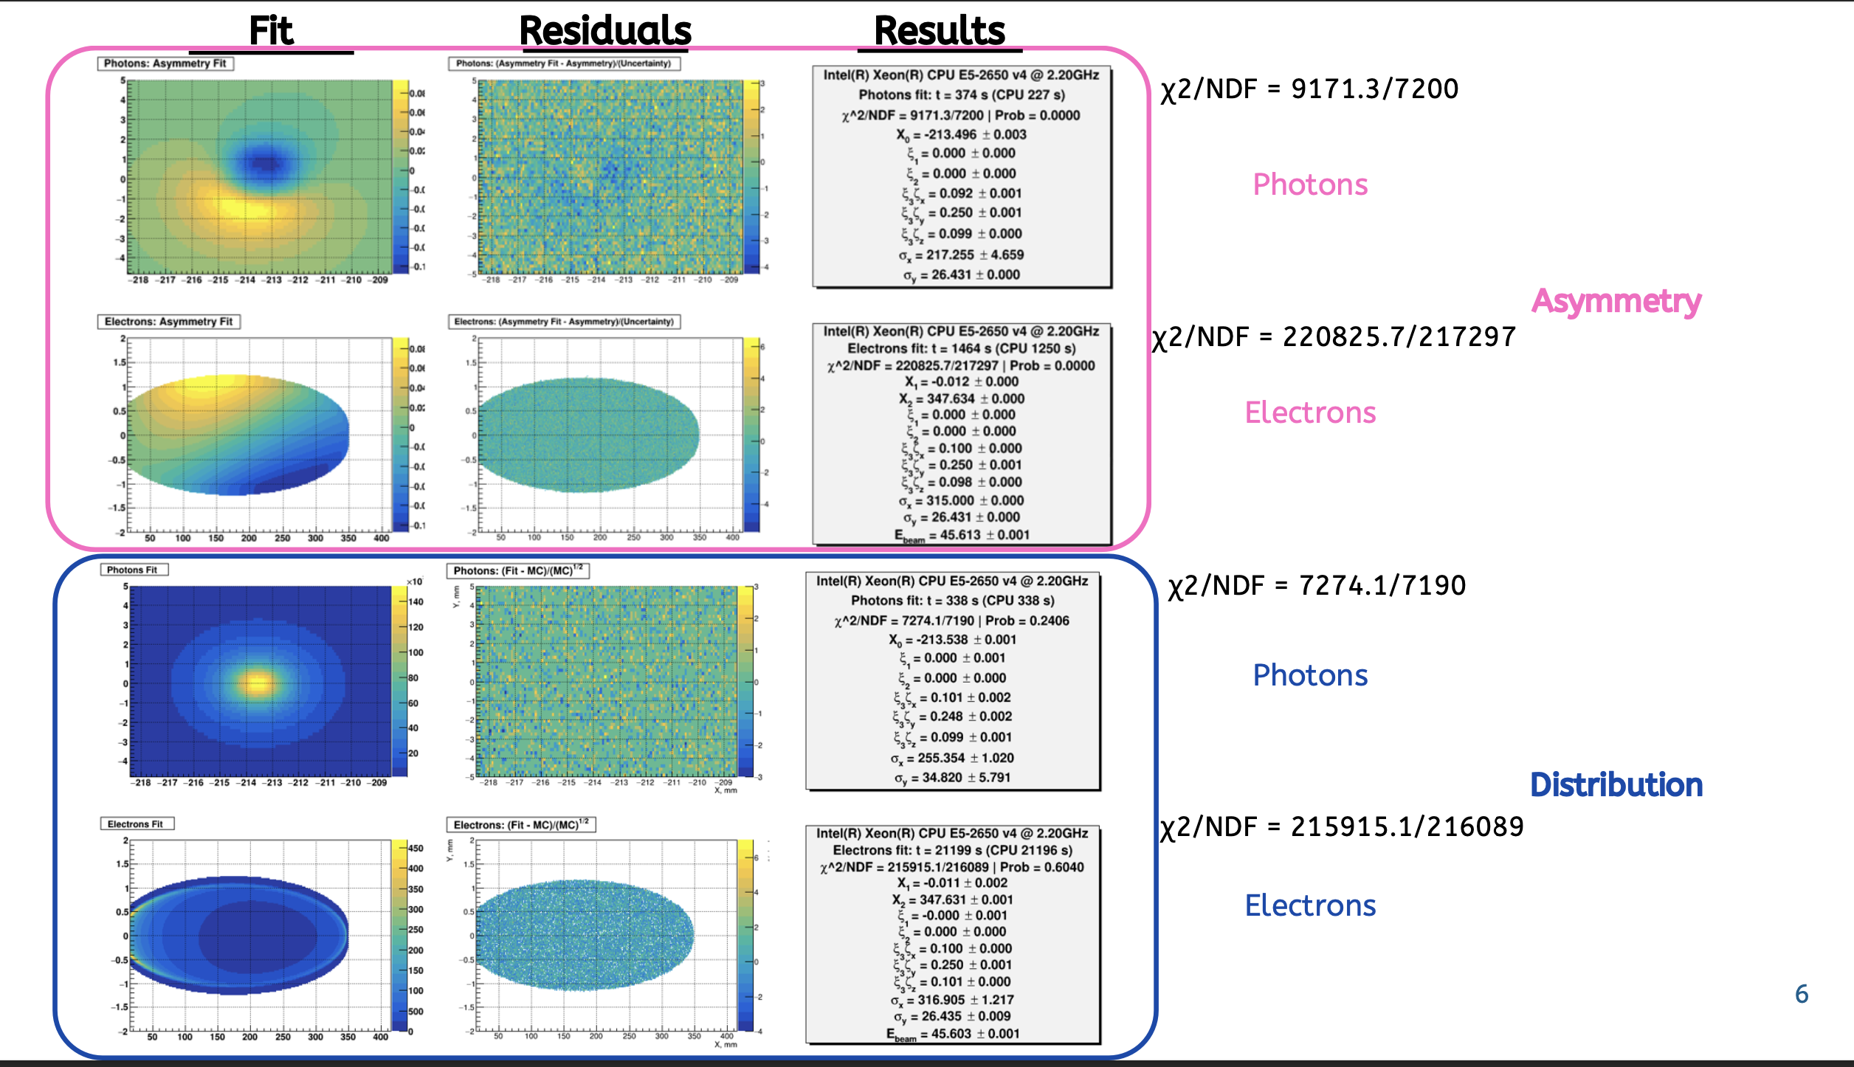
Asymmetry fit (preliminary)
Preliminary
More investigations
ongoing
Narvaez, EPOL meeting

Slide 25
Typical result – fit of Asymetry
Typically obtained in 30s for a single bunch
Based on measurement of scattered particles transverse distributions (pixelized detectors)
Blondel et al., arXiv:1909.12245; Muchnoi, INST 17 P10014 (2022)
All components extracted with ~0.001 precision in few seconds
Beam energy may be extracted too! → redundancy with RDP

Slide 26
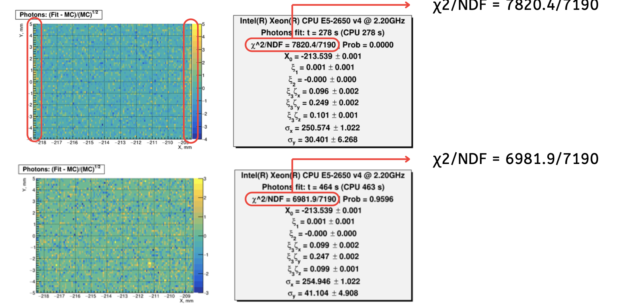
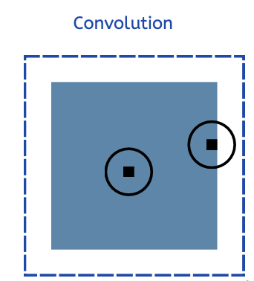
Fit refinements
Narvaez, EPOL meeting
Extend calculation over extended range beyond sensitive area

Slide 27





Updated toy study
see also J. Tamazirt poster
A toy MonteCarlo procedure is applied (100 experiments, 10⁸ events each
Beam energy [GeV]
$ζ_{y}$ (electron detector)
X: 1200 1400 1600 1800
Y: 40 60 80 100
Npixels for electrons
X: 1200 1400 1600 1800
Y: 40 60 80 100
Electron detector
4mm
$ζ_{z}$ (electron detector)
$ζ_{x}$ (photon detector)
400 mm
Photon detector
10 mm
X: 1200 1400 1600 1800
Y: 40 60 80 100
X: 40 60 80 100
Y: 40 60 80 100
Npixels for electron detector
Npixels for photon detector
Residual biases (1-5 10⁻⁴) under investigation
Combined fit to be investigated

Slide 28


Impact on integration
Laser does not travel through dipole → easier integration
(Q-switch would)
Vacuum chamber concept adapted from SuperKEKB concept
Validated for impedance budget

Slide 29


Physics requirements
Required accuracy of <1ppm
Blondel et al., arXiv:1909.12245
High reproductibility of measurements for various sqrt(s) is critically needed
Extract as much information as possible from physics experiments themselves
(crossing angle, luminosity, sqrt(s) spread)
Beam-based measurements in real time, including beams energy with resonant depolarization
24/7 operable measurement of (de-)polarization

Slide 30


Integration
Oide
Polarimeter integrated close to experiments IP
1/beam (baseline)
e-beam size at Compton IP :
~500µm (horizontal)
Oide, https://indico.cern.ch/event/1237189
Robust laser technology is available nowadays
Demanding operational constraints
laser room in the parallel technical gallery
24/7 access to the laser system and related electronics

Slide 31

Laser helicity asymmetries
Blondel et al., arXiv:1909.12245
Reproductible and well known laser helicity flip is required

Slide 32





QED corrections
Studied in details at SLD
Measurement of transverse polarization at FCCee :
Denner & Dittmaier Nucl. Phys. B 540 (1999) 58, Swartz Phys. Rev. D 58 014010 (1998), Veltman Phys. Rev. D 40 2810 (1989), Veltman Phys. Rev D 42 1856E (1990);
A. Martens et al 2023 JINST 18 P10001
photons
$\frac{δP}{P}≈1×{10}^{−3} \left(0.5×{10}^{−3}\right)$at 45 (80) GeV
electrons
$\frac{δP}{P}≈4×{10}^{−3} \left(10×{10}^{−3}\right)$at 45 (80) GeV
Measurement of longitudinal polarization at FCCee :
$\frac{δP}{P}≈1×{10}^{−3}$at 45 GeV
If and only if laser helicity asymmetries are measured

Slide 33




Magnetic field tolerancing
Many potential sources of ‘bending angle’ uncertainties (for instance genuine inhomogeneities of B-field, short-/long-term fluctuations of currents, temperatures, alignments)
$$\frac{σ(\int{B_{y}dl})}{\int{B_{y}dl}}≪2×{10}^{−4}$$
Over the useful aperture of the magnet:
Fringe fields also may affect performance of polarimeter
Nominal vertical field for reference:
By product: angular alignment
NB: Requirements not met → not a show-stopper but detailed studies required

Slide 34


Physics requirements cont’d
Wilkinson at EPOL workshop https://indico.cern.ch/event/1181966
High accuracy longitudinal polarization measurement is needed
Naturally small at IPs but with what accuracy ?
Measure it !

Slide 35



Compton cross-section
$$x=\frac{2E_{0}ω_{0}}{m^{2}}\left(1+\cos{α}\right)$$
$$y=\frac{E_{γ}}{E_{0}}$$
The Compton cross-section averaged over scattered particles spins:
Differential cross-section
Transverse laser polarisation: nuisance parameter to minimize and keep under control
Transverse electron beam polarisation: intervenes as an asymmetry in the transverse plane
Berestskii & Lfshitz QED textbook
$$\frac{dσ}{dydφ_{obs}}\left(x,y\right)=\frac{dσ_{0}}{dy}\left(x,y\right)+\frac{dσ_{⊥}}{dy}\left(x,y\right)\cos\left(2\left(φ_{obs}−φ_{las}\right)\right)𝒫_{L}^{las}+\frac{dσ_{∥}}{dy}\left(x,y\right)𝒫_{C}^{las}(P_{T}f_{T}\left(x,y\right)\cos\left(φ_{obs}−φ_{elec}\right)+P_{z}f_{z}(x,y))$$
Electron beam polarization independent
Electron beam polarization dependent
⚠️ But small opening angle of scattered particles:
  Electrons → spectrometer
  Photons → difficult to measure asymmetric distribution of a narrow spot → long lever arm needed

Slide 36


Laser integration
SuperKEKB upgrade concept
Some constraints
  Small crossing angles are preferred (cross-section, beam jitters) few mrad typically
  Beams crossing plane neither horizontal nor vertical
  beam impedance
  beam induced currents in metallic parts ← avoid
  mechanical stability
  ease of maintenance works
Polarisation &
beam shaping
laser
Box with rough temperature control
Box with rough temperature control
Polarisation monitoring
Duplicated at injection
Add Position and pointing monitoring
R&D needed to reach required perf.
Position, pointing control and monitoring
Polarisation independent intensity monitoring
Optical spectrum monitoring possible
24/7 operable laser system, with full monitoring, remote control

Slide 37
Some laser systems
Nikolai’s baseline (Q-switch Nd-YAG)
Versatile Yb system
Laser param. | 1 pilot | 1 pilot v2 | All colliding bunches (at Z)
Repetition rate | 3 kHz | 3 kHz | 30 kHz
Pulse energy | 1 mJ | 1 mJ | 10x0.05mJ
Pulse duration | 3 ns | 30 ps ^{(**)} | 30 ps
Average power | 3 W | 3 W | 15 W ^{(***)}
Scattering rate | 3x10⁵/s ^{(*)} | 3x10⁵/s ^{(****)} | 4x10⁷/s ^{(****)}
Scattering rate per bunch | 3x10⁵/s ^{(*)} | 3x10⁵/s | 4x10⁵/s
adaptable
Same oscillator may be used but two different amplification schemes
^{(*)} crossing angle ~ 2mrad
^{(**)} related to optical bandwidth ← constrains resolution of ‘direct’ energy measurement from polarimeter
^{(***)} Can be increased to typically ~100W (nowadays) but requires operational validation
^{(****)} not limited by Piwinski contribution → can be several degrees without affecting rate

Slide 38



Scattering rates
Laser-beam single pulse energy
Compton cross-section
Electron bunch charge
(25nC for colliding bunches,
1.5nC for pilots)
Geometrical factor
  $ℱ^{−1}=\sqrt{1+{\left(\frac{σ_{z}}{σ_{x}}\tan{\frac{θ_{0}}{2}}\right)}^{2}}$
  $θ_{0}\sim 2mrad$
$$n=σ_{C}\frac{ℰ}{E_{λ}}\frac{Q}{q}\frac{ℱ}{2π{σ_{y}σ}_{x}}$$
Photon rate
Transverse beam sizes:
  $σ_{x,y,z}=\sqrt{σ_{x,y,z,laser}^{2}+σ_{x,y,z,e−}^{2}}$
  $σ_{x,laser}=$ $σ_{y,laser}$=1000µm
  $σ_{x,e−}=$ 500µm, $σ_{y,e−}$=10µm, $σ_{z,e−}\sim 10$mm
Laser photon energy
(2.4eV for 0.5µm wavelengths)

Slide 39


QED corrections
Involved processes e𝛾→ e𝛾, e𝛾→eee, e𝛾→ e𝛾𝛾
$$\frac{dσ}{dE^{′}}(E′)≅\frac{dσ_{0}}{dE′}\left(1+δ\right)\left[1+𝒫_{z}𝒫_{C,las}\left(A+ΔA\right)\right]$$
QED corrections<0.001 @ 45 GeV
Denner & Dittmaier Nucl. Phys. B 540 (1999) 58, Swartz Phys. Rev. D 58 014010 (1998), Veltman Ophys. Rev. D 40 2810 (1989), Veltman Phys. Rev D 42 1856E (1990)
Scattered electron energy
Need to be eventually included in simulations…

Slide 40


The Compton process
Compton x-section
~0.3b (Ee~45GeV)
Klein O. and Nishina Y., Z. Phys. 52(1929) 853; Ginzburg I. et al., Nucl. Instr. Methods in Phys. Research 219 (1984) 5, V. B. Berestetskii, E. M. Lifshitz, L. P. Pitaevskii (1982). Quantum Electrodynamics. Vol. 4 (2nd ed.)
Kinematic edge

