Slide 1
Integration of vertex detector services and cooling
Gherardo Ammirabile¹
Daniele Benvenuti¹,Manuela Boscolo²,Filippo Bosi¹,Andrea Ciarma²,Francesco Fransesini²,Stefano Lauciani²,Maurizio Massa¹,Andrea Moggi¹,
Fabrizio Palla¹
¹ INFN Sezione di Pisa, Italy
² INFN Laboratori Nazionali di Frascati (RM), Italy
11th FCC Week
Vienna (Austria)
19-23 May 2025

Slide 2

Vienna, 22/05/2025
Gherardo Ammirabile, INFN Pisa
INTRODUCTION
Current vertex layout
Services of vertex:
  Inner vertex: air cooling and cables
  Middle/Outer vertex and discs: water cooling and cables
  Beam pipe cooling
  Constraints and requirements:
      Limit the LumiCal material budget below 130 mrad
      Minimize the material budget for the vertex and the drift chamber
      Facilitate assembly, opening and maintenance operations

Slide 3
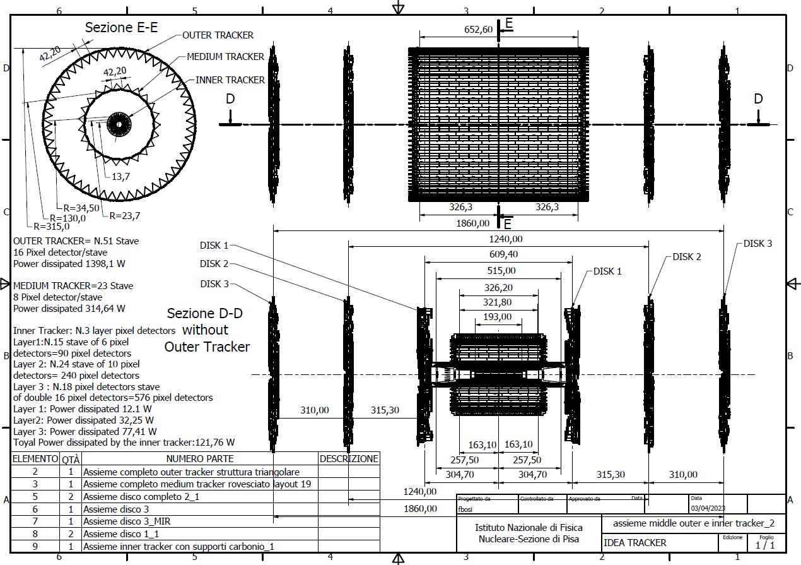
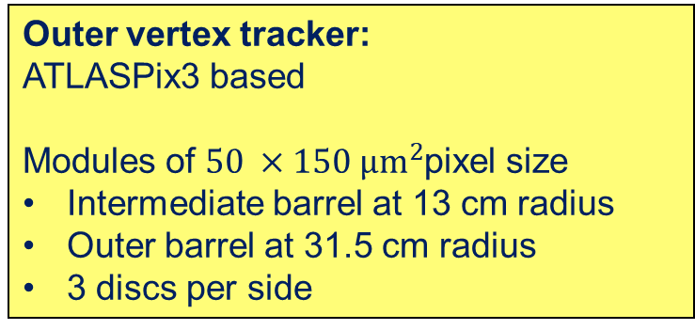
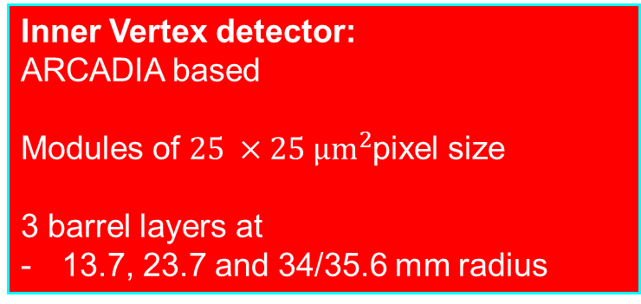
Vienna, 22/05/2025
Gherardo Ammirabile, INFN Pisa
Current vertex layout
Outer vertex tracker:
ATLASPix3 based
Modules of $50 ×150 µm^{2}$pixel size
Intermediate barrel at 13 cm radius
Outer barrel at 31.5 cm radius
3 discs per side
Inner Vertex detector:
ARCADIA based
Modules of $25 ×25 µm^{2}$pixel size
3 barrel layers at
13.7, 23.7 and 34/35.6 mm radius

Slide 4
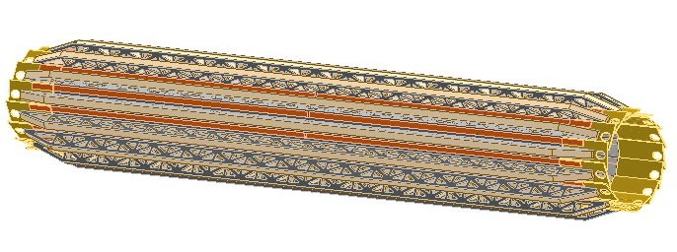
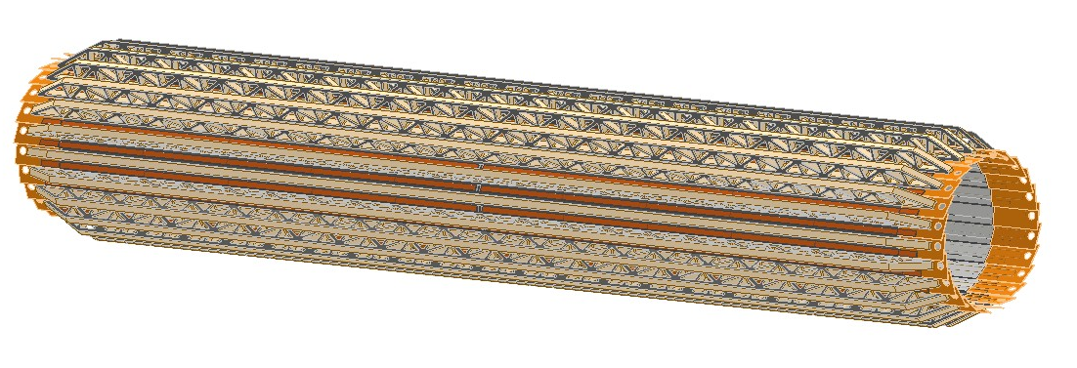
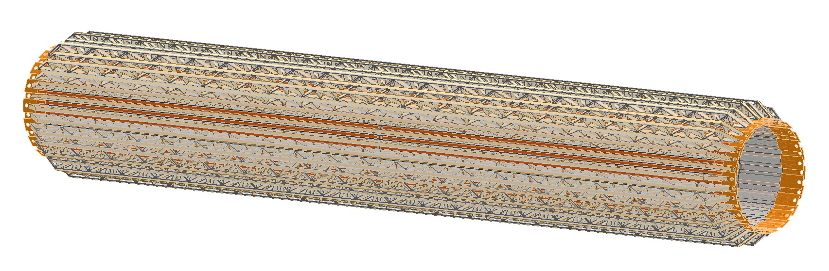
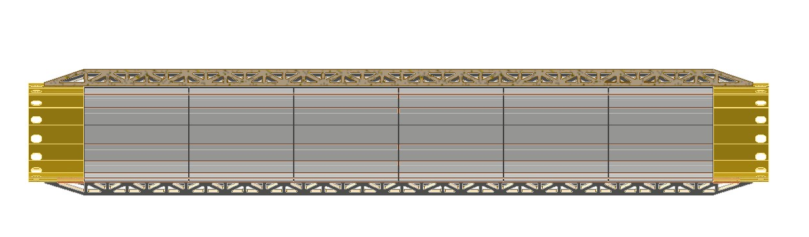
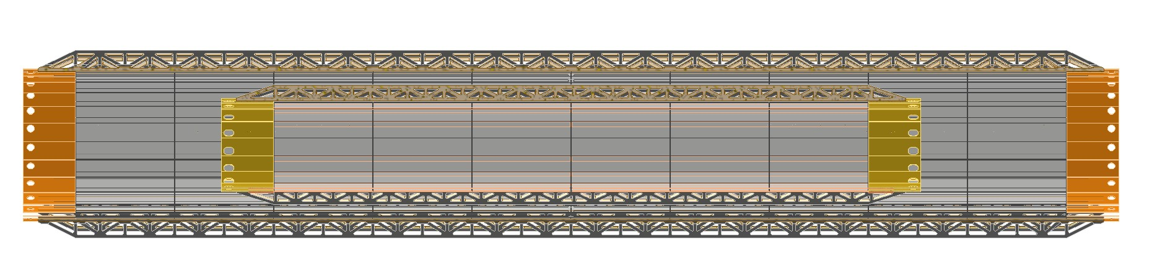
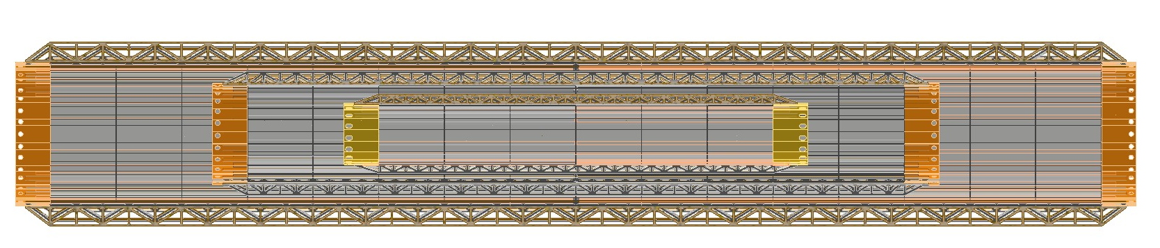
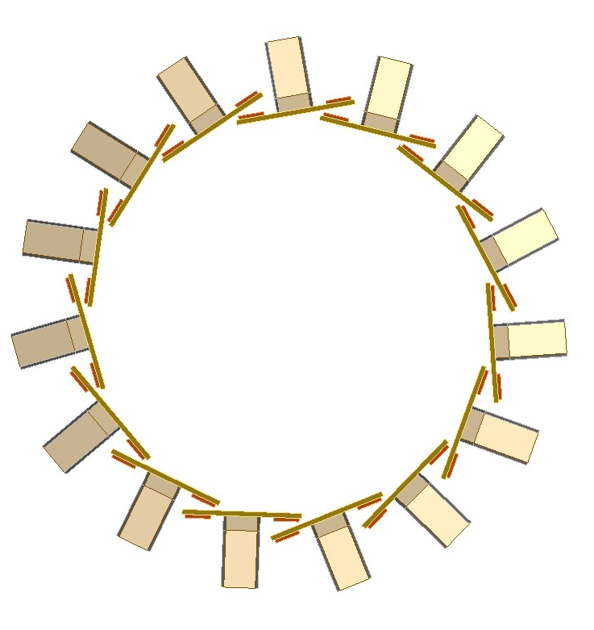
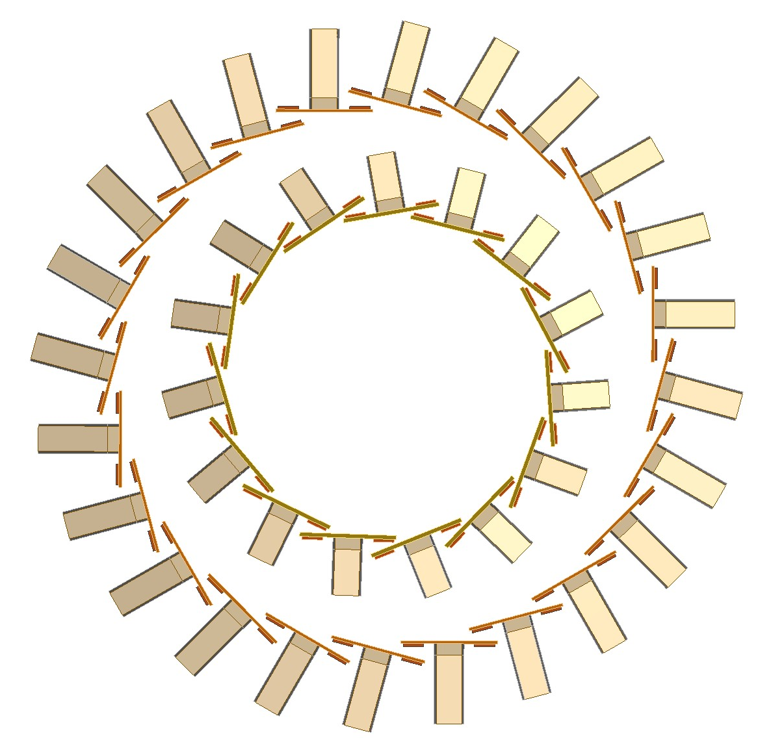
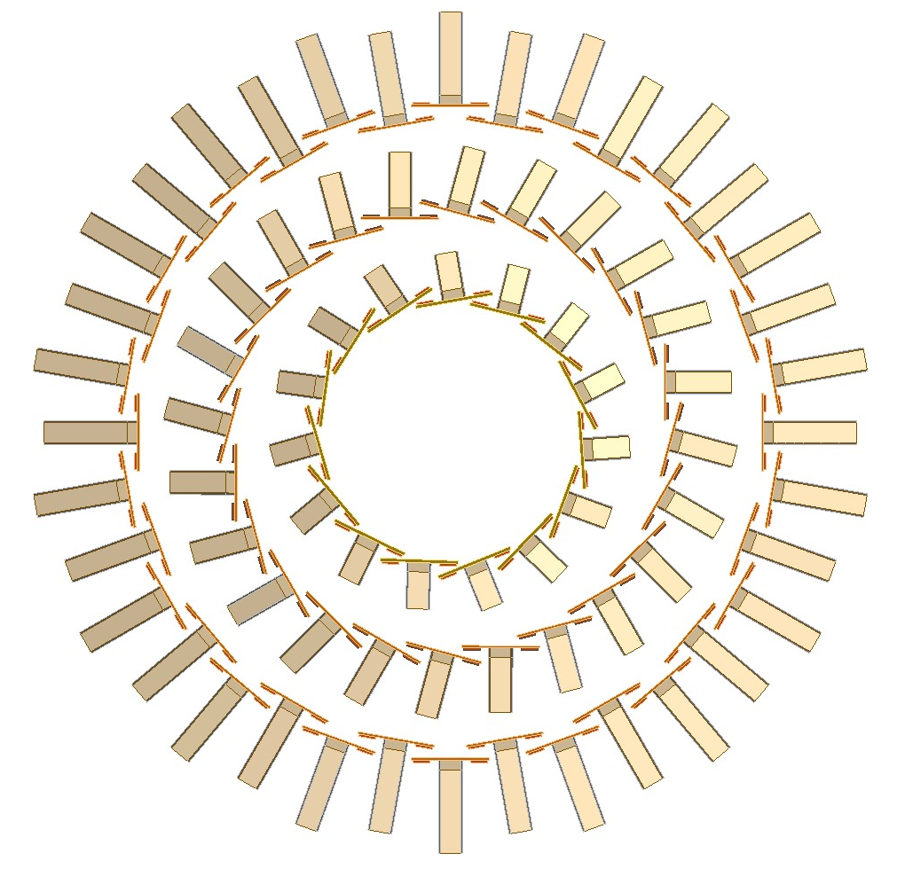
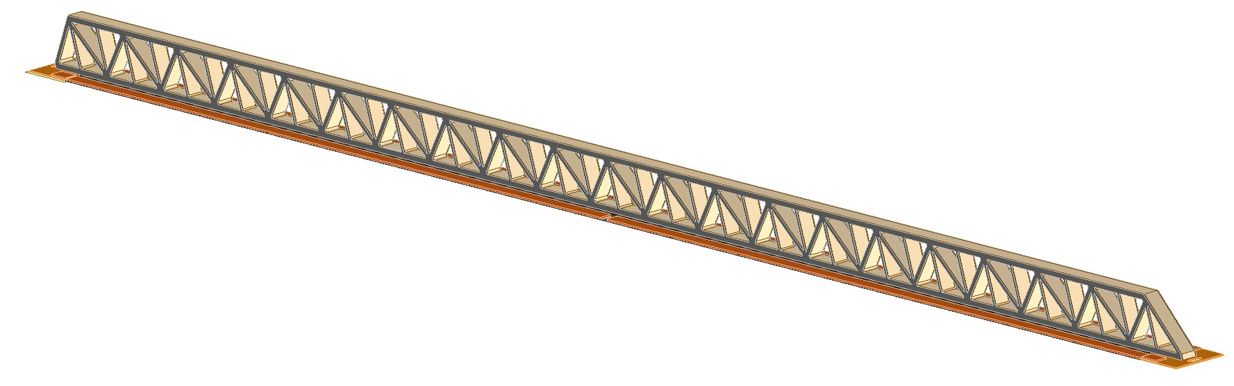
Vienna, 22/05/2025
Gherardo Ammirabile, INFN Pisa
Inner vertex
Layer 1:
15 staves of 6 modules each
Power budget ≈ 12 W
Layer 2:
24 staves of 10 modules each
Power budget ≈ 32 W
Layer 3:
36 staves of 16 modules each
Power budget ≈ 77 W
227.4 mm
356.2 mm
549.4 mm
13.7
23.7
35.6
Reticular lightweight support to provide stiffness:
Thin carbon fiber walls interleaved with Rohacell
2 buses (data and power) 1.8 mm wide and 250 μm thick

Slide 5
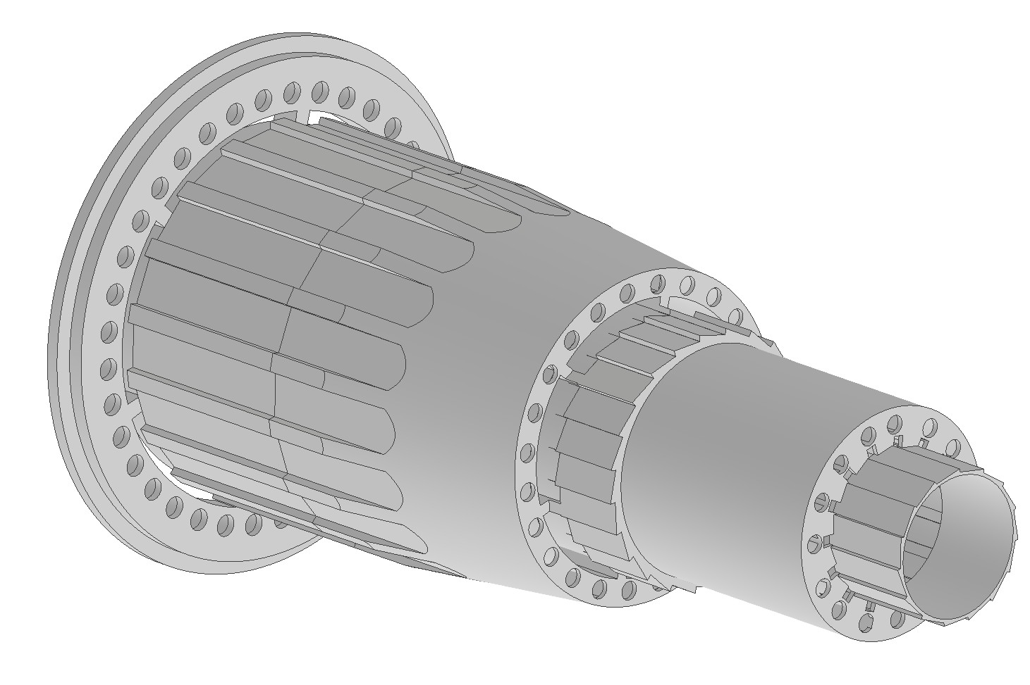
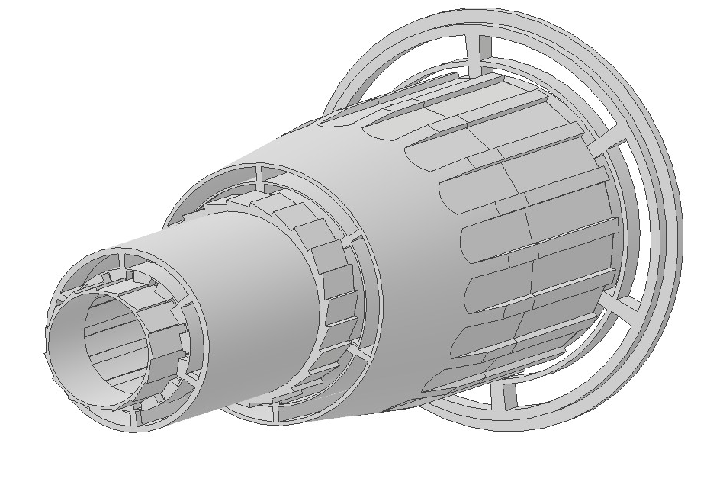
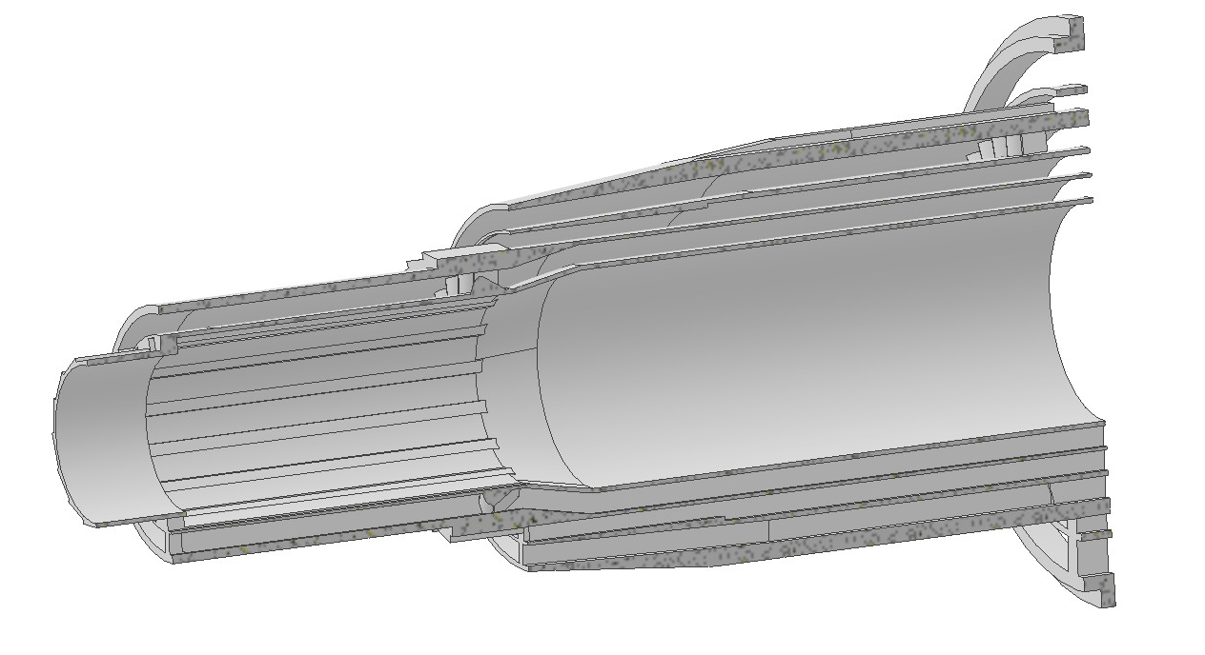
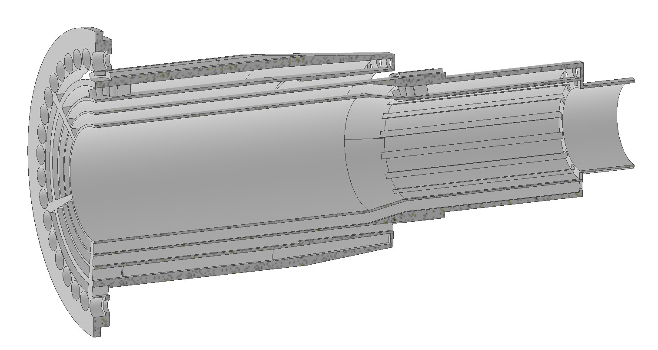
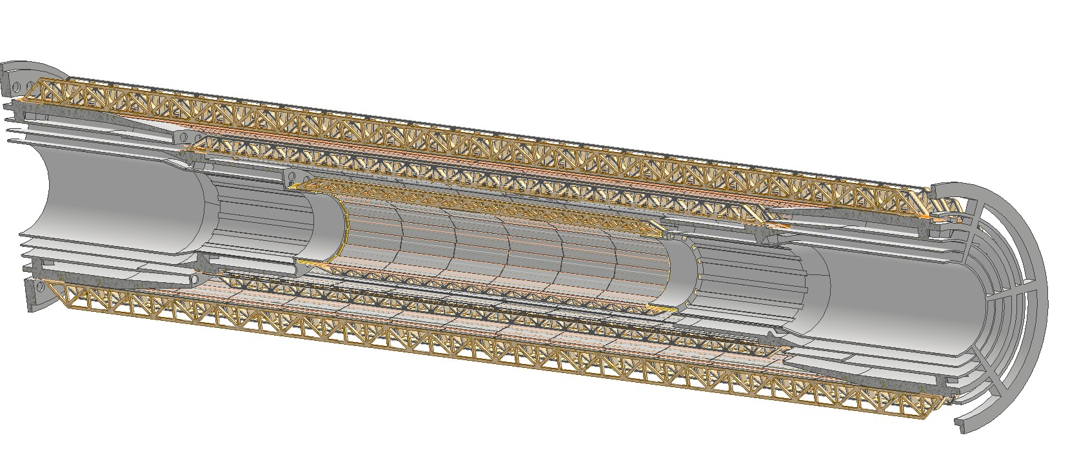
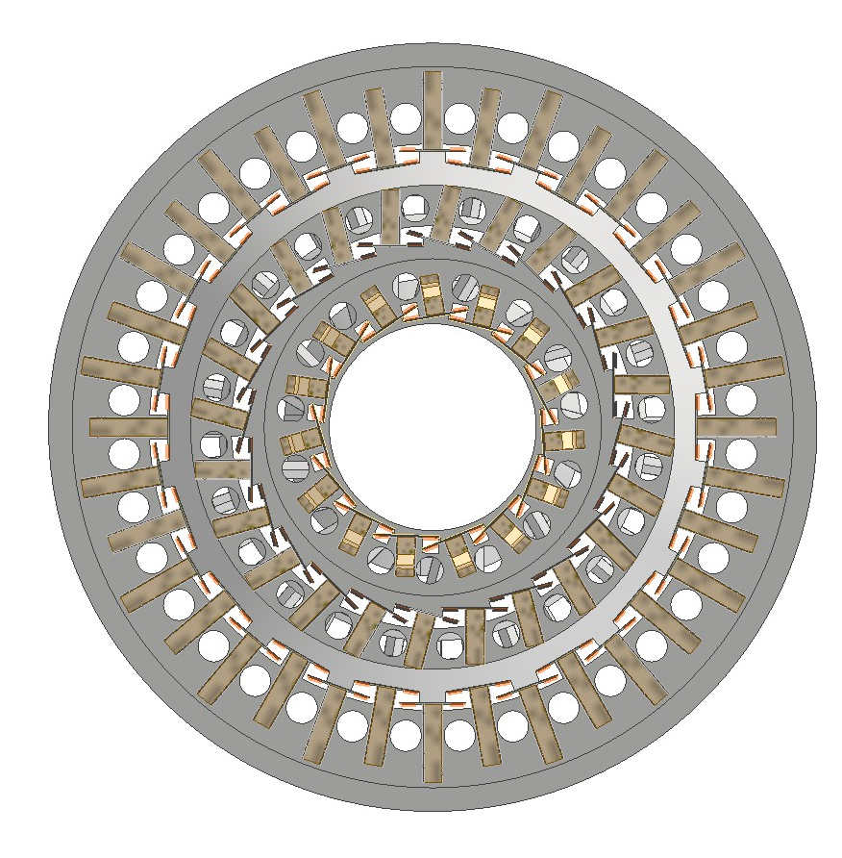
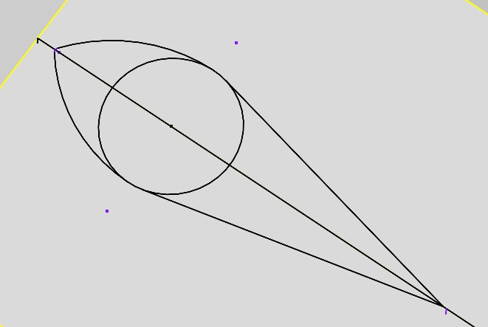
Vienna, 22/05/2025
Gherardo Ammirabile, INFN Pisa
AIR
INLET
SUPPORT
Air cooling system to keep at a stable and uniform manageable temperature the silicon detectors
AIR
OUTLET
SUPPORT
3D printed support with integrated air ducts
(High Temp Resin)
Layer 3
Layer 2
Layer 1
Bus
Bus
3 separated ducts one for each of the layers
Aerodynamic fairing at the stave mounting screw locations
Split support for assembly
IP
Front view

Slide 6
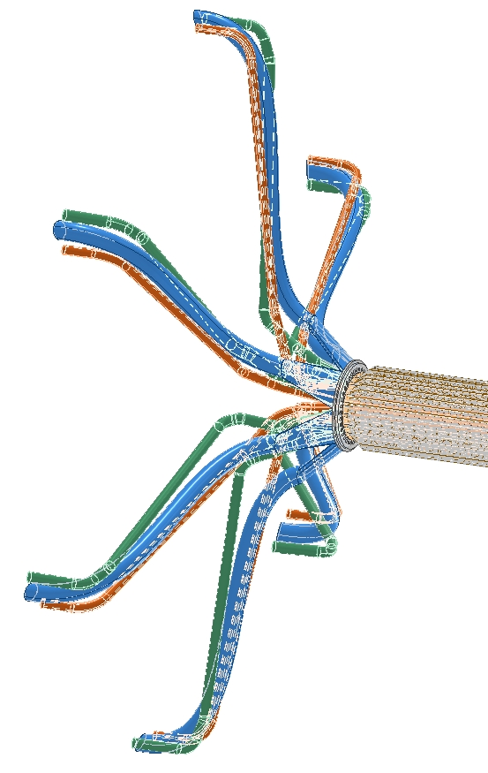
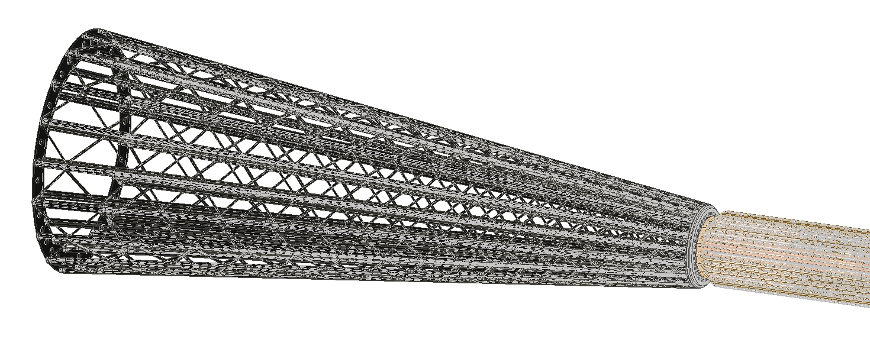
Vienna, 22/05/2025
Gherardo Ammirabile, INFN Pisa
Next step: how to join supports with integrated ducts to the air supply and outlet
Two different solutions
1. Axial inlet/outlet of air ducts
2. Radial inlet/outlet of air ducts
Conical support structure to allow connection to the inner vertex
System of pipes attached to the support tube
Choice based on physical and mechanical constraints

Slide 7
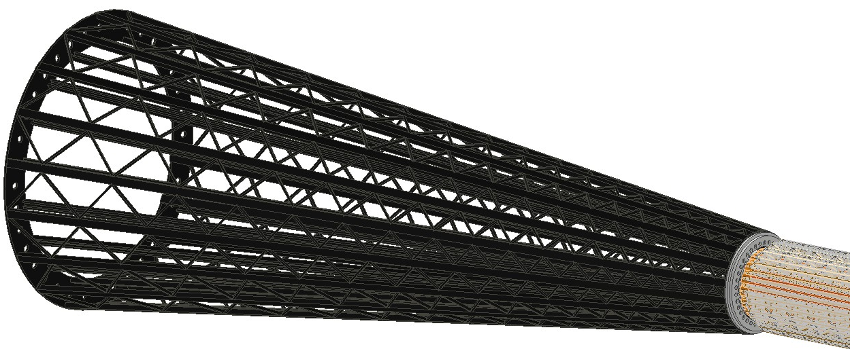
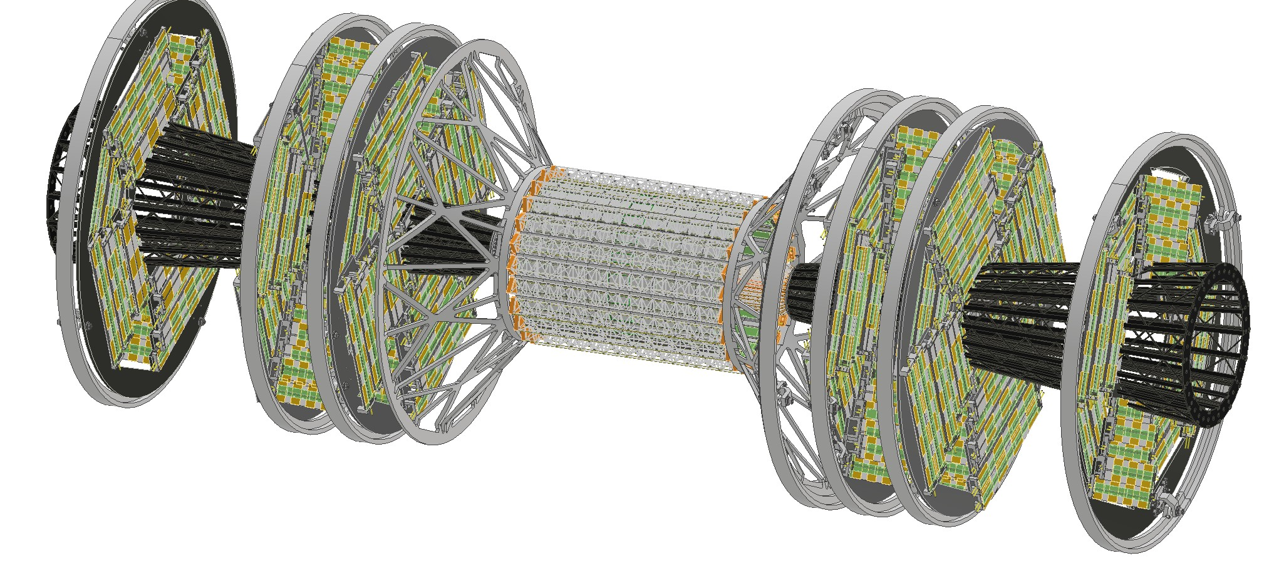
Vienna, 22/05/2025
Gherardo Ammirabile, INFN Pisa
1. Axial inlet/outlet
The conical structure, with the air ducts for the three layers inside, is fixed to the 3D printed support
Conical structure
3D printed support
In the assembly, attention needs to be paid to
Physics:
  Projective geometry
  Particles could follow the direction of the cones
  Passive material in front of the LumiCal and discs
Integration/Maintenance:
  Need to split the discs
  Uneasy in opening the detector
  Connection of the cones to the beam pipe and to air ducts at the end
Optimization of the shape still under study
Hyperbolic structure
(impact discs acceptance)

Slide 8
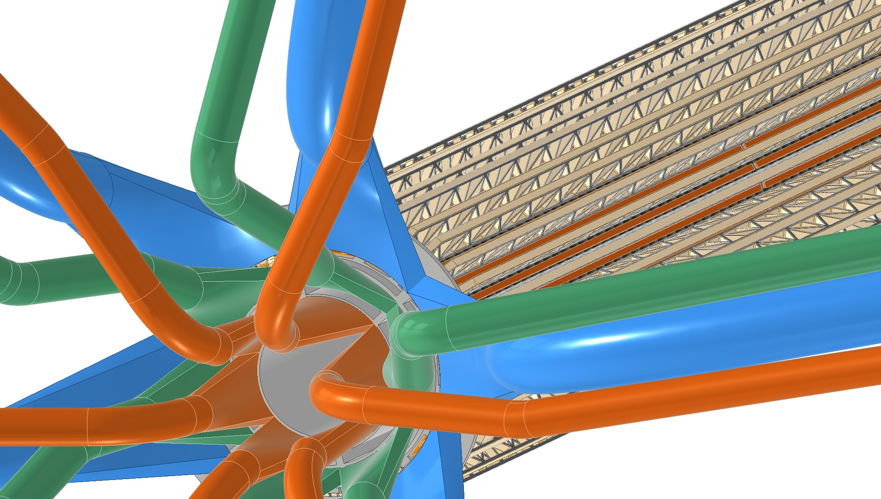
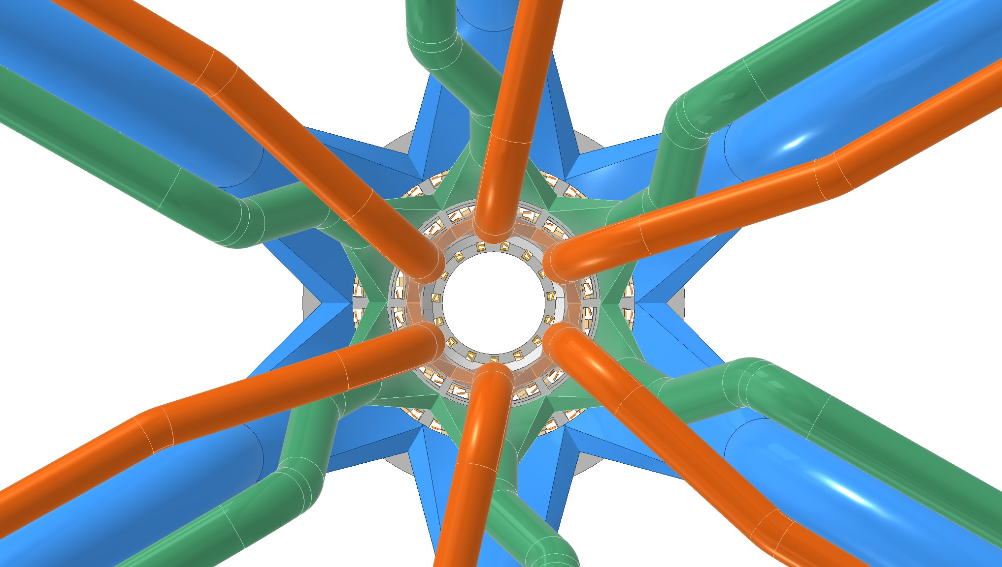
Vienna, 22/05/2025
Gherardo Ammirabile, INFN Pisa
2. Radial inlet/outlet
Diffusers
IP
Cables inlet/outlet
Layer 3 ducts
Layer 2 ducts
Layer 1 ducts
Rear view
6 sectors of 60° for each of the three indipendently powered layers
Diffusers included in the 3D printed support with hose connection
Need to be optimized in terms of length and pitch angle to allow for easy cables routing

Slide 9
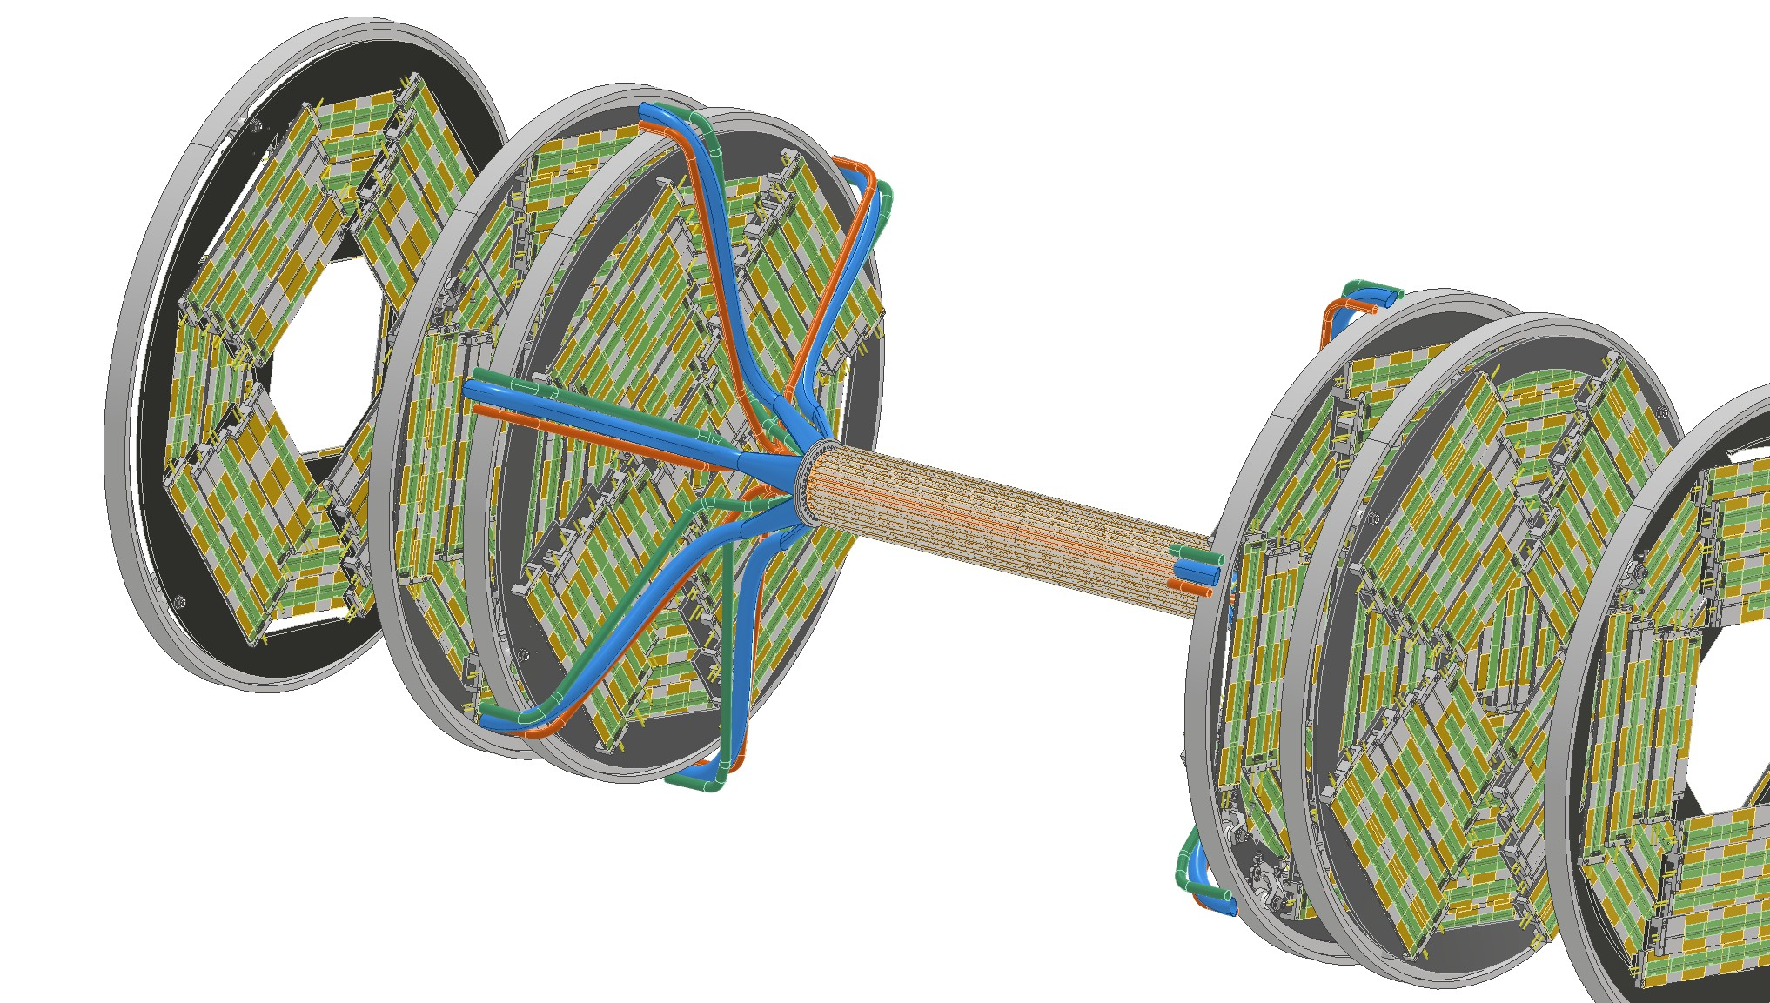
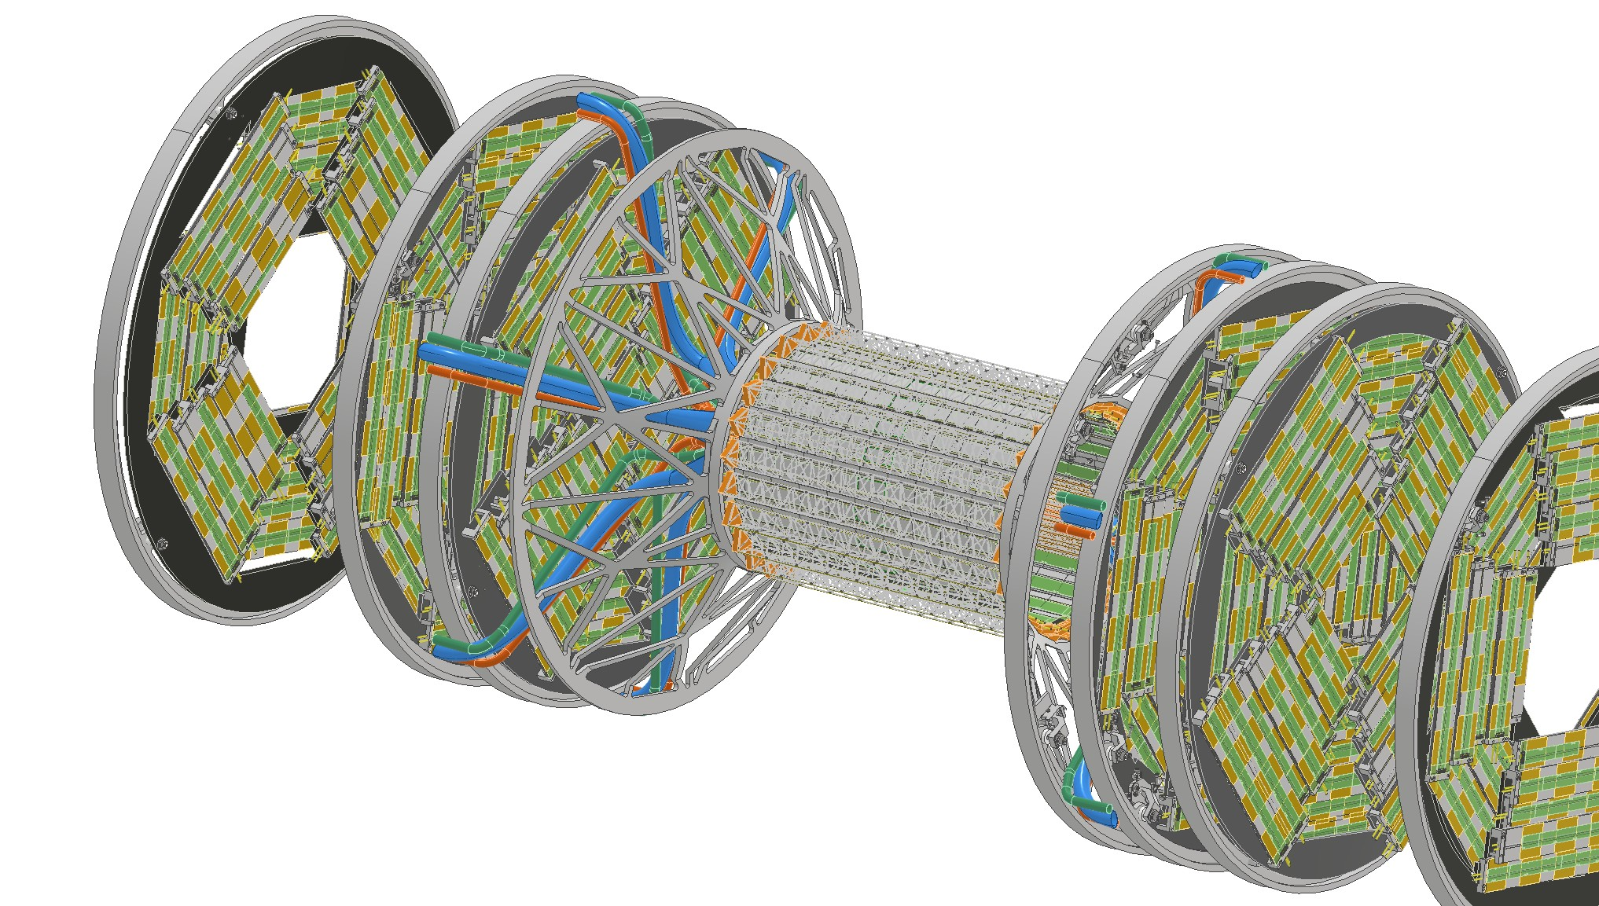
Vienna, 22/05/2025
Gherardo Ammirabile, INFN Pisa
2. Radial inlet/outlet
Inner Vertex
Medium vertex
Pipe system that wraps around the innermost disk:
Minimize the effect on the others
Necessity of an adequate assembly procedure

Slide 10
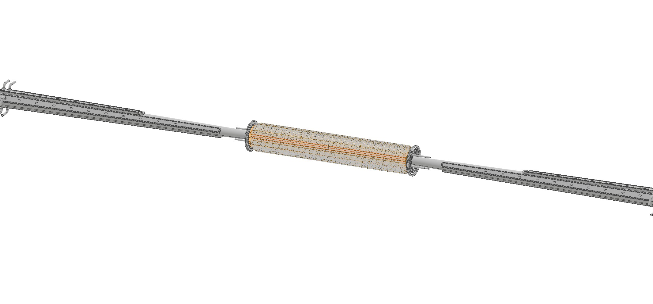
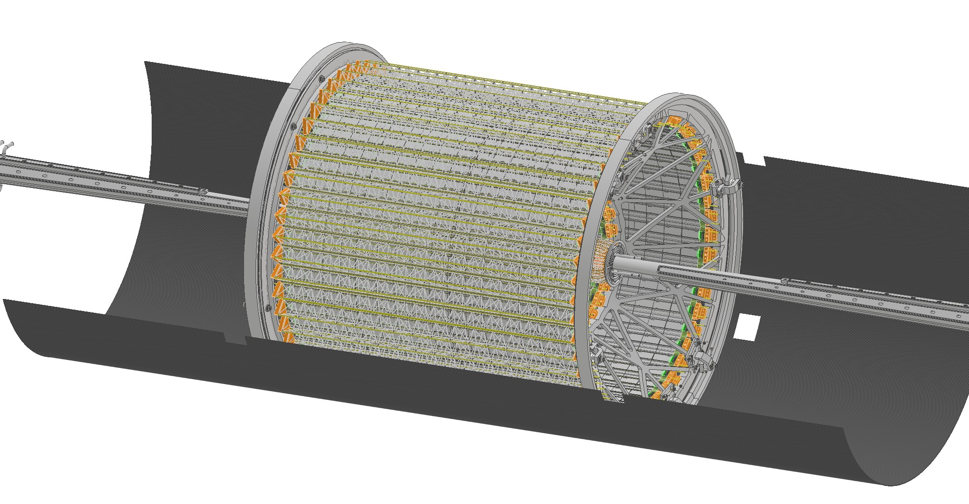
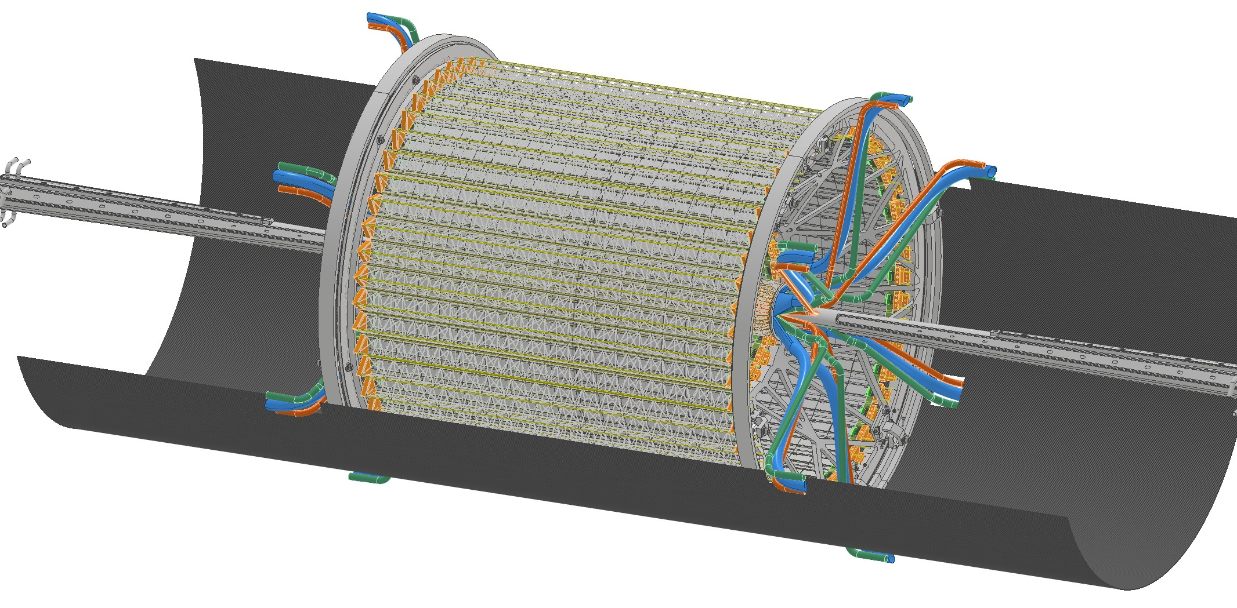
Vienna, 22/05/2025
Gherardo Ammirabile, INFN Pisa
Possible assembly procedure
1
2
Beam pipe with inner vertex
Medium and outer vertex assembly
3
Layer 3 ducts
Layer 2 ducts
Layer 1 ducts
Inner vertex services assembly

Slide 11
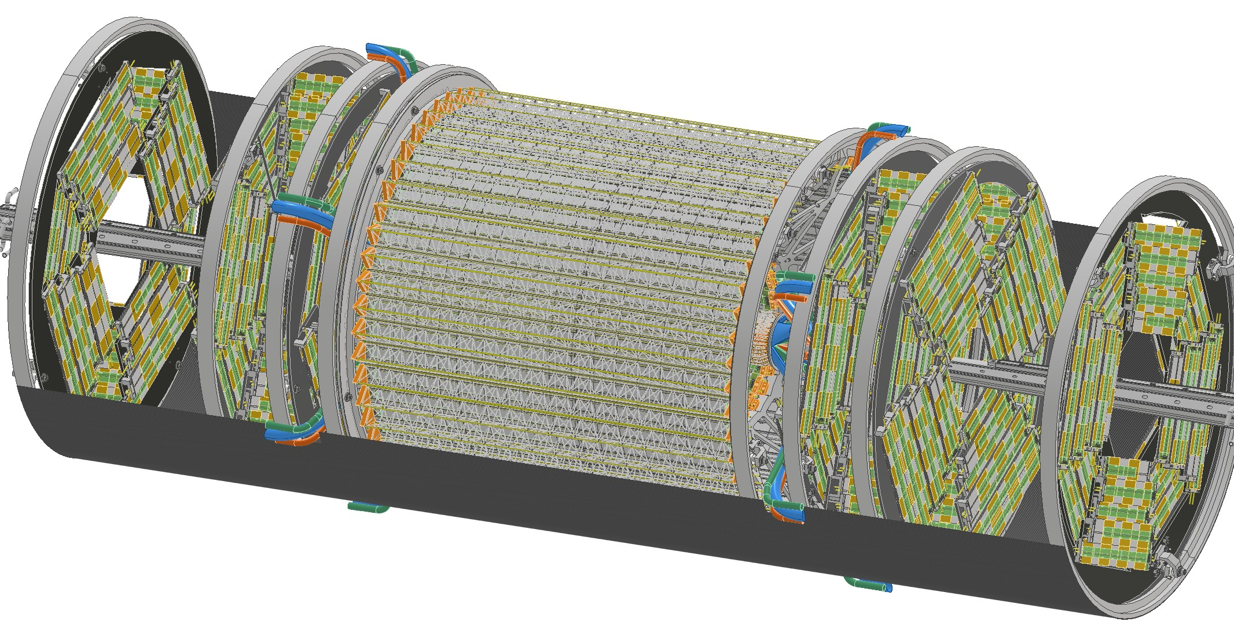
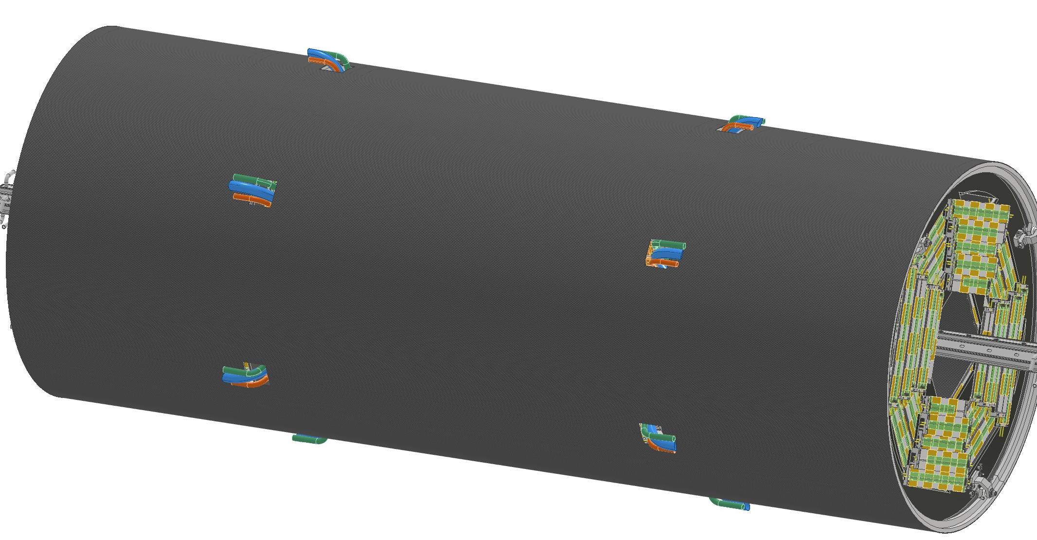
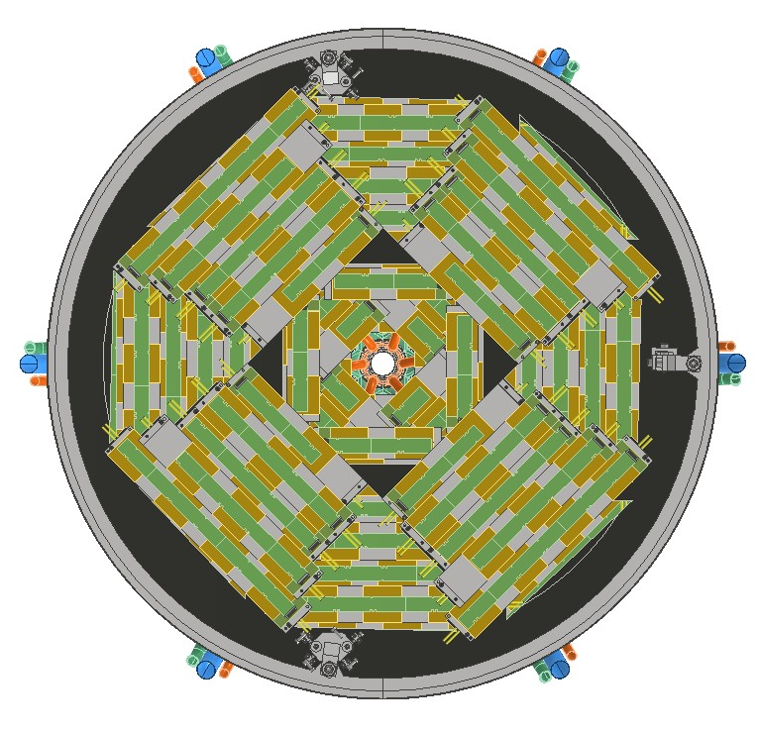
Vienna, 22/05/2025
Gherardo Ammirabile, INFN Pisa
Possible assembly procedure
4
5
SLOTS
Discs assembly
Slots are required on the support tube to allow ducts entry and exit
Support tube closure
Layer 3 ducts
Layer 2 ducts
Layer 1 ducts
The arrangement and shape of the slots must be studied to accomodate:
Air ducts of the three layers
Cooling water channels of discs, middle and outer barrels
Cables from the inner region
ADVANTAGES:
Easier routing of services
Full Discs

Slide 12
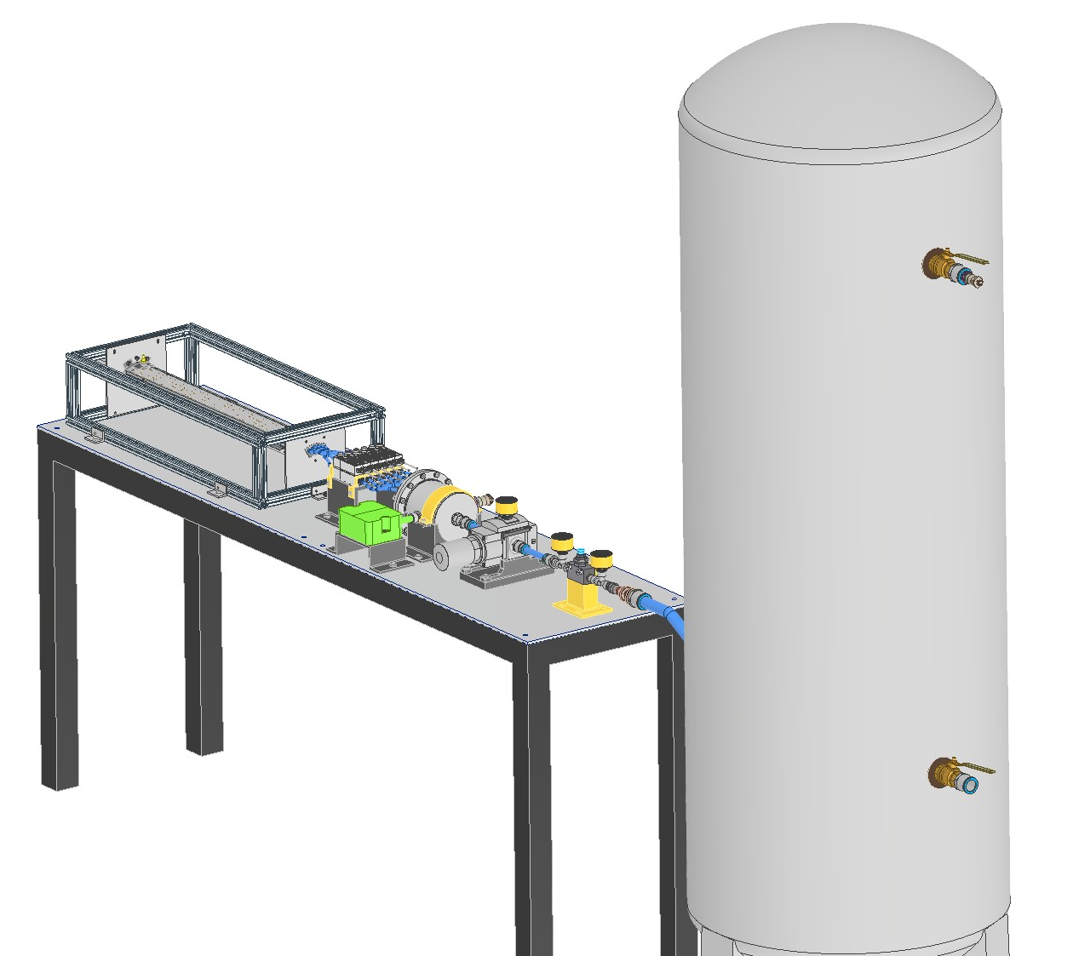
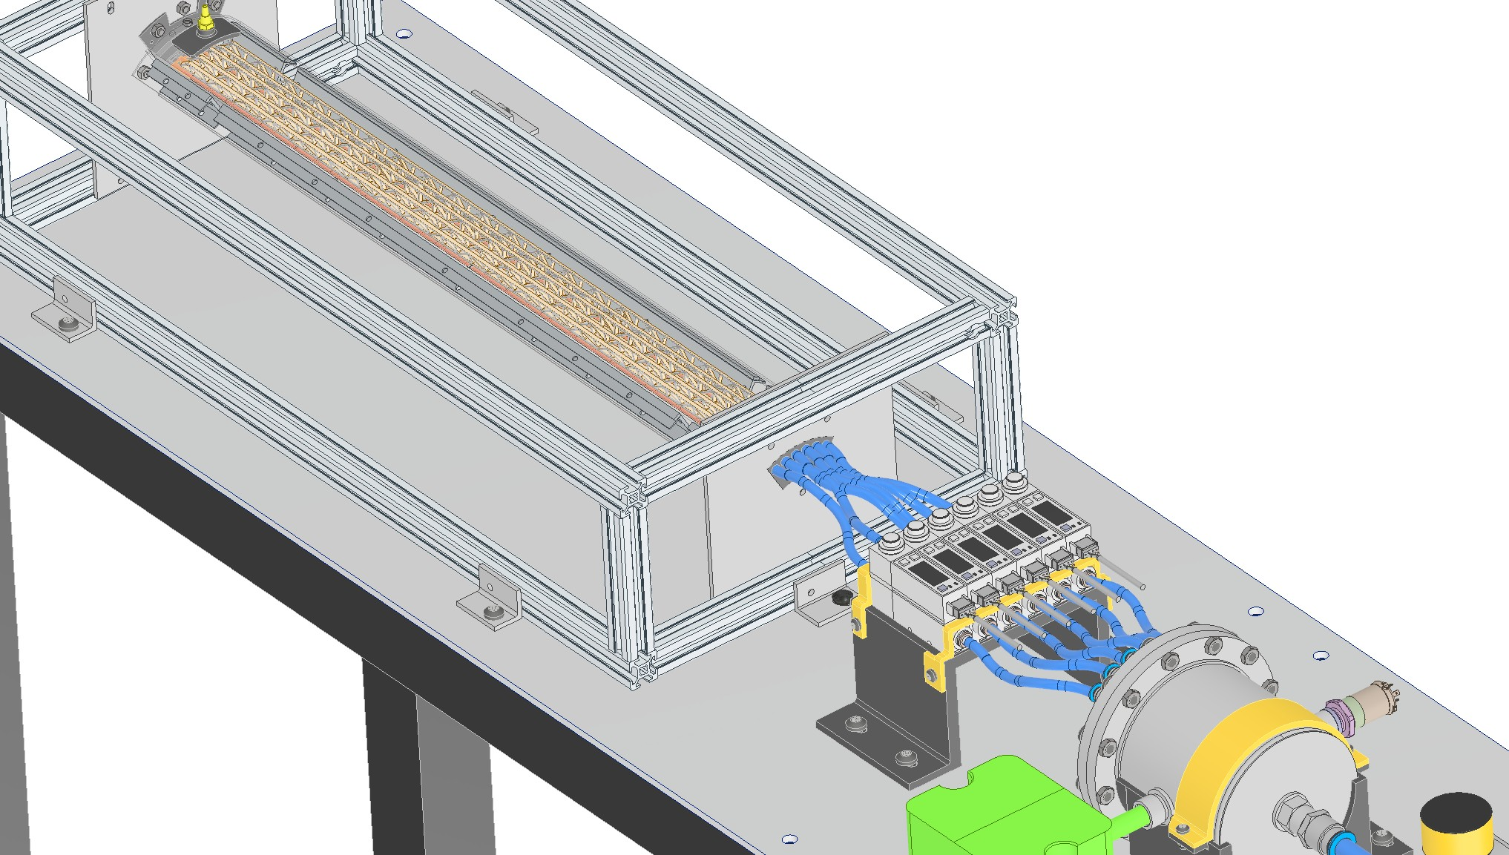
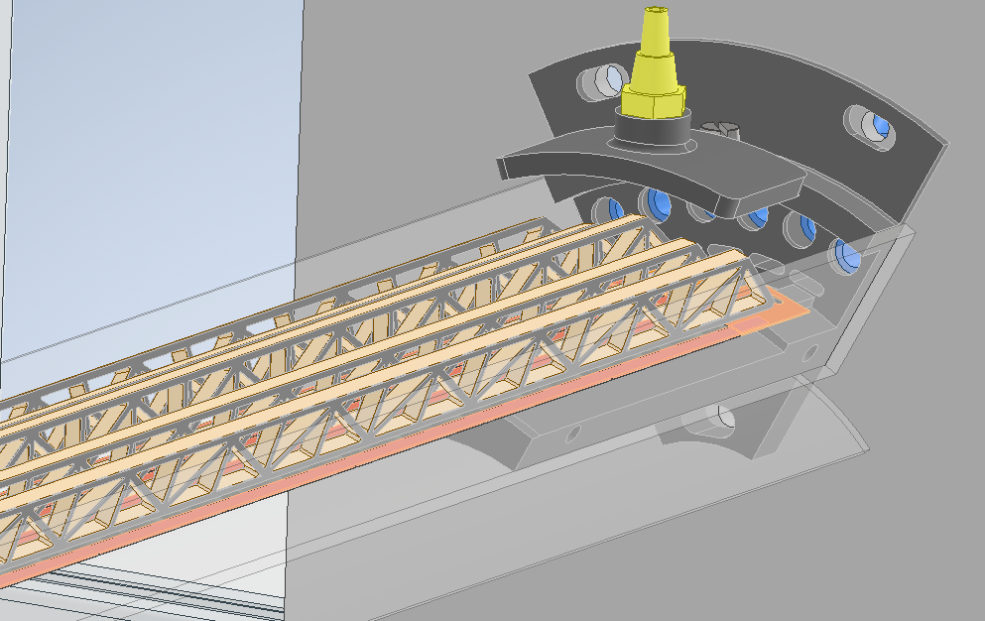
Vienna, 22/05/2025
Gherardo Ammirabile, INFN Pisa
Experimental setup to evaluate the effectiveness of air cooling
First test on a 60° circular sector of layer 3 including five staves
Compressed air system to define:
Flow rate needed to cool the detectors
Pressure drop in the central region
Temperature increase between inlet and outlet
Next test on the same circular sector with all three layers
In progress

Slide 13
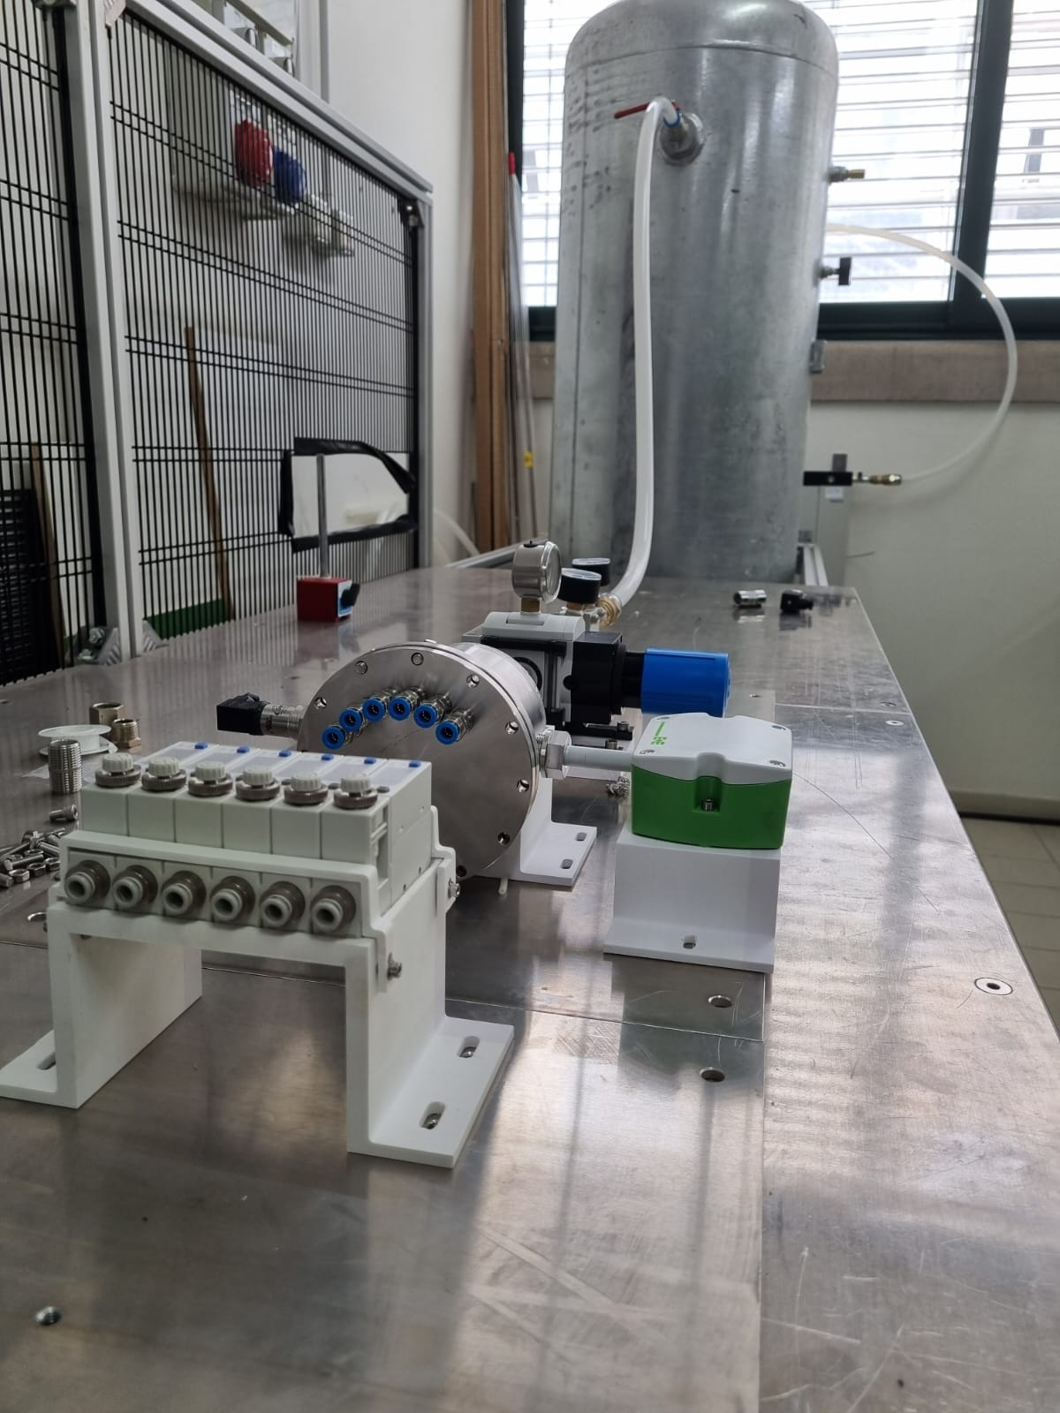
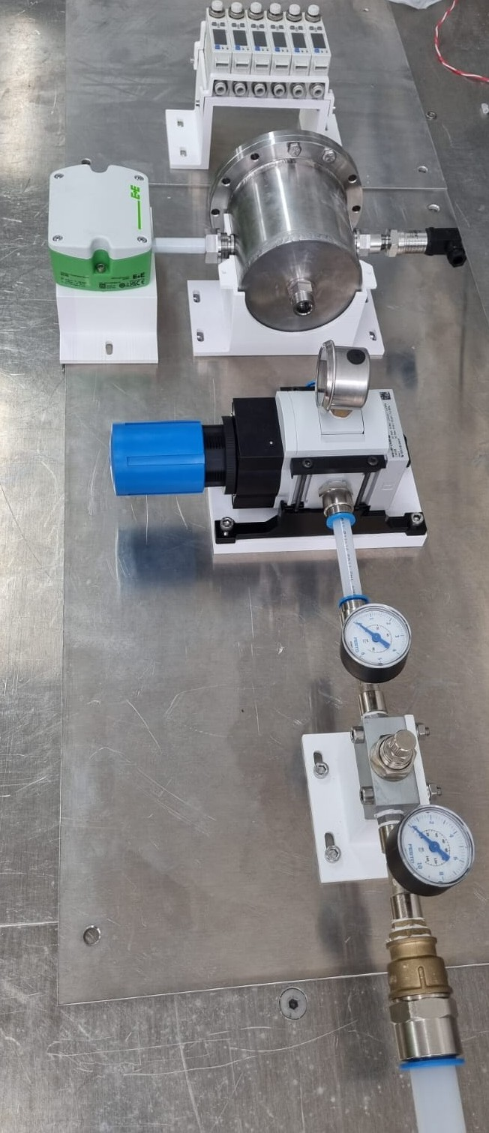
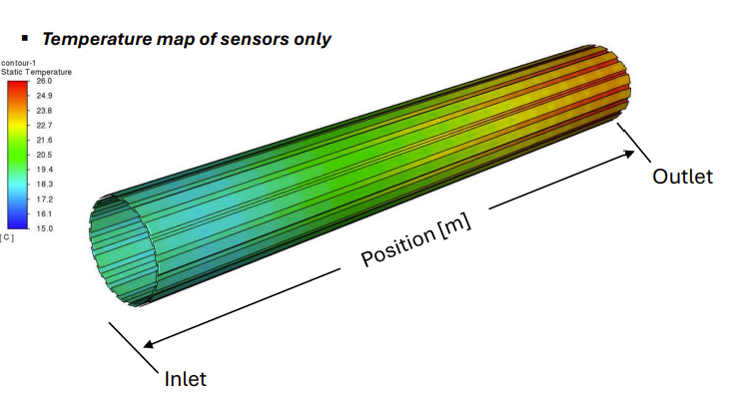
Vienna, 22/05/2025
Gherardo Ammirabile, INFN Pisa
Designed to:
Be adaptable
Be controlled
Allow CFD result verification
See ‘Vertex Detector Cooling simulations’, Baldinelli, Turrioni
https://indico.cern.ch/event/1439509/contributions/6289579/attachments/2995130/5276700/Baldinelli.pdf
Compressed air system under installation in Pisa

Slide 14
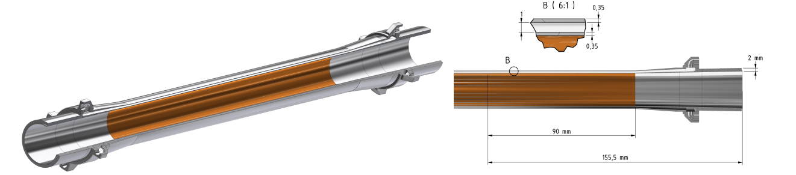
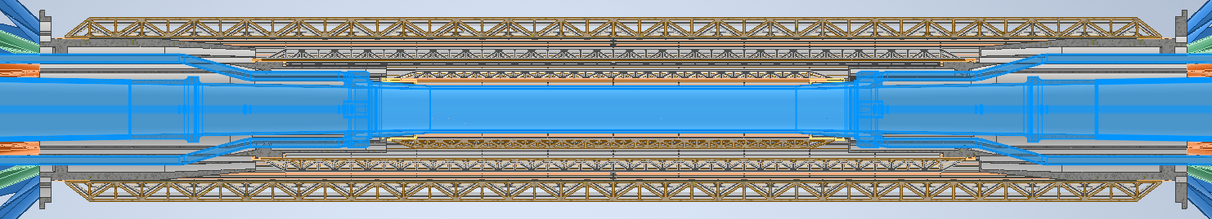
Vienna, 22/05/2025
Gherardo Ammirabile, INFN Pisa
Beam pipe cooling
PARAFFIN
OUTLET
PARAFFIN
INLET
POWER BUDGET = 54 W
COOLANT: PARAFFIN
Problems arise in the integration of liquid and air cooling systems
BEAM PIPE

Slide 15
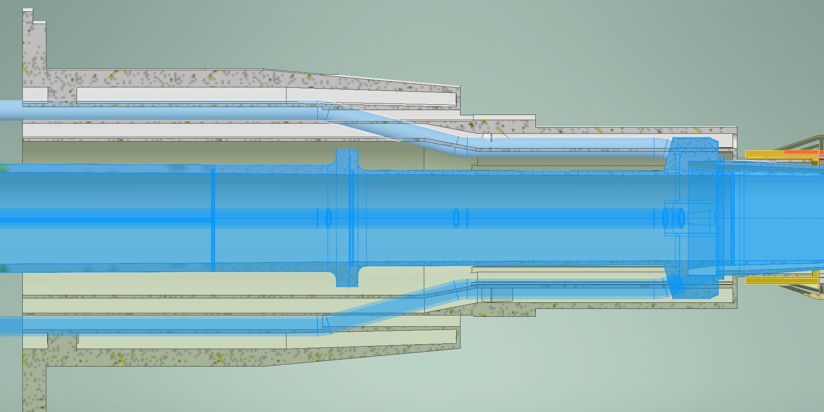
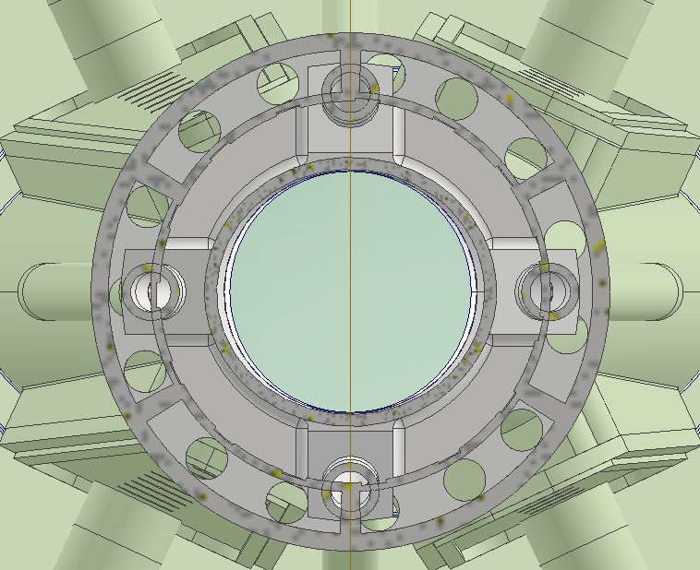
Vienna, 22/05/2025
Gherardo Ammirabile, INFN Pisa
Cooling systems integration
PARAFFIN
INLET
PARAFFIN
MANIFOLD
AIR
INLET LAYER 1
Ribs of the support
AIR
BEAM PIPE
Rear view
IP
Paraffin manifolds reduce the layer 1 airflow and make it difficult to route the cables
To allow the assembly of the 3D printed support, the paraffin ducts must be incorporated into the ribs of of the support
Investigations are ongoing to move further away the paraffin manifolds
Reduce the number of paraffin inlets from 4 to 3 arranged every 120°

Slide 16
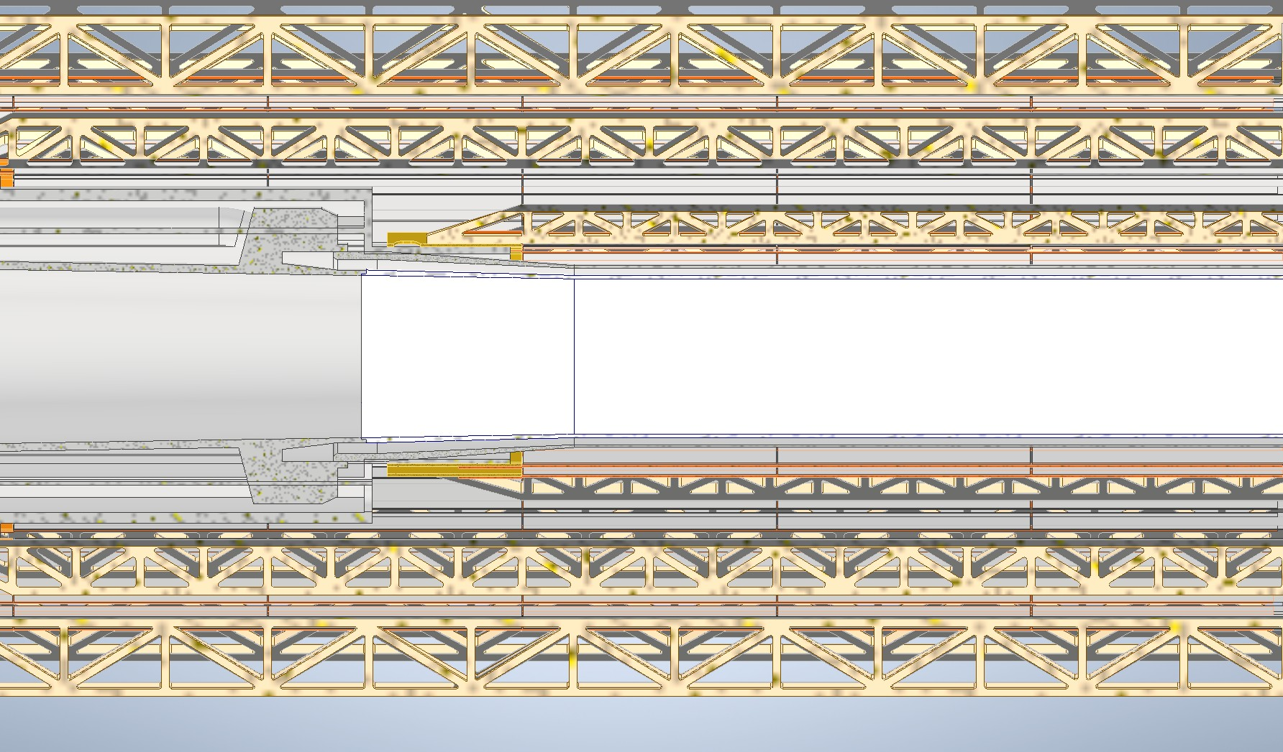
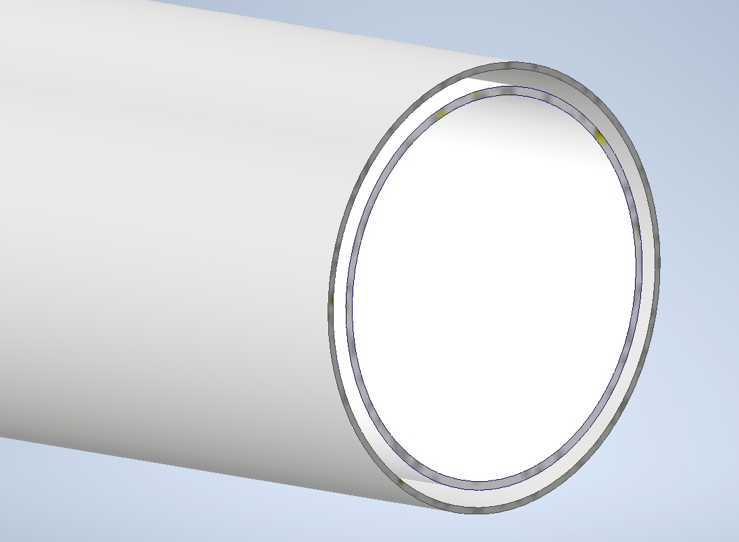
Vienna, 22/05/2025
Gherardo Ammirabile, INFN Pisa
Changing the paradigm of air cooling for layer 1
Layer 1
Outer ‘jacket’
Chambers cross section in AlBeMet
PARAFFIN FLOW
Layer 1 is only 2 mm away from the outer wall of the beam pipe
Why not to use the paraffin to cool the layer 1?
Needs an integrated design

Slide 17
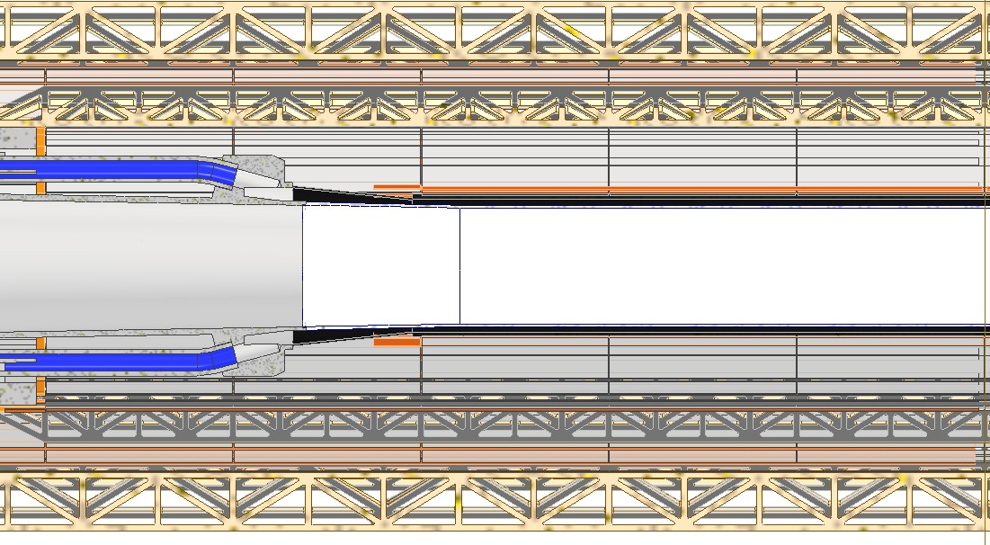
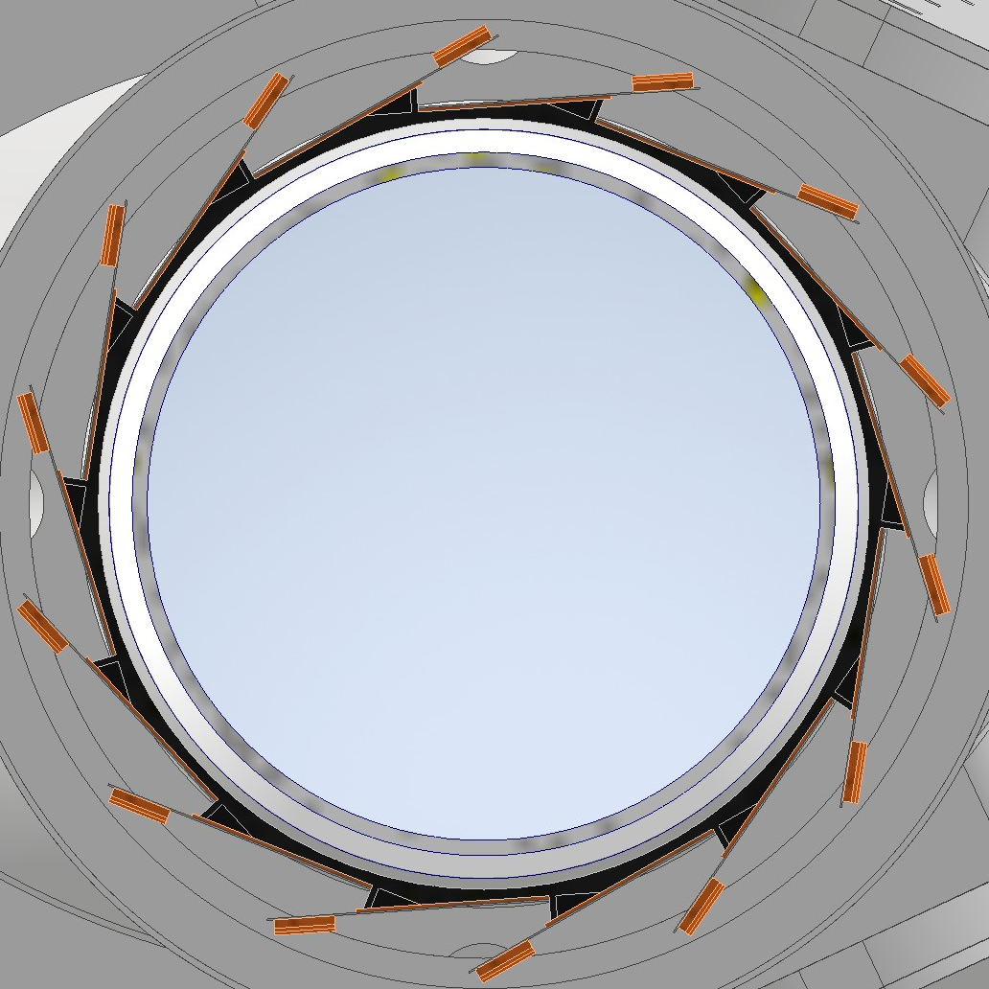
Vienna, 22/05/2025
Gherardo Ammirabile, INFN Pisa
Air-cooled Layer 1
Integrated design
A I R
A I R
With the integrated design solution:
ADVANTAGES:
Layer 1 stiffeners are eliminated
Layer 1 air ducts are eliminated
Small additional heat load (12 W compatible with the paraffin system performance)
Layer 1 is 2 mm closer to the interaction point
Easier integration of cooling systems
Contact between the detectors and the outer jacket mediated by a layer of electrical insulator:
Kapton
Ceramics
Need for a rigid support for the sensors:
Bonding
Centering
Assembly
PARAFFIN
Electrical insulator
Design under study

Slide 18
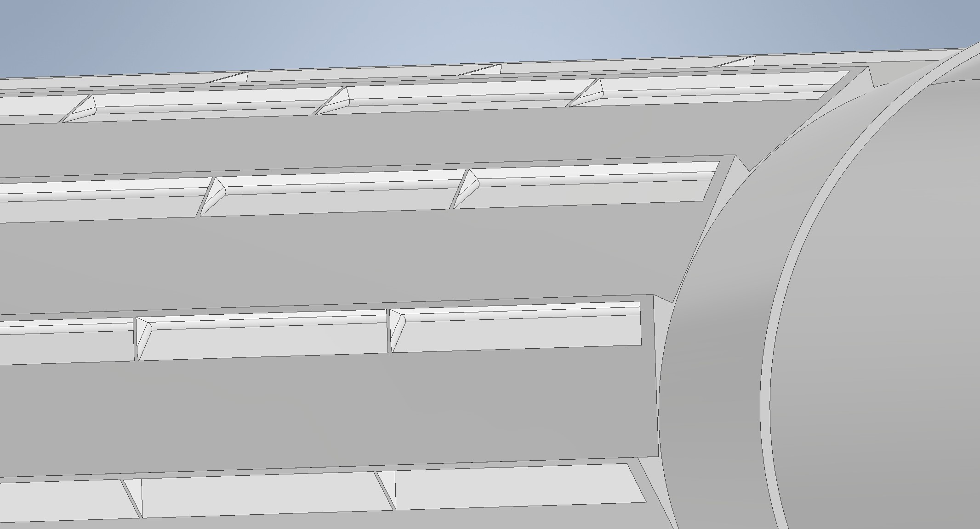
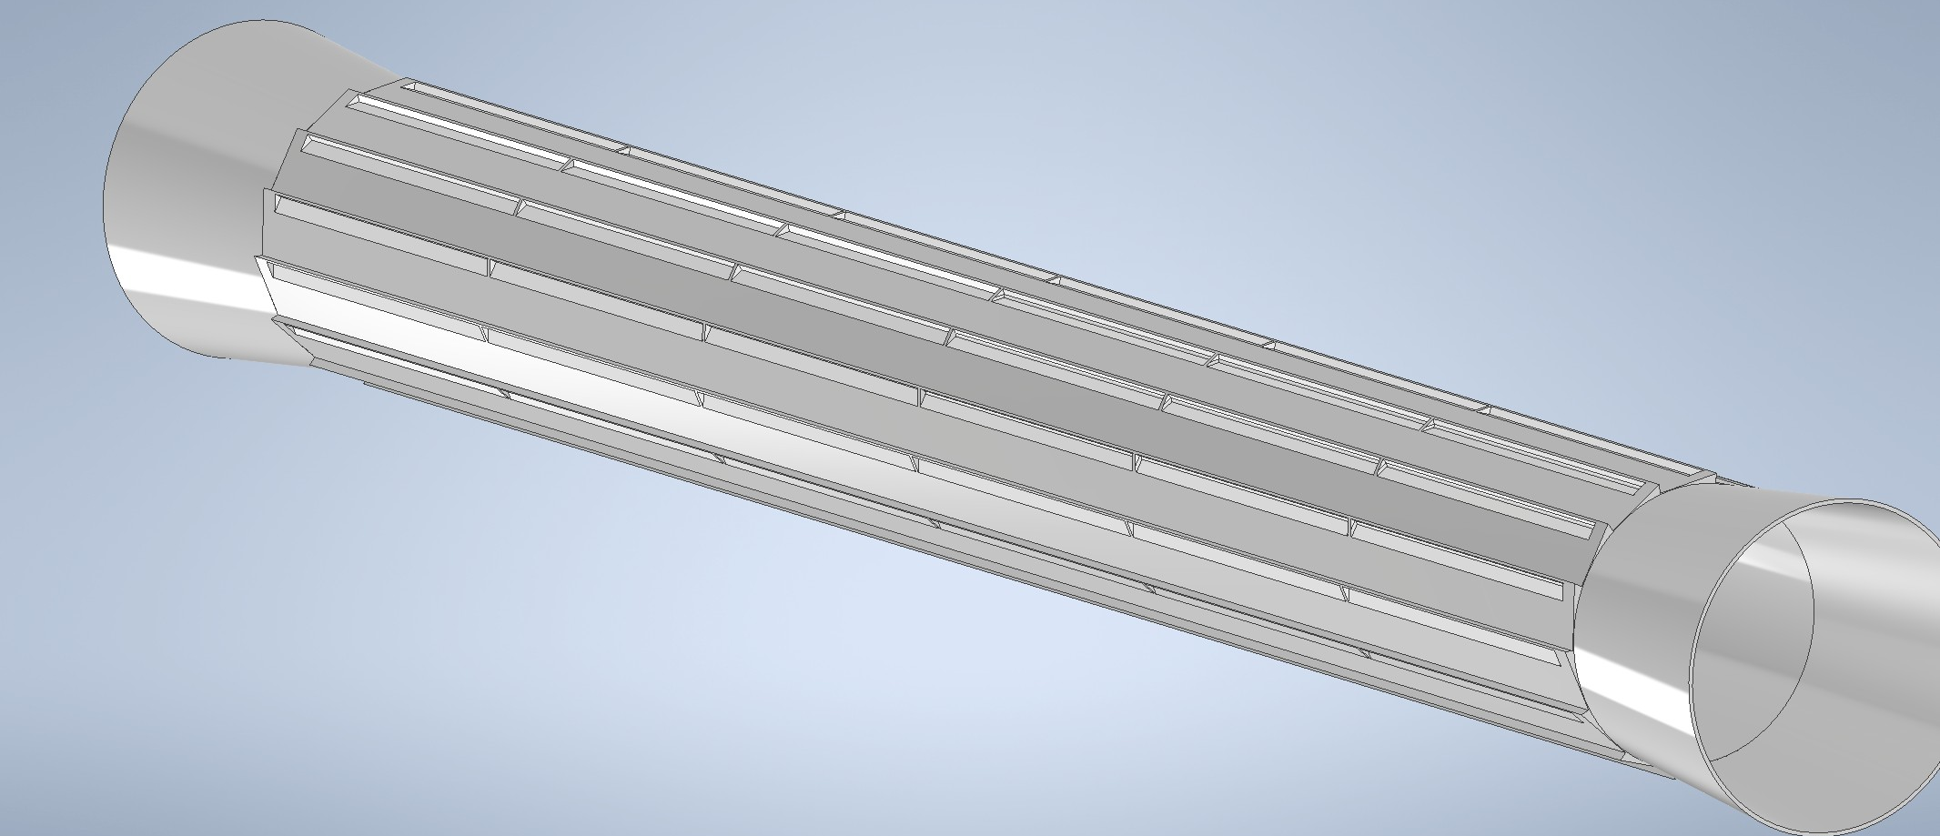
Vienna, 22/05/2025
Gherardo Ammirabile, INFN Pisa
Integrated design
Allow the flow of paraffin inside
Support silicon detectors
Be thin to reduce the material budget
Outer jacket
PARAFFIN
Lightening cut-outs
t = 0.35 mm
Conceptual design of the outer jacket
Modules with sensors wire-bonded:
On the r-φ side (ARCADIA like)
At the ±z ends (ALICE 3 like)

Slide 19

CONCLUSIONS:
The integration of the services of both the beam pipe and the detectors has posed challenges that are being resolved and that require some changes in the design.
The routing of the services seems to be feasible with the location of the large amount of cables and cooling ducts to the outside of the support cylinder.
The integrated cooling system of layer 1 allows for efficiency (fewer services needed) and brings it closer to the beam pipe.
The experimental tests will provide important indications on which solution is worth exploring further
Vienna, 22/05/2025
Gherardo Ammirabile, INFN Pisa

Slide 20
Thank you for your attention!
FCC Week, Vienna 22/05/25

