Slide 1
Status Report on the MDI Alignment Monitoring Study
22/05/2025, FCC week 2025, Vienna
1
Léonard WATRELOT
CERN BE-GM-FP
Many thanks to :
Manuela Boscolo, Francesco Fransesini, Hélène Mainaud Durand, Mateusz Sosin, Michel Noir, Leo Sjoberg, Bartlomiej Pudlo, Jürgen Gutekunst, Okan Dag
Notes:
Sources :

Slide 2
22/05/2025, FCC week 2025, Vienna
Léonard WATRELOT, BE-GM-FP
2
Overview
Quick reminder
External monitoring system
Deformation monitoring system
MDI alignment Mock up
Detector geometry monitoring

Slide 3
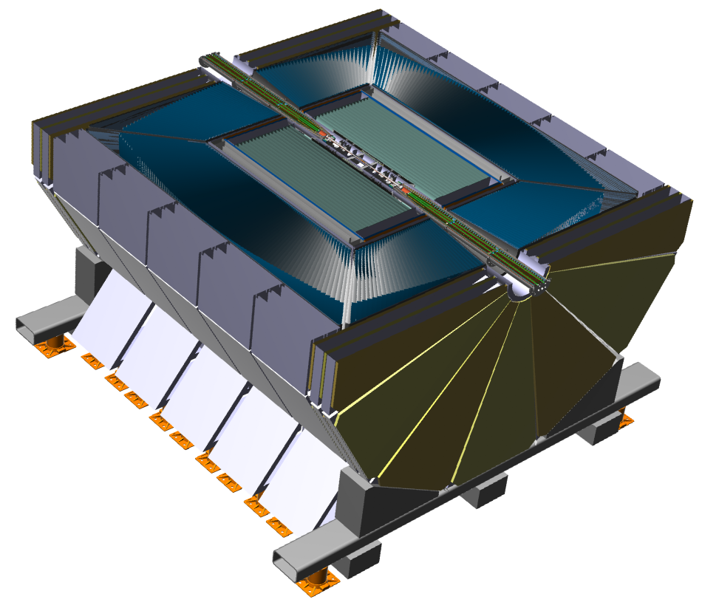
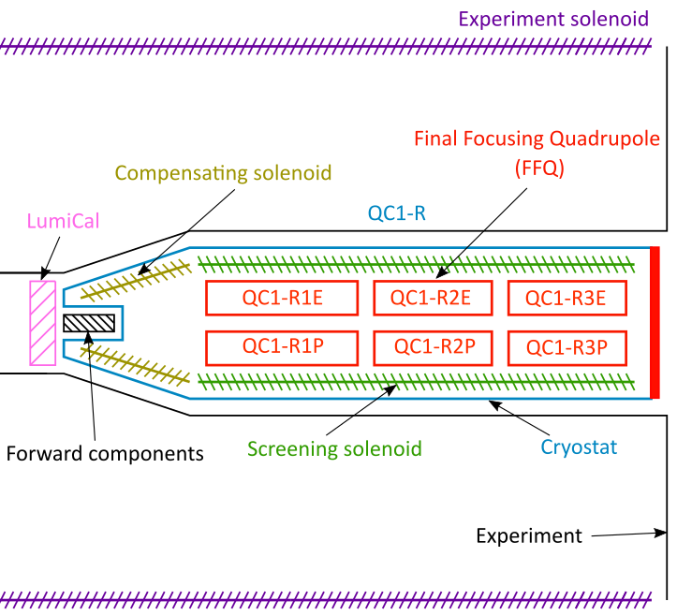
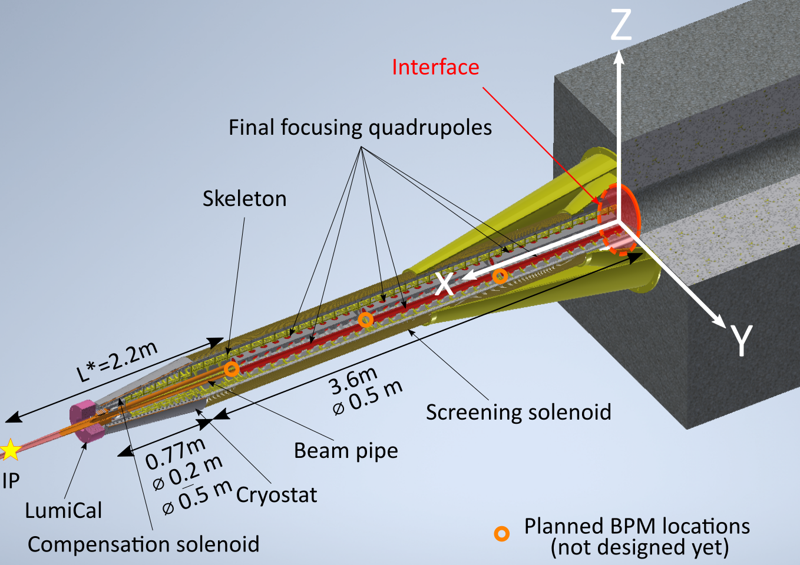
22/05/2025, FCC week 2025, Vienna
Léonard WATRELOT, BE-GM-FP
3
Reminder of the FCC-ee MDI region
10 m

Slide 4
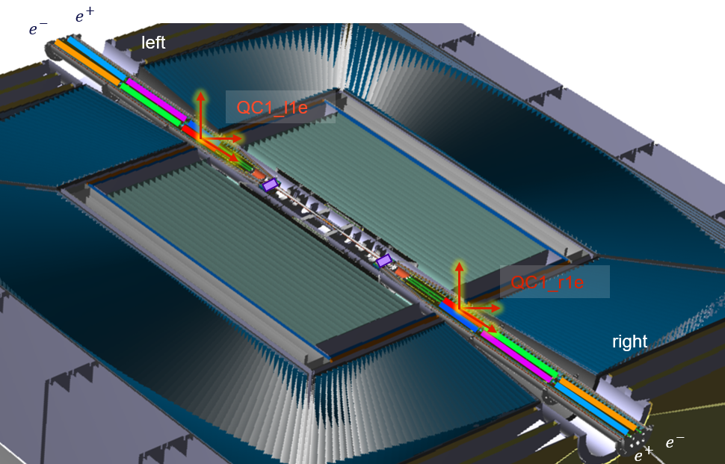
22/05/2025, FCC week 2025, Vienna
Léonard WATRELOT, BE-GM-FP
4
Alignment goal in the FCC-ee MDI: monitor the alignment of final focusing quadrupoles across the MDI

Slide 5
22/05/2025, FCC week 2025, Vienna
Léonard WATRELOT, BE-GM-FP
5
Sub-goal: first monitor the alignment of each side independently

Slide 6
22/05/2025, FCC week 2025, Vienna
Léonard WATRELOT, BE-GM-FP
6
Sub-goal: recover the data out of the interface at the end of the assembly

Slide 7
22/05/2025, FCC week 2025, Vienna
Léonard WATRELOT, BE-GM-FP
7
Sub-goal: monitor the alignment between the assembly and the detector (especially the detector solenoid)

Slide 8
22/05/2025, FCC week 2025, Vienna
Léonard WATRELOT, BE-GM-FP
8
Sub-goal: link the alignment between the assemblies on both sides of the detector

Slide 9
22/05/2025, FCC week 2025, Vienna
Léonard WATRELOT, BE-GM-FP
9
First: the external alignment system

Slide 10
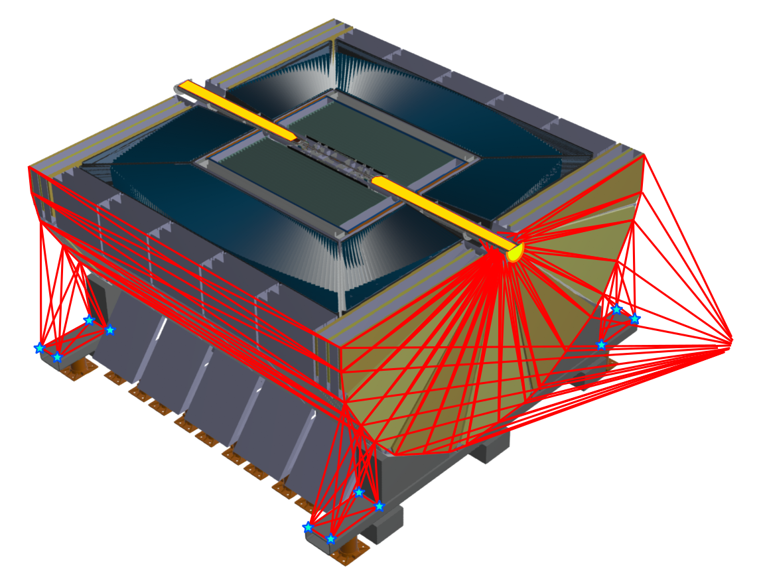
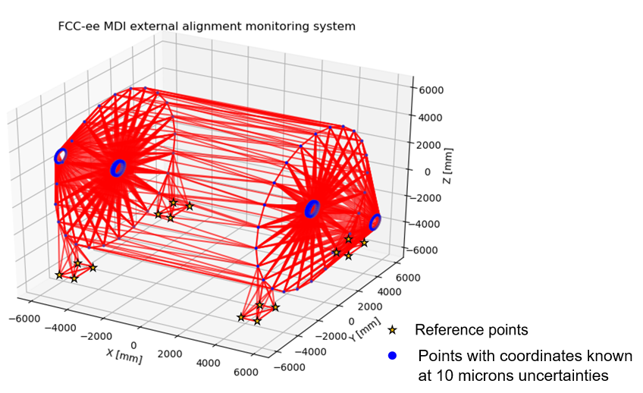
22/05/2025, FCC week 2025, Vienna
Léonard WATRELOT, BE-GM-FP
10
First: the external alignment system
Interferometric distance measurement network
Notes:
Difficult conditions
Radiations, magnetic fields, cryogenic temperature …
Need for an alignment system
A robust and redundant one as conditions will be very difficults and the access impossible

Slide 11
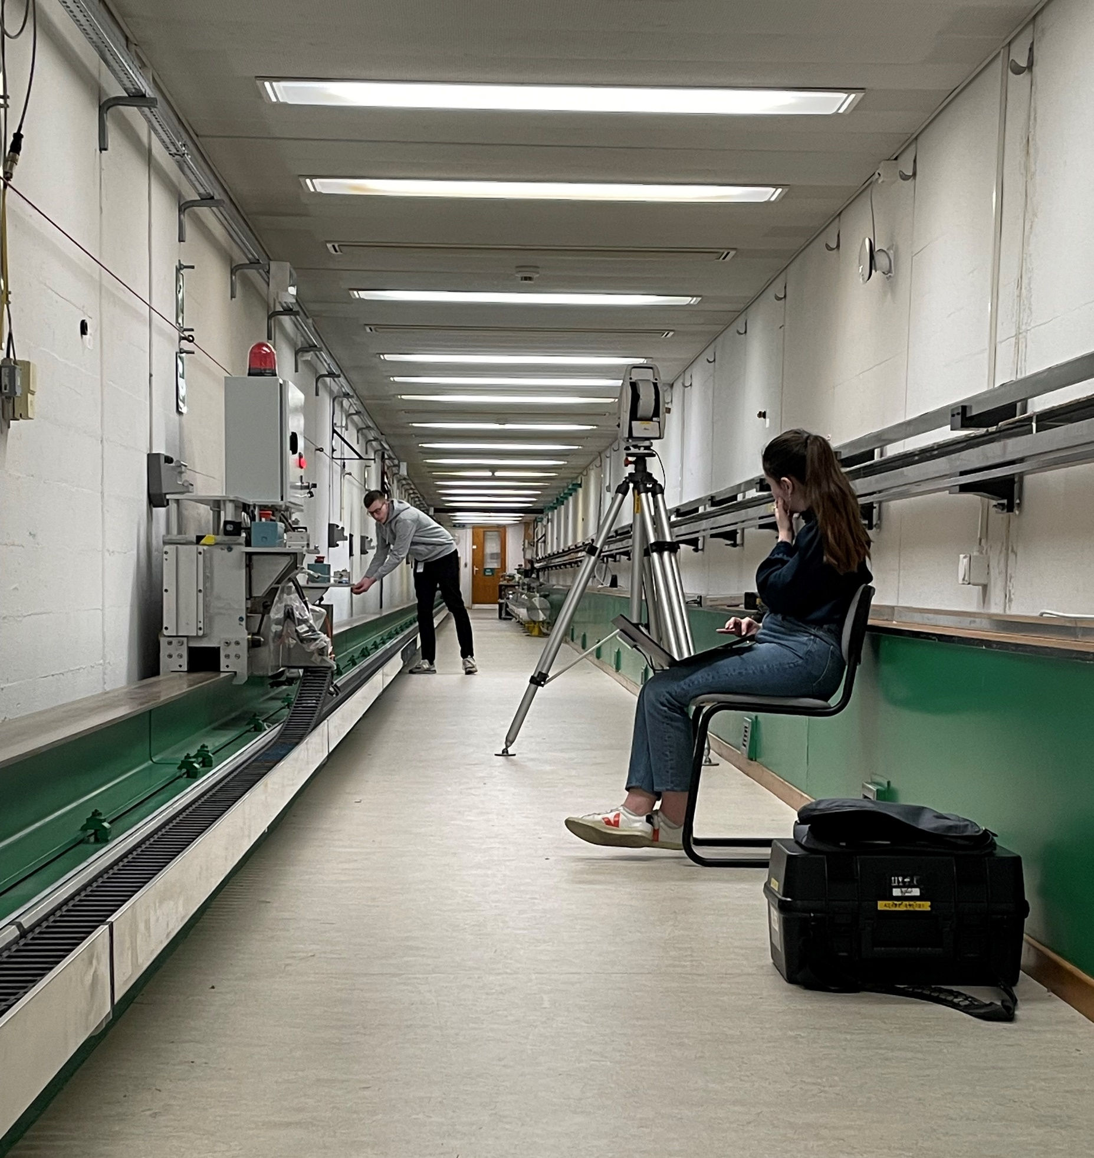


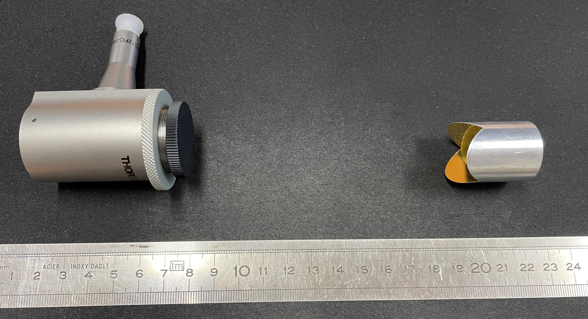
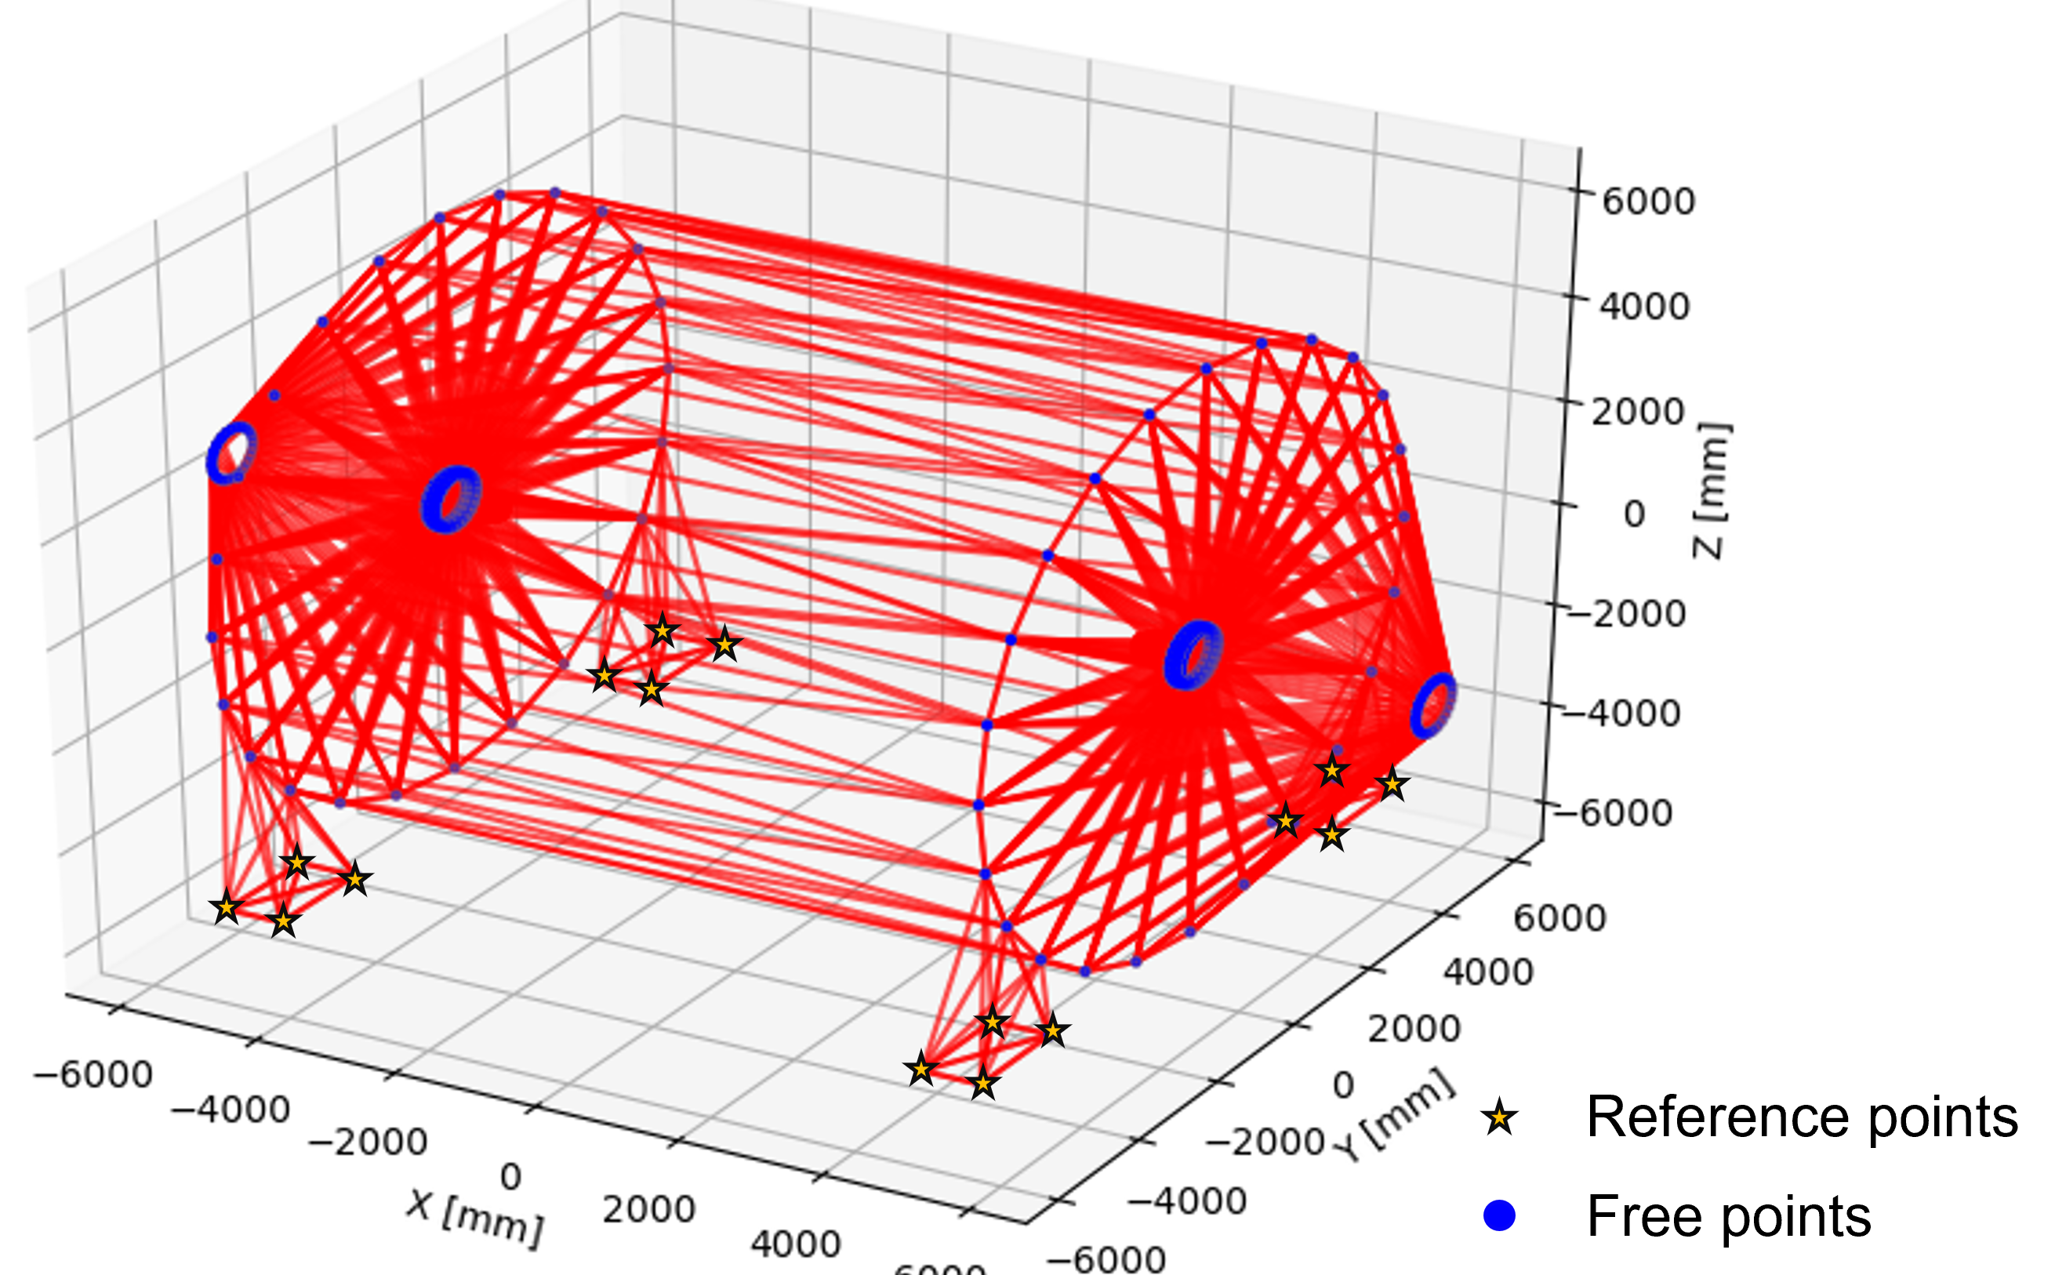
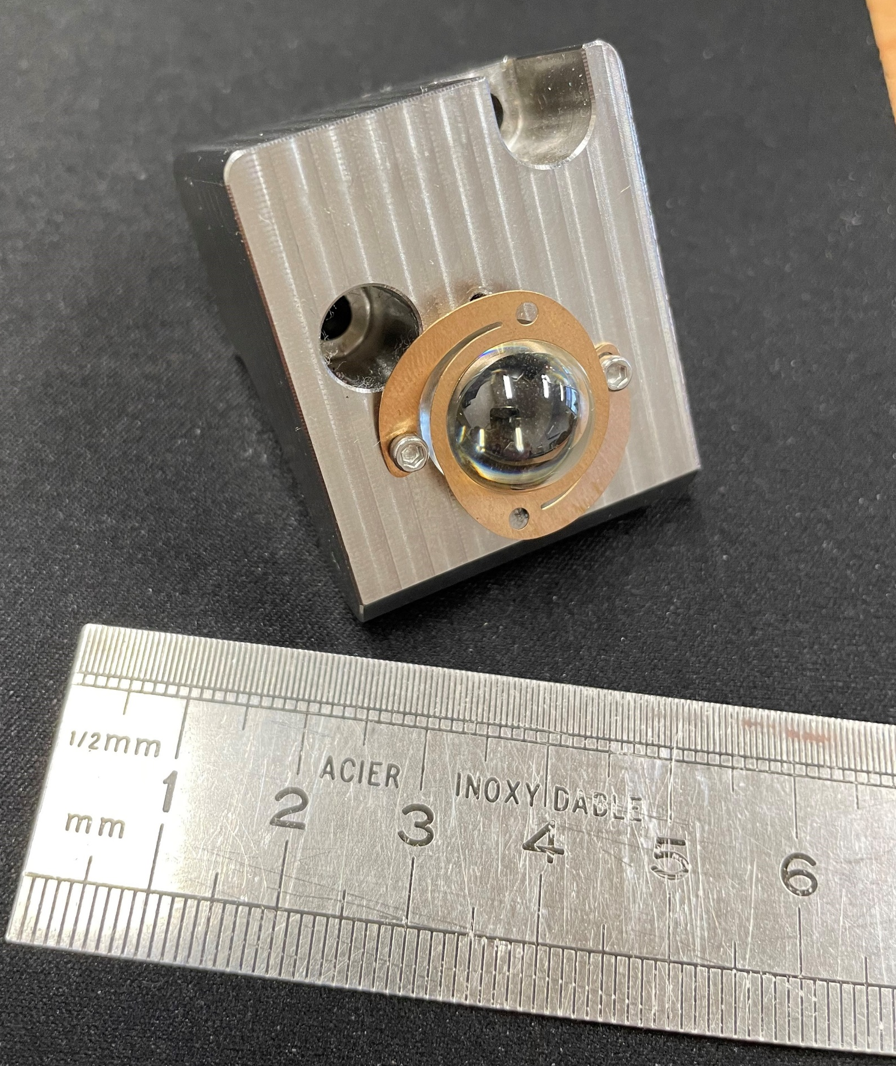
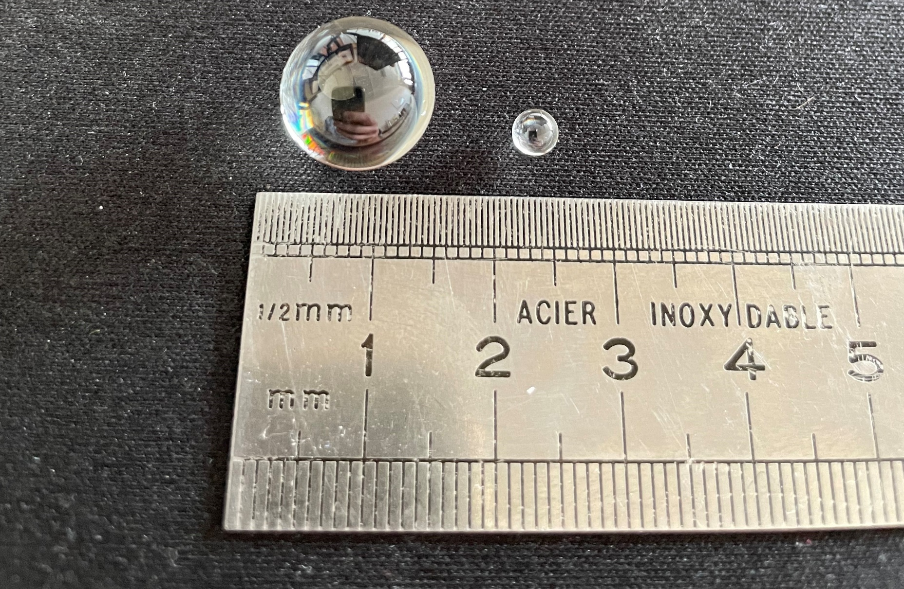
22/05/2025, FCC week 2025, Vienna
Léonard WATRELOT, BE-GM-FP
11
External alignment system
Hardware R&D
Simulations
FSI long range validation campaign
Permanent network of interferometric distance measurements based on Frequency Scanning Interferometry (FSI).
Multilateration over the network.
Collimator and Corner Cube retroreflector
Glass bead supports
Glass beads
Optimal network : too much measurements, some (plenty) wont be possible.
Updates on the design are followed carefully.
Thesis link
Notes:
Difficult conditions
Radiations, magnetic fields, cryogenic temperature …
Need for an alignment system
A robust and redundant one as conditions will be very difficults and the access impossible

Slide 12
22/05/2025, FCC week 2025, Vienna
Léonard WATRELOT, BE-GM-FP
12
Second: internal alignment system

Slide 13
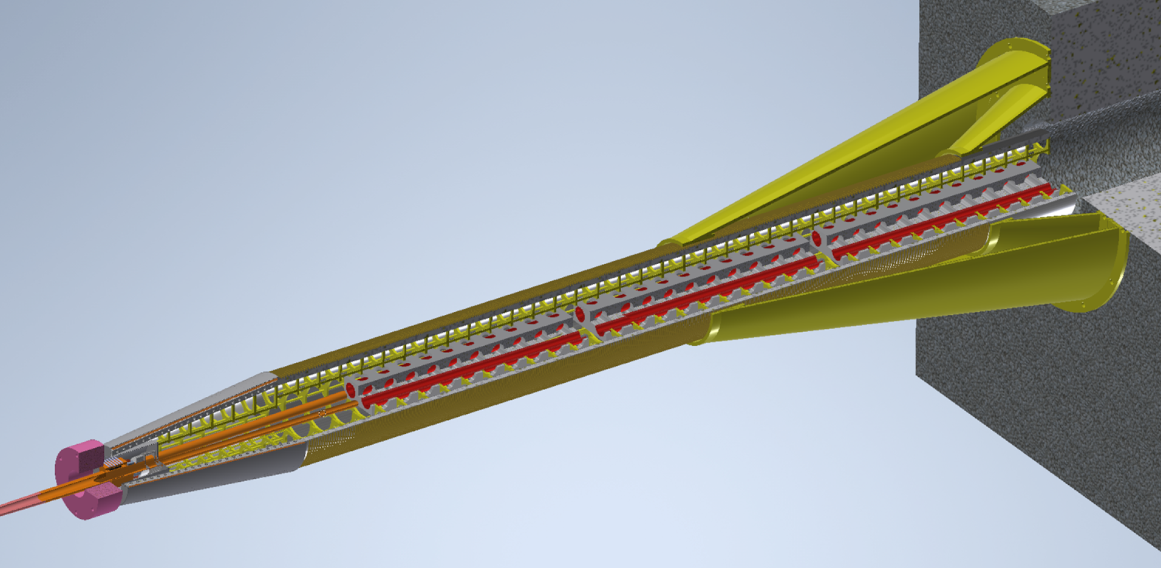
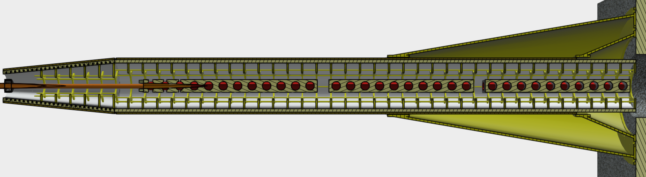
22/05/2025, FCC week 2025, Vienna
Léonard WATRELOT, BE-GM-FP
13
Second: internal alignment system
Goal : monitor the deformation extremely precisely over the length of the assembly
Create a network of points accurate enough so another system can measure from it onto the inner components
Design by M. Koratzinos
Final focusing quadrupoles to be monitored
Thesis link

Slide 14
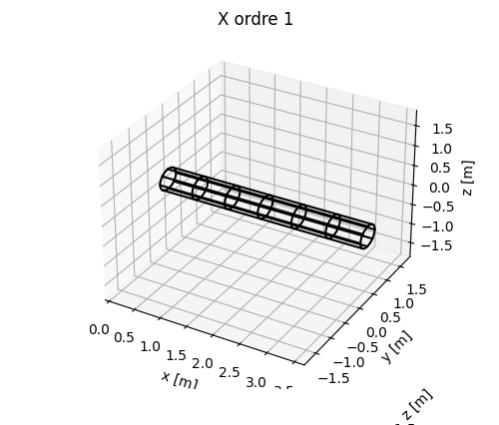
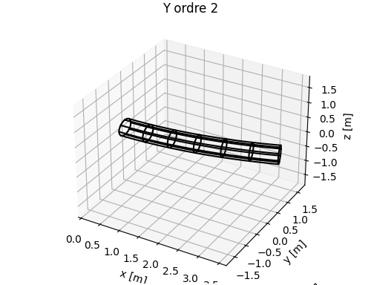
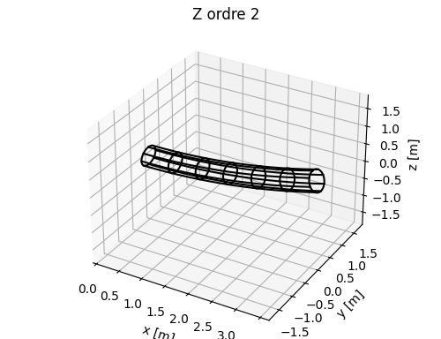
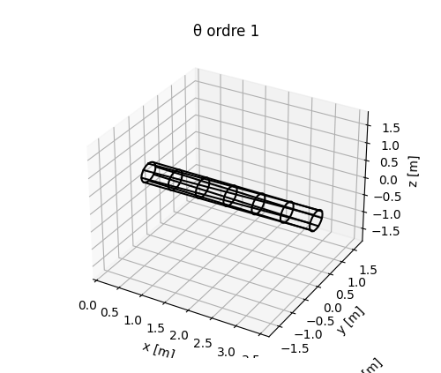
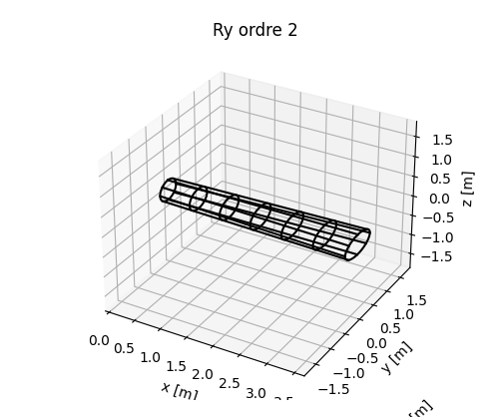
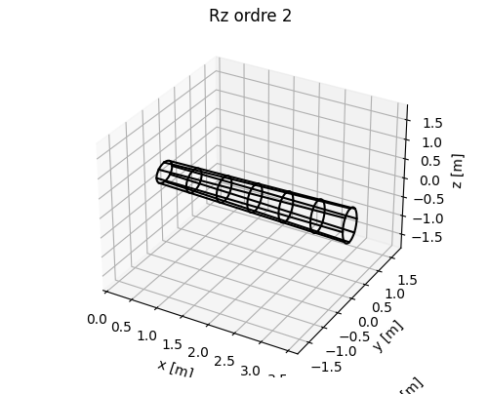
22/05/2025, FCC week 2025, Vienna
Léonard WATRELOT, BE-GM-FP
14
Second: internal alignment system
  Deformation models
Goal : monitor the deformation extremely precisely over the length of the assembly
Create a network of points accurate enough so another system can measure from it onto the inner components
Deformation monitoring system
Cylinder of which the deformation is well known and from which we will measure the inner components
Design by M. Koratzinos
Final focusing quadrupoles to be monitored
Thesis link

Slide 15
22/05/2025, FCC week 2025, Vienna
Léonard WATRELOT, BE-GM-FP
15
Second: internal alignment system
  Deformation models
Goal : monitor the deformation extremely precisely over the length of the assembly
Create a network of points accurate enough so another system can measure from it onto the inner components
Deformation monitoring system + distance measurement system
Cylinder of which the deformation is well known and from which we will measure the inner components
Design by M. Koratzinos
Measurement on the inner components
Final focusing quadrupoles to be monitored
Thesis link

Slide 16
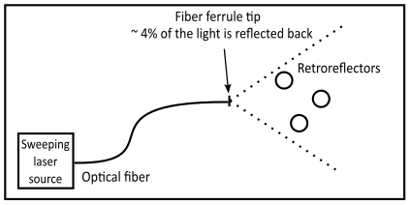
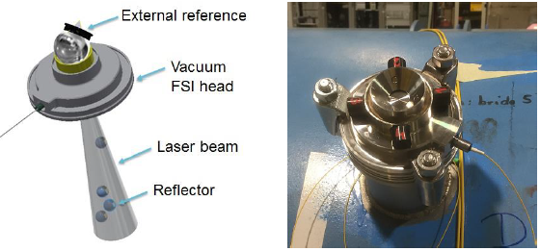
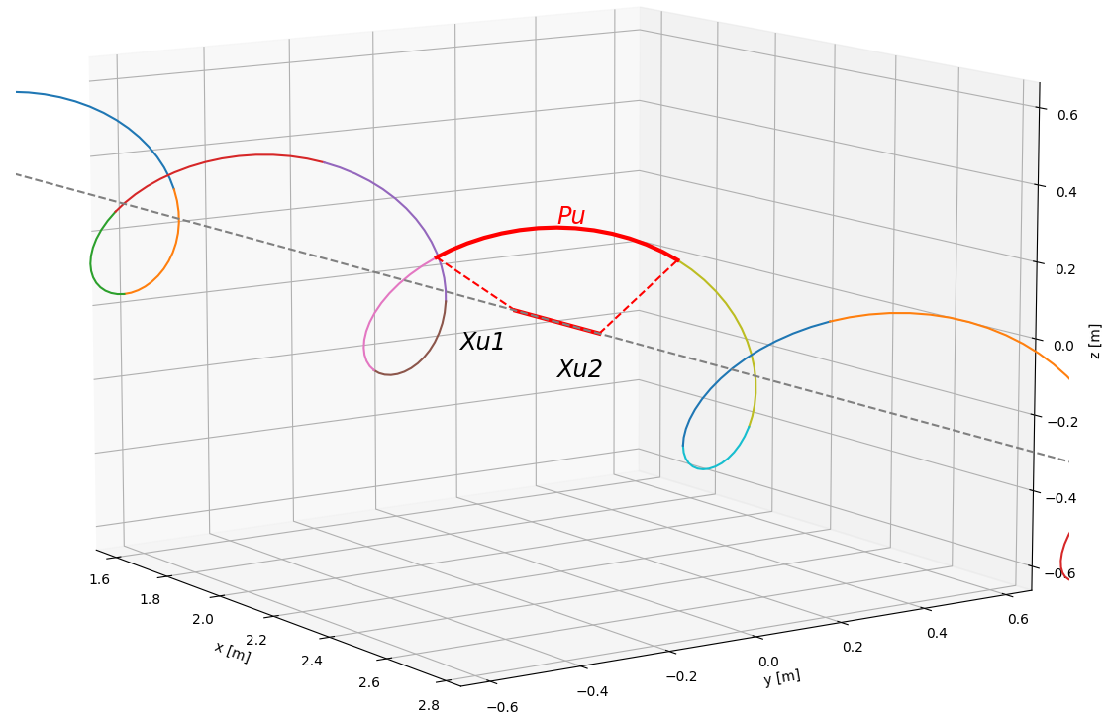
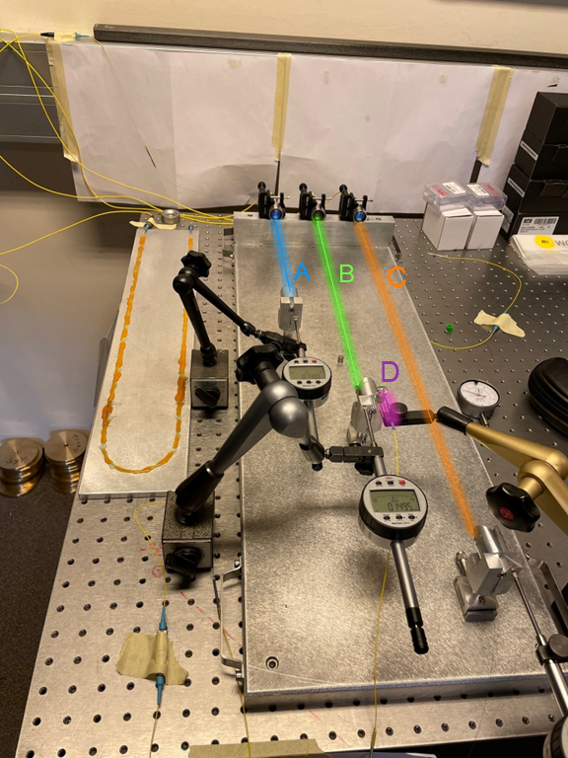
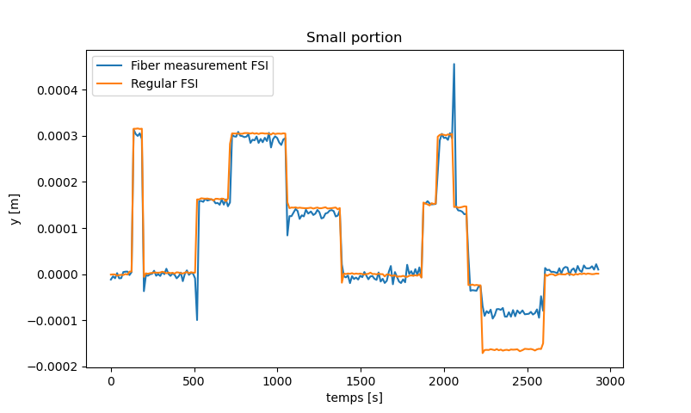
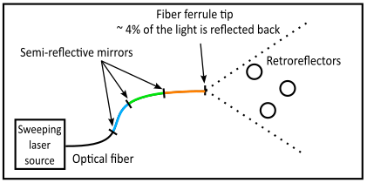
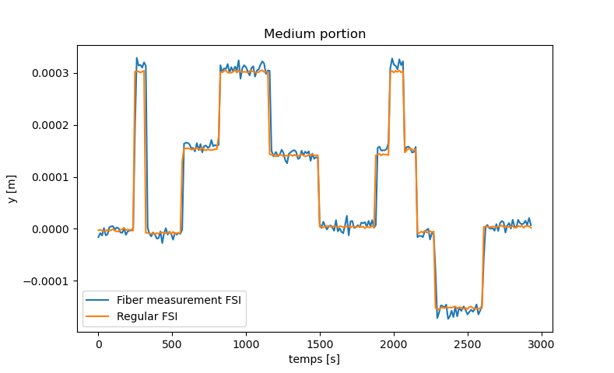
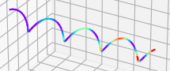
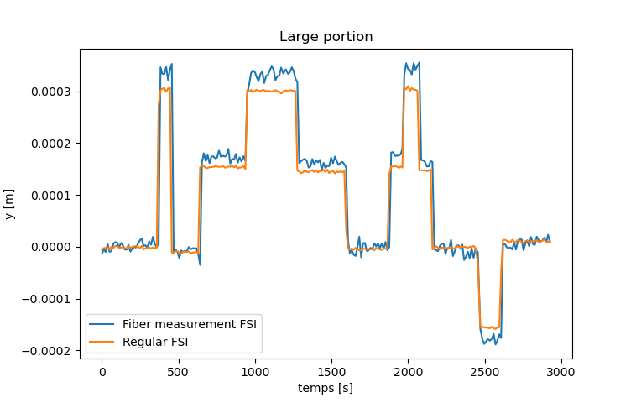
22/05/2025, FCC week 2025, Vienna
Léonard WATRELOT, BE-GM-FP
16
Deformation monitoring
https://iopscience.iop.org/article/10.1088/1361-6501/acc6e3
Current use of the FSI
Example of a FSI head prototype measuring on the cold mass from the cryostat
In-fiber measurements can be used to monitor deformations when placed in helix on the studied cylinder, portions measuring the local change of length.
Sosin, M., et al. "Frequency sweeping interferometry for robust and reliable distance measurements in harsh accelerator environment." Applied Optical Metrology III. Vol. 11102. SPIE, 2019.
Multiplexed measurements performed for the FCC
First prototype for the In-lined Multiplexed and Distributed FSI (cf. article)

Slide 17
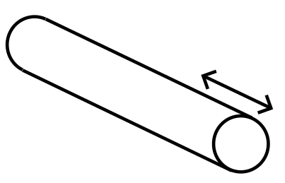
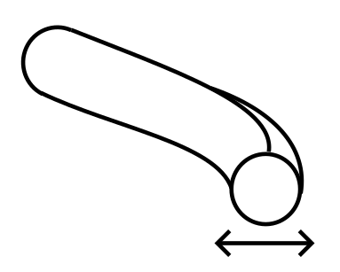
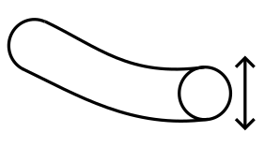
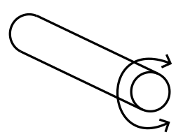
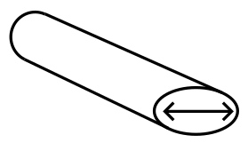
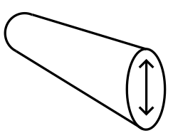
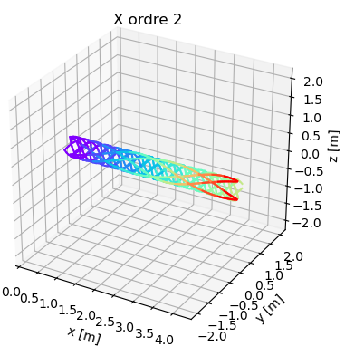
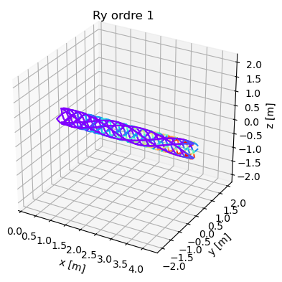
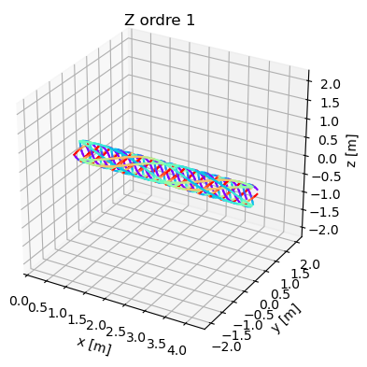
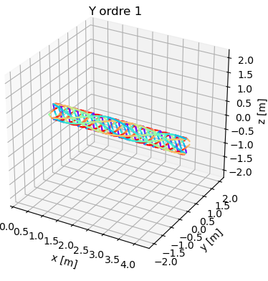
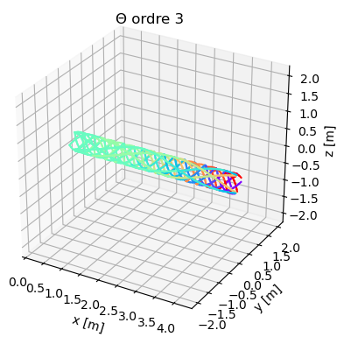

22/05/2025, FCC week 2025, Vienna
Léonard WATRELOT, BE-GM-FP
17
Deformation monitoring
https://iopscience.iop.org/article/10.1088/1361-6501/acc6e3

Slide 18
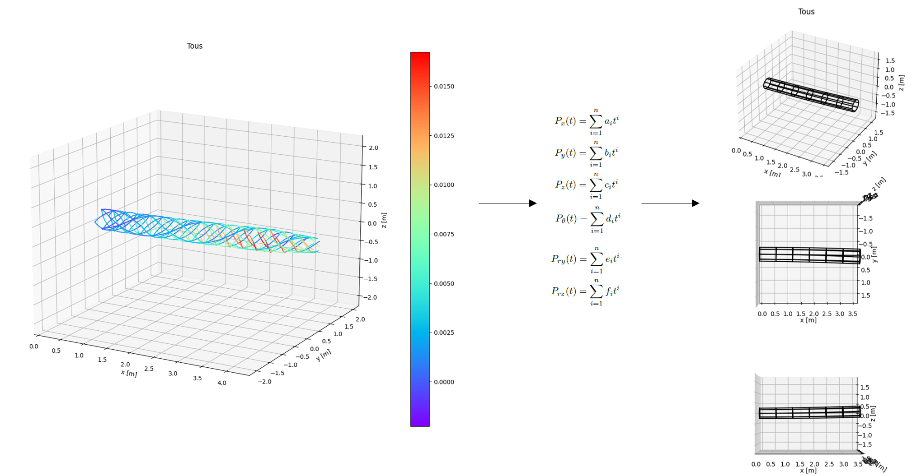
22/05/2025, FCC week 2025, Vienna
Léonard WATRELOT, BE-GM-FP
18
Deformation monitoring
Cylinder deformations
https://iopscience.iop.org/article/10.1088/1361-6501/acc6e3
Least square adjustment
Helixes observations
(= 3D lengths of portions)
+ equation of portion length as function of the deformation polynomials
3
Simulations shown micrometric accuracy
To be confirmed by a prototype
Total : 3600 measurements and ≈ 3 cm space taken by the sensing system in the assembly.

Slide 19
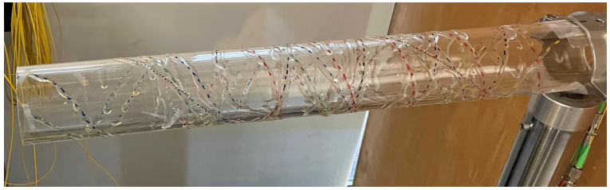
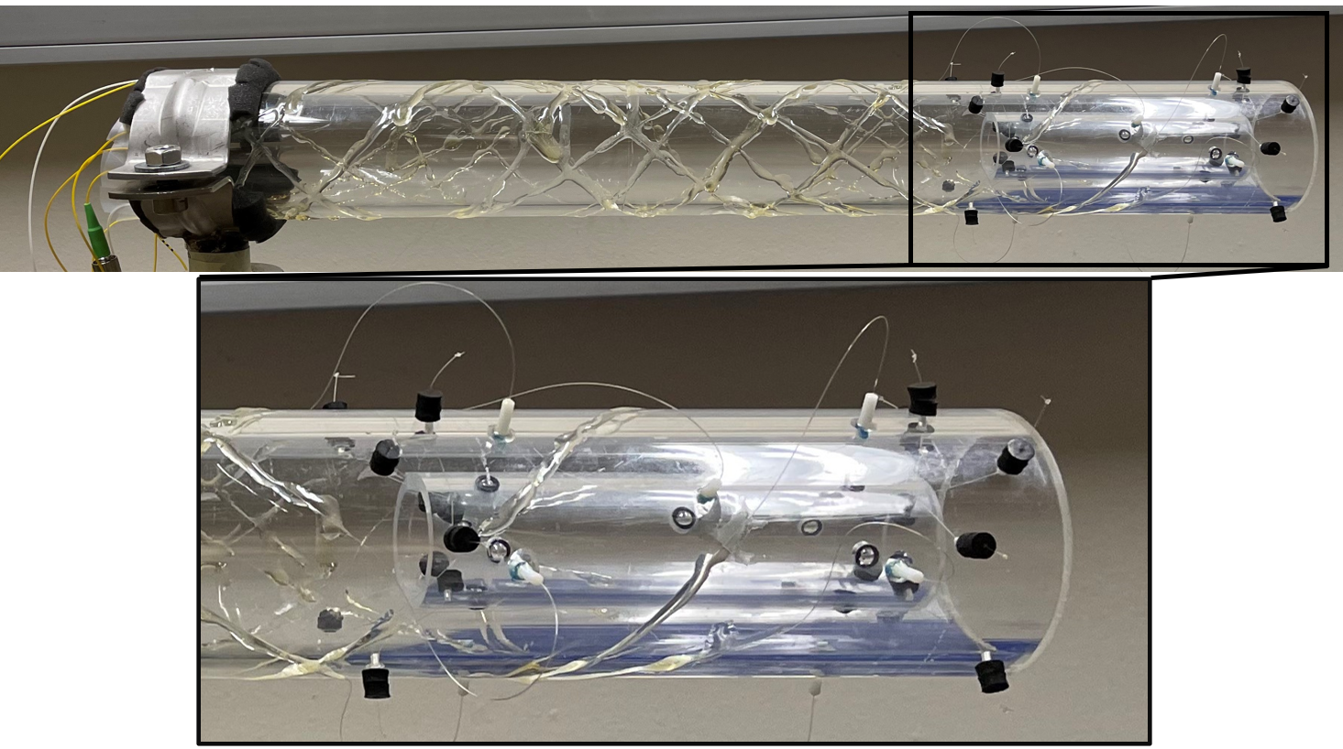
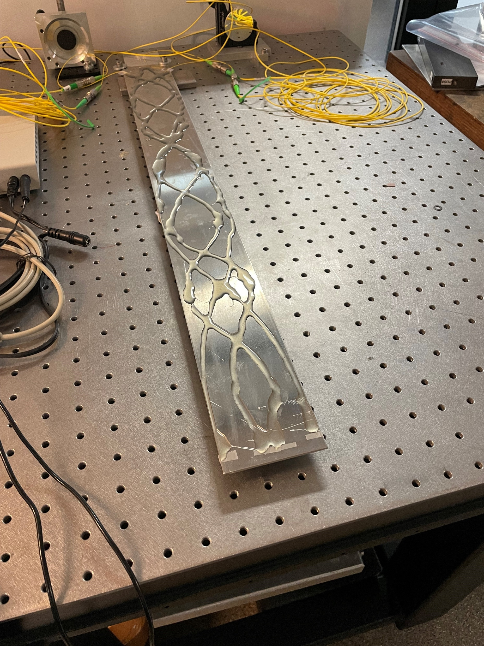
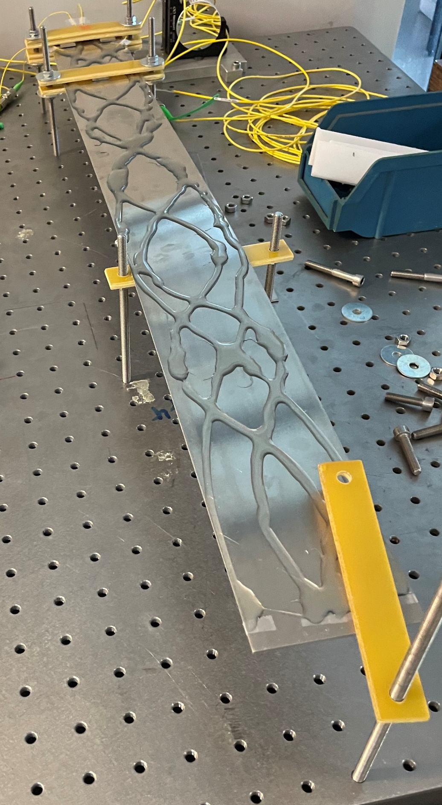
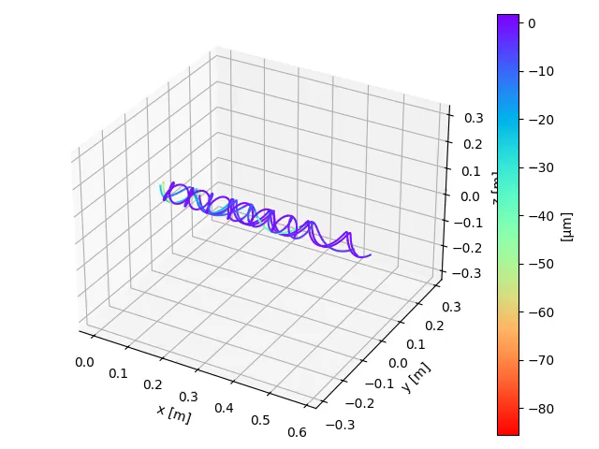
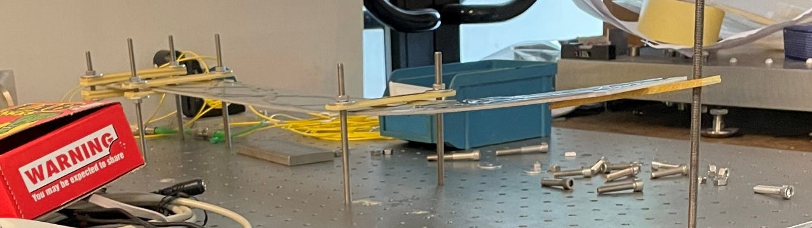
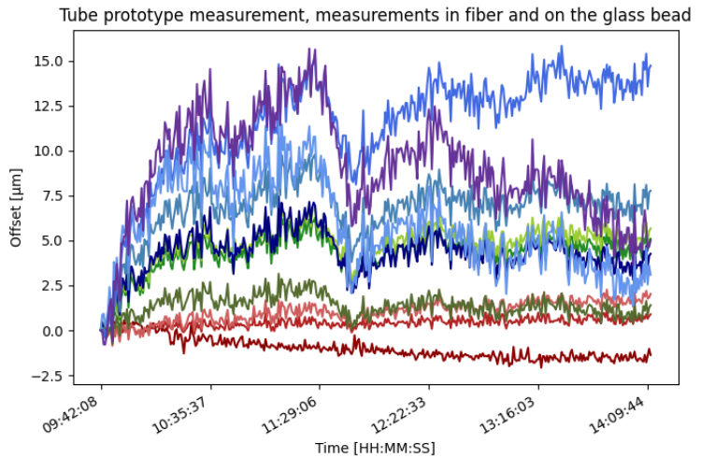
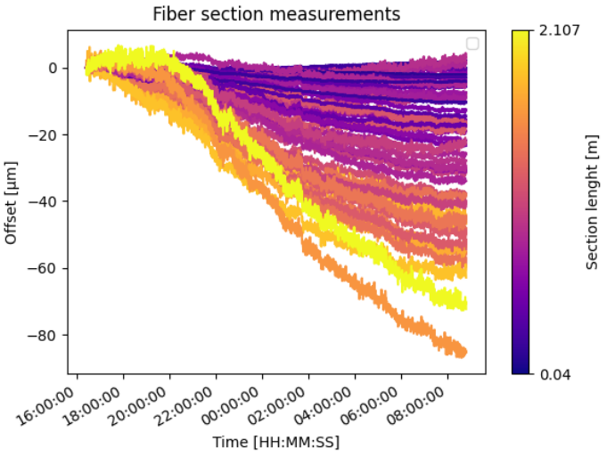
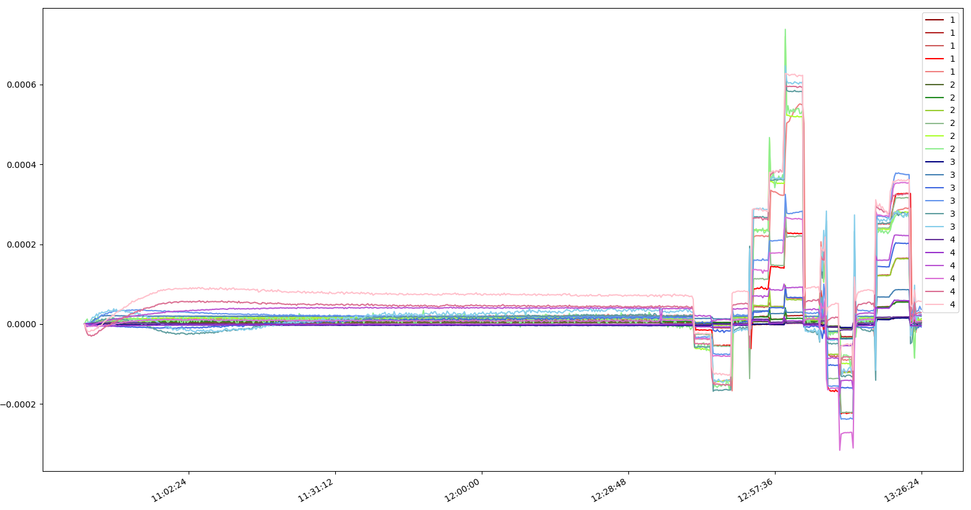
22/05/2025, FCC week 2025, Vienna
Léonard WATRELOT, BE-GM-FP
19
Latest and ongoing prototypes
Prototype implementing the fiber measurement and the FSI measurement on reflector
First prototype with helix fibers
Sensor glued on an aluminum plate
Monitoring of the glue curing
Measurements performed by a single fiber fiber
Stabilization stage
Deformation testing

Slide 20
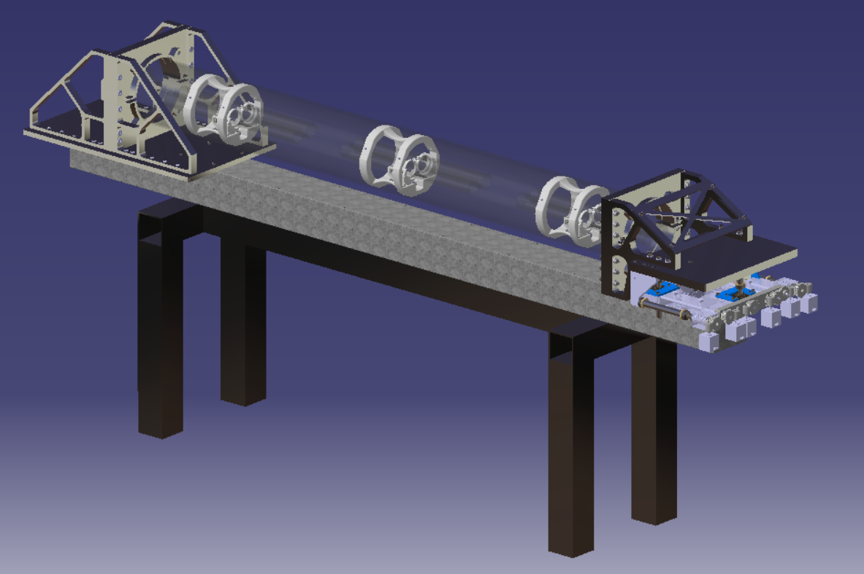
22/05/2025, FCC week 2025, Vienna
Léonard WATRELOT, BE-GM-FP
20
MDI alignment monitoring mock-up: design and goal
Stable support, simulating the support outside the detector
6x Smaller plastic tubes simulating the final focusing quadrupoles
3D printed supports and motorised kinematic mounts for the simulated final focusing quadrupoles
2m long plastic tube, simulating the support of the screening solenoid on which the fibers will be installed
Very precise movable plate (Universal Adjustement Platform) to induce deformations

Slide 21



22/05/2025, FCC week 2025, Vienna
Léonard WATRELOT, BE-GM-FP
21
MDI alignment monitoring mock-up: first assembly
3D printed supports for the smaller cylinders
First assembly of the alignment monitoring mock-up.
UAP is being updated.
Initial deformation tests to be done using a dummy cylinder.
New controls and gears for the UAP

Slide 22






22/05/2025, FCC week 2025, Vienna
Léonard WATRELOT, BE-GM-FP
22
MDI alignment monitoring mock-up: FSI heads preparation
Calibration of all measuring heads thanks to a calibration bench
Preparation of FSI heads that will perform the classic “in-air” measurement towards the final focusing quadrupoles.
Installation of the prisms and checking the measuring cone
Gluing of the prisms, ready for the calibration
Gluing of the magnets

Slide 23
22/05/2025, FCC week 2025, Vienna
Léonard WATRELOT, BE-GM-FP
23
Vertex detector geometry monitoring

Slide 24








22/05/2025, FCC week 2025, Vienna
Léonard WATRELOT, BE-GM-FP
24
To put to perspective : subdetector monitoring systems installed inside ATLAS
Cf. presentation
Gibson, S. M., et al. "Monitoring the heart of ATLAS using Frequency Scanning Interferometry." Proceedings of the Eighth International Workshop on Accelerator Alignment, CERN, Geneva. 2004.

Slide 25



22/05/2025, FCC week 2025, Vienna
Léonard WATRELOT, BE-GM-FP
25
Deformation monitoring: simulations ongoing
First simulations ongoing (here, the network of points and points visible from a measuring position):
Examples of optical systems available :
Regular glass bead retroreflector
3D printed prism and fiber holder
Prism for compact laser beam redirection
Optical fiber ferrule
Glass bead retroreflector (4 mm)
Inner tracker not studied yet

Slide 26
Thank you for your attention
22/05/2025, FCC week 2025, Vienna
Léonard WATRELOT, BE-GM-FP
26
Notes:
Sources :

Slide 27



22/05/2025, FCC week 2025, Vienna
Léonard WATRELOT, BE-GM-FP
28
Recovering the data from the fibers
Epoxy glued optical fiber for installation on low-beta quadrupole cryostat for HL-LHC
Design by M. Koratzinos
All the information from the fibers will go through there.
Challenges due to conditions (space, temperature gradient, radiations, vacuum …) -> interface with fibers brazed or glued using epoxy.
Grandal, Tania, et al. "Laser brazing metallic embedding technique for fiber optic sensors." 2017 25th Optical Fiber Sensors Conference (OFS). IEEE, 2017.
To be studied
Bosman, M. Z. C., et al. "DESIGN AND DEPLOYMENT OF AN IN-VACUUM ELECTRO-OPTIC BPM AT THE CERN SPS."

Slide 28





22/05/2025, FCC week 2025, Vienna
Léonard WATRELOT, BE-GM-FP
29
To put to perspective : subdetector monitoring systems installed inside ATLAS
Lines of sight
BCAM
Amelung, Christoph, et al. "The Optical Alignment System of the ATLAS Muon Spectrometer Endcaps." ATL-MUON-PUB-2008-003 (2008).

Slide 29


22/05/2025, FCC week 2025, Vienna
Léonard WATRELOT, BE-GM-FP
30
Re-adjustment system
The EUCLID VIS Read-out Shutter Unit, which will operate in space
Interest of having a system able to move one or multiple element without requiring to disassemble the entire QC1 ?
Not necessary to be accurate at 10 μm, a system able to correct major displacements ~0.2 mm to 1mm (due to transport, gravity deformation, movement during cool down, intense magnetic fields …) would be already extremely convenient.
Not necessary to work at cryogenic temperatures only at room temperature would be already extremely convenient.
Not necessary to be able to work during the run of the machine, during shut downs would be already extremely convenient.
Larchevêque, C., et al. "The Euclid VIS read-out shutter unit: a low disturbance mechanism at cryogenic temperature." arXiv preprint arXiv:1801.07496 (2018).
Universal Alignment Platform Tests, Kacper Widuch, Vivien Rude BE-GM-HPA 2021-03-11
A lot of possibilities are open, from the system working only at warm temperature allowing a re-adjustment to the 0,1mm level of major components at the end of shut downs, to the system able to realign in real time and during the run of the machine the cold components to the micrometer level.
Systems to work in these conditions exist, the difficulty is to quantify their advantage compared to a loss of luminosity due to any misquantified misalignment value or to the need to dismount, disassemble, realign, reassemble and remount the assembly.

