Slide 1

MDI efforts at Magnet Division, BNL: Corrector Magnets and Screening Solenoid design for Interaction region of FCC-ee
Vikas Teotia
Superconducting Magnet Division

Slide 2
Major activities being pursued at Brookhaven for FCCee-IR
Development of Platform for design of combined function canted cosine theta direct wind magnets with longitudinally varying harmonics.
Design, fabrication and testing of a concept-magnet for annulling cross-talk harmonics of an existing direct wind quadrupole magnet on adjacent beam axis
First design of corrector magnet set for first final focus quadrupole
Design of screening solenoid and compensation solenoid for IR
Possible interest of FCCee in nano-meter level Magnetic Field vibration measurements (BNL-KEK experience)
Vikas Teotia, FCC week 2025, Vienna

Slide 3

Magnets for FCC-ee IR @ Brookhaven
Vertical and Horizontal Dipole Correctors
Skew Quadrupole correctors
Normal Quadrupole correctors
Cancelation of cross-talk in adjoining beam axis
Realistic Magnetic field mapping of detector solenoid leading to Screening Solenoid Design
Compensating Solenoid
We would like to start building a complete magnet model for the IR encompassing detector, screening, compensating, quadrupoles and correctors.
Vikas Teotia, FCC week 2025, Vienna

Slide 4
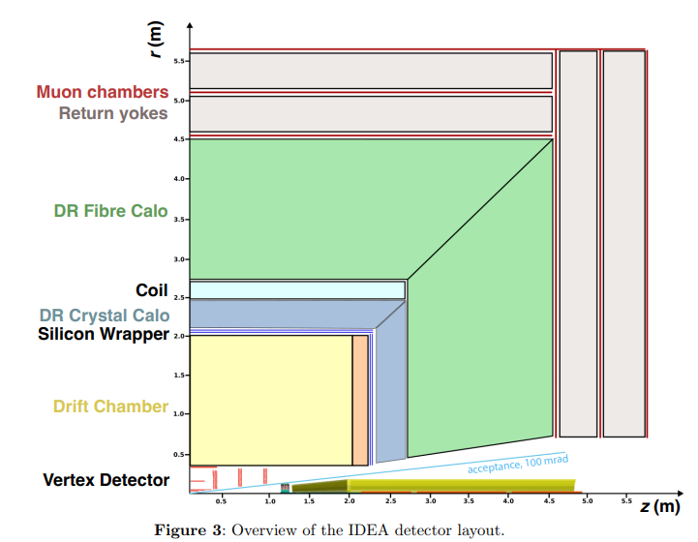
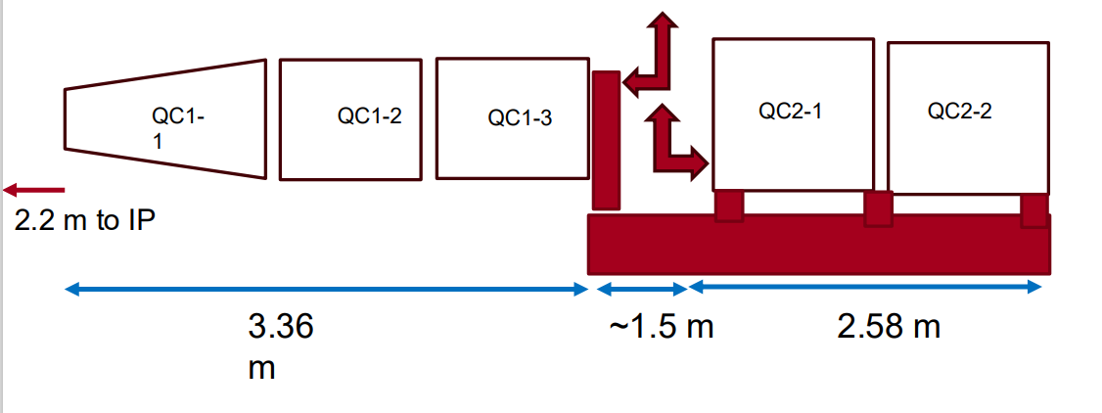

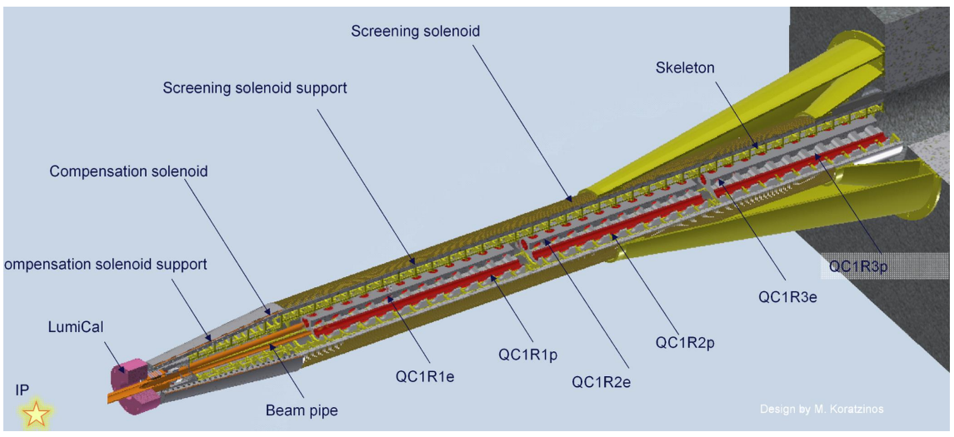

Layout of Magnets in FCC-ee IR
QC1 consists of three Quadrupoles (shown below) is yoke free
QC2 consists of two Quadrupoles (not-shown here) are away from IP and have iron yokes
The IDEA detector concept for FCC-ee :The IDEA Study Group∗
Local-compensation scheme
Non-Local compensation scheme
Vikas Teotia, FCC week 2025, Vienna

Slide 5
Correctors : Assumptions and requirements
The cross-talk due to equal gradient main quadrupoles are self consistently compensated. (m Koratzinos)
We need normal quadrupoles correctors to make un-equal gradient especially at higher energies (top energy, tapering). Need quadrupole correctors if we cannot neglect the errors. (refer next slide)
Skew Quadrupoles are critical in non-local scheme to take care of beam eigen-plane rotations. They are needed for local scheme to take care of errors.
Normal and skew dipole correctors are needed for both, but more crucial for non-local scheme.
Dedicated dipole correctors (HV) are part of the lattice towards IP side in non-local scheme.
Vikas Teotia, FCC week 2025, Vienna

Slide 6
Salient features of the IR Corrector magnets
The IR magnet (QC1) of FCC-ee does not have iron yoke. Thus, nearby beam is not passively shielded.
The Corrector coil(s) magnets need to cancel this cross-talk beside generating the field of intended polarity.
The beam-axis to beam-axis distance is non-constant thus the strength of cross-talk correction harmonics need to vary with longitudinal spacing.
The double helical magnets provides better local control for longitudinal variation of harmonic(s).
The QC2 cryostats could have Serpentine style correctors because they have yokes and cross talk can be handled by more conventional methods.
Vikas Teotia, FCC week 2025, Vienna

Slide 7
Main Quadrupole Gradient Fine-Tuning
Main Quad (Same Gradient)
Corrector Coil (Opposite Gradient)
Net Gradient in Each Aperture (Tunable to desired strength)
Is it useful to have a quad corrector with opposite gradient and same polarity symmetry to be able to make the gradients slightly different in each aperture without adding dipole kick and non-linear field components in the other aperture?
Vikas Teotia, FCC week 2025, Vienna

Slide 8
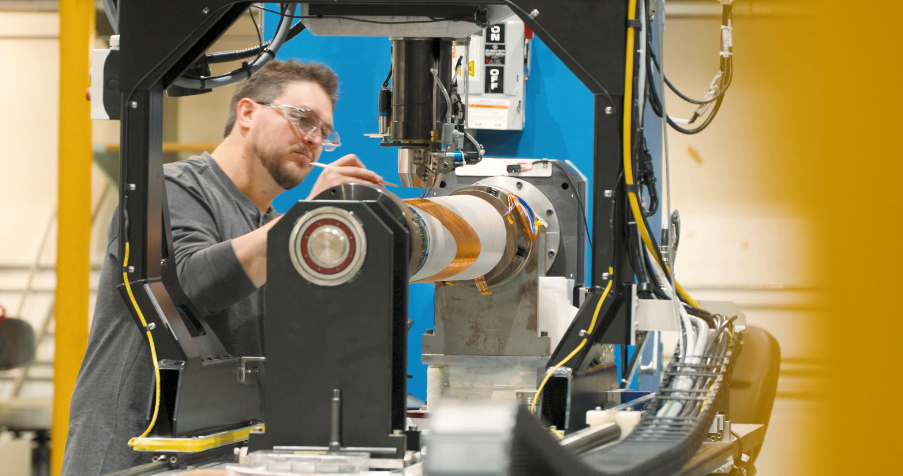
BNL Direct Wind Magnet Technology
Project | Status | Salient feature
RHIC, BNL (All the main ring correctors) | Deployed, Operational | First DW magnets (flat coils → wrapped) Many coils and many years of operation
HERA-II, DESY (IR magnets, correctors) | Deployed, Fulfilled Misson | IR magnets need high-uniformity field Only possible directly winding on tube
BEPC-II, IHEP/Beijing (IR magnets, correctors) | Deployed, Operational | Required even more compact coils → Invented efficient Serpentine patterns
Alpha, 3 generations, CERN (Anti-H trap octupoles) | Deployed, Operational | Rugged coils: survived thousands of deliberate quenches (no degradation)
JPARC, KEK (beamline correctors) | Deployed, Operational | Conduction cooled coils that can take advantage of interconnect region space
ILC, KEK-ATF2, BNL/KEK (IR magnets and correctors) | Design and prototypes | Compact, high-gradient coils to enable small crossing angle via active shielding
SuperKEKB, KEK (IR correctors) | Deployed, Operational | Challenging field quality requirements 43 coils were wound in nested groups Some shaped longitudinal field profiles
EIC, BNL/JLAB (IR magnets and correctors) | Design and prototypes | Actively shielded Nb₃Sn high-gradient quad (inner 9.3T → external few gauss) Double Helical tapered magnets
FCC-ee | Design | Combined function CCT magnets
US-Magnet Development Program | Exploratory studies | HTS Nb3Sn Conductor development
We place superconductor (round wire or cable) on a support tube under computer control.
  General purpose, e.g. no need for costly tooling.
  Very good field quality (correct during production).
  Compact coils (force management without collars).
  Easily nest coils (e.g. b₁, a₁, b₂, a₂, b₃, a₃, b₄...).
  Vary aperture along length (wind on tapered tubes).
  Vary field along length (SuperKEKB, EIC, FCC-ee).
  Technology appropriate for doing “one off magnets.”
  Used for decades in accelerators around the world.
Vikas Teotia, FCC week 2025, Vienna
Notes:
Direct Wind Technology is useful for constructing complex, multi-functional, multi-polarity, nested, compact, high homogeneity superconducting magnets without the need of custom tooling and fixtures for each new magnet project.
It is like 3-D printing of SC magnets and can be seen in the video. The SC conductor is being bonded to a substrate on circular tube.
They are useful for tapered magnets, magnets with tailored magnet field profile as seen in this picture showing SuperKEKB cancel coil. It shows difference in requirement and design which is negligible. It is discussed further.
Direct Wind is one of BNL’s original contribution to Accelerator Science and technology.

Slide 9
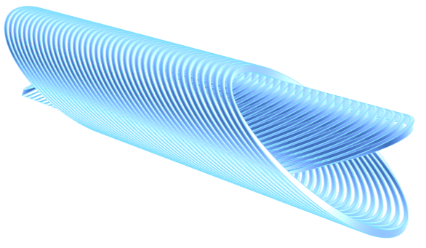
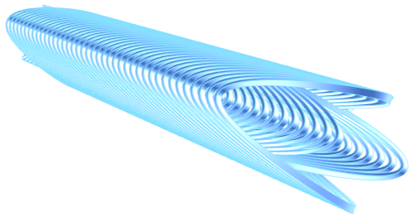
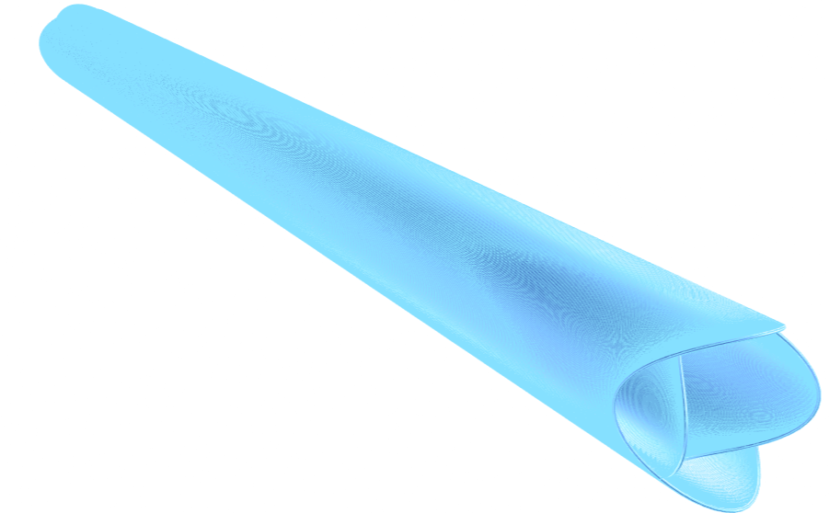
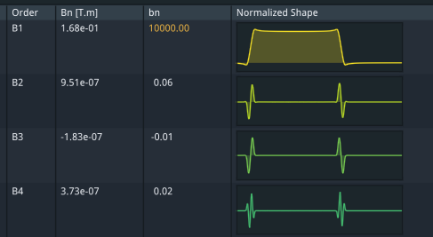
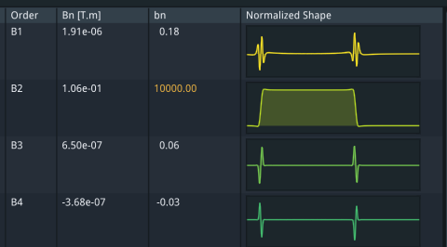
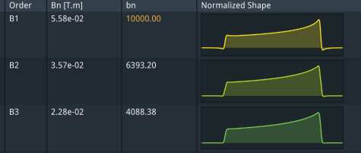
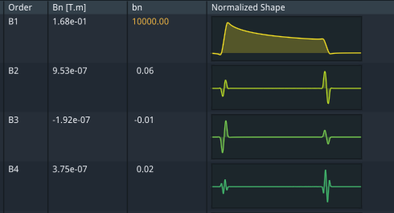
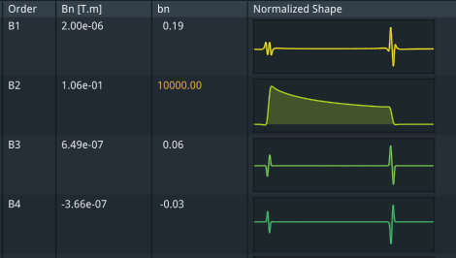
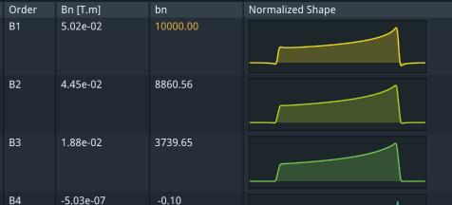
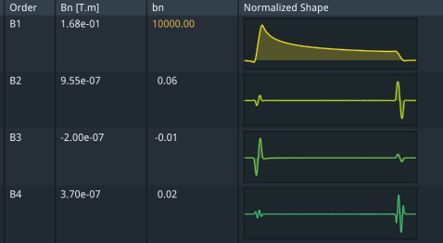
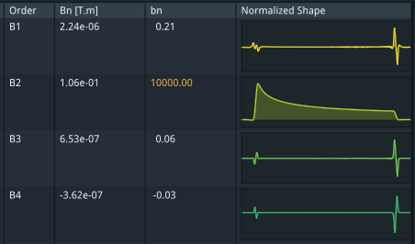
Double helical (CCT) magnet designs
Dipole
Quadrupole
Dipole + Quadrupole + Sextupole
Vikas Teotia, FCC week 2025, Vienna

Slide 10
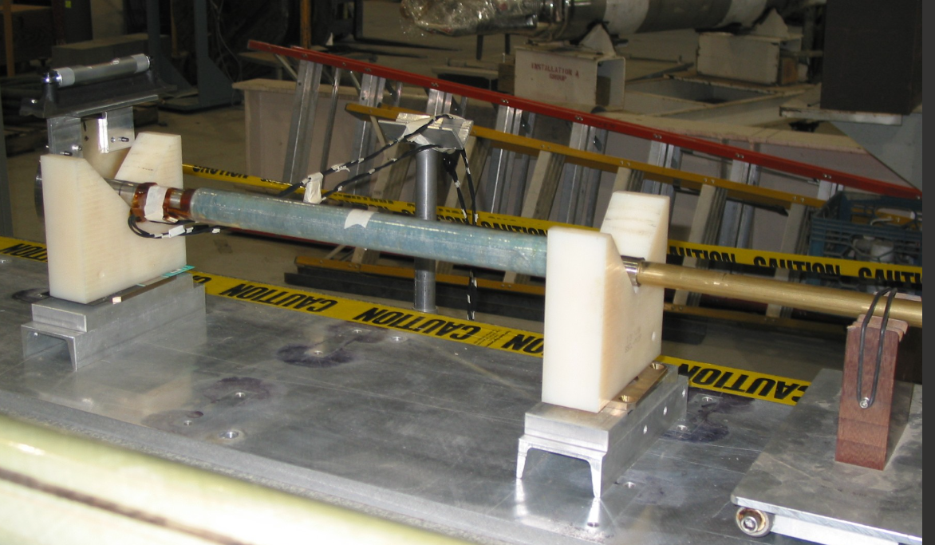
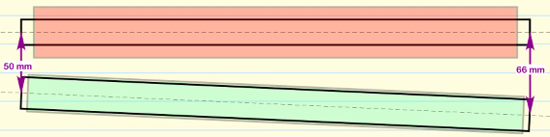
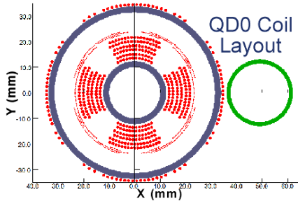
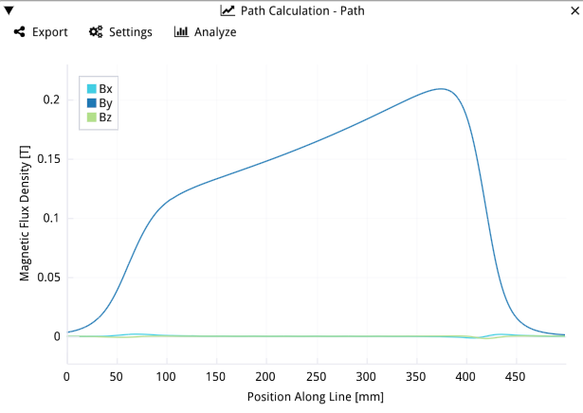
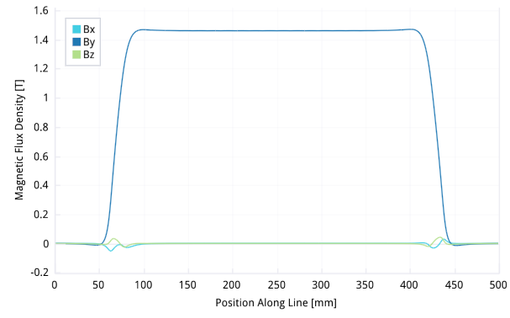
Design of Double Helical Compensating Magnet
ILC
Cross-talk is major challenge
Angle between magnets need more consideration
Side-by-side beam tubes
Magnetic Field along the magnet axis
Magnetic Field along the adjacent beam axis
Vikas Teotia, FCC week 2025, Vienna

Slide 11
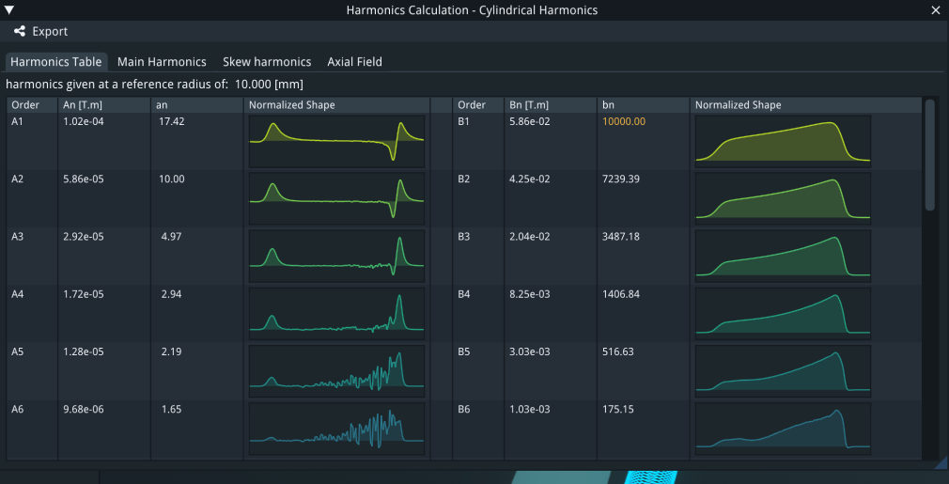
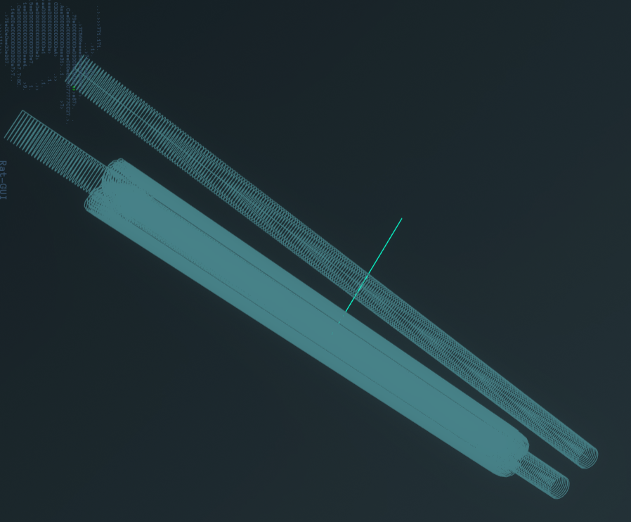
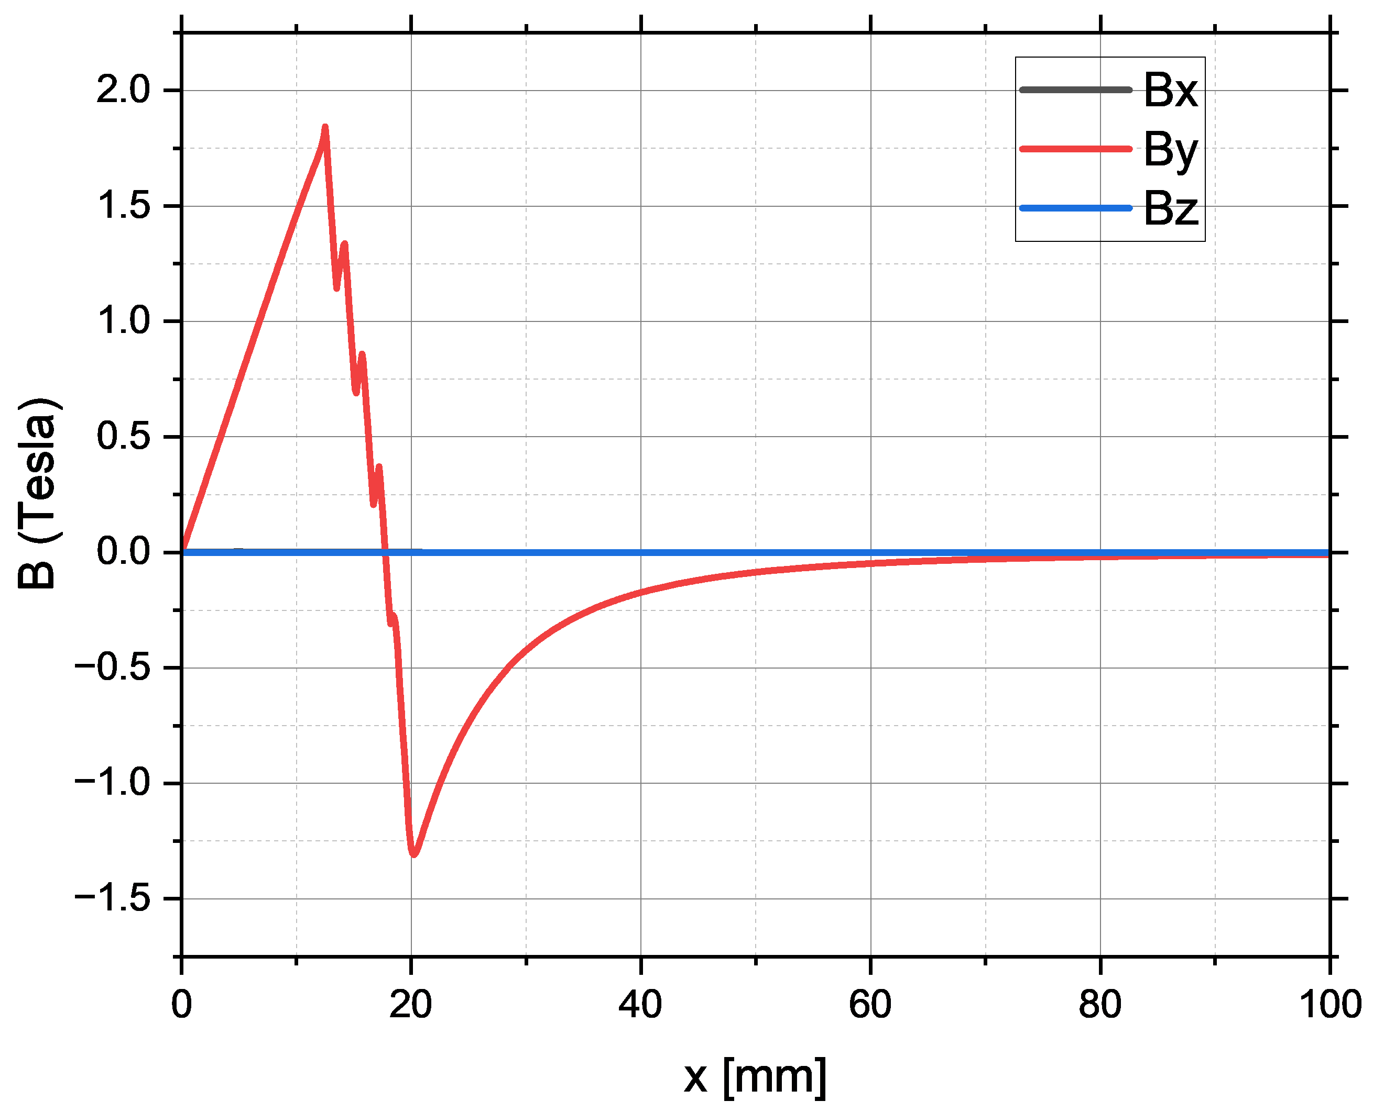
Harmonics along adjacent beam axis (Ref Rad=10mm)
Cross-talk is major challenge
Angle between magnets need more consideration
Adjacent beam line
RAT-GUI model
Along transverse
Vikas Teotia, FCC week 2025, Vienna

Slide 12
Design of concept compensator magnet (work in progress)
Cross-talk is major challenge
Angle between magnets need more consideration
Dipole + Quadrupole + Sextupole
Vikas Teotia, FCC week 2025, Vienna
Target

Slide 13
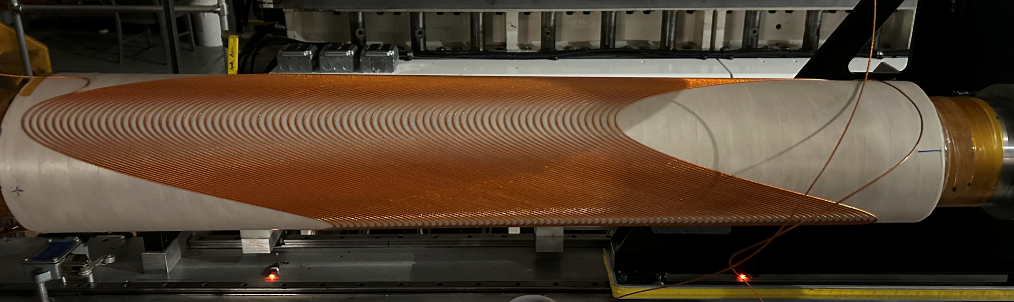
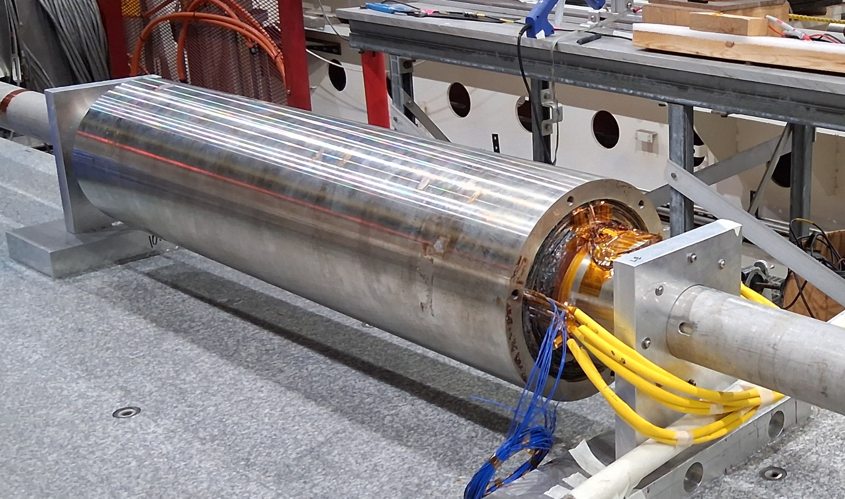
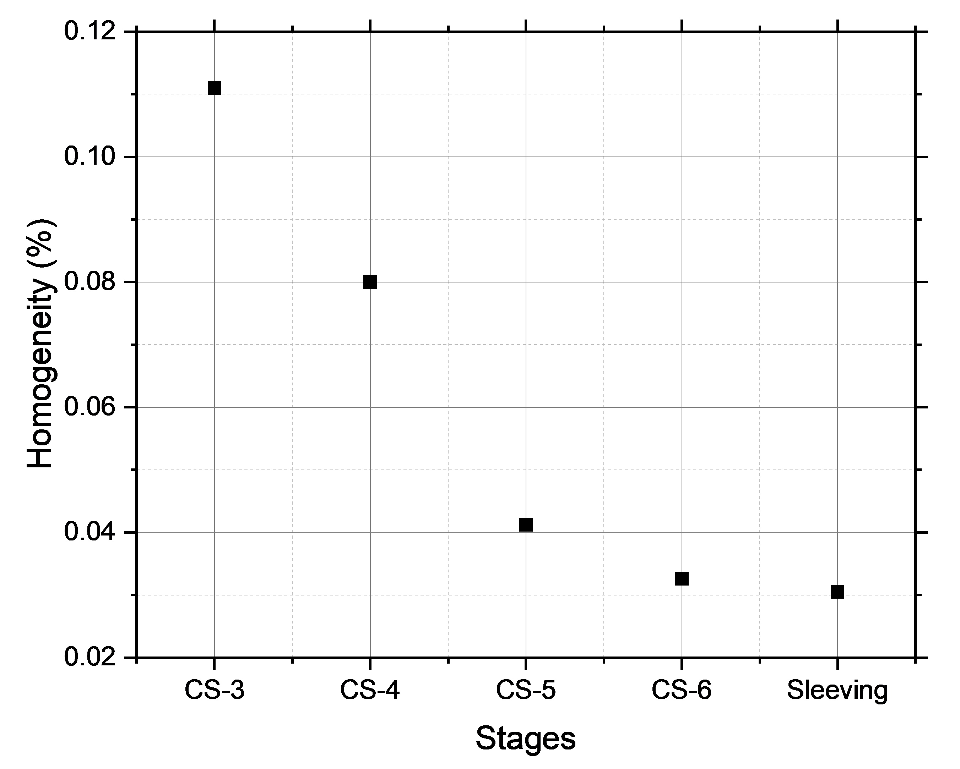
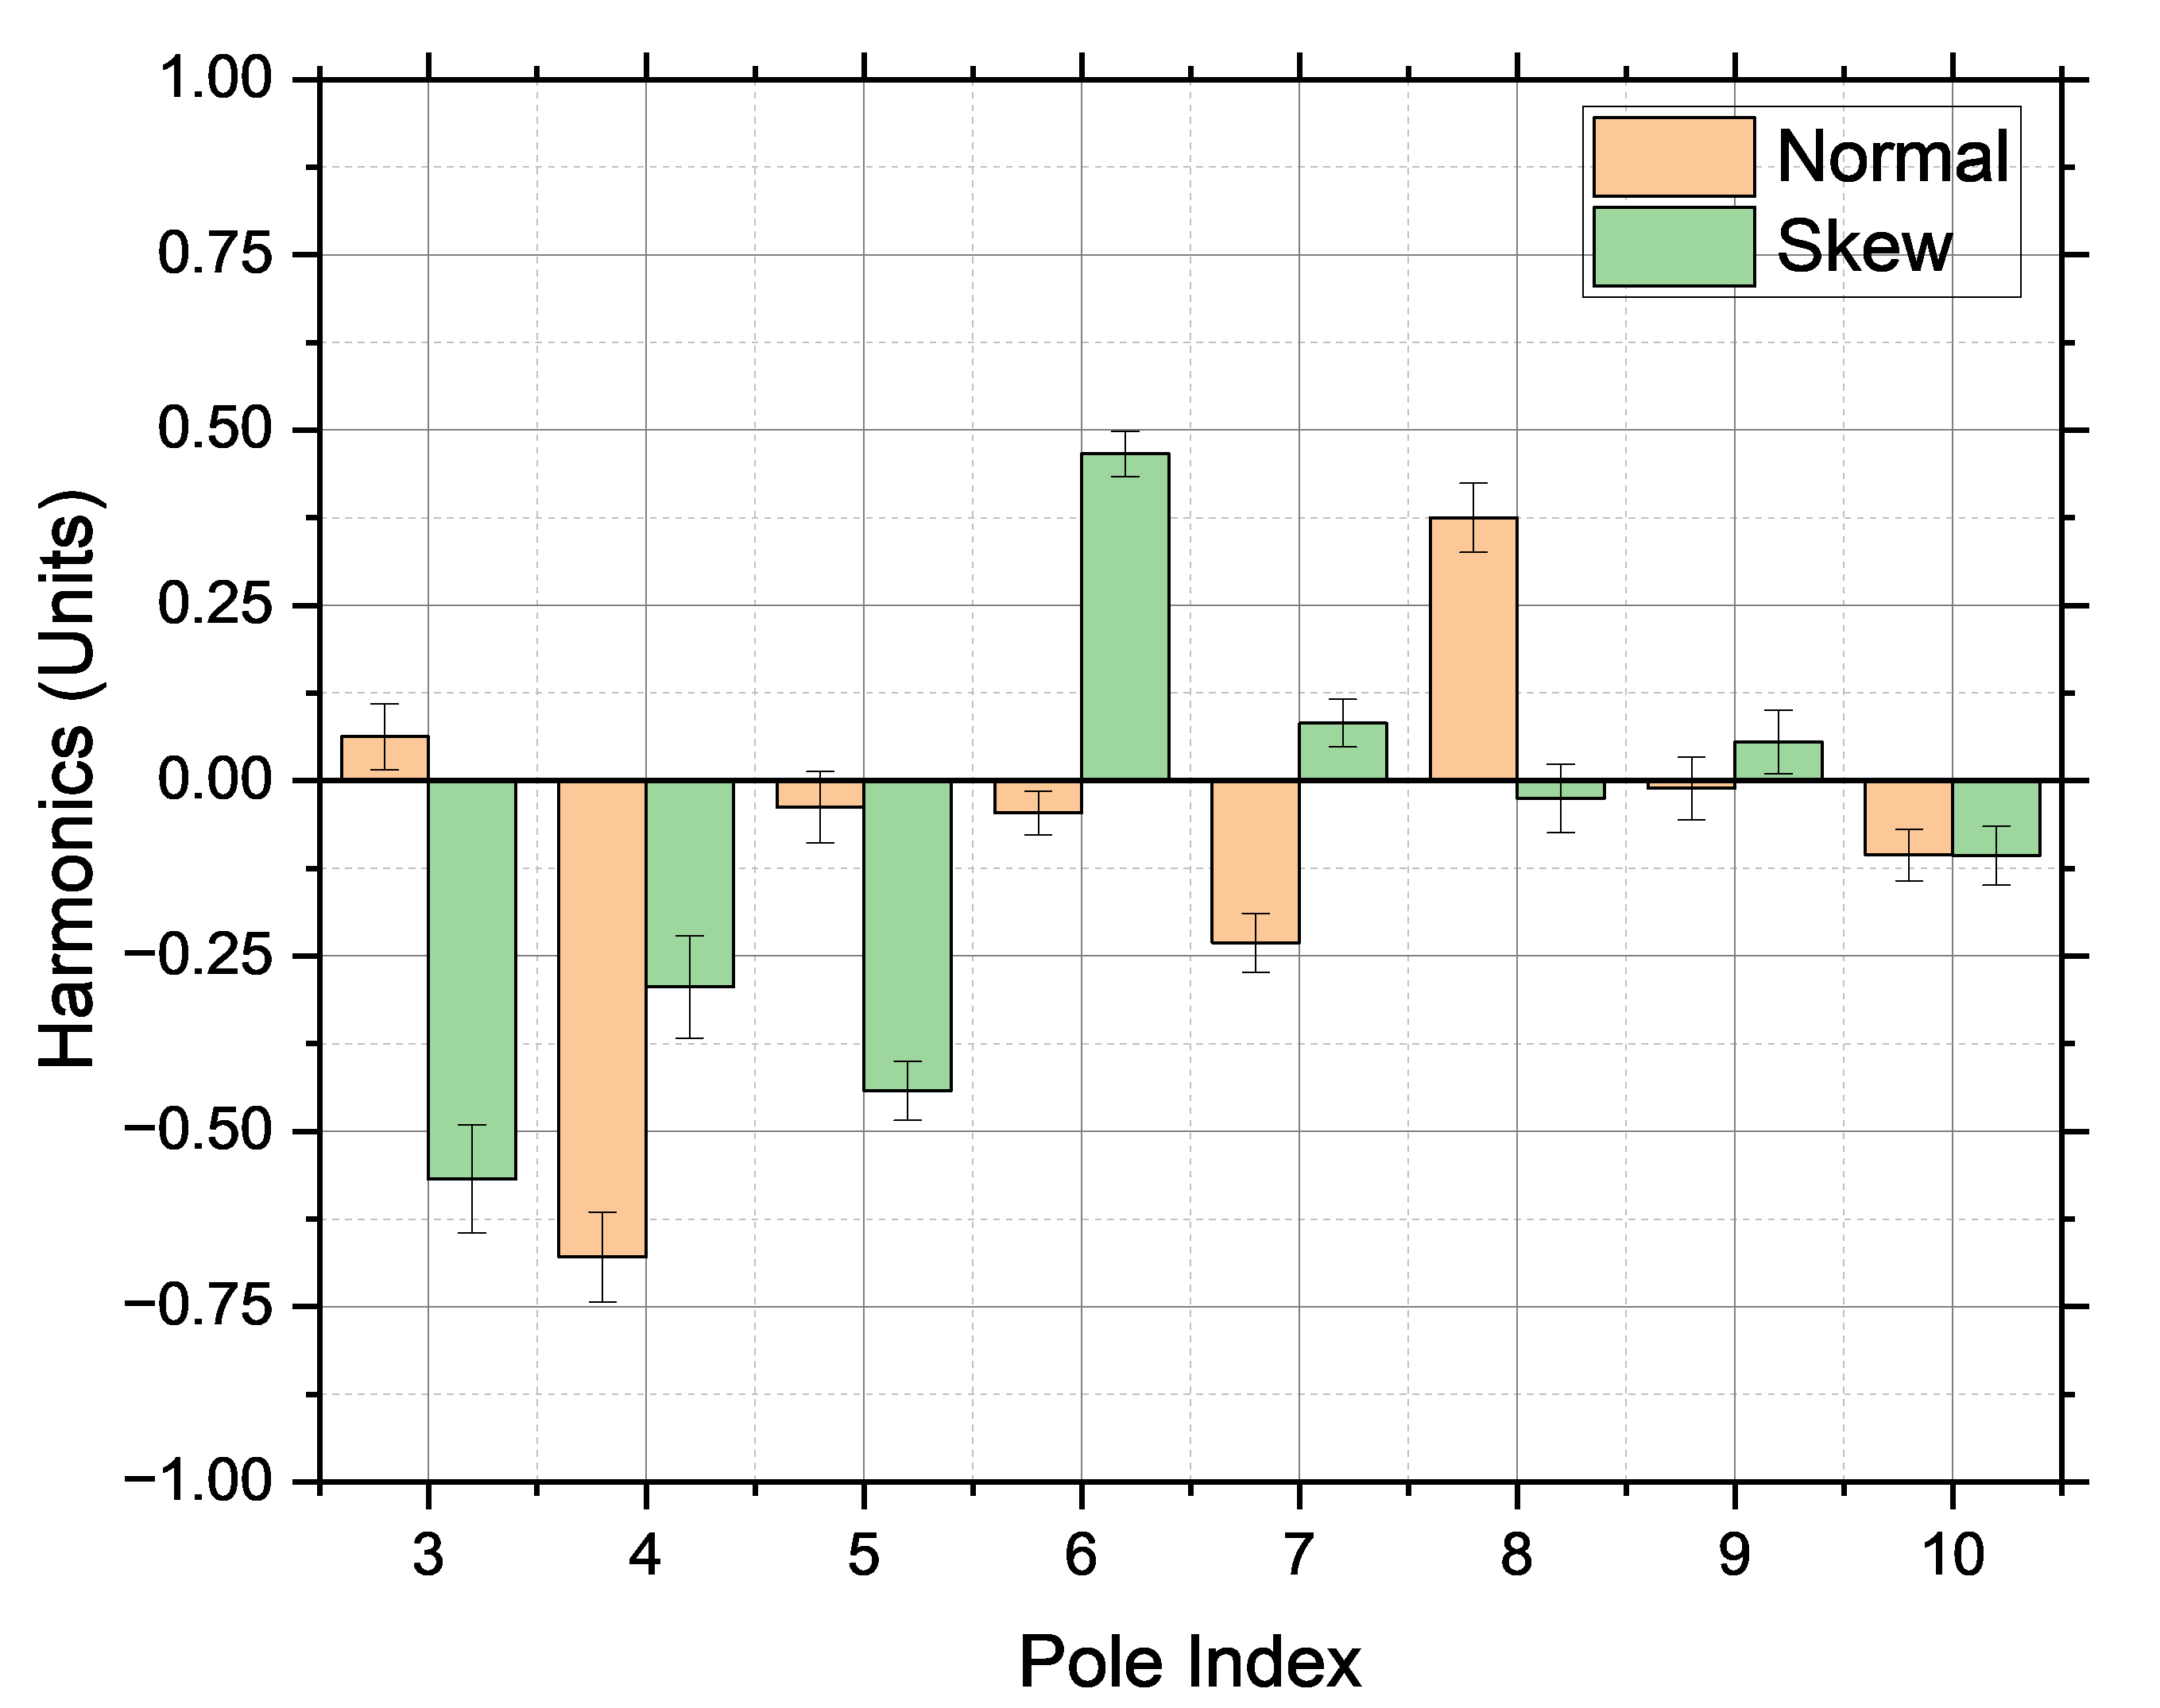
Recent tapered Double Helical Magnet for EIC
Length : 0.8 meter
Number of layers : 12 (6 coil sets)
Gradient : ~90 T/m
Homogeneity
Harmonics
Physics Design : EIC project Magnet Group
Vikas Teotia, FCC week 2025, Vienna

Slide 14
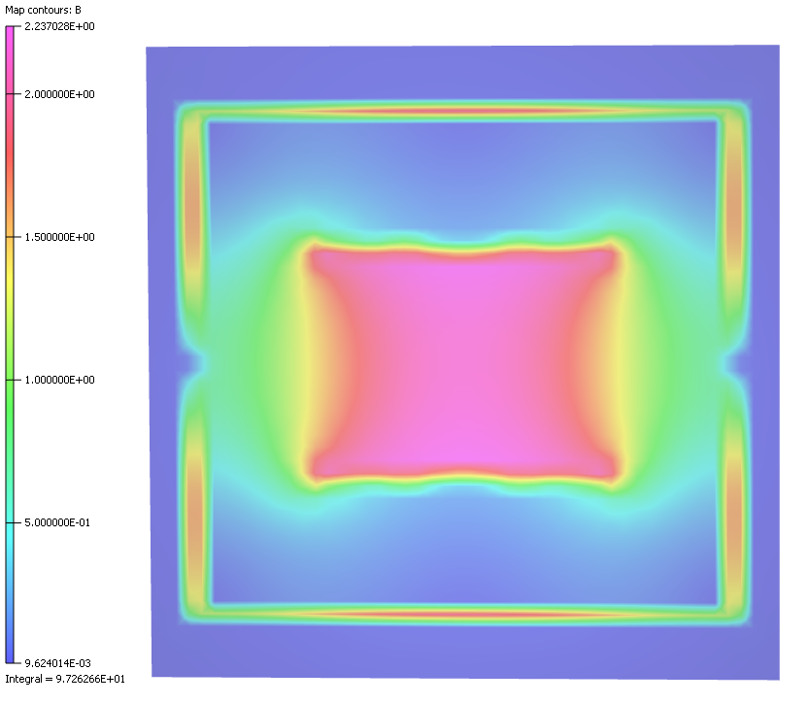
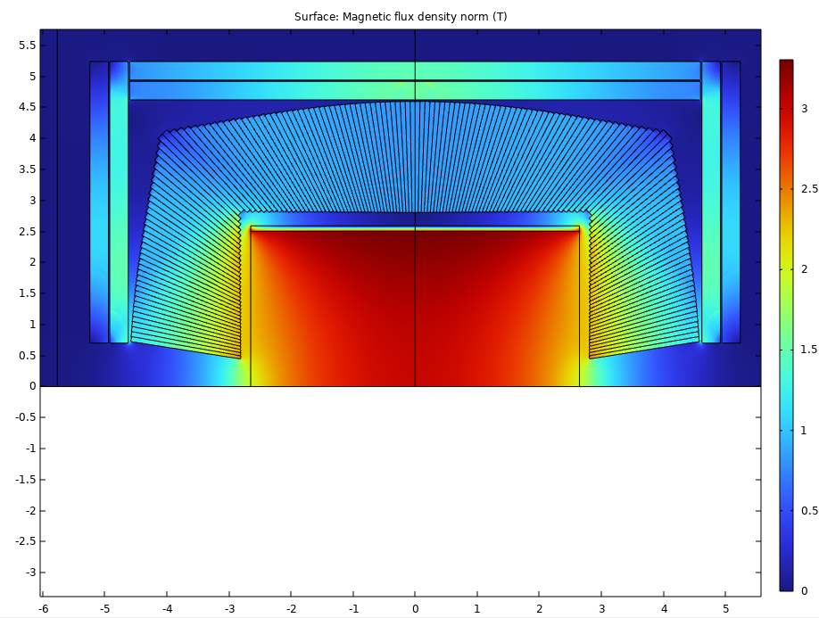
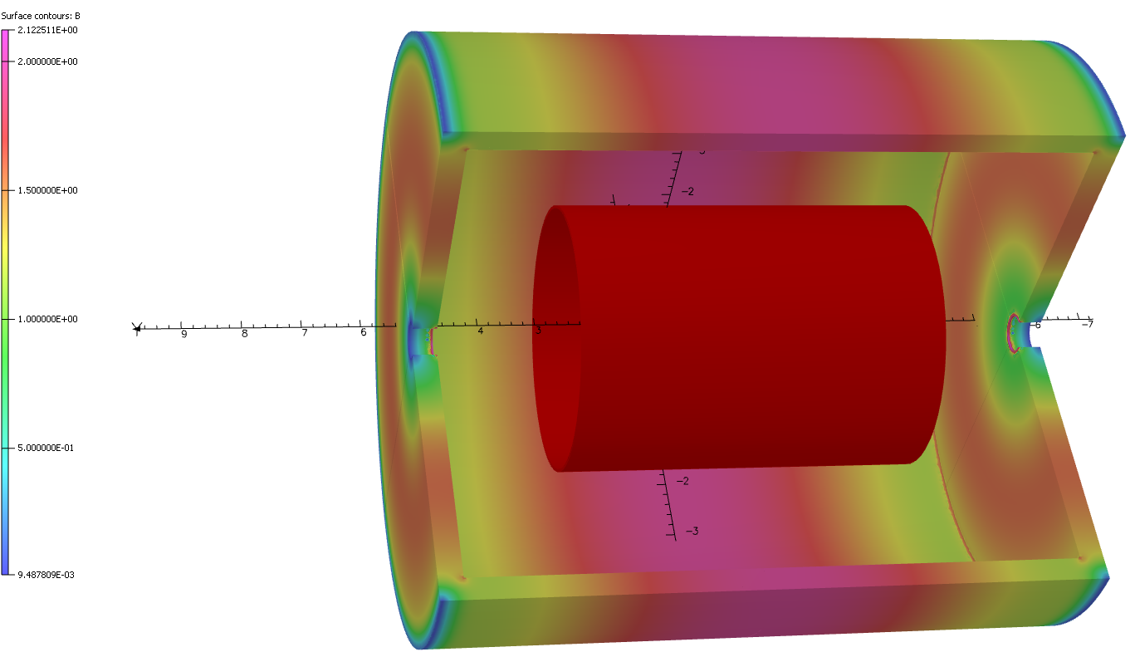
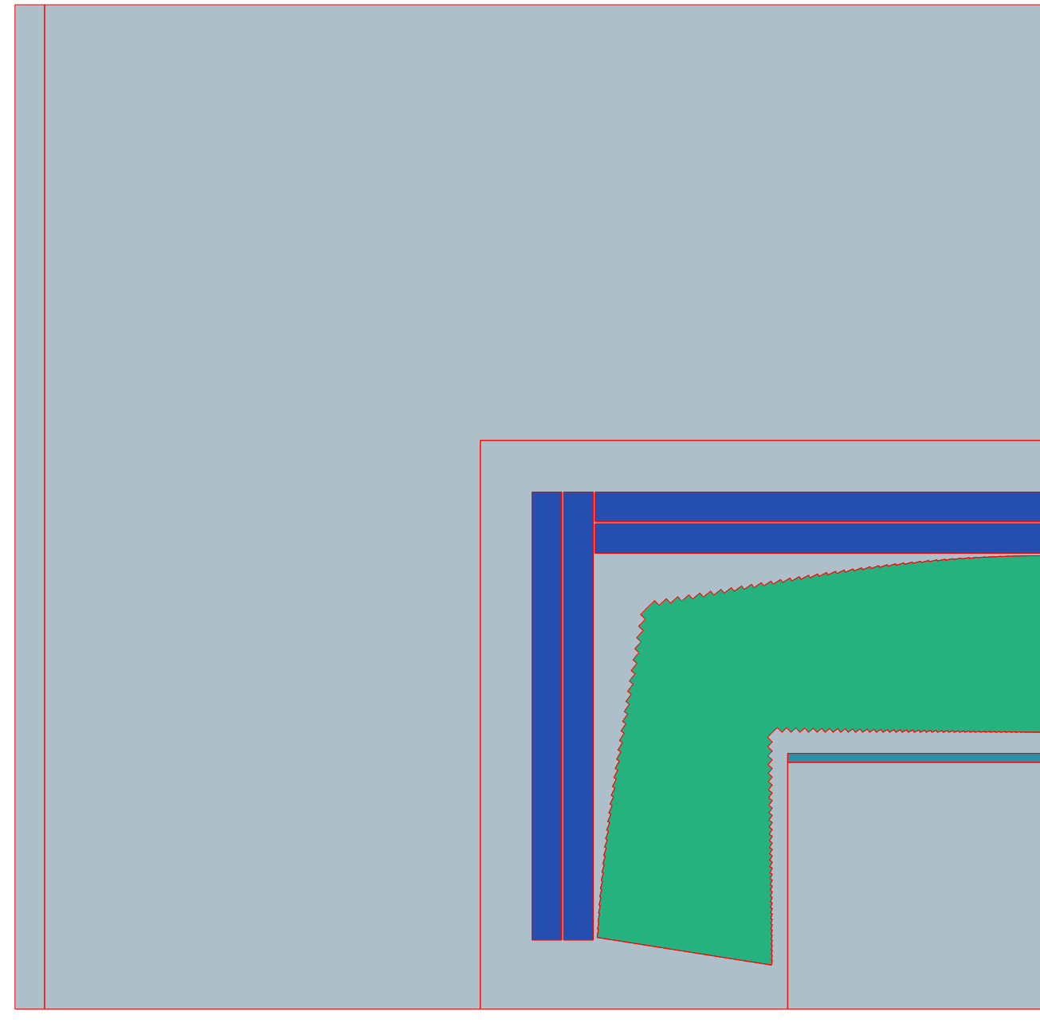
Screening Solenoid design
Cross-talk is major challenge
Angle between magnets need more consideration
Detector magnet field profile (COMSOL, Samuele)
Design of Screening solenoid and detector solenoid goes together.
Collaboration with detector group established for detector magnet design sharing.
To establish design philosophy, approach is to follow most mature and most likely detector concept.
Each IR will need its own screening solenoid
Detector magnet field profile (Opera, BNL)
Vikas Teotia, FCC week 2025, Vienna

Slide 15
Interaction with CERN/PSI/INFN colleagues
Having active engagement for
  Final focusing magnets (Mike), and
  Screening/Compensating solenoid magnet design (Matthias, Samuele, Lucio)
  Crab waist Sextupole
Vikas Teotia, FCC week 2025, Vienna

Slide 16
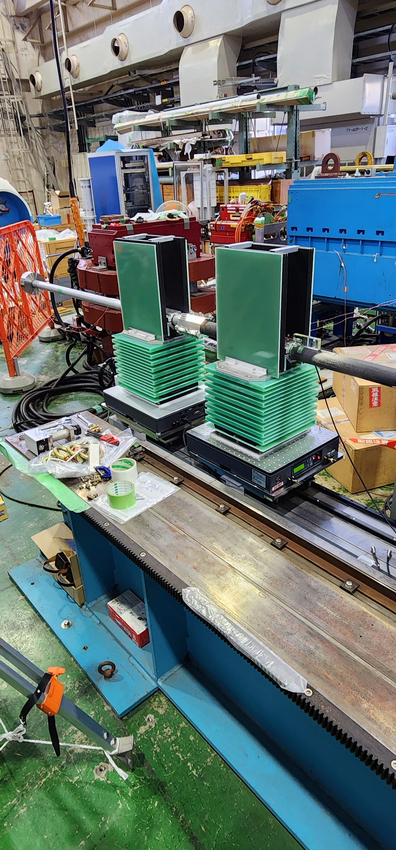
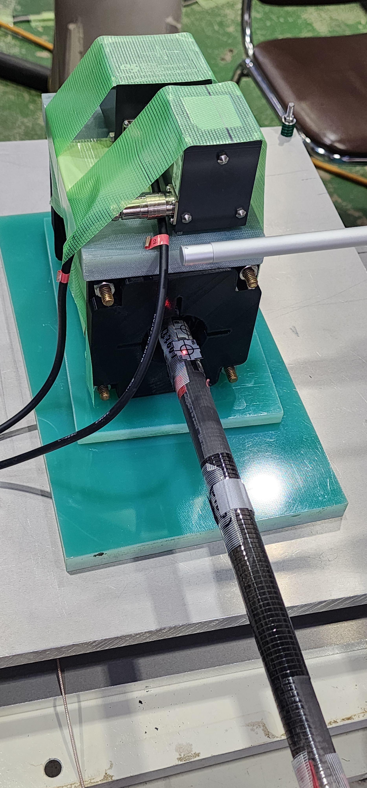
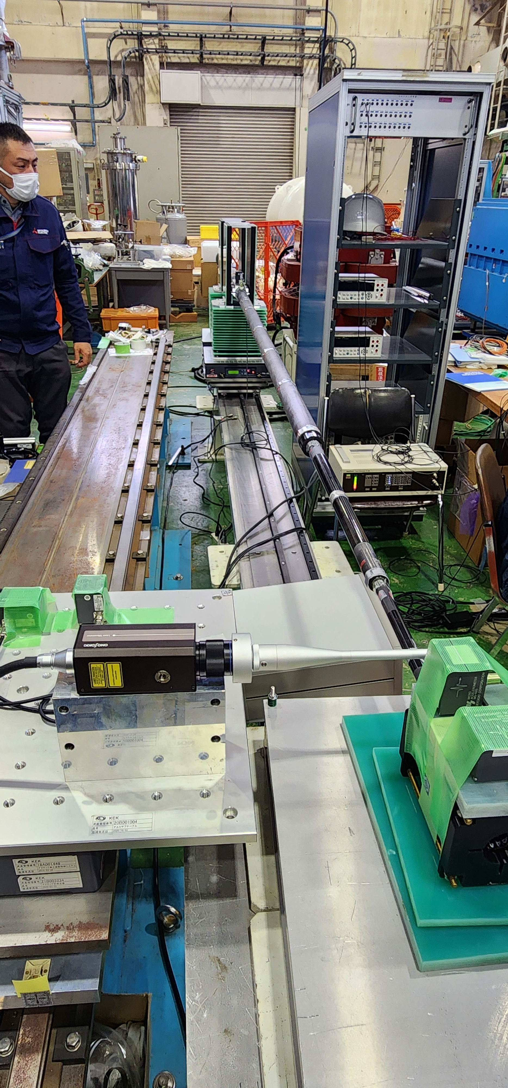
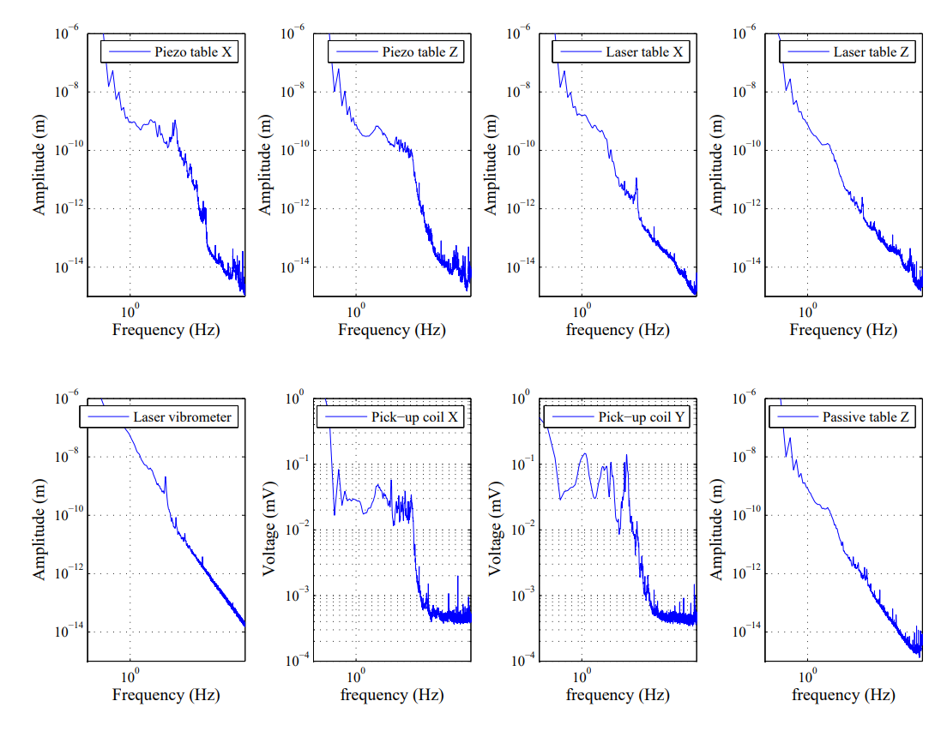
Nano-meter level Magnetic Field vibration measurement (BNL, KEK)
Cross-talk is major challenge
Angle between magnets need more consideration
Pick-up coil and Quadrupole
Measurement results
Vikas Teotia, FCC week 2025, Vienna

Slide 17
Summary
BNL is having state of the art facilities for design, production, testing and measurement of Superconducting Magnets including direct wind magnets.
A tapered CCT test magnet is developed for EIC. CCT magnets are choice for correctors in FCCee.
Status of FCC-ee IR MDI work packages at BNL
As separate exercise, we are exploring possibilities of HTS based Direct wind magnets
SN | Packages | Status
1. | Corrector Magnets | EM Design platform (FY25) Measurement of cross talk in existing Quadrupole (preparations underway) (FY25) Design of compensator magnet for annulling the cross talk above (Planned) (FY25) Fabrication of compensator magnet (Planned) (FY26) Testing of the compensator magnet (FY26-FY27)
2. | Design of screening/ compensating solenoid magnet | Preliminary simulations, gathering latest information
3. | Magnetic Field vibration measurement | Basic hardware for preliminary measurements exists Proposed for FY26
Vikas Teotia, FCC week 2025, Vienna

Slide 18
Thanks for your kind attention!

