Slide 1





IR beam losses and MDI collimators
G. Broggi^{1,2,3} A. Abramov², K. Andre², M. Boscolo^{2,3}, R. Bruce², A. Lechner², S. Marin², G. Nigrelli^{1,2,3}, A. Perillo-Marcone²,S. Redaelli², K. Skoufaris², F. Van der Veken²
¹ Sapienza University of Rome, Italy ² CERN, Meyrin, Switzerland ³ INFN-LNF, Frascati, Italy
FCC week 2025, Vienna, Austria, 22/05/2025
Acknowledgements:
X. Buffat, H. Burkhardt, Y. Dutheil, A. Frasca, D. Gibellieri, M. Hofer, G. Iadarola, R. Kersevan, P. Kicsiny, G. Lerner, L. Nevay, M. Migliorati, K. Oide, J. Salvesen, C. Zannini, F. Zimmermann

Slide 2
Outline
Introduction
  FCC-ee beam loss studies
  FCC-ee collimation system
  Workflow for detector background evaluation
FCC-ee beam losses and collimation simulations
  Simulation benchmark with SuperKEKB data
Updates on FCC-ee beam loss simulations: focus on IR beam losses
  Beam halo losses
  Beam-gas losses
  Touschek scattering losses
  Beam-beam losses
  Top-up injection losses
  Losses from fast instabilities
Outlook and next steps
22/05/2025
G. Broggi | IR beam losses and MDI collimators

Slide 3
Outline
Introduction
  FCC-ee beam loss studies
  FCC-ee collimation system
  Workflow for detector background evaluation
FCC-ee beam losses and collimation simulations
  Simulation benchmark with SuperKEKB data
Updates on FCC-ee beam loss simulations: focus on IR beam losses
  Beam halo losses
  Beam-gas losses
  Touschek scattering losses
  Beam-beam losses
  Top-up injection losses
  Losses from fast instabilities
Outlook and next steps
22/05/2025
G. Broggi | IR beam losses and MDI collimators

Slide 4
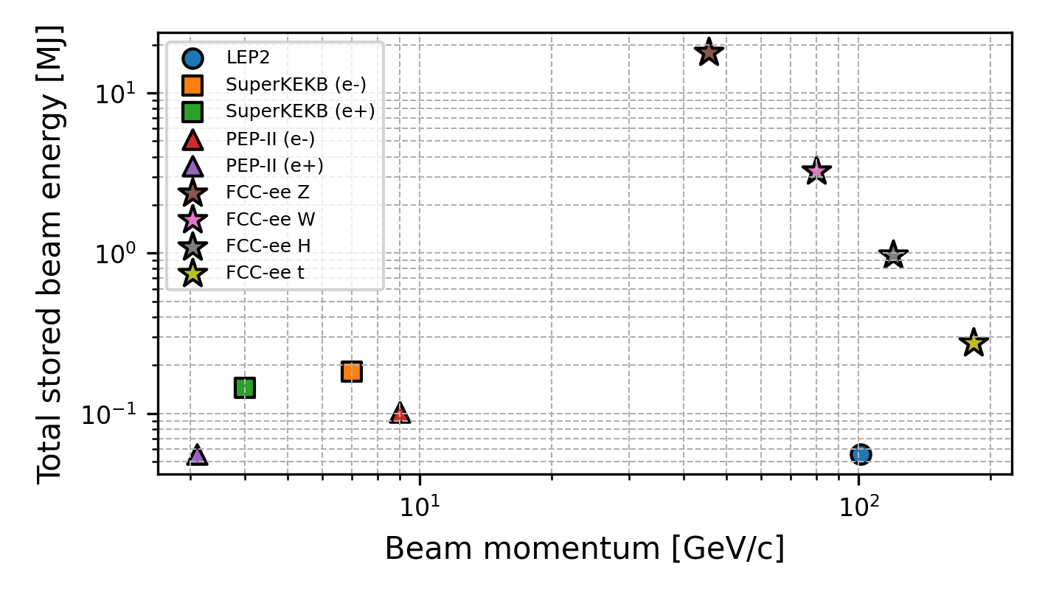
FCC-ee beam loss studies: overview
Studies and simulations of beam losses in the FCC-ee are being performed to study:
FCC-ee presents unique challenges:
  17.5 MJ stored beam energy in the Z mode (45.6 GeV)
  New regime for collimation of e± beams (highly destructive beams)
Collimation strategy for the FCC-ee
  Beam-halo (global) collimation
    + local protection collimation (e.g., experimental IRs)
  Secondary particle shower absorbers
  Synchrotron radiation (SR) collimation – upstream of the IPs
Optimization of the FCC-ee collimation system design
Minimization of beam losses on sensitive components (e.g. superconducting magnets)
Minimization of beam losses in the experimental interaction regions (IRs): can be source of backgrounds
~2 orders of magnitude
22/05/2025
G. Broggi | IR beam losses and MDI collimators

Slide 5
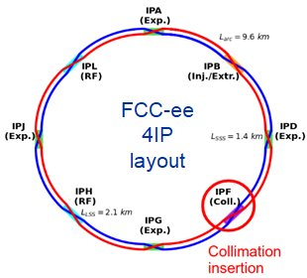
FCC-ee collimation system
Dedicated long straight section in PF for global beam halo collimation
  Two-stage betatron and off-momentum collimation
  Ensure protection of the aperture bottlenecks in different conditions
    Aperture bottleneck at Z: 11.5σ (H plane), 81.5σ (V plane)
  Secondary particle shower absorbers between primary and secondary betatron collimators (FLUKA team)
SR collimators upstream of each IP
  Designed to reduce detector backgrounds and power loads in the inner beampipe due to photon losses
Tertiary local protection collimators
  Placed upstream of each IP: 690 m and 420 m upstream
  s-location optimized for optimal phase-advance (multiple of π) between TCTs and
More details in: G. Broggi, Collimation studies for the FCC-ee, FCC week 2025
SR collimators
aperture bottlenecks
22/05/2025
G. Broggi | IR beam losses and MDI collimators

Slide 6
Workflow for detector background evaluation
Workflow to evaluate beam-induced backgrounds:
Multi-turn collimation tracking
(Xsuite-BDSIM, Xsuite-FLUKA, …)
Dedicated shower simulations
(FLUKA)
Detector simulations (DDSim/key4hep)
Beam loss distributions impacting IR collimators and aperture
Particle showers reaching the detectors
Background assessment
Step 1
In this talk
IR model
(FLUKA)
Step 2
Step 3
Detector model
(DDSim/key4hep)
MDI collimator impacts from multi-turn collimation tracking of beam-gas scattered particles provided to the FLUKA team to move on to the «step 2»
  First results in A. Frasca, TID and Fluence in the detector and IR
  Similar studies for injection background and to assess fast instabilities impact on detector
    G. Nigrelli, First look at injection backgrounds
Similar studies are planned for all beam loss scenarios
  GOAL: converge on a complete beam-induced background evaluation campaign
22/05/2025
G. Broggi | IR beam losses and MDI collimators

Slide 7
Outline
Introduction
  FCC-ee beam loss studies
  FCC-ee collimation system
  Workflow for detector background evaluation
FCC-ee beam losses and collimation simulations
  Simulation benchmark with SuperKEKB data
Updates on FCC-ee beam loss simulations: focus on IR beam losses
  Beam halo losses
  Beam-gas losses
  Touschek scattering losses
  Beam-beam losses
  Top-up injection losses
  Losses from fast instabilities
Outlook and next steps
22/05/2025
G. Broggi | IR beam losses and MDI collimators

Slide 8
FCC-ee beam loss scenarios
The FCC-ee Z mode is the current focus: has the highest stored beam energy 17.5 MJ
Important to identify different beam loss scenarios and define the ones to protect against
Current selection of beam loss scenarios to study and simulate:
  Generic beam halo losses
  Beam losses from interactions with residual gas
  Beam losses from Touschek scattering
  Beam losses from beam-beam interactions
  Beam losses due to fast instabilities
  Beam losses from top-up injection (G. Nigrelli, previous talk)
  Beam losses from interactions with thermal photons: study planned for 2025-2026
    Important effect at LEP - analytical estimates first to understand potential impact on FCC-ee
  Accidental scenarios (asynchronous dump, others): waiting for inputs to set up models
In this talk: focus on IR losses
22/05/2025
G. Broggi | IR beam losses and MDI collimators

Slide 9
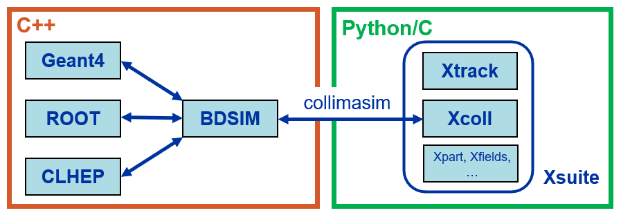
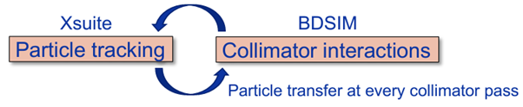
FCC-ee collimation simulations
FCC-ee presents unique challenges for collimation simulations
  Synchrotron radiation and magnet strength adjustment (tapering) to compensate it
  Complex beam dynamics – strong sextupoles in the lattice and strong beam-beam effects
  Detailed aperture and collimator geometry modelling + beam particle-matter interactions
  Electron/positron Large accelerator system – 90+ km beamline
Xsuite + BDSIM (Geant4) coupling (JINST paper)
  Developed for FCC collimation simulations
  Benchmarked against
  Other tools available: Xsuite-FLUKA coupling – already used for hadron beam collimation, ready to use for lepton beam collimation
other simulation codes: MAD-X, pyAT, Sixtrack-FLUKA
measured data from: SPS, LHC, SuperKEKB, DAFNE is also considered
22/05/2025
G. Broggi | IR beam losses and MDI collimators

Slide 10

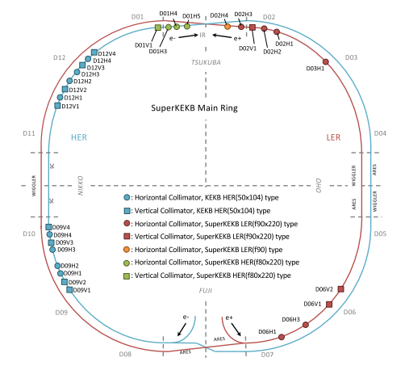
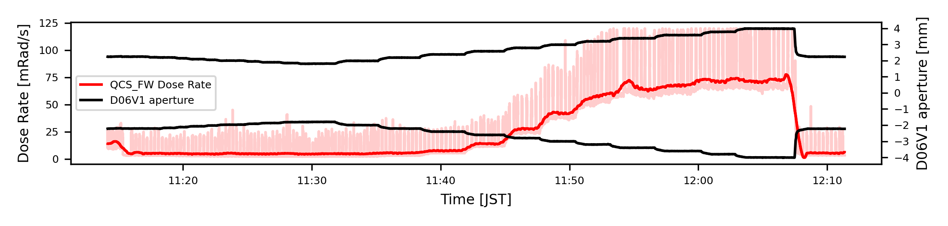
Xsuite-BDSIM benchmark at SuperKEKB
Comparison of Xsuite–BDSIM simulations with measured backgrounds at SuperKEKB (IPAC'25 paper)
Dedicated single-beam background study at SuperKEKB LER (June 2020, A. Natochii, PRAB)
  D06V1 collimator aperture scan
  Radiation dose rates measured by Belle II radiation monitors
SuperKEKB collimator layout as of June 2020
Experimental conditions reproduced in simulations
  Beam-gas (Brems, Coulomb) and Touschek scattering
  IR aperture losses recorded and used as input to detector simulations (basf2*) to estimate the response of IR radiation monitors
*basf2: Belle II Analysis Software Framework – Geant4-based framework for Belle II detector simulations
22/05/2025
G. Broggi | IR beam losses and MDI collimators

Slide 11
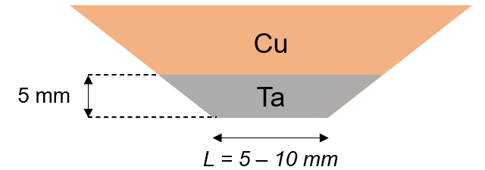
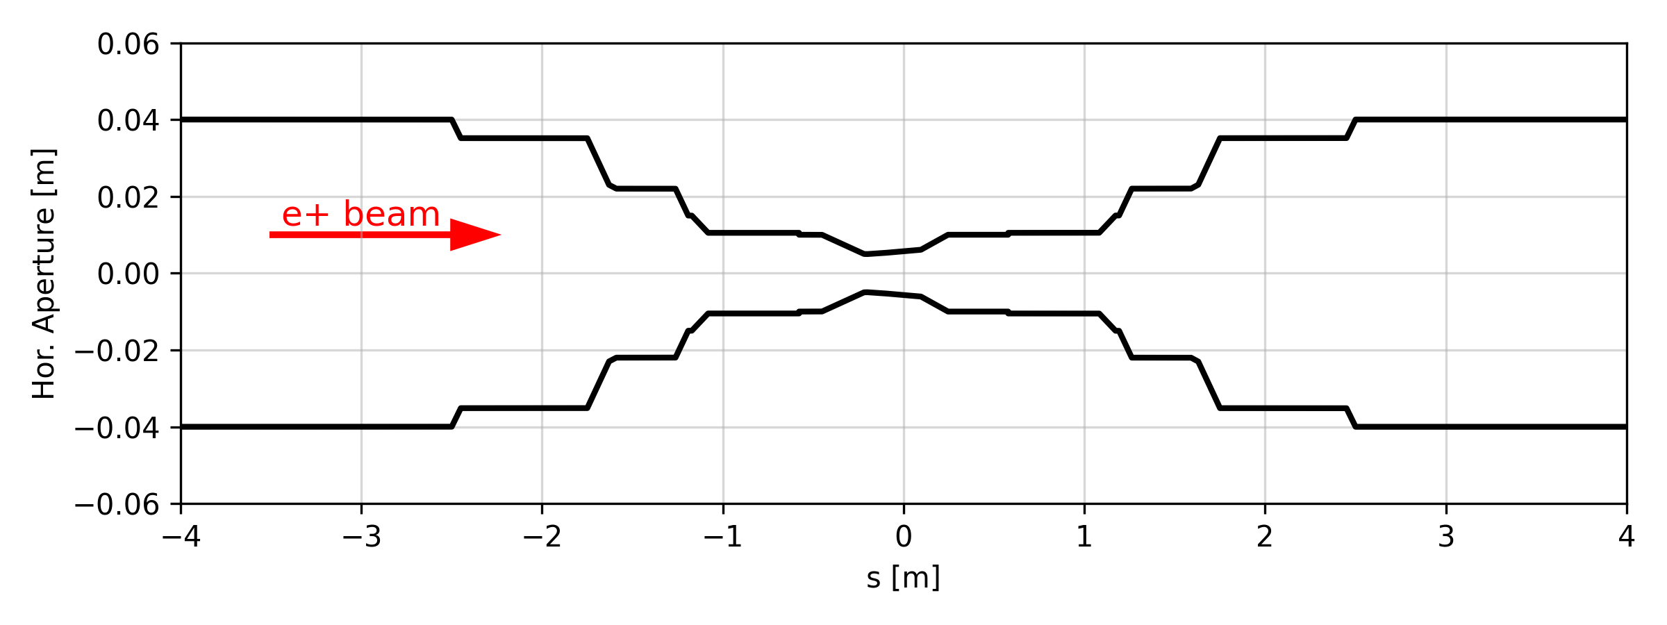
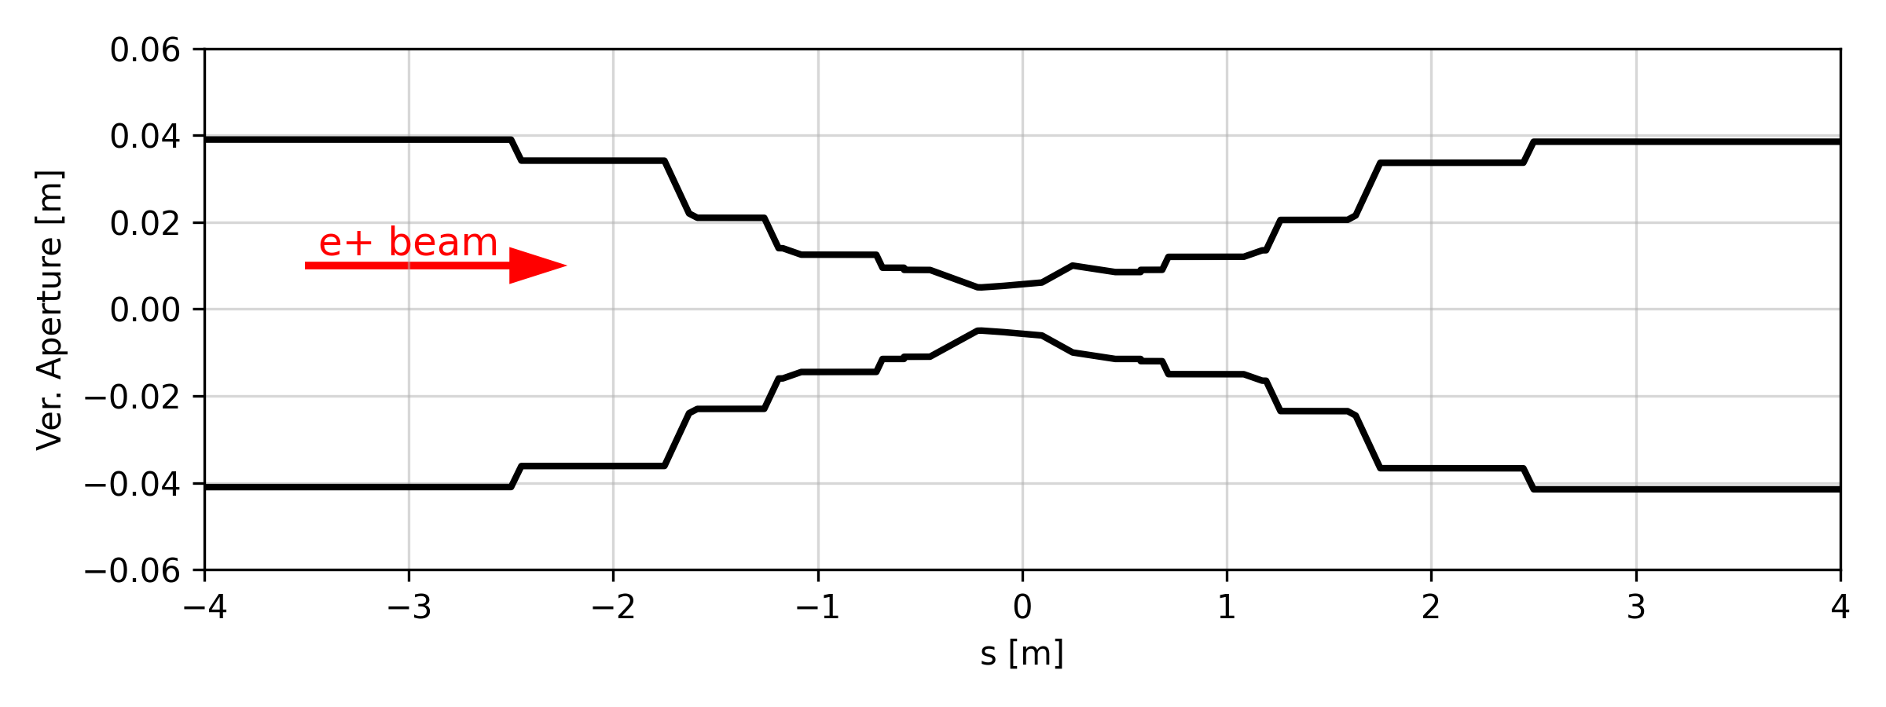
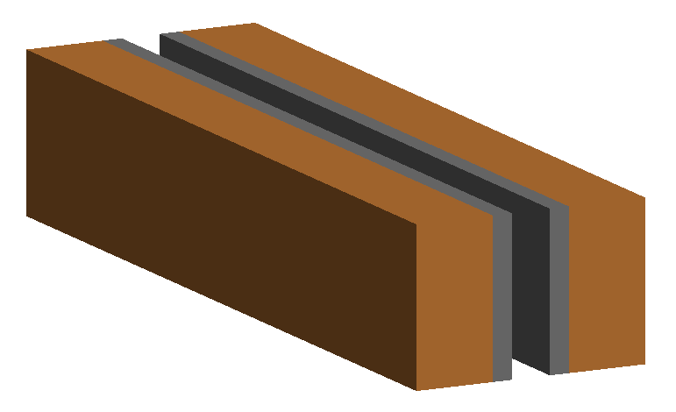
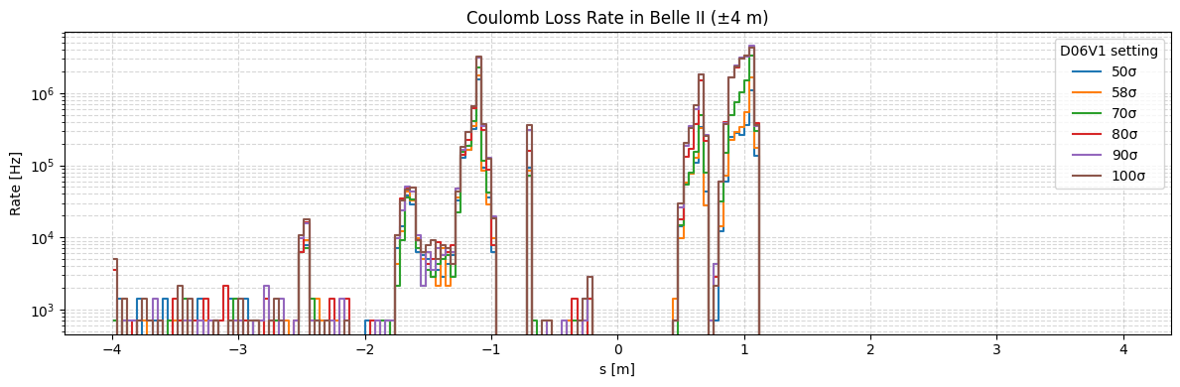
Xsuite-BDSIM benchmark at SuperKEKB
SuperKEKB (LER) aperture model
BDSIM CollimatorTipJaw
New collimator type implemented in BDSIM to reproduce the SuperKEKB-type collimators
IR loss rate from Coulomb scattering
22/05/2025
G. Broggi | IR beam losses and MDI collimators

Slide 12
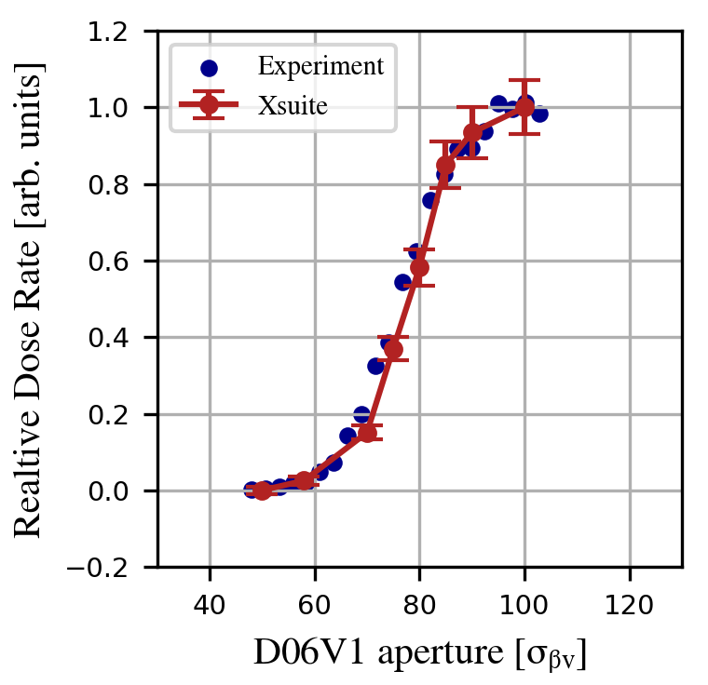
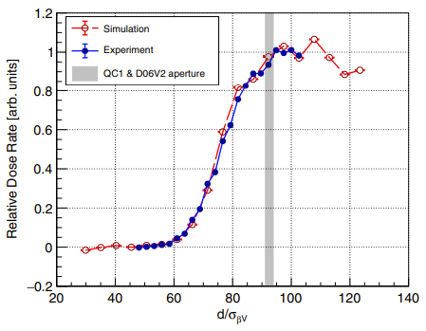
Xsuite-BDSIM benchmark at SuperKEKB
Propagating IR losses in basf2 detector simulations and comparing with the measured background trend vs. D06V1 collimator aperture:
Relative total dose rate for QCS-FW diamond detector vs. D06V1 collimator aperture in units of σβV
Simulations accurately reproduce the measured background trend
In absolute, Data/MC~3-4, consistently with independent SAD/Geant4 simulations
  Excellent result given uncertainties on gas pressure and composition, ideal machine without errors, etc.
A. Natochii et al., Ref.
Validates Xsuite–BDSIM for collimation and background studies in e+e− machines
Many thanks to G. Iadarola, A. Natochii, J. Salvesen, KEK colleagues and EAJADE programme for the support!
22/05/2025
G. Broggi | IR beam losses and MDI collimators

Slide 13
Outline
Introduction
  FCC-ee beam loss studies
  FCC-ee collimation system
  Workflow for detector background evaluation
FCC-ee beam losses and collimation simulations
  Simulation benchmark with SuperKEKB data
Updates on FCC-ee beam loss simulations: focus on IR beam losses
  Beam halo losses
  Beam-gas losses
  Touschek scattering losses
  Beam-beam losses
  Top-up injection losses
  Losses from fast instabilities
Outlook and next steps
22/05/2025
G. Broggi | IR beam losses and MDI collimators

Slide 14
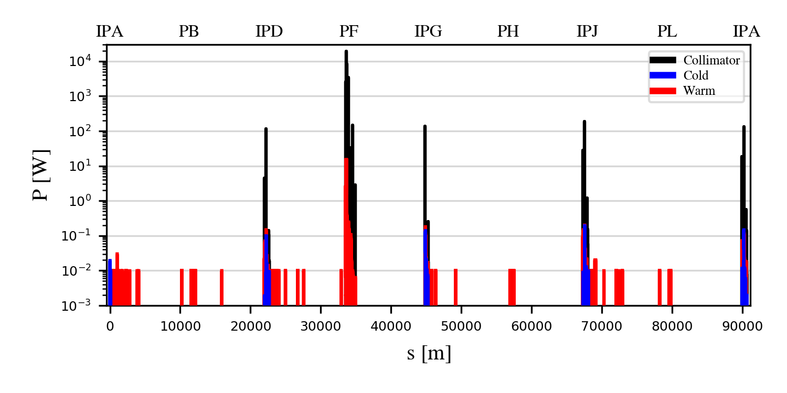
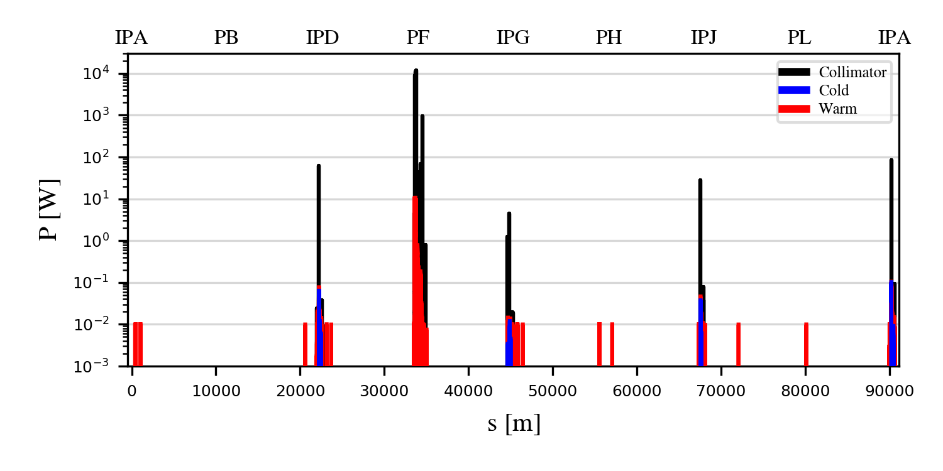
Generic halo losses for the Z mode
Generic halo losses:
  Slow loss process assumed
  The loss process is not simulated
  Beam halo directly impacts one of the TCPs
  Beam lifetime drop to 5 min is assumed
Horizontal and vertical betatron collimation losses (B1H, B1V)
Good halo cleaning performance overall
  Losses well contained within the collimation insertion PF
  Loss suppressed by:
    ∼2 orders of magnitude on the TCTs
    ∼4-5 orders of magnitude on the SR collimators
    >5 orders of magnitude on all the other elements outside PF
B1H
B1V
*Loss maps are obtained by binning aperture losses in 10 cm bins, except for the collimators, for which the binning is equal to the collimator length
22/05/2025
G. Broggi | IR beam losses and MDI collimators

Slide 15
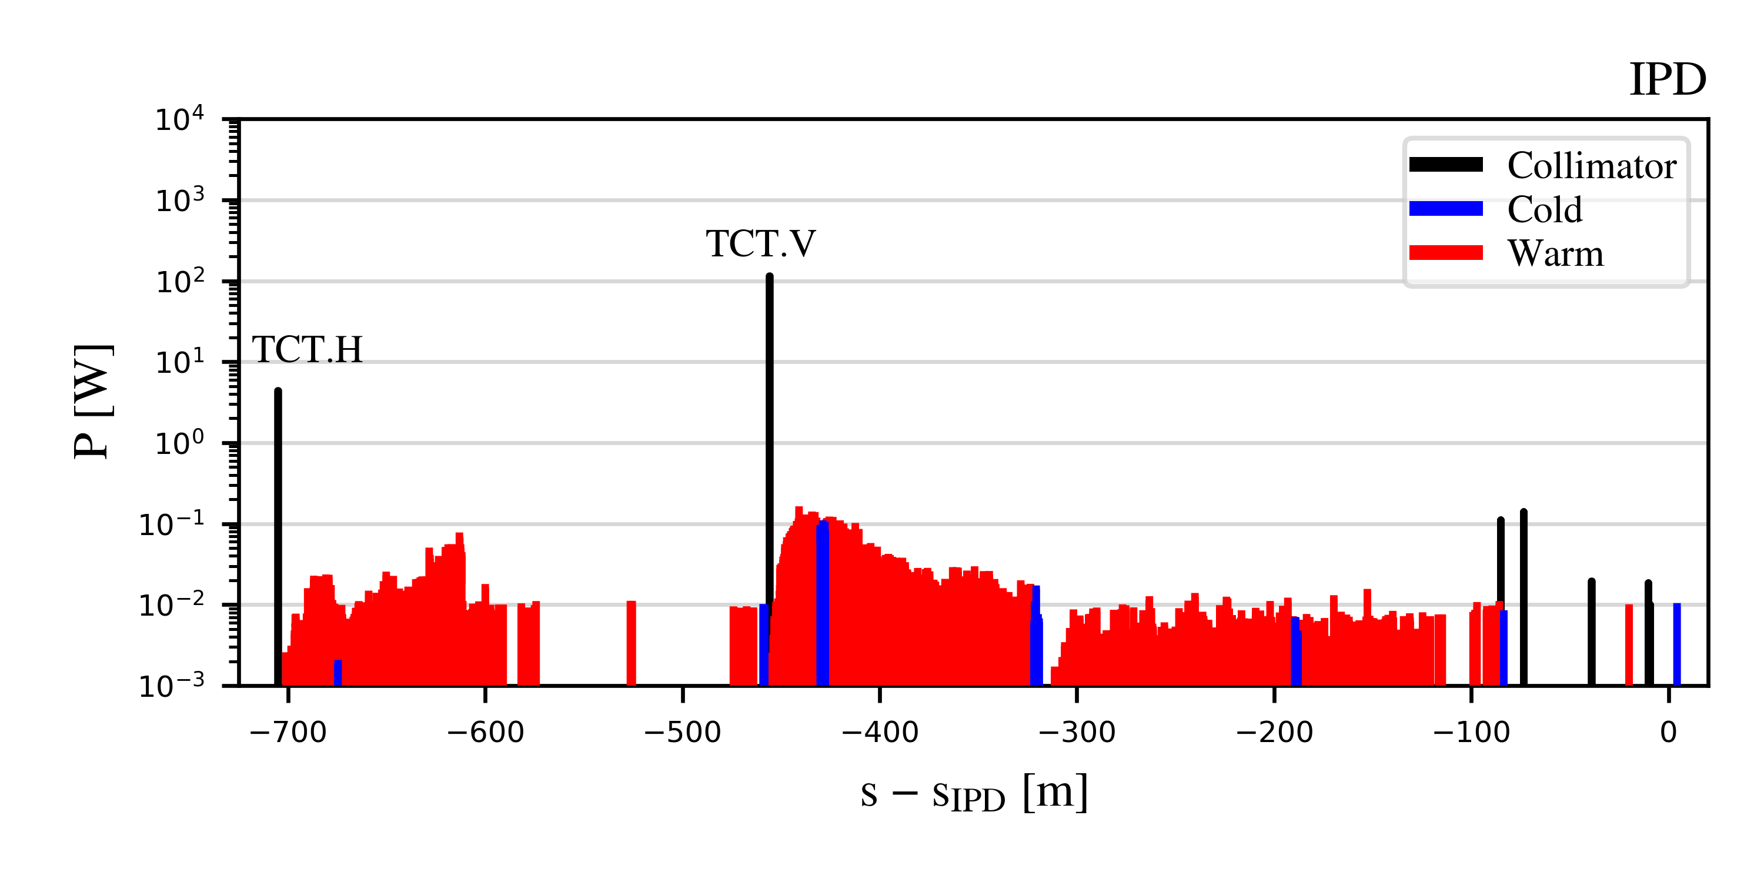
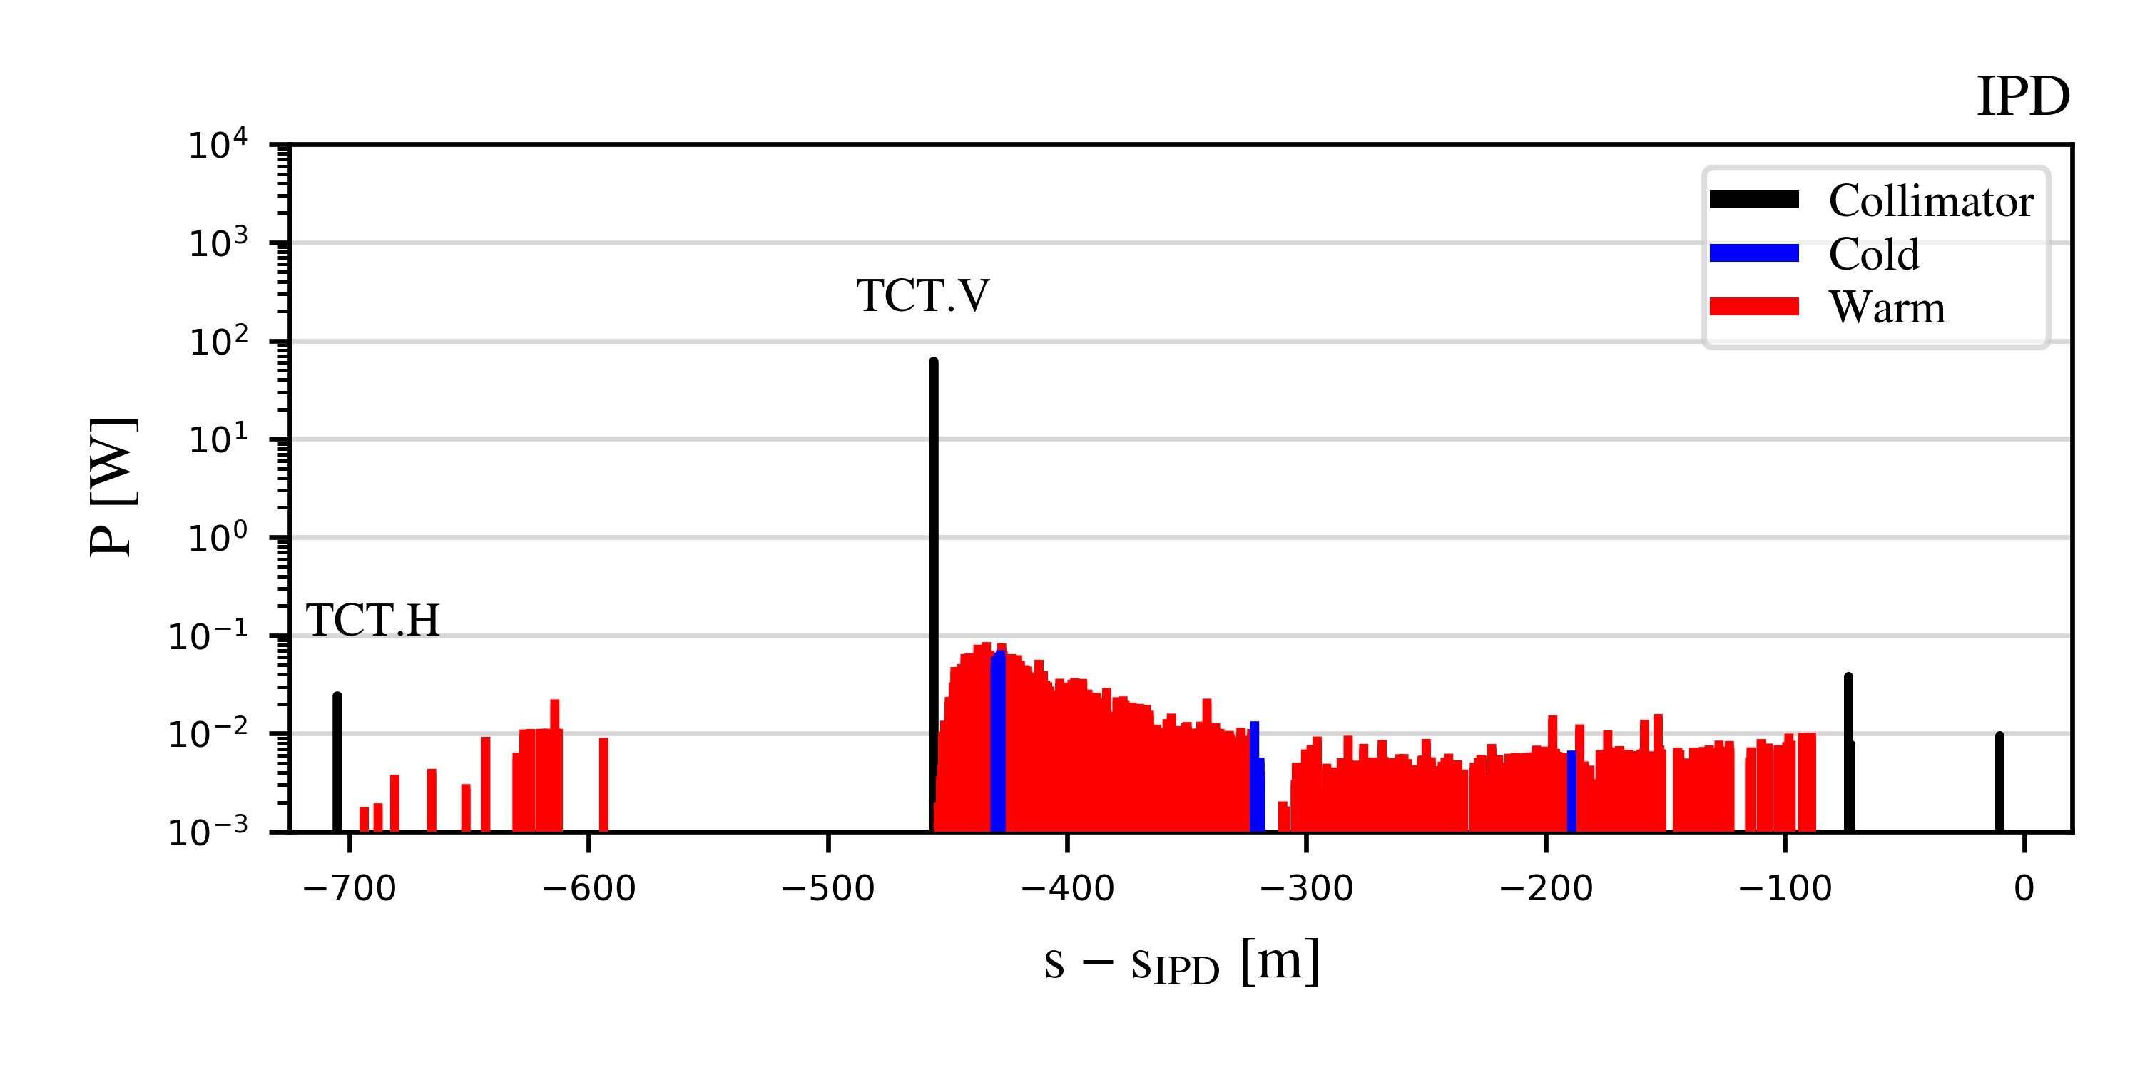
IR generic halo losses for the Z mode
IR losses from generic beam halo losses: focus on IPD (farther from collimation insertion in PF)
B1H
B1V
Vast majority of losses intecepted by the local protection tertiary collimators (TCTs)
  Max. recorded power loads ~100 W
  Residual losses on SR collimators with max. recorded power loads ~100 mW
  Near absence of losses beyond the last SR collimator
Showers from TCTs may determine radiation to tunnel/environment and may generate backgrounds
  Shower absorbers downstream of the TCTs will be studied by the FLUKA team (similarly to PF)
  Impact on background to be studied
22/05/2025
G. Broggi | IR beam losses and MDI collimators

Slide 16
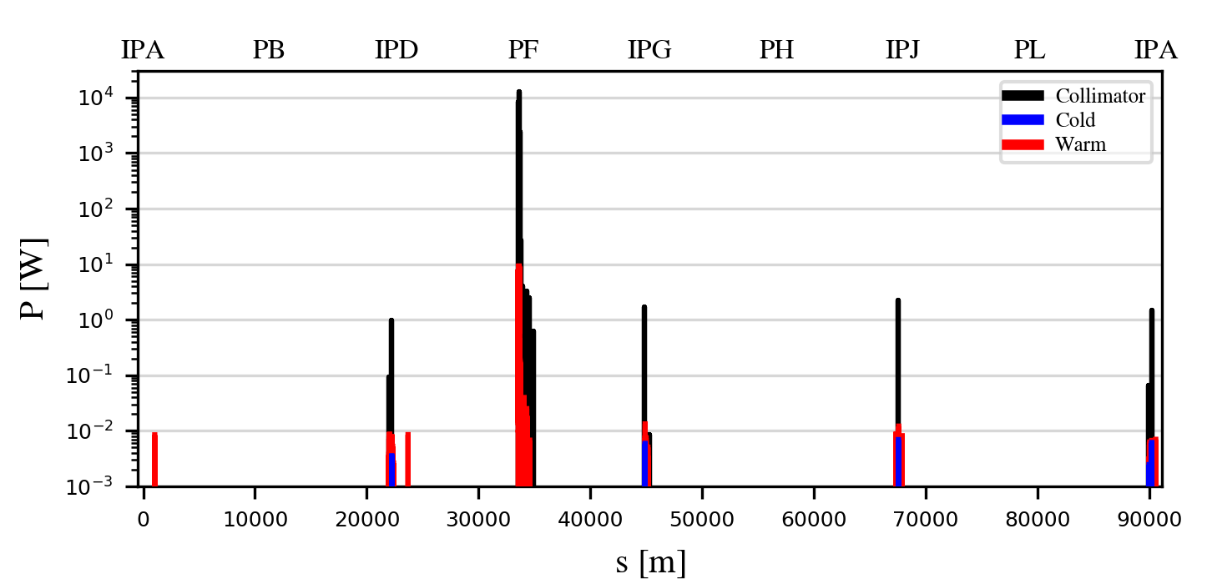
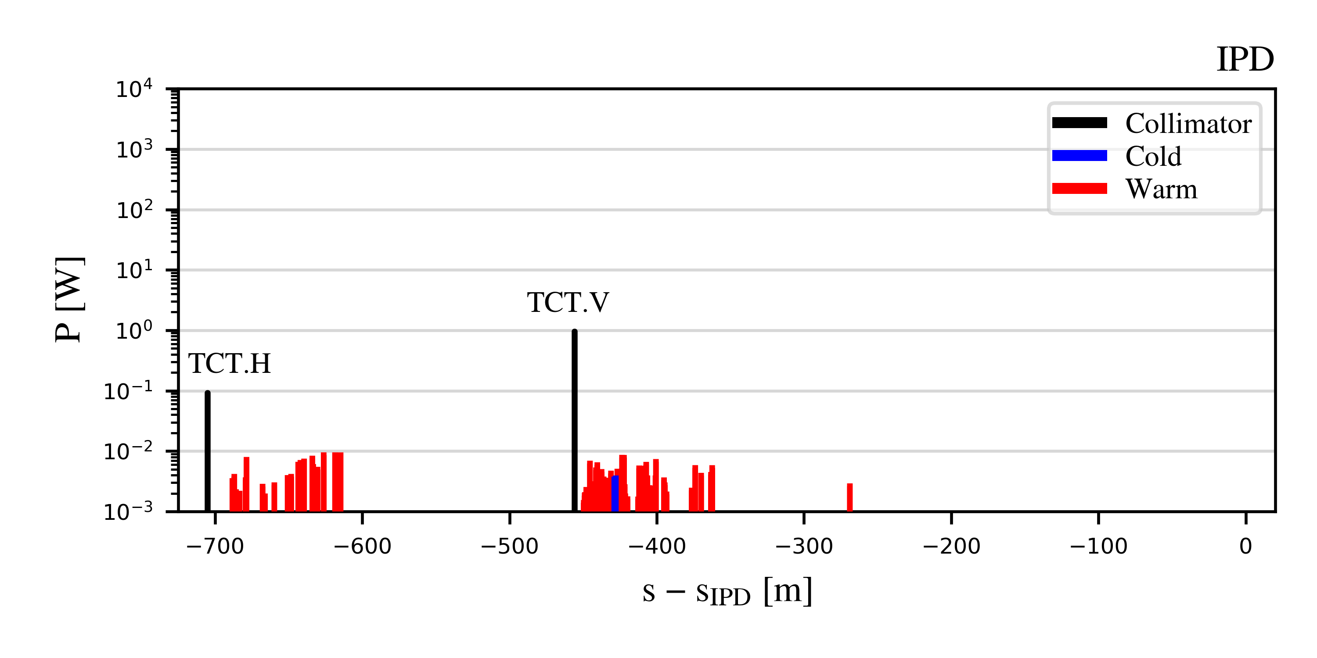
Collimator angular alignment
As found in previous studies, collimator angular alignment can significantly improve the collimation performance
Important input for the hardware design (A. Perillo-Marcone, FCC week 2025 talk)
  Collaboration with the engineering team
  Tolerances on the collimator angular alignment are being evaluated
B1H
B1H + tilt
B1H + tilt
B1H
22/05/2025
G. Broggi | IR beam losses and MDI collimators

Slide 17
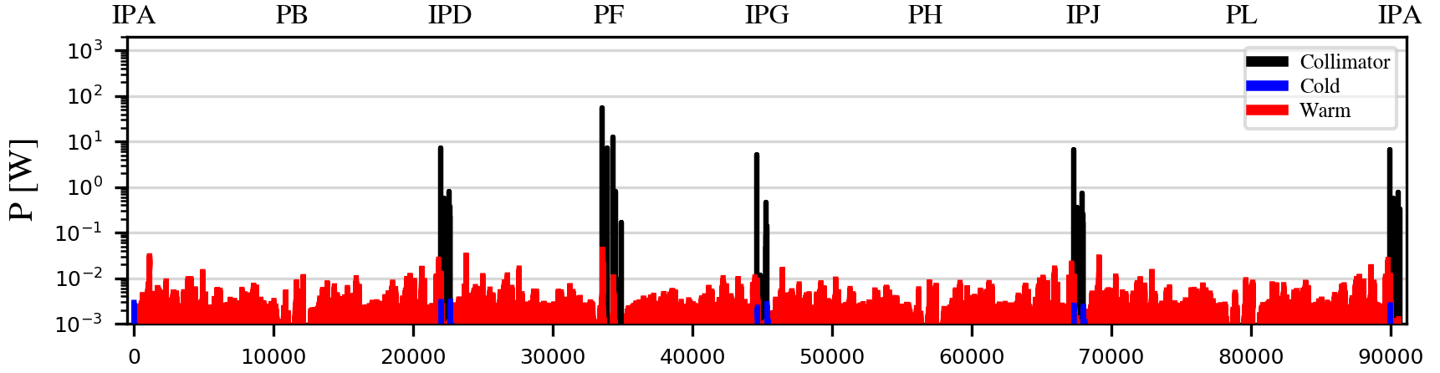
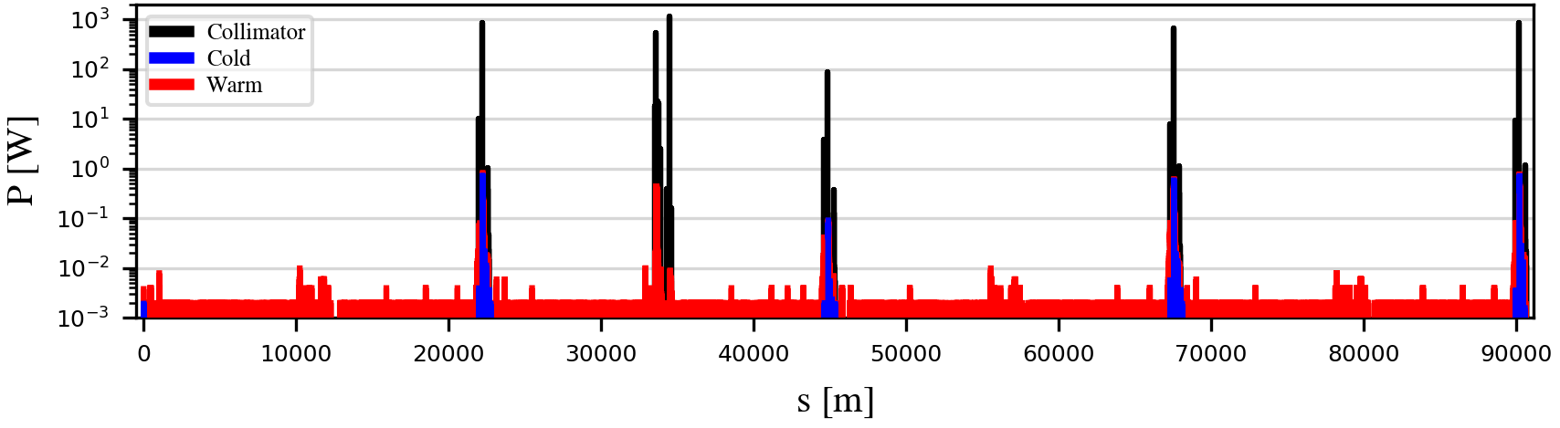
*1h beam conditioning at full nominal current (1.27 A): pressure is expected to condition down further (up to a factor ~100) over time
Beam-gas losses for the Z mode
A scattering routine to simulate beam-gas interactions while tracking in Xsuite has been developed​ (IPAC'25 paper)
  Based on realistic pressure and gas composition profile provided as input
Beam-gas bremsstrahlung
Estimated lifetime*: 274 min
Expected to increase to > 100 h in a fully conditioned machine
Beam-gas Coulomb scattering
Estimated lifetime*: 41 min
Expected to increase to > 10 h in a fully conditioned machine
At the FCC-ee beam energies, bremsstrahlung is expected to dominate beam-gas-induced lifetime degradation
BUT, under particular machine conditions, such as limited DA, even small angular deflections from a single Coulomb scattering event can be sufficient to drive particles beyond the DA limit
22/05/2025
G. Broggi | IR beam losses and MDI collimators

Slide 18
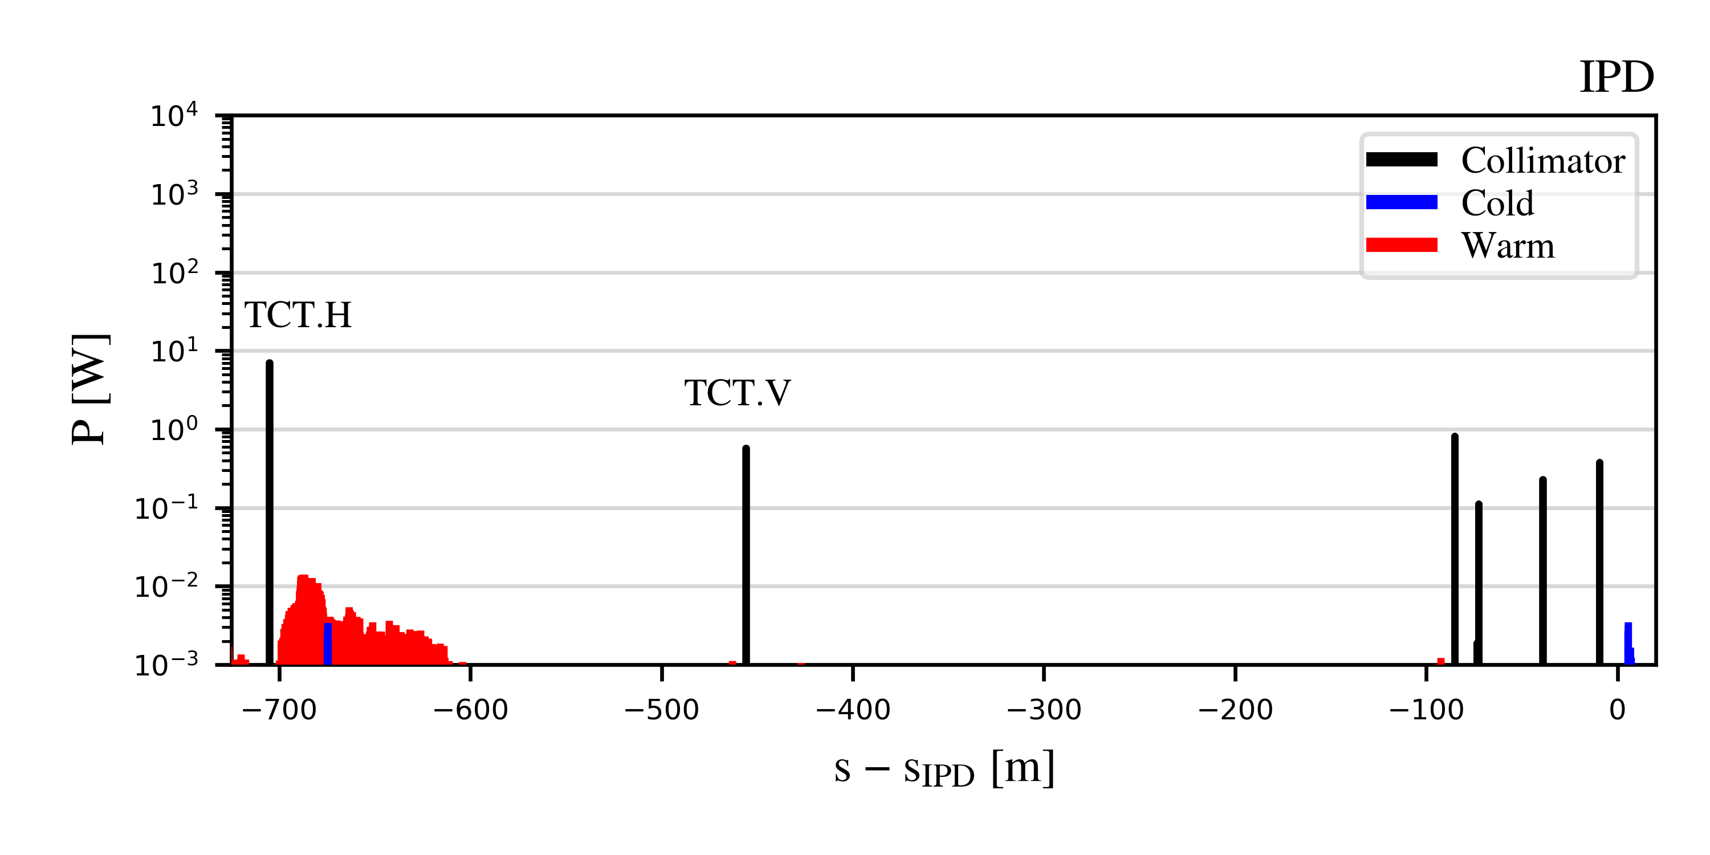
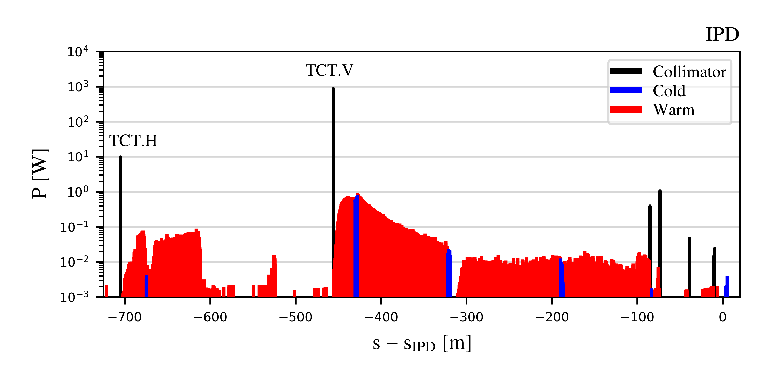
*1h beam conditioning at full nominal current (1.27 A): pressure is expected to condition down further (up to a factor ~100) over time
IR beam-gas losses for the Z mode
Beam-gas bremsstrahlung
Estimated lifetime*: 274 min
Expected to increase to > 100 h in a fully conditioned machine
Vast majority of losses intecepted by the TCTs
  Max. recorded power loads ~kW (Coulomb)
  Residual losses on SR collimators with max. recorded power loads ~1 W
  Near absence of losses beyond the last SR collimator
Beam-gas Coulomb scattering
Estimated lifetime*: 41 min
Expected to increase to > 10 h in a fully conditioned machine
Showers from TCTs may cause sizeable radiation to tunnel/environment and may generate backgrounds
  Shower absorbers downstream of the TCTs will be studied by the FLUKA team (similarly to PF)
  Impact on backgrounds is being evaluated (A. Frasca, TID and Fluence in the detector and IR)
22/05/2025
G. Broggi | IR beam losses and MDI collimators

Slide 19
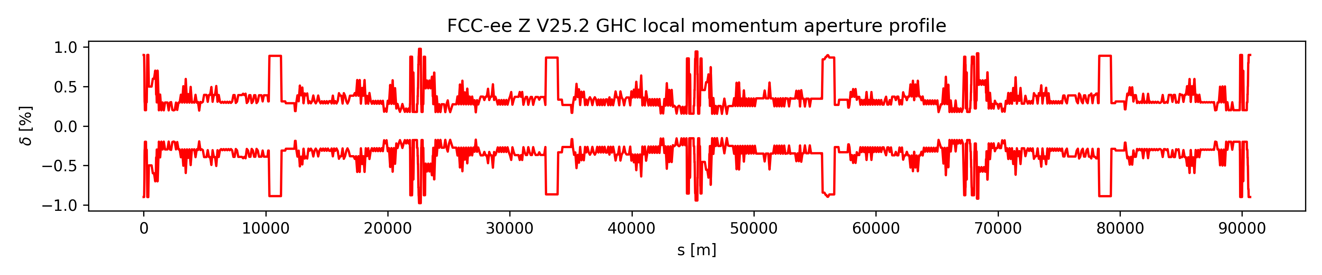
Touschek scattering losses for the Z mode
A Monte Carlo routine to simulate Touschek scattering has recently developed
  The routine follows the approach by A. Xiao and M. Borland (PRSTAB paper) implemented in ELEGANT
  Monte Carlo method + Piwinski formula
  Local momentum aperture profile provided as input (retrieved from tracking):
Touschek lifetime estimates in SuperKEKB/DAFNE in agreement with expectations
More details on the implementation in backup slides (or G. Broggi, Xsuite-based simulations of Touschek effect in DAFNE, FCC-ee MDI meeting #65)
First application of the routine to the FCC-ee (Z mode)
  The Z mode is the one at which Touschek scattering is most important (lowest energy, highest intensity)
22/05/2025
G. Broggi | IR beam losses and MDI collimators

Slide 20
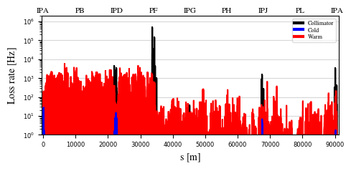
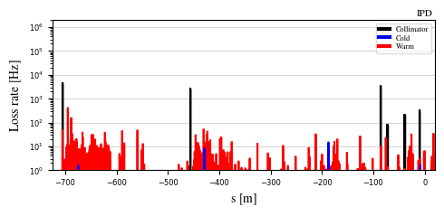
Touschek scattering losses for the Z mode
First tracking-estimated Touschek lifetime in the FCC-ee (Z): 2069 min (~35 h)
  Consistent with previous MAD-X/SAD analytical estimates (M. Boscolo, FCC week 2019)
  Touschek scattering is not a lifetime-limiting effect in the FCC-ee
    Lifetime from radiative Bhabha scattering: 22 min
    Lattice lifetime (q + BS + lattice): 83 min
    Beam-gas lifetime: 36 min (1h conditioning), >500 min (conditioned machine)
    Loss maps show only Touschek primary losses
N.B. These are the very first results of this type – detailed checks are still ongoing
PRELIMINARY detailed checks ongoing
22/05/2025
G. Broggi | IR beam losses and MDI collimators

Slide 21
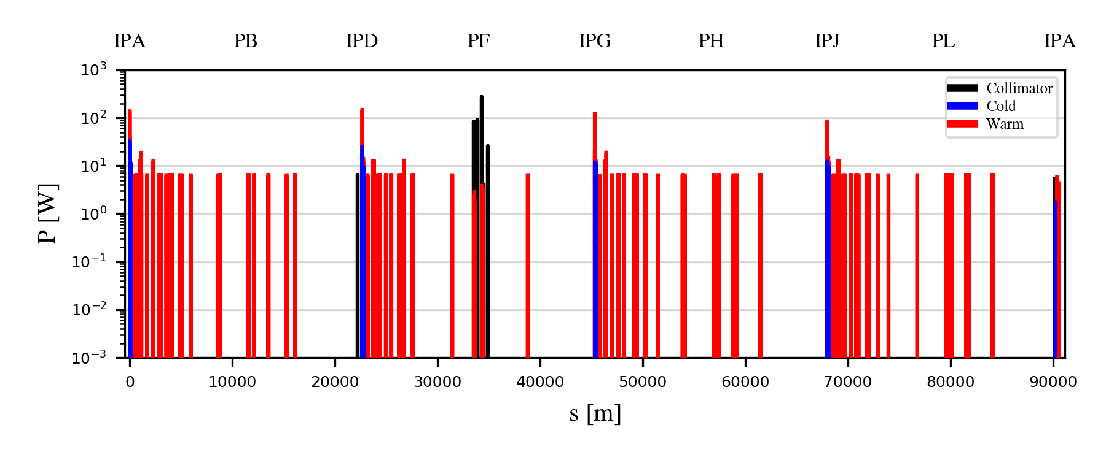
*quantum + lattice + BS + lum.
Beam-beam losses for the Z mode
Xsuite allows to set-up complex combined-effects simulations: beam-beam + collimation
  Beam-beam kicks, radiative Bhabha, beamstrahlung in 4 IPs + detailed aperture and collimator model
    Weak-strong beam-beam model
  Common technical insertion optics shows significant advantages
    Absence of strong-vertical emittance blow-up previously observed (BB'24 talk)
    Beam lifetime* in agreement with expectations: ~14 min vs. ~17 min without aperture and collimators
Beam-beam losses intercepted by the collimation system in PF
Beam-beam losses outside PF mostly on elements downstream of the IPs
22/05/2025
G. Broggi | IR beam losses and MDI collimators

Slide 22
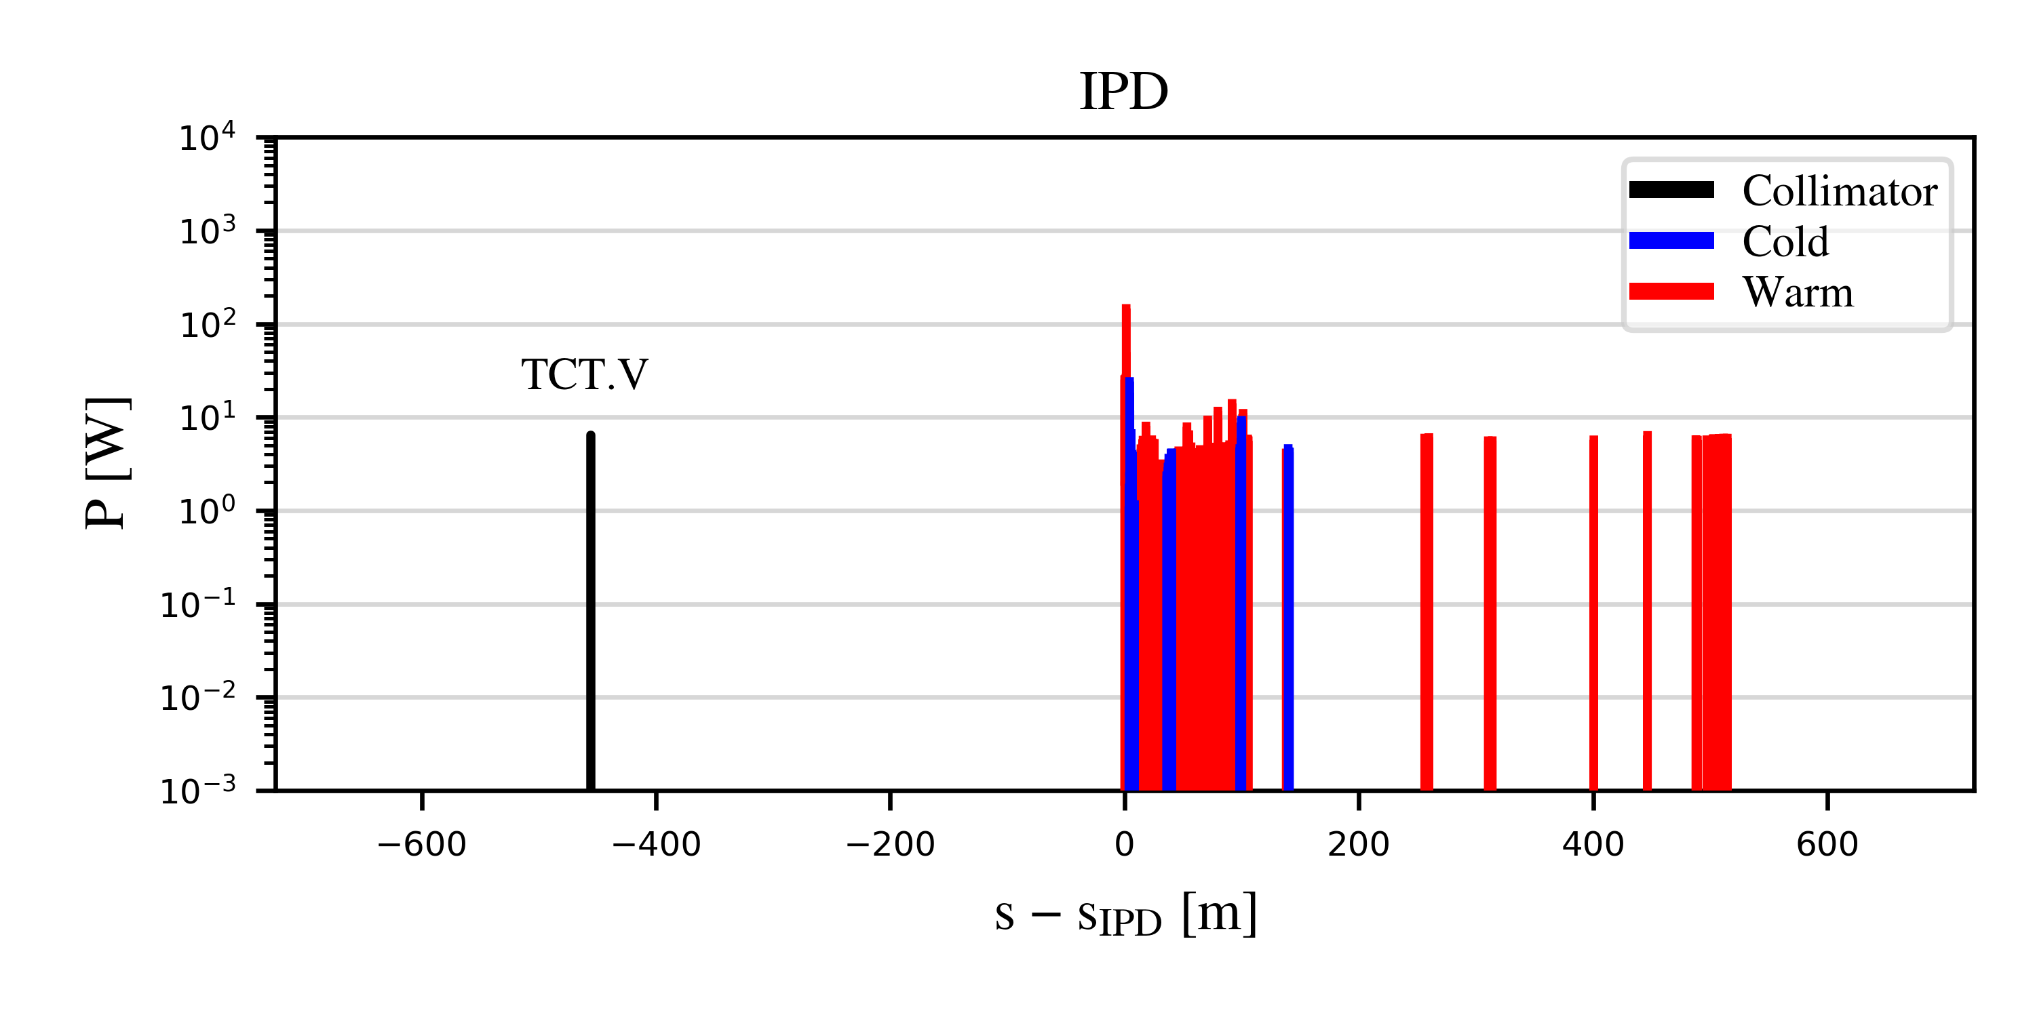
IR beam-beam losses for the Z mode
Beam-beam losses outside PF mostly on elements downstream of the IPs
  Local losses that cannot be intercepted in PF on a second turn
  Physics-debris-like collimators downstream of the IPs ?
Physics debris collimators might also suppress losses upstream of the IPs
  These are losses from the beam halo being populated by beam-beam interactions at previous passages through the Ips
It is planed to use beam distributions from multi-turn tracking as input to dedicated beam-beam simulations for evaluation of impact on backgorunds
22/05/2025
G. Broggi | IR beam losses and MDI collimators

Slide 23
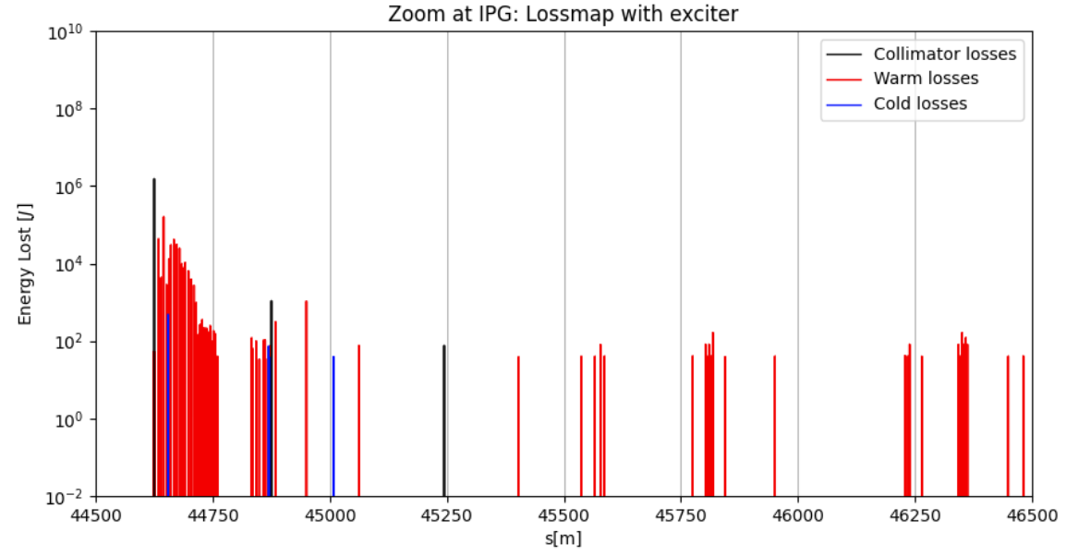
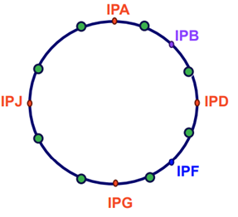
Fast instability losses for the Z mode
Studies on fast instability losses have been performed (G. Nigrelli – FCC physics workshop 2025 talk)
  Fast instability modeled by synchronized kicks placed along the ring with raising strength
    Mimic instabilities with different rise times
    Studied beam loss distributions around the ring and across multiple turns
The fast instability develops if the feedback system fails – feedback system redundancy ?
  Most likely unacceptable for machine operation
  Full beam potentially lost within few turns
  Almost 50% of beam energy lost in one turn, losses of order of MJ in the collimator can be expected
  Potential impact on the detectors is being evaluated
22/05/2025
G. Broggi | IR beam losses and MDI collimators

Slide 24
Outline
Introduction
  FCC-ee beam loss studies
  FCC-ee collimation system
  Workflow for detector background evaluation
FCC-ee beam losses and collimation simulations
  Simulation benchmark with SuperKEKB data
Updates on FCC-ee beam loss simulations: focus on IR beam losses
  Beam halo losses
  Beam-gas losses
  Touschek scattering losses
  Beam-beam losses
  Top-up injection losses
  Losses from fast instabilities
Outlook and next steps
22/05/2025
G. Broggi | IR beam losses and MDI collimators

Slide 25
Outlook and next steps
Studies of beam losses and collimation for the FCC-ee
  Workflow to evaluate beam-induced backgrounds set up in collaboration with FLUKA and the MDI team
  First collimation system design available, including beam halo, SR collimators and shower absorbers
  Simulations of several beam loss scenarios ongoing:
    Beam halo losses, beam-gas losses, Touschek scattering losses (first preliminary results), beam-beam losses, top-up injection losses, losses from fast instabilities for the most critical Z mode
    Good collimation performance – residual IR losses safely disposed by MDI collimators
  First validation of Xsuite-BDSIM simulation results against measured data from an e+e- collider (SuperKEKB)
Next steps​
  Converge on a complete beam-induced background evaluation campaign
    Detector tolerances need to be evaluated
  Study other beam loss scenarios – e.g., failure scenarios
  Extend the studies to the electron beam (B2)
  Extend the studies to all beam modes
22/05/2025
G. Broggi | IR beam losses and MDI collimators

Slide 26
Thank you!
22/05/2025
G. Broggi | IR beam losses and MDI collimators

Slide 27
Backup
22/05/2025
G. Broggi | IR beam losses and MDI collimators

Slide 28
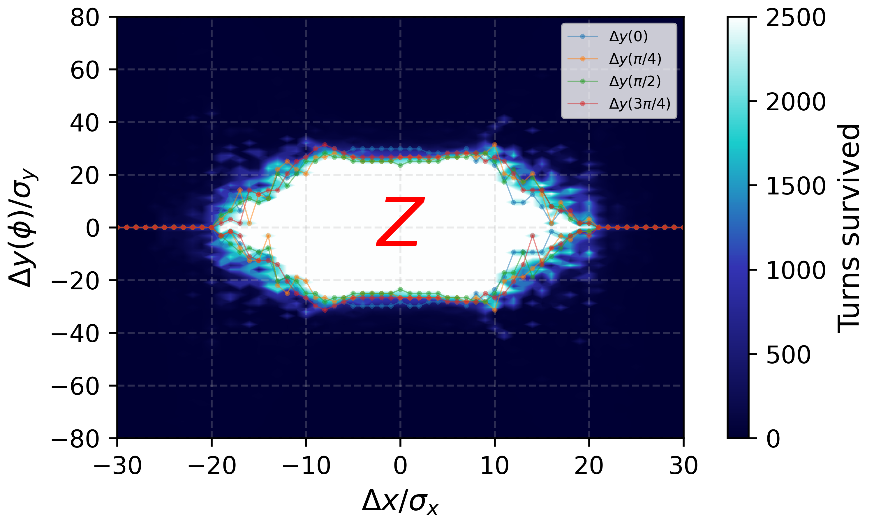
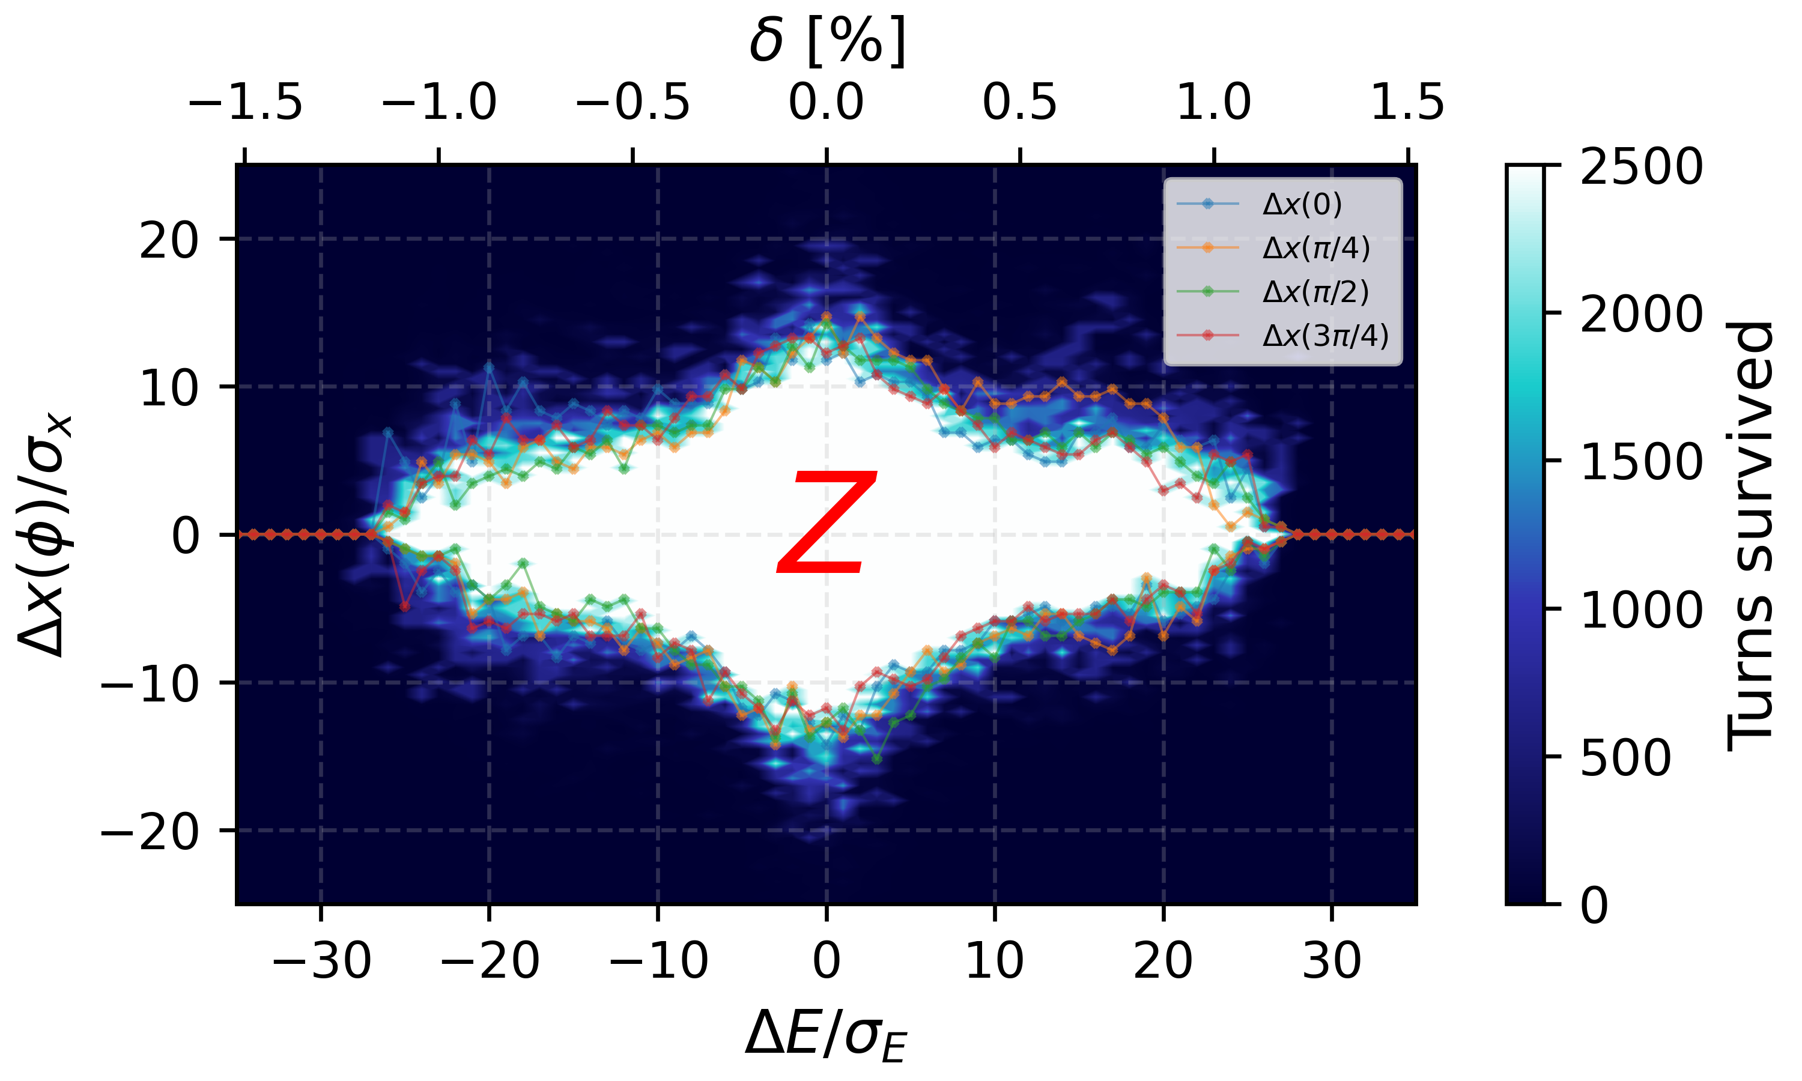
Beam-gas losses for the Z mode
FCC-ee Z V25.2 GHC DA and MA
Vertical DA in the FCC-ee Z-mode lattice is limited to ~30 σ
  Beam is highly sensitive to vertical angular kicks
  Typical vertical divergence (arcs): σₚᵧ ≈ 0.3 μrad
  A 10 μrad vertical kick → >30 σₚᵧ → particle loss
Sensitivity increases near IPs
  βᵧ reaches several km → σₚᵧ further reduced
  Even smaller kicks can cause losses
Horizontal sensitivity is lower
  σₚₓ ≫ σₚᵧ (due to much larger εₓ and lower IR-βₓ )
  Same kick → smaller normalized deflection
  Horizontal DA ≈ vertical DA
Bremsstrahlung losses more sensitive to longitudinal DA (~1%)
  Caused by photon emission → off-momentum particles
22/05/2025
G. Broggi | IR beam losses and MDI collimators

Slide 29
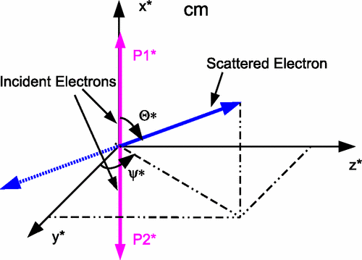
Touschek scattering
Touschek scattering: Coulomb collision between relativistic electrons (or positrons) within a particle beam
  Causes sudden energy change in scattered particles
Touschek scattering is a relativistic effect
  Momentum transfer from transverse to longitudinal plane
  In lab. frame, transfer is amplified by Lorentz factor γ
Touschek scattering causes beam losses if:
  Energy deviation exceeds RF acceptance
  Off-energy orbit/oscillation exceeds the dynamic/physical aperture
Touschek scattering may lead to:
  Beam lifetime reduction
  Beam backgrounds
22/05/2025
G. Broggi | IR beam losses and MDI collimators

Slide 30




Touschek scattering: theory snapshot
In center-of-mass (c.m.) system:
  Scattering probability into solid angle dΩ⁎ given by Møller differential cross section:
re: classical electron radius
Θ*: scattering angle
γ*: Lorentz gamma factor​
β*: Lorentz beta factor
NOTE: starred quantities are in the c.m. system
Total Touschek scattering rate R - obtained by integrating:
  Møller cross section over all possible scattering angles
  Phase space distribution of all particles in the bunch
v: particle velocity after scattering
σ: total Møller cross section
ρ: phase-space density
22/05/2025
G. Broggi | IR beam losses and MDI collimators

Slide 31
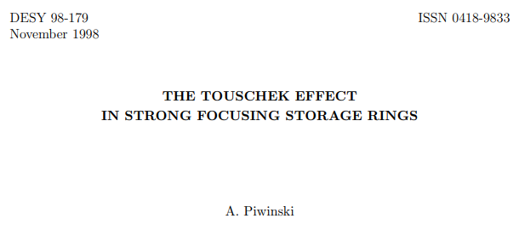
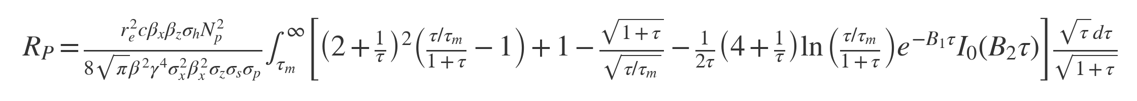
Touschek scattering: theory snapshot
Total Touschek scattering rate R:
Piwinski made a detailed evaluation of the above equation for R for a Gaussian-distributed bunch:
Piwinski Touschek scattering rate
22/05/2025
G. Broggi | IR beam losses and MDI collimators

Slide 32
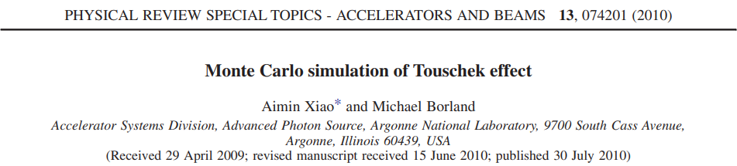


Touschek scattering: Monte Carlo simulation
The integral in Piwinski formula can be computed via Monte Carlo integration with N uniformly distributed random points in the n-dimensional volume V (if N is large enough):
The average scattering rate for particles that results in momentum deviation δ greater than a min. value δm is given by:
Monte Carlo Touschek scattering rate
v*': particle velocity
γ: Lorentz gamma factor
dσ*'/dΩ*': Møller DCS
ρ: phase-space density
N: number of simulated scattering events
M: total number of scattered particles with δ>δm
NOTE: starred quantities are in the c.m. system
NOTE: primed quantities mean "after scattering"
NOTE: when δm = δa, with δa being the local momentum acceptance, the above equation gives the Touschek beam loss rate
22/05/2025
G. Broggi | IR beam losses and MDI collimators

Slide 33



Touschek scattering: Monte Carlo simulation
To use Monte Carlo integration, one needs to generate a series of random scattering events
  Each event involves a pair of scattering particles
A gaussian-distributed bunch is considered
  Nine uniformly distributed random numbers are generated in the normalized phase-space range
Let us call these 9 random numbers n0, n1, …, n8. These are assigned as:
rx, ry, rz: user-defined parameters (default is 3) ex, ey, ez: geometric emittances
X1 = n0
X1' = n1
Y1 = n2
Y1' = n3
z1 = n4
δ1 = n5
Since the two particles are colliding the spatial coordinates x, y, zeta for particle 2 are identical to those of particle 1:
X2' = n6
Y2' = n7
δ2 = n8
particle 1
particle 2
x2 = x1, y2 = y1, z2 = z1
X, X', Y, Y': transverse normalized coordinates z, δ: longitudinal coordinates
22/05/2025
G. Broggi | IR beam losses and MDI collimators

Slide 34




Touschek scattering: Monte Carlo simulation
Particle 1: converting from normalized to real phase space coordinates and including dispersive effects:
Particle 2:
Complete set of coordinates (x, y, z, x1', y1', δ1, x2', y2', δ2) for both particles before scattering defined
Phase-space density (Gaussian-distributed bunch):
  Computed for each scattering particle
22/05/2025
G. Broggi | IR beam losses and MDI collimators

Slide 35

Touschek scattering: Monte Carlo simulation
Random uniform sampling for Θ* ∈ (0, π/2] and Ψ* ∈ [0, 2π]
  Møller DCS is computed
Phase space volume computed as:
Scattering is applied
  Transform particle momenta from lab frame to c.m. frame
  Rotate momenta according to Θ* and Ψ* (in the c.m. frame)
  Transform back to the lab frame
All ingredients to compute the Touschek scattering rate (via Monte Carlo integration) available:
22/05/2025
G. Broggi | IR beam losses and MDI collimators

Slide 36
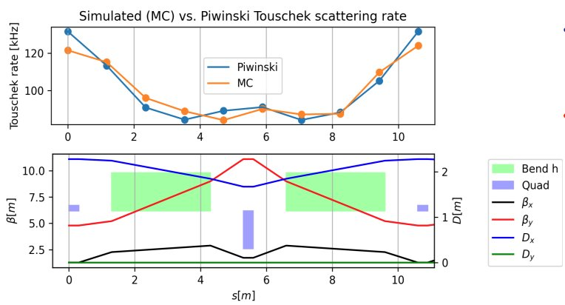
Monte Carlo simulation vs. Piwinski formula
Excellent agreement between simulated (MC) and Piwinski Touschek scattering rate for a Gaussian-distributed beam
Level of agreement depends on number of simulated scattering events
  For the comparison presented here, 1E+7 scattering events are simulated at each scattering center
  Such value is currently being considered as a standard for these simulations
22/05/2025
G. Broggi | IR beam losses and MDI collimators

Slide 37




Xsuite-based Touschek scattering simulations
Scattering rate simulation validated vs. Piwinski formula
Using Xsuite particle tracking it is possible to simulate Touschek scattering beam losses
  To each simulated scattered particle is assigned a total scattering rate Ri
  The integral of RP is taken over each section upstream of each Touschek scattering center, starting from the previous scattering center: this way, the simulated scattered particles accurately represent the scattering rate from the entire upstream section
The beam-loss rate and location can be calculated by tracking the Touschek-scattered particles and recording all lost particles
The total loss rate Rtot will be the sum of Ri for all the particles lost at any location:
  The Touschek lifetime can be computed as:
22/05/2025
G. Broggi | IR beam losses and MDI collimators

Slide 38
Xsuite-based Touschek scattering simulations
Starting from an Xtrack line, the following procedure is used:
1
2
3
An arbitrary number of Touschek scattering centers (Xtrack markers called TMarker) is inserted in the line
If not pre-computed, local momentum aperture is estimated by tracking test particles and recording the max. stable δ
Piwinski formula to assign to each TMarker the integrated scattering rate from the upstream section
6
4
5
Generate pre-scattering particle coordinates at TMarkers, compute phase-space density and phase-space volume
Compute Monte Carlo scattering rate RMC and assign total scattering rate Ri to each particle
SCATTER
7
8
9
TRACK*
Record lost particles
Compute Touschek loss rate and Touschek lifetime
*To speed-up simulations, only highest-weight particles that contribute to the 99% of the scattering rate are tracked
22/05/2025
G. Broggi | IR beam losses and MDI collimators

Slide 39
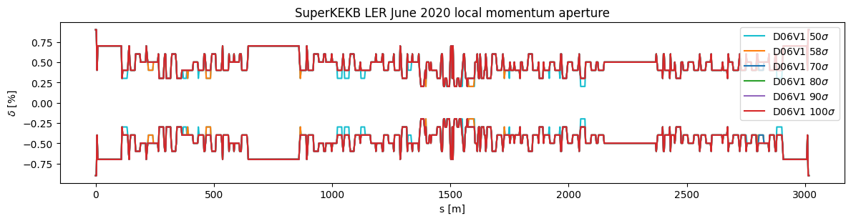
Local momentum aperture
Tracked for 1000 turns from 1000 distinct s-locations particles starting on the on-momentum closed orbit with different momentum offsets
  Recorded the maximum stable momentum offset
Local momentum aperture serves as input for Touschek scattering simulation
  Required for computing Piwinski and Monte Carlo Touschek scattering rates
A 0.9 safety factor is applied to the local momentum aperture values to ensure all potentially lost Touschek-scattered particles are tracked—untracked losses would otherwise not contribute to the total Touschek loss rate (lifetime).
22/05/2025
G. Broggi | IR beam losses and MDI collimators

