Slide 1
First look at injection backgrounds
22/05/2025 FCC Week 2025 - Joint effort PED & accelerators: Machine Detector Interface (ii)
Giulia Nigrelli
G. Nigrelli^{1,2,3}, M. Boscolo², G. Broggi^{1,2,3}, R. Bruce¹, A. Frasca^{1,4},
S. Redaelli¹, K. Skoufaris¹
¹ CERN, Geneva, Switzerland,
² INFN-LNF, Frascati, Italy,
³ Sapienza Università di Roma, Roma, Italy
⁴ University of Liverpool, Liverpool, UK

Slide 2
Outline
22/05/2025 FCC Week 2025 - Joint effort PED & accelerators: Machine Detector Interface (ii)
Giulia Nigrelli
Introduction
  Beam loss scenarios
  FCC-ee collimation overview
Top-up injection & case studies
  Injected beam
  Circulating beam
Background estimate
  Workflow overview
  Preliminary results
Conclusions & future steps

Slide 3
Outline
22/05/2025 FCC Week 2025 - Joint effort PED & accelerators: Machine Detector Interface (ii)
Giulia Nigrelli
Introduction
  Beam loss scenarios
  FCC-ee collimation overview
Top-up injection & case studies
  Injected beam
  Circulating beam
Background estimate
  Workflow overview
  Preliminary results
Conclusions & future steps

Slide 4
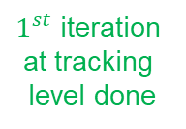
FCC-ee beam loss scenarios
22/05/2025 FCC Week 2025 - Joint effort PED & accelerators: Machine Detector Interface (ii)
Giulia Nigrelli
Important to investigate different beam loss scenarios and identify the ones to protect against. Currently the focus is on the Z mode, and the status is:
  Generic beam halo losses
  Beam losses from interactions with residual gas
  Beam losses from beam-beam interactions
  Beam losses due to fast instabilities
  Beam losses from top-up injection (this talk)
  Beam losses from Touschek scattering
  Injection failure
  SuperKEKB-like sudden beam loss events
  Beam losses from interactions with thermal photons
  Extraction failure
  Other failures: power supplies, RF, missing beam-beam, feedback ...
(Giacomo’s talk)
$1^{st}$ iteration
at tracking
level done
Work in progress
Not started

Slide 5
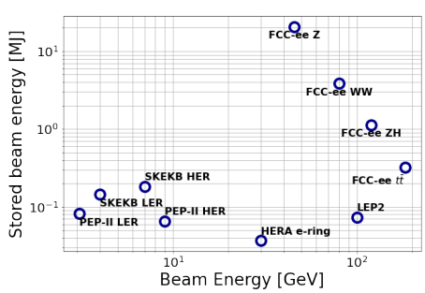
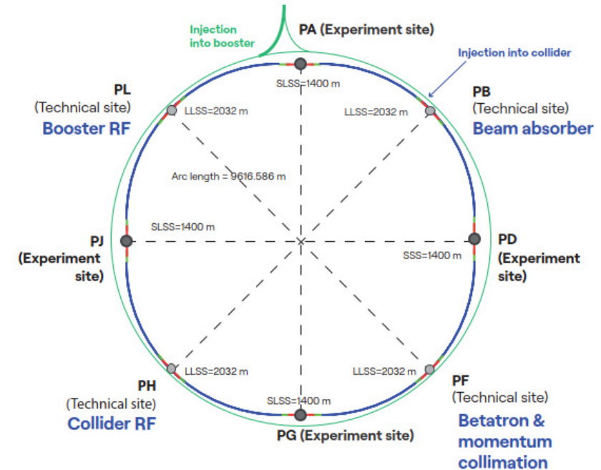
FCC-ee collimation overview
22/05/2025 FCC Week 2025 - Joint effort PED & accelerators: Machine Detector Interface (ii)
Giulia Nigrelli
FCC-ee presents unique challenges:
  At Z pole 17.5 MJ of stored beam energy (two orders of
  magnitude bigger than any other lepton collider).
  Beams are highly destructive.
Collimation system must:
  Protect the machine and the detectors from unavoidable beam losses.
  Minimize background for the experiments.
Collimation setup (for details see Giacomo’s talk on
Tuesday):
  Global system in PF: 2 stage betatron + momentum.
  Experimental IRs: SR collimators and mask +
  robust tertiary collimator.
  Local protection for injection, extraction, etc..
  Secondary particle shower absorber.

Slide 6
Outline
22/05/2025 FCC Week 2025 - Joint effort PED & accelerators: Machine Detector Interface (ii)
Giulia Nigrelli
Introduction
  Beam loss scenarios
  FCC-ee collimation overview
Top-up injection & case studies
  Injected beam
  Circulating beam
Background estimate
  Workflow overview
  Preliminary results
Conclusions & future steps

Slide 7
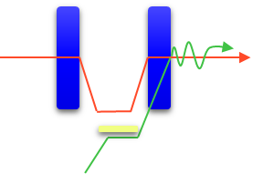
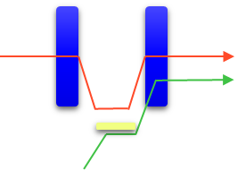
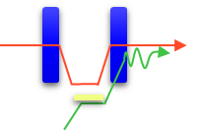

Top-up Injection for FCC-ee
22/05/2025 FCC Week 2025 - Joint effort PED & accelerators: Machine Detector Interface (ii)
Giulia Nigrelli
For more information see Yann’s talk.
Beam lifetime during collisions well below 1h → top-up injection scheme required.
Z-mode most critical for injection → up to 1 % of full beam intensity is injected every 3 s.
On-axis & Off-energy current baseline scheme. Hybrid mode, i.e., Off-axis & Off-energy, is considered as an option, and as baseline for W-mode.
Off-axis & On-energy injection scheme not feasible for synchrotron radiation (SR) levels at the SR mask collimator.
On-axis & Off-energy
Off-axis & On-energy
Off-axis & Off-energy
$π−$bump
Circulating
beam
Septum blade
Injected beam

Slide 8
Top-up Injection for FCC-ee
22/05/2025 FCC Week 2025 - Joint effort PED & accelerators: Machine Detector Interface (ii)
Giulia Nigrelli
We focus on ring losses during the injection process. The cases of interest include:
Perfect injection:
  Injected beam, both baseline scheme and hybrid mode.
  Losses due to the bump: the beam circulating in the collider must be brought close to the injected one. In this procedure part of the beam is scraped at the septum/absorber placed at the injection point. Core beam and halo beam are treated separately.
Injection failures (work in progress):
  Issues with the bump, like partial closure.
  Mismatched injected beam, like higher energy offset or not perfectly on axis.

Slide 9
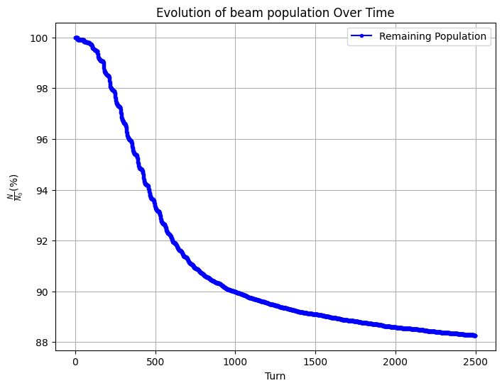
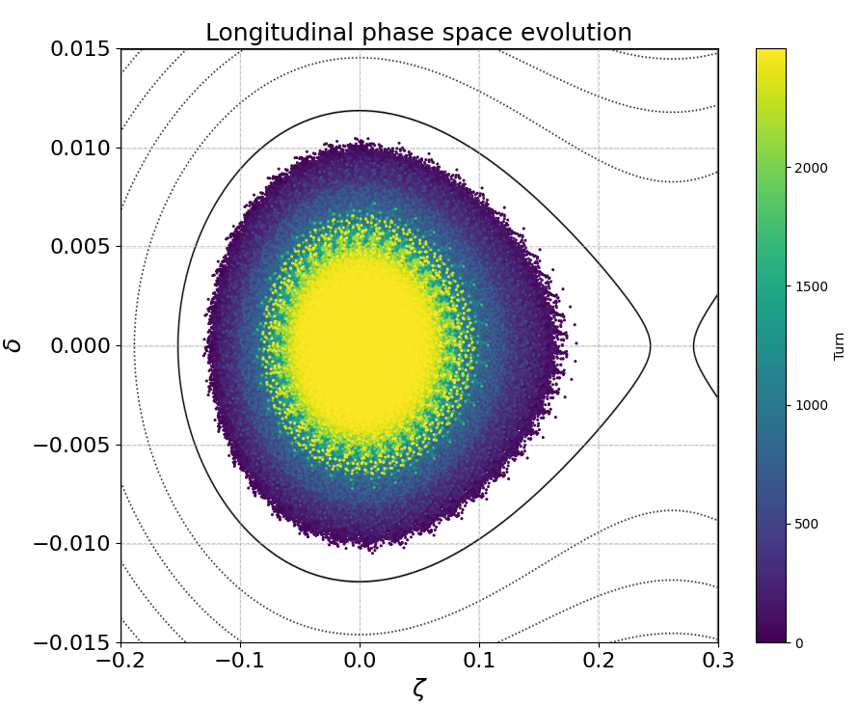
Injected beam - baseline
22/05/2025 FCC Week 2025 - Joint effort PED & accelerators: Machine Detector Interface (ii)
Giulia Nigrelli
Beam distribution is generated at the injection point in the chromatic orbit with designed injection parameters.
Injection efficiency is assed at 88% for lattice V25.1_GHC.

Slide 10
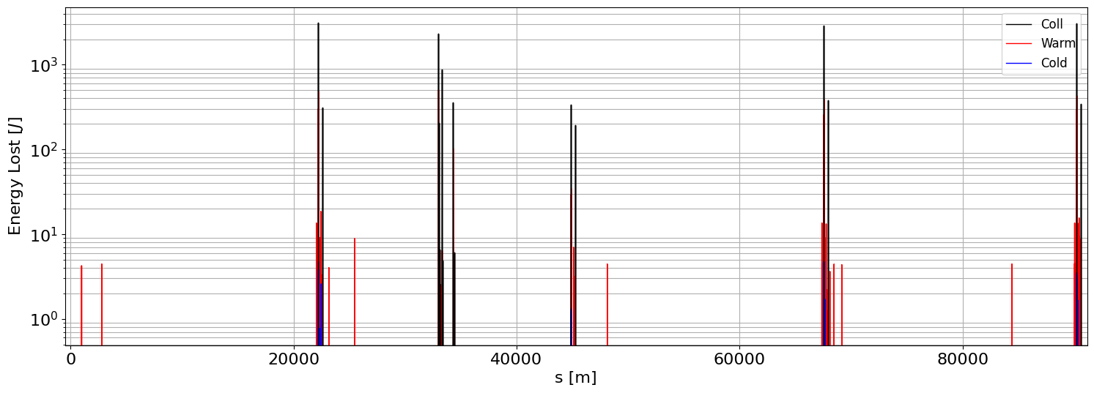
Injected beam - baseline
22/05/2025 FCC Week 2025 - Joint effort PED & accelerators: Machine Detector Interface (ii)
Giulia Nigrelli
The 12% of the injected beam is lost and distributed along the whole ring.
The tertiary collimator close to the IPs get as much losses as the collimation insertion in PF.
Note that this is a perfect injection! As observed at SuperKEKB, the losses coming from the injected beam could be dangerous, collimation efficiency must be assessed.
INJ
IP
COLL
IP
IP
IP

Slide 11
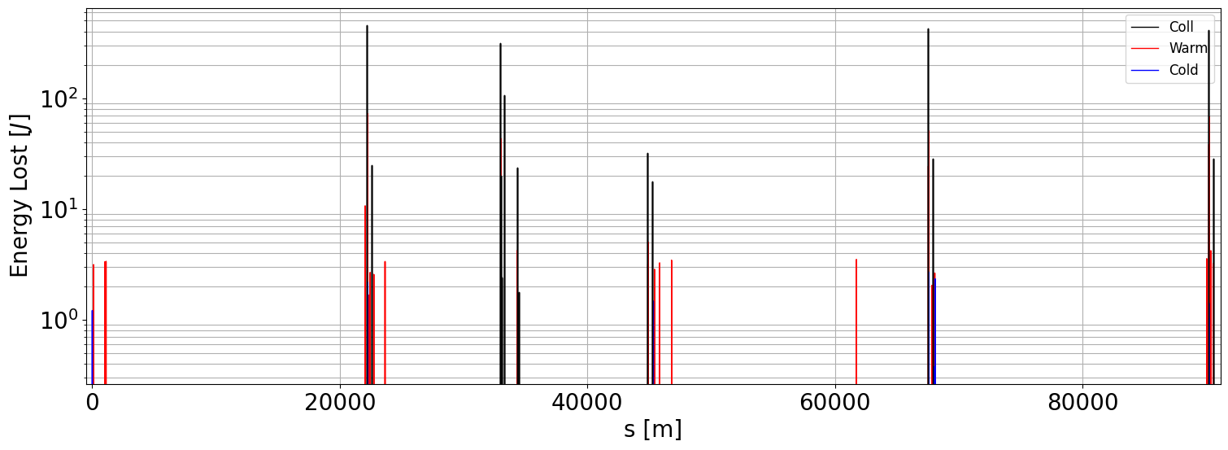
Injected beam – hybrid mode
22/05/2025 FCC Week 2025 - Joint effort PED & accelerators: Machine Detector Interface (ii)
Giulia Nigrelli
In hybrid mode the beam is generated with lower energy offset, compesated by an horizontal offset.
Injection efficiency increase up to 98.5% hence only 1.5% of the injected beam is lost and distributed along the whole ring. With respect to the on-axis scheme, the hybrid mode presents better performances.
INJ
IP
COLL
IP
IP
IP

Slide 12
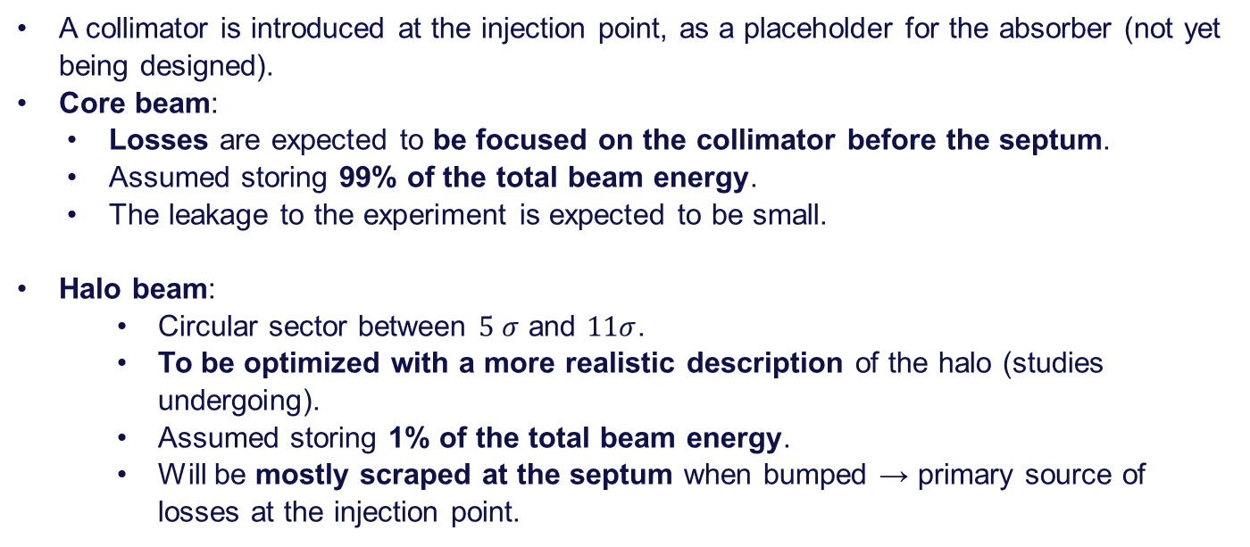
Circulating beam
22/05/2025 FCC Week 2025 - Joint effort PED & accelerators: Machine Detector Interface (ii)
Giulia Nigrelli
A collimator is introduced at the injection point, as a placeholder for the absorber (not yet being designed).
Core beam:
  Losses are expected to be focused on the collimator before the septum.
  Assumed storing 99% of the total beam energy.
  The leakage to the experiment is expected to be small.
Halo beam:
    Circular sector between $5 σ$ and $11σ$.
    To be optimized with a more realistic description of the halo (studies undergoing).
    Assumed storing 1% of the total beam energy.
    Will be mostly scraped at the septum when bumped → primary source of losses at the injection point.

Slide 13
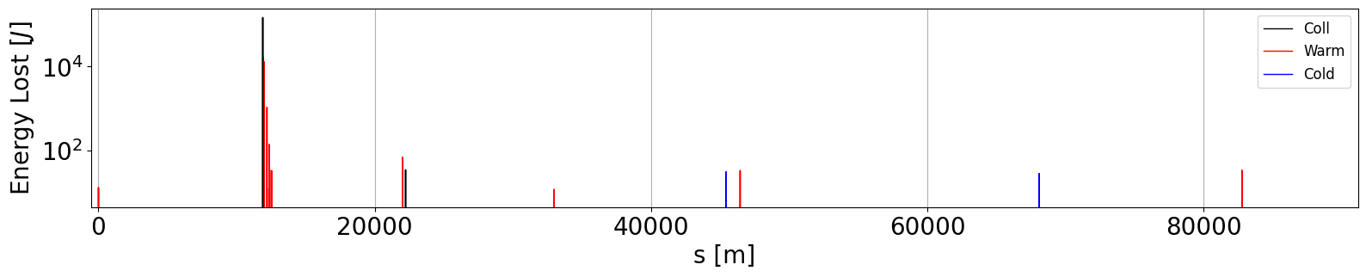
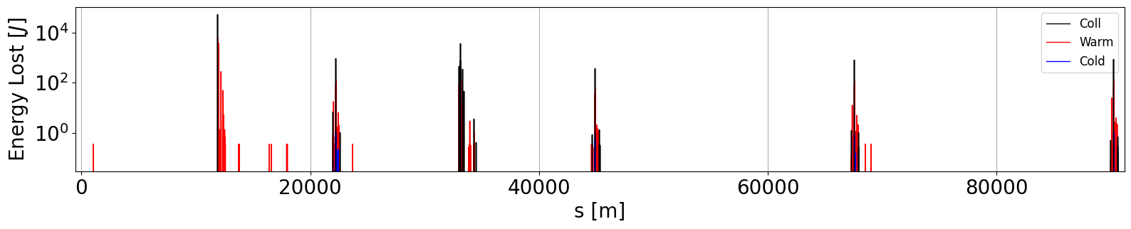
Circulating beam
22/05/2025 FCC Week 2025 - Joint effort PED & accelerators: Machine Detector Interface (ii)
Giulia Nigrelli
Almost 50% of the halo is lost at the injection point and the leakage to the experiment is significant and need further investigation.
No significant contribution from the core beam.
INJ
IP
COLL
IP
IP
IP
CORE
HALO

Slide 14
Outline
22/05/2025 FCC Week 2025 - Joint effort PED & accelerators: Machine Detector Interface (ii)
Giulia Nigrelli
Introduction
  Beam loss scenarios
  FCC-ee collimation overview
Top-up injection & case studies
  Injected beam
  Circulating beam
Background estimate
  Workflow overview
  Preliminary results
Conclusions & future steps

Slide 15
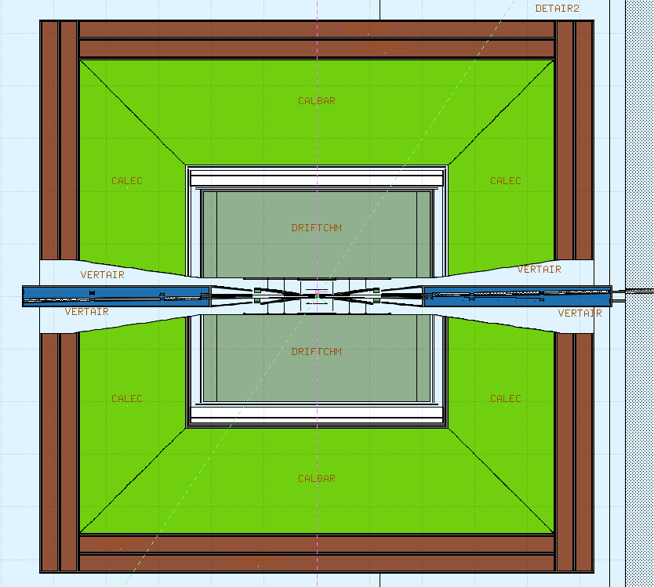
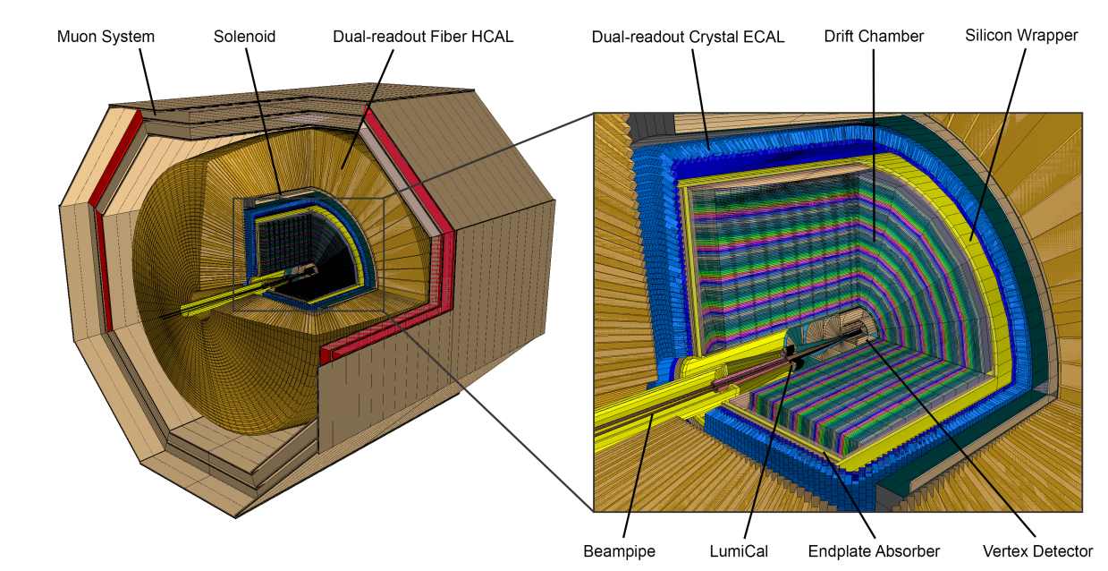
Background simulation workflow
22/05/2025 FCC Week 2025 - Joint effort PED & accelerators: Machine Detector Interface (ii)
Giulia Nigrelli
For more details on the geometry see Alessandro’s talk.
IP
FLUKA
IPB
BDSIM
IP
IP
XSUITE
IPF
IP
IDEA
Should be extended to other detector design.
WE ARE
HERE!
Notes:
The impacts on the tertiary collimators close to the Ips have been used in the FLUKA geometry of the Interaction region, developed by A. Frasca et al, to track electromagnetic shower that can produce background to the experiment.

Slide 16
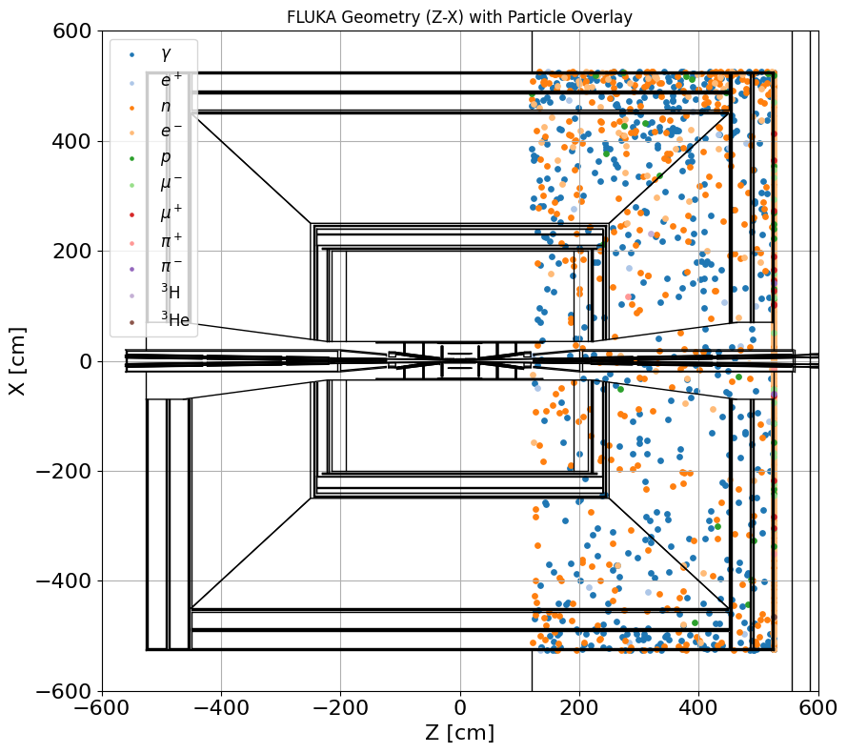
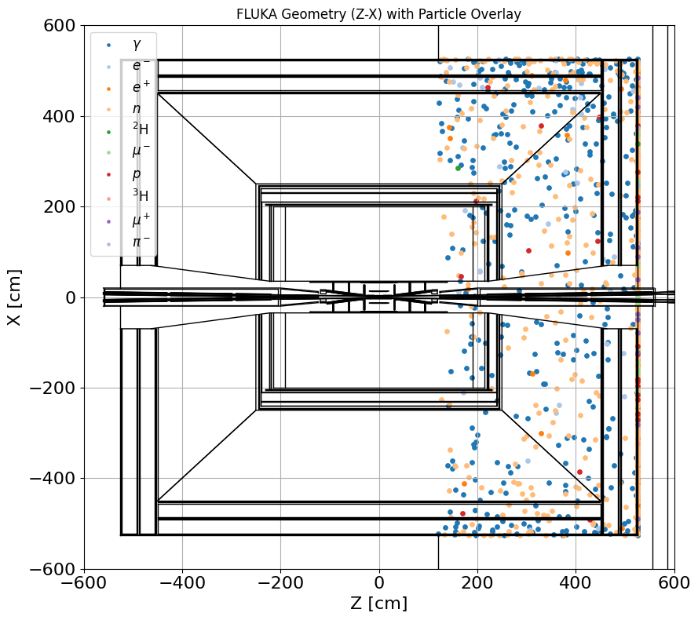
Preliminary results on injection background
22/05/2025 FCC Week 2025 - Joint effort PED & accelerators: Machine Detector Interface (ii)
Giulia Nigrelli
HALO
INJECTED
Returning to the injection scenario, the hits on the tertiary collimator were input into the FLUKA geometry and propagated up to the interface.
Preliminary results shows that a fraction of the secondary
particles reach the experiment, but further investigation is needed.
Assessment with detector simulation tools are needed to obtain a final estimate of the injection background!
Notes:
1.3% of simulated particles get to the detector for halo
0.6% of simulated particles get to the detector for injected

Slide 17
Outline
22/05/2025 FCC Week 2025 - Joint effort PED & accelerators: Machine Detector Interface (ii)
Giulia Nigrelli
Introduction
  Beam loss scenarios
  FCC-ee collimation overview
Top-up injection & case studies
  Injected beam
  Circulating beam
Background estimate
  Workflow overview
  Preliminary results
Conclusions & future steps

Slide 18
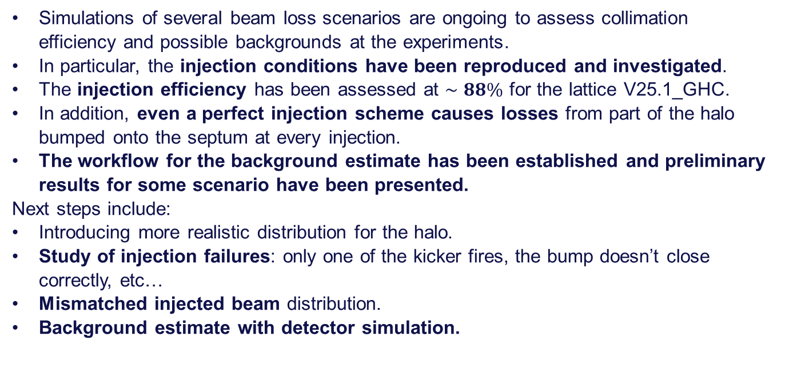
Conclusion and Future Steps
22/05/2025 FCC Week 2025 - Joint effort PED & accelerators: Machine Detector Interface (ii)
Giulia Nigrelli
Simulations of several beam loss scenarios are ongoing to assess collimation efficiency and possible backgrounds at the experiments.
In particular, the injection conditions have been reproduced and investigated.
The injection efficiency has been assessed at $∼88\%$ for the lattice V25.1_GHC.
In addition, even a perfect injection scheme causes losses from part of the halo bumped onto the septum at every injection.
The workflow for the background estimate has been established and preliminary results for some scenario have been presented.
Next steps include:
Introducing more realistic distribution for the halo.
Study of injection failures: only one of the kicker fires, the bump doesn’t close correctly, etc…
Mismatched injected beam distribution.
Background estimate with detector simulation.
Notes:
In addition, even a perfect injection scheme causes losses from part of the halo bumped onto the septum at every injection

Slide 19
Thank you for your attention!
22/05/2025 FCC Week 2025 - Joint effort PED & accelerators: Machine Detector Interface (ii)
Giulia Nigrelli

Slide 20
Backup
22/05/2025 FCC Week 2025 - Joint effort PED & accelerators: Machine Detector Interface (ii)
Giulia Nigrelli

Slide 21
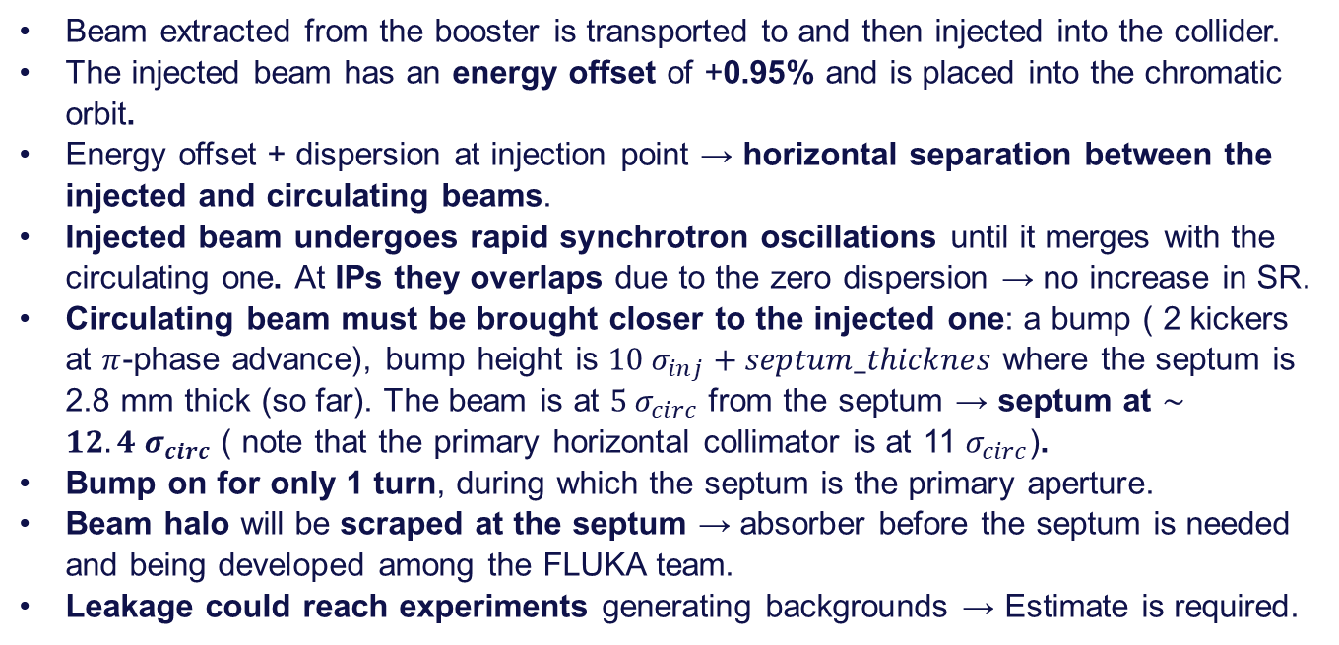
On-axis & Off-Energy injection scheme
22/05/2025 FCC Week 2025 - Joint effort PED & accelerators: Machine Detector Interface (ii)
Giulia Nigrelli
Beam extracted from the booster is transported to and then injected into the collider.
The injected beam has an energy offset of +0.95% and is placed into the chromatic orbit.
Energy offset + dispersion at injection point → horizontal separation between the injected and circulating beams.
Injected beam undergoes rapid synchrotron oscillations until it merges with the circulating one. At IPs they overlaps due to the zero dispersion → no increase in SR.
Circulating beam must be brought closer to the injected one: a bump ( 2 kickers at $π$-phase advance), bump height is $10 σ_{inj}+septum_thicknes$ where the septum is 2.8 mm thick (so far). The beam is at $5 σ_{circ}$ from the septum → septum at $∼12.4 σ_{circ}$ ( note that the primary horizontal collimator is at 11 $σ_{circ}$).
Bump on for only 1 turn, during which the septum is the primary aperture.
Beam halo will be scraped at the septum → absorber before the septum is needed and being developed among the FLUKA team.
Leakage could reach experiments generating backgrounds → Estimate is required.

Slide 22
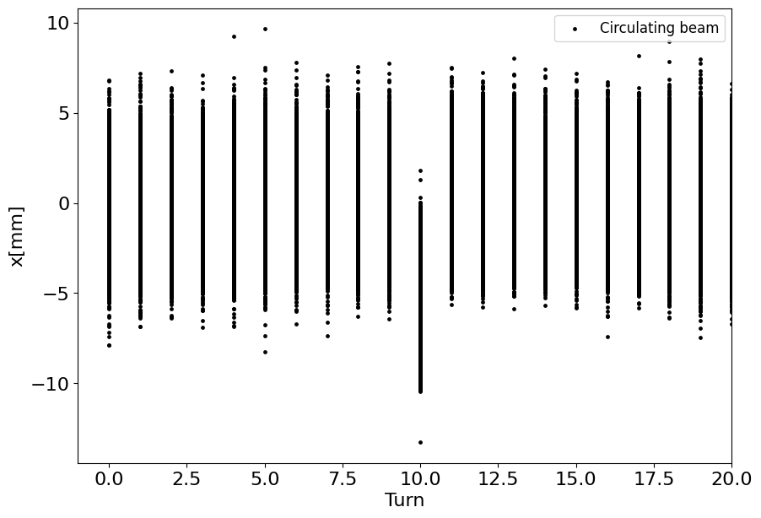
Circulating beam
22/05/2025 FCC Week 2025 - Joint effort PED & accelerators: Machine Detector Interface (ii)
Giulia Nigrelli
In both cases, the beam is bumped towards the injected one only for 1 turn.
Important to control the bump, to ensure not only that the bump is closed but also that is on only for the necessary amount of time!
Any error on the bump set-up could cause beam losses/backgrounds.
Absence of failures cannot be guaranteed, scenarios in which the kickers partially fire or don’t do at all need to explored.

Slide 23
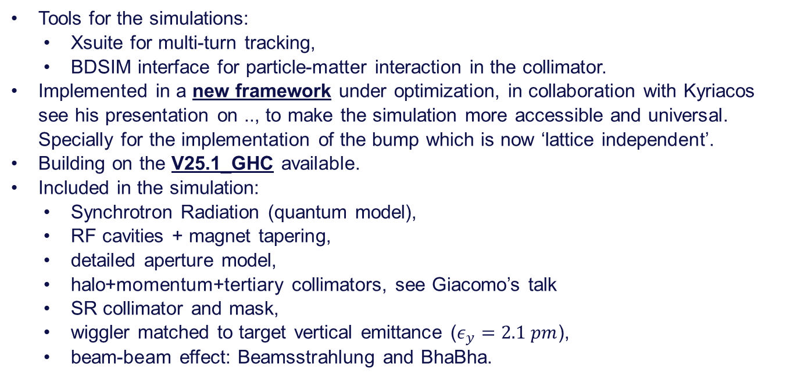
Simulation framework
22/05/2025 FCC Week 2025 - Joint effort PED & accelerators: Machine Detector Interface (ii)
Giulia Nigrelli
Tools for the simulations:
  Xsuite for multi-turn tracking,
  BDSIM interface for particle-matter interaction in the collimator.
Implemented in a new framework under optimization, in collaboration with Kyriacos see his presentation on .., to make the simulation more accessible and universal. Specially for the implementation of the bump which is now ‘lattice independent’.
Building on the V25.1_GHC available.
Included in the simulation:
  Synchrotron Radiation (quantum model),
  RF cavities + magnet tapering,
  detailed aperture model,
  halo+momentum+tertiary collimators, see Giacomo’s talk
  SR collimator and mask,
  wiggler matched to target vertical emittance ($ε_{y}=2.1 pm$),
  beam-beam effect: Beamsstrahlung and BhaBha.

Slide 24
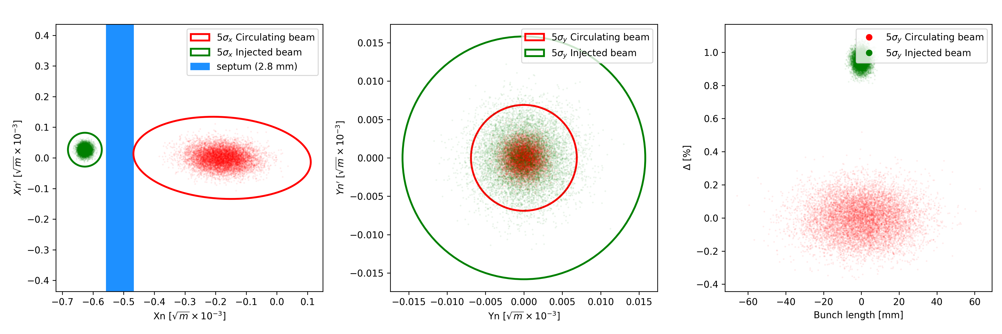
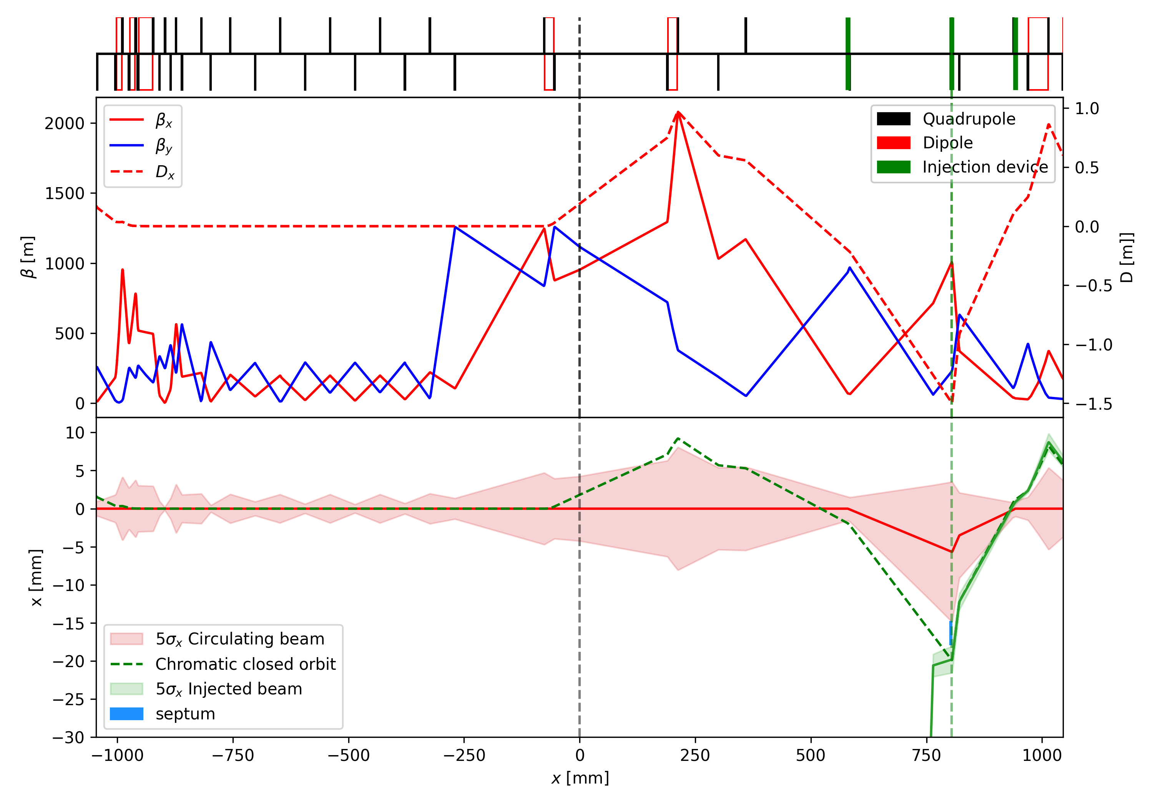
On-axis & Off-Energy injection scheme
22/05/2025 FCC Week 2025 - Joint effort PED & accelerators: Machine Detector Interface (ii)
Giulia Nigrelli

Slide 25
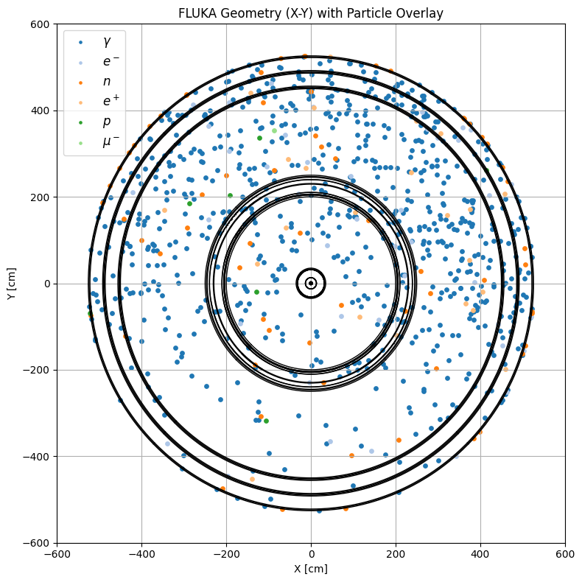
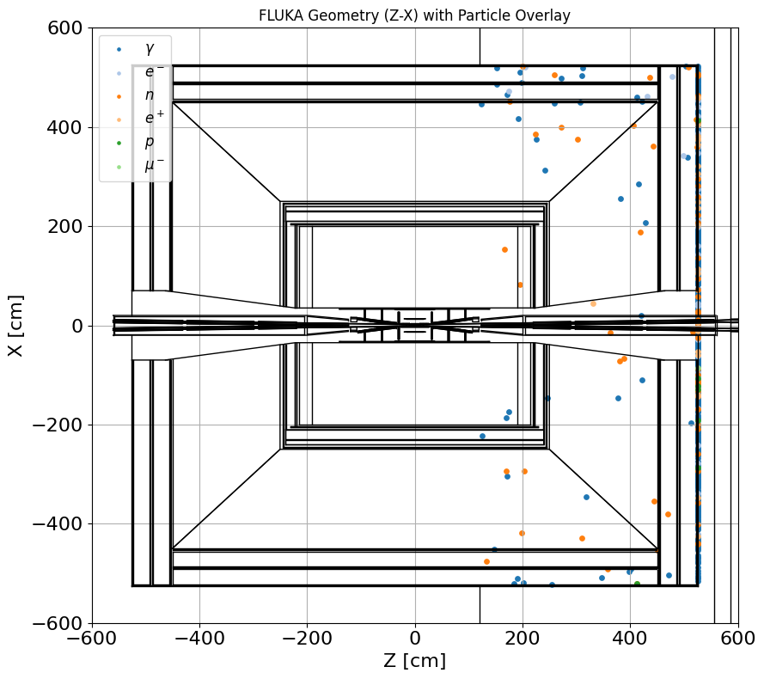
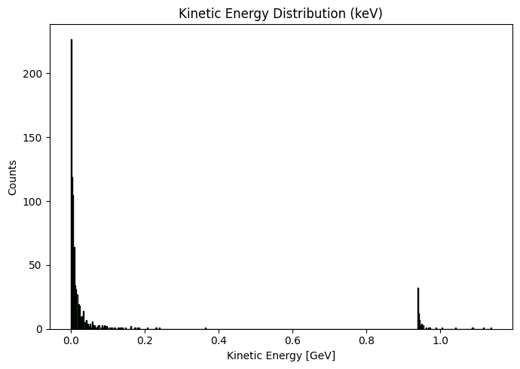
Mention to Fast INSTABILITY
22/05/2025 FCC Week 2025 - Joint effort PED & accelerators: Machine Detector Interface (ii)
Giulia Nigrelli
Same workflow can be applied to other beam losses scenario.
For instance, the fast instability case, in which the beam oscillation amplitude grows exponentially in time, is under investigation.
Preliminary results show particles reaching the detectors.

Slide 26
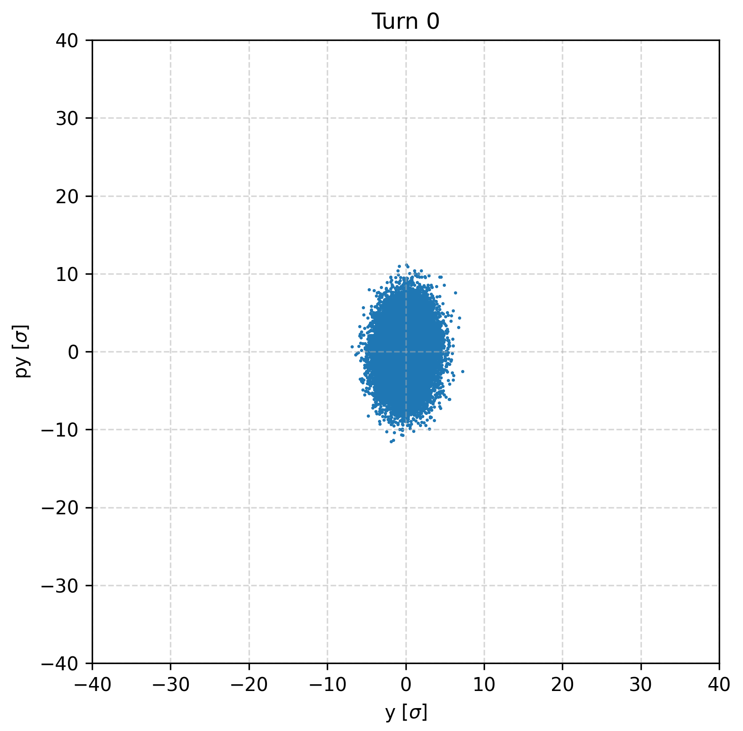
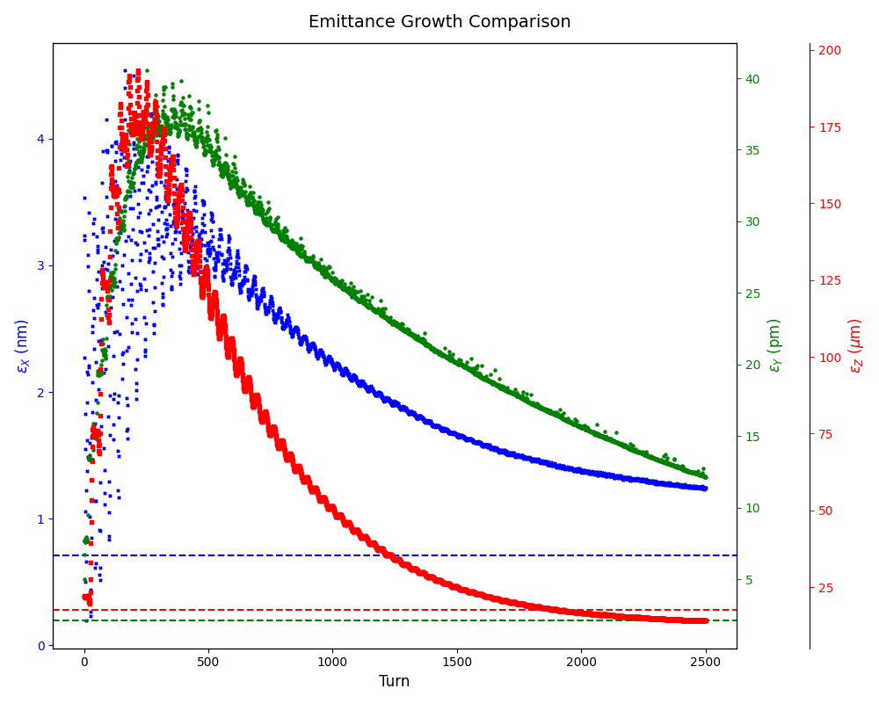
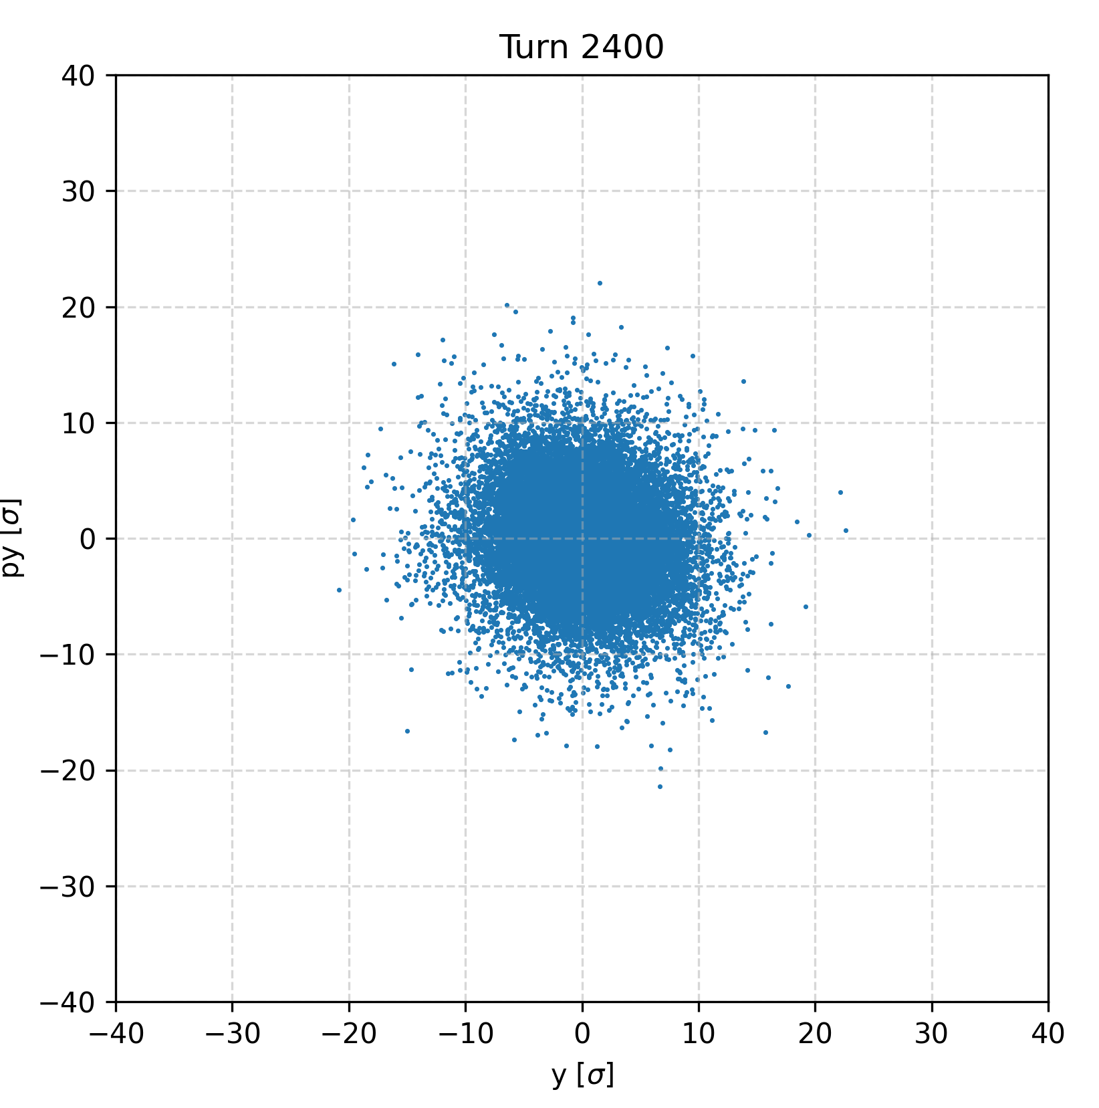
Emittance blow up
22/05/2025 FCC Week 2025 - Joint effort PED & accelerators: Machine Detector Interface (ii)
Giulia Nigrelli

Slide 27
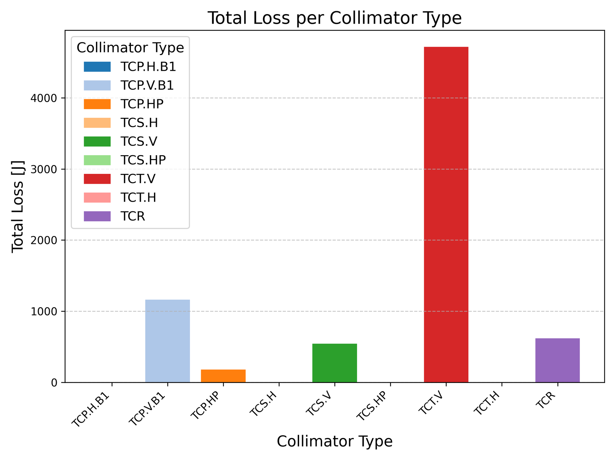
Case studies: Injected beam
22/05/2025 FCC Week 2025 - Joint effort PED & accelerators: Machine Detector Interface (ii)
Giulia Nigrelli
NB: Losses in the TCT should be divided by the number of tcts (4), same for TCR(6)

Slide 28
Colors
Backgrounds
Background Blue
Background Purple
Background Yellow
Background Grey
Use for Layout
Radiant Blue
Flash
Energy
Green
Red
Deep
Blue

Slide 29
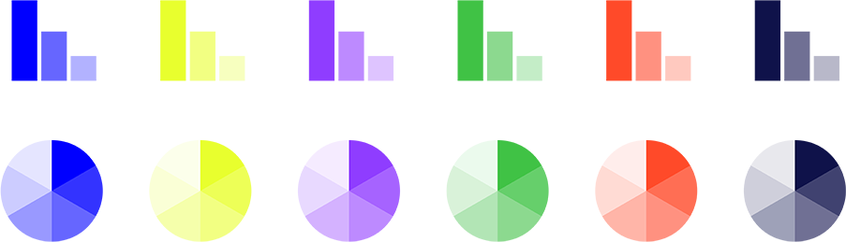
Graphical Elements
Badges
This information is a badge because it is important!
This information is a badge because it is important!
Separation lines 1.5 pt
Arrows
Use blue badges on light backgrounds
Infographics
This information is a badge because it is important!
This information is a badge because it is important!
Use light badges on dark backgrounds

