Slide 1
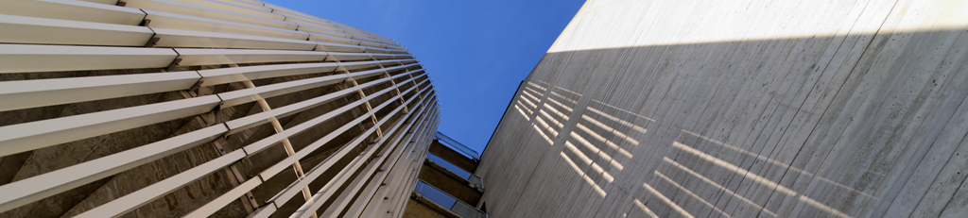

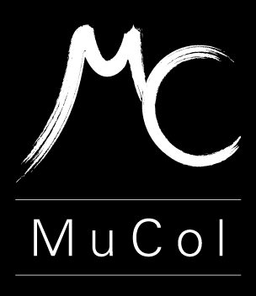


A 3 T High Temperature Solenoid Design for the IDEA detector project
S. Mariotto^{1,2}, S. Busatto^{1,3}, L. Rossi^{1,2}, M. Sorbi^{1,2}, M. Statera²
¹Università di Milano, ²INFN- Sez. di Milano – LASA, ³Università di Roma La Sapienza
Future Circular Collider Week 2025
Vienna, 2025 May 20th

Slide 2
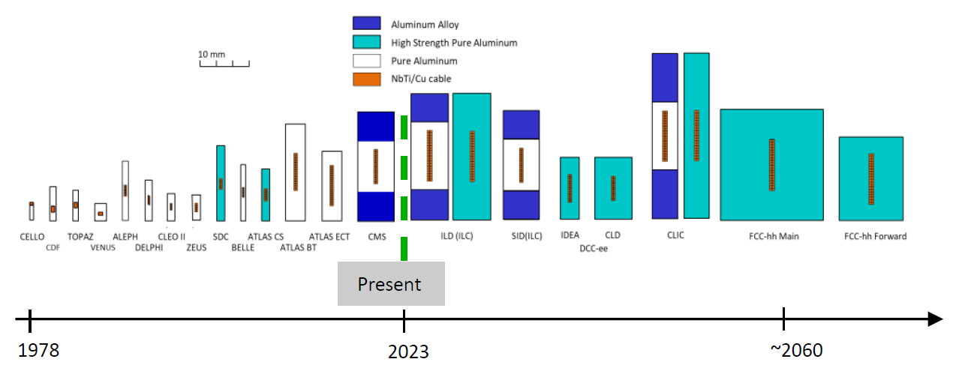
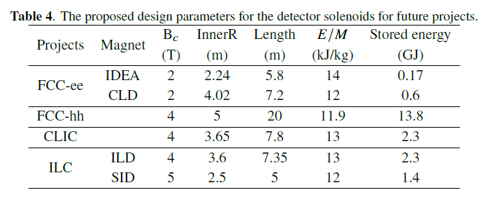
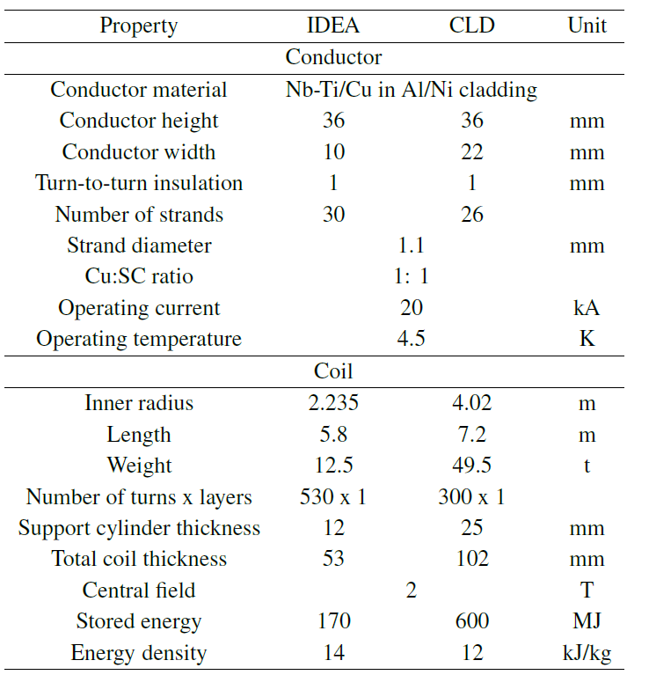
Current Technology for Detector Magnets
Detector magnets are all based on historically proved aluminum-stabilized NbTi Rutherford cables:
Well understood technology, affordable and good mechanical properties
«M. Mentink et al 2023 JINST 18 T06013»
Aluminum-stabilized Nb-Ti conductors: Courtesy of A. Yamamoto
NO Commercially available nowadays
  Re-establishing conductor technology in industry
Required low temperature operation (< 5 K)
  Large energy consumption (low sustainability)
  Large inventory of LHe (limited resources)
FCC-ee Detector Magnets, CDR

Slide 3
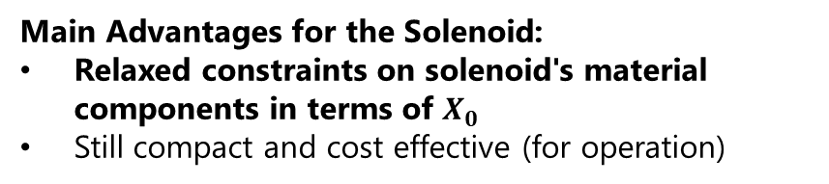
IDEA Detector
Innovative Detector for e+e- accelerator
Innovative proposal to move the EM calo inside the solenoid!
Silicon vertex detector
Short-drift, ultra-light wire chamber
Dual-readout calorimeter options
  Longitudinal unsegmented dual-readout fibre calorimeter (combined EM+HAD)
  Dual-readout crystal (EM calo) + dual-readout fibre calorimeter (HAD calo)
Thin and light solenoid coil between two different calorimeters
Muon system: 3 layers of μ-RWELL detectors in return yoke
Main Advantages for the Solenoid:
Relaxed constraints on solenoid's material components in terms of $X_{0}$
Still compact and cost effective (for operation)
Courtesy of P. Giacomelli

Slide 4
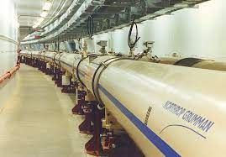
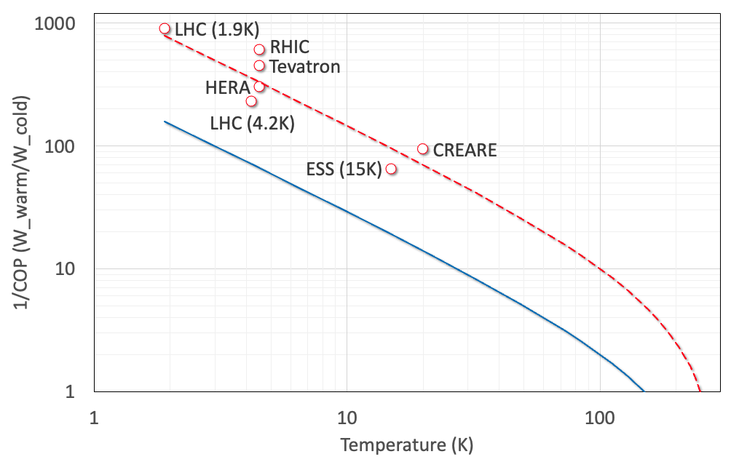
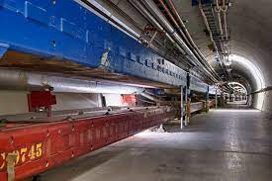
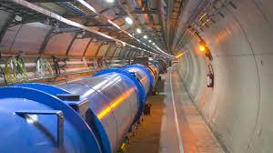
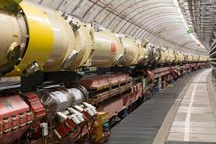
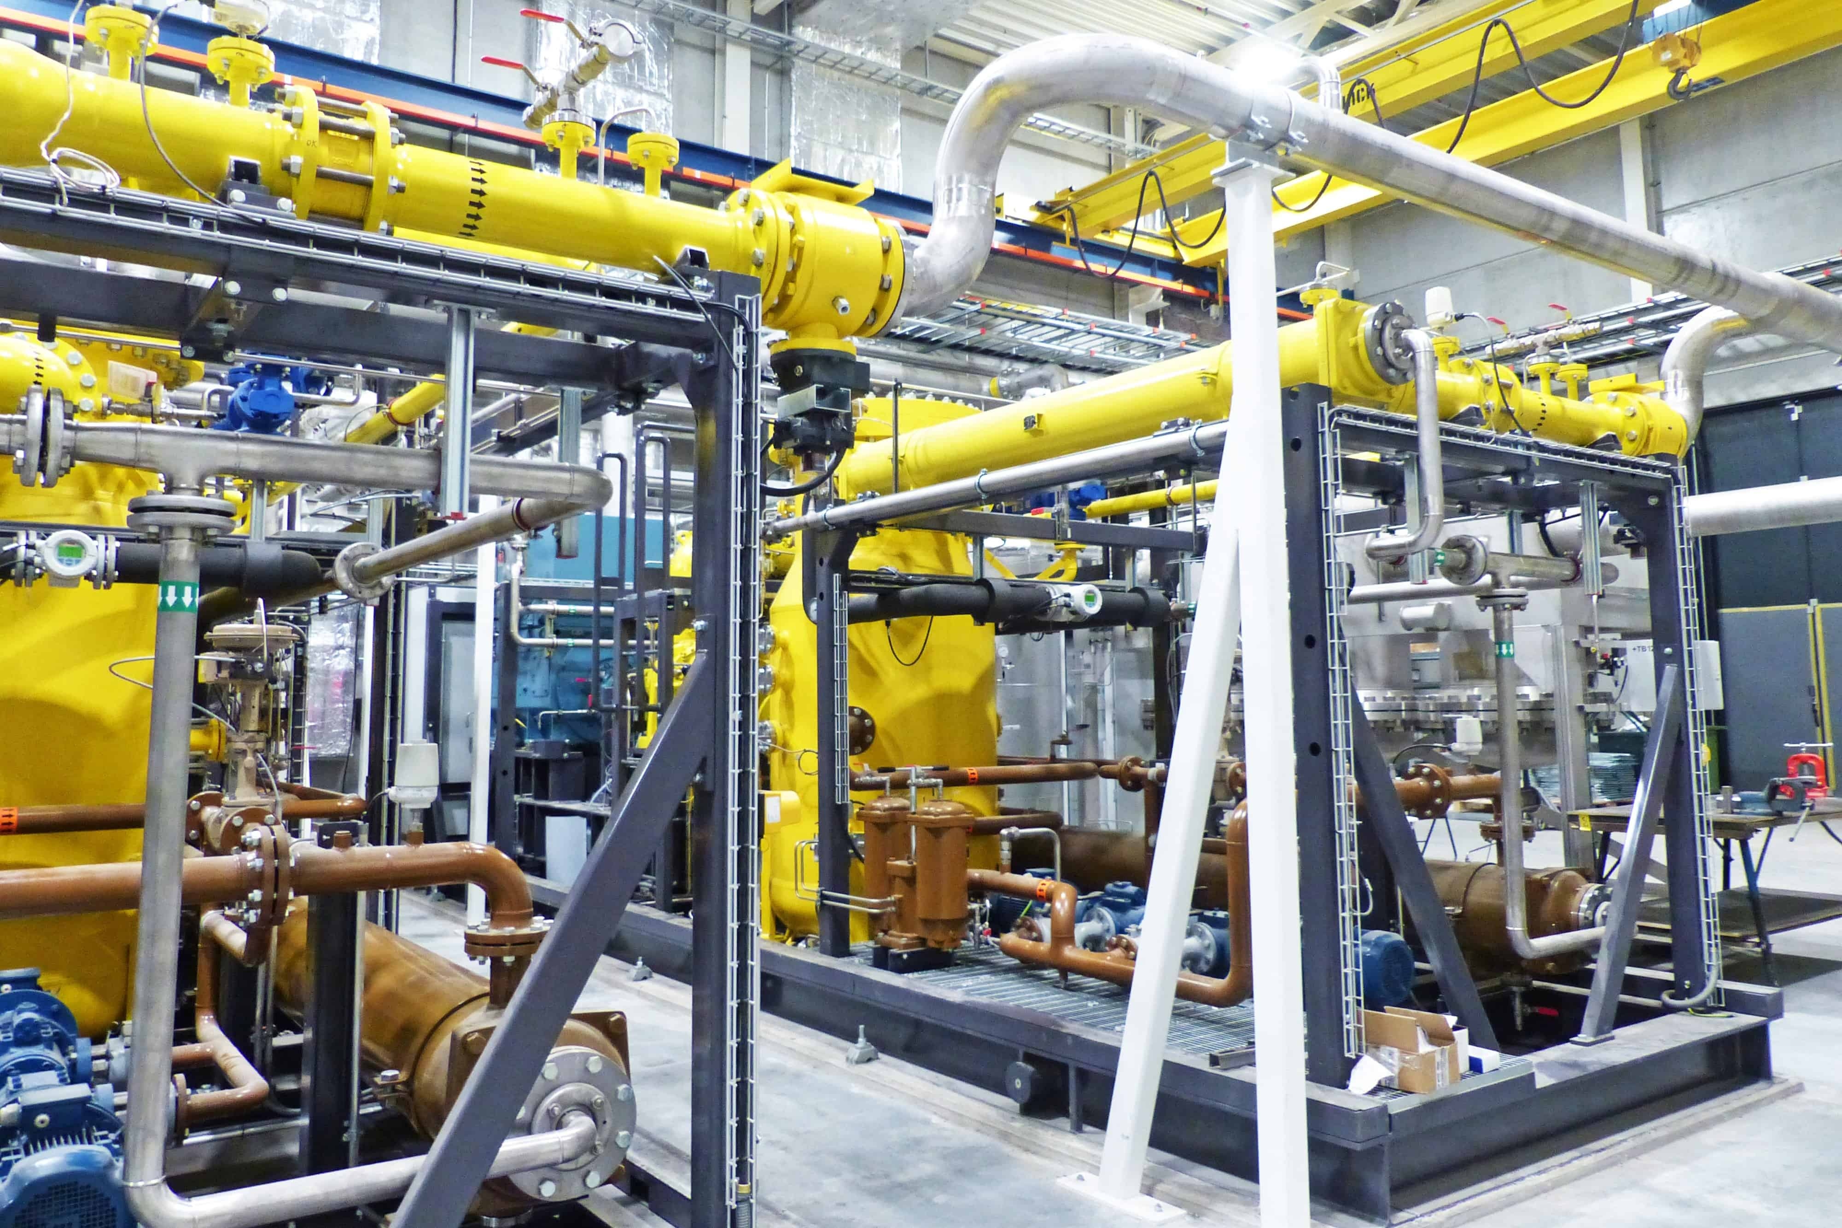


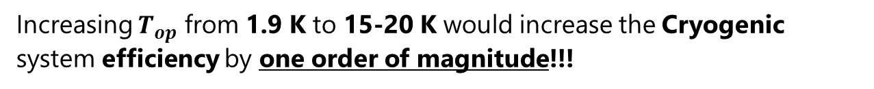

Operating Costs
Cryogenic Efficiency
Blue Line Carnot Refrigerator
Circles: cryogenic machines built and operated in accelerators; the dotted line is a guide to the measured COP
Conductor technology used in a superconducting magnet is heavily affected by operating temperature
Energy efficiency of cryogenic implant is characterized by a Coefficient of Performance (COP)
Nb-Ti
COP⁻¹
8T
5T
Nb₃Sn
16T
12…14T
$$COP_{Carnot}=\frac{T_{cold}}{T_{hot}−T_{cold}}$$
$$COP_{REAL}=\frac{Q_{cold}}{L}$$
HTS
This could be the best range of $T_{op}$ for future HEP
Advantages of high cryogenic temperatures:
  Reduction of He inventory
  Reduction of power consumption (higher sustainability)
1.9
4.5
Increasing $T_{op}$ from 1.9 K to 15-20 K would increase the Cryogenic system efficiency by one order of magnitude!!!

Slide 5
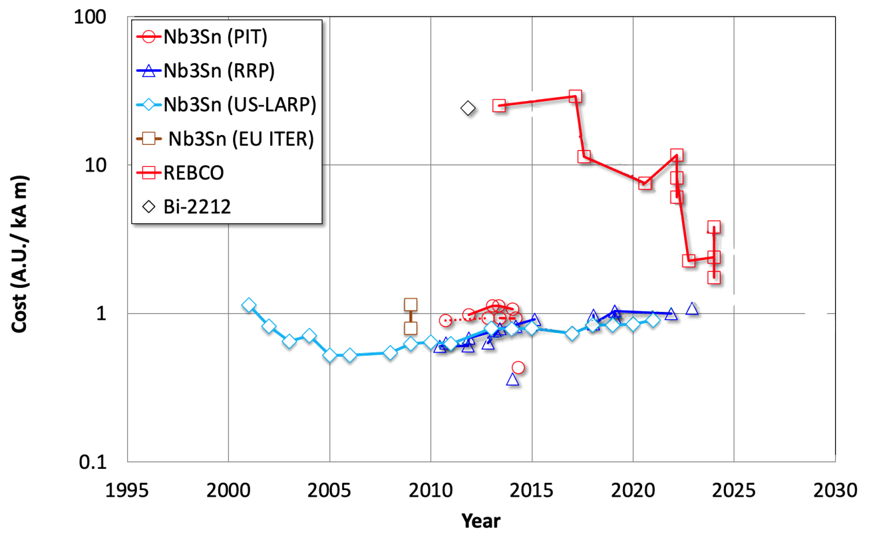


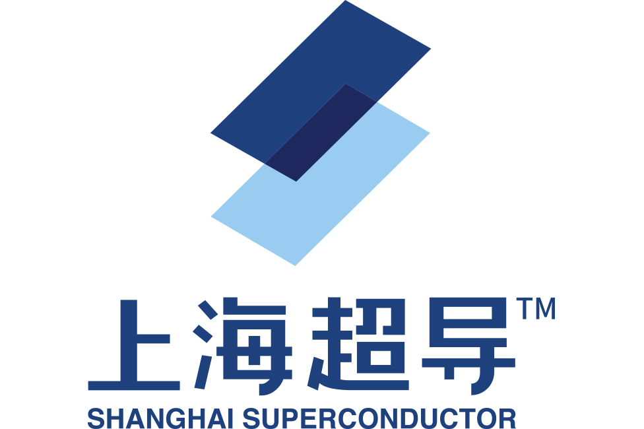



Why HTS Technology?
Cost per unit length and current for Nb3Sn and HTS purchased at CERN, US labs and ITER
Fast-growing Technology with rapidly decreasing costs
Massive production of HTS for Fusion Reactors
Huge R&D and production quality effort in industry
5 qualified vendors world-wide (more are coming)
4.2 K
$x2
20 K
LTS is still the most advanced superconductor (restricted to low T = 1.9-4.5 K)
HTS possible alternative with T > 10 K (but require R&D)
Critical Current normalized at 4.2 K and B=12 T with B$∥$c-axis of HTS tape
Courtesy of L. Bottura
MAIN GOAL of the proposal:
(B= 3 T, T= 20-50 K) HTS solenoid for IDEA detector
HIGHER FIELD for better resolution (Designed to reach 3 T and operate at 2 T at the Z peak energy)

Slide 6

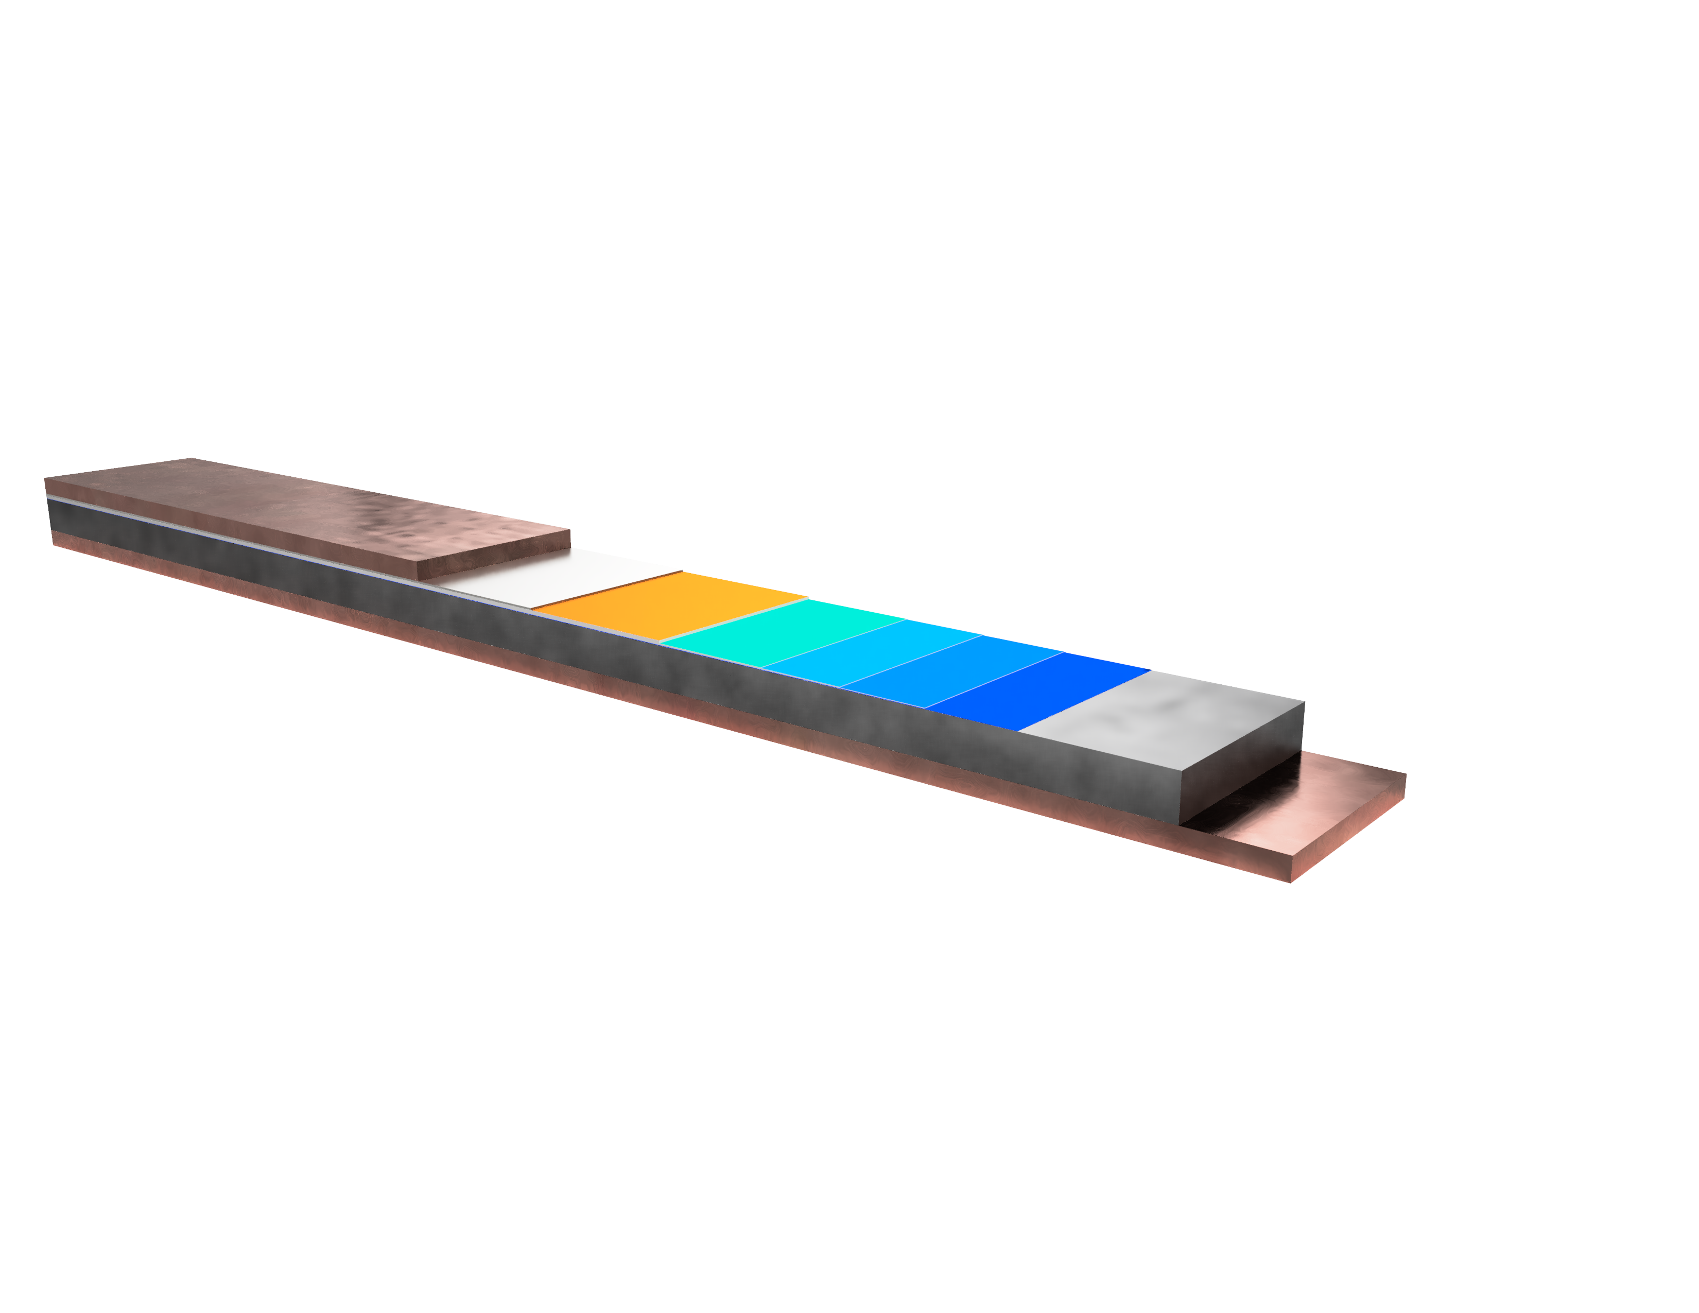
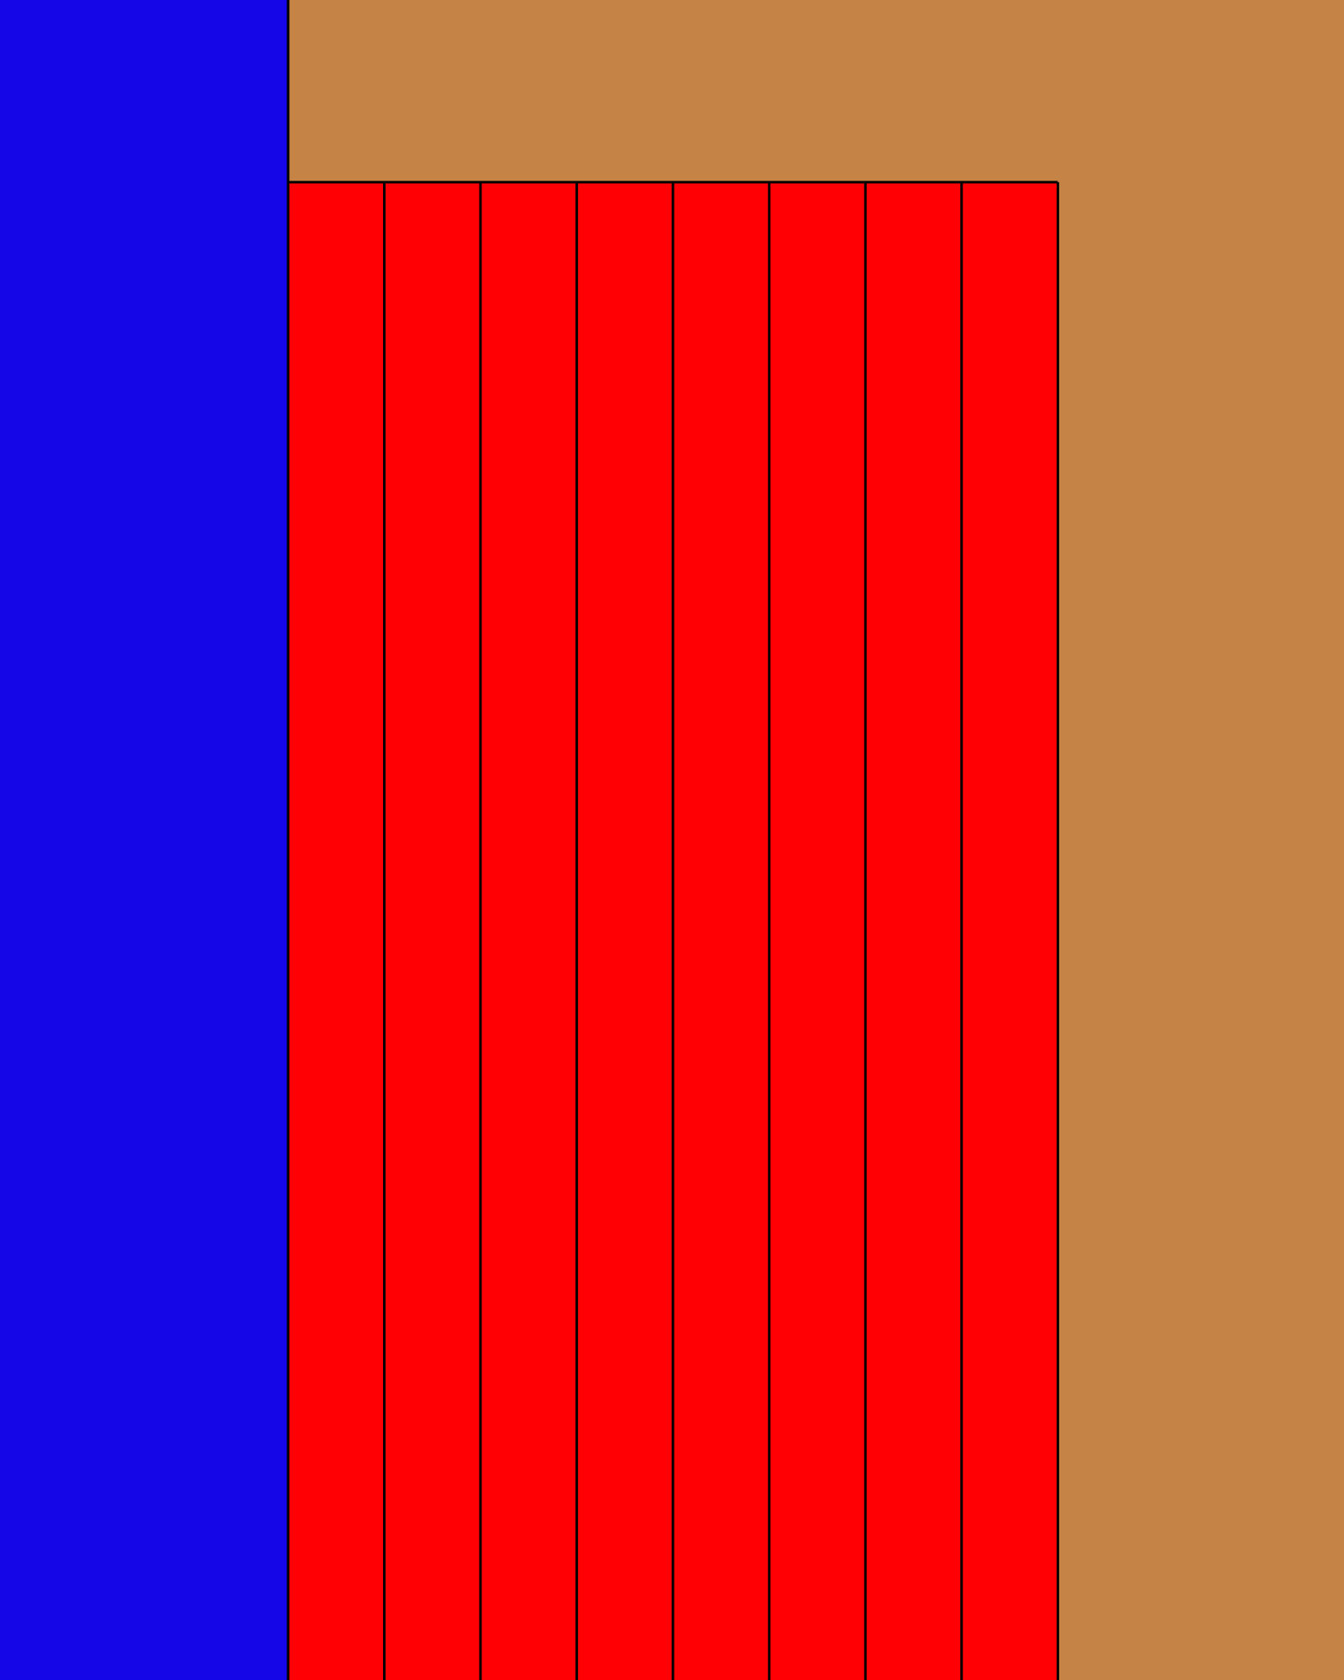
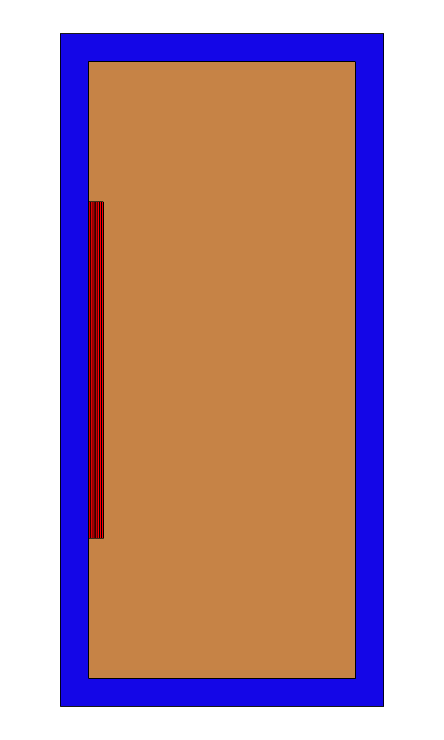

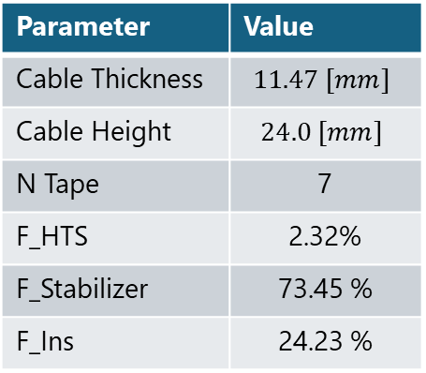
Cable Technology
Copper Stabilizer (10 μm)
Ag Cap Layer (2.5 μm)
Cable concept: U Shape channel cable with Faraday Factory HTS REBCO Tapes
Critical current depending on cable orientation along field lines
Aluminum stabilizer for thermal conductivity and protection
Stabilizer Material under study:
Pure Aluminum (99.999%)
Al2.0%wtNi (RRR=170, Yield Strength=170 MPa @ 4.2 K)
HTS ReBCO (2 μm)
buffer layers stack
Hastelloy (40 μm)
Copper
c
Stabilizer (10 μm)
a
b-axis
$B_{∥} c$-$axis$
Thickness
3000
T=20 [K]
Parameter | Value
Cable Thickness | $$11.47 [mm]$$
Cable Height | $$24.0 [mm]$$
N Tape | 7
F_HTS | 2.32%
F_Stabilizer | 73.45 %
F_Ins | 24.23 %
T=30 [K]
2500
T=40 [K]
T=50 [K]
2000
T=60 [K]
T=70 [K]
HTS
Tapes
1500
3.5[T], 1152[A]
Critical Current [A]
1000
HTS
Tapes
Height
Stabilizer
500
0
Insulation
0
0.5
1
1.5
2
2.5
3
3.5
4
Magnetic Field Flux B [T]

Slide 7
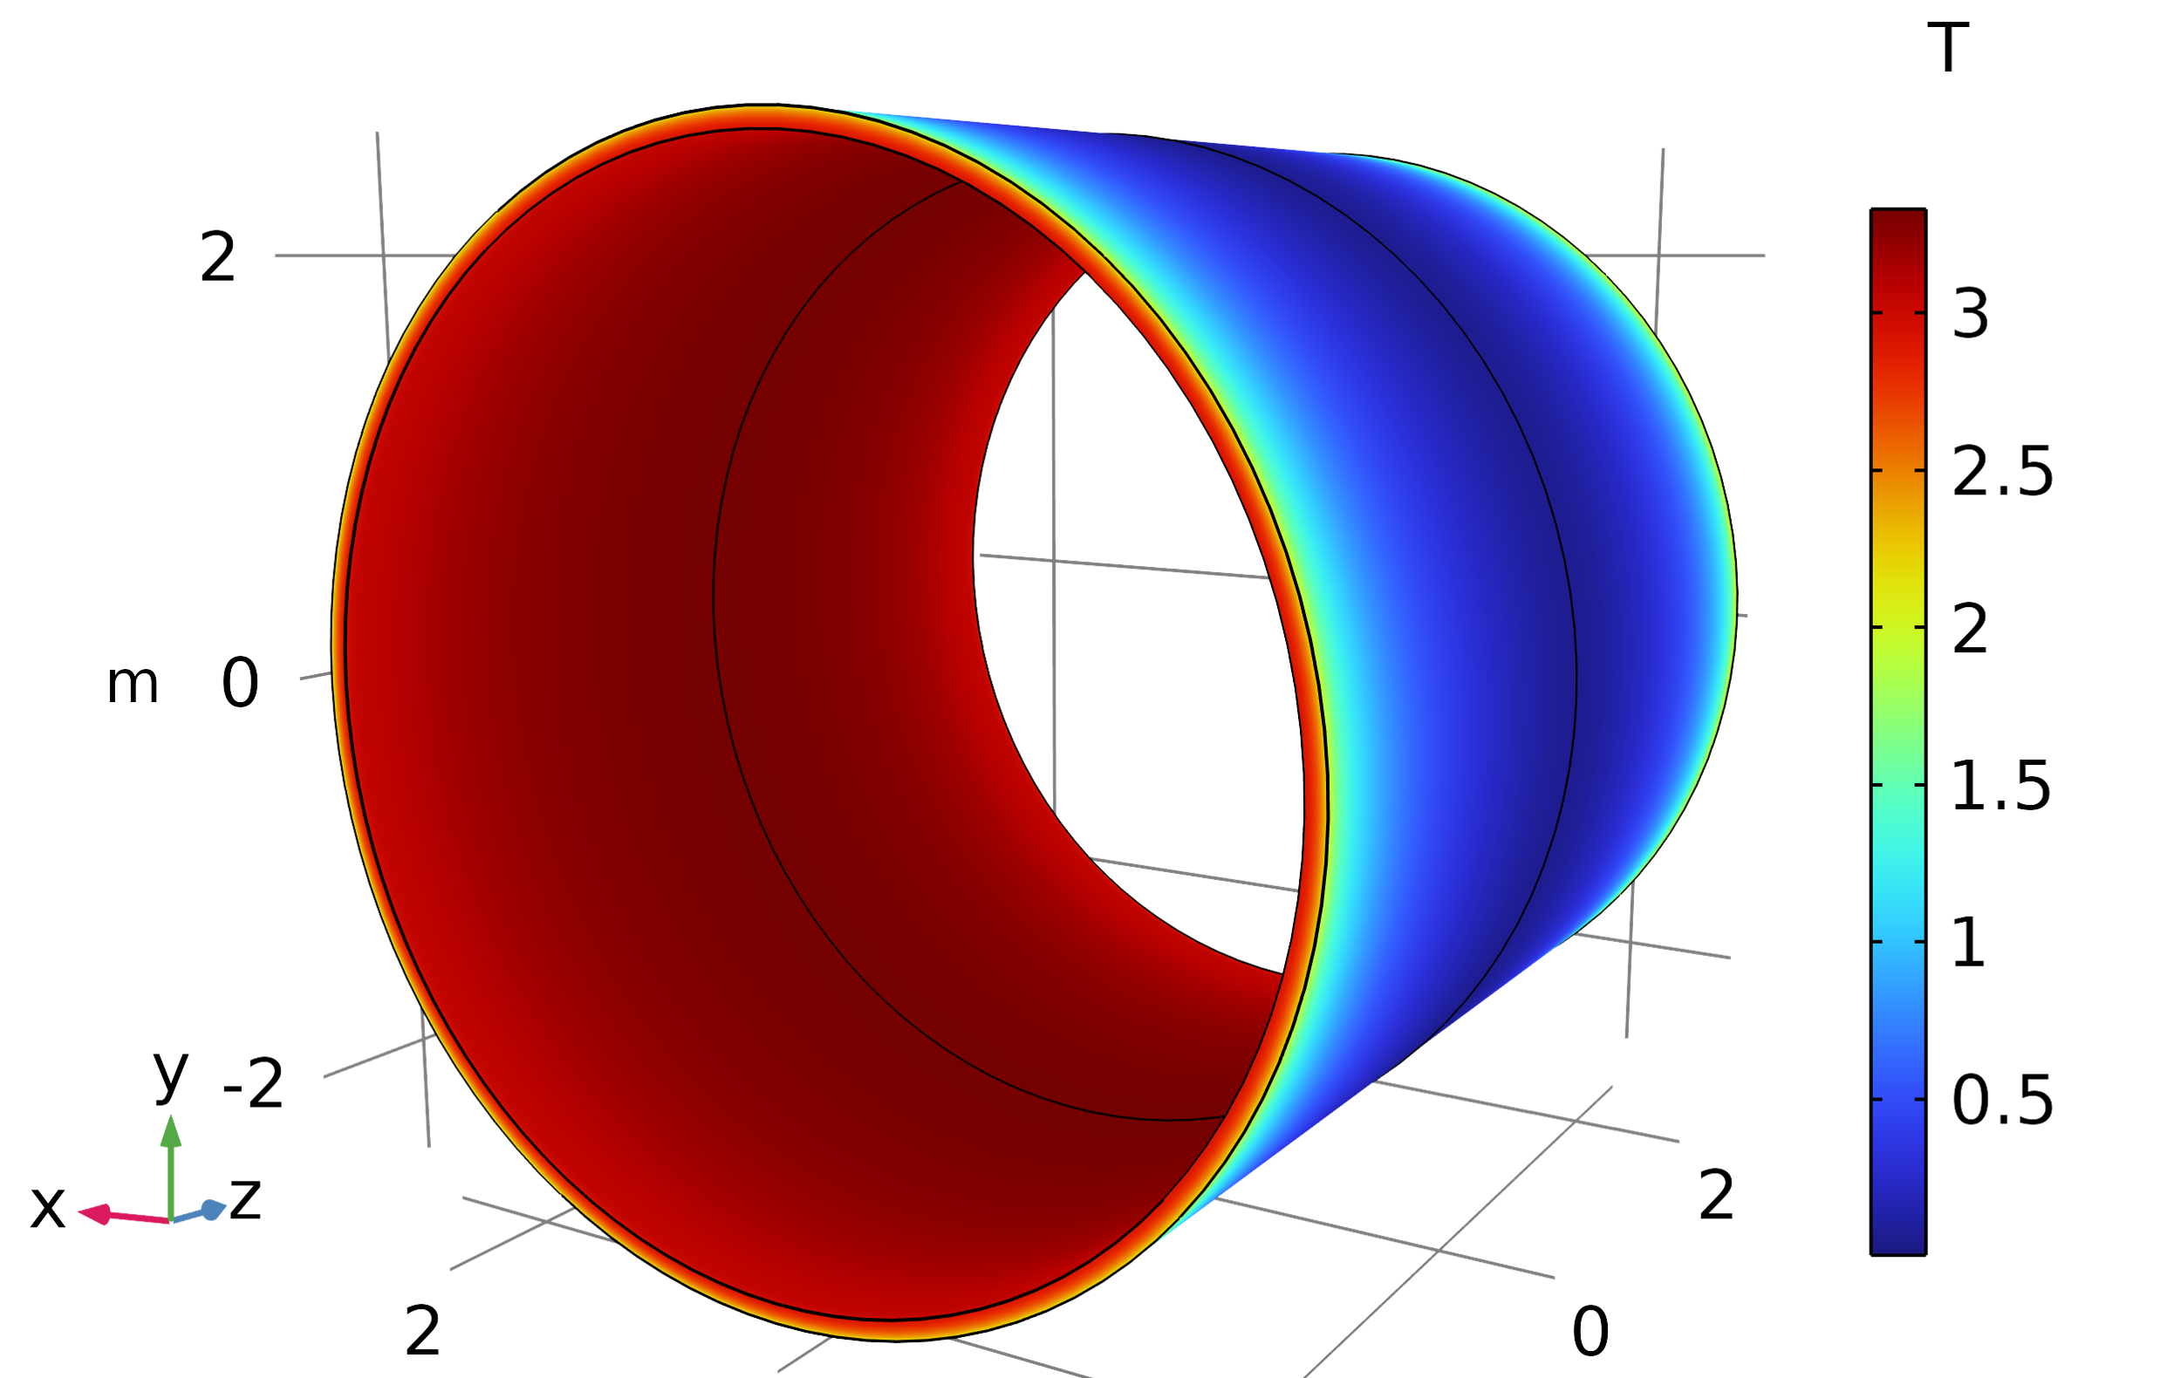
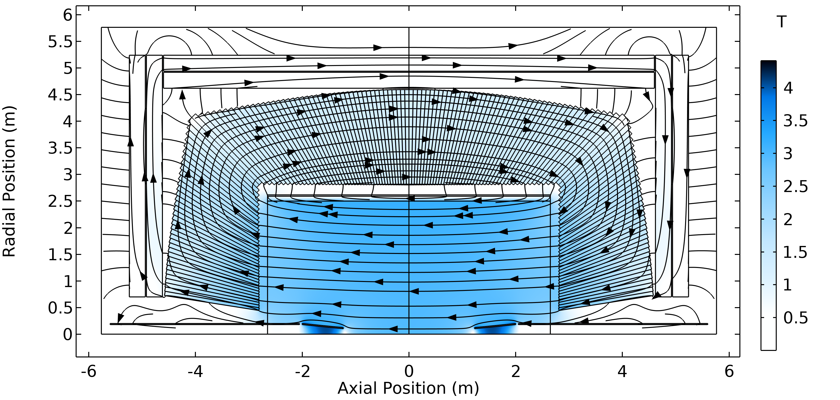
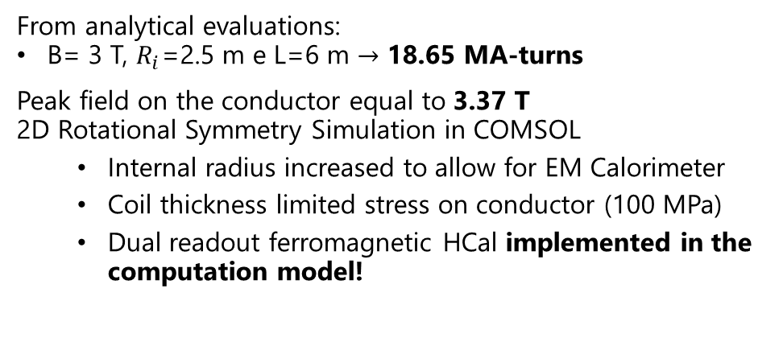
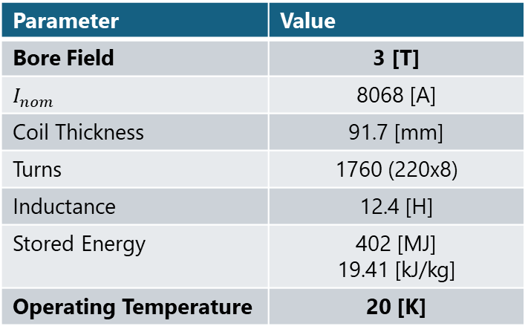
First Considerations: Magnet
From analytical evaluations:
B= 3 T, $R_{i}$=2.5 m e L=6 m $→$ 18.65 MA-turns
Peak field on the conductor equal to 3.37 T
2D Rotational Symmetry Simulation in COMSOL
  Internal radius increased to allow for EM Calorimeter
  Coil thickness limited stress on conductor (100 MPa)
  Dual readout ferromagnetic HCal implemented in the computation model!
Parameter | Value
Bore Field | 3 [T]
$$I_{nom}$$ | 8068 [A]
Coil Thickness | 91.7 [mm]
Turns | 1760 (220x8)
Inductance | 12.4 [H]
Stored Energy | 402 [MJ] 19.41 [kJ/kg]
Operating Temperature | 20 [K]

Slide 8
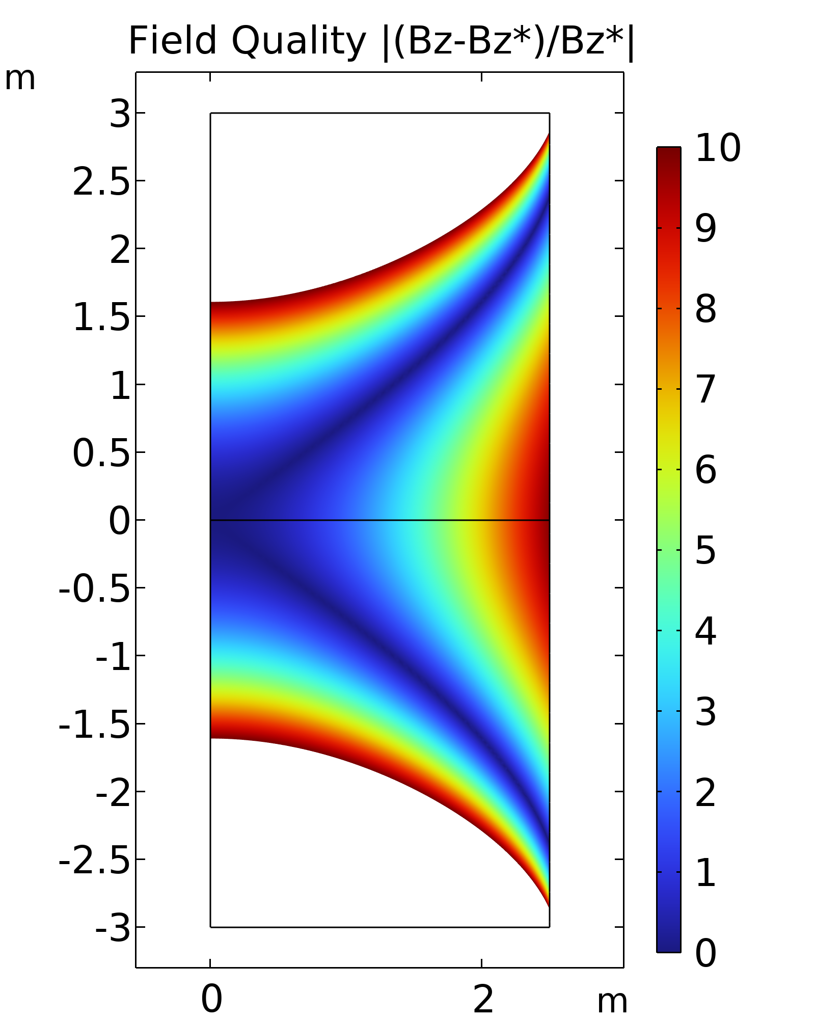
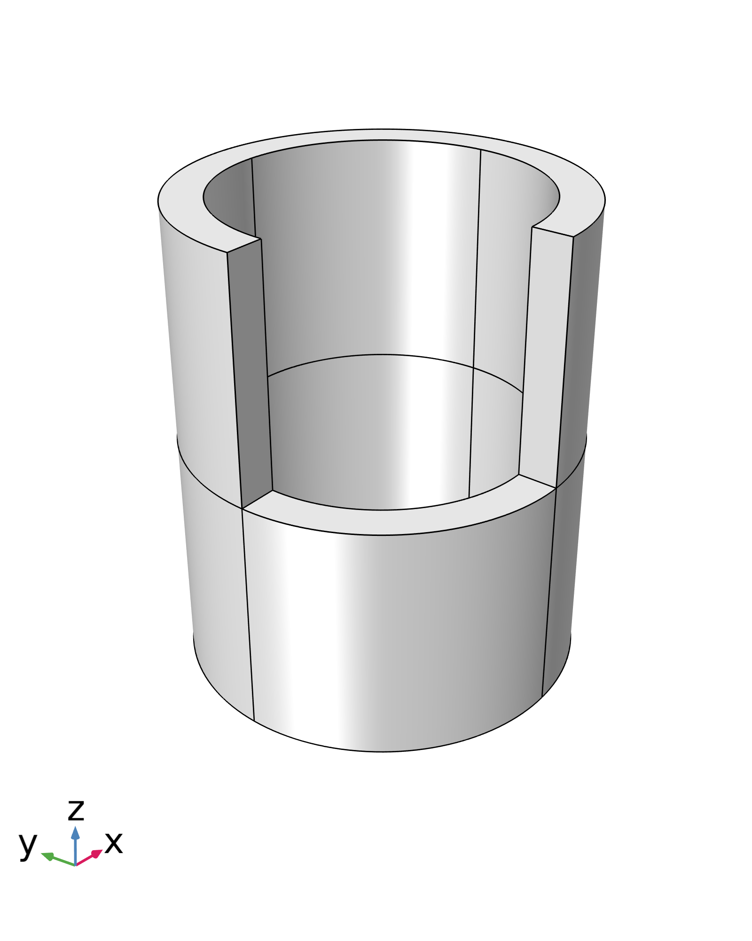
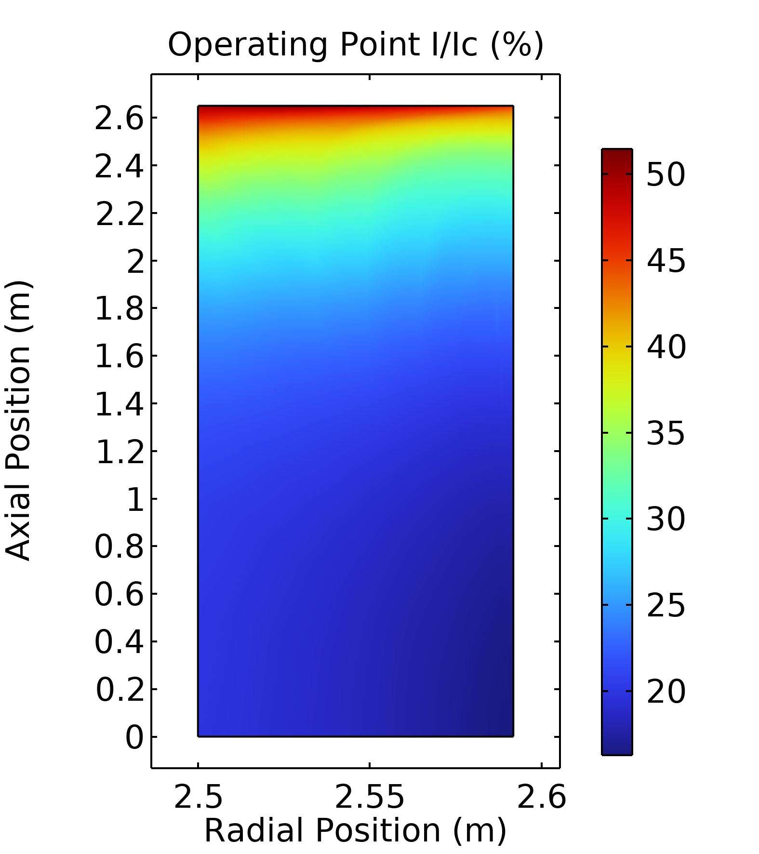
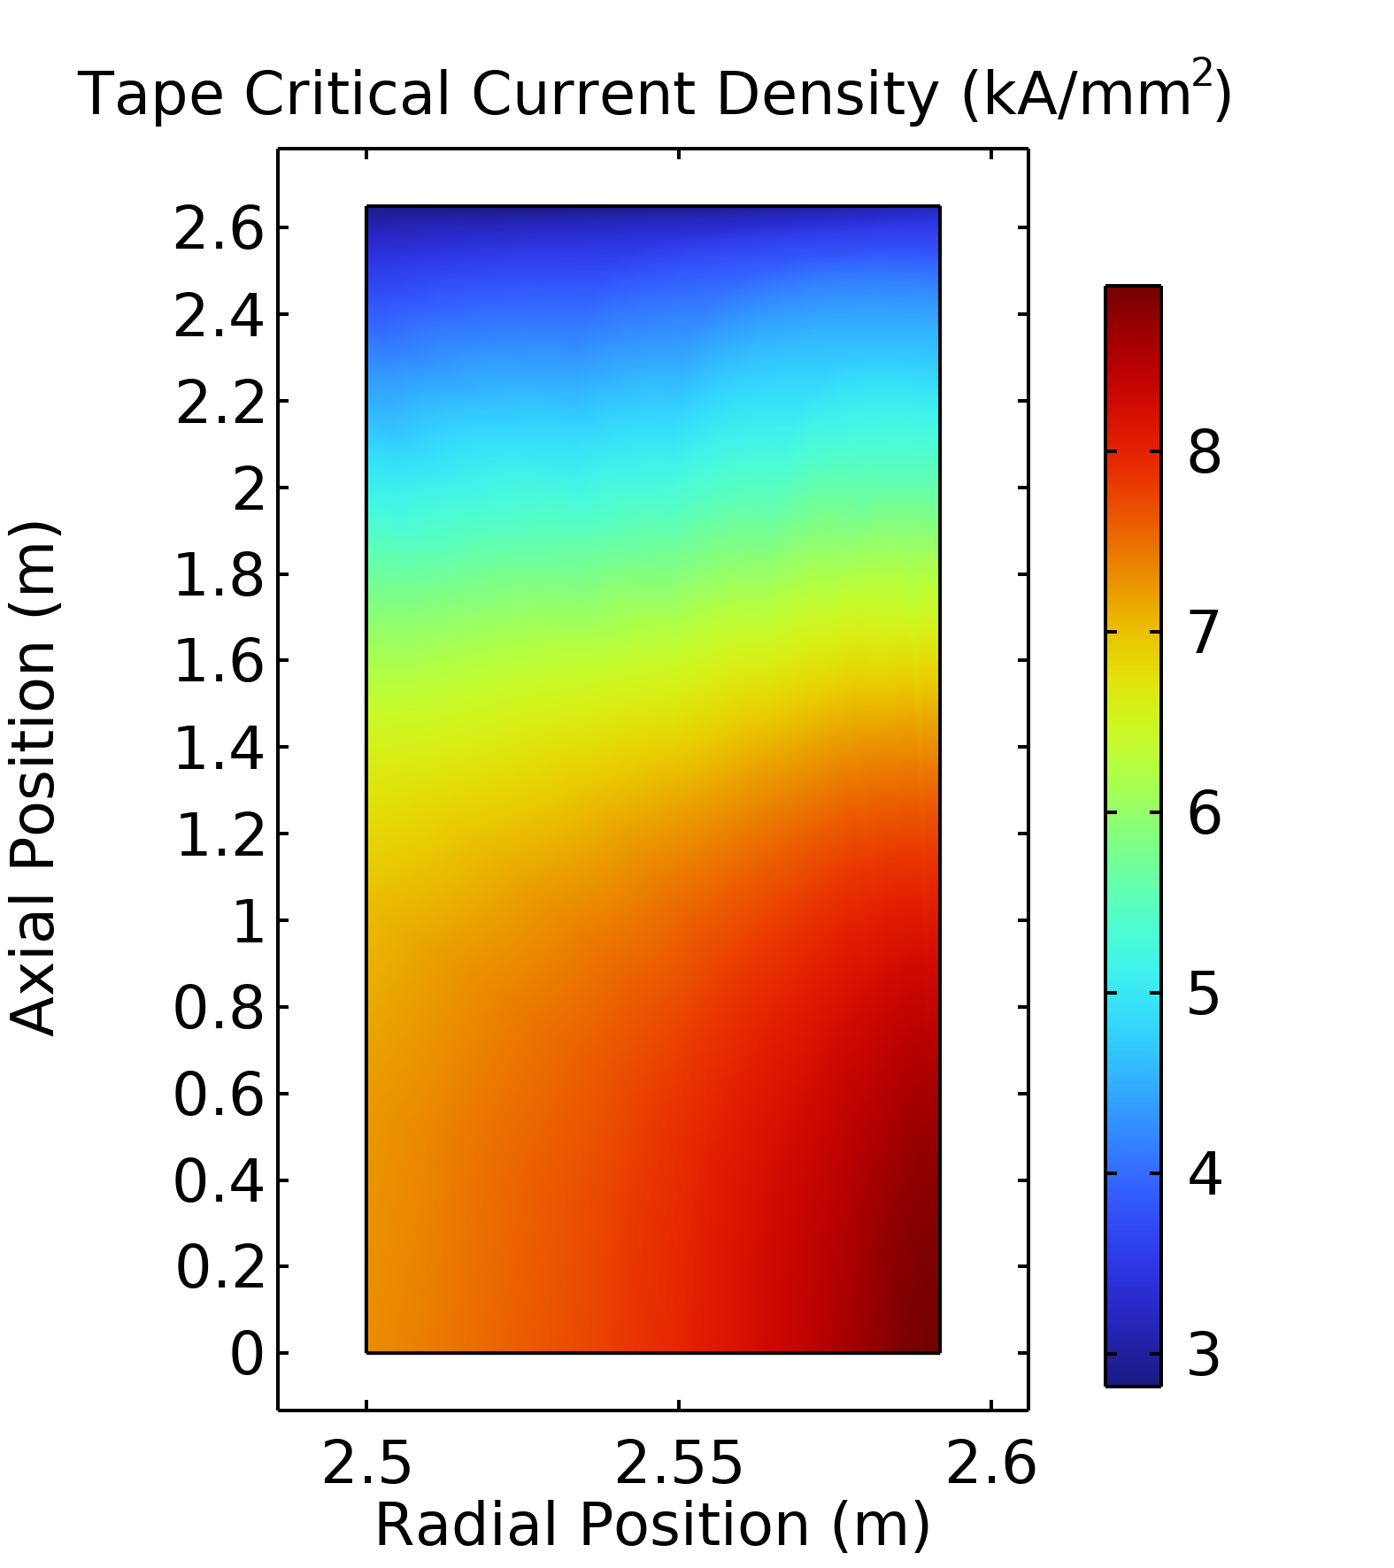
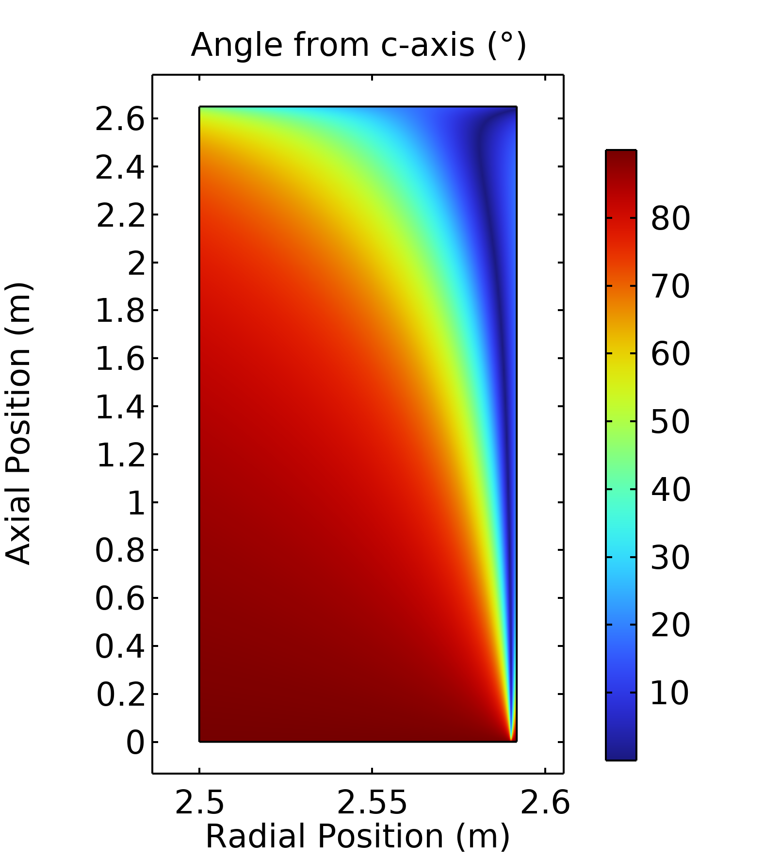
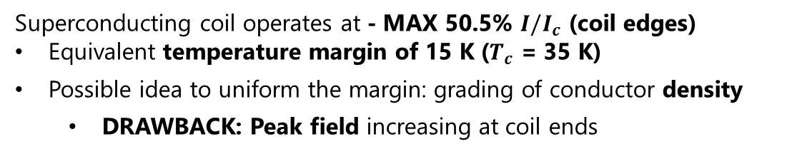
Field Quality and Margin
Superconducting coil operates at - MAX 50.5% $I/I_{c}$ (coil edges)
Equivalent temperature margin of 15 K ($T_{c}$ = 35 K)
Possible idea to uniform the margin: grading of conductor density
  DRAWBACK: Peak field increasing at coil ends

Slide 9
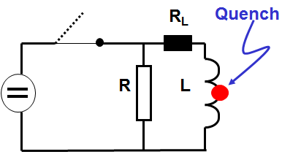
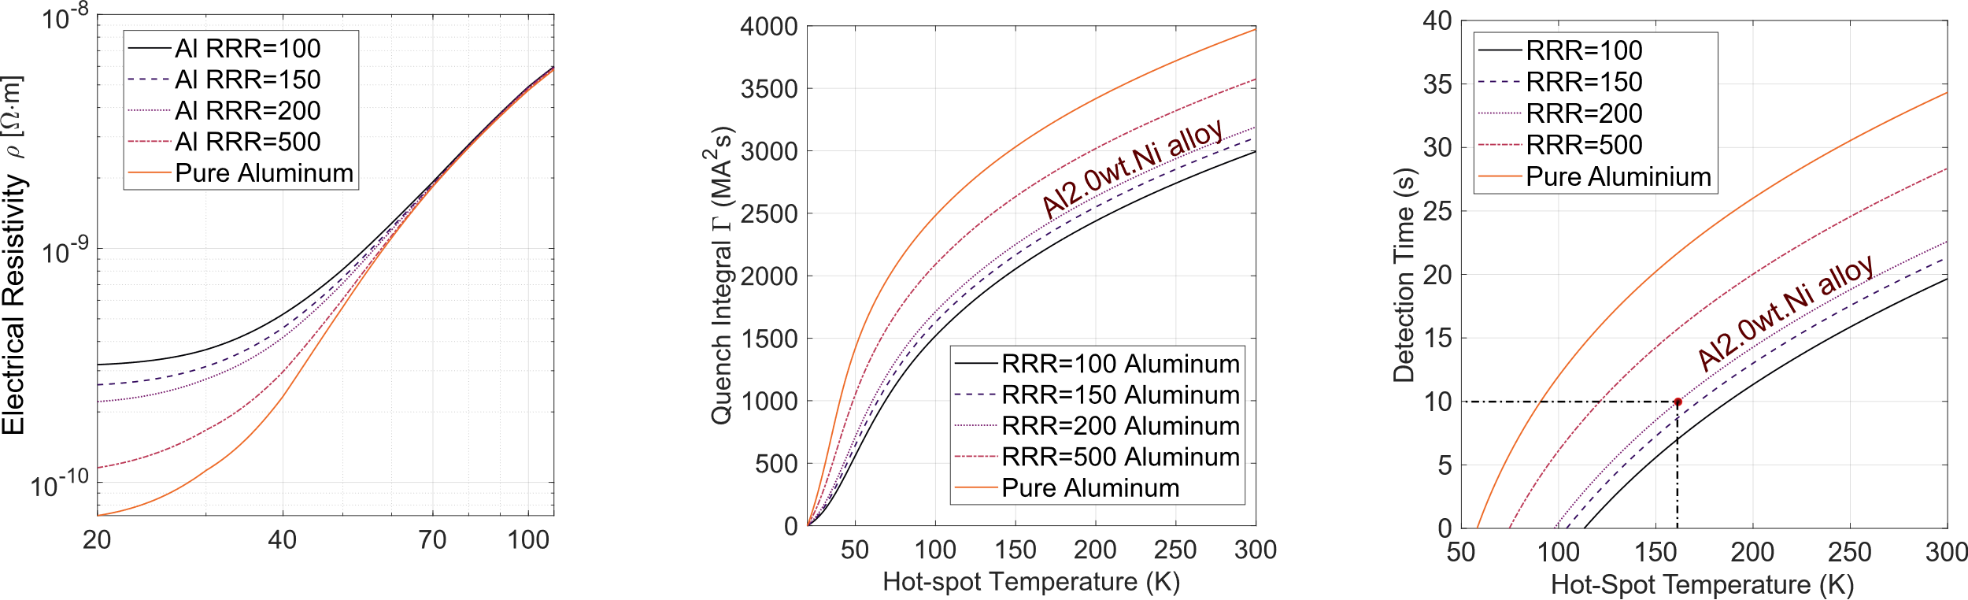
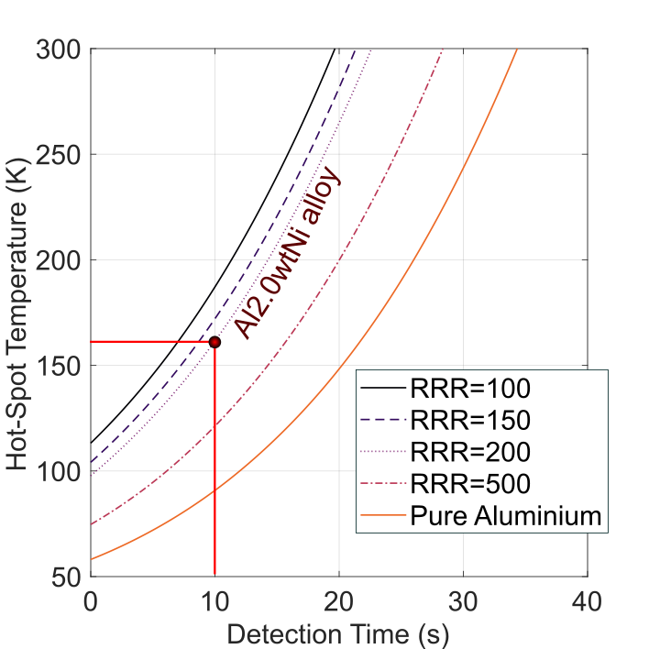
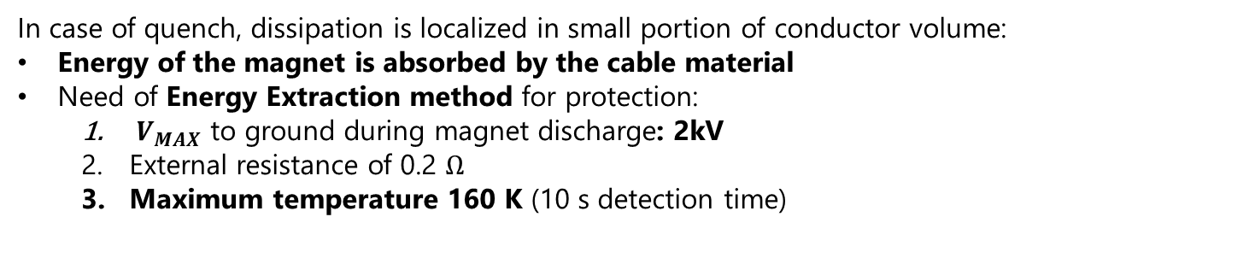
Magnet Protection and Stability
In case of quench, dissipation is localized in small portion of conductor volume:
Energy of the magnet is absorbed by the cable material
Need of Energy Extraction method for protection:
  ${ V}_{MAX}$ to ground during magnet discharge: 2kV
  External resistance of 0.2 $Ω$
  Maximum temperature 160 K (10 s detection time)
To be further investigated:
Detailed simulation at conductor level for quench propagation analysis and detection accuracy
Charge/Discharge magnet time: 65 s acceptable?

Slide 10
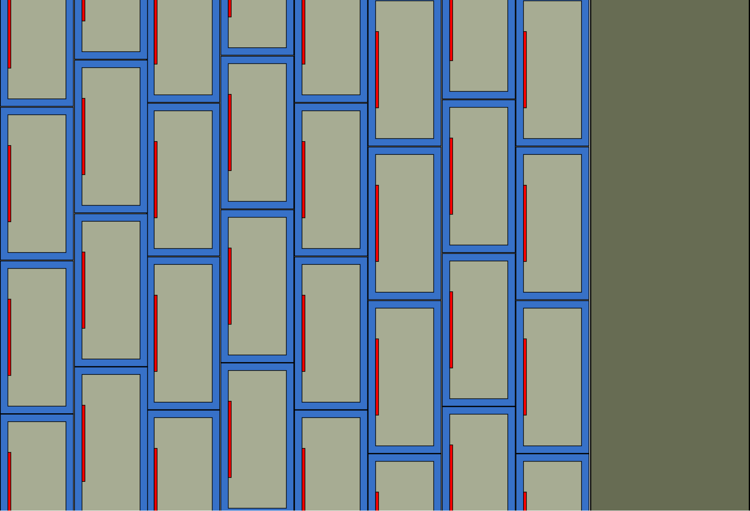
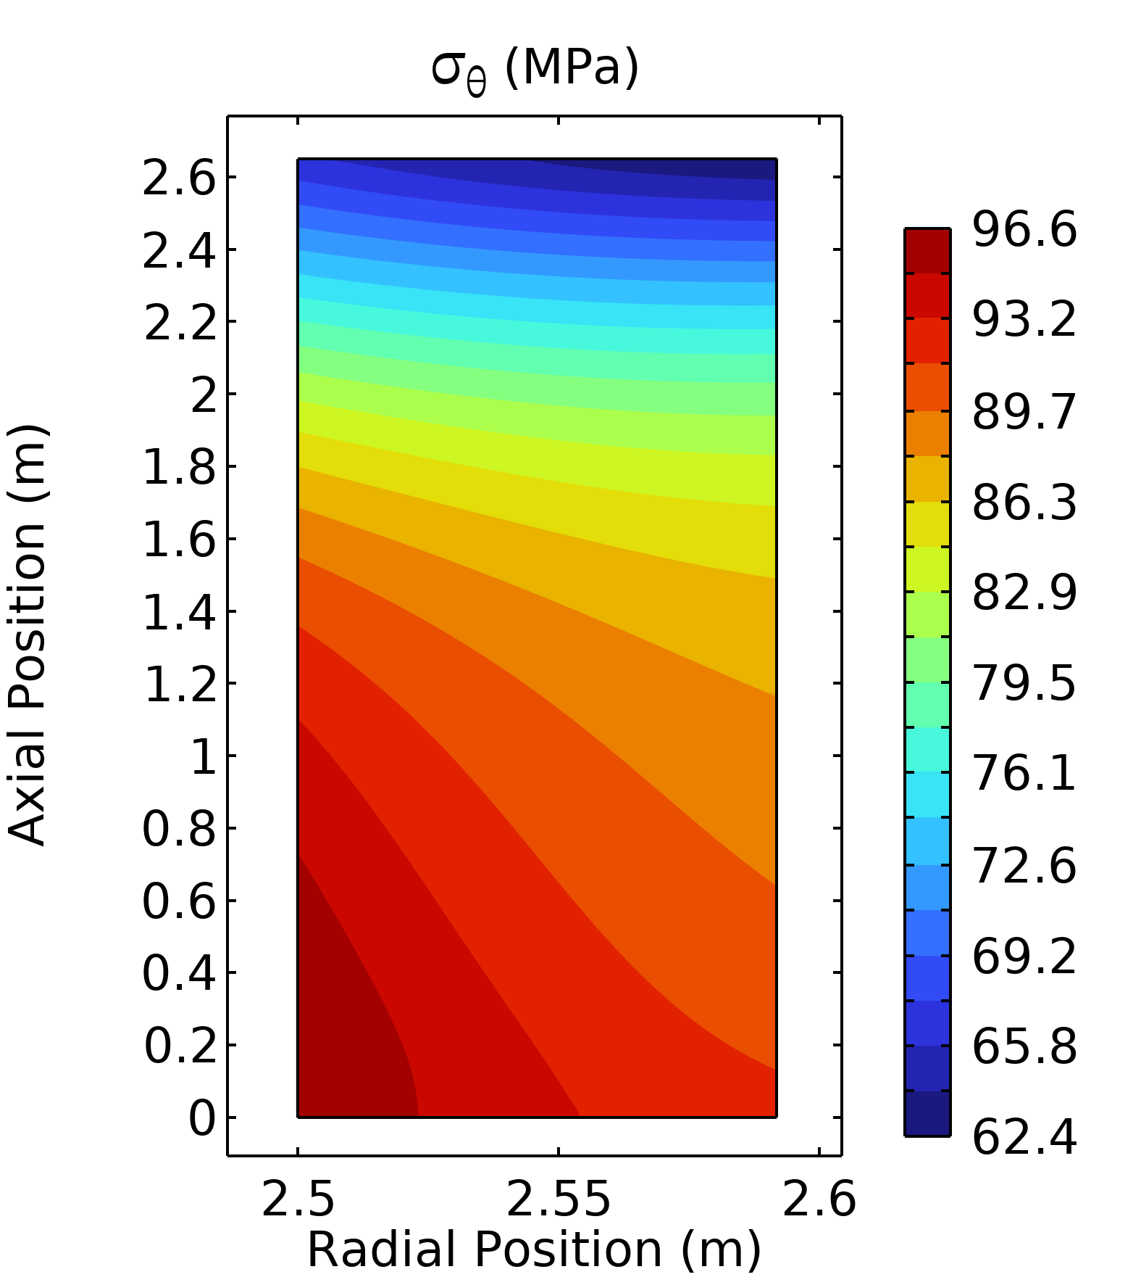
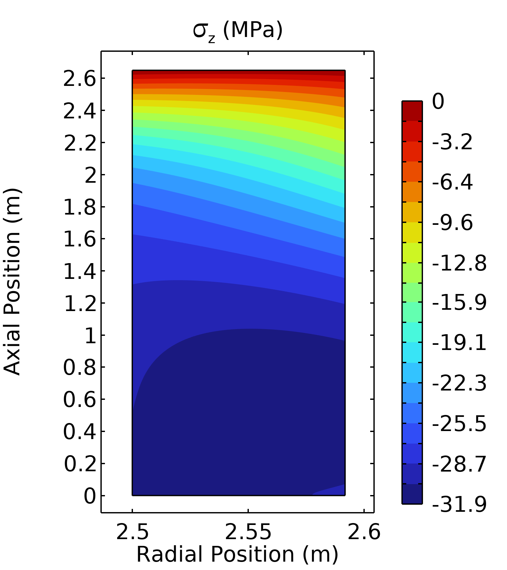
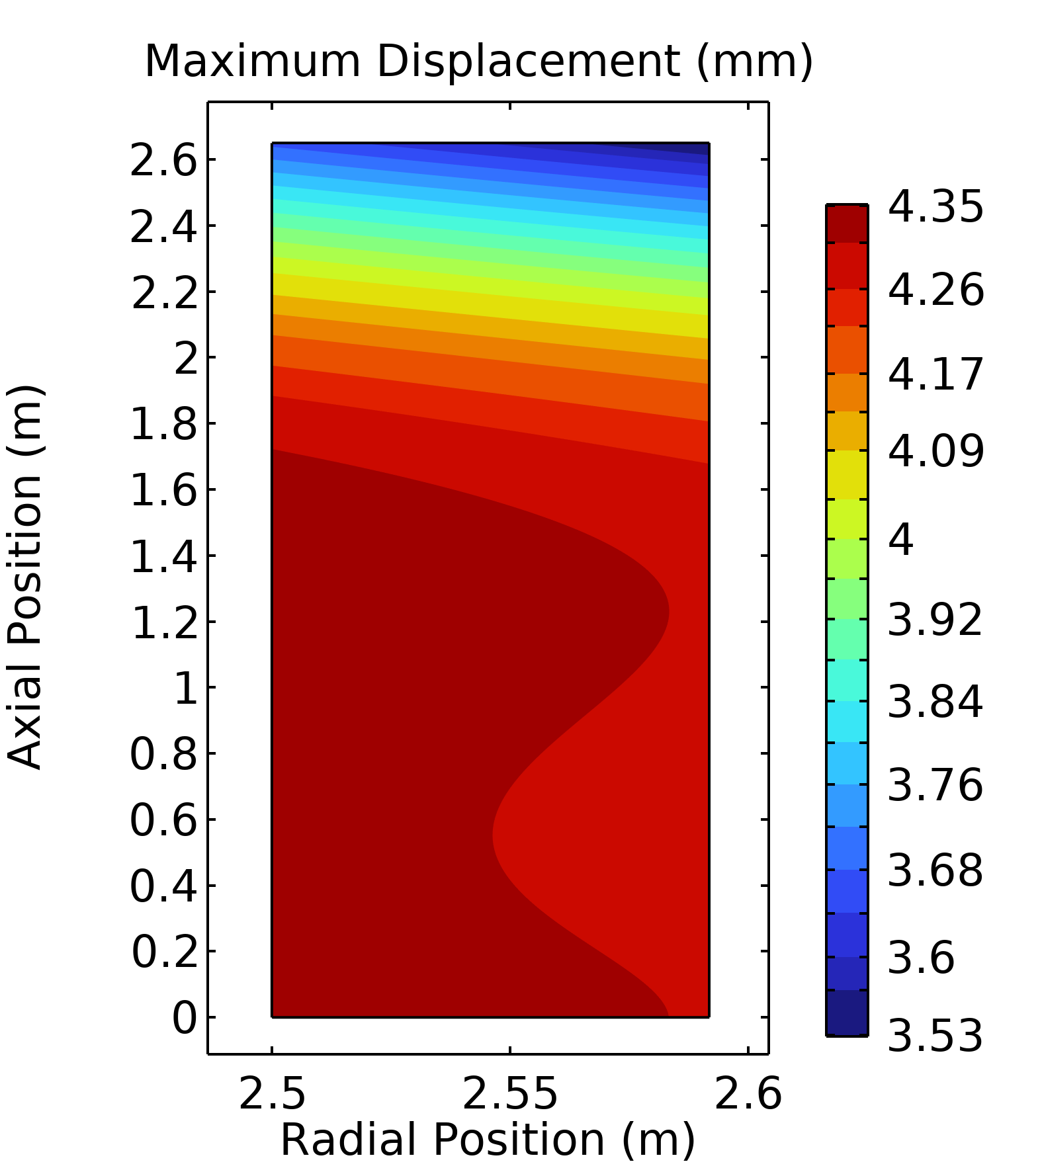
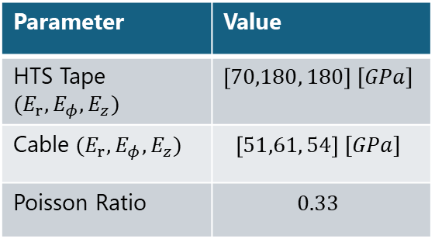
Preliminary Mechanical Performances
Support Shell
Coil simulated as an ortotropic material with averaged properties on the material fraction and cable geometry
Maximum stress (only Lorentz Forces): 97 MPa (well below 500 MPa limit)
Longitudinal Strain on the cable: 0.18% (no HTS degradation)
HTS Cables
Rotational Axis z
Outer Side
Internal Side
1
2
…
8
N layers
Radial Direction r
Parameter | Value
HTS Tape $(E_{r},E_{φ},E_{z})$ | $$\left[70,180, 180\right] [GPa]$$
Cable $(E_{r},E_{φ},E_{z})$ | $$\left[51,61, 54\right] [GPa]$$
Poisson Ratio | $$0.33$$
Aluminum alloy 5083 (25 mm) shell as support for the coil
Maximum hoop stress of 120 [MPa] (Tensile Strength 400 [MPa])

Slide 11
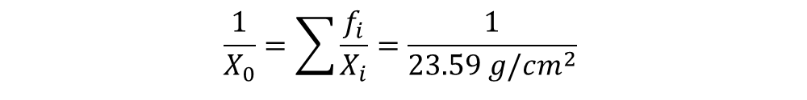
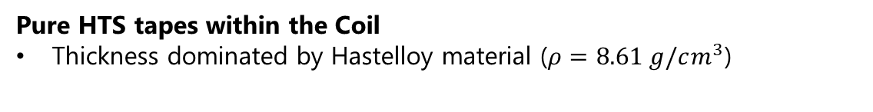
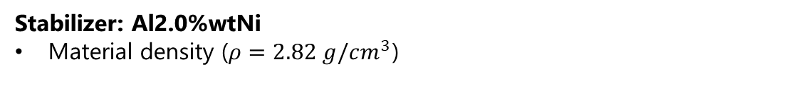
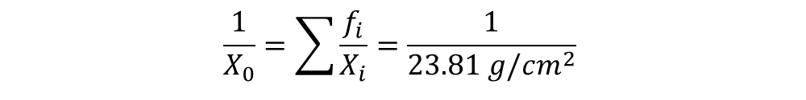
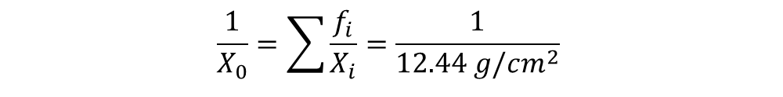
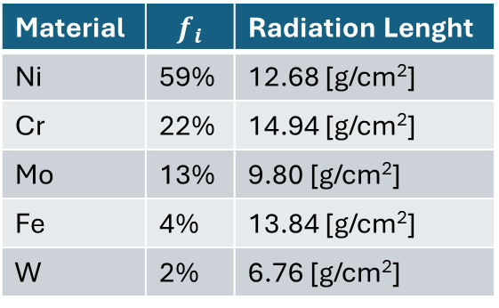
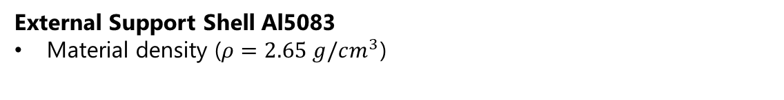
Coil Transparency
Hastelloy C276
Material | $$f_{i}$$ | Radiation Lenght
Ni | 59% | 12.68 [g/cm²]
Cr | 22% | 14.94 [g/cm²]
Mo | 13% | 9.80 [g/cm²]
Fe | 4% | 13.84 [g/cm²]
W | 2% | 6.76 [g/cm²]
Coil Transparency dominated by HTS tape, Cable Stabilizer (Al2.0%wtNi for currently considered configuration) and Shell
Pure HTS tapes within the Coil
Thickness dominated by Hastelloy material ($ρ=8.61 g/cm^{3}$)
$$\frac{1}{X_{0}}=\sum{\frac{f_{i}}{X_{i}}}=\frac{1}{12.44 g/cm^{2}}$$
$$X_{0}[cm]=1.40 cm$$
Stabilizer: Al2.0%wtNi
Material density ($ρ=2.82 g/cm^{3}$)
Coil Total Normalized Radiation Length
Material | Total Thickness | X/X0
HTS Tape | 4.0 mm | 0.296
Al2.0%wtNi | 72 mm | 0.862
Insulation | 16 mm | 0.056
Shell | 25 mm | 0.278
TOTAL | 117.3 mm | 1.492
$$\frac{1}{X_{0}}=\sum{\frac{f_{i}}{X_{i}}}=\frac{1}{23.59 g/cm^{2}}$$
$$X_{0}[cm]=8.35 cm$$
External Support Shell Al5083
Material density ($ρ=2.65 g/cm^{3}$)
$$\frac{1}{X_{0}}=\sum{\frac{f_{i}}{X_{i}}}=\frac{1}{23.81 g/cm^{2}}$$
$$X_{0}[cm]=8.99 cm$$
If we want to use Cu as stabilizer: X/X0 = 5.646

Slide 12

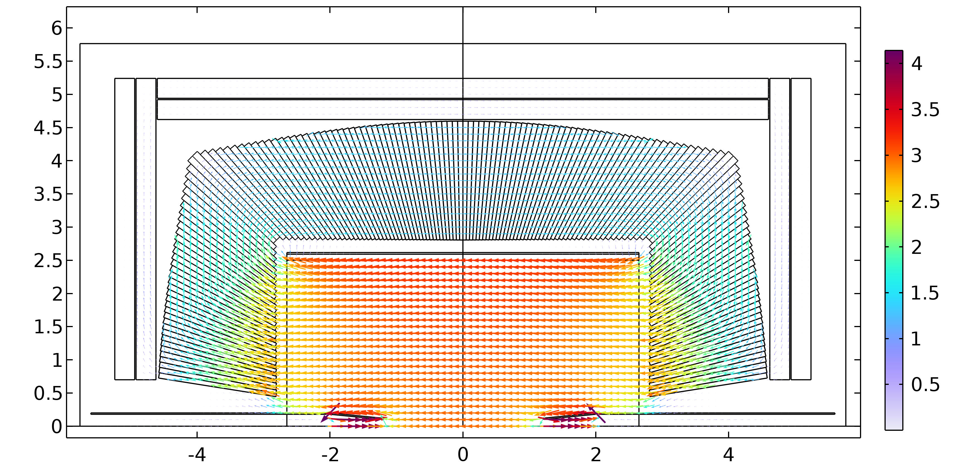
Field Maps
Generation of detailed magnetic field maps for subdetectors and particle simulations for other WP or collaborators
Implementation of different magnetic components for unified magnetic field simulation of IDEA Detector
  Main Solenoid
  Muon Chambers
  HAD Calo
  Local/Non local correction scheme of antisolenoids
  Main focusing magnet of MDI region
Common geometry Implemented: GitHub k4geo IDEA_o2_v01
Field Map Example:
Radial Grid
  ( 0< r <6.5 [m], -6.5 [m]< z < 6.5 [m])
  Binning distance: 1 cm
  Dimensions: 845k points (80 MB)
3D Grid (X,Y,Z)
  Work in progress

Slide 13



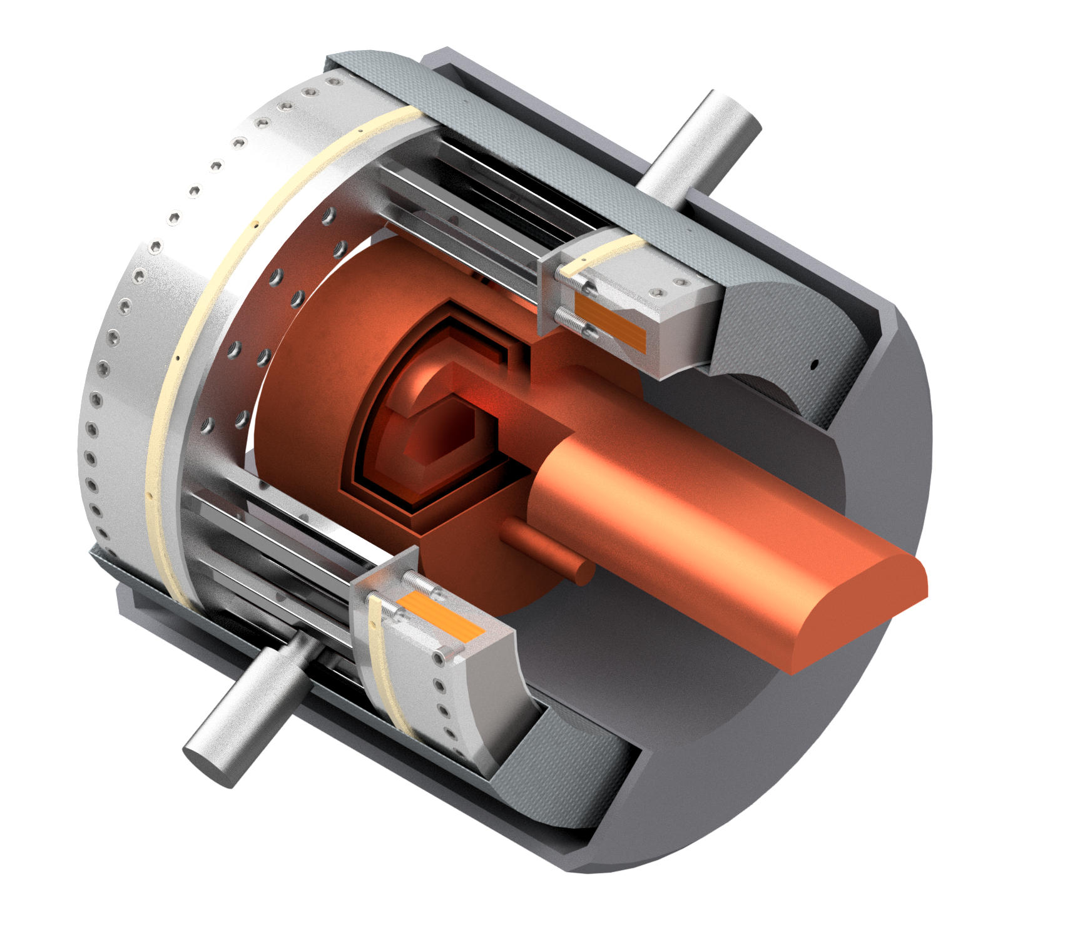


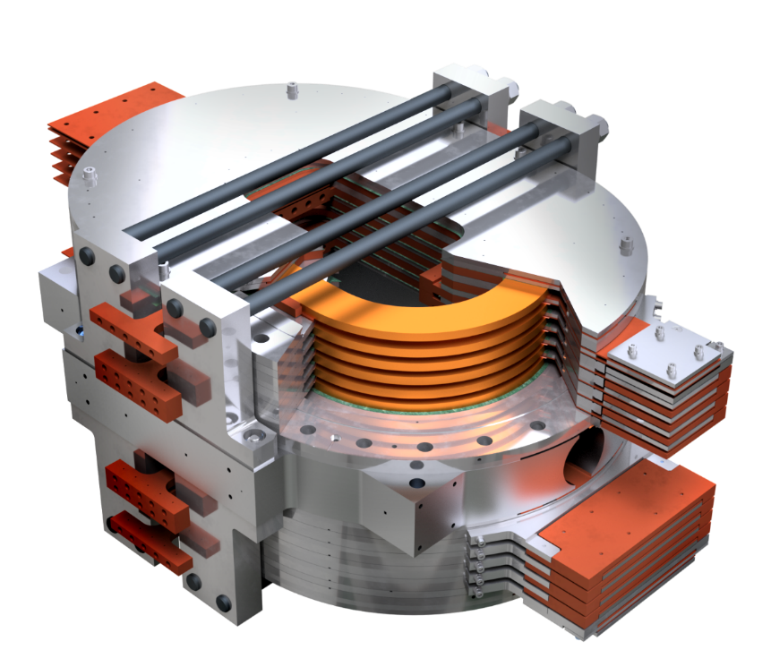
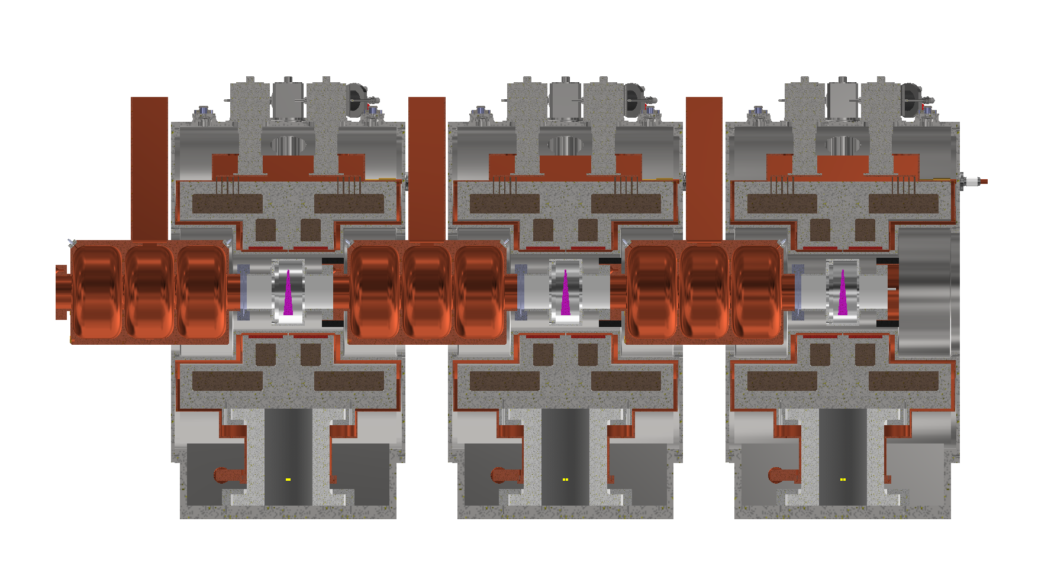







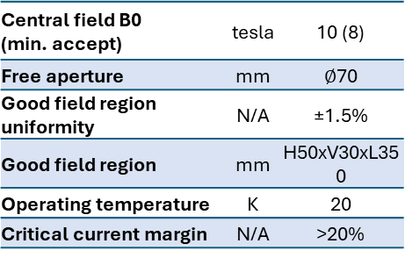
Synergies with LASA activity
LASA Superconducting Magnet research group involved in several R&D projects on HTS and major international collaboration for collider magnet design: HFM program, FCC, MuonCollider
10 T HTS Dipole Magnet: ESMA
Split Coil – RFMTF
Two stage
cryocooler
New Development project (PNRR-IRIS) 2022-2025
“Innovative Research Infrastructure on Applied Superconductivity”
Improvement of 6 National research infrastructures and university laboratories to perform cutting-edge technology research activity on superconductivity
Magnet Test Facility for RF
10 T gradient split coil design
(300 mm warm bore)
Operation @ 20 K
Conduction cooled cryogenic system
Thermal shield
Coil support structure
Central field B0 (min. accept) | tesla | 10 (8)
Free aperture | mm | $∅$70
Good field region uniformity | N/A | ±1.5%
Good field region | mm | H50xV30xL350
Operating temperature | K | 20
Critical current margin | N/A | >20%
Vacuum vessel
HTS coils
HFM Program for HTS Magnets
Common R&D program to increase the TRL of HTS magnet technology for next generation future colliders and accelerator sustainability
Courtesy of S. Sorti and L. Balconi,
University of Milano and INFN-Milano, LASA

Slide 14
Conclusions and Next Steps
Preliminary design evaluations did not identified any showstopper for the feasibility of an HTS compact solenoid design operating @ 3T and 20K
Magnetic Design and Quench Protection
  Field quality enhancement
  Margin optimization with coil grading
  Detailed quench analysis and failure estimation
Detailed Mechanical Assembly and Cool-down/energization stresses on conductor
  Optimization of coil/cryostat thermal and mechanical supports
  Cryostat losses and cooling technologies evaluation
Cable manufacturing and characterization
  Properties of HTS aluminum stabilized cables at cryogenic temperatures
  Joints: LASA facility equipped with necessary infrastructure for cable testing (ATLAS Cable joints)
Field Maps for subdetector and MDI working groups under development
  IR region magnetic elements and beam pipe
  Fringe field analysis for Booster accelerator beamline

Slide 15
Thank you for the attention

