Slide 1
FCC electrical grid and infrastructure update
FCC Week – 20th May 2025
Charline MARCEL (CERN-EN/EL)

Slide 2
Outline
Overall concept of the electrical grid defined for the Feasibility Study
Feasibility study of the HV lines
Electrical infrastructure layout
Secured network concept
Next steps for the pre-TDR phase

Slide 3
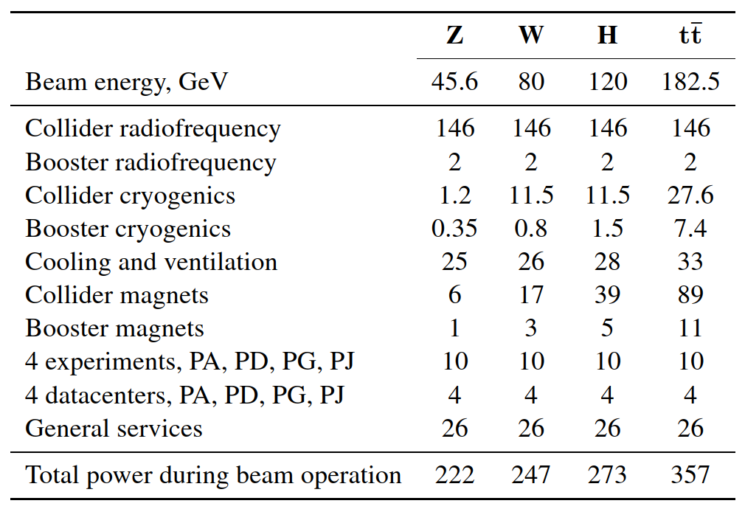
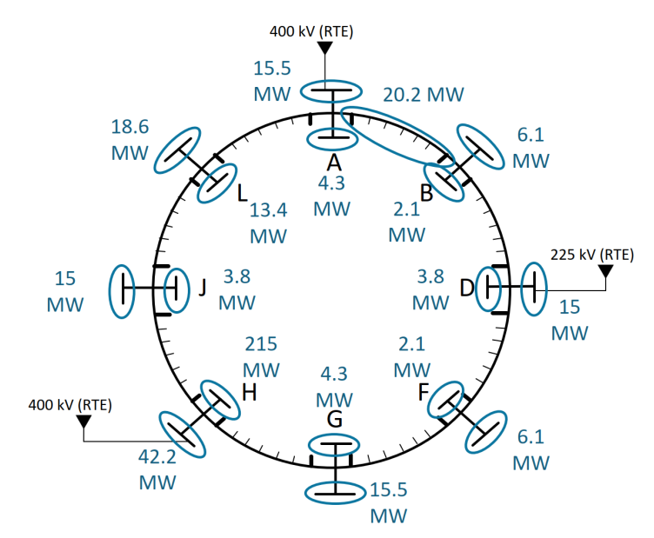
Overall concept of the electrical grid defined for the Feasibility Study
Energy consumption of the FCC-ee machine
Power demand by systems in MW:
Load mapping of the machine:

Slide 4
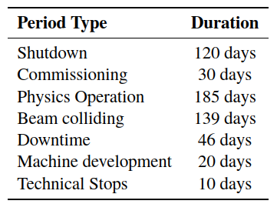
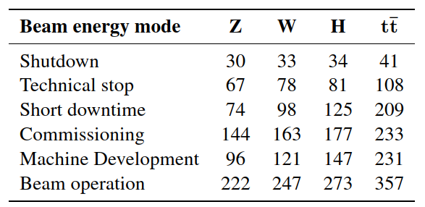
Overall concept of the electrical grid defined for the Feasibility Study
Energy consumption of the FCC-ee machine
Operation modes:
Power demand by operation modes in MW:
Energy consumption between 1,07 TWh (Z mode) and 1,77 TWh ($t\overline{t}$ mode)

Slide 5
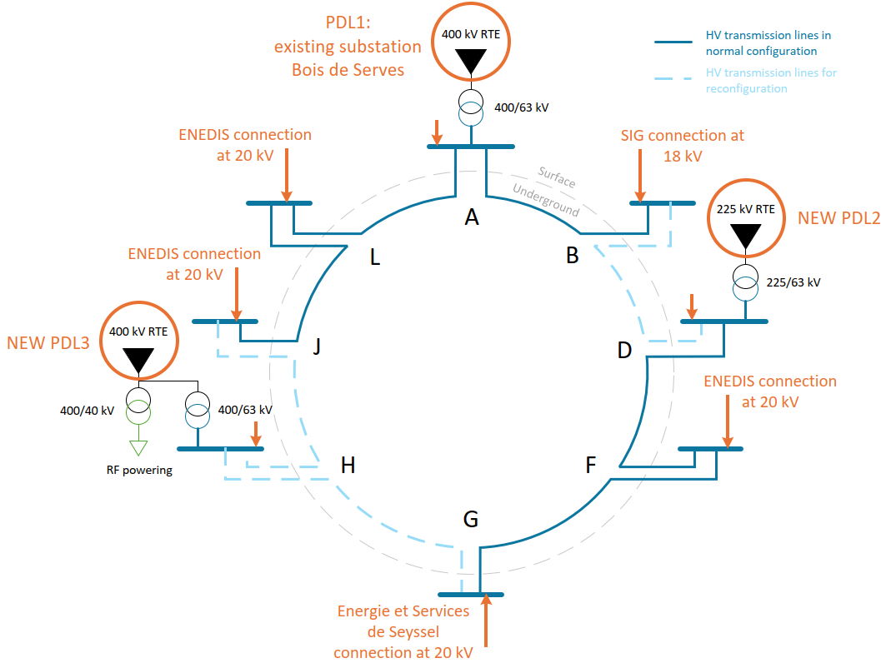
Overall concept of the electrical grid defined for the Feasibility Study
Grid connections and transmission network
3 connections to RTE (French Electricity Transmission Network) at 400 or 225 kV
All points connected to local grid at 20 or 18 kV for, first works phase, then back-up sources
HV lines, passing through the tunnel, between all HV substations on surface, designed to allow reconfigurations
HV internal network at 63 kV

Slide 6
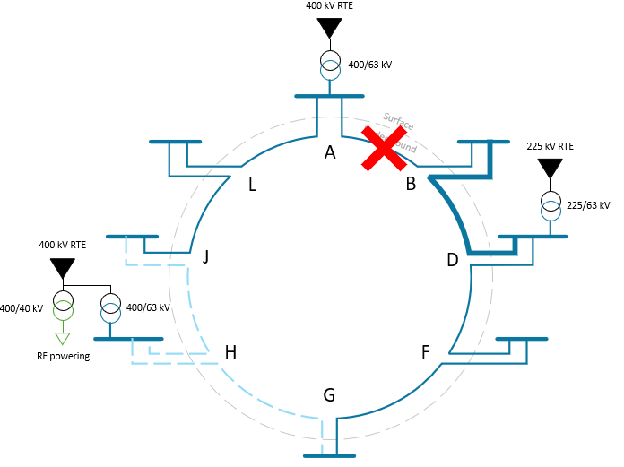
Overall concept of the electrical grid defined for the Feasibility Study
Grid connections and transmission network
Loss of the line PA – PB:
Reconfiguration by activating the line PD – PB
The machine can normally work
The HV lines must be designed at 115 MVA to allow normal operation for the loss of any lines or source of PA & PD

Slide 7
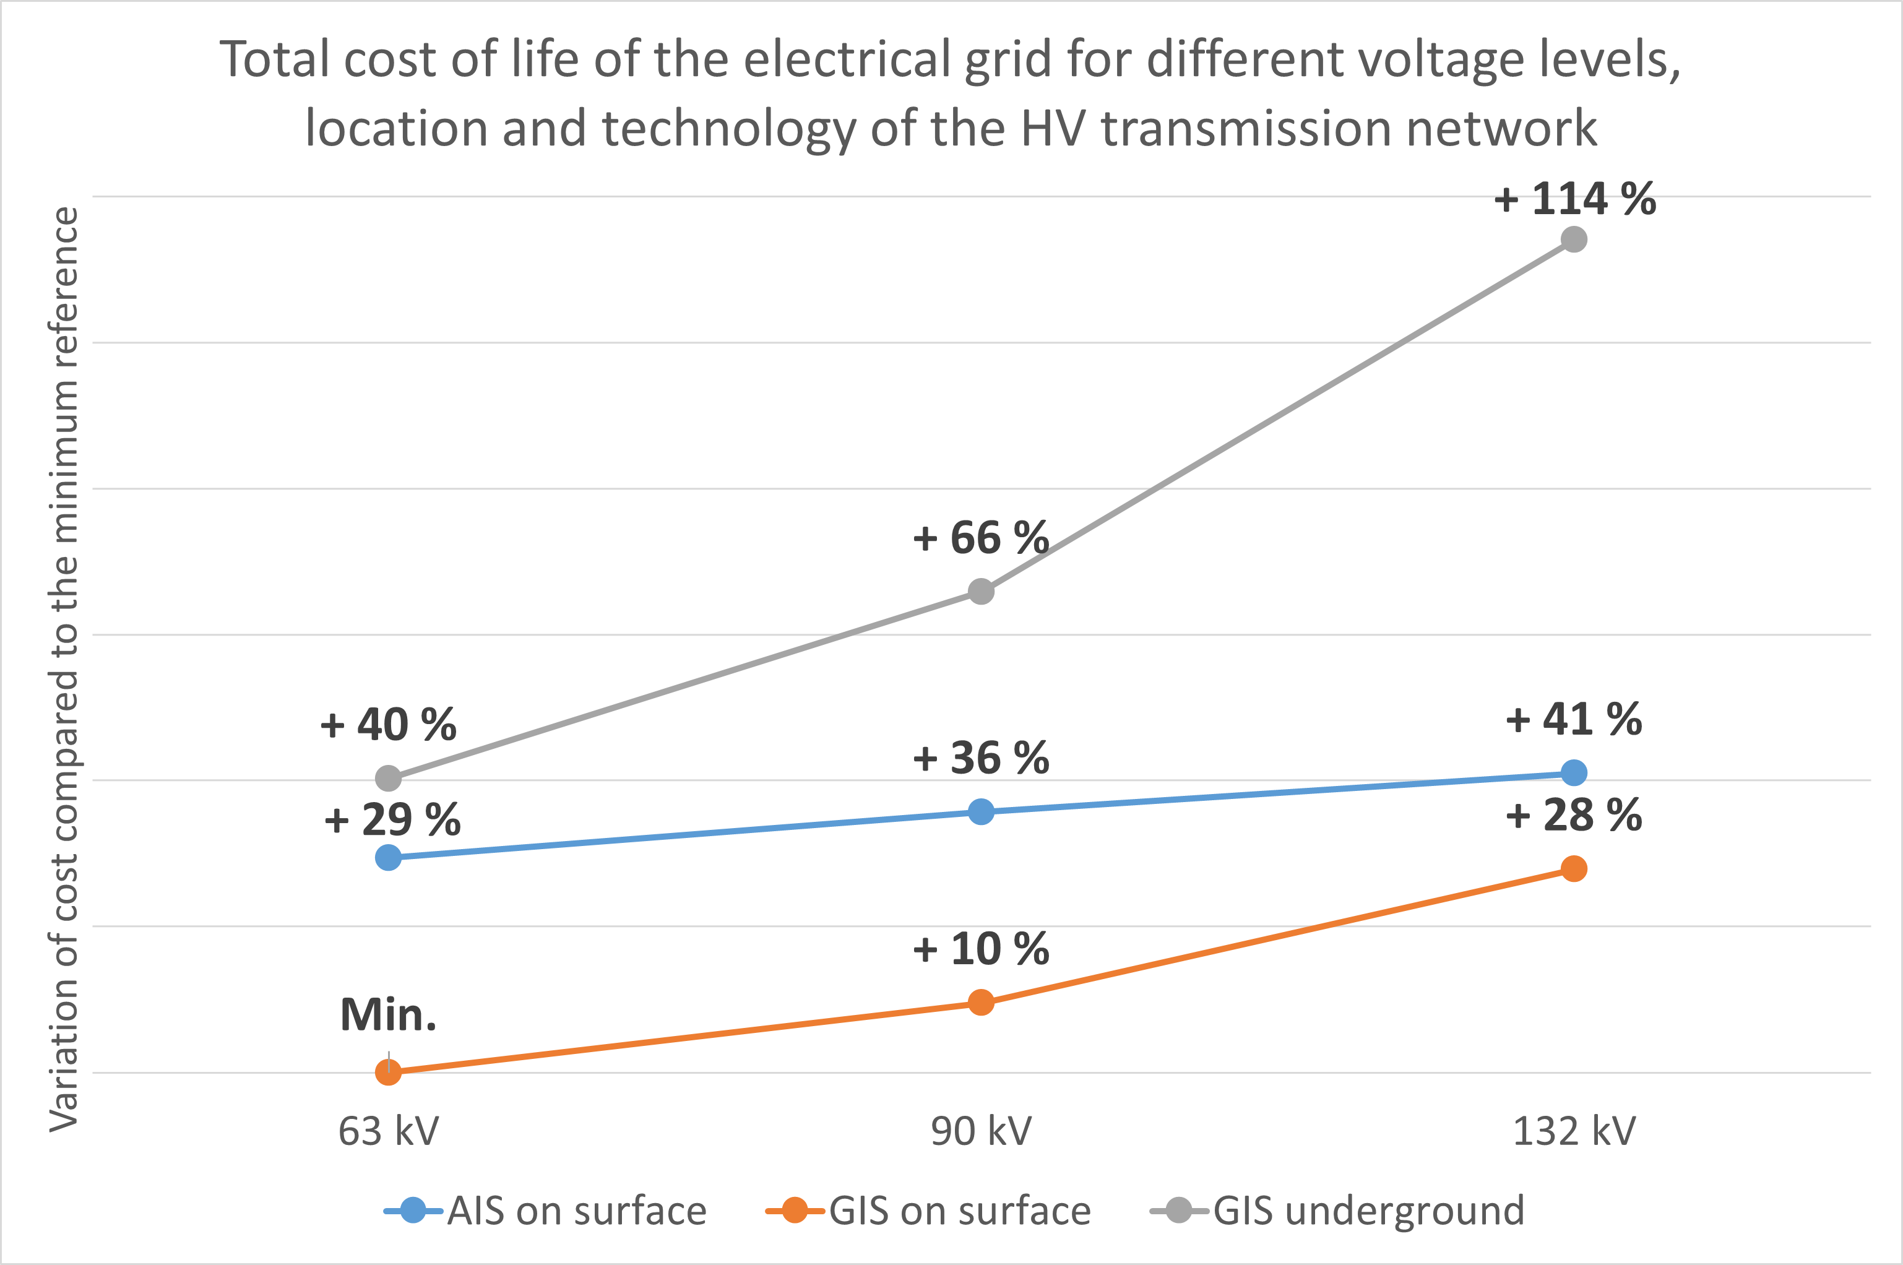
Overall concept of the electrical grid defined for the Feasibility Study
Grid connections and transmission network
Optimization study:
Based on CAPEX/OPEX over the total lifetime of FCC
Including HV lines and substations
For different scenarios:
  High voltage level: 63, 90 & 132 kV
  Substations technology and location: AIS or GIS, on surface or underground
Baseline: 63 kV with GIS on surface

Slide 8

Feasibility study on the HV lines
Consulting study realized in 2024 to verify the feasibility of installing an HV line between surface substations of access points through the tunnel
Definition of:
Requirements of the installation of an HV line in the tunnel, shafts, service caverns, surface galleries and zones in between
Design of the HV line: HV cables with a power flow defined, accessories, earthing, impact on the environment
Design of the junction chambers: needs, quantities and layout
Installation process and needs
Cost and timelines of installation
Maintenance and reparation requirements
Feasibility confirmed
Report foundable on EDMS: https://edms.cern.ch/document/3170168/1
58 pages, in French

Slide 9
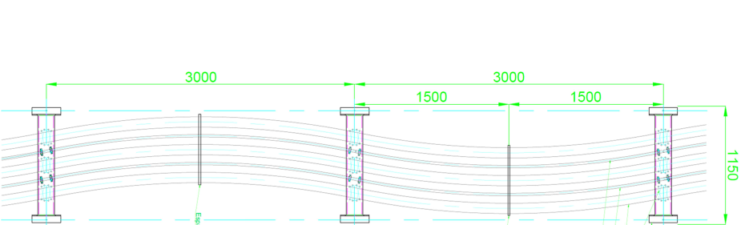
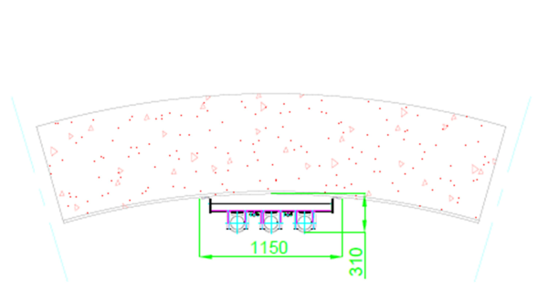
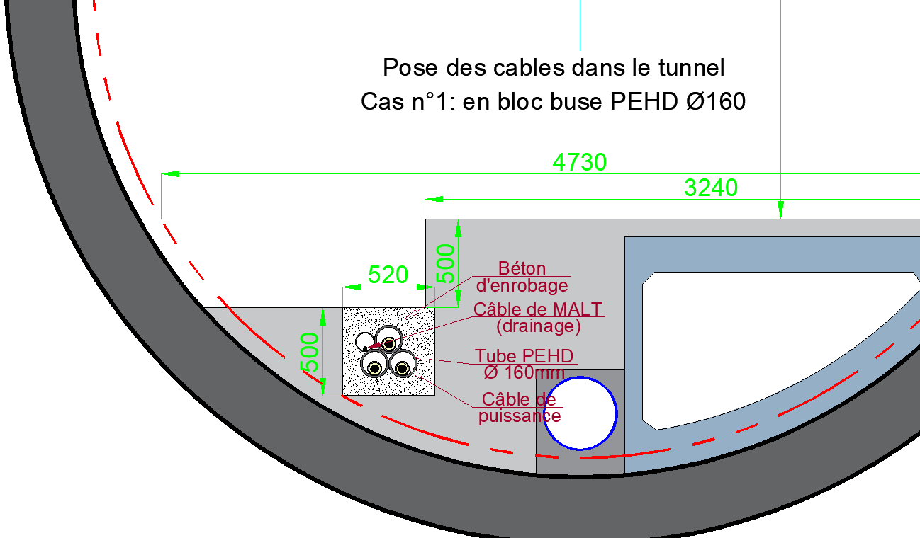
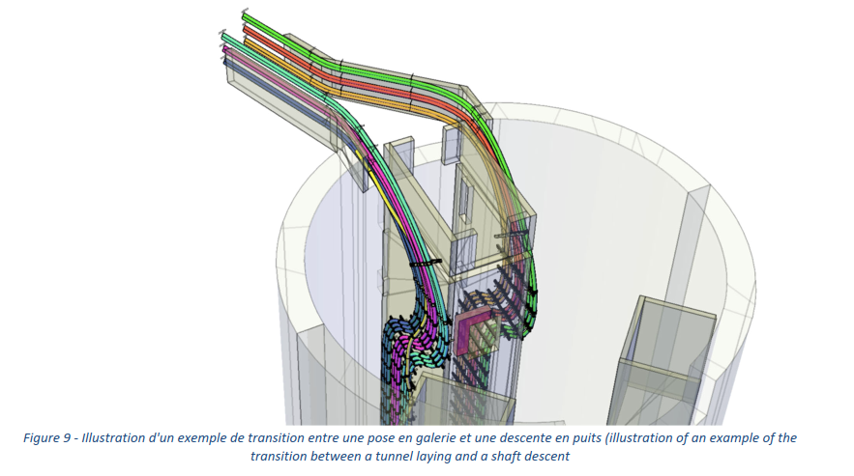
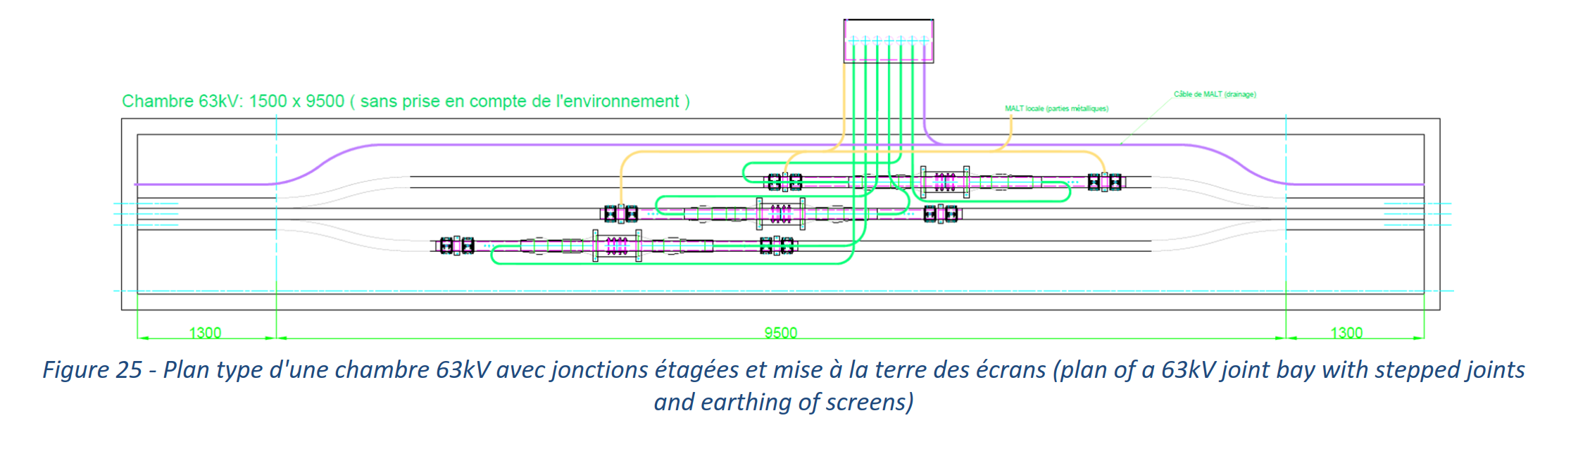
Feasibility study on the HV lines
Main outcomes of the study
Space requirements:
In the arc: HV cables in PEHD ducts buried in a 520 x 500 mm concrete block
In the alcove area: one 1,5 x 9,5 m junction chamber to be installed at each alcove
In the shaft: against the wall with clamps and applying a “snaking”
Areas in between for cable routing: 2,34 m bending radius while pulling, 1,56 m bending radius when installed
Cost and timelines:
Total of 6,4 M€
160 days of installation
per 12 km section

Slide 10
Electrical infrastructure layout
Estimation of the electrical equipment requirements across various underground facilities
Example given: PH

Slide 11
Electrical infrastructure layout
Estimation of the electrical equipment requirements across various underground facilities
Example given: PH underground

Slide 12
Electrical infrastructure layout
Estimation of the electrical equipment requirements across various underground facilities
Example given: PH klystron gallery

Slide 13
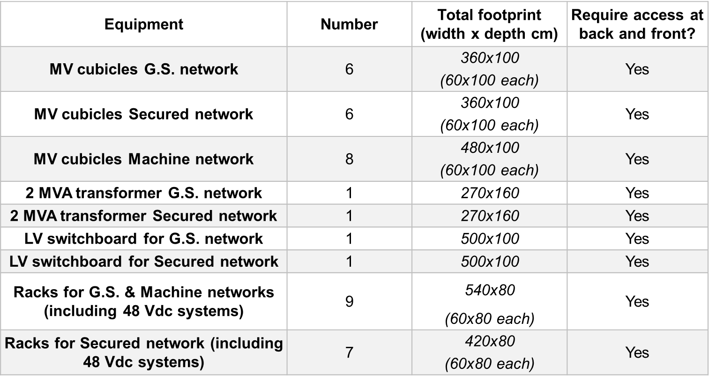
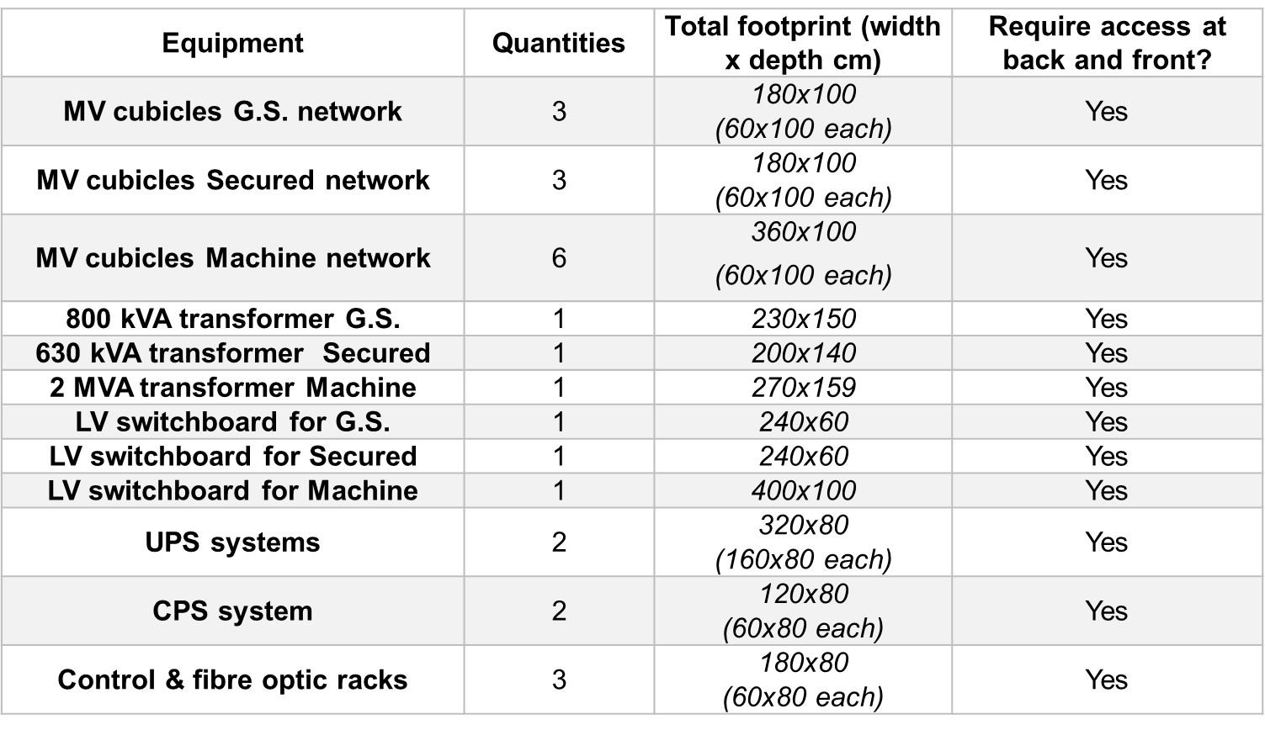
Electrical infrastructure layout
Estimation of the electrical equipment requirements across various underground facilities
Example given: PH underground
Electrical substation in the service cavern:
In big alcoves:
+ Cable tray needs in the different tunnels

Slide 14
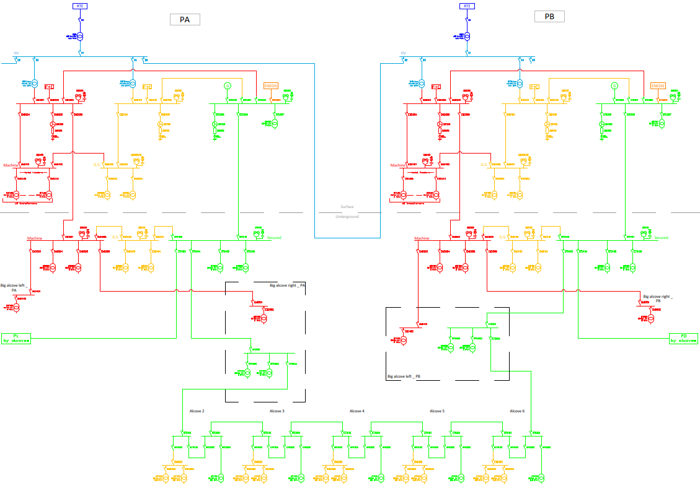
14
Secured network concept
From distribution network concept
  Nominal mode: two MV networks for each point (machine and general services). Each point supplies half sector.
  For each point: Possible mutual re-supply in surface.
  For each point: Possible mutual re-supply in underground.
  Possible re-supply of the full sector from one point.
SURFACE
UNDERGROUND
Per point:
2x 40 MVA HV/MV transformers
Main MV links rated 20 MVA
Tunnel MV links rated 14 MVA
TUNNEL (ALCOVES)

Slide 15
Secured network concept
15
To an optimized secured network concept
  Two backups per point for MV (20 kV) power supply:
    Gensets & local public utility
  Same links for normal and secured networks
    Load-shedding
    High maintainability
  Two networks arriving in all the alcoves (from the two points)
    Possibility to re-supply from the adjacent point in case of maintenance or major fault on the sources
BACKUP
BACKUP
SURFACE
Proposal accepted by safety team under specific conditions
UNDERGROUND
  Challenges:
    Fire-resistance of MV infrastructure
    Opportunity: protection through the civil works (ducts)
TUNNEL (ALCOVES)

Slide 16
Next steps for the pre-TDR phase
Main goals
Looking for a reliable solution to collect, store and follow up users’ rquirements
Define the space reservations to prepare the civil engineering tender (special focus on underground areas):
  Reserve space for electrical equipment in the integration
  Reserve space for cable trays in the integration
  Detail the electrical grid
    Update and increase the accuracy of the load requirements and cable needs estimates
    Detail the transmission network and grid connections
    Detail the distribution networks, including the secured network requirements
Study systems and solutions to improve efficiency and sustainability of the network
Study systems and solutions for the network and voltage stability and for power quality
Study systems and technologies to optimize installation and maintenance
Develop CAPEX/OPEX optimizations

Slide 17
Next steps for the pre-TDR phase
Planning overview
 |  | 2025 |  |  | 2026 |  |  |  | 2027
Category | Task | Q2 | Q3 | Q4 | Q1 | Q2 | Q3 | Q4 | Q1 | Q2 | Q3 | Q4
Users' requirements | Update/collect of power demand
 | Update/collect of cable needs
HV grid | Detail external grid connections
 | Detail HV substations requirements
 | Refine the optimisation study of the transmission network with operation modes
Distribution networks | Design surface and underground distribution for each point
Secured network | Study load shedding technologies
 | Design secured network distribution for each point
Integration | Define requirements to integration
General - EL | Study systems and solutions to improve efficiency and sustainability
 | Study systems and solutions for the network and voltage stability and for power quality
 | Study systems and technologies to optimize installation and maintenance
 | Develop OPEX and CAPEX estimate
 | Study of FCC-ee staging and FCC-hh implementation
 | Contribute to the comparison between AC and DC distribution
General | Update requirements to other services (CV, transport, safety, etc.)
 | Contribution to pre-TDR report
Injector | Define electrical infrastructure and HV connection strategy for the injector

Slide 18
Thanks for your attention.
Questions?

