Slide 1
Technical InfrastructurE AVailability
Challenges and opportunities from LHC to FCC-ee
Hannah Dostmann, Jack Heron,
Lukas Felsberger, Daniel Wollmann, Jan Uythoeven

Slide 2

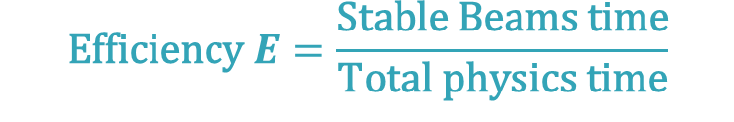
Availability and Efficiency
$$\text{Efficiency} E=\frac{\text{Stable} \text{Beams} \text{time}}{\text{Total} \text{physics} \text{time}}$$
FCC-ee:
365 days
−120 (extended shutdowns)
− 30 (annual commissioning)
− 20 (machine development)
− 10 (technical stops)
185 days for physics
min 75% !
$$\text{Availability} A=\frac{\text{Up} \text{time}}{\text{Total} \text{physics} \text{time}}$$
Operation
Stable Beams
Down Time
20 May 2025

Slide 3
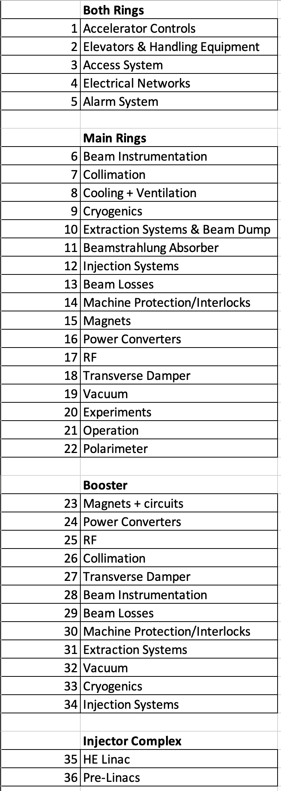
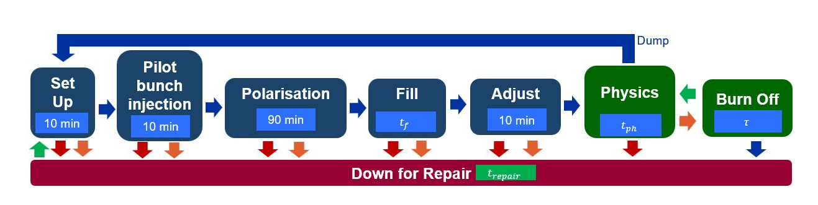

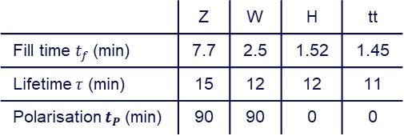
Simulation Environment
FCC-ee
MTBF
Stable Beams
Operation
Availability
Luminosity
Mean
Down Time
 | Z | W | H | tt
Fill time $t_{f}$ (min) | 7.7 | 2.5 | 1.52 | 1.45
Lifetime $τ$ (min) | 15 | 12 | 12 | 11
Polarisation $t_{P}$(min) | 90 | 90 | 0 | 0
Default
$$t_{P}$$
Repair completed
Main ring failure
Injector Complex failure
Hannah Dostmann | Technical Infrastructure Availability - Challenges and Opportunities from LHC to FCC-ee
20 May 2025
3

Slide 4
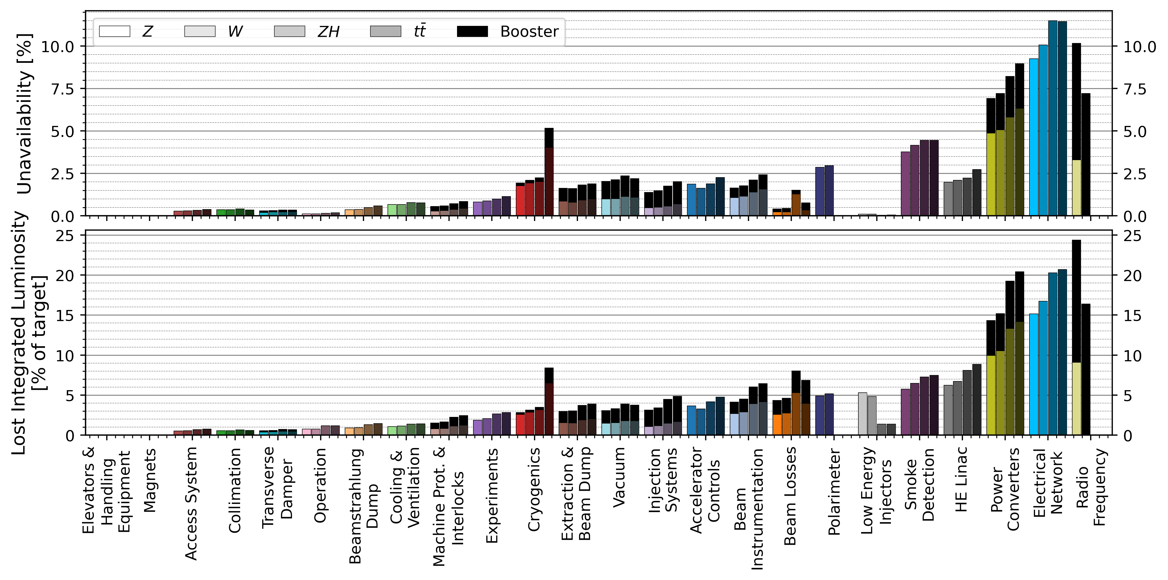
FCC-ee Forecast
Electrical Network
Cryogenics
Cooling and Ventilation
More details:
“Availability, Efficiency and Integrated Luminosity”
Jack Heron, 23th May, Machine Protection and Availability
Hannah Dostmann | Technical Infrastructure Availability - Challenges and Opportunities from LHC to FCC-ee
20 May 2025

Slide 5
Cooling & Ventilation
Acknowledgment: Guillermo Peon, Inigo Martin Melero, Andrew Nicholas Coleman
20 May 2025
Hannah Dostmann | Technical Infrastructure Availability - Challenges and Opportunities from LHC to FCC-ee

Slide 6
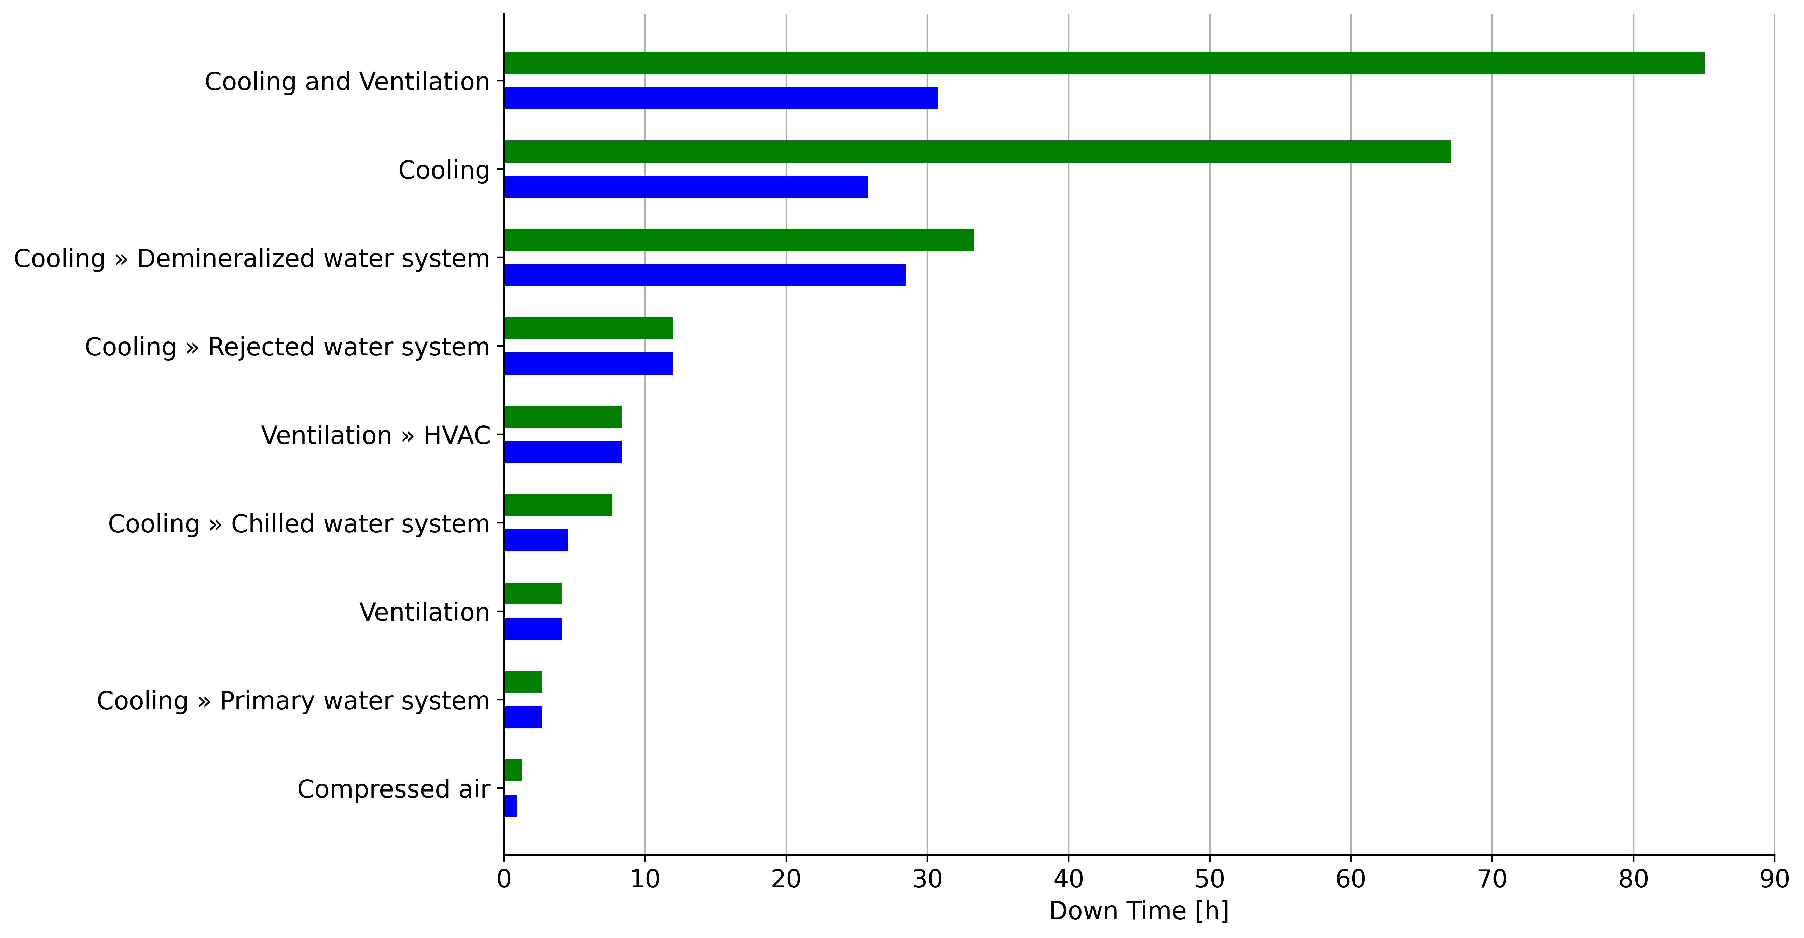
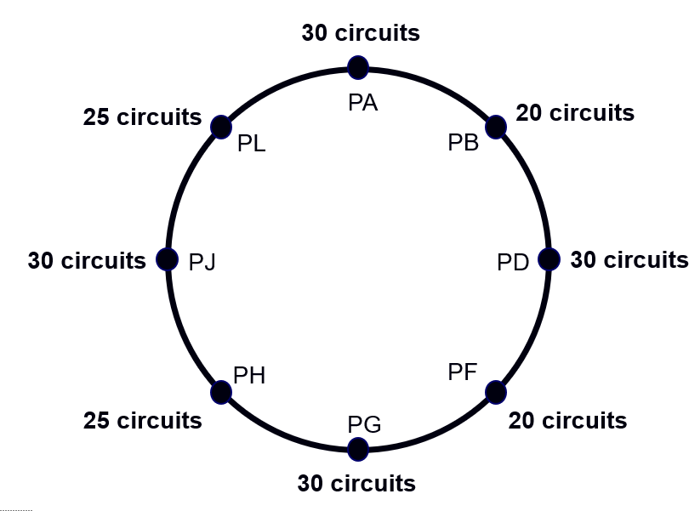

Cooling & Ventilation
LHC
FCC-ee
With child systems
CV only
MTBF scaled by number of critical circuits
Same repair duration as the LHC
MTBF
Mean Down Time
Down Time [h]
Proton and Ion runs from start of stable beams to end of physics, excluding machine developments and technical stops (2015-2024)
Hannah Dostmann | Technical Infrastructure Availability - Challenges and Opportunities from LHC to FCC-ee
20 May 2025

Slide 7
Cryogenics
Acknowledgment: Laurent Delprat
20 May 2025
Hannah Dostmann | Technical Infrastructure Availability - Challenges and Opportunities from LHC to FCC-ee

Slide 8
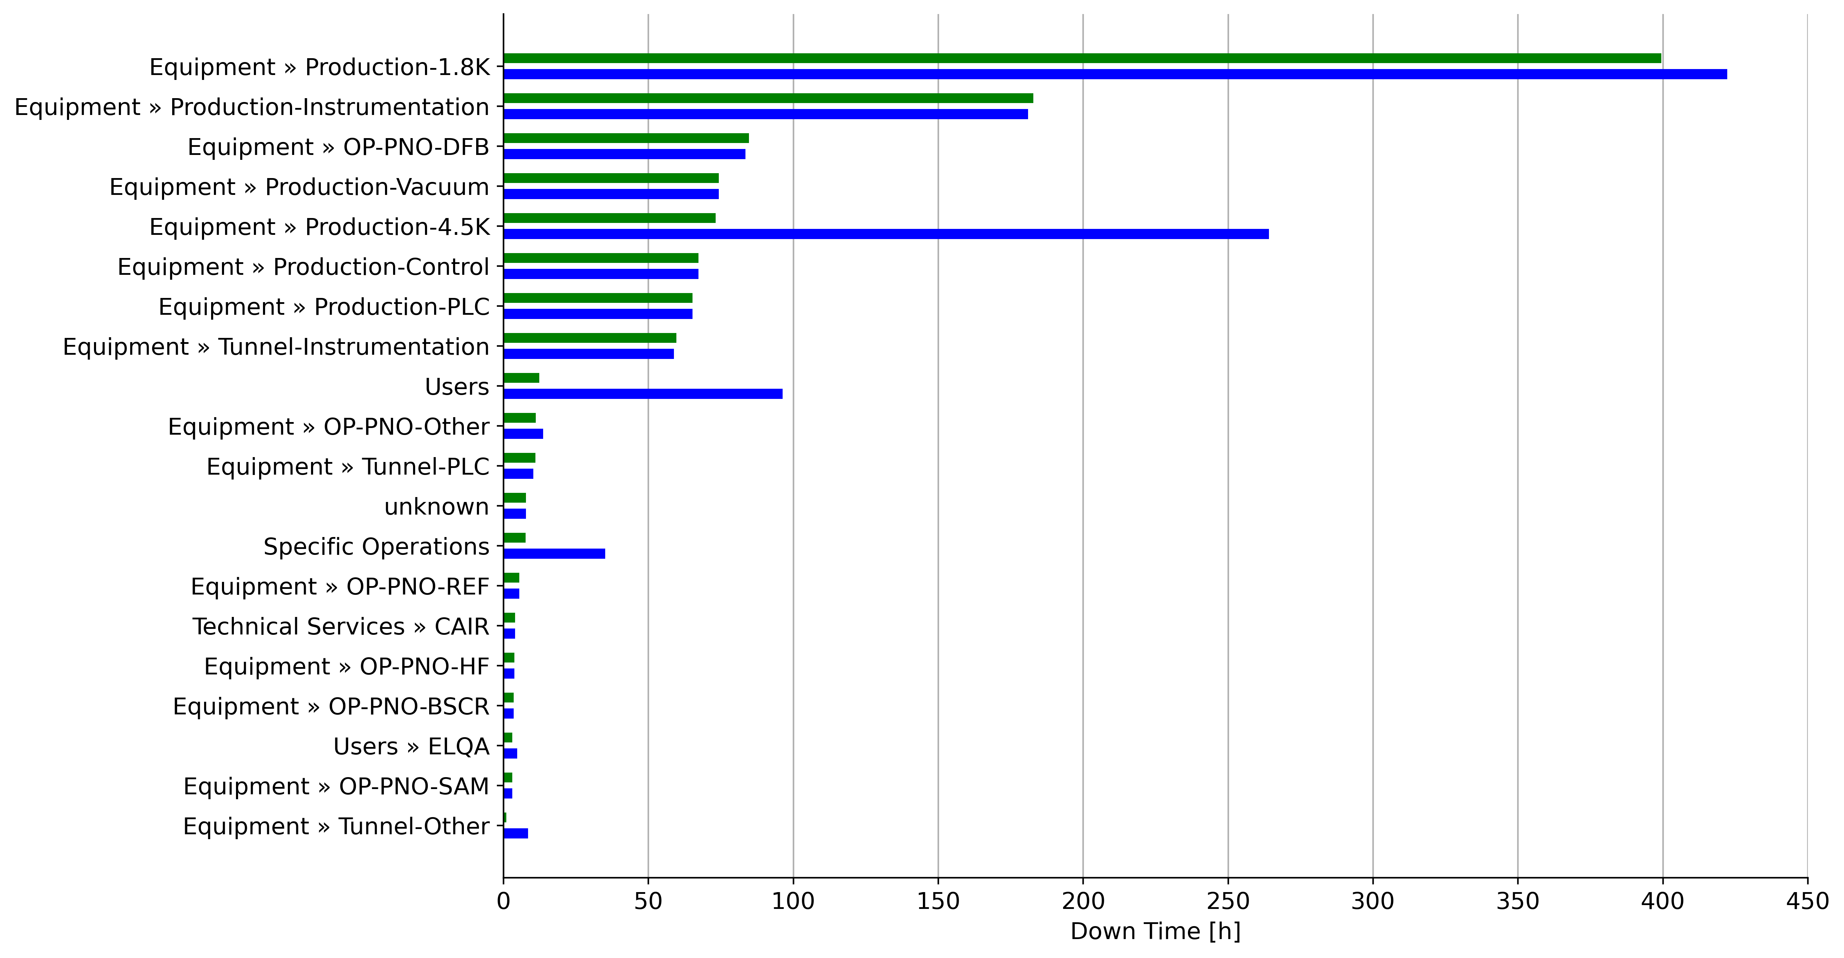
Cryogenics – LHC
Helium level oscillations (distribution feed box)
Specific to superconducting magnets
Beam screen regulation related issues
Helium level oscillations (standalone magnets)
With child systems
Cryogenics only
Proton and Ion runs from start of stable beams to end of physics, excluding machine developments and technical stops (2015-2024)
20 May 2025
Hannah Dostmann | Technical Infrastructure Availability - Challenges and Opportunities from LHC to FCC-ee

Slide 9
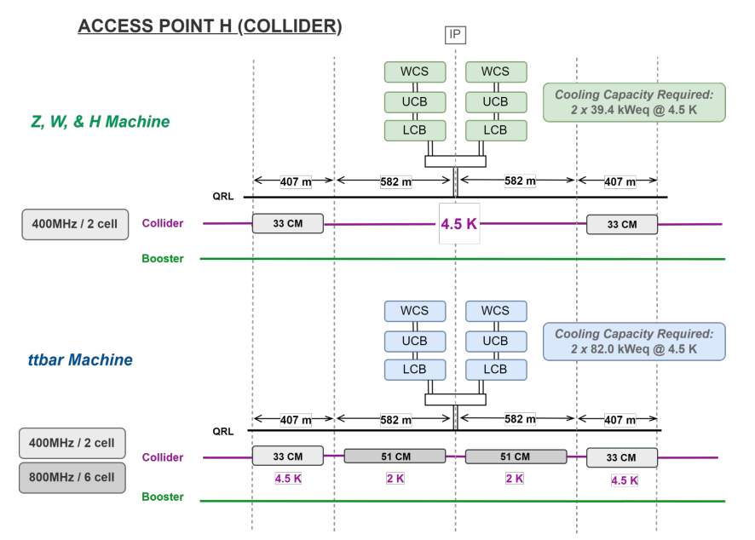
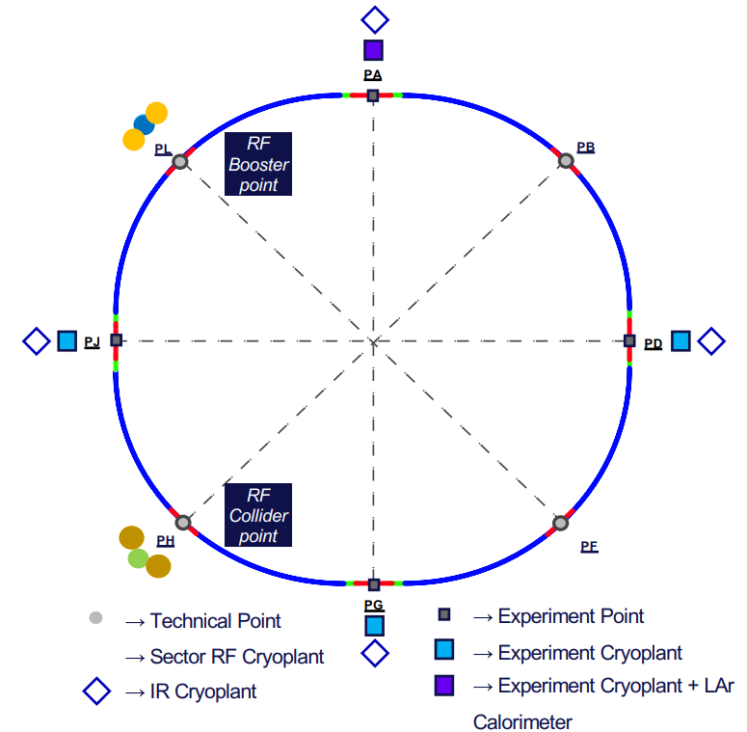
Cryogenics – FCC-ee
PH (Collider)
~40 kWeq @ 4.5K
Cryoplants for RF system located at PH & PL
MTBF scaled according to power level eq @ 4.5K
82 kWeq @ 4.5K
PL (Booster)
Z,W & ZH Machine : 1 x 13.3 kW eq @ 4.5K
tt Machine: 2 x 22 kW eq @ 4.5K
not modeled yet!
https://cds.cern.ch/record/2928793/files/2505.00274.pdf
20 May 2025
Hannah Dostmann | Technical Infrastructure Availability - Challenges and Opportunities from LHC to FCC-ee

Slide 10
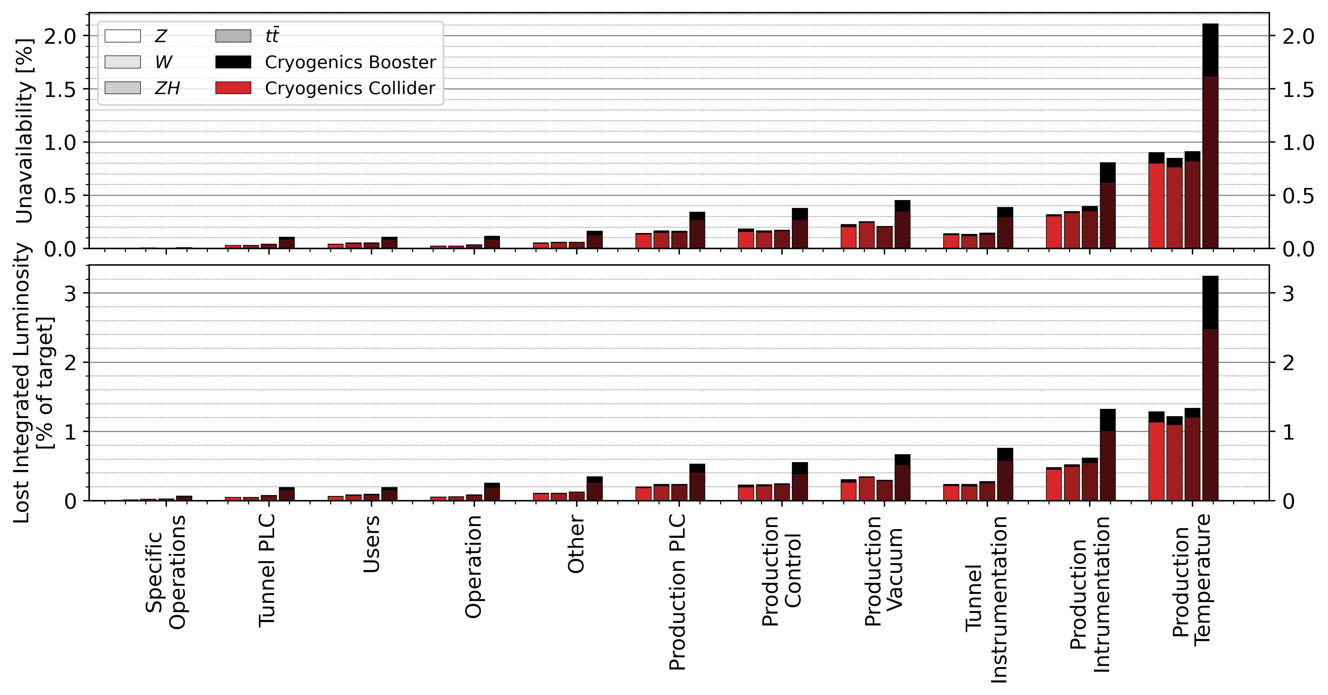
Cryogenics – FCC-ee
R&D Opportunities
FCC-ee will use Turbo Brayton Cycles which are supposed to be more reliable
positive effect on all “Production” faults
2 plants at one location will provide some redundancy
20 May 2025
Hannah Dostmann | Technical Infrastructure Availability - Challenges and Opportunities from LHC to FCC-ee

Slide 11
Electrical Network
Acknowledgement: Mario Parodi, Charline Marcel
20 May 2025
Hannah Dostmann | Technical Infrastructure Availability - Challenges and Opportunities from LHC to FCC-ee

Slide 12
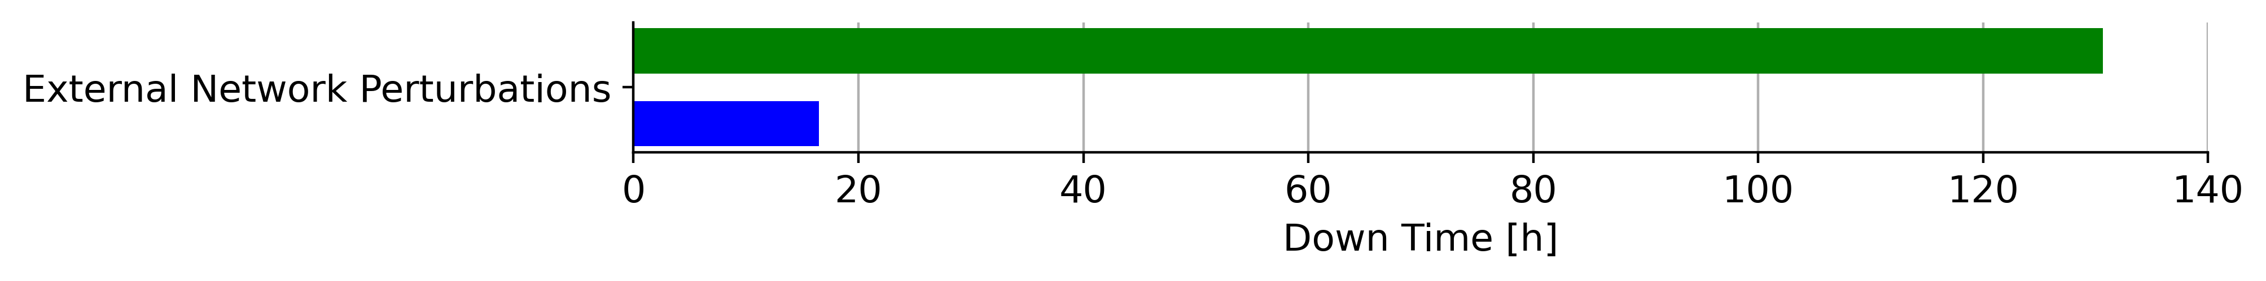
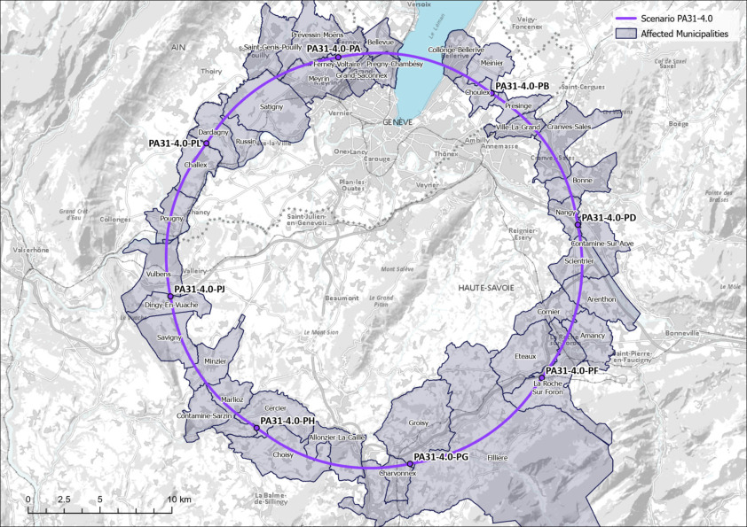
Electrical Network
External Network Perturbations
LHC
Proton and Ion runs from start of stable beams to end of physics, excluding machine developments and technical stops (2015-2024)
LHC
With child systems
External Perturbations only
PA
Line 1
FCC
Power in FCC-ee comes from two transmission lines with node at Genissat
External perturbations should appear at twice the rate of LHC (conservative assumption)
PD
Genissiat
PH
Line 2
https://cds.cern.ch/record/2888389/files/Map%20V0500.jpg?subformat=icon-1440
20 May 2025
Hannah Dostmann | Technical Infrastructure Availability - Challenges and Opportunities from LHC to FCC-ee

Slide 13
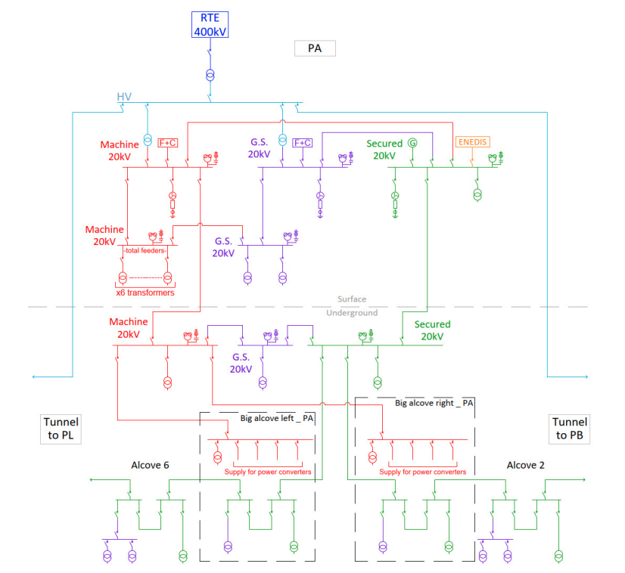
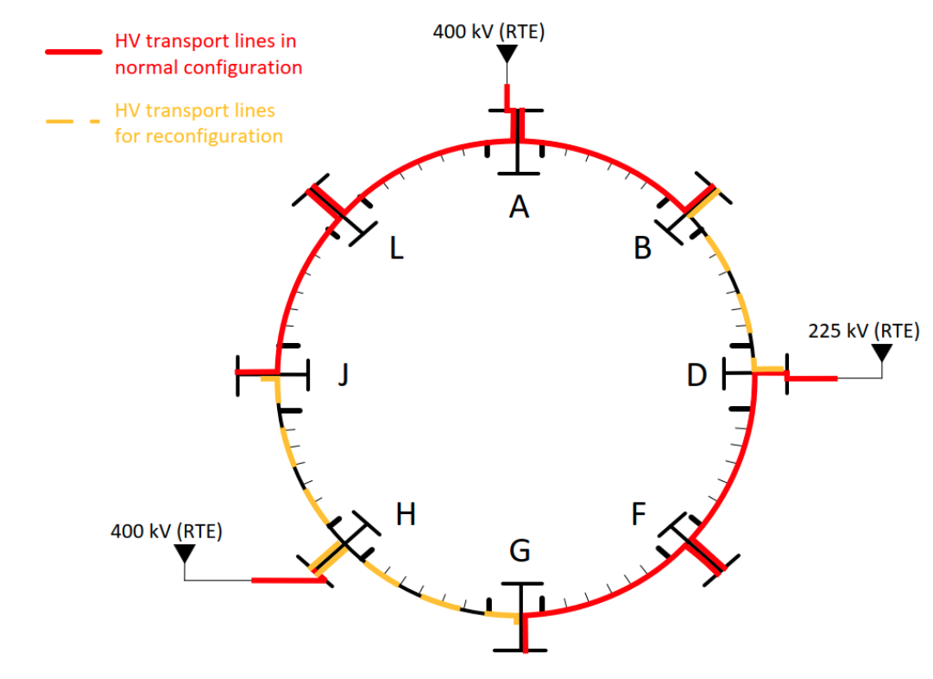
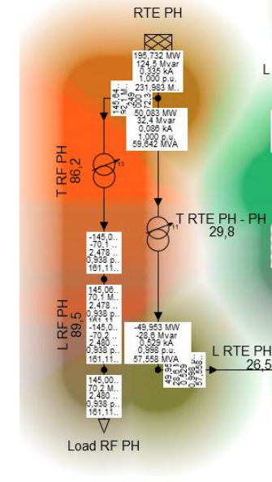
Electrical Network – FCC-ee
Internal Equipment
MTBF should scale with the number of substations at PA,PD & PH
Mean Down Time as with LHC
Exception: redundancy in High Voltage (HV) network
→ Averaged reconfiguration down time of 1h
Main RF power line at PH
From 400 kV LHC faults
Scaled by power level:
LHC: 440 MVA
FCC: 150 MVA (~0.34 LHC)
4 substations
3 substations
0.34
1 substation
*https://indico.cern.ch/event/1509818/contributions/6353584/attachments/3010188/5307118/RF_powering_6_Feb_2025_Davide.pdf
20 May 2025
Hannah Dostmann | Technical Infrastructure Availability - Challenges and Opportunities from LHC to FCC-ee

Slide 14
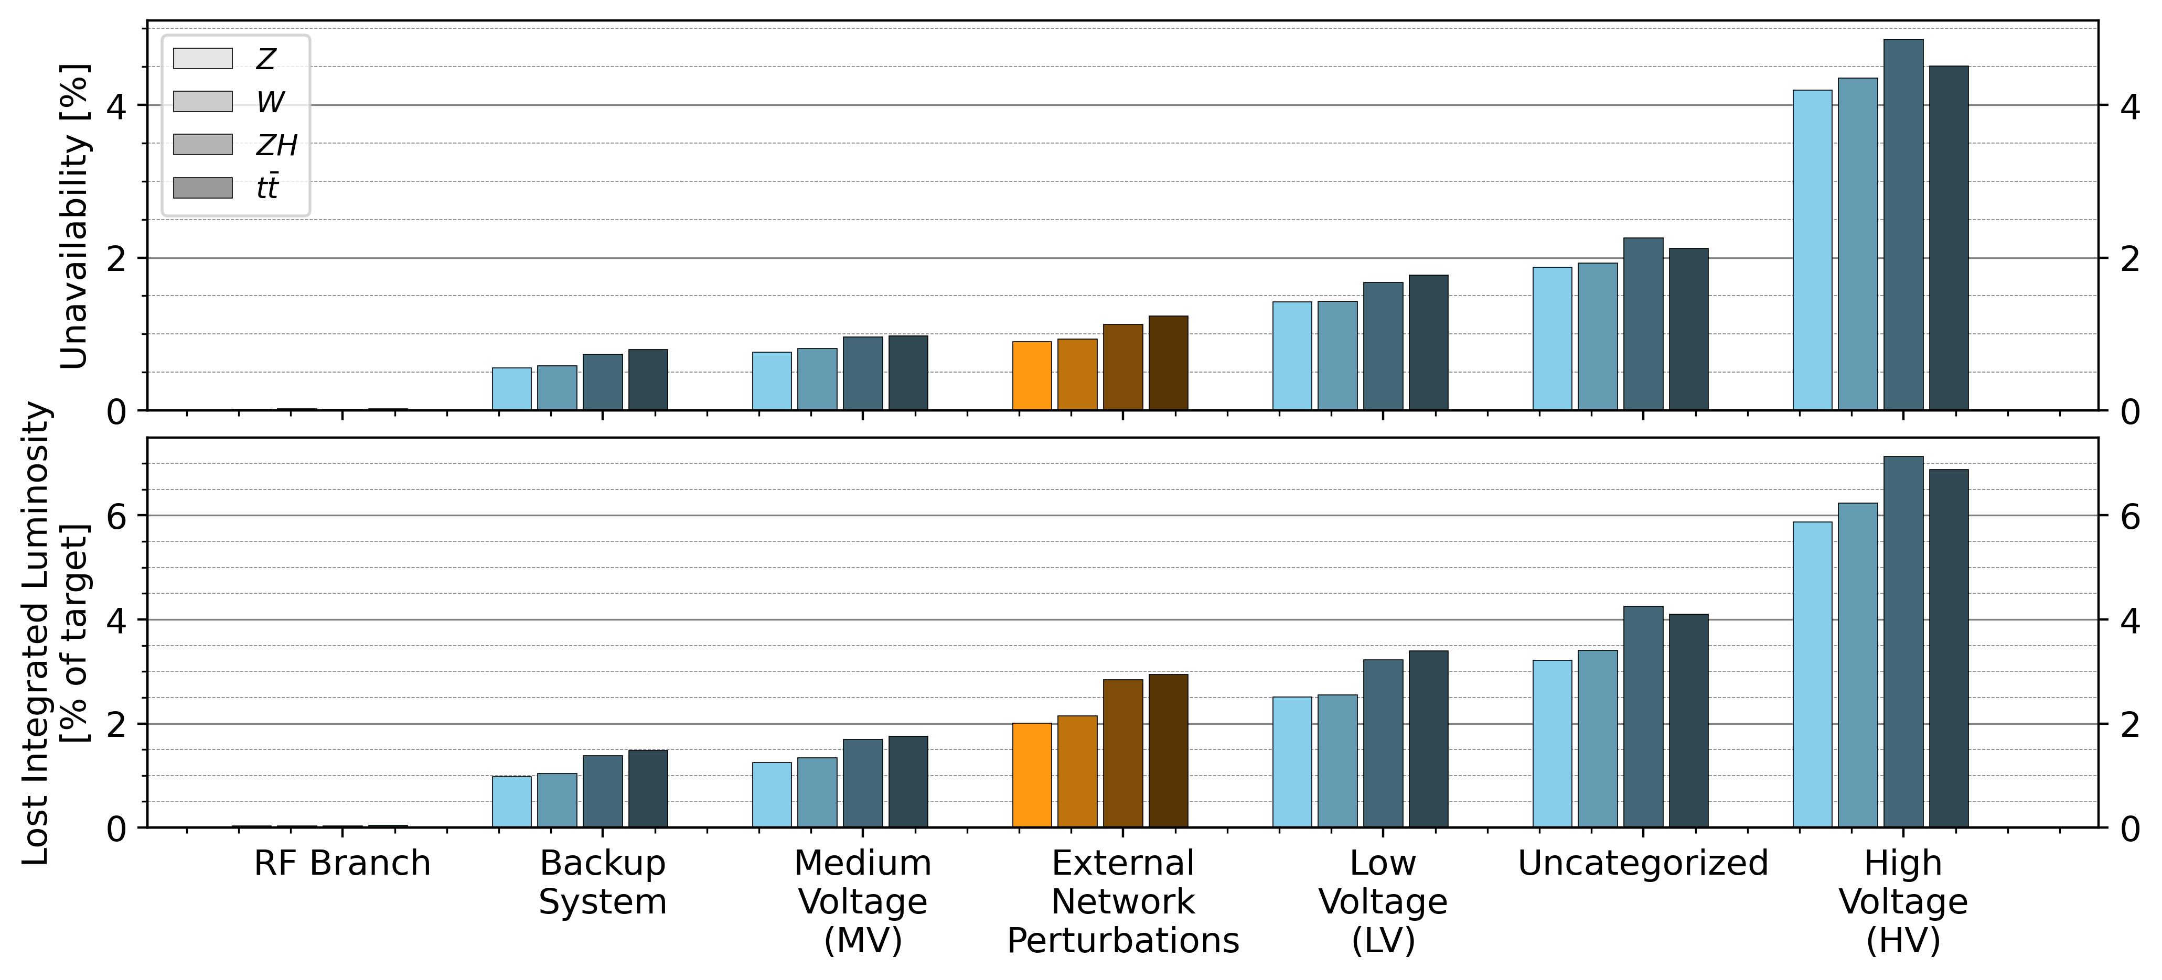
Electrical Network – FCC-ee
Faults without children
Faults with children
Most improvement to be made at High Voltage Network
The Redundancy works, but child faults must also be reduced!
20 May 2025
Hannah Dostmann | Technical Infrastructure Availability - Challenges and Opportunities from LHC to FCC-ee

Slide 15
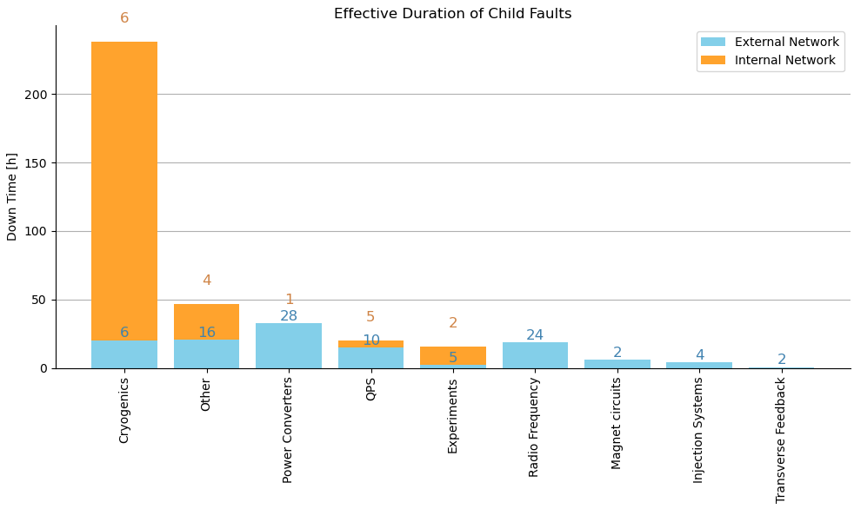
Electrical Network - Child Faults in LHC
Child Fault Down Time in LHC [h]
(2015-2024 Physics Operation)
External Perturbations
Internal Equipment
2%
Child faults in other systems
40%
58%
Redundancy could be effective
Most downtime due to Cryogenics child faults
The proportions might change in FCC:
Less cryogenics
More RF & power converters
20 May 2025
Hannah Dostmann | Technical Infrastructure Availability - Challenges and Opportunities from LHC to FCC-ee

Slide 16


Child Faults in the Technical Design Stage
First - we have to better understand these perturbations
Child Systems
Detailed requirements for resilience to voltage deviations issued to relevant equipment design teams
Ensure they are given priority through the design progress
Electrical Network
“User Friendly“
Solutions to dampen voltage deviations (e.g Unified Powerflow Controllers)
https://coaching-persoenlichkeitsentwicklung.ch/wp-content/uploads/2017/02/verstehen_lernen_fotolia_63574038_S-1.jpg
https://unternehmer.de/wp-content/uploads/2012/09/%C2%A9-ioannis-kounadeas-97473562.jpg
20 May 2025
Hannah Dostmann | Technical Infrastructure Availability - Challenges and Opportunities from LHC to FCC-ee

Slide 17
Conclusion & Outlook
We have a simulation for Availability and Luminosity of the FCC-ee extrapolating from current working systems in other accelerators
Availability is one of the main challenges for integrated luminosity in the FCC
Success requires a machine-wide improvement in reliability
Cooling and Ventilation
Performance expected to be similar as in LHC
Cryogenics
Won’t be as highly ranked as it is in the LHC right now, but significant in tt
Sensitive as child to electrical network failures
R&D opportunities:
Turbo Brayton Cycles
Redundancy between the two cryoplants at each point
Electrical Network:
Could be one of the highest contributors to down time and luminosity losses in FCC-ee (dominated by child faults and internal equipment)
R&D opportunities:
Reducing Child faults
Redundancy
Both must happen in parallel !
20 May 2025
Hannah Dostmann | Technical Infrastructure Availability - Challenges and Opportunities from LHC to FCC-ee

